Slide 1
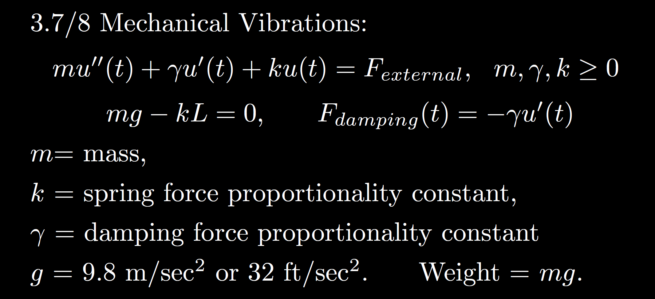
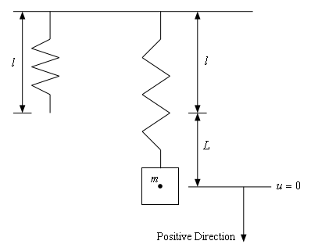
https://tutorial.math.lamar.edu/Classes/DE/Vibrations.aspx

Slide 2
Overdamped: large $γ$
3.1
3.3
Underdamped: small $γ$ or
no damping if $γ$ = 0
3.4
Critically damped

Slide 3
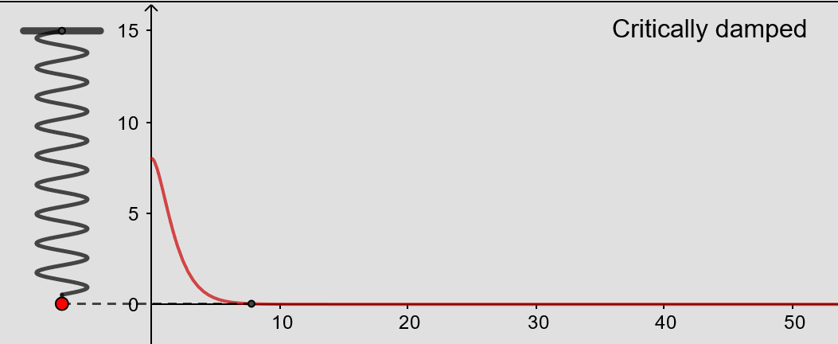
From https://www.geogebra.org/m/ZzKbkvnz
Note: Sign convention is opposite our convention

Slide 4
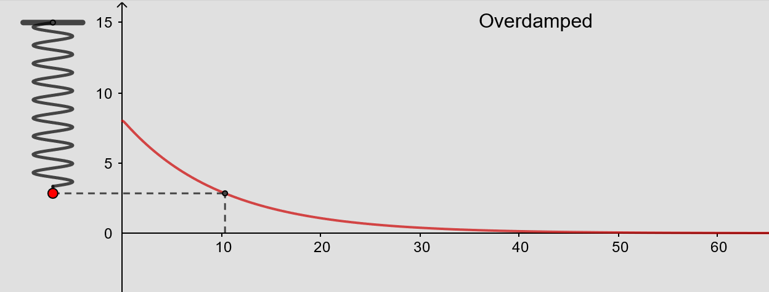
From https://www.geogebra.org/m/ZzKbkvnz
Note: Sign convention is opposite our convention

Slide 5
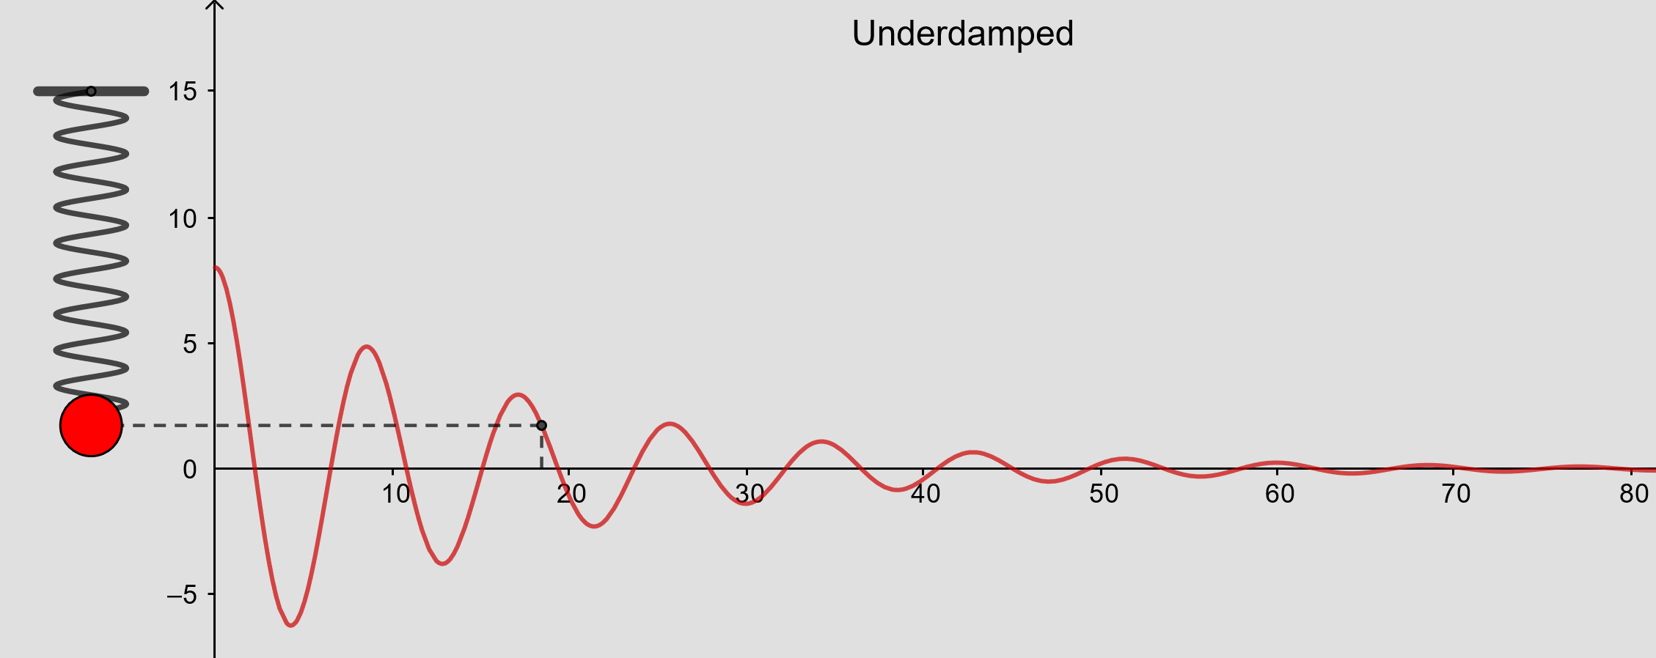
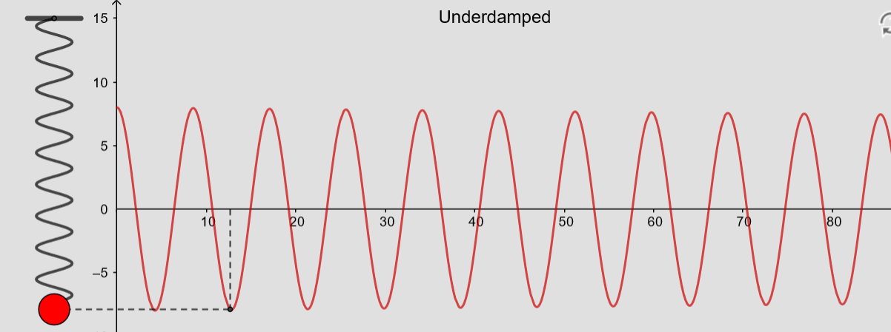
From https://www.geogebra.org/m/ZzKbkvnz
Note: Sign convention is opposite our convention

Slide 6
From https://www.geogebra.org/m/ZzKbkvnz
Note: Sign convention is opposite our convention

Slide 7
Overdamped: large $γ$
3.1
3.3
Underdamped: small $γ$ or
no damping if $γ$ = 0
3.4
Critically damped

Slide 8
is the steady state response when

Slide 9
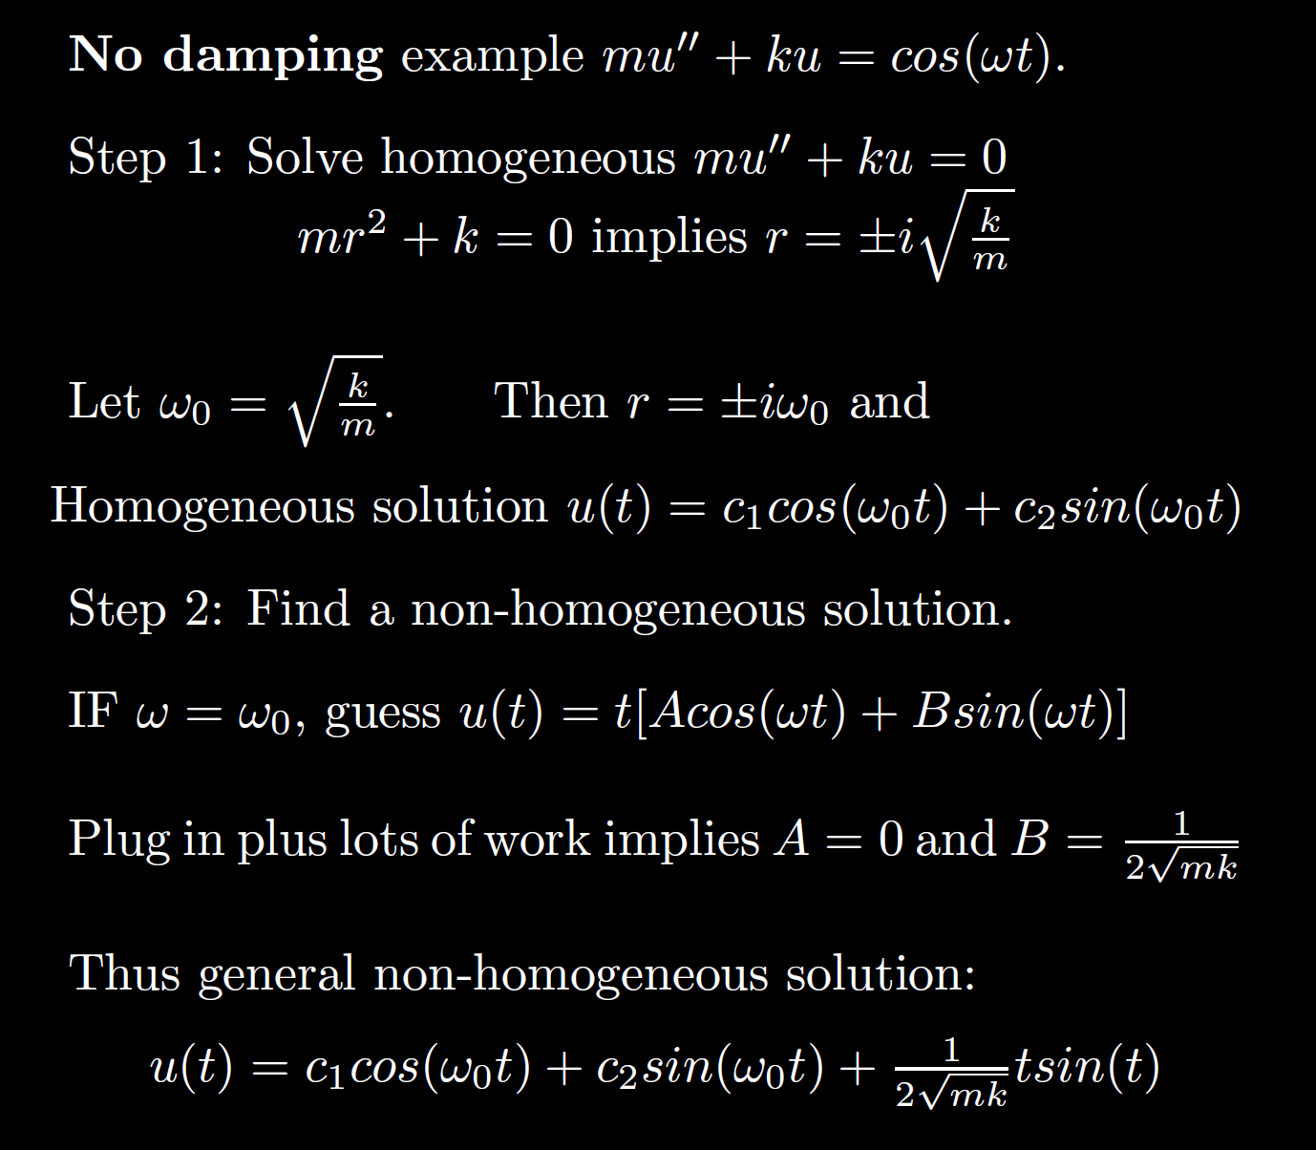
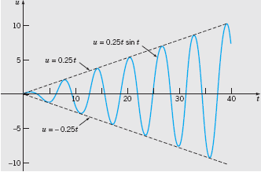
Boyce/DiPrima/Meade 11th ed, Ch 3.8: Forced Periodic Vibrations
Resonance

Slide 14
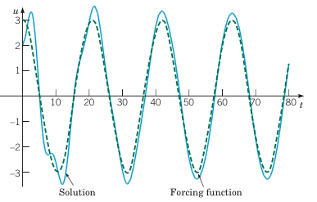
Example 2: Forced Vibrations with Damping (2 of 4)
Graphs of the solution and external force for .
Boyce/DiPrima/Meade 11th ed, Ch 3.8: Forced Periodic Vibrations

Slide 15
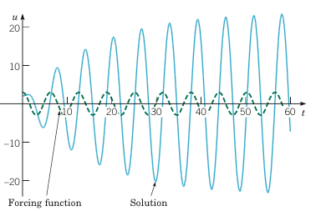
Example 2: Forced Vibrations with Damping (3 of 4)
Graphs of the solution and external force for
Boyce/DiPrima/Meade 11th ed, Ch 3.8: Forced Periodic Vibrations

Slide 16
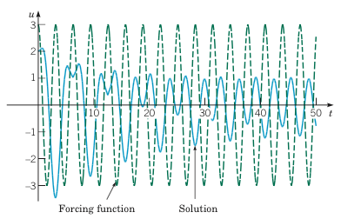
Example 2: Forced Vibrations with Damping (4 of 4)
Graphs of the solution and external force for
Boyce/DiPrima/Meade 11th ed, Ch 3.8: Forced Periodic Vibrations

