Slide 1
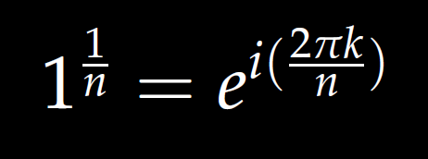

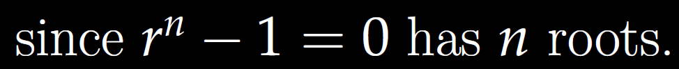
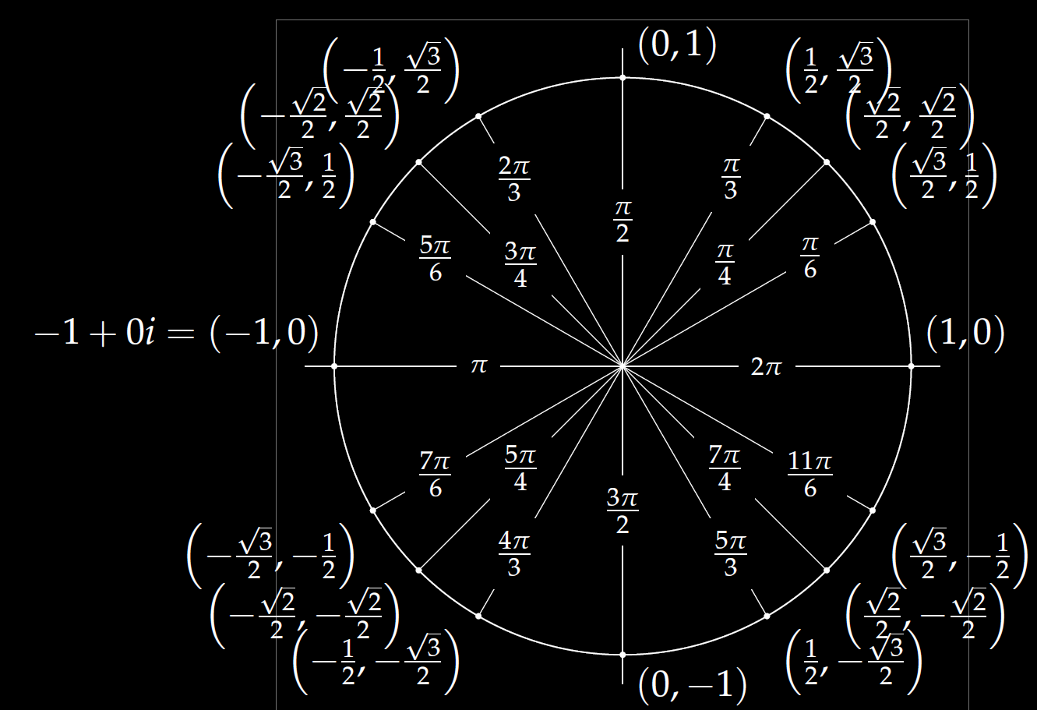
Roots of unity
r^{n} = 1

Slide 2
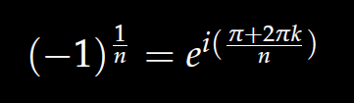

We will also solve
r^{n} = -1

Slide 3


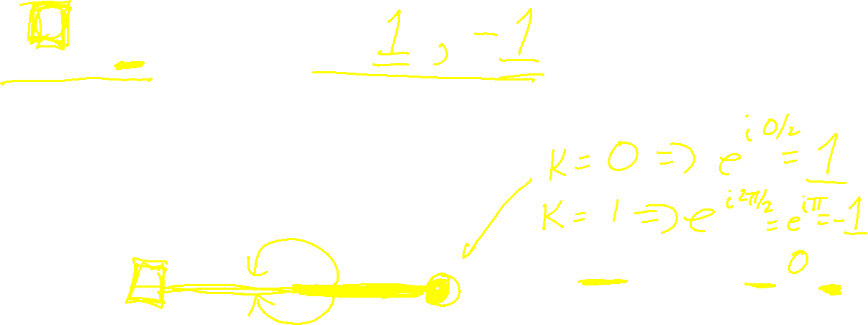


$r^{2}=$ 1 implies r =
$$1^{1/2}=ⅇ^{ⅈ\left(2πk/2\right)}$$
Roots of unity
r^{n} = 1

Slide 4


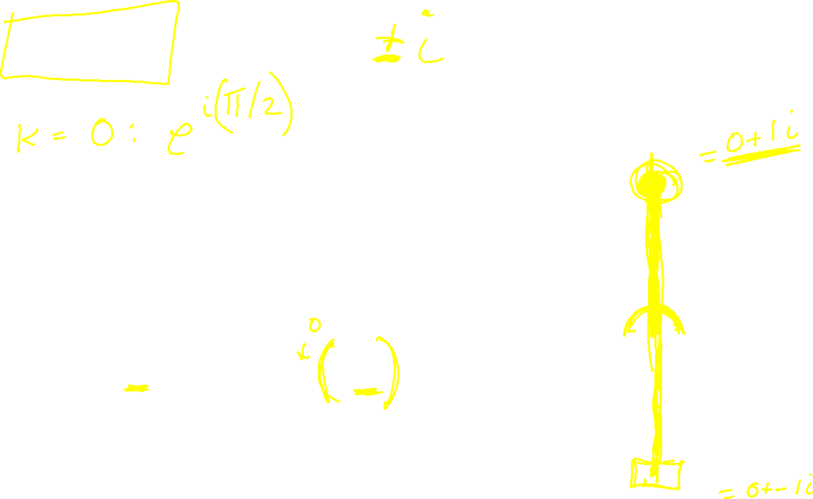
$r^{2}=$ -1 implies r =
$${(−1)}^{1/2}=ⅇ^{ⅈ\left(1+2k\right)π/2}$$

Slide 5

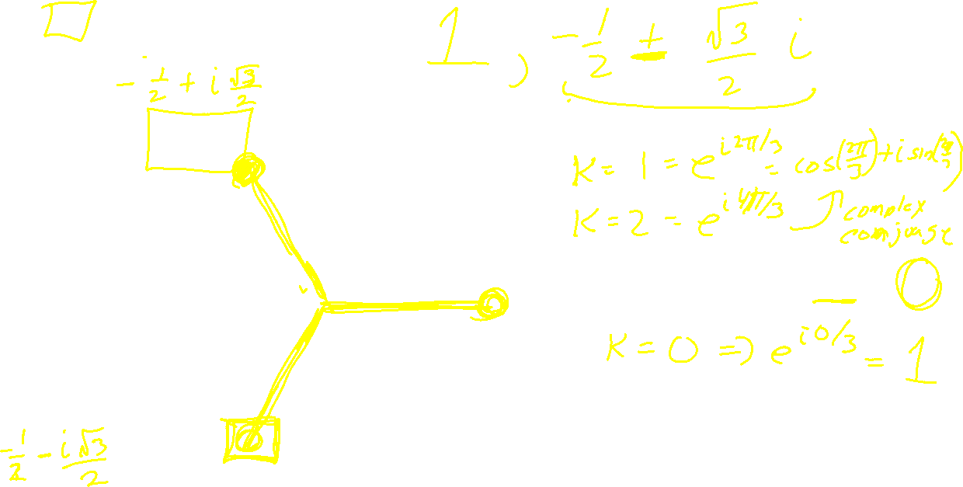

$r^{3}=$ 1 implies r =
$$1^{1/3}=ⅇ^{ⅈ\left(2πk/3\right)}$$
Roots of unity
r^{n} = 1

Slide 6


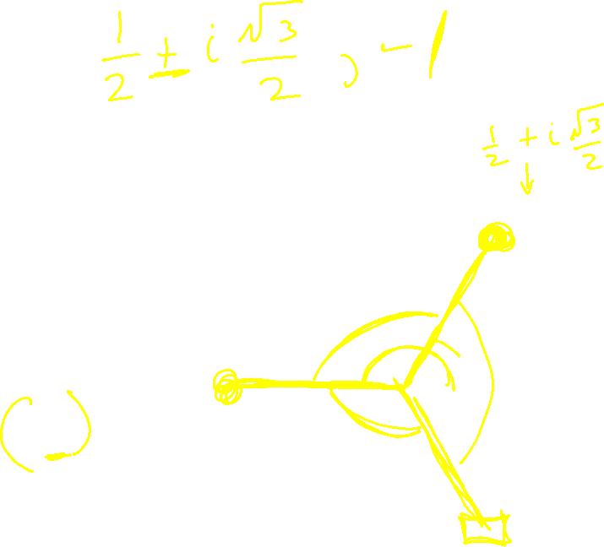
$r^{3}=$ -1 implies r =
$${(−1)}^{1/3}=ⅇ^{ⅈ\left(1+2k\right)π/3}$$

Slide 7


$r^{4}=$ 1 implies r =
$$1^{1/4}=ⅇ^{ⅈ\left(2πk/4\right)}$$
Roots of unity
r^{n} = 1

Slide 8


$r^{4}=$ -1 implies r =
$${(−1)}^{1/4}=ⅇ^{ⅈ\left(1+2k\right)π/4}$$

Slide 9
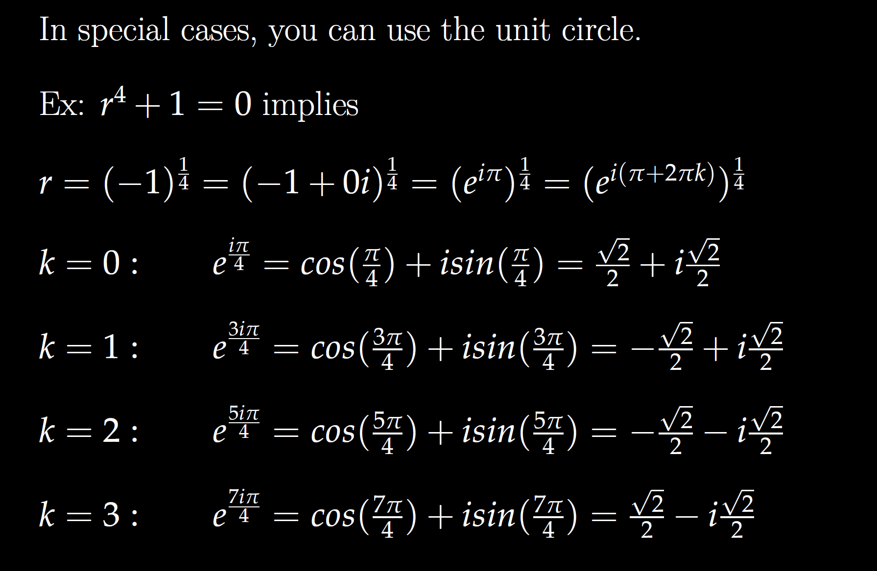

Slide 10
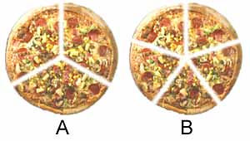


$r^{5}=$ 1 implies r =
$$1^{1/5}=ⅇ^{ⅈ\left(2πk/5\right)}$$
Roots of unity
r^{n} = 1

Slide 11


$r^{5}=$ -1 implies r =
$${(−1)}^{1/5}=ⅇ^{ⅈ\left(1+2k\right)π/5}$$

