Slide 1
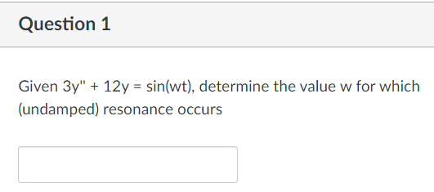

Slide 2
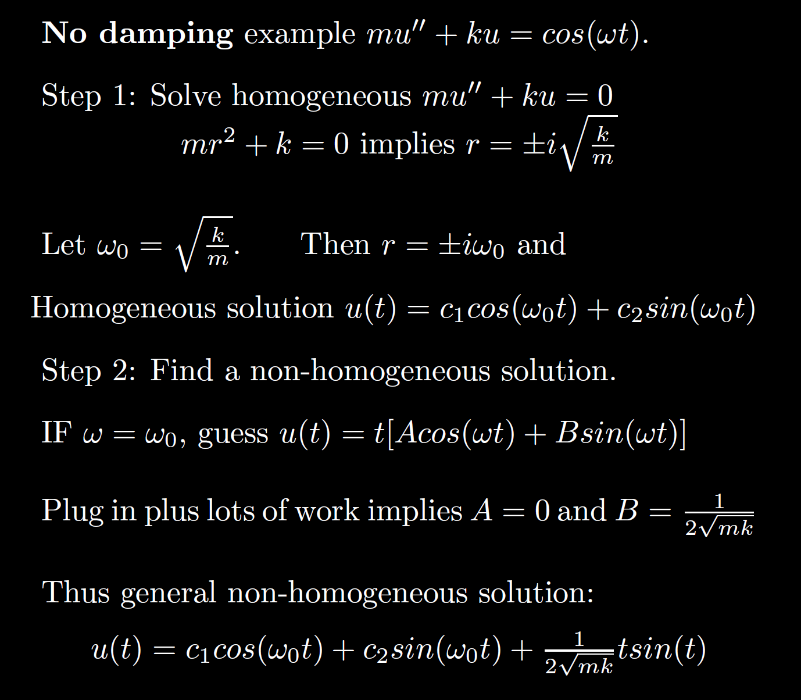
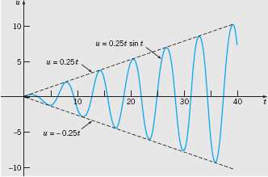

Boyce/DiPrima/Meade 11th ed, Ch 3.8: Forced Periodic Vibrations

Slide 3
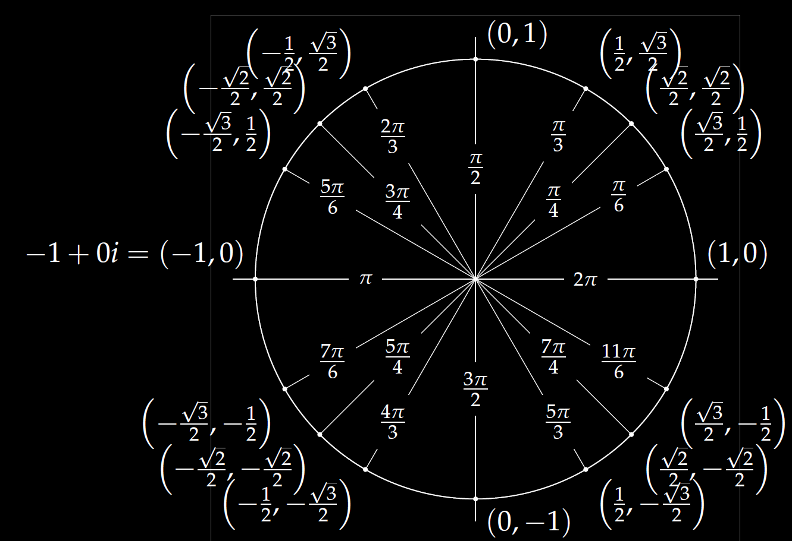
(a, b) = a + ib
= ( Rcos(x), R sin(x) )
= R [cos(x) + i sin(x)]
= R e^{ix}

Slide 4
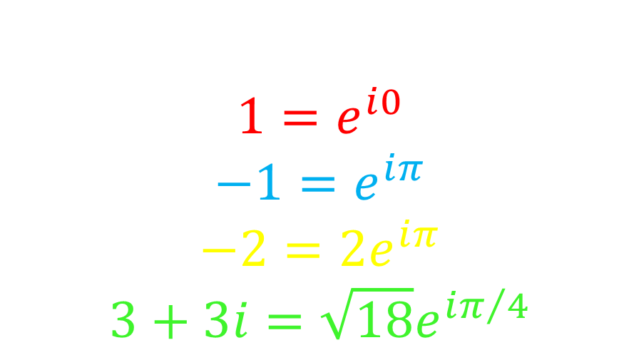
Examples:
$$1=ⅇ^{ⅈ0}$$
$$−1=ⅇ^{ⅈπ}$$
$$−2=2ⅇ^{ⅈπ}$$
$$3+3ⅈ=\sqrt{18}ⅇ^{iπ/4}$$

Slide 5
Quiz Friday over section 3.5
4.3 is the higher order version of 3.5, thus you could do your HW 9 section 4.3 problems early (optional) and/or
Study the 3.5 worksheet
3.5/3.8 WileyPlus homework
3.5 problems from the exam 1 reviews.

Slide 6
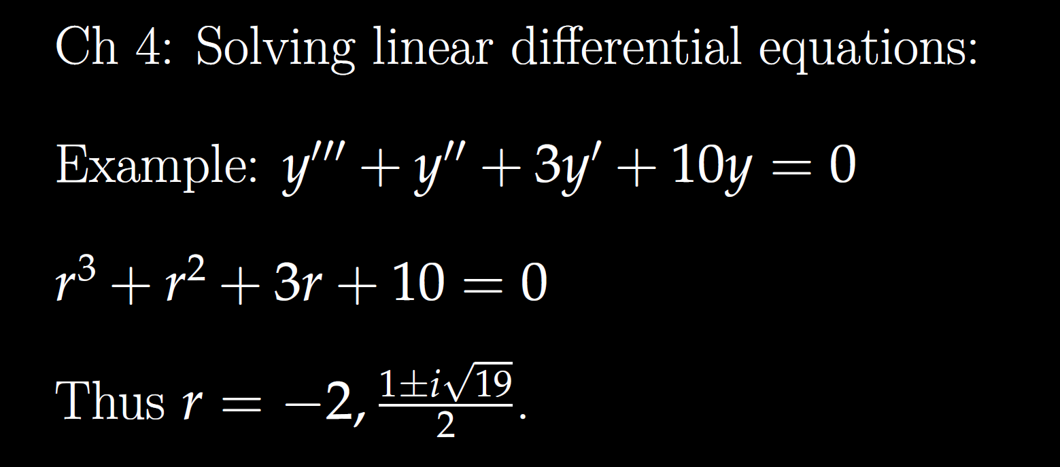
All your problems will involve special factoring cases, so you don’t need to know how to factor higher order polynomials in general.
Thus you don’t need to know how to factor the characteristic equation for the DE above.

Slide 7
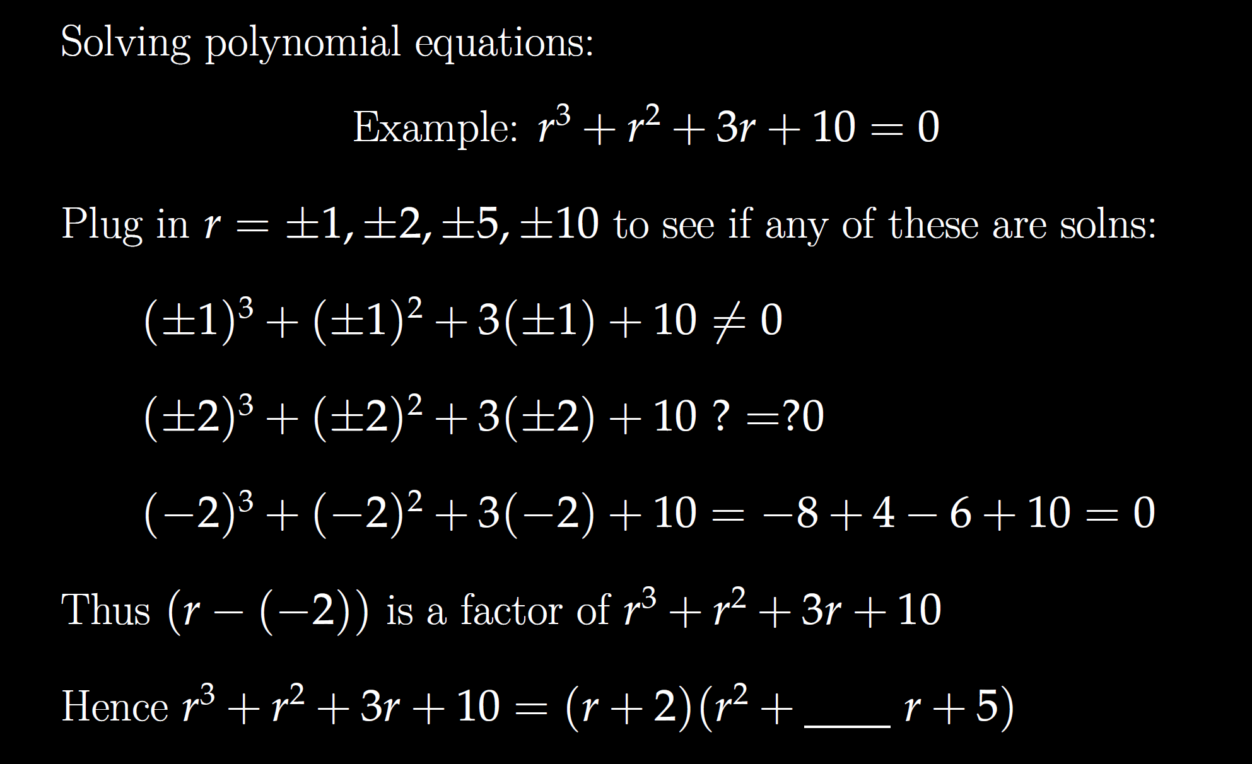

Slide 9
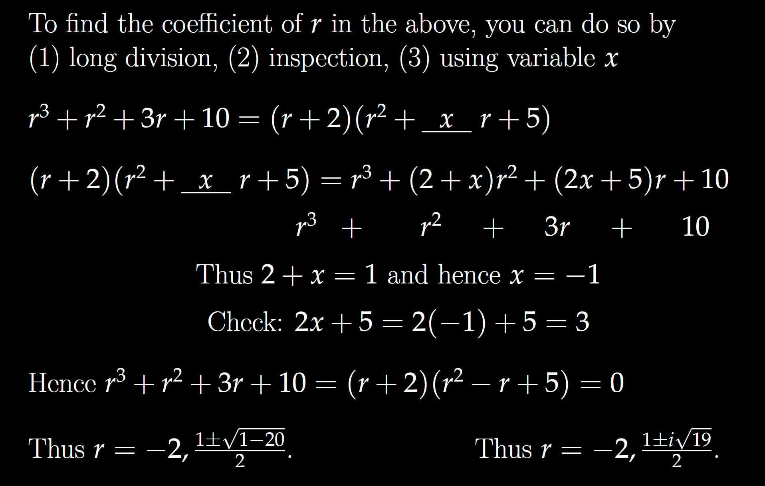

Slide 11
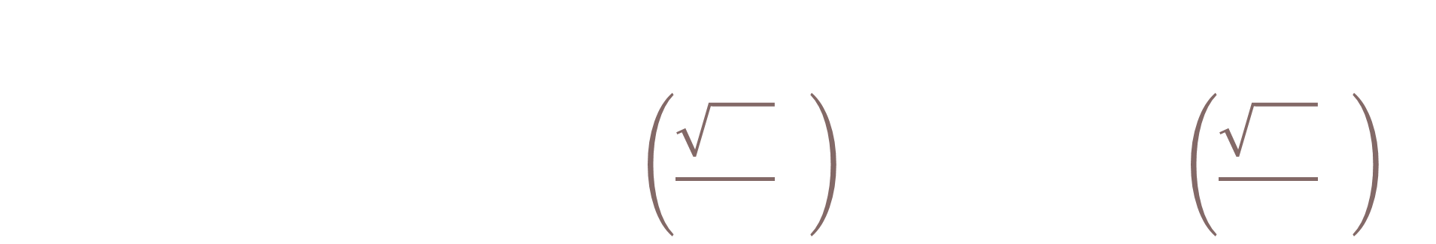
General solution:
$$y=c_{1}ⅇ^{−2t}+c_{2}ⅇ^{t/2}\sin\left(\frac{\sqrt{19}}{2}t\right)+c_{3}ⅇ^{{t/2}^{}}\cos\left(\frac{\sqrt{19}}{2}t\right)$$

Slide 12

Be able to factor the following:
$$ar4 − b = 0$$
$$ar4+ br2+ c = 0$$
$$kar3+ kbr2+ nar + nb =kr2(ar + b)+ n\left(ar + b\right)$$
$= (kr2+ n)(ar + b)$

Slide 13

Solve $y^{′′}′′ – 16y = 0$

Slide 14


Solve $y’’’’ – 16y = 0$
$$r^{4}−16=0\left(r^{2}−4\right)\left(r^{2}+4\right)$$
$r^{2}=4⇒r=±2 r^{2}=−4⇒r=±$2i

Slide 15

Solve $y^{′′}′′–3y^{′′}−4y = 0$

Slide 16
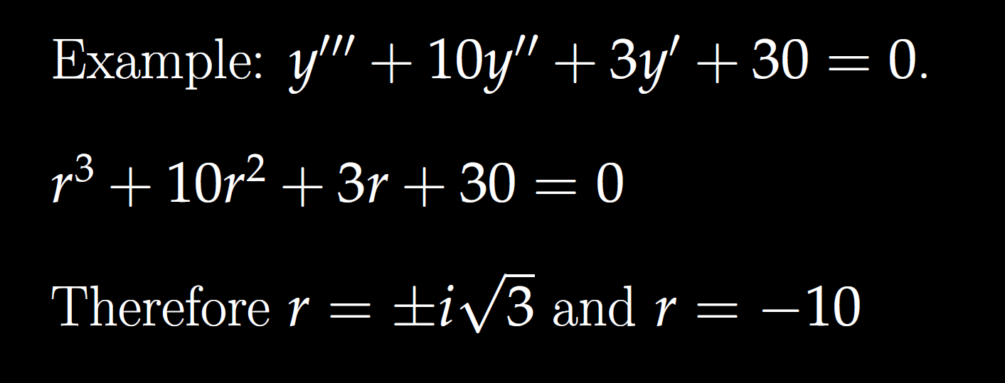

Slide 17
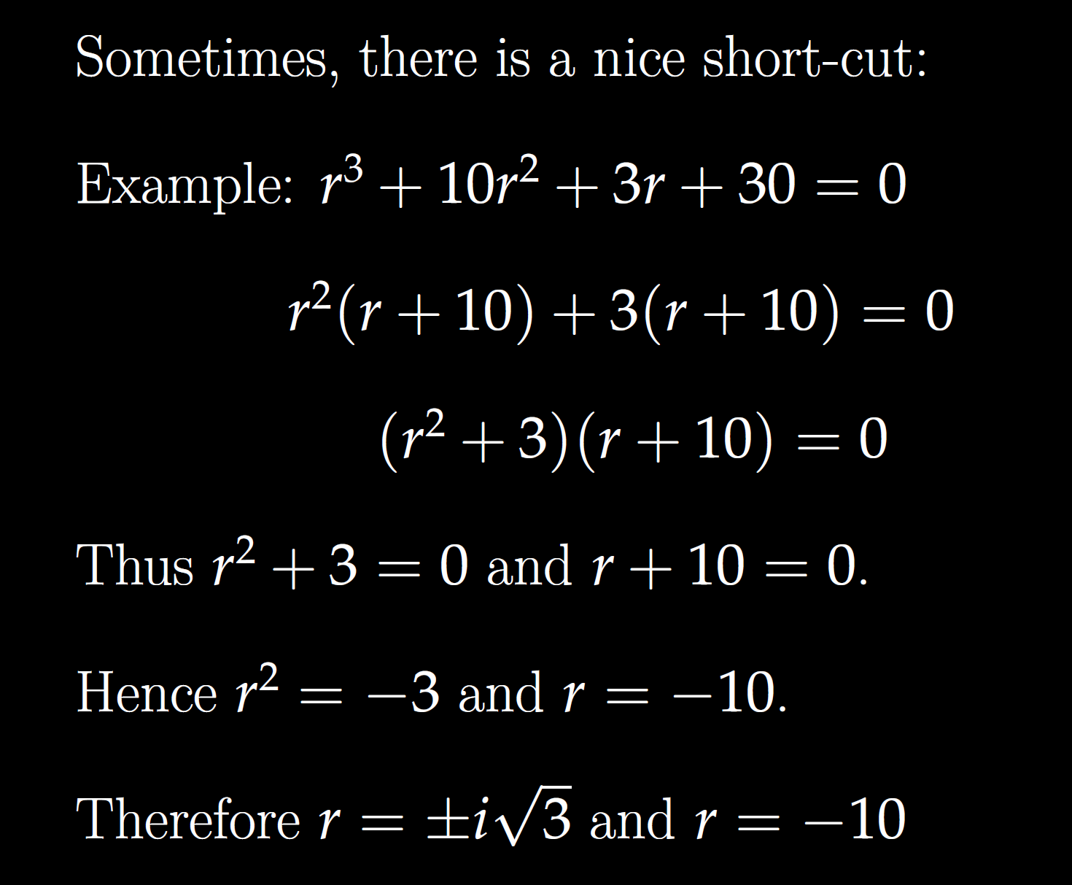

Slide 20

General solution:
$$y=c1cos\left(\sqrt{3}t\right)+c_{2}\sin\left(\sqrt{3}t\right)+c_{3}ⅇ^{−10t}$$

Slide 21
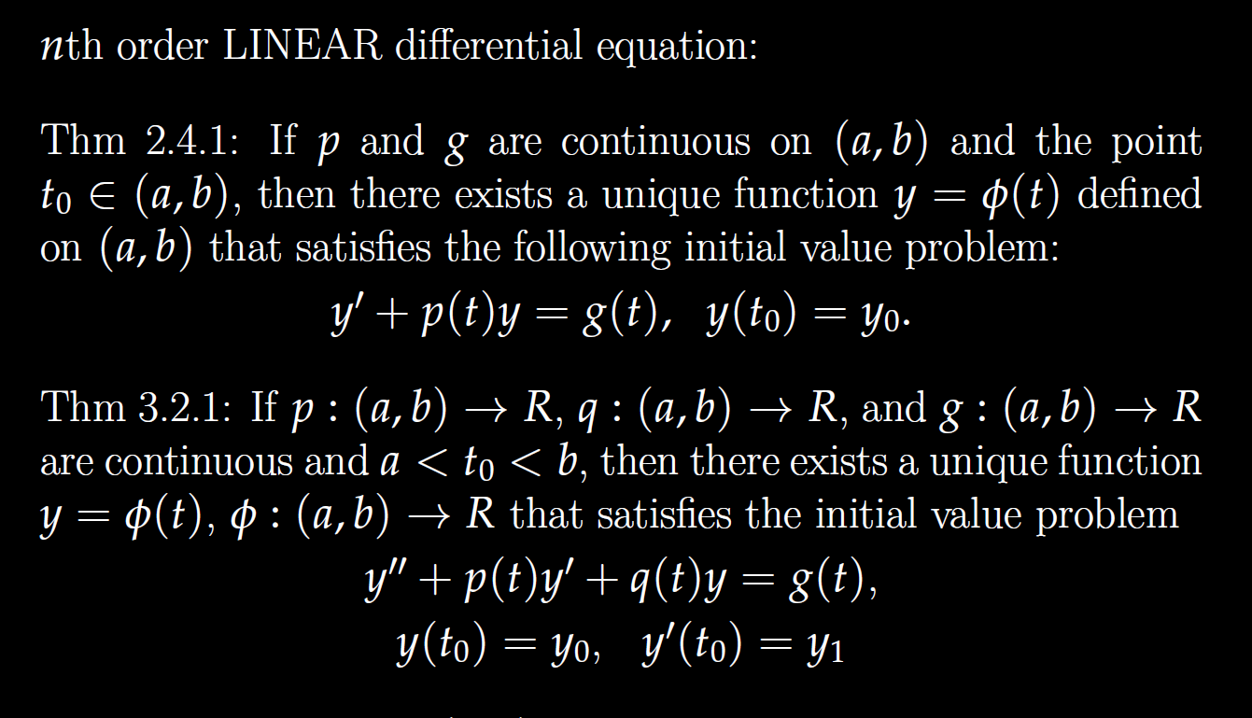

Slide 22
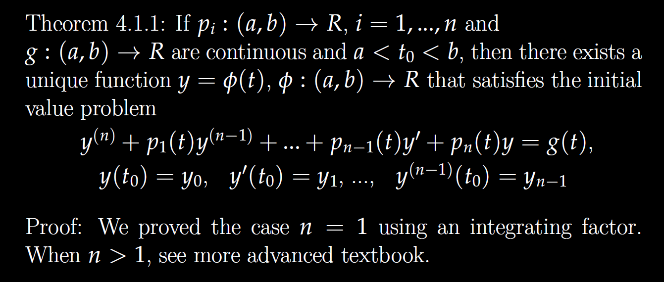

Slide 23
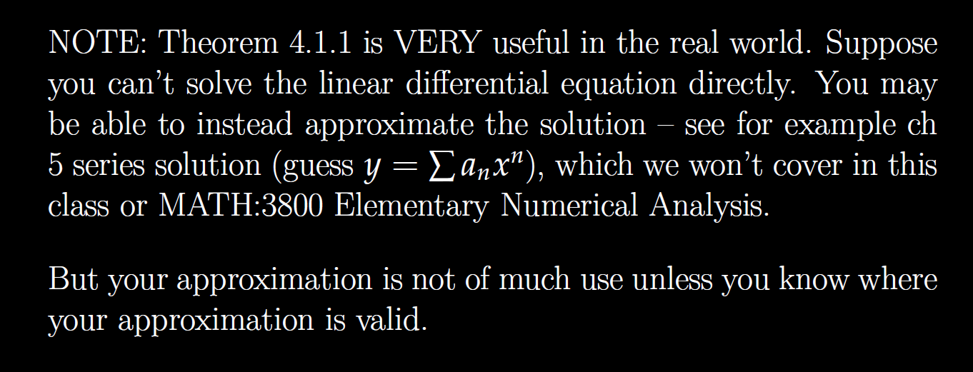

Slide 24
Determine (without solving the problem) an interval in which the solution of the given initial value problem is certain to exist and be unique.
$$\left(1 − t\right)\left(1 + t^{2}\right)y^{′′′}+\ln\left|t − 5\right|y^{′}+2y = \sqrt{t+4} y(0) = 3$$

Slide 25
Determine (without solving the problem) an interval in which the solution of the given initial value problem is certain to exist and be unique.
$$\left(1 − t\right)\left(1 + t^{2}\right)y^{′′′}+\ln\left|t − 5\right|y^{′}+2y = \sqrt{t+4} y(0) = 3$$
( )( )(
-4 1 5

Slide 26
Determine (without solving the problem) an interval in which the solution of the given initial value problem is certain to exist and be unique.
$$\left(1 − t\right)\left(1 + t^{2}\right)y^{′′′}+\ln\left|t − 5\right|y^{′}+2y = \sqrt{t+4} y(0) = 3$$
( )( )(
-4 1 5
t = 0, thus domain is (-4, 1) for the solution to this initial value problem.

Slide 27
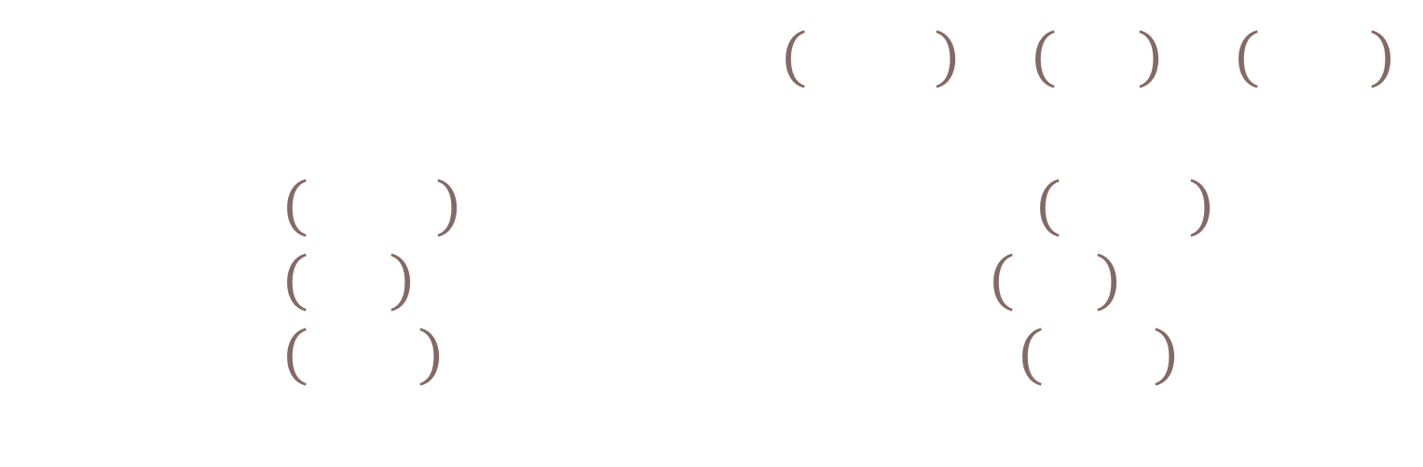
Determine (without solving the problem) an interval in which the solution of the given initial value problem is certain to exist and be unique.
$$\left(1 − t\right)\left(1 + t^{2}\right)y^{′′′}+\ln\left|t − 5\right|y^{′}+2y = \sqrt{t+4} y\left(t0\right)= ?$$
( )( )(
-4 1 5
Unique solution exists if $t_{0}∈\left(−4,1\right)∪\left(1,5\right)∪\left(5,∞\right)$
  If $t_{0}∈\left(−4,1\right)$, domain of solution is $\left(−4,1\right)$.
  If $t_{0}∈\left(1,5\right)$, domain of solution is $\left(1,5\right)$.
  If $t_{0}∈\left(5,∞\right)$, domain of solution is $\left(5,∞\right)$.

Slide 28
Linear Independence and the Wronskian

Slide 29
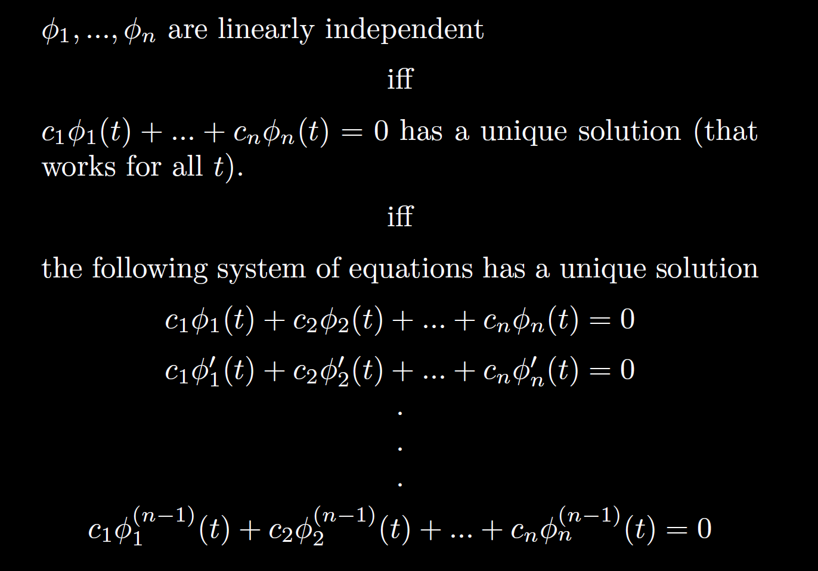

Slide 30
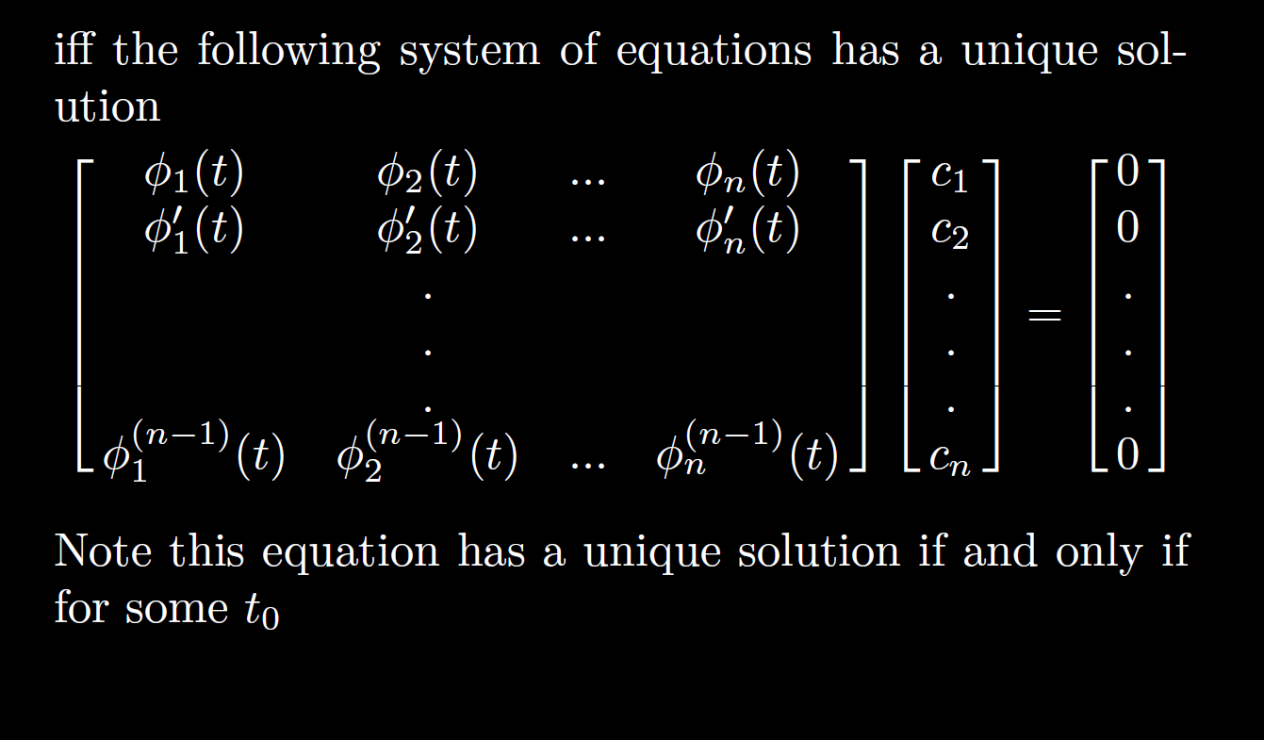

Slide 31
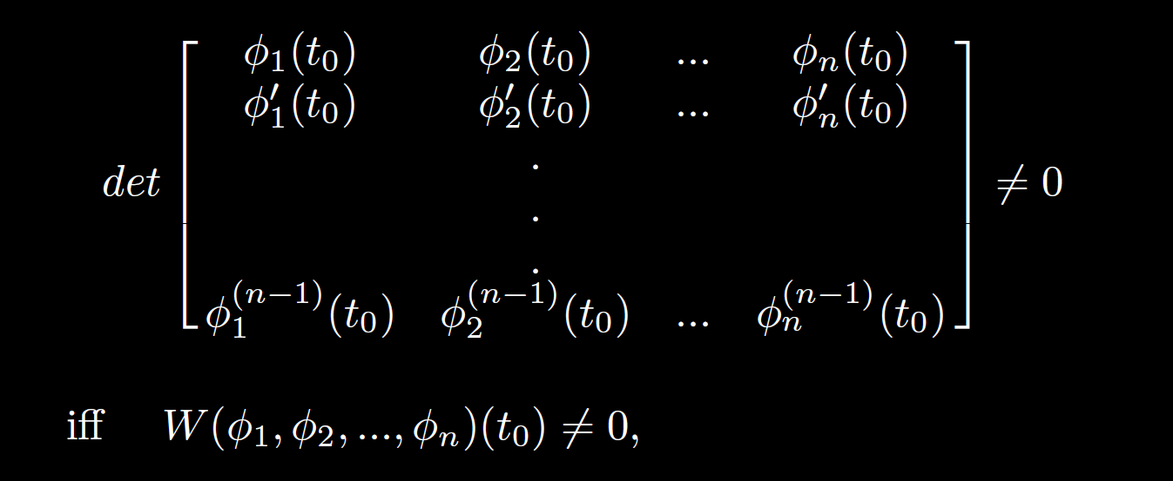

Slide 32
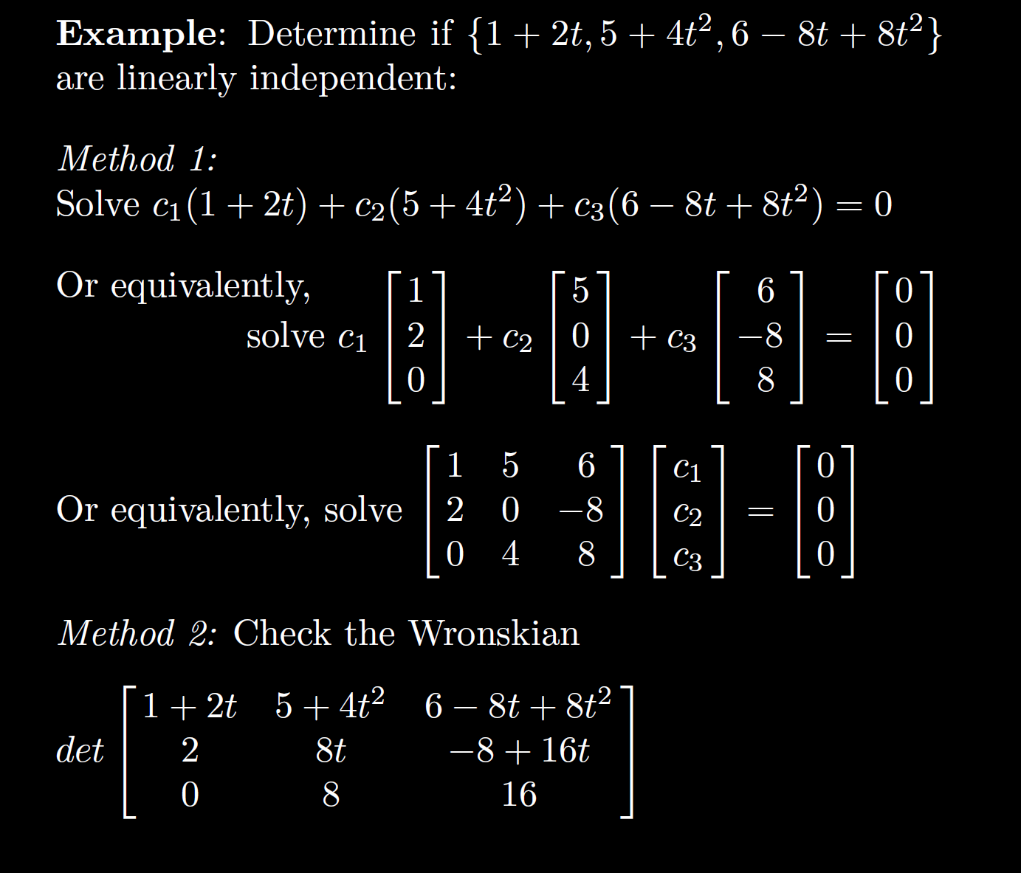

Slide 34
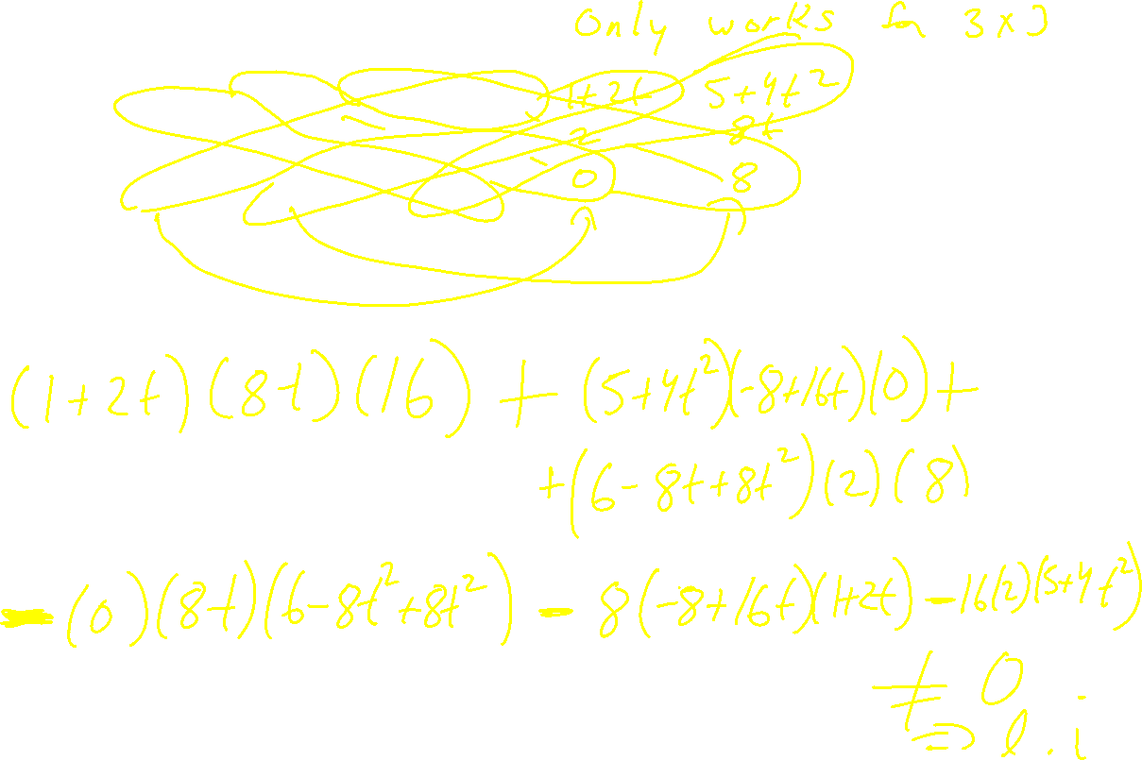

Slide 35
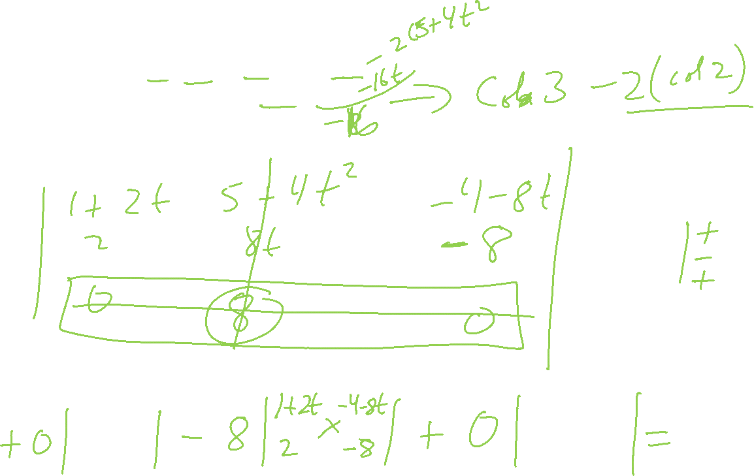

Slide 36
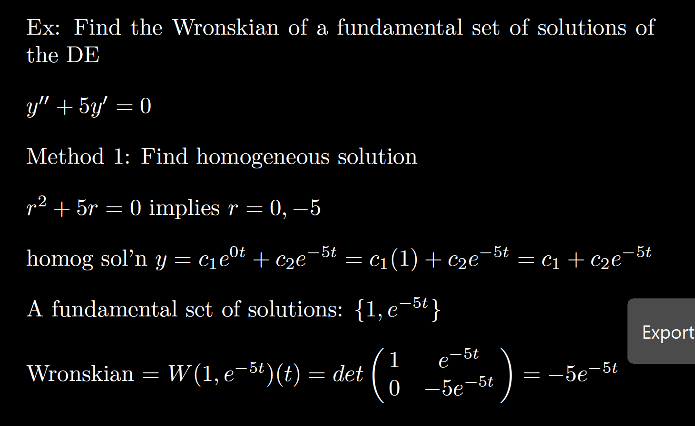

Slide 37
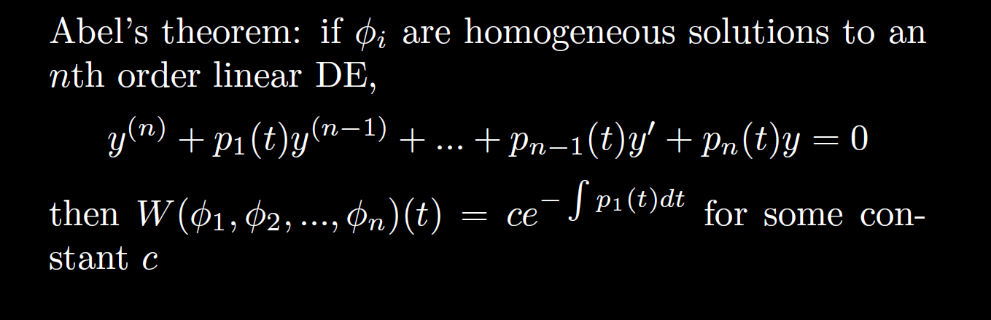

Slide 38
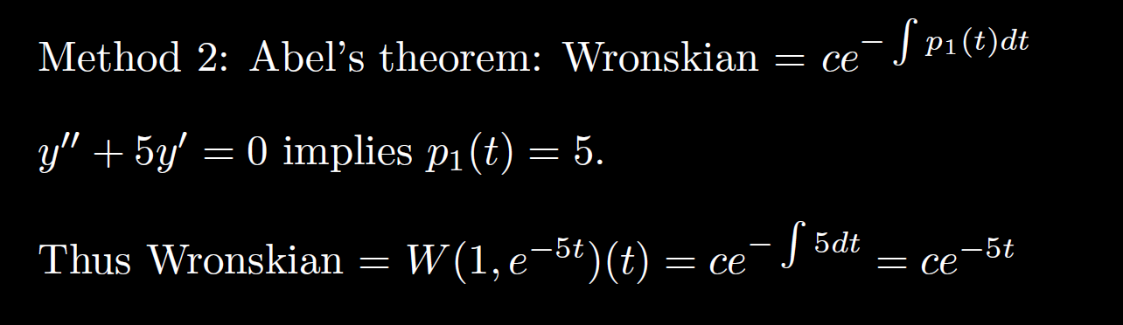

Slide 42
0
0
k
= C

Slide 43
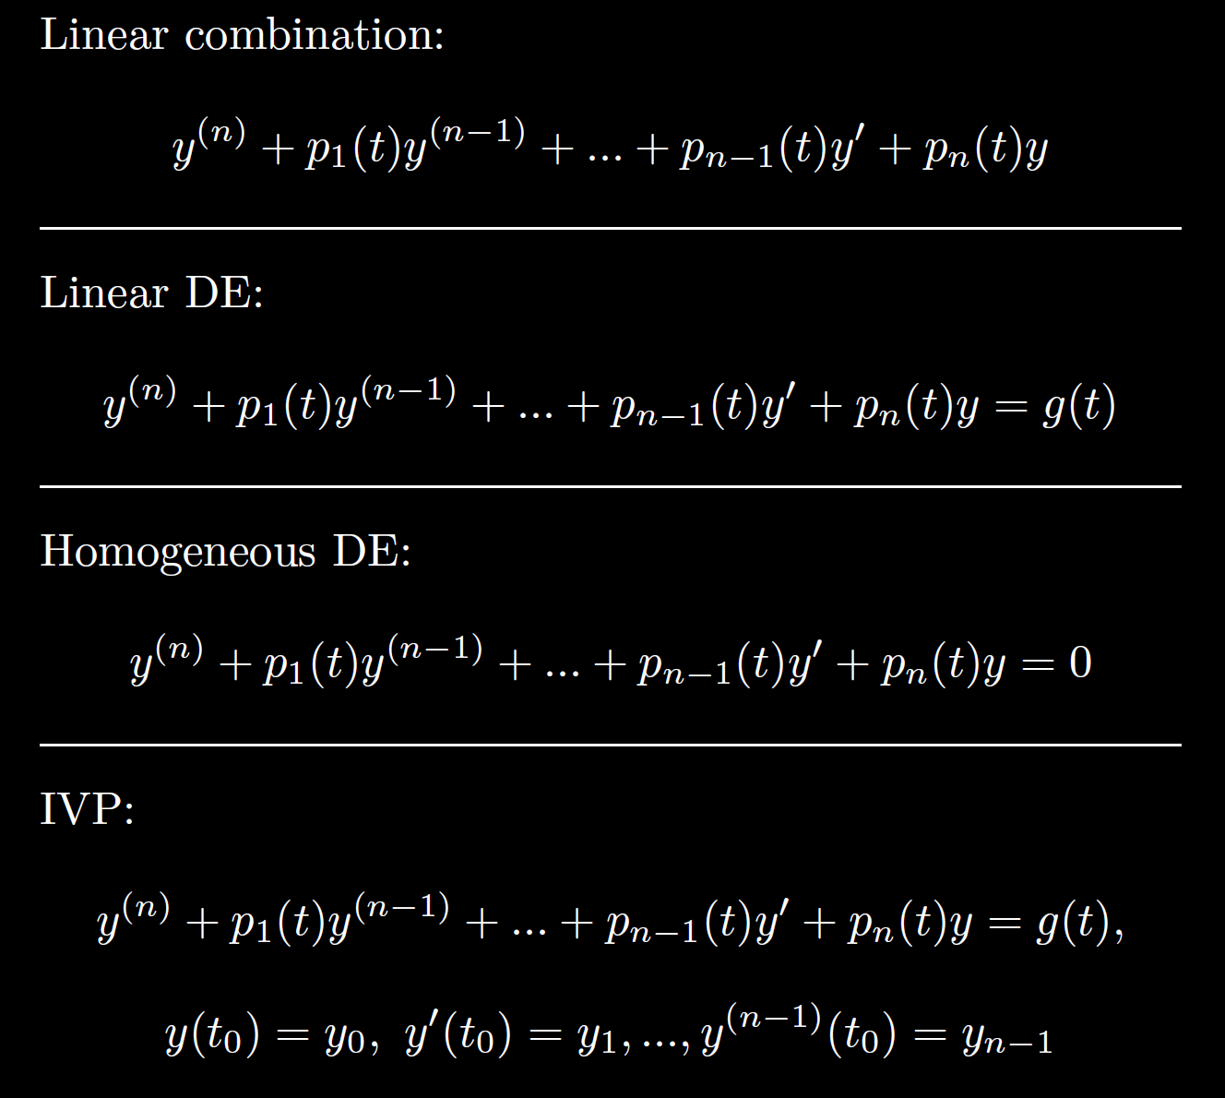

Slide 44
