Slide 1

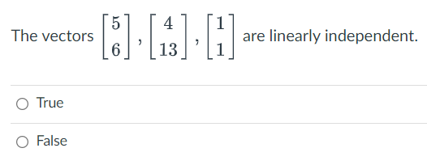


Slide 2
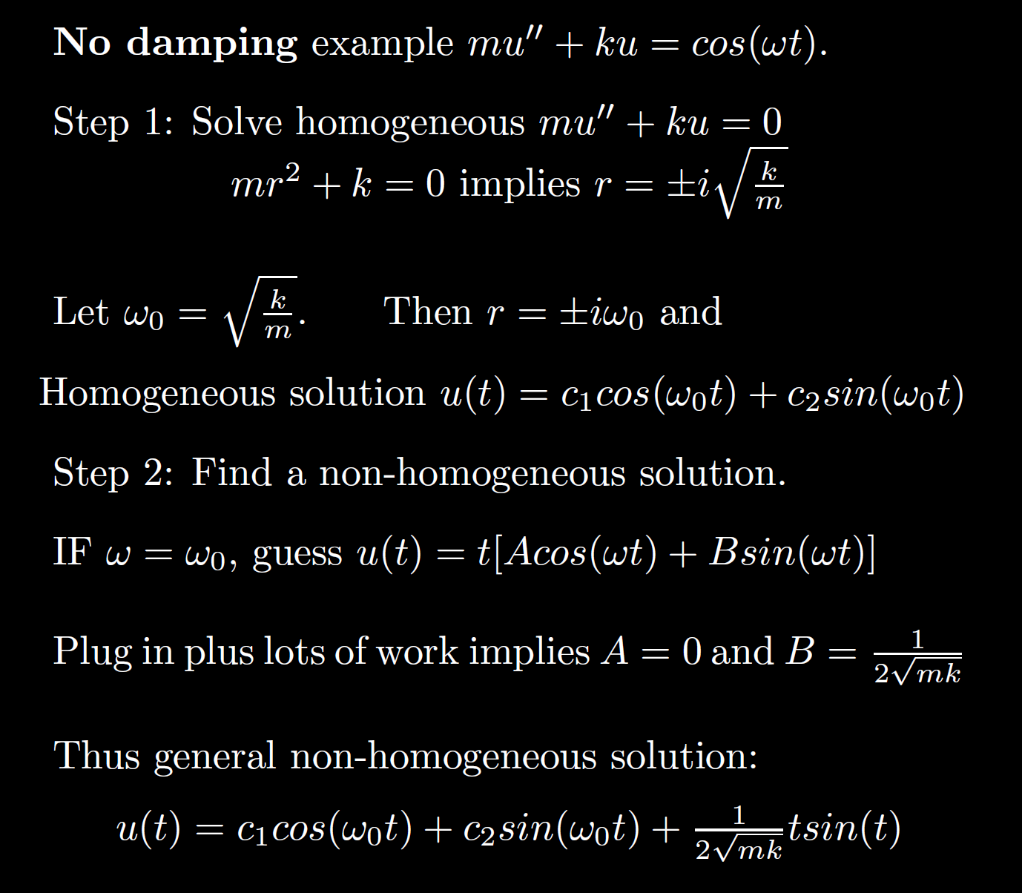
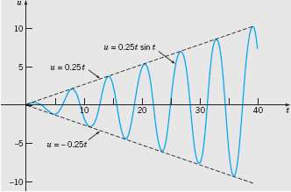

Boyce/DiPrima/Meade 11th ed, Ch 3.8: Forced Periodic Vibrations

Slide 3

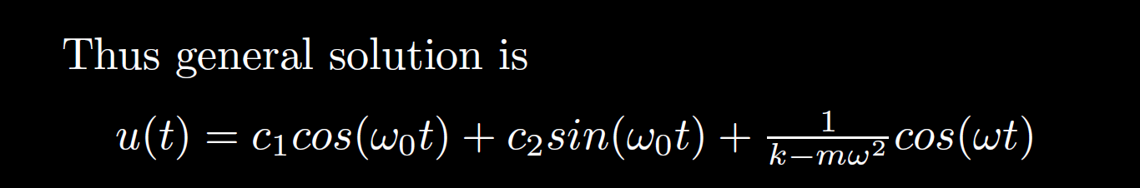
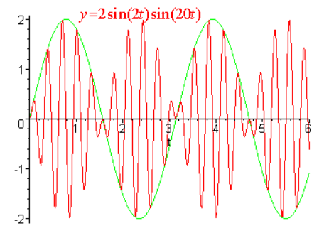
Beat:
(note initial conditions)
http://ltcconline.net/greenl/courses/204/appsHigherOrder/forcedVibrations.htm

Slide 4
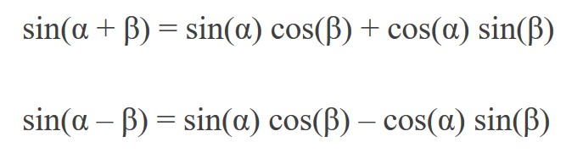

HW 8 #1 hint:
Formulas from: https://www.purplemath.com/modules/idents.htm

Slide 5
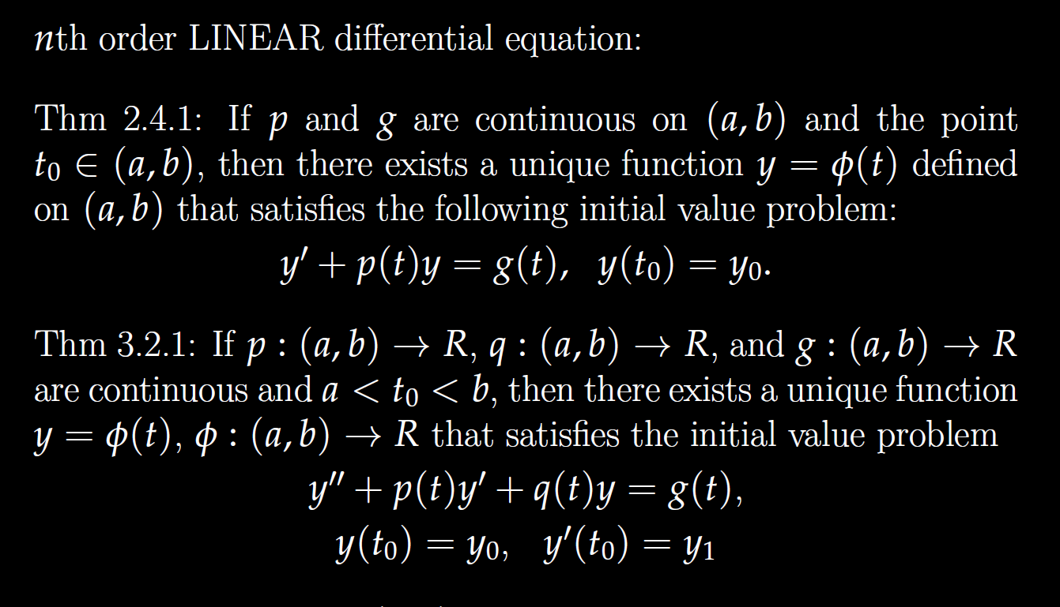

Slide 6
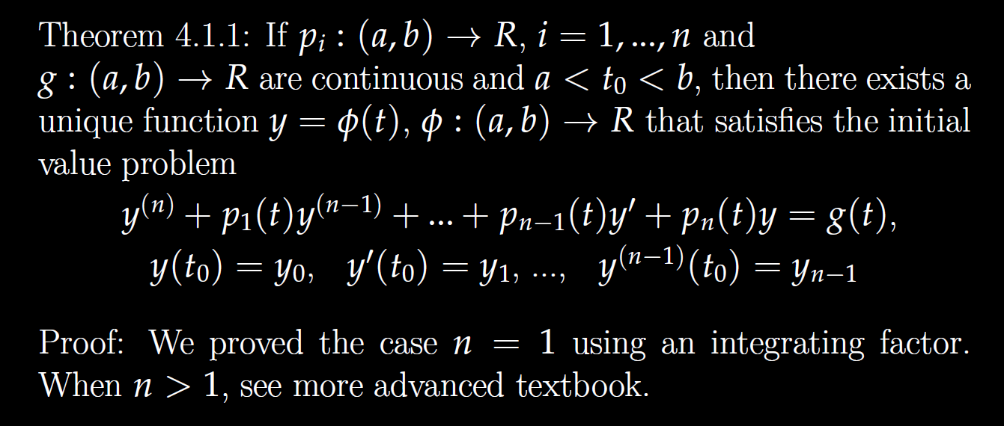

Slide 7
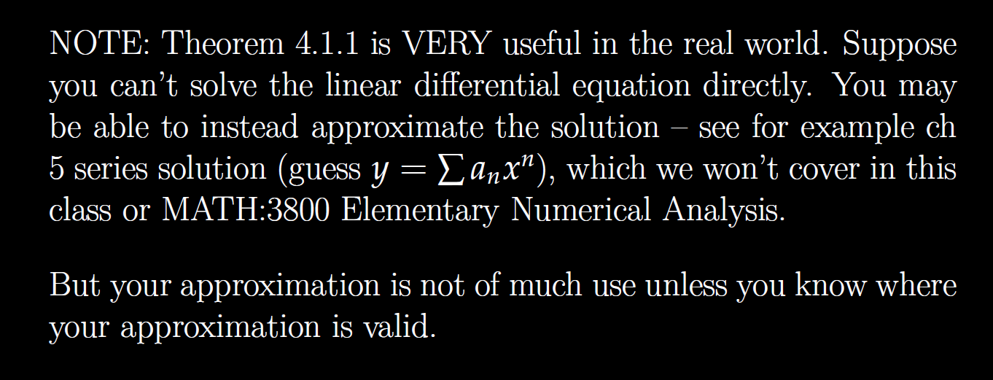

Slide 8
Determine (without solving the problem) an interval in which the solution of the given initial value problem is certain to exist and be unique.
$$\left(1 − t\right)\left(1 + t^{2}\right)y^{′′′}+\ln\left|t − 5\right|y^{′}+2y = \sqrt{t+4} y(0) = 3$$

Slide 9
Determine (without solving the problem) an interval in which the solution of the given initial value problem is certain to exist and be unique.
$$\left(1 − t\right)\left(1 + t^{2}\right)y^{′′′}+\ln\left|t − 5\right|y^{′}+2y = \sqrt{t+4} y(0) = 3$$
( )( )(
-4 1 5

Slide 10
Determine (without solving the problem) an interval in which the solution of the given initial value problem is certain to exist and be unique.
$$\left(1 − t\right)\left(1 + t^{2}\right)y^{′′′}+\ln\left|t − 5\right|y^{′}+2y = \sqrt{t+4} y(0) = 3$$
( )( )(
-4 1 5
t = 0, thus domain is (-4, 1) for the solution to this initial value problem.

Slide 11
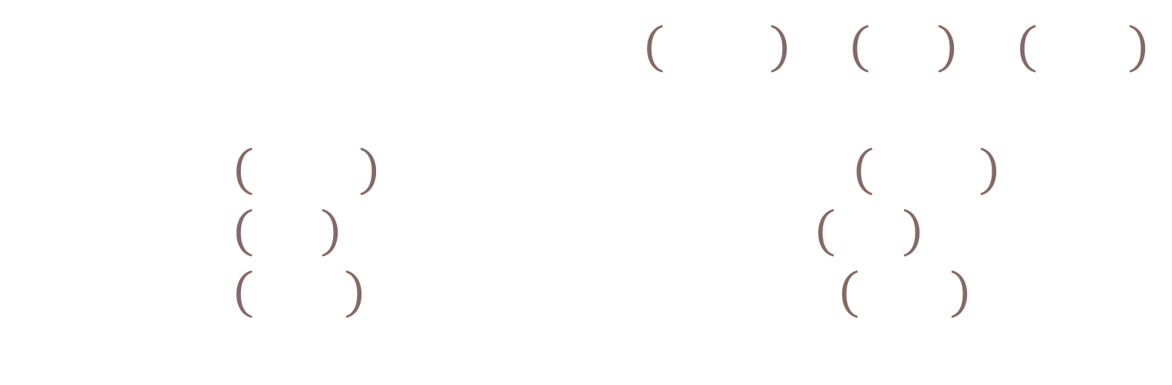
Determine (without solving the problem) an interval in which the solution of the given initial value problem is certain to exist and be unique.
$$\left(1 − t\right)\left(1 + t^{2}\right)y^{′′′}+\ln\left|t − 5\right|y^{′}+2y = \sqrt{t+4} y\left(t0\right)= ?$$
( )( )(
-4 1 5
Unique solution exists if $t_{0}∈\left(−4,1\right)∪\left(1,5\right)∪\left(5,∞\right)$
  If $t_{0}∈\left(−4,1\right)$, domain of solution is $\left(−4,1\right)$.
  If $t_{0}∈\left(1,5\right)$, domain of solution is $\left(1,5\right)$.
  If $t_{0}∈\left(5,∞\right)$, domain of solution is $\left(5,∞\right)$.

Slide 12
Linear Independence and the Wronskian

Slide 13
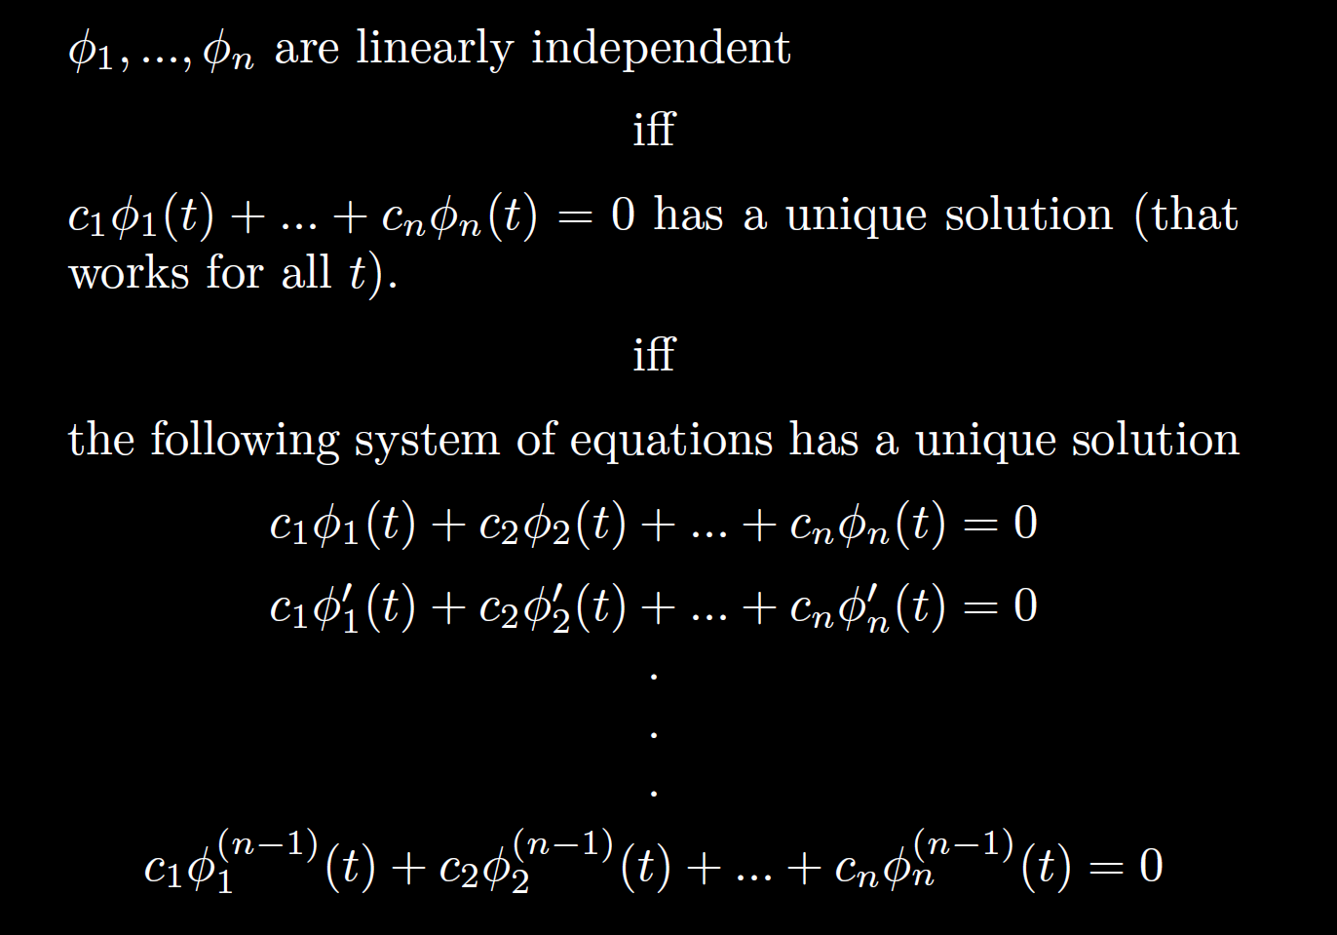

Slide 14
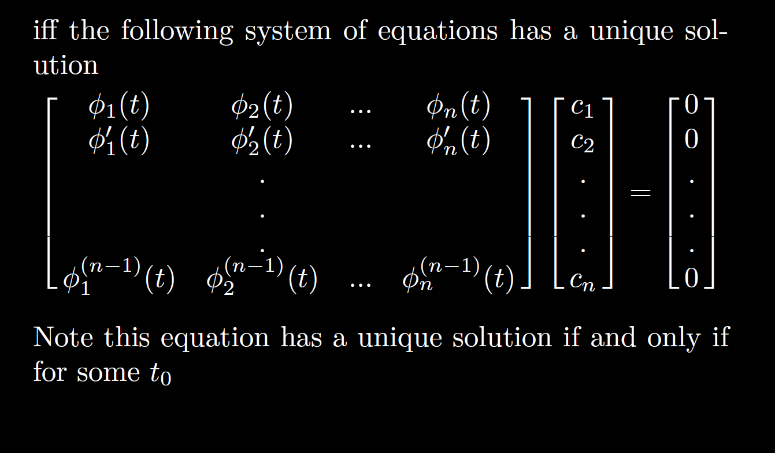

Slide 15
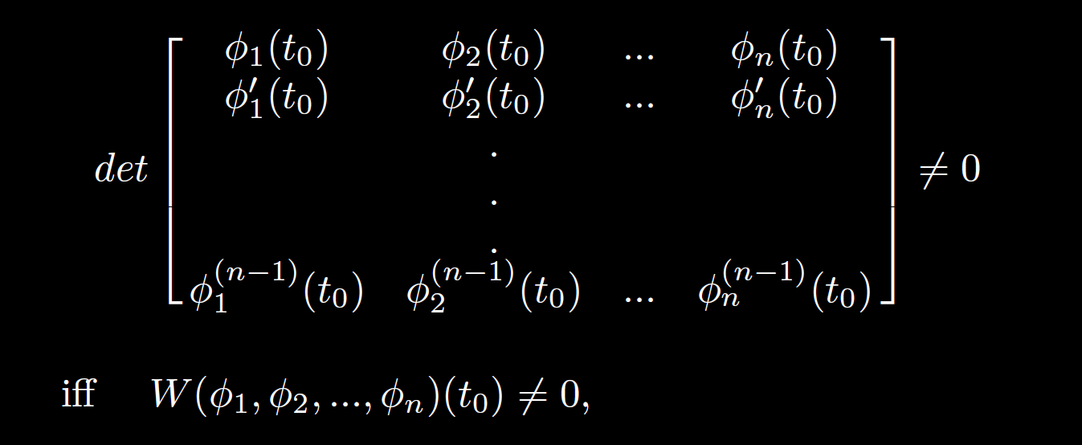

Slide 16
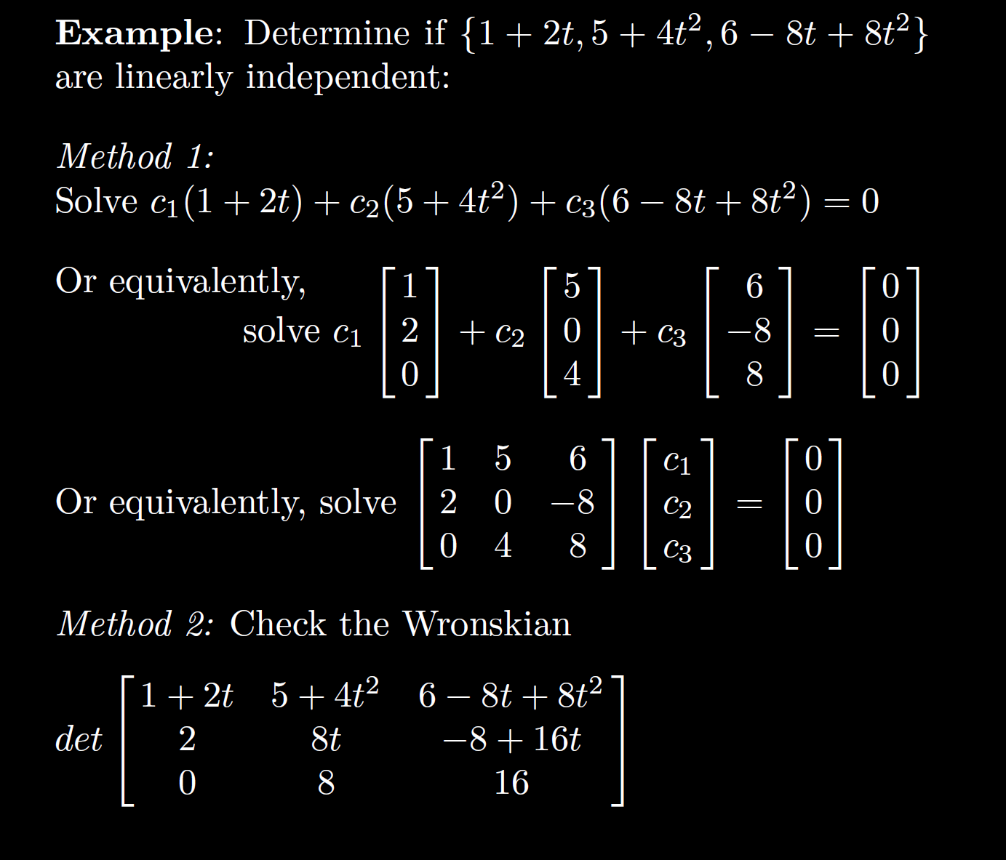

Slide 18
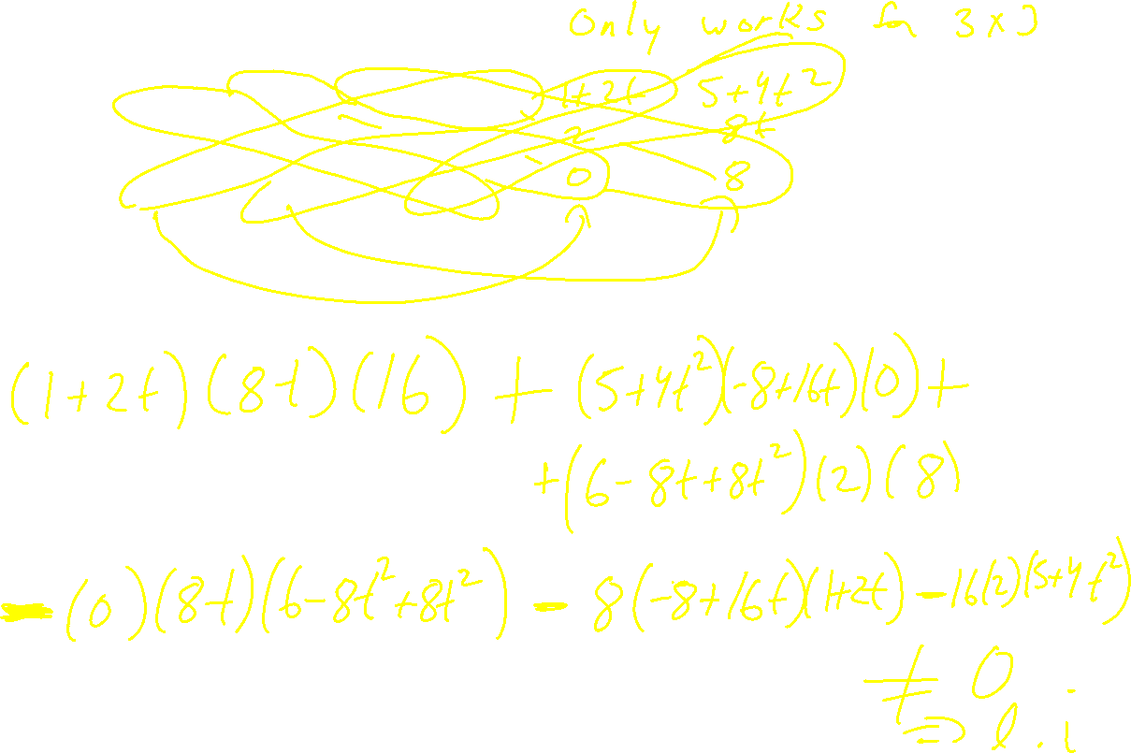

Slide 19
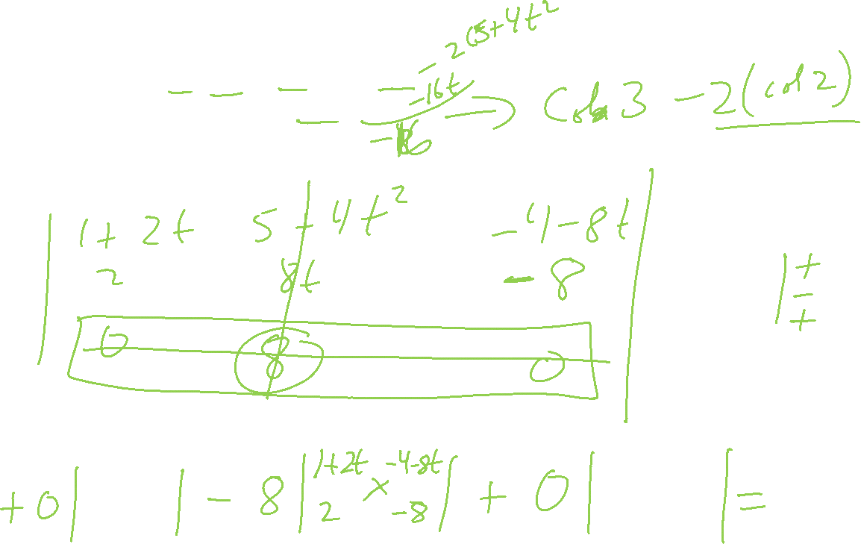

Slide 20
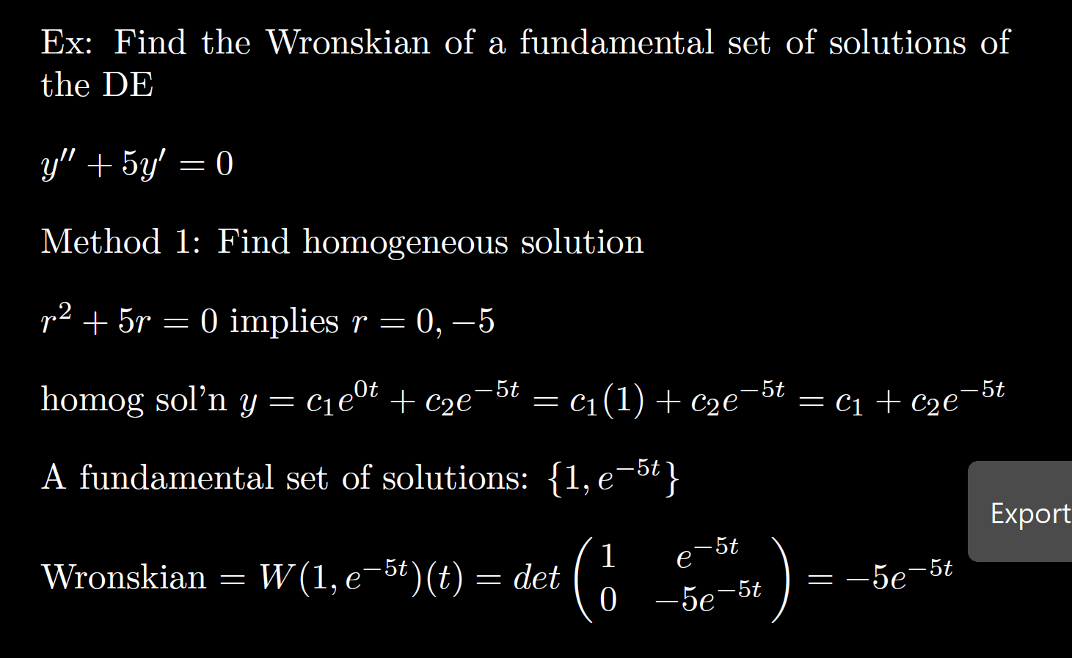

Slide 21
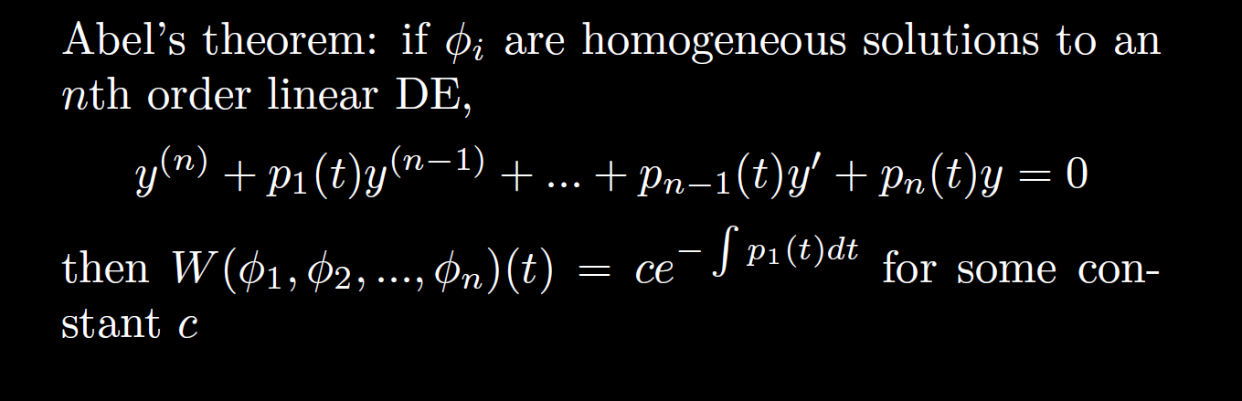

Slide 22
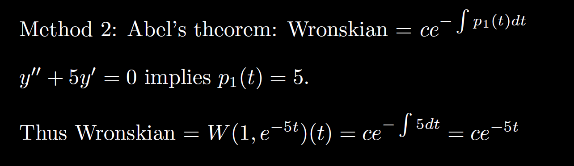

Slide 26
0
0
k
= C

Slide 27
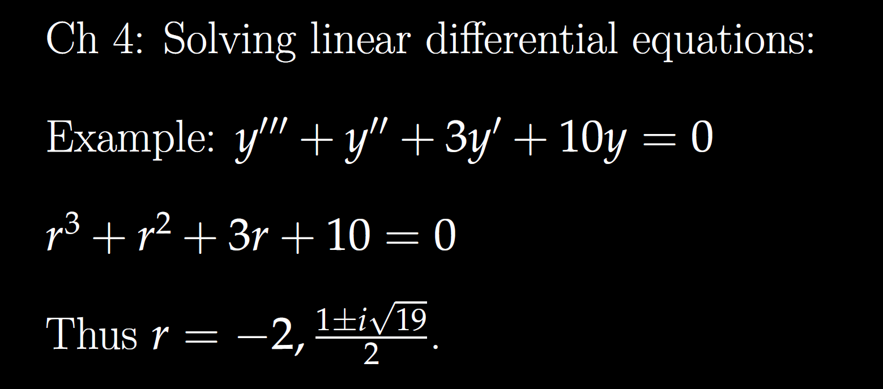

Slide 28
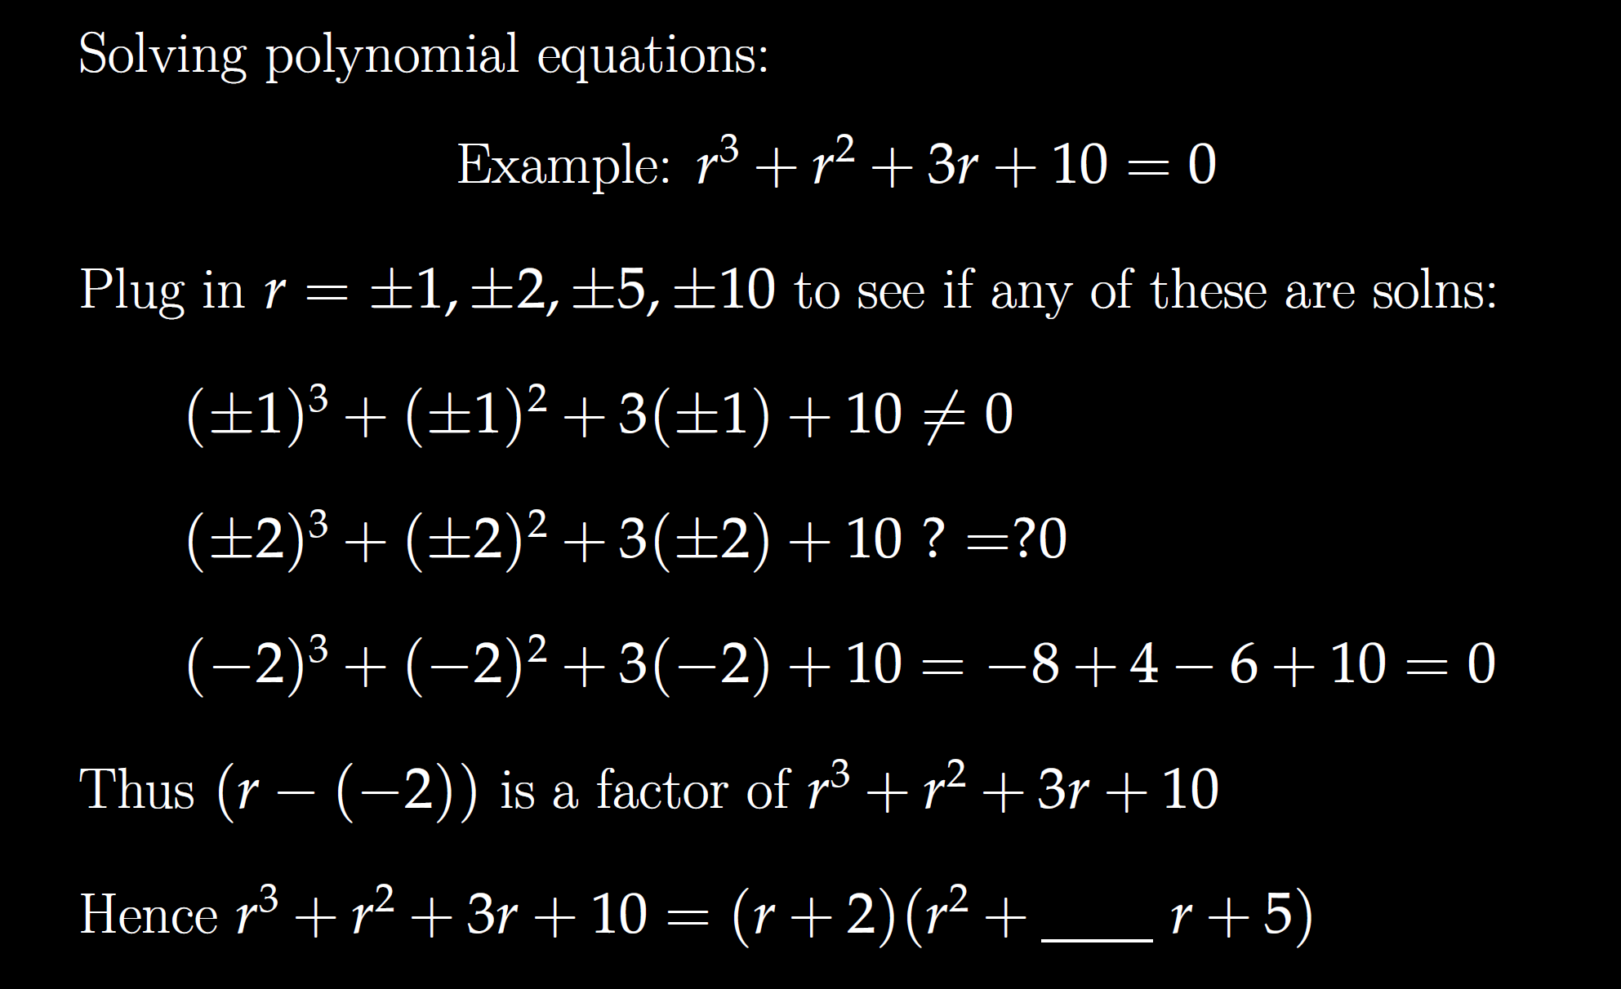

Slide 30
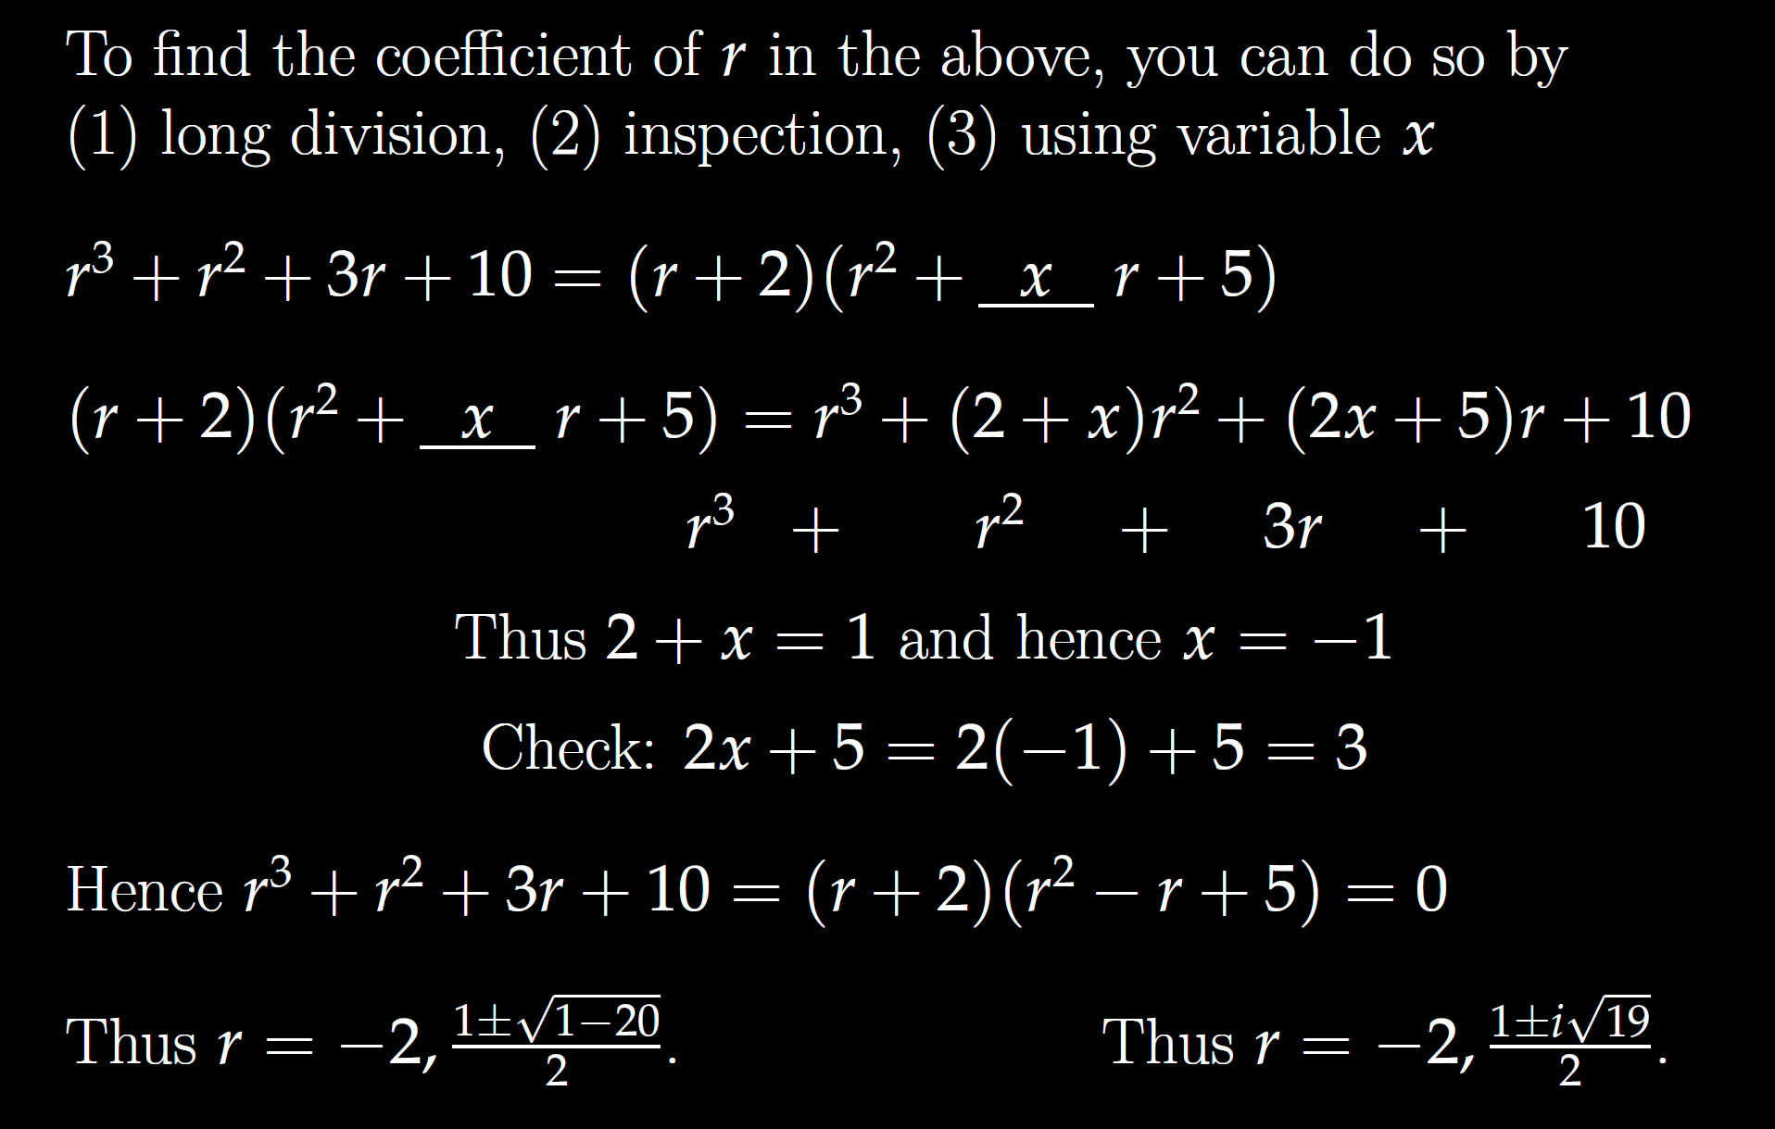

Slide 32
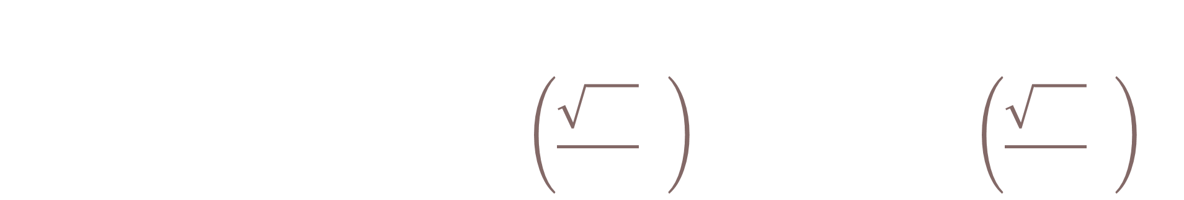
General solution:
$$y=c_{1}ⅇ^{−2t}+c_{2}ⅇ^{t/2}\sin\left(\frac{\sqrt{19}}{2}t\right)+c_{3}ⅇ^{{t/2}^{}}\cos\left(\frac{\sqrt{19}}{2}t\right)$$

Slide 33
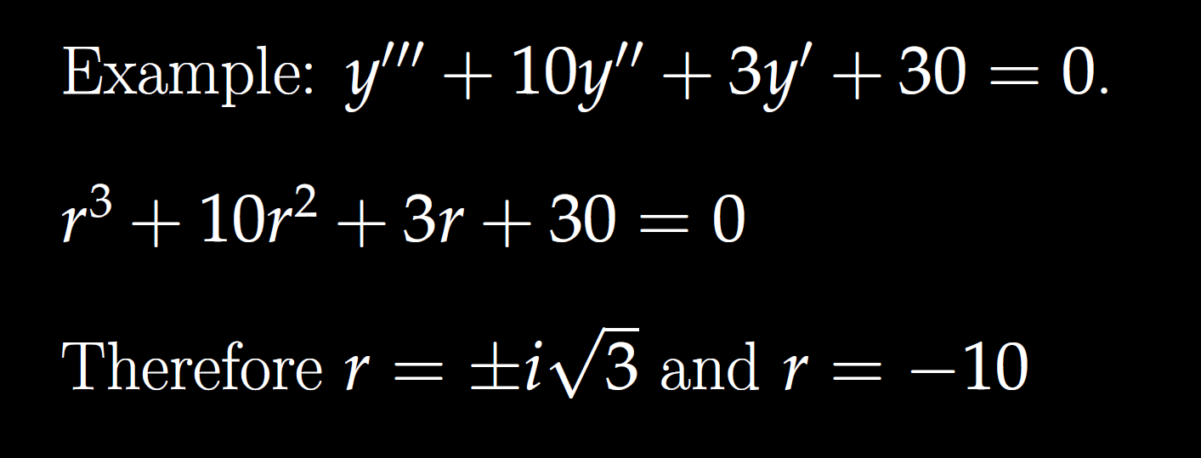

Slide 34
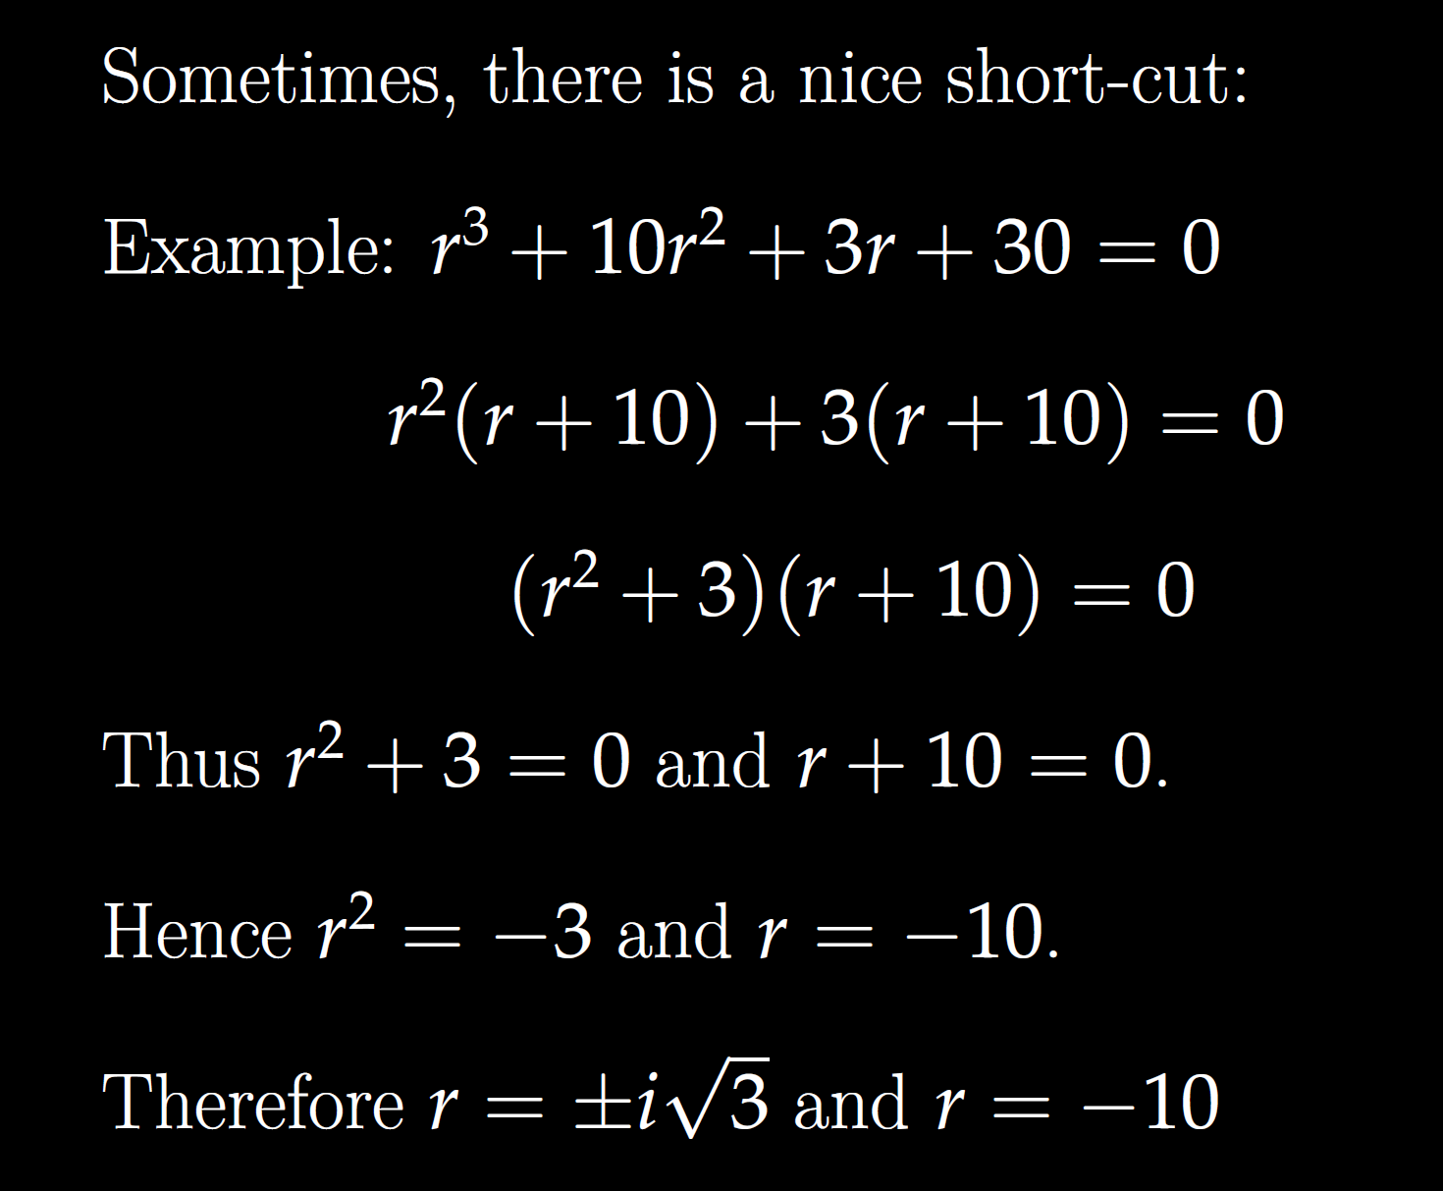

Slide 37

General solution:
$$y=c1cos\left(\sqrt{3}t\right)+c_{2}\sin\left(\sqrt{3}t\right)+c_{3}ⅇ^{−10t}$$

Slide 38
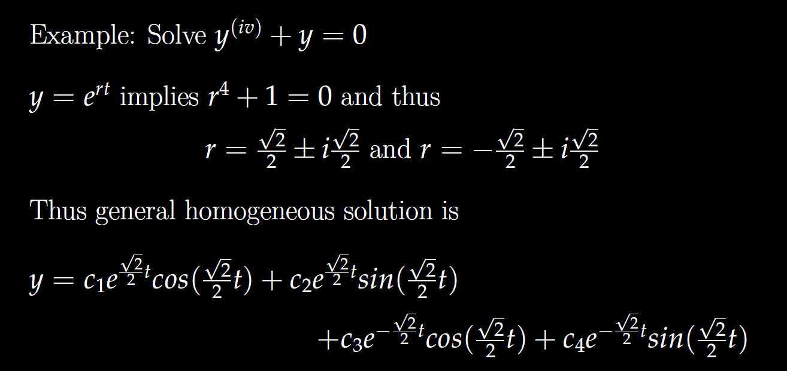
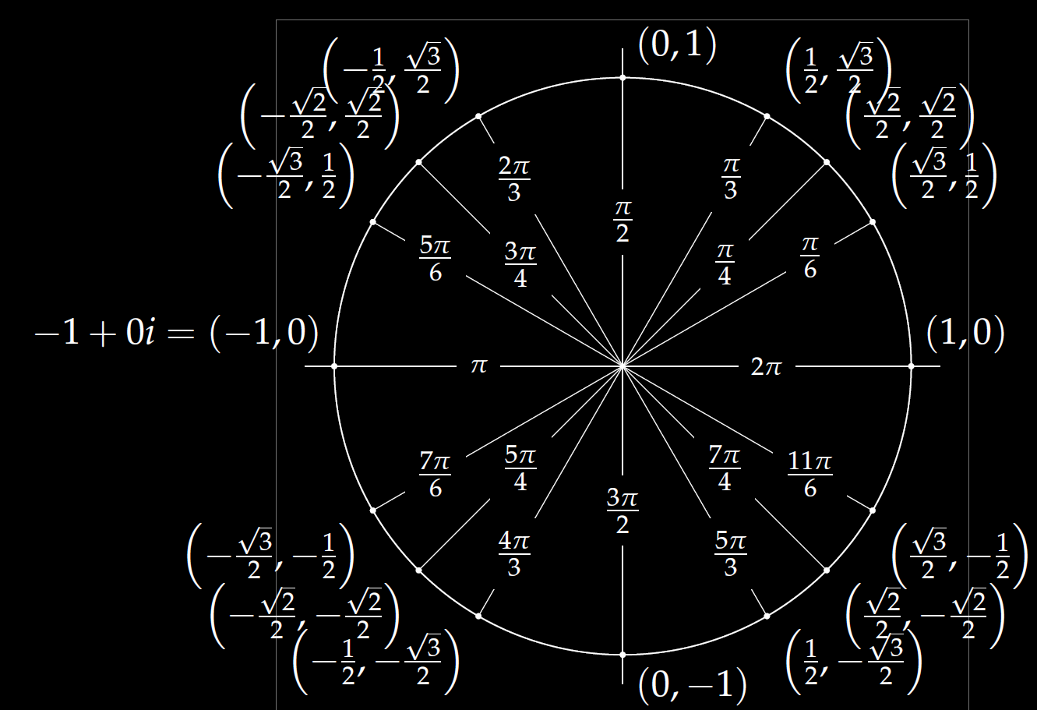

Slide 39




$r^{4}=$ -1 implies r =
$${(−1)}^{1/4}=ⅇ^{ⅈ\left(1+2k\right)π/4}$$

Slide 40
(a, b) = a + ib
= ( Rcos(x), R sin(x) )
= R [cos(x) + i sin(x)]
= R e^{ix}

Slide 41
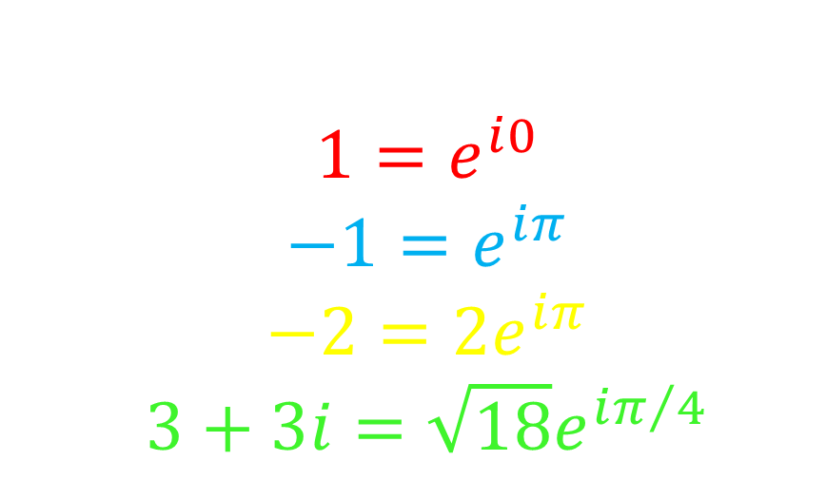
Examples:
$$1=ⅇ^{ⅈ0}$$
$$−1=ⅇ^{ⅈπ}$$
$$−2=2ⅇ^{ⅈπ}$$
$$3+3ⅈ=\sqrt{18}ⅇ^{iπ/4}$$

Slide 42
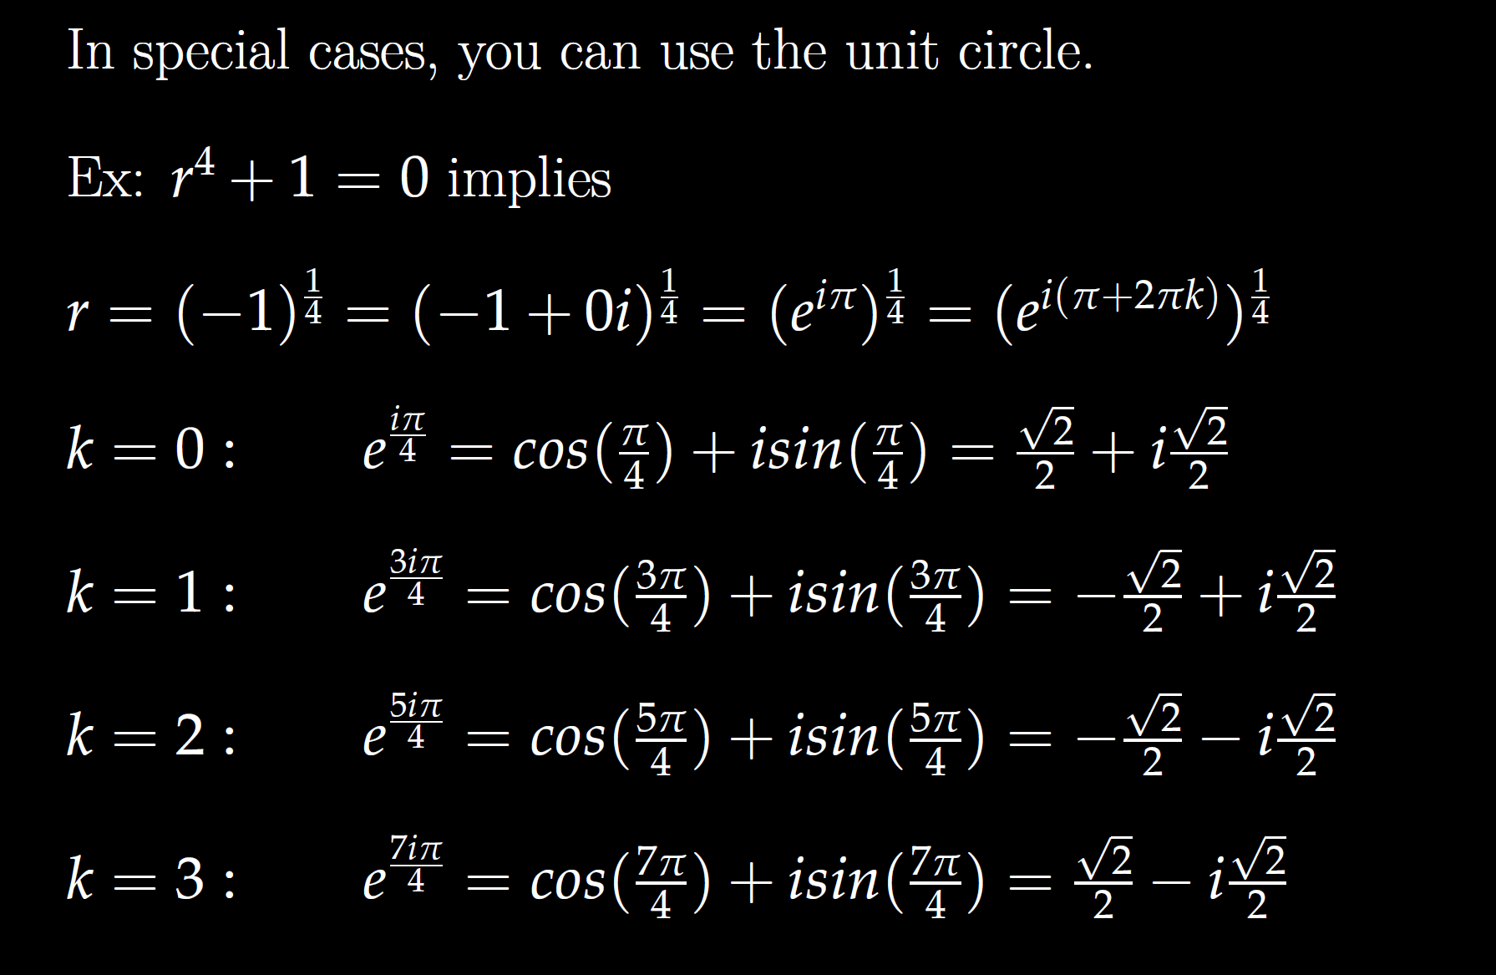

Slide 51


$r^{4}=$ 1 implies r =
$$1^{1/4}=ⅇ^{ⅈ\left(2πk/4\right)}$$
Roots of unity
r^{n} = 1

