Slide 1
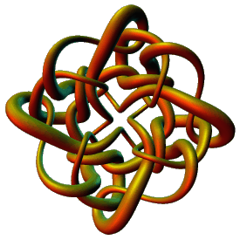
Topological Data Analysis
Applications III
Isabel K. Darcy
Mathematics Department
Applied Mathematical and
Computational Sciences (AMCS)
University of Iowa
http://www.math.uiowa.edu/~idarcy
This work was partially supported by the Joint DMS/NIGMS Initiative to Support Research in the Area of Mathematical Biology (NSF 0800285).

Slide 2
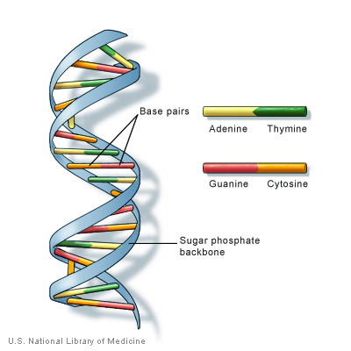
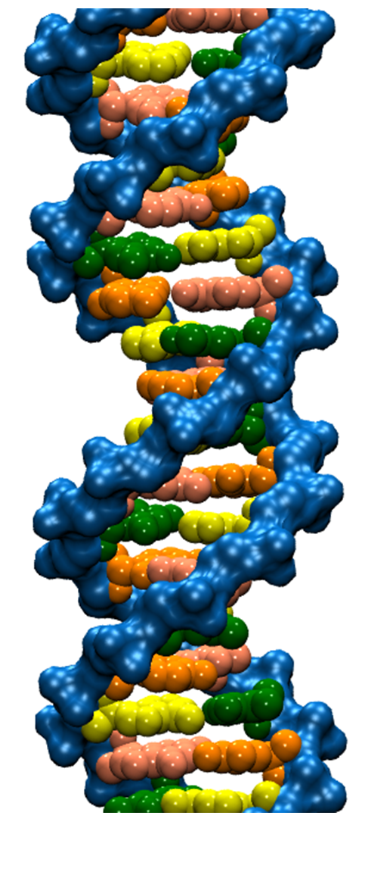
DNA trivia: Who are the authors of the 1953 paper on DNA with the following quotes:
“DNA is a helical structure”
with “two co-axial molecules.”
“period is 34 Å”
“one repeating unit contains ten
nucleotides on each of two . . . co-axial molecules.'’
“The phosphate groups lie on the outside of the structural unit, on a helix of diameter about 20 Å”
“the sugar and base groups must accordingly be turned inwards towards the helical axis.”

Slide 3

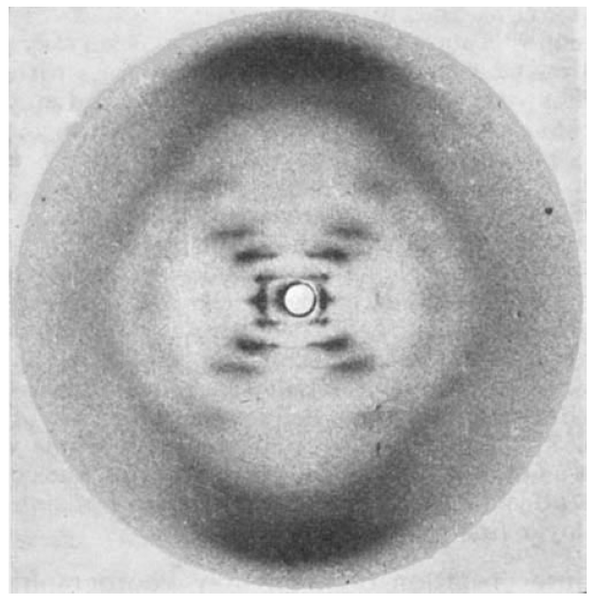


Slide 4
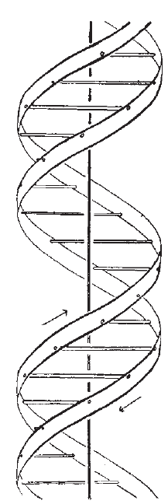


Also published in the same issue of Nature:

Slide 5
If someone gives you data, check with them BEFORE you share it with others.
If it involves human data, you may need approval from the ethics board.
If it involves human data, you may need to keep it secure – i.e, not on an unsecured laptop.

Slide 6
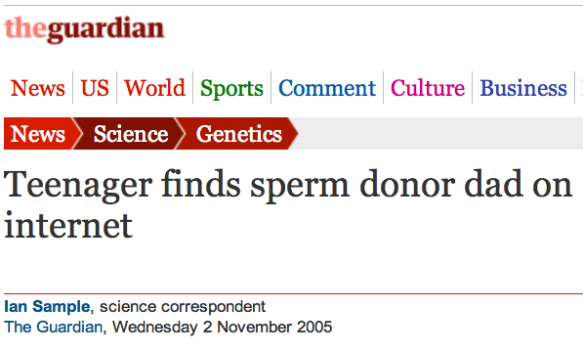
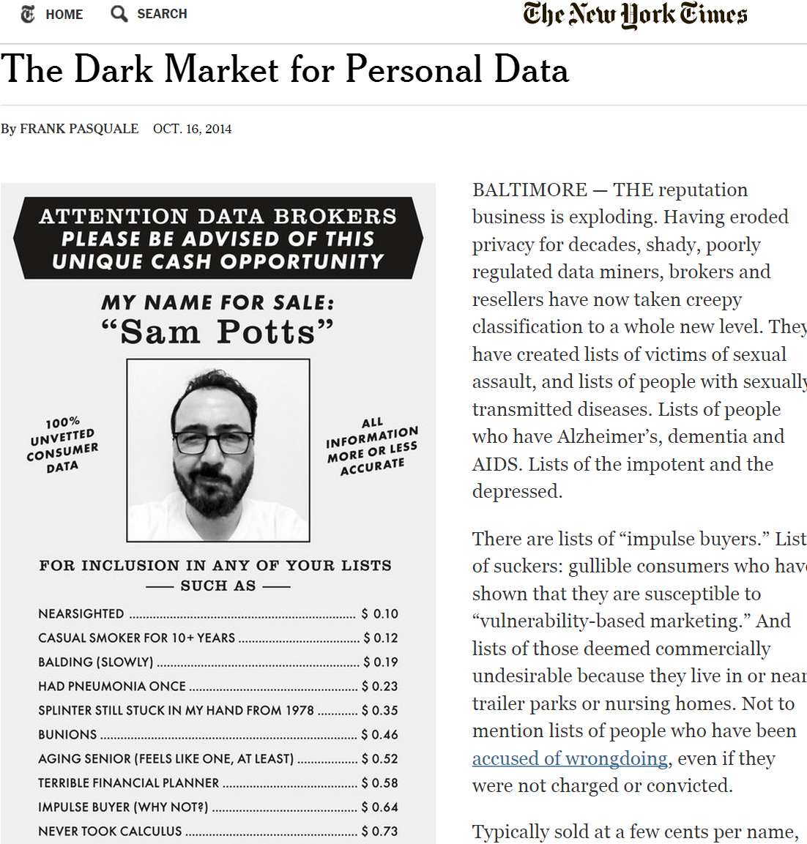
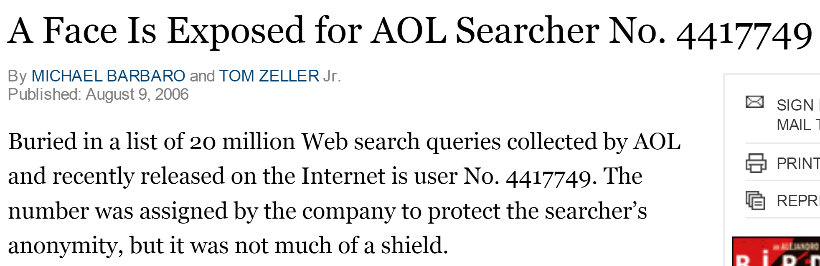

Data is NEVER fully anonymized
http://www.theguardian.com/science/2005/nov/03/genetics.news
http://www.nytimes.com/2014/10/17/opinion/the-dark-market-for-personal-data.html
http://www.nytimes.com/2006/08/09/technology/09aol.html, https://www.sciencemag.org/content/339/6117/262

Slide 7
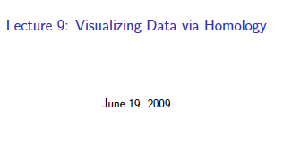
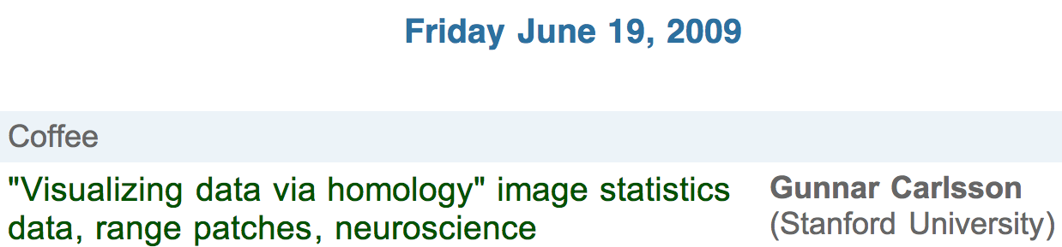
http://www.ima.umn.edu/videos/?id=856
http://ima.umn.edu/2008-2009/ND6.15-26.09/activities/Carlsson-Gunnar/imafive-handout4up.pdf

Slide 8
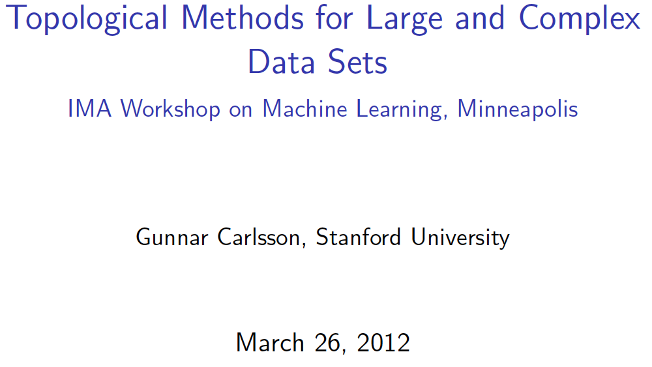
Application to Natural Image Statistics
With V. de Silva, T. Ishkanov, A. Zomorodian
http://www.ima.umn.edu/videos/?id=1846
http://www.ima.umn.edu/2011-2012/W3.26-30.12/activities/Carlsson-Gunnar/imamachinefinal.pdf

Slide 9
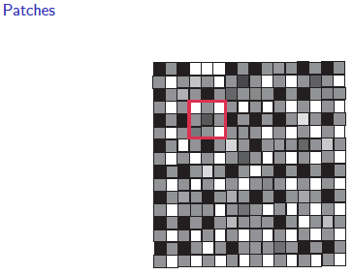
An image taken by black and white digital camera can be viewed as a vector, with one coordinate for each pixel
Each pixel has a “gray scale” value, can be thought of as a real number (in reality, takes one of 255 values)
Typical camera uses tens of thousands of pixels, so images lie in a very high dimensional space, call it pixel space, P

Slide 10
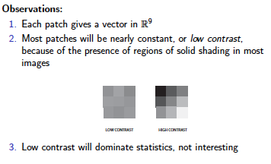
Lee-Mumford-Pedersen [LMP] study only high contrast patches.
Collection: 4.5 x 10⁶ high contrast patches from a
collection of images obtained by van Hateren and van der Schaaf
http://www.kyb.mpg.de/de/forschung/fg/bethgegroup/downloads/van-hateren-dataset.html

Slide 11
Lee-Mumford-Pedersen [LMP] study only high contrast patches.
Collection: 4.5 x 10⁶ high contrast patches from a
collection of images obtained by van Hateren and van der Schaaf
Choose how to model your data

Slide 12
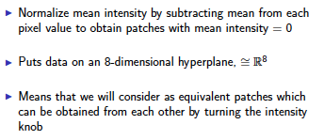
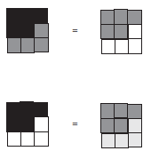

Choose how to model your data
Consult previous methods.

Slide 13
What to do if you are overwhelmed by the number of possible ways to model your data (or if you have no ideas):
Do what the experts do.
Borrow ideas.
Use what others have done.

Slide 14
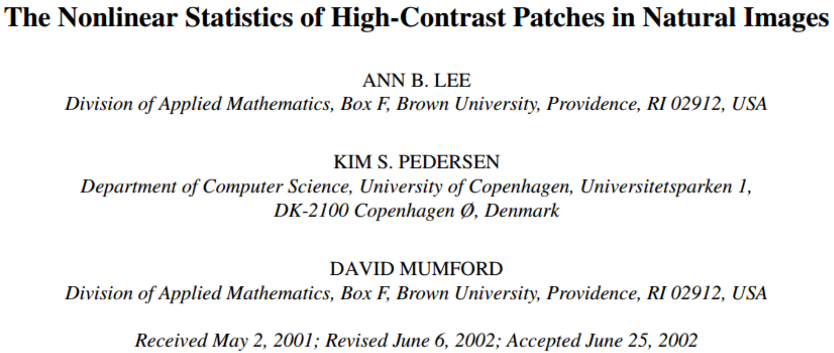
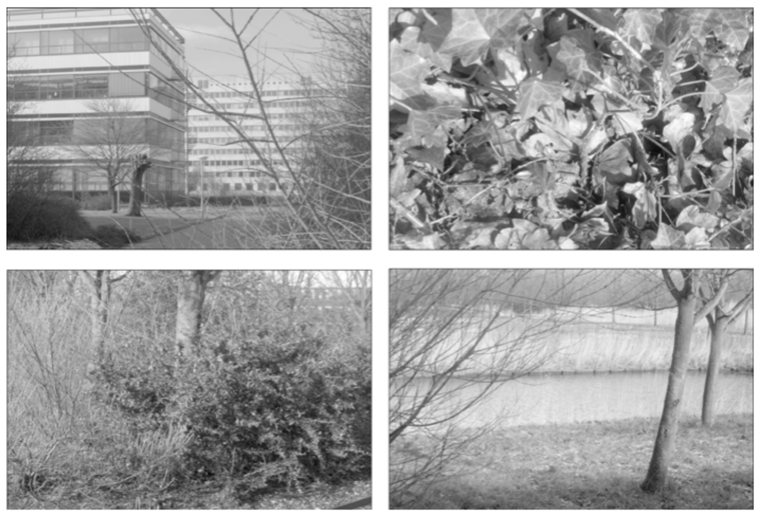
Carlsson et al used

Slide 15
Carlsson et al used
The majority of high-contrast optical patches are concentrated around a 2-dimensional C₁ submanifold
embedded in the 7-dimensional sphere.

Slide 16
Persistent Homology: Create the Rips complex
0.) Start by adding 0-dimensional data points
is a point in S⁷
Notes:
We can compute the number of clusters for a variety of diameters.
We start with 17 data points, so if the diameter is 0, we have 17 clusters. Increasing the diameter, these 2 balls intersect so I now have 16 clusters.
If we continue to increase the diameter, we will eventually create the complex we saw before with 5 clusters, etc until we only have one cluster left.
Eventually this entire page will be purple, but right now, we know have one component.
To choose the threshold, one can determine how long a particular number of clusters lasts, for example for what set of radii do we have five clusters. If we have five clusters for the largest set of radii, then have gives us a good idea where to set the threshold and which simplicial complex best models our data.
I have put links to better animations on my on my YouTube site which may better illustrate this persistence concept. Next month, we will also talk much more about persistence during the live lectures for this course. This is just a preliminary introduction.

Slide 17
For each fixed ε, create Rips complex from the data
is a point in S⁷
1.) Adding 1-dimensional edges (1-simplices)
Add an edge between data points that are close
Notes:
a one dimensional simplicial complex. Note that we have clustered our data into five disjoint connected sets. So this is one way to cluster our data – that is grouping our data points into disjoint sets based on some definition of similarity. In this case, we have 5 clusters.
We can now add higher dimensional simplices.

Slide 18
For each fixed ε, create Rips complex from the data
2.) Add all possible simplices of dimensional > 1.
is a point in S⁷
Notes:
Thus we now have the Vietoris Rips simplicial complex. Note we get the same simplex by adding one dimension at a time

Slide 19
For each fixed ε, create Rips complex from the data
In reality used Witness complex (see later slides).
2.) Add all possible simplices of dimensional > 1.
is a point in S⁷
Notes:
Thus we now have the Vietoris Rips simplicial complex. Note we get the same simplex by adding one dimension at a time

Slide 20
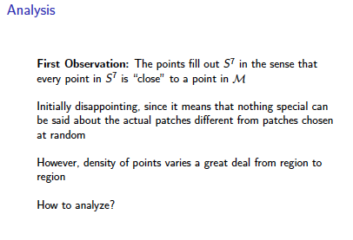
Probe the data

Slide 21
Probe the data

Slide 22
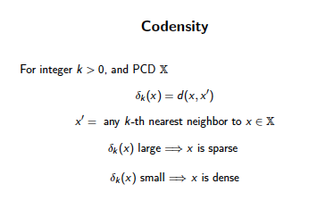
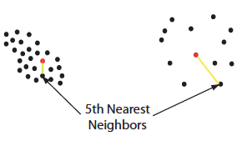

Can use function on data to probe the data
e.g. Morse function

Slide 23
Large values of k:
measuring density of large neighborhoods of x,
Smaller values mean we are using smaller neighborhoods
← smoothed out version

Slide 24
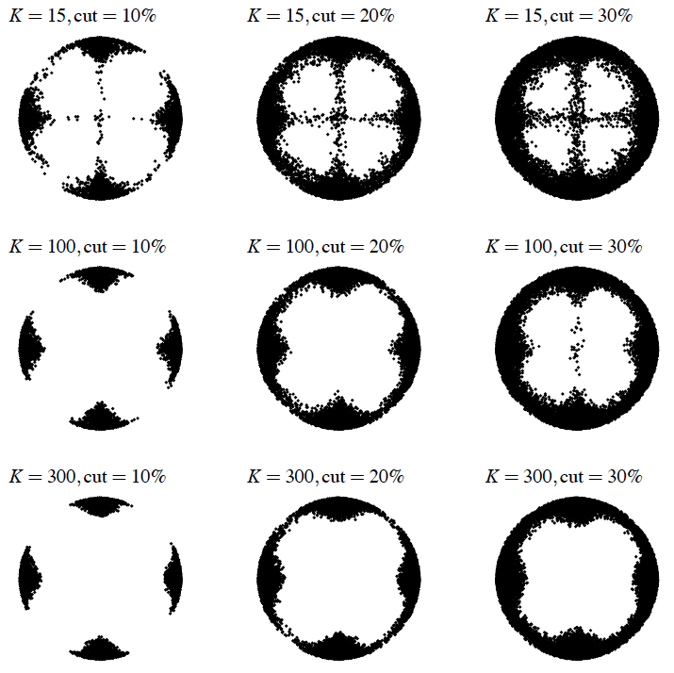
Eurographics Symposium on Point-Based Graphics (2004)
Topological estimation using witness complexes
Vin de Silva and Gunnar Carlsson

Slide 25
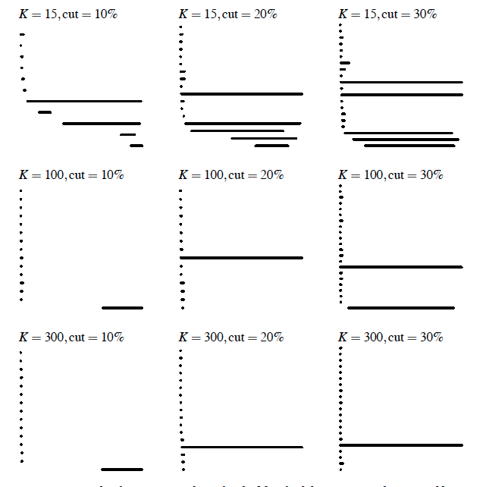
Eurographics Symposium on Point-Based Graphics (2004)
Topological estimation using witness complexes
Vin de Silva and Gunnar Carlsson

Slide 26
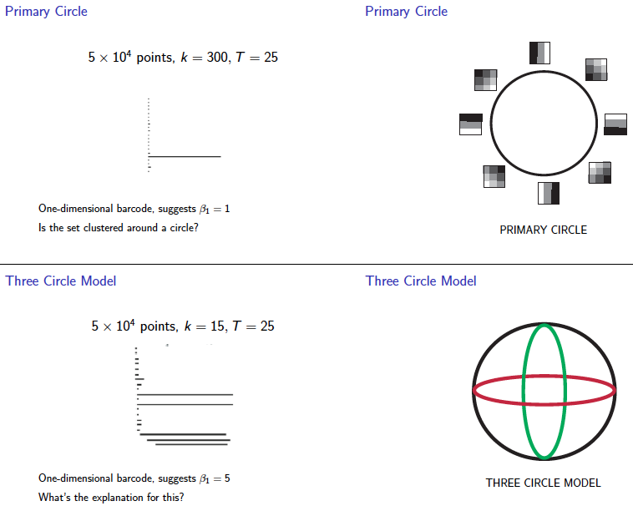
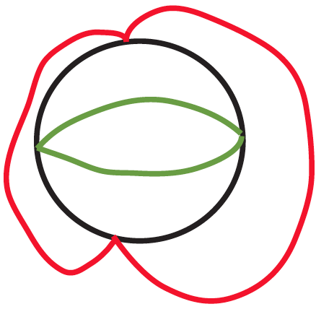

Slide 27
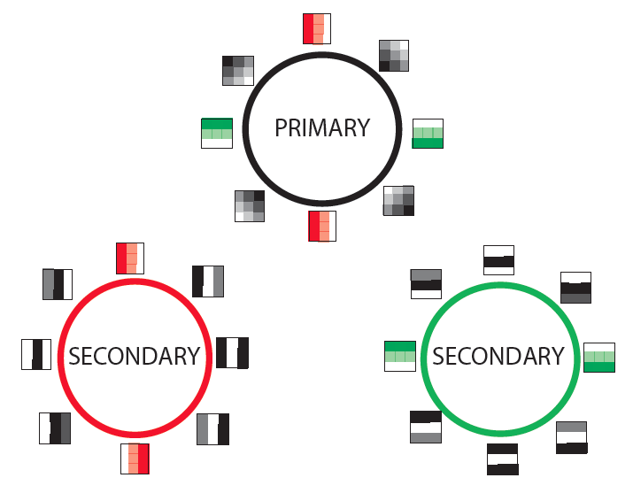

Slide 28
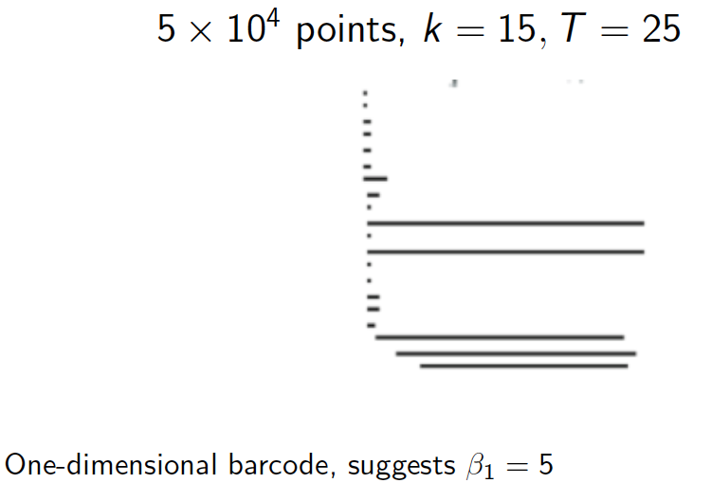

Slide 29
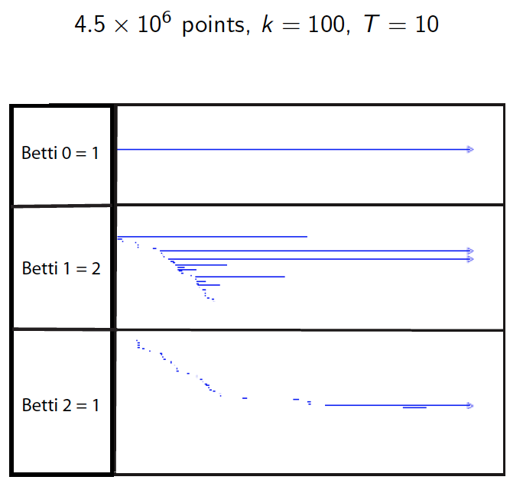

Slide 30
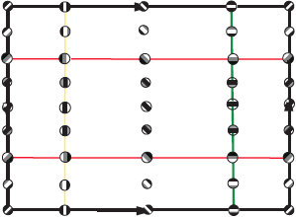

Slide 31
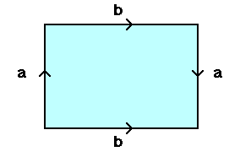
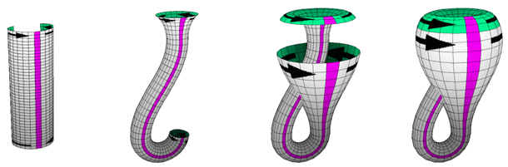
From: http://www.math.osu.edu/~fiedorowicz.1/math655/Klein2.html
Klein Bottle
From:
http://plus.maths.org/content/imaging-maths-inside-klein-bottle

Slide 32
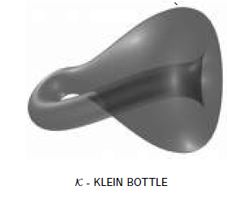
M(100, 10) U Q
where |Q| = 30
On the Local Behavior of Spaces of Natural Images, Gunnar Carlsson, Tigran Ishkhanov, Vin de Silva, Afra Zomorodian, International Journal of Computer Vision 2008, pp 1-12.

Slide 33
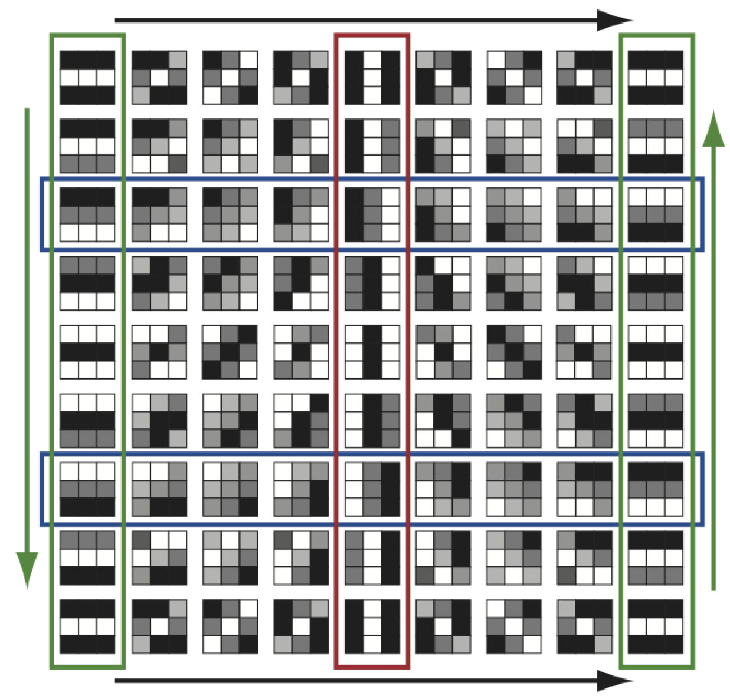
http://www.maths.ed.ac.uk/~aar/papers/ghristeat.pdf

Slide 34
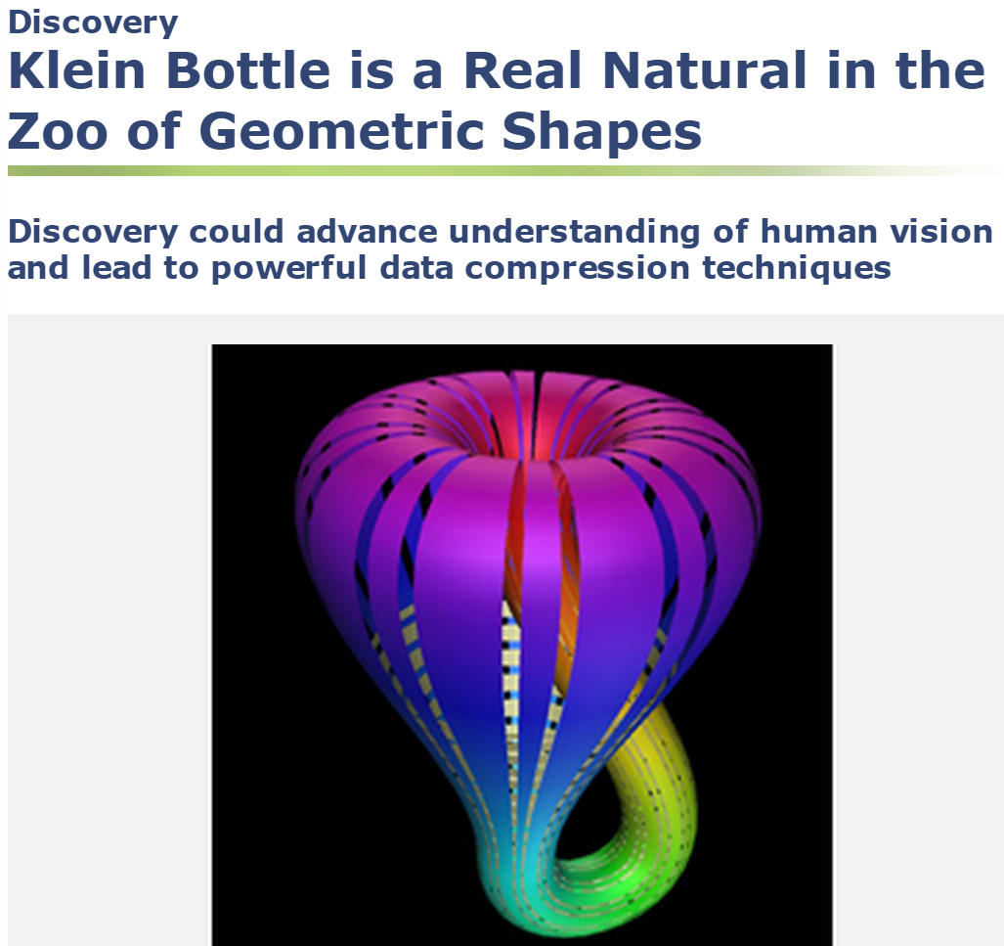
http://www.maths.ed.ac.uk/~aar/papers/ghristeat.pdf

Slide 35
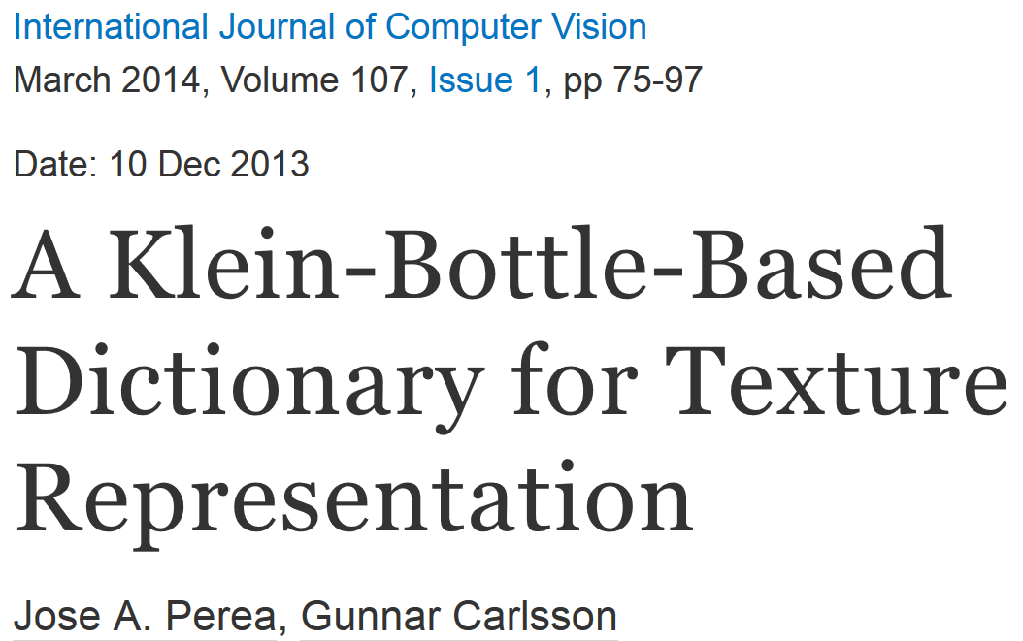
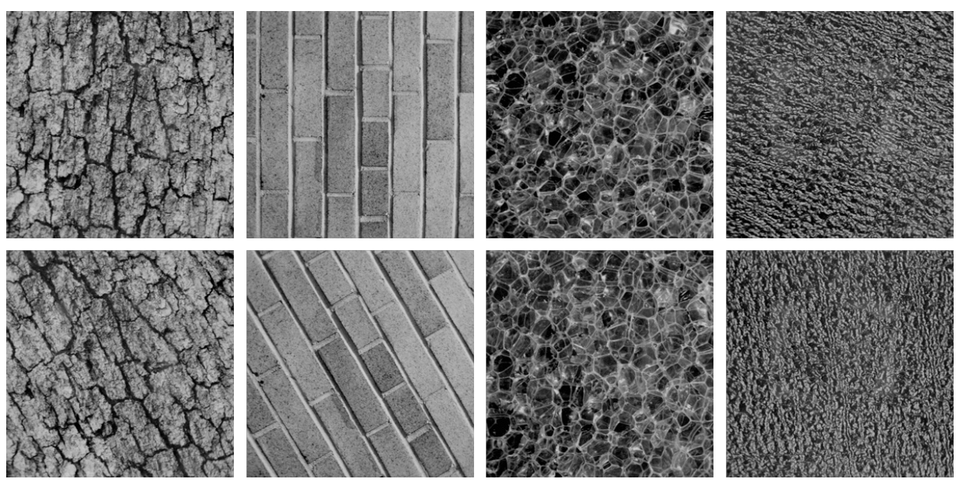
Combine your analysis with other tools

Slide 36
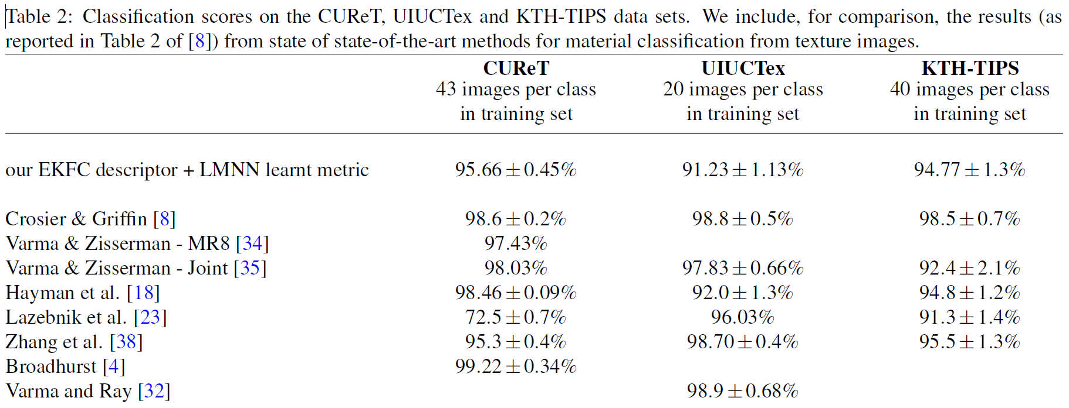
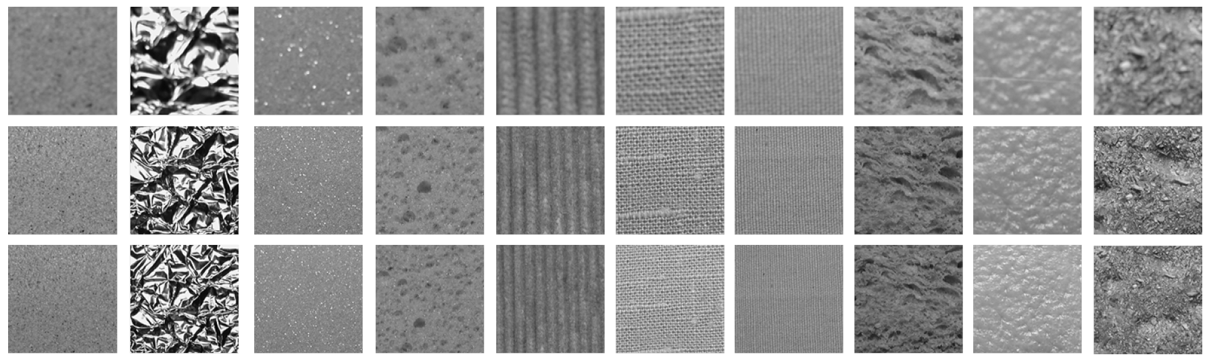

Slide 37
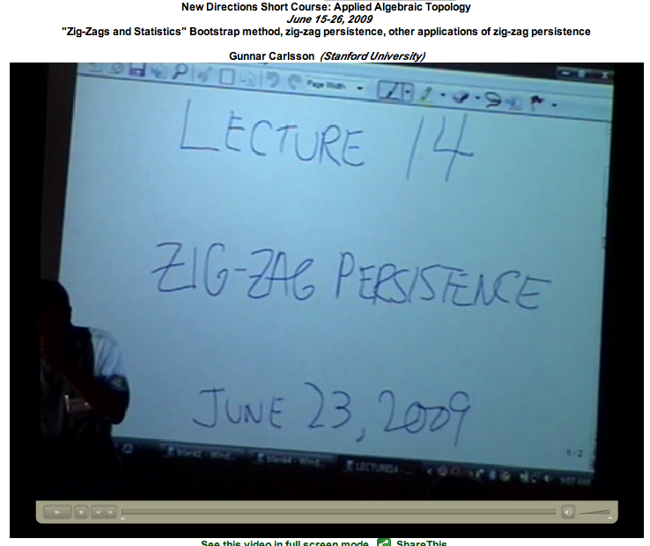
http://www.ima.umn.edu/videos/?id=863
http://www.ima.umn.edu/2008-2009/ND6.15-26.09/activities/Carlsson-Gunnar/lecture14.pdf

Slide 38
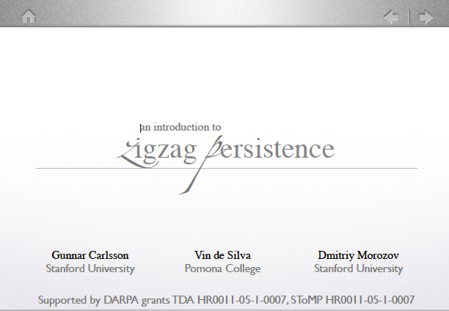
http://geometrica.saclay.inria.fr/workshops/TGDA_07_2009/workshop_files/slides/deSilva_TGDA.pdf

Slide 39
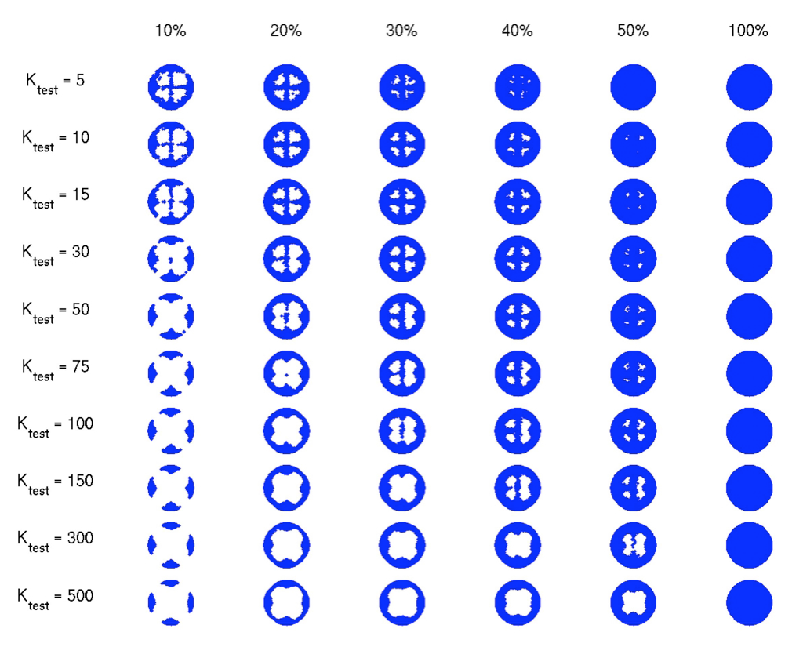

Slide 40
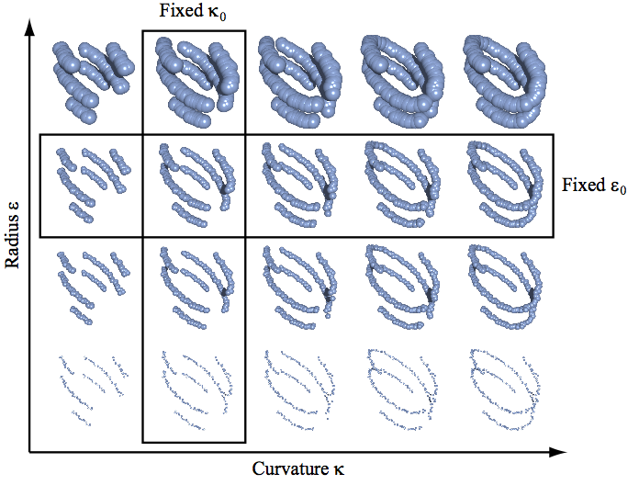
The Theory of Multidimensional Persistence, Gunnar Carlsson, Afra Zomorodian
"Persistence and Point Clouds" Functoriality, diagrams, difficulties in classifying diagrams,
multidimensional persistence, Gröbner bases, Gunnar Carlsson
http://www.ima.umn.edu/videos/?id=862

Slide 41
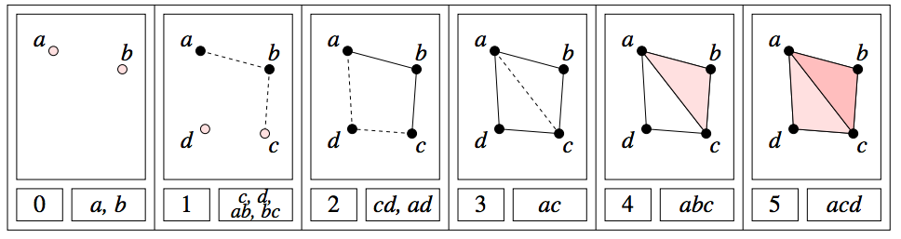
H₀ = < a, b, c, d : tc + td, tb + c, ta + tb>
H₁ = <z₁, z₂ : t z₂, t³z₁ + t²z₂ >
[ )
[ )
[ )
[ )
[
z₁ = ad + cd + t(bc) + t(ab), z₂ = ac + t²bc + t²ab

Slide 42
The Theory of Multidimensional Persistence, Gunnar Carlsson, Afra Zomorodian
"Persistence and Point Clouds" Functoriality, diagrams, difficulties in classifying diagrams,
multidimensional persistence, Gröbner bases, Gunnar Carlsson
http://www.ima.umn.edu/videos/?id=862

Slide 44
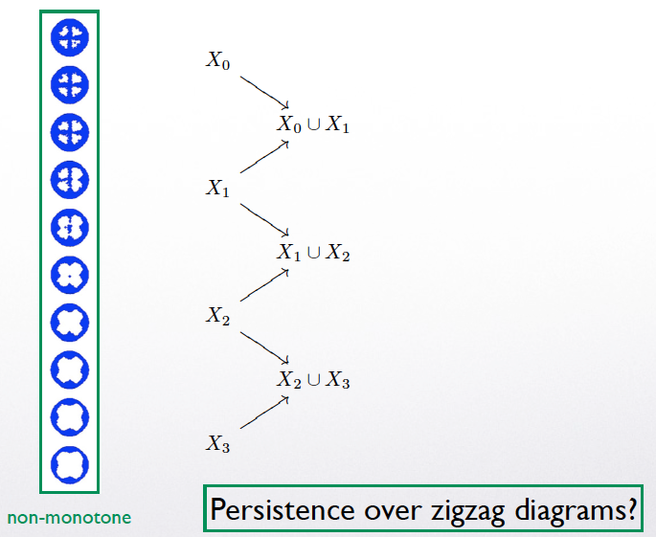

Slide 45
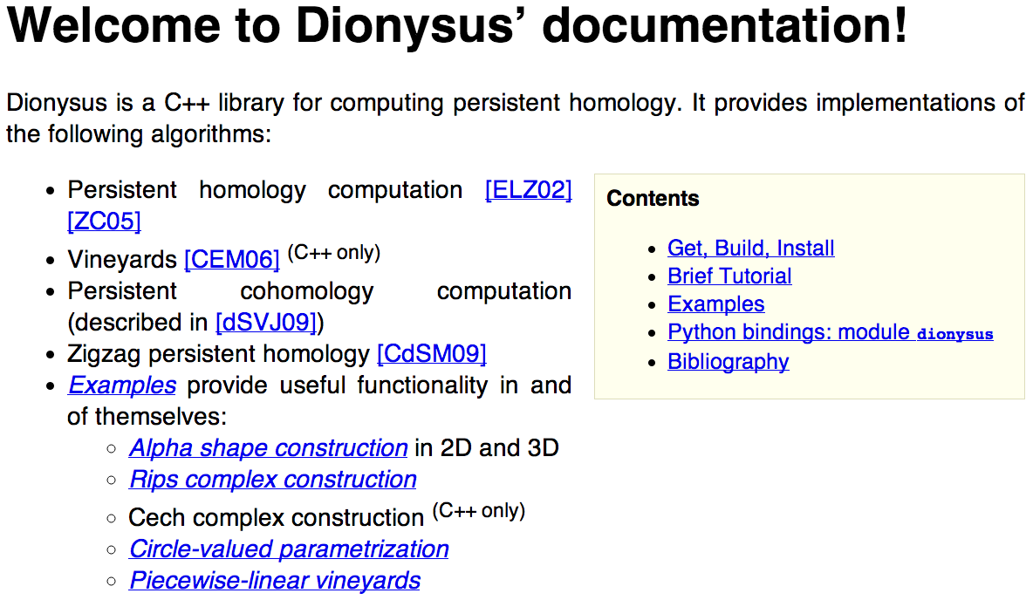
http://www.mrzv.org/software/dionysus/

