Slide 2
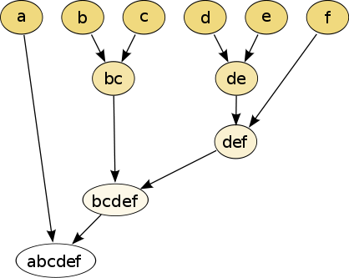
single linkage
hierarchical clustering
Increasing threshold
Connect vertices whose distance is less than a given threshold
single linkage hierarchical clustering

Slide 3
single linkage
hierarchical clustering
Persistent homology barcode
Increasing threshold

Slide 4
Persistent homology barcode
Increasing threshold

Slide 5
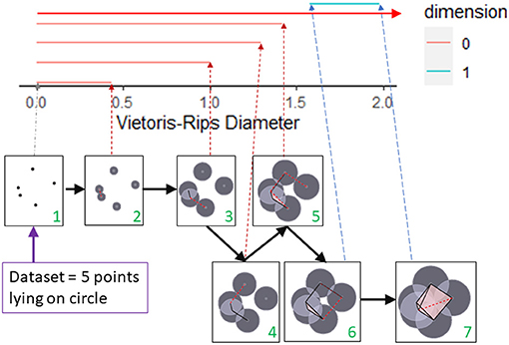
Persistent homology barcode
Filtration of simplicial complexes
This figure was created by modifying the output of the R package TDAstat (Wadhwa et al., 2018) and latex code written by Catalina Betancourt. https://www.frontiersin.org/articles/10.3389/frai.2021.659037/full

Slide 6
Homology
3 ingredients:
1.) Objects
2.) Grading
3.) Boundary map

Slide 7
1.) OBJECTS

Slide 8
Building blocks for a simplicial complex
0-simplex = vertex = v
1-simplex = edge = {v₁, v₂}
v₁
v₂
e
2-simplex = triangle = {v₁, v₂, v₃}
v₂
e₁
e₂
v₁
v₃
e₃
Notes:
The building blocks for a simplicial complex consist of zero simplices which are zero dimensional vertices, one simplices which are one-dimensional edges, and 2-simplices which are two dimensional triangles,

Slide 9
Objects = generators
Generators = X = { x_{α} | α in A }
Let R be a ring (or field)
R[X] = { n₁x₁ + n₂x₂ + … + n_{k}x_{k} : x_{i} in R }
Ex: Z₂[X] = { n₁x₁ + n₂x₂ + … + n_{k}x_{k} : x_{i} in Z₂ }
Notes:
Complex, C = R[x]

Slide 10
A free vector space over the field F generated by the elements x₁, x₂, …, x_{k} consists of all elements of the
form
n₁x₁ + n₂x₂ + … + n_{k}x_{k}
where n_{i} in F.
Examples of a field: R = set of real numbers
Q = set of rational numbers
Z₂ = {0, 1}
Addition:
(n₁x₁ + n₂x₂ + … + n_{k}x_{k}) + (m₁x₁ + m₂x₂ + … + m_{k}x_{k})
= (n₁ + m₁) x₁ + (n₂ + m₂)x₂ + … + (n_{k} + m_{k})x_{k}
Slide from preparatory lecture 4: Addition (and free vector spaces)
Notes:
We will now define free vector space. Note that the only difference between a free vector space and free abelian group is that our coefficients need not be integers.

Slide 11
A free vector space over the field F generated by the elements x₁, x₂, …, x_{k} consists of all elements of the
form
n₁x₁ + n₂x₂ + … + n_{k}x_{k}
where n_{i} in F.
Examples of a field:
R = set of real numbers:
πx + √2 y + 3z is in R[x, y, z]
Q = set of rational numbers (i.e. fractions):
(½)x + 4y is in Q[x, y]
Z₂ = {0, 1}: 0x + 1y + 1w + 0z is in Z₂[x, y, z, w]
Slide from preparatory lecture 4: Addition (and free vector spaces)
Notes:
For example, our coefficients could be real numbers such as pi, sqrt 2 or 3
Or they could be rational numbers, fractions like ½ or 4
We will focus on Z mod 2 coefficients. In this case our coefficients are either 0 or 1
You don’t actually need to know the formal definition of a field since we will stick with Z mod 2 coefficients, but for completeness, I will quickly summarize a few definitions.

Slide 12

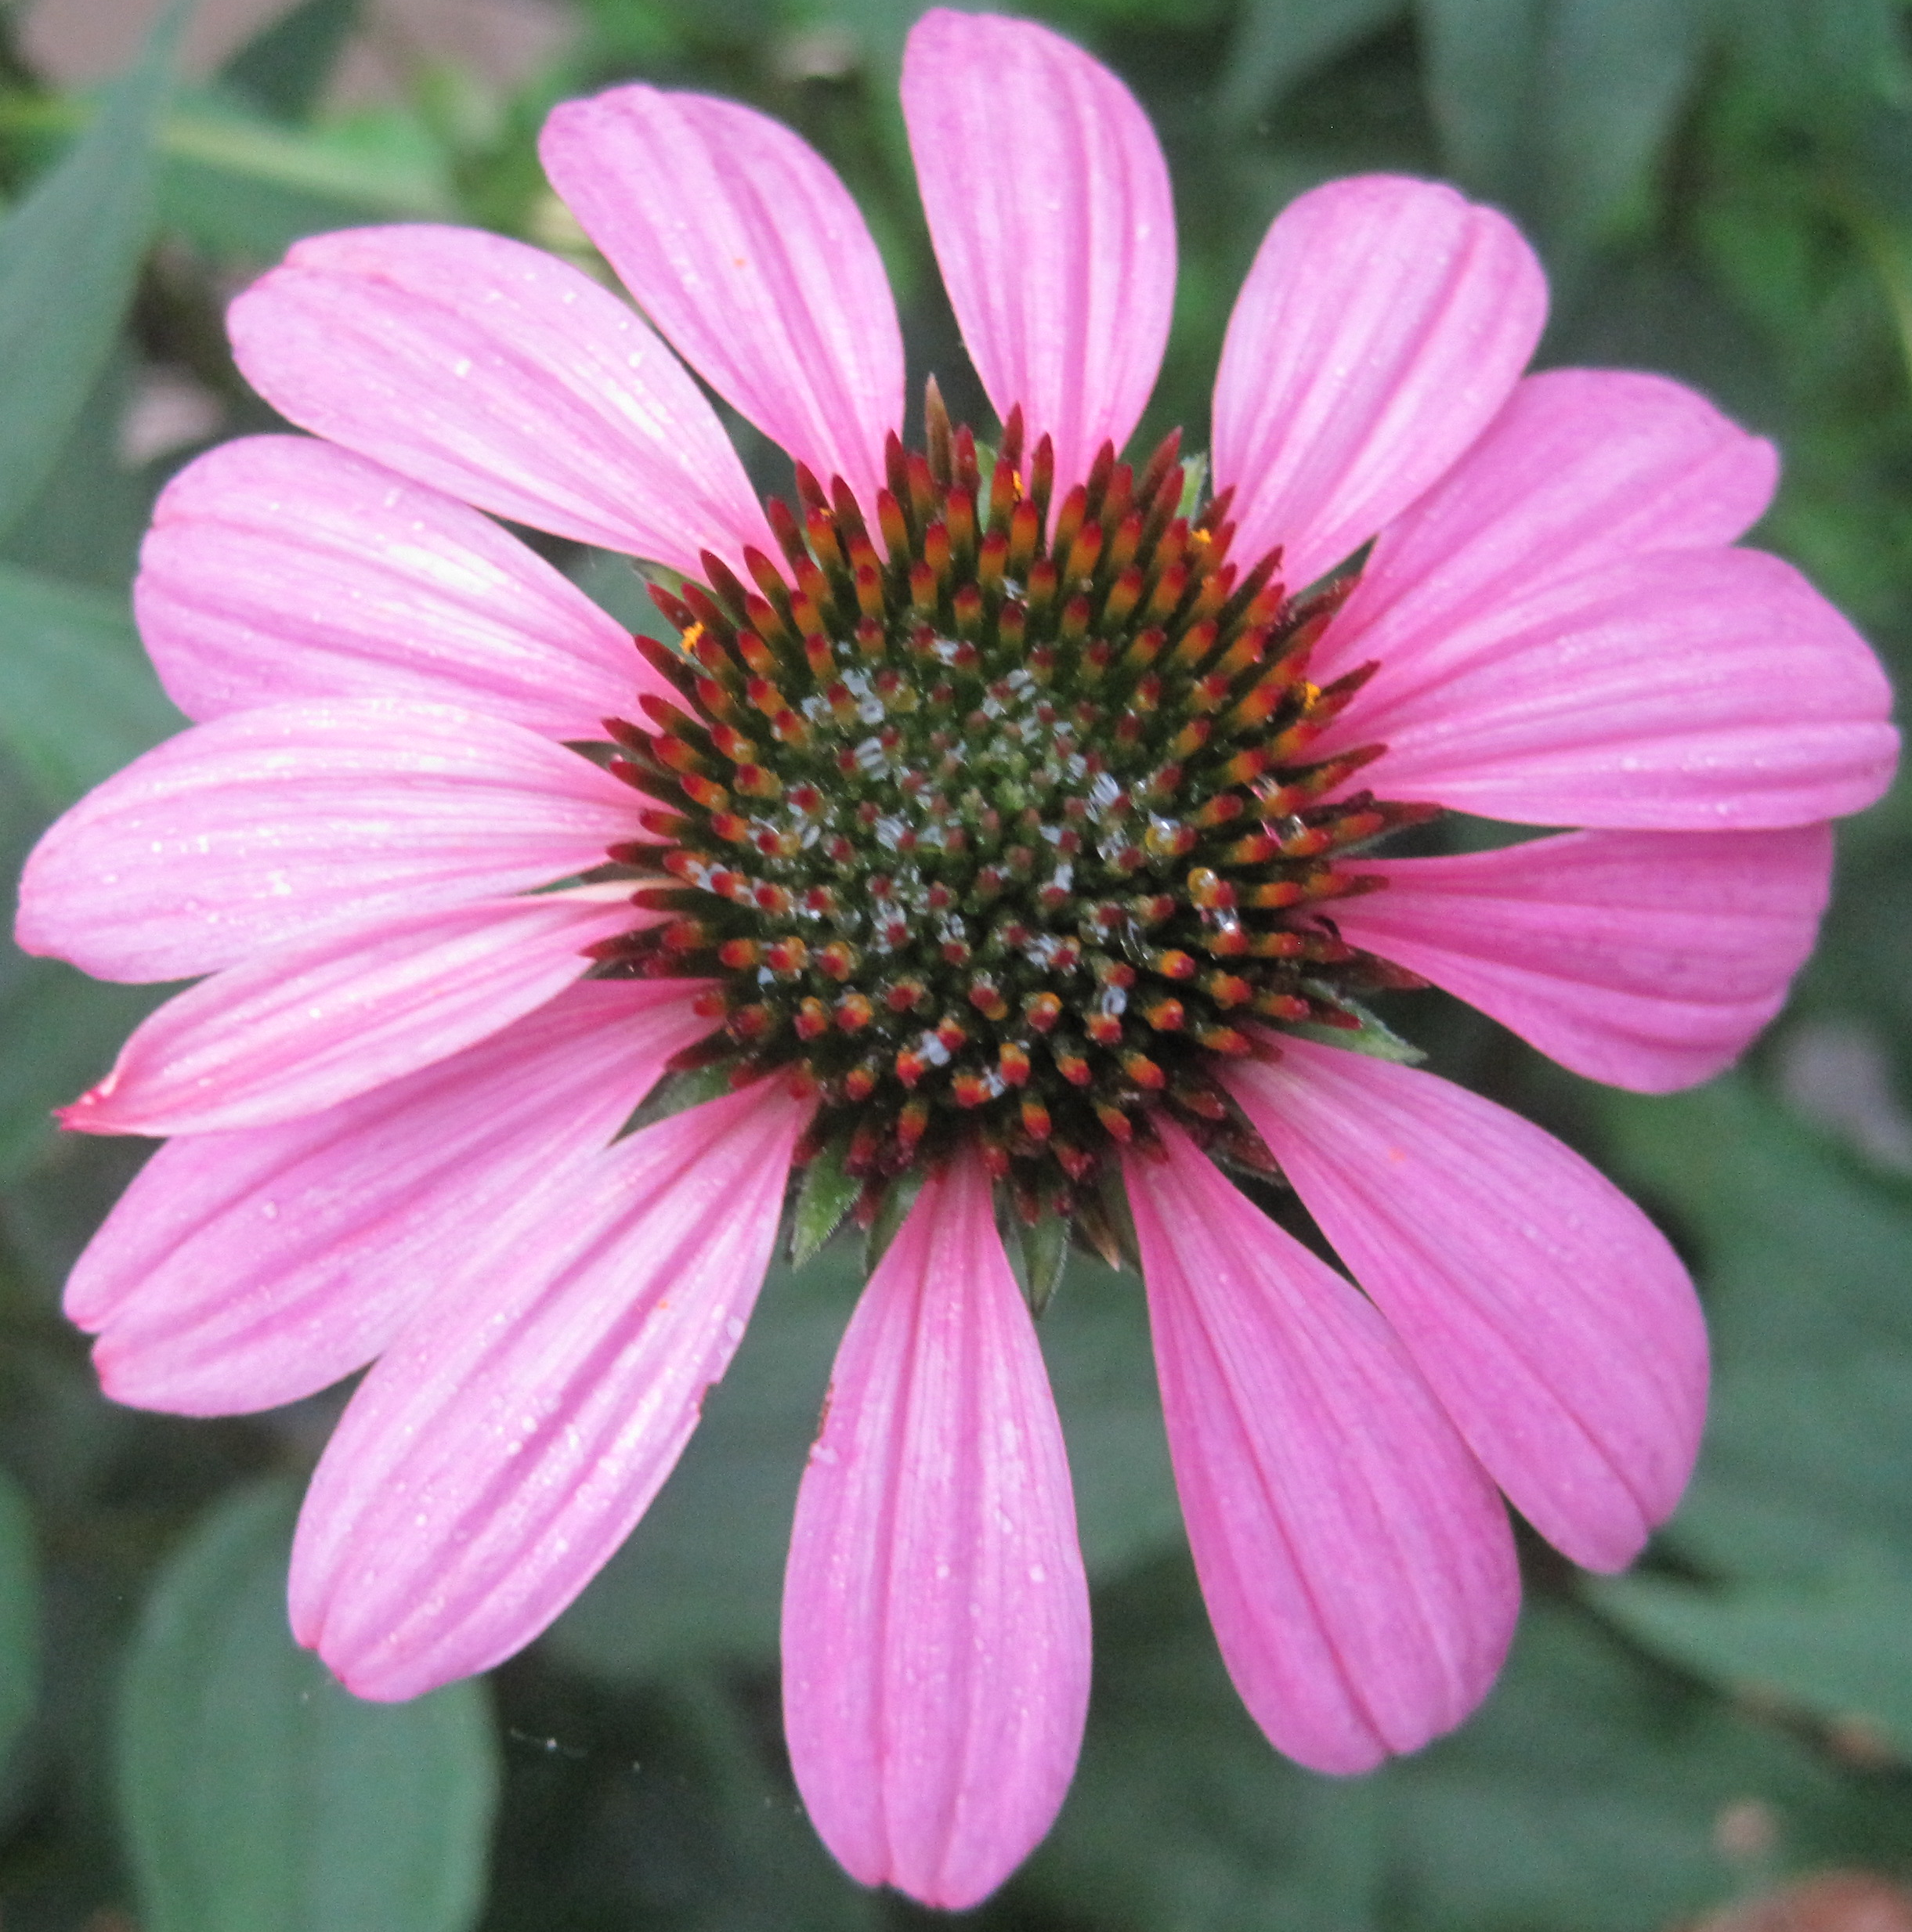
A free abelian group generated by the elements
x₁, x₂, …, x_{k} consists of all elements of the form
n₁x₁ + n₂x₂ + … + n_{k}x_{k}
where n_{i} are integers.
Example: Z[ x , x ]
4 ix + 2 I
x – 2 i
-3 x
k + n iii
Z = The set of integers = { …, -2, -1, 0, 1, 2, …}
Notes:
Note generators can be anything. This is a very important point.
Mathematical objects may be the most obvious, but what if the generators could be neurons or genes or your own discovery
Algebraic topology is a very rich large field. It you notice that some real life objects satisfy the properties needed to create a homology, then all the tools from algebraic topology become available and that could be a great discovery. In other words a simple observation could bring great results.
1tv
So what are the properties that we need. In addition to objects, we need

Slide 13
2.) GRADING

Slide 14
Grading
Grading: Each object is assigned a unique grade
Grading = Partition of R[x]
Ex: Grade = dimension
Grade 0: 0-simplex = vertex = v
v₁
v₂
e
Grade 1: 1-simplex = edge = {v₁, v₂}
v₂
Grade 2: 2-simplex = triangle = {v₁, v₂, v₃}
e₁
e₂
v₁
v₃
e₃

Slide 15
Grading
Grading: Each object is assigned a unique grade
Grading = Partition of R[x]
Ex: Grade: Cardinality
Grade 0: 0-simplex = vertex = {v}
Grade 1: 1-simplex = edge = {v₁, v₂}
Grade 2: 2-simplex = triangle = {v₁, v₂, v₃}
Grade 3: 3-simplex = tetrahedron = {v₁, v₂, v₃, v₄}

Slide 16
Grading
Grading: Each object is assigned a unique grade.
Grading = Partition of R[x].
Let X_{n} = {x₁, …, x_{k}} = generators of grade n.
C_{n} = set of n-chains = R[X_{n}]
Notes:
Vi t^2vi 1t^2vi

Slide 17
3.) BOUNDARY MAP

Slide 18

Boundary Map
_{n} : C_{n} → C_{n-1} such that ² = 0
v₁
v₂
→
v₁
v₂
→ 0
e
v₂
v₂
→
→ 0
e₁
e₂
e₁
e₂
v₁
v₃
v₁
v₃
e₃
e₃

Slide 19
Boundary Map
_{n} : C_{n} → C_{n-1} such that ² = 0
{v₁, v₂} → {v₁} + {v₂}
→ 0
{v₁, v₂, v₃} → {v₁, v₂} + {v₁, v₃}
+ {v₂, v₃}
→ 0

Slide 20
_{n+1}
_{n}
₂
₁
₀
C_{n+1} → C_{n} → C_{n-1} →. . . → C₂ → C₁ → C₀ → 0
H_{n} = Z_{n}/B_{n} = (kernel of )/ (image of )
null space of M_{n}
column space of M_{n+1}
Rank H_{n} = Rank Z_{n} – Rank B_{n}
_{n}
_{n+1}
=

Slide 21
Your name homology
3 ingredients:
1.) Objects
2.) Grading
3.) Boundary map

Slide 22
How many connected components?

Slide 23
Counting number of connected components using homology
v₂
v₅
e₁
e₂
e₃
e₄
v₁
v₃
v₄
v₆
e₅
C₀ = Z₂[v₁, v₂, v₃, v₄, v₅, v₆] = set of 0-chains
C₁ = Z₂[e₁, e₂, e₃, e₄, e₅] = set of 1-chains

Slide 24
Counting number of connected components using homology
v₂
v₅
e₁
e₂
e₃
e₄
v₁
v₃
v₄
v₆
e₅
(e₁) = v₁ + v₂
o
Components are
{v₁, v₂, v₃} and
{v₄, v₅, v₆}
(e₂) = v₂ + v₃
o
(e₃) = v₄ + v₅
o
(e₄) = v₅ + v₆
o
(e₅) = v₄ + v₆
o

Slide 25
Counting number of connected components using homology
v₂
v₅
e₁
e₂
e₃
e₄
v₁
v₃
v₄
v₆
e₅
C₀ = Z₂[v₁, v₂, v₃, v₄, v₅, v₆] = set of 0-chains
C₁ = Z₂[e₁, e₂, e₃, e₄, e₅] = set of 1-chains
: C₁ → C₀
o

Slide 26
Counting number of connected components using homology
v₂
v₅
e₁
e₂
e₃
e₄
v₁
v₃
v₄
v₆
e₅
: C₁ → C₀
o
(e₁) = v₁ + v₂
o
(e₂) = v₂ + v₃
o
(e₃) = v₄ + v₅
o
(e₄) = v₅ + v₆
o
(e₅) = v₄ + v₆
o

Slide 27
Counting number of connected components using homology
v₂
v₅
e₁
e₂
e₃
e₄
v₁
v₃
v₄
v₆
e₅
: C₁ → C₀
o
(e₁) = v₁ + v₂
Extend linearly:
o
(e₂) = v₂ + v₃
o
(e₃) = v₄ + v₅
o
(e₄) = v₅ + v₆
o
(e₅) = v₄ + v₆
o

Slide 28
Counting number of connected components using homology
v₂
v₅
e₁
e₂
e₃
e₄
v₁
v₃
v₄
v₆
e₅
: C₁ → C₀
o
(e₁) = v₁ + v₂
o
(e₂) = v₂ + v₃
o
Extend linearly:
(e₃) = v₄ + v₅
o
(Σn_{i}e_{i}) = n_{i} Σ (e_{i})
o
o
(e₄) = v₅ + v₆
o
(e₅) = v₄ + v₆
o

Slide 29
Counting number of connected components using homology
v₂
v₅
e₁
e₂
e₃
e₄
v₁
v₃
v₄
v₆
e₅
: C₁ → C₀
o
(e₁) = v₁ + v₂
o
(e₂) = v₂ + v₃
o
Extend linearly:
(e₁ + e₂) = v₁ + v₂ + v₂ + v₃
= v₁ + 2v₂ + v₃ = v₁ + v₃
o
(Σn_{i}e_{i}) = n_{i} Σ (e_{i})
o
o

Slide 30
Counting number of connected components using homology
v₂
v₅
: C₁ → C₀
o
e₁
e₂
e₃
e₄
v₁
v₃
v₄
v₆
e₅
(e₃) = v₄ + v₅
o
(e₄) = v₅ + v₆
Extend linearly:
o
(e₅) = v₄ + v₆
o
(Σn_{i}e_{i}) = n_{i} Σ (e_{i})
o
o
(e₃ + e₄ + e₅) = 2v₄ + 2v₅ + 2v₆ = 0
o

Slide 31
Counting number of connected components using homology
v₂
v₅
e₁
e₂
e₃
e₄
v₁
v₃
v₄
v₆
e₅
o₁
o₀
C₁ → C₀ → 0
Z₀ = kernel of
= {x : (x) = 0}
o₀
o₀

Slide 32
Counting number of connected components using homology
v₂
v₅
e₁
e₂
e₃
e₄
v₁
v₃
v₄
v₆
e₅
o₁
o₀
C₁ → C₀ → 0
Z₀ = kernel of
= {x : (x) = 0}
= C₀ = Z₂[v₁, v₂, v₃, v₄, v₅, v₆] = <v₁, v₂, v₃, v₄, v₅, v₆>
o₀
o₀

Slide 33
Counting number of connected components using homology
v₂
v₅
e₁
e₂
e₃
e₄
v₁
v₃
v₄
v₆
e₅
o₁
o₀
(e₁) = v₁ + v₂
C₁ → C₀ → 0
Z₀ = Z₂[v₁, v₂, v₃, v₄, v₅, v₆]
B₀ = image of
o
(e₂) = v₂ + v₃
o
(e₃) = v₄ + v₅
o
(e₄) = v₅ + v₆
o
o₁
(e₅) = v₄ + v₆
o

Slide 34
Counting number of connected components using homology
v₂
v₅
e₁
e₂
e₃
e₄
v₁
v₃
v₄
v₆
e₅
H₀ = Z₀/B₀ = <v₁, v₂, v₃, v₄, v₅, v₆ :
v₁ + v₂ = 0,
v₂ + v₃ = 0,
v₄ + v₅ = 0,
v₅ + v₆ = 0,
v₄ + v₆ = 0>

Slide 35
Counting number of connected components using homology
v₂
v₅
e₁
e₂
e₃
e₄
v₁
v₃
v₄
v₆
e₅
Z₀/B₀ = <v₁, v₂, v₃, v₄, v₅, v₆ : v₁ + v₂ = 0, v₂ + v₃ = 0,
v₄ + v₅ = 0, v₅ + v₆ = 0, v₄ + v₆ = 0>

Slide 36
Counting number of connected components using homology
v₂
v₅
e₁
e₂
e₃
e₄
v₁
v₃
v₄
v₆
e₅
Z₀/B₀ = <v₁, v₂, v₃, v₄, v₅, v₆ : v₁ + v₂ = 0, v₂ + v₃ = 0,
v₄ + v₅ = 0, v₅ + v₆ = 0, v₄ + v₆ = 0>
= <v₁, v₂, v₃, v₄, v₅, v₆ : v₁ + v₂ , v₂ + v₃ , v₄ + v₅ , v₅ + v₆ ,
v₄ + v₆ >

Slide 37
Counting number of connected components using homology
v₂
v₅
e₁
e₂
e₃
e₄
v₁
v₃
v₄
v₆
e₅
Z₀/B₀ = <v₁, v₂, v₃, v₄, v₅, v₆ : v₁ + v₂ = 0, v₂ + v₃ = 0,
v₄ + v₅ = 0, v₅ + v₆ = 0, v₄ + v₆ = 0>

Slide 38
Counting number of connected components using homology
v₂
v₅
e₁
e₂
e₃
e₄
v₁
v₃
v₄
v₆
e₅
Z₀/B₀ = <v₁, v₂, v₃, v₄, v₅, v₆ : v₁ + v₂ = 0, v₂ + v₃ = 0,
v₄ + v₅ = 0, v₅ + v₆ = 0, v₄ + v₆ = 0>
v₁ + v₂ = 0 implies v₁ = v₂
Z₀/B₀ = <v₁, v₃, v₄, v₅, v₆ : v₂ + v₃ = 0, v₄ + v₅ = 0,
v₅ + v₆ = 0, v₄ + v₆ = 0>

Slide 39
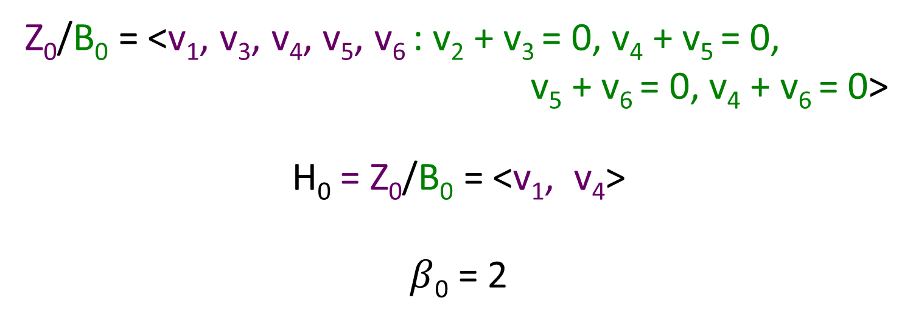
Counting number of connected components using homology
v₂
v₅
e₁
e₂
e₃
e₄
v₁
v₃
v₄
v₆
e₅
Z₀/B₀ = <v₁, v₃, v₄, v₅, v₆ : v₂ + v₃ = 0, v₄ + v₅ = 0,
v₅ + v₆ = 0, v₄ + v₆ = 0>
H₀ = Z₀/B₀ = <v₁, v₄>
$β$₀ = 2

Slide 40
Counting number of connected components using homology
v₂
v₅
e₁
e₂
e₃
e₄
v₁
v₃
v₄
v₆
e₅
Z₀/B₀ = <v₁, v₂, v₃, v₄, v₅, v₆ : v₁ + v₂ = 0, v₂ + v₃ = 0,
v₄ + v₅ = 0, v₅ + v₆ = 0, v₄ + v₆ = 0>
Z₀/B₀ = <[v₁], [v₄]> where [v₁] = {v₁, v₂, v₃}
and [v₄] = {v₄, v₅, v₆}

Slide 41

Counting number of connected components using homology
v₂
v₅
: C₁ → C₀
o
e₁
e₂
e₃
e₄
v₁
v₃
v₄
v₆
e₅
(e₃) = v₄ + v₅
o
(e₄) = v₅ + v₆
Extend linearly:
o
(e₅) = v₄ + v₆
o
(Σn_{i}e_{i}) = n_{i} Σ (e_{i})
o
o
(e₃ + e₄ + e₅) = 2v₄ + 2v₅ + 2v₆ = 0
o
$β$₁ = 0

Slide 42

Counting number of connected components using homology
v₂
v₅
: C₁ → C₀
o
e₁
e₂
e₃
e₄
v₁
v₃
v₄
v₆
e₅
(e₃) = v₄ + v₅
o
(e₄) = v₅ + v₆
Extend linearly:
o
(e₅) = v₄ + v₆
o
(Σn_{i}e_{i}) = n_{i} Σ (e_{i})
o
o
(e₃ + e₄ + e₅) = 2v₄ + 2v₅ + 2v₆ = 0
o
$β$₁ = 1

Slide 43
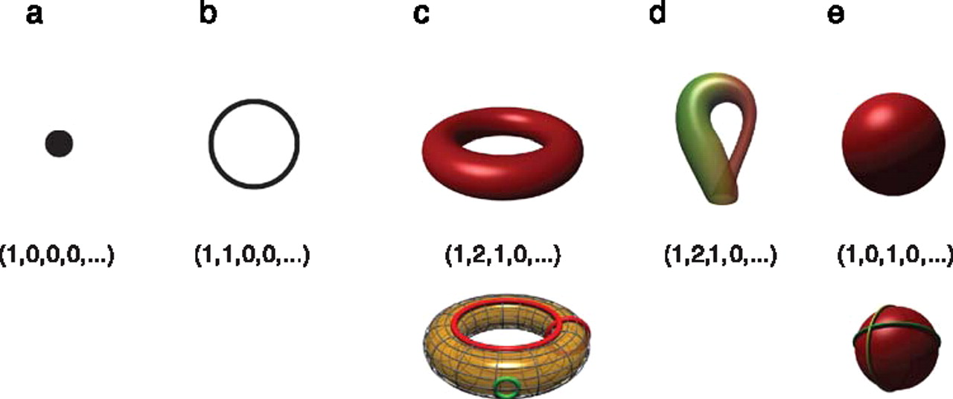

Betti numbers provide a signature of the underlying topology.
Using Z₂ coefficients
Singh G et al. J Vis 2008;8:11
©2008 by Association for Research in Vision and Ophthalmology
Notes:
Betti numbers provide a signature of the underlying topology. Illustrated in the figure are five simple objects (topological spaces) together with their Betti number signatures: (a) a point, (b) a circle, (c) a hollow torus, (d) a Klein bottle, and (e) a hollow sphere. For the case of the torus (c), the figure shows three loops on its surface. The red loops are “essential” in that they cannot be shrunk to a point, nor can they be deformed one into the other without tearing the loop. The green loop, on the other hand, can be deformed to a point without any obstruction. For the torus, therefore, we have b 1 = 2. For the case of the sphere, the loops shown (and actually all loops on the sphere) can be contracted to points, which is reflected by the fact that b 1 = 0. Both the sphere and the torus have b 2 = 1, this is due to the fact both surfaces enclose a part of space (a void).

Slide 44
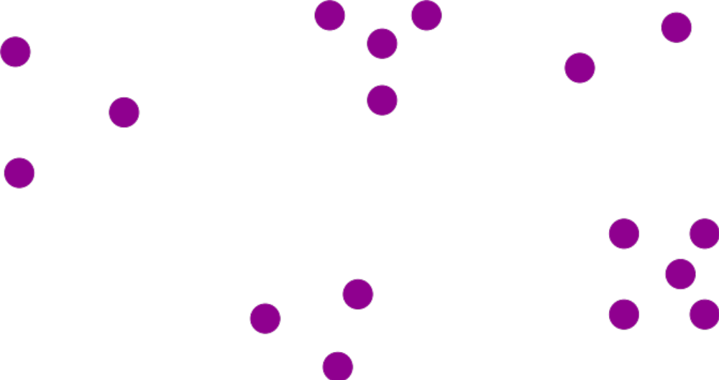
Creating a simplicial complex
Step 0.) Start by adding 0-dimensional vertices
(0-simplices)
Notes:
Recall that to create a simplicial complex, we start by adding 0-simplices (ie 0-dimensional vertices). So our step zero will be to add 0-simplices, but in this case our 0-dimensional points will be

Slide 45

Creating a simplicial complex
1.) Adding 1-dimensional edges (1-simplices)
Add an edge between data points that are “close”
Notes:
So we can measure (or calculate) the distance between two points to determine if they are “close”. But we still need to define close.

Slide 46
Creating a simplicial complex
1.) Adding 1-dimensional edges (1-simplices)
Let T = Threshold
Connect vertices v and w with an edge iff
the distance between v and w is less than T
Notes:
Thus we will choose a threshold. We will connect a pair of vertices with an edge if and only if their distance is less then our chosen threshold.
But it is not always obvious how to choose the threshold. This problem can be dealt with by using persistence which we will briefly introduce later in this lecture. For now let’s somewhat arbitrarily choose a distance, say 1.8 cm.

Slide 47
Creating a simplicial complex
1.) Adding 1-dimensional edges (1-simplices)
Let T = Threshold =
Connect vertices v and w with an edge iff
the distance between v and w is less than T
Notes:
So we will connect every pair of vertices if their distance is less than 1.8 cm. If the center of these points represent the 0-dimensional vertices, then this distance is less than our threshold, so we add an edge. Similarly this pair of points satisfy our definition of close, so we add an edge
The distance between this pair of vertices is greater than 1.8, so we won’t connect them with an edge. Continuing to add edges between vertices whenever their distance is less than our threshold of 1.8cm, we now have

Slide 48
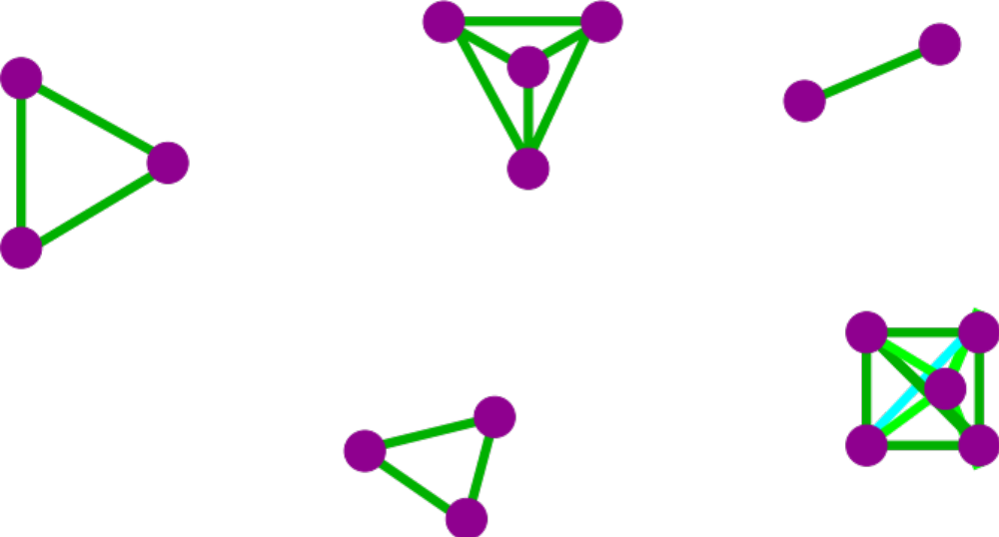
Creating a simplicial complex
1.) Adding 1-dimensional edges (1-simplices)
Add an edge between data points that are “close”
Note: we only need a definition of closeness between data points. The data points do not need to be actual points in R^{n}
Notes:
a one dimensional simplicial complex. Note that we have clustered our data into five disjoint connected sets. So this is one way to cluster our data – that is grouping our data points into disjoint sets based on some definition of similarity. In this case, we have 5 clusters.
We can now add higher dimensional simplices.

Slide 49
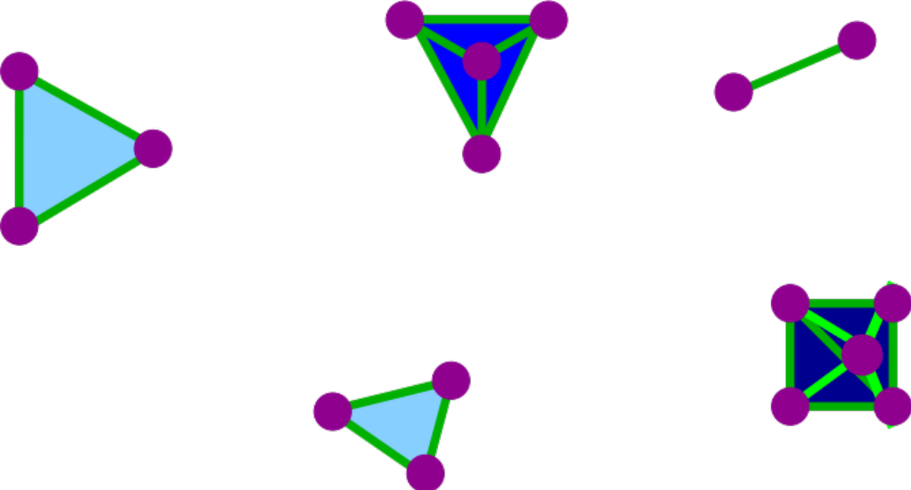
Creating the Vietoris Rips simplicial complex
2.) Add all possible simplices of dimensional > 1.
Notes:
Thus we now have the Vietoris Rips simplicial complex. Note we get the same simplex by adding one dimension at a time

Slide 50
Creating the Vietoris Rips simplicial complex
0.) Start by adding 0-dimensional data points
Use balls to measure distance (Threshold = diameter).
Two points are close if their corresponding balls intersect
Notes:
We start again by adding our 0-simplices, our data points. I can indicate the threshold using a ball centered at my data point. The diameter of the ball will be my threshold, so if two balls intersect then the distance between the vertices is less than the threshold, so we connect the pair of vertices with an edge if and only if the balls intersect, so we can get edges after which we can then add all possible higher dimensional simplices.
Note how I grew my balls. As the diameter increases, my threshold which is equal to my diameter increases.

Slide 51
Creating the Vietoris Rips simplicial complex
0.) Start by adding 0-dimensional data points
Use balls of varying radii to determine persistence of clusters.
H. Edelsbrunner, D. Letscher, and A. Zomorodian, Topological persistence and
simplication, Discrete and Computational Geometry 28, 2002, 511-533.
Notes:
We can compute the number of clusters for a variety of diameters.
We start with 17 data points, so if the diameter is 0, we have 17 clusters. Increasing the diameter, these 2 balls intersect so I now have 16 clusters.
If we continue to increase the diameter, we will eventually create the complex we saw before with 5 clusters, etc until we only have one cluster left.
Eventually this entire page will be purple, but right now, we know have one component.
To choose the threshold, one can determine how long a particular number of clusters lasts, for example for what set of radii do we have five clusters. If we have five clusters for the largest set of radii, then have gives us a good idea where to set the threshold and which simplicial complex best models our data.
I have put links to better animations on my on my YouTube site which may better illustrate this persistence concept. Next month, we will also talk much more about persistence during the live lectures for this course. This is just a preliminary introduction.

Slide 52
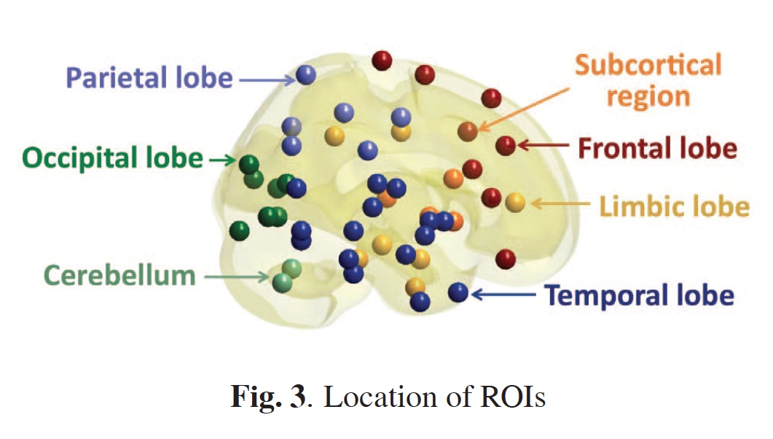
Discriminative persistent homology of brain networks, 2011 Hyekyoung Lee Chung, M.K.; Hyejin Kang; Bung-Nyun Kim;Dong Soo Lee
Constructing functional brain networks with 97 regions of interest (ROIs) extracted from FDG-PET data for
24 attention-deficit hyperactivity disorder (ADHD),
26 autism spectrum disorder (ASD) and
11 pediatric control (PedCon).
Data = measurement f_{j}
taken at region j
Graph: 97 vertices representing 97 regions of interest
edge exists between two vertices i,j if correlation
between f_{j} and f_{j} ≥ threshold
How to choose the threshold? Don’t, instead use persistent homology

Slide 53
Creating the Vietoris Rips simplicial complex
Note to determine clusters, only need vertices and edges (but we will use higher dimensional simplices Friday to look at holes in data).
Notes:
Thus we now have the Vietoris Rips simplicial complex. Note we get the same simplex by adding one dimension at a time

Slide 54
Creating a simplicial complex
Note to determine clusters, only need vertices and edges.
Notes:
a one dimensional simplicial complex. Note that we have clustered our data into five disjoint connected sets. So this is one way to cluster our data – that is grouping our data points into disjoint sets based on some definition of similarity. In this case, we have 5 clusters.
We can now add higher dimensional simplices.

Slide 55
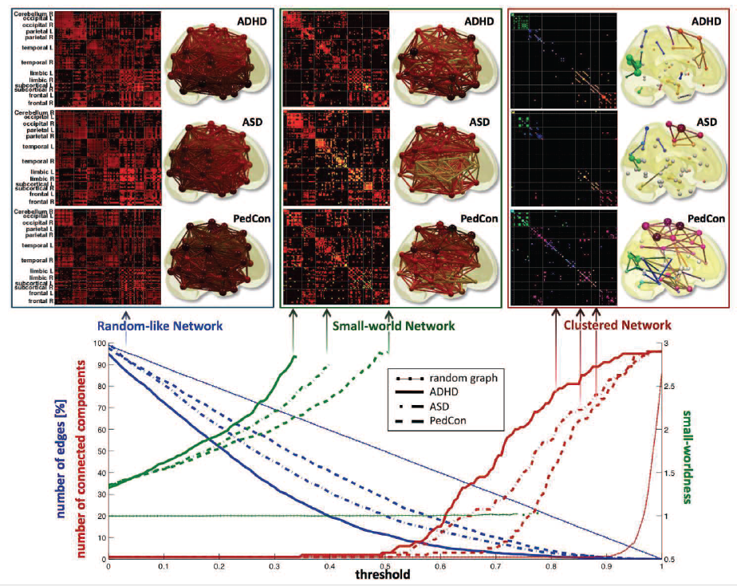

Slide 56
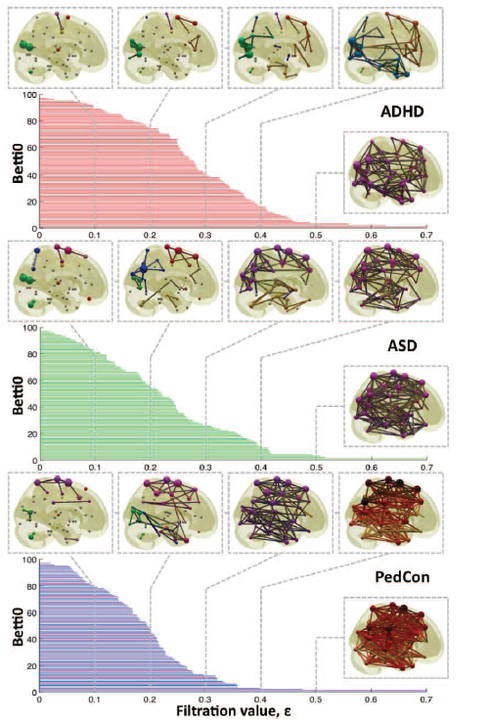

Vertices = Regions of Interest
Create Rips complex by growing epsilon balls (i.e. decreasing threshold) where distance between two vertices is given by
where f_{i} =
measurement at location i

Slide 57
Persistent homology barcode
Filtration of simplicial complexes
This figure was created by modifying the output of the R package TDAstat (Wadhwa et al., 2018) and latex code written by Catalina Betancourt. https://www.frontiersin.org/articles/10.3389/frai.2021.659037/full

Slide 58
Persistent homology barcode
Increasing threshold

Slide 59
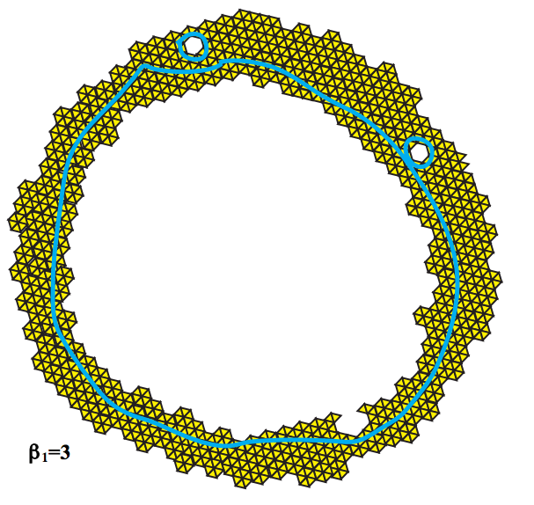
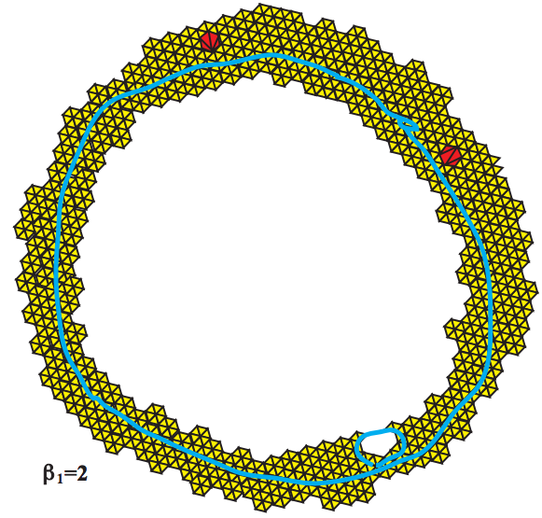
Topology and Data. Gunnar Carlsson
www.ams.org/journals/bull/2009-46-02/S0273-0979-09-01249-X

Slide 60
Vietoris Rips complex = flag complex = clique complex
Notes:
Thus we now have the Vietoris Rips simplicial complex. Note we get the same simplex by adding one dimension at a time

Slide 61
Vietoris Rips complex = flag complex = clique complex
2.) Add all possible simplices of dimensional > 1.
Notes:
Thus we now have the Vietoris Rips simplicial complex. Note we get the same simplex by adding one dimension at a time

Slide 62
Creating the Čech simplicial complex
1.) B₁ … B_{k+1} ≠ ⁄ , create k-simplex {v₁, ... , v_{k+1}}.
U
U
0
Notes:
Thus we now have the Vietoris Rips simplicial complex. Note we get the same simplex by adding one dimension at a time

Slide 63
Creating the Čech simplicial complex
1.) B₁ … B_{k+1} ≠ ⁄ , create k-simplex {v₁, ... , v_{k+1}}.
U
U
0
Notes:
Thus we now have the Vietoris Rips simplicial complex. Note we get the same simplex by adding one dimension at a time

Slide 64
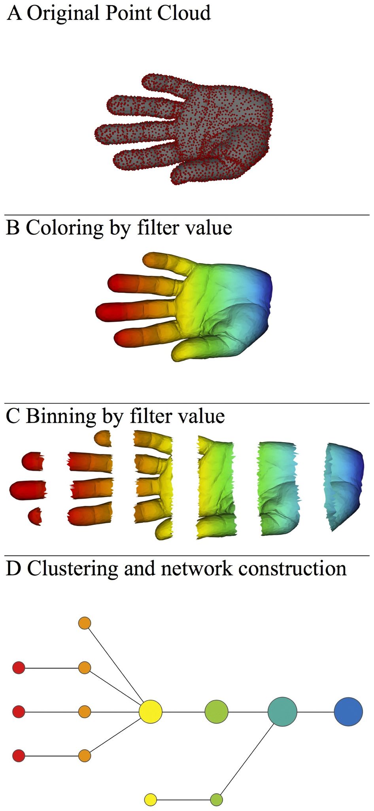
A) Data Set
Example: Point cloud data
representing a hand.
B) Function f : Data Set → R
Example: x-coordinate
f : (x, y, z) → x
Put data into overlapping bins.
Example: f⁻¹(a_{i}, b_{i})
Cluster each bin & create network.
Vertex = a cluster of a bin.
Edge = nonempty intersection
between clusters
Vietoris Rips complex = flag complex = clique complex
http://www.nature.com/srep/2013/130207/srep01236/full/srep01236.html

Slide 65
Creating the Čech simplicial complex
1.) B₁ … B_{k+1} ≠ ⁄ , create k-simplex {v₁, ... , v_{k+1}}.
U
U
0
Notes:
Thus we now have the Vietoris Rips simplicial complex. Note we get the same simplex by adding one dimension at a time

Slide 66
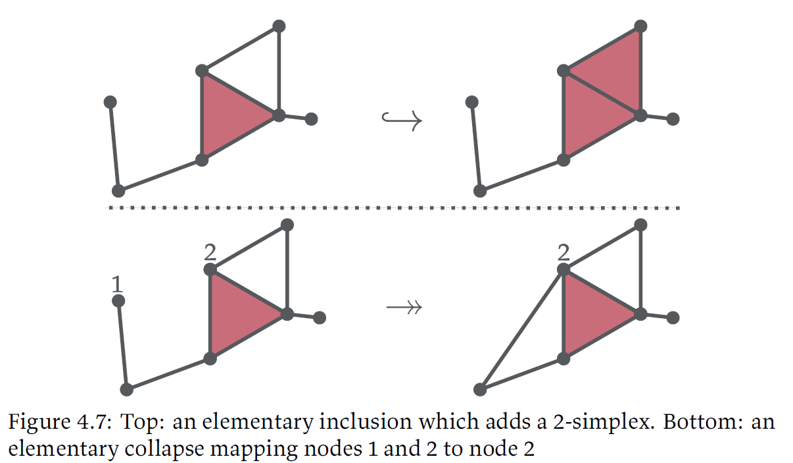
Let X be a simplex with vertex set V and
Y be a simplex with vertex set W
A simplicial map is a function f:V → W such that
if {v₁, .., v_{k}} is a simplex in X, then {f(v₁), .., f(v_{k})} is a simplex in Y.

Slide 67
Let X be a simplex with vertex set V and
Y be a simplex with vertex set W
A simplicial map is a function f:V → W such that
if {v₁, .., v_{k}} is a simplex in X, then {f(v₁), .., f(v_{k})} is a simplex in Y.

Slide 68
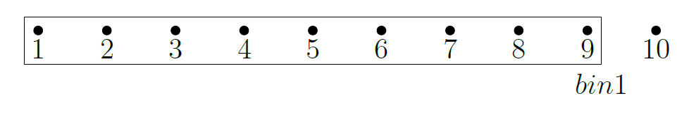
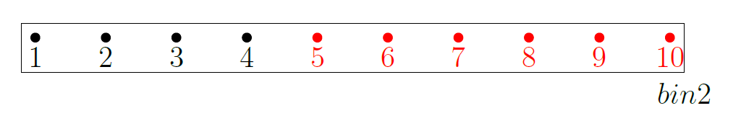
Growing the bin size:
Not a simplicial map
One cluster in bin1 when complete linkage with cutting height h = 8.
Two clusters in bin2 when complete linkage with cutting height h = 8.

Slide 69
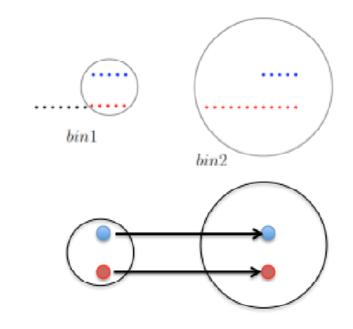
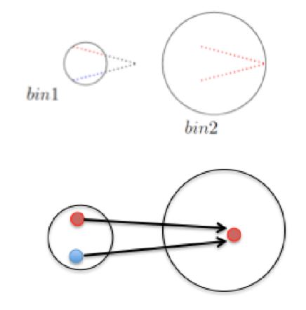
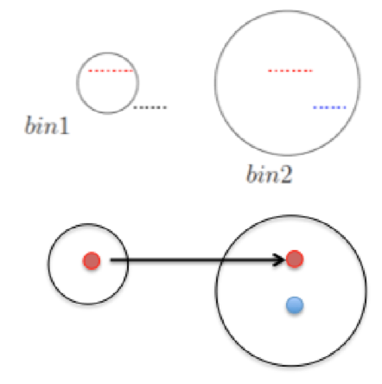
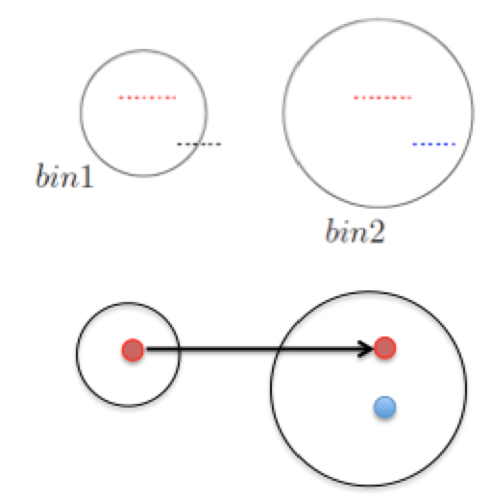
Dissertation: Bi-filtration and stability of TDA mapper for point cloud data Wako Tasisa Bungula 2019
Growing the bin size

Slide 70
Let X be a simplex with vertex set V and
Y be a simplex with vertex set W
A simplicial map is a function f:V → W such that
if {v₁, .., v_{k}} is a simplex in X, then {f(v₁), .., f(v_{k})} is a simplex in Y.

Slide 71
single linkage
hierarchical clustering
Increasing threshold

Slide 72
single linkage
hierarchical clustering
Increasing threshold

Slide 73
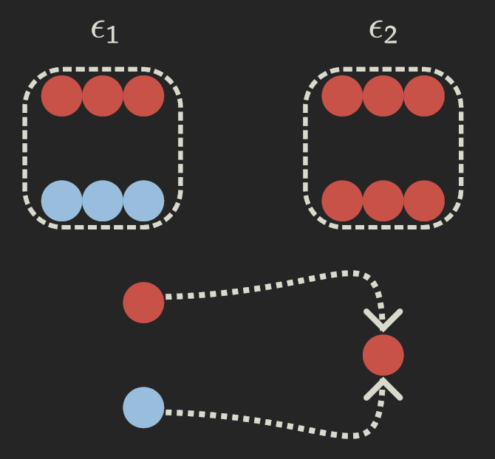
single linkage
hierarchical clustering
Increasing threshold

Slide 74
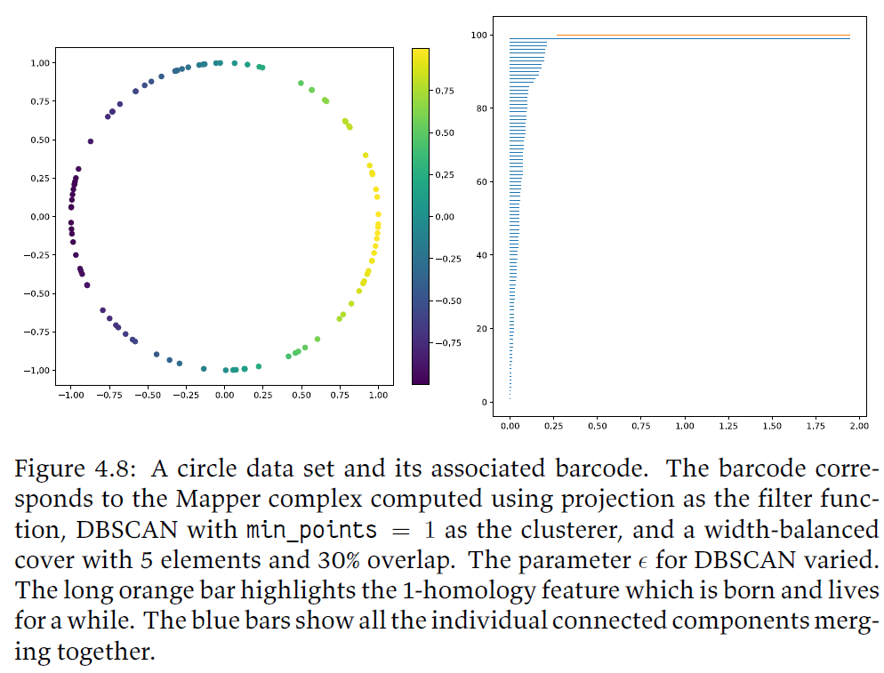

Slide 75
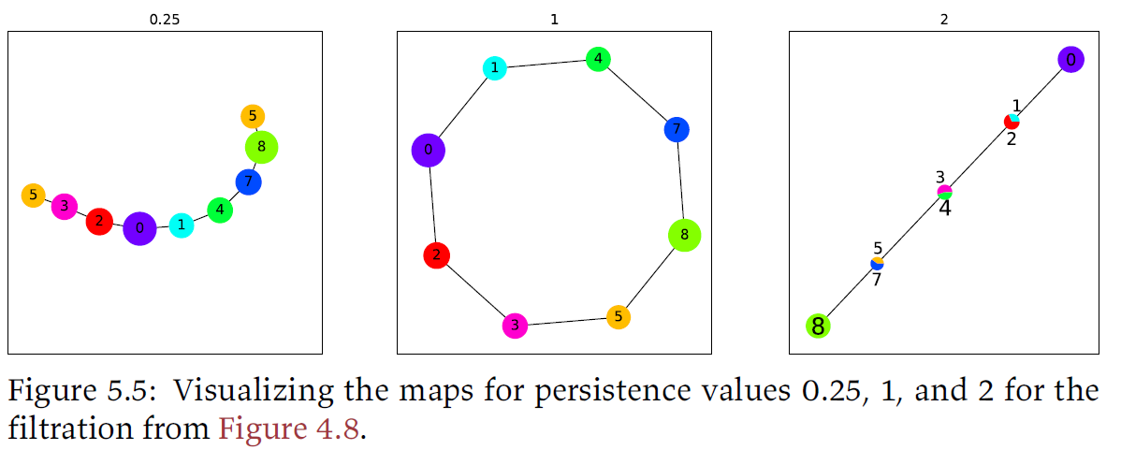
Let X be a simplex with vertex set V and
Y be a simplex with vertex set W
A simplicial map is a function f: V → W such that
if {v₁, .., v_{k}} is a simplex in X, then {f(v₁), .., f(v_{k})} is a simplex in Y.

Slide 76
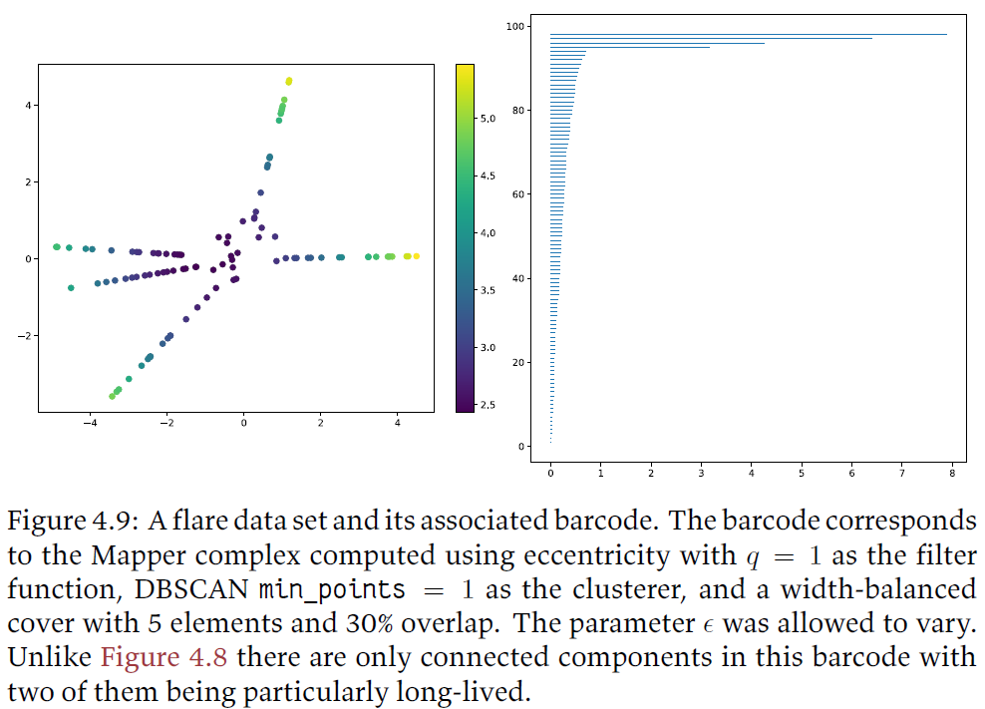

Slide 77
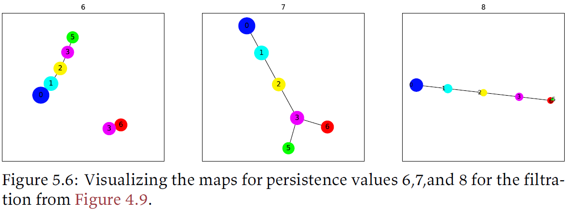
Let X be a simplex with vertex set V and
Y be a simplex with vertex set W
A simplicial map is a function f: V → W such that
if {v₁, .., v_{k}} is a simplex in X, then {f(v₁), .., f(v_{k})} is a simplex in Y.

Slide 78
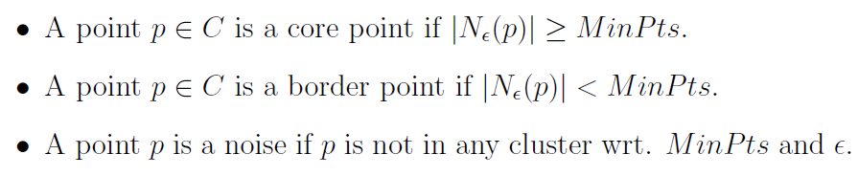
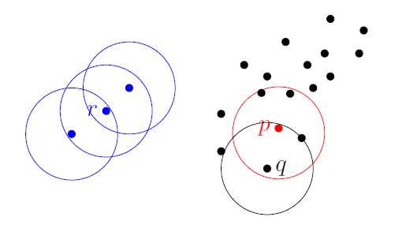
Dbscan (Density-based spatial clustering of applications with noise )
If MinPts = 5
p = core point
q = border point
r = noise
Figures courtesy of Wako Bungula

Slide 79
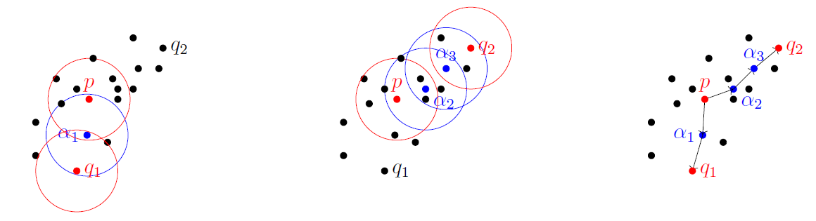
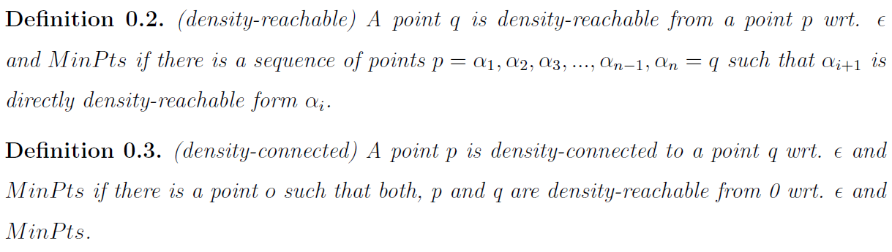
Figures courtesy of Wako Bungula

Slide 80
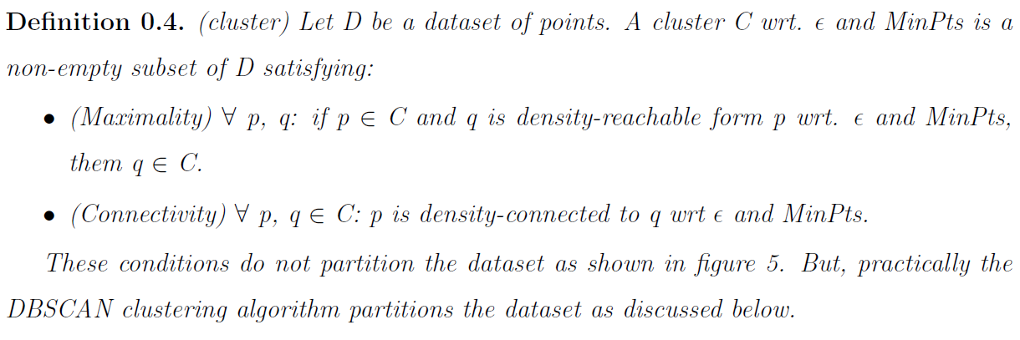
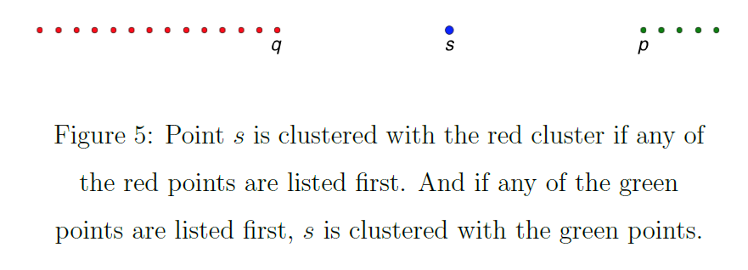
Figures courtesy of Wako Bungula

Slide 81
Figures courtesy of Wako Bungula

Slide 82
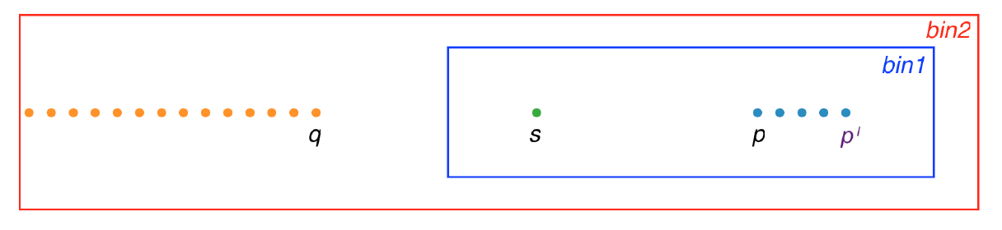
Dbscan clustering: Free border points may imply no simplicial map as bin size increases:

Slide 83
Dbscan clustering: Free border points may imply no simplicial map as bin size increases:

Slide 84
Dbscan clustering: Free border points may imply no simplicial map as bin size increases:

Slide 85
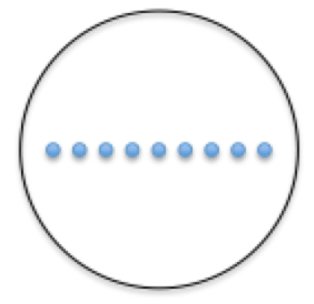
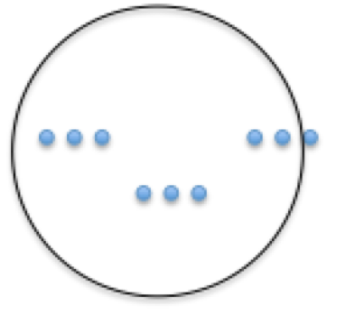
What if measurements are noisy?

Slide 86
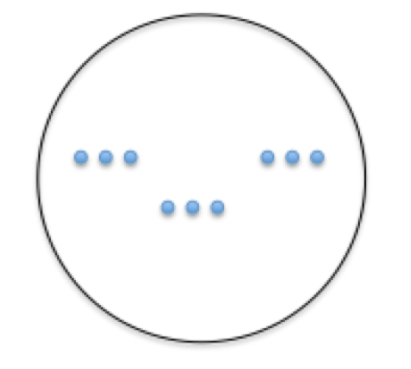
What if measurements are noisy?

