Slide 1
https://www.scientificamerican.com/article/why-developers-using-ai-are-working-longer-hours/
March 3, 2026
AI was supposed to save coders time. It may be doing the opposite
Studies find AI helps developers release more software—while logging longer hours and fixing problems after the code goes live
By Steven Melendez edited by Eric Sullivan

Slide 2
https://www.anthropic.com/research/AI-assistance-coding-skills
How AI assistance impacts the formation of coding skills Jan 29, 2026
See also: https://arxiv.org/pdf/2601.20245
How AI Impacts Skill Formation
Judy Hanwen Shen∗ Alex Tamkin† (*Anthropic Fellow) February 3, 2026
We found that using AI assistance led to a statistically significant decrease in mastery. On a quiz that covered concepts they’d used just a few minutes before, participants in the AI group scored 17% lower than those who coded by hand, or the equivalent of nearly two letter grades. Using AI sped up the task slightly, but this didn’t reach the threshold of statistical significance.
Importantly, using AI assistance didn’t guarantee a lower score. How someone used AI influenced how much information they retained. The participants who showed stronger mastery used AI assistance not just to produce code but to build comprehension while doing so—whether by asking follow-up questions, requesting explanations, or posing conceptual questions while coding independently.

Slide 3
https://arxiv.org/pdf/2601.20245
How AI Impacts Skill Formation
Judy Hanwen Shen∗ Alex Tamkin† (*Anthropic Fellow) February 3, 2026
The erosion of conceptual understanding, code reading, and debugging skills that we measured among participants using AI assistance suggests that workers acquiring new skills should be mindful of their reliance on AI during the learning process.
Among participants who use AI, we find a stark divide in skill formation outcomes between high-scoring interaction patterns (65%-86% quiz score) vs low-scoring interaction patterns (24%-39% quiz score). The high scorers only asked AI conceptual questions instead of code generation or asked for explanations to accompany generated code; these usage patterns demonstrate a high level of cognitive engagement.

Slide 4
https://arxiv.org/pdf/2601.20245
How AI Impacts Skill Formation
Judy Hanwen Shen∗ Alex Tamkin† (*Anthropic Fellow) February 3, 2026
We did not observe a significant performance boost in task completion
Around 20% of participants relied on AI to generate all the code and never asked conceptual questions or for explanations. This group finished much faster than the control group (19.5 minutes vs 23 minutes)
Other participants in the AI group who asked a large number of queries (e.g., 15 queries), spent a long time composing queries (e.g., 10 minutes), or asked for follow-up explanations, raised the average task completion time.
we found that the biggest difference in test scores is between the debugging question

Slide 5
https://www.anthropic.com/candidate-ai-guidance
Scenario | Guidance | Example
Using Claude to better articulate your experience | ✅ Encouraged | Your draft: "I led our team's migration to a new platform." Prompt: "Help me think of ways to quantify the impact of the platform migration that I led."
Using Claude to create experiences | ❌ Not allowed | Prompt: "Write a cover letter for an AI safety researcher position at Anthropic." Result: Generic content with experiences you haven't actually had
Using Claude for interview prep | ✅ Encouraged | Prompt: "What does Anthropic value in candidates based on their public information?" Prompt: “Help me practice explaining my experience with transformer models.”
Using Claude during assessments (unless permitted) | ❌ Not allowed | Having Claude write your code when we haven't explicitly allowed it

Slide 6
https://www.anthropic.com/candidate-ai-guidance
We see AI as a great tool and partner. We encourage you to use it for preparation and refinement, and we're excited to get to know you and see your thinking in action during assessments and interviews.
Regardless of which role you’re applying for, we expect you to:
Use Claude thoughtfully. We encourage you to use Claude to strengthen your application and prepare for interviews; think of Claude as your collaborator in showcasing your authentic story.
Be yourself. Use AI to refine your ideas, not replace them. We want to see your actual experience and how you think—not AI-generated responses.
Be transparent. In the section below, we are transparent about the ways that we use Claude in our hiring process. We expect the same transparency from you in following this guidance.

Slide 7
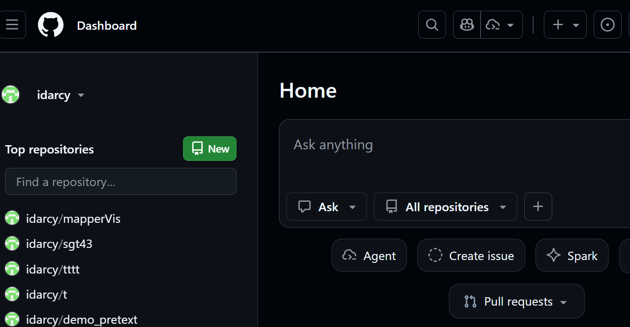
Create new repository

Slide 8
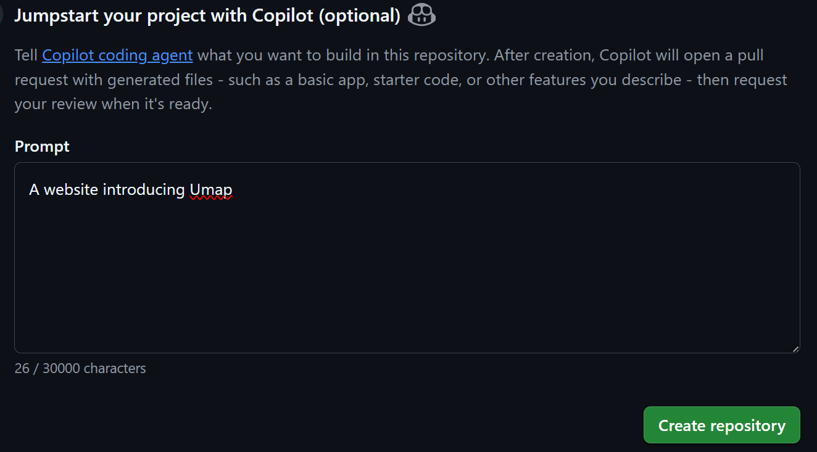

Slide 9
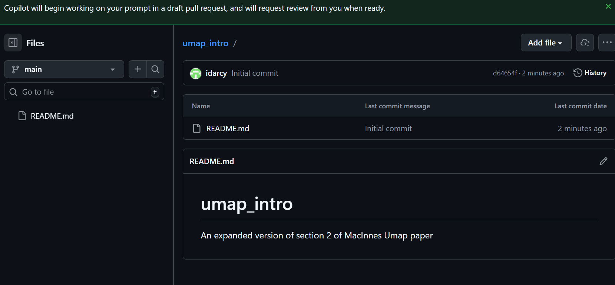

Slide 10
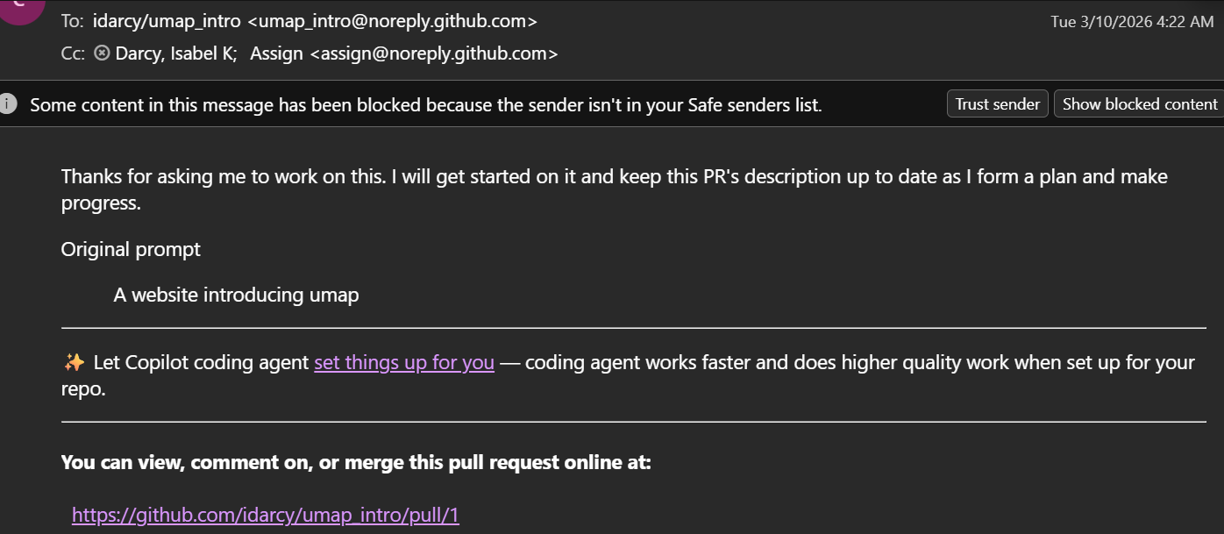

Slide 11
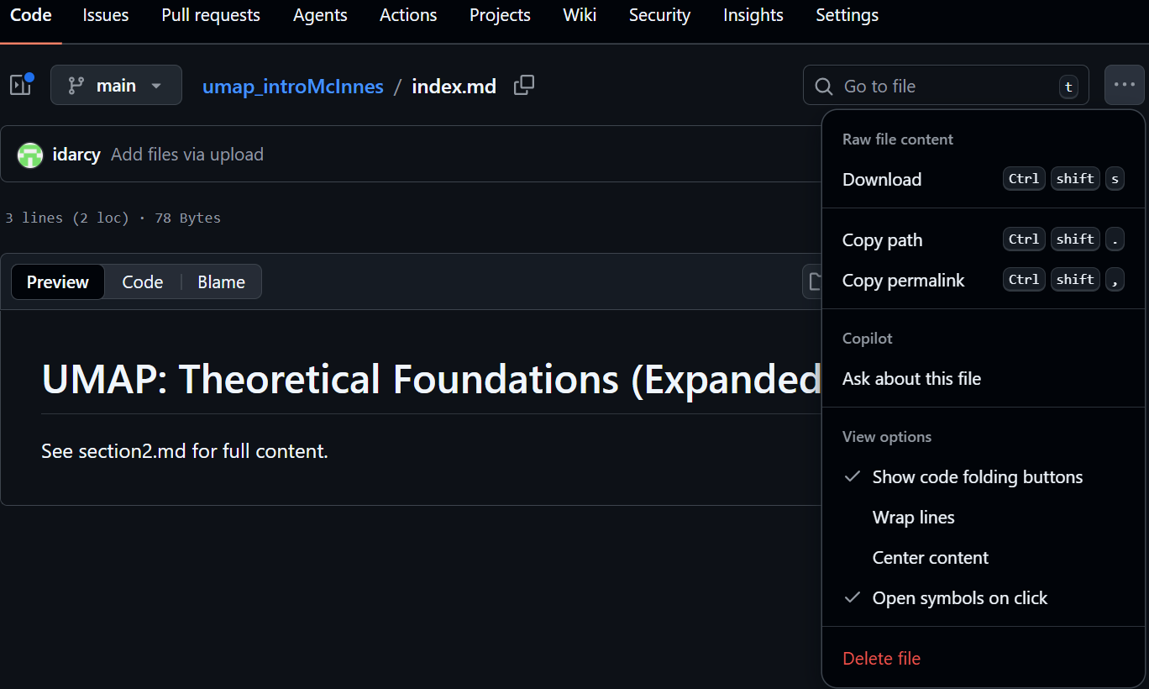



Slide 12
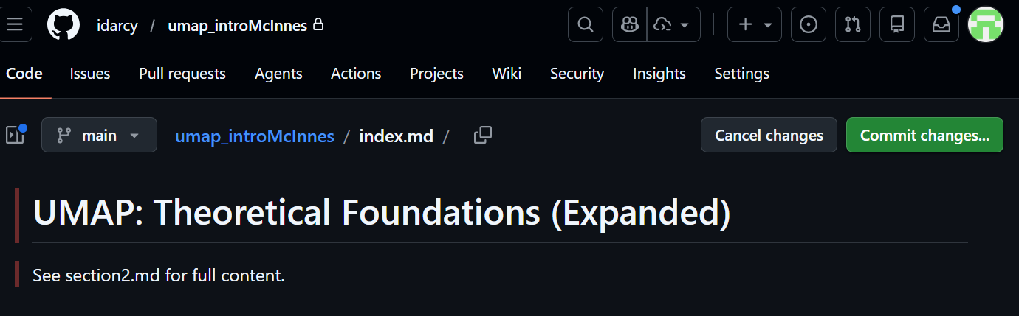
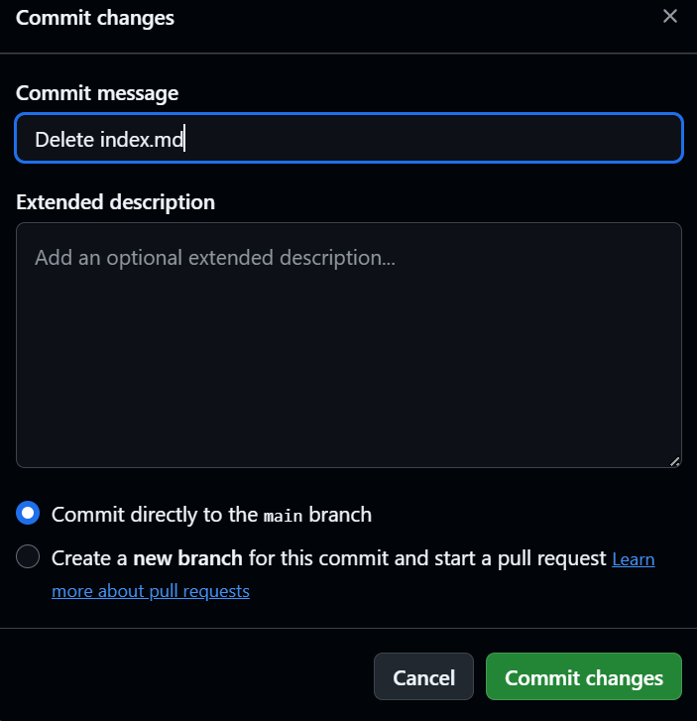


Slide 13
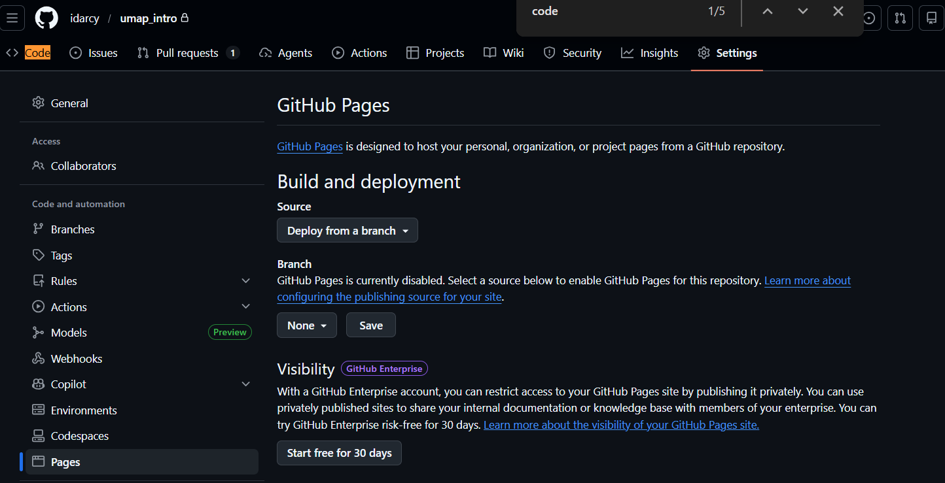



Slide 14
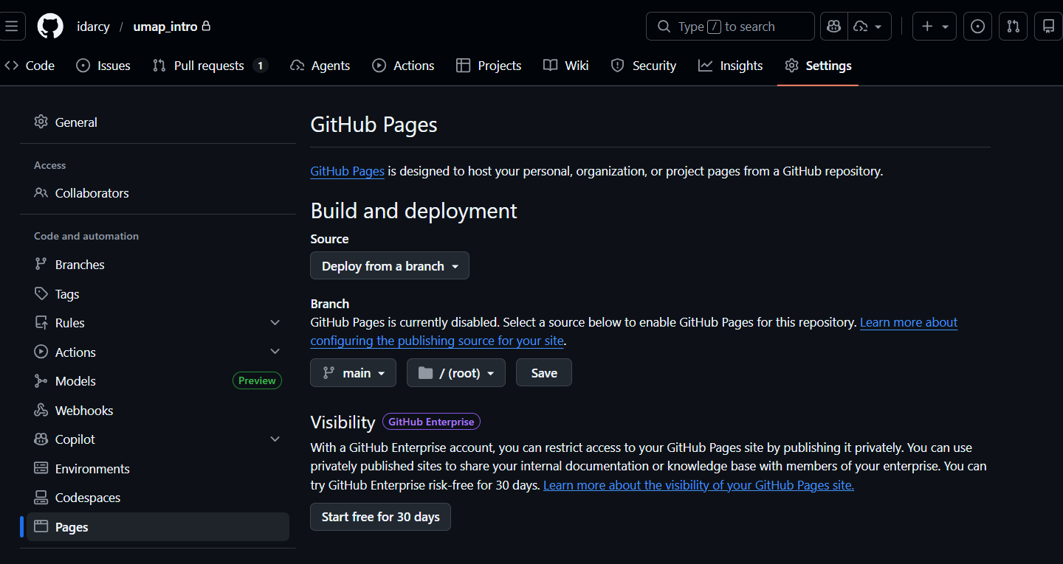

Slide 15
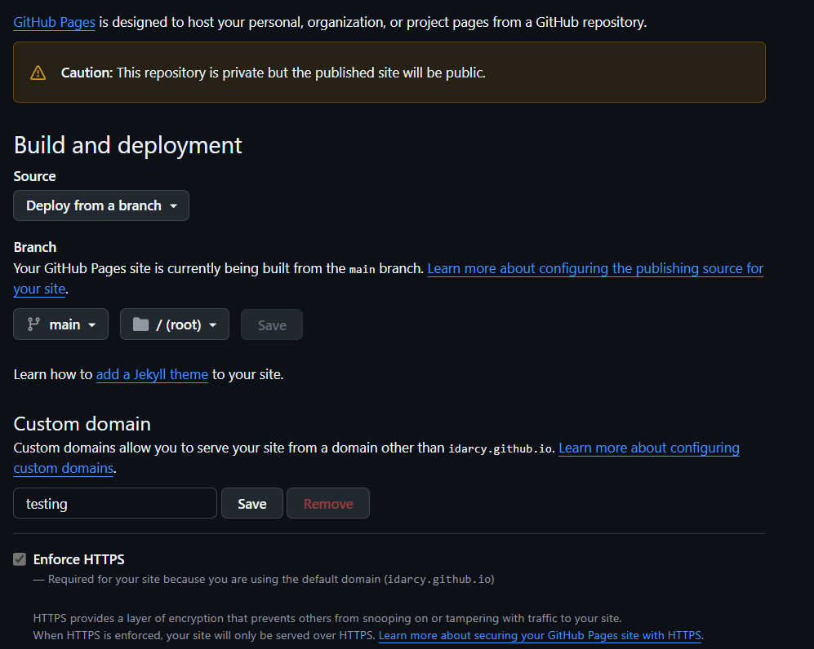

Slide 16


Slide 17
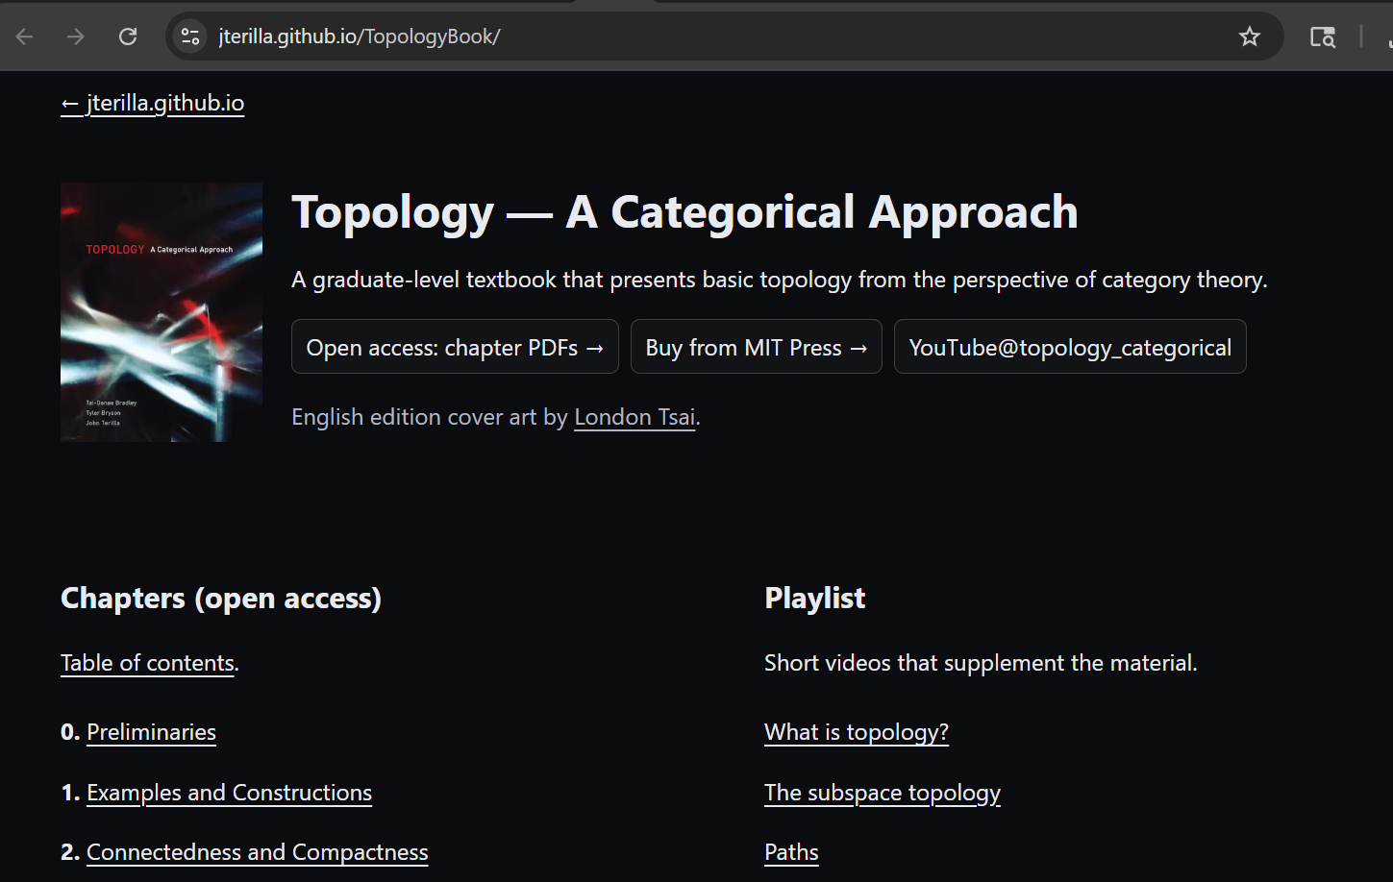
https://jterilla.github.io/TopologyBook oo/

Slide 18
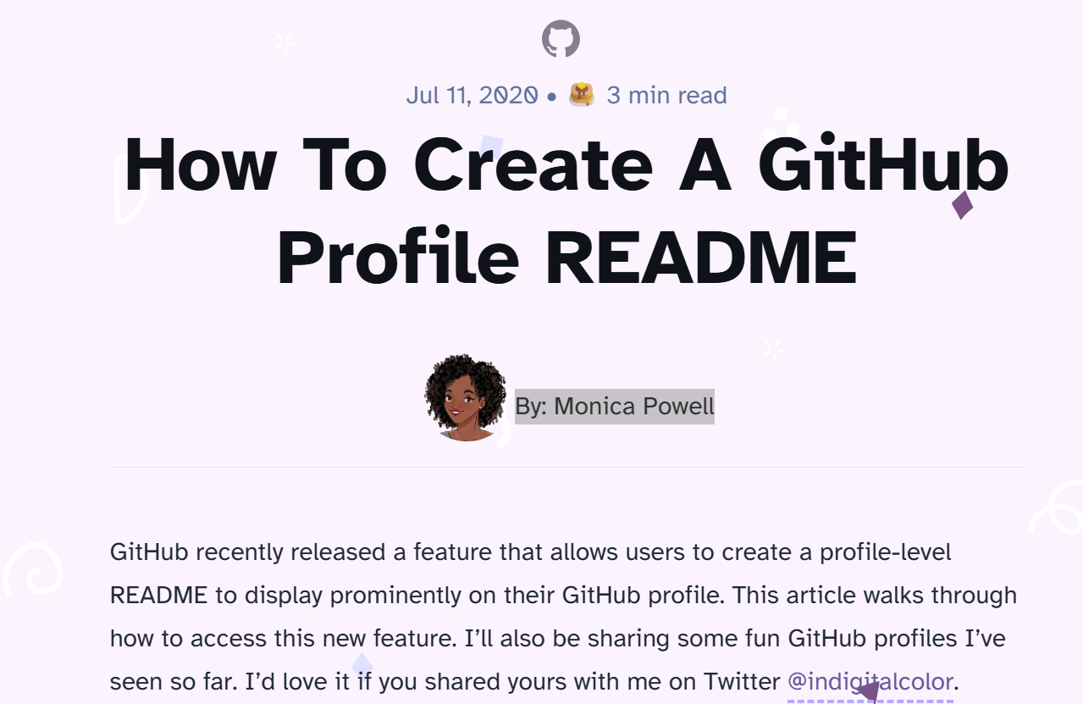
https://www.aboutmonica.com/blog/how-to-create-a-github-profile-readme/

Slide 19
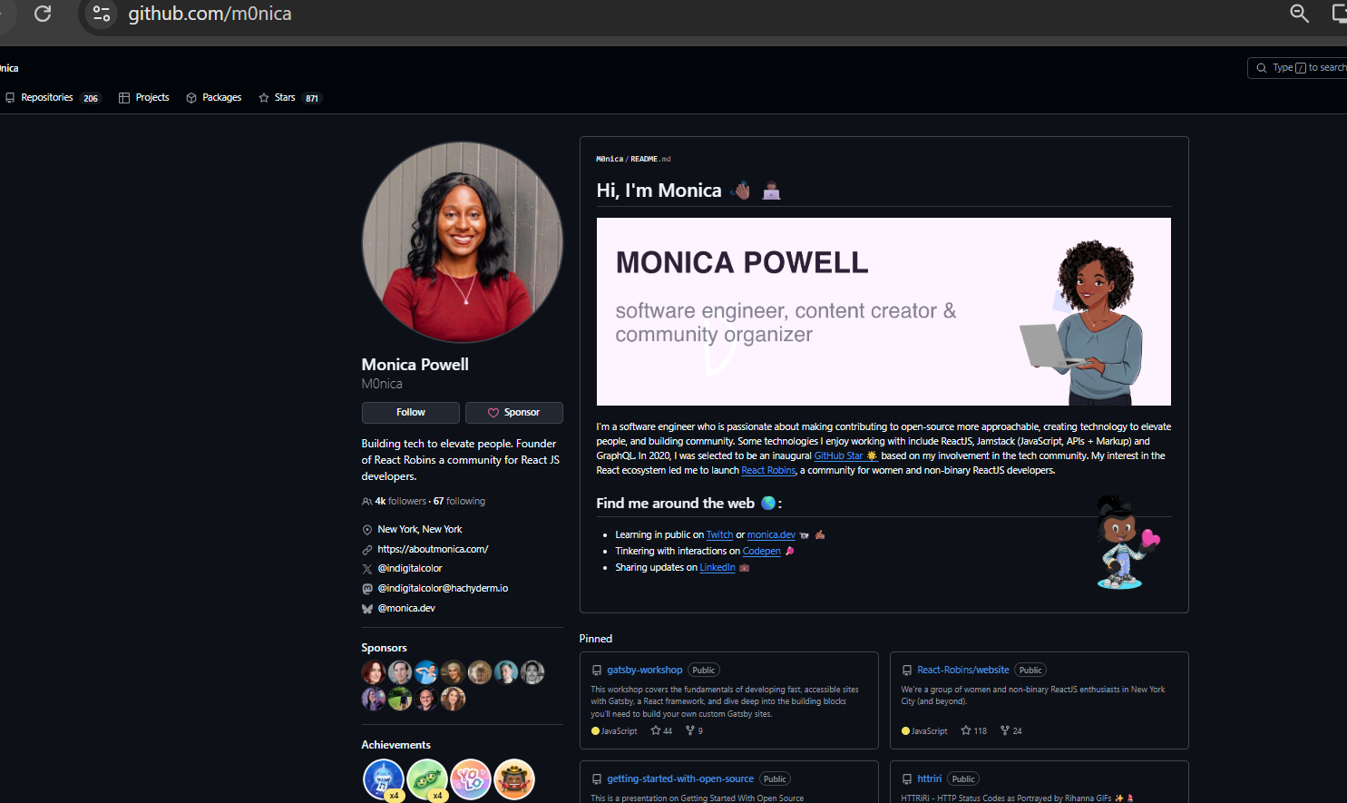
You can also have a simpler github profile README (in addition or instead of website)
https://github.com/m0nica

