Slide 1
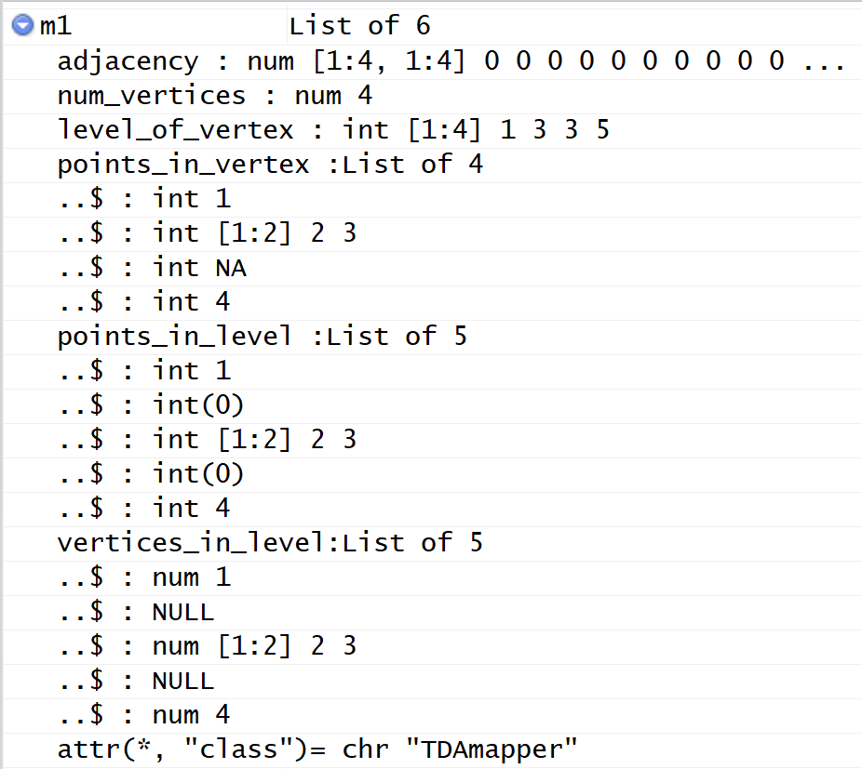
Data structure of mapper1D output.
From upper right corner of Rstudio
Created using
m1datastructureLecture.r

Slide 2
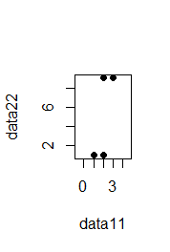
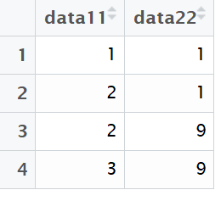
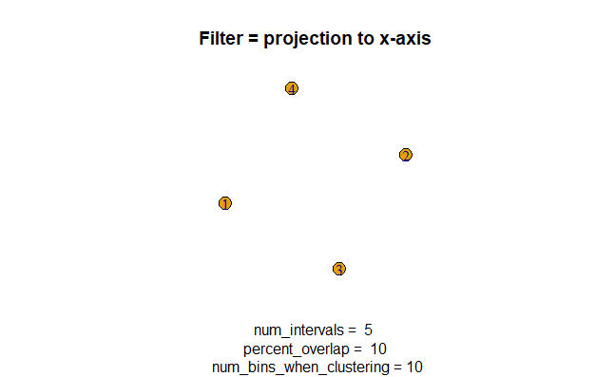
> m1
$adjacency
[,1] [,2] [,3] [,4]
[1,] 0 0 0 0
[2,] 0 0 0 0
[3,] 0 0 0 0
[4,] 0 0 0 0
$num_vertices
[1] 4
$level_of_vertex
[1] 1 3 3 5

Slide 3
$points_in_vertex
$points_in_vertex[[1]]
[1] 1
$points_in_vertex[[2]]
[1] 2 3
$points_in_vertex[[3]]
[1] NA
$points_in_vertex[[4]]
[1] 4

Slide 5
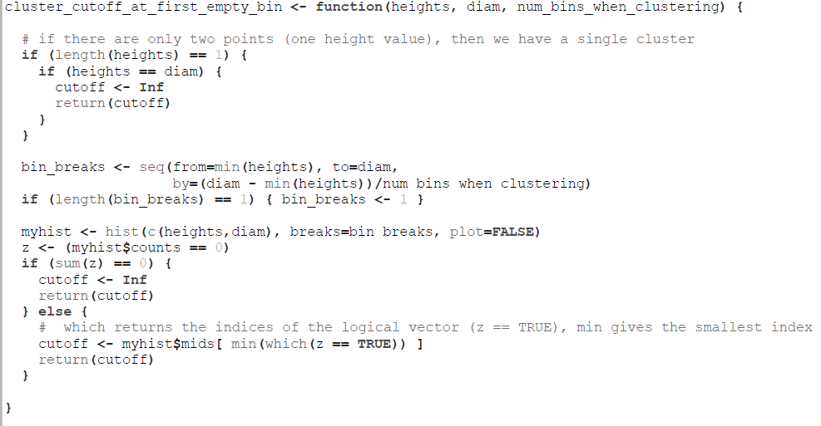
cluster_cutoff_at_first_empty_bin.r

Slide 6
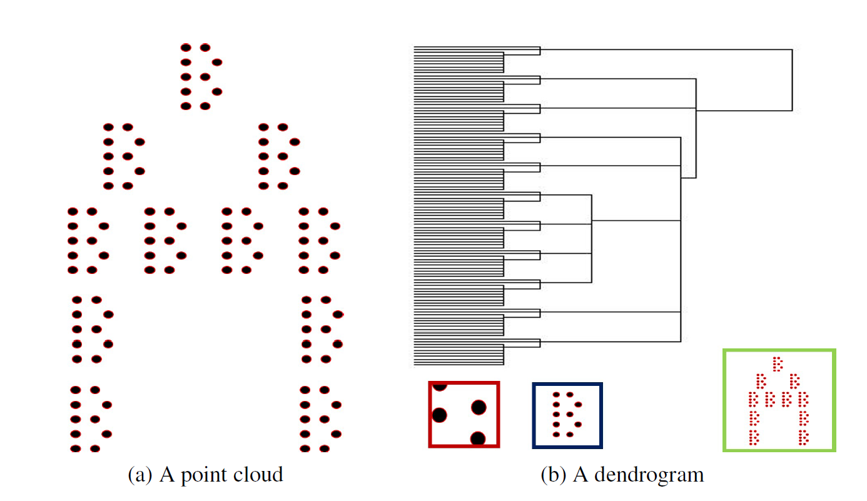
num_bins_when_clustering = ???
Figure courtesy of Paul Samuel Ignacio

Slide 7
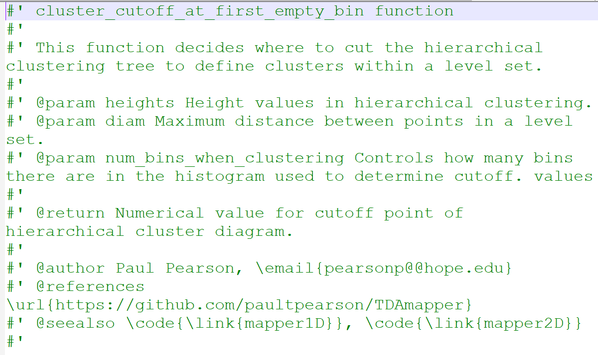
cluster_cutoff_at_first_empty_bin.r

Slide 8
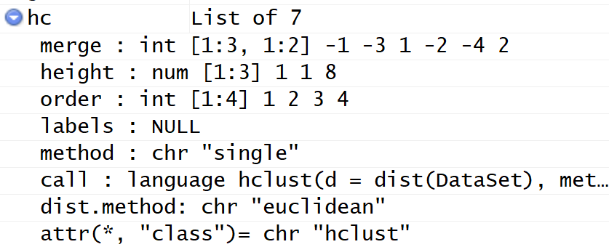
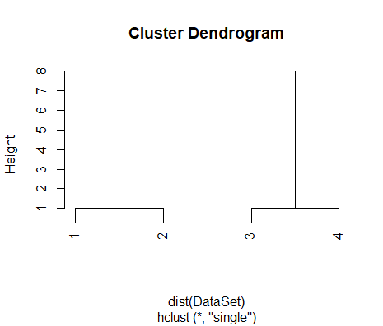
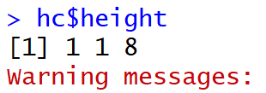
> hc <-hclust(dist(DataSet), method="single")

Slide 9
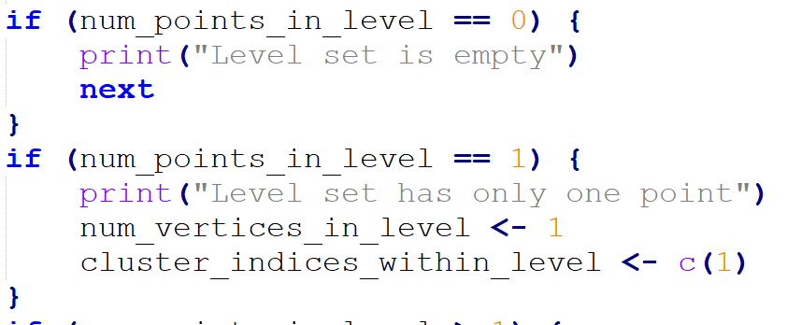
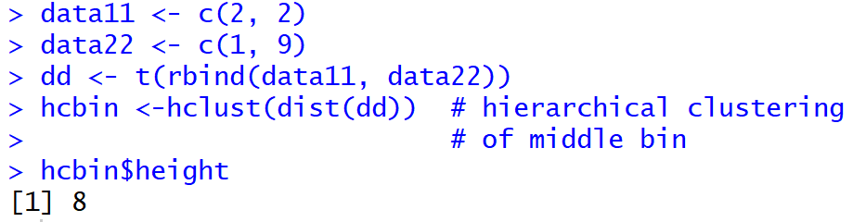
Bin with 2 points

Slide 10
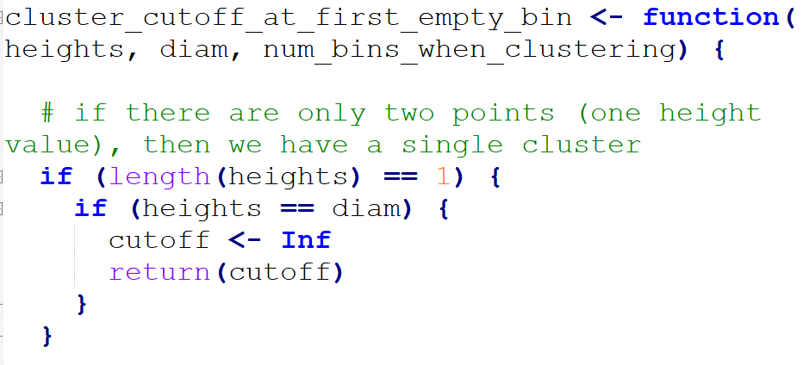
For entire data set of 4 points
For middle bin with 2 points
Diam = ((3-1)² + (9-1)² )^{1/2}
Diam = 9-1 = 8

Slide 11
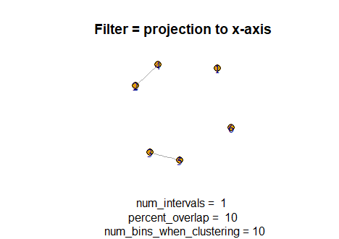

Slide 12
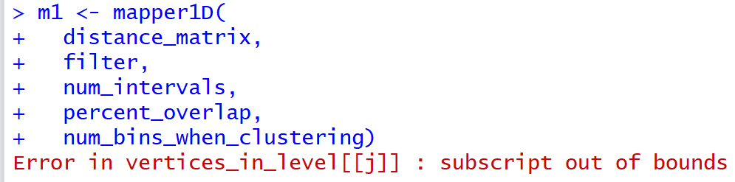

Slide 13
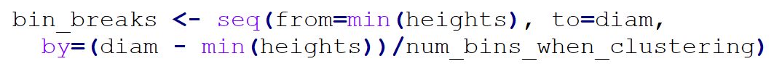
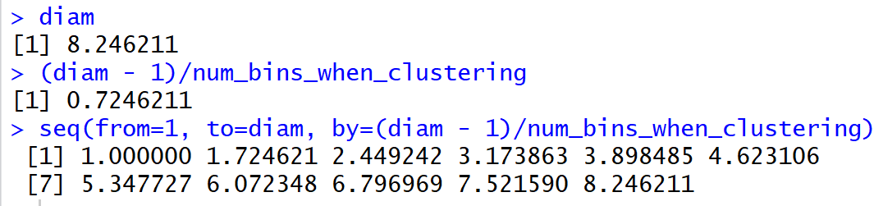
Suppose bin consists of these 4 points
Diam = ((3-1)² + (9-1)² )^{1/2}

Slide 14
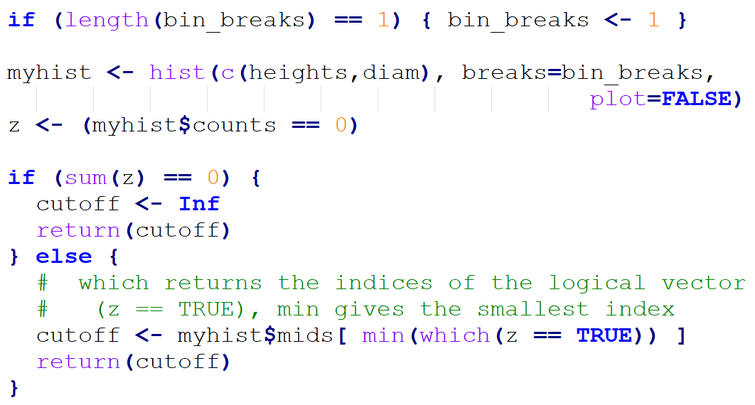

Slide 15
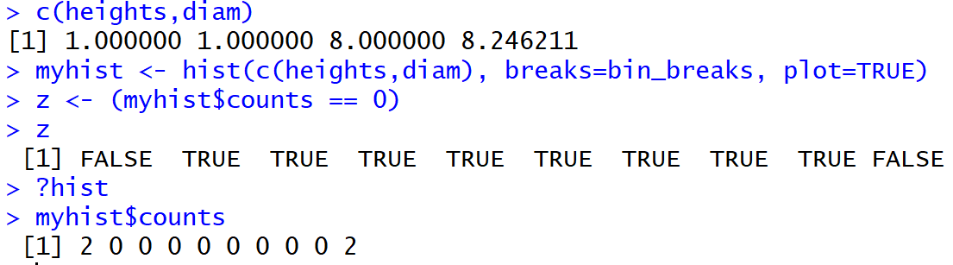
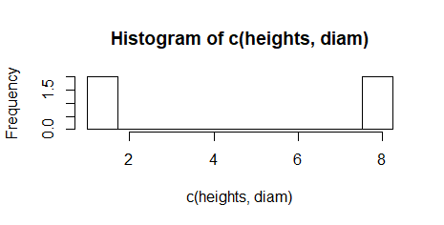

Slide 16

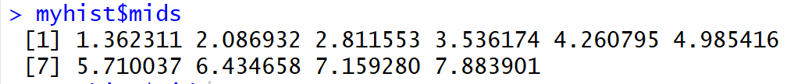

Slide 18
num_bins_when_clustering = ???
Figure courtesy of Steve Oudet

Slide 19
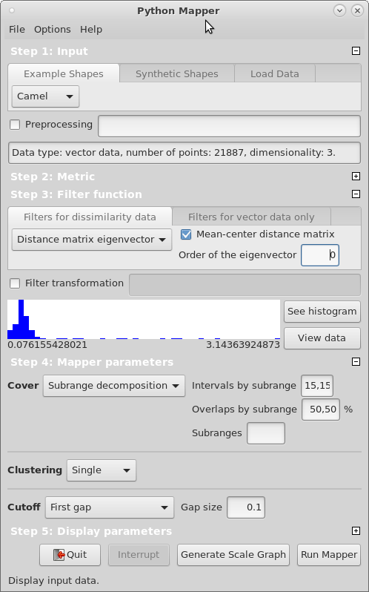

Slide 20
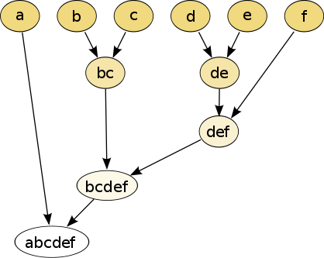
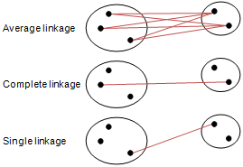
Different type of hierarchical clustering
What is the distance between 2 clusters?
http://en.wikipedia.org/wiki/File:Hierarchical_clustering_simple_diagram.svg
http://www.multid.se/genex/hs515.htm

Slide 21
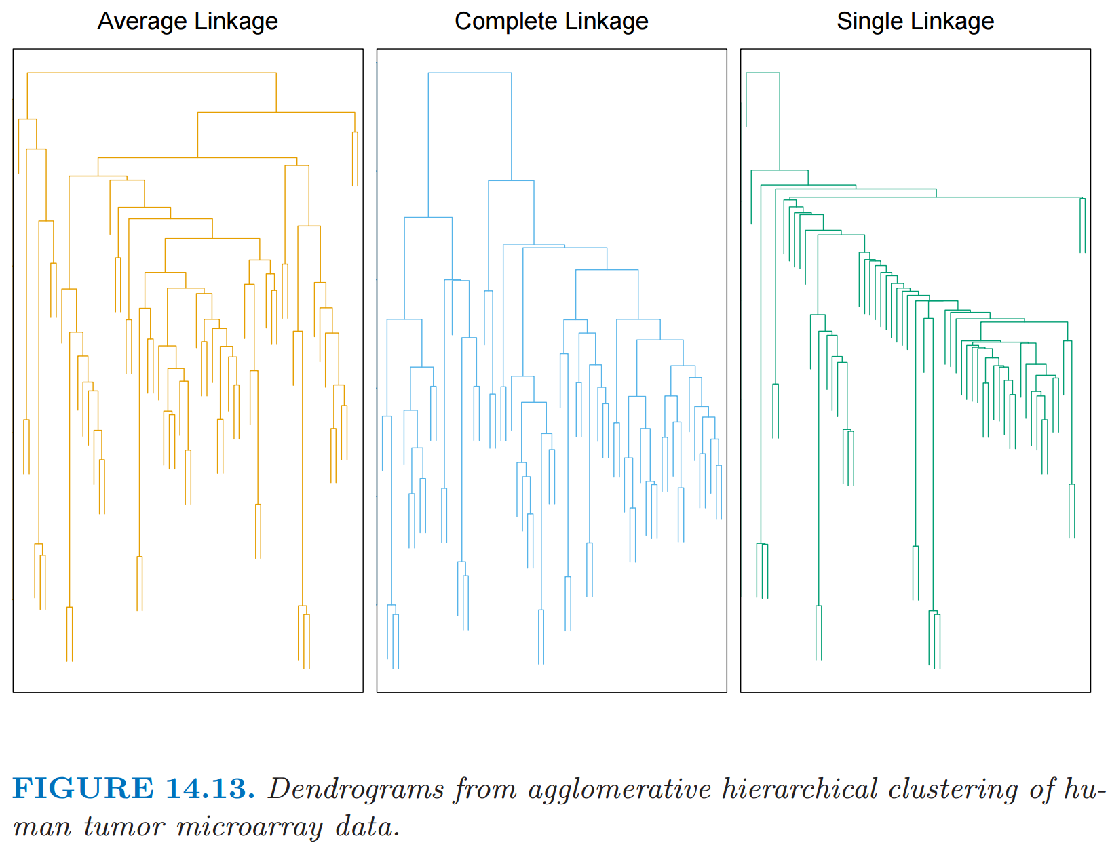
http://statweb.stanford.edu/~tibs/ElemStatLearn/
The Elements of Statistical Learning (2nd edition) Hastie, Tibshirani and Friedman

