Slide 1
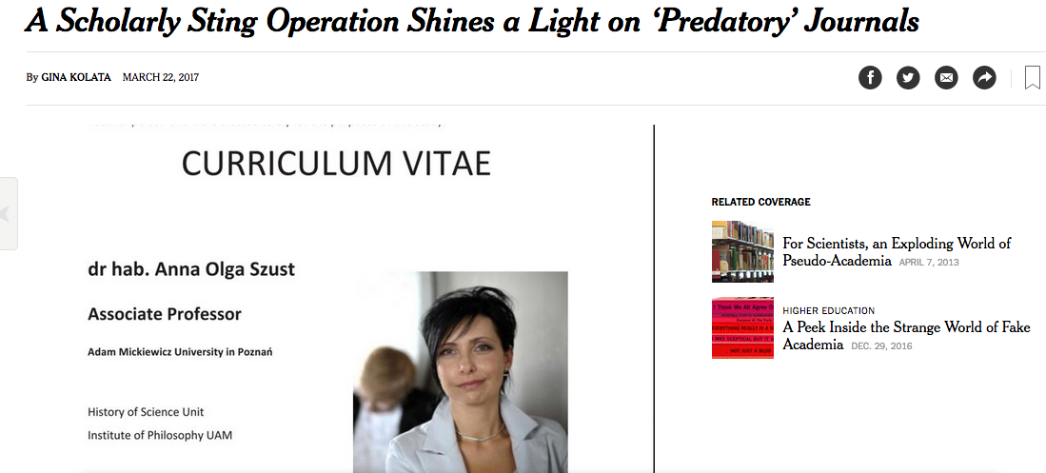
https://www.nytimes.com/2017/03/22/science/open-access-journals.html

Slide 2
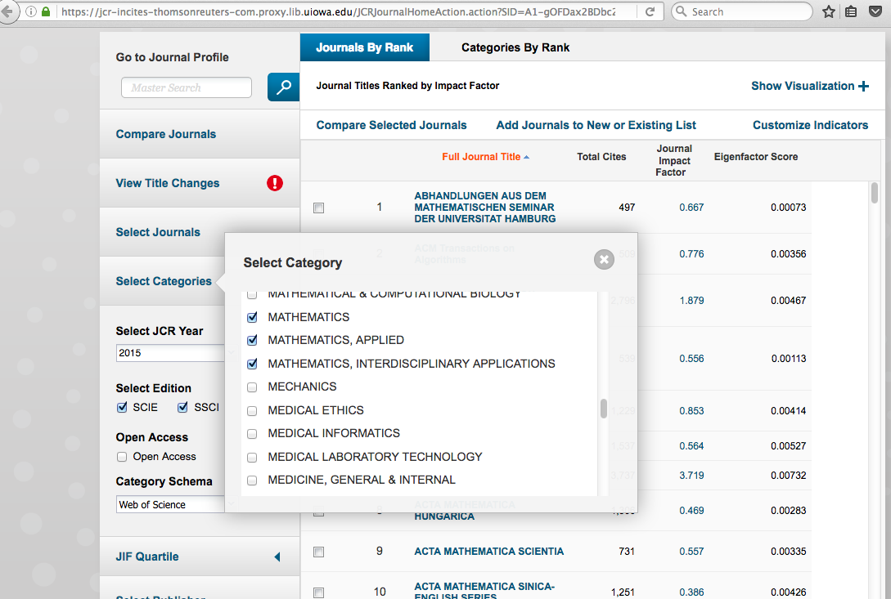
Web of Science Journal Citation Reports

Slide 3
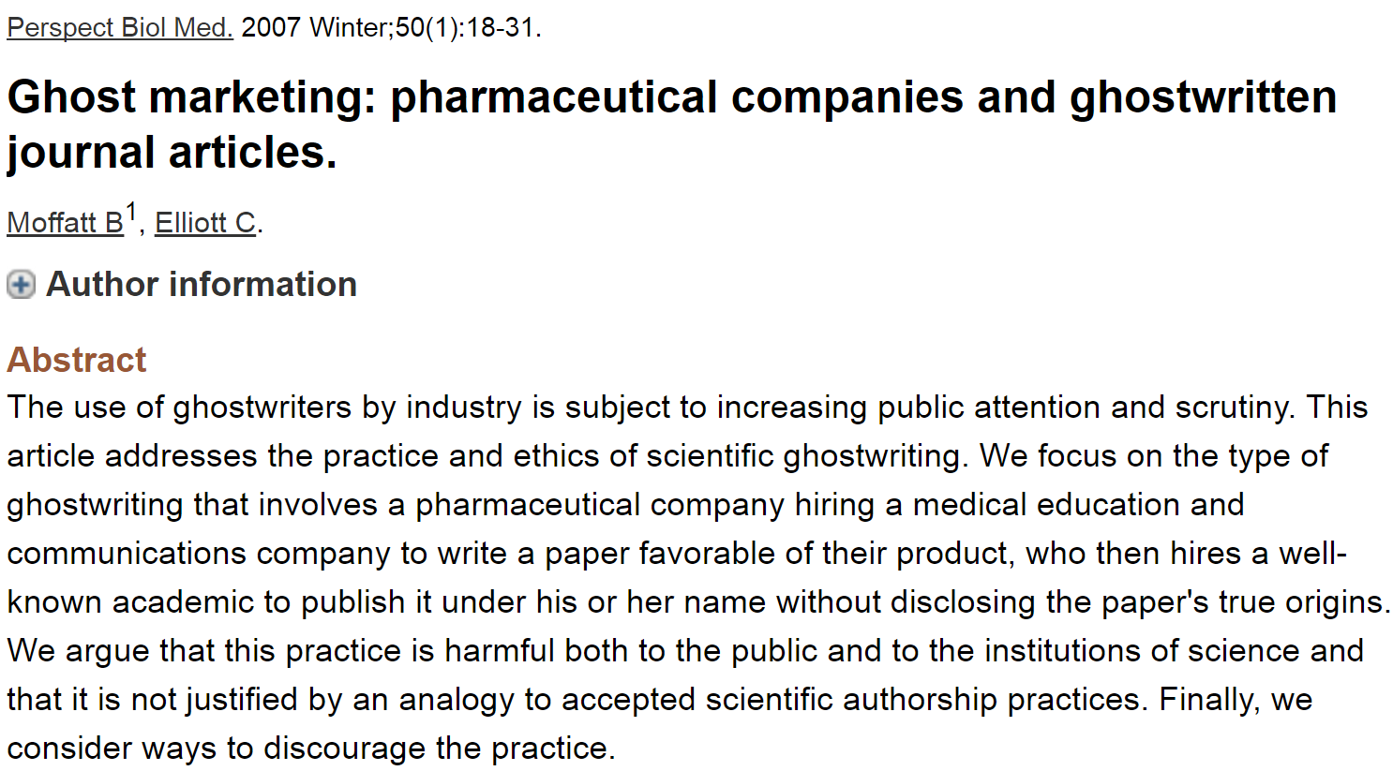
Most journals now require at least a conflicts of interest statement.
Many also require author contribution list.

Slide 4
http://www.medscape.com/viewarticle/749577

Slide 5
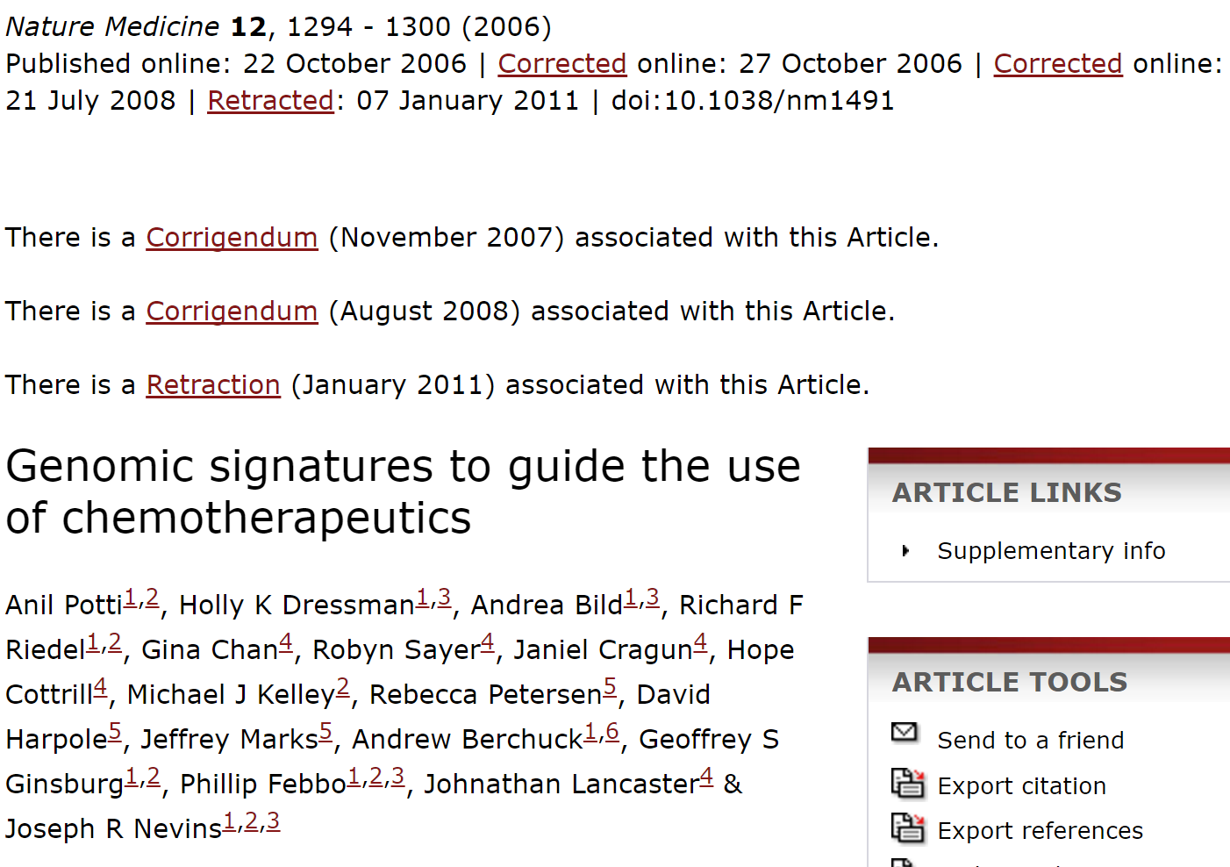
http://www.nature.com/nm/journal/v12/n11/full/nm1491.html

Slide 6
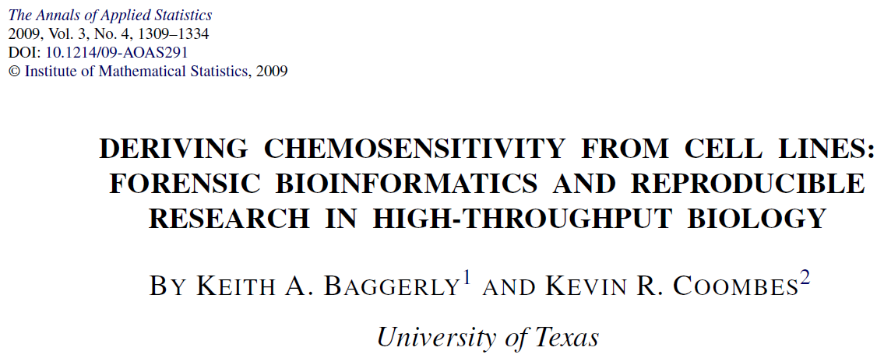
http://projecteuclid.org/download/pdfview_1/euclid.aoas/1267453942
High-throughput biological assays such as microarrays let us ask very detailed questions about how diseases operate, and promise to let us personalize therapy. Data processing, however, is often not described well enough to allow for exact reproduction of the results, leading to exercises in “forensic bioinformatics” where aspects of raw data and reported results are used to infer what methods must have been employed. Unfortunately, poor documentation can shift from an inconvenience to an active danger when it obscures not just methods but errors. In this report we examine several related papers purporting to use microarray-based signatures of drug sensitivity derived from cell lines to predict patient response. Patients in clinical trials are currently being allocated to treatment arms on the basis of these results. However, we show in five case studies that the results incorporate several simple errors that may be putting patients at risk. One theme that emerges is that the most common errors are simple (e.g., row or column offsets); conversely, it is our experience that the most simple errors are common. We then discuss steps we are taking to avoid such errors in our own investigations.

Slide 7
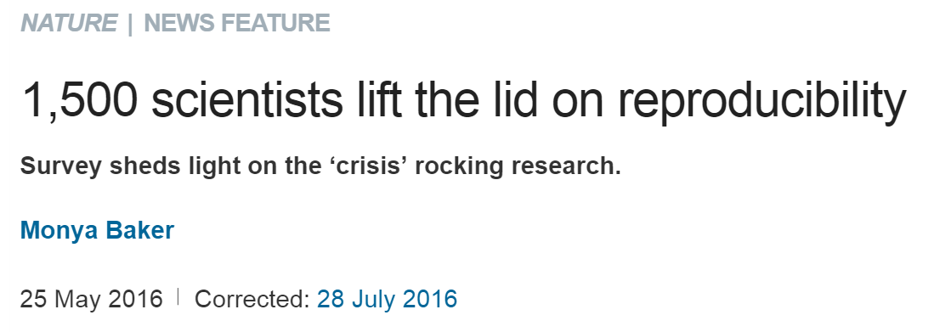
http://www.nature.com/news/1-500-scientists-lift-the-lid-on-reproducibility-1.19970
Note the following are based on researchers opinions,
not actual facts

Slide 8
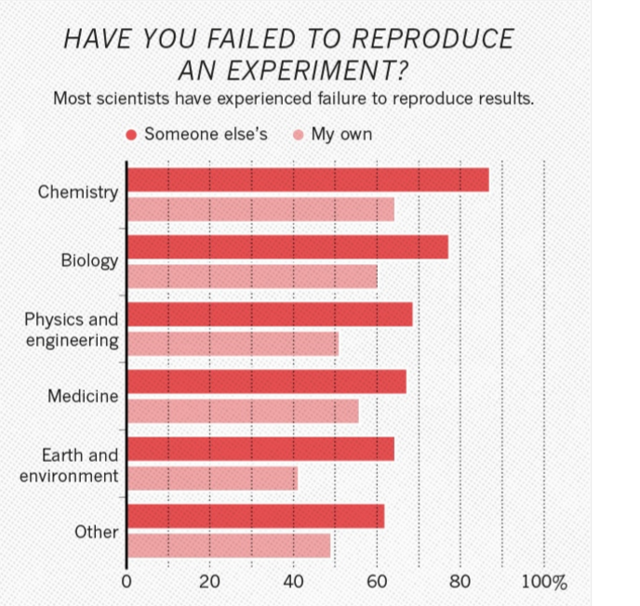

Slide 9
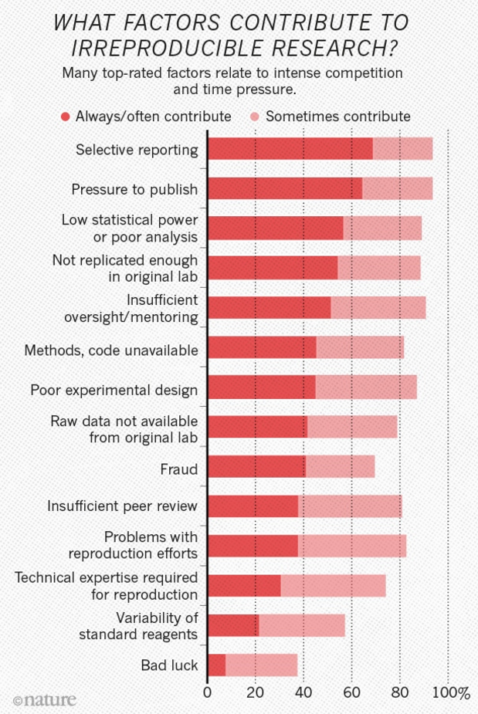
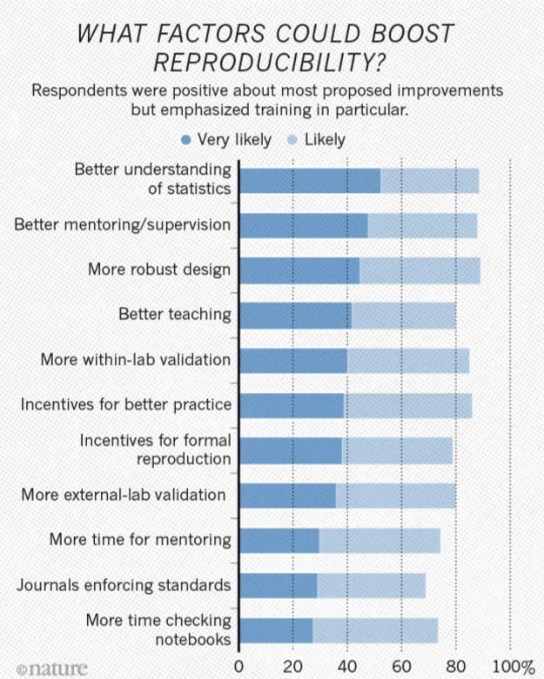

Slide 10
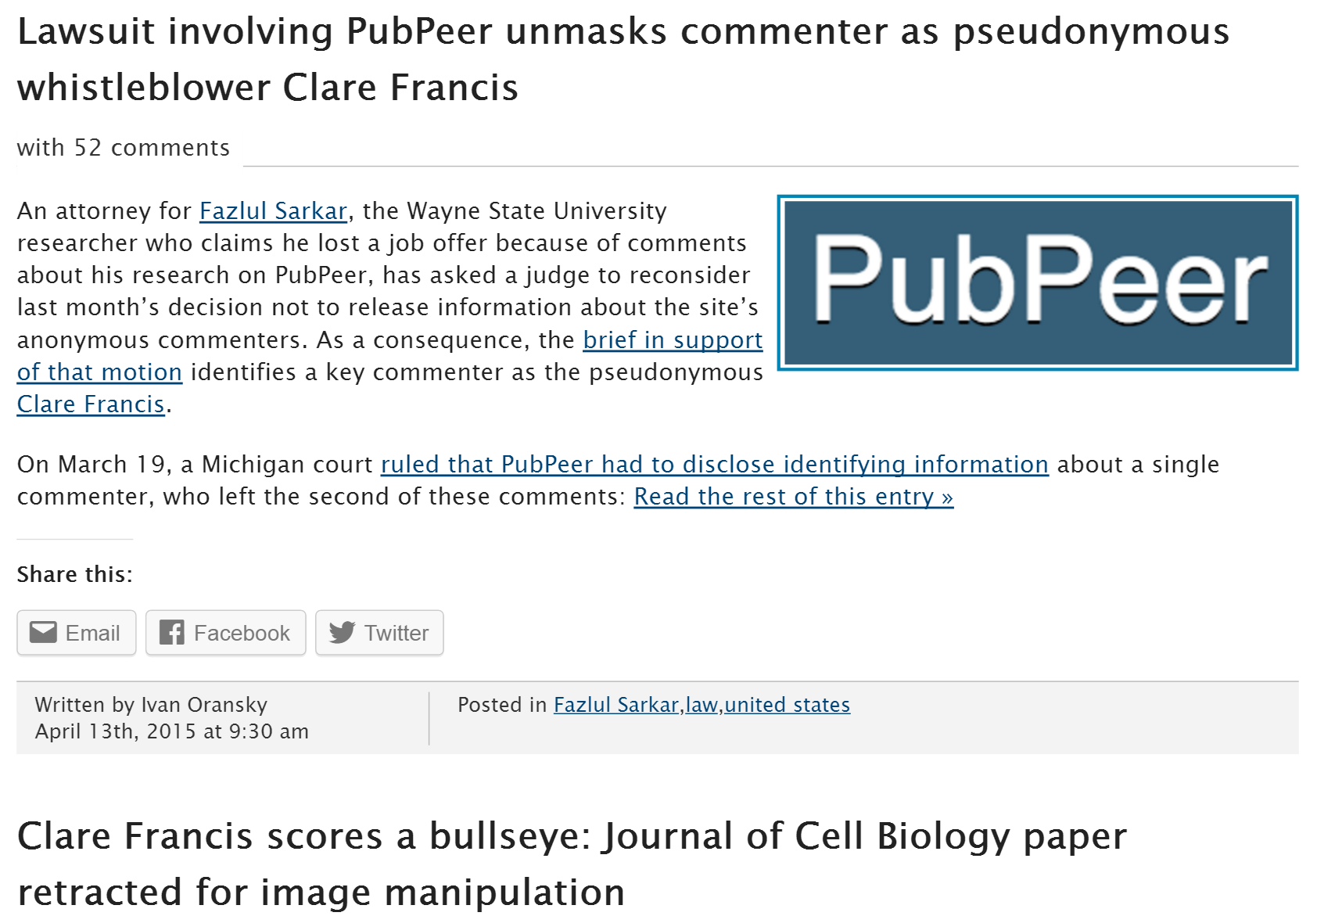
http://retractionwatch.com/?s=clare+francis

Slide 11
http://www.ncbi.nlm.nih.gov/pubmed/22784623

Slide 12
False Positives will occur
https://xkcd.com/882/

Slide 13
http://www.ncbi.nlm.nih.gov/pubmed/2406472?dopt=Abstract&holding=npg

Slide 14
False Positives will occur
https://xkcd.com/882/

Slide 15
If someone gives you data, check with them BEFORE you share it with others.
If it involves human data, you may need approval from the ethics board.
If it involves human data, you may need to keep it secure – i.e, not on an unsecured laptop.

Slide 16
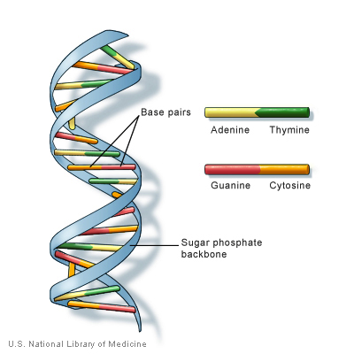
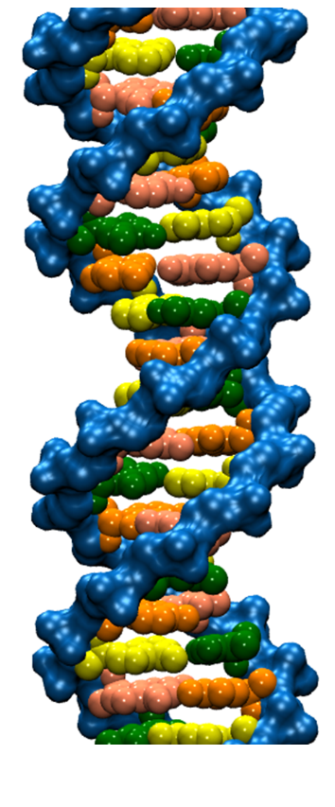
DNA trivia: Who are the authors of the 1953 paper on DNA with the following quotes:
“DNA is a helical structure”
with “two co-axial molecules.”
“period is 34 Å”
“one repeating unit contains ten
nucleotides on each of two . . . co-axial molecules.'’
“The phosphate groups lie on the outside of the structural unit, on a helix of diameter about 20 Å”
“the sugar and base groups must accordingly be turned inwards towards the helical axis.”

Slide 17
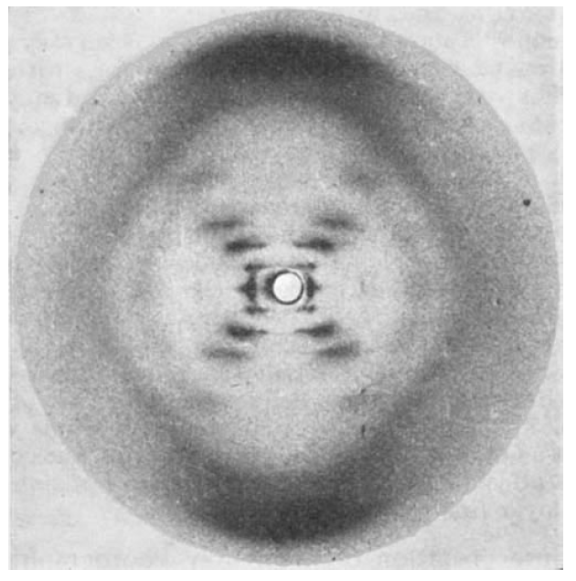

Slide 18
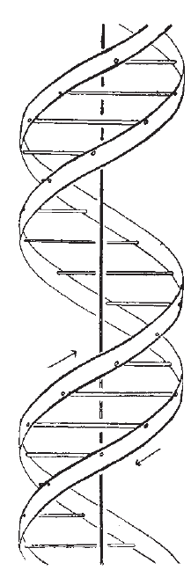
Also published in the same issue of Nature:

Slide 19
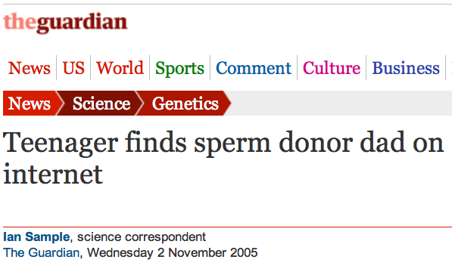
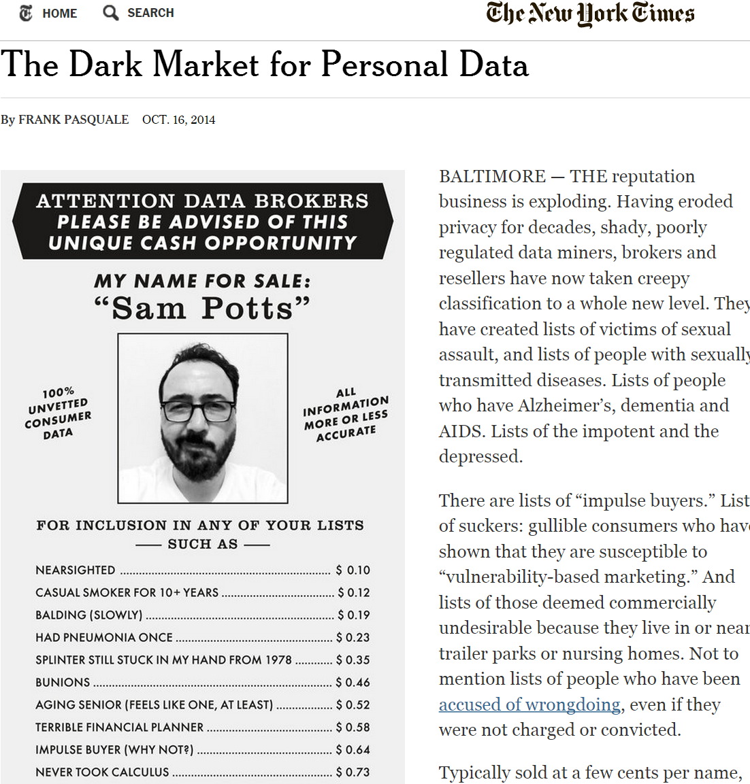
Data is NEVER fully anonymized
http://www.theguardian.com/science/2005/nov/03/genetics.news
http://www.nytimes.com/2014/10/17/opinion/the-dark-market-for-personal-data.html
http://www.nytimes.com/2006/08/09/technology/09aol.html, https://www.sciencemag.org/content/339/6117/262

Slide 20
http://www.smithsonianmag.com/science-nature/Henrietta-Lacks-Immortal-Cells.html
…HeLa cells could float on dust particles in the air & travel on unwashed hands and contaminate other cultures. It became an enormous controversy. In the midst of that, one group of scientists tracked down Henrietta’s relatives to take some samples with hopes that they could use the family’s DNA to make a map of Henrietta’s genes so they could tell which cell cultures were HeLa and which weren’t, to begin straightening out the contamination problem.

Slide 21
http://www.nature.com/news/deal-done-over-hela-cell-line-1.13511
1951 Biopsy of Henrietta Lacks’ tumour collected without her knowledge or consent. HeLa cell line soon established.
1971 The journal Obstetrics and Gynecology names Henrietta Lacks as HeLa source; word later spreads in Nature, Science and mainstream press.
1973 Lacks family members learn about HeLa cells. Scientists later collect their blood to map HeLa genes, without proper informed consent.
1996 Lacks family honored at the first annual HeLa Cancer Control Symposium, organized by former student of scientist who isolated HeLa cells.
2013 HeLa genome published without knowledge of the family, which later endorses restricted access to HeLa genome data.

Slide 22
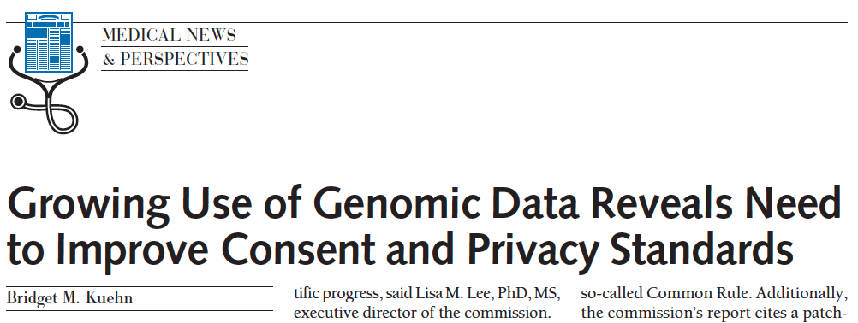
http://jama.jamanetwork.com/article.aspx?articleid=1690694
JAMA. 2013;309(20):2083-2084. doi:10.1001/jama.2013.5048
“IN MARCH, THE PUBLICATION OF THE complete genome sequence of cancer cells from a Maryland woman who died in 1951 ignited an ethical firestorm. These cells, called HeLa because they were derived from the cervical tumor of Henrietta Lacks, have been widely cultured in laboratories and used in research.”

Slide 23
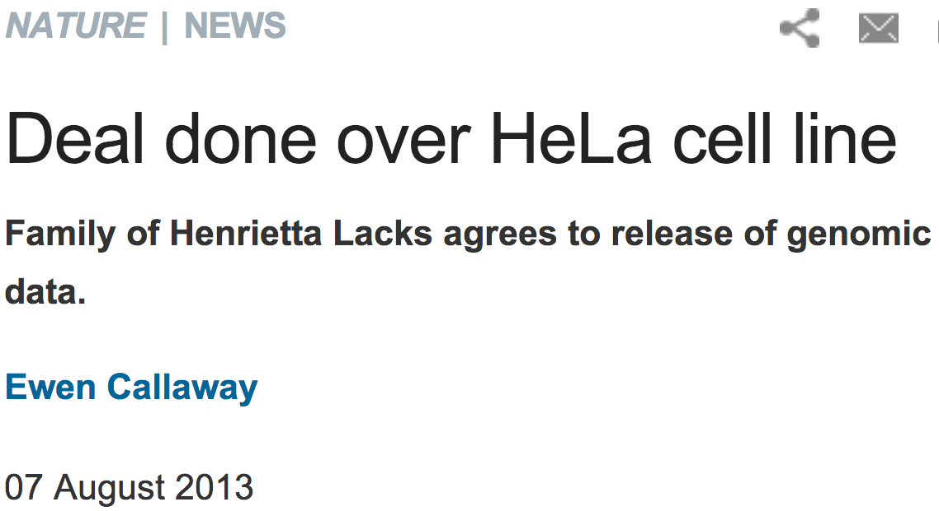
http://www.nature.com/news/deal-done-over-hela-cell-line-1.13511

Slide 24
http://www.npr.org/blogs/health/2013/01/17/169634045/some-types-of-insurance-can-discriminate-based-on-genes
In the USA, Under GINA (2009), it's (mostly) illegal for
an employer to fire someone based on his genes, and it's illegal for health insurers to raise rates or to deny coverage because of someone's genetic code.
But the law has a loophole: It only applies to health insurance. It doesn't say anything about companies that sell life insurance, disability insurance or long-term-care insurance.”
People who discover they have the gene, ApoE4, associated with Alzheimer’s are 5 times more likely than the average person to go out and buy long-term-care insurance.

Slide 25
Science 18 January 2013: Vol. 339 no. 6117 p. 262
NEWS & ANALYSIS GENETICS
Genealogy Databases Enable Naming of Anonymous DNA Donors by John Bohannon
Science 18 January 2013: Vol. 339 no. 6117 pp. 321-324
Identifying Personal Genomes by Surname Inference
Melissa Gymrek, Amy L. McGuire, David Golan, Eran Halperin, Yaniv Erlich
able to expose the identity of 50 individuals whose DNA was donated anonymously for scientific study through consortiums such as the 1000 Genomes Project.

Slide 26
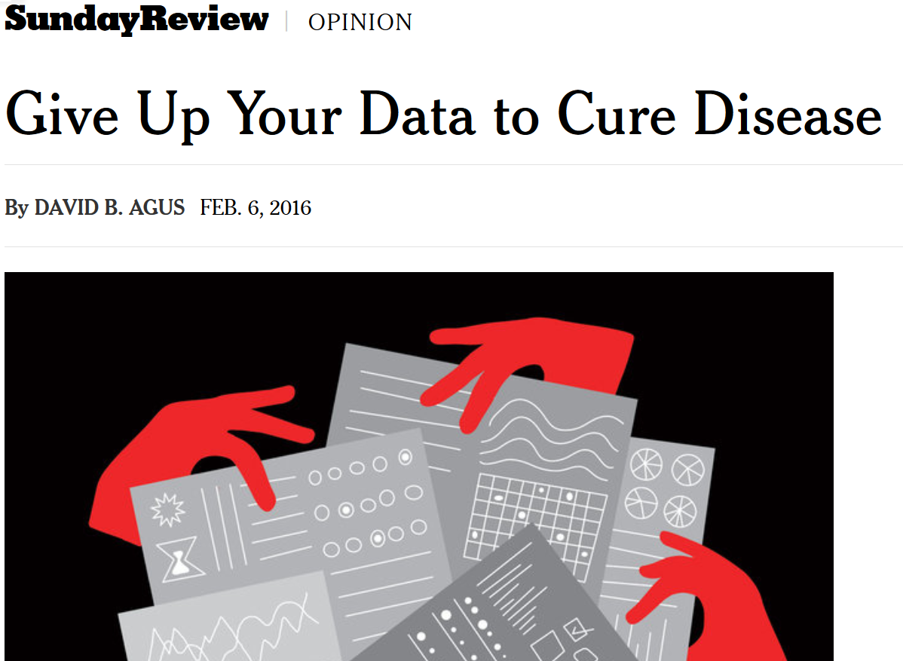
http://www.nytimes.com/2016/02/07/opinion/sunday/give-up-your-data-to-cure-disease.html

Slide 27
http://americangut.org

Slide 28
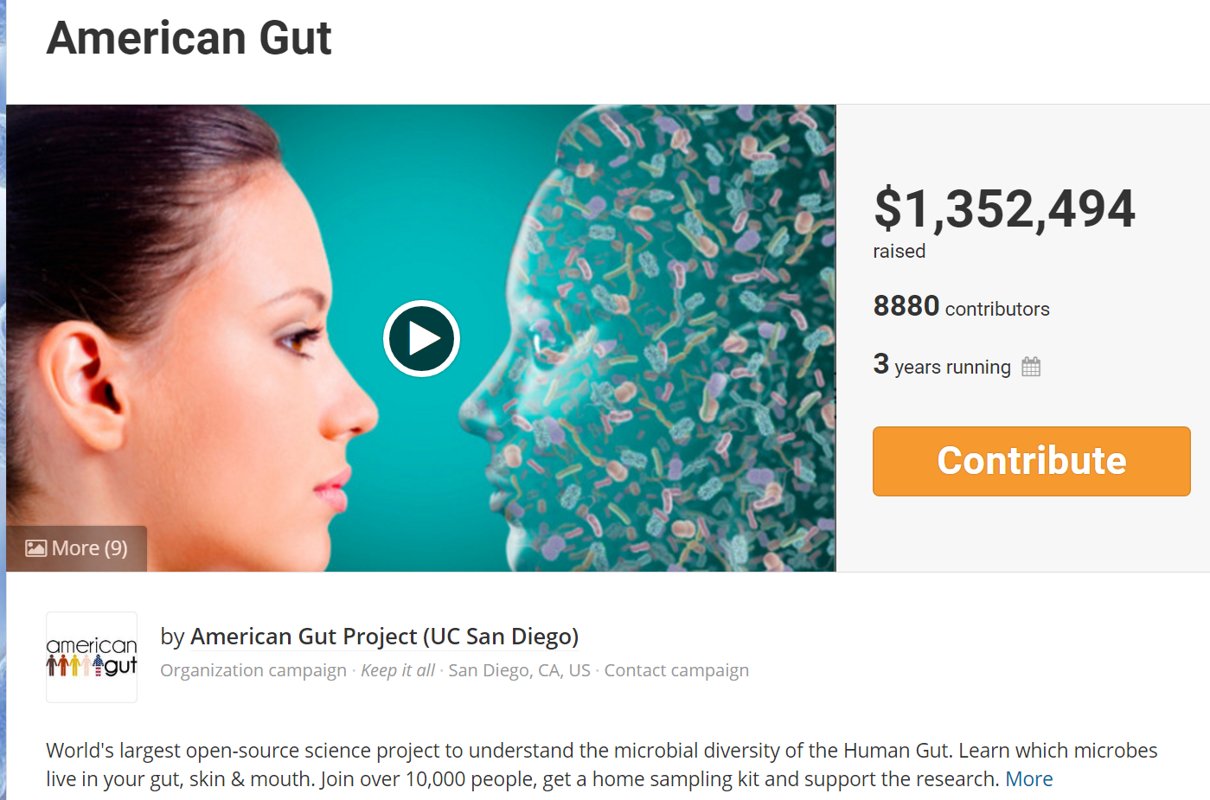
https://fundrazr.com/campaigns/4Tqx5

Slide 29
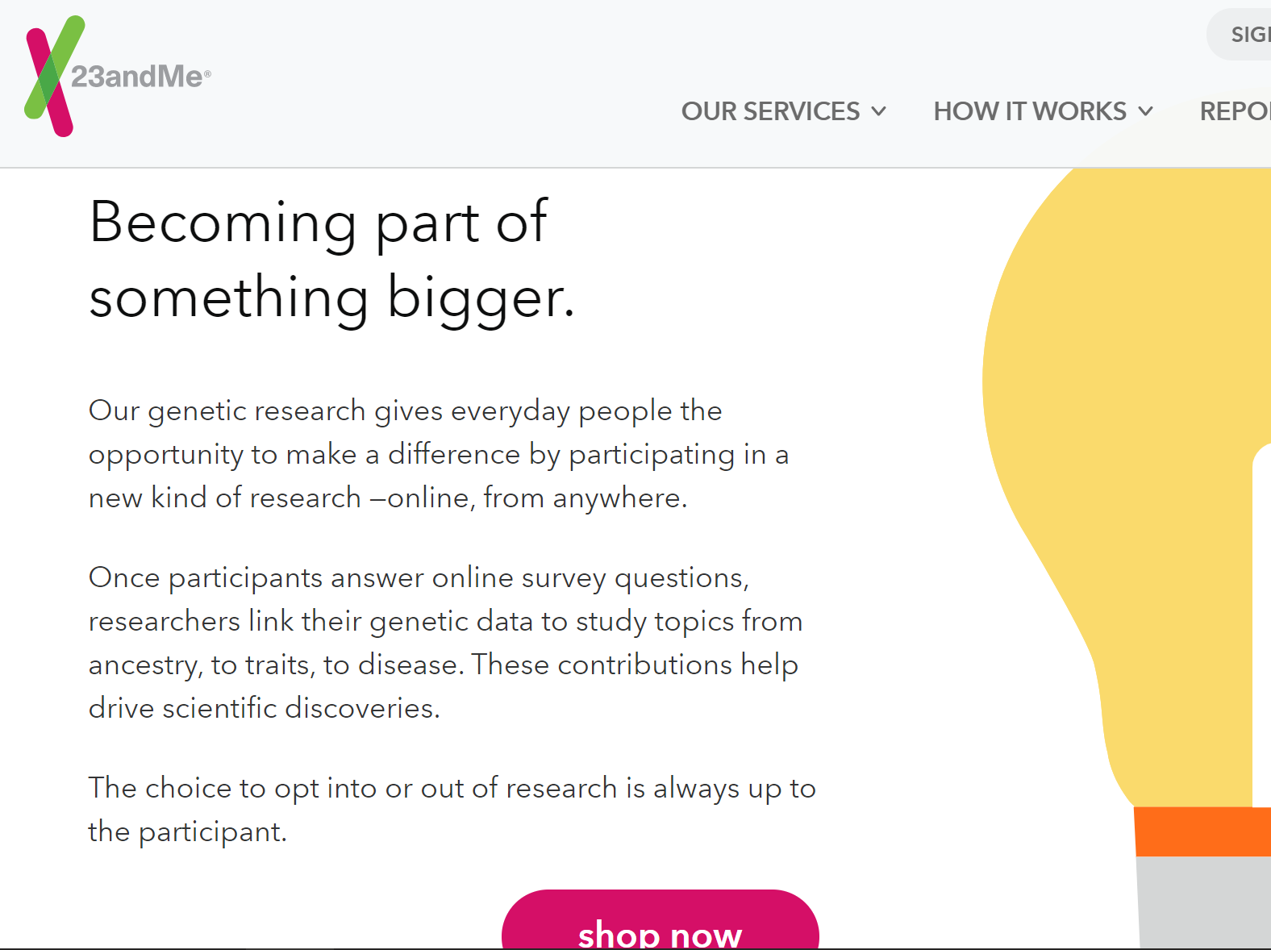

Slide 30
https://allofus.nih.gov
The future of health begins with you
The All of Us Research Program is a historic effort to gather data from one million or more people living in the United States to accelerate research and improve health. By taking into account individual differences in lifestyle, environment, and biology, researchers will uncover paths toward delivering precision medicine.
If you decide to join All of Us, we will ask you to share different kinds of information over time. We will ask you basic information like your name and where you live. We will ask you questions about your health, family, home, and work. If you have an electronic health record, we may ask for access. We may ask you to go to a local clinic or drug store for a free appointment with us. At this appointment we would measure your weight, height, hips, and waist, as well as your blood pressure and heart rate. We might ask you to give samples, like blood or urine at the appointment.

Slide 31
https://cancergenome.nih.gov/abouttcga

Slide 32
https://cancergenome.nih.gov/abouttcga

