Slide 1
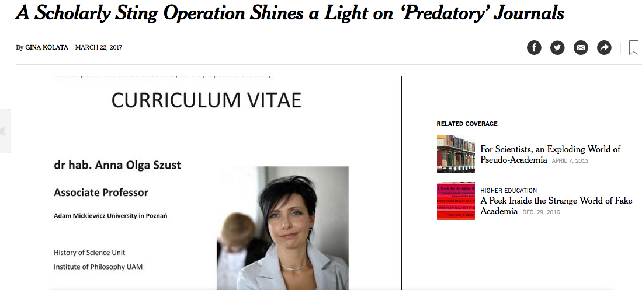
https://www.nytimes.com/2017/03/22/science/open-access-journals.html

Slide 2
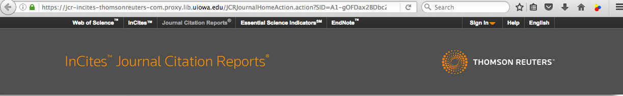
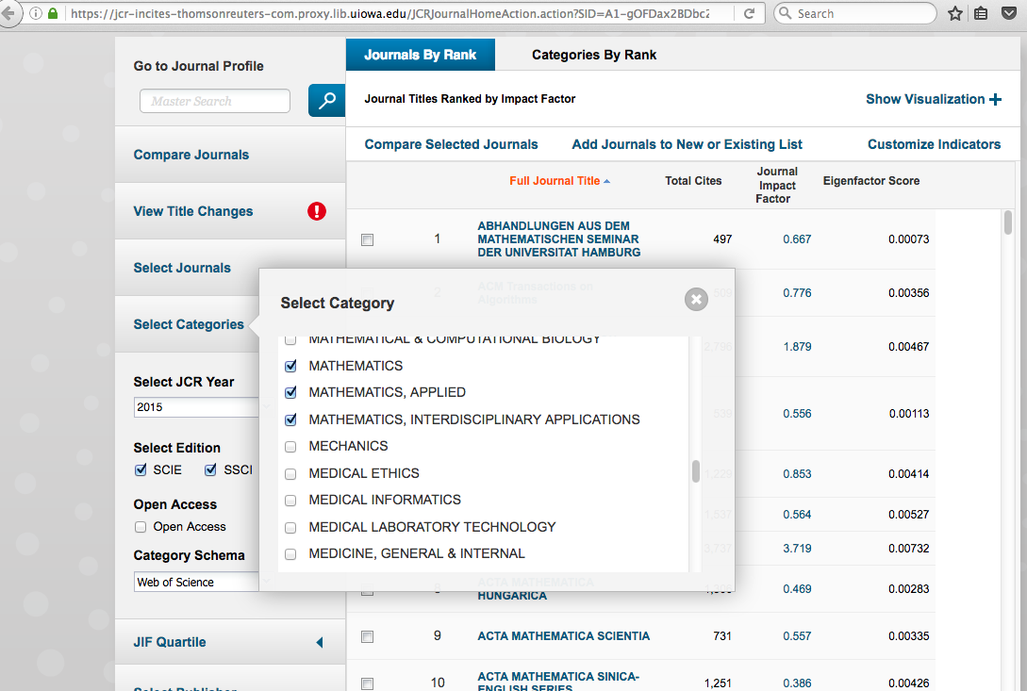
Web of Science Journal Citation Reports

Slide 4
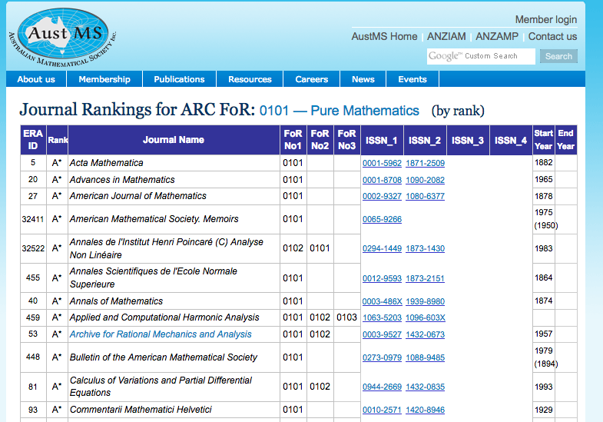
http://www.austms.org.au/Rankings/0101_AustMS_final_ranked.html

Slide 5
http://www.austms.org.au/Rankings/0101_AustMS_final_ranked.html

Slide 6
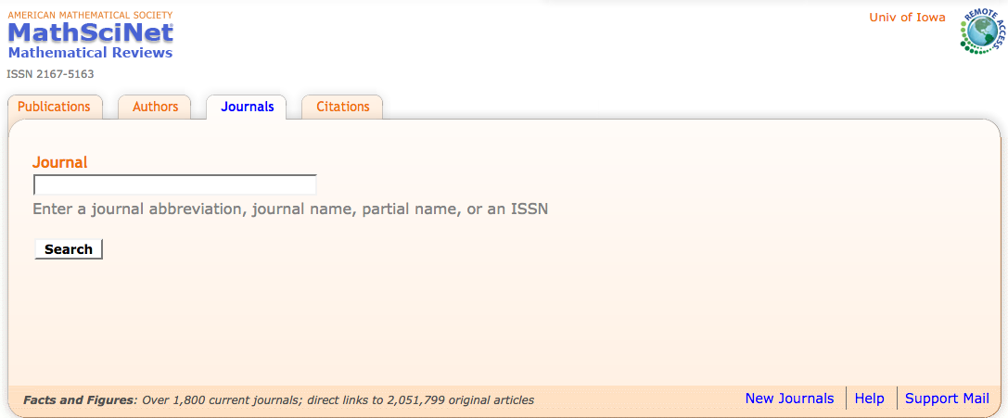
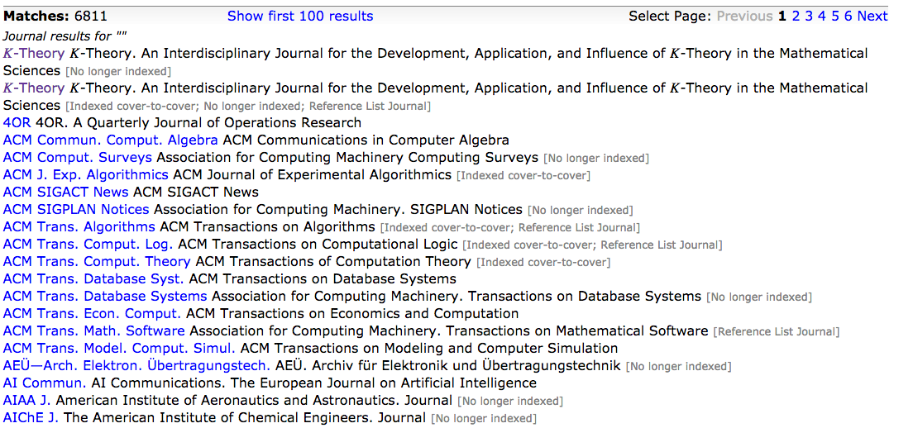

Slide 8
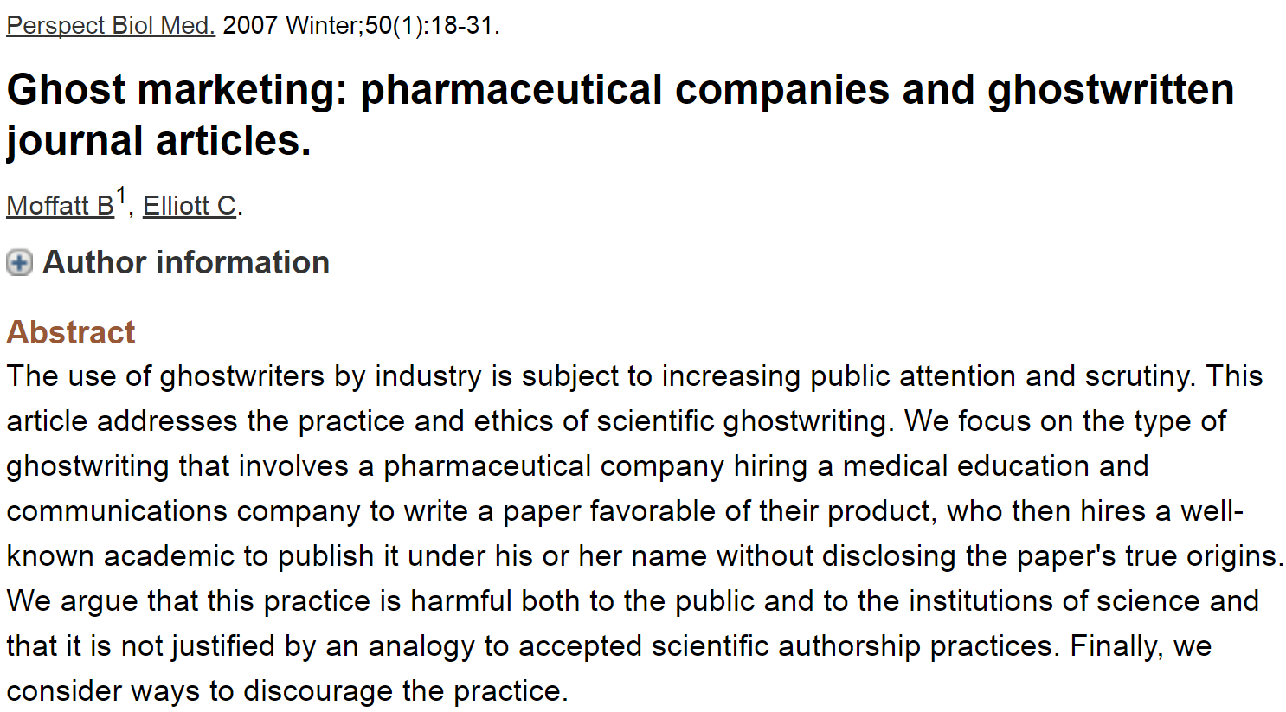
Most journals now require at least a conflicts of interest statement.
Many also require author contribution list.

Slide 9
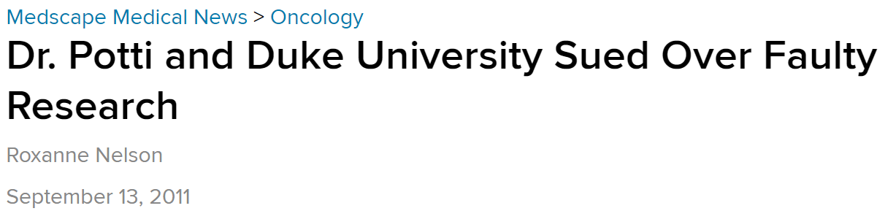
http://www.medscape.com/viewarticle/749577

Slide 10
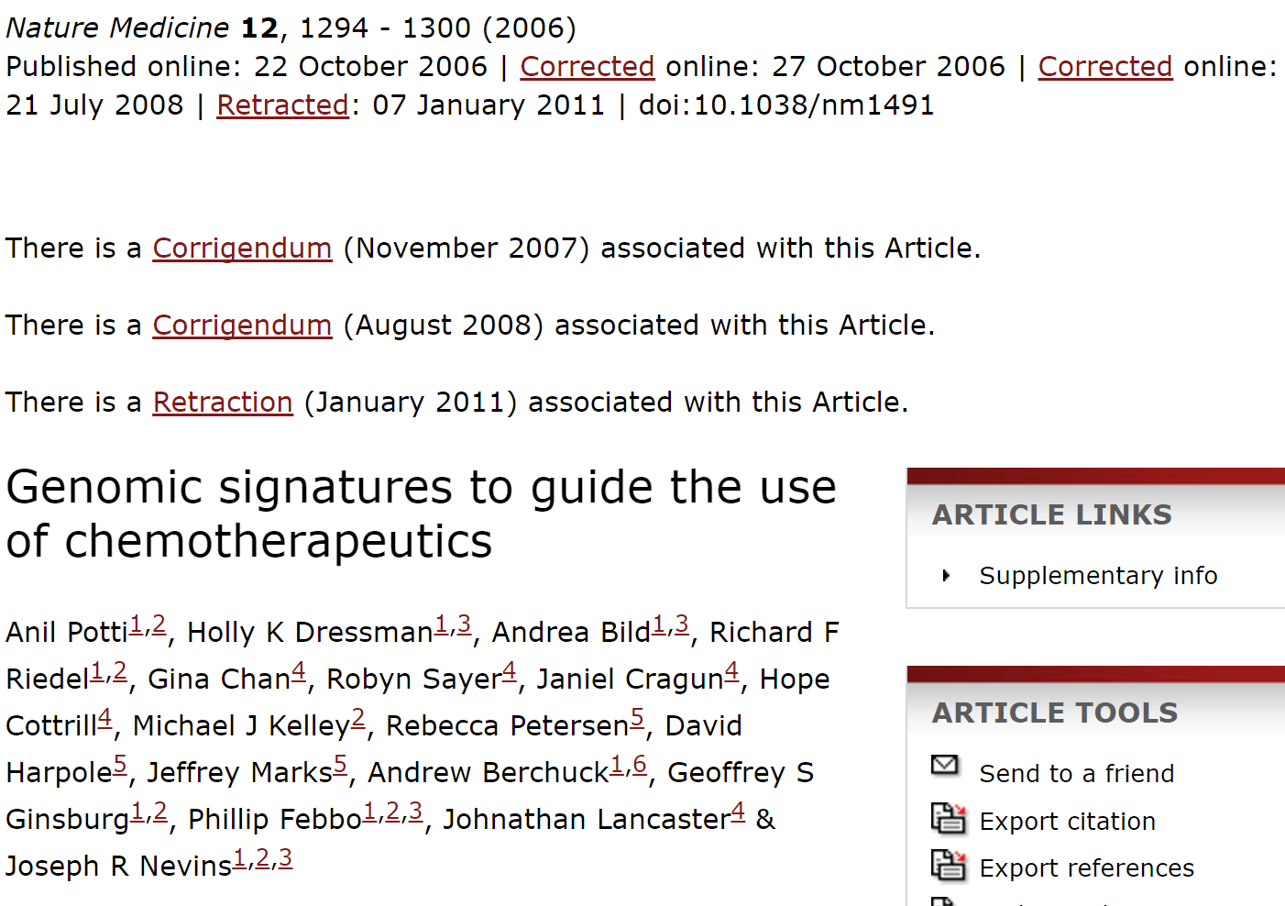
http://www.nature.com/nm/journal/v12/n11/full/nm1491.html

Slide 11
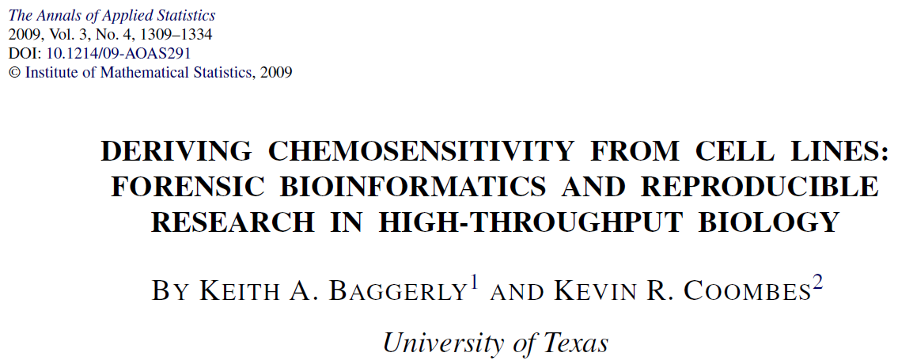
http://projecteuclid.org/download/pdfview_1/euclid.aoas/1267453942
High-throughput biological assays such as microarrays let us ask very detailed questions about how diseases operate, and promise to let us personalize therapy. Data processing, however, is often not described well enough to allow for exact reproduction of the results, leading to exercises in “forensic bioinformatics” where aspects of raw data and reported results are used to infer what methods must have been employed. Unfortunately, poor documentation can shift from an inconvenience to an active danger when it obscures not just methods but errors. In this report we examine several related papers purporting to use microarray-based signatures of drug sensitivity derived from cell lines to predict patient response. Patients in clinical trials are currently being allocated to treatment arms on the basis of these results. However, we show in five case studies that the results incorporate several simple errors that may be putting patients at risk. One theme that emerges is that the most common errors are simple (e.g., row or column offsets); conversely, it is our experience that the most simple errors are common. We then discuss steps we are taking to avoid such errors in our own investigations.

Slide 12
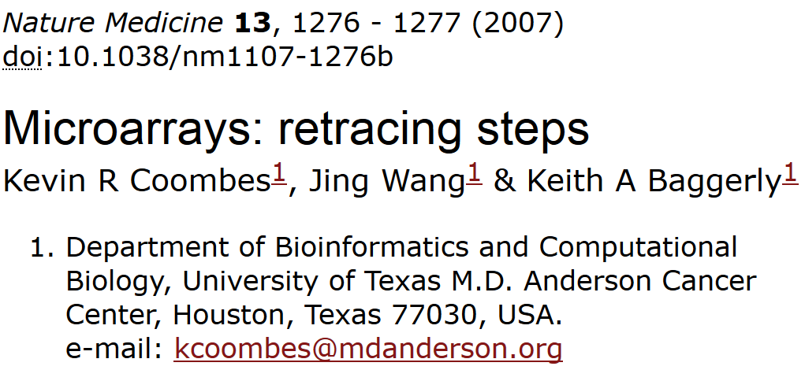
“We report here our inability to reproduce their findings.”

Slide 13
2. The lists of genes initially reported in the supplementary information on the Nature Medicine website¹ are wrong because of an 'off-by-one' indexing error.
3. Using their software and lists of cell lines, we reproduced their published heatmaps for six out of seven drugs. (We could not reproduce the heatmap for cytoxan.) However, after correcting for the off-by-one error, we matched the reported gene lists exactly for only three out of seven drugs (Supplementary Report 9). The other lists contain outliers.
5. Their software does not maintain the independence of training and test sets, and the test data alter the model.
7. When we apply the same methods but maintain the separation of training and test sets, predictions are poor (Fig. 1 and Supplementary Report 7). Simulations show that the results are no better than those obtained with randomly selected cell lines (Supplementary Report 8).

Slide 14
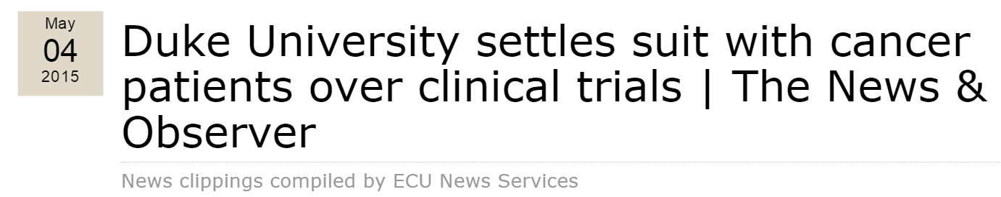
http://blog.ecu.edu/sites/dailyclips/blog/2015/05/04/duke-university-settles-suit-with-cancer-patients-over-clinical-trials-the-news-observer/
By Joseph Neff
Duke University has settled the lawsuit filed by the families of eight cancer patients treated in clinical trials based on bogus science, a Duke spokesman said Saturday.
The settlement ends another chapter in the long-running scandal over research conducted by Dr. Anil Potti, once a rising scientist who has retracted 11 research papers and left Duke in disgrace in 2011.
Duke spokesman Michael Schoenfeld declined to discuss the amount of settlement or any other questions about the lawsuit.
But the dollar amount of the settlement is likely to be substantial, given the depth of the research misconduct and damaging evidence discovered in the lawsuit, including a whistleblower who alerted Duke to the misconduct in 2008 but went ignored.
Duke officials shut down the trials in 2010 and flatly said they should never have been done.
Potti is now working at a cancer center in North Dakota.

Slide 15
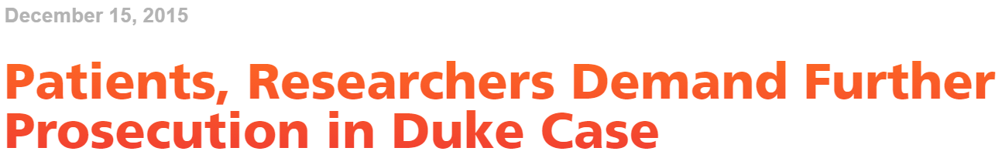
http://www.bna.com/patients-researchers-demand-n57982065145/
By Llewellyn Hinkes-JonesDec. 2 — Patients and researchers have harshly criticized the leniency of research misconduct findings against former Duke University cancer researcher Anil Potti and the sole focus on Potti by the Department of Health and Human Services Office of Research Integrity.
On Nov. 9, the ORI made a formal finding of research misconduct against Potti for altering data sets, falsifying grant applications and disregarding accepted scientific methodology surrounding his widely celebrated “Holy Grail” of cancer research. While Potti neither admits nor denies his guilt, the ORI banned Potti from U.S. Public Health Service-supported research for five years

Slide 16
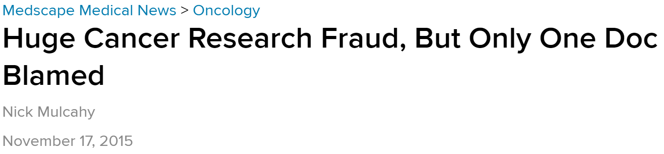
http://www.medscape.com/viewarticle/854595
However, the Cancer Letter editorialists have damning words for Duke about the handling of the protracted scandal.
"This case is about as serious as one can imagine at the individual level. At the institutional level, it is beyond disappointing at every turn: in handing an internal whistleblower; in responding to credible, serious, and repeated external scientific queries; in managing the multiple conflicts of interest in the situation; in limiting the information available to an interim scientific review; in how its leaders testified to an IOM review committee; in its legal responses," the pair write.

Slide 17
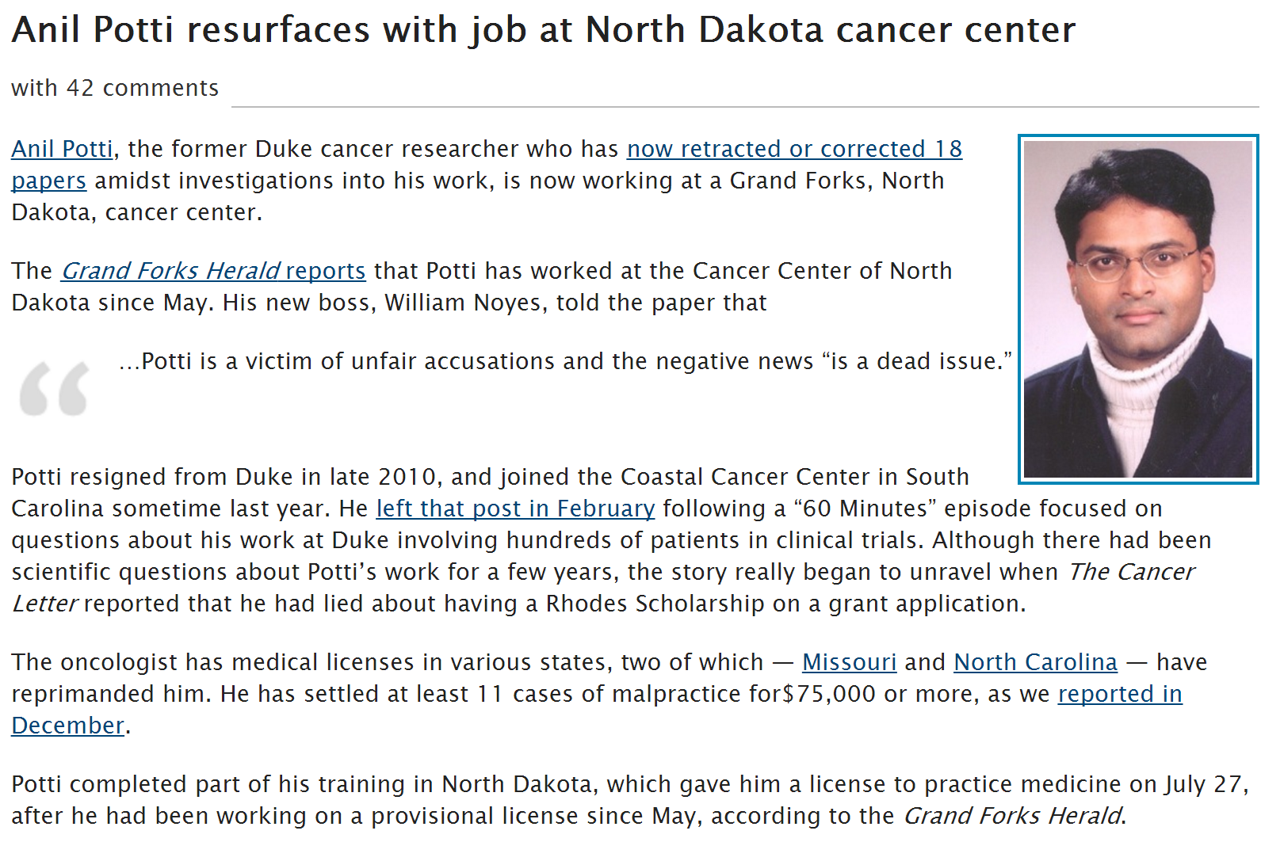
http://retractionwatch.com/2012/08/20/anil-potti-resurfaces-with-job-at-north-dakota-cancer-center/

Slide 18
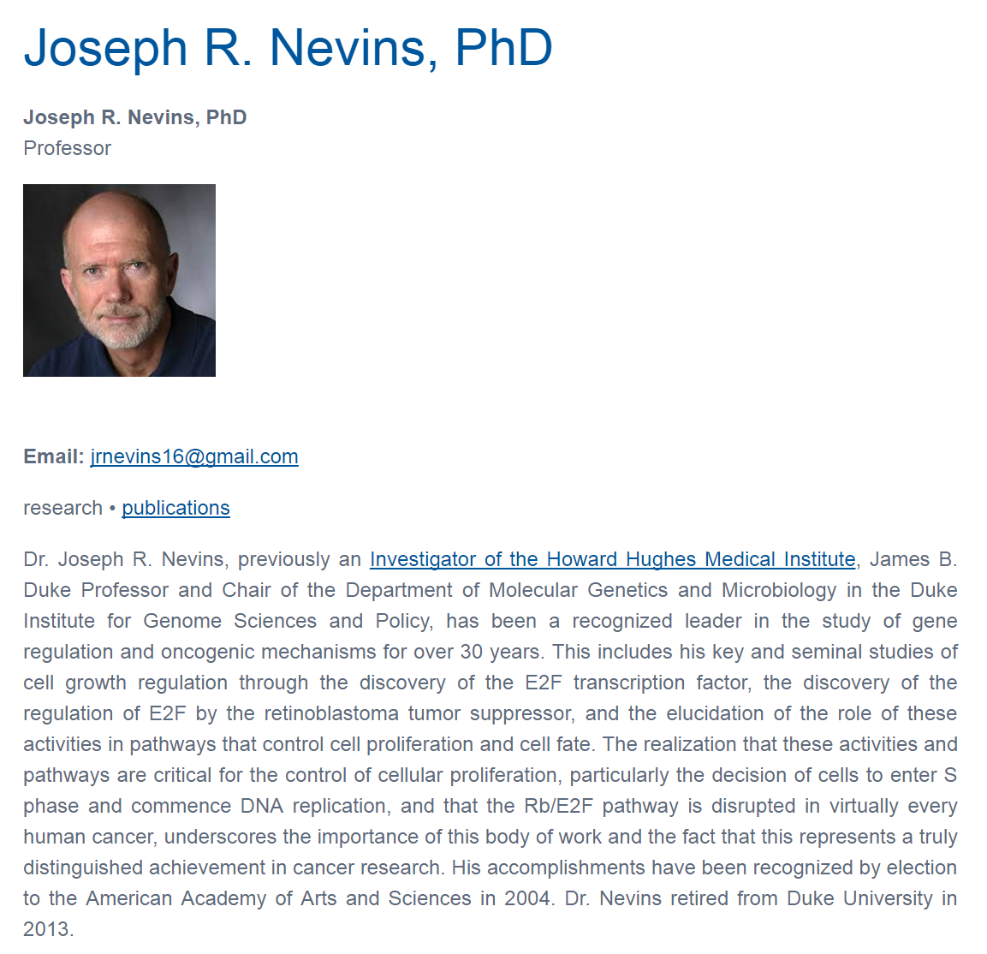

Slide 19
http://www.nature.com/nm/journal/v12/n11/full/nm1491.html

Slide 20

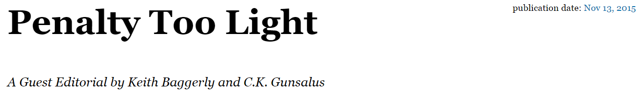
http://cancerletter.com/articles/20151113_2
This case is about as serious as one can imagine at the individual level. At the institutional level, it is beyond disappointing at every turn: in handing an internal whistleblower, in responding to credible, serious and repeated external scientific queries, in managing the multiple conflicts of interest in the situation, in limiting the information available to an interim scientific review, in how its leaders testified to an IOM review committee, in its legal responses.

Slide 21
Cite original source.
Cite everything including figures (copywrite might not allow modifying figures – but even if modified, must still be referenced)
For more info:
http://www.biomedicalcomputationreview.org/7/2/9.pdf
ERROR! What biomedical computing can learn from its mistakes
BY KRISTIN SAINANI, PhD

Slide 22
http://projecteuclid.org/download/pdfview_1/euclid.aoas/1267453942
We now require most of our reports to be written using Sweave [Leisch(2002)], a literate programming combination of LATEX source and R [R Development Core Team (2008)] code (SASweave and odfWeave are also available) so
that we can rerun the reports as needed and get the same results.
http://www.statistik.lmu.de/~leisch/Sweave/
help("Sweave", package="utils")
http://yihui.name/knitr/

Slide 23
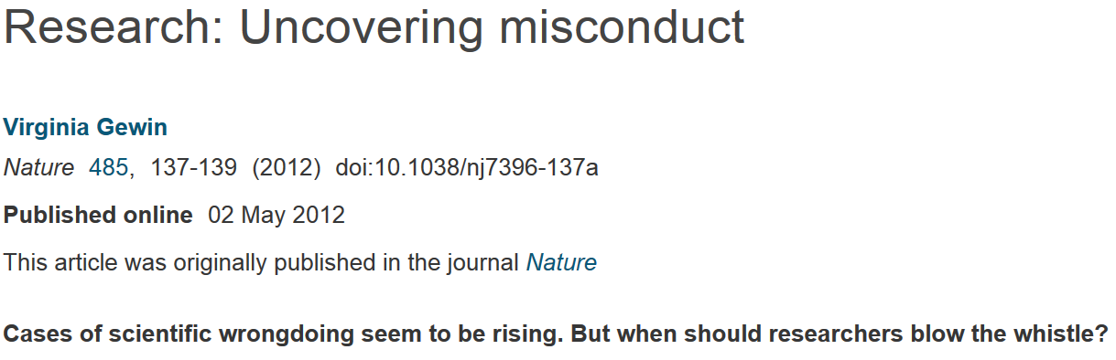
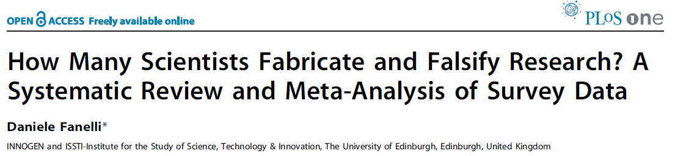
http://www.nature.com/naturejobs/science/articles/10.1038/nj7396-137a
http://journals.plos.org/plosone/article?id=10.1371/journal.pone.0005738
A pooled weighted average of 1.97% (N = 7, 95%CI: 0.86–4.45) of scientists admitted to have fabricated, falsified or modified data or results at least once –a serious form of misconduct by any standard– and up to 33.7% admitted other questionable research practices.

Slide 24
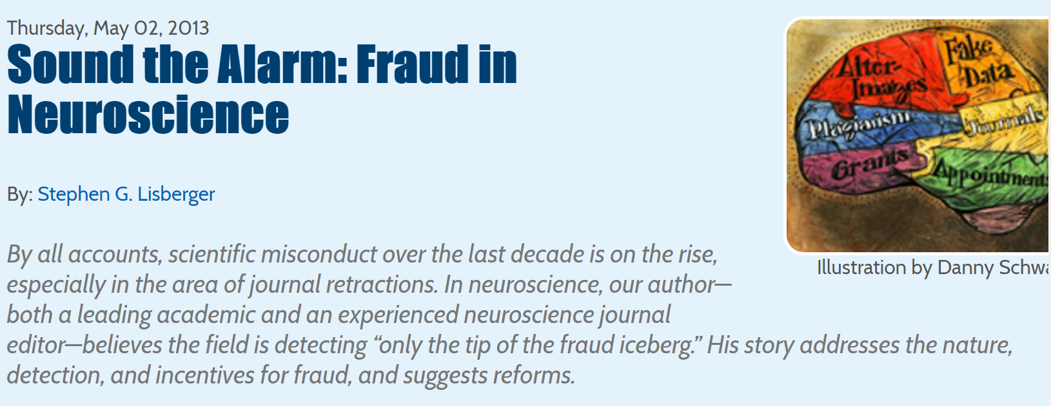
http://dana.org/Cerebrum/Default.aspx?id=39490

Slide 25
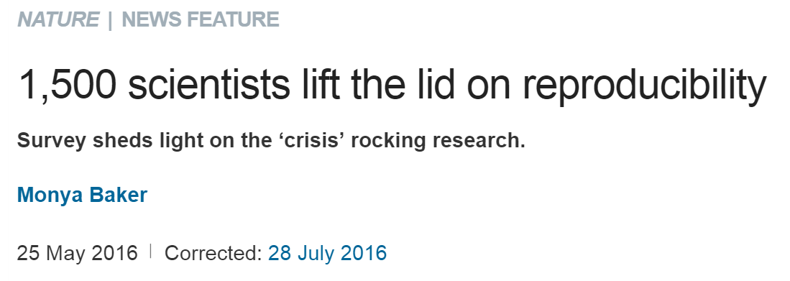
http://www.nature.com/news/1-500-scientists-lift-the-lid-on-reproducibility-1.19970
Note the following are based on researchers opinions,
not actual facts

Slide 26
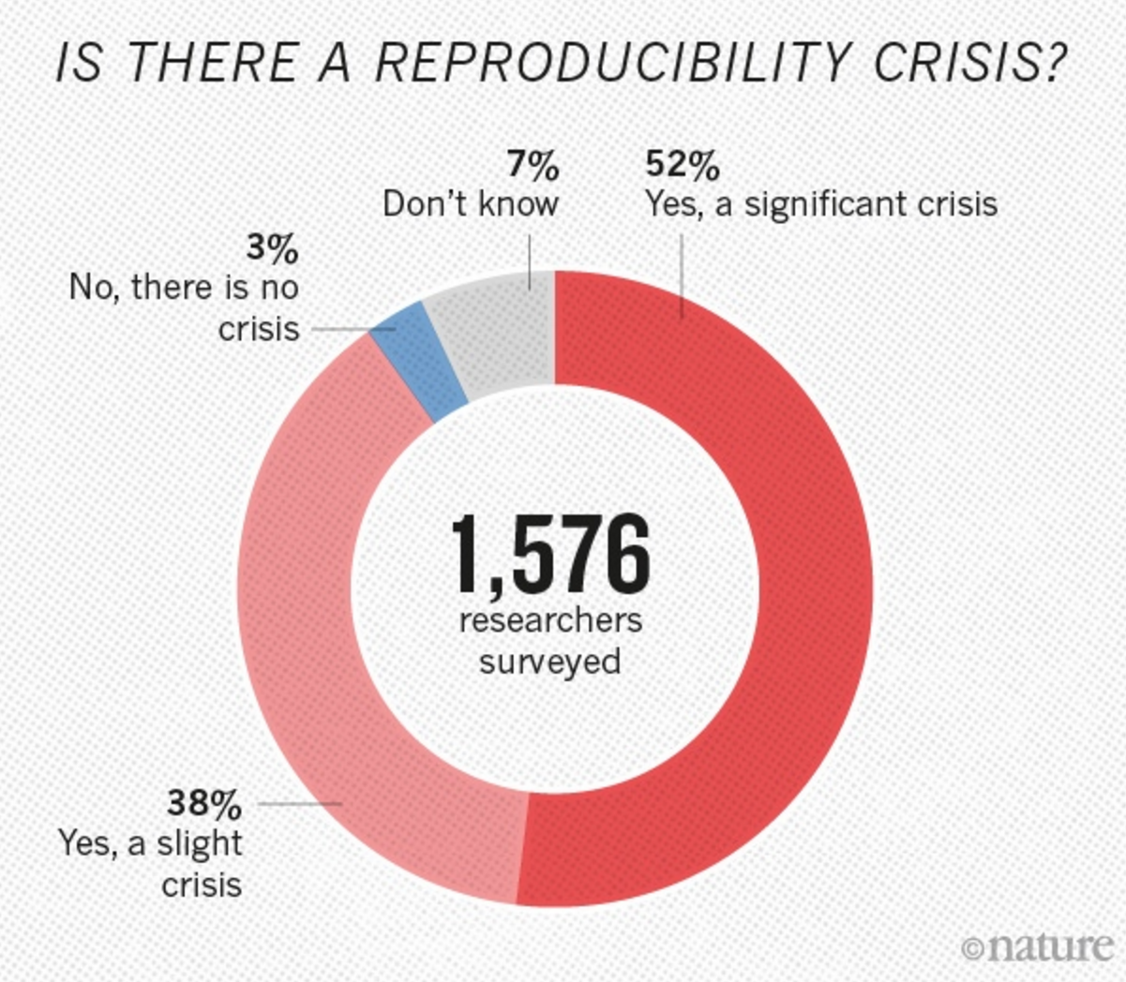
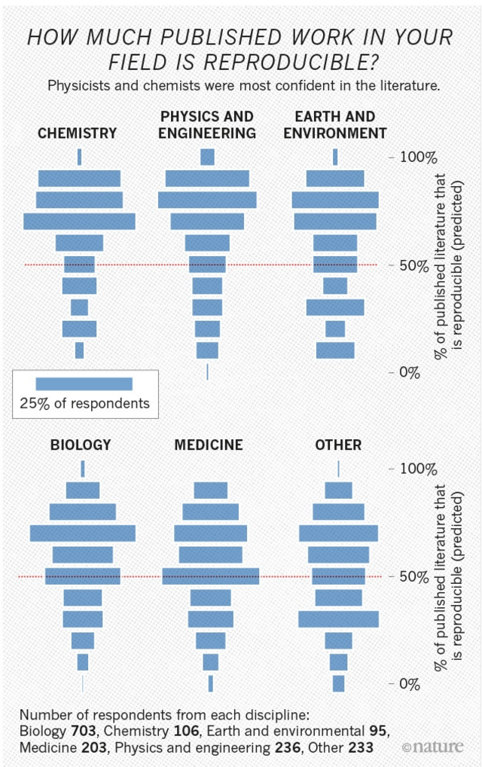

Slide 28
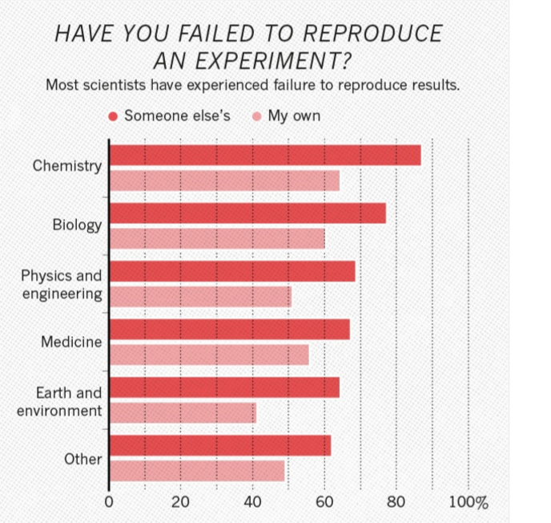

Slide 29
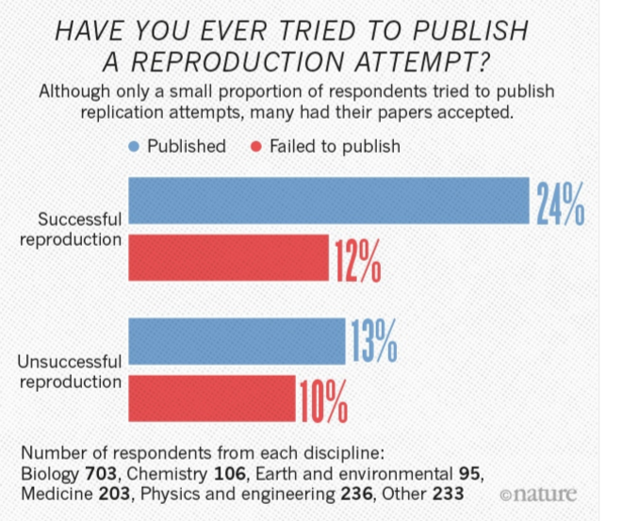

Slide 30
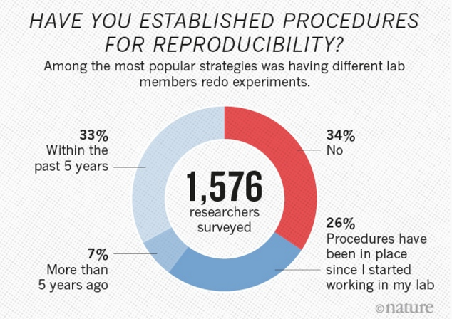

Slide 31
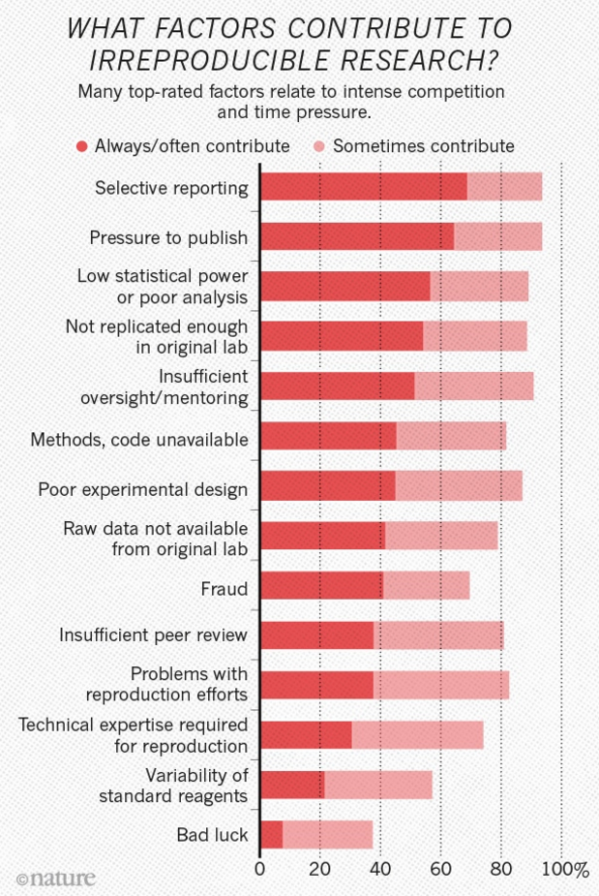
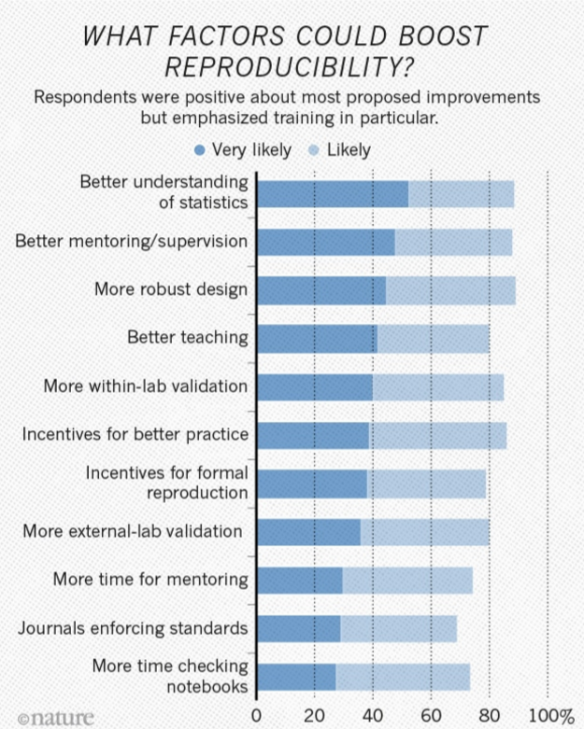

Slide 32
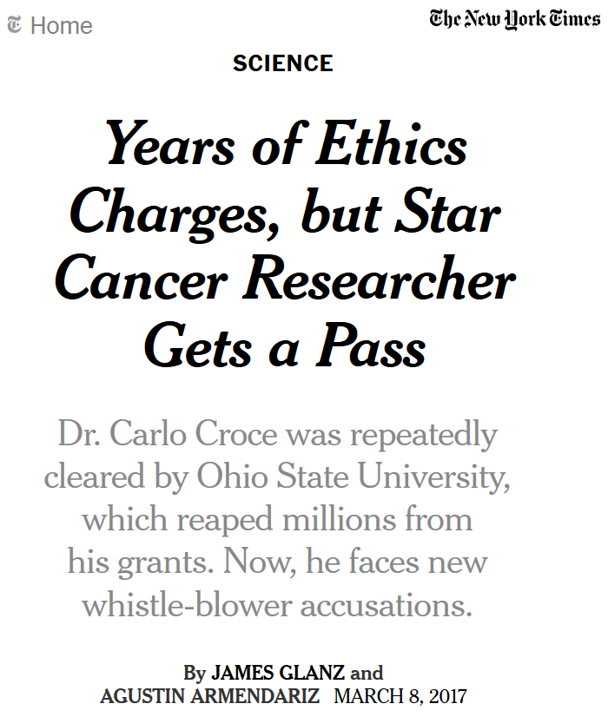
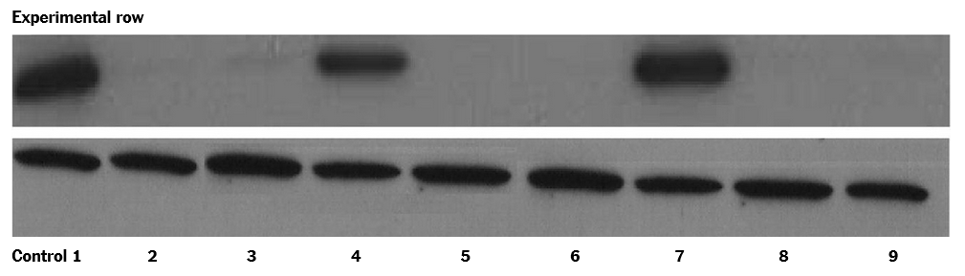
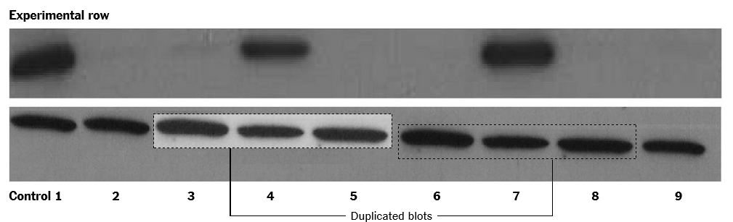
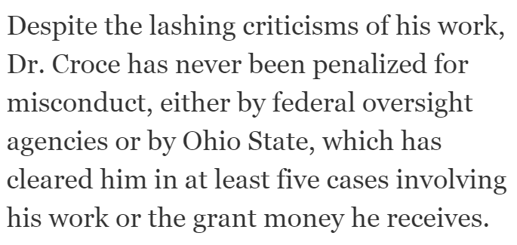
https://www.nytimes.com/2017/03/08/science/cancer-carlo-croce.html

Slide 33
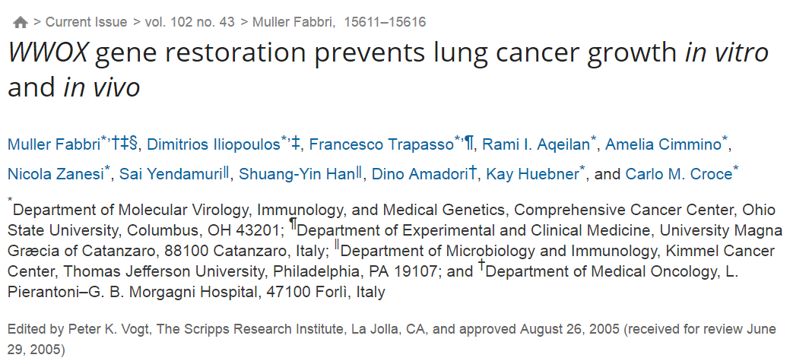
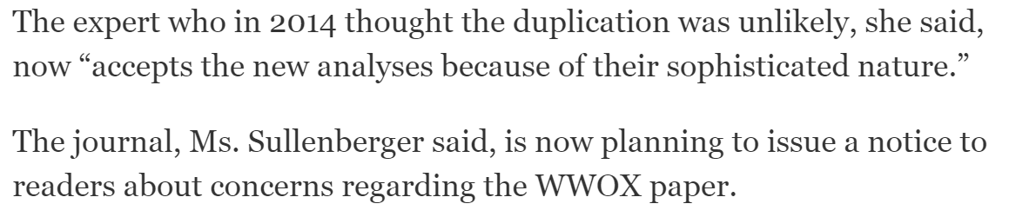
http://www.pnas.org/content/102/43/15611.full
https://www.nytimes.com/2017/03/08/science/cancer-carlo-croce.html

Slide 34

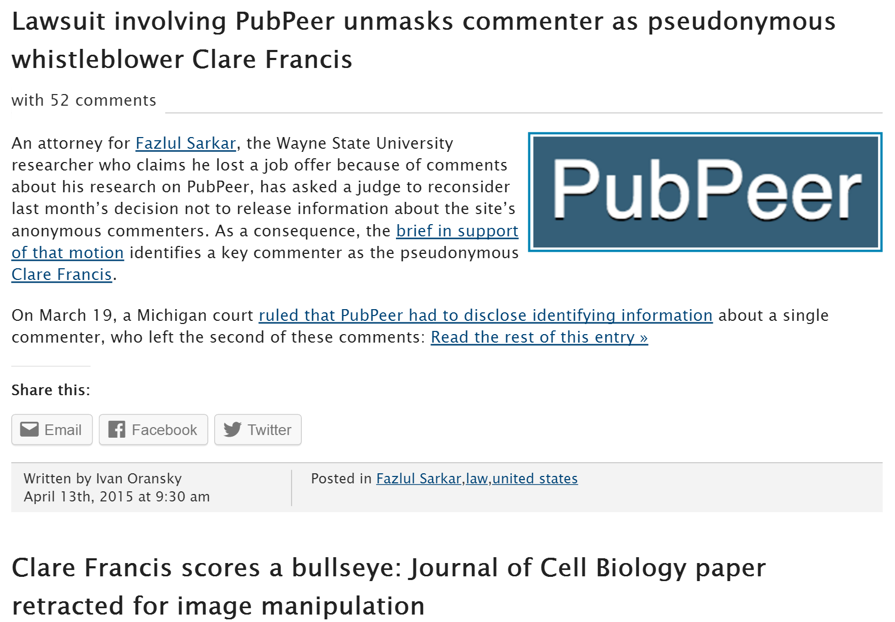
http://retractionwatch.com/?s=clare+francis

Slide 35
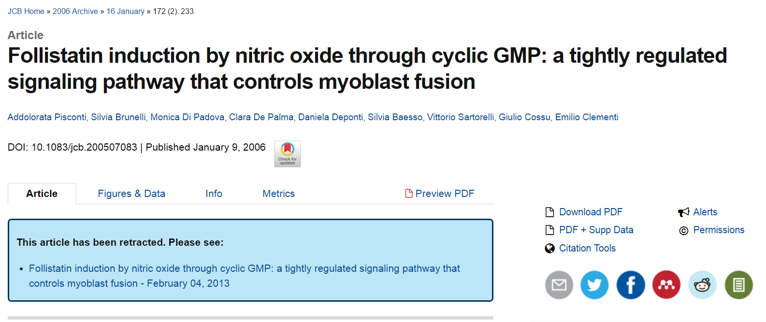
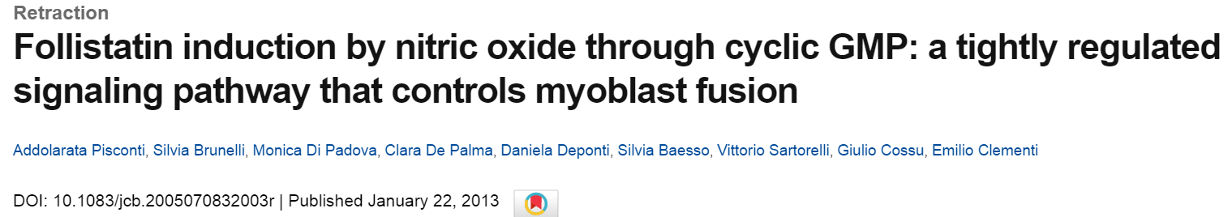
http://jcb.rupress.org/content/172/2/233
http://jcb.rupress.org/content/early/2013/01/21/jcb.2005070832003r

Slide 36
http://jcb.rupress.org/content/early/2013/01/21/jcb.2005070832003r
Vol. 172 No. 2, January 9, 2006. Pages 233–244.
After concerns were raised by a reader, the Editors of The Journal of Cell Biology detected the following issues with the data in the above article:
(1) The top panel in Fig. 1 F (NOS-1μ) is identical to the top panel in Fig. 2 B (α-sGC).
(2) The bottom panel in Fig. 1 F (NOS-III) is identical to the bottom panel in Fig. 2 B (GAPDH).
(3) Lanes 2 and 3 of the Follistatin panel for satellite cells in Fig. 4 A are identical to lanes 1 and 2 of the Myostatin panel for satellite cells in the same figure.
(4) A band appears to have been erased from lane 4 of the Follistatin panel for satellite cells in Fig. 4 A.
(5) Lane 4 of the Myostatin panel for satellite cells in Fig. 4 A is identical to lane 1 of the Follistatin panel for E12.5/E15.5 in the same figure.
(6) The E9.5 explants and E12.5/E15.5 panels for GAPDH in Fig. 4 A are identical.
Given the above issues with the experimental data in Fig. 4 A, the quantification data in Fig. S1 A cannot be validated.
No issues were detected with the other figures in the paper nor with the other parts of the figures listed above (Fig. 1, A–E, G, and H; Fig. 2, A and C–E; Fig. 4 B; and Fig. S1 B).
The authors were contacted by the Executive Editor of the journal and provided the following statement:
“Given the time that has elapsed since the original date of publication, we are unable to find the original data used to prepare these figures and are not able to explain these observations. We thus retract the paper and apologize for any confusion it may have caused to the research community. Because of the issues noted above, the conclusions presented in this paper that changes in NOS activity are the consequence of activation and inhibition of enzyme activity and not of changes in protein expression (Fig. 1 F), that regulation of guanylate cyclase occurs through posttranslational events (Fig. 2 B), that there is a role for nitric oxide in expression of follistatin mRNA in cultured cells (Figs. 4 A and S1 A), and that there are roles for nitric oxide and cGMP in expression of follistatin mRNA in vivo (Figs. 4 A and S1 A) cannot be validated. The reported observations on the effects of nitric oxide and cGMP on myoblast fusion in cultured cells, of cGMP on myogenesis in vivo, of cGMP on expression of follistatin mRNA in cultured cells, of cGMP and nitric oxide on expression of follistatin protein in cultured cells, and of cGMP on expression of follistatin protein in vivo are not affected by the flaws detected in the figures.”
As a result of this retraction, no data in this paper should be cited in the scientific literature.
The Authors and Editors have informed the University of Milan of this retraction. © 2013 Pisconti et al.

Slide 37
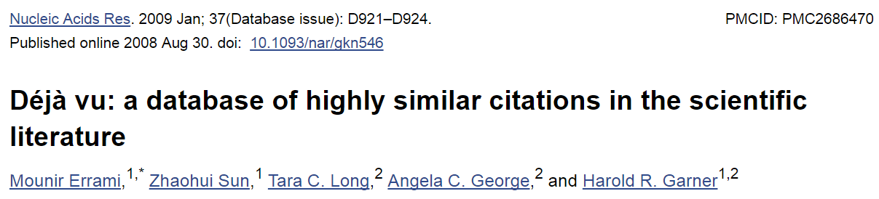
https://www.ncbi.nlm.nih.gov/pmc/articles/PMC2686470/
ABSTRACT
In the scientific research community, plagiarism and covert multiple publications of the same data are considered unacceptable because they undermine the public confidence in the scientific integrity. Yet, little has been done to help authors and editors to identify highly similar citations, which sometimes may represent cases of unethical duplication. For this reason, we have made available Déjà vu, a publicly available database of highly similar Medline citations identified by the text similarity search engine eTBLAST. Following manual verification, highly similar citation pairs are classified into various categories ranging from duplicates with different authors to sanctioned duplicates. Déjà vu records also contain user-provided commentary and supporting information to substantiate each document's categorization. Déjà vu and eTBLAST are available to authors, editors, reviewers, ethicists and sociologists to study, intercept, annotate and deter questionable publication practices. These tools are part of a sustained effort to enhance the quality of Medline as ‘the’ biomedical corpus. The Déjà vu database is freely accessible at http://spore.swmed.edu/dejavu. The tool eTBLAST is also freely available at http://etblast.org.

Slide 38
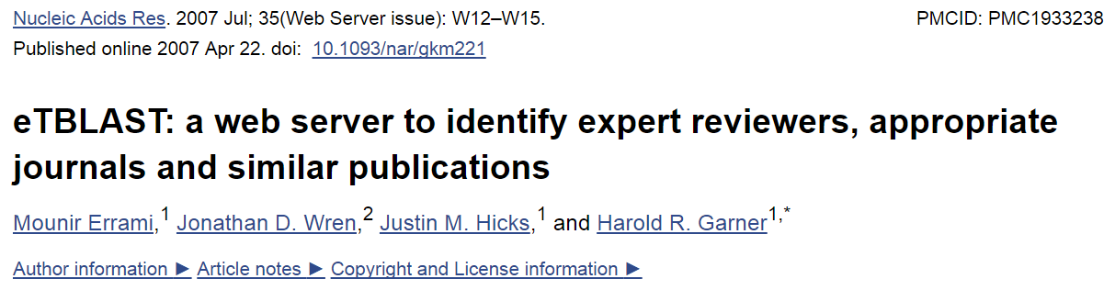
https://www.ncbi.nlm.nih.gov/pmc/articles/PMC1933238/
ABSTRACT
Authors, editors and reviewers alike use the biomedical literature to identify appropriate journals in which to publish, potential reviewers for papers or grants, and collaborators (or competitors) with similar interests. Traditionally, this process has either relied upon personal expertise and knowledge or upon a somewhat unsystematic and laborious process of manually searching through the literature for trends. To help with these tasks, we report three utilities that parse and summarize the results of an abstract similarity search to find appropriate journals for publication, authors with expertise in a given field, and documents similar to a submitted query. The utilities are based upon a program, eTBLAST, designed to identify similar documents within literature databases such as (but not limited to) MEDLINE. These services are freely accessible through the Internet at http://invention.swmed.edu/etblast/etblast.shtml, where users can upload a file or paste text such as an abstract into the browser interface.

Slide 39
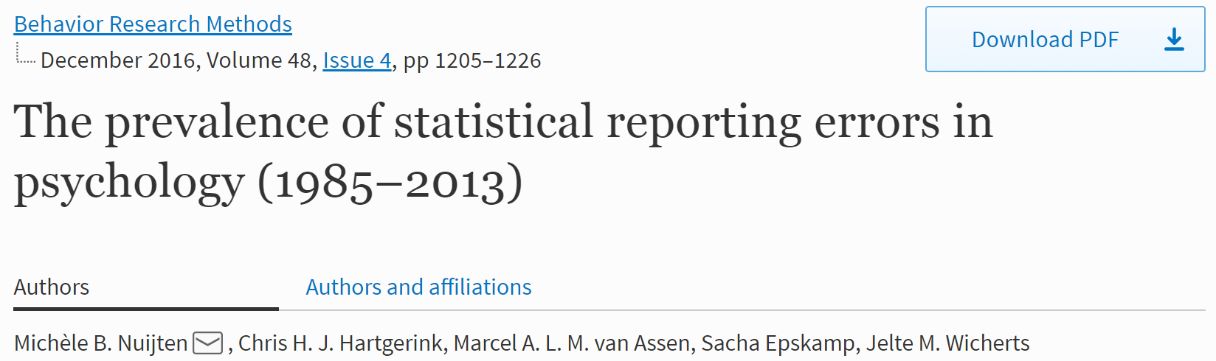
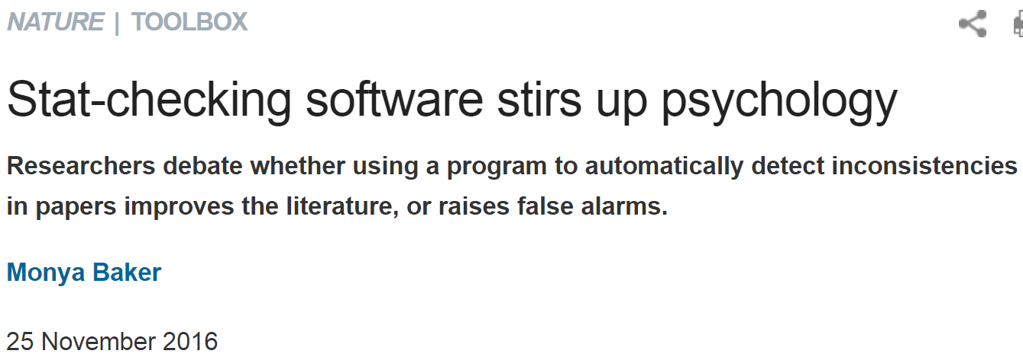
https://link.springer.com/article/10.3758%2Fs13428-015-0664-2
http://www.nature.com/news/stat-checking-software-stirs-up-psychology-1.21049

Slide 40
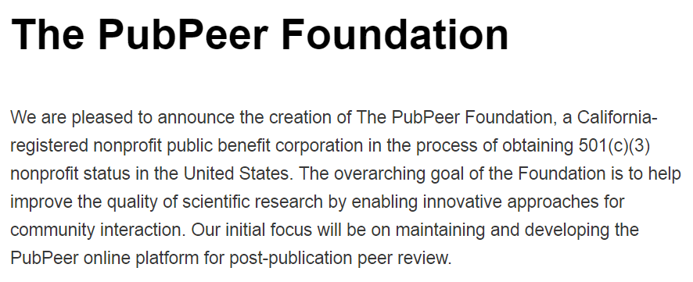
http://blog.pubpeer.com/?p=190

Slide 41
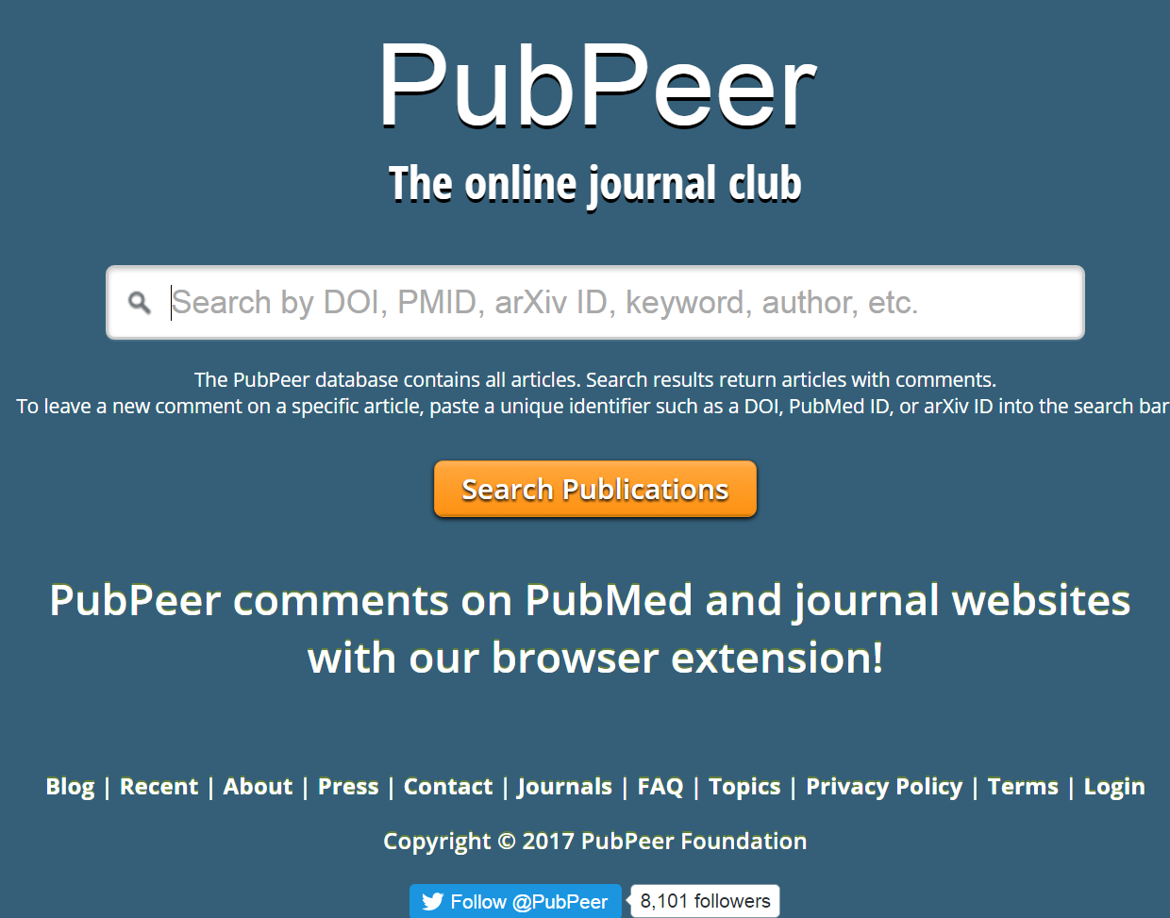
https://pubpeer.com

Slide 42
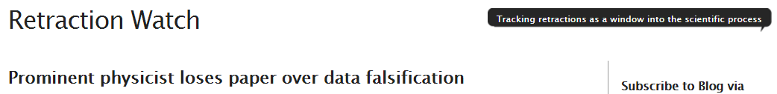
http://retractionwatch.com

Slide 43
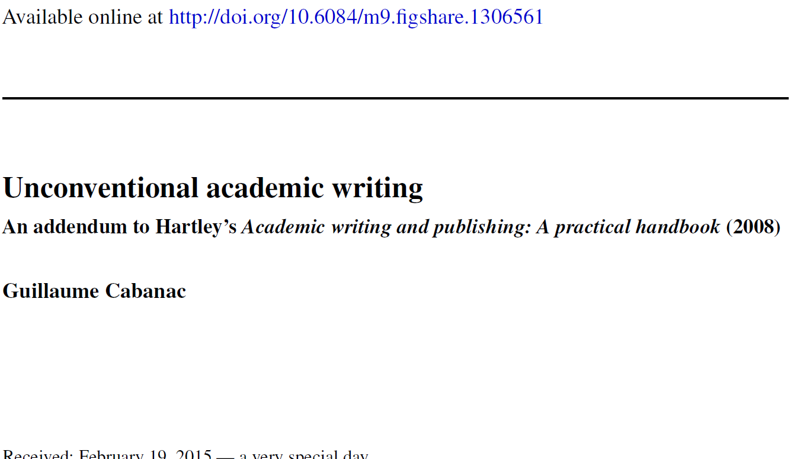

Slide 44
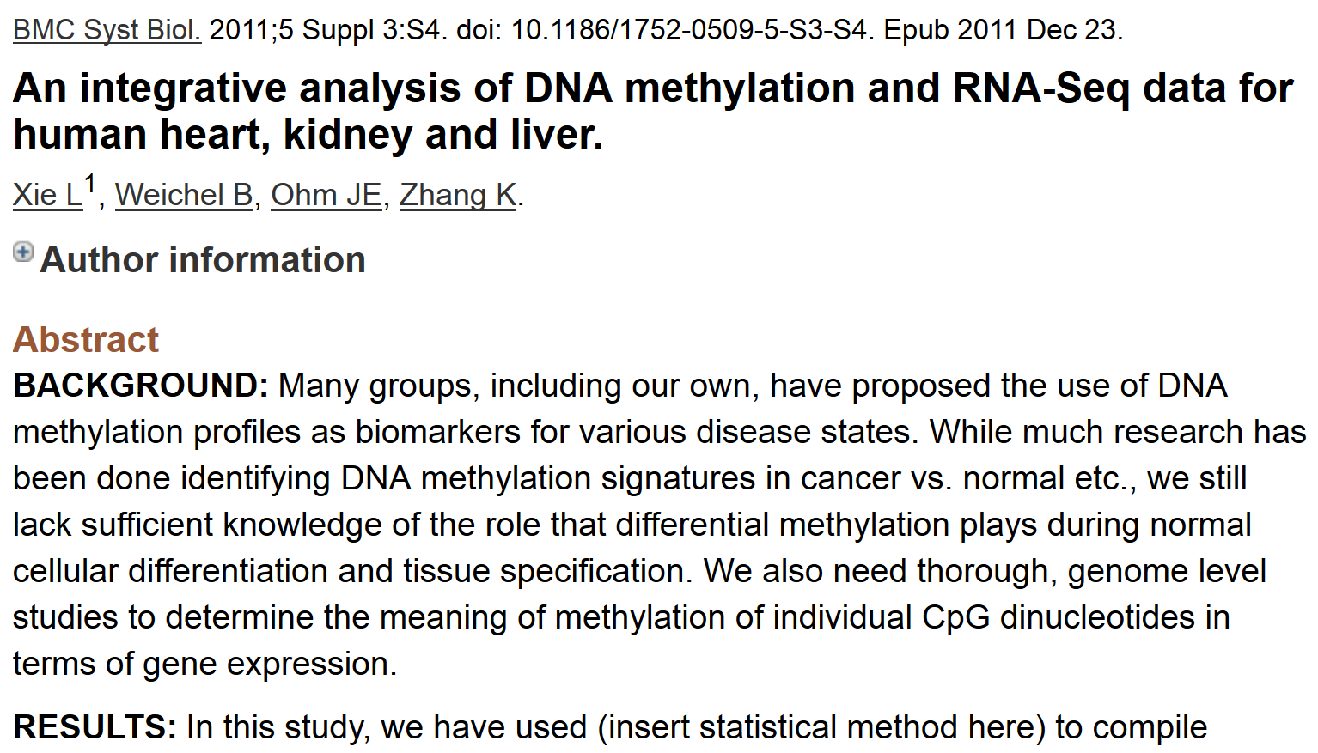
http://www.ncbi.nlm.nih.gov/pubmed/22784623

Slide 45
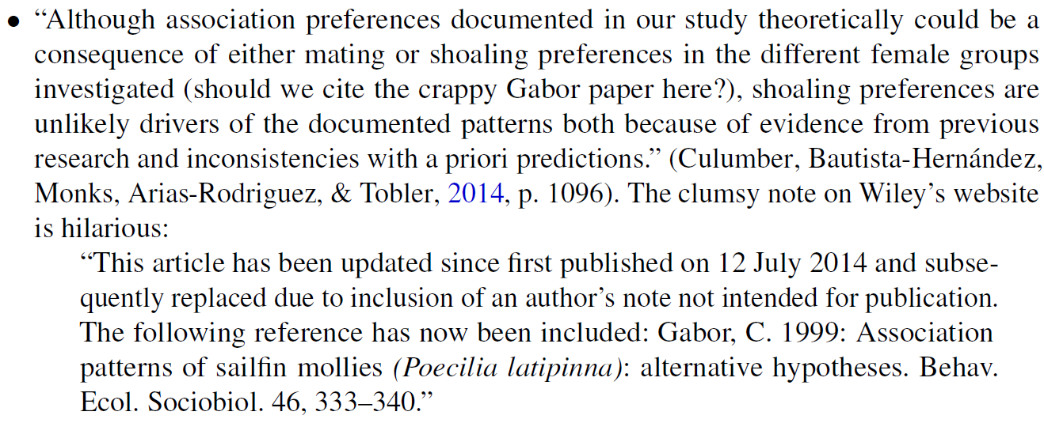

Slide 46
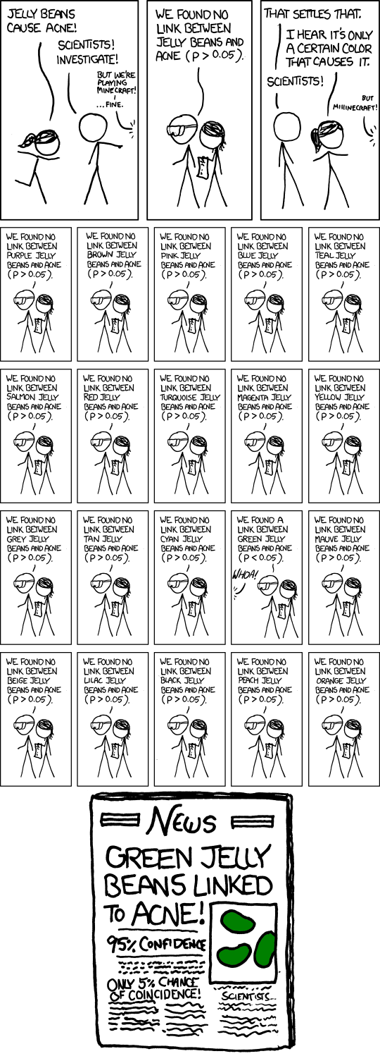
False Positives will occur
https://xkcd.com/882/

Slide 47
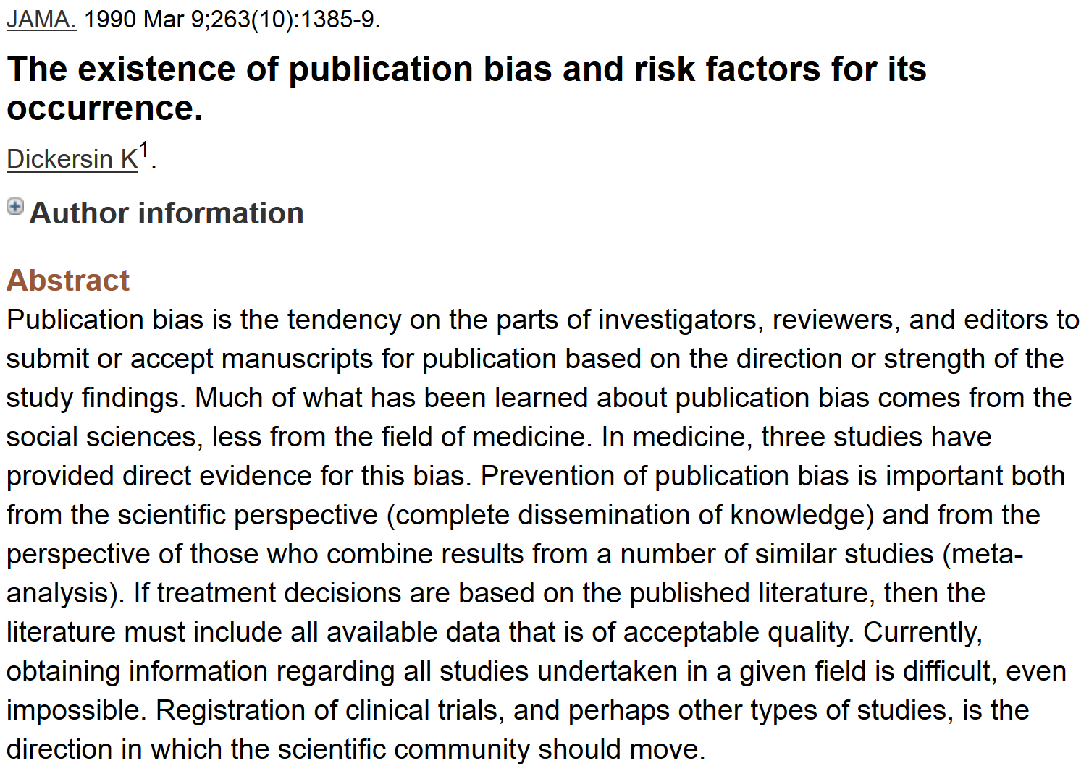
http://www.ncbi.nlm.nih.gov/pubmed/2406472?dopt=Abstract&holding=npg

Slide 48
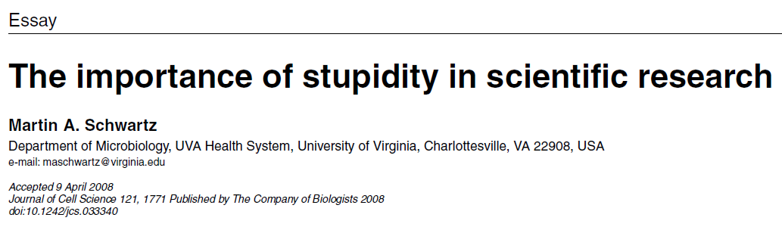
http://jcs.biologists.org/content/121/11/1771
I'd like to suggest that our Ph.D. programs often do students a disservice in two ways. First, I don't think students are made to understand how hard it is to do research. And how very, very hard it is to do important research. It's a lot harder than taking even very demanding courses. What makes it difficult is that research is immersion in the unknown. We just don't know what we're doing. We can't be sure whether we're asking the right question or doing the right experiment until we get the answer or the result.

Slide 49
https://www.ncbi.nlm.nih.gov/pmc/articles/PMC2686470/
ABSTRACT
In the scientific research community, plagiarism and covert multiple publications of the same data are considered unacceptable because they undermine the public confidence in the scientific integrity. Yet, little has been done to help authors and editors to identify highly similar citations, which sometimes may represent cases of unethical duplication. For this reason, we have made available Déjà vu, a publicly available database of highly similar Medline citations identified by the text similarity search engine eTBLAST. Following manual verification, highly similar citation pairs are classified into various categories ranging from duplicates with different authors to sanctioned duplicates. Déjà vu records also contain user-provided commentary and supporting information to substantiate each document's categorization. Déjà vu and eTBLAST are available to authors, editors, reviewers, ethicists and sociologists to study, intercept, annotate and deter questionable publication practices. These tools are part of a sustained effort to enhance the quality of Medline as ‘the’ biomedical corpus. The Déjà vu database is freely accessible at http://spore.swmed.edu/dejavu. The tool eTBLAST is also freely available at http://etblast.org.

Slide 50
https://www.ncbi.nlm.nih.gov/pmc/articles/PMC1933238/
ABSTRACT
Authors, editors and reviewers alike use the biomedical literature to identify appropriate journals in which to publish, potential reviewers for papers or grants, and collaborators (or competitors) with similar interests. Traditionally, this process has either relied upon personal expertise and knowledge or upon a somewhat unsystematic and laborious process of manually searching through the literature for trends. To help with these tasks, we report three utilities that parse and summarize the results of an abstract similarity search to find appropriate journals for publication, authors with expertise in a given field, and documents similar to a submitted query. The utilities are based upon a program, eTBLAST, designed to identify similar documents within literature databases such as (but not limited to) MEDLINE. These services are freely accessible through the Internet at http://invention.swmed.edu/etblast/etblast.shtml, where users can upload a file or paste text such as an abstract into the browser interface.

Slide 51
https://link.springer.com/article/10.3758%2Fs13428-015-0664-2
http://www.nature.com/news/stat-checking-software-stirs-up-psychology-1.21049

Slide 52
https://pubpeer.com

Slide 53
http://blog.pubpeer.com/?p=190

Slide 54
http://www.ncbi.nlm.nih.gov/pubmed/2406472?dopt=Abstract&holding=npg

Slide 55
False Positives will occur
https://xkcd.com/882/

Slide 56
http://jcs.biologists.org/content/121/11/1771
I'd like to suggest that our Ph.D. programs often do students a disservice in two ways. First, I don't think students are made to understand how hard it is to do research. And how very, very hard it is to do important research. It's a lot harder than taking even very demanding courses. What makes it difficult is that research is immersion in the unknown. We just don't know what we're doing. We can't be sure whether we're asking the right question or doing the right experiment until we get the answer or the result.

Slide 57


DNA trivia: Who are the authors of the 1953 paper on DNA with the following quotes:
“DNA is a helical structure”
with “two co-axial molecules.”
“period is 34 Å”
“one repeating unit contains ten
nucleotides on each of two . . . co-axial molecules.'’
“The phosphate groups lie on the outside of the structural unit, on a helix of diameter about 20 Å”
“the sugar and base groups must accordingly be turned inwards towards the helical axis.”

Slide 58




Slide 59



Also published in the same issue of Nature:

Slide 60
If someone gives you data, check with them BEFORE you share it with others.
If it involves human data, you may need approval from the ethics board.
If it involves human data, you may need to keep it secure – i.e, not on an unsecured laptop.

Slide 61




Data is NEVER fully anonymized
http://www.theguardian.com/science/2005/nov/03/genetics.news
http://www.nytimes.com/2014/10/17/opinion/the-dark-market-for-personal-data.html
http://www.nytimes.com/2006/08/09/technology/09aol.html, https://www.sciencemag.org/content/339/6117/262

Slide 62

http://jama.jamanetwork.com/article.aspx?articleid=1690694
JAMA. 2013;309(20):2083-2084. doi:10.1001/jama.2013.5048
“IN MARCH, THE PUBLICATION OF THE complete genome sequence of cancer cells from a Maryland woman who died in 1951 ignited an ethical firestorm. These cells, called HeLa because they were derived from the cervical tumor of Henrietta Lacks, have been widely cultured in laboratories and used in research.”

Slide 63
http://www.nature.com/news/deal-done-over-hela-cell-line-1.13511
1951 Biopsy of Henrietta Lacks’ tumour collected without her knowledge or consent. HeLa cell line soon established.
1971 The journal Obstetrics and Gynecology names Henrietta Lacks as HeLa source; word later spreads in Nature, Science and mainstream press.
1973 Lacks family members learn about HeLa cells. Scientists later collect their blood to map HeLa genes, without proper informed consent.
1996 Lacks family honored at the first annual HeLa Cancer Control Symposium, organized by former student of scientist who isolated HeLa cells.
2013 HeLa genome published without knowledge of the family, which later endorses restricted access to HeLa genome data.

Slide 64

http://www.smithsonianmag.com/science-nature/Henrietta-Lacks-Immortal-Cells.html
…HeLa cells could float on dust particles in the air & travel on unwashed hands and contaminate other cultures. It became an enormous controversy. In the midst of that, one group of scientists tracked down Henrietta’s relatives to take some samples with hopes that they could use the family’s DNA to make a map of Henrietta’s genes so they could tell which cell cultures were HeLa and which weren’t, to begin straightening out the contamination problem.

Slide 65

http://www.nature.com/news/deal-done-over-hela-cell-line-1.13511

Slide 66
http://www.npr.org/blogs/health/2013/01/17/169634045/some-types-of-insurance-can-discriminate-based-on-genes
In the USA, Under GINA (2009), it's (mostly) illegal for
an employer to fire someone based on his genes, and it's illegal for health insurers to raise rates or to deny coverage because of someone's genetic code.
But the law has a loophole: It only applies to health insurance. It doesn't say anything about companies that sell life insurance, disability insurance or long-term-care insurance.”
People who discover they have the gene, ApoE4, associated with Alzheimer’s are 5 times more likely than the average person to go out and buy long-term-care insurance.

Slide 67
http://www.theguardian.com/science/2005/nov/03/genetics.news

Slide 68
The boy took the saliva sample late and sent it off to an online genealogy DNA-testing service.
boy's genetic father had never supplied his DNA
2 men on the database matched his Y-chromosome
The two men did not know each other, but shared a surname, albeit with a different spelling.
genetic similarity of their Y-chromosomes suggested a 50% chance that the 2 men & the boy shared the same father, grandfather or great-grandfather.
bought information on everyone born in the same place and on the same date as his father.

Slide 69
Science 18 January 2013: Vol. 339 no. 6117 p. 262
NEWS & ANALYSIS GENETICS
Genealogy Databases Enable Naming of Anonymous DNA Donors by John Bohannon
Science 18 January 2013: Vol. 339 no. 6117 pp. 321-324
Identifying Personal Genomes by Surname Inference
Melissa Gymrek, Amy L. McGuire, David Golan, Eran Halperin, Yaniv Erlich
able to expose the identity of 50 individuals whose DNA was donated anonymously for scientific study through consortiums such as the 1000 Genomes Project.

Slide 70

http://www.nytimes.com/2016/02/07/opinion/sunday/give-up-your-data-to-cure-disease.html

Slide 71

http://americangut.org

Slide 72

https://fundrazr.com/campaigns/4Tqx5

