Slide 1
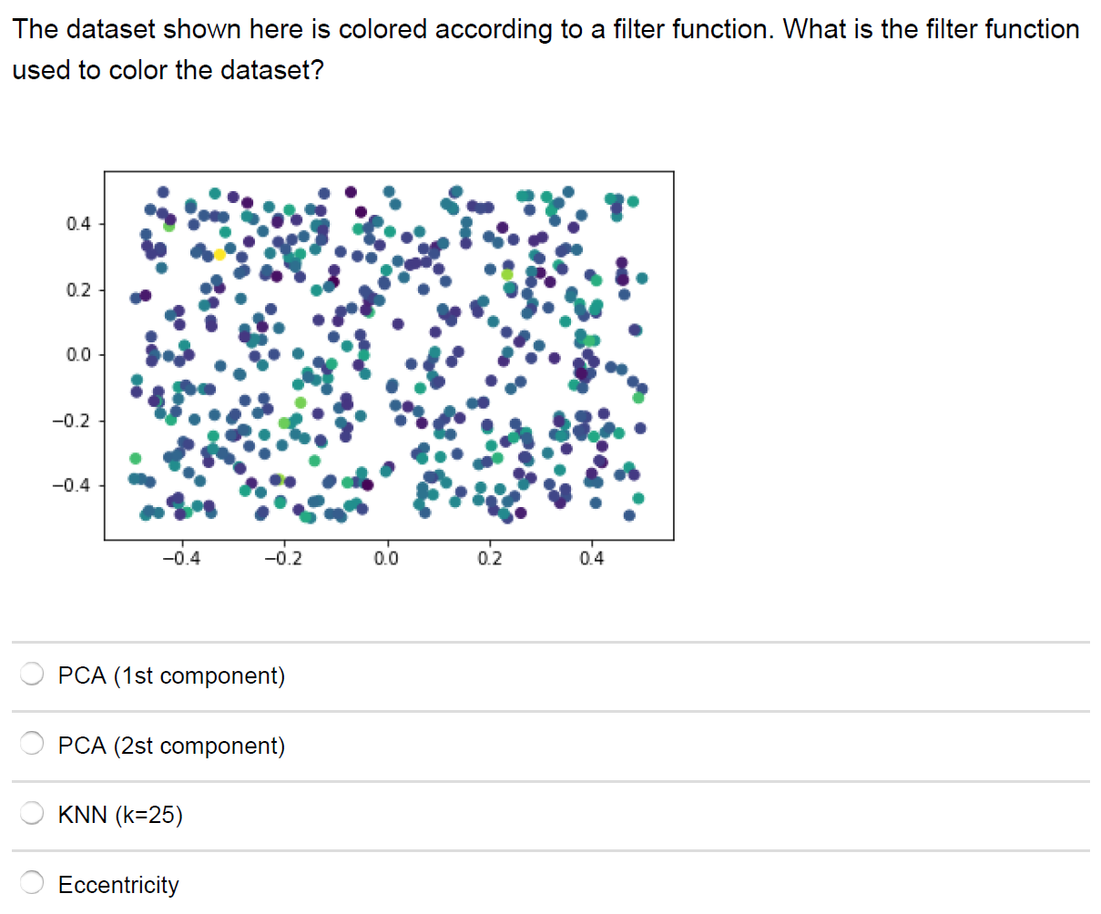

Slide 2
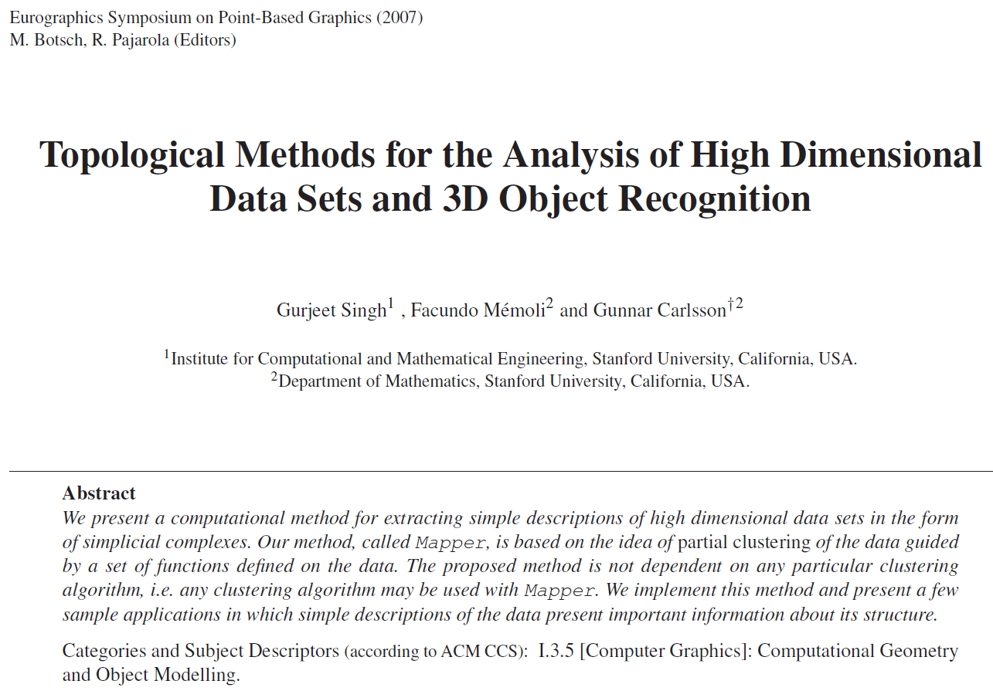
Introduction
The purpose of this paper is to introduce a new method for the qualitative analysis, simplification and visualization of high dimensional data sets, as well as the qualitative analysis of functions on these data sets.

Slide 3
Some quantitative analysis is also possible

Slide 4
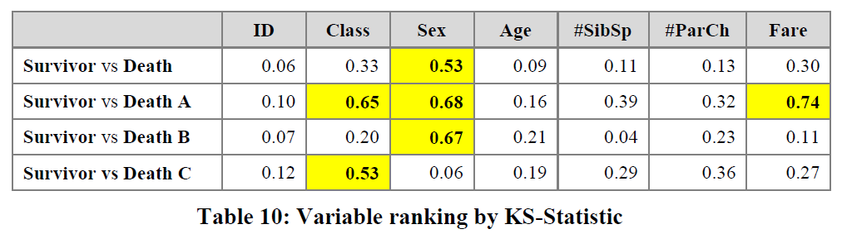
3.2.2.2 Insight by Ranked Variables
Going back to the Titanic example, the result of the KS-statistic show, that the variable “Sex” is the most strongly related to passengers death. We could generally assume that men conceded the places in lifeboats to women. Furthermore, it is feasible to deduct the subtle reasons of the death of each group. The passengers in group A died because of two reasons: they were man and the cabin class type was low. The passengers in the group B died because they were man. Finally, the passengers in the group C died because they were staying at third class even though most of them were women.

Slide 5
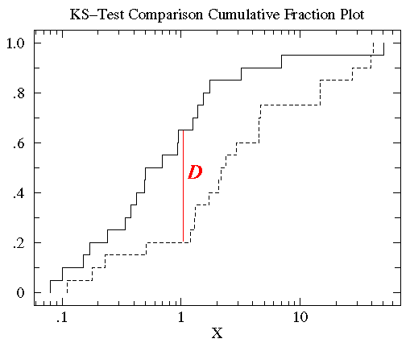
http://www.physics.csbsju.edu/stats/KS-test.html
The KS-test uses the maximum vertical deviation between the two curves as the statistic D. In this case the maximum deviation occurs near x=1 and has D=.45. (The fraction of the treatment group that is less then one is 0.2 (4 out of the 20 values); the fraction of the control group that is less than one is 0.65 (13 out of the 20 values). Thus the maximum difference in cumulative fraction is D=.45.)

Slide 6
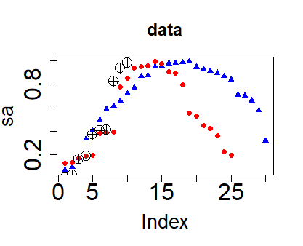
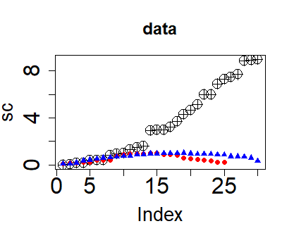
a <- sort(runif(30, 0,3))
sa <-sin(a)
b <- sort(runif(25, 0,3))
sb <-sin(b)
c <- sort(runif(30, 0,3))
sc <- c^2
plot(sa, main = "data", col="blue", pch = 17,
cex.main = 1.5, cex.lab = 1.7, cex.axis = 2)
points(sb, col="red", pch = 19)
points(sc, pch = 10, cex=2)
plot(sc, main = "data", pch = 10,
cex=2, cex.main = 1.5,
cex.lab = 1.7, cex.axis = 2)
points(sb, col="red", pch = 19)
points(sa, col="blue", pch = 17)

Slide 7
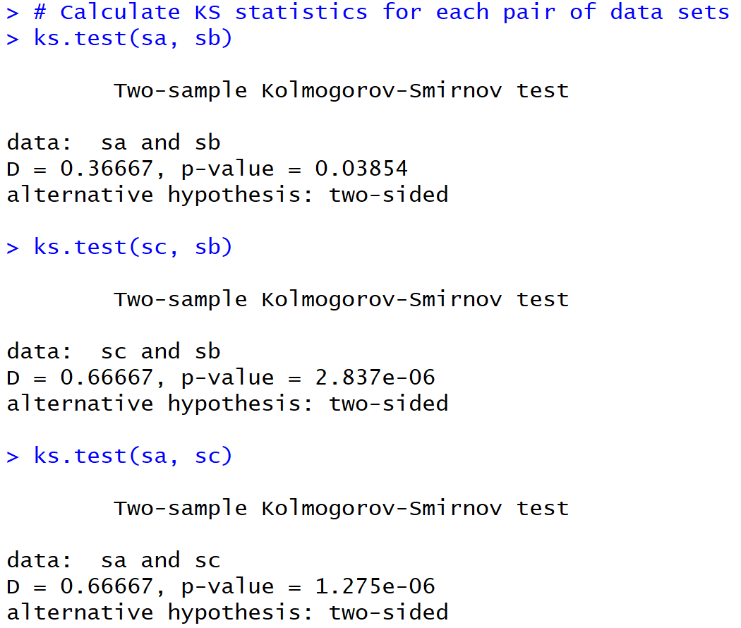
“small D” and “large p” means sa and sb may some from same distribution. But D isn’t that small and p < 0.05
Large D and small p means data come from different distributions
Ex sa and sb consist of points taken from sin curve, while sc consists of points taken from x² curve.

Slide 8
Sample size matters
“small D” and “large p” means sa and sb may some from same distribution. But D isn’t that small and p < 0.05
Large D and small p means data come from different distributions
Ex sa and sb consist of points taken from sin curve, while sc consists of points taken from x² curve.

Slide 9
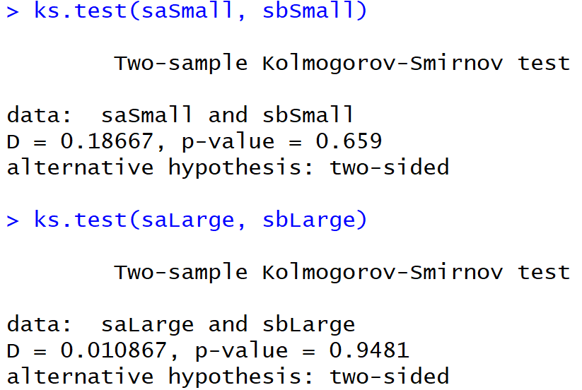
sa and sb consist of points taken from sin curve
Sample size matters
Sample size matters

Slide 10
sa and sb consist of points taken from sin curve
Sample size matters
But can compare samples with different sizes
Sample size matters

Slide 11
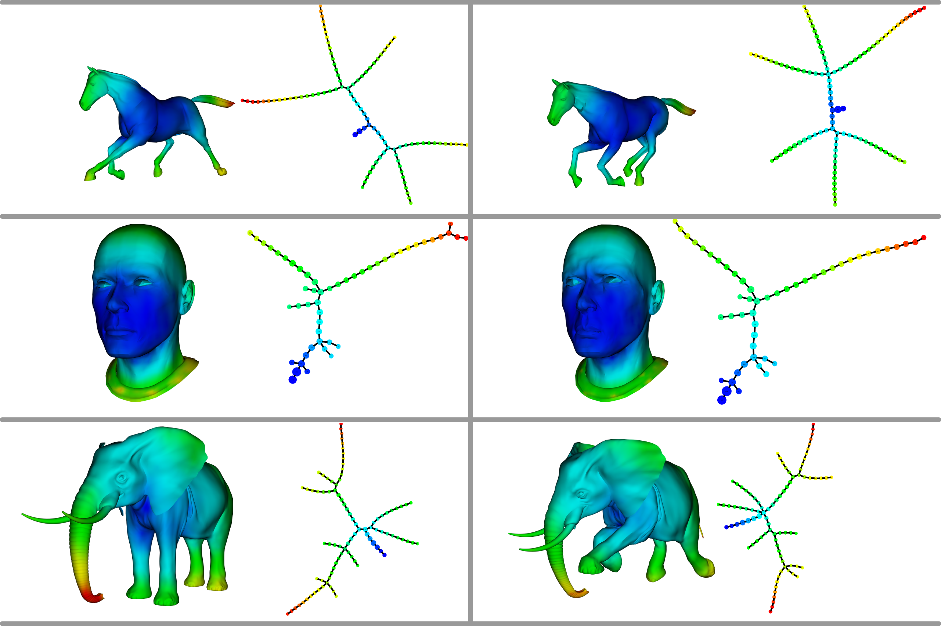
Topological Methods for the Analysis of High Dimensional Data Sets and 3D Object Recognition
Singh, Gurjeet; Memoli, Facundo; Carlsson, Gunnar
http://diglib.eg.org/handle/10.2312/SPBG.SPBG07.091-100

Slide 12
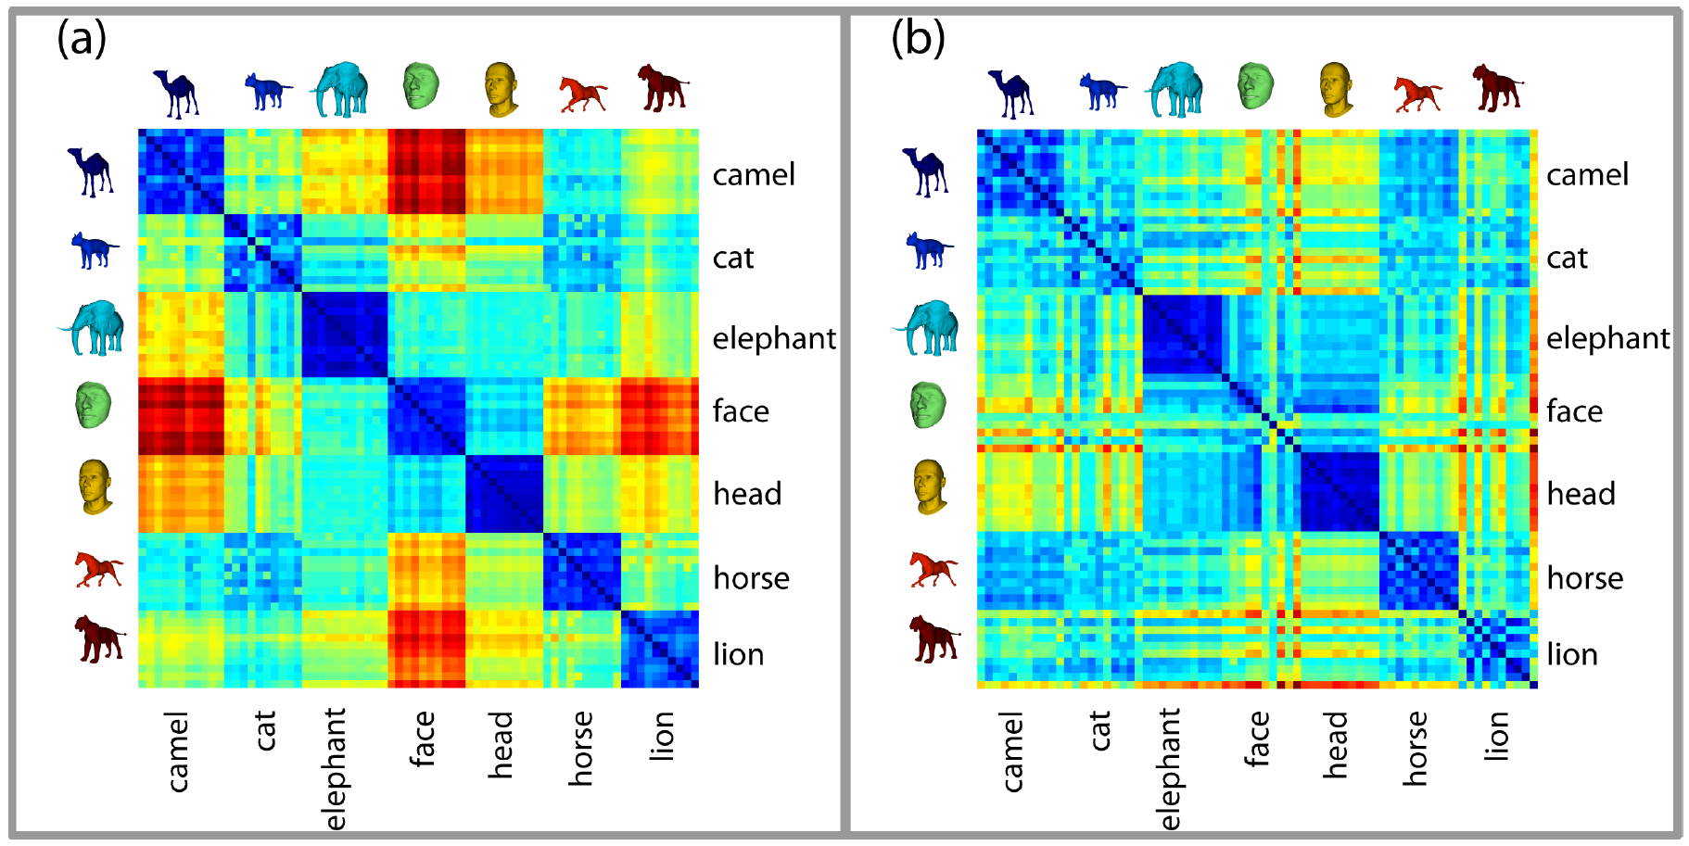
TDA mapper can also be used for classification and/or comparing different data sets via a “good” distance between graphs.
http://diglib.eg.org/handle/10.2312/SPBG.SPBG07.091-100

Slide 13
The idea is to provide another tool for a generalized notion of coordinatization for high dimensional data sets. Coordinatization can of course refer to a choice of real valued coordinate functions on a data set,
http://diglib.eg.org/handle/10.2312/SPBG.SPBG07.091-100

Slide 14
Dimensionality Reduction: Given dataset D R^{N}
Want: embedding f: D → R^{n} where n << N
    which “preserves” the structure of the data.
Many reduction methods:
f₁: D → R, f₂: D → R, … f_{n}: D → R
(f₁, f₂, … f_{n}): D → R^{n}
Many are linear, M: R^{N} → R^{n}, Mx = y
But there are also non-linear dimensionality reduction algorithms.
U

Slide 15
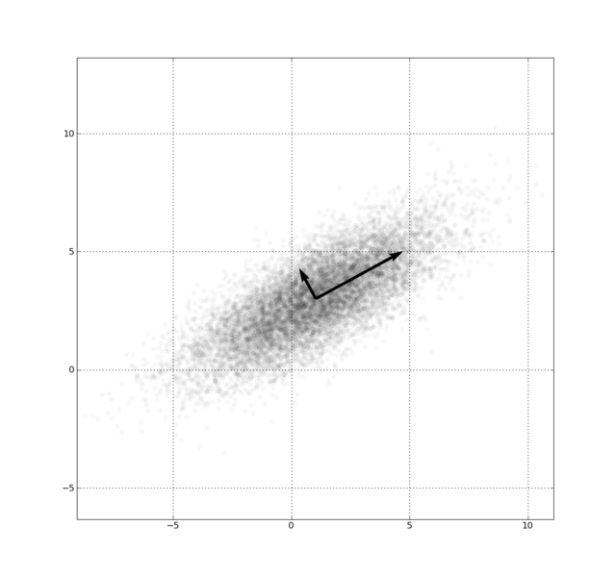
Example: Principle component analysis (PCA)
http://en.wikipedia.org/wiki/File:GaussianScatterPCA.png

Slide 16
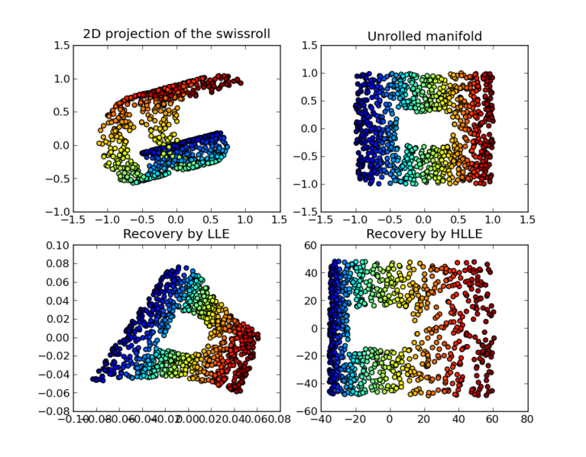
https://en.wikipedia.org/wiki/Nonlinear_dimensionality_reduction

Slide 17
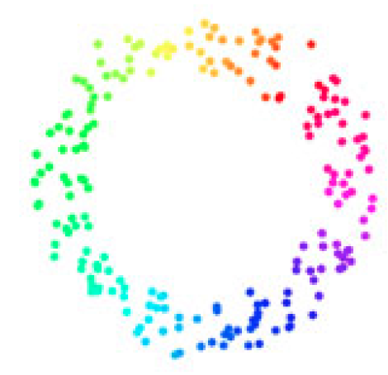
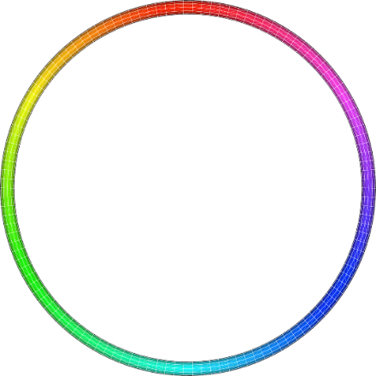
Goal
f: D → S¹ which “preserves” the structure of the data.
circle courtesy of knotplot.com

Slide 18
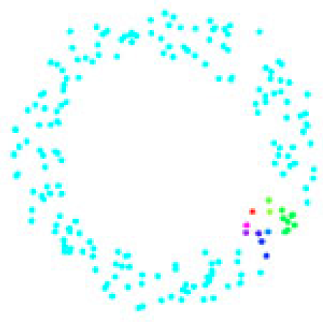
circle courtesy of knotplot.com

Slide 19
The idea is to provide another tool for a generalized notion of coordinatization for high dimensional data sets. Coordinatization can of course refer to a choice of real valued coordinate functions on a data set, but other notions of geometric representation (e.g., the
Reeb graph [Ree46]) are often useful and reflect interesting information more directly.
http://diglib.eg.org/handle/10.2312/SPBG.SPBG07.091-100

Slide 20
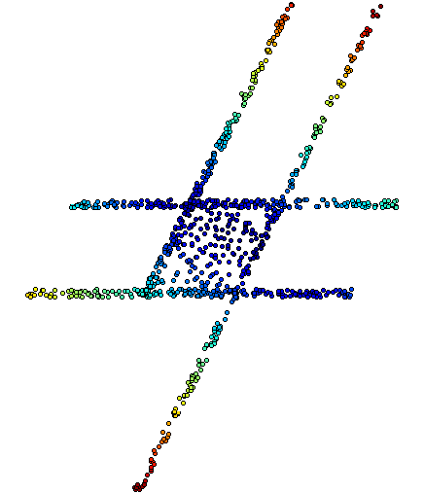
The idea is to provide another tool for a generalized notion of coordinatization for high dimensional data sets. Coordinatization can of course refer to a choice of real valued coordinate functions on a data set,
The graph/simplicial complex created by Mapper can be thought of as a partial coordinization of the data set.
BUT keep in mind that the output is an abstract graph/simplicial complex

Slide 21
Topological Data Analysis (TDA): Three key ideas of topology that make extracting of patterns via shape possible.
1.) coordinate free.
No dependence on the coordinate system chosen.
Can compare data derived from different platforms
vital when one is studying data collected with different technologies, or from different labs when the methodologies cannot be standardized.
http://www.nature.com/srep/2013/130207/srep01236/full/srep01236.html

Slide 22
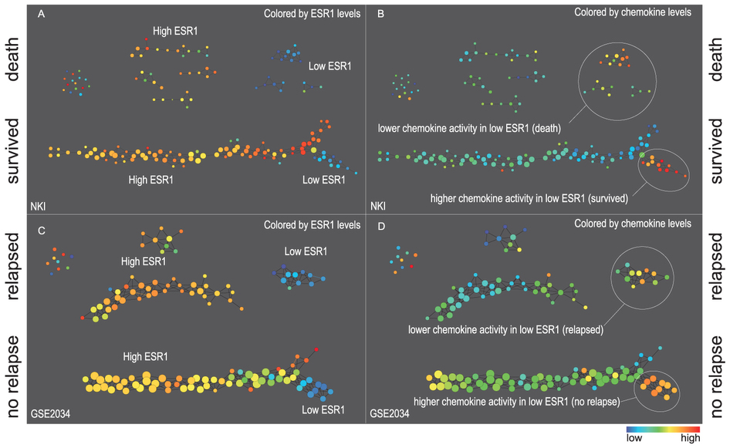
Two filter functions, L-Infinity centrality and survival or relapse were used to generate the networks. The top half of panels A and B are the networks of patients who didn't survive, the bottom half are the patients who survived. Panels C and D are similar to panels A and B except that one of the filters is relapse instead of survival. Panels A and C are colored by the average expression of the ESR1 gene. Panels B and D are colored by the average expression of the genes in the KEGG chemokine pathway. Metric: Correlation; Lens: L-Infinity Centrality (Resolution 70, Gain 3.0x, Equalized) and Event Death (Resolution 30, Gain 3.0x). Color bar: red: high values, blue: low values.
http://www.nature.com/srep/2013/130207/srep01236/full/srep01236.html

Slide 23
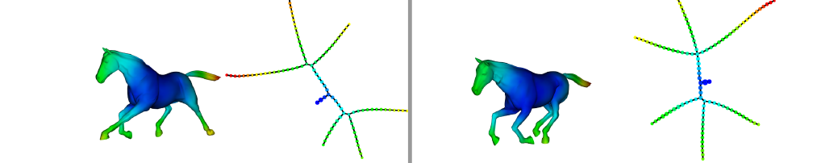
Topological Data Analysis (TDA): Three key ideas of topology that make extracting of patterns via shape possible.
2.) invariant under “small” deformations.
less sensitive to noise
Topological Methods for the Analysis of High Dimensional
Data Sets and 3D Object Recognition, Singh, Mémoli, Carlsson
Figure from http://comptop.stanford.edu/u/preprints/mapperPBG.pdf
http://www.nature.com/srep/2013/130207/srep01236/full/srep01236.html

Slide 24
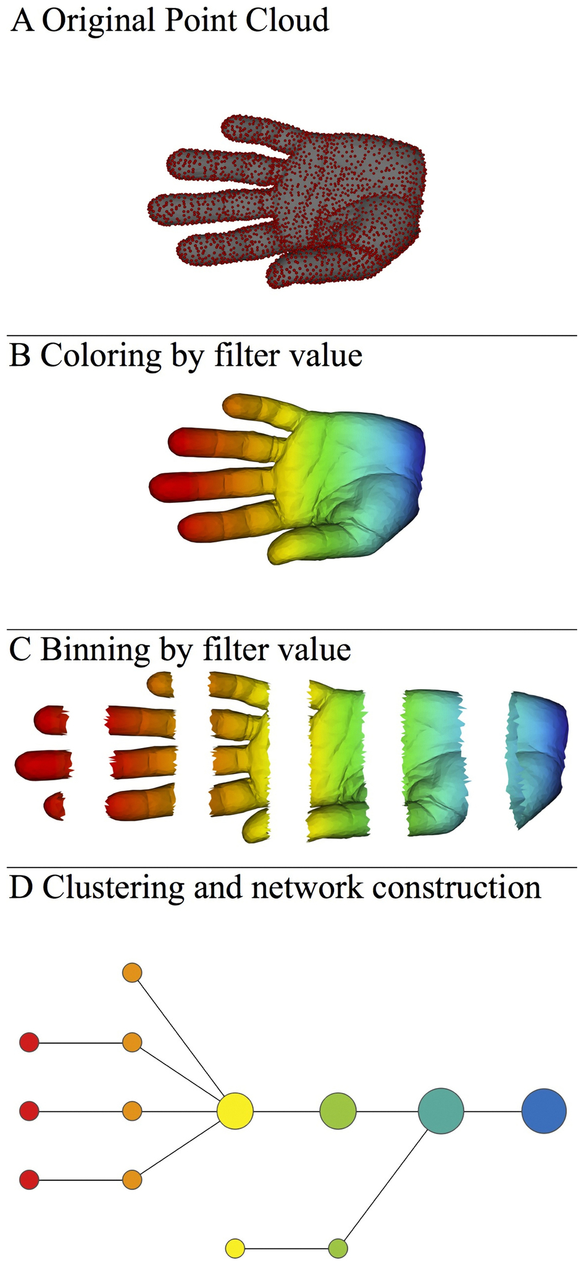
Topological Data Analysis (TDA): Three key ideas of topology that make extracting of patterns via shape possible.
3.) compressed representations of shapes.
Input: dataset with thousands of points
Output: network with
13 vertices and 12 edges.
http://www.nature.com/srep/2013/130207/srep01236/full/srep01236.html

Slide 25
Three key ideas of topology that make extracting of patterns via shape possible.
1.) coordinate free.
No dependence on the coordinate system chosen.
Can compare data derived from different platforms
2.) invariant under “small” deformations.
less sensitive to noise
3.) compressed representations of shapes.
Input: dataset with thousands of points
Output: network with 13 vertices and 12 edges.
TDA mapper benefits
http://www.nature.com/srep/2013/130207/srep01236/full/srep01236.html

Slide 26
Note: we made many, many choices
It helps to know what you are doing when you make choices, so collaborating with others is highly recommended.

Slide 27

We chose how to model the data set
A) Data Set
Example: Point cloud data
representing a hand.
http://www.nature.com/srep/2013/130207/srep01236/full/srep01236.html
Notes:
Be creative. Use ideas from pure and applied math (including stat) as well as area of application
Missing data, noise

Slide 28
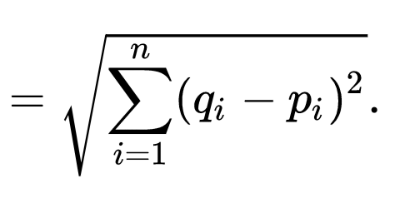

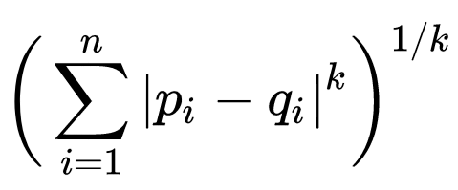

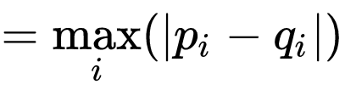
q
d(p, q) = ??
Euclidean
Minkowski distance
Chebyshev distance
5
4
p
3

Slide 29
q
d(p, q) = ??
Euclidean
5
Minkowski distance (k = 1)
7
Chebyshev distance
4
5
4
p
3

Slide 30
In R^{n}
If n small, Euclidean distance often makes sense
If n is large, consider Chebyshev distance or
performing PCA first to project data into R^{d}, for small d
and then using Euclidean distance
Chebyshev distance:

Slide 31
Why use PCA in data analysis?
Consider the points (0, 0, …, 0), (1, 0, …, 0), (10, 0, …, 0)
Add noise to first point (0, 0, …, 0) → (0, 1, …, 1)
In R¹⁰⁰, d((0, 1, …, 1), (1, 0, …, 0)) = 10 > 9.
Add small noise to first point (0, 0, …, 0) → (0, 0.1, …, 0.1)
In R^{39,900}, d((0, 0.1, …, 0.1), (1, 0, …, 0)) = 20 > 9.
0 1 10

Slide 32
But you may want to focus on Euclidean distance AFTER normalizing:
From databasics3900.r:
> # one way to normalize data
> scaledata2 <- scale(data2) # scales data so that mean = 0, sd = 1
> colMeans(scaledata2) # faster version of apply(scaled.dat, 2, mean)
# shows that mean of each column is 0
Sepal.Length Sepal.Width Petal.Length Petal.Width
-4.480675e-16 2.035409e-16 -2.844947e-17 -3.714621e-17
> apply(scaledata2, 2, sd) # shows that standard deviation
# of each column is 1
Sepal.Length Sepal.Width Petal.Length Petal.Width
1 1 1 1
-------------------------------------------------------------------------------------------
P<- select(tbl_df(scaledata2), Petal.Length) # Choose filter
m1 <- mapper1D( # Apply mapper
distance_matrix = dist(data.frame(scaledata2)),
filter_values = P,
num_intervals = 10,
percent_overlap = 50,
num_bins_when_clustering = 10)
# save data to current working
# directory as a text file
write.table(scaledata2, "data.txt", sep=" ",
row.names = FALSE, col.names = FALSE)

Slide 33
Function f : Data Set → R
Ex 1: x-coordinate
f : (x, y, z) → x
Chose filter function
http://www.nature.com/srep/2013/130207/srep01236/full/srep01236.html

Slide 34
Function f : Data Set → R
Ex 1: x-coordinate
f : (x, y, z) → x
Ex 2: y-coordinate
g : (x, y, z) → y
Chose filter function
http://www.nature.com/srep/2013/130207/srep01236/full/srep01236.html

Slide 35
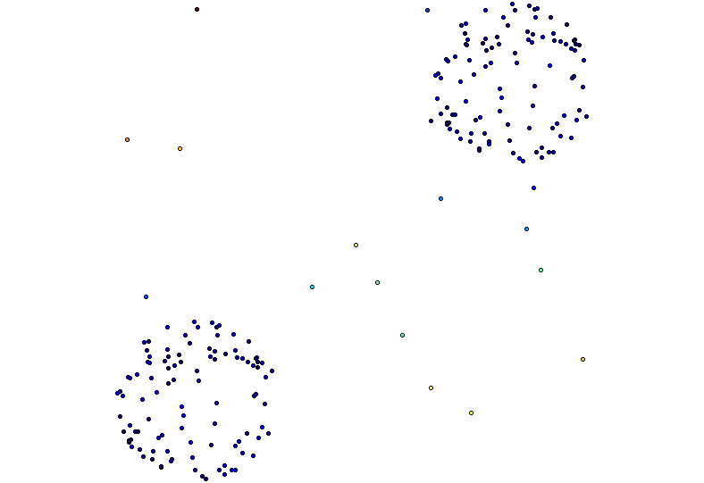
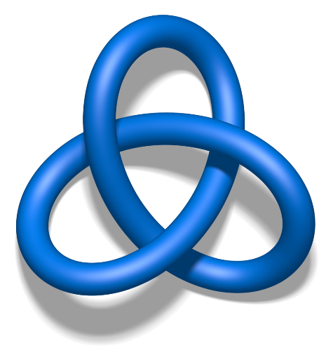
Filter Function
The method begins with a data set X and a real valued function f : X →R, to produce a graph.
This function can be a function which reflects geometric properties of the data set, such as the result of a density estimator, or
In the first case, one is attempting to obtain information
about the qualitative properties of the data set itself,
Are there
Flares?
Topology?
Blobs?
# of components?
http://diglib.eg.org/handle/10.2312/SPBG.SPBG07.091-100

Slide 36
Filter function: eccentricity

Slide 37
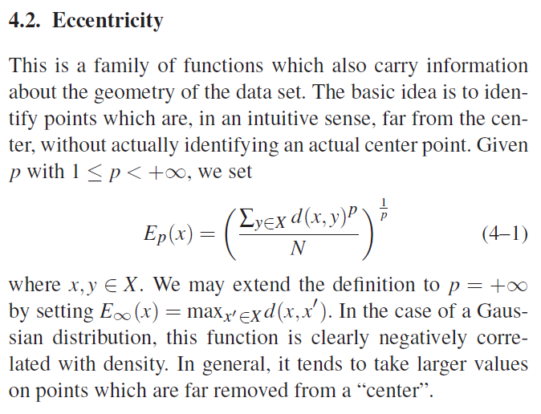
5.3. Mapper on 3D Shape Database
The top row shows the rendering of one model from each of the 7 classes.
The bottom row shows the same model colored by the E1 function
(setting p = 1 in equation 4–1) computed on the mesh.
diglib.eg.org/handle/10.2312/SPBG.SPBG07.091-100

Slide 38
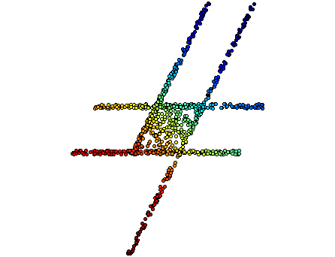
Filter function: PCA

Slide 39
knn distance with k = 5
3 intervals, 50% overlap
[ ( ) ) ]
(

Slide 40
knn distance with k = 5
3 intervals, 50% overlap
[ ( ) ) ]
(
What parameters can we change to improve output??

Slide 41
knn distance with k = 5, 3 intervals, 50% overlap
20% overlap

Slide 42
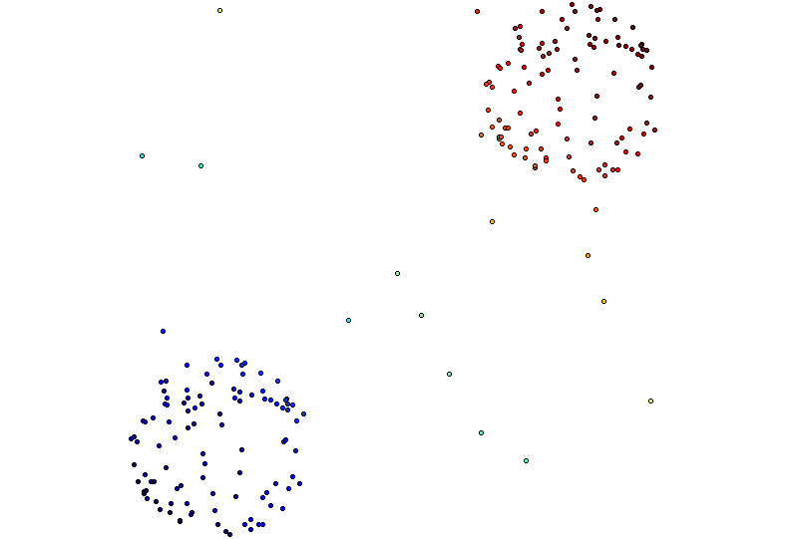
Distance Matrix Eigenvector, Mean Centered Distance Matrix
Order of eigenvector: 0
5 intervals, 50% Overlap

Slide 43

Different types of data sets

Slide 44
Different types of data sets
Some data sets contain background noise

Slide 45
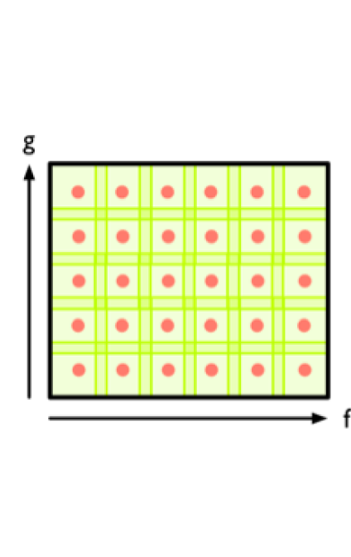
Use multiple filter functions
But for 2 filter functions with n intervals for each = n² bins
And for k filter functions with n intervals for each = n^{k} bins
http://www.nature.com/srep/2013/130207/srep01236/full/srep01236.html

Slide 46
Chose bins
For 1D filter:
Put data into overlapping bins.
Example: f⁻¹(a_{i}, b_{i})
If equal length intervals:
Choose length.
Choose % overlap.
http://www.nature.com/srep/2013/130207/srep01236/full/srep01236.html
Notes:
Need covering Resolution multiscale

Slide 47
We propose a method which can be used to reduce high dimensional data sets into simplicial complexes with far fewer points which can capture topological and geometric information at a specified resolution.
http://diglib.eg.org/handle/10.2312/SPBG.SPBG07.091-100

Slide 48
We propose a method which can be used to reduce high dimensional data sets into simplicial complexes with far fewer points which can capture topological and geometric information at a specified resolution.
Resolution means ????
Which choice refers to resolution?
http://diglib.eg.org/handle/10.2312/SPBG.SPBG07.091-100

Slide 49
This construction produces a “multiresolution" or “multiscale“ image of the data set.
One can actually construct a family of simplicial complexes (graphs in the case of a one-dimensional parameter space), which are viewed as images at varying levels of coarseness,
and maps between them moving from a complex at one resolution to one of coarser resolution.
http://diglib.eg.org/handle/10.2312/SPBG.SPBG07.091-100

Slide 50
knn distance with k = 5, 50% overlap
3 intervals
5 intervals
10 intervals
100 intervals

Slide 51
knn distance with k = 50, 50% overlap
3 intervals
5 intervals
10 intervals
100 intervals

Slide 52
This construction produces a “multiresolution" or “multiscale“ image of the data set.
One can actually construct a family of simplicial complexes (graphs in the case of a one-dimensional parameter space), which are viewed as images at varying levels of coarseness,
and maps between them moving from a complex at one resolution to one of coarser resolution.
http://diglib.eg.org/handle/10.2312/SPBG.SPBG07.091-100

Slide 53
This fact allows one to assess the extent to which features are “real" as opposed to “artifacts", since features which persist over a range of values of the coarseness would be viewed as being less likely to be artifacts.
http://diglib.eg.org/handle/10.2312/SPBG.SPBG07.091-100

Slide 54
Note: Many, many choices were made
“It is useful to think of it as a camera, with lens adjustments and other settings. A different filter function may generate a network with a different shape, thus allowing one to explore the data from a different mathematical perspective.”
False positives vs. robustness
http://www.nature.com/srep/2013/130207/srep01236/full/srep01236.html

Slide 55
We do not attempt to obtain a fully accurate representation of a data set, but rather a low dimensional image which is easy to understand, and which can point to areas of interest.
Note that it is implicit in the method that one fixes a parameter space, and its dimension will be an upper bound on the dimension of the simplicial complex one studies.
As such, it is in a certain way analogous to the idea of a Postnikov tower or the coskeletal filtration in algebraic topology [Hat02].
http://diglib.eg.org/handle/10.2312/SPBG.SPBG07.091-100

Slide 56
Chose how to cluster.
Normally need a definition of distance between data points
Cluster each bin & create network.
Vertex = a cluster of a bin.
Edge = nonempty intersection
between clusters
http://www.nature.com/srep/2013/130207/srep01236/full/srep01236.html

Slide 57
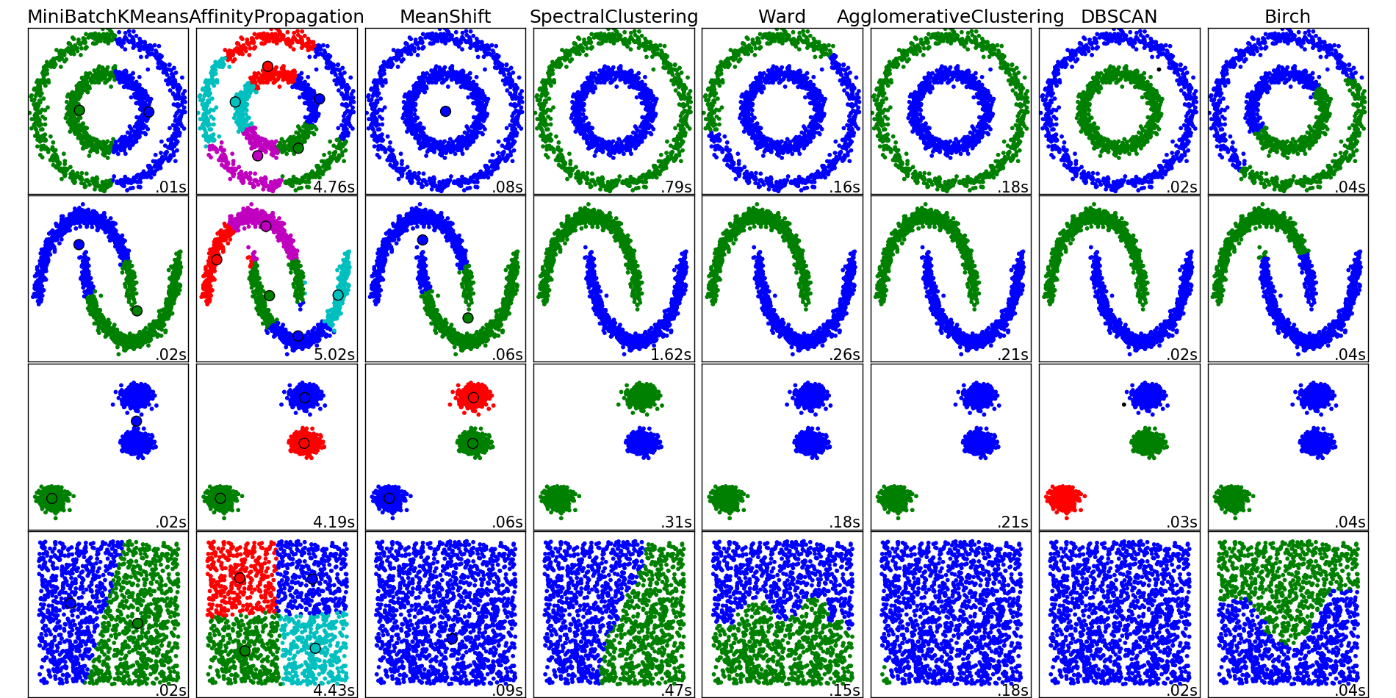
http://scikit-learn.org/stable/auto_examples/cluster/plot_cluster_comparison.html

Slide 58
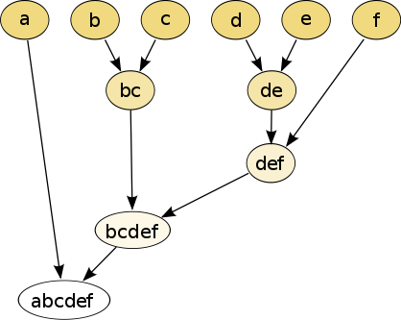
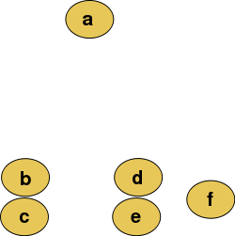
Increasing threshold
Connect vertices whose distance is less than a given threshold
single linkage hierarchical clustering

Slide 59
Increasing threshold
Connect vertices (or clusters) whose distance is less than a given threshold

Slide 60
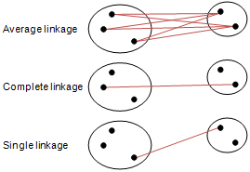
Different type of hierarchical clustering
What is the distance between 2 clusters?
http://en.wikipedia.org/wiki/File:Hierarchical_clustering_simple_diagram.svg
http://www.multid.se/genex/hs515.htm

Slide 61
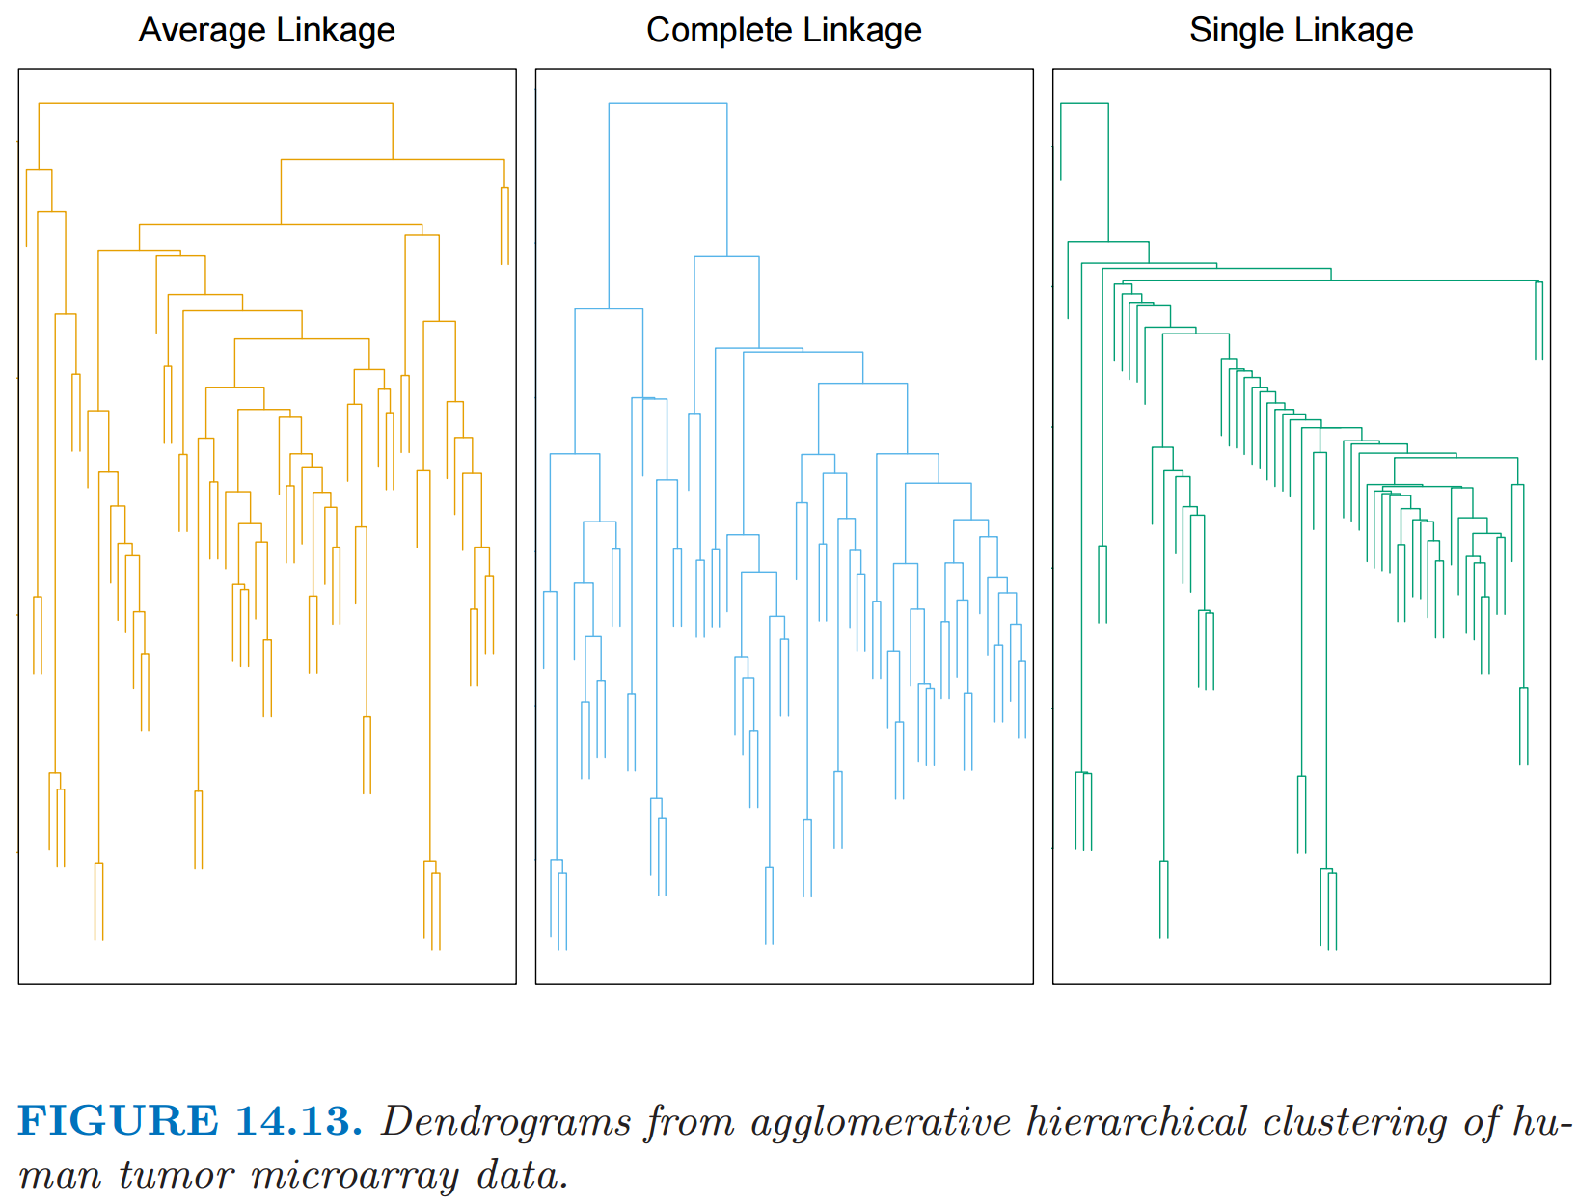
http://statweb.stanford.edu/~tibs/ElemStatLearn/
The Elements of Statistical Learning (2nd edition) Hastie, Tibshirani and Friedman

Slide 62
For hierarchical clustering, choose
Single linkage IF …
Complete or average linkage IF …

Slide 63
For hierarchical clustering, choose
Single linkage IF you are interested in shape
Complete or average linkage IF you are interested in closeness.

Slide 64
http://statweb.stanford.edu/~tibs/ElemStatLearn/
The Elements of Statistical Learning (2nd edition) Hastie, Tibshirani and Friedman

Slide 65
http://statweb.stanford.edu/~tibs/ElemStatLearn/
Where do you cut the dendrogram???
The Elements of Statistical Learning (2nd edition) Hastie, Tibshirani and Friedman

Slide 66
Higher up = fewer clusters
Lower down
= more clusters
http://statweb.stanford.edu/~tibs/ElemStatLearn/
Where do you cut the dendrogram???
The Elements of Statistical Learning (2nd edition) Hastie, Tibshirani and Friedman

Slide 67
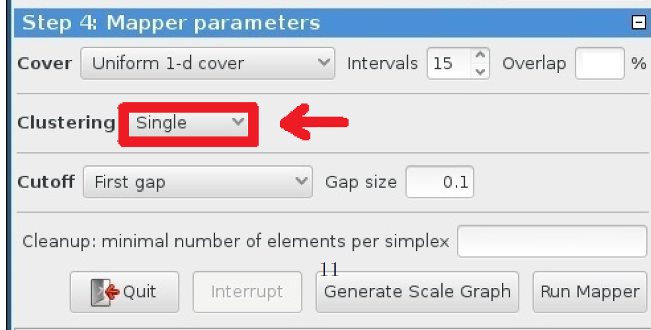


Slide 68
Note: Many, many choices were made
It helps to know what you are doing when you make choices, so collaborating with others is highly recommended.

Slide 69
Note: Many, many choices were made
“It is useful to think of it as a camera, with lens adjustments and other settings. A different filter function may generate a network with a different shape, thus allowing one to explore the data from a different mathematical perspective.”
http://www.nature.com/srep/2013/130207/srep01236/full/srep01236.html

Slide 70
Note: we made many, many choices
“It is useful to think of it as a camera, with lens adjustments and other settings. A different filter function may generate a network with a different shape, thus allowing one to explore the data from a different mathematical perspective.”
False positives???
http://www.nature.com/srep/2013/130207/srep01236/full/srep01236.html

Slide 71
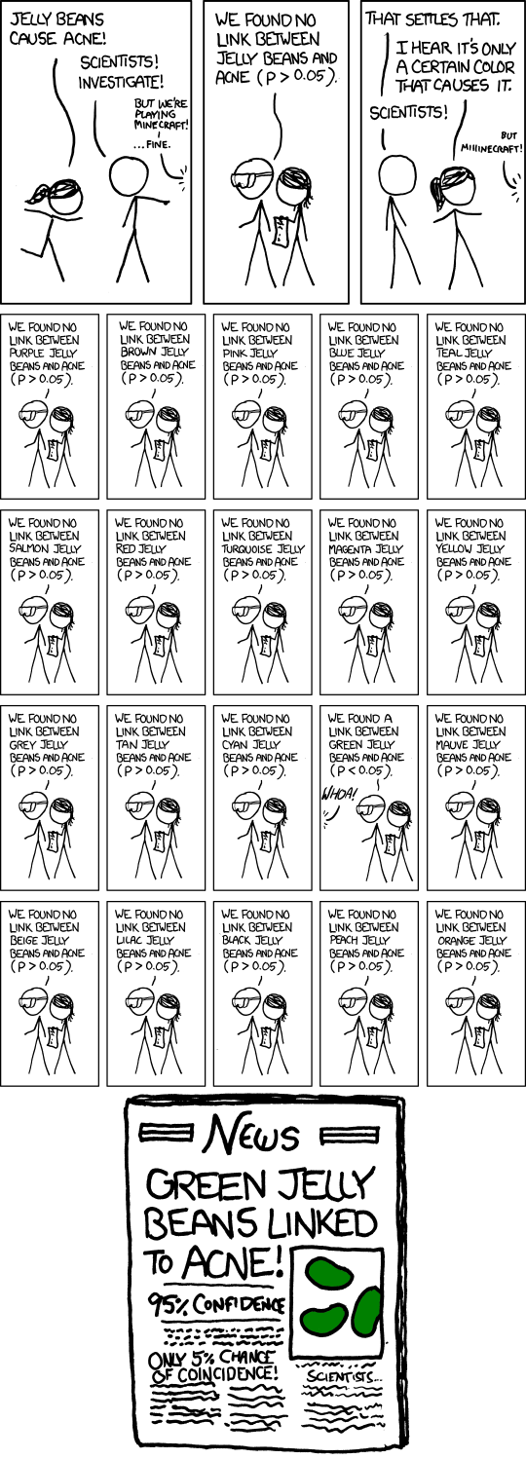
False Positives will occur
https://xkcd.com/882/

Slide 72
Note: Many, many choices were made
“It is useful to think of it as a camera, with lens adjustments and other settings. A different filter function may generate a network with a different shape, thus allowing one to explore the data from a different mathematical perspective.”
False positives vs. robustness
http://www.nature.com/srep/2013/130207/srep01236/full/srep01236.html

Slide 73
Tools to analyze TDA mapper output

Slide 74
3.2.2.2 Insight by Ranked Variables
Going back to the Titanic example, the result of the KS-statistic show, that the variable “Sex” is the most strongly related to passengers death. We could generally assume that men conceded the places in lifeboats to women. Furthermore, it is feasible to deduct the subtle reasons of the death of each group. The passengers in group A died because of two reasons: they were man and the cabin class type was low. The passengers in the group B died because they were man. Finally, the passengers in the group C died because they were staying at third class even though most of them were women.
KS statistic

Slide 75
Coloring
3.2.2.2 Insight by Ranked Variables
Going back to the Titanic example, the result of the KS-statistic show, that the variable “Sex” is the most strongly related to passengers death. We could generally assume that men conceded the places in lifeboats to women. Furthermore, it is feasible to deduct the subtle reasons of the death of each group. The passengers in group A died because of two reasons: they were man and the cabin class type was low. The passengers in the group B died because they were man. Finally, the passengers in the group C died because they were staying at third class even though most of them were women.

Slide 76

“Color ranges over red to blue and it has different meanings, depending on the type of attributes. For the continuous values, color represents an average of value. A red node contains data samples that have higher average values. In contrast, a blue node contains lower average values. In contrast, for the categorical values, color represents a value concentration.”
Analyze your data

Slide 77
Two filter functions, L-Infinity centrality and survival or relapse were used to generate the networks. The top half of panels A and B are the networks of patients who didn't survive, the bottom half are the patients who survived. Panels C and D are similar to panels A and B except that one of the filters is relapse instead of survival. Panels A and C are colored by the average expression of the ESR1 gene. Panels B and D are colored by the average expression of the genes in the KEGG chemokine pathway. Metric: Correlation; Lens: L-Infinity Centrality (Resolution 70, Gain 3.0x, Equalized) and Event Death (Resolution 30, Gain 3.0x). Color bar: red: high values, blue: low values.
http://www.nature.com/srep/2013/130207/srep01236/full/srep01236.html

Slide 78
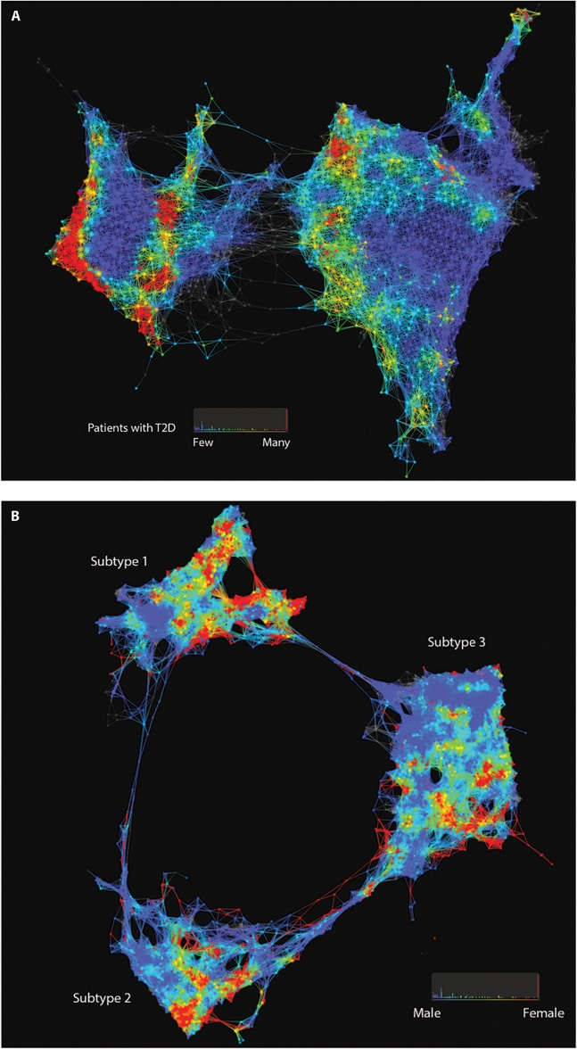

Fig. 1. Patient and genotype networks.
Patient-patient network for topology patterns on 11,210 Biobank patients. Each node represents a single or a group of patients with the significant similarity based on their clinical features. Edge connected with nodes indicates the nodes have shared patients. Red color represents the enrichment for patients with T2D diagnosis, and blue color represents the nonenrichment for patients with T2D diagnosis.
(B) Patient-patient network for topology patterns on 2551 T2D patients. Each node represents a single or a group of patients with the significant similarity based on their clinical
features. Edge connected with nodes indicates the nodes have shared patients. Red color represents the enrichment for patients with females, and blue color represents the enrichment for males.
Li Li et al., Sci Transl Med 2015;7:311ra174
From: http://stm.sciencemag.org/content/7/311/311ra174.full
Published by AAAS
Notes:
Patient and genotype networks. (A) Patient-patient network for topology patterns on 11,210 Biobank patients. Each node represents a single or a group of patients with the significant similarity based on their clinical features. Edge connected with nodes indicates the nodes have shared patients. Red color represents the enrichment for patients with T2D diagnosis, and blue color represents the nonenrichment for patients with T2D diagnosis. (B) Patient-patient network for topology patterns on 2551 T2D patients. Each node represents a single or a group of patients with the significant similarity based on their clinical features. Edge connected with nodes indicates the nodes have shared patients. Red color represents the enrichment for patients with females, and blue color represents the enrichment for males.

Slide 79
Fig. 1. Patient and genotype networks.
Patient-patient network for topology patterns on 11,210 Biobank patients. Each node represents a single or a group of patients with the significant similarity based on their clinical features. Edge connected with nodes indicates the nodes have shared patients. Red color represents the enrichment for patients with T2D diagnosis, and blue color represents the nonenrichment for patients with T2D diagnosis.
(B) Patient-patient network for topology patterns on 2551 T2D patients. Each node represents a single or a group of patients with the significant similarity based on their clinical
features. Edge connected with nodes indicates the nodes have shared patients. Red color represents the enrichment for patients with females, and blue color represents the enrichment for males.
Apply TDA mapper to a subset of your data by selecting
Column value
Grouping of nodes
(nodes = vertices = clusters)
Etc.
Li Li et al., Sci Transl Med 2015;7:311ra174
From: http://stm.sciencemag.org/content/7/311/311ra174.full
Published by AAAS
Notes:
Patient and genotype networks. (A) Patient-patient network for topology patterns on 11,210 Biobank patients. Each node represents a single or a group of patients with the significant similarity based on their clinical features. Edge connected with nodes indicates the nodes have shared patients. Red color represents the enrichment for patients with T2D diagnosis, and blue color represents the nonenrichment for patients with T2D diagnosis. (B) Patient-patient network for topology patterns on 2551 T2D patients. Each node represents a single or a group of patients with the significant similarity based on their clinical features. Edge connected with nodes indicates the nodes have shared patients. Red color represents the enrichment for patients with females, and blue color represents the enrichment for males.

