Slide 1
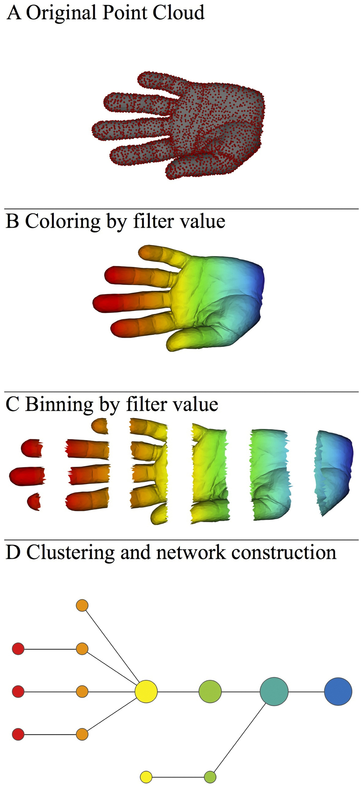
Data Visualization with TDA Mapper
Data Overlapping bins Graph
http://www.nature.com/srep/2013/130207/srep01236/full/srep01236.html

Slide 2
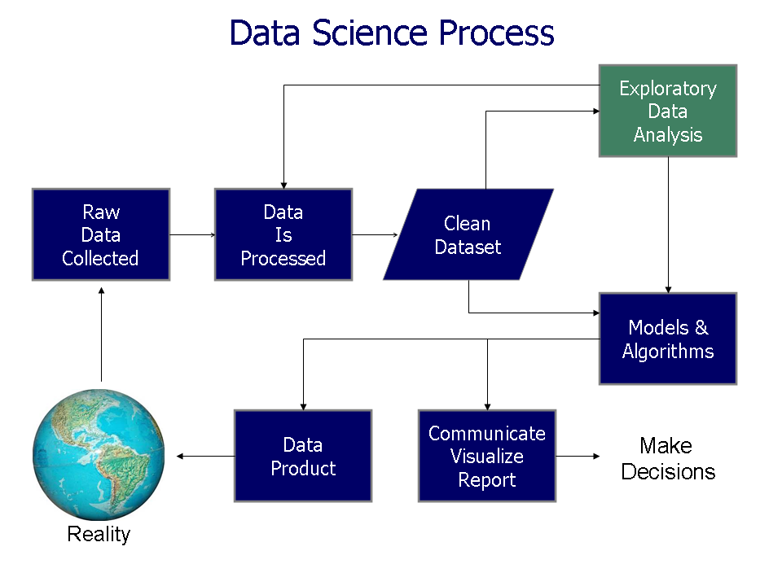
https://commons.wikimedia.org/wiki/File%3AData_visualization_process_v1.png

Slide 3
Data Visualization with TDA Mapper
Data Overlapping bins Graph
http://www.nature.com/srep/2013/130207/srep01236/full/srep01236.html

Slide 4
Data Visualization with TDA Mapper
Course outline:
Most Tuesdays: Lecture in 105 MLH
Most Thursdays: Lab in B5 MLH (basement computer lab)
  Bring a laptop on Thursdays and/or use the computers in B5.
  No computer background required. Mr. Bungula and I will be available to assist you.
  A few advanced labs will be available for those interested.
First 8 weeks: Basic introduction to data analysis focused on understanding the TDA Mapper algorithm:
Last 8 weeks: We will compare data visualization with TDA mapper to other data visualization techniques.
See course website for more info:
http://homepage.divms.uiowa.edu/~idarcy/COURSES/TDA/SPRING18/3900.html

Slide 5
Some journals require an author’s contributions section. For example:
Authors' contributions
CM and JN contributed to the mathematical analysis for applying the coloring invariant. JN also drafted significant portions of the sections The coloring invariants, Tangle generation, Checking the coloring invariants . AP, JS, and TT developed the software implementing the coloring invariant calculations. RM contributed to the Non-drawable section and is responsible for the subroutine which determines if a matrix corresponds to a drawable tangle. He was assisted by ND and JS. JC, ND, SM, and JS developed equivalence moves which were implemented by ND, RM, and JS. ID conceived of and oversaw this project, drafted much of the manuscript, and contributed to the mathematical and software development. All authors read and approved the final manuscript.
https://link.springer.com/article/10.1186/1471-2105-7-435
each student will be graded individually

Slide 6
Consider publishing your work in either a research journal or a journal aimed at students.
This is NOT required.
You will be assigned a writing fellow to help improve your writing.

Slide 7
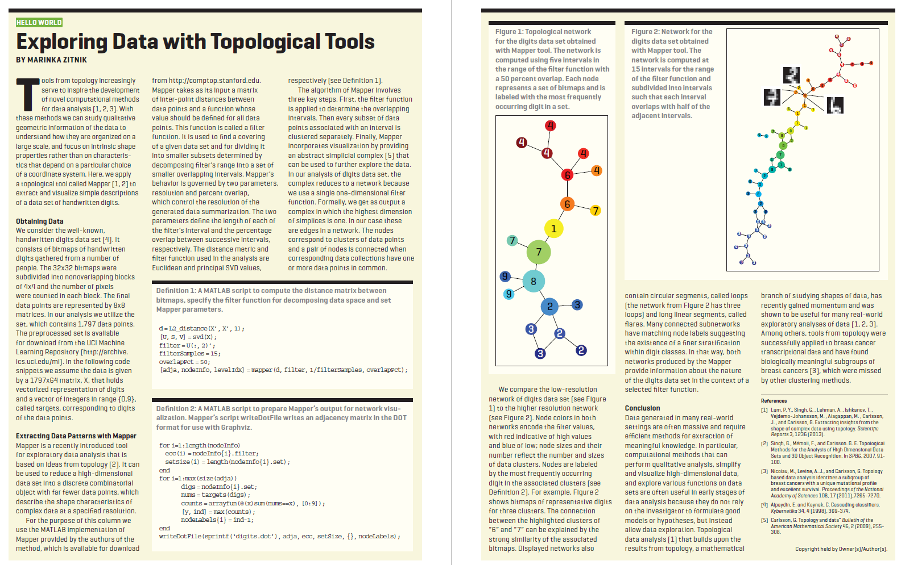
https://dl-acm-org.proxy.lib.uiowa.edu/citation.cfm?id=2634549.2627814&coll=portal&dl=ACM

Slide 8

Mapper
http://cs233.stanford.edu/ReferencedPapers/mapperPBG.pdf

Slide 9
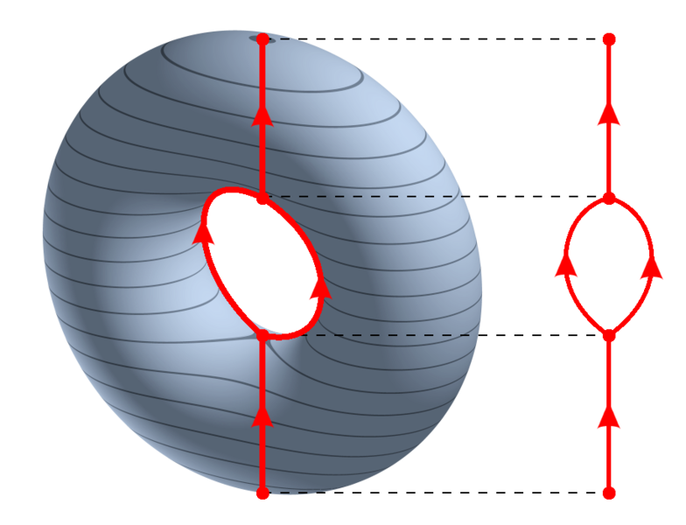
https://en.wikipedia.org/wiki/Reeb_graph

Slide 10
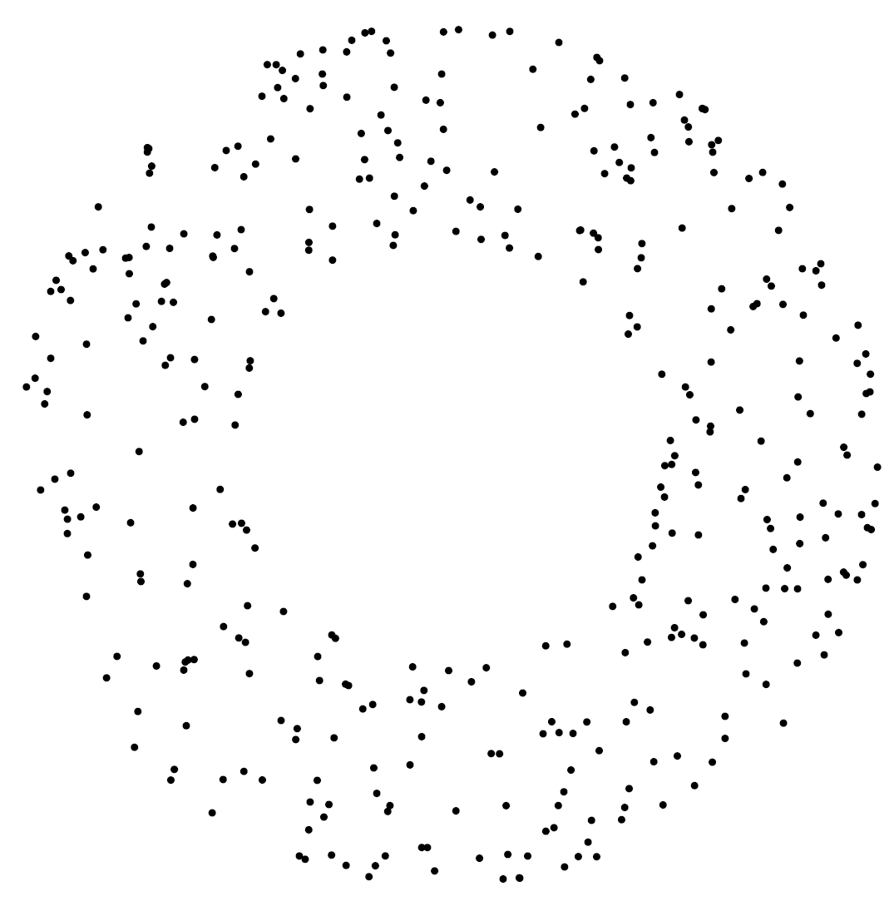
Can you create a similar graph if you have data points that lie on a torus?
How???

Slide 11

http://www.ayasdi.com/

Slide 12
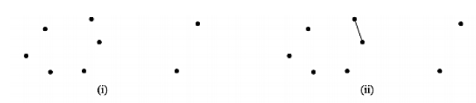
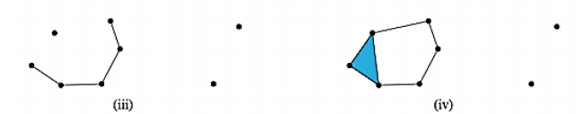
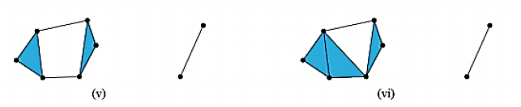
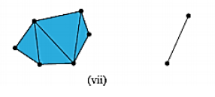

We are not (currently) covering persistent homology including barcodes

Slide 13
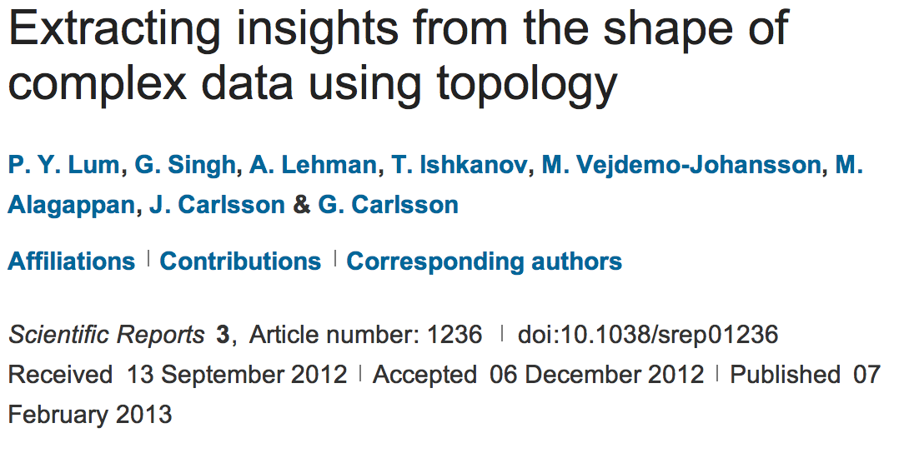
http://www.nature.com/srep/2013/130207/srep01236/full/srep01236.html

Slide 14

A) Data Set
Example: Point cloud data
representing a hand.
B) Function f : Data Set → R
Example: x-coordinate
f : (x, y, z) → x
Put data into overlapping bins.
Example: f⁻¹(a_{i}, b_{i})
Cluster each bin & create network.
Vertex = a cluster of a bin.
Edge = nonempty intersection
between clusters
http://www.nature.com/srep/2013/130207/srep01236/full/srep01236.html

Slide 15
A) Data Set
Example: Point cloud data
representing a hand.
http://www.nature.com/srep/2013/130207/srep01236/full/srep01236.html

Slide 16
Function f : Data Set → R
Ex 1: x-coordinate
f : (x, y, z) → x
http://www.nature.com/srep/2013/130207/srep01236/full/srep01236.html

Slide 17
Function f : Data Set → R
Ex 1: x-coordinate
f : (x, y, z) → x
http://www.nature.com/srep/2013/130207/srep01236/full/srep01236.html

Slide 18
Put data into overlapping bins.
Example: f⁻¹(a_{i}, b_{i})
( ( ) ( ) ( ) ( ) ( ) )
Function f : Data Set → R
Ex 1: x-coordinate
f : (x, y, z) → x
http://www.nature.com/srep/2013/130207/srep01236/full/srep01236.html

Slide 19
Put data into overlapping bins.
Example: f⁻¹(a_{i}, b_{i})
( ( ) ( ) ( ) ( ) ( ) )
Function f : Data Set → R
Ex 1: x-coordinate
f : (x, y, z) → x
http://www.nature.com/srep/2013/130207/srep01236/full/srep01236.html

Slide 20
D) Cluster each bin
http://www.nature.com/srep/2013/130207/srep01236/full/srep01236.html
Notes:
Need covering Resolution multiscale

Slide 21
D) Cluster each bin
Vertex = a cluster of a bin.
http://www.nature.com/srep/2013/130207/srep01236/full/srep01236.html
Notes:
Need covering Resolution multiscale

Slide 22
D) Cluster each bin
& create network.
Vertex = a cluster of a bin.
Edge = nonempty intersection
between clusters
http://www.nature.com/srep/2013/130207/srep01236/full/srep01236.html
Notes:
Need covering Resolution multiscale

Slide 23
D) Cluster each bin
& create network.
Vertex = a cluster of a bin.
Edge = nonempty intersection
between clusters
http://www.nature.com/srep/2013/130207/srep01236/full/srep01236.html
Notes:
Need covering Resolution multiscale

Slide 24
A) Data Set
Example: Point cloud data
representing a hand.
B) Function f : Data Set → R
Example: x-coordinate
f : (x, y, z) → x
Put data into overlapping bins.
Example: f⁻¹(a_{i}, b_{i})
Cluster each bin & create network.
Vertex = a cluster of a bin.
Edge = nonempty intersection
between clusters
http://www.nature.com/srep/2013/130207/srep01236/full/srep01236.html

Slide 25
In the next few examples, please note
The different types of data to which we can apply TDA mapper.
Several choices need to be made when applying TDA mapper. For example:
  How is the data modeled including how is the distance between data points calculated?
  How are the data put into overlapping bins?
Data Overlapping bins Graph
http://www.nature.com/srep/2013/130207/srep01236/full/srep01236.html

Slide 26

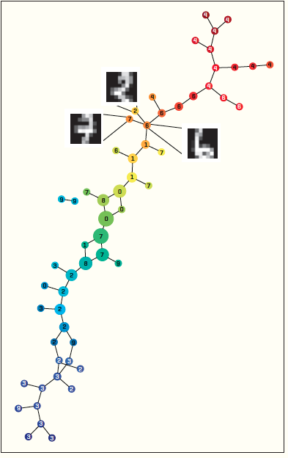
https://dl-acm-org/citation.cfm?id=2634549.2627814&coll=portal&dl=ACM
XRDS • SUMMER 2014 • VOL .20 • NO.4

Slide 27
https://dl-acm-org.proxy.lib.uiowa.edu/citation.cfm?id=2634549.2627814&coll=portal&dl=ACM

Slide 28
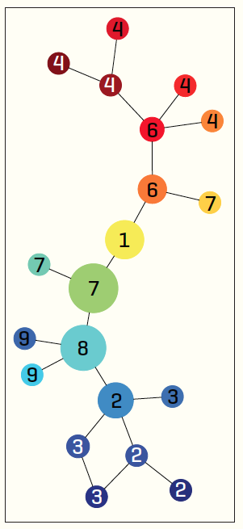
1,797 data points
data point:
8x8 matrix
Distance metric:
Euclidean
Filter function:
principal SVD values
Node colors:
filter values,
red = high and
blue = low
Nodes labels:
most frequently occurring digit in the associated clusters
5 intervals with 50 percent overlap.
15 intervals with 50 percent overlap.

Slide 29

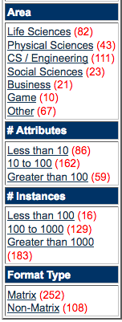
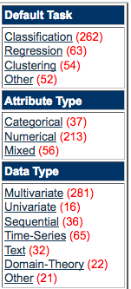
We currently maintain 412 data sets as a service to the machine learning community.
http://archive.ics.uci.edu/ml/index.php

Slide 30
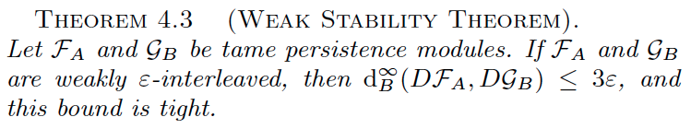
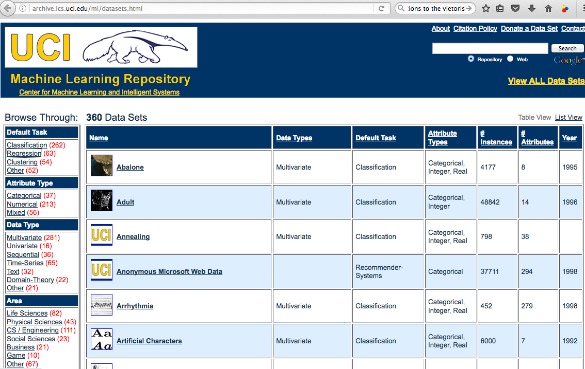
http://archive.ics.uci.edu/ml/datasets.html

Slide 31
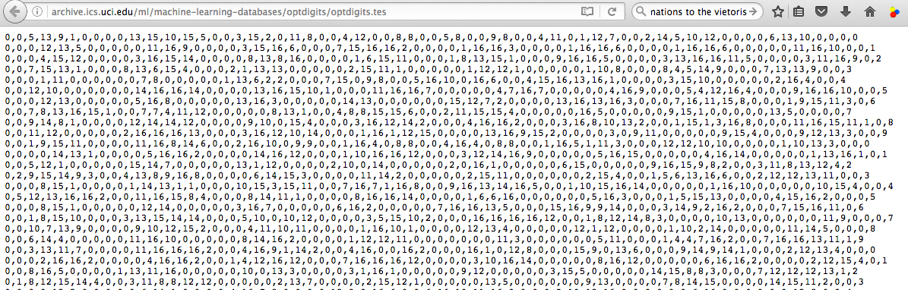
http://archive.ics.uci.edu/ml/datasets/Optical+Recognition+of+Handwritten+Digits
http://archive.ics.uci.edu/ml/machine-learning-databases/optdigits/
http://archive.ics.uci.edu/ml/machine-learning-databases/optdigits/optdigits.names
http://archive.ics.uci.edu/ml/machine-learning-databases/optdigits/optdigits.tes
5. Number of Instances
optdigits.tra Training 3823
optdigits.tes Testing 1797

Slide 32
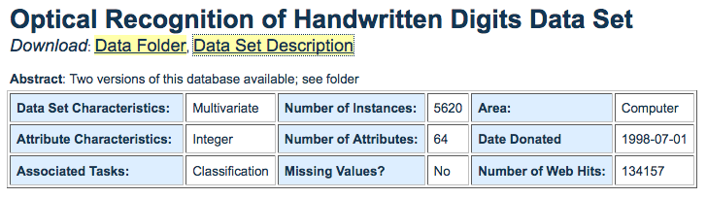
Source: E. Alpaydin, C. Kaynak, Department of Computer Engineering, Bogazici University, 80815 Istanbul Turkey, alpaydin '@' boun.edu.tr
Data Set Information: We used preprocessing programs made available by NIST to extract normalized bitmaps of handwritten digits from a preprinted form. From a total of 43 people, 30 contributed to the training set and different 13 to the test set. 32x32 bitmaps are divided into nonoverlapping blocks of 4x4 and the number of on pixels are counted in each block. This generates an input matrix of 8x8 where each element is an integer in the range 0..16. This reduces dimensionality and gives invariance to small distortions.
For info on NIST preprocessing routines, see M. D. Garris, J. L. Blue, G. T. Candela, D. L. Dimmick, J. Geist, P. J. Grother, S. A. Janet, and C. L. Wilson, NIST Form-Based Handprint Recognition System, NISTIR 5469, 1994.
Attribute Information: All input attributes are integers in the range 0..16.
The last attribute is the class code 0..9

Slide 33
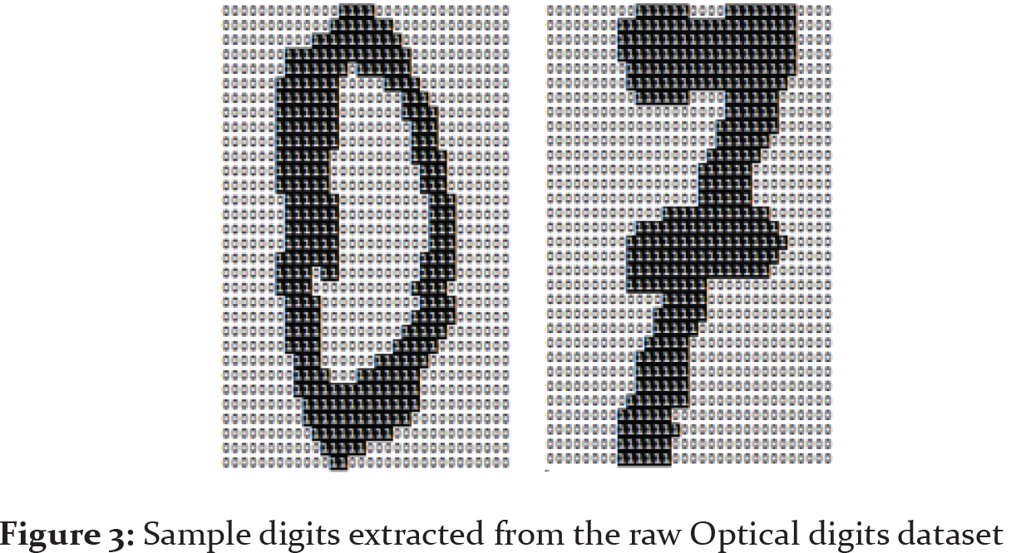
http://scientificpapers.org/wp- content/files/1345_Proposing_a_New_Framework_
for_Biometric_Optical_Recognition_for_Handwritten_Digits_Data_Set.pdf

Slide 34
http://scientificpapers.org/wp- content/files/1345_Proposing_a_New_Framework_
for_Biometric_Optical_Recognition_for_Handwritten_Digits_Data_Set.pdf

Slide 35
(0, 1, 6,15,12,1, 0, 0,…
http://scientificpapers.org/wp- content/files/1345_Proposing_a_New_Framework_
for_Biometric_Optical_Recognition_for_Handwritten_Digits_Data_Set.pdf

Slide 36
http://archive.ics.uci.edu/ml/datasets/Optical+Recognition+of+Handwritten+Digits
http://archive.ics.uci.edu/ml/machine-learning-databases/optdigits/
http://archive.ics.uci.edu/ml/machine-learning-databases/optdigits/optdigits.names
http://archive.ics.uci.edu/ml/machine-learning-databases/optdigits/optdigits.tes
5. Number of Instances
optdigits.tra Training 3823
optdigits.tes Testing 1797

Slide 37
1,797 data points
data point:
8x8 matrix
Distance metric:
Euclidean
Filter function:
principal SVD values
Node colors:
filter values,
red = high and
blue = low
Nodes labels:
most frequently occurring digit in the associated clusters
5 intervals with 50 percent overlap.
15 intervals with 50 percent overlap.

Slide 38
Goals for Thursday’s lab (meet in basement B5 MLH):
1.) Learn basics of R/Rstudio.
  lap1.pptx: Instructions on installing and working with R/Rstudio.
  Matrices_and_Data_Frames.R: commands from the Swirl course
                by this name.
  uploadDatatoRetc.R: commands for reading data into R.
also includes commands taken from the Swirl course
Manipulating data with dplyr - Getting and Cleaning Data.
createArtificalDataSets.r: various ways to create artificial data.
2.) Play with the TDA mapper R package (focus on artificial data).
TDAmapper.r: Modify this script by changing parameters and
            applying TDA mapper to a variety of data sets
    Create slides for some of these data sets. Follow the format in sample slide, sample.pptx
3.) Start draft of a poster on TDA mapper (Template Examples.pptx). See also Making A Poster_0.pdf both from ICRU)

Slide 39

To understand software, it helps to apply it to a variety of examples.
HW: If data points lived on the above objects,
what graph do you get when you apply mapper to these date sets if filter = projection to x-axis?

Slide 40
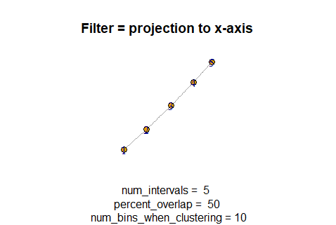
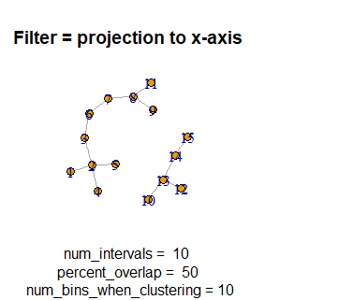
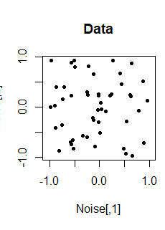
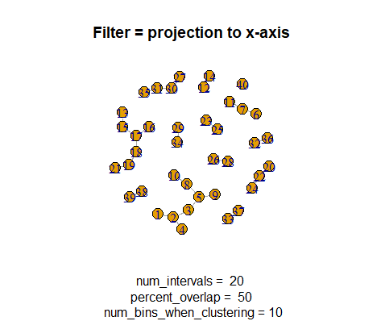
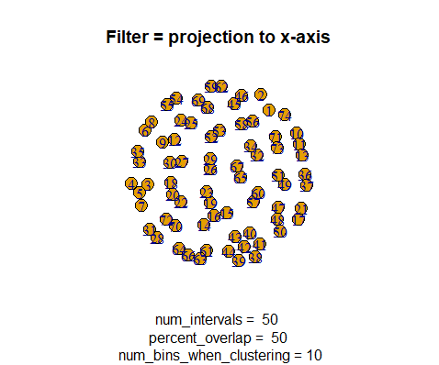

Slide 41
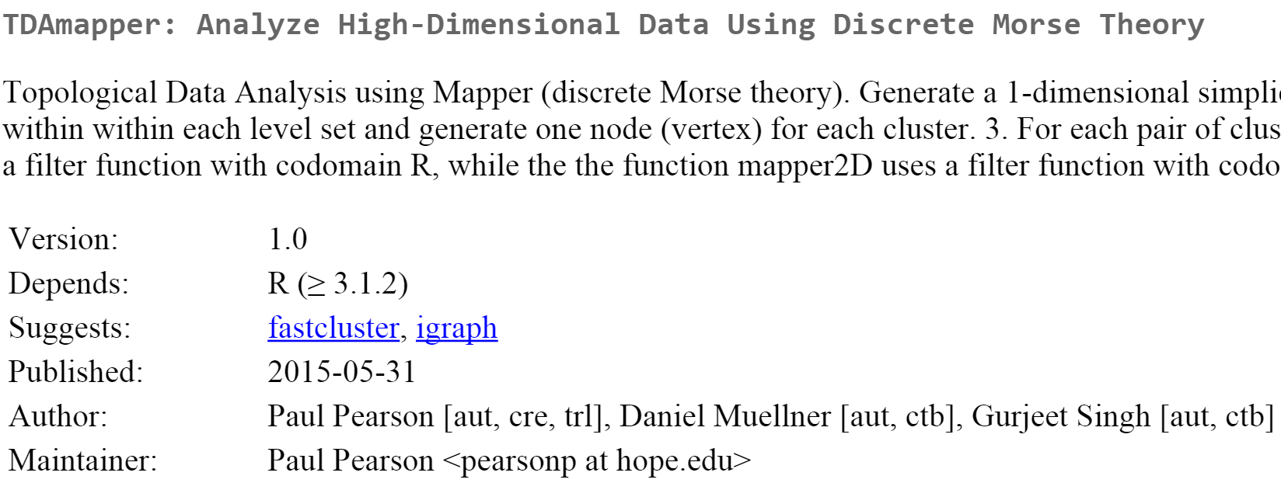

https://cran.r-project.org/web/packages/TDAmapper/
http://danifold.net/mapper/

Slide 42
3 minute break to meet classmates, discuss projects, questions, etc.
https://online.stopwatchpro.com/3-minute-timer/

Slide 43
http://www.nature.com/srep/2013/130207/srep01236/full/srep01236.html

Slide 44
Application 3 (in paper): Basketball
Data: rates (per minute played) of rebounds, assists, turnovers, steals, blocked shots, personal fouls, and points scored for 452 players.
➔ Input: 452 points in R⁷
For each player, we have a vector
= (r, a, t, s, b, f, p) in R⁷
Distance: variance normalized Euclidean distance.
Clustering: Single linkage.
( min , min , min , min , min , min , min )
rebounds assists turnovers steals blocked shots personal fouls points scored
http://www.nature.com/srep/2013/130207/srep01236/full/srep01236.html

Slide 45
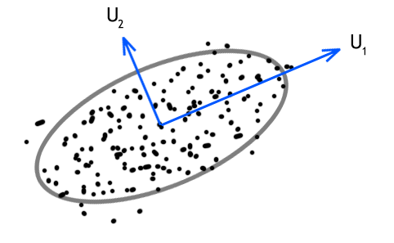
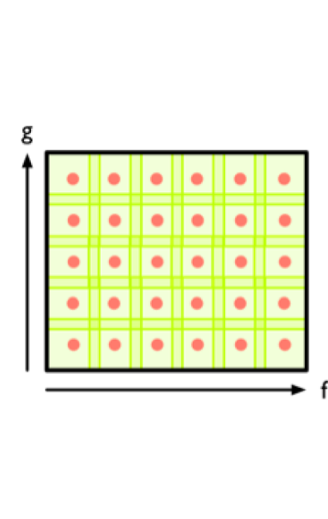
Filters: principle and secondary SVD values.
http://commons.wikimedia.org/wiki/File:SVD_Graphic_Example.png
Data
http://www.nature.com/srep/2013/130207/srep01236/full/srep01236.html

Slide 46
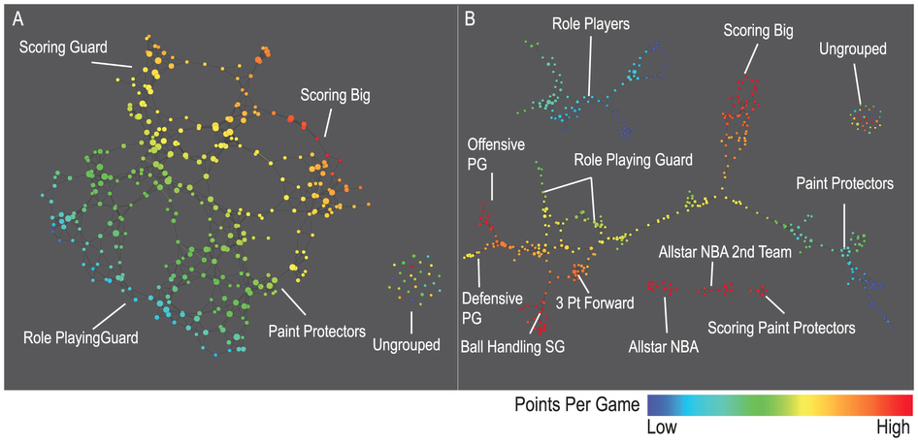
A) Low resolution map at 20 intervals for each filter B) High resolution map at 30 intervals for each filter. The overlap is such at that each interval overlaps with half of the adjacent intervals, the graphs are colored by points per game, and a variance normalized Euclidean distance metric is applied. Metric: Variance Normalized Euclidean; Lens: Principal SVD Value (Resolution 20, Gain 2.0x, Equalized) and Secondary SVD Value (Resolution 20, Gain 2.0x, Equalized). Color: red: high values, blue: low values.
http://www.nature.com/srep/2013/130207/srep01236/full/srep01236.html

Slide 47
LeBron James , Kobe Bryant, Brook Lopez
A) Low resolution map at 20 intervals for each filter B) High resolution map at 30 intervals for each filter. The overlap is such at that each interval overlaps with half of the adjacent intervals, the graphs are colored by points per game, and a variance normalized Euclidean distance metric is applied. Metric: Variance Normalized Euclidean; Lens: Principal SVD Value (Resolution 20, Gain 2.0x, Equalized) and Secondary SVD Value (Resolution 20, Gain 2.0x, Equalized). Color: red: high values, blue: low values.
http://www.nature.com/srep/2013/130207/srep01236/full/srep01236.html
Notes:
Compare how graphs drawn. Note disconnected means not close Don’t be mislead by graph drawing

Slide 48
Application 2: US House of Representatives Voting records
Data: (aye, abstain, nay, …. )
= ( +1 , 0 , -1 , … )
Distance: Pearson correlation
Filters: principal and secondary metric SVD
Clustering: Single linkage.
http://www.nature.com/srep/2013/130207/srep01236/full/srep01236.html

Slide 49
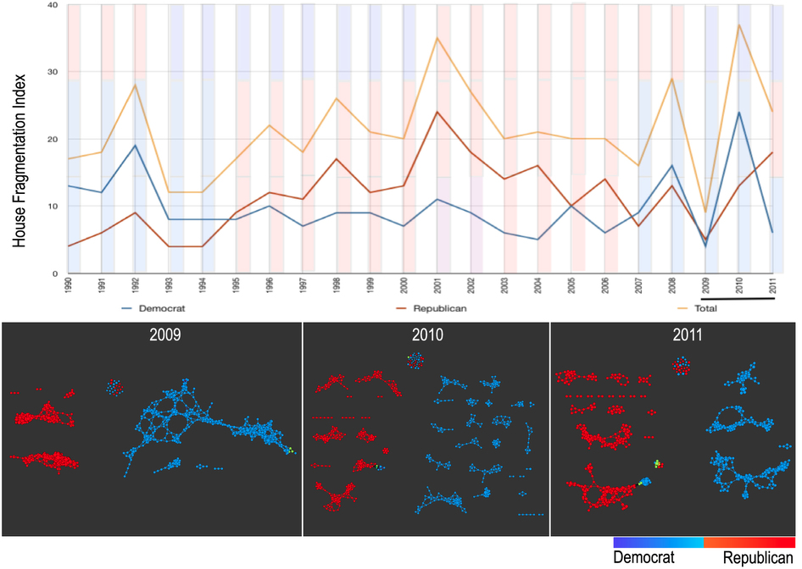
number of sub-networks formed each year per political party.
X-axis: 1990–2011. Y-axis: Fragmentation index. Color bars denote, from top to bottom, party of the President, party for the House, party for the Senate (red: republican; blue: democrat; purple: split). The bottom 3 panels are the actual topological networks for the members. Networks are constructed from voting behavior of the member of the house, with an “aye” vote coded as a 1, “abstain” as zero, and “nay” as a -1. Each node contains sets of members. Each panel labeled with the year contains networks constructed from all the members for all the votes of that year. Note high fragmentation in 2010 in both middle panel and in the Fragmentation Index plot (black bar). The distance metric and filters used in the analysis were Pearson correlation and principal and secondary metric SVD. Metric: Correlation; Lens: Principal SVD Value (Resolution 120, Gain 4.5x, Equalized) and Secondary SVD Value (Resolution 120, Gain 4.5x, Equalized). Color: Red: Republican; Blue: Democrats.
http://www.nature.com/srep/2013/130207/srep01236/full/srep01236.html

Slide 50
Application 1: breast cancer gene expression
Data: microarray gene expression data from 2 data sets, NKI and GSE2034
Distance: correlation distance
Filters: (1) L-infinity centrality:
f(x) = max{d(x, p) : p in data set}
captures the structure of the points far removed from the center or norm.
(2) NKI: survival vs. death
GSE2034: no relapse vs. relapse
Clustering: Single linkage.

Slide 51
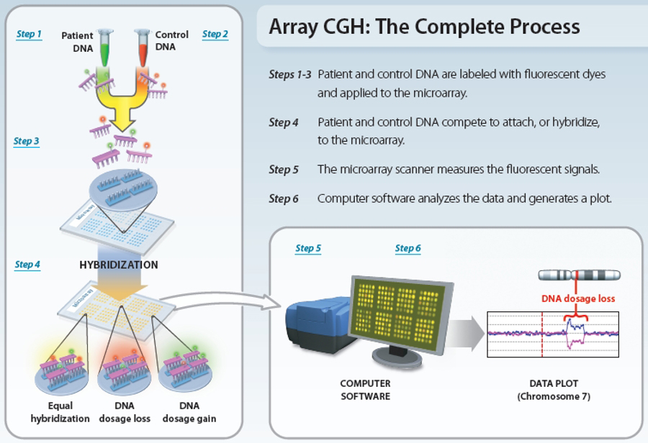
www.nature.com/scitable/topicpage/microarray-based-comparative-genomic-hybridization-acgh-45432

Slide 52
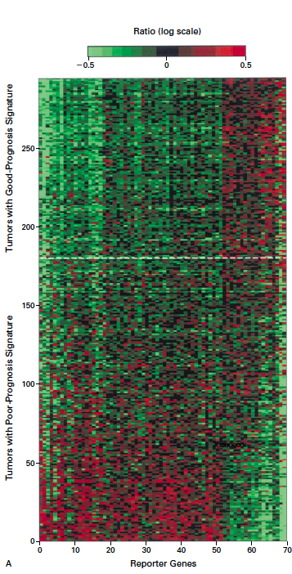
Gene expression profiling predicts clinical outcome of breast cancer
van 't Veer LJ, Dai H, van de Vijver MJ, He YD, Hart AA, Mao M, Peterse HL, van der Kooy K, Marton MJ, Witteveen AT, Schreiber GJ, Kerkhoven RM, Roberts C, Linsley PS, Bernards R, Friend SH
Nature. 2002 Jan 31; 415(6871):530-6.

Slide 53
2 breast cancer data sets:
1.) NKI (2002):
gene expression levels of 24,000 from 272 tumors. Includes node-negative and node-positive patients, who had or had not received adjuvant systemic therapy. Also includes survival information.
2.) GSE203414 (2005)
expression of 22,000 transcripts from total RNA of frozen tumour samples from 286 lymph-node-negative patients who had not received adjuvant systemic treatment. Also includes time to relapse information.

Slide 54
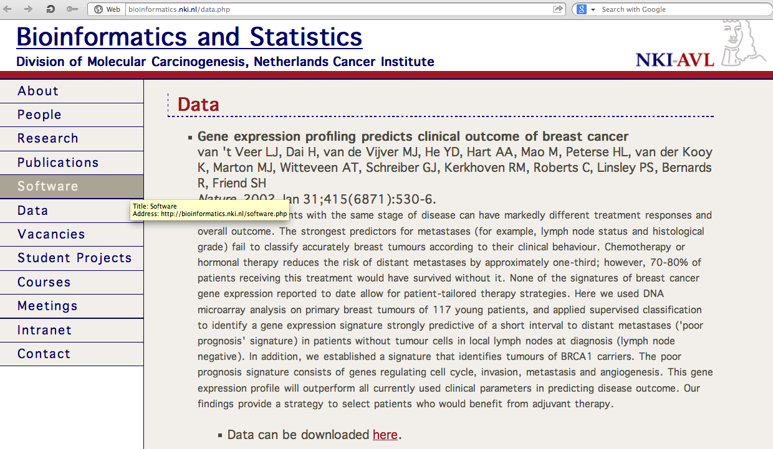
http://bioinformatics.nki.nl/data.php

Slide 55
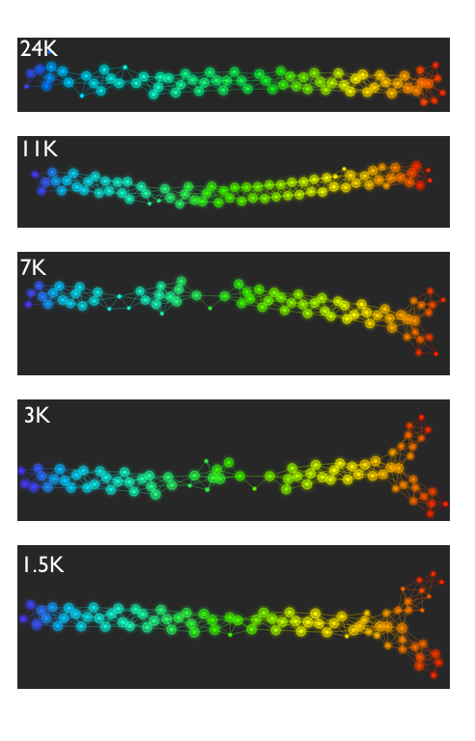
Fig. S1. Shape of the data becomes more distinct as the analysis columns are restricted to the top
varying genes.
24K: all the genes on the microarray were used in the analysis;
11K: 10,731 top most varying genes were used in the analysis;
7K: 6.688 top most varying genes were used in the analysis;
3K: 3212 top most varying genes were used in the analysis;
1.5K: 1553 top most varying genes were used in the analysis.
Graphs colored by the L-infinity centrality values. Red: high; Blue: low
http://www.nature.com/srep/2013/130207/srep01236/full/srep01236.html

Slide 56
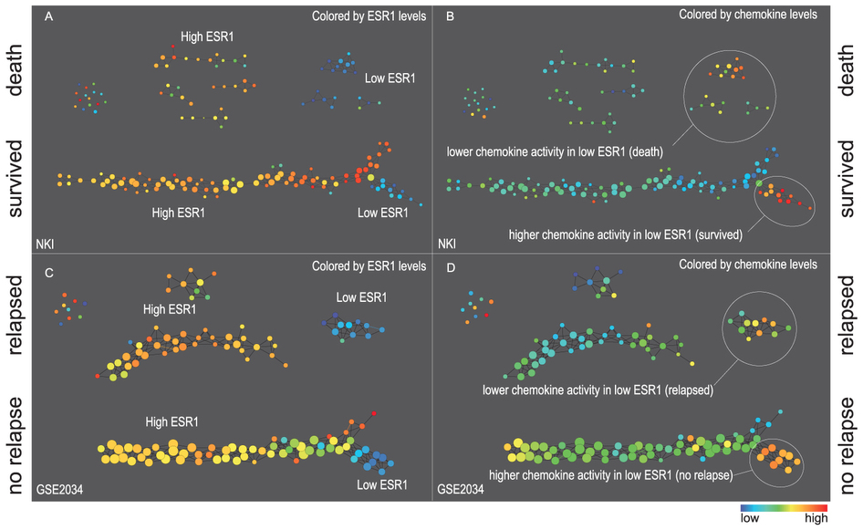
Two filter functions, L-Infinity centrality and survival or relapse were used to generate the networks. The top half of panels A and B are the networks of patients who didn't survive, the bottom half are the patients who survived. Panels C and D are similar to panels A and B except that one of the filters is relapse instead of survival. Panels A and C are colored by the average expression of the ESR1 gene. Panels B and D are colored by the average expression of the genes in the KEGG chemokine pathway. Metric: Correlation; Lens: L-Infinity Centrality (Resolution 70, Gain 3.0x, Equalized) and Event Death (Resolution 30, Gain 3.0x). Color bar: red: high values, blue: low values.
http://www.nature.com/srep/2013/130207/srep01236/full/srep01236.html

Slide 57
Comparison of our results with those of Van de Vijver and colleagues is difficult because of differences in patients, techniques, and materials used.
Their study included node-negative and node-positive patients, who had or had not received adjuvant systemic therapy, and only women younger than 53 years.
microarray platforms used in the studies differ—Affymetrix and Agilent.
Of the 70 genes in the study by van't Veer and co-workers, 48 are present on the Affymetrix U133a array, whereas only 38 of our 76 genes are present on the Agilent array. There is a three-gene overlap between the two signatures (cyclin E2, origin recognition complex, and TNF superfamily protein).
Despite the apparent difference, both signatures included genes that identified several common pathways that might be involved in tumour recurrence. This finding supports the idea that although there might be redundancy in gene members, effective signatures could be required to include representation of specific pathways.
From: Gene-expression profiles to predict distant metastasis of lymph-node-negative primary breast cancer, Yixin Wang et al, The Lancet, Volume 365, Issue 9460, 19–25 February 2005, Pages 671–679

Slide 58
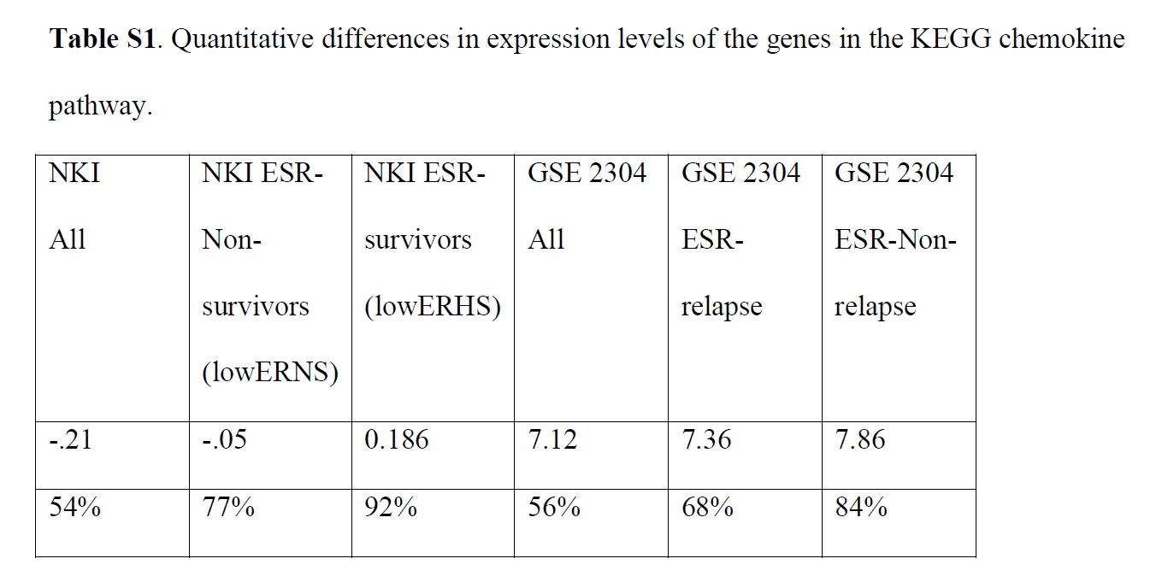
From: http://www.nature.com/srep/2013/130207/srep01236/full/srep01236.html
The numbers in the first row are the average levels of expressions of genes belonging to the chemokine pathway within the relevant groups. The second row gives these same levels reported as percentiles belonging to the collection of the chemokine expression levels across all the patients in the study to which the group belongs. Note that the lowERHS groups display very high chemokine expression levels, 92nd percentile in the case of NKI and 84th percentile in the case of GSE2304. The lowERNS groups are also consistently higher than the general population in the study, although to different degrees in the studies. The difference can perhaps be accounted for by the difference between the survival vs. non-relapse criteria in the two data sets.

Slide 59
Two filter functions, L-Infinity centrality and survival or relapse were used to generate the networks. The top half of panels A and B are the networks of patients who didn't survive, the bottom half are the patients who survived. Panels C and D are similar to panels A and B except that one of the filters is relapse instead of survival. Panels A and C are colored by the average expression of the ESR1 gene. Panels B and D are colored by the average expression of the genes in the KEGG chemokine pathway. Metric: Correlation; Lens: L-Infinity Centrality (Resolution 70, Gain 3.0x, Equalized) and Event Death (Resolution 30, Gain 3.0x). Color bar: red: high values, blue: low values.
http://www.nature.com/srep/2013/130207/srep01236/full/srep01236.html

Slide 60
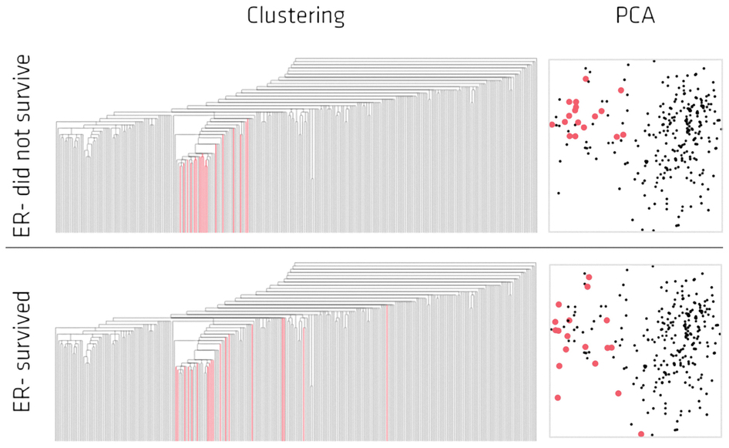
Highlighted in red are the lowERNS (top panel) and the lowERHS (bottom panel) patient sub-groups.
http://www.nature.com/srep/2013/130207/srep01236/full/srep01236.html

Slide 61
Identifying subtypes of cancer in a consistent manner is a challenge in the field since sub-populations can be small and their relationships complex
High expression level of the estrogen receptor gene (ESR1) is positively correlated with improved prognosis, given that this set of patients is likely to respond to standard therapies.
But , there are still sub-groups of high ESR1 that do not respond well to therapy.
Low ESR1 levels are strongly correlated with poor prognosis
But there are patients with low ESR1 levels but high survival rates
Many molecular sub-groups have been identified,
But often difficult to identify the same sub-group in a broader setting, where data sets are generated on different platforms, on different sets of patients and at a different times, because of the noise and complexity in the data.
From: http://www.nature.com/srep/2013/130207/srep01236/full/srep01236.html

Slide 62
Three key ideas of topology that make extracting of patterns via shape possible.
1.) coordinate free.
No dependence on the coordinate system chosen.
Can compare data derived from different platforms
2.) invariant under “small” deformations.
less sensitive to noise
3.) compressed representations of shapes.
Input: dataset with thousands of points
Output: network with 13 vertices and 12 edges.
http://www.nature.com/srep/2013/130207/srep01236/full/srep01236.html

Slide 63
Two filter functions, L-Infinity centrality and survival or relapse were used to generate the networks. The top half of panels A and B are the networks of patients who didn't survive, the bottom half are the patients who survived. Panels C and D are similar to panels A and B except that one of the filters is relapse instead of survival. Panels A and C are colored by the average expression of the ESR1 gene. Panels B and D are colored by the average expression of the genes in the KEGG chemokine pathway. Metric: Correlation; Lens: L-Infinity Centrality (Resolution 70, Gain 3.0x, Equalized) and Event Death (Resolution 30, Gain 3.0x). Color bar: red: high values, blue: low values.
http://www.nature.com/srep/2013/130207/srep01236/full/srep01236.html

Slide 64

http://www.pnas.org/content/early/2011/04/07/1102826108

Slide 65
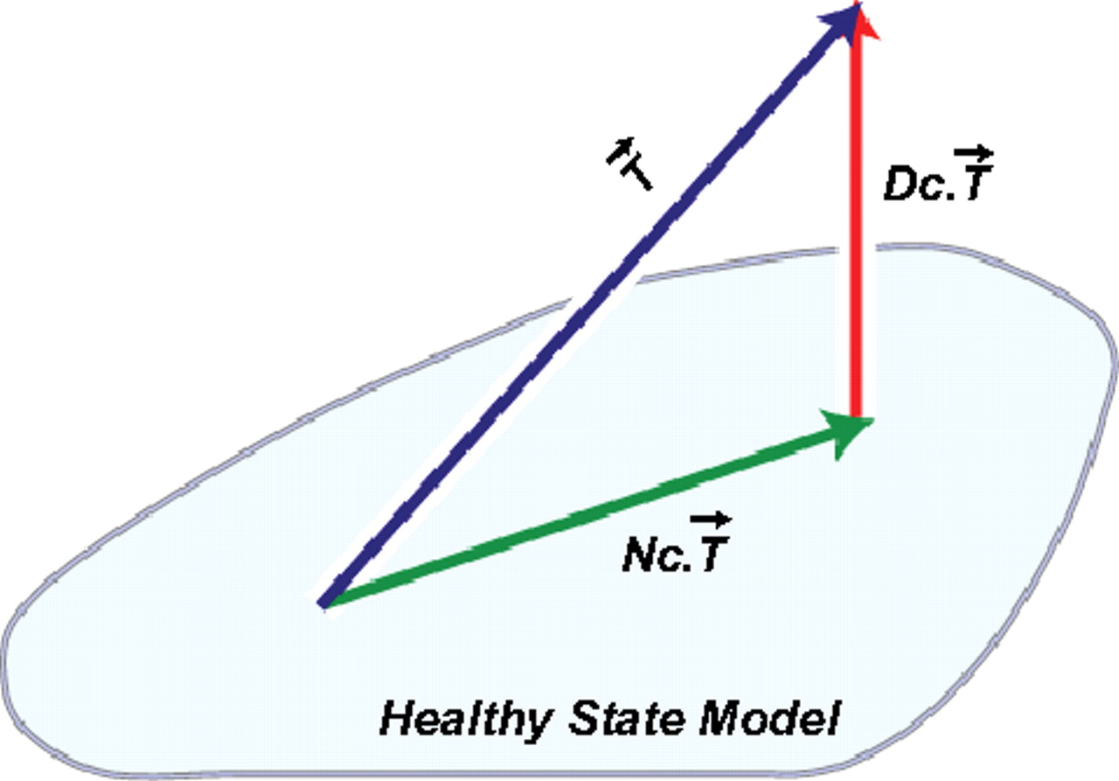
DSGA decomposition of the original tumor vector into the Normal component its linear models fit onto the Healthy State Model and the Disease component vector of residuals.
Nicolau M et al. PNAS 2011;108:7265-7270
©2011 by National Academy of Sciences
Notes:
DSGA decomposition of the original tumor vector into the Normal component its linear models fit onto the Healthy State Model and the Disease component vector of residuals.

Slide 66
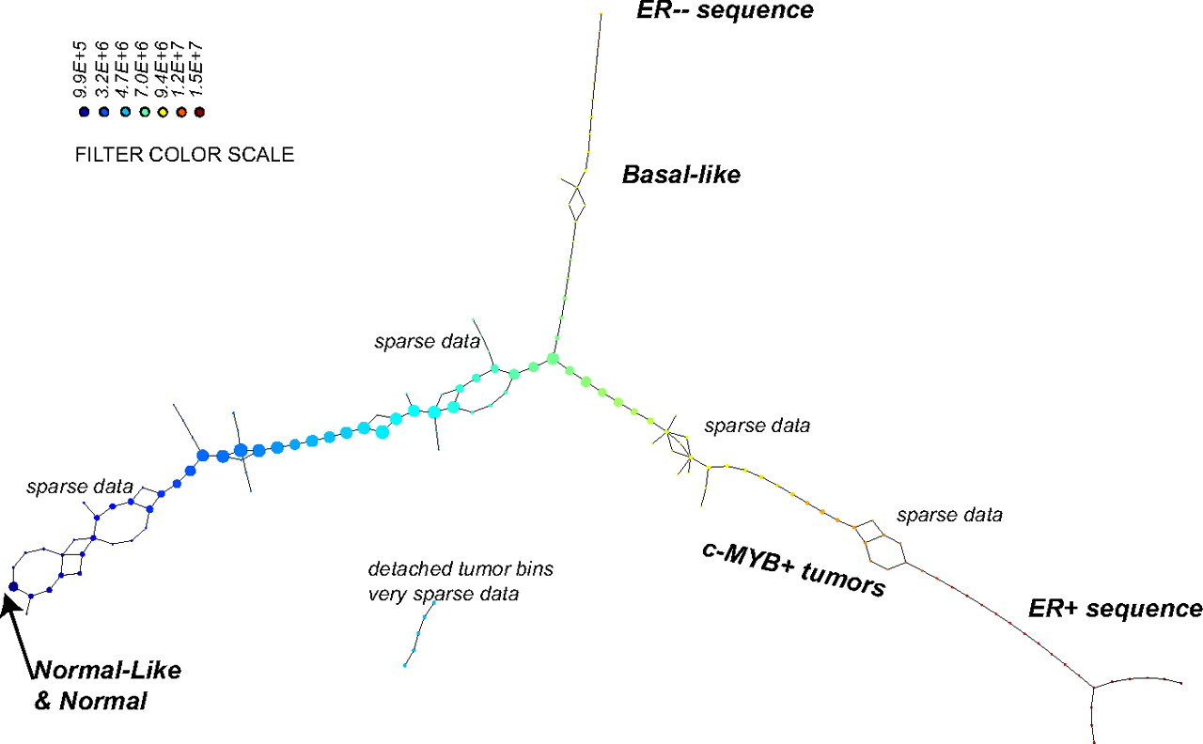
PAD analysis of the NKI data. The output has three progression arms, because tumors (data points) are ordered by the magnitude of deviation from normal (the HSM). Each bin is colored by the mean of the filter map on the points. Blue bins contain tumors whose total deviation from HSM is small (normal and Normal-like tumors). Red bins contain tumors whose deviation from HSM is large. The image of f was subdivided into 15 intervals with 80% overlap. All bins are seen (outliers included). Regions of sparse data show branching. Several bins are disconnected from the main graph. The ER− arm consists mostly of Basal tumors. The c-MYB+ group was chosen within the ER arm as the tightest subset, between the two sparse regions.
PAD analysis of the NKI data.
Nicolau M et al. PNAS 2011;108:7265-7270
©2011 by National Academy of Sciences
Notes:
PAD analysis of the NKI data. The output has three progression arms, because tumors (data points) are ordered by the magnitude of deviation from normal (the HSM). Each bin is colored by the mean of the filter map on the points. Blue bins contain tumors whose total deviation from HSM is small (normal and Normal-like tumors). Red bins contain tumors whose deviation from HSM is large. The image of f was subdivided into 15 intervals with 80% overlap. All bins are seen (outliers included). Regions of sparse data show branching. Several bins are disconnected from the main graph. The ER− arm consists mostly of Basal tumors. The c-MYB+ group was chosen within the ER arm as the tightest subset, between the two sparse regions.

Slide 67
