Slide 1
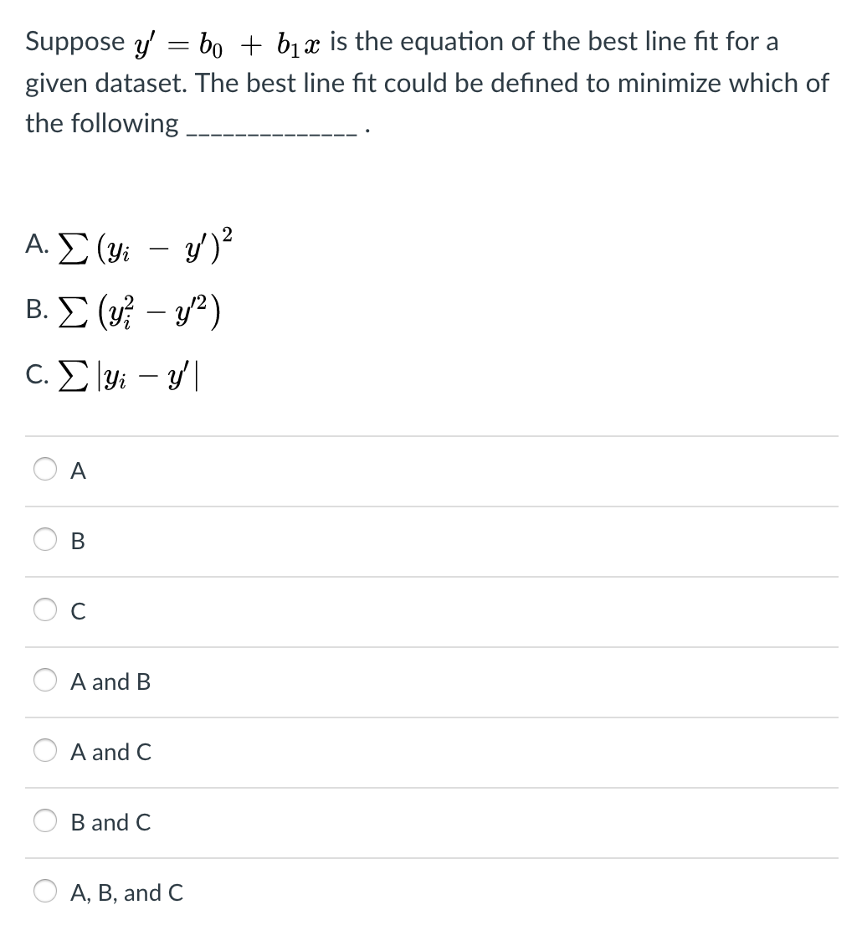

Slide 2
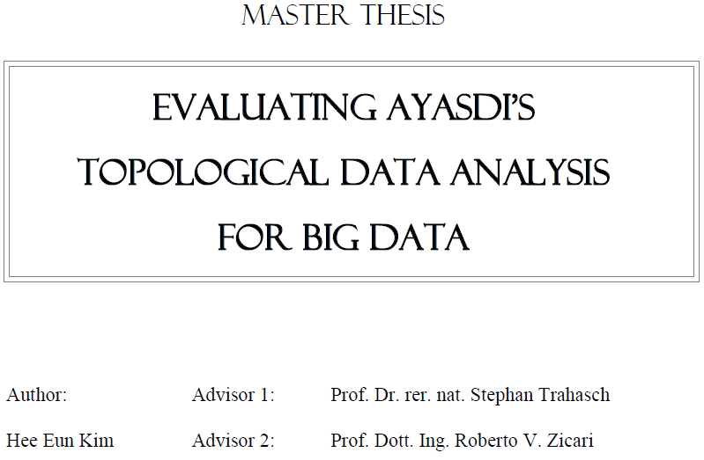


http://www.bigdata.uni-frankfurt.de/wp-content/uploads/2015/10/
Evaluating-Ayasdi’s-Topological-Data-Analysis-For-Big-Data_HKim2015.pdf

Slide 3

Option: Create figures where your data is colored using
1.) Filter function
default or point_color = f
2.) the ith variable
point_color = data[:,0]
3.) or any function of your choice (e.g. PCA, length, etc.)
point_color = (data[:,0]**2 + data[:,1]**2)**0.5
Analyze your data

Slide 4
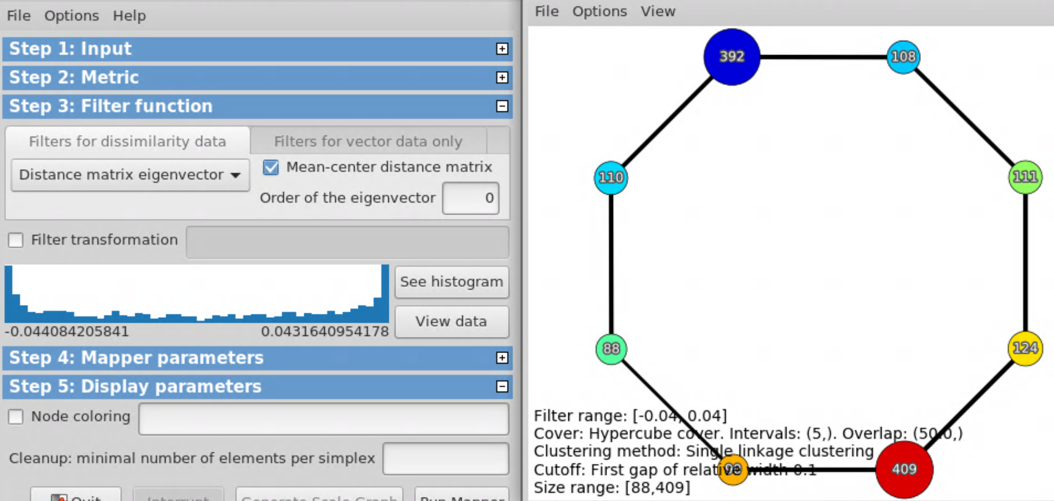
Default coloring is average filter value

Slide 5
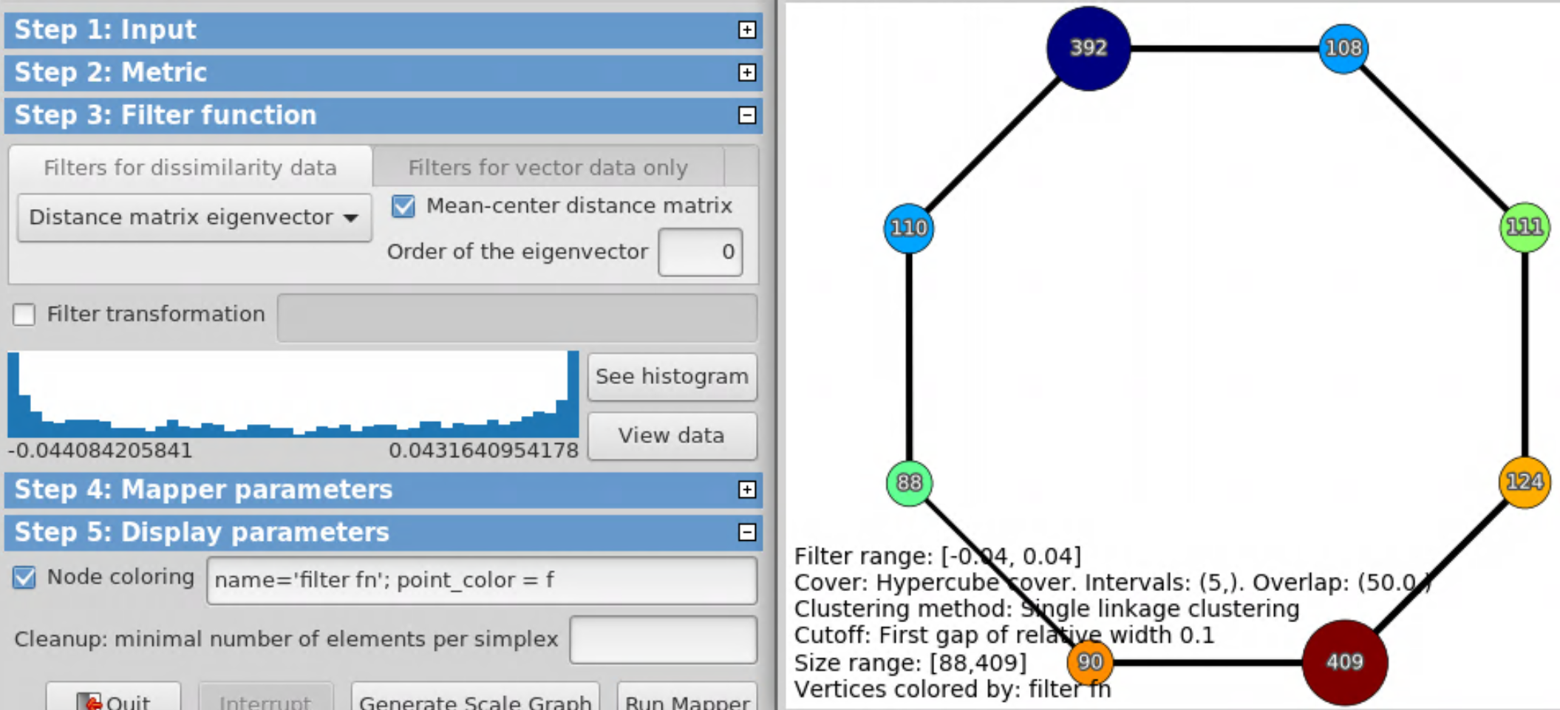
Can also specify color by filter function via
point_color = f

Slide 6
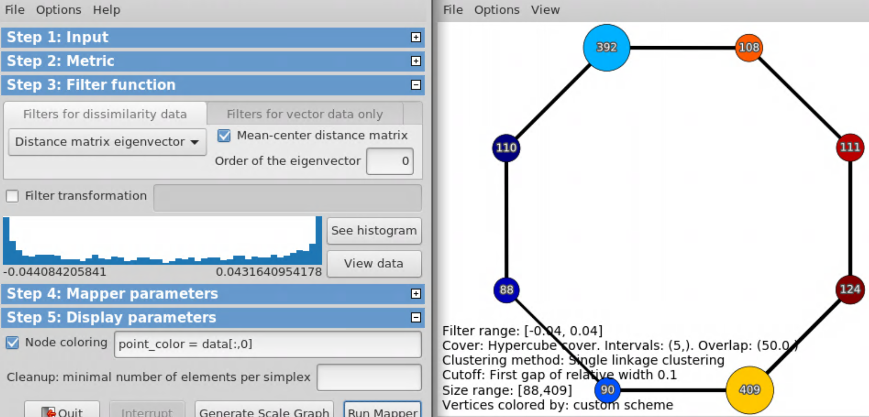
point_color = data[:,0]

Slide 7
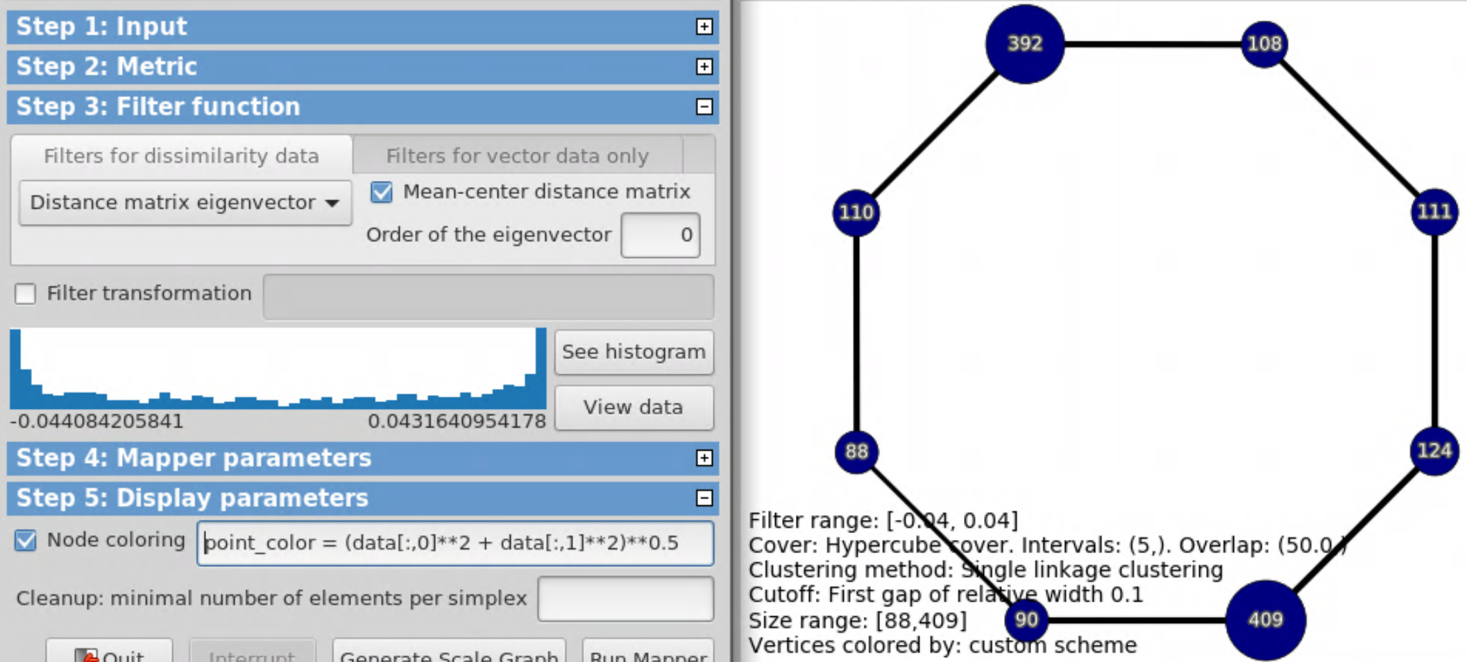
point_color = (data[:,0]**2 + data[:,1]**2)**0.5

Slide 8
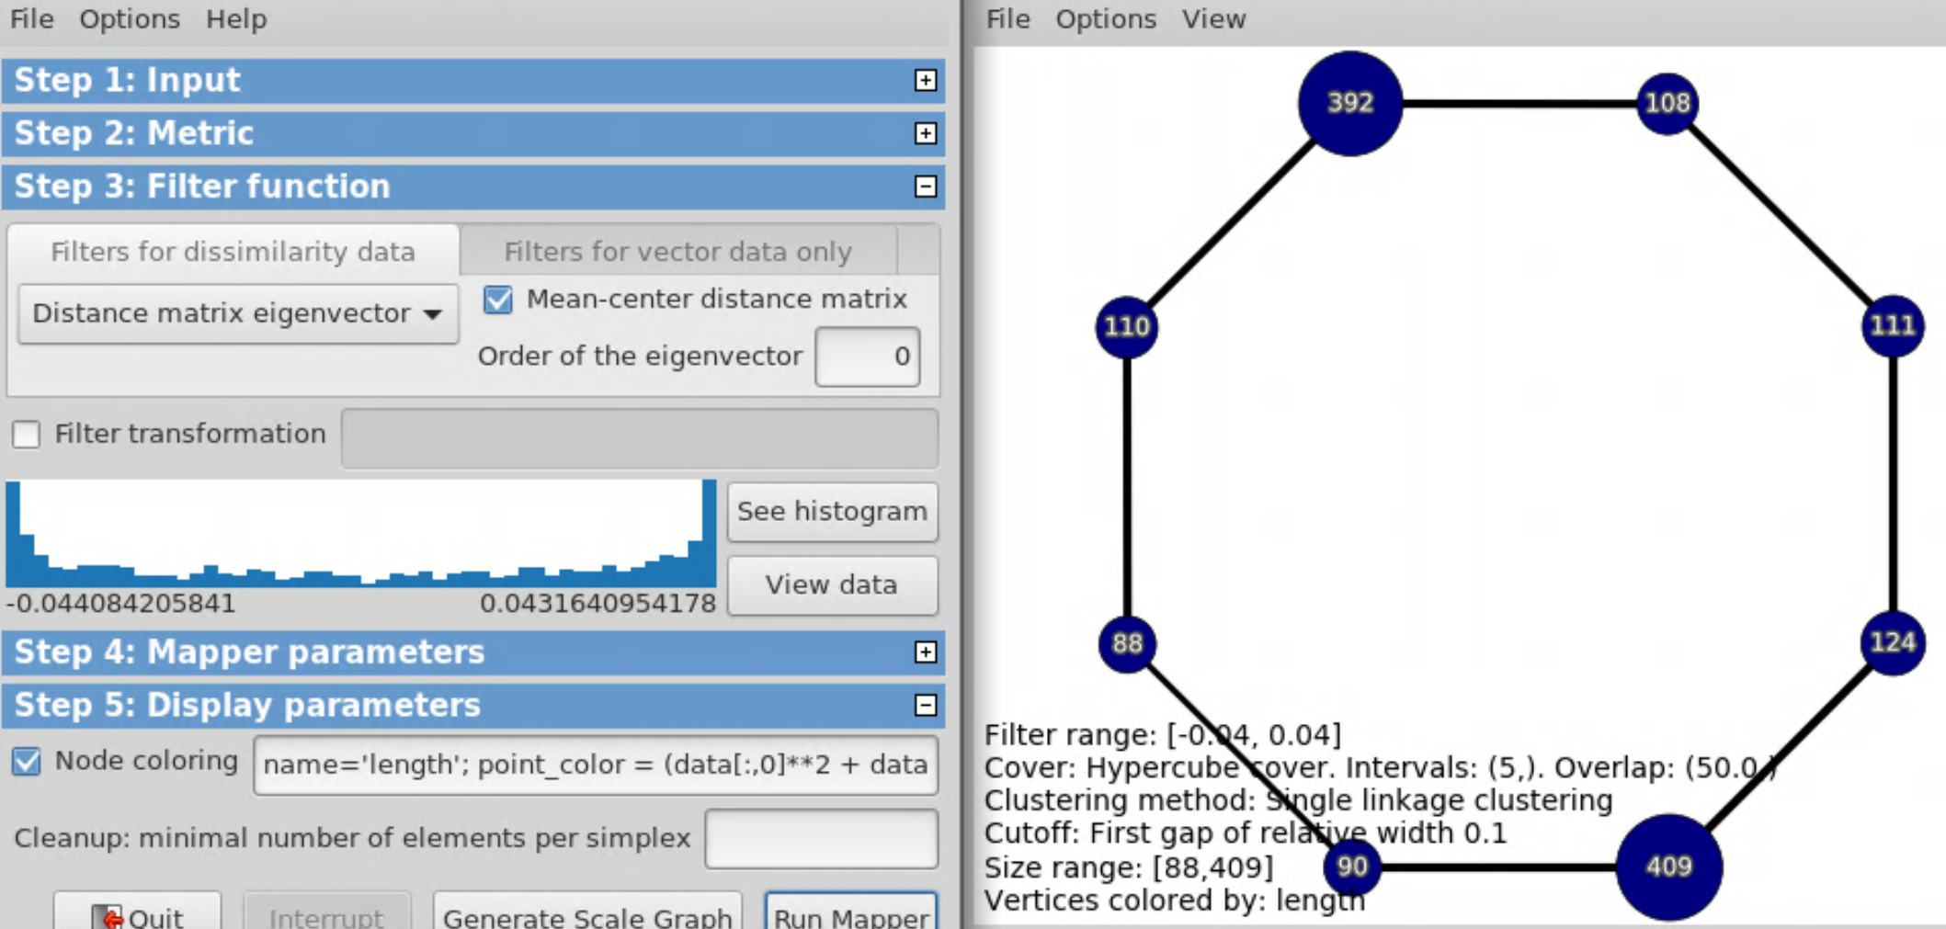
name = ‘length’;
point_color = (data[:,0]**2 + data[:,1]**2)**0.5

Slide 9
Option: Create figures where your data is colored using
1.) Filter function
default or point_color = f
2.) the ith variable
point_color = data[:,0]
3.) or any function of your choice (e.g. PCA, length, etc.)
point_color = (data[:,0]**2 + data[:,1]**2)**0.5
Analyze your data

Slide 10
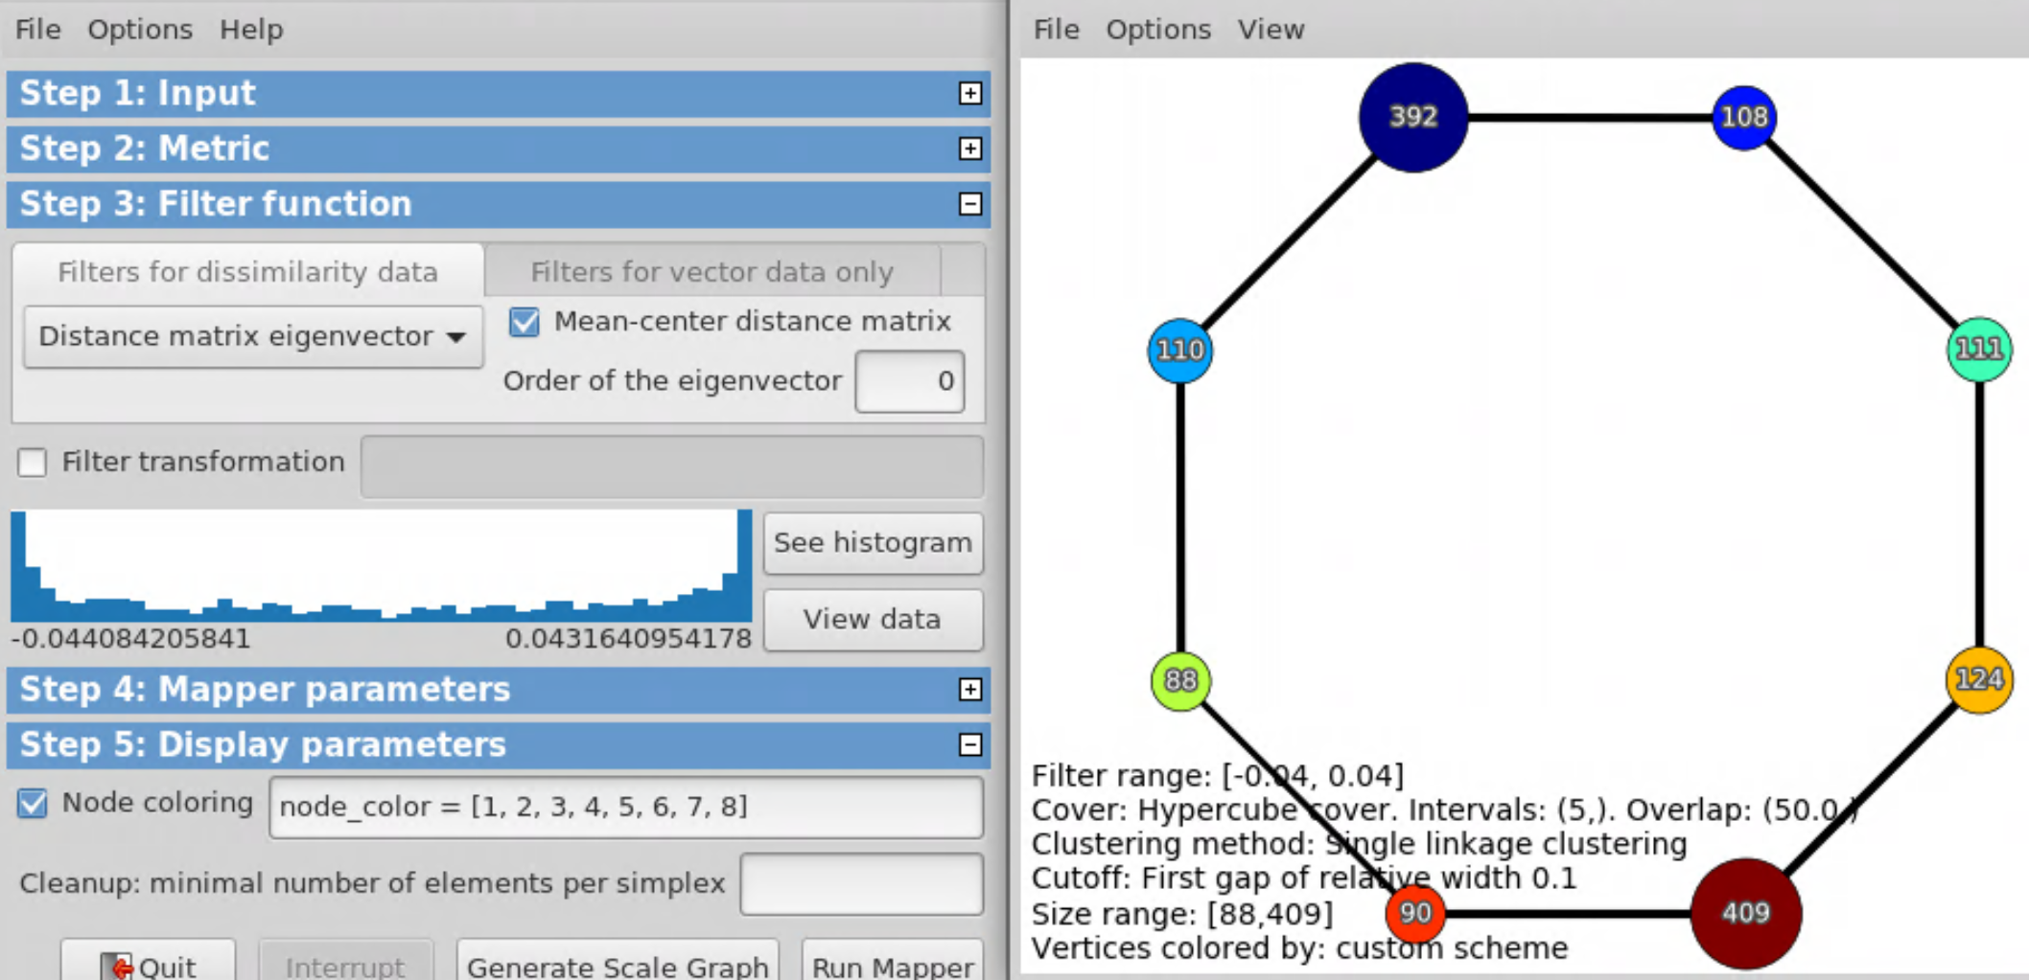
Alternatively, can specify node color
node_color = [1, 2, 3, 4, 5, 6, 7, 8]

Slide 11
Kolmogorov-Smirnov Test

Slide 12
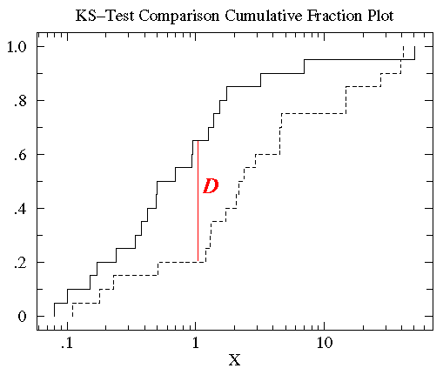
http://www.physics.csbsju.edu/stats/KS-test.html
The KS-test uses the maximum vertical deviation between the two curves as the statistic D. In this case the maximum deviation occurs near x=1 and has D=.45. (The fraction of the treatment group that is less then one is 0.2 (4 out of the 20 values); the fraction of the control group that is less than one is 0.65 (13 out of the 20 values). Thus the maximum difference in cumulative fraction is D=.45.)

Slide 13
http://www.bigdata.uni-frankfurt.de/wp-content/uploads/2015/10/
Evaluating-Ayasdi’s-Topological-Data-Analysis-For-Big-Data_HKim2015.pdf

Slide 14
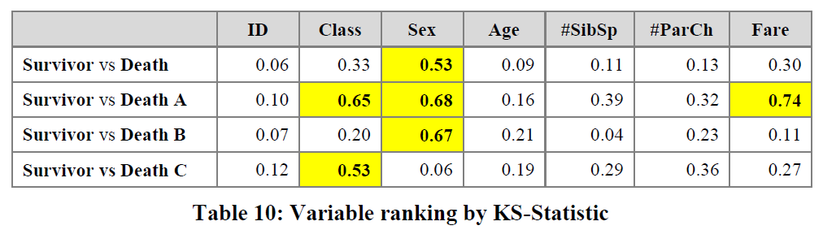
3.2.2.2 Insight by Ranked Variables
Going back to the Titanic example, the result of the KS-statistic show, that the variable “Sex” is the most strongly related to passengers death. We could generally assume that men conceded the places in lifeboats to women. Furthermore, it is feasible to deduct the subtle reasons of the death of each group. The passengers in group A died because of two reasons: they were man and the cabin class type was low. The passengers in the group B died because they were man. Finally, the passengers in the group C died because they were staying at third class even though most of them were women.

Slide 15
ksTable.rnw
##################################################
#### Create data set #############################
##################################################
footballdata <- read.csv("http://www.repole.com/sun4cast/stats/cfb20140906.csv")
nums <- sapply(footballdata, is.numeric)
fdata<- footballdata[ , nums]
#data1 <- fdata[fdata$ScoreOff >30, ]
#data2 <- fdata[fdata$ScoreOff <=30, ]
# Using selected nodes from python mapper
nodeset1 <- unlist(read.table("nodelist1.txt"))
nodeset2 <- unlist(read.table("nodelist2.txt"))
data1 <- fdata[nodeset1+1,]
data2 <- fdata[nodeset2+1,]

Slide 16
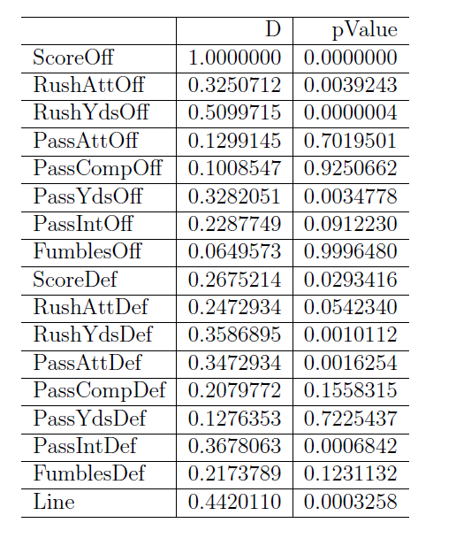
data1 <- fdata[fdata$ScoreOff >30, ]
data2 <- fdata[fdata$ScoreOff <=30, ]

