Slide 2
Outside Presentation: 50 pts
Researchers present their work at conferences. You should too. Find one that interests you and submit an abstract for either a talk or a poster. Travel funds may be available to cover your travel costs. You may present your work at a research conference, an undergraduate research conference, seminar, record a video podcast etc., either off-campus or on.
Note: the number of points earned on the outside presentation will depend on quality, time required, etc. For example, you may give one 50 point talk at a conference (this includes conferences aimed at undergraduates) including providing a 1 page summary of the conference. Alternatively, you could give 2 shorter/simpler (lower quality?) talks/posters (for example a 10 minute talk in mathbio seminar at UI – Mondays at 3:30pm).
You can also earn points by summarizing a talk/paper, etc.

Slide 3
Hey, Alexa, What Can You Hear? And What Will You Do With It?
By SAPNA MAHESHWARI MARCH 31, 2018
https://www.nytimes.com/2018/03/31/business/media/amazon-google-privacy-digital-assistants.html
In a starker example, detectives investigating a murder at an Arkansas home sought access to audio on an Echo device in 2016. Amazon resisted, but the recordings were ultimately shared with the permission of the defendant, James Bates. (A judge later dismissed Mr. Bates’s first-degree murder charge based on separate evidence.)
Kathleen Zellner, his lawyer, said in an interview that the Echo had been recording more than it was supposed to. Mr. Bates told her that it had been regularly lighting up without being prompted, and had logged conversations that were unrelated to Alexa commands, including a conversation about football in a separate room, she said.

Slide 4
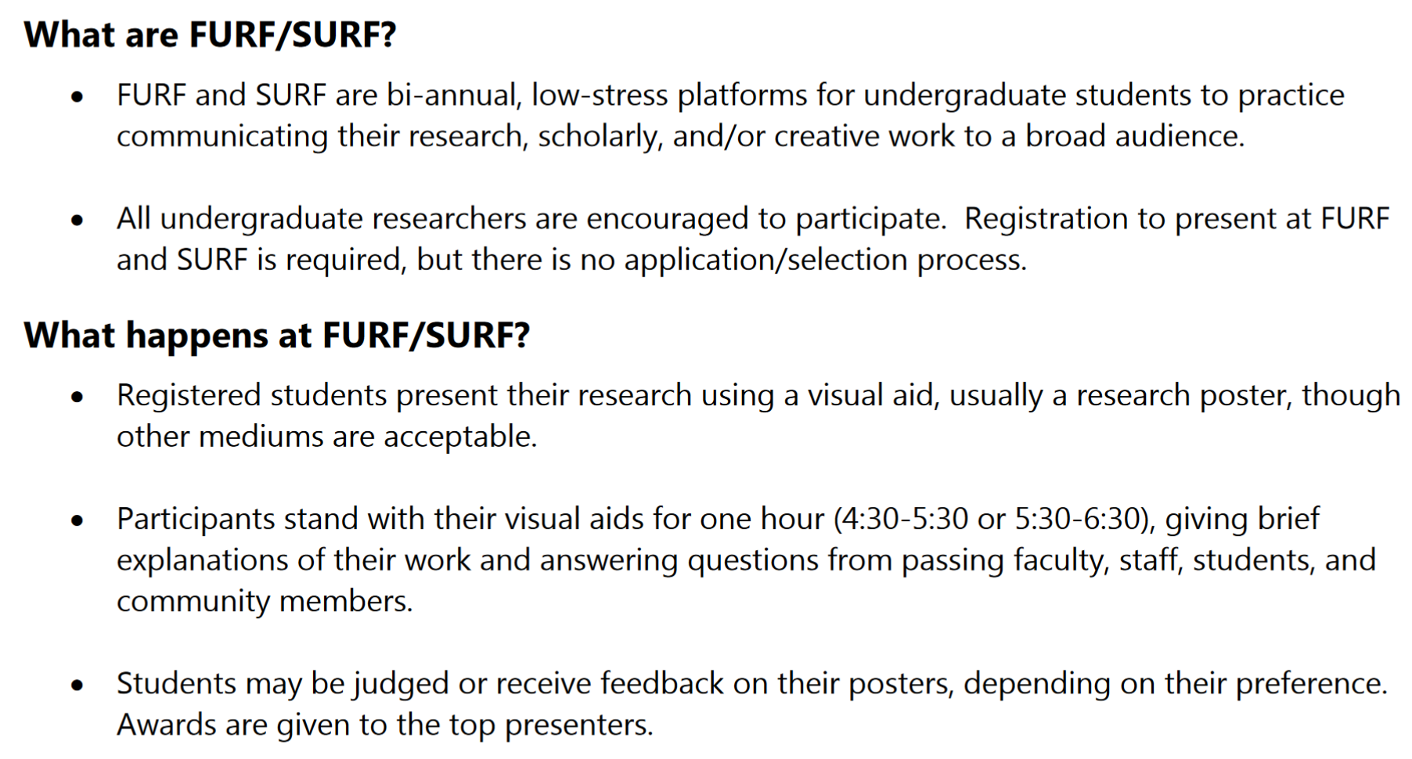
https://uiowa.edu/icru/sites/uiowa.edu.icru/files/wysiwyg_uploads/surf_furf_faqs_2017.pdf

Slide 5
Important Notes: -- You will need to be ready to submit TWO versions of your title and abstract: academic and general audience (200 words each). You may copy and paste into the text box provided, but will need to complete registration in one sitting as partial forms will not be saved. -- Presenters will stand with their posters for one hour of the festival (either 4:30-5:30PM or 5:30-6:30PM).

Slide 6
"Pitch Your Project" - A Three Minute Research Story Competition
https://uiowa.edu/icru/article/three-minute-research-story-competition
Application Deadline: Thursday, April 5th by 11:59PM
To apply to to participate, please complete this form. You will need to be ready to submit the following:
1. An general audience title and abstract (200 word max) of your research/creative work.
2. A 250 word (max) response (copy and paste your response in to the provided text box) to the following prompt:
The ability to create a compelling and accessible research narrative is an a invaluable skill. However, many scholars are either aren't very good at this style of communication or don't understand the importance. Why do you think this is and what value to you see in making research/creative work accessible?
3. Your ONE slide for the competition. (You may change your slide up to Friday, April 6th at 8:30 am by emailing it to icru@uiowa.edu. You will receive confirmation if it is received.)

Slide 7
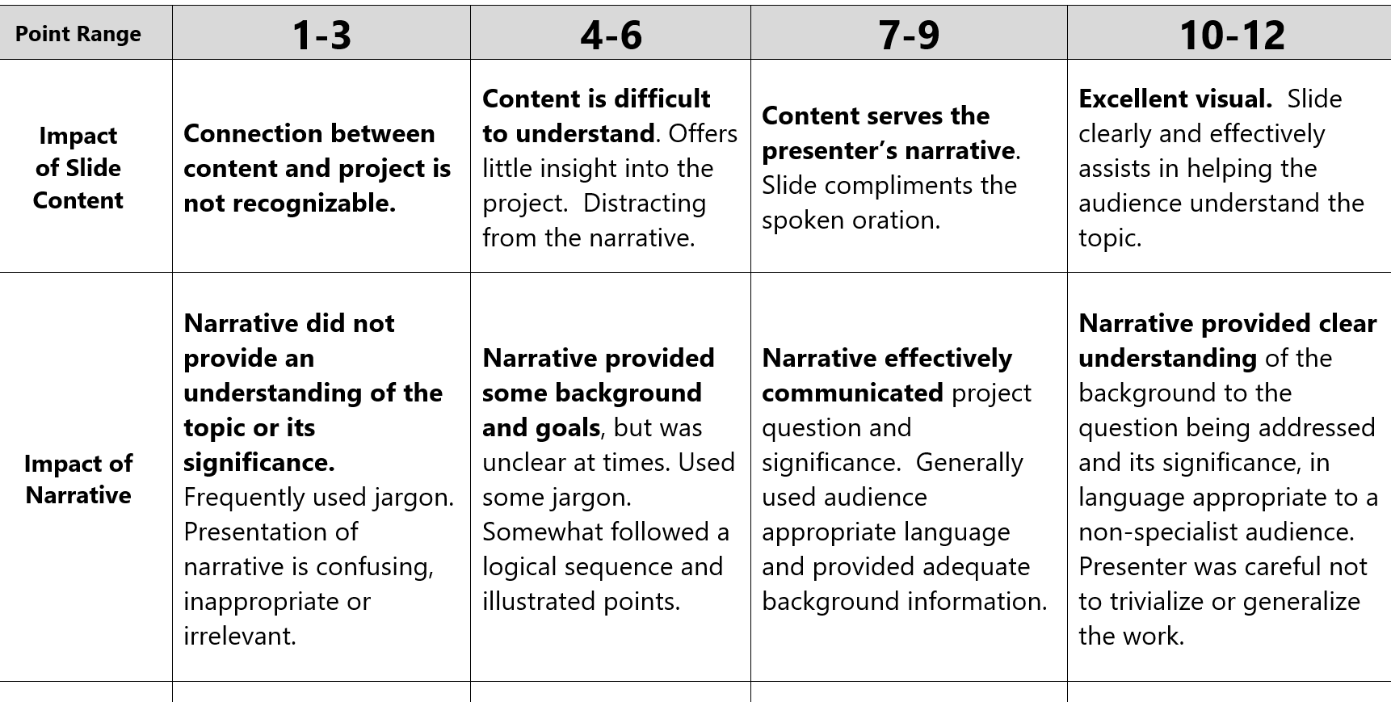

Slide 8
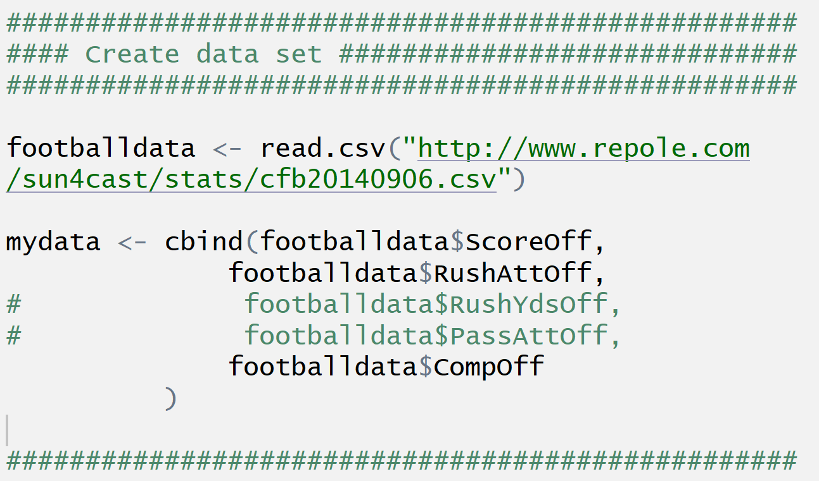

Slide 9
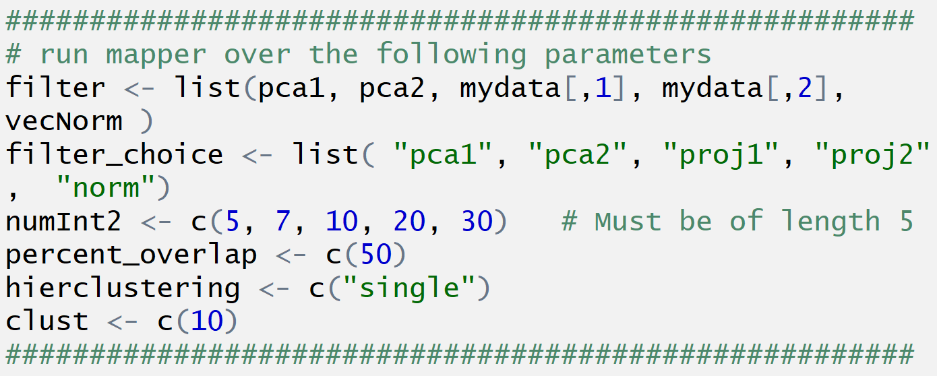

Slide 10
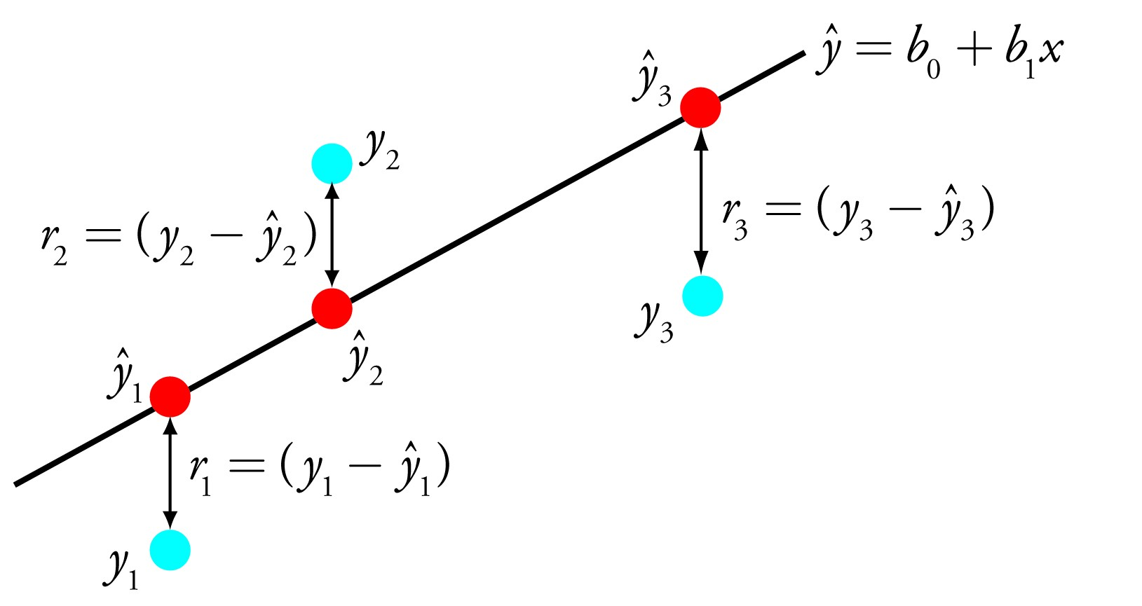
Linear regresson

Slide 11
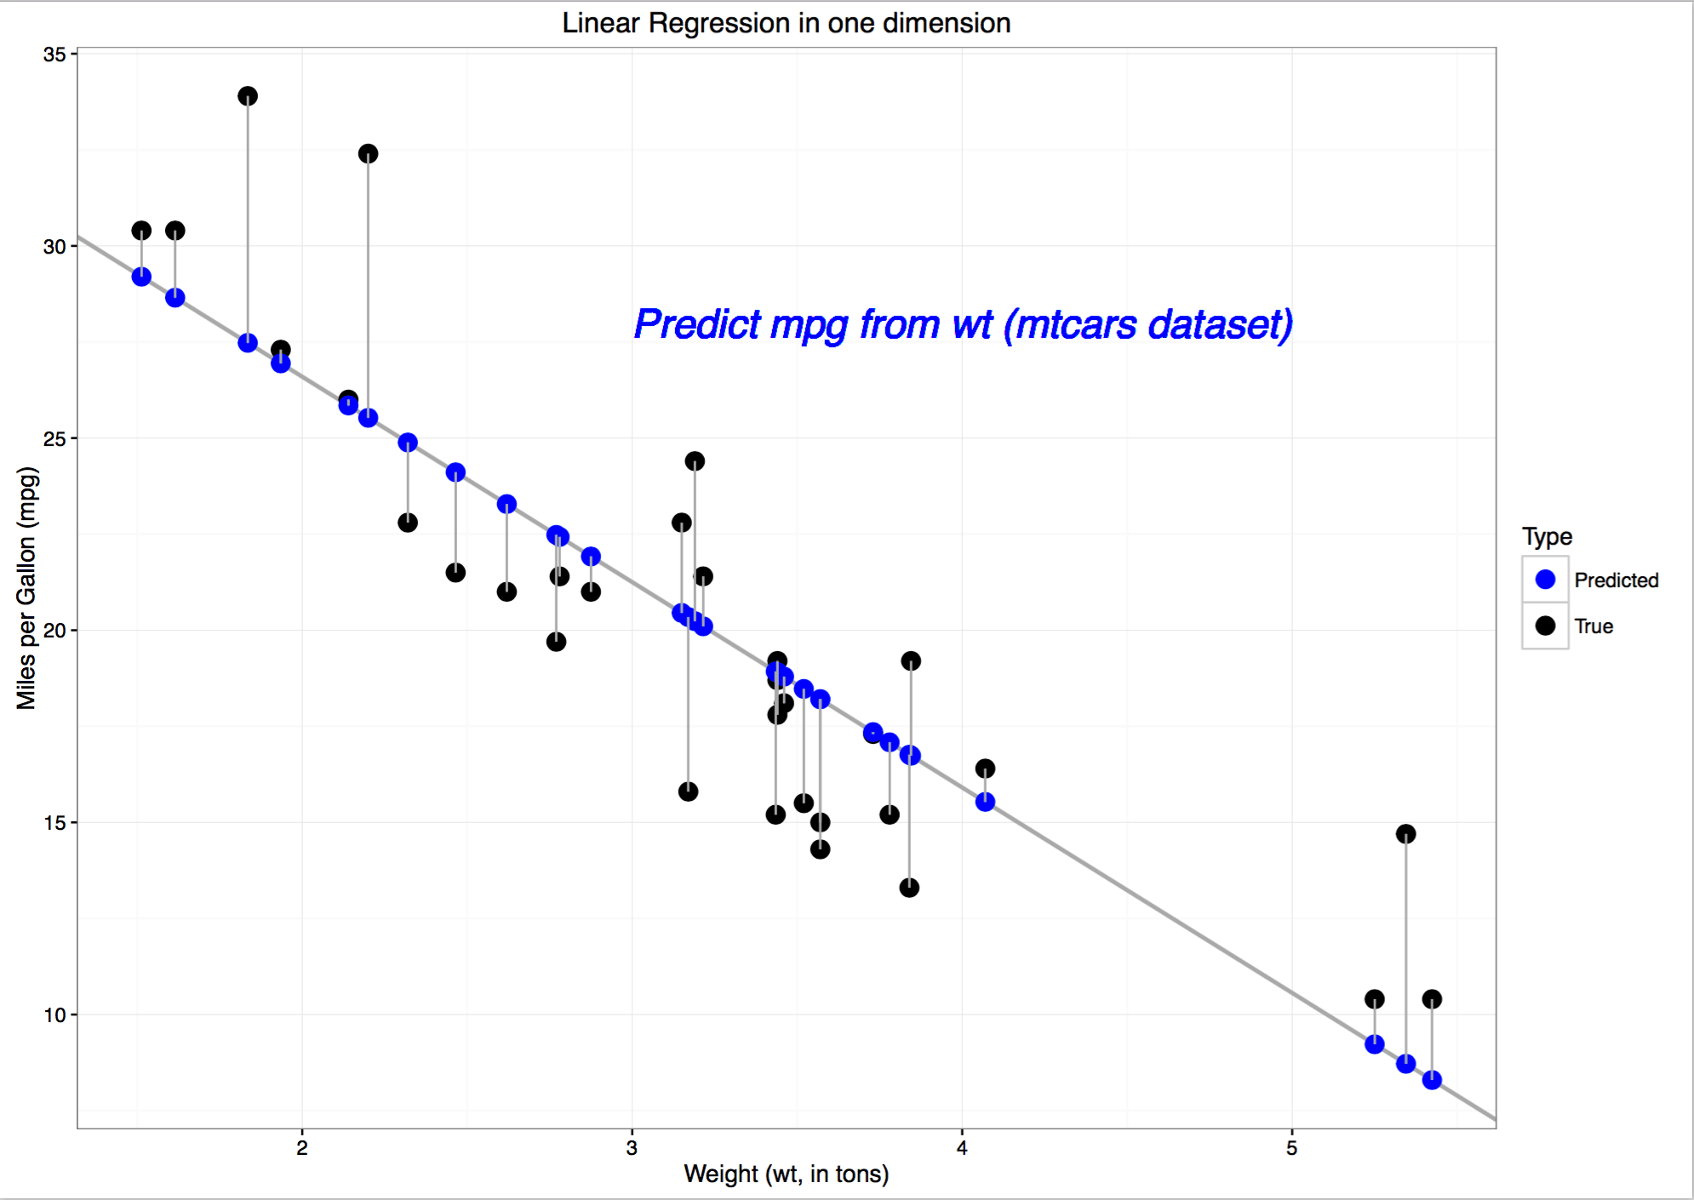

Slide 12
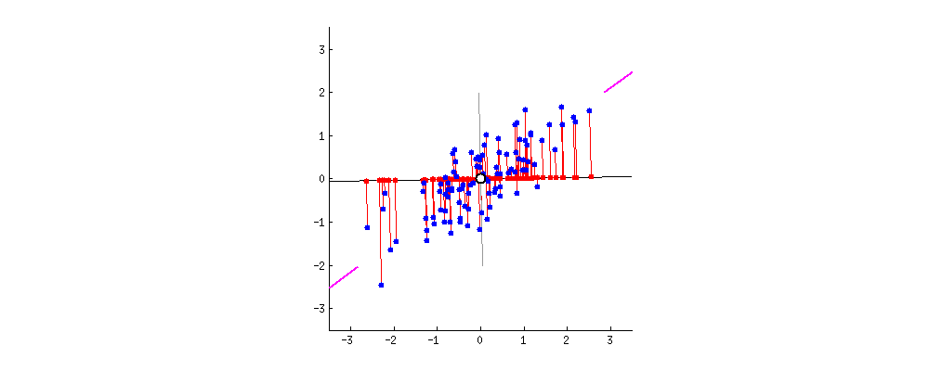
https://stats.stackexchange.com/questions/2691/making-sense-of-principal-component-analysis-eigenvectors-eigenvalues

