Slide 1
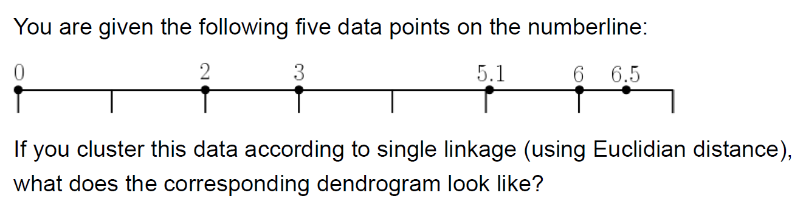
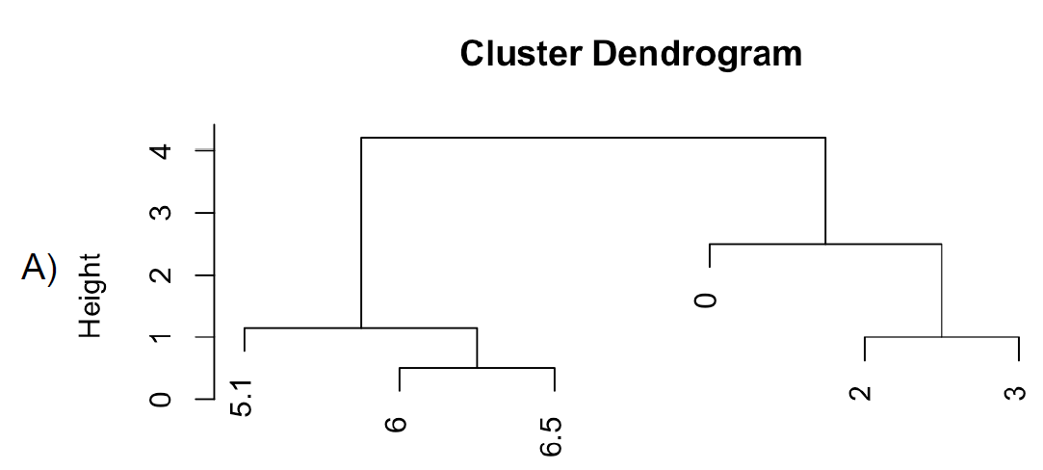
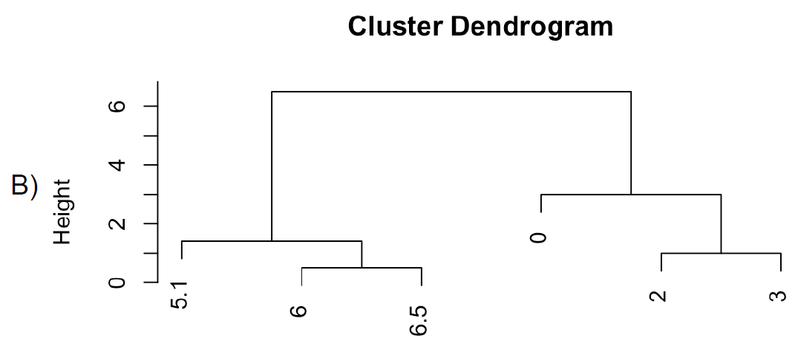
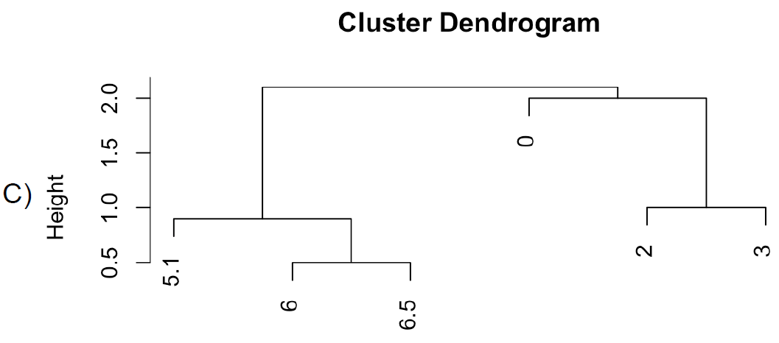
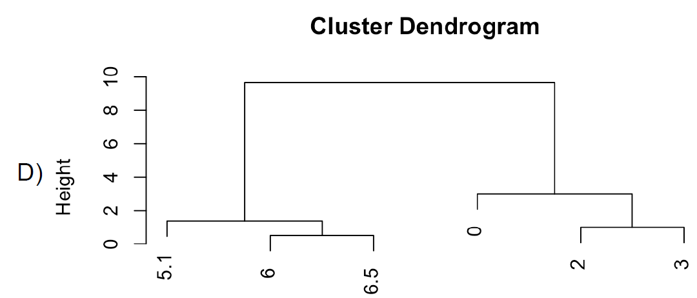

Slide 2
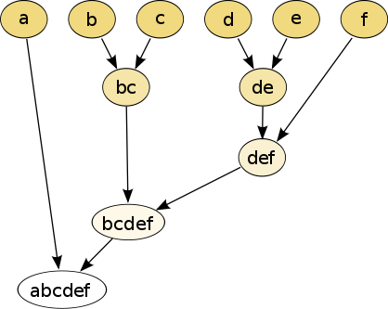
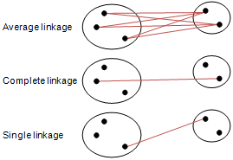
Different type of hierarchical clustering
What is the distance between 2 clusters?
http://en.wikipedia.org/wiki/File:Hierarchical_clustering_simple_diagram.svg
http://www.multid.se/genex/hs515.htm

Slide 3
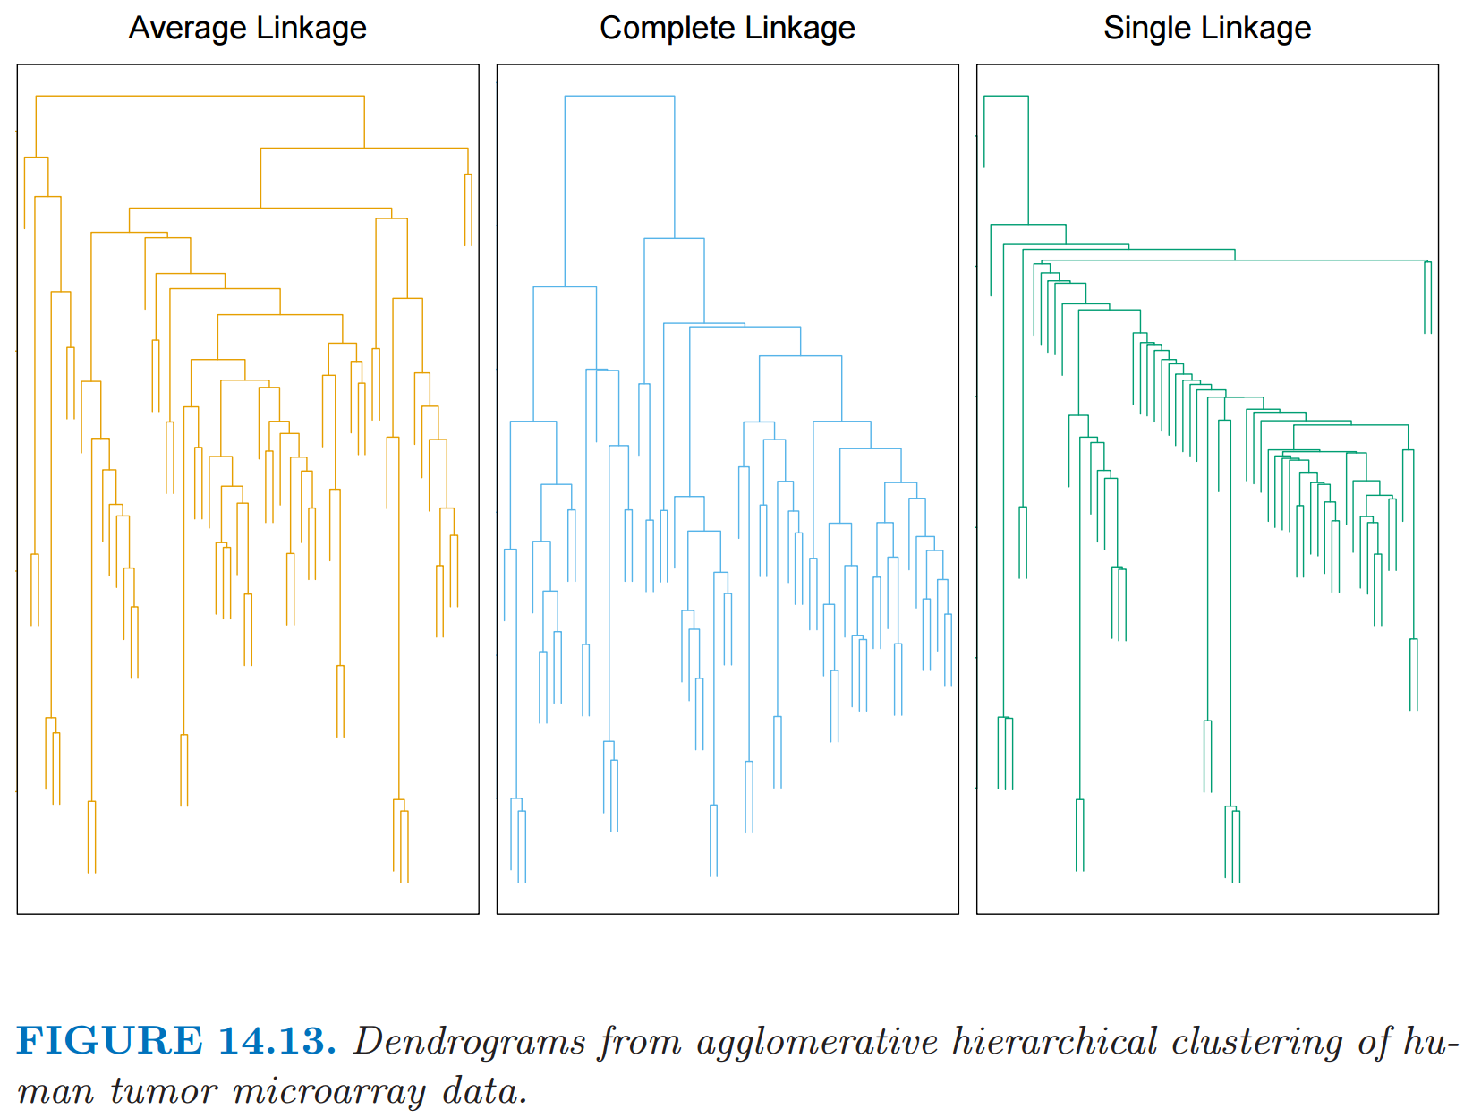
http://statweb.stanford.edu/~tibs/ElemStatLearn/
The Elements of Statistical Learning (2nd edition) Hastie, Tibshirani and Friedman

Slide 4
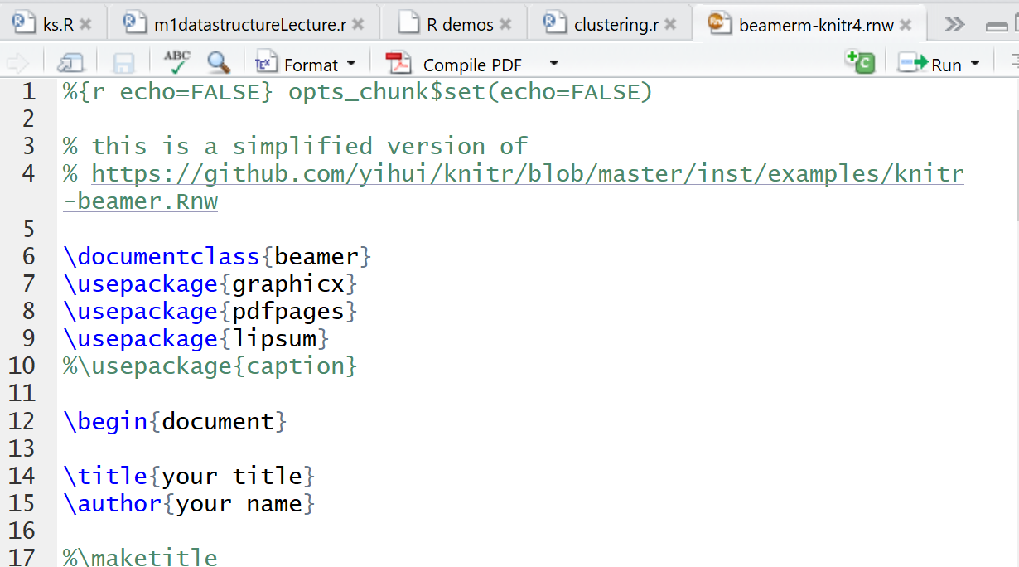

Slide 5
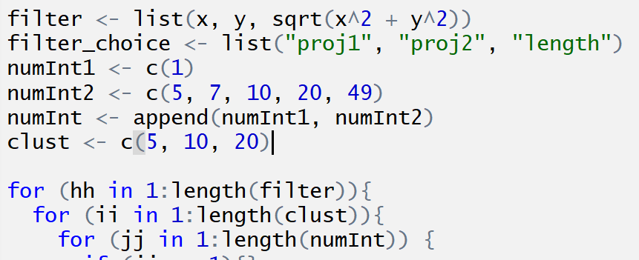

Slide 6
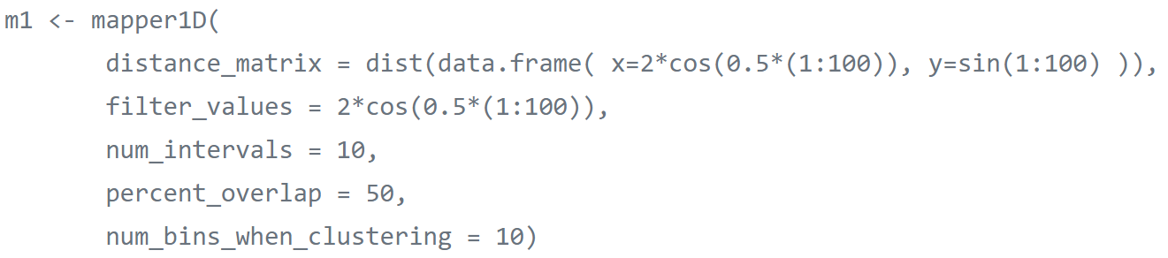

Slide 7
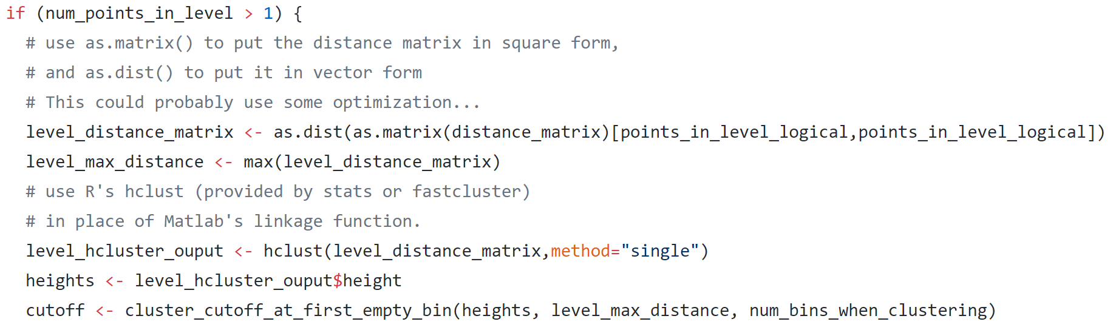

Slide 8
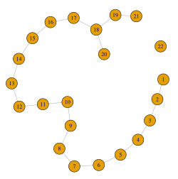
m <- mapper1D(distance_matrix = d, filter_values = f
num_intervals = 10, percent_overlap = 50,
num_bins_when_clustering = 10)
g <- graph.adjacency(m$adjacency, mode = "undirected")
plot(g1, layout = layout.auto(g1) )
help("igraph")
g <- barabasi.game(100)
plot(g, layout=layout_with_fr,
vertex.size=4,
vertex.label.dist=0.5,
vertex.color="red",
edge.arrow.size=0.5)

Slide 9
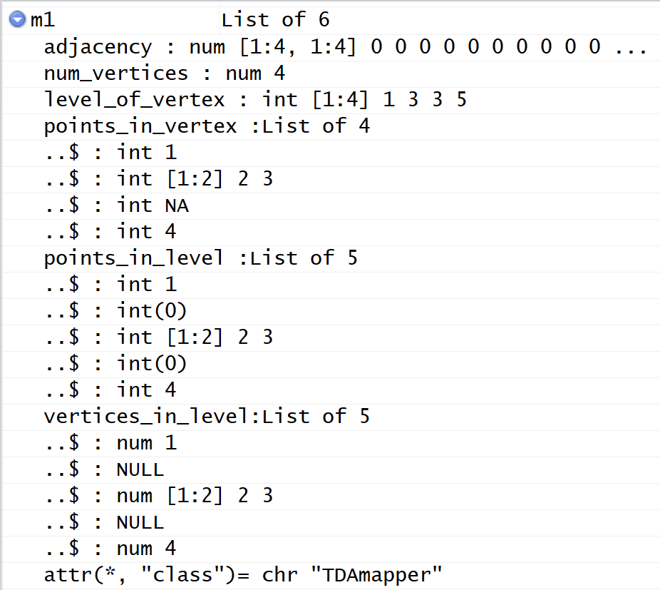
Data structure of mapper1D output.
From upper right corner of Rstudio
Created using
m1datastructureLecture.r

Slide 10
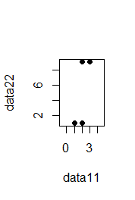
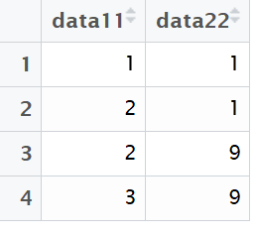
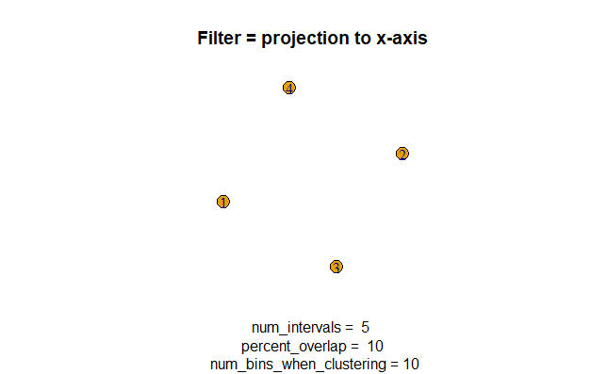
> m1
$adjacency
[,1] [,2] [,3] [,4]
[1,] 0 0 0 0
[2,] 0 0 0 0
[3,] 0 0 0 0
[4,] 0 0 0 0
$num_vertices
[1] 4
$level_of_vertex
[1] 1 3 3 5

Slide 11
$points_in_vertex
$points_in_vertex[[1]]
[1] 1
$points_in_vertex[[2]]
[1] 2 3
$points_in_vertex[[3]]
[1] NA
$points_in_vertex[[4]]
[1] 4

Slide 13
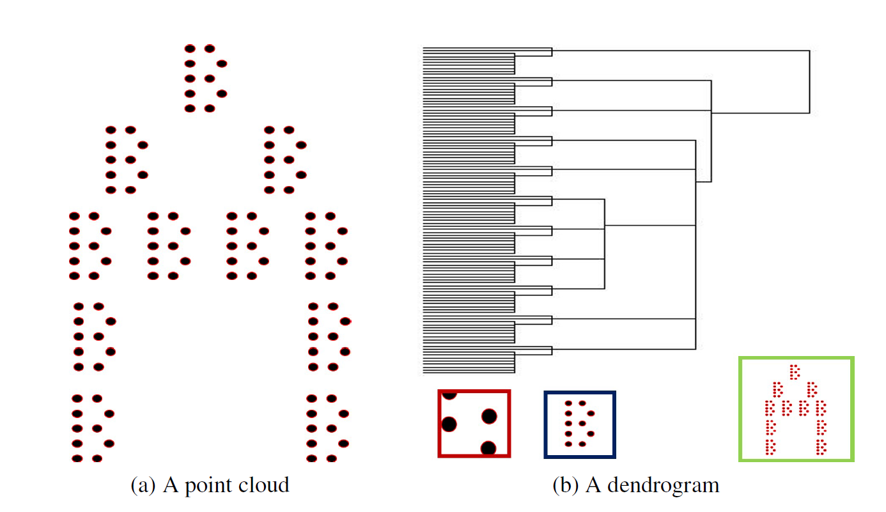
num_bins_when_clustering = ???
Figure courtesy of Paul Samuel Ignacio

Slide 14
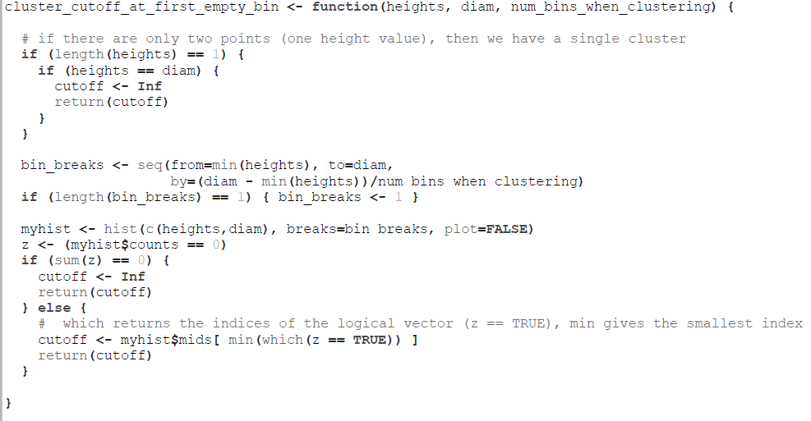
cluster_cutoff_at_first_empty_bin.r

Slide 15
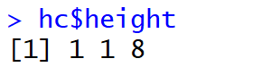
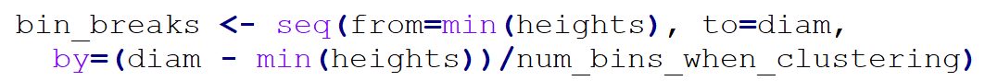
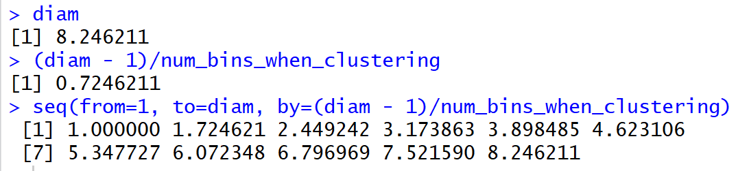
Suppose bin consists of these 4 points
Diam = ((3-1)² + (9-1)² )^{1/2} = 8.24

Slide 16
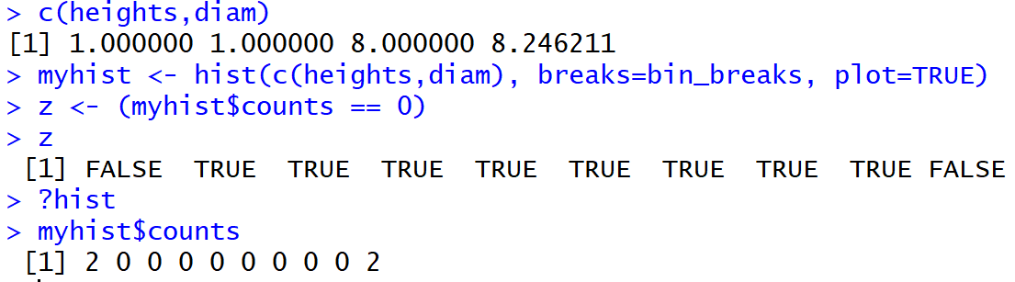
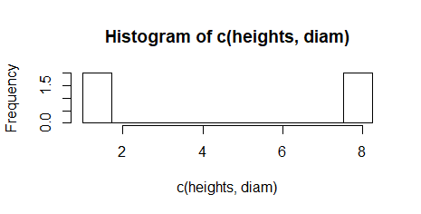
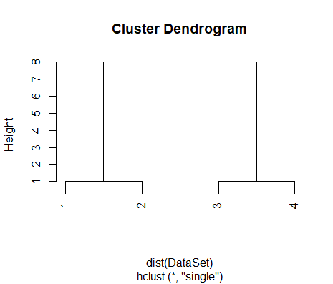

Slide 17
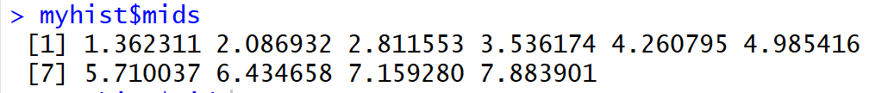

Slide 18
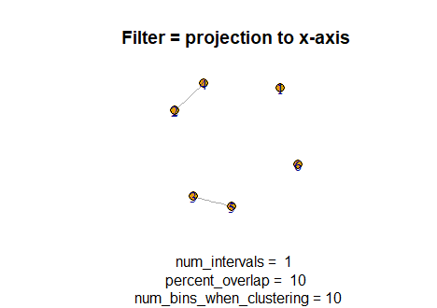
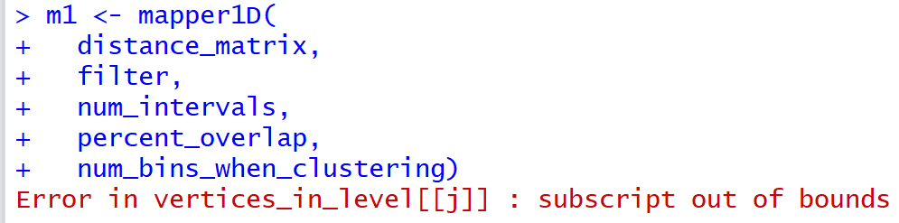

Slide 20
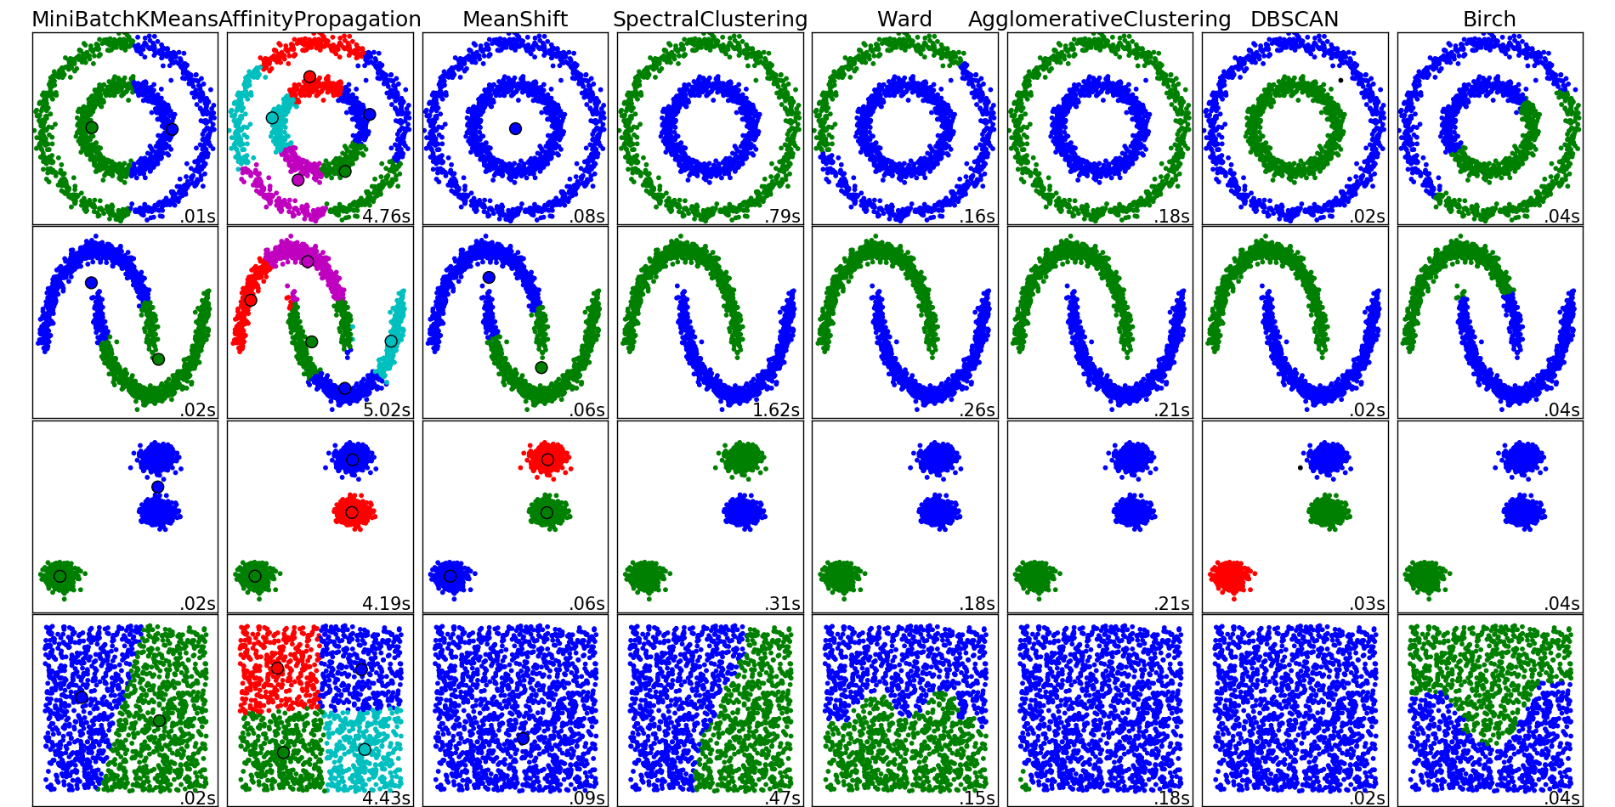
http://scikit-learn.org/stable/auto_examples/cluster/plot_cluster_comparison.html

