Slide 1
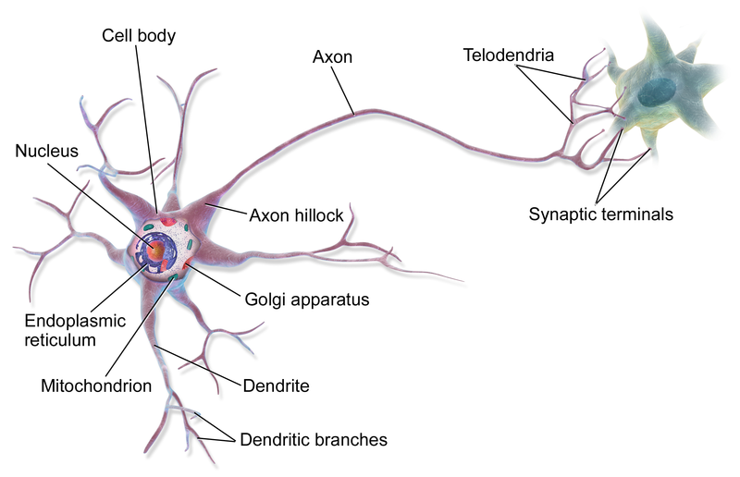
Brain contains
80 billion neurons
connected thru 100 trillion synapses
http://eyewire.org/explore
https://en.wikipedia.org/wiki/Neuron#/media/File:Blausen_0657_MultipolarNeuron.png

Slide 2
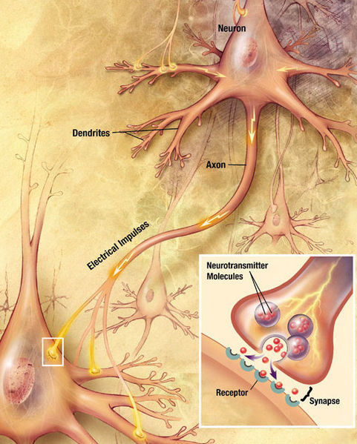
Brain contains
80 billion neurons
connected thru 100 trillion synapses
http://eyewire.org/explore
https://en.wikipedia.org/wiki/File:Chemical_synapse_schema_cropped.jpg

Slide 3
Untangling the brain - by Nature Video, Mar 9, 2011
https://youtu.be/dS_ONoUrptg?list=PLc8e2NNCopVtAZWSMSECmJIwWZnyzszWt
How brains see - by Nature Video, Aug 7, 2013
https://youtu.be/0oNHukxz5rI (beginning and 4:08)

Slide 4
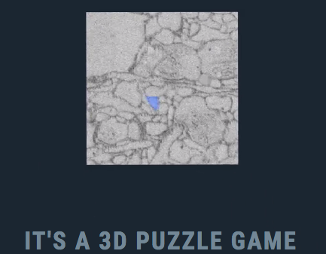
http://eyewire.org/explore

Slide 5
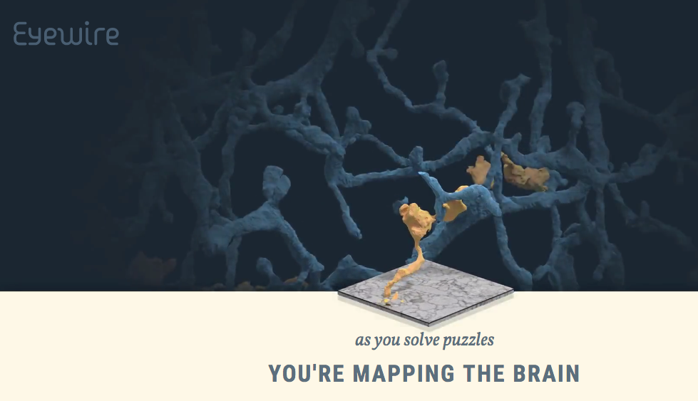

Slide 7
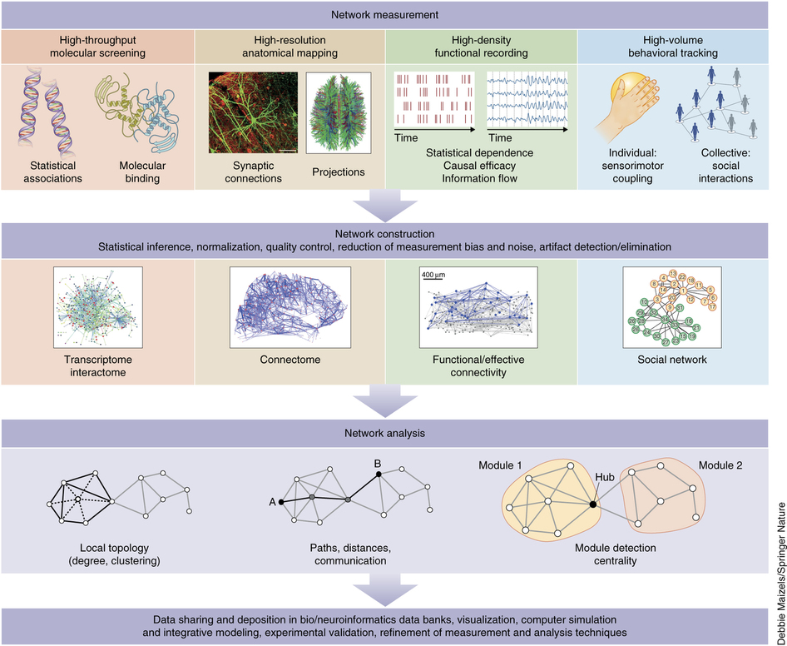
http://www.nature.com/neuro/journal/v20/n3/full/nn.4502.html

Slide 8
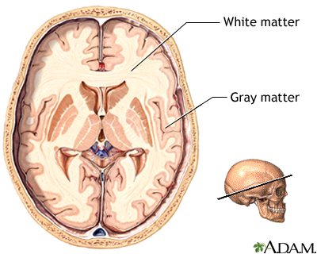
https://medlineplus.gov/ency/imagepages/18117.htm
The tissue called "gray matter" in the brain and spinal cord is made up of cell bodies.
"White matter” is composed of nerve fibers (axons).

Slide 9
Brain contains
80 billion neurons
connected thru 100 trillion synapses
http://eyewire.org/explore
https://en.wikipedia.org/wiki/Neuron#/media/File:Blausen_0657_MultipolarNeuron.png

Slide 10
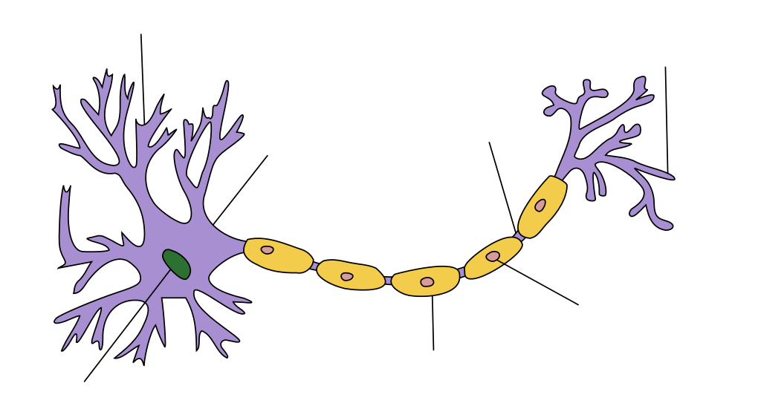
https://en.wikipedia.org/wiki/Axon#/media/File:Neuron_Hand-tuned.svg

Slide 11
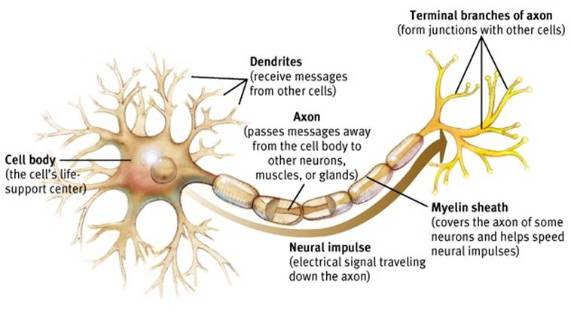
http://www.appsychology.com/Book/Biological/neuroscience.htm

Slide 12
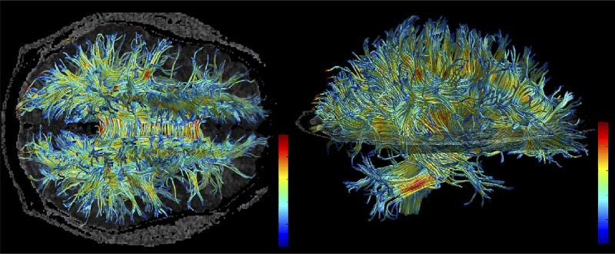
Fig. 6
Example of fiber tracking. High resolution data acquired on 3 Tesla magnet and post-processed using automated tracking procedure. Voxels within fiber bundles are color coded according to their FA values (i.e., blue, low anisotropy; and red, high anisotropy).
A review of diffusion tensor imaging studies in schizophrenia
Marek Kubicki, Robert McCarley, Carl-Fredrik Westin, Hae-Jeong Park, Stephan Maier,Ron Kikinis, Ferenc A. Jolesz, Martha E. Shenton J Psychiatr Res. 2007 Jan–Feb; 41(1-2): 15–30.
https://www.ncbi.nlm.nih.gov/pmc/articles/PMC2768134/

Slide 13
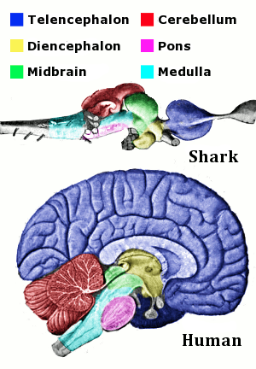
https://en.wikipedia.org/wiki/File:Vertebrate-brain-regions_small.png

Slide 14
http://www.nature.com/nature/journal/v536/n7615/full/nature18933.html
http://humanconnectome.org/about/pressroom/tag/brain-parcellation/
The ultimate brain map nature video
https://youtu.be/UHDfvfYCY0U

Slide 15
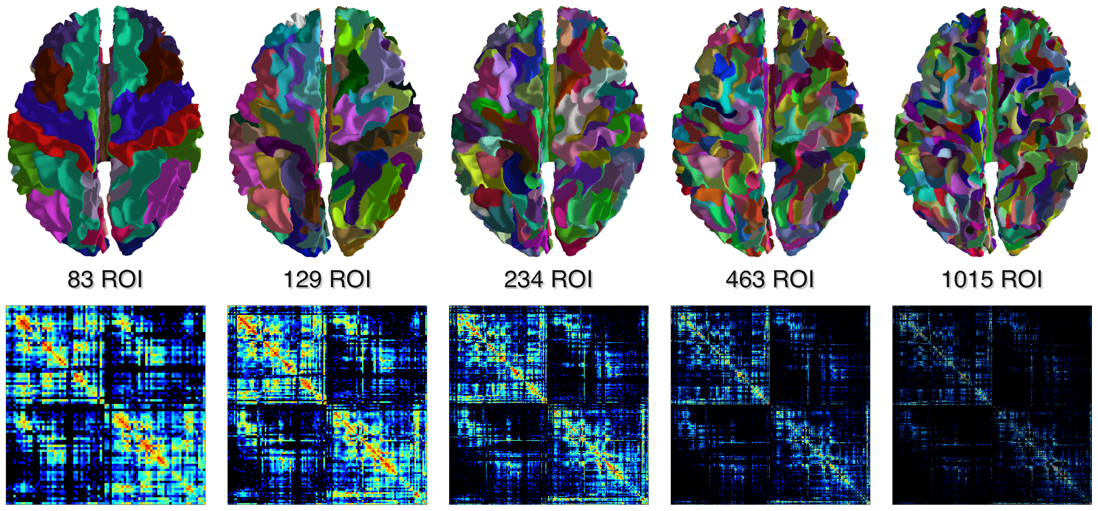
Figure 4. Multi-scale connectomes. The five multi-scale atlases derived from the Desikan-Killiany's anatomical atlas implemented in Freesurfer, and the corresponding connectivity matrices.
The Connectome Mapper: An Open-Source Processing Pipeline to Map Connectomes with MRI
Alessandro Daducci Stephan Gerhard Alessandra Griffa Alia Lemkaddem Leila Cammoun Xavier Gigandet Reto Meuli Patric Hagmann Jean-Philippe Thiran December 18, 2012
http://journals.plos.org/plosone/article?id=10.1371/journal.pone.0048121

Slide 16
Pattern Visualization of Human Connectome Data
Yishi Guo, Yang Wang, Shiaofen Fang, Hongyang Chao, Andrew J. Saykin, and Li Shen
Eurograph IEEE VGTC Symp Vis. 2012; 2012: 78–83.
doi: 10.2312/PE/EuroVisShort/EuroVisShort2012/078-083

Slide 17
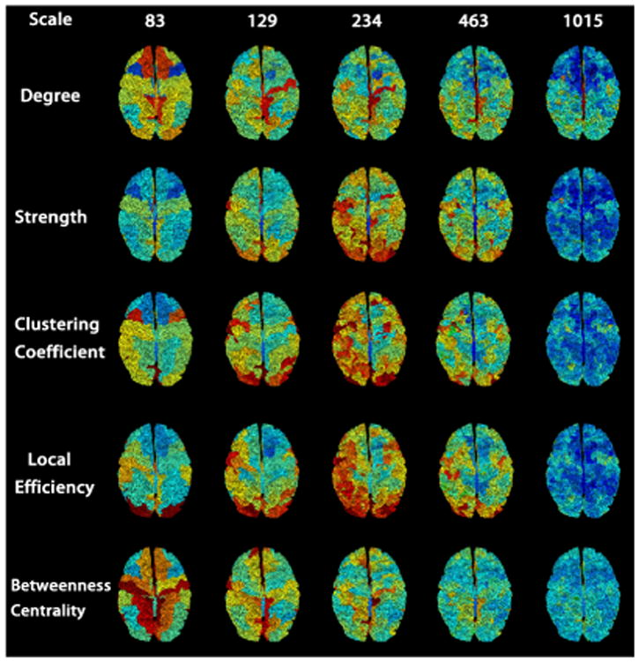
https://www.ncbi.nlm.nih.gov/pmc/articles/PMC4469287/

Slide 18
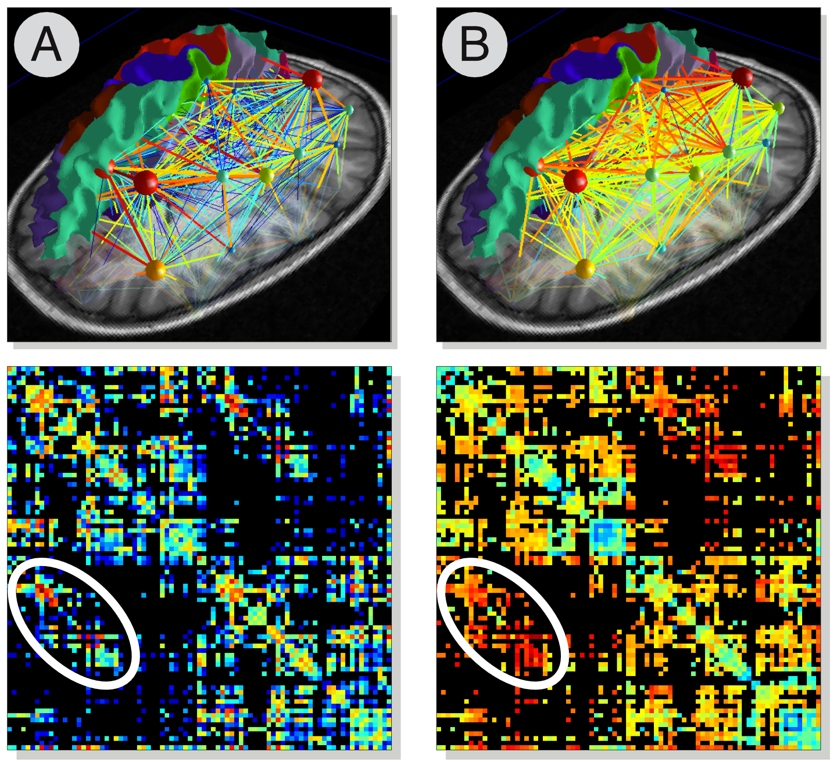
Figure 6. Multi-variate
connectomes.
Example of weighted
connectomes computed
using different measures
for quantifying the
connectivity strength
between each pair of
regions. In (A) the weight
of each edge is proportional
to the number of
connecting fibres
(logarithmic scale), while
in (B) the average GFA along
the bundles was used
instead. The
inter-hemispheric
connections are highlighted
here in white: although
they do not differ much in
number from the rest of the brain, they clearly manifest a higher GFA as they pass through the Corpus Callosum.
https://doi.org/10.1371/journal.pone.0048121.g006

Slide 19
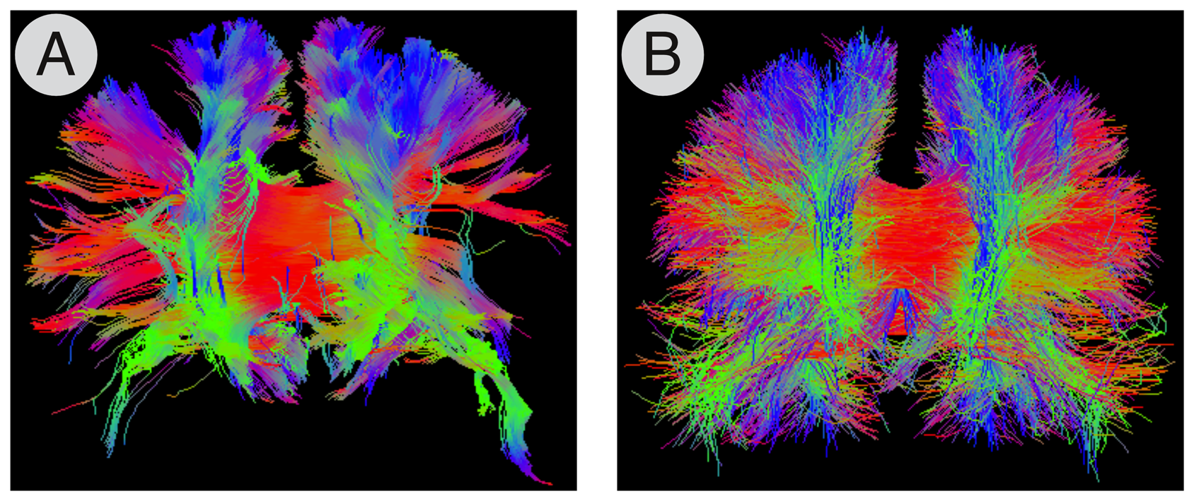
Figure 7. Whole-brain tractography.
Example tractograms estimated with (A) the standard deterministic streamline and (B) the global tractography approach [26].
https://doi.org/10.1371/journal.pone.0048121.g007

Slide 20
https://arxiv.org/format/1608.03520
In this network, nodes correspond to 83 brain regions defined by the Lausanne parcellation [26] and
edges correspond to the density of white matter tracts between node pairs
Data from 8 healthy adults scanned in triplicate
Compared group average to individual to minimally wired null network model.

Slide 21
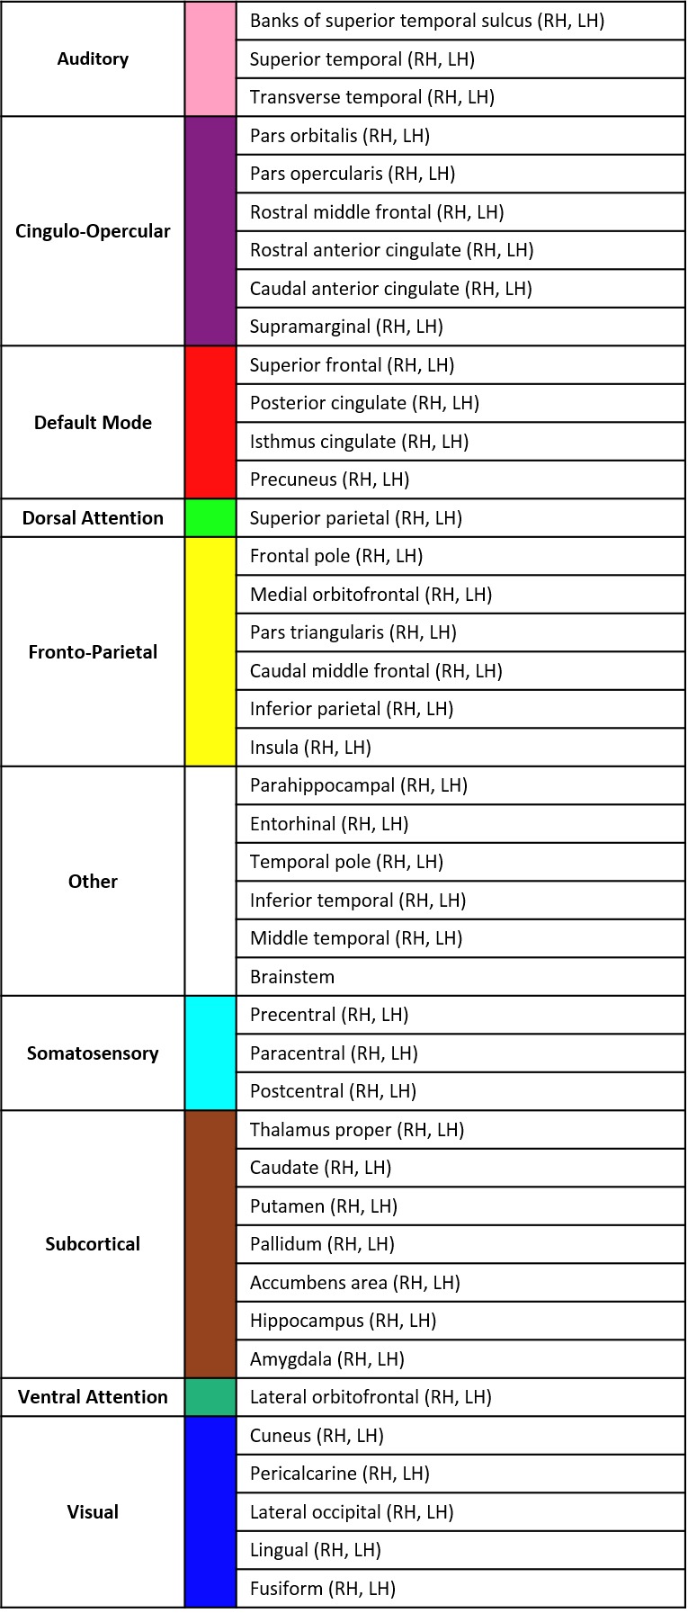

Slide 22
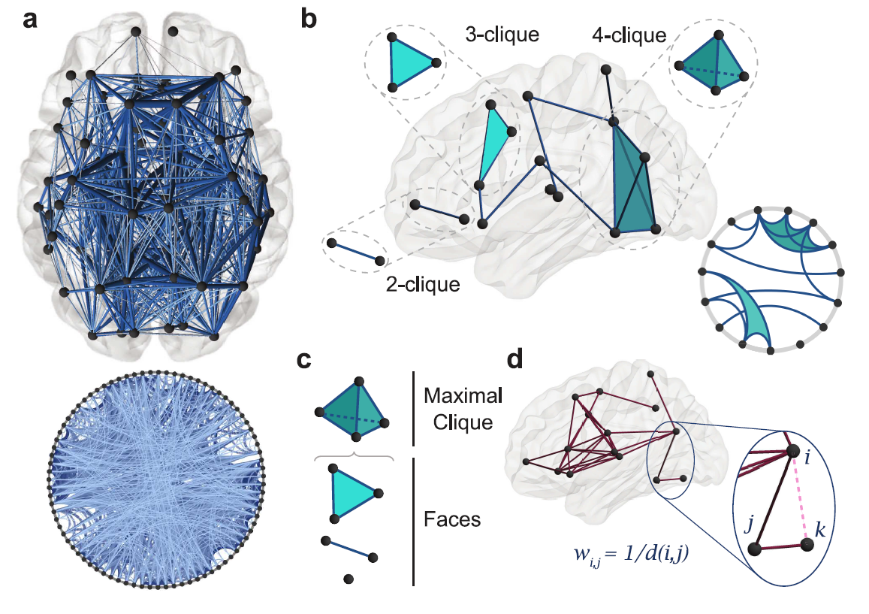
d.) For statistical validation, we construct a minimally wired null model by linking brain regions by edge weights equal to the inverse of the Euclidean distance between nodes corresponding to brain region centers. Here we show an example of this scheme on 15 randomly chosen brain regions

Slide 23
Spatial distribution of maximal cliques varies between average DSI and minimally wired null model.
(a) Distribution of maximal cliques in the average DSI (black) and individual minimally wired (gray) networks, thresholded at an edge density of ρ = 0.25. Heat maps of node participation on the brain for a range of clique degrees equal to
4--6 (left),
8--10 (middle), and
12--16 (right).

Slide 24
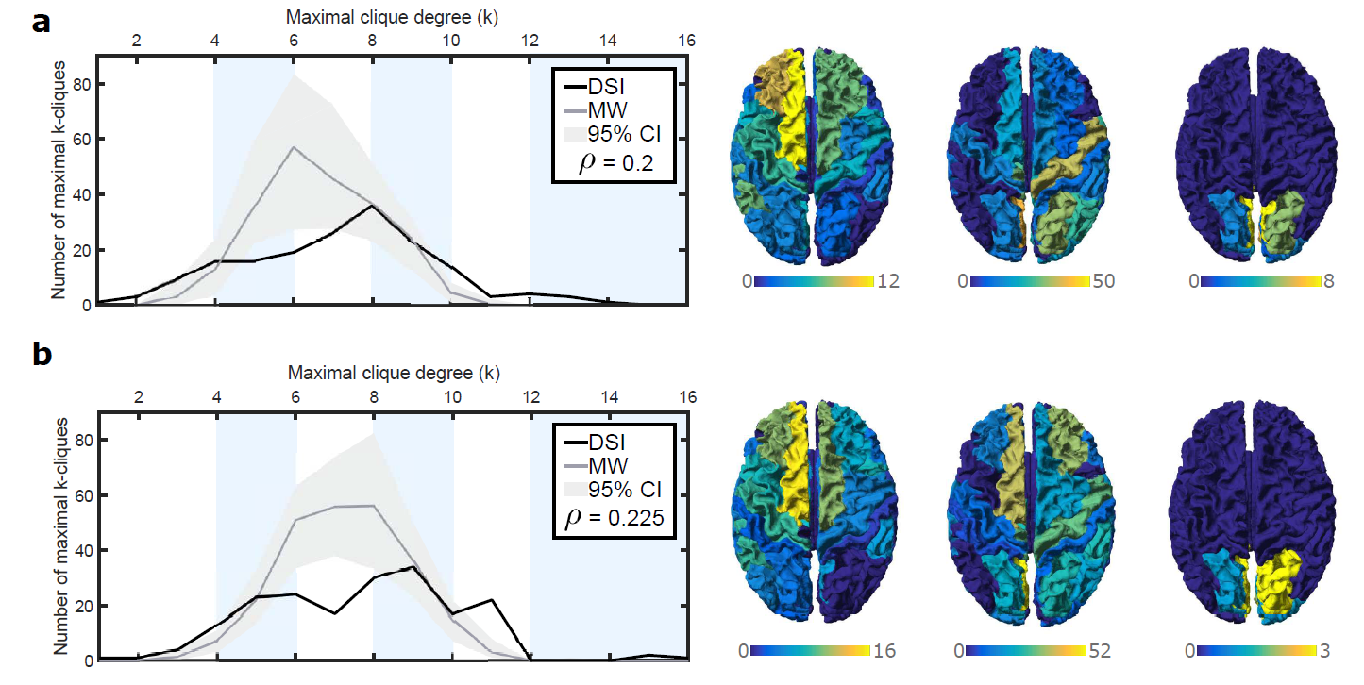
Maximal clique distribution and spatial organization at multiple edge densities.
(a) Distribution of maximal cliques in DSI and minimally wired null model at ρ = 0.2 (left).
Heat maps of node participation on the brain for maximal clique degrees
4-6 (left), 8-10 (middle), 12-16 (right).
(b) Plots as in (a) at ρ = 0.225

Slide 26
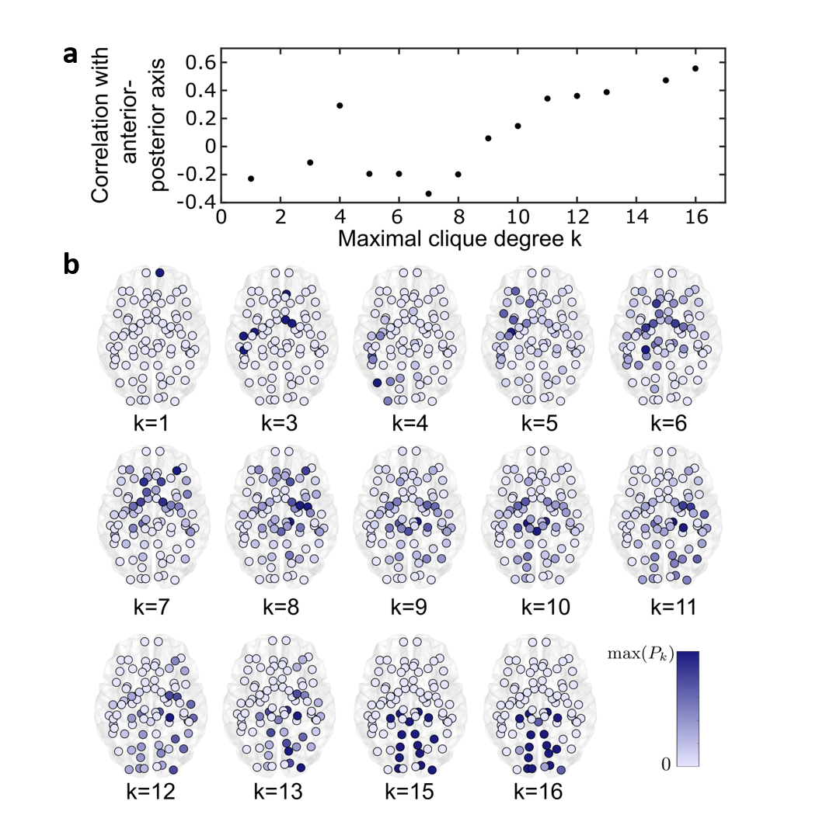

Slide 27
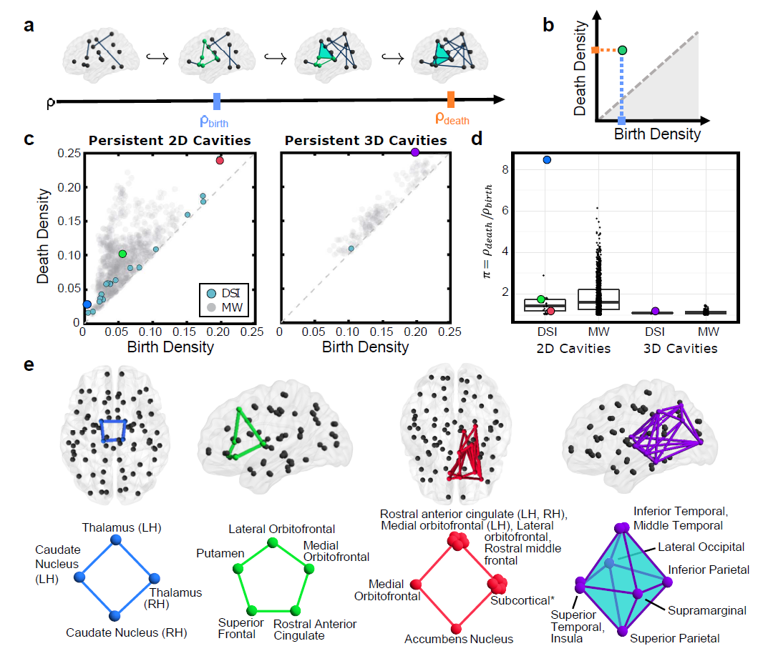

Slide 29
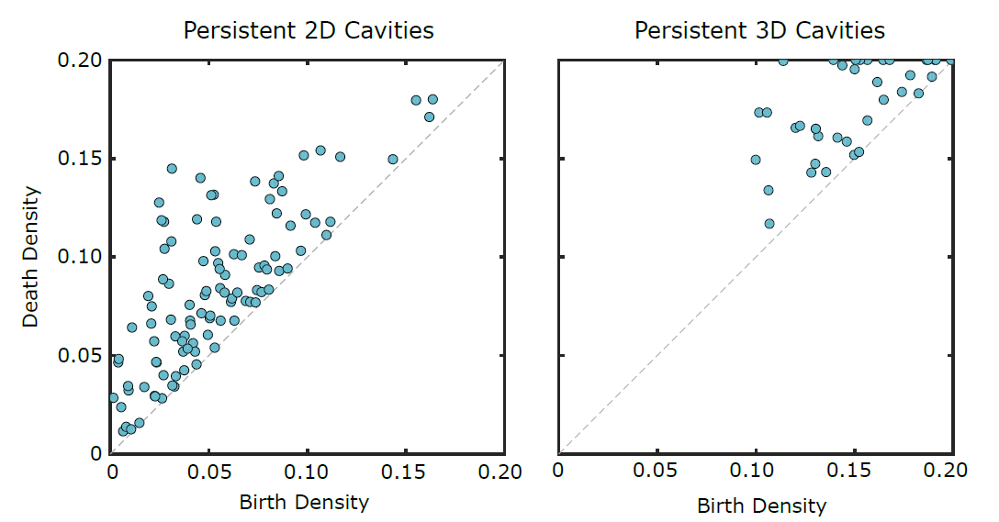
Persistence diagram of the structural connectome with the AAL 90 parcellation

Slide 35
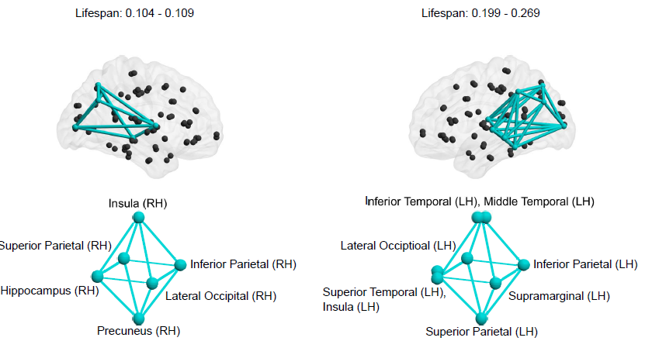

Slide 36
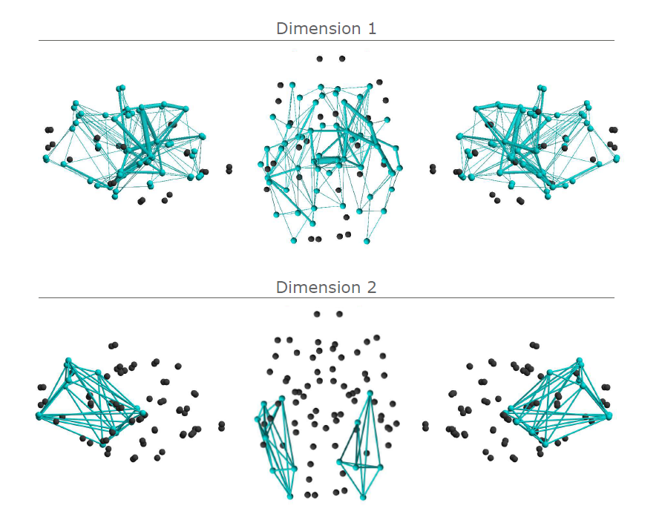

Slide 38
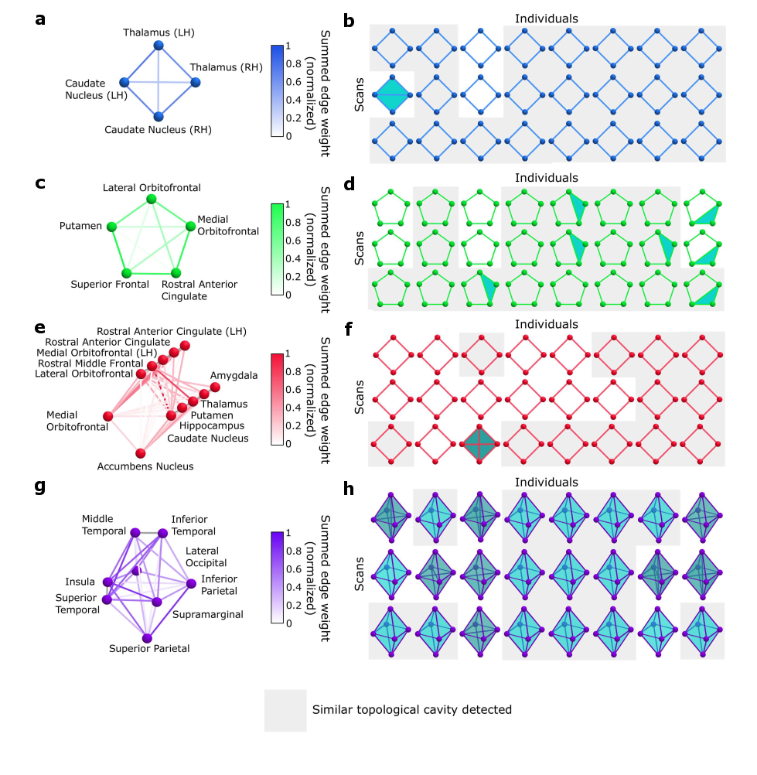

Slide 39
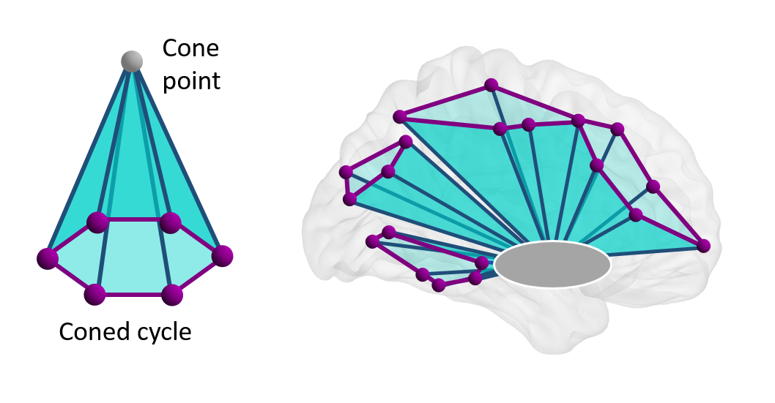

Slide 40
Removal of subcortical nodes allows for detection of nine-node cortical cycle

Slide 41
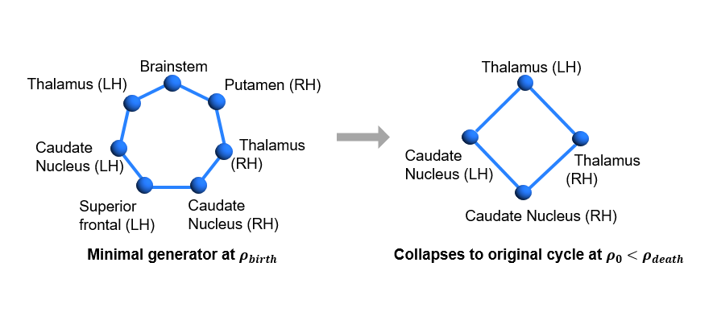

Slide 42
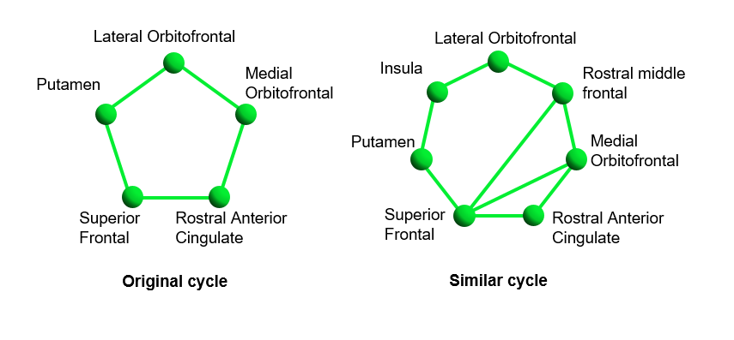

Slide 43
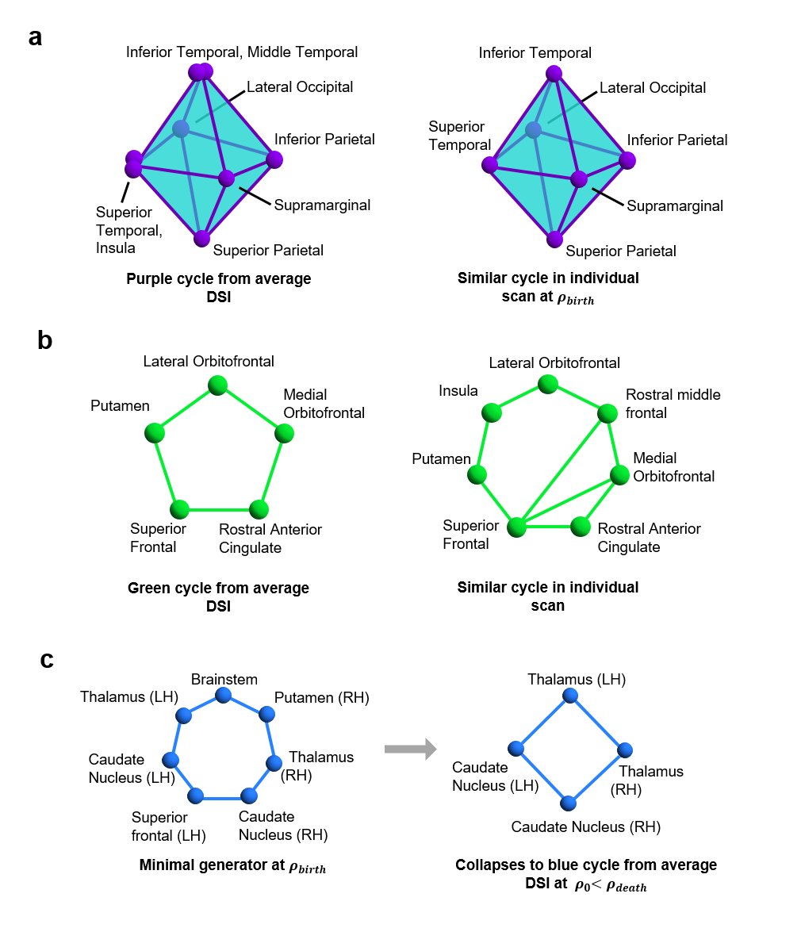

Slide 44
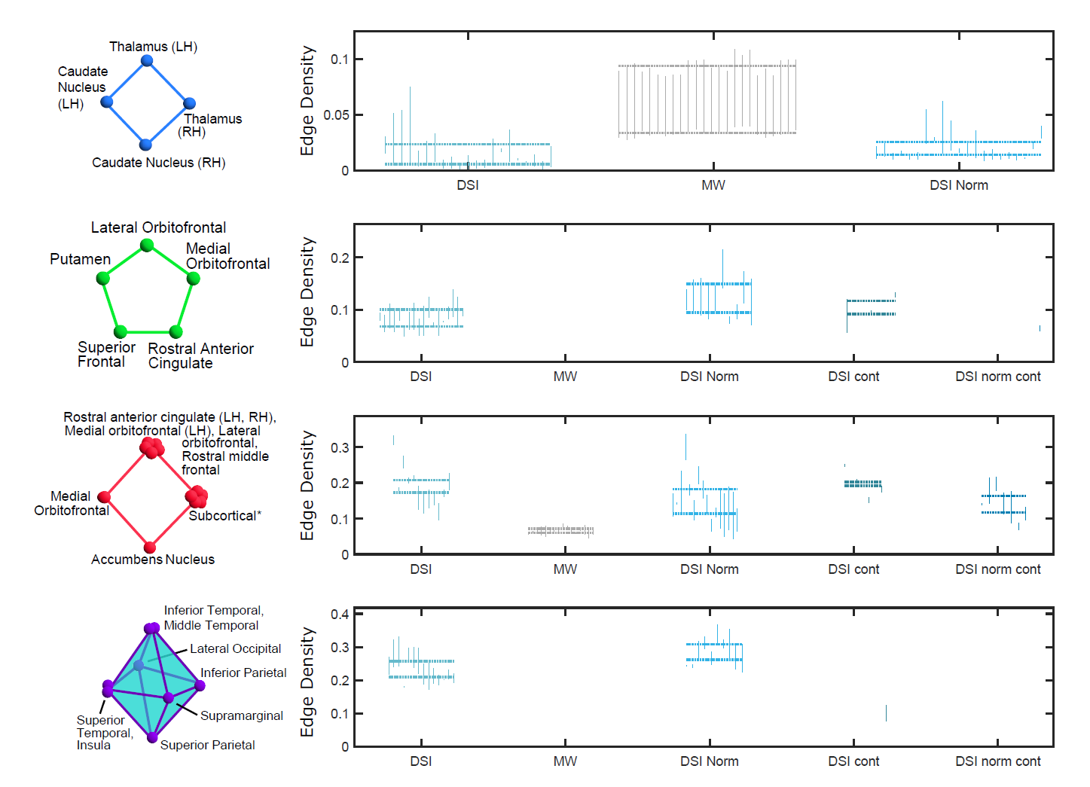

Slide 45
