Slide 1
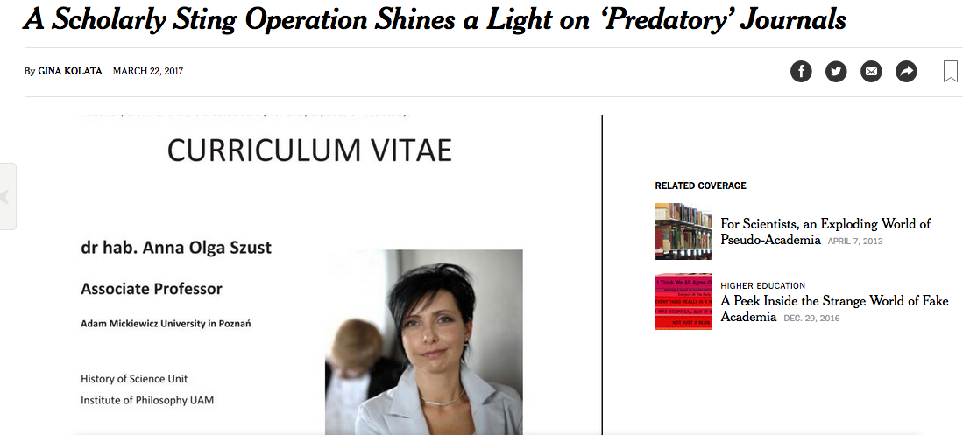
https://www.nytimes.com/2017/03/22/science/open-access-journals.html

Slide 2
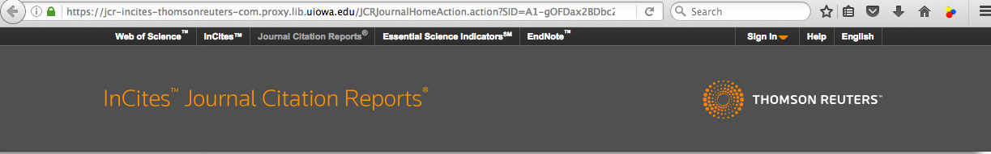
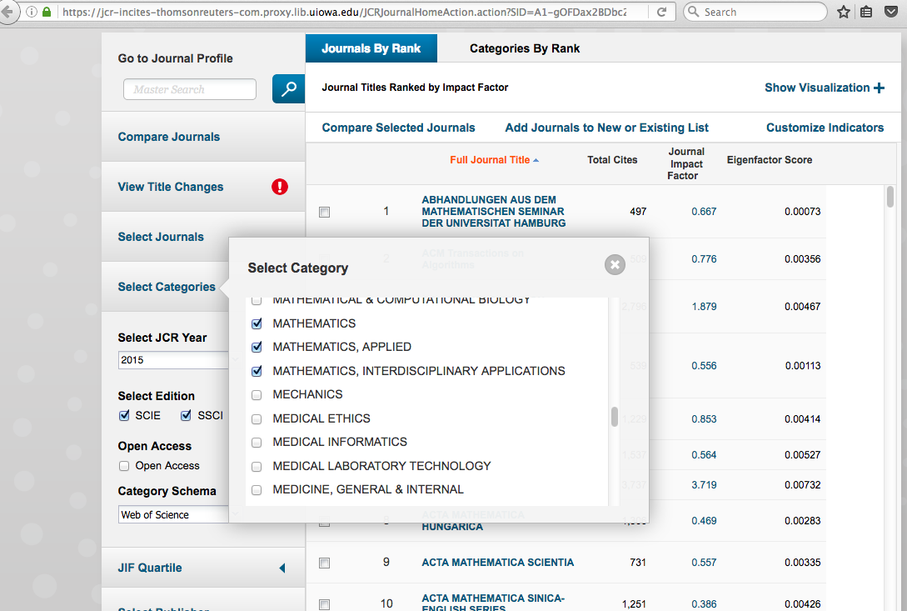
Web of Science Journal Citation Reports

Slide 4
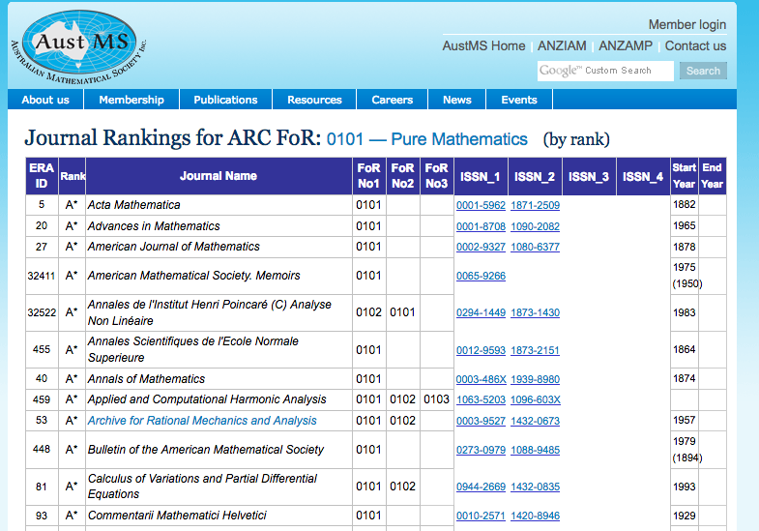
http://www.austms.org.au/Rankings/0101_AustMS_final_ranked.html

Slide 5
http://www.austms.org.au/Rankings/0101_AustMS_final_ranked.html

Slide 6
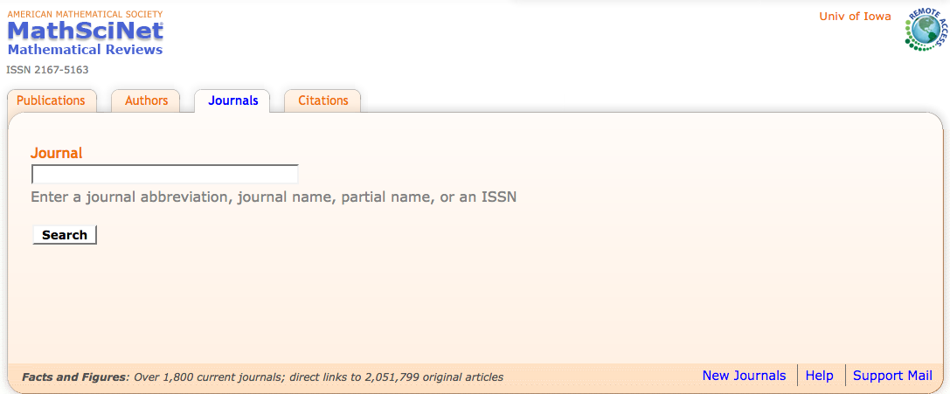
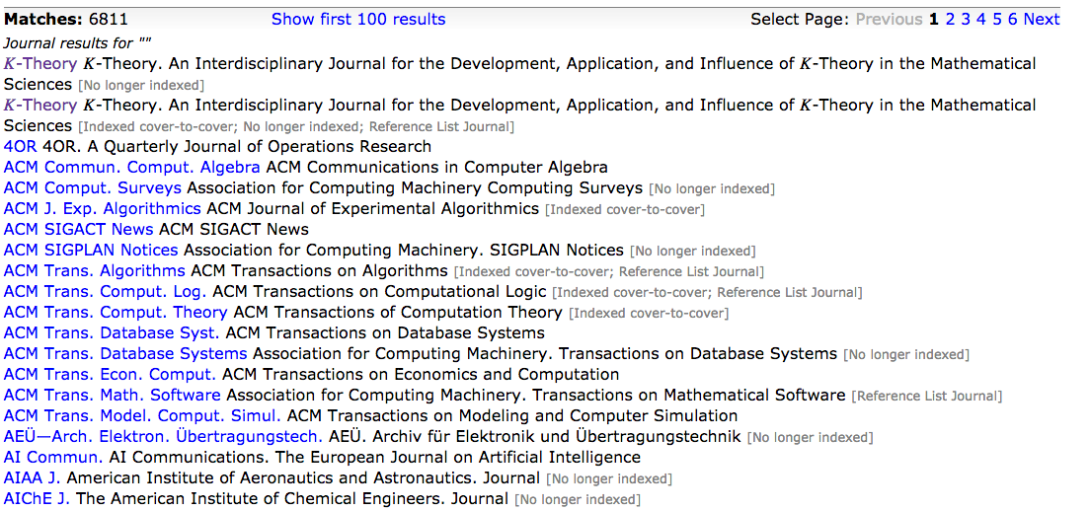

Slide 8
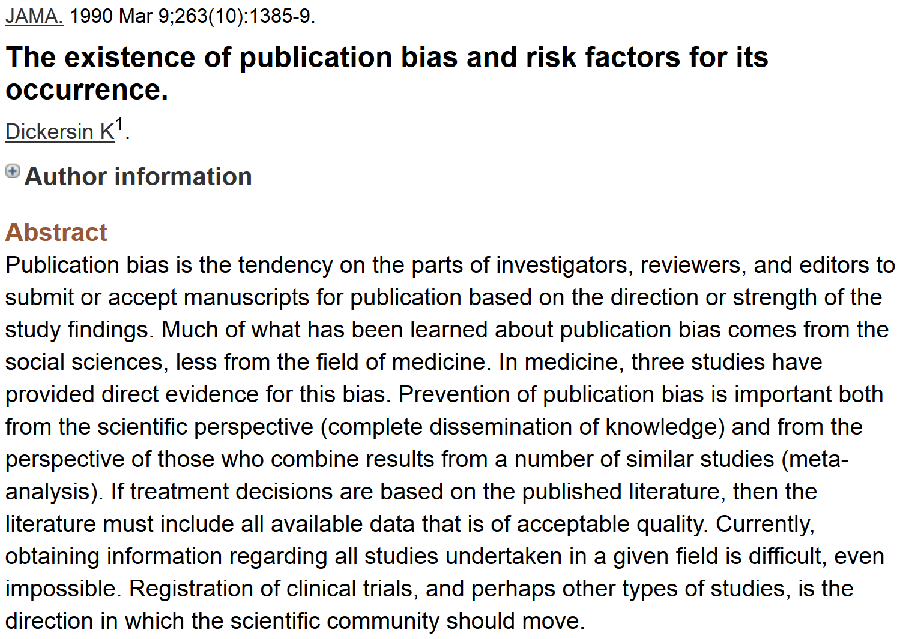
http://www.ncbi.nlm.nih.gov/pubmed/2406472?dopt=Abstract&holding=npg

Slide 9
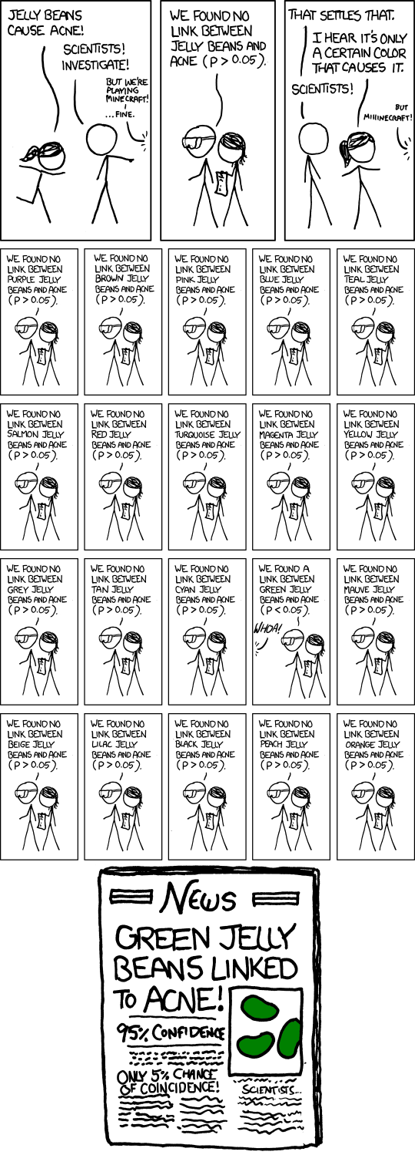
False Positives will occur
https://xkcd.com/882/

Slide 10
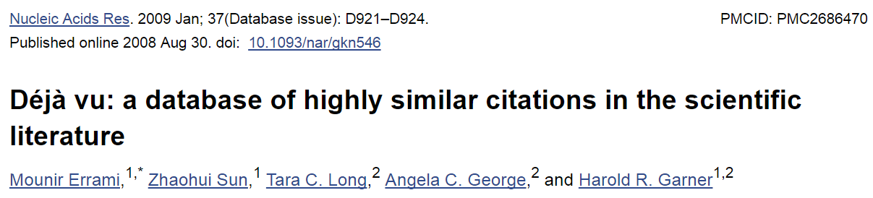
https://www.ncbi.nlm.nih.gov/pmc/articles/PMC2686470/
ABSTRACT
In the scientific research community, plagiarism and covert multiple publications of the same data are considered unacceptable because they undermine the public confidence in the scientific integrity. Yet, little has been done to help authors and editors to identify highly similar citations, which sometimes may represent cases of unethical duplication. For this reason, we have made available Déjà vu, a publicly available database of highly similar Medline citations identified by the text similarity search engine eTBLAST. Following manual verification, highly similar citation pairs are classified into various categories ranging from duplicates with different authors to sanctioned duplicates. Déjà vu records also contain user-provided commentary and supporting information to substantiate each document's categorization. Déjà vu and eTBLAST are available to authors, editors, reviewers, ethicists and sociologists to study, intercept, annotate and deter questionable publication practices. These tools are part of a sustained effort to enhance the quality of Medline as ‘the’ biomedical corpus. The Déjà vu database is freely accessible at http://spore.swmed.edu/dejavu. The tool eTBLAST is also freely available at http://etblast.org.

Slide 11
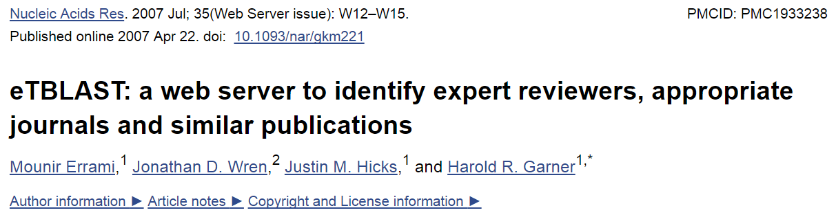
https://www.ncbi.nlm.nih.gov/pmc/articles/PMC1933238/
ABSTRACT
Authors, editors and reviewers alike use the biomedical literature to identify appropriate journals in which to publish, potential reviewers for papers or grants, and collaborators (or competitors) with similar interests. Traditionally, this process has either relied upon personal expertise and knowledge or upon a somewhat unsystematic and laborious process of manually searching through the literature for trends. To help with these tasks, we report three utilities that parse and summarize the results of an abstract similarity search to find appropriate journals for publication, authors with expertise in a given field, and documents similar to a submitted query. The utilities are based upon a program, eTBLAST, designed to identify similar documents within literature databases such as (but not limited to) MEDLINE. These services are freely accessible through the Internet at http://invention.swmed.edu/etblast/etblast.shtml, where users can upload a file or paste text such as an abstract into the browser interface.

Slide 12
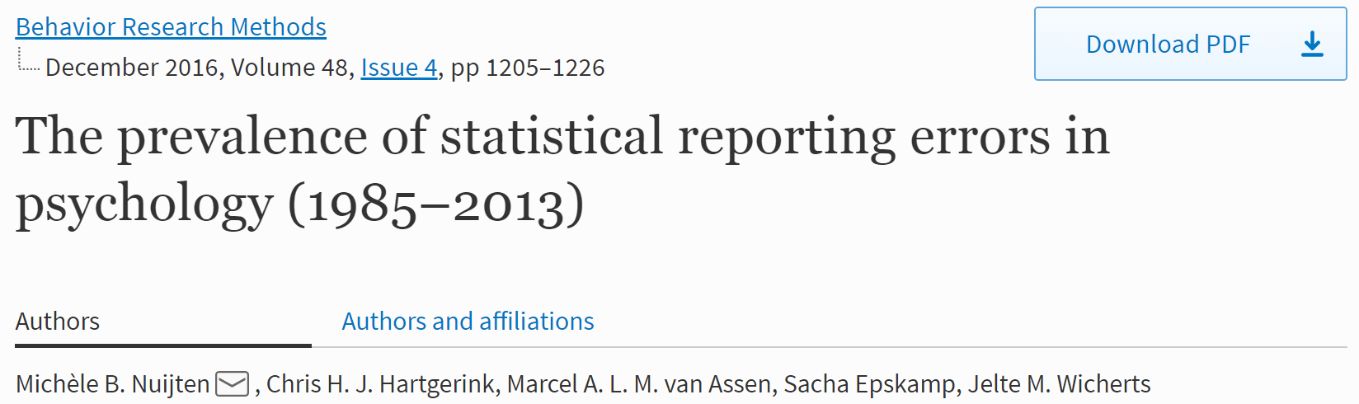
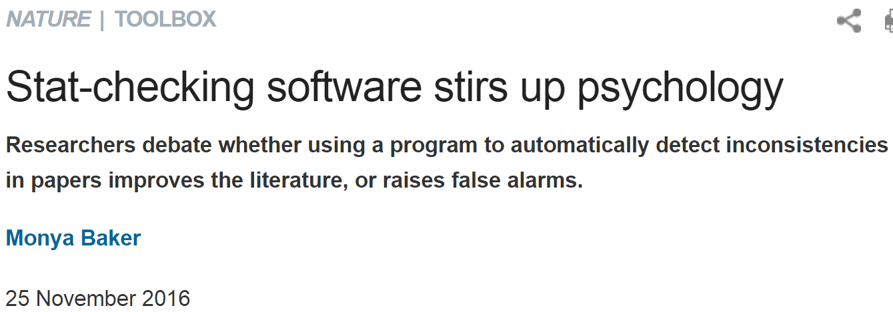
https://link.springer.com/article/10.3758%2Fs13428-015-0664-2
http://www.nature.com/news/stat-checking-software-stirs-up-psychology-1.21049

Slide 13
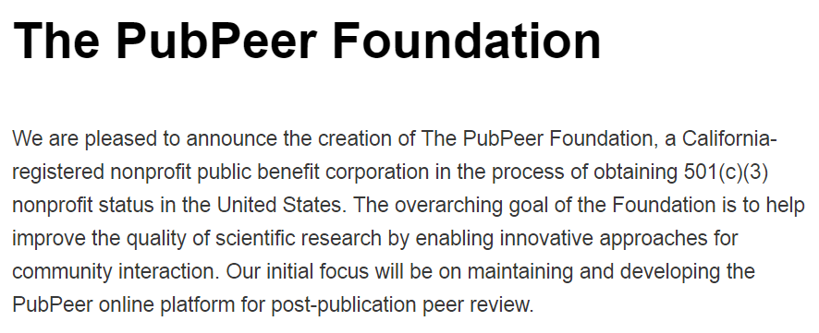
http://blog.pubpeer.com/?p=190

Slide 14
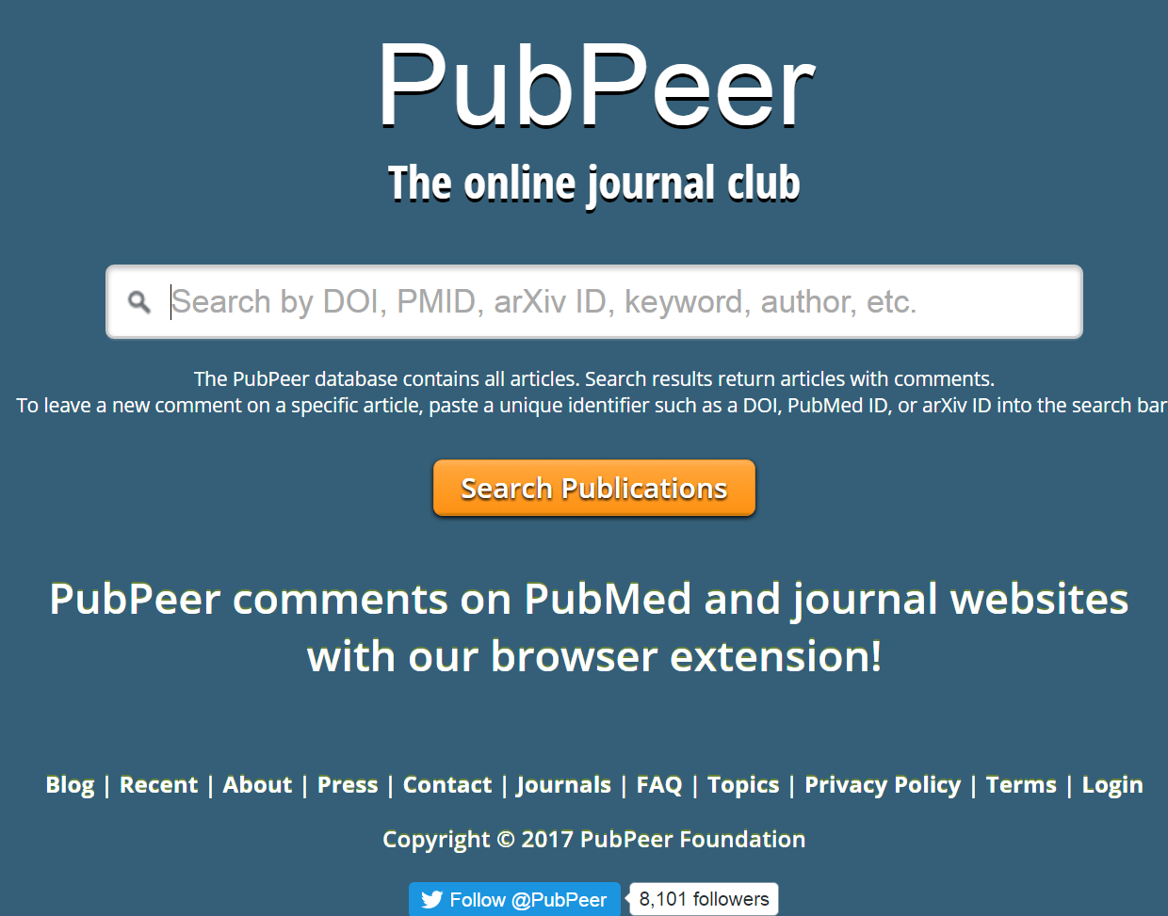
https://pubpeer.com

Slide 15
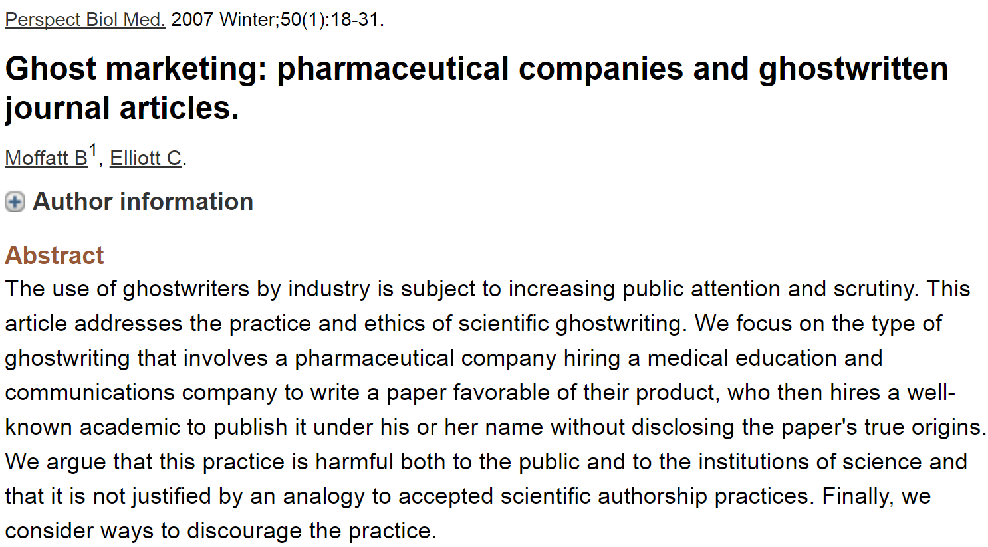
Most journals now require at least a conflicts of interest statement.
Many also require author contribution list.

Slide 16
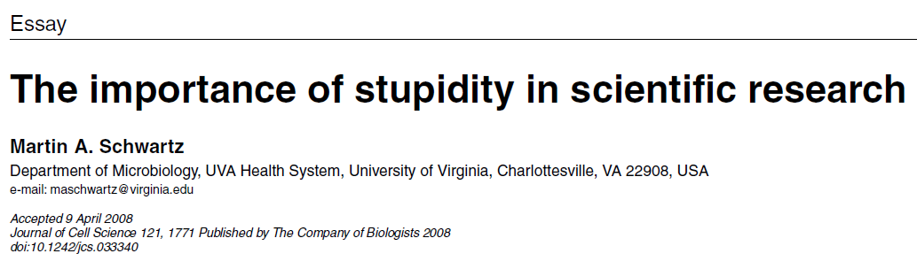
http://jcs.biologists.org/content/121/11/1771
I'd like to suggest that our Ph.D. programs often do students a disservice in two ways. First, I don't think students are made to understand how hard it is to do research. And how very, very hard it is to do important research. It's a lot harder than taking even very demanding courses. What makes it difficult is that research is immersion in the unknown. We just don't know what we're doing. We can't be sure whether we're asking the right question or doing the right experiment until we get the answer or the result.

Slide 17
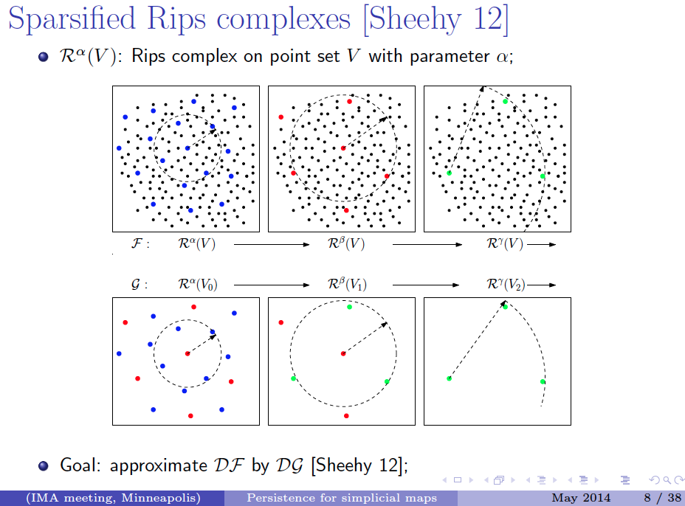
http://web.cse.ohio-state.edu/~tamaldey/paper/simplicial-map/simplicial-map.pdf

Slide 18
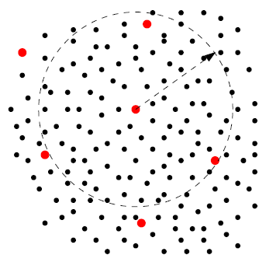

D ⊆ V is a δ-net of V if
(i) ∀ v ∈ V , ∃ d ∈ D such that ||v − d|| ≤ δ; and
(ii) no two points in D are within δ distance.
> δ
≤ δ

Slide 19
Choosing a δ-net :
Maxmin
1.) choose point l₁ randomly
2.) If {l₁, …, l_{k-1}} have been chosen, choose l_{k} such that {l₁, …, l_{k-1}} is in D - {l₁, …, l_{k-1}} and
min {d(l_{k}, l₁), …, d(l_{k}, l_{k-1})} ≥ min {d(v, l₁), …, d(v, l_{k-1})}

Slide 20
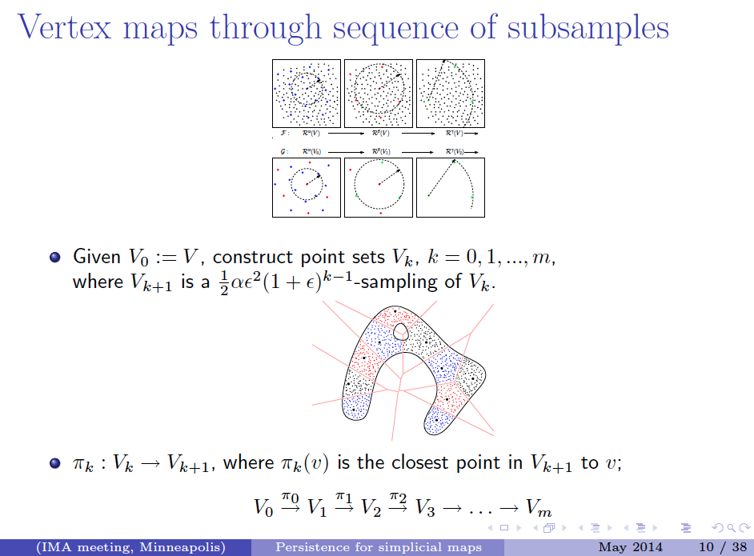
www.cse.ohio-state.edu/~tamaldey/talk/simplicial-map/PersistenceForSimplicialMap.pdf

Slide 21
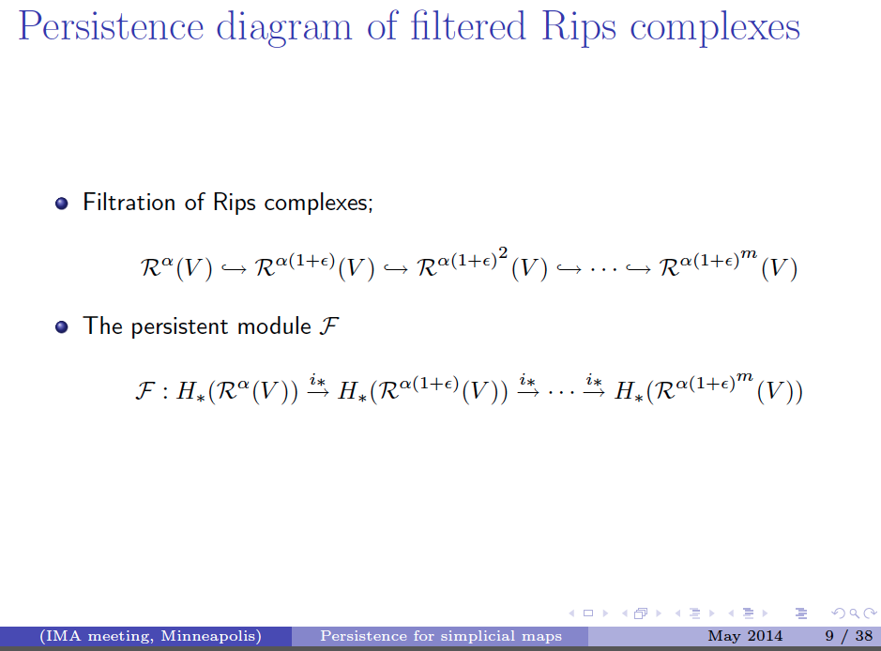
www.cse.ohio-state.edu/~tamaldey/talk/simplicial-map/PersistenceForSimplicialMap.pdf

Slide 22
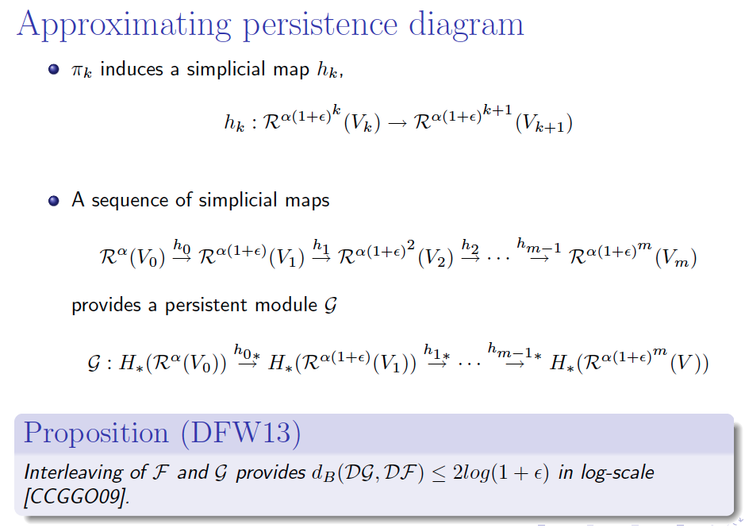
www.cse.ohio-state.edu/~tamaldey/talk/simplicial-map/PersistenceForSimplicialMap.pdf

Slide 23
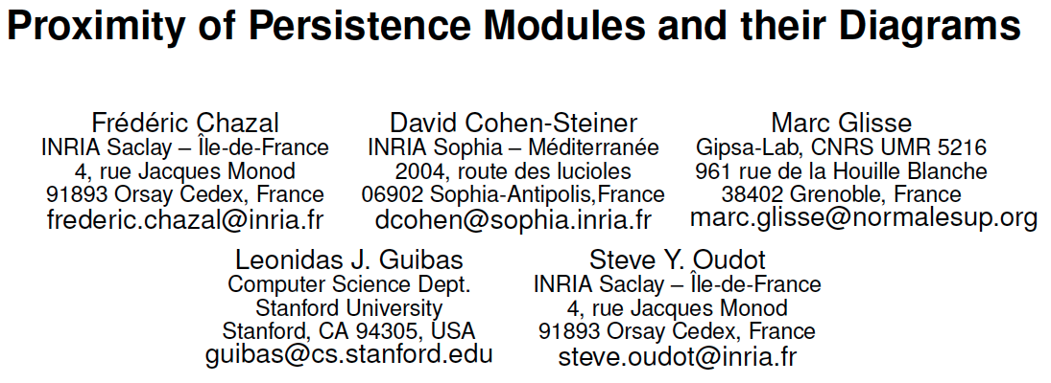
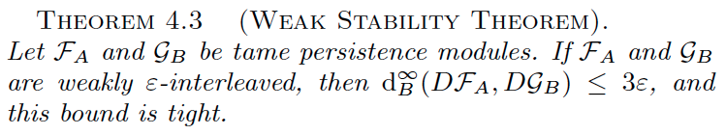
geometrica.saclay.inria.fr/team/Fred.Chazal/papers/socg09.pdf

Slide 24
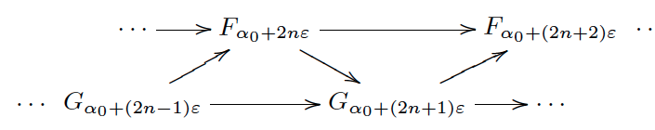

Slide 25
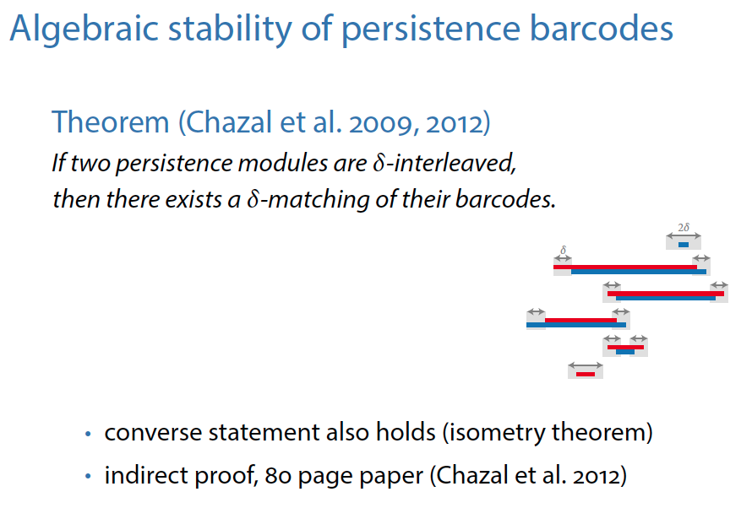
http://cmup.fc.up.pt/cmup/omgtp/2015/docs/Bauer_induced-matchings-talk.pdf
Ulrich Bauer

Slide 26
www.cse.ohio-state.edu/~tamaldey/talk/simplicial-map/PersistenceForSimplicialMap.pdf

