Slide 1
Let σ_{i} be a k-simplex.
Defn: degree of σ_{i} = deg σ_{i}
= time when σ_{i} enters the filtration. .
deg a = deg b = 0; deg c = deg d = deg ab = deg bc = 1
http://link.springer.com/article/10.1007%2Fs00454-004-1146-y

Slide 2
Let σ_{i} be a k-simplex.
Defn: degree of σ_{i} = deg σ_{i}
= time when σ_{i} enters the filtration. .
Defn: deg t^{n} σ_{i} = n + deg σ_{i}
A polynomial is homogeneous if all terms have the same degree: t³a – t²c + ac is in C³
http://link.springer.com/article/10.1007%2Fs00454-004-1146-y

Slide 3
Let { e_{j} } be a be a homogeneous basis for C_{k}
Let { e_{i} } be a be a homogeneous basis for C_{k-1}
deg e_{i} + deg M_{k}(i, j) = deg e_{j}
_{k}
C_{k} → C_{k-1}
_{i, p}
H_{k} =
Z_{k} / ( B_{k} Z_{k} )
_{i}
_{i+p}
_{i}
U

Slide 4
H₀ = < a, b, c, d : tc + td, tb + c, ta + tb>
H₁ = <z₁, z₂ : t z₂, t³z₁ + t²z₂ >
[ )
[ )
[ )
[ )
[
z₁ = ad + cd + t(bc) + t(ab), z₂ = ac + t²bc + t²ab

Slide 5
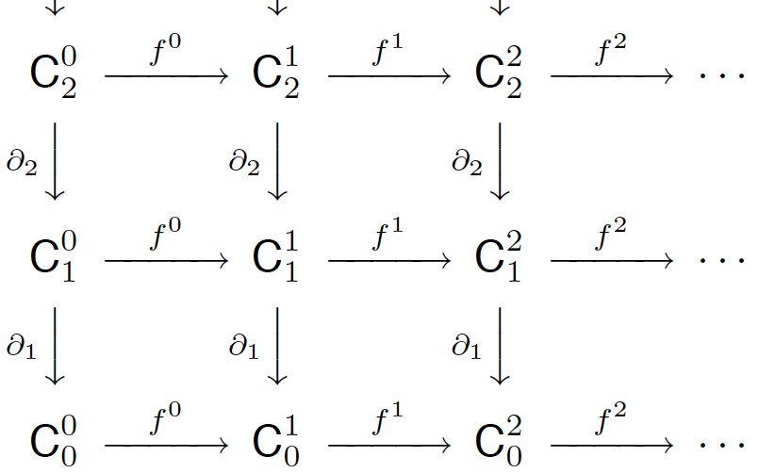
p-persistent k^{th} homology group:
_{i, p}
_{i}
_{i+p}
_{i}
H_{k} = Z_{k} / ( B_{k} Z_{k} )
U
http://link.springer.com/article/10.1007%2Fs00454-004-1146-y

Slide 6
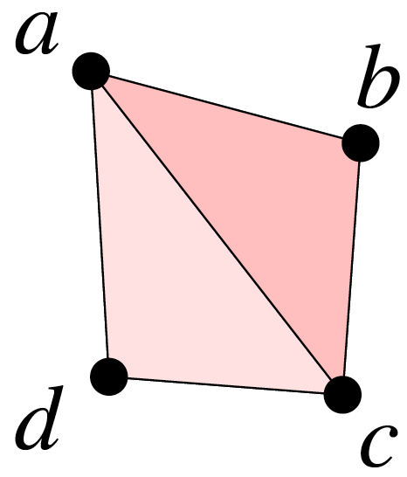
₃
→
C₂ = Z₂[abc, acd]
C₁ = Z₂[ab, bc, ac, ad, cd]
C₀ = Z₂[a, b, c, d]
₂
→
₁
→
→
₀
0

Slide 7
₃
→
C₂ = Z₂[abc, acd]
C₁ = Z₂[ab, bc, ac, ad, cd]
C₀ = Z₂[a, b, c, d]
₂
→
₁
→
+
+
+
+
+
C_{k} = C₀ C₁ C₂ C₃ …
→
₀
0

Slide 8
₃
→
C₂ = Z₂[abc, acd]
C₁ = Z₂[ab, bc, ac, ad, cd]
C₀ = Z₂[a, b, c, d]
₂
→
₁
+
+
+
→
C_{k} = C₀ C₁ C₂
→
₀
0

Slide 9
₃
→
C₂ = Z₂[abc, acd]
C₁ = Z₂[ab, bc, ac, ad, cd]
C₀ = Z₂[a, b, c, d]
₂
→
₁
+
+
+
→
C_{k} = C₀ C₁ C₂
→
a + b + bc + abc + acd
₀
0

Slide 10
₃
→
C₂ = Z₂[abc, acd]
C₁ = Z₂[ab, bc, ac, ad, cd]
C₀ = Z₂[a, b, c, d]
₂
→
₁
+
+
+
→
C_{k} = C₀ C₁ C₂
a + b bc abc + acd
(a + b, bc, abc + acd)
→
+
+
₀
0

Slide 11
₃
→
C₂ = Z₂[abc, acd]
C₁ = Z₂[ab, bc, ac, ad, cd]
C₀ = Z₂[a, b, c, d]
₂
→
₁
→
+
+
+
+
+
C_{k} = C₀ C₁ C₂ C₃ …
: C_{k} → C_{k}
+
+
→
₀
0
(0, ab, 0) = (a + b, 0, 0)
² = 0

Slide 12
₃
→
C₂ = Z₂[abc, acd]
C₁ = Z₂[ab, bc, ac, ad, cd]
C₀ = Z₂[a, b, c, d]
₂
→
₁
→
+
+
+
+
+
C_{k} = C₀ C₁ C₂ C₃ …
: C_{k} → C_{k}
+
+
→
₀
(0, ab, 0) = (a + b, 0, 0)
0
+
+
+
+
(0 ab 0) = a+b 0 0

Slide 13
₃
→
C₂ = Z₂[abc, acd]
C₁ = Z₂[ab, bc, ac, ad, cd]
C₀ = Z₂[a, b, c, d]
₂
→
₁
→
+
+
+
+
+
C_{k} = C₀ C₁ C₂ C₃ …
: C_{k} → C_{k}
+
+
→
₀
0

Slide 14
p-persistent k^{th} homology group:
_{i, p}
_{i}
_{i+p}
_{i}
H_{k} = Z_{k} / ( B_{k} Z_{k} )
U
http://link.springer.com/article/10.1007%2Fs00454-004-1146-y

Slide 15
⁰ ¹ ² ³ ⁴ ⁵
C_{j} → C_{j} → C_{j} → C_{j} → C_{j} → C_{j}

Slide 16
⁰ ¹ ² ³ ⁴ ⁵
C₀ → C₀ → C₀ → C₀ → C₀ → C₀

Slide 17
⁰ ¹ ² ³ ⁴ ⁵
C₀ → C₀ → C₀ → C₀ → C₀ → C₀ →…
+
<a, b> <c, d, ta, tb> <tc, td, t²a, t²b> …
C₀ =
+
+
+
^{i}
(a, c + ta, tc + t²b, t²c, t⁴b, t⁵b, t⁶b, … )

Slide 18
⁰ ¹ ² ³ ⁴ ⁵
C₀ → C₀ → C₀ → C₀ → C₀ → C₀ →…
+
<a, b> <c, d, ta, tb> <tc, td, t²a, t²b> …
C₀ =
+
+
+
^{i}
(a, c + ta, tc + t²b, t²c, t⁴b, t⁵b, t⁶b, … )
t • (a, c + ta, tc + t²b, t²c, t⁴b, t⁵b, t⁶b, … )
= (0, ta, tc + t²a, t²c + t³b, t³c, t⁵b, t⁶b, t⁷b, … )

Slide 19
H₀ = < a, b, c, d : tc + td, tb + c, ta + tb>
[ )
[ )
[

Slide 20
⁰ ¹ ² ³ ⁴ ⁵
C₀ → C₀ → C₀ → C₀ → C₀ → C₀ →…
+
<a, b> <c, d, ta, tb> <tc, td, t²a, t²b> …
C₀ =
+
+
+
^{i}
a: Z₂[t] b: Z₂[t] c: Σ¹ Z₂[t] d: Σ¹ Z₂[t]

Slide 21
⁰ ¹ ² ³ ⁴ ⁵
C₀ → C₀ → C₀ → C₀ → C₀ → C₀ →…
+
<a, b> <c, d, ta, tb> <tc, td, t²a, t²b> …
C₀ =
+
+
+
^{i}
a: Z₂[t] b: Z₂[t] c: Σ¹ Z₂[t] d: Σ¹ Z₂[t]
acd: Σ⁵ Z₂[t]

Slide 22
H₀ = < a, b, c, d : tc + td, tb + c, ta + tb>
[ )
[ )
[

Slide 23
[ )
[ )
[
H₀ = < a, b, c, d : tc + td, tb + c, ta + tb>
a: Z₂[t] = {n₀ + n₁t + n₂t² + … + n_{k}t^{k} : n_{i} in Z₂, k in Z₊}
= { (n₀, n₁, n₂, …, n_{k}, 0, 0, … ) : n_{i} in Z₂, k in Z₊}

Slide 24
[ )
[ )
[
H₀ = < a, b, c, d : tc + td, tb + c, ta + tb>
Z₂[t] = {n₀ + n₁t + n₂t² + … : n_{i} in Z₂}
b: Z₂[t]/t = {n₀ : n₀ in Z₂} = Z₂
= { (n₀, 0, 0, 0,… ) : n_{i} in Z₂}

Slide 25
[ )
[ )
[
H₀ = < a, b, c, d : tc + td, tb + c, ta + tb>
Z₂[t] = {n₀ + n₁t + n₂t² + … : n_{i} in Z₂}
d: Σ¹ Z₂[t]/t = Σ¹ {n₀ : n₀ in Z₂}
= { (0, n₀, 0, 0, 0, …) : n₀ in Z₂}

Slide 26
[ )
[ )
[
H₀ = < a, b, c, d : tc + td, tb + c, ta + tb>
Z₂[t] = {n₀ + n₁t + n₂t² + … : n_{i} in Z₂}
c: Σ¹ Z₂[t]/1 = { (0, 0, 0, … ) }

Slide 27
⁰ ¹ ² ³ ⁴ ⁵
C₀ → C₀ → C₀ → C₀ → C₀ → C₀ →…
H₀ = < a, b, c, d : tc + td, tb + c, ta + tb>
a: Z₂[t] = {n₀ + n₁t + n₂t² + … n_{j}t^{j} : n_{i} in Z₂}
b: Z₂[t]/t = {n₀ : n₀ in Z₂} = Z₂
c: Σ¹ Z₂[t]/1 = {0}
d: Σ¹ Z₂[t]/t = {n₀ : n₀ in Z₂} = {(0, n₀, 0, 0, 0, …)}

Slide 28
H₀ = < a, b, c, d : tc + td, tb + c, ta + tb>
= Z₂[t] Z₂[t]/t (Σ¹ Z₂[t])/t
[ )
[ )
[
+
+

Slide 29
H₀ = < a, b, c, d : tc + td, tb + c, ta + tb>
H₁ = <z₁, z₂ : t z₂, t³z₁ + t²z₂ >
[ )
[ )
[ )
[ )
[
z₁ = ad + cd + t(bc) + t(ab), z₂ = ac + t²bc + t²ab

Slide 30
H₀ = < a, b, c, d : tc + td, tb + c, ta + tb>
H₁ = < z₁, z₂ : t z₂, t³z₁ + t²z₂ >
[ )
[ )
[ ) (Σ² Z₂[t])/t³ (Σ³ Z₂[t])/t
[ )
[
+
z₁ = ad + cd + t(bc) + t(ab), z₂ = ac + t²bc + t²ab

Slide 31
[ )
[ )
H₁ = < z₁, z₂ : t z₂, t³z₁ + t²z₂ >
Z₂[t] = {n₀ + n₁t + n₂t² + n₂t³ + n₂t⁴ + … : n_{i} in Z₂}
z₁: (Σ² Z₂[t])/t³
= { (0, 0, n₀, n₁, n₂, 0, 0, 0,… ) : n_{i} in Z₂}

Slide 32
[ )
[ )
H₁ = < z₁, z₂ : t z₂, t³z₁ + t²z₂ >
Z₂[t] = {n₀ + n₁t + n₂t² + n₂t³ + n₂t⁴ + … : n_{i} in Z₂}
z₂: (Σ³ Z₂[t])/t
= { (0, 0, 0, n₀, 0, 0, 0, … ) : n_{i} in Z₂}

Slide 33
In general when calculating homology over the field F
H_{k} = ( Σ ^{i} F[t] ) ( Σ ^{j} F[t]/(t ^{j}) )
n
n
+
α
+
+
γ
k
i = 1
i = 1

Slide 34
From Gunnar Carlsson, Lecture 7: Persistent Homology, http://www.ima.umn.edu/2008-2009/ND6.15-26.09/activities/Carlsson-Gunnar/imafour-handout4up.pdf

Slide 35
From Gunnar Carlsson, Lecture 7: Persistent Homology, http://www.ima.umn.edu/2008-2009/ND6.15-26.09/activities/Carlsson-Gunnar/imafour-handout4up.pdf

Slide 36
From Gunnar Carlsson, Lecture 7: Persistent Homology, http://www.ima.umn.edu/2008-2009/ND6.15-26.09/activities/Carlsson-Gunnar/imafour-handout4up.pdf

Slide 37
From Gunnar Carlsson, Lecture 7: Persistent Homology, http://www.ima.umn.edu/2008-2009/ND6.15-26.09/activities/Carlsson-Gunnar/imafour-handout4up.pdf

Slide 38
From Gunnar Carlsson, Lecture 7: Persistent Homology, http://www.ima.umn.edu/2008-2009/ND6.15-26.09/activities/Carlsson-Gunnar/imafour-handout4up.pdf

Slide 39
1D persistence
1 1 0 0
V₀ = H₀⁰
V₁ = H₀¹
Rank L(0, 0) = 2; Rank L(0, 1) = 1; Rank L(1, 1) = 2
Note Rank determines persistence bars and vice versa

Slide 40
1D persistence
1 1 0 0
V₀ = H₀⁰
V₁ = H₀¹
Rank L(0, 0) = 2; Rank L(0, 1) = 1; Rank L(1, 1) = 2
H₀^{0, 0} H₀^{0, 1} H_{o}^{1, 0}
H_{k}^{i, p} = Z_{k}^{i} /(B_{k}^{i+p} Z_{k}^{i}) = L(i, i+p)( H_{k}^{i})
U

Slide 41
1D persistence
c
a b
ta tb
1 1 0 0
V₀ = H₀⁰
V₁ = H₀¹
ab
a -t
b t
c 0
(ab) = t(b - a)
H₀ Persistence module: F[t] + F[t]/(t) + Σ¹F[t]
( Σ f_{n}t^{n}, f , t Σ f_{n}t^{n} )

Slide 42
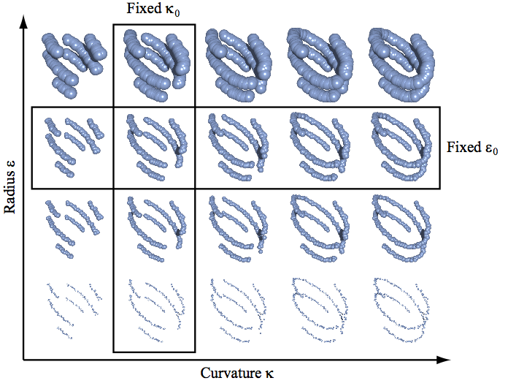
The Theory of Multidimensional Persistence, Gunnar Carlsson, Afra Zomorodian
"Persistence and Point Clouds" Functoriality, diagrams, difficulties in classifying diagrams,
multidimensional persistence, Gröbner bases, Gunnar Carlsson
http://www.ima.umn.edu/videos/?id=862

Slide 43
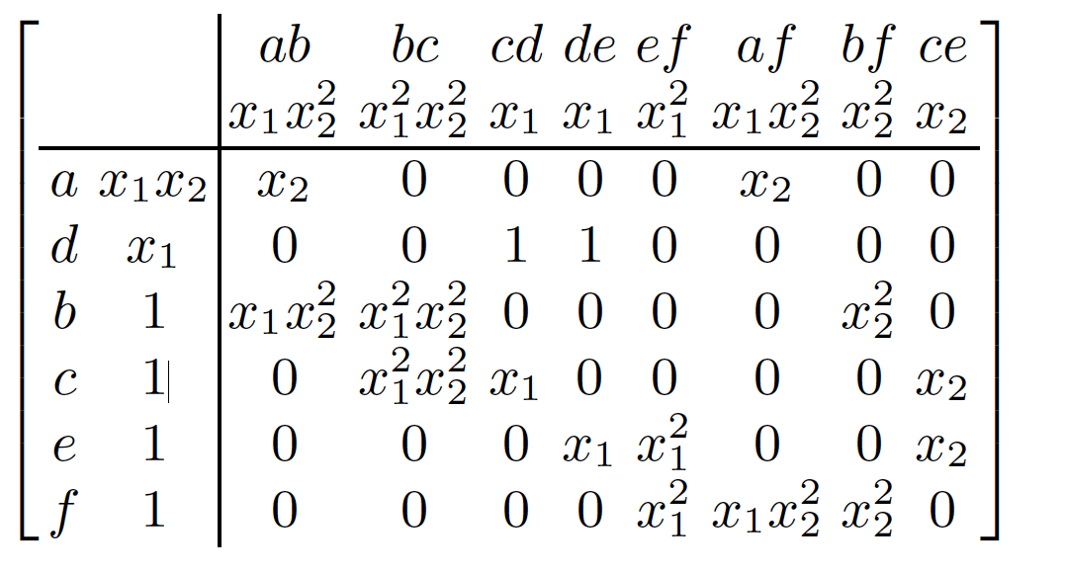
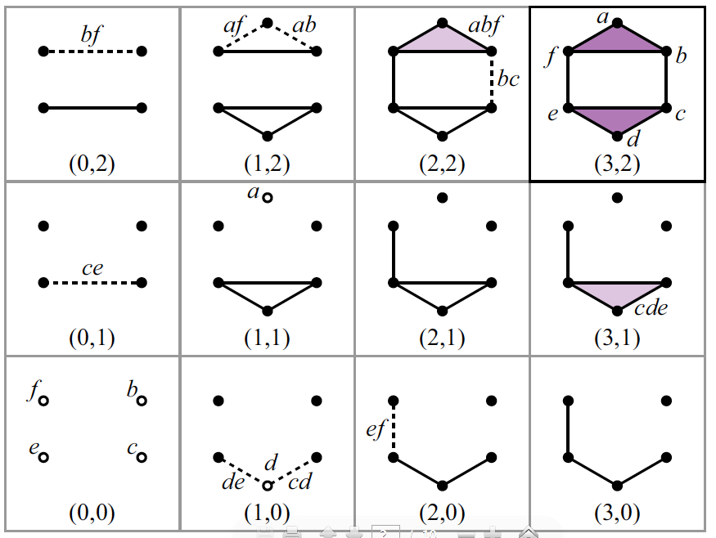
Computing Multidimensional Persistence,
Gunnar Carlsson, Gurjeet Singh, and Afra Zomorodian

Slide 44
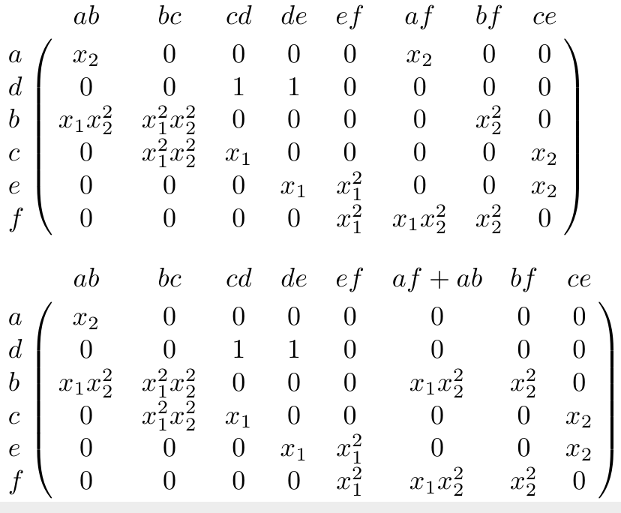

Slide 45
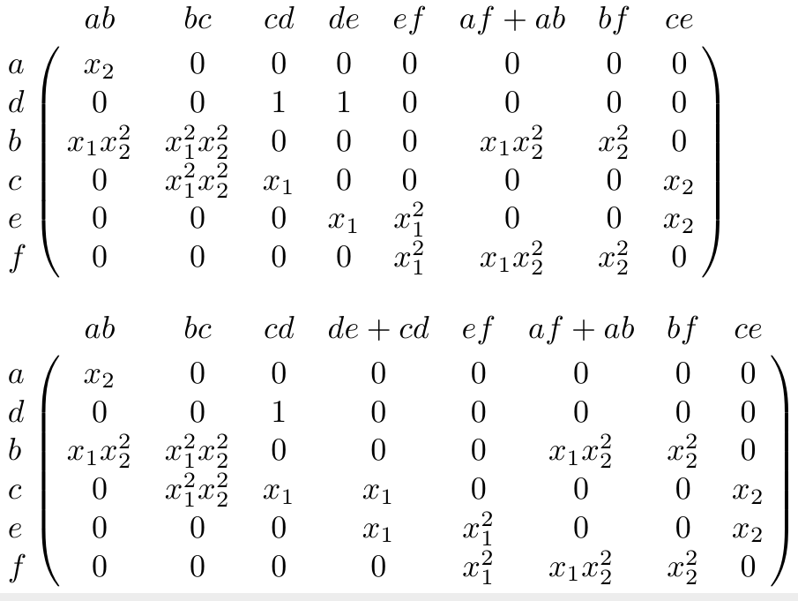

Slide 46
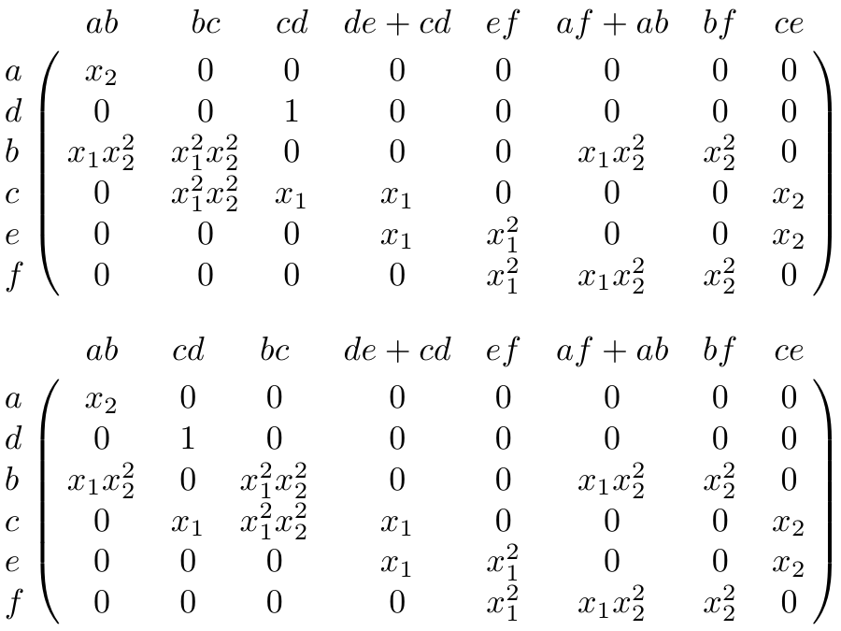

Slide 47
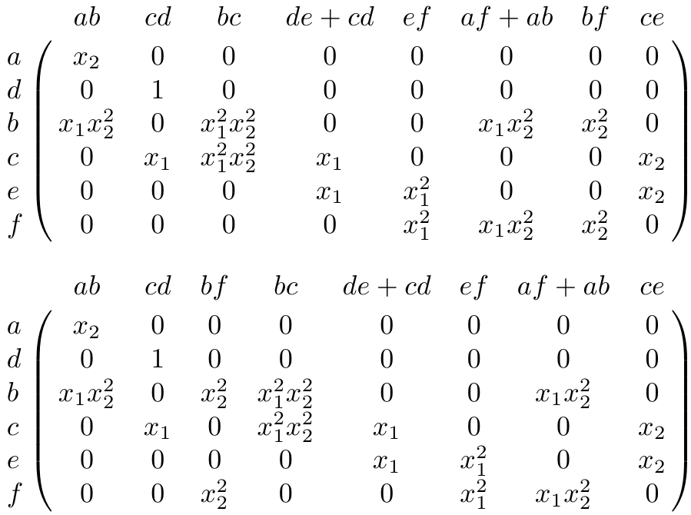

Slide 48
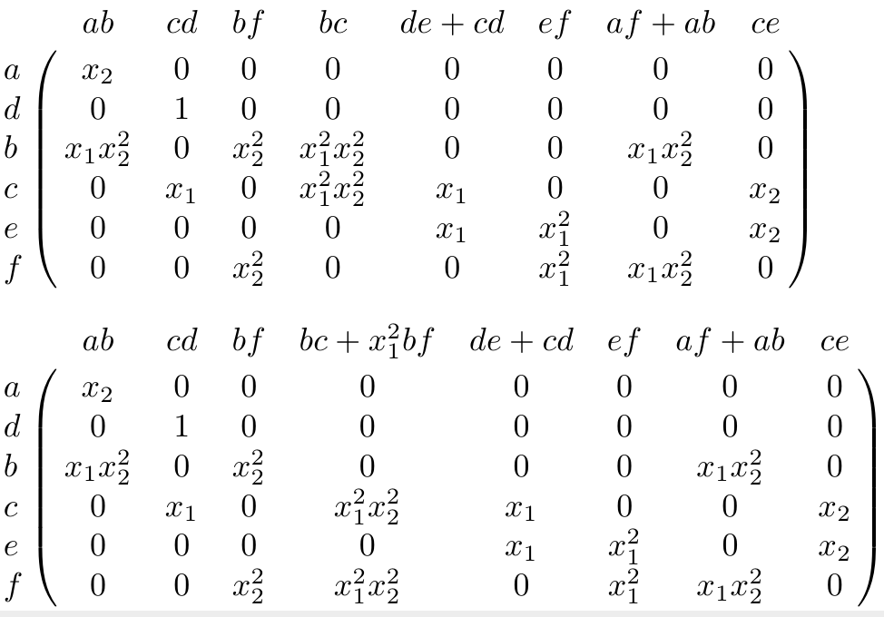

Slide 49
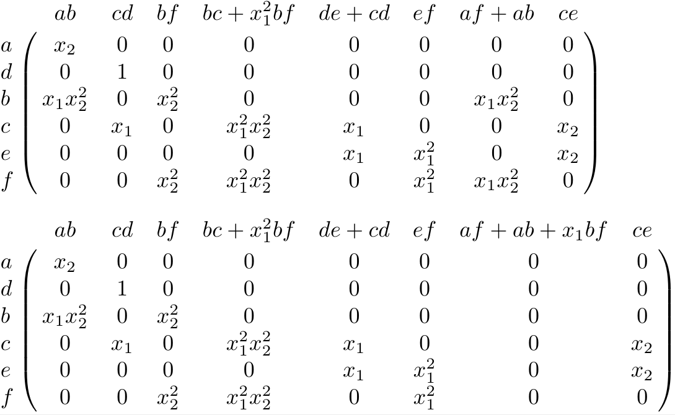

Slide 50
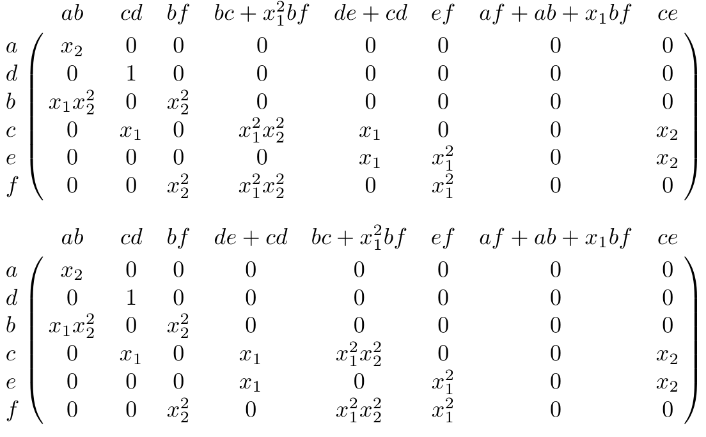

Slide 51
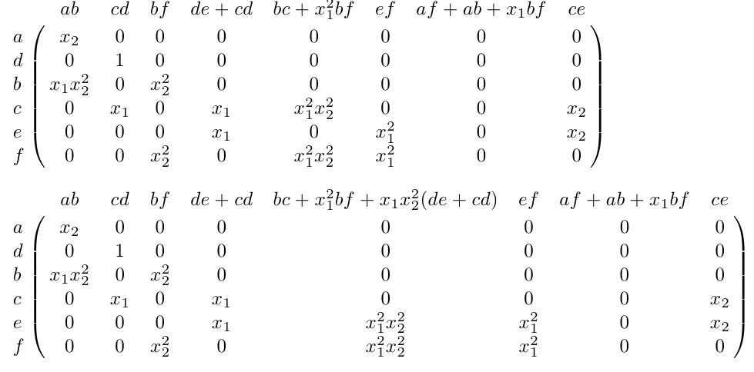

Slide 52
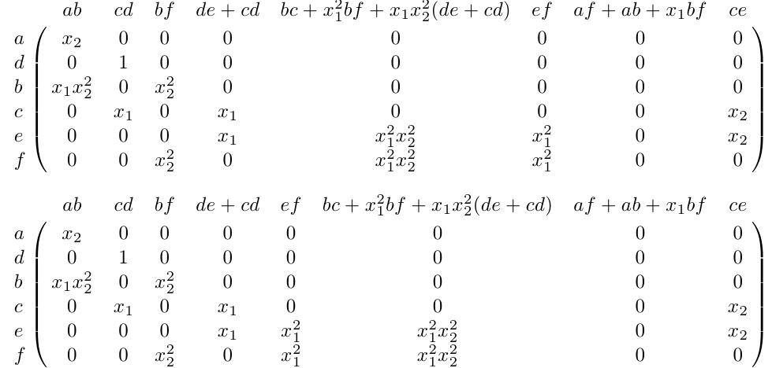

Slide 53
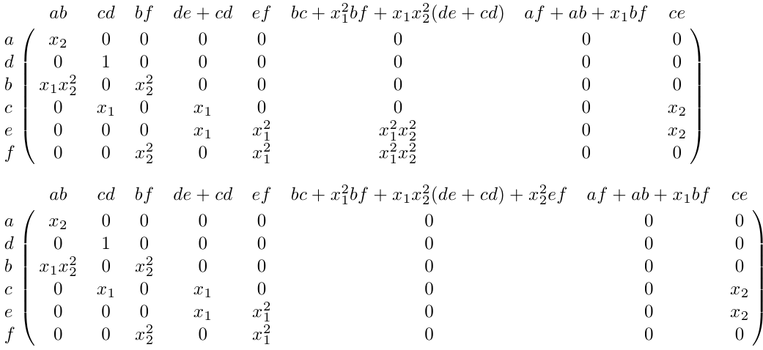

Slide 55
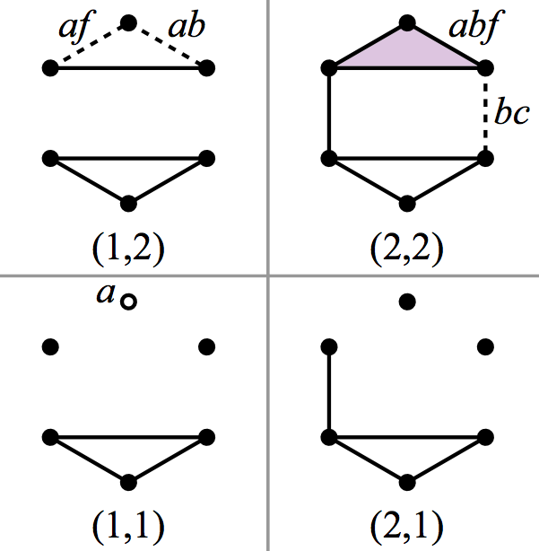
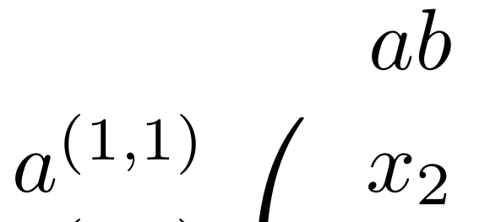

Slide 56
Σ^{(1, 1)} Z₂[x₁, x₂]/x₂

Slide 57
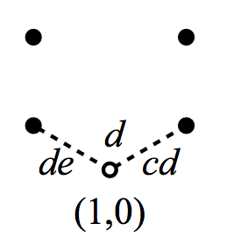
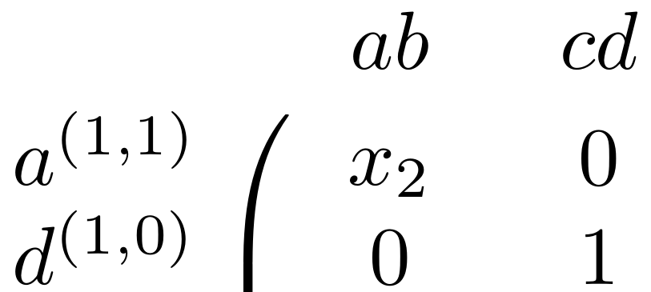

Slide 58
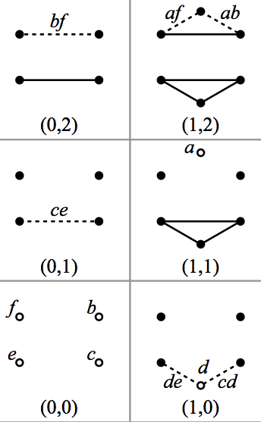
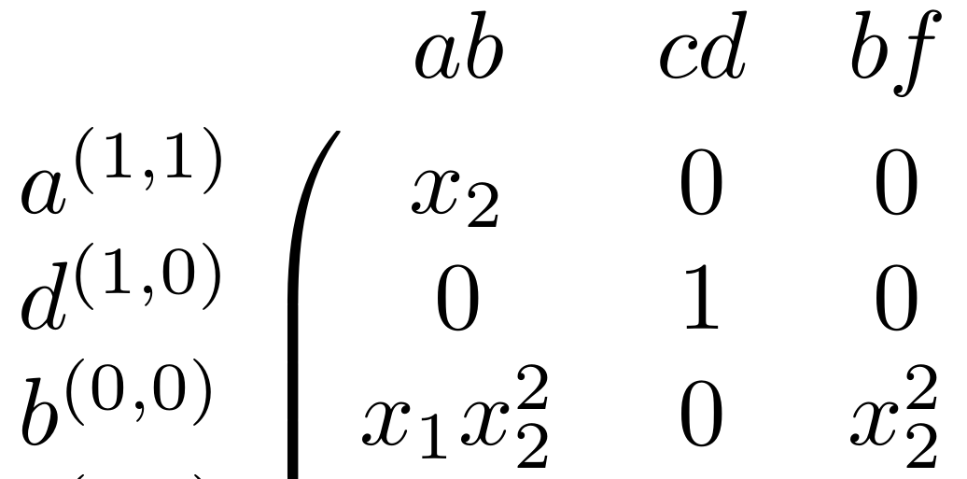

Slide 59
Z₂[x₁, x₂]/x₂²

Slide 61
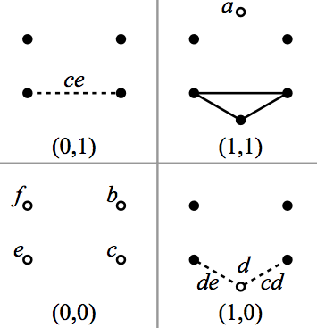

Slide 62
Z₂[x₁, x₂]/<x₁, x₂>

Slide 64
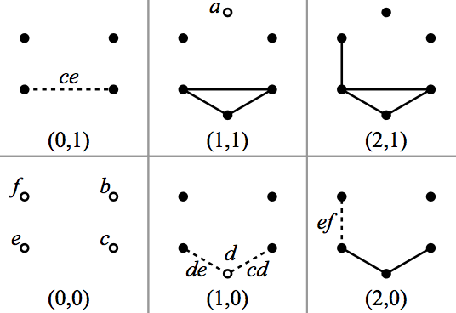

Slide 65
Z₂[x₁, x₂]/x₁²

Slide 66
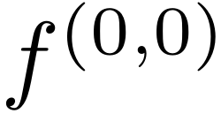

Slide 67
Z₂[x₁, x₂]

Slide 68
Σ^{(1, 1)} Z₂[x₁, x₂]/x₂
+
0
+
Z₂[x₁, x₂]/x₂²
+
Z₂[x₁, x₂]/<x₁, x₂>
+
Z₂[x₁, x₂]/x₁²
+
Z₂[x₁, x₂]

Slide 69
Σ^{(1, 1)} Z₂[x₁, x₂]/x₂
+
0
+
Z₂[x₁, x₂]/x₂²
+
Z₂[x₁, x₂]/<x₁, x₂>
+
Z₂[x₁, x₂]/x₁²
+
Z₂[x₁, x₂]
In general, use Buchberger’s/ algorithm for constructing a Grobner basis.
Algorithm described in Computing Multidimensional Persistence, by Carlsson, Singh, Zomorodian, can be computed in polynomial time.

Slide 70
Σ^{(1, 1)} Z₂[x₁, x₂]/x₂
+
0
+
Z₂[x₁, x₂]/x₂²
+
Z₂[x₁, x₂]/<x₁, x₂>
+
Z₂[x₁, x₂]/x₁²
+
Z₂[x₁, x₂]
In general, use Dionysus software,
http://www.mrzv.org/software/dionysus/

Slide 71
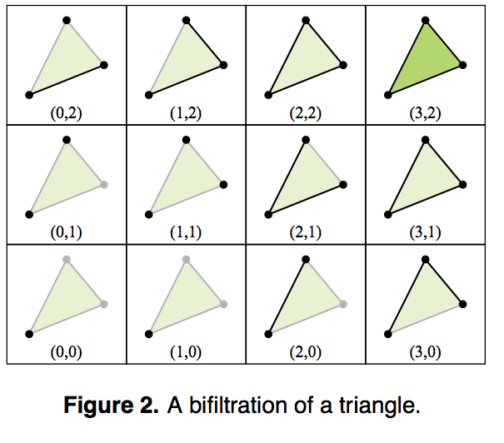

Slide 73
Computing Multidimensional Persistence,
Gunnar Carlsson, Gurjeet Singh, and Afra Zomorodian

Slide 74
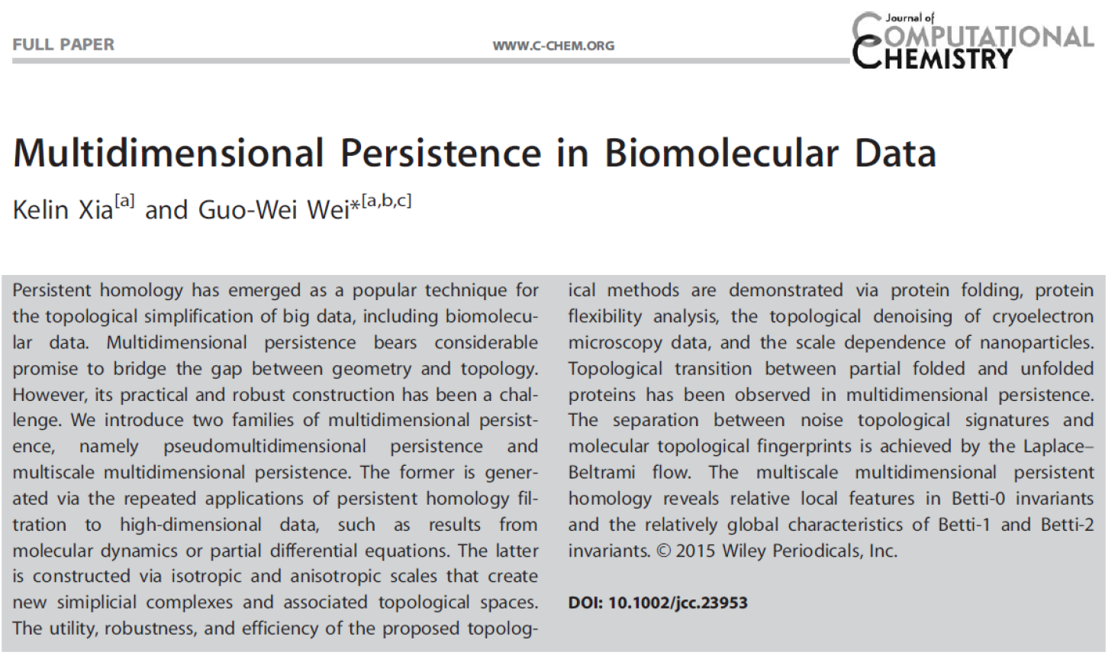
http://onlinelibrary.wiley.com/doi/10.1002/jcc.23953/full

Slide 75
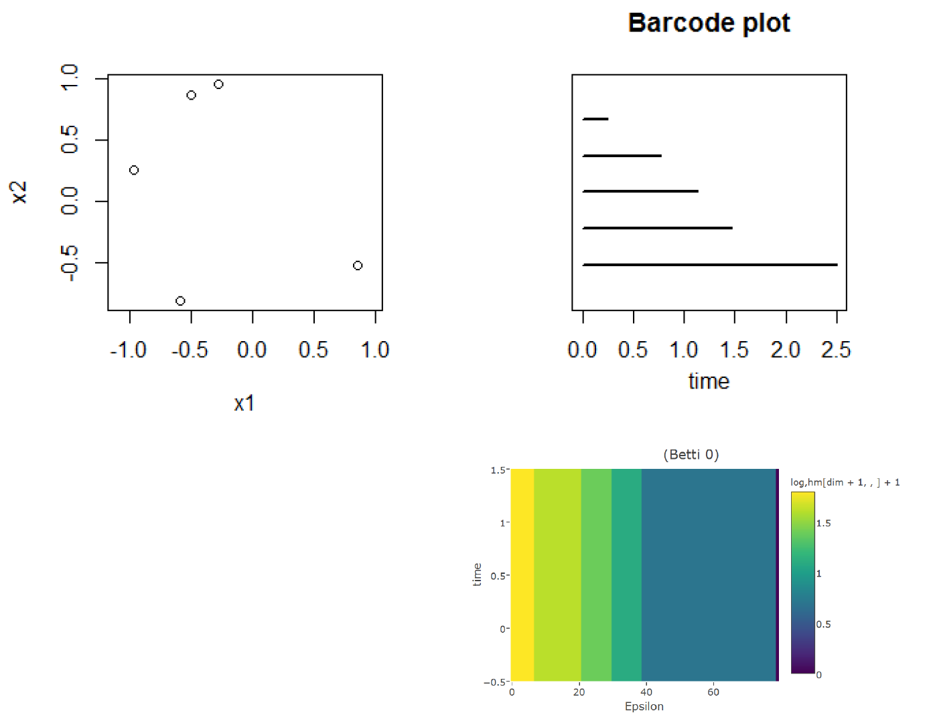

Slide 76
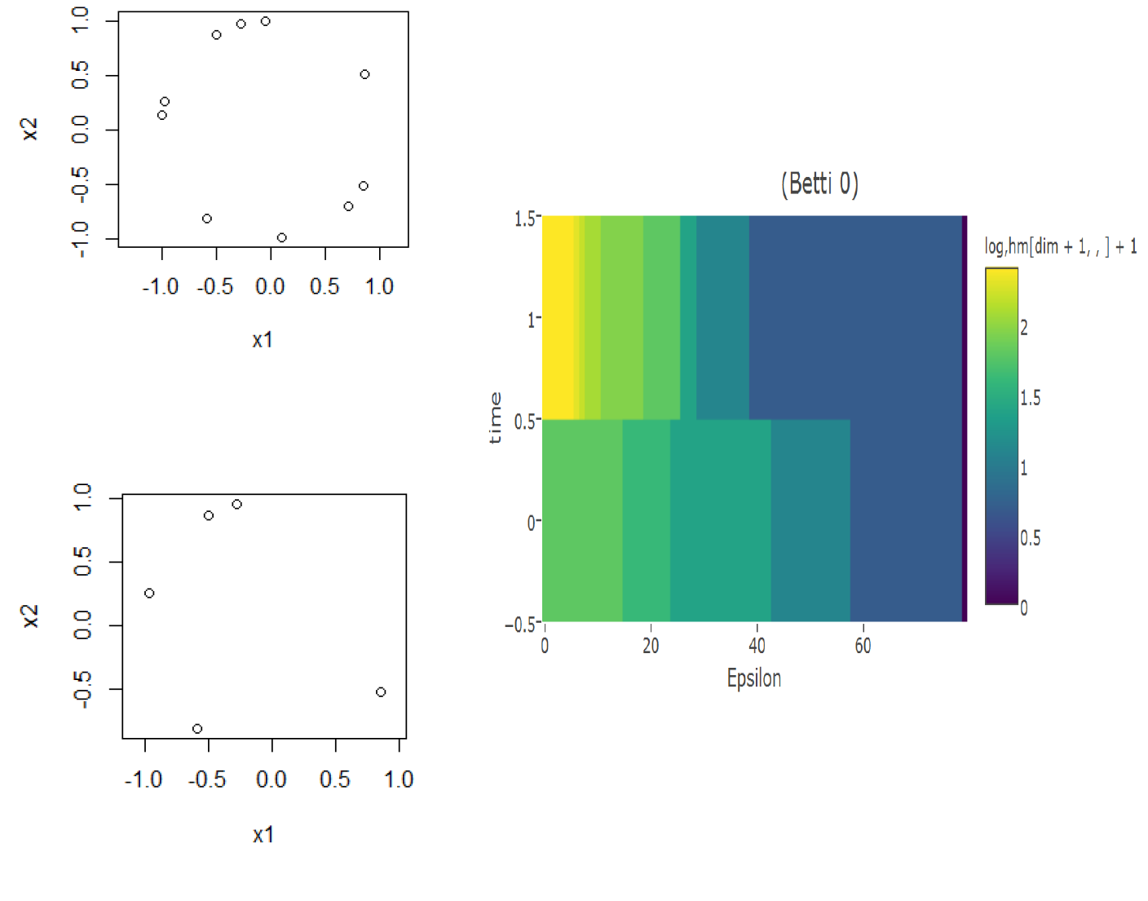

Slide 77
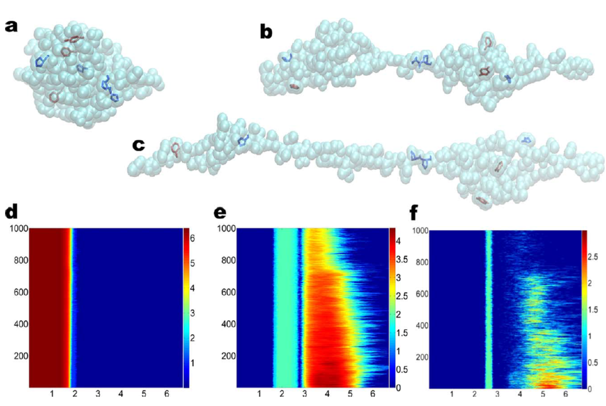
Figure 2. The unfolding of protein 1UBQ and the corresponding multidimensional persistence. a) All atom representation of the relaxed structure without hydrogen atoms;
b) All atom representation of the unfolded structure at the 300th frame;
c) All atom representation of the unfolded structure at the 500th frame;
d) 2D β₀ persistence; e) 2D β₁ persistence; f ) 2D β₂ persistence.
In subfigures d, e, and f, horizontal axes label the filtration radius (A° ) and the vertical axes are the configuration index. Color bars denote the natural logarithms of PBNs. We systematically add 1 to all PBNs to avoid the possible logarithm of 0.
http://onlinelibrary.wiley.com/doi/10.1002/jcc.23953/full

Slide 78
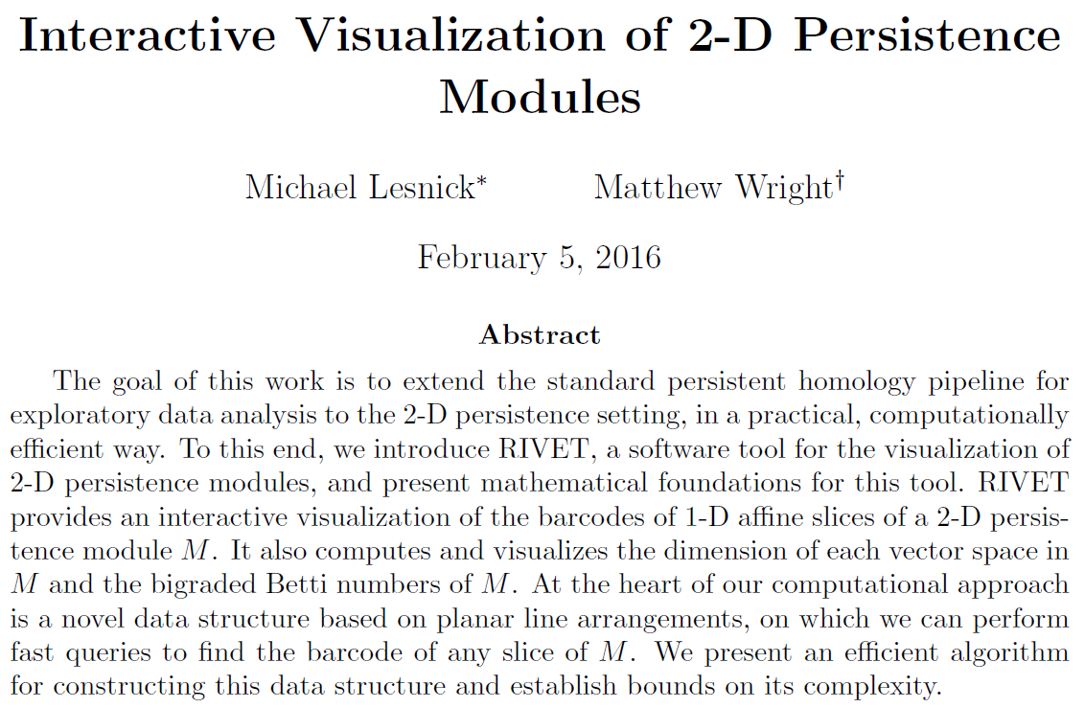

Slide 79
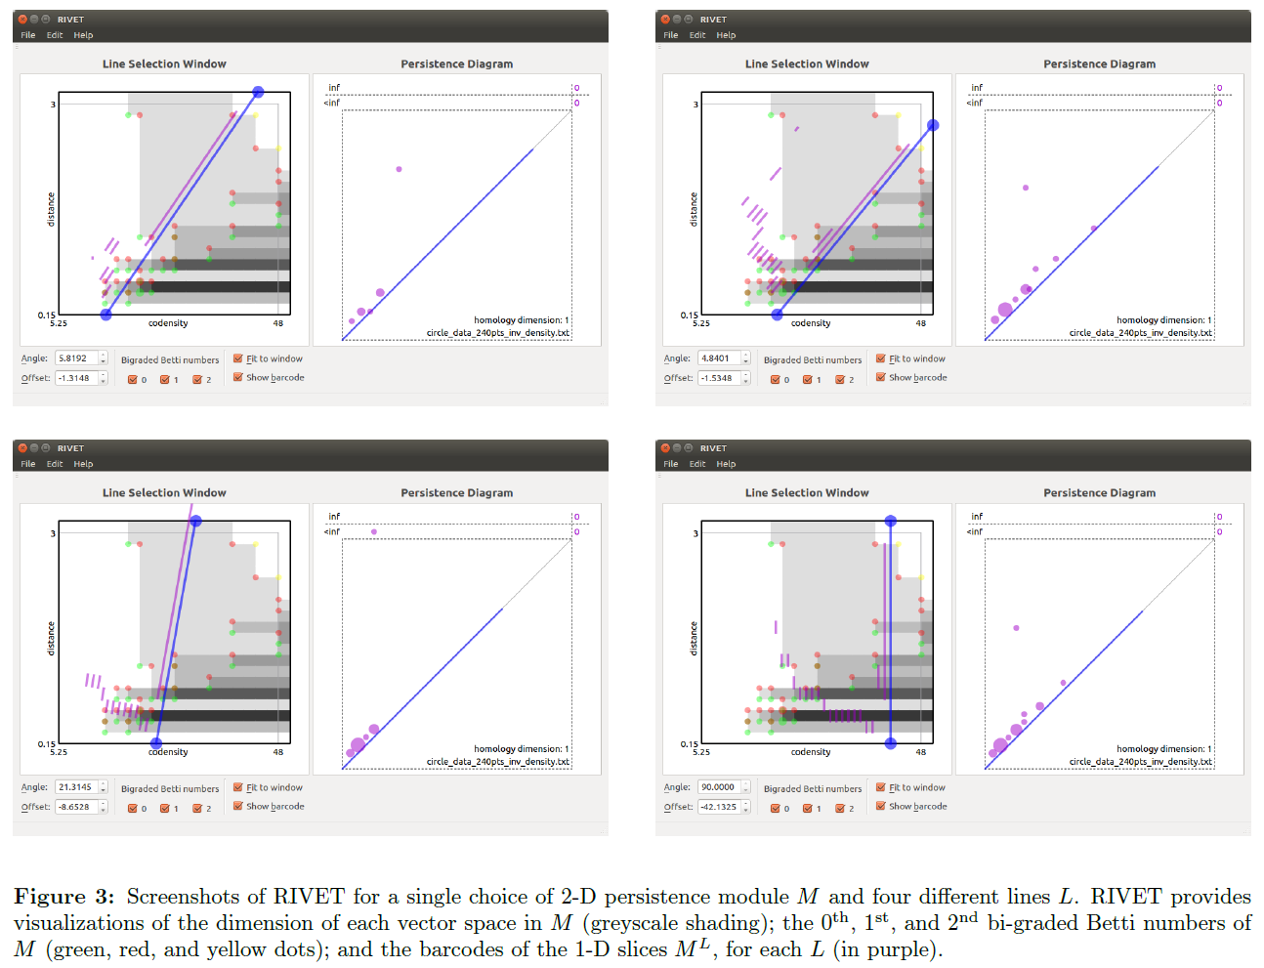

Slide 80
https://github.com/mlwright84/rivet

Slide 82
The primary visual cortex (V1)
1.) V1 is a component in the visual pathway, which begins with
the retinal cells in the eye,
proceeds through the lateral geniculate locus,
then to the primary visual cortex,
and then through a number of higher level processing units, such as V2, V3, V4, middle temporal area (MT), and others
2.) V1 performs low level tasks, such as edge and line detection, and its output is then processed for higher level and larger scale properties further along the visual pathway. However, the mechanism by which it carries out these tasks is not understood.

Slide 83
Studied via method 2: embedded electrode arrays
Record voltages at points in time at each electrode.
Spike train: lists of firing times for a neuron
obtained via spike sorting –i.e. signal processing.
Data = an array of N spike trains.
Compared spontaneous (eyes occluded) to evoked (via movie clips).
10 second segments broken into 50 ms bins
The 5 neurons with the highest firing rate in each ten second window were chosen
For each bin, create a vector in R⁵ corresponding to the number of firings of each of the 5 neurons.
200 bins = 200 data points in R⁵
Many 10 second segments = many data sets

Slide 84
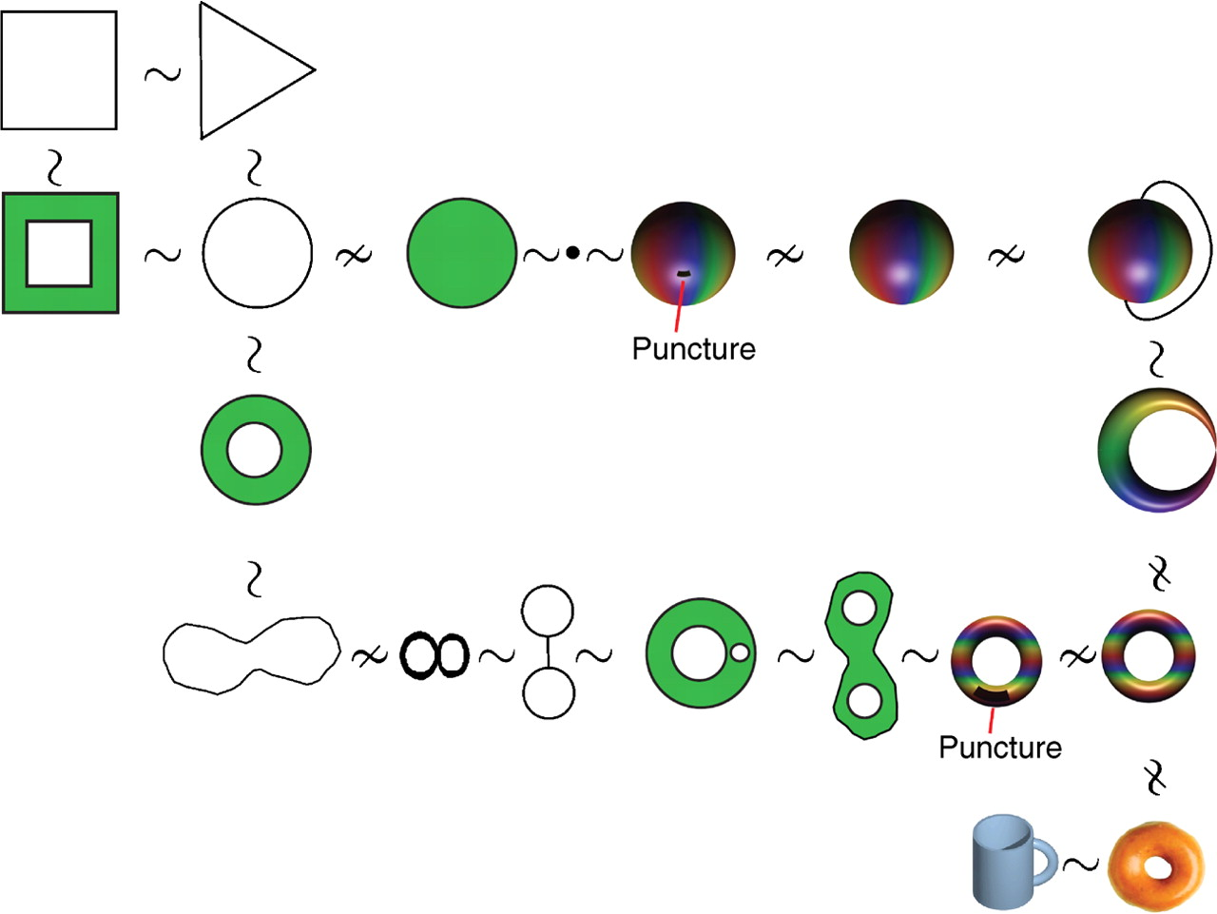
Topological equivalence in rubber-world.
Singh G et al. J Vis 2008;8:11
©2008 by Association for Research in Vision and Ophthalmology
Notes:
Topological equivalence in rubber-world. The figure illustrates the notion of equivalence by showing several objects (topological spaces) connected by the symbols ∼ when they are equivalent or by ≁ when they are not. The reader should think that all the objects shown are made of an elastic material and visualize the equivalence of two spaces by imagining a deformation between to objects.

Slide 85
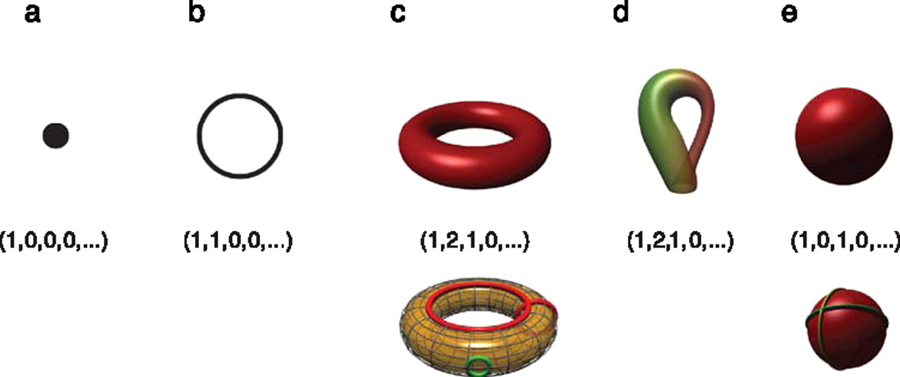
Betti numbers provide a signature of the underlying topology.
Singh G et al. J Vis 2008;8:11
©2008 by Association for Research in Vision and Ophthalmology
Notes:
Betti numbers provide a signature of the underlying topology. Illustrated in the figure are five simple objects (topological spaces) together with their Betti number signatures: (a) a point, (b) a circle, (c) a hollow torus, (d) a Klein bottle, and (e) a hollow sphere. For the case of the torus (c), the figure shows three loops on its surface. The red loops are “essential” in that they cannot be shrunk to a point, nor can they be deformed one into the other without tearing the loop. The green loop, on the other hand, can be deformed to a point without any obstruction. For the torus, therefore, we have b 1 = 2. For the case of the sphere, the loops shown (and actually all loops on the sphere) can be contracted to points, which is reflected by the fact that b 1 = 0. Both the sphere and the torus have b 2 = 1, this is due to the fact both surfaces enclose a part of space (a void).

Slide 86
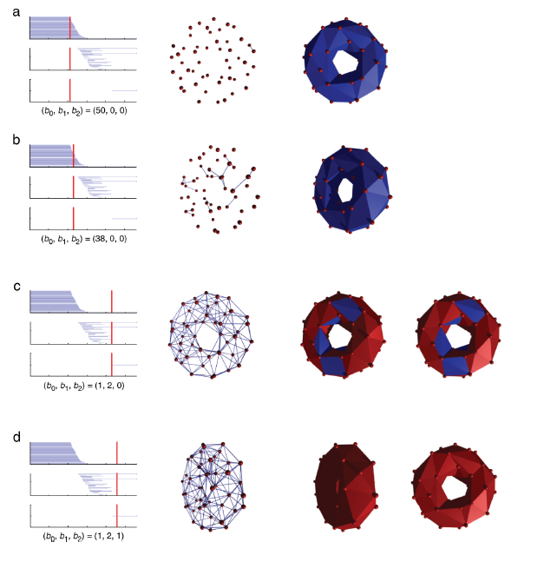
http://www.journalofvision.org/
content/8/8/11.full
Figure 4 animation

Slide 87
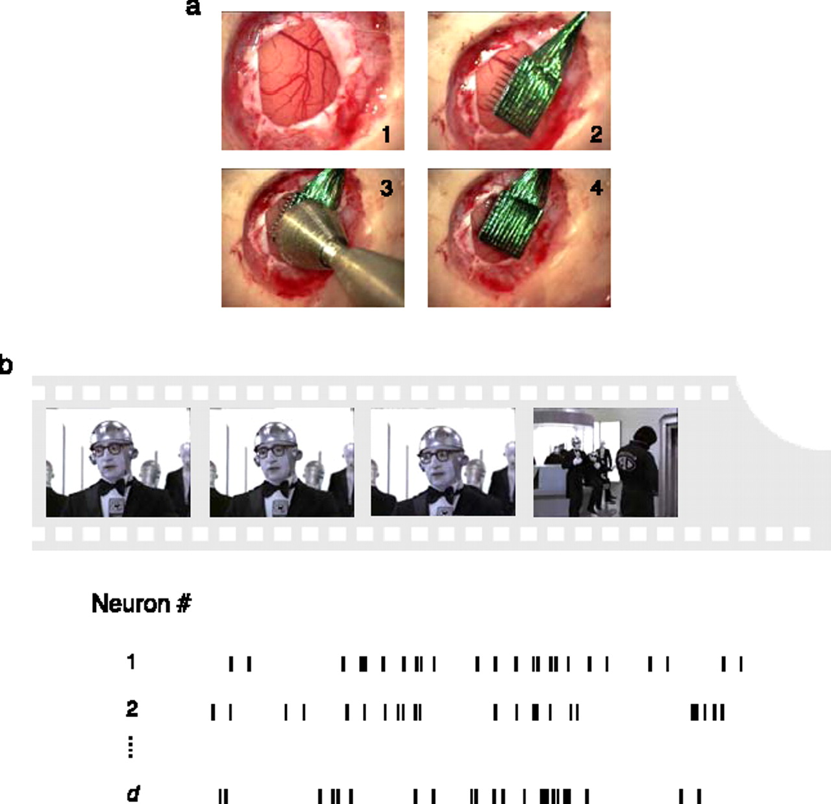
Experimental recordings in primary visual cortex.
Singh G et al. J Vis 2008;8:11
©2008 by Association for Research in Vision and Ophthalmology
Notes:
Experimental recordings in primary visual cortex. (a) Insertion sequence of a multi-electrode array into primary visual cortex (Nauhaus & Ringach, 2007). (b) Natural image sequences, sampled from commercial movies, were used to stimulate all receptive fields of neurons isolated by the array. In the spontaneous condition, activity was recorded while both eyes were occluded.

Slide 88
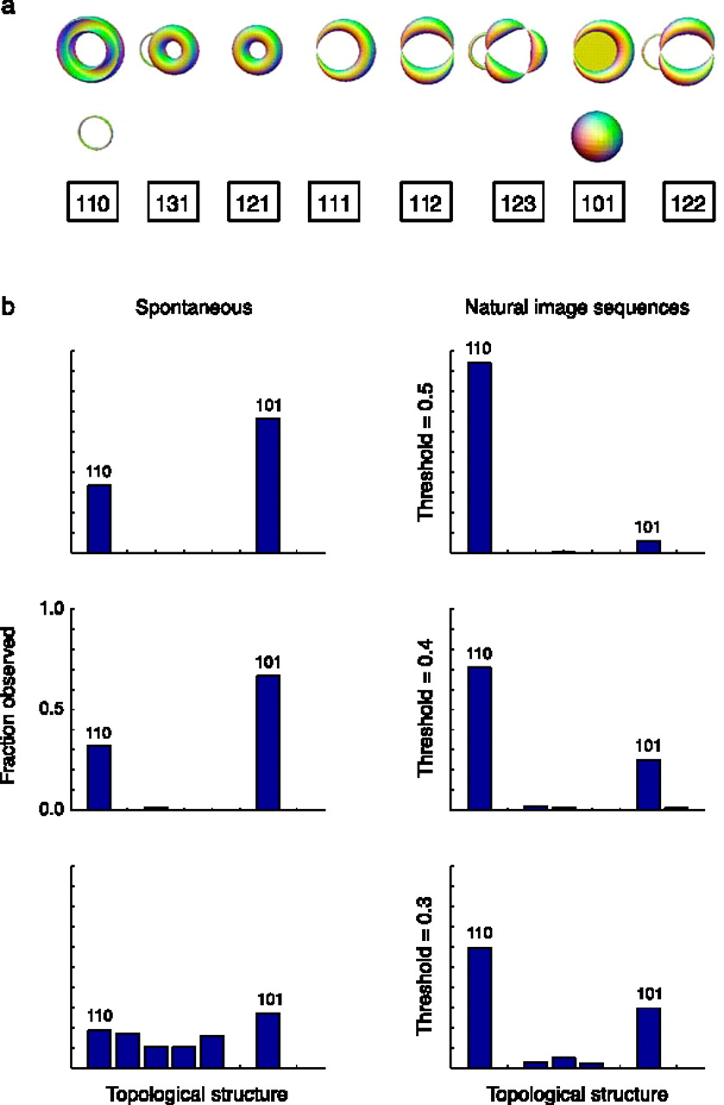
Estimation of topological structure in driven and spontaneous conditions.
Record voltages at points in time at each electrode.
Spike train: lists of firing times for a neuron
obtained via spike sorting –i.e. signal processing.
Data = an array of N spike trains.
Compared spontaneous (eyes occluded) to evoked (via movie clips).
10 second segments broken into 50 ms bins
Transistion between states about 80ms
The 5 neurons with the highest firing rate in each ten second window were chosen
For each bin, create a vector in R⁵ corresponding to the number of firings of each of the 5 neurons.
200 bins = 200 data points in R⁵.
Used 35 landmark points.
20-30minutes of data = many data sets
Control: shuffled data 52700 times.
Singh G et al. J Vis 2008;8:11
©2008 by Association for Research in Vision and Ophthalmology
Notes:
Estimation of topological structure in driven and spontaneous conditions. (a) Ordering of topological signatures observed in our experiments. Each triplet ( b 0, b 1, b 2) is shown along an illustration of objects consistent with these signature. (b) Distribution of topological signatures in the spontaneous and natural image stimulation conditions pooled across the three experiments performed. Each row correspond to signatures with a minimum interval length (denoted as the threshold) expressed as a fraction of the covering radius of the data cloud (see Appendix A for the definition of the covering radius).

Slide 89
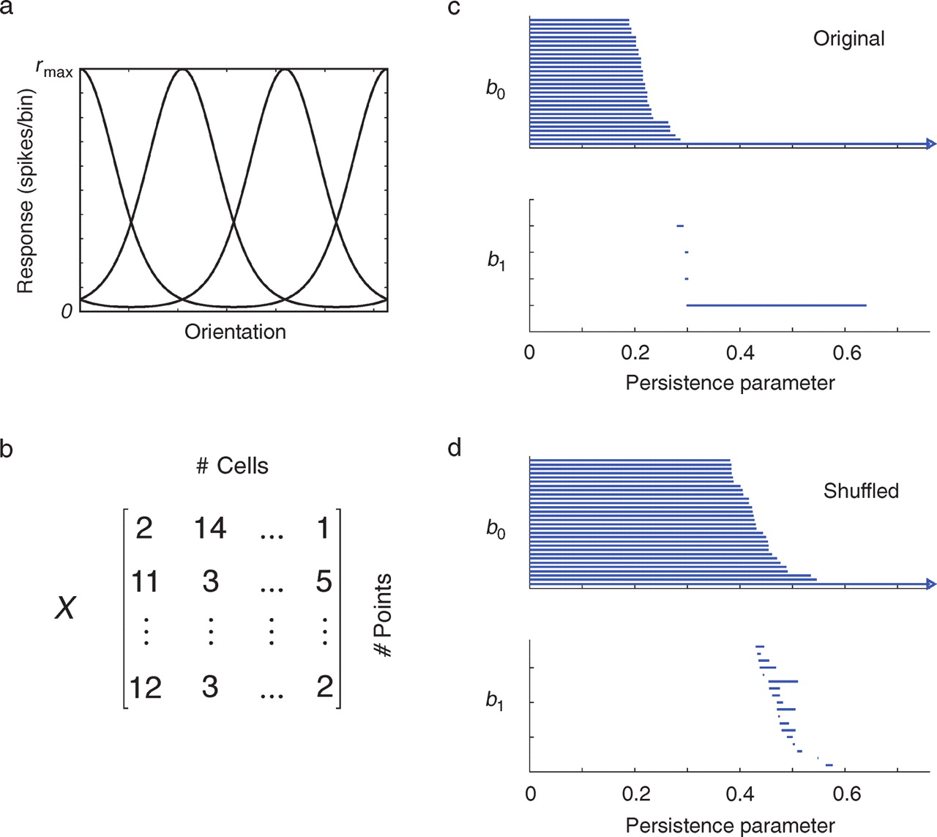
Testing the statistical significance of barcodes.
Singh G et al. J Vis 2008;8:11
©2008 by Association for Research in Vision and Ophthalmology
Notes:
Testing the statistical significance of barcodes. (a) We assume an initial population of Poisson-spiking neurons tuned for orientation. (b) The simulated response of this population to the presentation of different orientations is collected into a data matrix (or point cloud). (c) Analysis of the simulated data shows a long interval with a signature (b0, b1) = (1, 1), which correctly identifies the underlying object as a circle. (d) We also compute the barcodes by shifting the relative positions of the columns (data shuffling). In this case, the statistical distributions of spike counts for each axis remain unchanged, but their relationship is destroyed. By computing the distribution of maximal b1 lengths under this null hypothesis, we can evaluate the likelihood that our data was generated by the null hypothesis that there the coordinates of the points are independent.

