Slide 1
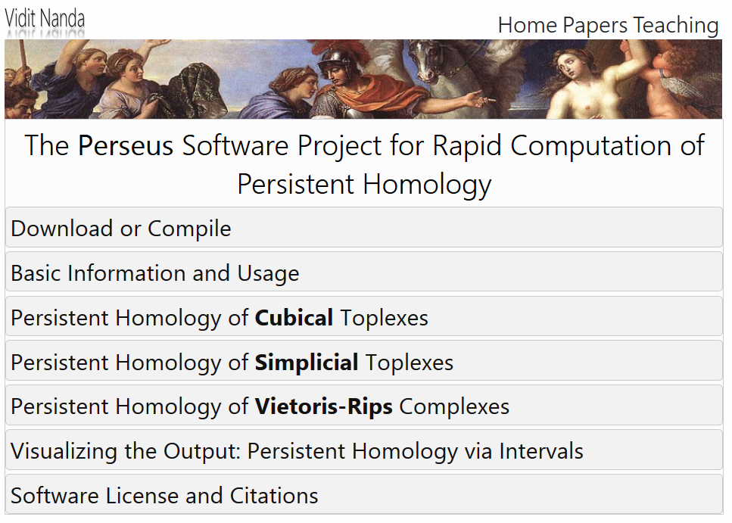
http://people.maths.ox.ac.uk/nanda/perseus/index.html
If you use it, cite it

Slide 2
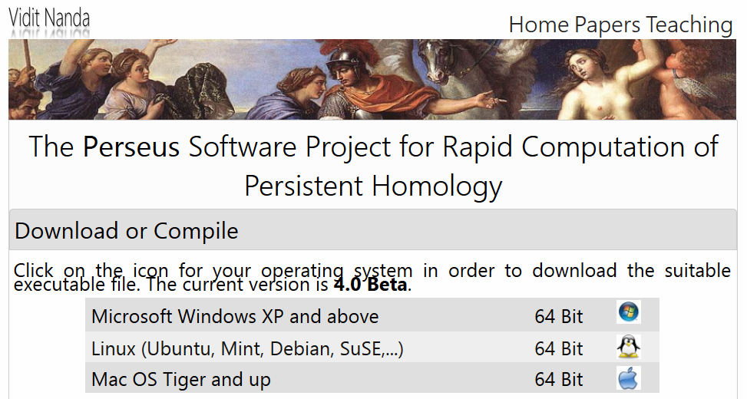
Click here to download for linux

Slide 3
Create your data file. Note first 2 rows contain the information described below
Number of coordinates (i.e., number of columns in your original data set).
3
1 0.01 50
1.2 3.4 -0.9 0.1
2.0 -6.6 4.1 0.1
Your data points plus extra column = starting radius r
Scaling factor k = 1,
step size s = 0.1,
number of steps N = 5,
At time step i,
radius of ball = kr + si,
for i = 0, …, N

Slide 4
Note: Instead of entering data points, you can use a distance matrix
Number of data points.
I.e., size of matrix is 3x3
3
0 0.1 5 2
0 0.26 0.4
0.26 0 2.1
0.4 2.1 0
distance matrix (symmetric)
initial radius r = 0,
step size s = 0.1,
number of steps N = 5,
dimension cap C = 2
Increase radius by 0.1 five times.
max dim of simplices

Slide 5
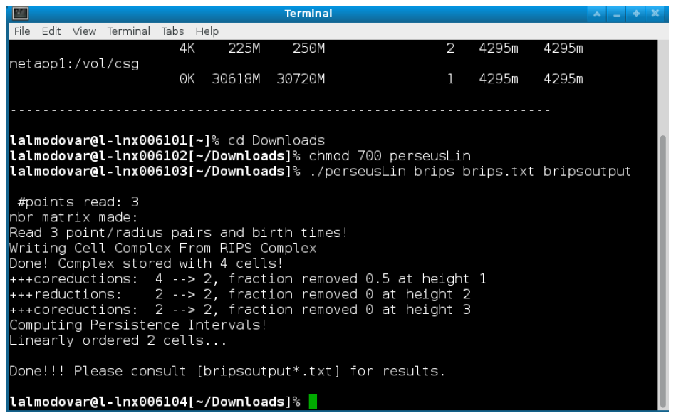
Run Perseus in a Terminal Window

Slide 6
To change directory into Downloads: cd Downloads
To make perseusLin executable: chmod 700 perseusLin.
To run your file: ./perseusLin brips input.txt output or
./perseus distmat distancematrix.txt output
This will create several files (overwriting existing files):
output_0.txt, output_1.txt,... and so on. How many such files are created depends on how many dimensions the discrete Morse-reduced complex actually has.
Some files will be empty.
output_i.txt contains birth death times for ith homology.
output_betti.txt contains the Betti numbers at each step in the filtration.
See Visualizing the Output: Persistent Homology via Intervals for more info.

Slide 7
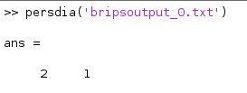
Plotting Persistence Diagrams
In order to aid with visualization, a simple Matlab script called persdia has been bundled along with the source code for Perseus. This script may be called from the Matlab command prompt to plot the Perseus output file as a persistence diagram in the following way:
Make sure you set the directory to the one containing your Perseus files.

Slide 8
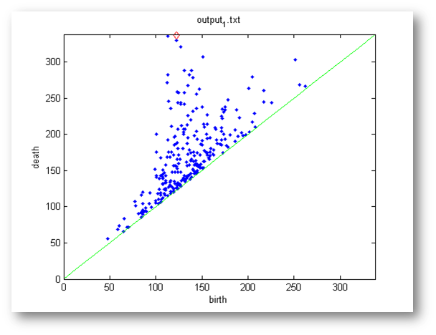
Plotting Persistence Diagrams
In order to aid visualization, a simple Matlab script called persdia has been bundled along with the source code for Perseus. This script may be called from the Matlab command prompt to plot the Perseus output file as a persistence diagram in the following way:
>> persdia('output_1.txt');
Of course, you may need to change the string argument 'output_1.txt' to point to the path where the output files from Perseus are stored on your computer. Here is a sample persistence diagram created by persdia:

Slide 9
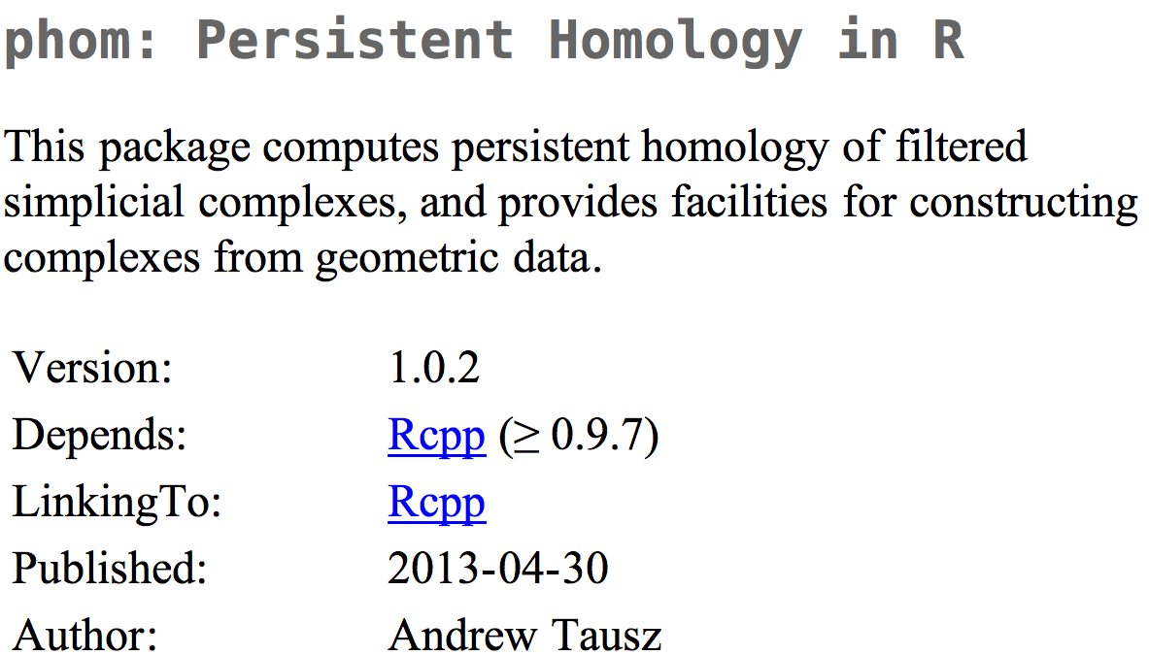
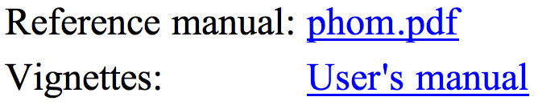
http://cran.r-project.org/web/packages/phom/
OLD, no longer in use

Slide 10
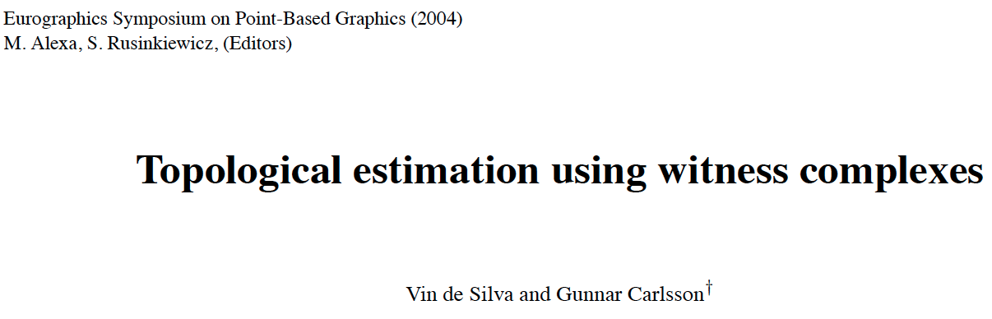
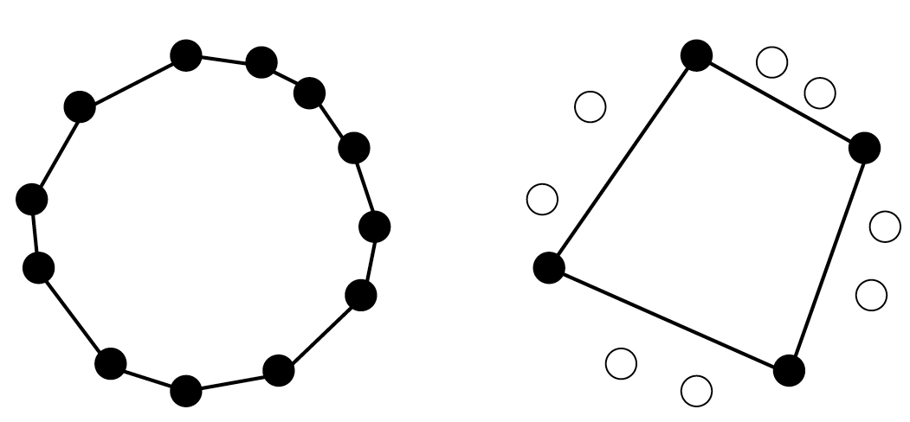
comptop.stanford.edu/preprints/witness.pdf

Slide 11
W∞(D) = Witness complex
v₀,v₁,...,v_{k} span a k-simplex
iff
there is a point w ∈ D, whose k+1 nearest
neighbours in L are v₀,v₁,...,v_{k}
and all the faces of {v₀,v₁,...,v_{k}} belong to the witness complex.
w is called a “weak” witness.
Let D = set of point cloud data points.
Choose L D,
L = set of landmark points = vertices.
U

Slide 12
W₁(D) = Lazy witness complex
Let L = set of landmark points.
1-skeletion of W₁(D) = 1-skeletion of W∞ (D).
Create the flag (or clique) complex:
Add all possible simplices of dimensional > 1.

Slide 13
Choosing Landmark points:
A.) Random
B.) Maxmin
1.) choose point l₁ randomly
2.) If {l₁, …, l_{k-1}} have been chosen, choose l_{k} such that {l₁, …, l_{k-1}} is in D - {l₁, …, l_{k-1}} and
min {d(l_{k}, l₁), …, d(l_{k}, l_{k-1})} ≥ min {d(v, l₁), …, d(v, l_{k-1})}

Slide 14
Strong witness complex:
Let D = set of point cloud data points.
Choose L D, L = set of landmark points.
Let m_{v} = dist (v, L) = min{ d(v, l ) : l in L }
U
{l₁, …, l_{k+1}} is a k-simplex
iff
d(v, l_{i}) ≤ m_{v} + ε for all i
v is the witness

Slide 15
Weak witness complex:
Let D = set of point cloud data points.
Choose L D, L = set of landmark points.
U
σ = {l₁, …, l_{k+1}} is a k-simplex
iff
d(v, l_{i}) ≤ d(v, x) for all i
and all x not in σ
v is the weak witness

Slide 16
Weak witness complex:
Let D = set of point cloud data points.
Choose L D, L = set of landmark points.
U
σ = {l₁, …, l_{k+1}} is a k-simplex
iff
d(v, l_{i}) ≤ d(v, x) + ε for all i
and all x not in σ
v is the ε-weak witness

Slide 17
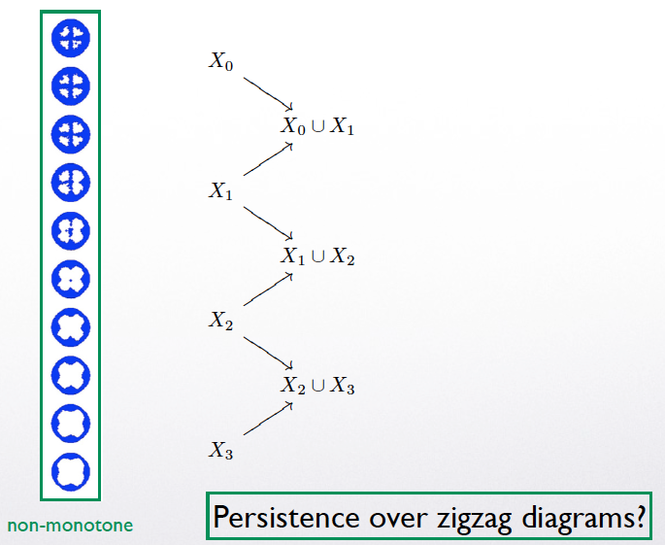

Slide 18
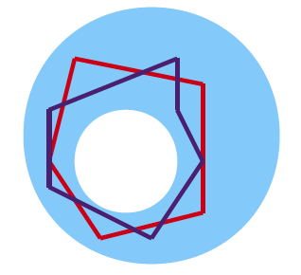
Witness Complexes

Slide 19
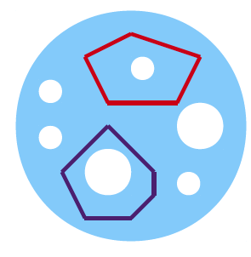
Witness Complexes

Slide 20
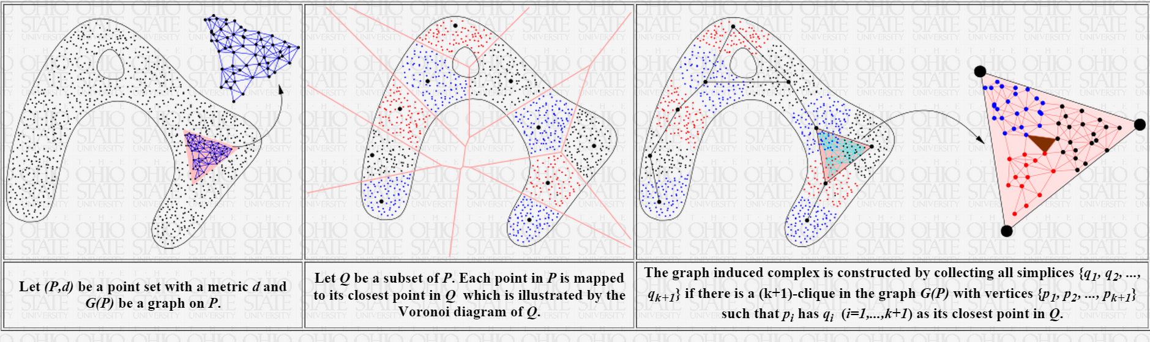
Tamal K. Dey http://www.cse.ohio-state.edu/~tamaldey/
Graph Induced Complex: A Data Sparsifier for Homology Inference
Video: http://www.ima.umn.edu/videos/?id=2497
Slides: http://web.cse.ohio-state.edu/~tamaldey/talk/GIC/GIC.pdf
Paper: http://web.cse.ohio-state.edu/~tamaldey/paper/GIC/GIC.pdf
Graph Induced Complex on Point Data T. K. Dey, F. Fan, and Y. Wang,
(SoCG 2013) Proc. 29th Annu. Sympos. Comput. Geom. 2013, 107-116.
Website: http://web.cse.ohio-state.edu/~tamaldey/GIC/gic.html
The efficiency of extracting topological information from point data depends largely on the complex that is built on top of the data points. From a computational viewpoint, the most favored complexes for this purpose have so far been Vietoris-Rips and witness complexes. While the Vietoris-Rips complex is simple to compute and is a good vehicle for extracting topology of sampled spaces, its size is huge--particularly in high dimensions. The witness complex on the other hand enjoys a smaller size because of a subsampling, but fails to capture the topology in high dimensions unless imposed with extra structures. We investigate a complex called the {em graph induced complex} that, to some extent, enjoys the advantages of both. It works on a subsample but still retains the power of capturing the topology as the Vietoris-Rips complex. It only needs a graph connecting the original sample points from which it builds a complex on the subsample thus taming the size considerably. We show that, using the graph induced complex one can (i) infer the one dimensional homology of a manifold from a very lean subsample, (ii) reconstruct a surface in three dimension from a sparse subsample without computing Delaunay triangulations, (iii) infer the persistent homology groups of compact sets from a sufficiently dense sample. We provide experimental evidences in support of our theory.

Slide 21
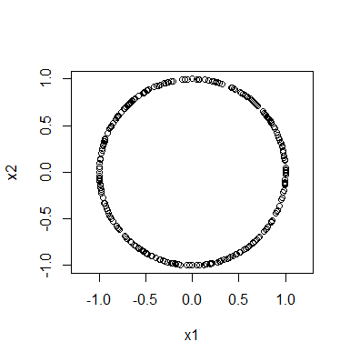
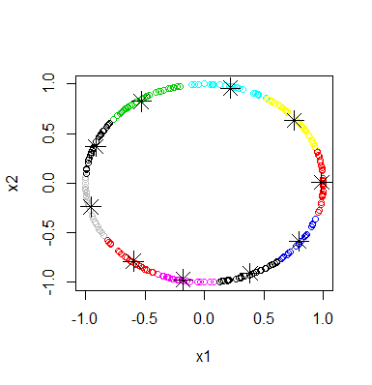
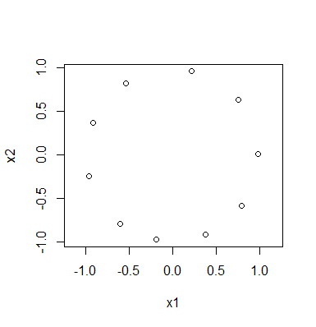
Rstudio:
library("TDA")
circle = circleUnif(300, r = 1)
plot(circle, asp = 1)
cl <- kmeans(circle, 10)
plot(circle,col=cl$cluster)
points(cl$centers, pch=8, cex = 2)
plot(cl$centers, asp = 1)

Slide 22
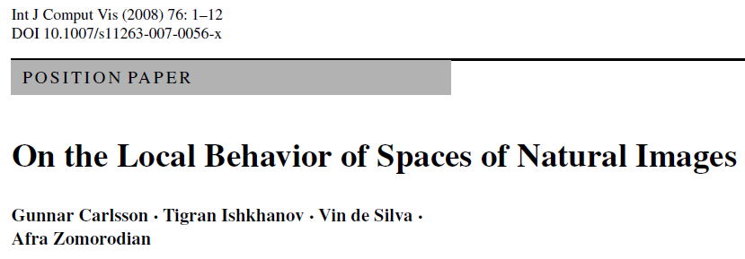
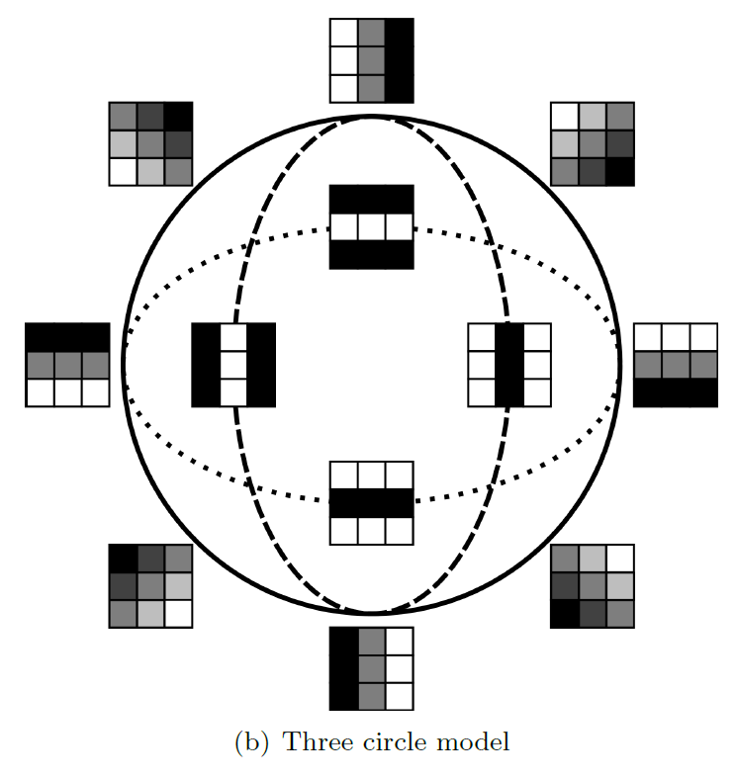
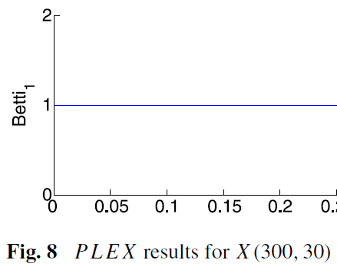
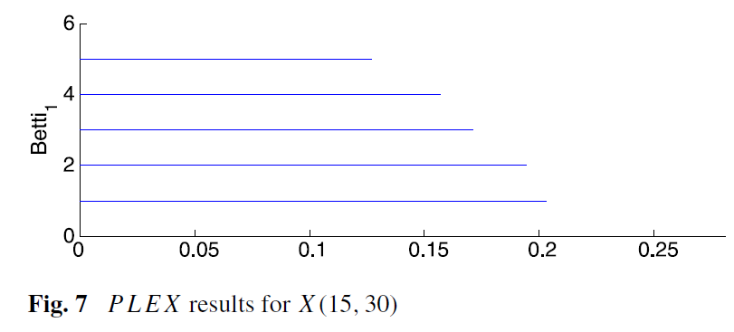
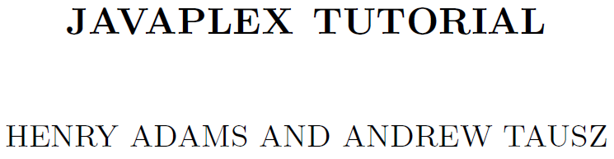
15000 points from 30% densest points based on knn distance

Slide 23
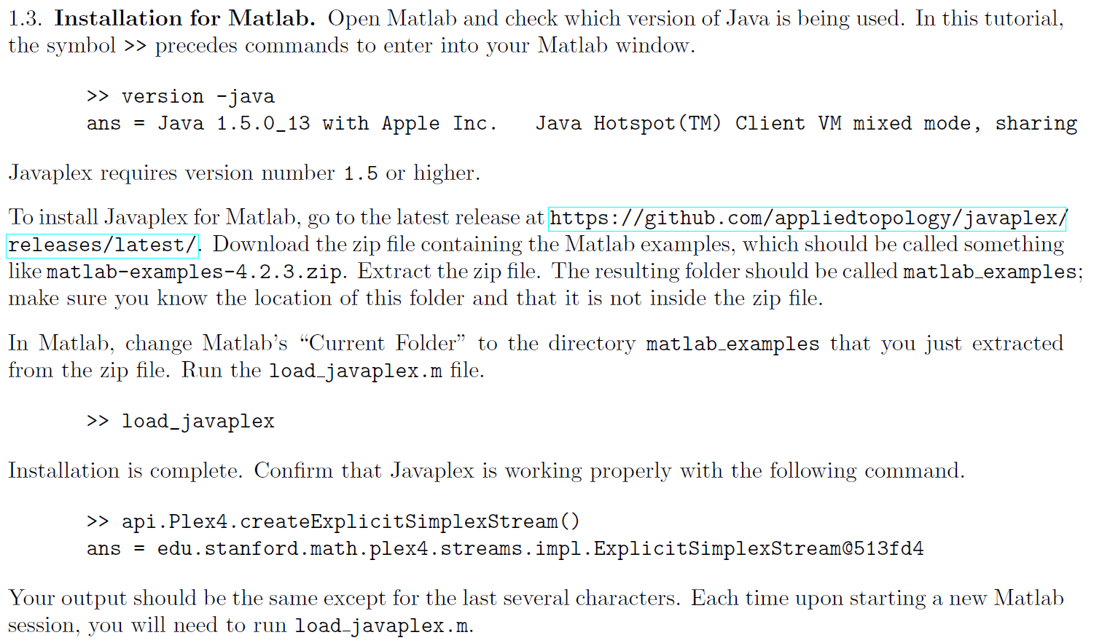

Slide 24
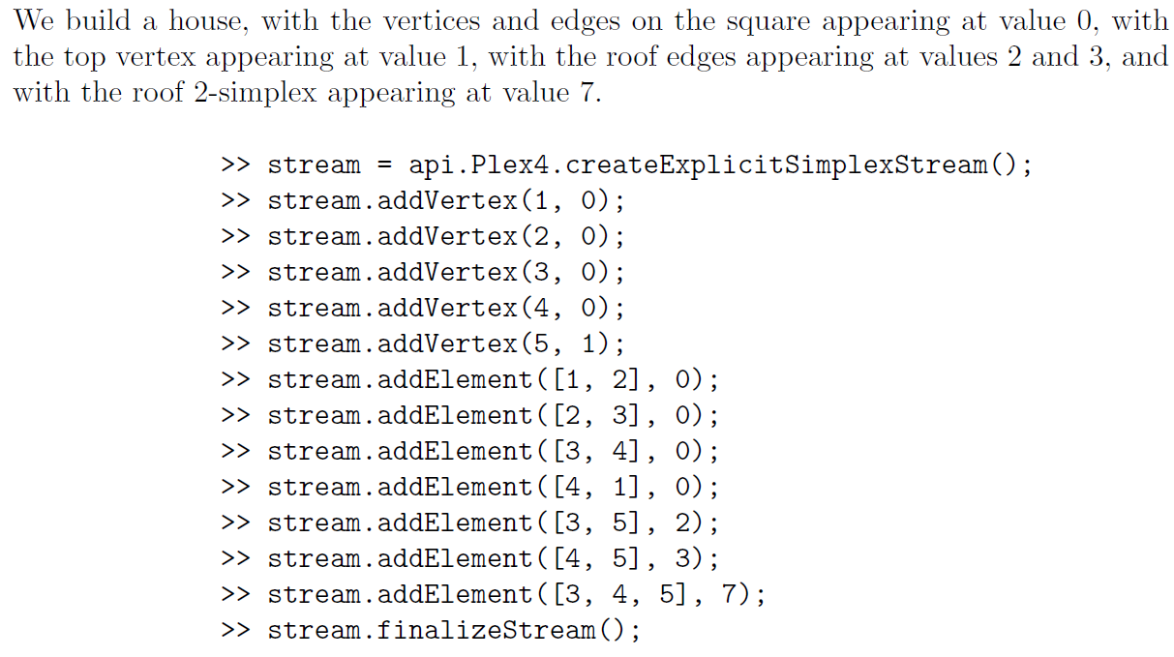
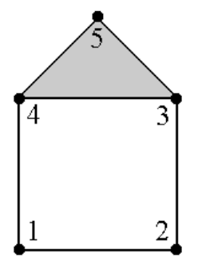
Can build a filtered simplicial complex:
Time entered
Simplex

Slide 25
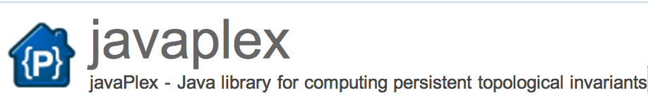
Point Cloud Data: Load points or distance matrix.
>> cd tutorial examples
>> load pointsOpticalDct_k300.mat % X(300; 30): k = 300, top 30%
>> load pointsOpticalDct_k15.mat % X(15; 30): k = 15, top 30%
>> Point_cloud = dataset;
>> num_landmark_points = 100;
>> random_selector = api.Plex4.createRandomSelector(point_cloud, num_landmark_points); % choose landmark points randomly
>> maxmin_selector = api.Plex4.createMaxMinSelector(point_cloud, num_landmark_points); ); % choose landmark points using MaxMin

Slide 26
Choosing Landmark points:
A.) Random
B.) Maxmin
1.) choose point l₁ randomly
2.) If {l₁, …, l_{k-1}} have been chosen,
choose l_{k} is in D - {l₁, …, l_{k-1}} and
min {d(l_{k}, l₁), …, d(l_{k}, l_{k-1})} ≥ min {d(v, l₁), …, d(v, l_{k-1})}

Slide 27
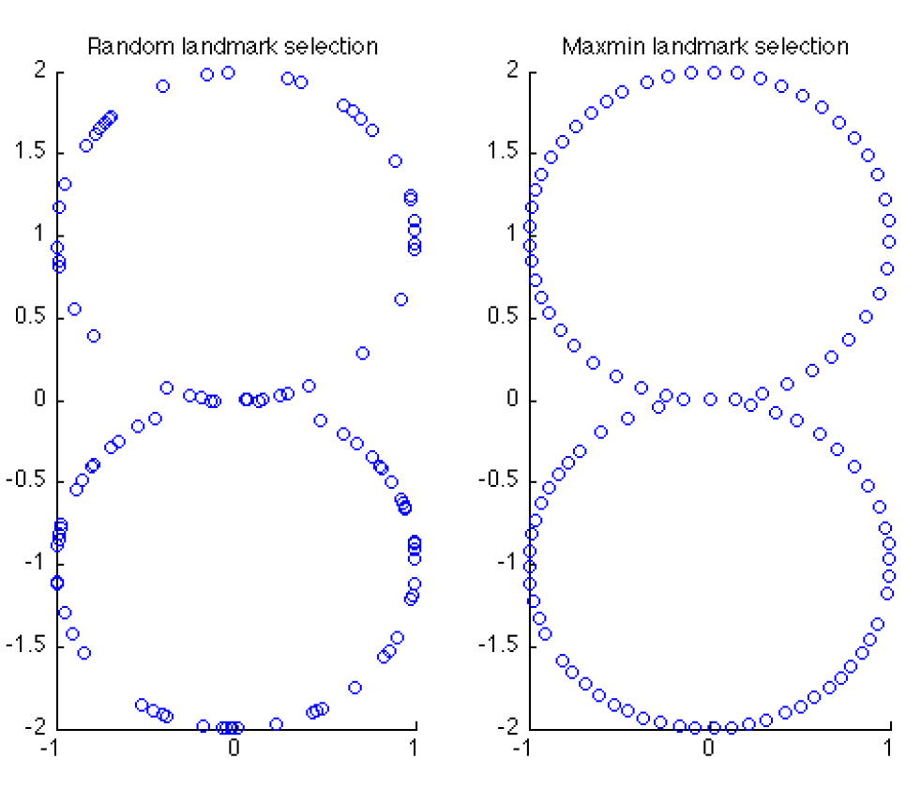

Slide 28
Javaplex Witness complex W(D, L, ε):
Let D = set of point cloud data points.
Choose L D, L = set of landmark points.
Let m_{k} (v) = dist (v, l) where l is the k+1 closest point in L to v.
U
{l₁, …, l_{k+1}} is a k-simplex
iff
d(v, l_{i}) ≤ m_{k} (v)+ ε for all i
v is the witness

Slide 29
>> num_landmark_points = 50;
>> max_dimension = 3;
>> num_divisions = 100;
>> landmark_selector = api.Plex4.createMaxMinSelector(point_cloud, num_landmark_points);
>> random_selector = api.Plex4.createRandomSelector(point_cloud, num_landmark_points);

Slide 30
The next command returns the landmark covering measure R from Section 5.2. Often the value for tmax is chosen in proportion to R.
>> R = landmark_selector.getMaxDistanceFromPointsToLandmarks()
R = 0.7033 % Generally close to 0.7
>> max_filtration_value = R / 8;

Slide 31
We create the witness stream.
>> stream = api.Plex4.createWitnessStream(
landmark_selector, max_dimension,
max_filtration_value, num_divisions);
>> num_simplices = stream.getSize()
num_simplices = 1164 % Generally close to 1200

Slide 32
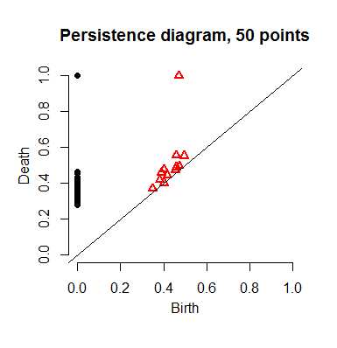
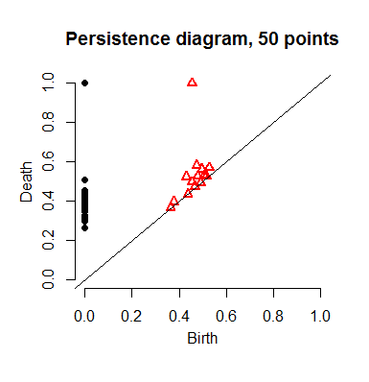
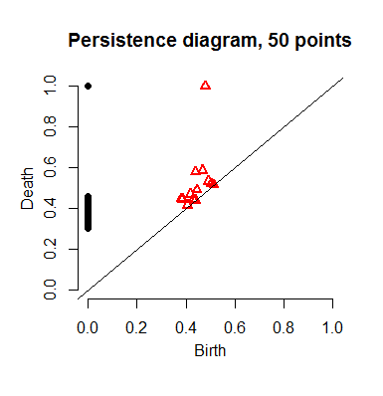
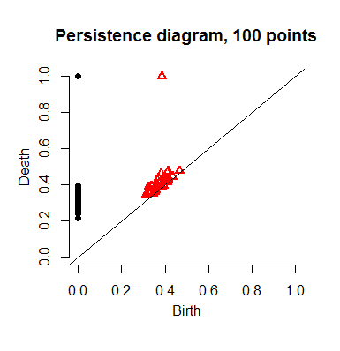
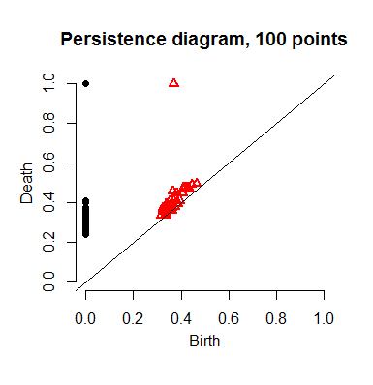
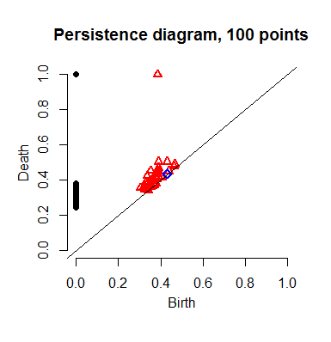

Slide 33
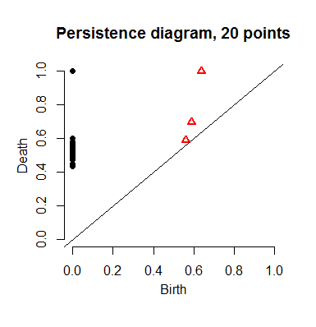

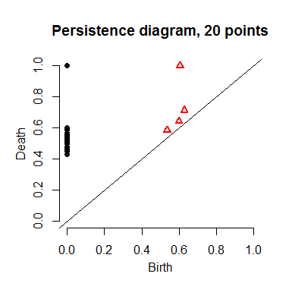
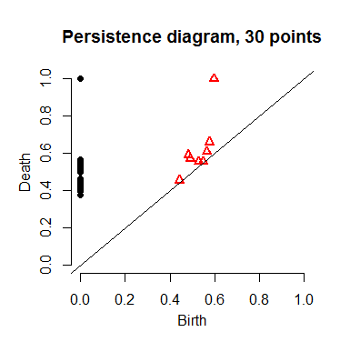
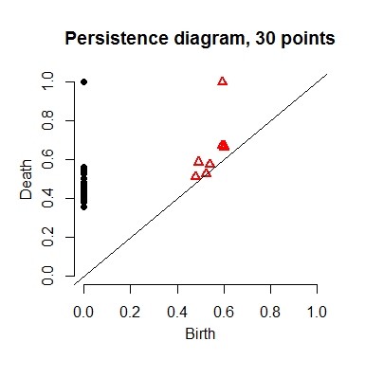
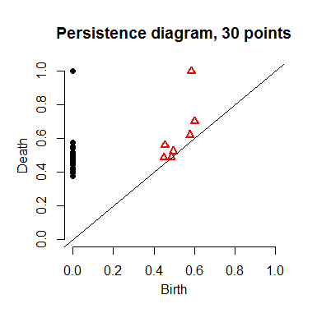

Slide 34
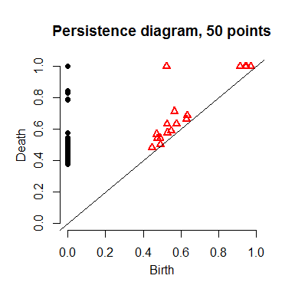
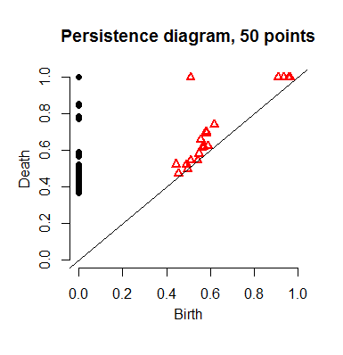
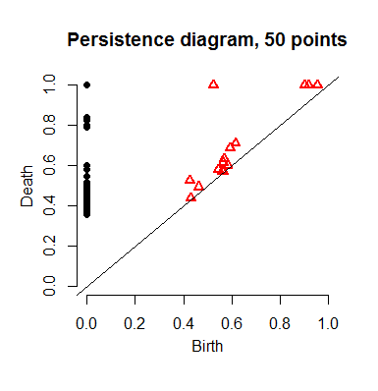
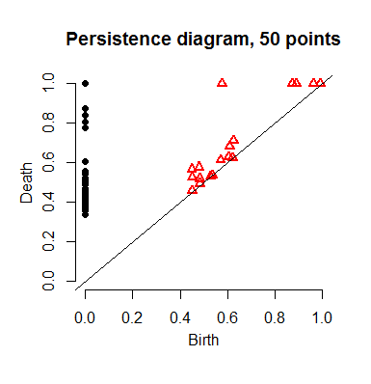

Slide 35
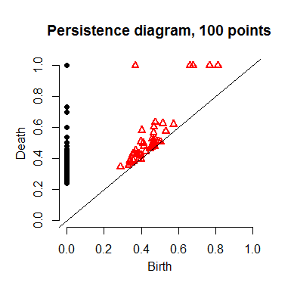
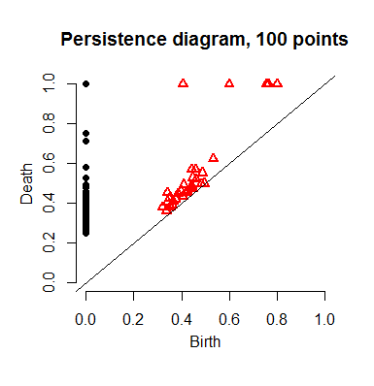
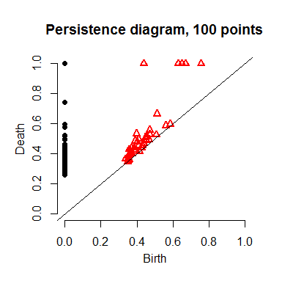


Slide 36
Rstudio:
library("TDA")
circle = circleUnif(300, r = 1)
plot(circle, asp = 1)
cl <- kmeans(circle, 10)
plot(circle,col=cl$cluster)
points(cl$centers, pch=8, cex = 2)
plot(cl$centers, asp = 1)

Slide 37
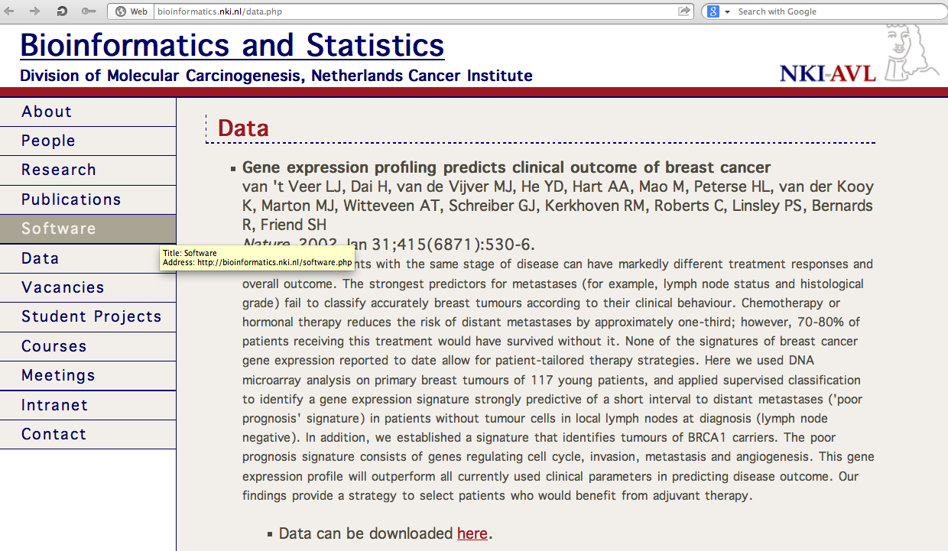
http://bioinformatics.nki.nl/data.php

Slide 38
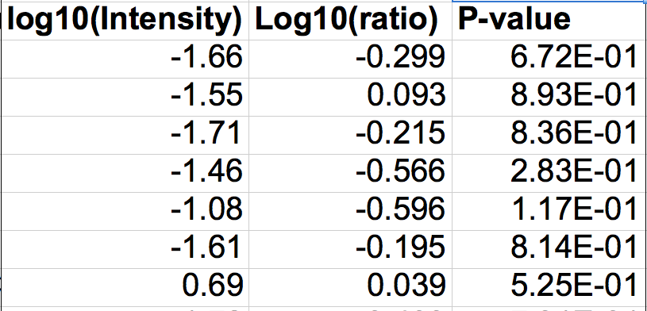
3 columns = patient
middle column (ratio) = data point
rows = genes

Slide 39
Create Data Matrix
load_javaplex
C = csvread('Array5yr.csv',2,1,[2,1,3,21])
C(1, 2)
for i = 1:7 D(:,i) = C(:,3*i-1); end
R = transpose(D)
size(R)

Slide 40
Use standard Euclidean Metric:
m_space = metric.impl.EuclideanMetricSpace(R);
m_space.getPoint(0)
m_space.distance(m_space.getPoint(0), m_space.getPoint(1))
sqrt([R(1,1) - R(2, 1)]^2 + [R(1,2) - R(2,2)]^2)

Slide 41
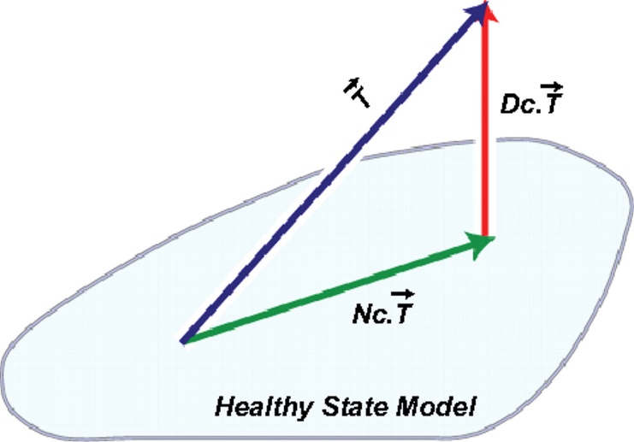
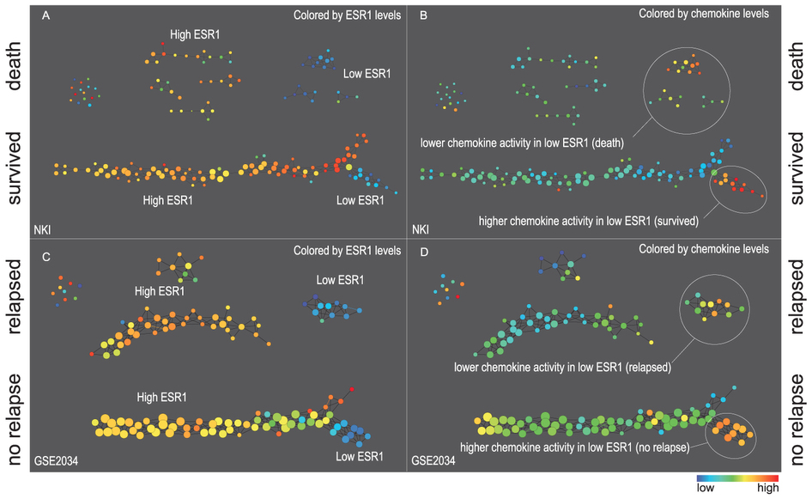
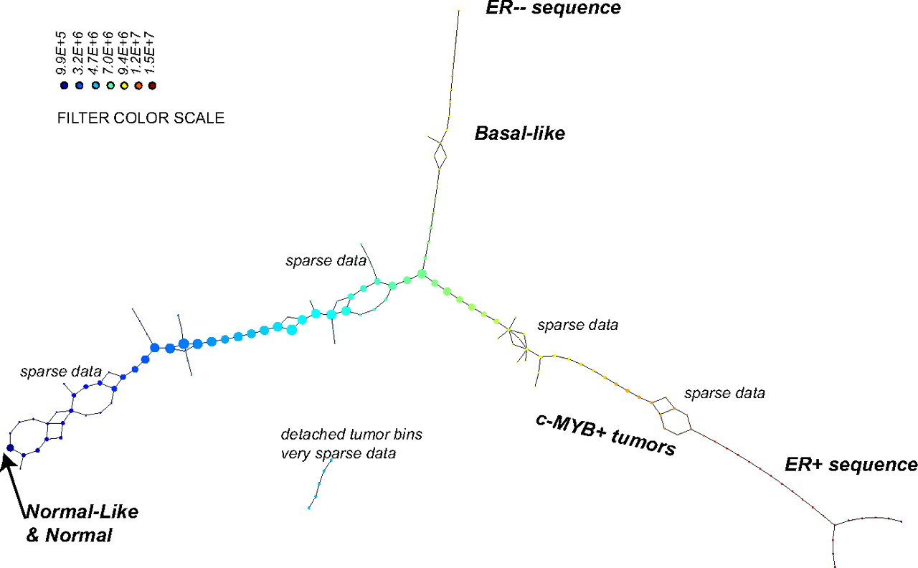
[Σ |x_{i}|^{p}]^{k/p}
k = 1…10
p = 1…5
Pearson correlation
Extracting insights from the shape of complex data using topology P. Y. Lum, G. Singh, A. Lehman, T. Ishkanov, M. Vejdemo-Johansson, M. Alagappan, J. Carlsson, G. Carlsson (2013)
p = 2, k=4
Topology based data analysis identifies a subgroup of breast cancers with a unique mutational profile and excellent survival
Monica Nicolau, Arnold J. Levineb,1, and Gunnar Carlsson, PNAS 2011

Slide 42
Choose your own distance matrix:
dist = ones(7) - eye(7)
dist_space = metric.impl.ExplicitMetricSpace(dist);
dist_space.distance(0,1)

Slide 43
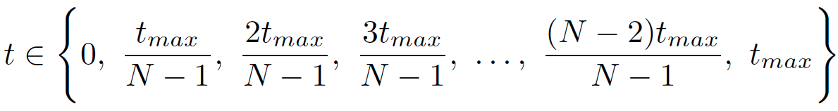
Calculate Vietoris Rips Complex
max_dimension = 6;
max_filtration_value = 2;
num_divisions = 100;
stream = api.Plex4.createVietorisRipsStream(R, max_dimension,max_filtration_value, num_divisions);

Slide 44
Calculate Persistence
persistence =api.Plex4.getModularSimplicialAlgorithm(max_dimension, 2);
intervals = persistence.computeIntervals(stream)
intervals = persistence.computeAnnotatedIntervals(stream)
betti_numbers_array = infinite_barcodes.getBettiSequence()
betti_numbers_string = infinite_barcodes.getBettiNumbers()

Slide 45
options.filename = ’small_data’
options.max_filtration_value = max_filtration_value
options.max_dimension = max_dimension – 1
plot_barcodes(intervals, options)

Slide 46
Run on entire set:
load_javaplex;
clear C; clear D; clear R;
C = csvread('Array5yr.csv',2,1);
for i = 1:35 D(:,i) = C(:,3*i-1); end
R = transpose(D);
stream = api.Plex4.createVietorisRipsStream(R, max_dimension,max_filtration_value, num_divisions);
persistence =api.Plex4.getModularSimplicialAlgorithm(max_dimension, 2);
intervals = persistence.computeIntervals(stream)
options.filename = ’data’;
options.max_filtration_value = max_filtration_value;
options.max_dimension = max_dimension - 1;
plot_barcodes(intervals, options)

Slide 47
Finding generators
for H₁

Slide 48


HanTun software available at
http://web.cse.ohio-state.edu/~tamaldey/handle/hantun.html

Slide 49


HanTun software available at
http://web.cse.ohio-state.edu/~tamaldey/handle/hantun.html

Slide 50





Shortloop software (more general) available at
http://web.cse.ohio-state.edu/~tamaldey/shortloop.html
Figures from http://web.cse.ohio-state.edu/~tamaldey/shortloop-pictures.html

Slide 51

http://web.cse.ohio-state.edu/~tamaldey/homology.html

Slide 52


400 data points were uniformly chosen from a torus using the TDA R-package. The shortest loops generating the first homology were determined using ShortLoop: http://web.cse.ohio-state.edu/~tamaldey/shortloop.html
.
Katie Betancourt
University of Iowa

Slide 53
Finding generators
for H₀

Slide 54


Hierarchical clustering
Data
Dendrogram
http://en.wikipedia.org/wiki/File:Clusters.svg
http://en.wikipedia.org/wiki/File:Hierarchical_clustering_simple_diagram.svg

Slide 55

https://www.python.org/
Download newer 3.4.3 or older 2.7.9 version

Slide 56



Slide 57
https://www.python.org/
Download newer 3.4.3 or older 2.7.9 version

Slide 58

https://www.python.org/downloads/release/python-343/

Slide 59

https://www.python.org/downloads/release/python-343/
Bottom of webpage:

Slide 60

https://www.python.org/downloads/release/python-279/
Bottom of webpage:

Slide 61
https://www.python.org/

Slide 62

https://www.python.org/about/gettingstarted/

Slide 63


https://wiki.python.org/moin/BeginnersGuide/NonProgrammers

Slide 64
python script for comparing 2 files, oldOut.txt and newOut.txt
import itertools
with open('oldOut.txt') as f1, open('newOut.txt') as f2:
for lineno, (line1, line2) in enumerate(itertools.izip(f1, f2), 1):
if line1 != line2:
print line1, line2, 'mismatch', lineno
The above code was modified from:
http://stackoverflow.com/questions/20686674/how-to-compare-two-files-and-print-mismatched-line-number-in-python
To run and output into a file: python same.py > file.txt
where python script filename: same.py
output filename: file.txt

Slide 65

http://www.python-course.eu/python3_blocks.php
https://www.python.org/dev/peps/pep-0008/#tabs-or-spaces
Tabs or Spaces?
Spaces are the preferred indentation method.
Tabs should be used solely to remain consistent with code that is already indented with tabs.
Python 3 disallows mixing the use of tabs and spaces for indentation.
Python 2 code indented with a mixture of tabs and spaces should be converted to using spaces exclusively.
When invoking the Python 2 command line interpreter with the -t option, it issues warnings about code that illegally mixes tabs and spaces. When using -tt these warnings become errors. These options are highly recommended!

Slide 66
same.py
import itertools
with open('oldOut.txt') as f1, open('newOut.txt') as f2:
for lineno, (line1, line2) in enumerate(itertools.izip(f1, f2), 1):
if line1 != line2:
print line1, line2, 'mismatch', lineno
file.txt
-1-1-1-1-1-1-1-1Gauss -1 3 -2 1 -3 2
-1-1-1-1-1-1-1-1Gauss: -1 3 -2 1 -3 2
mismatch 1
11111111Gauss 2 -1 3 -2 1 -3
11111111Gauss: 2 -1 3 -2 1 -3
mismatch 11

Slide 67
yamltoR.py: extracts R code from Swirl lesson
## yamltoR.py: extracts R code from Swirl lesson
## Author: Isabel Darcy
# open file lesson.yaml for reading, call the open file f
f = open('lesson.yaml',"r”)
data_line = f.readlines() # read in each line of the file now called f
for i in data_line: # for each line
if i[:16] == " CorrectAnswer:": # for each line check if first 16
# characters are __CorrectAnswer:
print(i[17:]) # print all characters after 16 in line i
f.close() # close file f

Slide 68
yamltoRwithComments.py
f = open('lesson.yaml',"r")
data_line = f.readlines()
for i in data_line:
if i[:16] == " CorrectAnswer:":
print(i[17:])
else:
print("#"+i)
f.close()

Slide 69
PEP 8 - Style Guide for Python Code
https://www.python.org/dev/peps/pep-0008/
There are many places to learn python.
Python For Beginners includes links to a variety of resources at Python for Non-Programmers and Python for Programmers
For beginners: codecademy. Intro-active lessons that you can do in your web browser. You can also learn HTML & CSS, Javascript, jQuery, Ruby, PHP at Codecademy
Coursera course
Python via Lynda. Note Lynda is free to all UI students/staff/faculty by logging in here

Slide 70
Git & Github
Timothy McRoy

Slide 71

Git
Version Control System
  Allows you to track changes in a project
Old Line
New Line
Modified from slides
Of Timothy McRoy
https://github.com/blog/1707-soft-wrapping-on-prose-diffs

Slide 72
Git: Can download and run on your own computer.
Not a backup system
  A backup system is used to recover files in case something bad happens to the original copy
  Git tracks changes locally in a directory called .git
    If that directory was deleted, git would lose all of the previous versions
Modified from slides
Of Timothy McRoy

Slide 73
Github: Web-based collaboration
  Github is a website which will help visualize some of the features of git
  Github, like many code hosting websites, allows for public hosting of programs
    This allows for interested programmers to take part in furthering development
Modified from slides
Of Timothy McRoy

Slide 74
For the free version of Github (where all repositories are public):
File and repository size limitations
We recommend repositories be kept under 1GB each. This limit is easy to stay within if large files are kept out of the repository.
If your repository exceeds 1GB, you might receive a polite email from GitHub Support requesting that you reduce the size of the repository to bring it back down.
In addition, we place a strict limit of files exceeding 100 MB in size. For more information, see "Working with large files.“
https://help.github.com/articles/what-is-my-disk-quota/

Slide 75
Github
  Github will store your work, but it is not a backup system
    It may be somewhere other than your computer
    Limited file size (100MB)
    Not part of the design of Git or Github
      Encryption, distributed copies, guarantee of uptime, etc.
Modified from slides
Of Timothy McRoy

Slide 76
Share and collaborate
  Easy to distribute work
    clone
  Easy to improve on the work of others
    fork
  Easy to take help from others
    pull
Modified from slides
Of Timothy McRoy

Slide 77
Résumé pad
  A Github profile is a great way to showcase your work
  Link to LinkedIn, but it’s not a LinkedIn replacement
Modified from slides
Of Timothy McRoy

Slide 78

https://help.github.com/articles/good-resources-for-learning-git-and-github/

Slide 79
Getting software from Github
Open up a terminal and change your current directory to the one where you would like the repository (Program) to be saved.
Navigate to the repositories Github page in a web browser
For this example, we’ll use
https://github.com/timothy-mcroy/mapper
Modified from slides
Of Timothy McRoy

Slide 80
Getting software from Github
If you decide that you like the repository, you can
  Copy the URL of the page
  Type “git clone ” into the terminal
  Paste the URL in to the terminal
  Press enter
This will download the entire repository in a directory named after the repository. In the case of the example, the directory would be called mapper.
https://github.com/timothy-mcroy/mapper
Hosting site Author Repository
  hawkid@serv1234[~]% git clone https://github.com/timothy-mcroy/mapper
Modified from slides
Of Timothy McRoy

Slide 81
Don’t forget to install it
Check the Github wiki page for installation instructions
  Sometimes, a package has several dependencies that need to be installed and that won’t necessarily be mentioned
  Occasionally, those instructions require administrator privileges.
    For the mapper repository, the CSG administrators have already installed everything that you wouldn’t be able to install. You will still need to get the other things installed, as they work on a per-profile basis.
Modified from slides
Of Timothy McRoy

Slide 82

Another Distributed Version Control System

