Slide 1

Application to Natural Image Statistics
With V. de Silva, T. Ishkanov, A. Zomorodian
http://www.ima.umn.edu/videos/?id=1846
http://www.ima.umn.edu/2011-2012/W3.26-30.12/activities/Carlsson-Gunnar/imamachinefinal.pdf

Slide 2
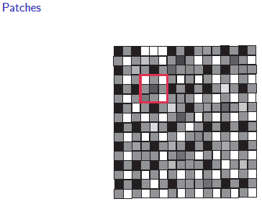
An image taken by black and white digital camera can be viewed as a vector, with one coordinate for each pixel
Each pixel has a “gray scale” value, can be thought of as a real number (in reality, takes one of 255 values)
Typical camera uses tens of thousands of pixels, so images lie in a very high dimensional space, call it pixel space, P

Slide 3
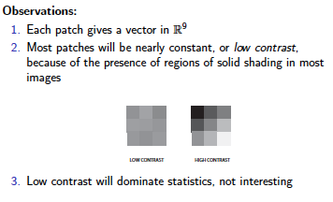
Lee-Mumford-Pedersen [LMP] study only high contrast patches.
Collection: 4.5 x 10⁶ high contrast patches from a
collection of images obtained by van Hateren and van der Schaaf
http://www.kyb.mpg.de/de/forschung/fg/bethgegroup/downloads/van-hateren-dataset.html

Slide 4
Lee-Mumford-Pedersen [LMP] study only high contrast patches.
Collection: 4.5 x 10⁶ high contrast patches from a
collection of images obtained by van Hateren and van der Schaaf
Choose how to model your data

Slide 5
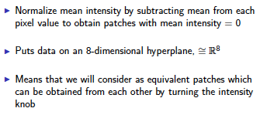
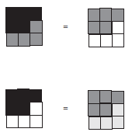

Choose how to model your data
Consult previous methods.

Slide 6
What to do if you are overwhelmed by the number of possible ways to model your data (or if you have no ideas):
Do what the experts do.
Borrow ideas.
Use what others have done.

Slide 7
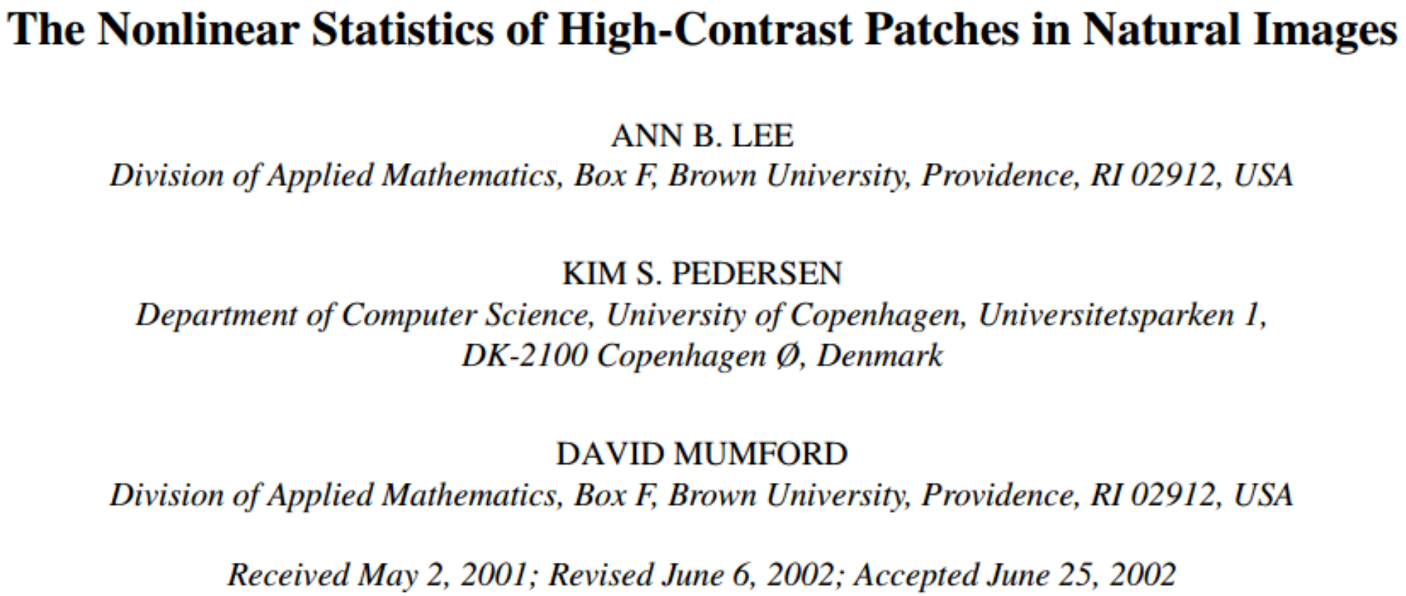
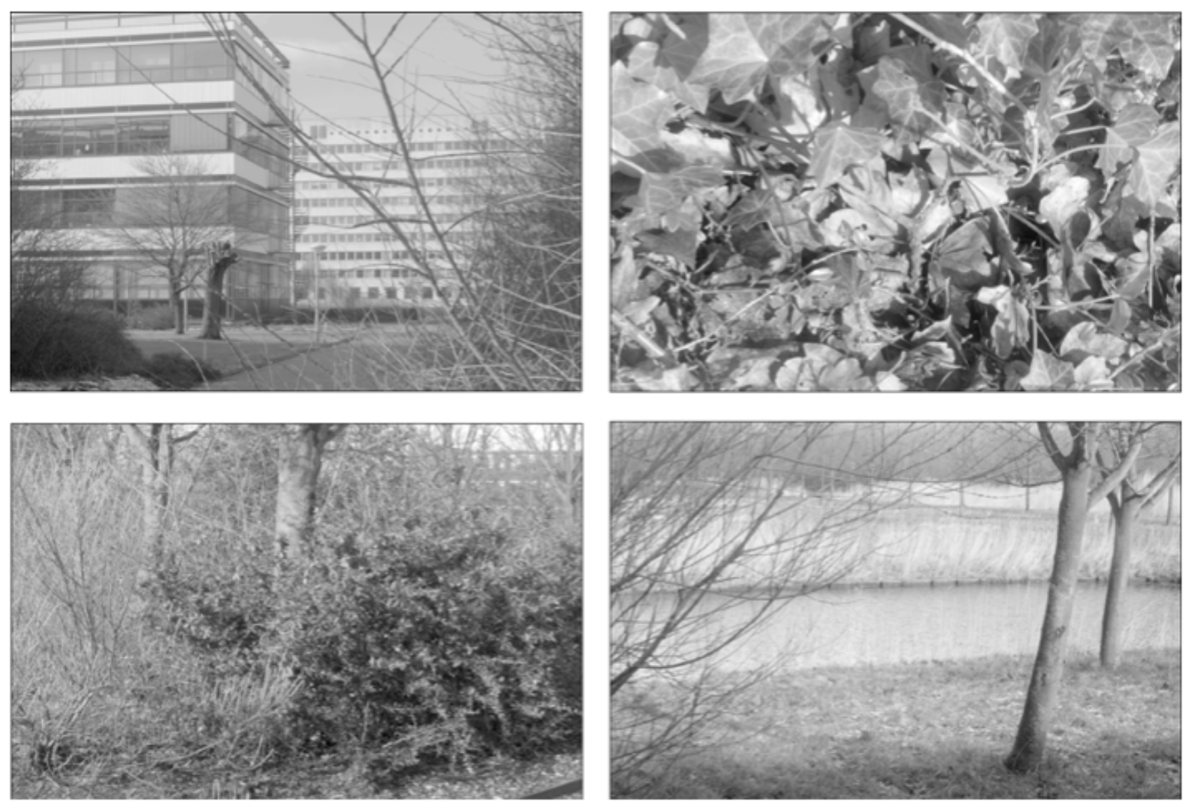
Carlsson et al used

Slide 8
Carlsson et al used
The majority of high-contrast optical patches are concentrated around a 2-dimensional C₁ submanifold
embedded in the 7-dimensional sphere.

Slide 9
Persistent Homology: Create the Rips complex
0.) Start by adding 0-dimensional data points
is a point in S⁷
Notes:
We can compute the number of clusters for a variety of diameters.
We start with 17 data points, so if the diameter is 0, we have 17 clusters. Increasing the diameter, these 2 balls intersect so I now have 16 clusters.
If we continue to increase the diameter, we will eventually create the complex we saw before with 5 clusters, etc until we only have one cluster left.
Eventually this entire page will be purple, but right now, we know have one component.
To choose the threshold, one can determine how long a particular number of clusters lasts, for example for what set of radii do we have five clusters. If we have five clusters for the largest set of radii, then have gives us a good idea where to set the threshold and which simplicial complex best models our data.
I have put links to better animations on my on my YouTube site which may better illustrate this persistence concept. Next month, we will also talk much more about persistence during the live lectures for this course. This is just a preliminary introduction.

Slide 10
For each fixed ε, create Rips complex from the data
is a point in S⁷
1.) Adding 1-dimensional edges (1-simplices)
Add an edge between data points that are close
Notes:
a one dimensional simplicial complex. Note that we have clustered our data into five disjoint connected sets. So this is one way to cluster our data – that is grouping our data points into disjoint sets based on some definition of similarity. In this case, we have 5 clusters.
We can now add higher dimensional simplices.

Slide 11
For each fixed ε, create Rips complex from the data
2.) Add all possible simplices of dimensional > 1.
is a point in S⁷
Notes:
Thus we now have the Vietoris Rips simplicial complex. Note we get the same simplex by adding one dimension at a time

Slide 12
For each fixed ε, create Rips complex from the data
In reality used Witness complex (see later slides).
2.) Add all possible simplices of dimensional > 1.
is a point in S⁷
Notes:
Thus we now have the Vietoris Rips simplicial complex. Note we get the same simplex by adding one dimension at a time

Slide 13
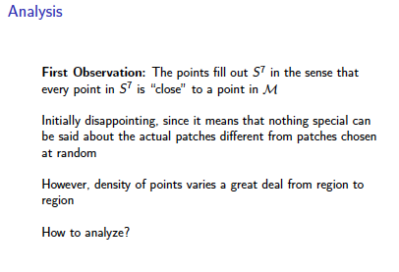
Probe the data

Slide 14
Probe the data

Slide 15
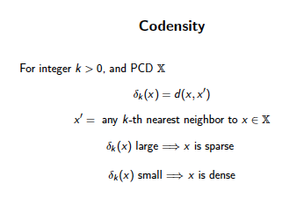
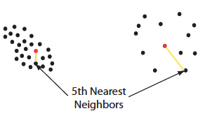

Can use function on data to probe the data

Slide 16
Large values of k:
measuring density of large neighborhoods of x,
Smaller values mean we are using smaller neighborhoods
Large k = smoothed out version →

Slide 17
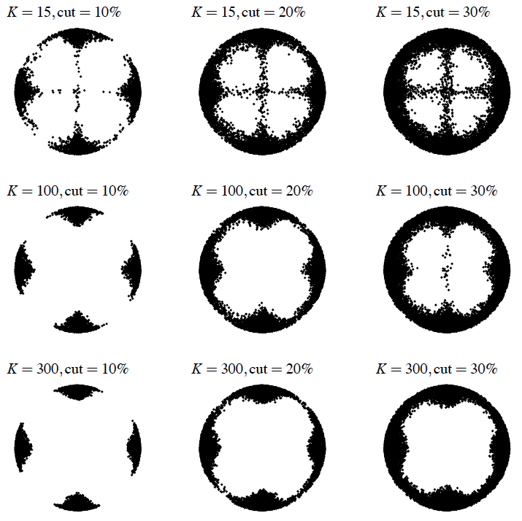
Eurographics Symposium on Point-Based Graphics (2004)
Topological estimation using witness complexes
Vin de Silva and Gunnar Carlsson

Slide 18
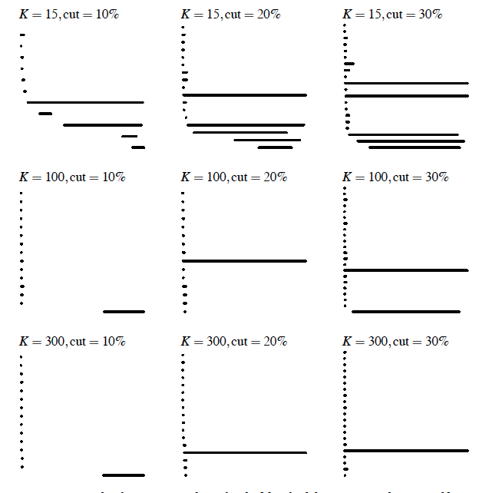
Eurographics Symposium on Point-Based Graphics (2004)
Topological estimation using witness complexes
Vin de Silva and Gunnar Carlsson

Slide 19
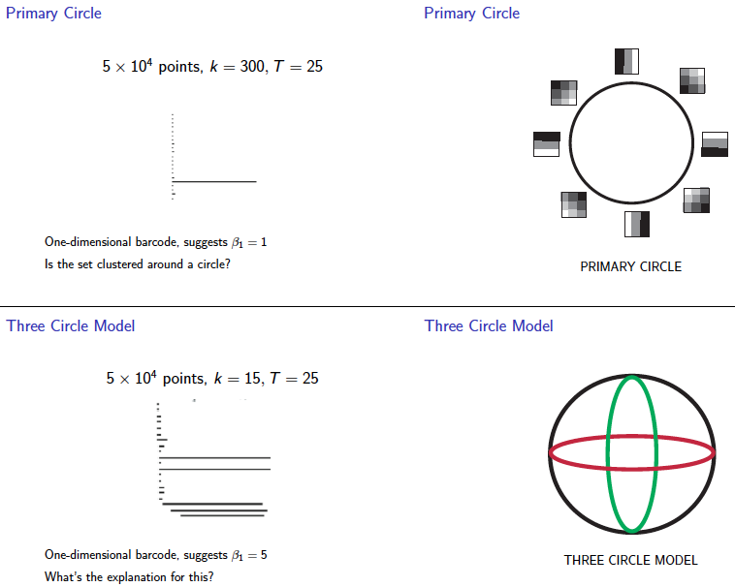
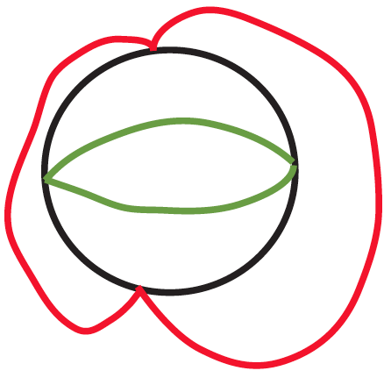

Slide 20
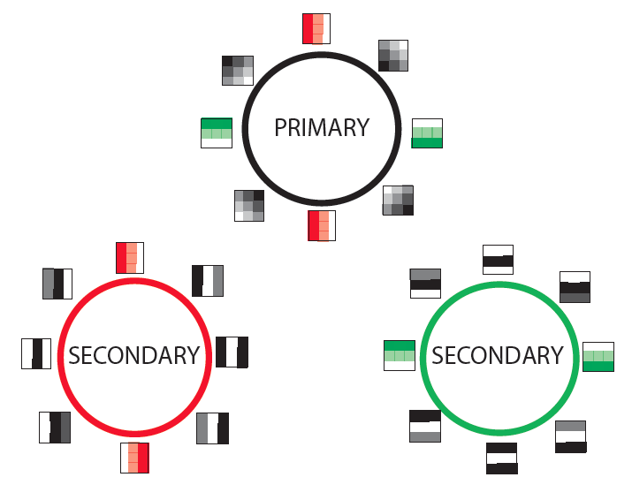

Slide 21
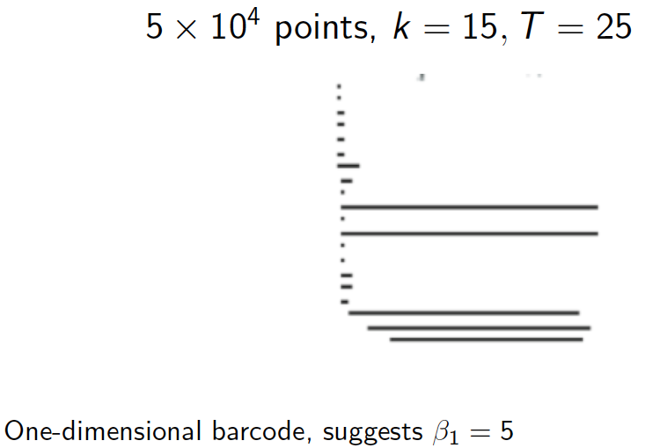

Slide 22
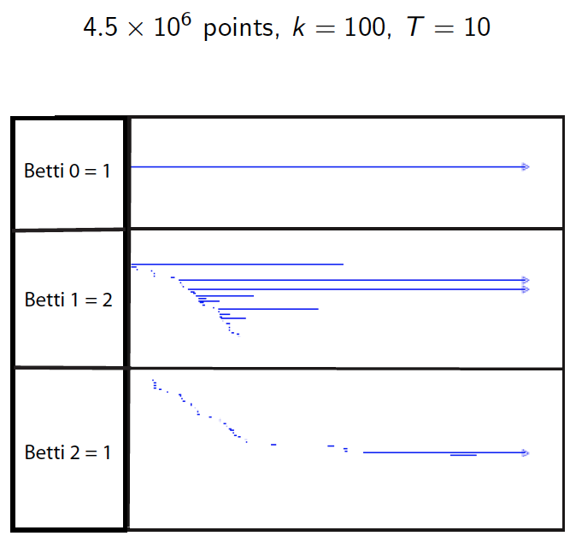

Slide 23
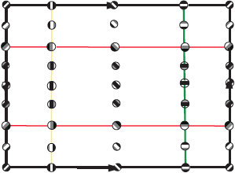

Slide 24
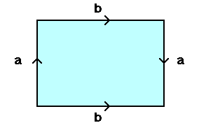
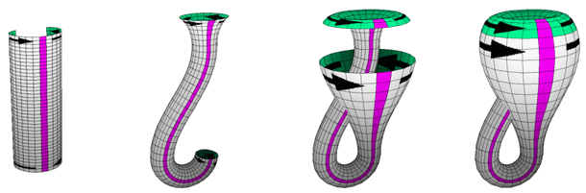
From: http://www.math.osu.edu/~fiedorowicz.1/math655/Klein2.html
Klein Bottle
From:
http://plus.maths.org/content/imaging-maths-inside-klein-bottle

Slide 25
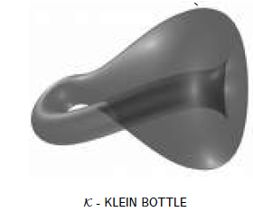
M(100, 10) U Q
where |Q| = 30
On the Local Behavior of Spaces of Natural Images, Gunnar Carlsson, Tigran Ishkhanov, Vin de Silva, Afra Zomorodian, International Journal of Computer Vision 2008, pp 1-12.

Slide 26
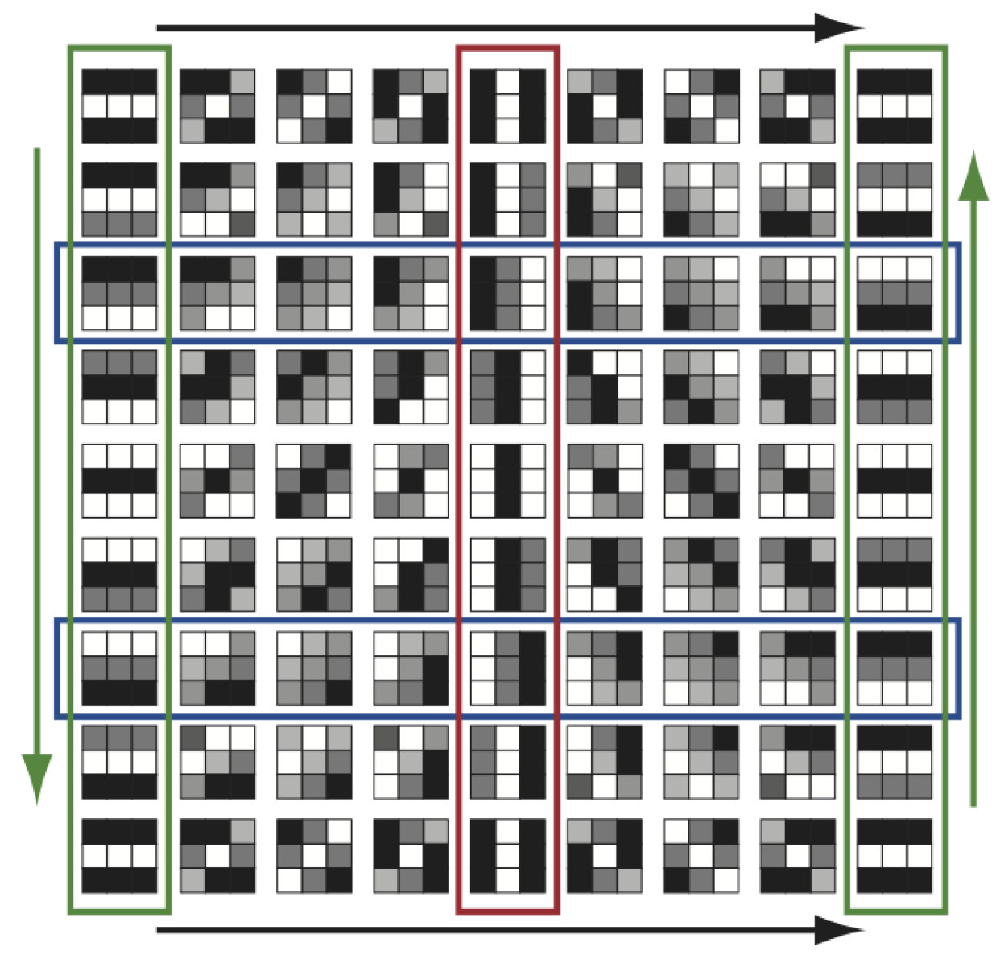
http://www.maths.ed.ac.uk/~aar/papers/ghristeat.pdf

Slide 27

http://www.maths.ed.ac.uk/~aar/papers/ghristeat.pdf

Slide 28
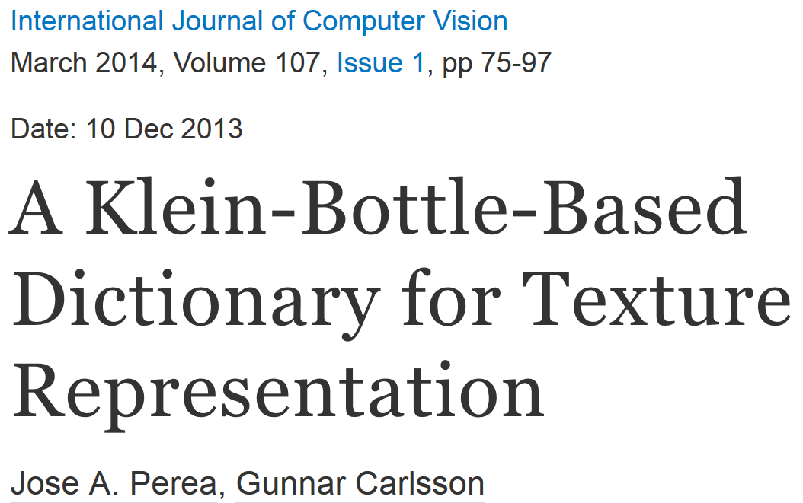
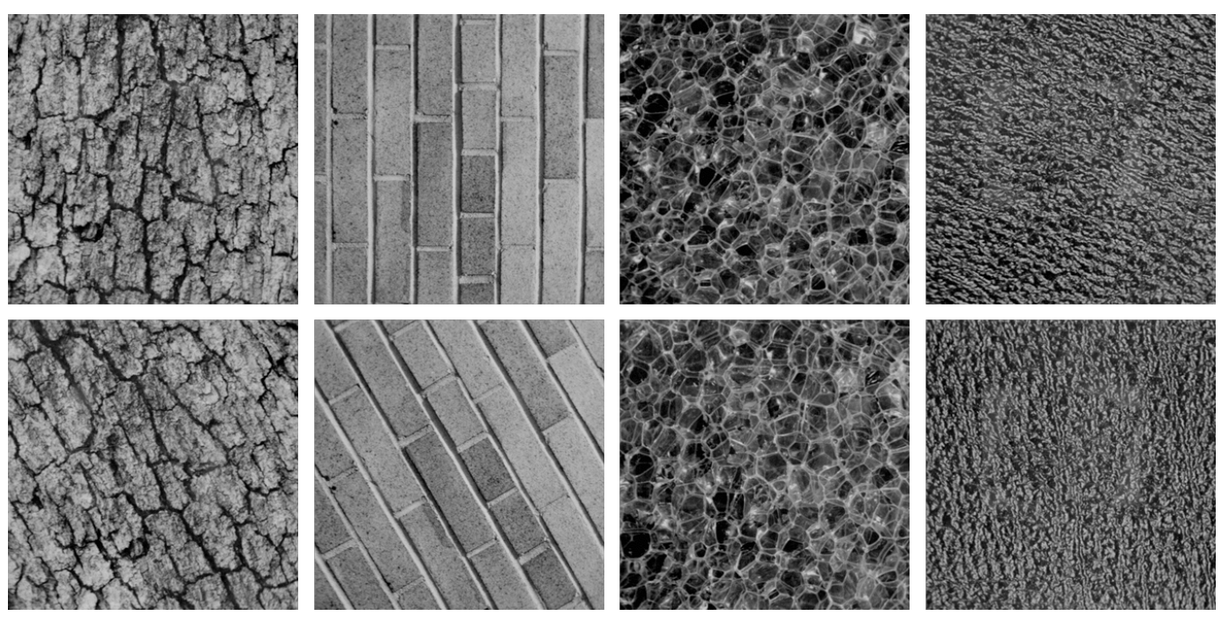
Combine your analysis with other tools

Slide 29
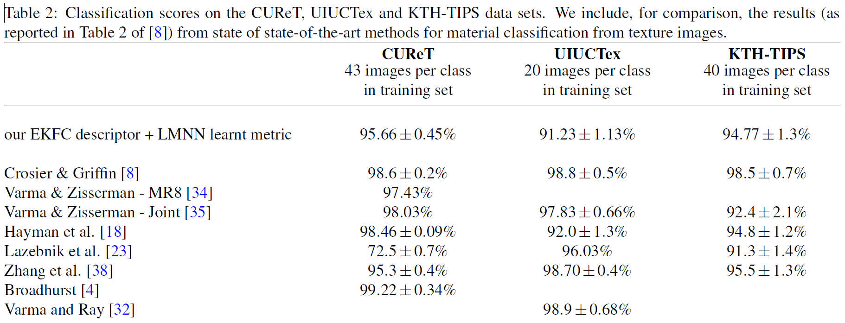
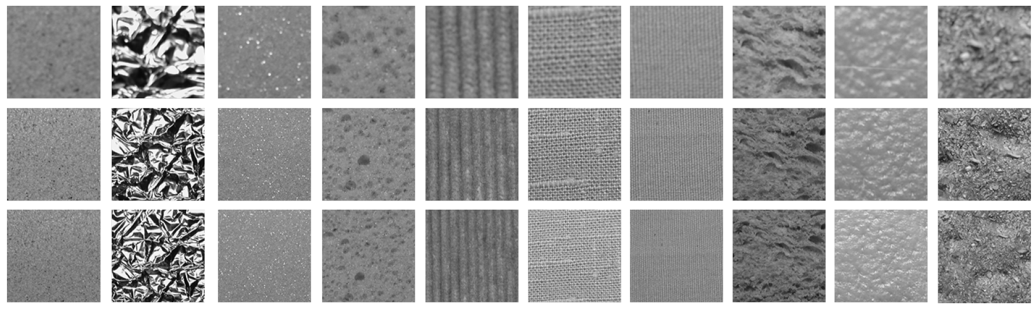

Slide 30
http://en.wikipedia.org/wiki/Machine_learning
Machine learning is a scientific discipline that explores the construction and study of algorithms that can learn from data.[1] Such algorithms operate by building a model from example inputs and using that to make predictions or decisions,[2]:2 rather than following strictly static program instructions.
https://www.cs.princeton.edu/courses/archive/spring08/cos511/scribe_notes/0204.pdf
Machine learning studies computer algorithms for learning to do stuff.
The emphasis of machine learning is on automatic methods. In other words, the goal is to devise learning algorithms that do the learning automatically without human intervention or assistance.

Slide 31




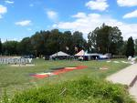
Image Categorization
Training
Training Labels
Training Images
Image Features
Classifier Training
Trained Classifier
Testing
Image Features
Trained Classifier
Prediction
Outdoor
Test Image
http://cs.brown.edu/courses/cs143/lectures/15.ppt

Slide 32
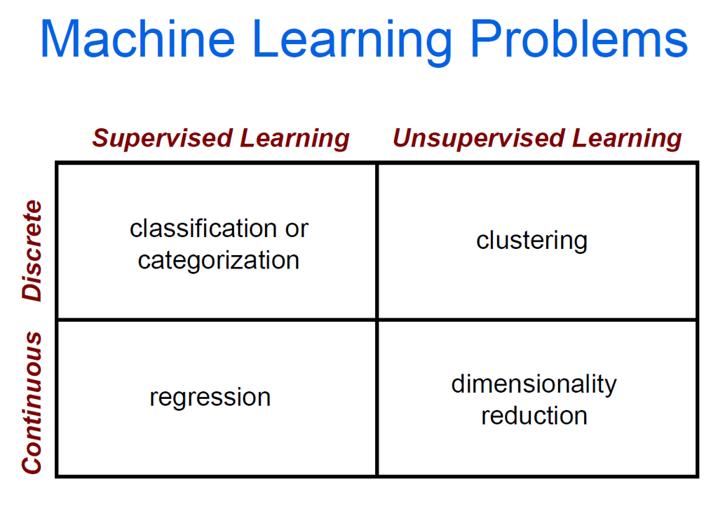
cs.brown.edu/courses/cs143/lectures/17.ppt

Slide 34
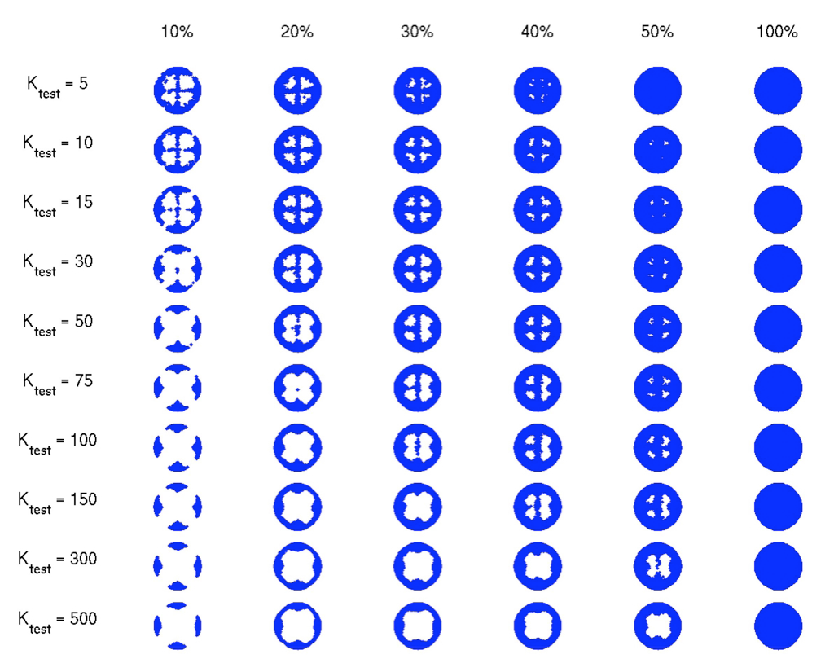

Slide 35
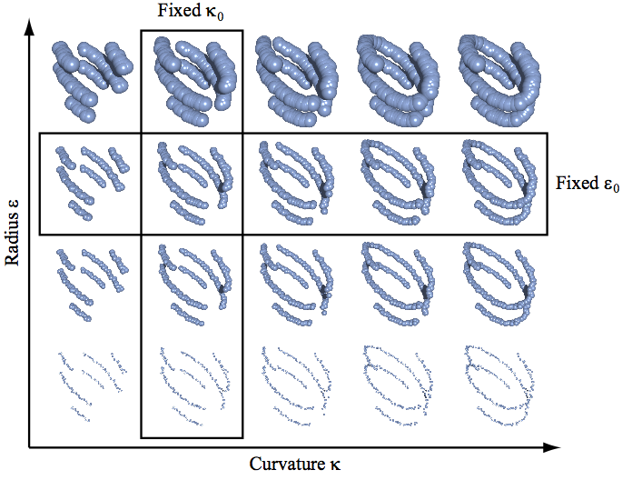
The Theory of Multidimensional Persistence, Gunnar Carlsson, Afra Zomorodian
"Persistence and Point Clouds" Functoriality, diagrams, difficulties in classifying diagrams,
multidimensional persistence, Gröbner bases, Gunnar Carlsson
http://www.ima.umn.edu/videos/?id=862

Slide 37
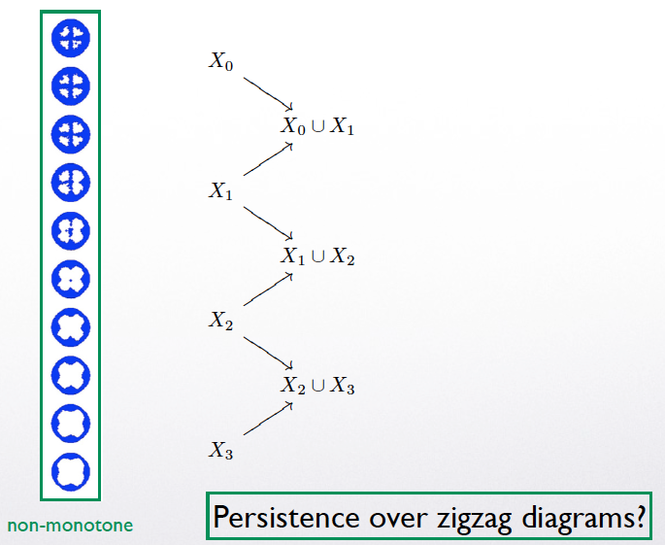

Slide 38
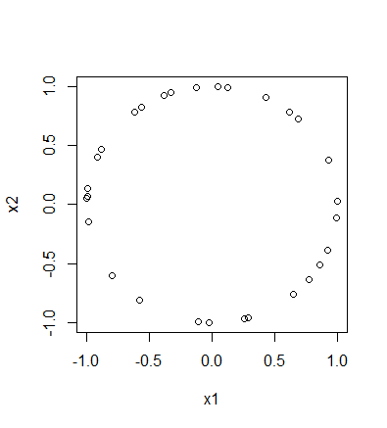
To install the TDA package on a PC:
install.packages("TDA")
To install the TDA package on a Mac:
install.packages("TDA", type = "source")
XX = circleUnif(30)

Slide 39
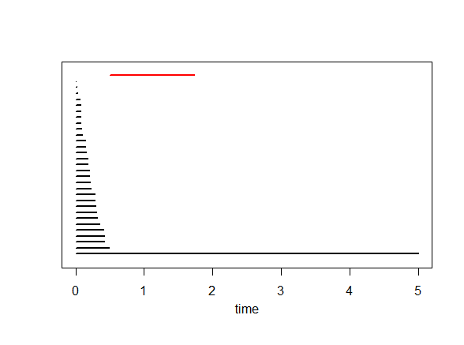
Plot of data points Barcode
Each bar in the barcode represents a cycle in some H_{i}.
The red bar represents the element in H₁ (i.e., the circle = 1 dimensional cycle = sum of edges where the boundary of this sum = 0).
Bars representing an element in H₀ (i.e, 0-dimensional cycles = vertices) are drawn in black
→
→
Birth Death

Slide 40
Plot of data points Barcode
Each bar in the barcode represents a cycle in some H_{i}.
A bar starts at the birth time of the cycle it represents and ends at its death time.
→
→
Birth Death

Slide 41
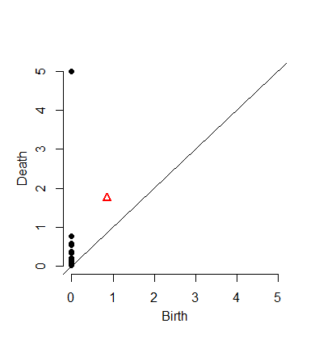
Barcode
→
→
Birth Death
A bar starts at the birth time of the cycle it represents and ends at its death time
For each cycle in H_{i} = bar in barcode, we can plot the point (birth, death)
where
birth = birth time of this cycle
death = death time of this cycle
Black point = cycle in H₀.
Red triangle = cycle in H₁.
(Birth, Death)
→

Slide 42
Barcode
→
→
Birth Death
A bar starts at the birth time of the cycle it represents and ends at its death time
This plot of points
(birth, death)
is called the
Persistence Diagram
where we also throw in the diagonal.
(Birth, Death)
→

Slide 43
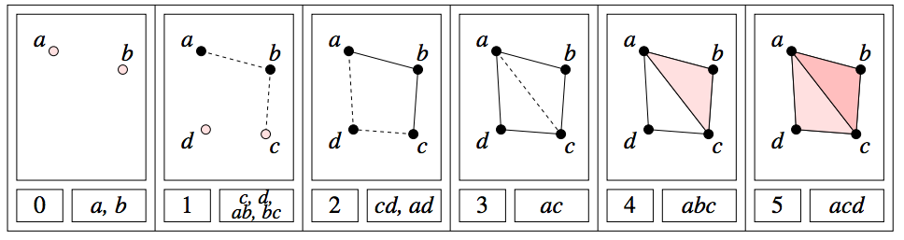
H₀ = < a, b, c, d : tc + td, tb + c, ta + tb>
H₁ = <z₁, z₂ : t z₂, t³z₁ + t²z₂ >
[ )
[ )
[ )
[ )
[
z₁ = ad + cd + t(bc) + t(ab), z₂ = ac + t²bc + t²ab

Slide 44
Since we can’t plot (0, ∞), we instead plot (0, 5) where
5 = maximum time = maximum threshold
= 3rd argument in ripsDiag(XX,maxdimension,maxscale, …)
[ )
[ )
[ )
[ )
[
(3, 4)
(1, 2)
(2, 5)
(0, 1)
(0, ∞) → (0, 5)

Slide 45
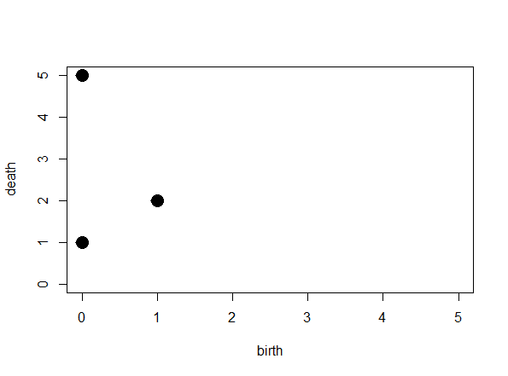
[ )
[ )
[ )
[ )
[
(3, 4)
(1, 2)
(2, 5)
(0, 1)
(0, 5)

Slide 46
[ )
[ )
[ )
[ )
[
(3, 4)
(1, 2)
(2, 5)
(0, 1)
(0, 5)
Remember to add the diagonal

Slide 47
[ )
[ )
[ )
[ )
[
(3, 4)
(1, 2)
(2, 5)
(0, 1)
(0, 5)
The diagonal will be useful when we compute distance between persistence diagrams
Remember to add the diagonal

Slide 48
The homology of a circle is as follows:
Rank of H₀ = 1
since a circle has only one component
Rank of H₁ = 1
since a circle has a single 1-d component
Rank of H₂ = 0
since we don’t have any 2-d circles.

Slide 49
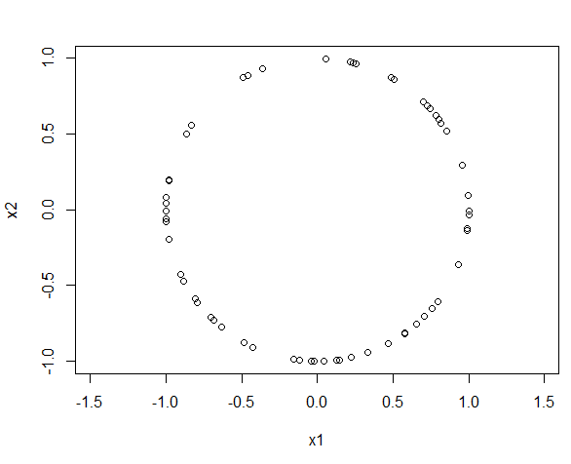
The homology of a circle is as follows:
Rank of H₀ = 1
since a circle has only one component
Rank of H₁ = 1
since a circle has a single 1-d component
Rank of H₂ = 0
since we don’t have any 2-d circles.
This data set consists of 60 points randomly taken from a circle of radius 1.
What should we expect the barcode to look like?
What should we expect the persistence diagram to look like?
Can we use TDA to determine that our points came from a circle

Slide 50
Can we use TDA to determine that our points came from a circle
The homology of a circle is as follows:
Rank of H₀ = 1 since a circle has only one component
Thus we expect 1 persistent (long) bar in the 0-dim barcode
plus some shorter bars that we can “ignore”
Rank of H₁ = 1: circle has a single 1-d cycle that does not bound surface
Thus we expect 1 persistent (long) bar in the 1-dim barcode
plus possible some shorter bars that we can “ignore”
Rank of H₂ = 0 since we don’t have any 2-d ccles.
Thus we expect 0 persistent (long) bars in the 2-dim barcode
plus possible some shorter bars that we can “ignore”

Slide 51
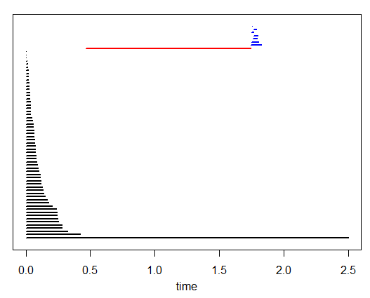
The homology of a circle is as follows:
Rank of H₀ = 1 since a circle has only one component
Thus we expect 1 persistent (long) bar in the 0-dim barcode
plus some shorter bars that we can “ignore”
Rank of H₁ = 1: circle has a single 1-d cycle that does not bound surface
Thus we expect 1 persistent (long) bar in the 1-dim barcode
plus possible some shorter bars that we can “ignore”
Rank of H₂ = 0 since we don’t have any 2-d ccles.
Thus we expect 0 persistent (long) bars in the 2-dim barcode
plus possible some shorter bars that we can “ignore”

Slide 52
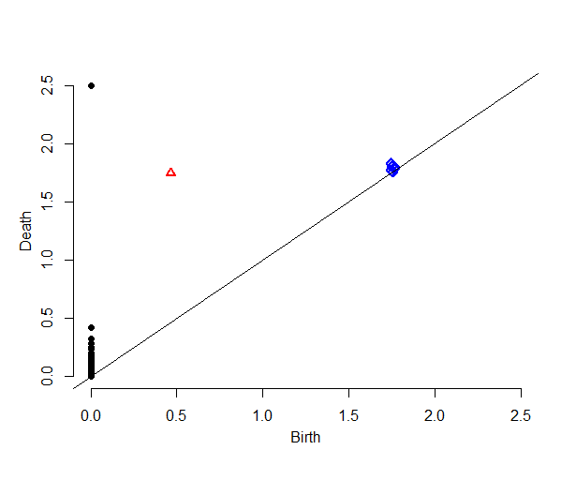
Our data set = 60 points randomly taken from a circle of radius 1
Can you determine from the barcode that our data set came from a circle?
Do you see 1 persistent 0-dim cycle?
Do you see 1 persistent 1-dim cycle?
Do you see 0 persistent 2-dim cycle?
Does the persistent diagram make sense?
1 black point (cycle in H₀) is far from the diagonal, while remaining black points are “close” to diagonal
1 red point (cycle in H₁) is far from diagonal
All blue points (cycles in H₂) are close to diagonal

Slide 53
From the barcode:
1 persistent 0-dim cycle ➔ H₀ = 1
1 persistent 1-dim cycle ➔ H₁ = 1
No persistent 2-dim cycles ➔ H₂ = 0
Ignore bars with “small” length
Definition of “small” depends on dimension, data set, application, etc.
From the persistent diagram:
1 black point far from the diagonal ➔ H₀ = 1
1 red point far from diagonal ➔ H₁ = 1
All blue points close to diagonal ➔ H₂ = 0
Ignore points “close” to diagonal
Definition of “close” depends on dimension, data set, application, etc.

Slide 54
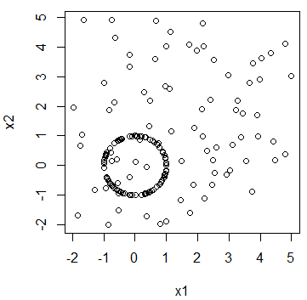
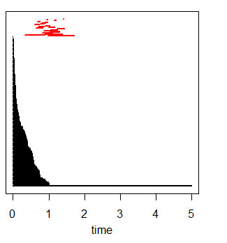
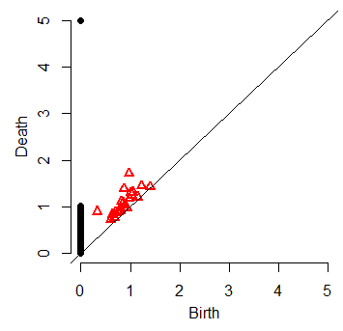
Next week in B5 MLH you can explore the difference between circle and (circle + various amounts of noise)
How does background noise affect persistent diagram?

Slide 55
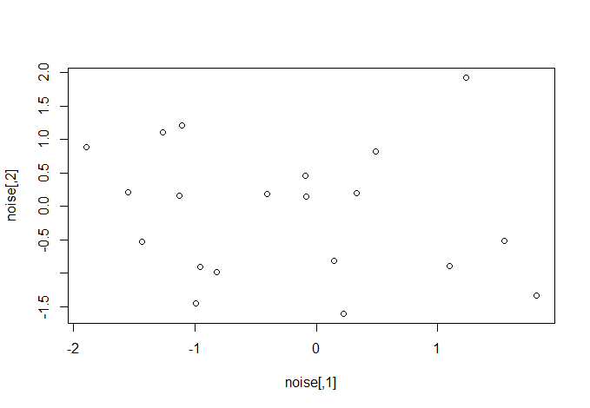
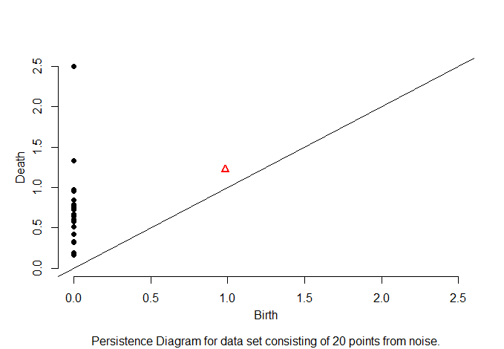
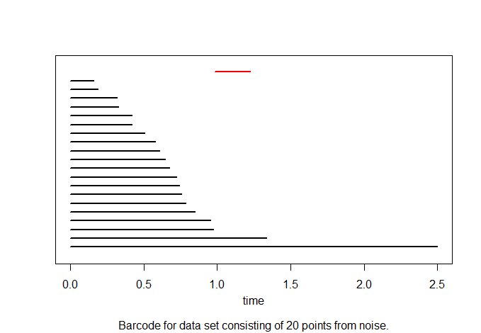
What does noise look like?

Slide 56
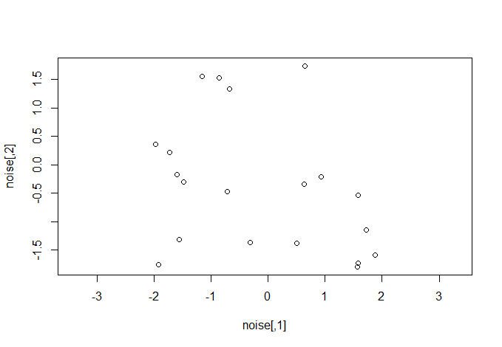
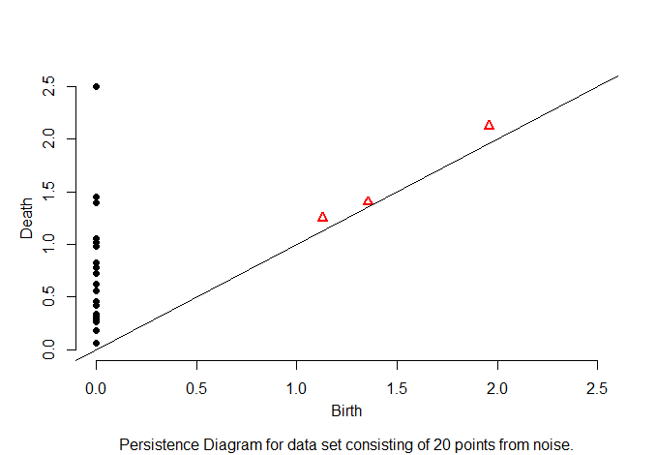
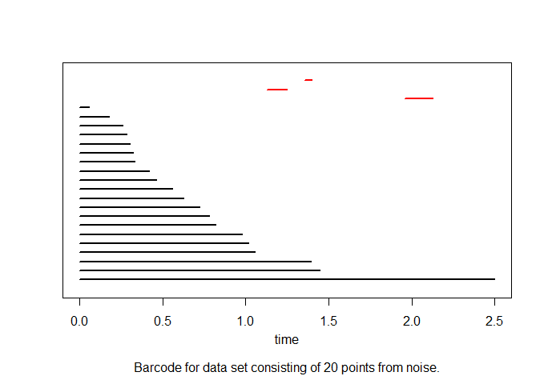
What does noise look like?

Slide 57
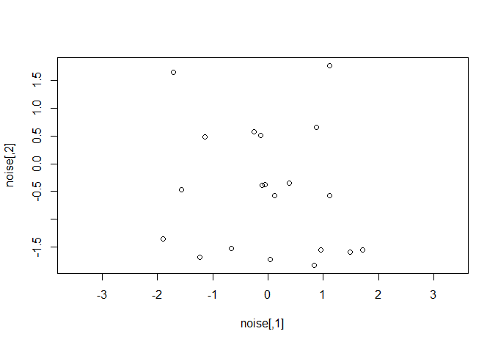
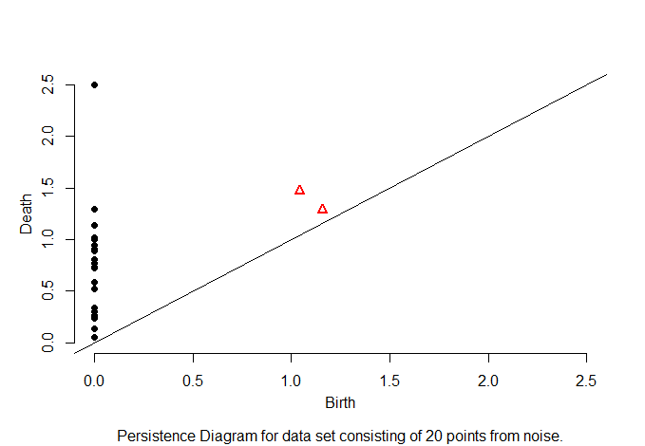
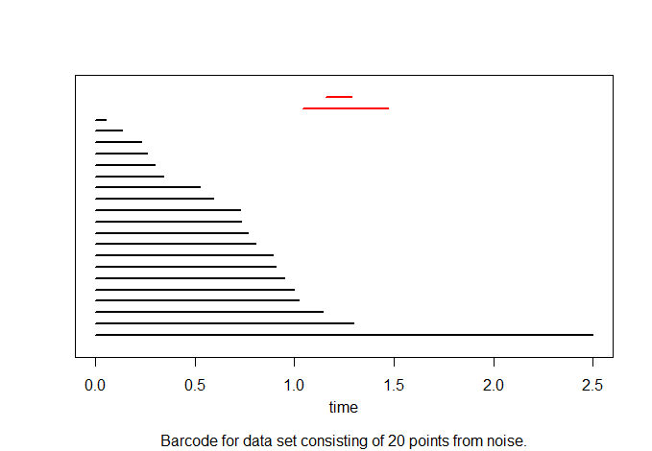
What does noise look like?

Slide 58
What does noise look like?

Slide 59



What does noise look like?

Slide 60



What does noise look like?

Slide 61



What does noise look like?

Slide 62
What does noise look like?

Slide 63
What does noise look like?

Slide 64



What does noise look like?

Slide 66
Stability

Slide 67
Next week in B5 MLH you can explore the difference between circle and (circle + various amounts of noise)
How does background noise affect persistent diagram?

Slide 68

Discrete & Computational Geometry
January 2007, Volume 37, Issue 1, pp 103-120
Stability of Persistence Diagrams
David Cohen-Steiner, Herbert Edelsbrunner, John Harer
http://www.cs.duke.edu/~edels/Papers/2007-J-01-StabilityPersistenceDiagrams.pdf
f: X → R
f⁻¹(-∞, r)
(b_{i}, d_{i})

Slide 69
Bottleneck Distance.
Let Diag1and Diag2 be persistence diagrams.
The bottleneck distance is
the infimum over all bijections h: Diag1 → Diag 2 of
sup_{i} d(i; h(i)).

Slide 70
|| (x₁,…,x_{n}) – (y₁,…,y_{n}) ||∞ = max{|x₁ – y₁|,…,|x_{n} - y_{n}|}
Given sets X, Y and bijection β: X → Y,
Bottleneck Distance: d_{B}(X, Y) = inf sup || x – β(x) ||∞
β x

Slide 71
Stability theorem:
Let X be a triangulable space with continuous
tame functions f, g : X → R. Then the persistence diagrams, D(f)and D(g), satisfy
d_{B}(D(f), D(g)) ≤ || f − g ||∞ = sup{|f(x) – g(x)|}
x

Slide 72
|| (x₁,…,x_{n}) – (y₁,…,y_{n}) ||∞ = max{|x₁ – y₁|,…,|x_{n} - y_{n}|}
Given sets X, Y and bijection β : X → Y,
Wasserstein distance:
W_{q}(X, Y) = [inf Σ || x – β(x) ||∞]^{1/q}
^{q}
β x in X

Slide 73

(Wasserstein distance). The p-th Wasserstein distance between two persistence diagrams,
d₁ and d₂, is defined as
where γ ranges over all bijections from d₁ to d₂.

Slide 74
Stability theorem:
Let X be a triangulable space whose triangulations grow polynomially with constant exponent j.
Let f, g : X → R be tame Lipschitz functions .
Then there are constants C and k > j no smaller than 1 such that persistence diagrams, D(f) and D(g), satisfy
W_{q}(D(f), D(g)) ≤ C|| f − g ||∞
for every q ≥ k.
1 – k/q

Slide 75
Next week in B5 MLH you can explore the difference between circle and (circle + various amounts of noise)
How does background noise affect persistent diagram?

Slide 76
> print( bottleneck(Diag1, Diag2, dimension=0) )
[1] 0.4942465
> print( wasserstein(Diag1, Diag2, p=2, dimension=0) )
[1] 5.750874
> print( bottleneck(Diag1, Diag2, dimension=1) )
[1] 0.279019
> print( wasserstein(Diag1, Diag2, p=2, dimension=1) )
[1] 0.301575

Slide 77


http://www.plosone.org/article/info%3Adoi%2F10.1371%2Fjournal.pone.0002856
2008
And section 9.1 in Computational Topology: An Introduction By Herbert Edelsbrunner, John Harer

Slide 78
Goal: To determine what genes are involved in a particular periodic pathway
Application: segmentation clock of mouse embryo.
1 somite develops about every 2 hours
What genes are involved in somite development?

Slide 79
Persistence:
For each of 7549 genes, create
f_{k}: S¹ → R, k = 1, …, 7549
f_{k} (time point i) = amount of RNA at time point i for gene k
If gene k is involved in somite development, then f_{k} should have period 2

Slide 80
Not period 2:

Slide 81
Not period 2:

Slide 82
Not period 2:

Slide 83
Not period 2:

