Slide 1
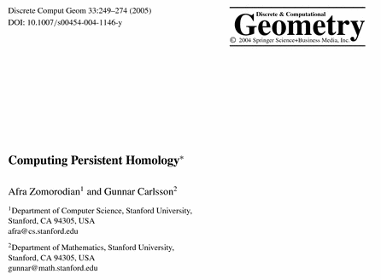
http://link.springer.com/article/10.1007%2Fs00454-004-1146-y

Slide 2
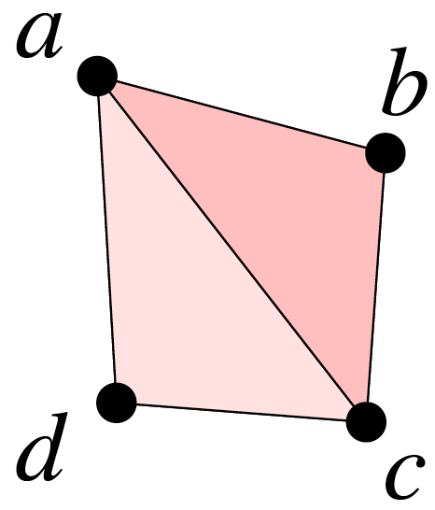
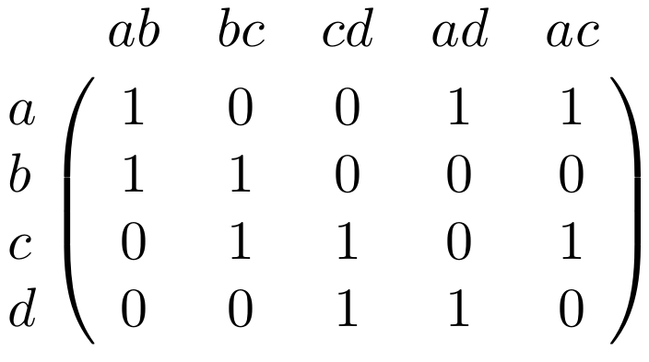
Computing Persistent Homology by
Afra Zomorodian,
Gunnar Carlsson
M₁ =
http://link.springer.com/article/10.1007%2Fs00454-004-1146-y

Slide 3
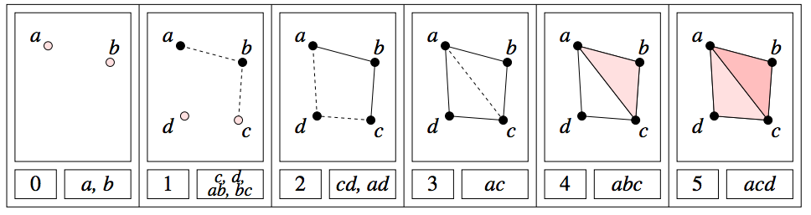
Computing Persistent Homology by Afra Zomorodian, Gunnar Carlsson
M₁ =
http://link.springer.com/article/10.1007%2Fs00454-004-1146-y

Slide 4
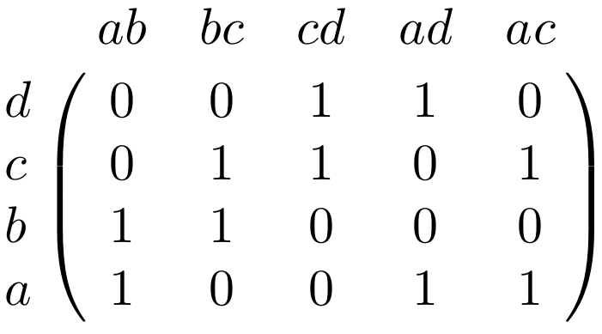
0 | 0 | 1 | 1 | 1 | 1 | 2 | 2 | 3 | 4 | 5
+ | + | + | + | - | - | - | + | + | - | -
a | b | c | d | ab | bc | cd | ad | ac | abc | acd
0 | 1 | 2 | 3 | 4 | 5 | 6 | 7 | 8 | 9 | 10
M₁ =

Slide 5
0 | 0 | 1 | 1 | 1 | 1 | 2 | 2 | 3 | 4 | 5
+ | + | + | + | - | - | - | + | + | - | -
a | b | c | d | ab | bc | cd | ad | ac | abc | acd
0 | 1 | 2 | 3 | 4 | 5 | 6 | 7 | 8 | 9 | 10
M₁ =
_{i, p}
H_{k} =
Z_{k} / ( B_{k} Z_{k} )
_{i}
_{i+p}
_{i}
U

Slide 6

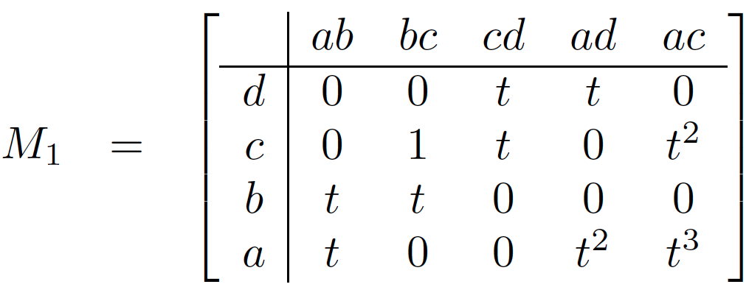
Computing Persistent Homology by Afra Zomorodian, Gunnar Carlsson
₁
C₁ → C₀
_{i, p}
H_{k} =
Z_{k} / ( B_{k} Z_{k} )
_{i}
_{i+p}
_{i}
U
http://link.springer.com/article/10.1007%2Fs00454-004-1146-y

Slide 7
Let σ_{i} be a k-simplex.
Defn: degree of σ_{i} = deg σ_{i}
= time when σ_{i} enters the filtration. .
deg a = deg b = 0; deg c = deg d = deg ab = deg bc = 1
http://link.springer.com/article/10.1007%2Fs00454-004-1146-y

Slide 8
Let σ_{i} be a k-simplex.
Defn: degree of σ_{i} = deg σ_{i}
    = time when σ_{i} enters the filtration. .
Defn: deg t^{n} σ_{i} = n + deg σ_{i}
A polynomial is homogeneous if all terms have the same degree: t³a – t²c + ac is in C³
http://link.springer.com/article/10.1007%2Fs00454-004-1146-y

Slide 9
H₀ = < a, b, c, d : tc + td, tb + c, ta + tb>
H₁ = <z₁, z₂ : t z₂, t³z₁ + t²z₂ >
[ )
[ )
[ )
[ )
[
z₁ = ad + cd + t(bc) + t(ab), z₂ = ac + t²bc + t²ab

Slide 10
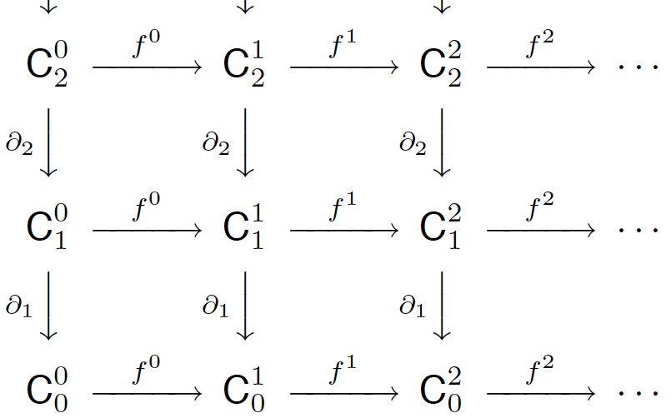
p-persistent k^{th} homology group:
_{i, p}
_{i}
_{i+p}
_{i}
H_{k} = Z_{k} / ( B_{k} Z_{k} )
U
http://link.springer.com/article/10.1007%2Fs00454-004-1146-y

Slide 11
Computing Persistent Homology by Afra Zomorodian, Gunnar Carlsson
_{i, p}
H_{k} =
Z_{k} / ( B_{k} Z_{k} )
_{i}
_{i+p}
_{i}
U
http://link.springer.com/article/10.1007%2Fs00454-004-1146-y

Slide 12
Let { e_{j} } be a be a homogeneous basis for C_{k}
Let { e_{i} } be a be a homogeneous basis for C_{k-1}
deg e_{i} + deg M_{k}(i, j) = deg e_{j}
_{k}
C_{k} → C_{k-1}
_{i, p}
H_{k} =
Z_{k} / ( B_{k} Z_{k} )
_{i}
_{i+p}
_{i}
U

Slide 13
Computing Persistent Homology by Afra Zomorodian, Gunnar Carlsson
_{i, p}
H_{k} =
Z_{k} / ( B_{k} Z_{k} )
_{i}
_{i+p}
_{i}
U
http://link.springer.com/article/10.1007%2Fs00454-004-1146-y

Slide 14
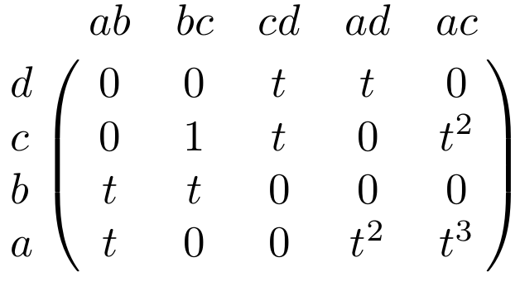
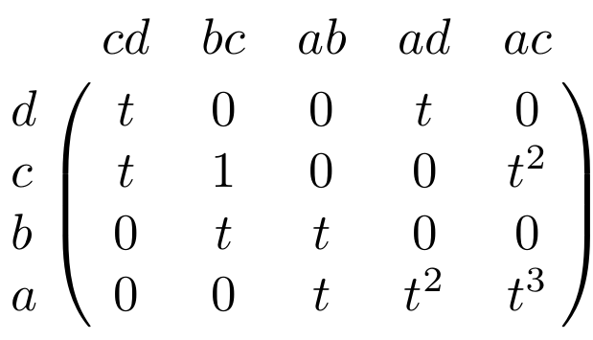
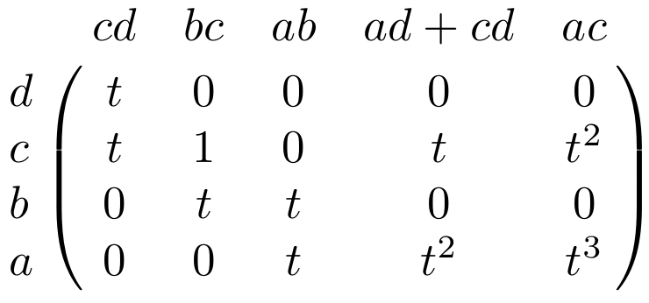

Slide 15
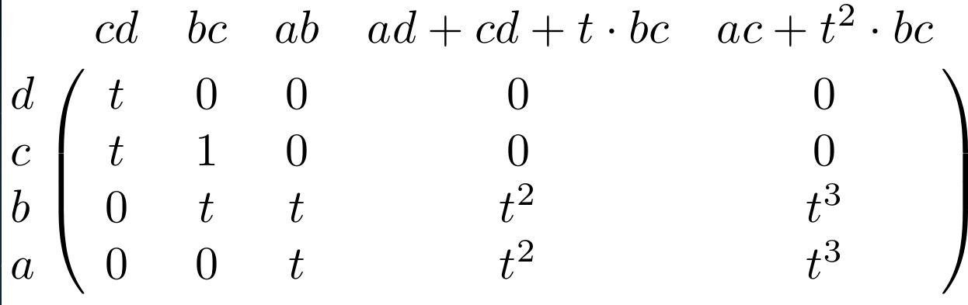

Slide 16
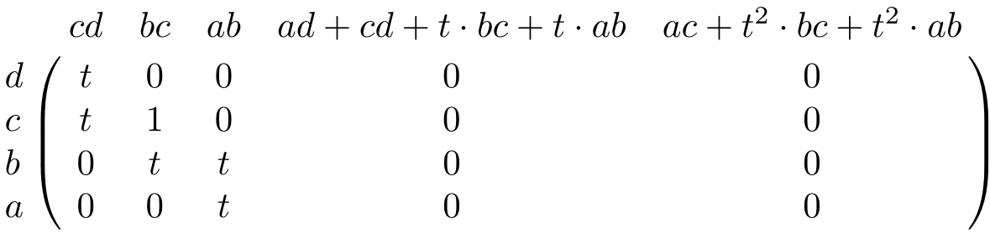

Slide 17
B₀ = image of ₁ = column space of M₁
= < tc + td, tb + c, ta + tb>
Z₁ = kernel of ₁ = null space of M₁
= < ad + cd + t(bc) + t(ab), ac + t²bc + t²ab >

Slide 18
₁
₀
C₁ → C₀ → 0
H₀ = Z₀/B₀ = (kernel of ₀)/ (image of ₁)
null space of M₀
column space of M₁
= < a, b, c, d : tc + td, tb + c, ta + tb >
=

Slide 19
H₀ = Z₀/B₀ = (kernel of ₀)/ (image of ₁)
null space of M₀
column space of M₁
= < a, b, c, d : tc + td, tb + c, ta + tb>
=
_{i, p}
_{i}
_{i+p}
_{i}
H₀ = Z₀ / ( B₀ Z₀ )
U
_{0, 0}
₂
H₀ = Z₂
For p > 0: H₀ = Z₂
_{0, p}

Slide 20
< a, b, c, d : tc + td, tb + c, ta + tb>
_{i, p}
_{i}
_{i+p}
_{i}
H₀ = Z₀ / ( B₀ Z₀ )
U
_{0, 0}
₂
H₀ = Z₂
For p > 0: H₀ = Z₂
_{0, p}
http://link.springer.com/article/10.1007%2Fs00454-004-1146-y

Slide 21
< a, b, c, d : tc + td, tb + c, ta + tb>
_{i, p}
_{i}
_{i+p}
_{i}
H₀ = Z₀ / ( B₀ Z₀ )
U
_{1, 0}
₂
H₀ = Z₂
For p > 0 : H₀ = Z₂
For i > 1 : H₀ = Z₂
_{i, p}
_{i, p}
http://link.springer.com/article/10.1007%2Fs00454-004-1146-y

Slide 22
< a, b, c, d : tc + td, tb + c, ta + tb>
[ )
[ )
[ )
[ )
[
http://link.springer.com/article/10.1007%2Fs00454-004-1146-y

Slide 23
₁
₁
C₂ → C₁ → C₀
H₁ = Z₁/B₁ = (kernel of ₁)/ (image of ₂)
null space of M₁
column space of M₂
= < ad + cd + t(bc) + t(ab), ac + t²bc + t²ab
: ??????? >
Let z₁ = ad + cd + t(bc) + t(ab), z₂ = ac + t²bc + t²ab
H₁ = Z₁/B₁ = <z₁, z₂ : ?? > .
=

Slide 24
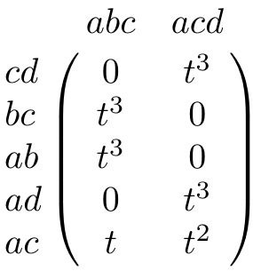
Computing Persistent Homology by Afra Zomorodian, Gunnar Carlsson
₂
C₂ → C₁
M₂ =
http://link.springer.com/article/10.1007%2Fs00454-004-1146-y

Slide 25
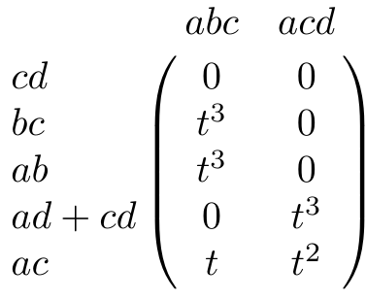
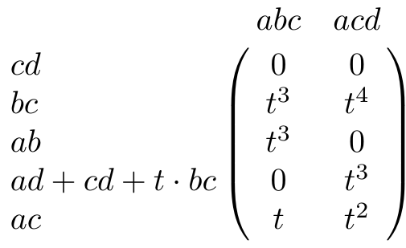
Long method for determining column space of M₂

Slide 26
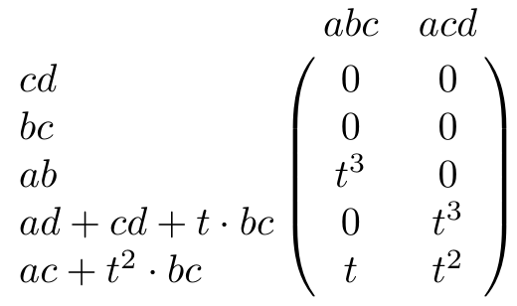

Slide 27
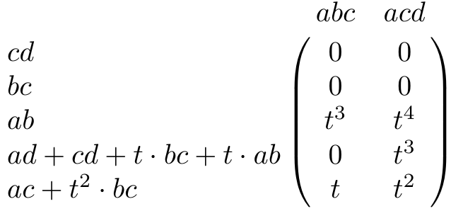

Slide 28
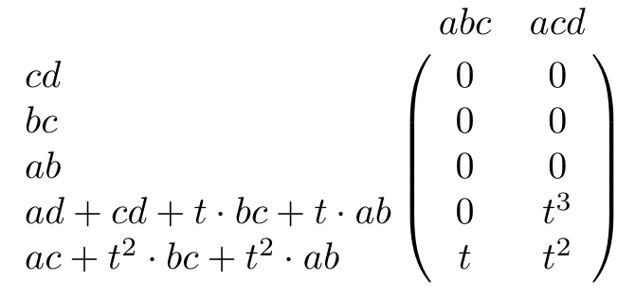

Slide 29
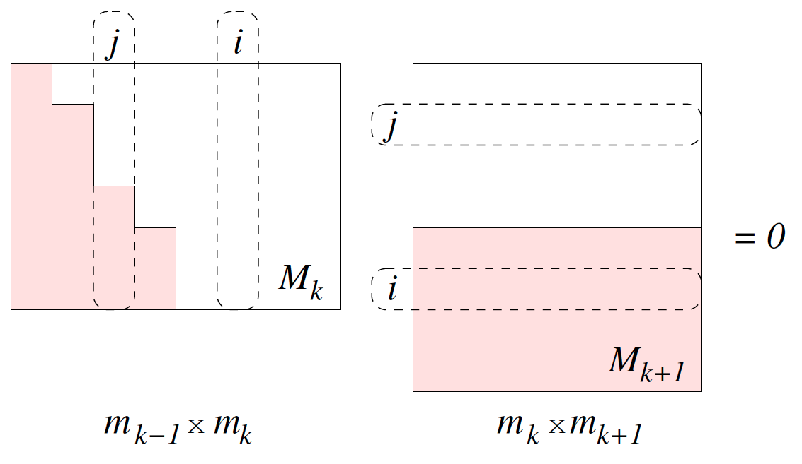
_{k+1}
_{k}
C_{k+1} → C_{k} → C_{k-1}, m_{k} = # of k-simplices
http://link.springer.com/article/10.1007%2Fs00454-004-1146-y

Slide 30
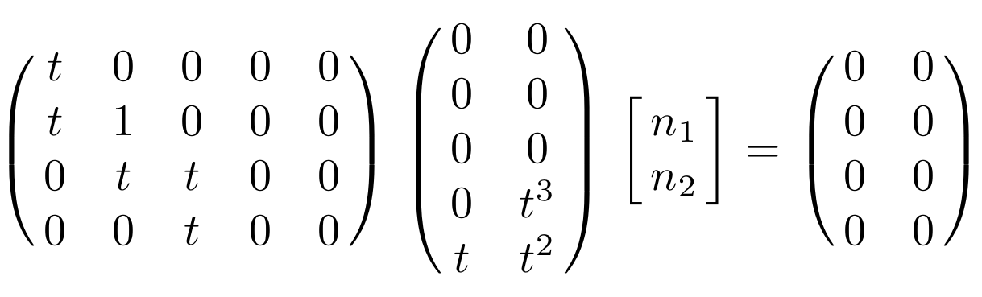

Slide 32
Short method for determining column space of M₂

Slide 33
₁
₁
C₂ → C₁ → C₀
H₁ = Z₁/B₁ = (kernel of ₁)/ (image of ₂)
null space of M₁
column space of M₂
= < ad + cd + t(bc) + t(ab), ac + t²bc + t²ab
: ??????? >
Let z₁ = ad + cd + t(bc) + t(ab), z₂ = ac + t²bc + t²ab
H₁ = Z₁/B₁ = <z₁, z₂ : ?? > .
=

Slide 34
image of ₂ =
kernel of ₂ =

Slide 35
image of ₂ = < t z₂, t³z₁ + t²z₂ >
kernel of ₂ = 0

Slide 36
₂
₁
C₂ → C₁ → C₀
H₁ = Z₁/B₁ = (kernel of ₁)/ (image of ₂)
null space of M₁
column space of M₂
= <z₁, z₂ : t z₂, t³z₁ + t²z₂ >
where
z₁ = ad + cd + t(bc) + t(ab), z₂ = ac + t²bc + t²ab
=

Slide 37
₃
₂
C₃ → C₂ → C₁
H₂ = Z₂/B₂ = (kernel of ₂)/ (image of ₃)
null space of M₂
column space of M₃
= 0
=

Slide 38
<z₁, z₂ : t z₂, t³z₁ + t²z₂ > where
z₁ = ad + cd + t(bc) + t(ab), z₂ = ac + t²bc + t²ab
_{i, p}
_{i}
_{i+p}
_{i}
H₁ = Z₁ / ( B₁ Z₁ )
U
Note deg z₁ = 2, deg z₂ = 3
_{i, p}
_{i}
_{i+p}
_{i}
H₁ = Z₁ / ( B₁ Z₁ ) = 0 for i < 2
U

Slide 39
<z₁, z₂ : tz₂, t³z₁ + t²z₂ > where
z₁ = ad + cd + t(bc) + t(ab), z₂ = ac + t²bc + t²ab
_{i, p}
_{i}
_{i+p}
_{i}
H₁ = Z₁ / ( B₁ Z₁ )
U
deg z₁ = 2, deg z₂ = 3, deg tz₂ = 4, deg t³z₁ + t²z₂ = 5
_{2, p}
₂
_{2+p}
₂
H₁ = Z₁ / ( B₁ Z₁ ) = Z/2Z for p =
U

Slide 40
<z₁, z₂ : tz₂, t³z₁ + t²z₂ > where
z₁ = ad + cd + t(bc) + t(ab), z₂ = ac + t²bc + t²ab
_{i, p}
_{i}
_{i+p}
_{i}
H₁ = Z₁ / ( B₁ Z₁ )
U
deg z₁ = 2, deg z₂ = 3, deg tz₂ = 4, deg t³z₁ + t²z₂ = 5
_{2, p}
₂
_{2+p}
₂
H₁ = Z₁ / ( B₁ Z₁ ) = Z/2Z for p = 0, 1, 2
U

Slide 41
<z₁, z₂ : tz₂, t³z₁ + t²z₂ > where
z₁ = ad + cd + t(bc) + t(ab), z₂ = ac + t²bc + t²ab
_{i, p}
_{i}
_{i+p}
_{i}
H₁ = Z₁ / ( B₁ Z₁ )
U
deg z₁ = 2, deg z₂ = 3, deg tz₂ = 4, deg t³z₁ + t²z₂ = 5
_{2, p}
₂
_{2+p}
₂
H₁ = Z₁ / ( B₁ Z₁ ) = 0 for p =
U

Slide 42
<z₁, z₂ : tz₂, t³z₁ + t²z₂ > where
z₁ = ad + cd + t(bc) + t(ab), z₂ = ac + t²bc + t²ab
_{i, p}
_{i}
_{i+p}
_{i}
H₁ = Z₁ / ( B₁ Z₁ )
U
deg z₁ = 2, deg z₂ = 3, deg tz₂ = 4, deg t³z₁ + t²z₂ = 5
_{2, p}
₂
_{2+p}
₂
H₁ = Z₁ / ( B₁ Z₁ ) = 0 for p = 3
U

Slide 43
<z₁, z₂ : tz₂, t³z₁ + t²z₂ > where
z₁ = ad + cd + t(bc) + t(ab), z₂ = ac + t²bc + t²ab
_{i, p}
_{i}
_{i+p}
_{i}
H₁ = Z₁ / ( B₁ Z₁ )
U
deg z₁ = 2, deg z₂ = 3, deg tz₂ = 4, deg t³z₁ + t²z₂ = 5
_{3, p}
₃
_{3+p}
₃
H₁ = Z₁ / ( B₁ Z₁ ) = ???
U

Slide 44
<z₁, z₂ : tz₂, t³z₁ + t²z₂ > where
z₁ = ad + cd + t(bc) + t(ab), z₂ = ac + t²bc + t²ab
_{i, p}
_{i}
_{i+p}
_{i}
H₁ = Z₁ / ( B₁ Z₁ )
U
deg z₁ = 2, deg z₂ = 3, deg tz₂ = 4, deg t³z₁ + t²z₂ = 5
_{4, 0}
₄
₄₊₀
₄
H₁ = Z₁ / ( B₁ Z₁ ) =
U

Slide 45
<z₁, z₂ : tz₂, t³z₁ + t²z₂ > where
z₁ = ad + cd + t(bc) + t(ab), z₂ = ac + t²bc + t²ab
_{i, p}
_{i}
_{i+p}
_{i}
H₁ = Z₁ / ( B₁ Z₁ )
U
deg z₁ = 2, deg z₂ = 3, deg tz₂ = 4, deg t³z₁ + t²z₂ = 5
_{4, 1}
₄
₄₊₁
₄
H₁ = Z₁ / ( B₁ Z₁ ) =
U

Slide 46
<z₁, z₂ : tz₂, t³z₁ + t²z₂ > where
z₁ = ad + cd + t(bc) + t(ab), z₂ = ac + t²bc + t²ab
_{i, p}
_{i}
_{i+p}
_{i}
H₁ = Z₁ / ( B₁ Z₁ )
U
deg z₁ = 2, deg z₂ = 3, deg tz₂ = 4, deg t³z₁ + t²z₂ = 5
_{5, 0}
₅
₅₊₀
₅
H₁ = Z₁ / ( B₁ Z₁ ) =
U

Slide 47
H₀ = < a, b, c, d : tc + td, tb + c, ta + tb>
H₁ = <z₁, z₂ : t z₂, t³z₁ + t²z₂ >
[ )
[ )
[ )
[ )
[
z₁ = ad + cd + t(bc) + t(ab), z₂ = ac + t²bc + t²ab

Slide 48

Application to Natural Image Statistics
With V. de Silva, T. Ishkanov, A. Zomorodian
http://www.ima.umn.edu/videos/?id=1846
http://www.ima.umn.edu/2011-2012/W3.26-30.12/activities/Carlsson-Gunnar/imamachinefinal.pdf

Slide 49
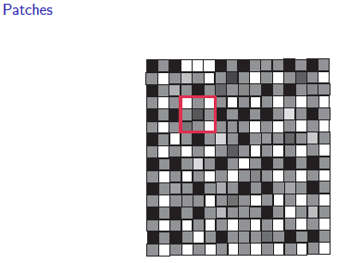
An image taken by black and white digital camera can be viewed as a vector, with one coordinate for each pixel
Each pixel has a “gray scale” value, can be thought of as a real number (in reality, takes one of 255 values)
Typical camera uses tens of thousands of pixels, so images lie in a very high dimensional space, call it pixel space, P

Slide 50
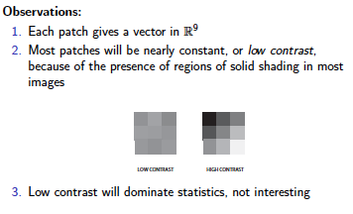
Lee-Mumford-Pedersen [LMP] study only high contrast patches.
Collection: 4.5 x 10⁶ high contrast patches from a
collection of images obtained by van Hateren and van der Schaaf
http://www.kyb.mpg.de/de/forschung/fg/bethgegroup/downloads/van-hateren-dataset.html

Slide 51
Lee-Mumford-Pedersen [LMP] study only high contrast patches.
Collection: 4.5 x 10⁶ high contrast patches from a
collection of images obtained by van Hateren and van der Schaaf
Choose how to model your data

Slide 52
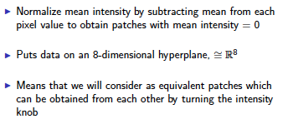
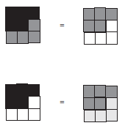

Choose how to model your data
Consult previous methods.

Slide 53
What to do if you are overwhelmed by the number of possible ways to model your data (or if you have no ideas):
Do what the experts do.
Borrow ideas.
Use what others have done.

Slide 54

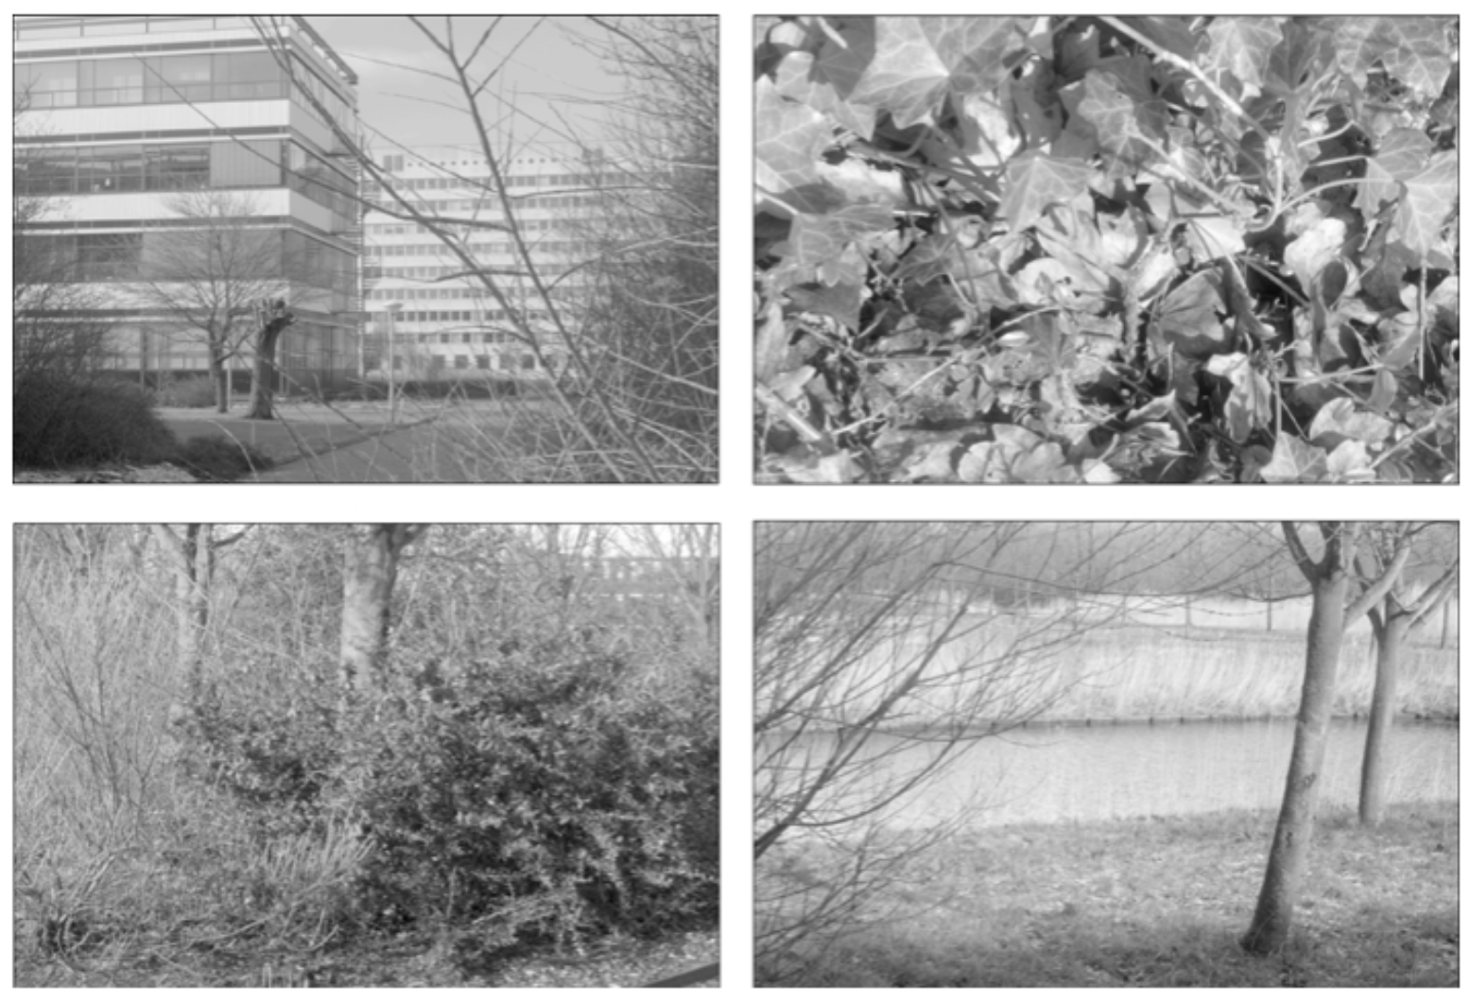
Carlsson et al used

Slide 55
Carlsson et al used
The majority of high-contrast optical patches are concentrated around a 2-dimensional C₁ submanifold
embedded in the 7-dimensional sphere.

Slide 56
Persistent Homology: Create the Rips complex
0.) Start by adding 0-dimensional data points
is a point in S⁷
Notes:
We can compute the number of clusters for a variety of diameters.
We start with 17 data points, so if the diameter is 0, we have 17 clusters. Increasing the diameter, these 2 balls intersect so I now have 16 clusters.
If we continue to increase the diameter, we will eventually create the complex we saw before with 5 clusters, etc until we only have one cluster left.
Eventually this entire page will be purple, but right now, we know have one component.
To choose the threshold, one can determine how long a particular number of clusters lasts, for example for what set of radii do we have five clusters. If we have five clusters for the largest set of radii, then have gives us a good idea where to set the threshold and which simplicial complex best models our data.
I have put links to better animations on my on my YouTube site which may better illustrate this persistence concept. Next month, we will also talk much more about persistence during the live lectures for this course. This is just a preliminary introduction.

Slide 57
For each fixed ε, create Rips complex from the data
is a point in S⁷
1.) Adding 1-dimensional edges (1-simplices)
Add an edge between data points that are close
Notes:
a one dimensional simplicial complex. Note that we have clustered our data into five disjoint connected sets. So this is one way to cluster our data – that is grouping our data points into disjoint sets based on some definition of similarity. In this case, we have 5 clusters.
We can now add higher dimensional simplices.

Slide 58
For each fixed ε, create Rips complex from the data
2.) Add all possible simplices of dimensional > 1.
is a point in S⁷
Notes:
Thus we now have the Vietoris Rips simplicial complex. Note we get the same simplex by adding one dimension at a time

Slide 59
For each fixed ε, create Rips complex from the data
In reality used Witness complex (see later slides).
2.) Add all possible simplices of dimensional > 1.
is a point in S⁷
Notes:
Thus we now have the Vietoris Rips simplicial complex. Note we get the same simplex by adding one dimension at a time

Slide 60
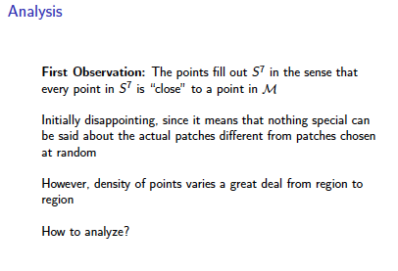
Probe the data

Slide 61
Probe the data

Slide 62
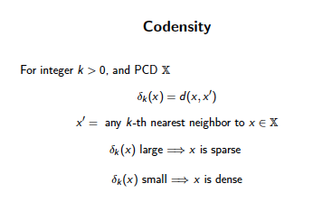
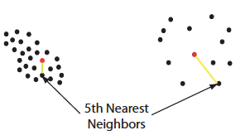

Can use function on data to probe the data

Slide 63
Large values of k:
measuring density of large neighborhoods of x,
Smaller values mean we are using smaller neighborhoods
← smoothed out version

Slide 64
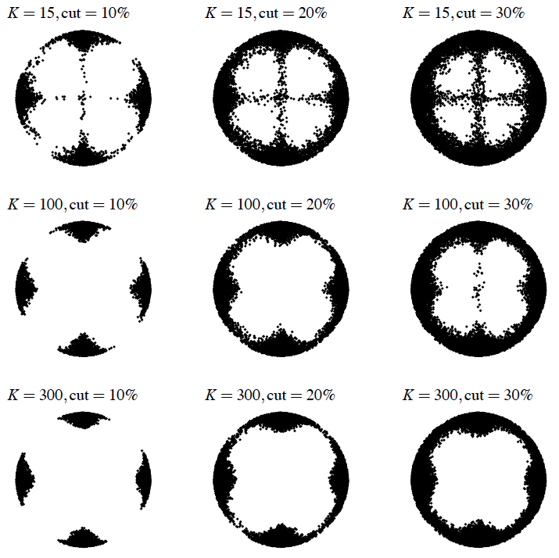
Eurographics Symposium on Point-Based Graphics (2004)
Topological estimation using witness complexes
Vin de Silva and Gunnar Carlsson

Slide 65
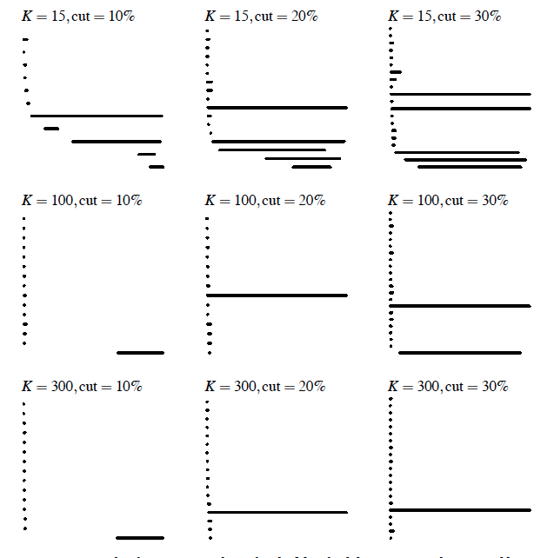
Eurographics Symposium on Point-Based Graphics (2004)
Topological estimation using witness complexes
Vin de Silva and Gunnar Carlsson

Slide 66
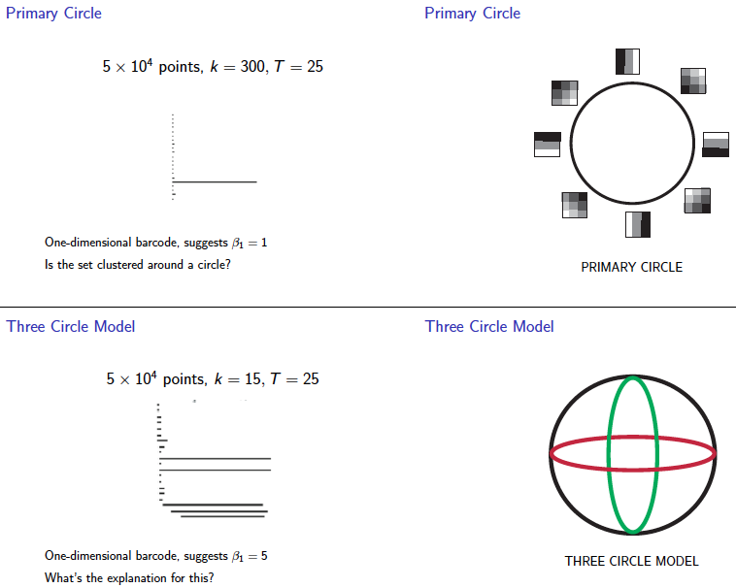
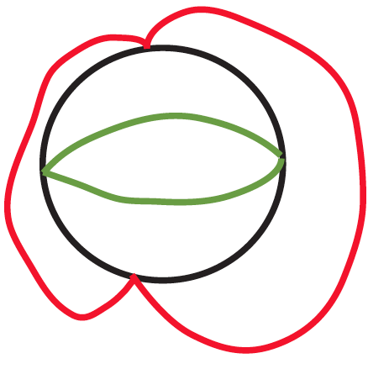

Slide 67
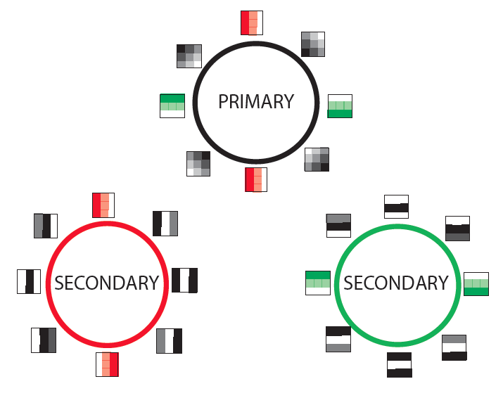

Slide 68
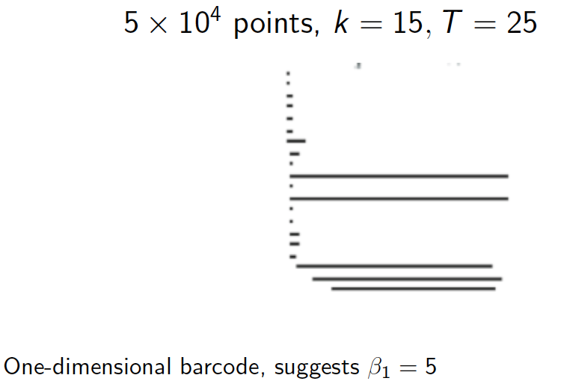

Slide 69
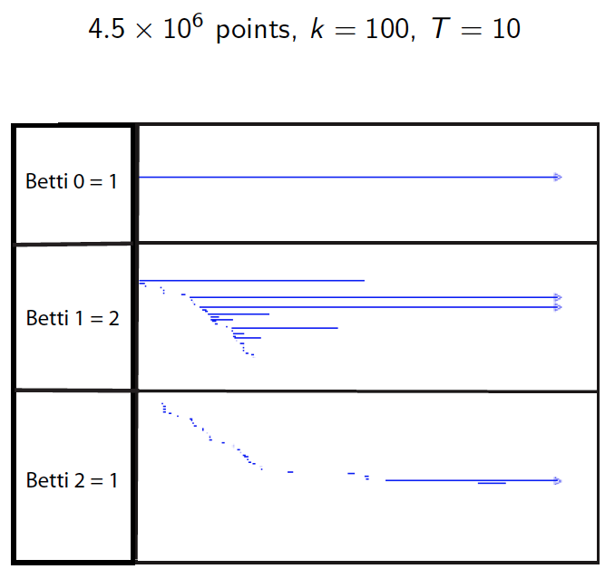

Slide 70
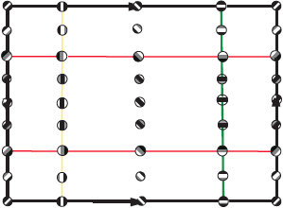

Slide 71
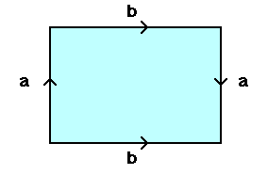
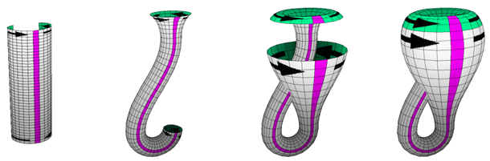
From: http://www.math.osu.edu/~fiedorowicz.1/math655/Klein2.html
Klein Bottle
From:
http://plus.maths.org/content/imaging-maths-inside-klein-bottle

Slide 72
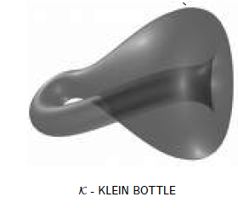
M(100, 10) U Q
where |Q| = 30
On the Local Behavior of Spaces of Natural Images, Gunnar Carlsson, Tigran Ishkhanov, Vin de Silva, Afra Zomorodian, International Journal of Computer Vision 2008, pp 1-12.

Slide 73
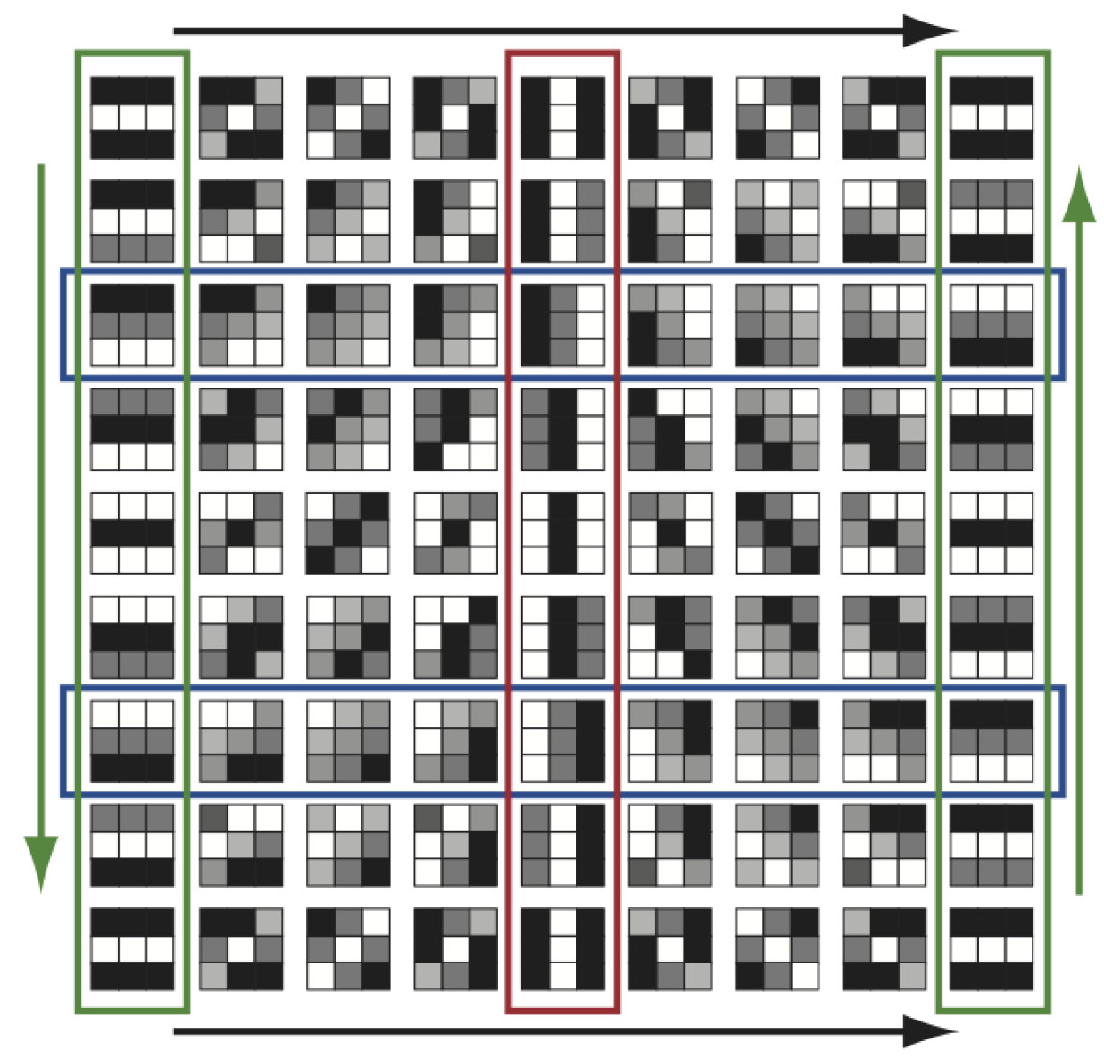
http://www.maths.ed.ac.uk/~aar/papers/ghristeat.pdf

Slide 74

http://www.maths.ed.ac.uk/~aar/papers/ghristeat.pdf

Slide 75

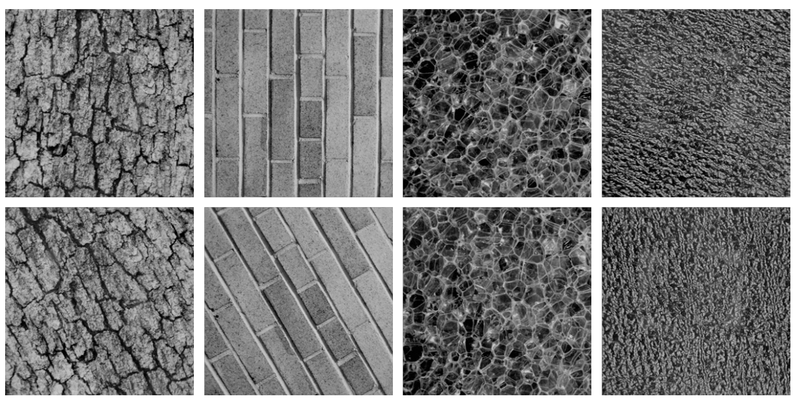
Combine your analysis with other tools

Slide 76
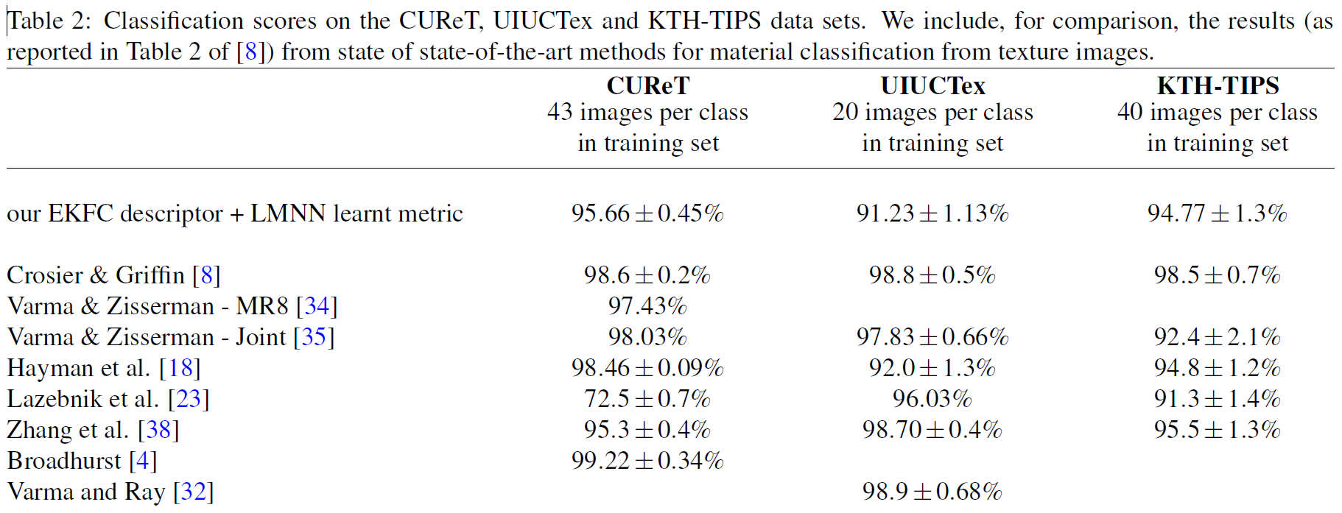
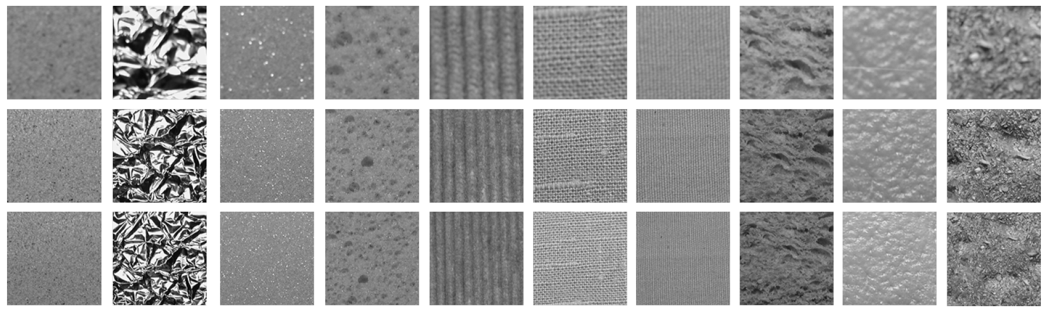

Slide 77
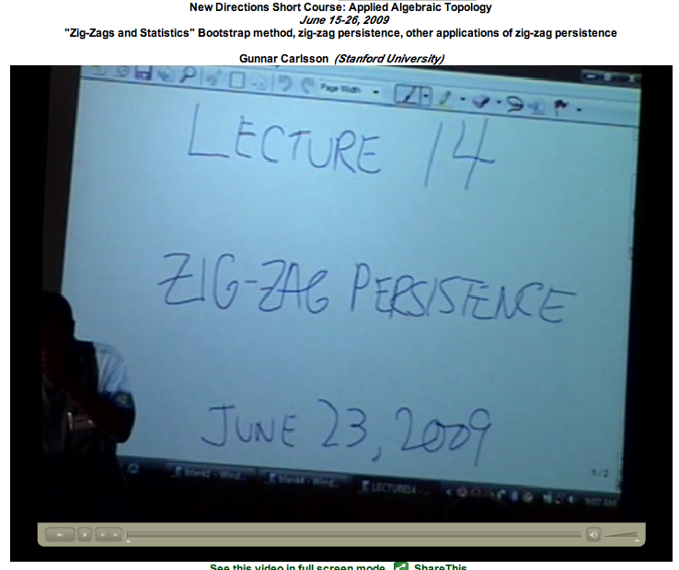
http://www.ima.umn.edu/videos/?id=863
http://www.ima.umn.edu/2008-2009/ND6.15-26.09/activities/Carlsson-Gunnar/lecture14.pdf

Slide 78

http://geometrica.saclay.inria.fr/workshops/TGDA_07_2009/workshop_files/slides/deSilva_TGDA.pdf

Slide 79
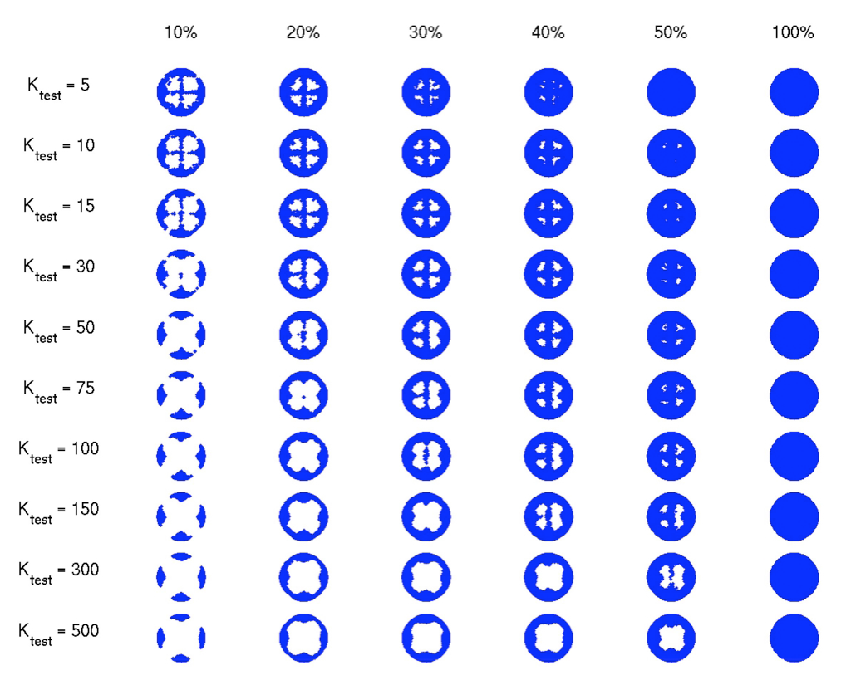

Slide 80
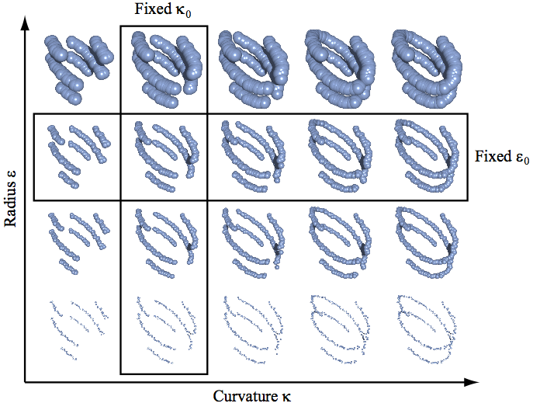
The Theory of Multidimensional Persistence, Gunnar Carlsson, Afra Zomorodian
"Persistence and Point Clouds" Functoriality, diagrams, difficulties in classifying diagrams,
multidimensional persistence, Gröbner bases, Gunnar Carlsson
http://www.ima.umn.edu/videos/?id=862

Slide 81
H₀ = < a, b, c, d : tc + td, tb + c, ta + tb>
H₁ = <z₁, z₂ : t z₂, t³z₁ + t²z₂ >
[ )
[ )
[ )
[ )
[
z₁ = ad + cd + t(bc) + t(ab), z₂ = ac + t²bc + t²ab

Slide 82
The Theory of Multidimensional Persistence, Gunnar Carlsson, Afra Zomorodian
"Persistence and Point Clouds" Functoriality, diagrams, difficulties in classifying diagrams,
multidimensional persistence, Gröbner bases, Gunnar Carlsson
http://www.ima.umn.edu/videos/?id=862

Slide 84
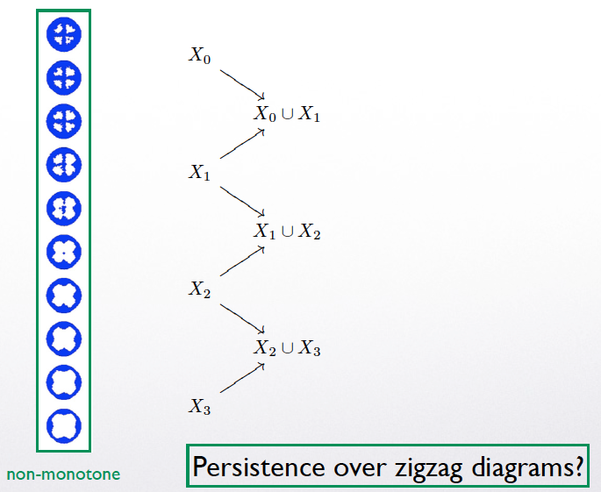

Slide 85
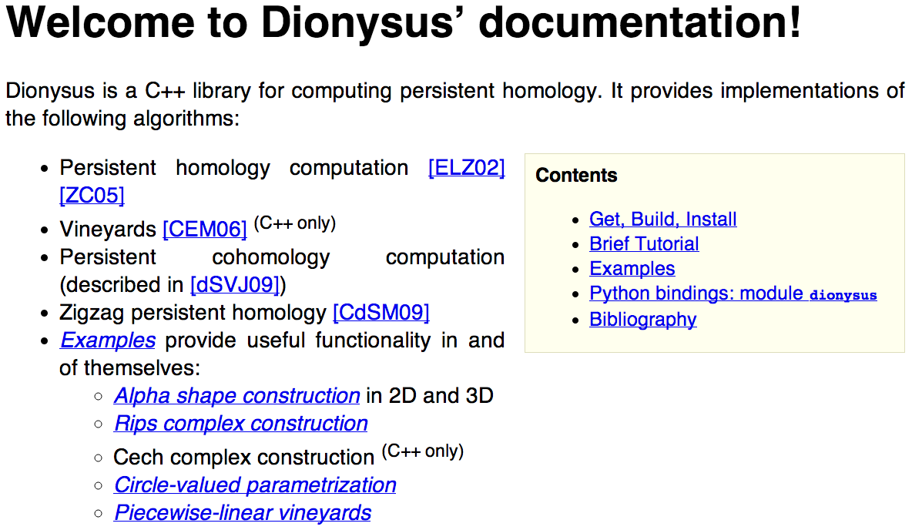
http://www.mrzv.org/software/dionysus/

