Slide 1

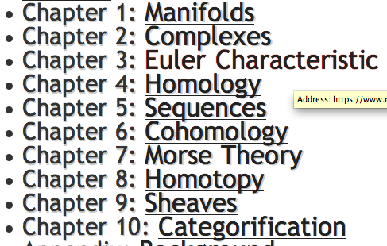
https://www.math.upenn.edu/~ghrist/notes.html

Slide 2
Background for
k-means clustering

Slide 3
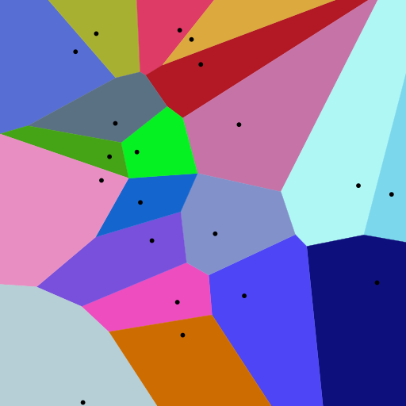
Creating Voronoi diagrams
https://commons.wikimedia.org/wiki/File:Euclidean_Voronoi_diagram.svg
Isabel K. Darcy
Mathematics Department/Applied Math & Computational Sciences
University of Iowa
http://www.math.uiowa.edu/~idarcy/
This material is based upon work supported by the National Science Foundation under Grant No. DMS-1407216: EXTREEMS-QED: Large Data Analysis and Visualization at the University of Iowa
Any opinions, findings, and conclusions or recommendations expressed in this material are those of the author(s) and do not necessarily reflect the views of the National Science Foundation.
Notes:
data points.
In this very simplified case my data points lie in a two-dimensional plane. Normally data points are high dimensional.
For example, I may be comparing the expression or thousands of genes in tumor cells to healthy cells using microarray data. OR I might be comparing politicians voting records. Or I might be comparing the stats of basketball players. These three applications were all, by the way, published by Lum et al this past February in Nature’s Scientific Reports. I have included a link to their paper on my youtube site.
http://www.nature.com/srep/2013/130207/srep01236/full/srep01236.html

Slide 4
Voronoi diagram:
Suppose your data points live in R^{n}.
A Voronoi diagram is a partition of space into Voronoi cells.
The Voronoi cell associated with v is
C_{v}= { x in R^{n} : d(x, v) ≤ d(x, w) for all w ≠ v }
= the set of all points in R^{n} closer v than to
any of the other points in your data set.
Notes:
data points.
In this very simplified case my data points lie in a two-dimensional plane. Normally data points are high dimensional.
For example, I may be comparing the expression or thousands of genes in tumor cells to healthy cells using microarray data. OR I might be comparing politicians voting records. Or I might be comparing the stats of basketball players. These three applications were all, by the way, published by Lum et al this past February in Nature’s Scientific Reports. I have included a link to their paper on my youtube site.
http://www.nature.com/srep/2013/130207/srep01236/full/srep01236.html

Slide 5
Voronoi diagram:
Suppose your data points live in R^{n}.
Choose data point v.
The Voronoi cell
associated with v is
H(v,w)
U
w ≠ v
Half-plane closer to v:
H(v,w) = { x in R^{n} : d(x, v) ≤ d(x, w) }
Notes:
data points.
In this very simplified case my data points lie in a two-dimensional plane. Normally data points are high dimensional.
For example, I may be comparing the expression or thousands of genes in tumor cells to healthy cells using microarray data. OR I might be comparing politicians voting records. Or I might be comparing the stats of basketball players. These three applications were all, by the way, published by Lum et al this past February in Nature’s Scientific Reports. I have included a link to their paper on my youtube site.
http://www.nature.com/srep/2013/130207/srep01236/full/srep01236.html

Slide 6
Voronoi diagram:
Suppose your data points live in R^{n}.
Choose data point v.
The Voronoi cell associated with v is
H(v,w)
U
w ≠ v
H(v,w) = { x in R^{n} : d(x, v) ≤ d(x, w) }
Notes:
data points.
In this very simplified case my data points lie in a two-dimensional plane. Normally data points are high dimensional.
For example, I may be comparing the expression or thousands of genes in tumor cells to healthy cells using microarray data. OR I might be comparing politicians voting records. Or I might be comparing the stats of basketball players. These three applications were all, by the way, published by Lum et al this past February in Nature’s Scientific Reports. I have included a link to their paper on my youtube site.
http://www.nature.com/srep/2013/130207/srep01236/full/srep01236.html

Slide 7
Voronoi diagram:
Suppose your data points live in R^{n}.
Choose data point v.
The Voronoi cell associated with v is
H(v,w)
U
w ≠ v
H(v,w) = { x in R^{n} : d(x, v) ≤ d(x, w) }
Notes:
data points.
In this very simplified case my data points lie in a two-dimensional plane. Normally data points are high dimensional.
For example, I may be comparing the expression or thousands of genes in tumor cells to healthy cells using microarray data. OR I might be comparing politicians voting records. Or I might be comparing the stats of basketball players. These three applications were all, by the way, published by Lum et al this past February in Nature’s Scientific Reports. I have included a link to their paper on my youtube site.
http://www.nature.com/srep/2013/130207/srep01236/full/srep01236.html

Slide 8
Voronoi diagram:
Suppose your data points live in R^{n}.
Choose data point v.
The Voronoi cell associated with v is
H(v,w)
U
w ≠ v
H(v,w) = { x in R^{n} : d(x, v) ≤ d(x, w) }
Notes:
data points.
In this very simplified case my data points lie in a two-dimensional plane. Normally data points are high dimensional.
For example, I may be comparing the expression or thousands of genes in tumor cells to healthy cells using microarray data. OR I might be comparing politicians voting records. Or I might be comparing the stats of basketball players. These three applications were all, by the way, published by Lum et al this past February in Nature’s Scientific Reports. I have included a link to their paper on my youtube site.
http://www.nature.com/srep/2013/130207/srep01236/full/srep01236.html

Slide 9
Voronoi diagram:
Suppose your data points live in R^{n}.
Choose data point v.
The Voronoi cell associated with v is
H(v,w)
U
w ≠ v
H(v,w) = { x in R^{n} : d(x, v) ≤ d(x, w) }
Notes:
data points.
In this very simplified case my data points lie in a two-dimensional plane. Normally data points are high dimensional.
For example, I may be comparing the expression or thousands of genes in tumor cells to healthy cells using microarray data. OR I might be comparing politicians voting records. Or I might be comparing the stats of basketball players. These three applications were all, by the way, published by Lum et al this past February in Nature’s Scientific Reports. I have included a link to their paper on my youtube site.
http://www.nature.com/srep/2013/130207/srep01236/full/srep01236.html

Slide 10
Voronoi diagram:
Suppose your data points live in R^{n}.
Choose data point v.
The Voronoi cell associated with v is
H(v,w)
U
w ≠ v
H(v,w) = { x in R^{n} : d(x, v) ≤ d(x, w) }
Notes:
data points.
In this very simplified case my data points lie in a two-dimensional plane. Normally data points are high dimensional.
For example, I may be comparing the expression or thousands of genes in tumor cells to healthy cells using microarray data. OR I might be comparing politicians voting records. Or I might be comparing the stats of basketball players. These three applications were all, by the way, published by Lum et al this past February in Nature’s Scientific Reports. I have included a link to their paper on my youtube site.
http://www.nature.com/srep/2013/130207/srep01236/full/srep01236.html

Slide 11
Voronoi diagram:
Suppose your data points live in R^{n}.
Choose data point v.
The Voronoi cell associated with v is
H(v,w)
U
w ≠ v
H(v,w) = { x in R^{n} : d(x, v) ≤ d(x, w) }
Notes:
data points.
In this very simplified case my data points lie in a two-dimensional plane. Normally data points are high dimensional.
For example, I may be comparing the expression or thousands of genes in tumor cells to healthy cells using microarray data. OR I might be comparing politicians voting records. Or I might be comparing the stats of basketball players. These three applications were all, by the way, published by Lum et al this past February in Nature’s Scientific Reports. I have included a link to their paper on my youtube site.
http://www.nature.com/srep/2013/130207/srep01236/full/srep01236.html

Slide 12
Choose data point v.
The Voronoi cell associated with v is
H(v,w)
U
w ≠ v
Notes:
data points.
In this very simplified case my data points lie in a two-dimensional plane. Normally data points are high dimensional.
For example, I may be comparing the expression or thousands of genes in tumor cells to healthy cells using microarray data. OR I might be comparing politicians voting records. Or I might be comparing the stats of basketball players. These three applications were all, by the way, published by Lum et al this past February in Nature’s Scientific Reports. I have included a link to their paper on my youtube site.
http://www.nature.com/srep/2013/130207/srep01236/full/srep01236.html

Slide 13
Choose data point v.
The Voronoi cell associated with v is
H(v,w)
U
w ≠ v
Notes:
data points.
In this very simplified case my data points lie in a two-dimensional plane. Normally data points are high dimensional.
For example, I may be comparing the expression or thousands of genes in tumor cells to healthy cells using microarray data. OR I might be comparing politicians voting records. Or I might be comparing the stats of basketball players. These three applications were all, by the way, published by Lum et al this past February in Nature’s Scientific Reports. I have included a link to their paper on my youtube site.
http://www.nature.com/srep/2013/130207/srep01236/full/srep01236.html

Slide 14
Choose data point v.
The Voronoi cell associated with v is
H(v,w)
U
w ≠ v
Notes:
data points.
In this very simplified case my data points lie in a two-dimensional plane. Normally data points are high dimensional.
For example, I may be comparing the expression or thousands of genes in tumor cells to healthy cells using microarray data. OR I might be comparing politicians voting records. Or I might be comparing the stats of basketball players. These three applications were all, by the way, published by Lum et al this past February in Nature’s Scientific Reports. I have included a link to their paper on my youtube site.
http://www.nature.com/srep/2013/130207/srep01236/full/srep01236.html

Slide 15
Choose data point v.
The Voronoi cell associated with v is
H(v,w)
U
w ≠ v
Notes:
data points.
In this very simplified case my data points lie in a two-dimensional plane. Normally data points are high dimensional.
For example, I may be comparing the expression or thousands of genes in tumor cells to healthy cells using microarray data. OR I might be comparing politicians voting records. Or I might be comparing the stats of basketball players. These three applications were all, by the way, published by Lum et al this past February in Nature’s Scientific Reports. I have included a link to their paper on my youtube site.
http://www.nature.com/srep/2013/130207/srep01236/full/srep01236.html

Slide 16
Choose data point v.
The Voronoi cell associated with v is
H(v,w)
U
w ≠ v
Notes:
data points.
In this very simplified case my data points lie in a two-dimensional plane. Normally data points are high dimensional.
For example, I may be comparing the expression or thousands of genes in tumor cells to healthy cells using microarray data. OR I might be comparing politicians voting records. Or I might be comparing the stats of basketball players. These three applications were all, by the way, published by Lum et al this past February in Nature’s Scientific Reports. I have included a link to their paper on my youtube site.
http://www.nature.com/srep/2013/130207/srep01236/full/srep01236.html

Slide 17
Choose data point v.
The Voronoi cell associated with v is
H(v,w)
U
w ≠ v
Notes:
data points.
In this very simplified case my data points lie in a two-dimensional plane. Normally data points are high dimensional.
For example, I may be comparing the expression or thousands of genes in tumor cells to healthy cells using microarray data. OR I might be comparing politicians voting records. Or I might be comparing the stats of basketball players. These three applications were all, by the way, published by Lum et al this past February in Nature’s Scientific Reports. I have included a link to their paper on my youtube site.
http://www.nature.com/srep/2013/130207/srep01236/full/srep01236.html

Slide 18
Choose data point v.
The Voronoi cell associated with v is
H(v,w)
U
w ≠ v
Notes:
data points.
In this very simplified case my data points lie in a two-dimensional plane. Normally data points are high dimensional.
For example, I may be comparing the expression or thousands of genes in tumor cells to healthy cells using microarray data. OR I might be comparing politicians voting records. Or I might be comparing the stats of basketball players. These three applications were all, by the way, published by Lum et al this past February in Nature’s Scientific Reports. I have included a link to their paper on my youtube site.
http://www.nature.com/srep/2013/130207/srep01236/full/srep01236.html

Slide 19
Choose data point v.
The Voronoi cell associated with v is
H(v,w)
U
w ≠ v
Notes:
data points.
In this very simplified case my data points lie in a two-dimensional plane. Normally data points are high dimensional.
For example, I may be comparing the expression or thousands of genes in tumor cells to healthy cells using microarray data. OR I might be comparing politicians voting records. Or I might be comparing the stats of basketball players. These three applications were all, by the way, published by Lum et al this past February in Nature’s Scientific Reports. I have included a link to their paper on my youtube site.
http://www.nature.com/srep/2013/130207/srep01236/full/srep01236.html

Slide 20
Choose data point v.
The Voronoi cell associated with v is
H(v,w)
U
w ≠ v
Notes:
data points.
In this very simplified case my data points lie in a two-dimensional plane. Normally data points are high dimensional.
For example, I may be comparing the expression or thousands of genes in tumor cells to healthy cells using microarray data. OR I might be comparing politicians voting records. Or I might be comparing the stats of basketball players. These three applications were all, by the way, published by Lum et al this past February in Nature’s Scientific Reports. I have included a link to their paper on my youtube site.
http://www.nature.com/srep/2013/130207/srep01236/full/srep01236.html

Slide 21
Voronoi diagram:
Suppose your data points live in R^{n}.
Choose data point v.
The Voronoi cell associated with v is
H(v,w)
U
w ≠ v
The Voronoi cell associated with v is
C_{v}= { x in R^{n} : d(x, v) ≤ d(x, w) for all w ≠ v }
Notes:
data points.
In this very simplified case my data points lie in a two-dimensional plane. Normally data points are high dimensional.
For example, I may be comparing the expression or thousands of genes in tumor cells to healthy cells using microarray data. OR I might be comparing politicians voting records. Or I might be comparing the stats of basketball players. These three applications were all, by the way, published by Lum et al this past February in Nature’s Scientific Reports. I have included a link to their paper on my youtube site.
http://www.nature.com/srep/2013/130207/srep01236/full/srep01236.html

Slide 22
A Voronoi diagram is a partition of space into Voronoi cells.
Notes:
data points.
In this very simplified case my data points lie in a two-dimensional plane. Normally data points are high dimensional.
For example, I may be comparing the expression or thousands of genes in tumor cells to healthy cells using microarray data. OR I might be comparing politicians voting records. Or I might be comparing the stats of basketball players. These three applications were all, by the way, published by Lum et al this past February in Nature’s Scientific Reports. I have included a link to their paper on my youtube site.
http://www.nature.com/srep/2013/130207/srep01236/full/srep01236.html

Slide 23
A Voronoi diagram is a partition of space into Voronoi cells.
Notes:
data points.
In this very simplified case my data points lie in a two-dimensional plane. Normally data points are high dimensional.
For example, I may be comparing the expression or thousands of genes in tumor cells to healthy cells using microarray data. OR I might be comparing politicians voting records. Or I might be comparing the stats of basketball players. These three applications were all, by the way, published by Lum et al this past February in Nature’s Scientific Reports. I have included a link to their paper on my youtube site.
http://www.nature.com/srep/2013/130207/srep01236/full/srep01236.html

Slide 24
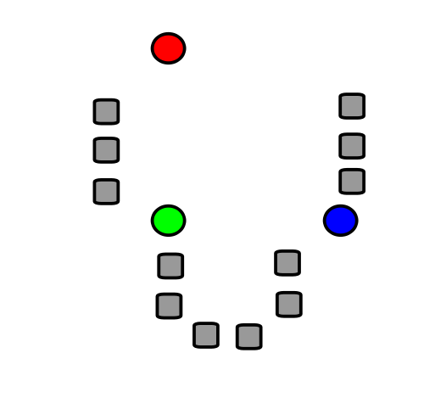
A very basic introduction to
k-means clustering
Isabel K. Darcy
Mathematics Department/Applied Math & Computational Sciences
University of Iowa
http://www.math.uiowa.edu/~idarcy/
This material is based upon work supported by the National Science Foundation under Grant No. DMS-1407216: EXTREEMS-QED: Large Data Analysis and Visualization at the University of Iowa
Any opinions, findings, and conclusions or recommendations expressed in this material are those of the author(s) and do not necessarily reflect the views of the National Science Foundation.
Notes:
data points.
In this very simplified case my data points lie in a two-dimensional plane. Normally data points are high dimensional.
For example, I may be comparing the expression or thousands of genes in tumor cells to healthy cells using microarray data. OR I might be comparing politicians voting records. Or I might be comparing the stats of basketball players. These three applications were all, by the way, published by Lum et al this past February in Nature’s Scientific Reports. I have included a link to their paper on my youtube site.
http://www.nature.com/srep/2013/130207/srep01236/full/srep01236.html

Slide 25
k-means clustering
k = desired number
of clusters
Data set = grey boxes
Let k = 3
Figure modified from https://en.wikipedia.org/wiki/File:K_Means_Example_Step_1.svg

Slide 26
k-means clustering
k = desired number
of clusters
Data set = grey boxes
Let k = 3
Step 1: Randomly choose
3 points
(points need not be in data set)
3 points = colored circle
Figure from https://en.wikipedia.org/wiki/File:K_Means_Example_Step_1.svg

Slide 27
Data set = grey boxes
Let k = 3
Randomly choose 3 points
(points need not be in data set)
3 points = colored circle
Partition data set into 3 voronoi cells corresponding to the 3 colored circles
Figure modified from https://en.wikipedia.org/wiki/File:K_Means_Example_Step_1.svg

Slide 28
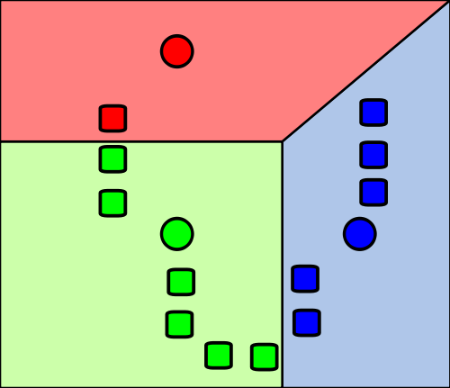
Data set = grey boxes
Let k = 3
Randomly choose 3 points
(points need not be in data set)
3 points = colored circle
Partition data set into 3 voronoi cells corresponding to the 3 colored circles
Figure modified from https://en.wikipedia.org/wiki/File:K_Means_Example_Step_1.svg

Slide 29
X
X
X
Data set = grey boxes
Let k = 3
Randomly choose 3 points
(points need not be in data set)
3 points = colored circle
Partition data set into 3 voronoi cells corresponding to the 3 colored circles
Figure modified from https://en.wikipedia.org/wiki/File:K_Means_Example_Step_1.svg

Slide 30
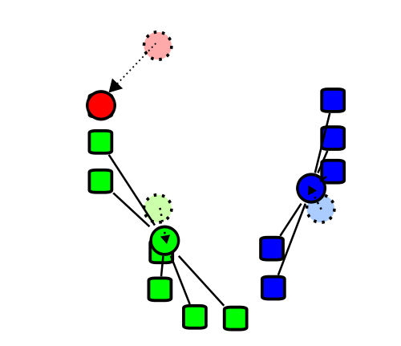
X
X
X
Repeat the process with
3 new points:
Figure modified from https://en.wikipedia.org/wiki/File:K_Means_Example_Step_1.svg

Slide 31
X
X
X
Repeat the process with
3 new points:
Find the centroids of the data cells in each of the voronoi cells
Figure modified from https://en.wikipedia.org/wiki/File:K_Means_Example_Step_1.svg

Slide 32
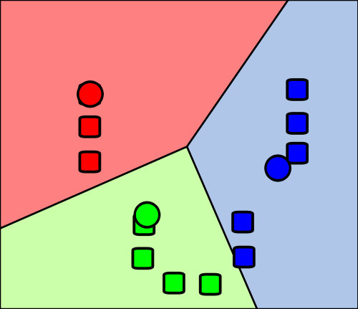
Re-partition data set into 3 voronoi cells corresponding to the 3 centroids
Figure modified from https://en.wikipedia.org/wiki/File:K_Means_Example_Step_1.svg

Slide 33
Re-partition data set into 3 voronoi cells corresponding to the 3 centroids
Figure modified from https://en.wikipedia.org/wiki/File:K_Means_Example_Step_1.svg

Slide 34
Re-partition data set into 3 voronoi cells corresponding to the 3 centroids
Figure modified from https://en.wikipedia.org/wiki/File:K_Means_Example_Step_1.svg

Slide 35
Re-partition data set into 3 voronoi cells corresponding to the 3 centroids
Repeat
Figure modified from https://en.wikipedia.org/wiki/File:K_Means_Example_Step_1.svg

Slide 36
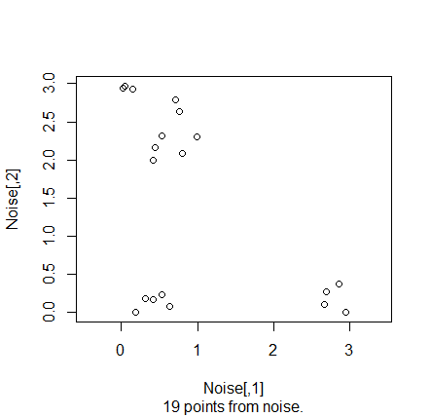
Applications of k-means clustering:
1.) Group like items together

Slide 37
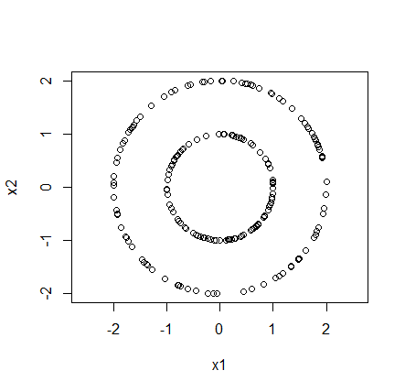
# create data set from 2 concentric circles
circle1 = circleUnif(100, r = 1)
circle2 = circleUnif(100, r = 2)
circle = rbind(circle1, circle2)
plot(circle, asp = 1)
# 2-means cluster this data set
cl <- kmeans(circle, 2)
plot(circle,col=cl$cluster, asp = 1)

Slide 38
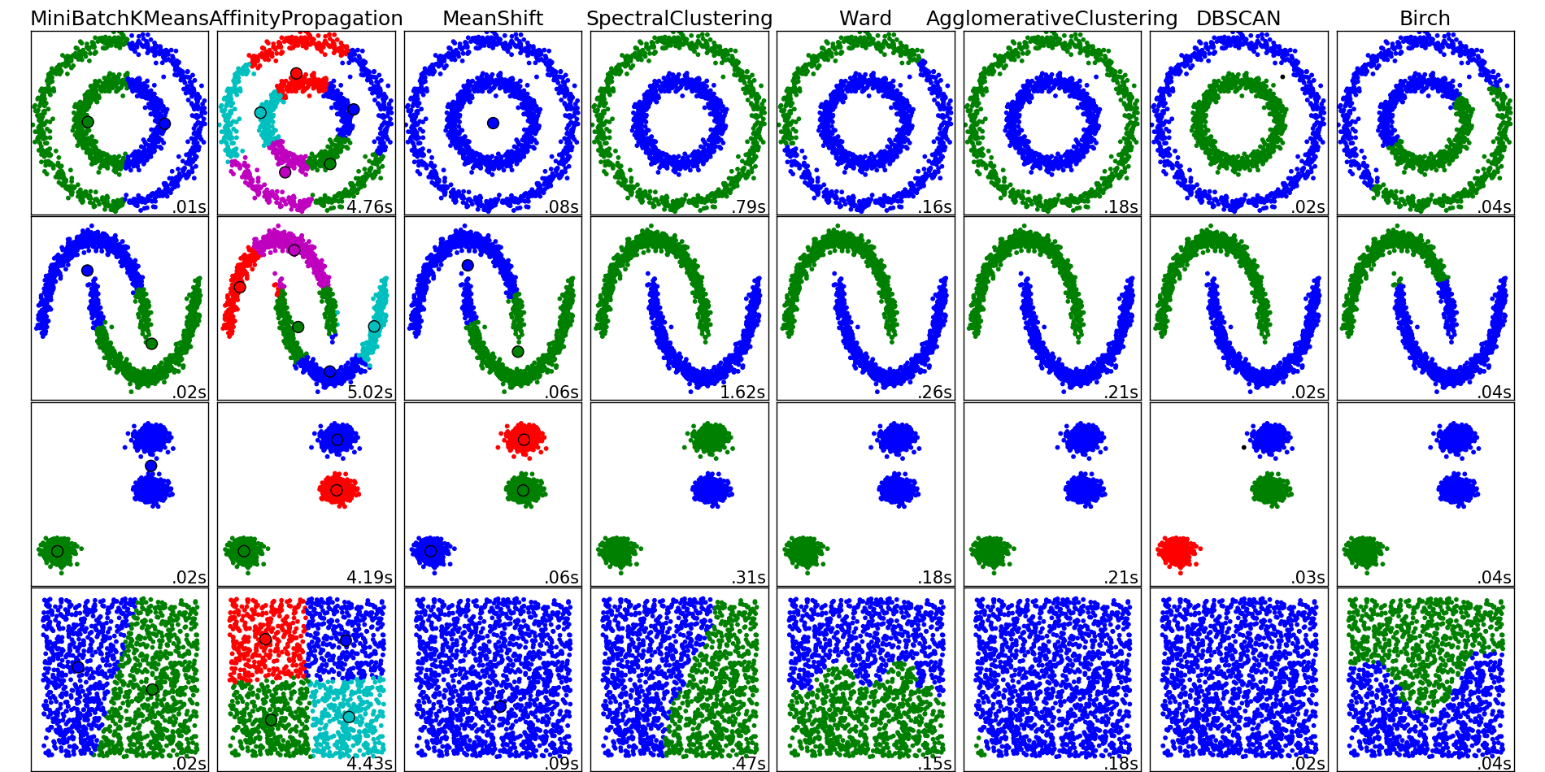
http://scikit-learn.org/stable/auto_examples/cluster/plot_cluster_comparison.html

Slide 39
Applications of k-means clustering:
1.) Group like items together
2.) Reduce your data set.

Slide 40
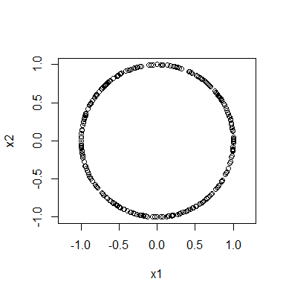
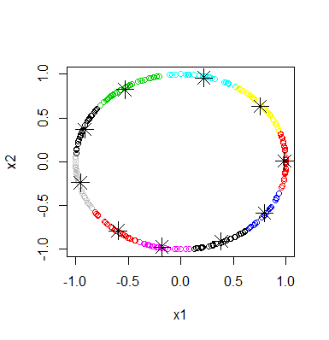
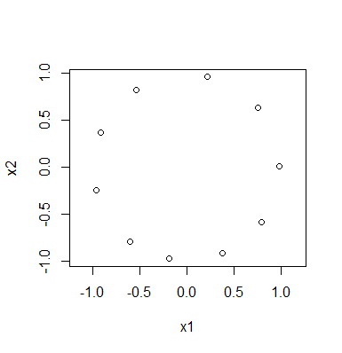
Rstudio:
library("TDA")
circle = circleUnif(300, r = 1)
plot(circle, asp = 1)
cl <- kmeans(circle, 10)
plot(circle,col=cl$cluster)
points(cl$centers, pch=8, cex = 2)
plot(cl$centers, asp = 1)

Slide 41
Applications of k-means clustering:
1.) Group like items together
2.) Reduce your data set.
3.) Color quantization.
  (a) Reduce memory use.
  (b) Certain devices might have limited number of colors for display.

Slide 42
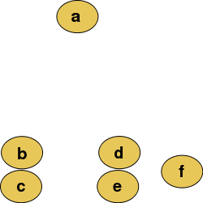
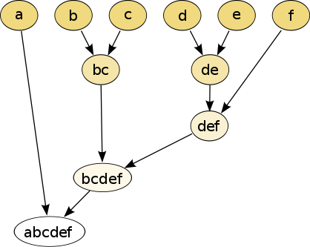
Hierarchical clustering
Isabel K. Darcy
Mathematics Department/Applied Math & Computational Sciences
University of Iowa
http://www.math.uiowa.edu/~idarcy/
This material is based upon work supported by the National Science Foundation under Grant No. DMS-1407216: EXTREEMS-QED: Large Data Analysis and Visualization at the University of Iowa
Any opinions, findings, and conclusions or recommendations expressed in this material are those of the author(s) and do not necessarily reflect the views of the National Science Foundation.
Notes:
data points.
In this very simplified case my data points lie in a two-dimensional plane. Normally data points are high dimensional.
For example, I may be comparing the expression or thousands of genes in tumor cells to healthy cells using microarray data. OR I might be comparing politicians voting records. Or I might be comparing the stats of basketball players. These three applications were all, by the way, published by Lum et al this past February in Nature’s Scientific Reports. I have included a link to their paper on my youtube site.
http://www.nature.com/srep/2013/130207/srep01236/full/srep01236.html

Slide 43
Hierarchical clustering
Data
Dendrogram
http://en.wikipedia.org/wiki/File:Clusters.svg
http://en.wikipedia.org/wiki/File:Hierarchical_clustering_simple_diagram.svg

Slide 44
Increasing threshold
Connect vertices whose distance is less than a given threshold
single linkage hierarchical clustering

Slide 45
Hierarchical clustering
Data
Dendrogram
http://en.wikipedia.org/wiki/File:Clusters.svg
http://en.wikipedia.org/wiki/File:Hierarchical_clustering_simple_diagram.svg

Slide 46
Increasing threshold
Connect vertices (or clusters) whose distance is less than a given threshold

Slide 47
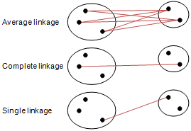
Different type of hierarchical clustering
What is the distance between 2 clusters?
http://en.wikipedia.org/wiki/File:Hierarchical_clustering_simple_diagram.svg
http://www.multid.se/genex/hs515.htm

Slide 48
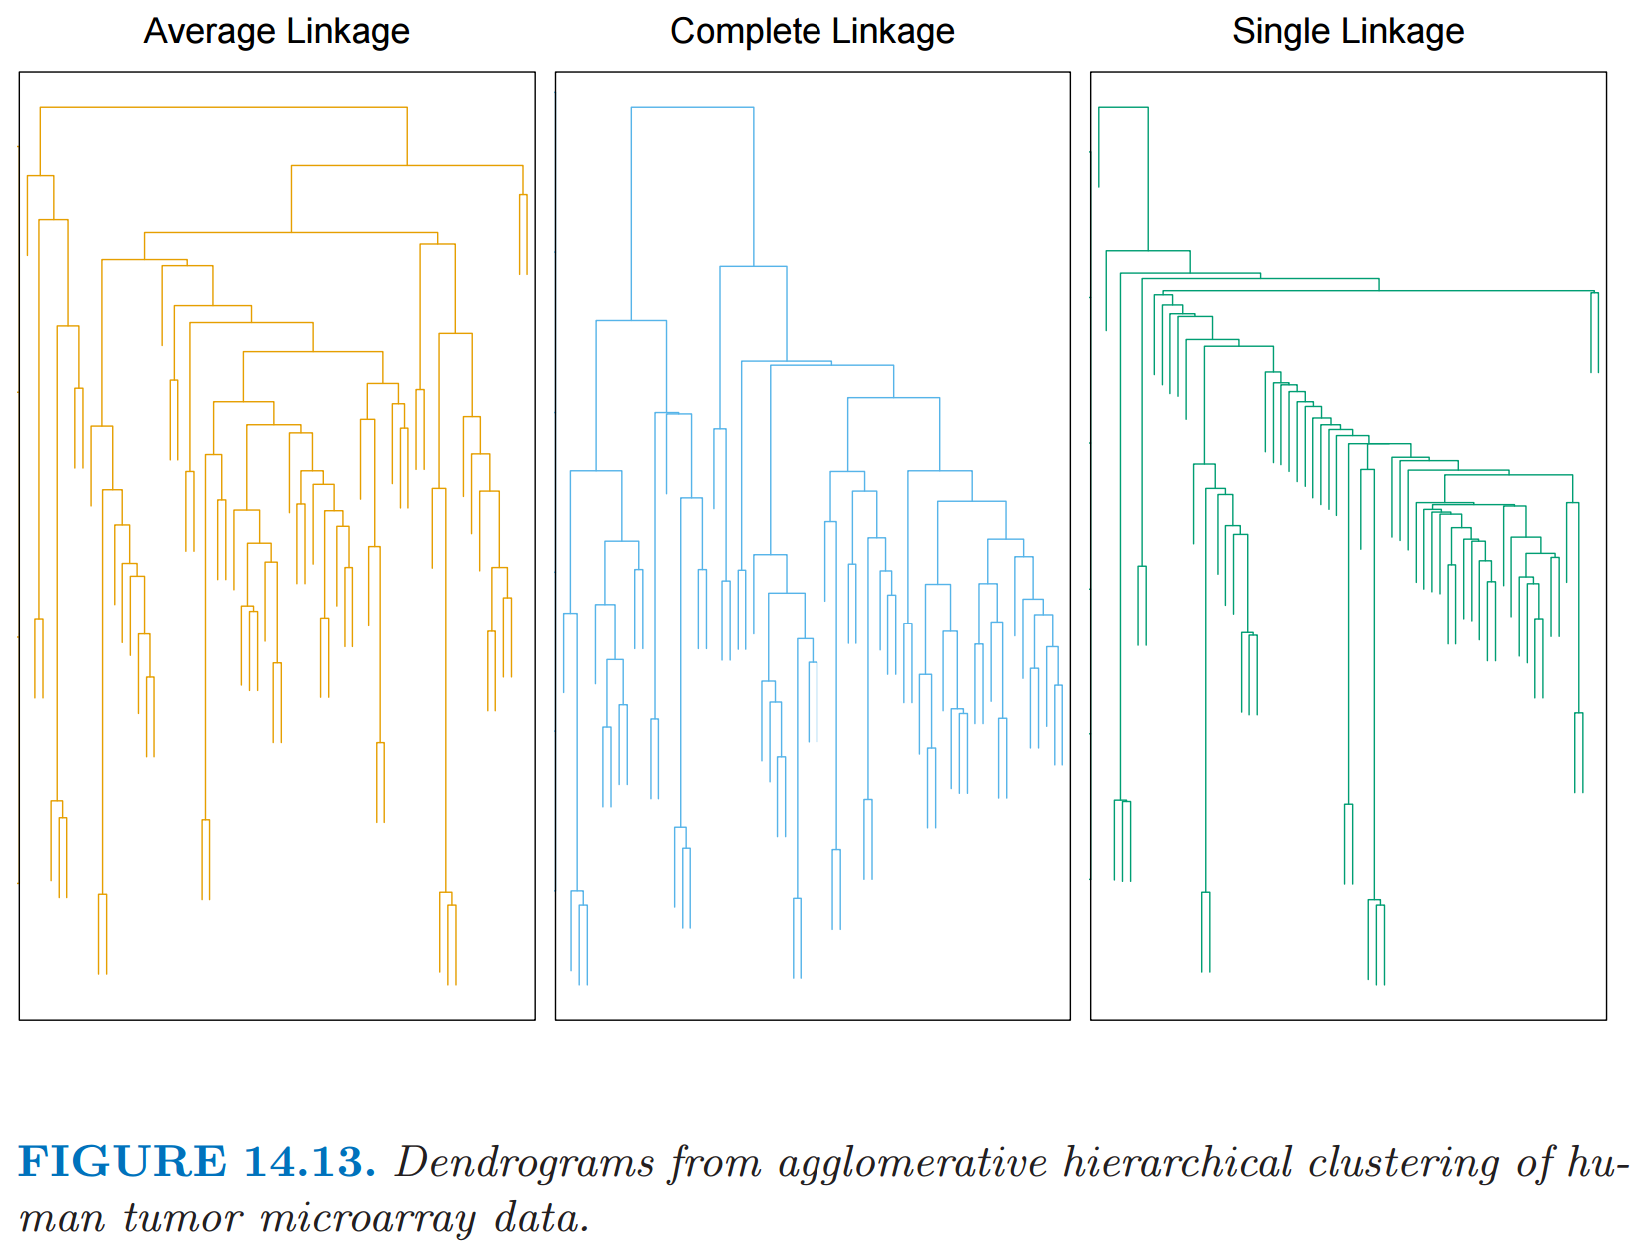
http://statweb.stanford.edu/~tibs/ElemStatLearn/
The Elements of Statistical Learning (2nd edition) Hastie, Tibshirani and Friedman

Slide 49
Introduction to
Gurjeet Singh, Facundo Mémoli and Gunnar Carlsson’s
Mapper Algorithm
Isabel K. Darcy
Mathematics Department/Applied Mathematical & Computational Sciences
University of Iowa
http://www.math.uiowa.edu/~idarcy/
This material is based upon work supported by the National Science Foundation under Grant No. DMS-1407216: EXTREEMS-QED: Large Data Analysis and Visualization at the University of Iowa
Any opinions, findings, and conclusions or recommendations expressed in this material are those of the author(s) and do not necessarily reflect the views of the National Science Foundation.

Slide 50
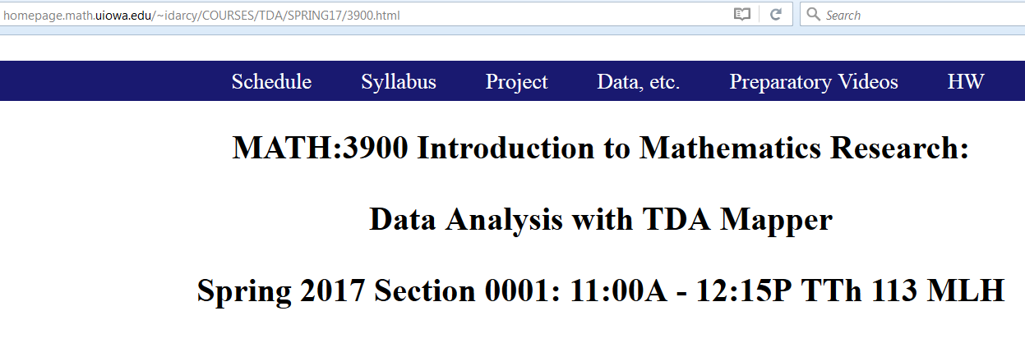

Slide 51

Mapper

Slide 52

http://www.ayasdi.com/

Slide 53
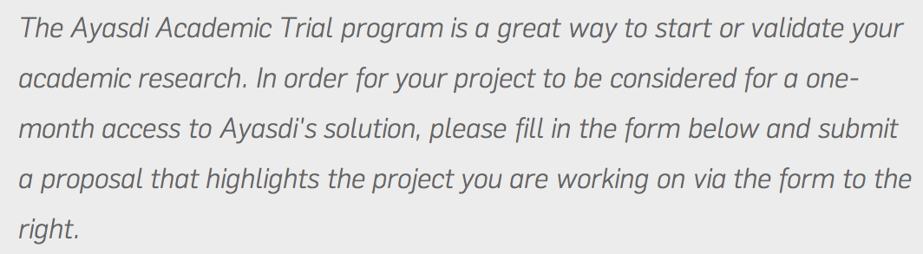
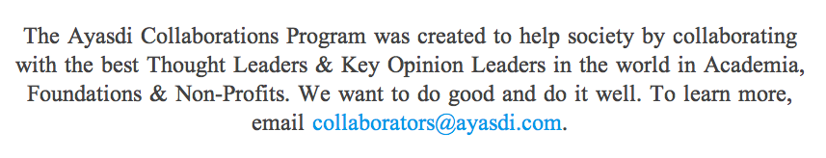
https://www.ayasdi.com/inquiry/academic-trial.html
https://www.ayasdi.com/customers#collaborators

Slide 54

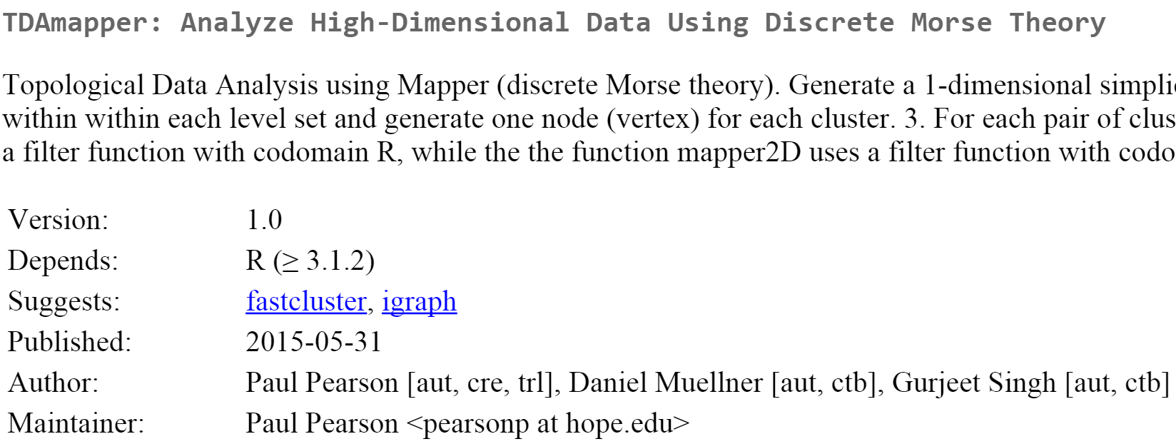
http://danifold.net/mapper/
https://cran.r-project.org/web/packages/TDAmapper/

Slide 55
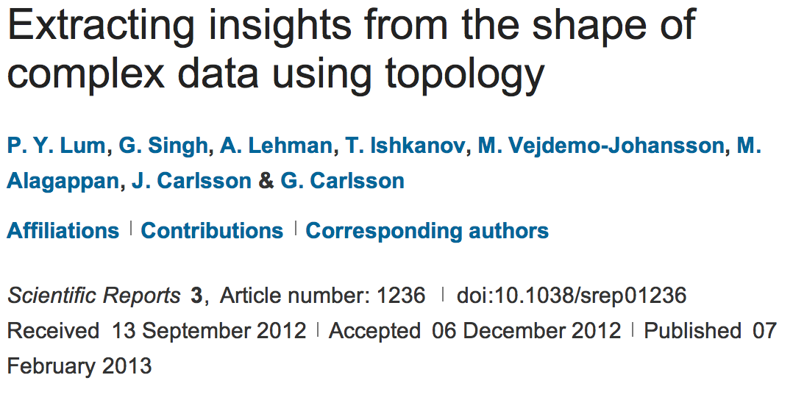
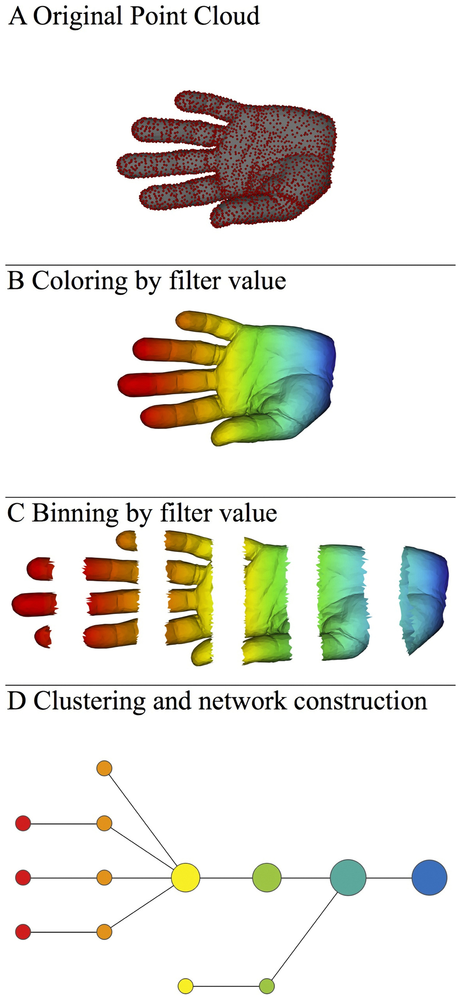
http://www.nature.com/srep/2013/130207/srep01236/full/srep01236.html

Slide 56
Mapper
Data Overlapping bins Graph
http://www.nature.com/srep/2013/130207/srep01236/full/srep01236.html

Slide 57

A) Data Set
Example: Point cloud data
representing a hand.
http://www.nature.com/srep/2013/130207/srep01236/full/srep01236.html

Slide 58
Function f : Data Set → R
Ex 1: x-coordinate
f : (x, y, z) → x
http://www.nature.com/srep/2013/130207/srep01236/full/srep01236.html

Slide 59
Function f : Data Set → R
Ex 1: x-coordinate
f : (x, y, z) → x
http://www.nature.com/srep/2013/130207/srep01236/full/srep01236.html

Slide 60
Function f : Data Set → R
Ex 1: x-coordinate
f : (x, y, z) → x
http://www.nature.com/srep/2013/130207/srep01236/full/srep01236.html

Slide 61
Put data into overlapping bins.
Example: f⁻¹(a_{i}, b_{i})
( ( ) ( ) ( ) ( ) ( ) )
Function f : Data Set → R
Ex 1: x-coordinate
f : (x, y, z) → x
http://www.nature.com/srep/2013/130207/srep01236/full/srep01236.html

Slide 62
Put data into overlapping bins.
Example: f⁻¹(a_{i}, b_{i})
( ( ) ( ) ( ) ( ) ( ) )
Function f : Data Set → R
Ex 1: x-coordinate
f : (x, y, z) → x
http://www.nature.com/srep/2013/130207/srep01236/full/srep01236.html

Slide 63
Data Set
Example: Point cloud data
representing a hand.
Function f : Data Set → R
Example: x-coordinate
f : (x, y, z) → x
Put data into overlapping bins.
Example: f⁻¹(a_{i}, b_{i})
http://www.nature.com/srep/2013/130207/srep01236/full/srep01236.html

Slide 64
D) Cluster each bin
http://www.nature.com/srep/2013/130207/srep01236/full/srep01236.html
Notes:
Need covering Resolution multiscale

Slide 65
D) Cluster each bin
http://www.nature.com/srep/2013/130207/srep01236/full/srep01236.html
Notes:
Need covering Resolution multiscale

Slide 66
D) Cluster each bin
Vertex = a cluster of a bin.
http://www.nature.com/srep/2013/130207/srep01236/full/srep01236.html
Notes:
Need covering Resolution multiscale

Slide 67
D) Cluster each bin
& create network.
Vertex = a cluster of a bin.
Edge = nonempty intersection
between clusters
http://www.nature.com/srep/2013/130207/srep01236/full/srep01236.html
Notes:
Need covering Resolution multiscale

Slide 68
D) Cluster each bin
& create network.
Vertex = a cluster of a bin.
Edge = nonempty intersection
between clusters
http://www.nature.com/srep/2013/130207/srep01236/full/srep01236.html
Notes:
Need covering Resolution multiscale

Slide 69
A) Data Set
Example: Point cloud data
representing a hand.
B) Function f : Data Set → R
Example: x-coordinate
f : (x, y, z) → x
Put data into overlapping bins.
Example: f⁻¹(a_{i}, b_{i})
Cluster each bin & create network.
Vertex = a cluster of a bin.
Edge = nonempty intersection
between clusters
http://www.nature.com/srep/2013/130207/srep01236/full/srep01236.html

Slide 70
Examples illustrating
Gurjeet Singh , Facundo Mémoli and Gunnar Carlsson’s
Mapper Algorithm
Guest lecturer: Isabel K. Darcy
Mathematics Department/Applied Mathematical & Computational Sciences
University of Iowa
http://www.math.uiowa.edu/~idarcy/
This material is based upon work supported by the National Science Foundation under Grant No. DMS-1407216: EXTREEMS-QED: Large Data Analysis and Visualization at the University of Iowa
Any opinions, findings, and conclusions or recommendations expressed in this material are those of the author(s) and do not necessarily reflect the views of the National Science Foundation.

Slide 71
To understand software, it helps to apply it to a variety of examples.

Slide 72

What graph do you get when you apply mapper to the ideal trefoil knot if filter = projection to x-axis?
( ( ) ( ) ( ) ( ) ( ) )

Slide 73
1.) Put data into overlapping bins.
( ( ) ( ) ( ) ( ) ( ) )
Example: f⁻¹(a_{i}, b_{i})

Slide 74
Put data into overlapping
bins.

Slide 75
https://www.math.upenn.edu/~ghrist/notes.html

Slide 76
Cluster each bin.

Slide 77
Cluster each bin.
Each cluster is represented by a vertex.

Slide 79
Create a graph representing the data set:
Cluster each bin.
Each cluster is represented by a vertex.
Draw an edge between 2 vertices if
their clusters have points in common.

Slide 81
Create a graph representing the data set:
Cluster each bin.
Each cluster is represented by a vertex.
Draw an edge between 2 vertices if
their clusters have points in common.

Slide 84
D
C
A
B
E

Slide 85
A
E
D
C
B

Slide 86
2
3
4
1
A
E
D
C
B

Slide 87
3
2
1
4
A
E
D
C
B

Slide 88
4
1
3
2
E
A
D
B
C

Slide 89
D
C
2
3
4
A
B
E
1
A
E
D
B
C
4
1
3
2
4
1
3
2
E
A
E
D
A
D
C
B
B
C

Slide 90
4
1
3
2
E
A
D
B
C

Slide 91
What graph do you get when you apply mapper to the above blob if filter = projection to x-axis?

Slide 92
( ( ) ( ) ( ) ( ) ( ) )

Slide 93
( ( ) ( ) ( ) ( ) ( ) )

Slide 94
( ( ) ( ) ( ) ( ) ( ) )

Slide 95
( ( ) ( ) ( ) ( ) ( ) )

Slide 96
( ( ) ( ) ( ) ( ) ( ) )

Slide 97
( ( ) ( ) ( ) ( ) ( ) )

Slide 98
( ( ) ( ) ( ) ( ) ( ) )

Slide 99
( ( ) ( ) ( ) ( ) ( ) )

Slide 100
( ( ) ( ) ( ) ( ) ( ) )

Slide 101
( ( ) ( ) ( ) ( ) ( ) )

Slide 103
To understand software, it helps to apply it to a variety of examples.

Slide 104
Discussion and Summary
Gurjeet Singh , Facundo Mémoli and Gunnar Carlsson’s
Mapper Algorithm
Guest lecturer: Isabel K. Darcy
Mathematics Department/Applied Mathematical & Computational Sciences
University of Iowa
http://www.math.uiowa.edu/~idarcy/
This material is based upon work supported by the National Science Foundation under Grant No. DMS-1407216: EXTREEMS-QED: Large Data Analysis and Visualization at the University of Iowa
Any opinions, findings, and conclusions or recommendations expressed in this material are those of the author(s) and do not necessarily reflect the views of the National Science Foundation.

Slide 105
http://www.nature.com/srep/2013/130207/srep01236/full/srep01236.html

Slide 106
A) Data Set
Example: Point cloud data
representing a hand.
B) Function f : Data Set → R
Example: x-coordinate
f : (x, y, z) → x
Put data into overlapping bins.
Example: f⁻¹(a_{i}, b_{i})
Cluster each bin & create network.
Vertex = a cluster of a bin.
Edge = nonempty intersection
between clusters
http://www.nature.com/srep/2013/130207/srep01236/full/srep01236.html

Slide 107
Note: we made many, many choices
It helps to know what you are doing when you make choices, so collaborating with others is highly recommended.

Slide 108
We chose how to model the data set
A) Data Set
Example: Point cloud data
representing a hand.
http://www.nature.com/srep/2013/130207/srep01236/full/srep01236.html
Notes:
Be creative. Use ideas from pure and applied math (including stat) as well as area of application
Missing data, noise

Slide 109
Function f : Data Set → R
Ex 1: x-coordinate
f : (x, y, z) → x
Chose filter function
http://www.nature.com/srep/2013/130207/srep01236/full/srep01236.html

Slide 110
Function f : Data Set → R
Ex 1: x-coordinate
f : (x, y, z) → x
Ex 2: y-coordinate
g : (x, y, z) → y
Chose filter function
http://www.nature.com/srep/2013/130207/srep01236/full/srep01236.html

Slide 111
Function f : Data Set → R
Ex 1: x-coordinate
f : (x, y, z) → x
Chose filter function
Possible filter functions:
Principle component analysis
L-infinity centrality:
f(x) = max{d(x, p) : p in data set}
Norm: f(x) = ||x || = length of x
http://www.nature.com/srep/2013/130207/srep01236/full/srep01236.html
Notes:
Need distance
Depends on what prop you want to explore
Can also choose any co-domain

Slide 112
Chose bins
Put data into overlapping bins.
Example: f⁻¹(a_{i}, b_{i})
If equal length intervals:
Choose length.
Choose % overlap.
http://www.nature.com/srep/2013/130207/srep01236/full/srep01236.html
Notes:
Need covering Resolution multiscale

Slide 113
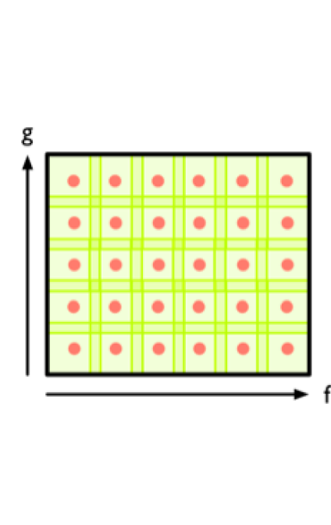
Create overlapping bins:
http://www.nature.com/srep/2013/130207/srep01236/full/srep01236.html

Slide 114
Chose how to cluster.
Normally need a definition of distance between data points
Cluster each bin & create network.
Vertex = a cluster of a bin.
Edge = nonempty intersection
between clusters
http://www.nature.com/srep/2013/130207/srep01236/full/srep01236.html

Slide 115
Note: Many, many choices were made
It helps to know what you are doing when you make choices, so collaborating with others is highly recommended.

Slide 116
Note: Many, many choices were made
“It is useful to think of it as a camera, with lens adjustments and other settings. A different filter function may generate a network with a different shape, thus allowing one to explore the data from a different mathematical perspective.”
http://www.nature.com/srep/2013/130207/srep01236/full/srep01236.html

Slide 117
Note: we made many, many choices
“It is useful to think of it as a camera, with lens adjustments and other settings. A different filter function may generate a network with a different shape, thus allowing one to explore the data from a different mathematical perspective.”
False positives???
http://www.nature.com/srep/2013/130207/srep01236/full/srep01236.html

Slide 118
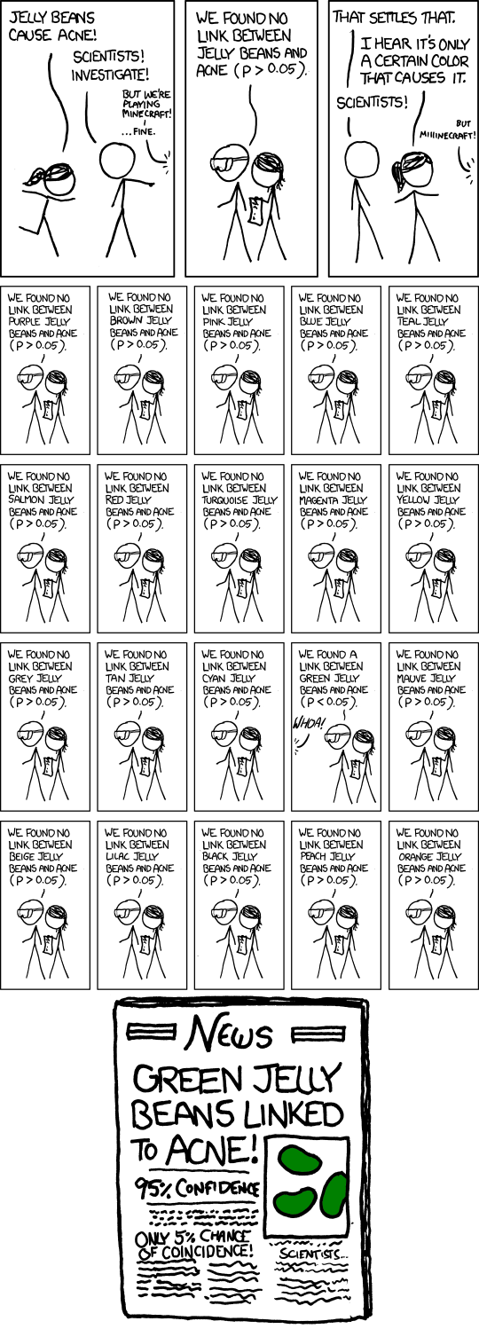
False Positives will occur
https://xkcd.com/882/

Slide 119
Note: Many, many choices were made
“It is useful to think of it as a camera, with lens adjustments and other settings. A different filter function may generate a network with a different shape, thus allowing one to explore the data from a different mathematical perspective.”
False positives vs. robustness
http://www.nature.com/srep/2013/130207/srep01236/full/srep01236.html

Slide 120
Three key ideas of topology that make extracting of patterns via shape possible.
1.) coordinate free.
No dependence on the coordinate system chosen.
Can compare data derived from different platforms
2.) invariant under “small” deformations.
less sensitive to noise
3.) compressed representations of shapes.
Input: dataset with thousands of points
Output: network with 13 vertices and 12 edges.
http://www.nature.com/srep/2013/130207/srep01236/full/srep01236.html

