Slide 1
Examples illustrating Gurjeet Singh , Facundo Mémoli and Gunnar Carlsson’s Mapper Algorithm
Guest lecturer: Isabel K. Darcy
Mathematics Department/Applied Mathematical & Computational Sciences
University of Iowa
http://www.math.uiowa.edu/~idarcy/
This material is based upon work supported by the National Science Foundation under Grant No. DMS-1407216: EXTREEMS-QED: Large Data Analysis and Visualization at the University of Iowa
Any opinions, findings, and conclusions or recommendations expressed in this material are those of the author(s) and do not necessarily reflect the views of the National Science Foundation.

Slide 2
To understand software, it helps to apply it to a variety of examples.

Slide 3
What graph do you get when you apply mapper to the ideal trefoil knot if filter = projection to x-axis?
( ( ) ( ) ( ) ( ) ( ) )

Slide 4
1.) Put data into overlapping bins.
( ( ) ( ) ( ) ( ) ( ) )
Example: f⁻¹(a_{i}, b_{i})

Slide 5
Put data into overlapping
bins.

Slide 6
Cluster each bin.

Slide 7
Cluster each bin.
Each cluster is represented by a vertex.

Slide 10
Create a graph representing the data set:
Cluster each bin.
Each cluster is represented by a vertex.
Draw an edge between 2 vertices if
their clusters have points in common.

Slide 12
Create a graph representing the data set:
Cluster each bin.
Each cluster is represented by a vertex.
Draw an edge between 2 vertices if
their clusters have points in common.

Slide 15
D
C
A
B
E

Slide 16
A
E
D
C
B

Slide 17
2
3
4
1
A
E
D
C
B

Slide 18
3
2
1
4
A
E
D
C
B

Slide 19
4
1
3
2
E
A
D
B
C

Slide 20
D
C
2
3
4
A
B
E
1
A
E
D
B
C
4
1
3
2
4
1
3
2
E
A
E
D
A
D
C
B
B
C

Slide 21
4
1
3
2
E
A
D
B
C

Slide 22
4
1
3
2
E
A
D
B
C

Slide 23
What graph do you get when you apply mapper to the above blob if filter = projection to x-axis?

Slide 24
( ( ) ( ) ( ) ( ) ( ) )

Slide 25
( ( ) ( ) ( ) ( ) ( ) )

Slide 26
( ( ) ( ) ( ) ( ) ( ) )

Slide 27
( ( ) ( ) ( ) ( ) ( ) )

Slide 28
( ( ) ( ) ( ) ( ) ( ) )

Slide 29
( ( ) ( ) ( ) ( ) ( ) )

Slide 30
( ( ) ( ) ( ) ( ) ( ) )

Slide 31
( ( ) ( ) ( ) ( ) ( ) )

Slide 32
( ( ) ( ) ( ) ( ) ( ) )

Slide 33
( ( ) ( ) ( ) ( ) ( ) )

Slide 35
To understand software, it helps to apply it to a variety of examples.

Slide 36
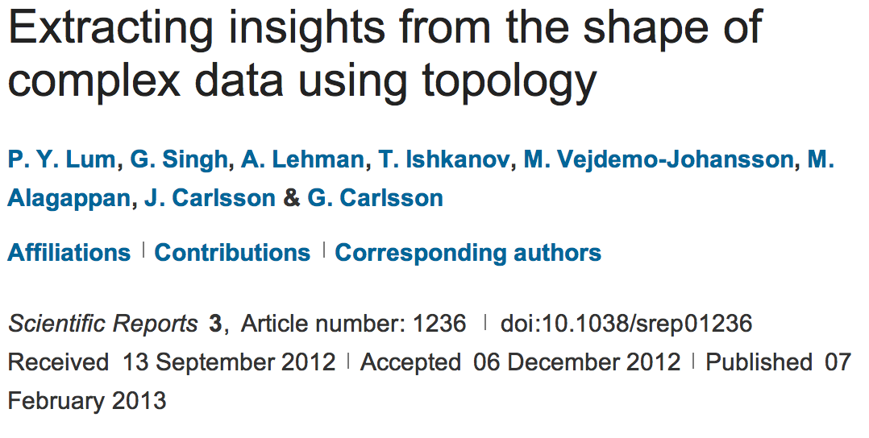
http://www.nature.com/srep/2013/130207/srep01236/full/srep01236.html

