Slide 1
We propose a method which can be used to reduce high dimensional data sets into simplicial complexes with far fewer points which can capture topological and geometric information at a specified resolution.

Slide 2
Building blocks for a simplicial complex
0-simplex = vertex = v
1-simplex = edge = {v₁, v₂}
Note that the boundary of this edge is v₂ + v₁
v₁
v₂
e
2-simplex = triangle = {v₁, v₂, v₃}
v₂
Note that the boundary
of this triangle is the cycle
e₁ + e₂ + e₃
= {v₁, v₂} + {v₂, v₃} + {v₁, v₃}
e₁
e₂
v₁
v₃
e₃
Notes:
The building blocks for a simplicial complex consist of zero simplices which are zero dimensional vertices, one simplices which are one-dimensional edges, and 2-simplices which are two dimensional triangles,

Slide 3
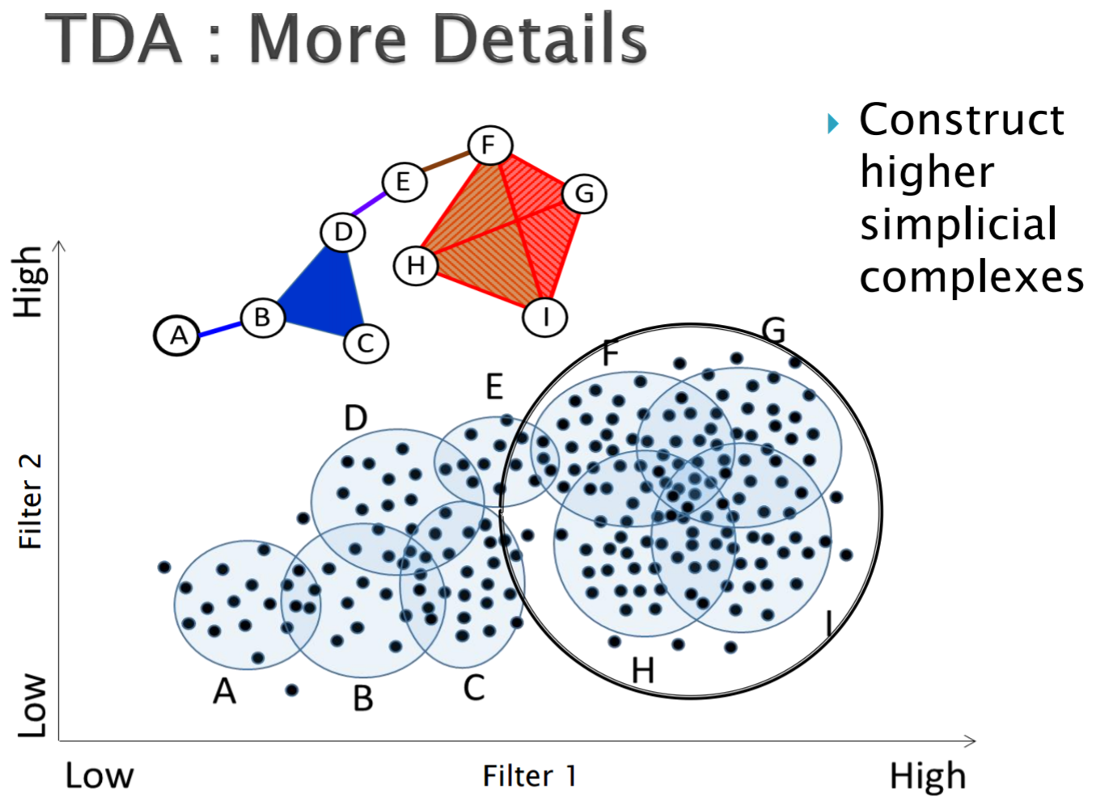
http://www.math.wsu.edu/math/faculty/bkrishna/AbsAlgTopo_PSB2016/Slides_Topology.pdf

Slide 4
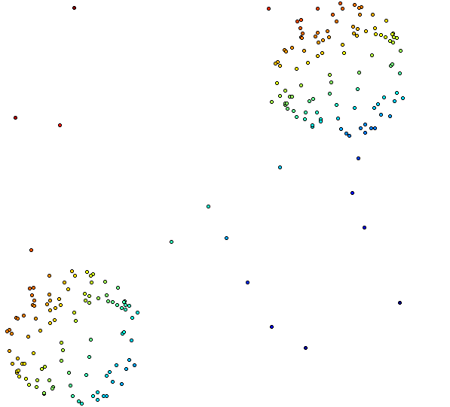
Distance Matrix Eigenvector, Mean Centered Distance Matrix
Order of eigenvector: 1
20 intervals, 80% Overlap

Slide 5
Create overlapping bins:
http://www.nature.com/srep/2013/130207/srep01236/full/srep01236.html

Slide 6
Create overlapping bins:
http://www.nature.com/srep/2013/130207/srep01236/full/srep01236.html

Slide 7
We propose a method which can be used to reduce high dimensional data sets into simplicial complexes with far fewer points which can capture topological and geometric information at a specified resolution.
Resolution means ????
Which choice refers to resolution?

Slide 8
The idea is to provide another tool for a generalized notion of coordinatization for high dimensional data sets. Coordinatization can of course refer to a choice of real valued coordinate functions on a data set,

Slide 9
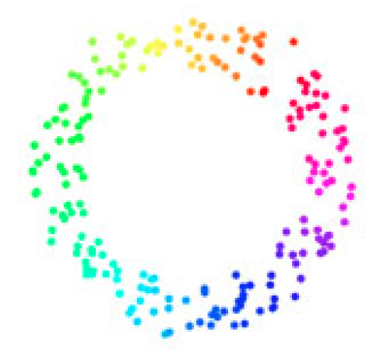
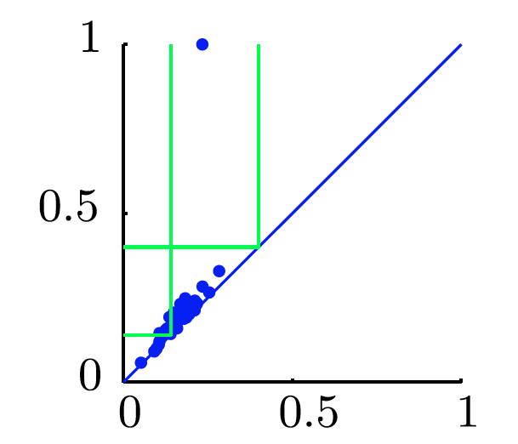
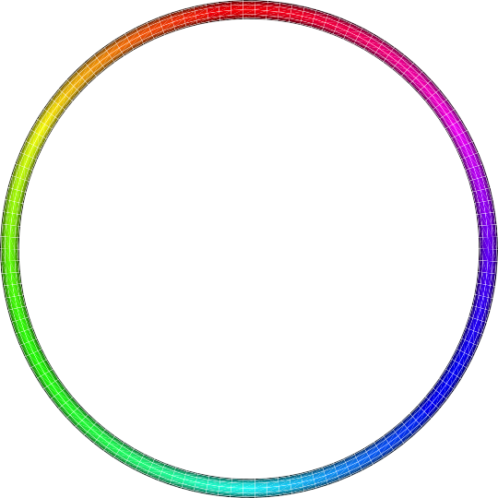
Goal
f: D → S¹ which “preserves” the structure of the data.
circle courtesy of knotplot.com

Slide 10
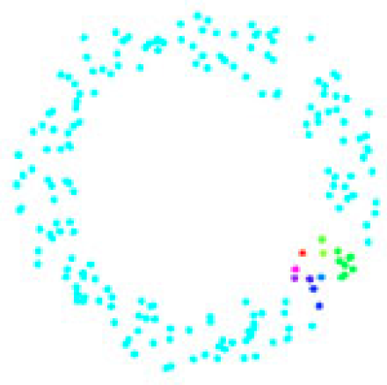
circle courtesy of knotplot.com

Slide 11
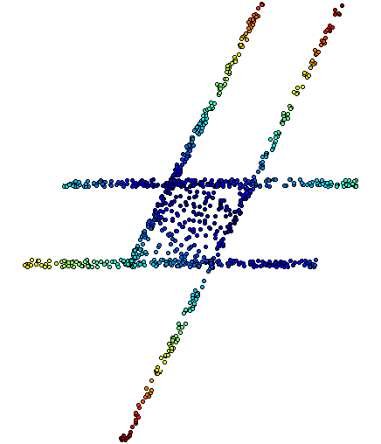
The idea is to provide another tool for a generalized notion of coordinatization for high dimensional data sets. Coordinatization can of course refer to a choice of real valued coordinate functions on a data set,
The graph/simplicial complex created by Mapper can be thought of as a partial coordinization of the data set.
BUT keep in mind that the output is an abstract graph/simplicial complex

Slide 12
The idea is to provide another tool for a generalized notion of coordinatization for high dimensional data sets. Coordinatization can of course refer to a choice of real valued coordinate functions on a data set, but other notions of geometric representation (e.g., the
Reeb graph [Ree46]) are often useful and reflect interesting information more directly.

Slide 13
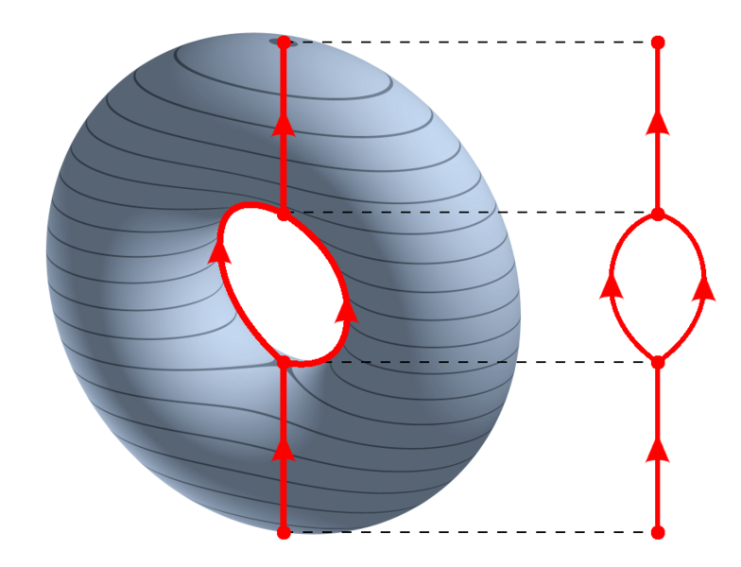
https://en.wikipedia.org/wiki/Reeb_graph
http://www.nature.com/srep/2013/130207/srep01236/full/srep01236.html

Slide 14
Our construction is more general than the Reeb graph and can also represent higher dimensional objects, such as spheres, tori, etc.
In the simplest case one can imagine reducing high dimensional data sets to a graph which has nodes corresponding to clusters in the data.

Slide 15
We begin by introducing a few general properties
of Mapper.
Our method is based on topological ideas, by which we
roughly mean that it preserves a notion of nearness, but can distort large scale distances.
This is often a desirable property, because while distance functions often encode a notion of similarity or nearness, the large scale distances often carry little meaning.

Slide 16
Geometry
=
=

Slide 17
Topology
=
=

Slide 18
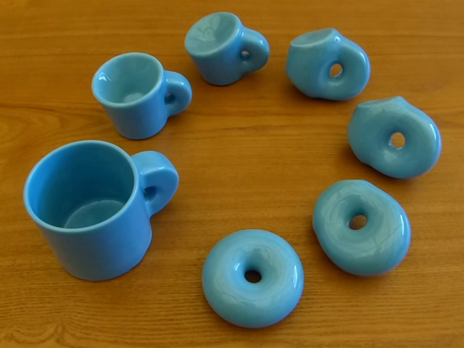
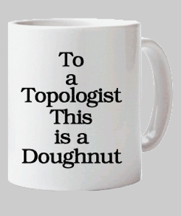
http://images.gmanews.tv/webpics/2016/10/Untitled_2016_10_05_15_45_40.png
http://2.bp.blogspot.com/-SGwFwBjFnBs/ThBqTV1TVUI/AAAAAAAAARw/F1ftHB0teJE/s1600/coffee+cup+as+donut.png

Slide 19
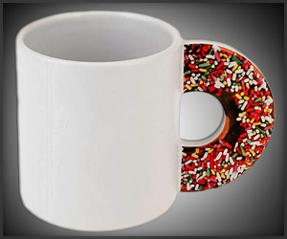
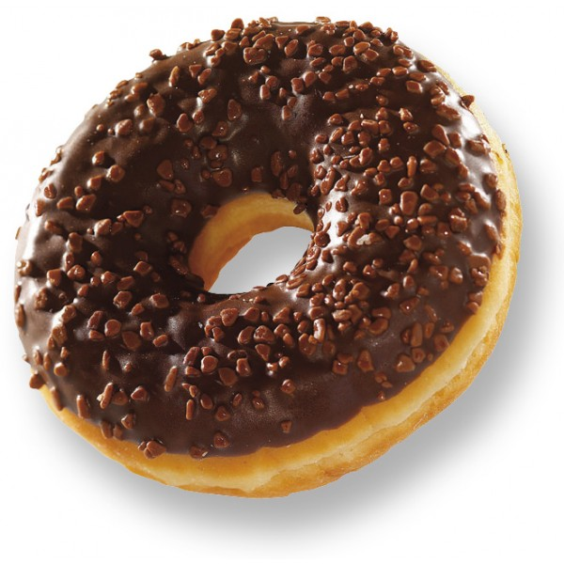
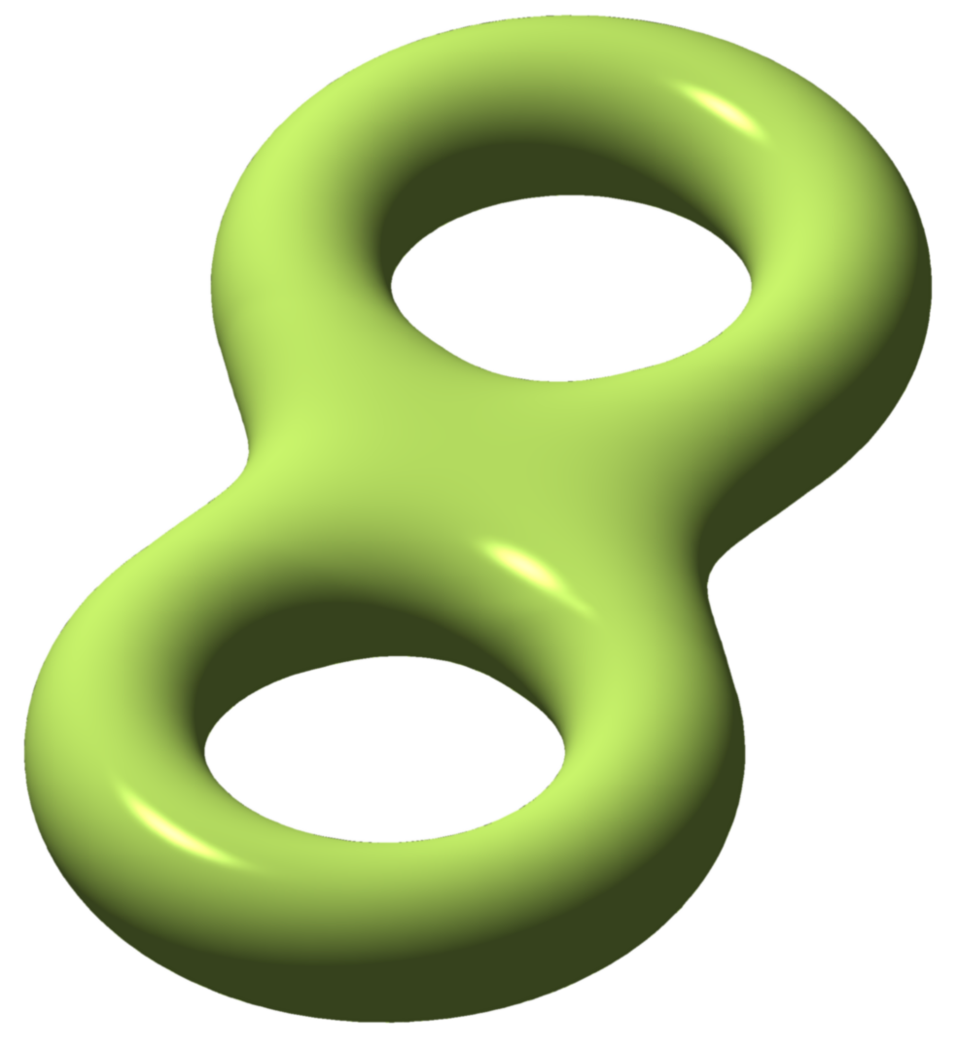
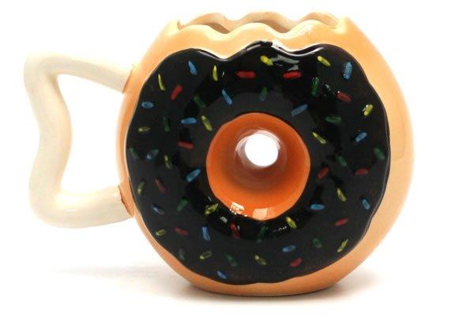
http://images.gmanews.tv/webpics/2016/10/Untitled_2016_10_05_15_45_40.png
http://2.bp.blogspot.com/-SGwFwBjFnBs/ThBqTV1TVUI/AAAAAAAAARw/F1ftHB0teJE/s1600/coffee+cup+as+donut.png
https://www.geekalerts.com/u/Donut-Mug.jpg
torus = donut
http://www.prevogel.fr/156-thickbox_default/donut-chocolat-surgel%C3%A9-vandermoortele.jpg
Not a donut (ie not a torus)
=
http://www.yellowoctopus.com.au/media/catalog/product/y/e/yellow-octopus-donutmug.jpg
https://en.wikipedia.org/wiki/Euler_characteristic

Slide 20
Topological Data Analysis (TDA): Three key ideas of topology that make extracting of patterns via shape possible.
2.) invariant under “small” deformations.
less sensitive to noise
Topological Methods for the Analysis of High Dimensional
Data Sets and 3D Object Recognition, Singh, Mémoli, Carlsson
Figure from http://comptop.stanford.edu/u/preprints/mapperPBG.pdf
http://www.nature.com/srep/2013/130207/srep01236/full/srep01236.html

Slide 21
Filter Function
The method begins with a data set X and a real valued function f : X →R, to produce a graph.
This function can be a function which reflects geometric properties of the data set, such as the result of a density estimator, or
can be a user defined function, which reflects properties of the data being studied.
In the first case, one is attempting to obtain information
about the qualitative properties of the data set itself,
and in the second case one is trying to understand how these properties interact with interesting functions on the data set.

Slide 22
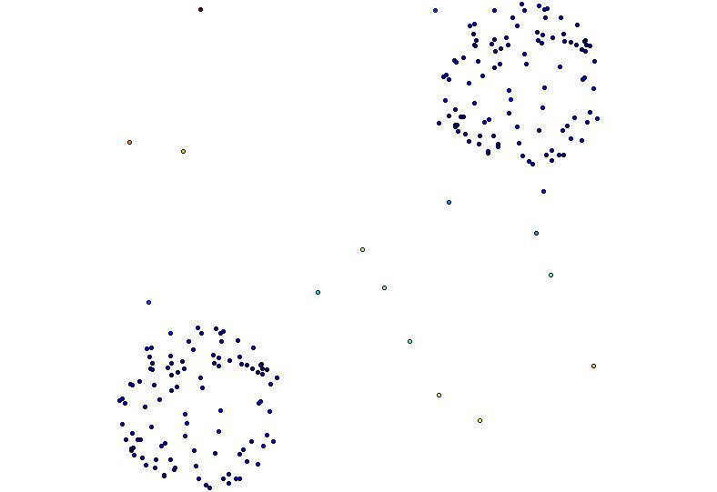
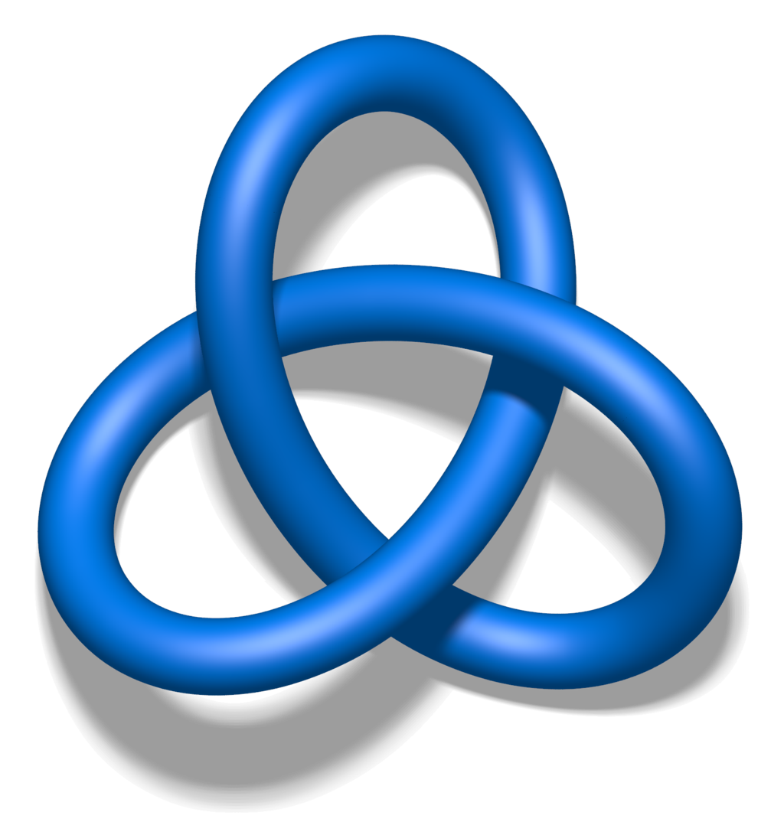
Filter Function
The method begins with a data set X and a real valued function f : X →R, to produce a graph.
This function can be a function which reflects geometric properties of the data set, such as the result of a density estimator, or
In the first case, one is attempting to obtain information
about the qualitative properties of the data set itself,
Are there
Flares?
Topology?
Blobs?
# of components?

Slide 23
Filter Function
The method begins with a data set X and a real valued function f : X →R, to produce a graph.
Or this function can be a user defined function, which reflects properties of the data being studied.
in the second case one is trying to understand how these properties interact with interesting functions on the data set.
The method begins with a data set X and a real valued function f : X →R, to produce a graph.
Or this function can be a user defined function, which reflects properties of the data being studied.
in the second case one is trying to understand how these properties interact with interesting functions on the data set.

Slide 24
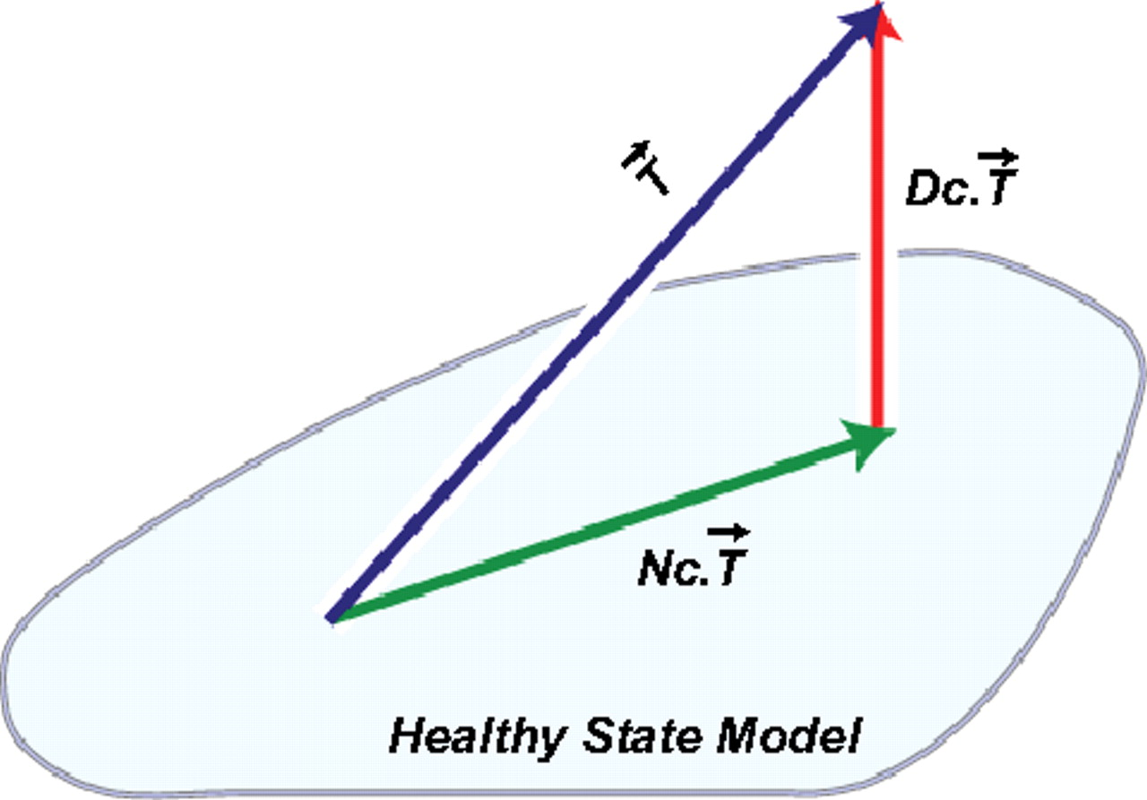
Introduction
The purpose of this paper is to introduce a new method for the qualitative analysis, simplification and visualization of high dimensional data sets, as well as the qualitative analysis of functions on these data sets.
Ex: 1.) f(x) = ||x||
2.) g(x₁, …, x_{n-1}) = x_{n}
3.) DSGA decomposition of the original tumor
vector into the Normal component its
linear models fit onto the Healthy State
Model and the Disease component vector of residuals.
http://www.pnas.org/content/early/2011/04/07/1102826108

Slide 25
The functions determine the space to which we produce a map.
The method can easily be modified to deal with maps
to parameter spaces other than R, such as R² or the unit circle S¹ in the plane.
In the first of these cases, one produces a two dimensional simplicial complex, together with a natural map from the data set to it.
In the second case, one constructs a graph with a map from the graph to a circle.

Slide 26
Create overlapping bins:
Oops!!!
http://www.nature.com/srep/2013/130207/srep01236/full/srep01236.html

Slide 27
Create overlapping bins:
http://www.nature.com/srep/2013/130207/srep01236/full/srep01236.html

Slide 28
The functions determine the space to which we produce a map.
The method can easily be modified to deal with maps
to parameter spaces other than R, such as R² or the unit circle S¹ in the plane.
In the first of these cases, one produces a two dimensional simplicial complex, together with a natural map from the data set to it.
In the second case, one constructs a graph with a map from the graph to a circle.

Slide 29
Distance Matrix Eigenvector, Mean Centered Distance Matrix
Order of eigenvector: 1
20 intervals, 80% Overlap
Oops!!!

Slide 30
The functions determine the space to which we produce a map.
The method can easily be modified to deal with maps
to parameter spaces other than R, such as R² or the unit circle S¹ in the plane.
In the first of these cases, one produces a two dimensional simplicial complex, together with a natural map from the data set to it.
In the second case, one constructs a graph with a map from the graph to a circle.

Slide 31
Filter function: eccentricity

Slide 32
https://en.wikipedia.org/wiki/Reeb_graph
http://www.nature.com/srep/2013/130207/srep01236/full/srep01236.html
In the case where the target parameter space is R, our construction amounts to a stochastic version of the Reeb graph (see [Ree46]) associated with the filter function. If the covering of R is too coarse, we will be constructing an image of the Reeb graph of the function, while if it is fine enough we will recover the Reeb graph precisely.

Slide 33
The basic idea can be referred to as partial clustering, in that a key step is to apply standard clustering algorithms to subsets of the original data set, and then to understand the interaction of the partial clusters formed in this way with each other.
That is, if U and V are subsets of the data set, and U ∩V is non-empty, then the clusters obtained from U and V respectively may have non-empty intersections, and these intersections are used in building a simplicial complex.

Slide 34
This construction produces a “multiresolution" or “multiscale“ image of the data set.
One can actually construct a family of simplicial complexes (graphs in the case of a one-dimensional parameter space), which are viewed as images at varying levels of coarseness,
and maps between them moving from a complex at one resolution to one of coarser resolution.

Slide 35
knn distance with k = 5, 50% overlap
3 intervals
5 intervals
10 intervals
100 intervals

Slide 36
knn distance with k = 50, 50% overlap
3 intervals
5 intervals
10 intervals
100 intervals

Slide 37
This fact allows one to assess the extent to which features are “real" as opposed to “artifacts", since features which persist over a range of values of the coarseness would be viewed as being less likely to be artifacts.

Slide 38
We do not attempt to obtain a fully accurate representation of a data set, but rather a low dimensional image which is easy to understand, and which can point to areas of interest.
Note that it is implicit in the method that one fixes a parameter space, and its dimension will be an upper bound on the dimension of the simplicial complex one studies.
As such, it is in a certain way analogous to the idea of a Postnikov tower or the coskeletal filtration in algebraic topology [Hat02].

