Slide 1
Main Project total points: 500
Introduction, Background,
Partial Results/Discussion,
Acknowledgement, Author contribution,
funding/conflicts, References
200/500 = 40% finished by March 27
250/500 = 50% finished by April 5
400/500 = 80% finished by April 17
500/500 = 100% finished by April 26

Slide 2

https://writingcenter.uiowa.edu/#services

Slide 3
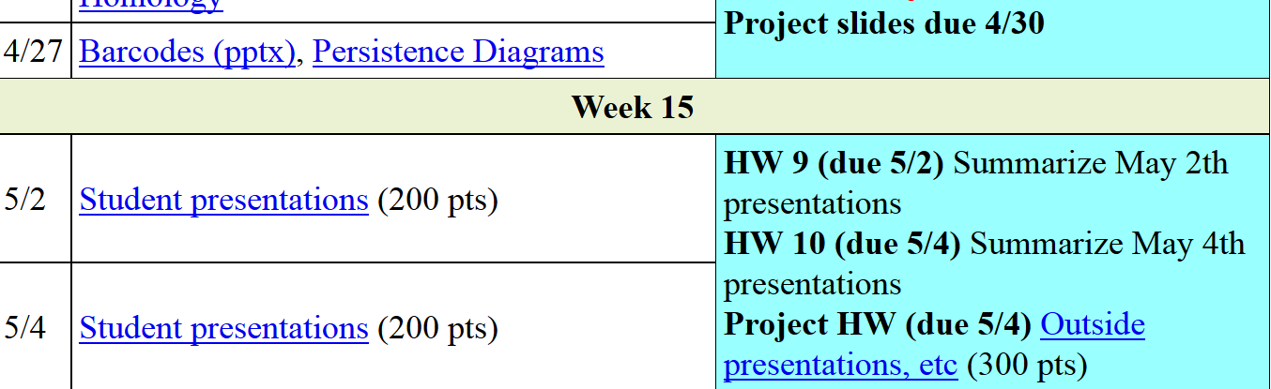
Mini-presentations in class:
End of March or beginning of April.
Over anything related to your project.
5 – 10 minutes/person.
Visit speaking center before presentation. Submit summary of visit – what did you learn.

Slide 4

https://speakingcenter.uiowa.edu/about-us

Slide 5
Modified from http://www.garrreynolds.com/preso-tips/design/
1. Keep it Simple
  Lots of white space is good: The less clutter you have on your slide, the more powerful your visual message will become.
2. Limit bullet points & text
  3. Limit transitions & builds (animation)
  Only use animations that illustrate a point.
  Don’t use unnecessary animations.
4. Use high-quality graphics
5. Have a visual theme, but avoid using PowerPoint templates
6. Use appropriate charts
7. Use color well
8. Choose your fonts well
  use the same font set throughout your entire slide presentation, and use no more than two complementary sans-serif fonts (e.g., Arial and Arial Bold).
9. Use video or audio when appropriate.
10. Organize your talk: Spend time in the slide sorter (or print out your slides at least 6 to a page).

Slide 6
In an assertion-evidence slide, the headline is a sentence that succinctly states the slide’s main message
Photograph, drawing, diagram, or graph
supporting the headline message (no bulleted list)
Call-out(s), if needed:
no more than two lines
PowerPoint Template: http://writing.engr.psu.edu/AE_template_PSU.ppt
Notes:
6
This file presents a template for making Assertion–Evidence (A–E) slides in a technical presentation. The design advocated by this template arises from pages 113-152 of The Craft of Scientific Presentations (Springer, 2003) and from the first Google listing for “presentation slides”:
http://www.writing.engr.psu.edu/slides.html
To follow this template, make sure that you create the slide within this PowerPoint file. Working with a New Slide (under Insert in older versions or as a button on the Home tab in version 2007) , you should first craft a sentence headline that states an assertion about your topic. Having no assertion translates to having no slide. In the body of the slide, you should then support that headline assertion visually: photographs, drawings, diagrams, equations, or words arranged visually. Use supporting text only where necessary. Do not use bulleted lists, because bulleted lists do not reveal the connections between details.
This slide shows one orientation for the image and supporting text. Other orientations exist, as shown in the sample slides that follow.

Slide 7
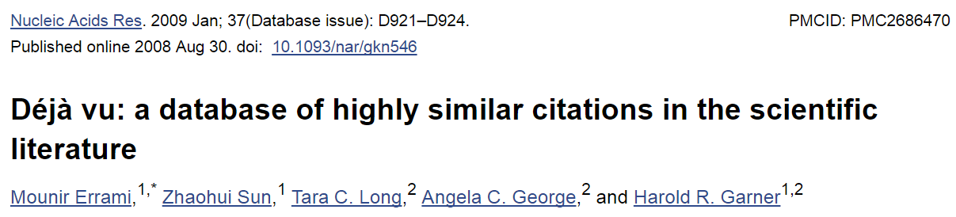
https://www.ncbi.nlm.nih.gov/pmc/articles/PMC2686470/
ABSTRACT
In the scientific research community, plagiarism and covert multiple publications of the same data are considered unacceptable because they undermine the public confidence in the scientific integrity. Yet, little has been done to help authors and editors to identify highly similar citations, which sometimes may represent cases of unethical duplication. For this reason, we have made available Déjà vu, a publicly available database of highly similar Medline citations identified by the text similarity search engine eTBLAST. Following manual verification, highly similar citation pairs are classified into various categories ranging from duplicates with different authors to sanctioned duplicates. Déjà vu records also contain user-provided commentary and supporting information to substantiate each document's categorization. Déjà vu and eTBLAST are available to authors, editors, reviewers, ethicists and sociologists to study, intercept, annotate and deter questionable publication practices. These tools are part of a sustained effort to enhance the quality of Medline as ‘the’ biomedical corpus. The Déjà vu database is freely accessible at http://spore.swmed.edu/dejavu. The tool eTBLAST is also freely available at http://etblast.org.

Slide 8
Kolmogorov-Smirnov Test

Slide 9
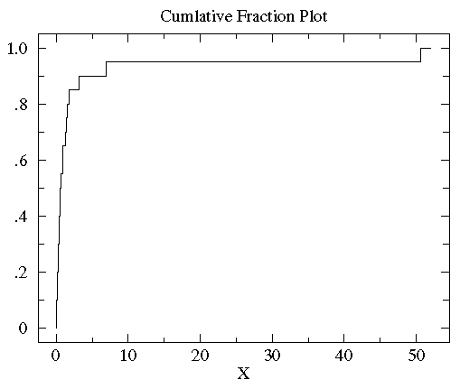
http://www.physics.csbsju.edu/stats/KS-test.html
Sorted controlB={0.08, 0.10, 0.15, 0.17, 0.24, 0.34, 0.38, 0.42, 0.49, 0.50, 0.70, 0.94, 0.95, 1.26, 1.37, 1.55, 1.75, 3.20, 6.98, 50.57}

Slide 10
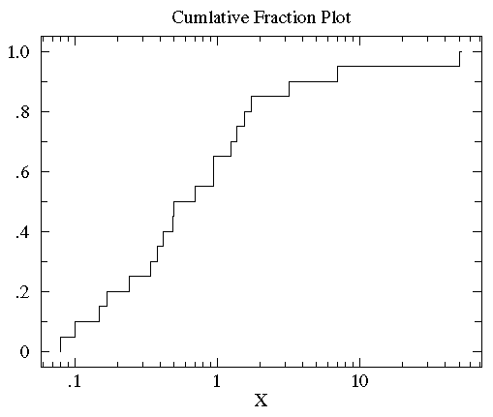
http://www.physics.csbsju.edu/stats/KS-test.html
Sorted controlB={0.08, 0.10, 0.15, 0.17, 0.24, 0.34, 0.38, 0.42, 0.49, 0.50, 0.70, 0.94, 0.95, 1.26, 1.37, 1.55, 1.75, 3.20, 6.98, 50.57}

Slide 11
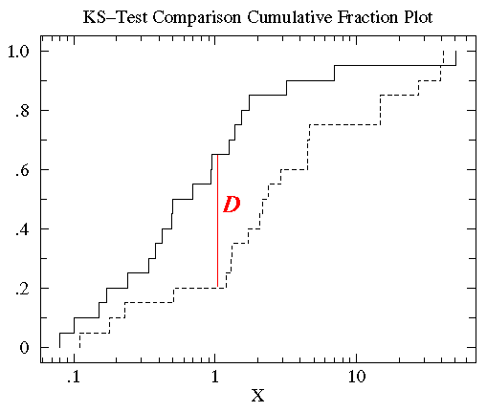
http://www.physics.csbsju.edu/stats/KS-test.html
treatmentB= {2.37, 2.16, 14.82, 1.73, 41.04, 0.23, 1.32, 2.91, 39.41, 0.11, 27.44, 4.51, 0.51, 4.50, 0.18, 14.68, 4.66, 1.30, 2.06, 1.19}

Slide 12
http://www.physics.csbsju.edu/stats/KS-test.html
treatmentB= {0.11, 0.18, 0.23, 0.51, 1.19, 1.30, 1.32, 1.73, 2.06, 2.16, 2.37, 2.91, 4.50, 4.51, 4.66, 14.68, 14.82, 27.44, 39.41, 41.04}

Slide 13
http://www.physics.csbsju.edu/stats/KS-test.html
The KS-test uses the maximum vertical deviation between the two curves as the statistic D. In this case the maximum deviation occurs near x=1 and has D=.45. (The fraction of the treatment group that is less then one is 0.2 (4 out of the 20 values); the fraction of the control group that is less than one is 0.65 (13 out of the 20 values). Thus the maximum difference in cumulative fraction is D=.45.)

Slide 14



http://www.bigdata.uni-frankfurt.de/wp-content/uploads/2015/10/
Evaluating-Ayasdi’s-Topological-Data-Analysis-For-Big-Data_HKim2015.pdf

Slide 15

“Color ranges over red to blue and it has different meanings, depending on the type of attributes. For the continuous values, color represents an average of value. A red node contains data samples that have higher average values. In contrast, a blue node contains lower average values. In contrast, for the categorical values, color represents a value concentration.”
Analyze your data

Slide 16
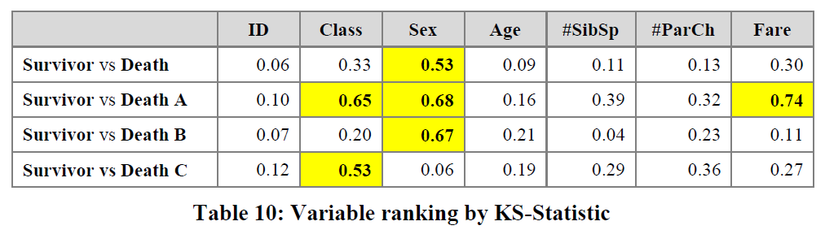
3.2.2.2 Insight by Ranked Variables
Going back to the Titanic example, the result of the KS-statistic show, that the variable “Sex” is the most strongly related to passengers death. We could generally assume that men conceded the places in lifeboats to women. Furthermore, it is feasible to deduct the subtle reasons of the death of each group. The passengers in group A died because of two reasons: they were man and the cabin class type was low. The passengers in the group B died because they were man. Finally, the passengers in the group C died because they were staying at third class even though most of them were women.

