Slide 1
Main Project total points: 500
Introduction, Background,
Partial Results/Discussion,
Acknowledgement, Author contribution,
funding/conflicts, References
200/500 = 40% finished by March 27
250/500 = 50% finished by April 5
400/500 = 80% finished by April 17
500/500 = 100% finished by April 26

Slide 2

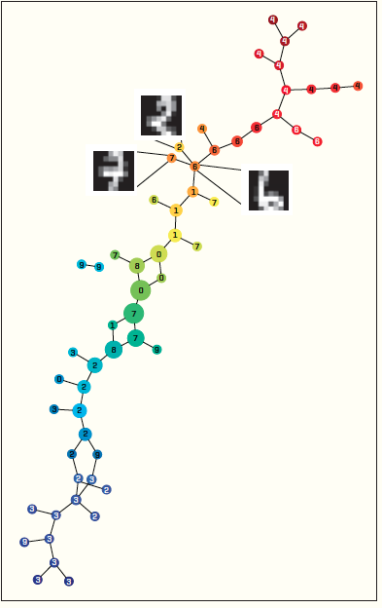
XRDS • SUMMER 2014 • VOL .20 • NO.4

Slide 3
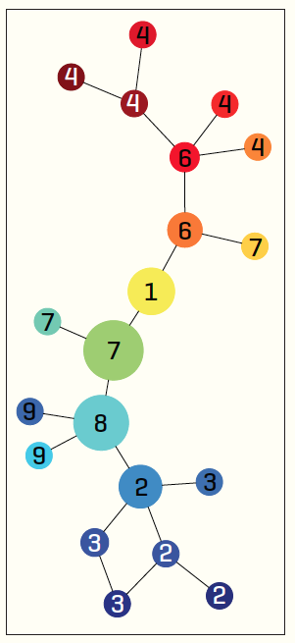
1,797 data points
data point:
8x8 matrix
Distance metric:
Euclidean
Filter function:
principal SVD values
Node colors:
filter values,
red = high and
blue = low
Nodes labels:
most frequently occurring digit in the associated clusters
5 intervals with 50 percent overlap.
15 intervals with 50 percent overlap.

Slide 4

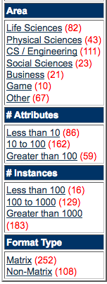
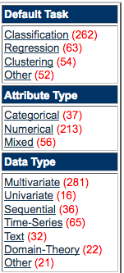
We currently maintain 360 data sets as a service to the machine learning community.

Slide 5
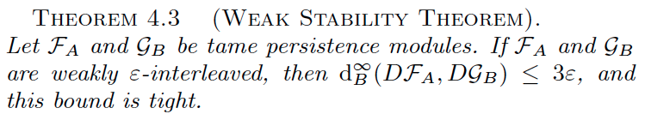
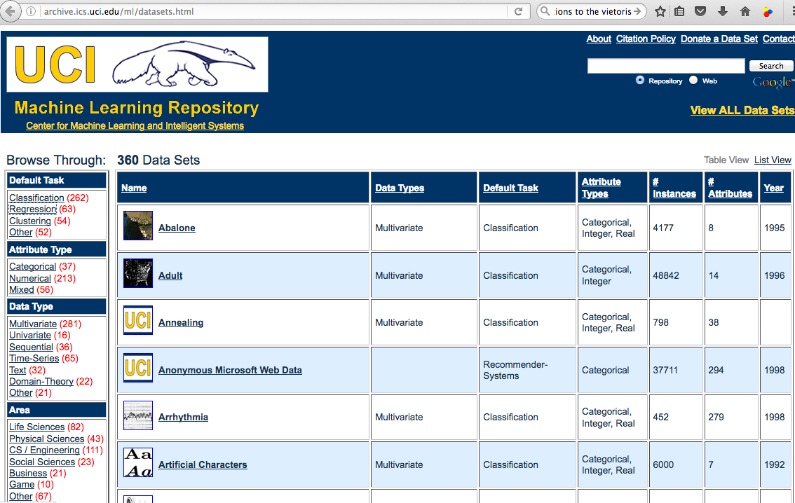

Slide 6
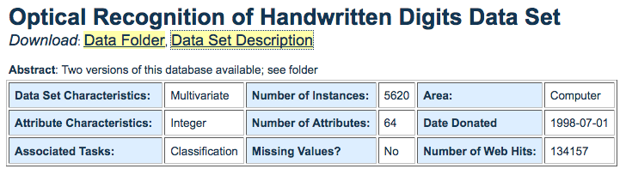
Source: E. Alpaydin, C. Kaynak, Department of Computer Engineering, Bogazici University, 80815 Istanbul Turkey, alpaydin '@' boun.edu.tr
Data Set Information: We used preprocessing programs made available by NIST to extract normalized bitmaps of handwritten digits from a preprinted form. From a total of 43 people, 30 contributed to the training set and different 13 to the test set. 32x32 bitmaps are divided into nonoverlapping blocks of 4x4 and the number of on pixels are counted in each block. This generates an input matrix of 8x8 where each element is an integer in the range 0..16. This reduces dimensionality and gives invariance to small distortions.
For info on NIST preprocessing routines, see M. D. Garris, J. L. Blue, G. T. Candela, D. L. Dimmick, J. Geist, P. J. Grother, S. A. Janet, and C. L. Wilson, NIST Form-Based Handprint Recognition System, NISTIR 5469, 1994.
Attribute Information: All input attributes are integers in the range 0..16.
The last attribute is the class code 0..9

Slide 7
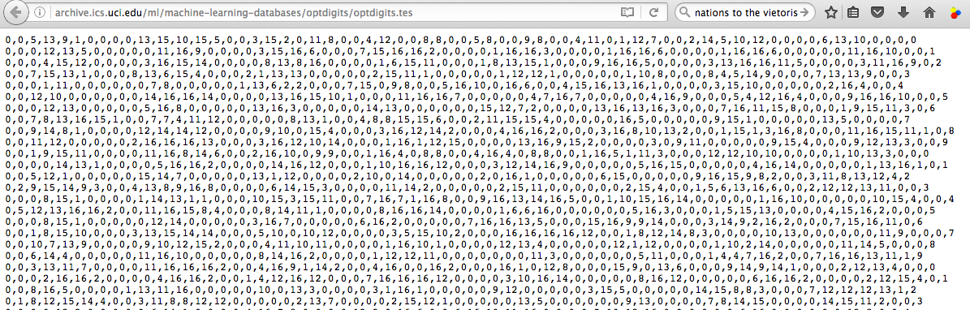
http://archive.ics.uci.edu/ml/datasets/Optical+Recognition+of+Handwritten+Digits
http://archive.ics.uci.edu/ml/machine-learning-databases/optdigits/optdigits.names
5. Number of Instances
optdigits.tra Training 3823
optdigits.tes Testing 1797

Slide 8
1,797 data points
data point:
8x8 matrix
Distance metric:
Euclidean
Filter function:
principal SVD values
Node colors:
filter values,
red = high and
blue = low
Nodes labels:
most frequently occurring digit in the associated clusters
5 intervals with 50 percent overlap.
15 intervals with 50 percent overlap.

Slide 9
We currently maintain 360 data sets as a service to the machine learning community.

Slide 10
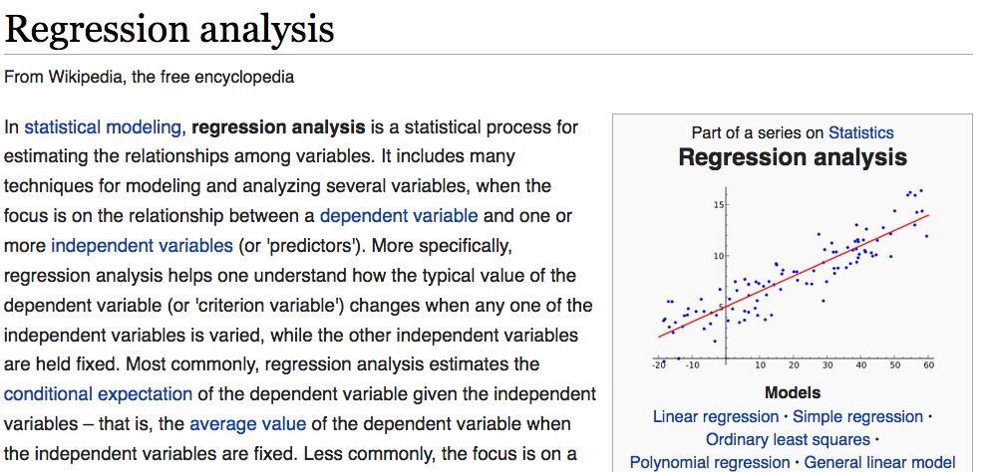
https://en.wikipedia.org/wiki/Regression_analysis
We will (most likely) NOT use TDA mapper for regression analysis

Slide 11
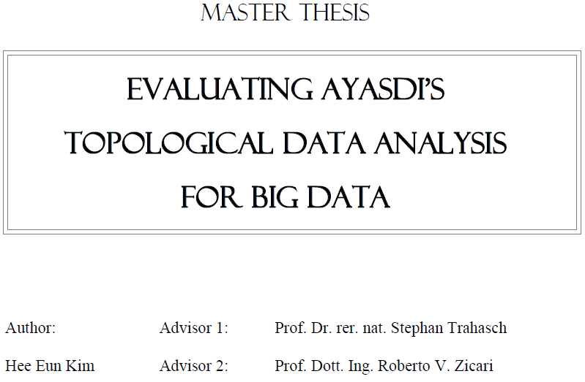


http://www.bigdata.uni-frankfurt.de/wp-content/uploads/2015/10/
Evaluating-Ayasdi’s-Topological-Data-Analysis-For-Big-Data_HKim2015.pdf

Slide 12

“Color ranges over red to blue and it has different meanings, depending on the type of attributes. For the continuous values, color represents an average of value. A red node contains data samples that have higher average values. In contrast, a blue node contains lower average values. In contrast, for the categorical values, color represents a value concentration.”
Analyze your data

Slide 13
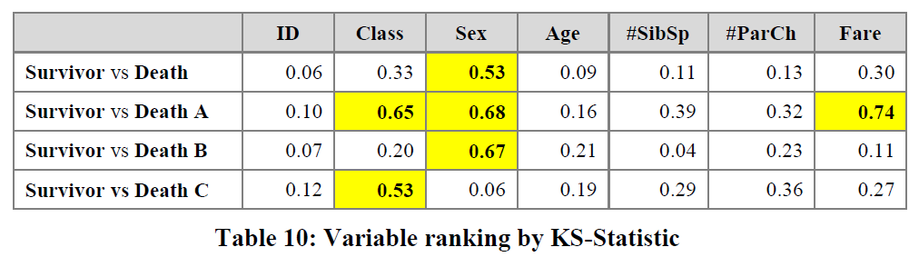
3.2.2.2 Insight by Ranked Variables
Going back to the Titanic example, the result of the KS-statistic show, that the variable “Sex” is the most strongly related to passengers death. We could generally assume that men conceded the places in lifeboats to women. Furthermore, it is feasible to deduct the subtle reasons of the death of each group. The passengers in group A died because of two reasons: they were man and the cabin class type was low. The passengers in the group B died because they were man. Finally, the passengers in the group C died because they were staying at third class even though most of them were women.

