Slide 1
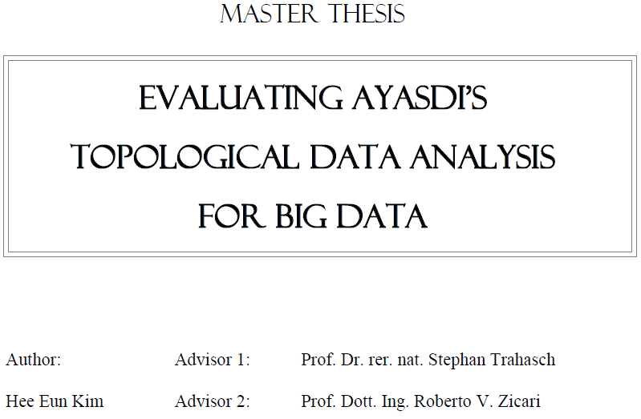


http://www.bigdata.uni-frankfurt.de/wp-content/uploads/2015/10/
Evaluating-Ayasdi’s-Topological-Data-Analysis-For-Big-Data_HKim2015.pdf

Slide 2
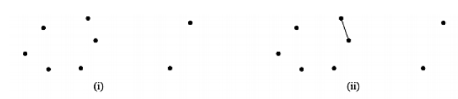
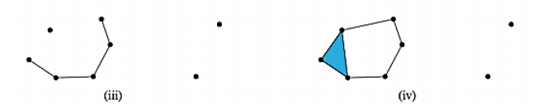
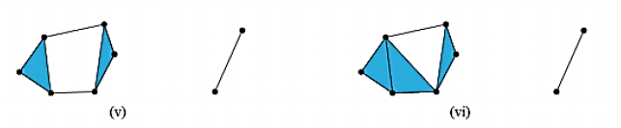
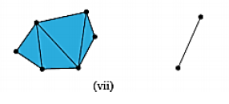


Slide 3
We are not (currently) covering persistent homology including barcodes

Slide 4
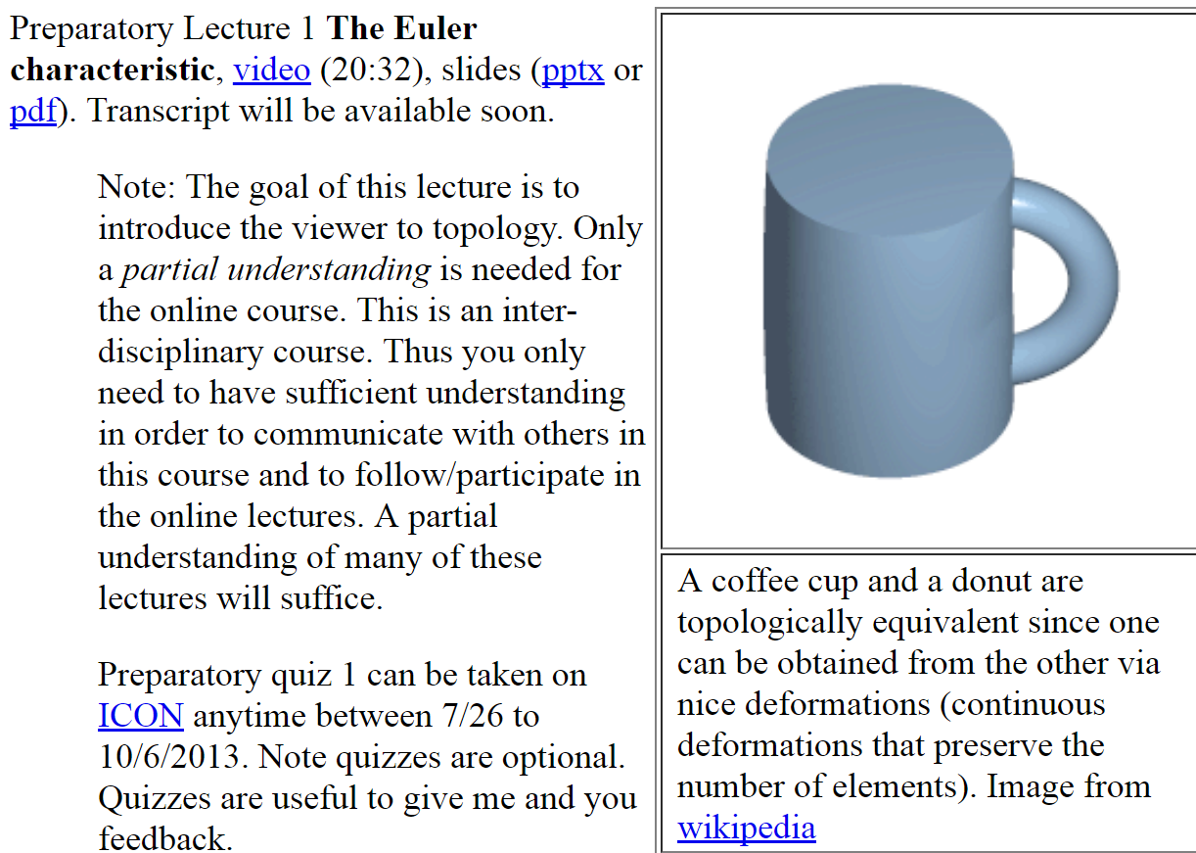

We may or may not introduce persistent homology via the preparatory lectures listed in weeks 11 - 13

Slide 5
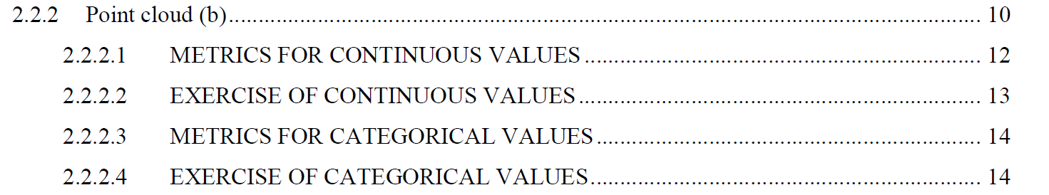
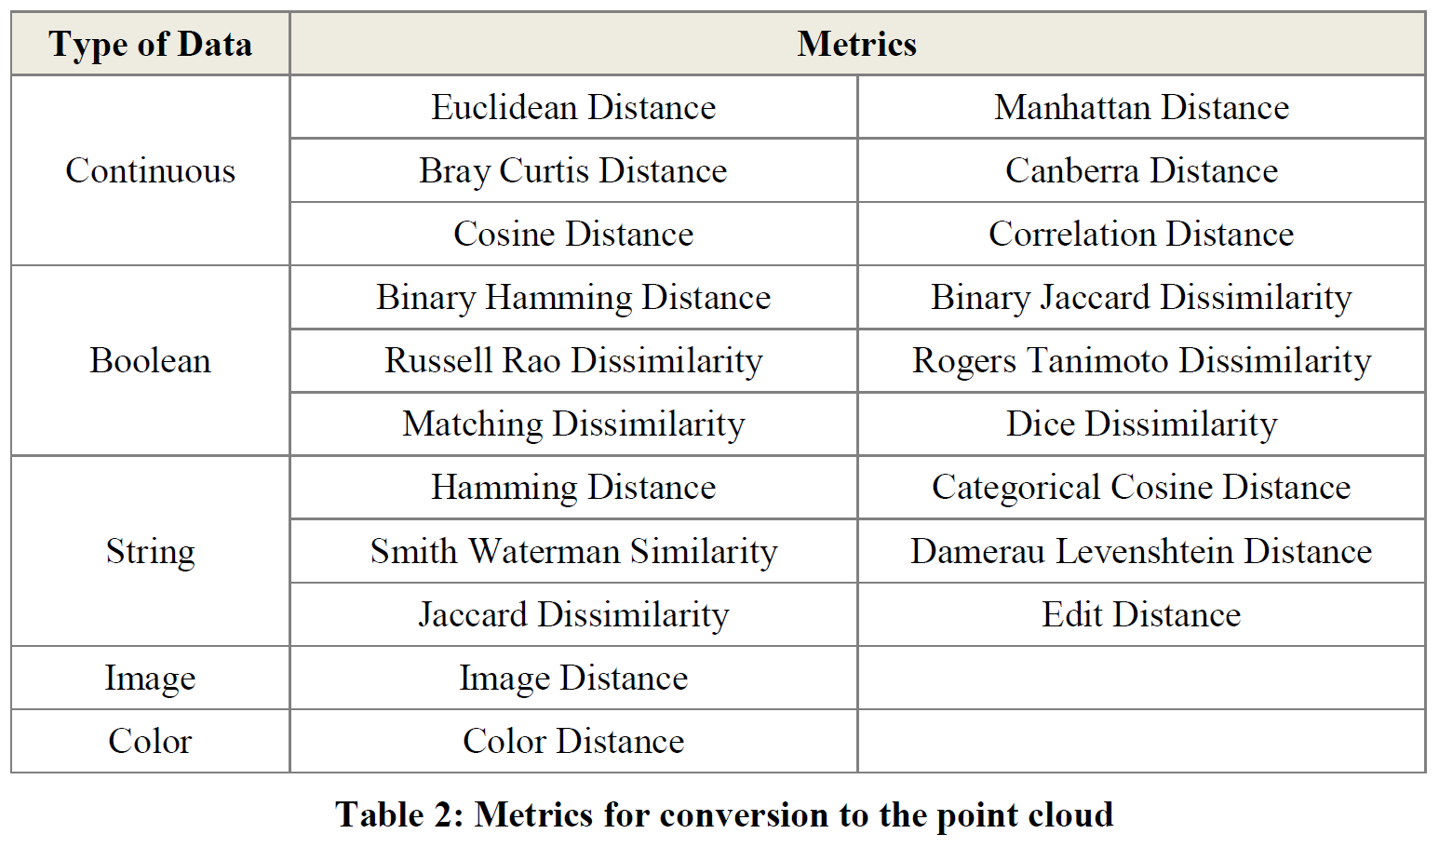
Section 2.2.2: Distances (optional)

Slide 6
But you may want to focus on Euclidean distance AFTER normalizing:
From databasics3900.r:
> # one way to normalize data
> scaledata2 <- scale(data2) # scales data so that mean = 0, sd = 1
> colMeans(scaledata2) # faster version of apply(scaled.dat, 2, mean)
# shows that mean of each column is 0
Sepal.Length Sepal.Width Petal.Length Petal.Width
-4.480675e-16 2.035409e-16 -2.844947e-17 -3.714621e-17
> apply(scaledata2, 2, sd) # shows that standard deviation
# of each column is 1
Sepal.Length Sepal.Width Petal.Length Petal.Width
1 1 1 1
-------------------------------------------------------------------------------------------
P<- select(tbl_df(scaledata2), Petal.Length) # Choose filter
m1 <- mapper1D( # Apply mapper
distance_matrix = dist(data.frame(scaledata2)),
filter_values = P,
num_intervals = 10,
percent_overlap = 50,
num_bins_when_clustering = 10)
# save data to current working
# directory as a text file
write.table(scaledata2, "data.txt", sep=" ",
row.names = FALSE, col.names = FALSE)

Slide 7
> ?dist
Distance Matrix Computation
Description
This function computes and returns the distance matrix
computed by using the specified distance measure to
compute the distances between the rows of a data matrix.
Usage
dist(x, method = "euclidean", diag = FALSE,
upper = FALSE, p = 2)
method: the distance measure to be used. This must be
one of "euclidean", "maximum", "manhattan", "canberra",
"binary" or "minkowski". Any unambiguous substring
can be given.

Slide 8
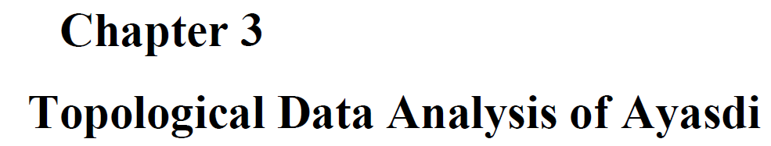
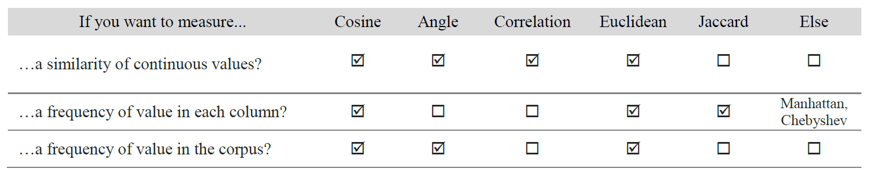
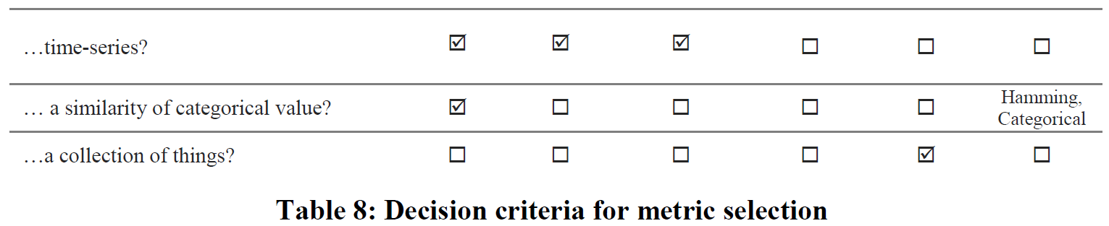

Slide 9
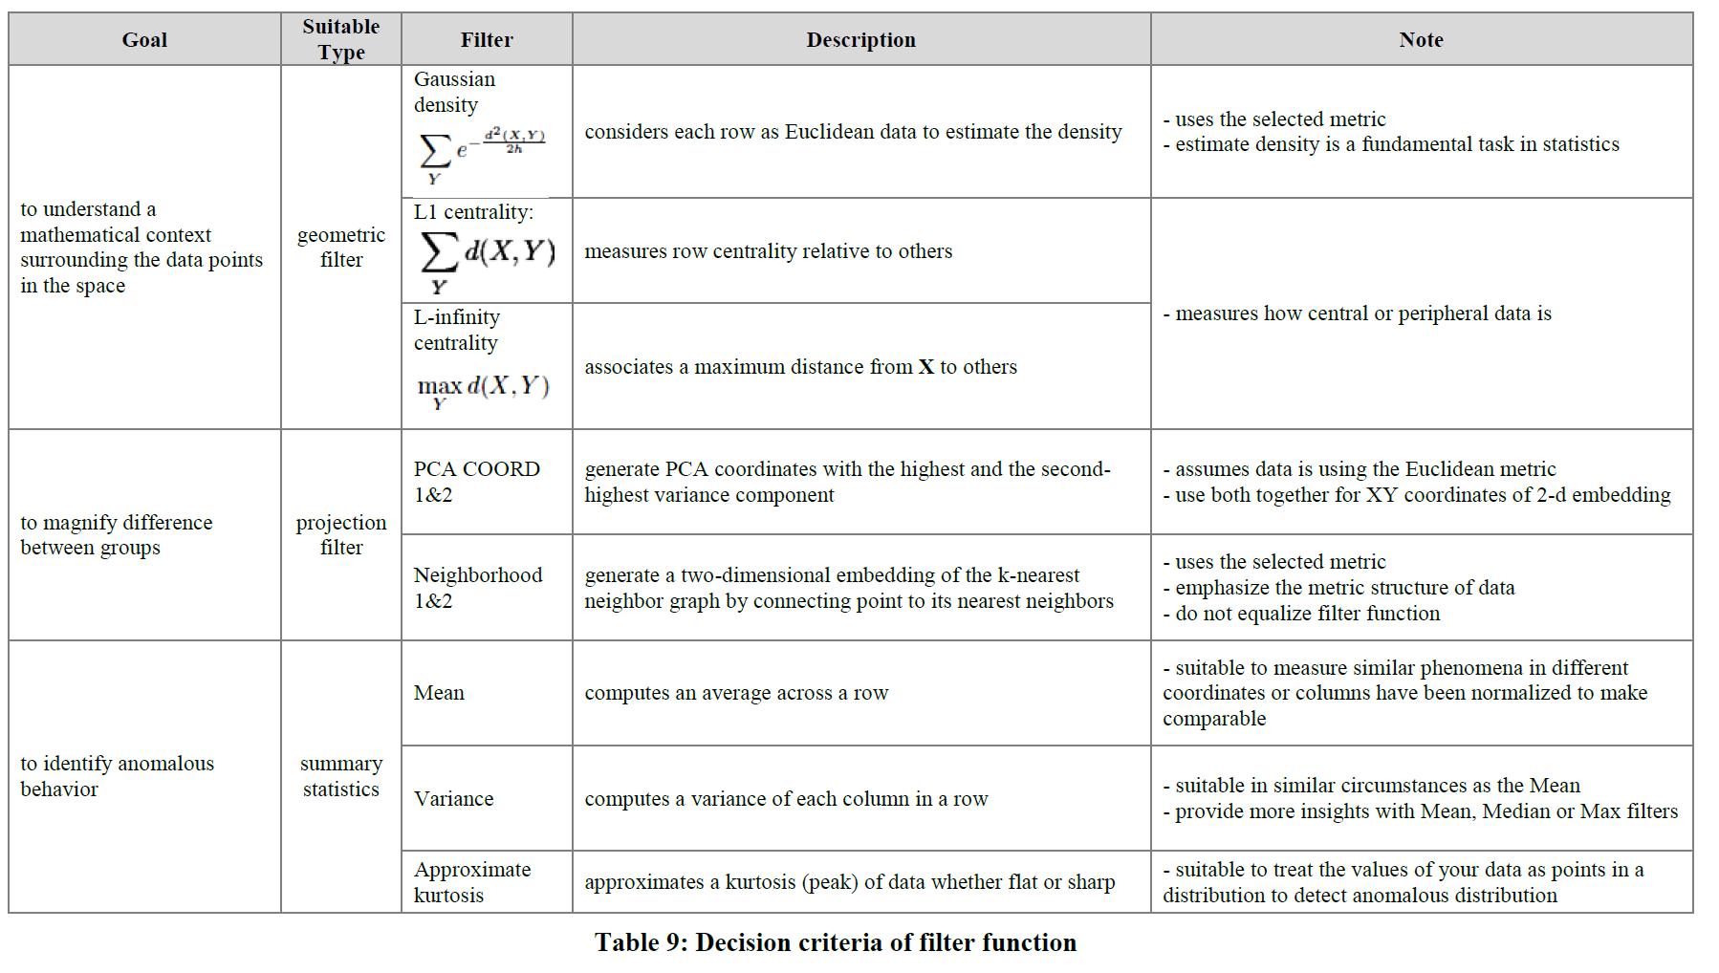

Slide 10

“Color ranges over red to blue and it has different meanings, depending on the type of attributes. For the continuous values, color represents an average of value. A red node contains data samples that have higher average values. In contrast, a blue node contains lower average values. In contrast, for the categorical values, color represents a value concentration.”
Analyze your data

Slide 11
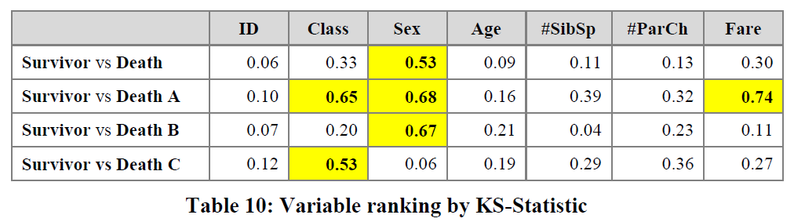
3.2.2.2 Insight by Ranked Variables
Going back to the Titanic example, the result of the KS-statistic show, that the variable “Sex” is the most strongly related to passengers death. We could generally assume that men conceded the places in lifeboats to women. Furthermore, it is feasible to deduct the subtle reasons of the death of each group. The passengers in group A died because of two reasons: they were man and the cabin class type was low. The passengers in the group B died because they were man. Finally, the passengers in the group C died because they were staying at third class even though most of them were women.

Slide 12
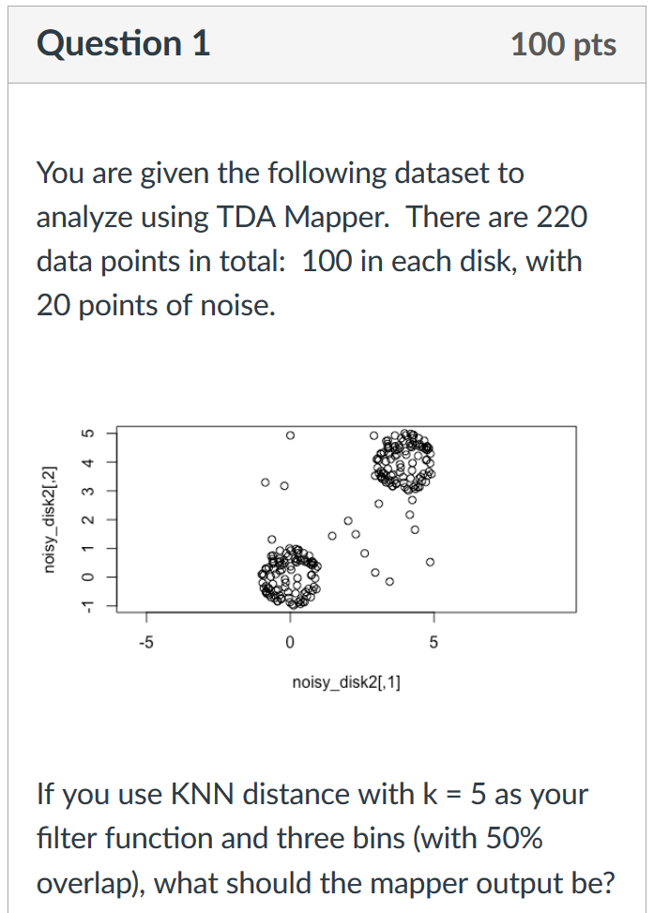
Project HW 5 (Due 2/28) -- 10 points:
a.) What do you expect the output of TDA mapper to be for the data set and conditions in today's attendance quiz. Explain. Note your answer need not be correct -- your focus should be on the explanation.
b.) Use python mapper to explore this data set with a focus on knn filter.
c.) What is the output of TDA mapper for the data set and conditions in today's attendance quiz.
Can you explain why this is the output?

Slide 13
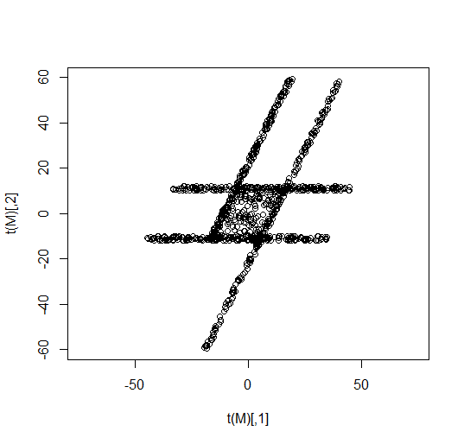
Project HW 6 (Due 3/4) -- 20 points
You are given the following dataset to analyze using TDA Mapper
a.) What do you expect the output of TDA mapper to be if using a PCA type filter. Note your answer need not be correct -- your focus should be on the explanation.
b.) Use python mapper to explore this data set using a variety of filters.
c.) Analyze the results.
See flaresTransformed.r
in LABS/ directory

Slide 14
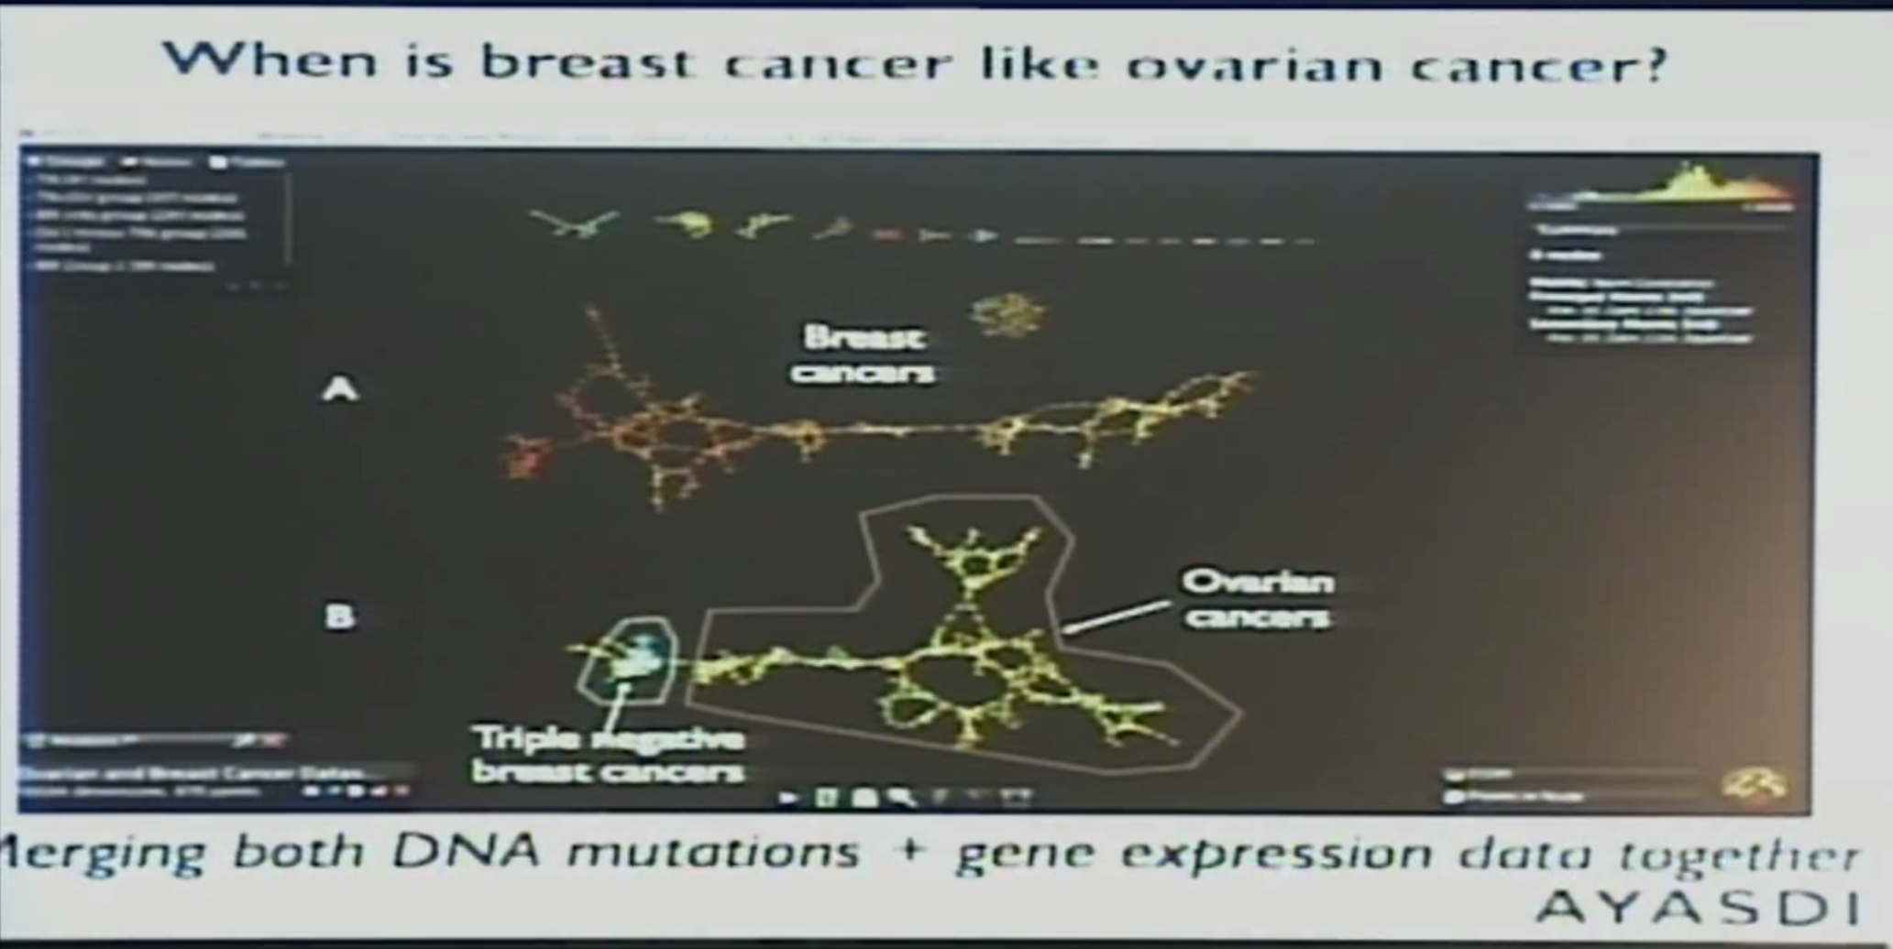
Combining categorical DNA mutation categorical information with numerical gene expression data

Slide 15
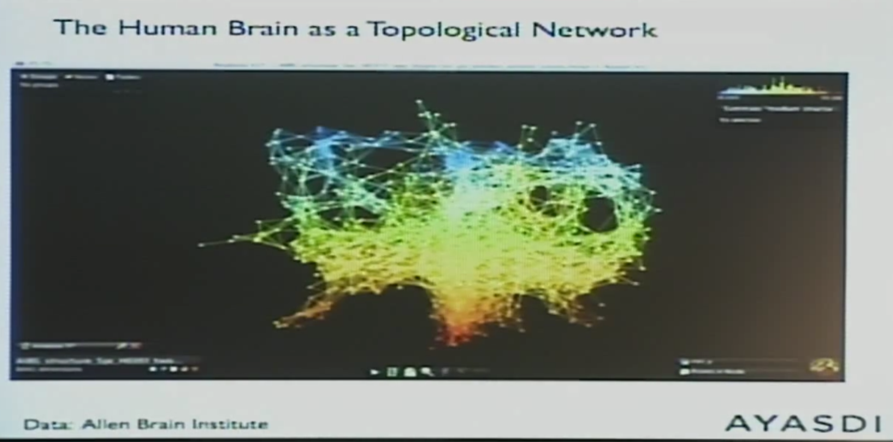
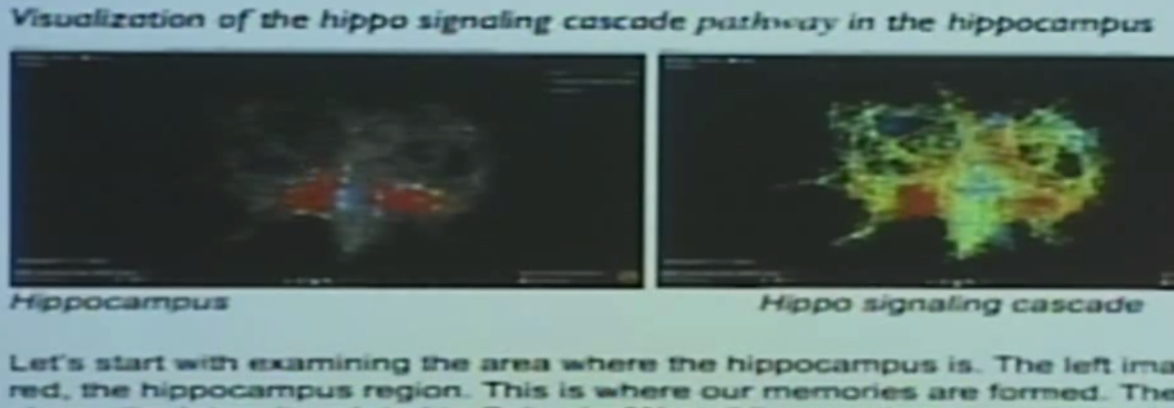

Slide 16
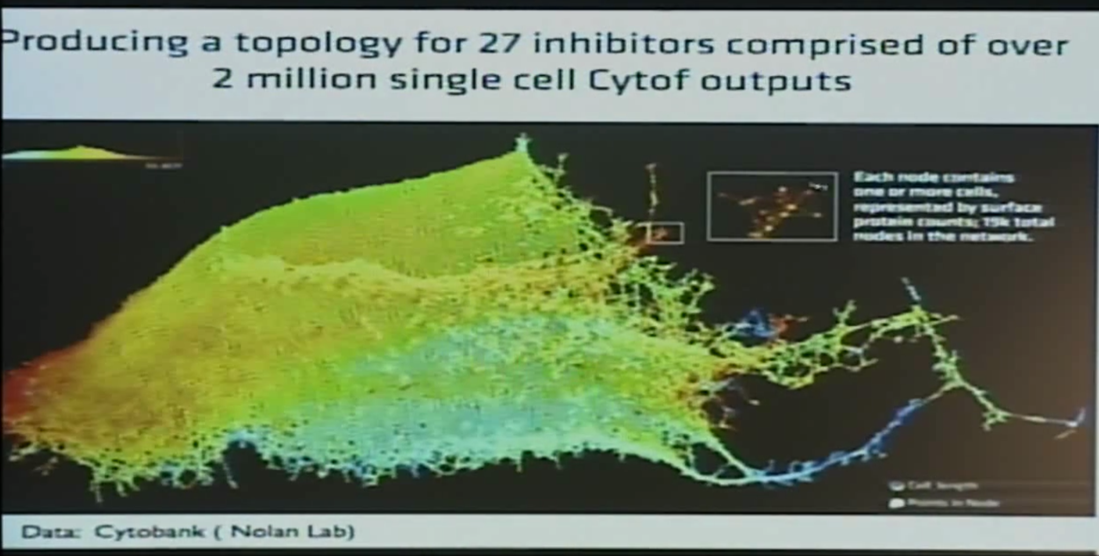

Slide 17
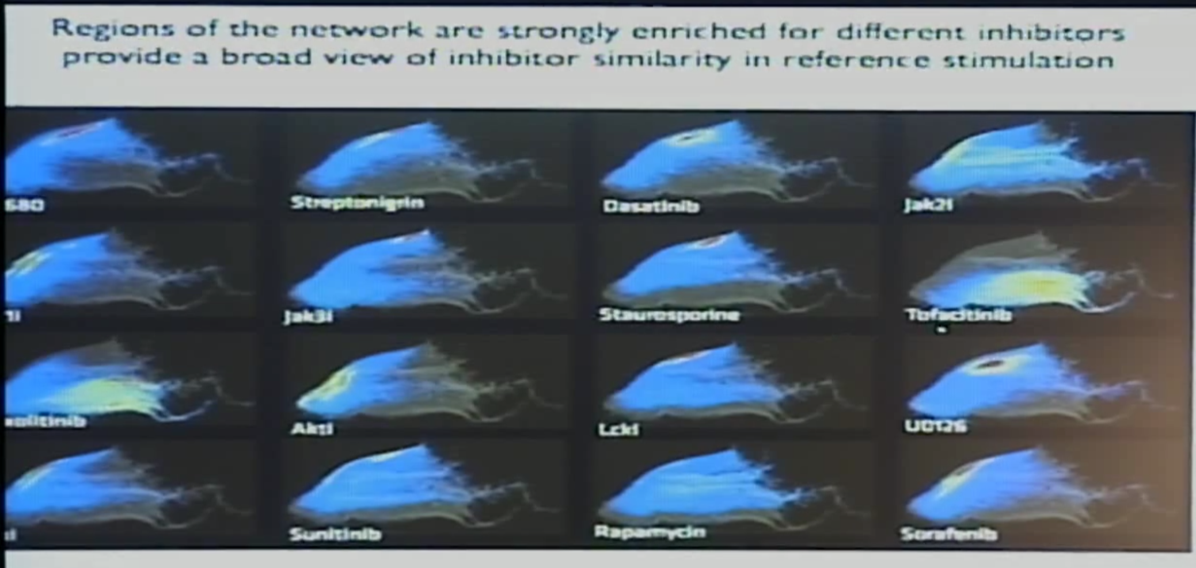

Slide 18
