Slide 1
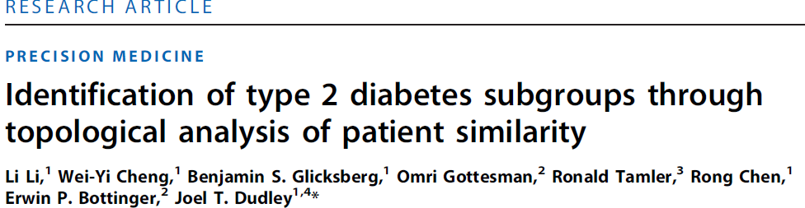
To access a restricted article from off-campus, add the following to the URL:
.proxy.lib.uiowa.edu
For example, change http://stm.sciencemag.org/content/7/311/311ra174.full
to
http://stm.sciencemag.org.proxy.lib.uiowa.edu/content/7/311/311ra174.full

Slide 2
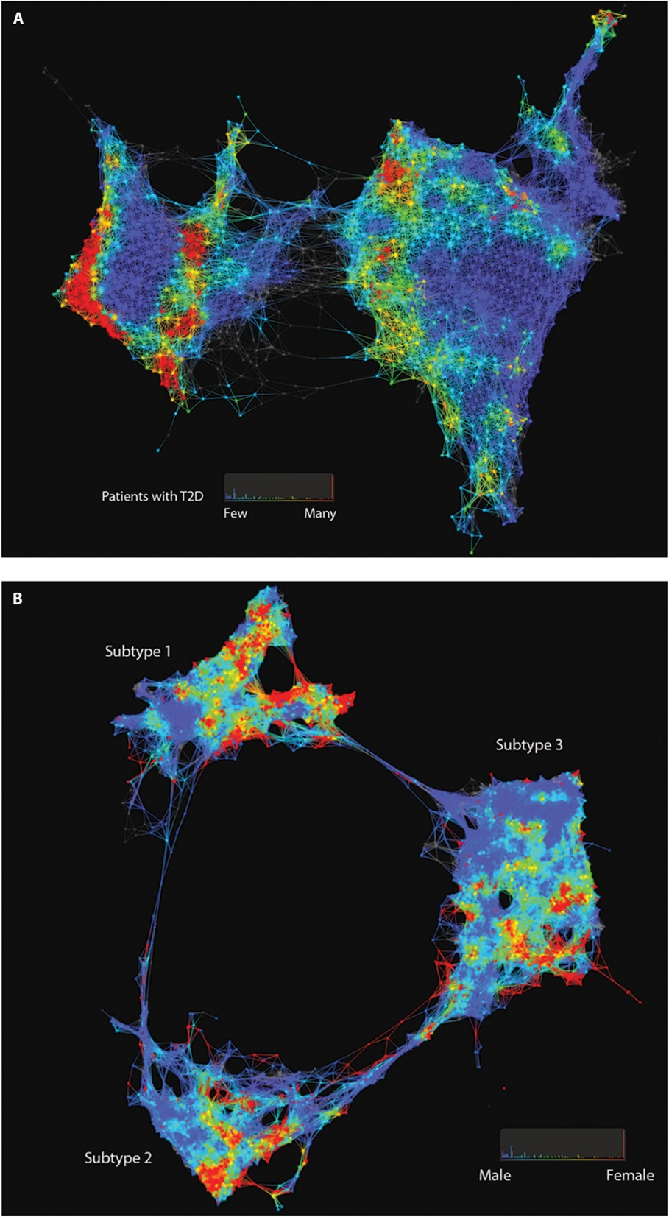

Slide 3
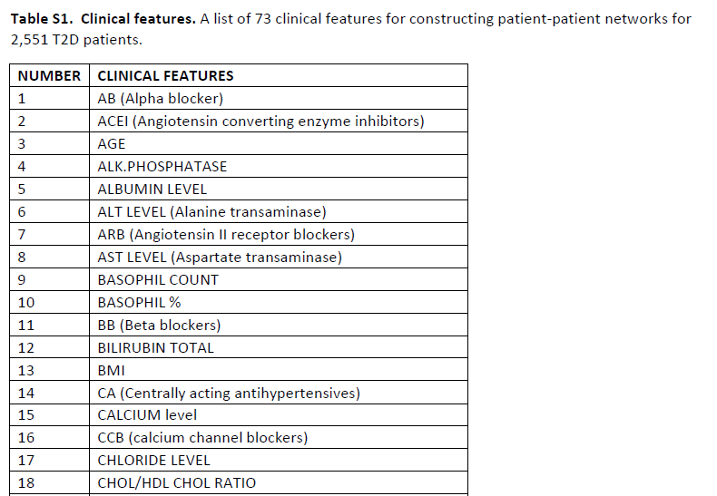
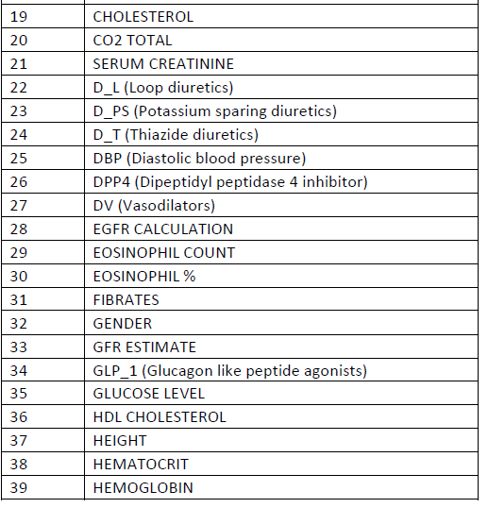

Slide 4
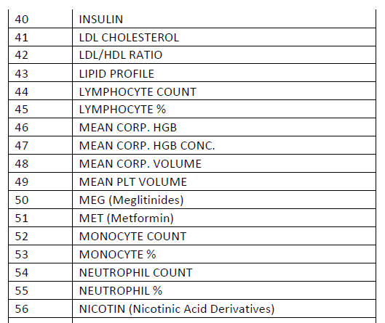
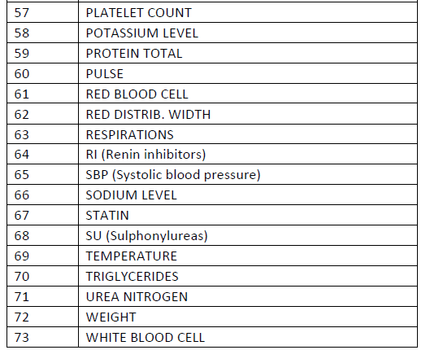

Slide 5
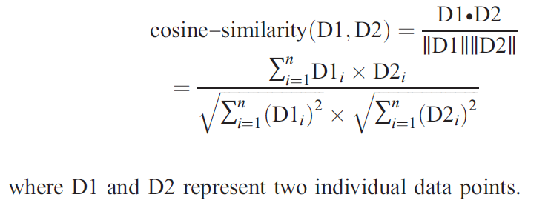
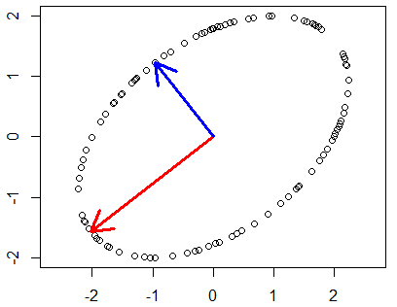
Distance between data points:
Filter functions:
L-infinity centrality:
f(x) = max{d(x, p) : p in data set}
captures the structure of the points far removed from the center or norm.
and
principal metric singular value
decomposition (SVD1)

Slide 7


Fig. 1. Patient and genotype networks.
Patient-patient network for topology patterns on 11,210 Biobank patients. Each node represents a single or a group of patients with the significant similarity based on their clinical features. Edge connected with nodes indicates the nodes have shared patients. Red color represents the enrichment for patients with T2D diagnosis, and blue color represents the nonenrichment for patients with T2D diagnosis.
(B) Patient-patient network for topology patterns on 2551 T2D patients. Each node represents a single or a group of patients with the significant similarity based on their clinical
features. Edge connected with nodes indicates the nodes have shared patients. Red color represents the enrichment for patients with females, and blue color represents the enrichment for males.
Li Li et al., Sci Transl Med 2015;7:311ra174
Published by AAAS
Notes:
Patient and genotype networks. (A) Patient-patient network for topology patterns on 11,210 Biobank patients. Each node represents a single or a group of patients with the significant similarity based on their clinical features. Edge connected with nodes indicates the nodes have shared patients. Red color represents the enrichment for patients with T2D diagnosis, and blue color represents the nonenrichment for patients with T2D diagnosis. (B) Patient-patient network for topology patterns on 2551 T2D patients. Each node represents a single or a group of patients with the significant similarity based on their clinical features. Edge connected with nodes indicates the nodes have shared patients. Red color represents the enrichment for patients with females, and blue color represents the enrichment for males.

Slide 8
Distance between data points:
Filter functions:
L-infinity centrality:
f(x) = max{d(x, p) : p in data set}
captures the structure of the points far removed from the center or norm.
and
principal metric singular value
decomposition (SVD1)

Slide 9
Distances in Graphs
http://adiwijaya.staff.telkomuniversity.ac.id/wp-content/uploads/sites/56/2014/02/Terminology-of-graph-2015.pptx
u
The maximum distance from a vertex u to any other vertex in the graph
is called the
eccentricity of u e(u).
The largest eccentricity is called the diameter, the smallest eccentricity is called the radius.
d
e
a
b
c
f
v
e(u) = 4
e(b) = 3
e(e) = 4
e(a) = 4
Note: If the graph is disconnected, the radius and diameter
are infinity

Slide 10
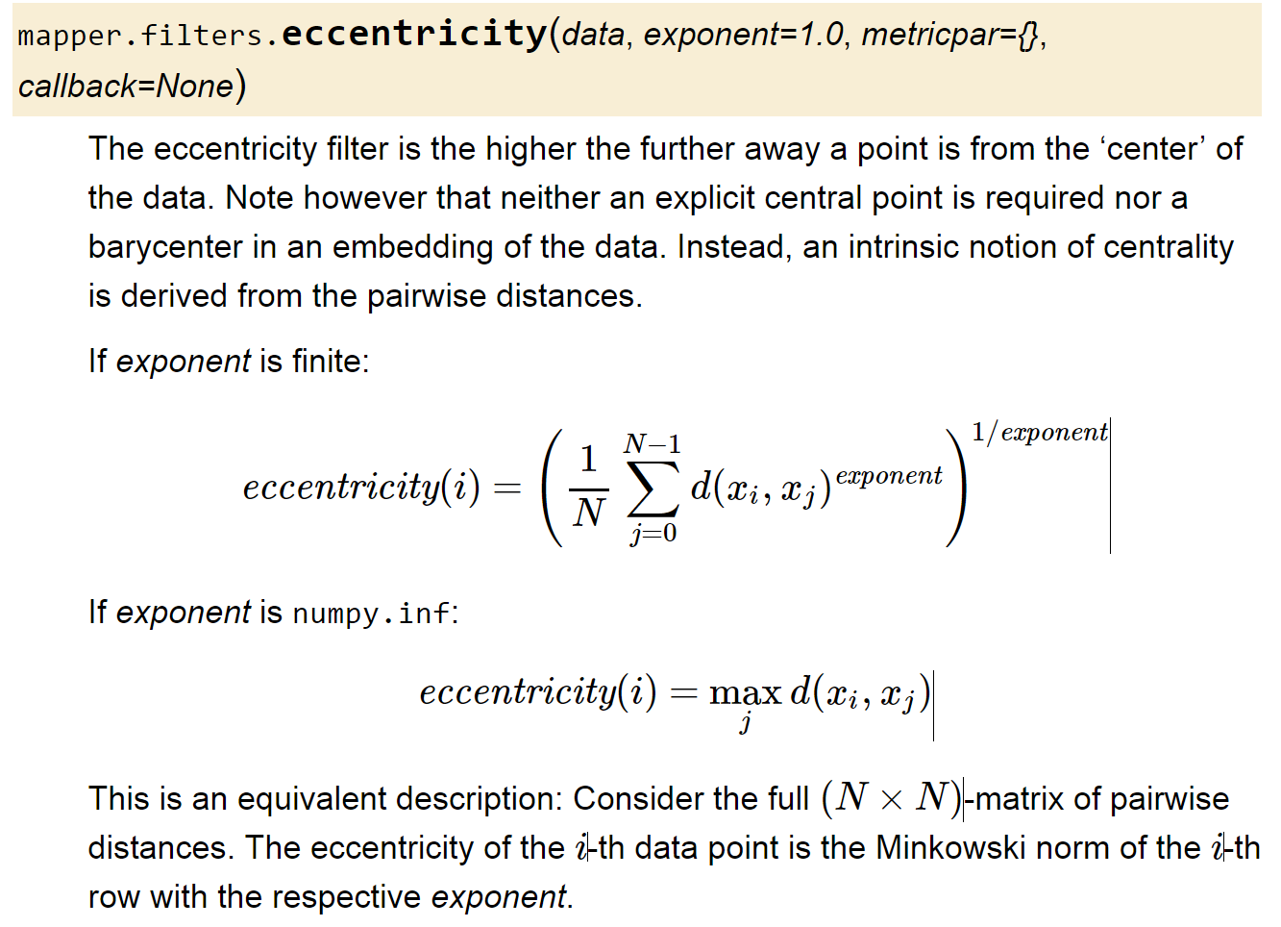

Slide 11
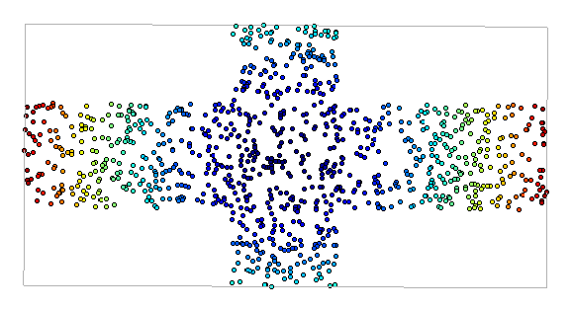

Metric: Euclidian
Filter Function: Eccentricity with exponent = 1
Cover: Uniform 1-d cover
Clustering: Single
Maria Gommel

Slide 12
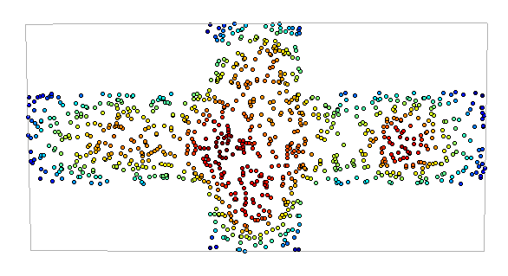
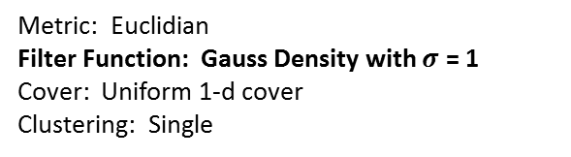
Metric: Euclidian
Filter Function: Gauss Density with $σ$ = 1
Cover: Uniform 1-d cover
Clustering: Single
Maria Gommel

Slide 13


Slide 14


Slide 15
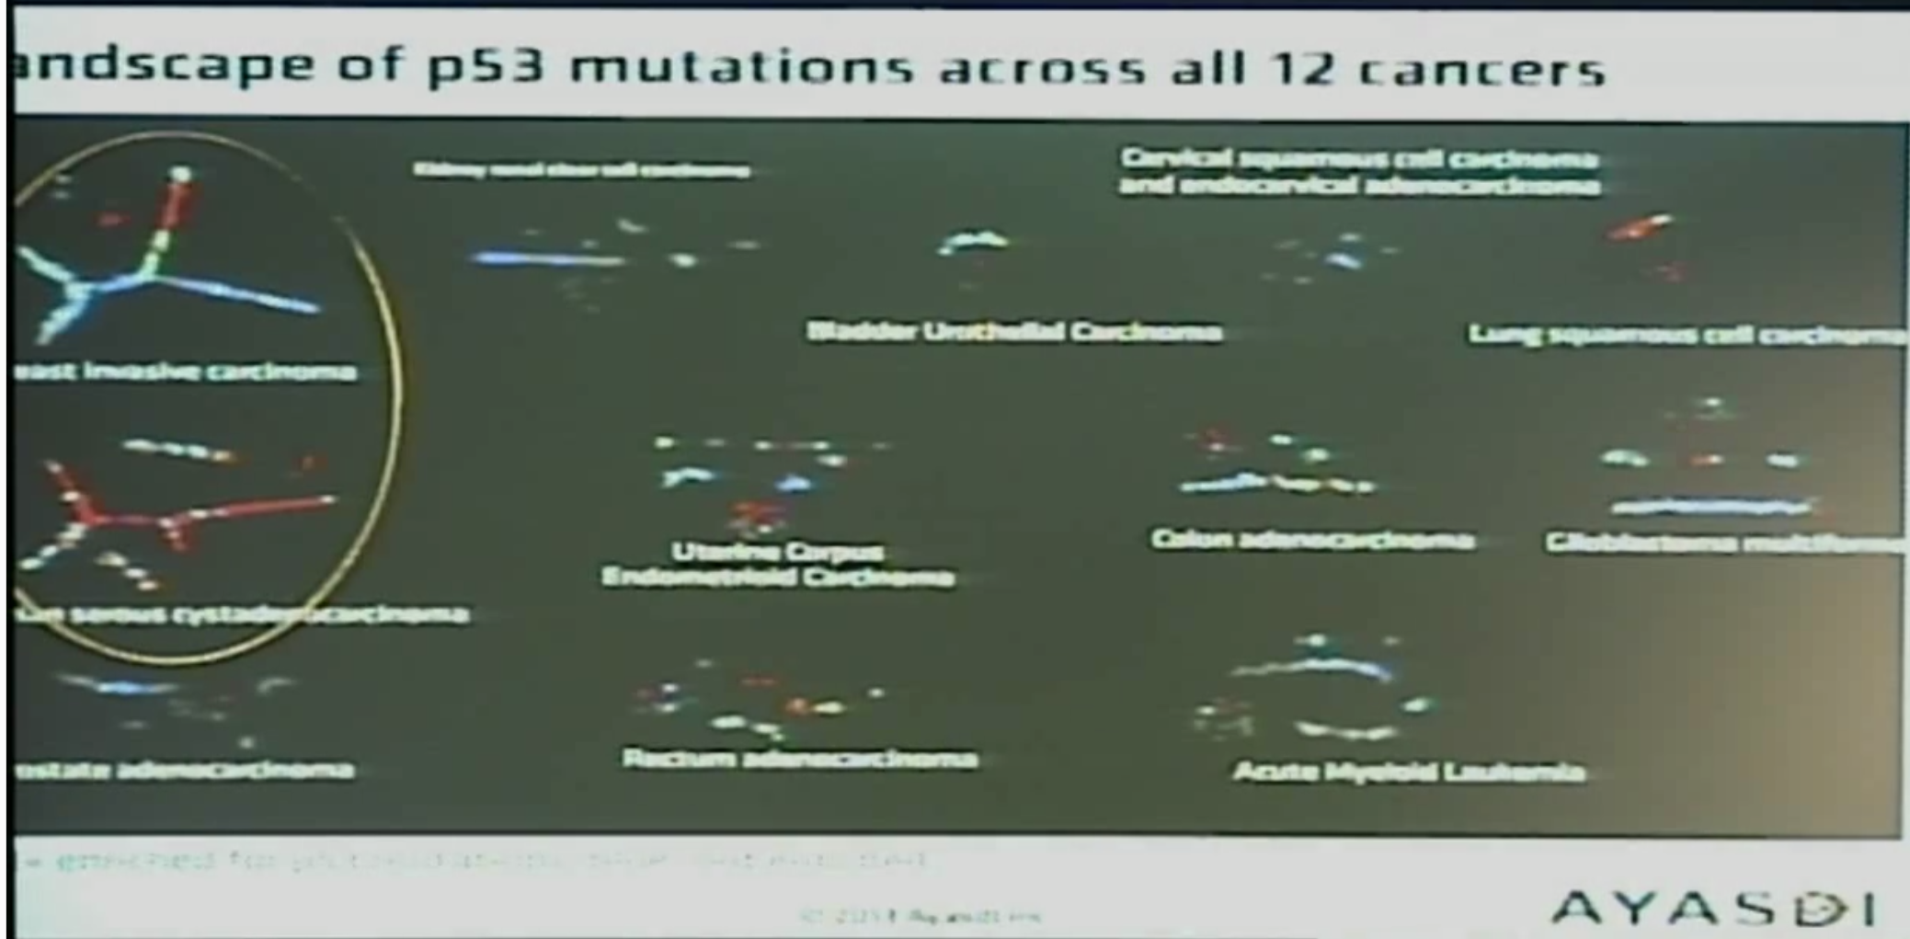

Slide 16
