Slide 1
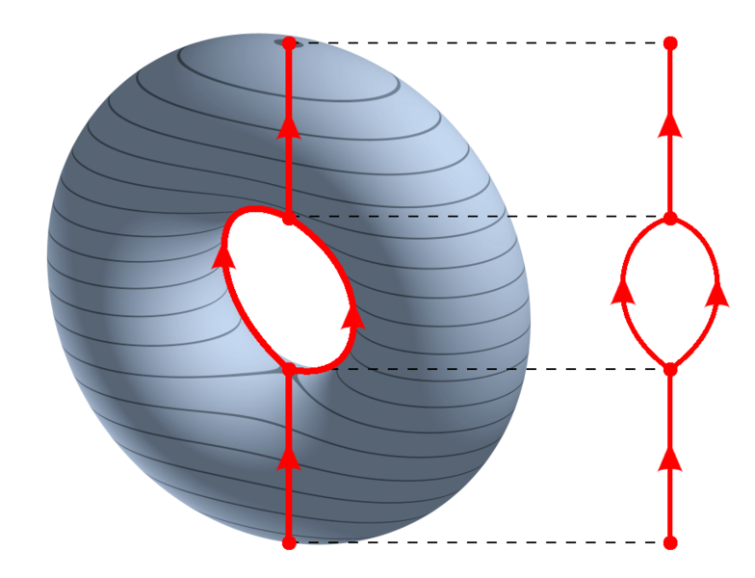
https://en.wikipedia.org/wiki/Reeb_graph

Slide 2
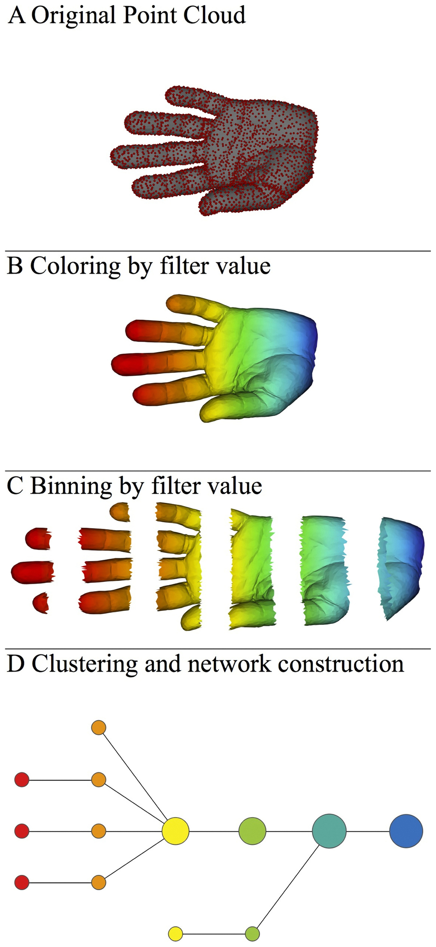
https://en.wikipedia.org/wiki/Reeb_graph
http://www.nature.com/srep/2013/130207/srep01236/full/srep01236.html

Slide 3
mapper.filters.kNN_distance(data, k, metricpar={}, callback=None)
The distance to the k-th nearest neighbor as an (inverse) measure of density.
Note how the number of nearest neighbors is understood:
k=1, the first neighbor, makes no sense for a filter function since the first nearest neighbor of a data point is always the point itself, and hence this filter function is constantly zero.
The parameter k=2 measures the distance from x_{i} to the nearest data point other than x_{i} itself.

Slide 4
mapper.filters.kNN_distance(data, k, metricpar={}, callback=None)
The distance to the k-th nearest neighbor as an (inverse) measure of density.
Note how the number of nearest neighbors is understood:
k=1, the first neighbor, makes no sense for a filter function since the first nearest neighbor of a data point is always the point itself, and hence this filter function is constantly zero.
The parameter k=2 measures the distance from x_{i} to the nearest data point other than x_{i} itself.
δ₁(x) =
δ₂(x) =
δ₃(x) =
δ₄(x) =
z
5 4
x y
3

Slide 5
x
y
If x is in a denser region than y, then δ_{k}(x) δ_{k}(y)

Slide 6
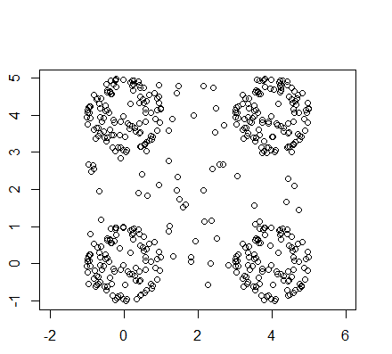
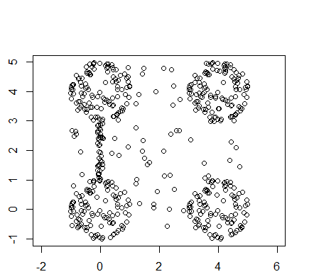
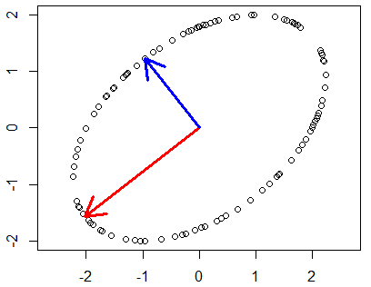
Image of a circle under linear transformation T(x) = Ax where A is a symmetric matrix

Slide 7
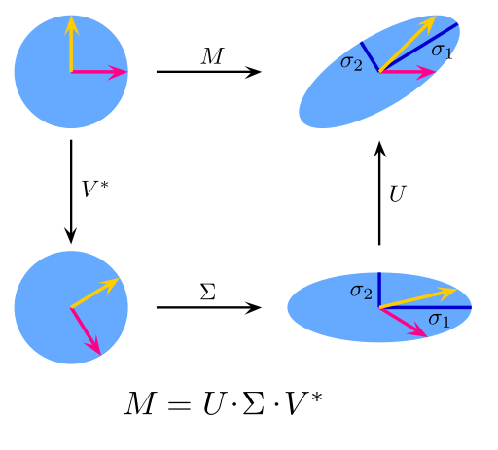
https://en.wikipedia.org/wiki/File:Singular-Value-Decomposition.svg
The SVD decomposes M into three simple transformations:
a rotation V*,
a scaling Σ along the coordinate axes and
a second rotation U.

Slide 8
mapper.filters.dm_eigenvector(data, k=0, mean_center=True, metricpar={}, verbose=True, callback=None)
Return the k-th eigenvector of the distance matrix.
The matrix of pairwise distances is symmetric, so it has an orthonormal basis of eigenvectors.
The parameter k can be either an integer or an array of integers (for multi-dimensional filter functions).
The index is zero-based, and eigenvalues are sorted by absolute value, so k=0 returns the eigenvector corresponding to the largest eigenvalue in magnitude.
If mean_center is True, the distance matrix is double-mean-centered before the eigenvalue decomposition.
Reference: [R6], subsection “Principal metric SVD filters”.

