Slide 1
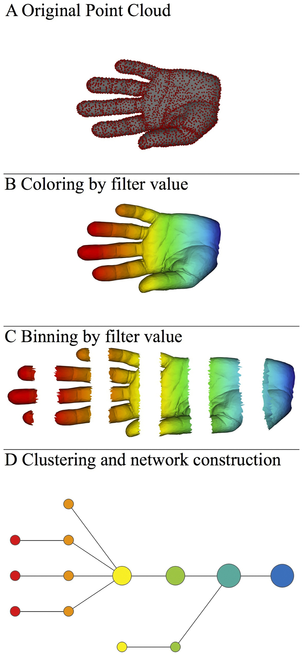
Three key ideas of topology that make extracting of patterns via shape possible.
1.) coordinate free.
No dependence on the coordinate system chosen.
Can compare data derived from different platforms
2.) invariant under “small” deformations.
less sensitive to noise
3.) compressed representations of shapes.
Input: dataset with thousands of points
Output: network with 13 vertices and 12 edges.
http://www.nature.com/srep/2013/130207/srep01236/full/srep01236.html

Slide 2
Application 1: breast cancer gene expression
Data: microarray gene expression data from 2 data sets, NKI and GSE2034
Distance: correlation distance
Filters: (1) L-infinity centrality:
f(x) = max{d(x, p) : p in data set}
captures the structure of the points far removed from the center or norm.
(2) NKI: survival vs. death
GSE2034: no relapse vs. relapse
Clustering: Single linkage.

Slide 3
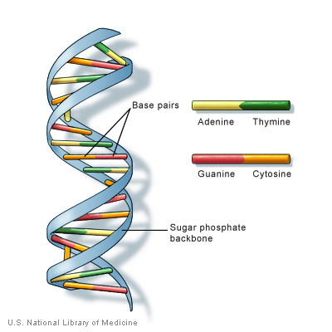
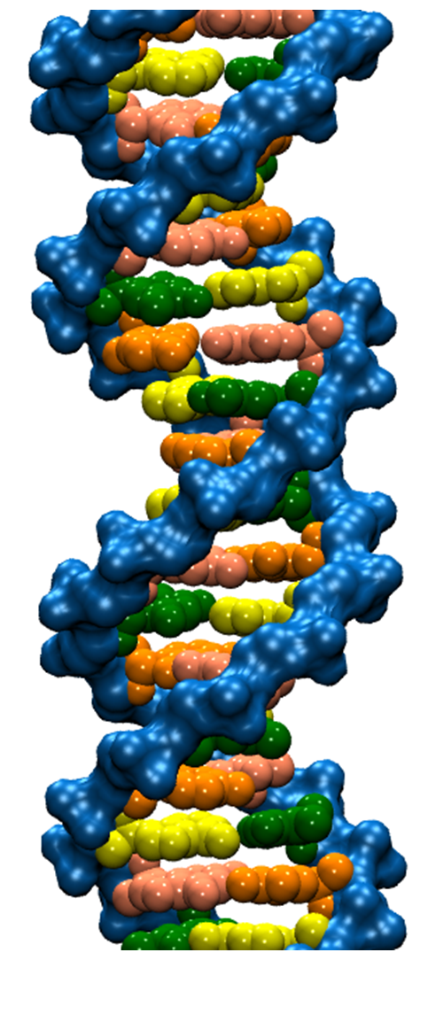
But first some fun biology

Slide 4
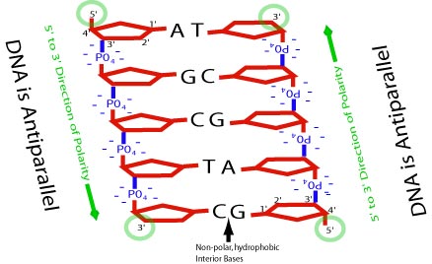
Fun fact

Slide 5
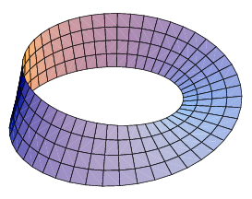
Antiparallel implied no Mobius bands

Slide 6
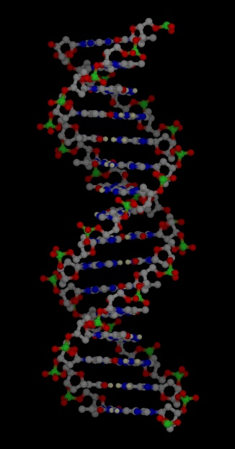
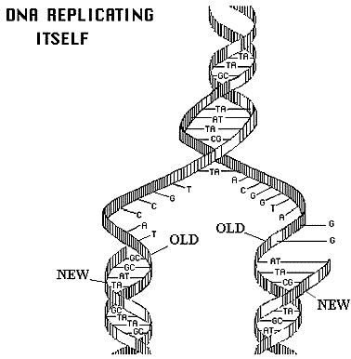
http://www.accessexcellence.org/RC/VL/GG/images/dna_replicating.gif
http://www.ch.cam.ac.uk/magnus/molecules/nucleic/dna1.jpg

Slide 7
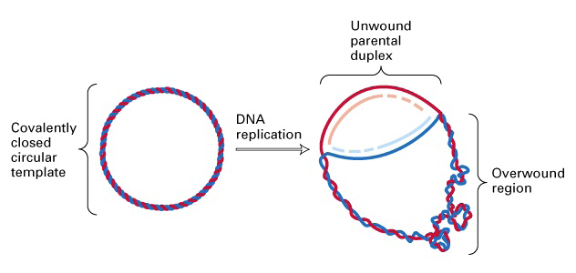
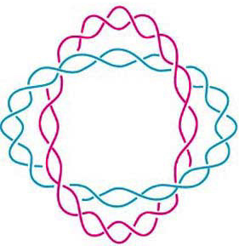
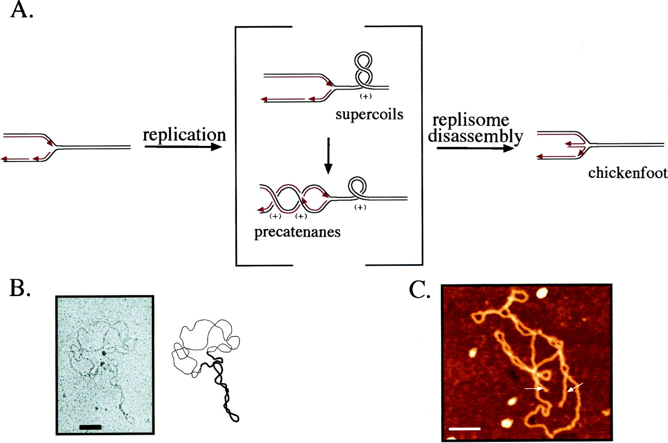
(J. Mann) http://www.sbs.utexas.edu/herrin/bio344/
Postow L. et.al. PNAS;2001;98:8219-8226

Slide 8
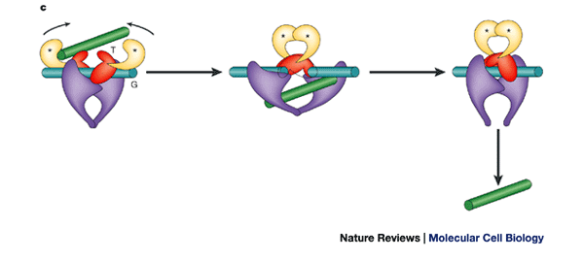
Topoisomerase II performing a crossing change on DNA:
Cellular roles of DNA topoisomerases: a molecular perspective, James C. Wang, Nature Reviews Molecular Cell Biology 3, 430-440 (June 2002)

Slide 9
Topoisomerases are involved in
  Replication
  Transcription
  Unknotting, unlinking, supercoiling.
  Targets of many anti-cancer drugs.

Slide 10
Topoisomerases are proteins which cut one segment of DNA allowing a second DNA segment to pass through before resealing the break.

Slide 11
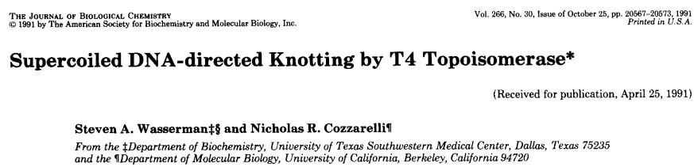
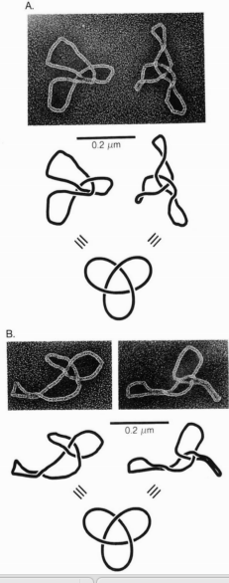
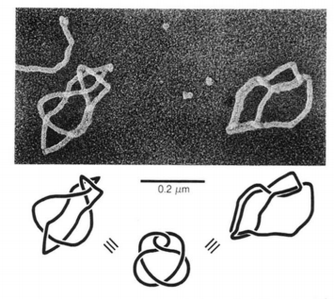
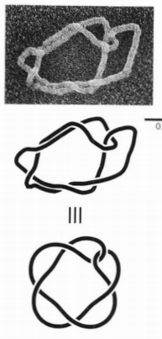
Notes:
Type 2 topo acting on supercoiled DNA. note how the action of topo traps DNA supercoils. Normally topo unknots instead of creating knots, but at high concentrations topo can create knots.

Slide 12
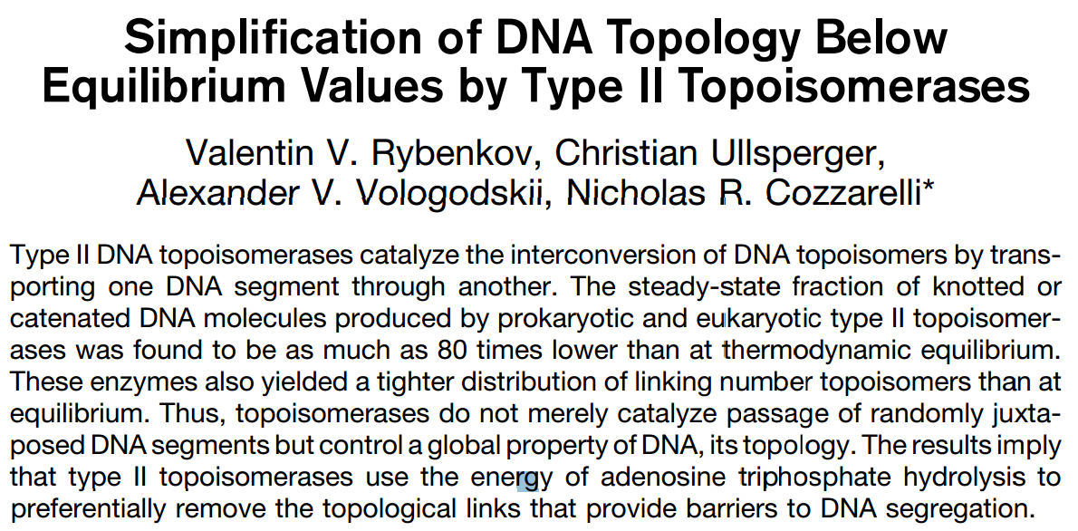
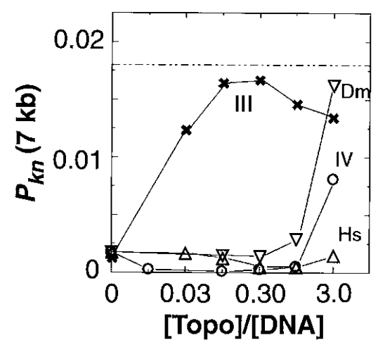
http://www.sciencemag.org/content/277/5326/690.full.pdf, Science. 1997;277(5326):690-3.
Notes:
The action of 4 different topos are shown acting on nicked DNA. Note that 3 of them (human
Experimentally, Type-II topoisomerases (with ATP hydrolysis) lower knotted and catenated DNA populations to steady-state levels well below that at topological equilibrium.
7-kb pAB4 DNA: knots: 90 times lower
catenanes: 16 times lower
10-kb P4 DNA: knots: 50 times lower

Slide 13
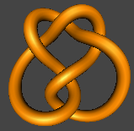
What products would you predict if topoisomerase acted exactly once on the following 5 crossing knot?

Slide 14


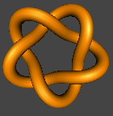
.
.
.

Slide 15
Lynn Zechiedrich and
Jennifer Mann,
unpublished result.
.
.
.

Slide 16
Notes:
control needed for publication

Slide 17
How can topoisomerase acting locally determine best action for global result, unknotting the DNA??

Slide 18
But first some fun biology

Slide 19
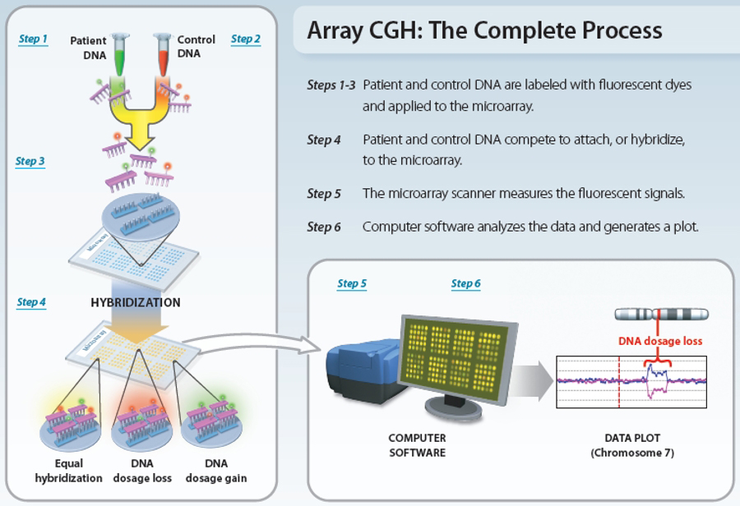
www.nature.com/scitable/topicpage/microarray-based-comparative-genomic-hybridization-acgh-45432

Slide 20
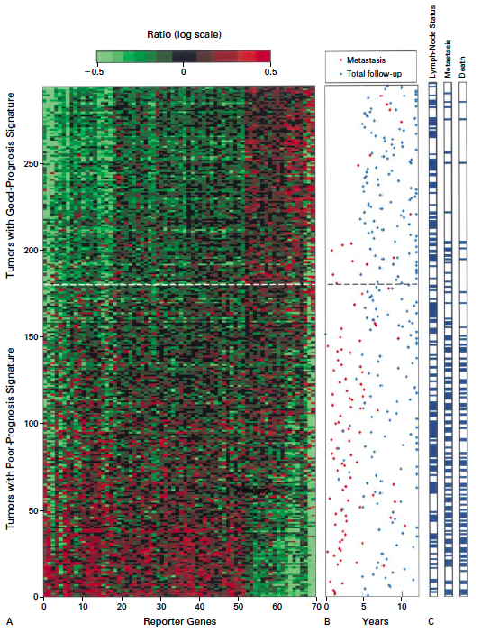
Gene expression profiling predicts clinical outcome of breast cancer
van 't Veer LJ, Dai H, van de Vijver MJ, He YD, Hart AA, Mao M, Peterse HL, van der Kooy K, Marton MJ, Witteveen AT, Schreiber GJ, Kerkhoven RM, Roberts C, Linsley PS, Bernards R, Friend SH
Nature. 2002 Jan 31;415(6871):530-6.

Slide 21
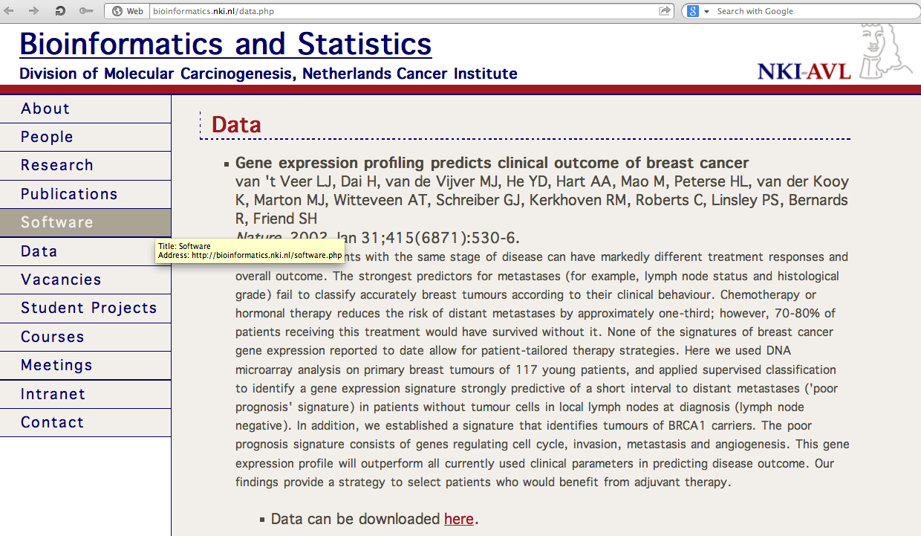
http://bioinformatics.nki.nl/data.php

Slide 22
2 breast cancer data sets:
1.) NKI (2002):
gene expression levels of 24,000 from 272 tumors. Includes node-negative and node-positive patients, who had or had not received adjuvant systemic therapy. Also includes survival information.
2.) GSE203414 (2005)
expression of 22,000 transcripts from total RNA of frozen tumour samples from 286 lymph-node-negative patients who had not received adjuvant systemic treatment. Also includes time to relapse information.

Slide 23
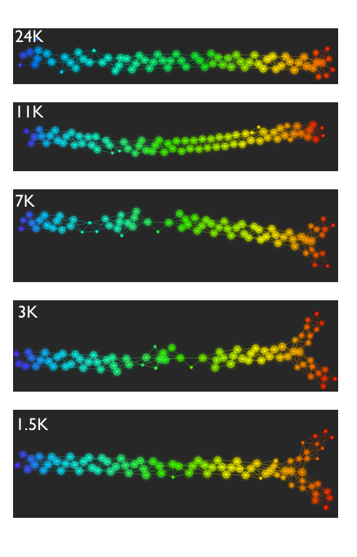
Fig. S1. Shape of the data becomes more distinct as the analysis columns are restricted to the top
varying genes.
24K: all the genes on the microarray were used in the analysis;
11K: 10,731 top most varying genes were used in the analysis;
7K: 6.688 top most varying genes were used in the analysis;
3K: 3212 top most varying genes were used in the analysis;
1.5K: 1553 top most varying genes were used in the analysis.
Graphs colored by the L-infinity centrality values. Red: high; Blue: low
http://www.nature.com/srep/2013/130207/srep01236/full/srep01236.html

Slide 24
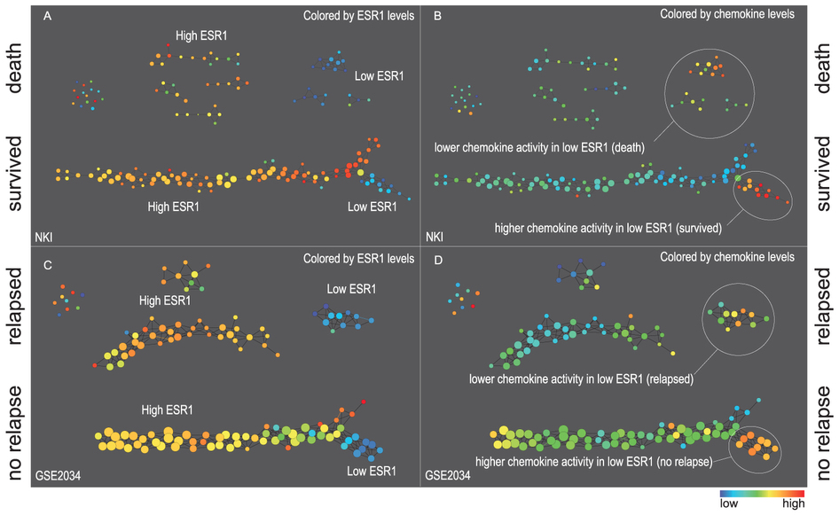
Two filter functions, L-Infinity centrality and survival or relapse were used to generate the networks. The top half of panels A and B are the networks of patients who didn't survive, the bottom half are the patients who survived. Panels C and D are similar to panels A and B except that one of the filters is relapse instead of survival. Panels A and C are colored by the average expression of the ESR1 gene. Panels B and D are colored by the average expression of the genes in the KEGG chemokine pathway. Metric: Correlation; Lens: L-Infinity Centrality (Resolution 70, Gain 3.0x, Equalized) and Event Death (Resolution 30, Gain 3.0x). Color bar: red: high values, blue: low values.
http://www.nature.com/srep/2013/130207/srep01236/full/srep01236.html

Slide 25
Comparison of our results with those of Van de Vijver and colleagues is difficult because of differences in patients, techniques, and materials used.
Their study included node-negative and node-positive patients, who had or had not received adjuvant systemic therapy, and only women younger than 53 years.
microarray platforms used in the studies differ—Affymetrix and Agilent.
Of the 70 genes in the study by van't Veer and co-workers, 48 are present on the Affymetrix U133a array, whereas only 38 of our 76 genes are present on the Agilent array. There is a three-gene overlap between the two signatures (cyclin E2, origin recognition complex, and TNF superfamily protein).
Despite the apparent difference, both signatures included genes that identified several common pathways that might be involved in tumour recurrence. This finding supports the idea that although there might be redundancy in gene members, effective signatures could be required to include representation of specific pathways.
From: Gene-expression profiles to predict distant metastasis of lymph-node-negative primary breast cancer, Yixin Wang et al, The Lancet, Volume 365, Issue 9460, 19–25 February 2005, Pages 671–679

Slide 26
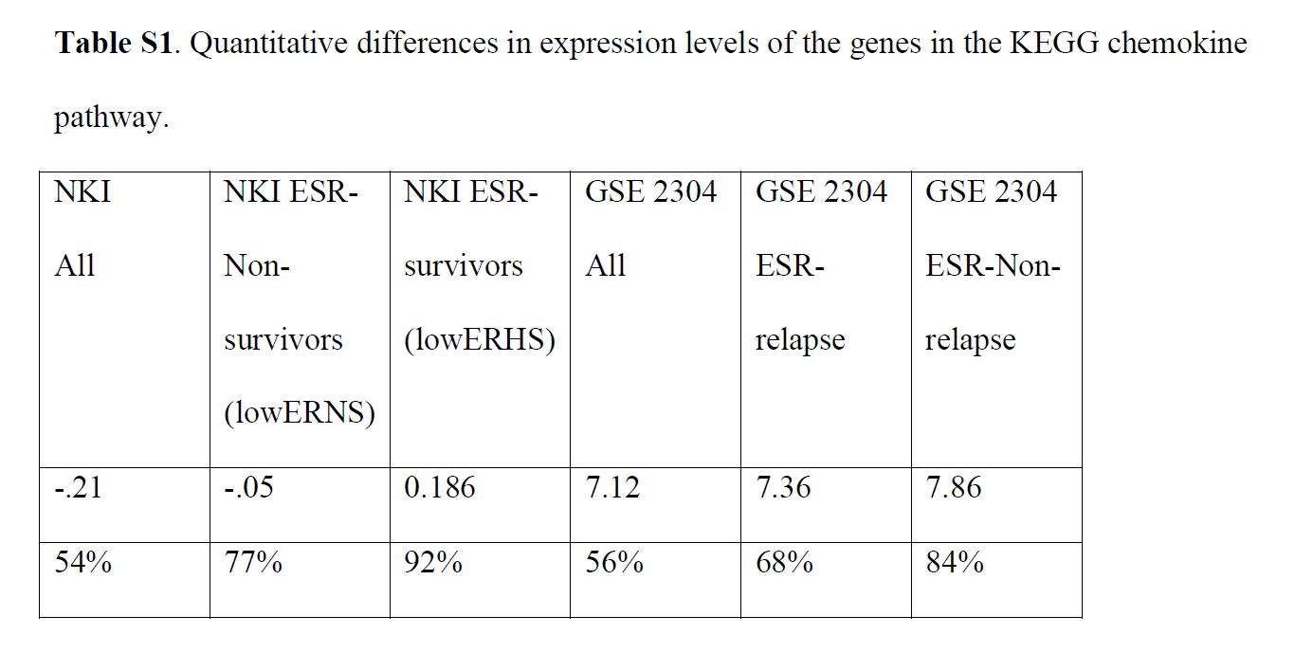
From: http://www.nature.com/srep/2013/130207/srep01236/full/srep01236.html
The numbers in the first row are the average levels of expressions of genes belonging to the chemokine pathway within the relevant groups. The second row gives these same levels reported as percentiles belonging to the collection of the chemokine expression levels across all the patients in the study to which the group belongs. Note that the lowERHS groups display very high chemokine expression levels, 92nd percentile in the case of NKI and 84th percentile in the case of GSE2304. The lowERNS groups are also consistently higher than the general population in the study, although to different degrees in the studies. The difference can perhaps be accounted for by the difference between the survival vs. non-relapse criteria in the two data sets.

Slide 27
www.nature.com/scitable/topicpage/microarray-based-comparative-genomic-hybridization-acgh-45432

Slide 28
Three key ideas of topology that make extracting of patterns via shape possible.
1.) coordinate free.
No dependence on the coordinate system chosen.
Can compare data derived from different platforms
2.) invariant under “small” deformations.
less sensitive to noise
3.) compressed representations of shapes.
Input: dataset with thousands of points
Output: network with 13 vertices and 12 edges.
http://www.nature.com/srep/2013/130207/srep01236/full/srep01236.html

Slide 29
Two filter functions, L-Infinity centrality and survival or relapse were used to generate the networks. The top half of panels A and B are the networks of patients who didn't survive, the bottom half are the patients who survived. Panels C and D are similar to panels A and B except that one of the filters is relapse instead of survival. Panels A and C are colored by the average expression of the ESR1 gene. Panels B and D are colored by the average expression of the genes in the KEGG chemokine pathway. Metric: Correlation; Lens: L-Infinity Centrality (Resolution 70, Gain 3.0x, Equalized) and Event Death (Resolution 30, Gain 3.0x). Color bar: red: high values, blue: low values.
http://www.nature.com/srep/2013/130207/srep01236/full/srep01236.html

Slide 30
Identifying subtypes of cancer in a consistent manner is a challenge in the field since sub-populations can be small and their relationships complex
High expression level of the estrogen receptor gene (ESR1) is positively correlated with improved prognosis, given that this set of patients is likely to respond to standard therapies.
But , there are still sub-groups of high ESR1 that do not respond well to therapy.
Low ESR1 levels are strongly correlated with poor prognosis
But there are patients with low ESR1 levels but high survival rates
Many molecular sub-groups have been identified,
But often difficult to identify the same sub-group in a broader setting, where data sets are generated on different platforms, on different sets of patients and at a different times, because of the noise and complexity in the data.
http://www.nature.com/srep/2013/130207/srep01236/full/srep01236.html

Slide 31
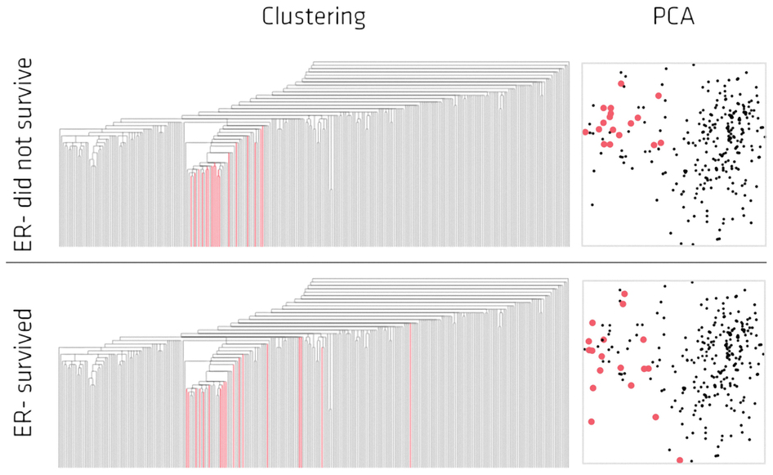
Highlighted in red are the lowERNS (top panel) and the lowERHS (bottom panel) patient sub-groups.
http://www.nature.com/srep/2013/130207/srep01236/full/srep01236.html

Slide 32
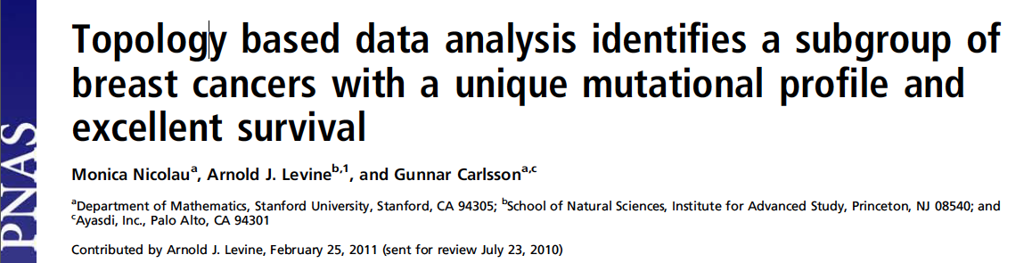
http://www.pnas.org/content/early/2011/04/07/1102826108

Slide 33
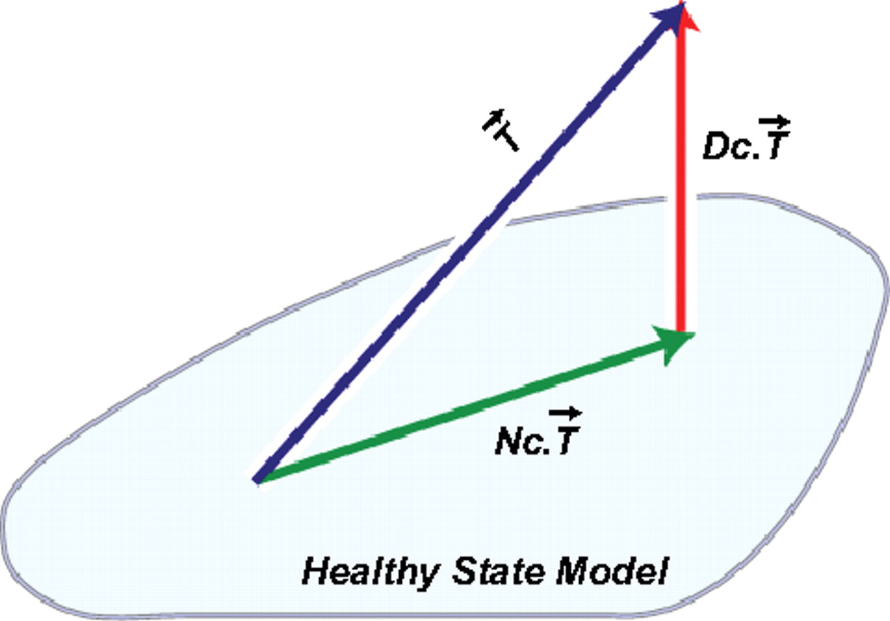
DSGA decomposition of the original tumor vector into the Normal component its linear models fit onto the Healthy State Model and the Disease component vector of residuals.
Nicolau M et al. PNAS 2011;108:7265-7270
©2011 by National Academy of Sciences
Notes:
DSGA decomposition of the original tumor vector into the Normal component its linear models fit onto the Healthy State Model and the Disease component vector of residuals.

Slide 34
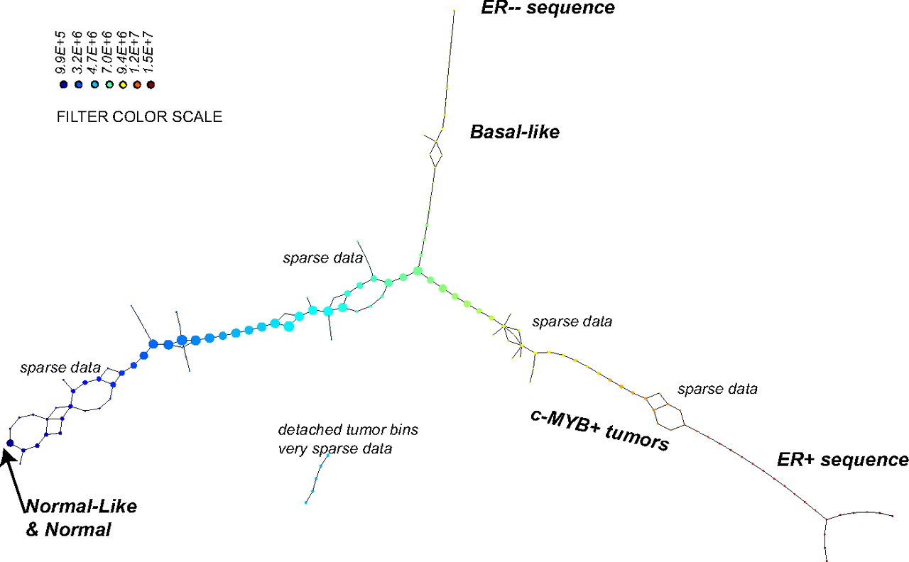
PAD analysis of the NKI data. The output has three progression arms, because tumors (data points) are ordered by the magnitude of deviation from normal (the HSM). Each bin is colored by the mean of the filter map on the points. Blue bins contain tumors whose total deviation from HSM is small (normal and Normal-like tumors). Red bins contain tumors whose deviation from HSM is large. The image of f was subdivided into 15 intervals with 80% overlap. All bins are seen (outliers included). Regions of sparse data show branching. Several bins are disconnected from the main graph. The ER− arm consists mostly of Basal tumors. The c-MYB+ group was chosen within the ER arm as the tightest subset, between the two sparse regions.
PAD analysis of the NKI data.
Nicolau M et al. PNAS 2011;108:7265-7270
©2011 by National Academy of Sciences
Notes:
PAD analysis of the NKI data. The output has three progression arms, because tumors (data points) are ordered by the magnitude of deviation from normal (the HSM). Each bin is colored by the mean of the filter map on the points. Blue bins contain tumors whose total deviation from HSM is small (normal and Normal-like tumors). Red bins contain tumors whose deviation from HSM is large. The image of f was subdivided into 15 intervals with 80% overlap. All bins are seen (outliers included). Regions of sparse data show branching. Several bins are disconnected from the main graph. The ER− arm consists mostly of Basal tumors. The c-MYB+ group was chosen within the ER arm as the tightest subset, between the two sparse regions.

Slide 35
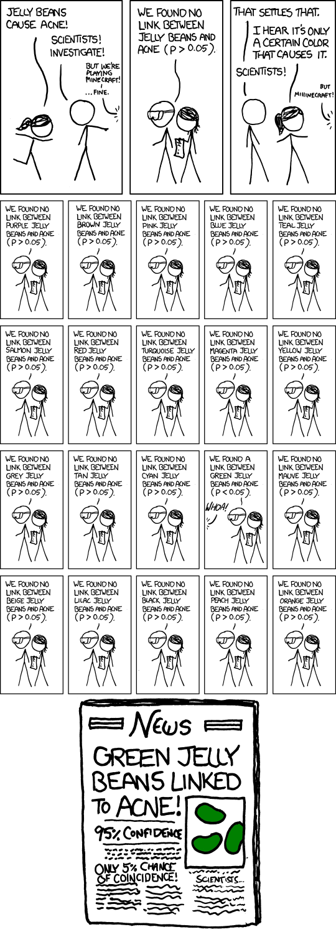
False Positives will occur

Slide 36
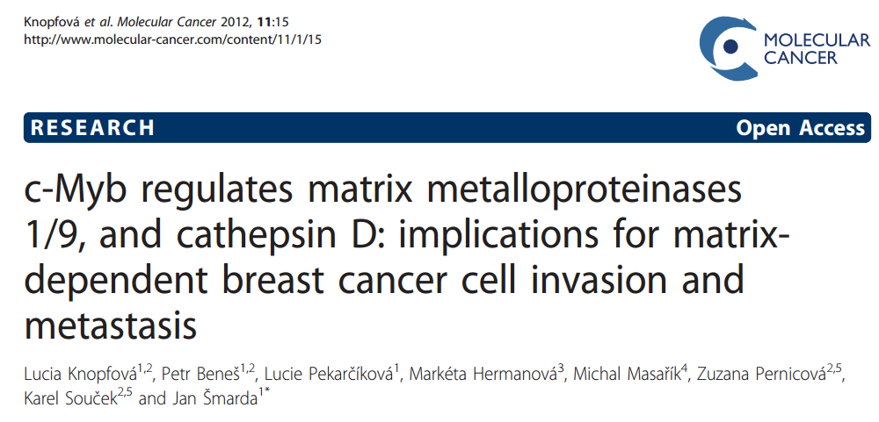
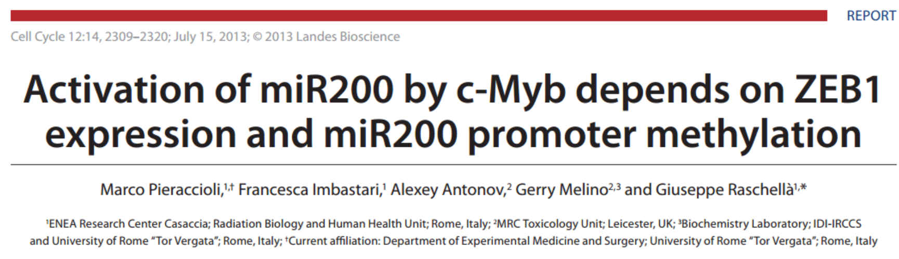

Slide 37
Note: Many, many choices were made
It helps to know what you are doing when you make choices, so collaborating with others is highly recommended.

Slide 38

A) Data Set
Example: Point cloud data
representing a hand.
B) Function f : Data Set → R
Example: x-coordinate
f : (x, y, z) → x
Put data into overlapping bins.
Example: f⁻¹(a_{i}, b_{i})
Cluster each bin & create network.
Vertex = a cluster of a bin.
Edge = nonempty intersection
between clusters
http://www.nature.com/srep/2013/130207/srep01236/full/srep01236.html

Slide 39
Note: Many, many choices were made
“It is useful to think of it as a camera, with lens adjustments and other settings. A different filter function may generate a network with a different shape, thus allowing one to explore the data from a different mathematical perspective.”
http://www.nature.com/srep/2013/130207/srep01236/full/srep01236.html

Slide 40
Note: we made many, many choices
“It is useful to think of it as a camera, with lens adjustments and other settings. A different filter function may generate a network with a different shape, thus allowing one to explore the data from a different mathematical perspective.”
False positives???
http://www.nature.com/srep/2013/130207/srep01236/full/srep01236.html

Slide 41
False Positives will occur
https://xkcd.com/882/

Slide 42
Note: Many, many choices were made
“It is useful to think of it as a camera, with lens adjustments and other settings. A different filter function may generate a network with a different shape, thus allowing one to explore the data from a different mathematical perspective.”
False positives vs. robustness
http://www.nature.com/srep/2013/130207/srep01236/full/srep01236.html

Slide 43
Topological Data Analysis (TDA): Three key ideas of topology that make extracting of patterns via shape possible.
1.) coordinate free.
No dependence on the coordinate system chosen.
Can compare data derived from different platforms
vital when one is studying data collected with different technologies, or from different labs when the methodologies cannot be standardized.
http://www.nature.com/srep/2013/130207/srep01236/full/srep01236.html

Slide 44
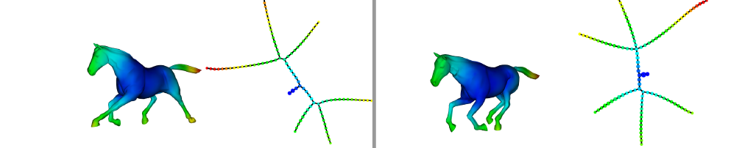
Topological Data Analysis (TDA): Three key ideas of topology that make extracting of patterns via shape possible.
2.) invariant under “small” deformations.
less sensitive to noise
Topological Methods for the Analysis of High Dimensional
Data Sets and 3D Object Recognition, Singh, Mémoli, Carlsson
Figure from http://comptop.stanford.edu/u/preprints/mapperPBG.pdf
http://www.nature.com/srep/2013/130207/srep01236/full/srep01236.html

Slide 45
Topological Data Analysis (TDA): Three key ideas of topology that make extracting of patterns via shape possible.
3.) compressed representations of shapes.
Input: dataset with thousands of points
Output: network with
13 vertices and 12 edges.
http://www.nature.com/srep/2013/130207/srep01236/full/srep01236.html

Slide 46
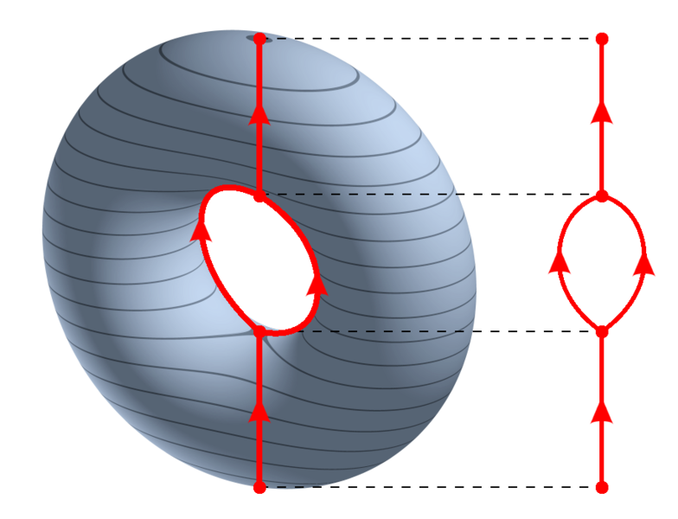
https://en.wikipedia.org/wiki/Reeb_graph

Slide 47
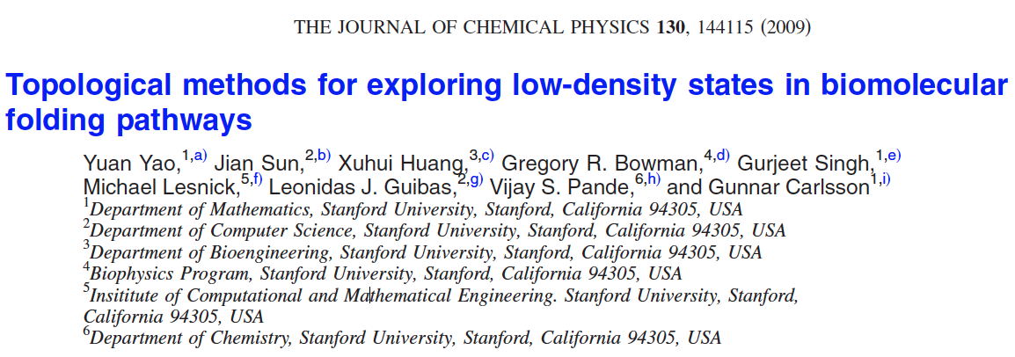
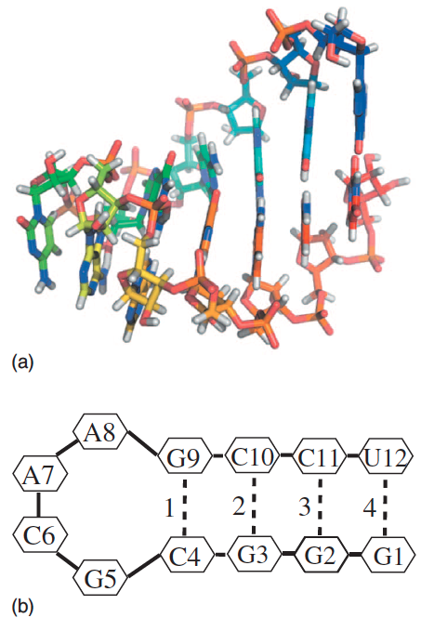
http://scitation.aip.org/content/aip/journal/jcp/130/14/10.1063/1.3103496

Slide 48
Data: Contact maps from 2,800 Serial Replica Exchange Molecular Dynamics (SREMD) simulations of the GCAA tetraloop on the Folding@home distributed computing platform.
760 trajectories with a complete unfolding event
550 trajectories with a complete refolding event.
Goal: To determine secondary structure pathways between folded and unfolded state

Slide 49
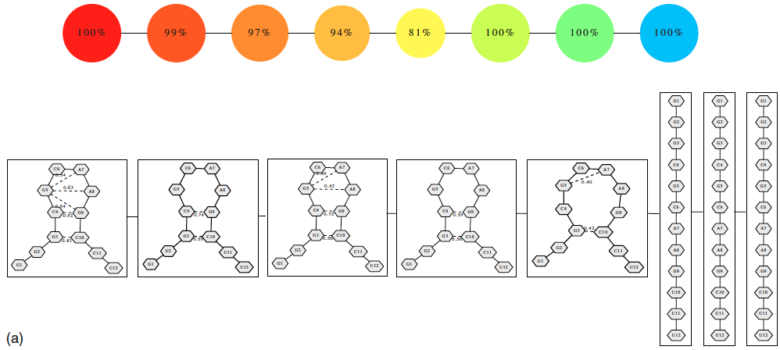
Problem: Many more folded and unfolded conformations than intermediate conformations
How to distinguish intermediate conformations from noise?
Solution
Choose f: space of conformations → R
f(conformation) = density

Slide 50
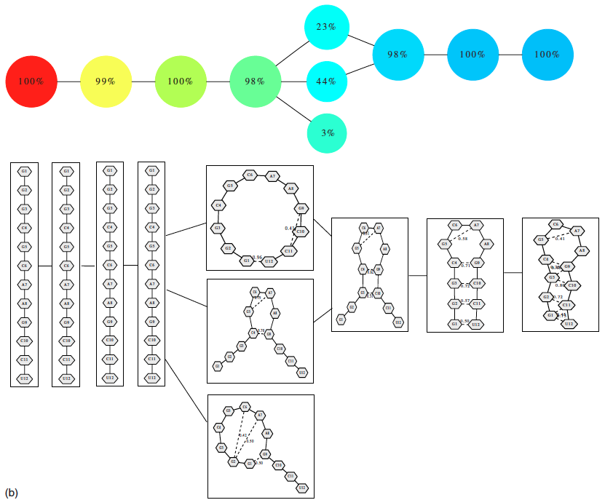
550 trajectories with a complete refolding event
2952 configurations

Slide 51

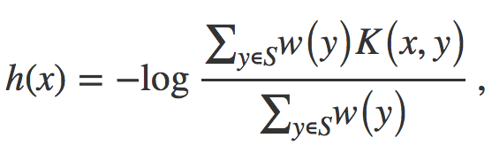


Distance = Hamming distance

Slide 52
550 trajectories with a complete refolding event
2952 configurations

Slide 53
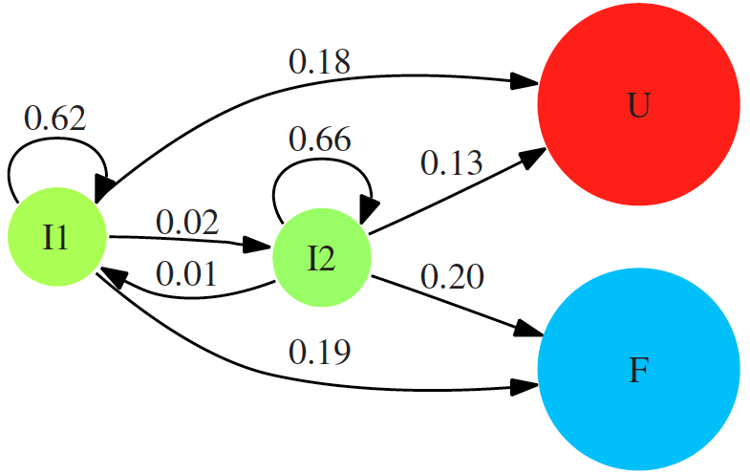

Slide 54
760 trajectories with a complete unfolding event
4330 configurations

