Slide 1
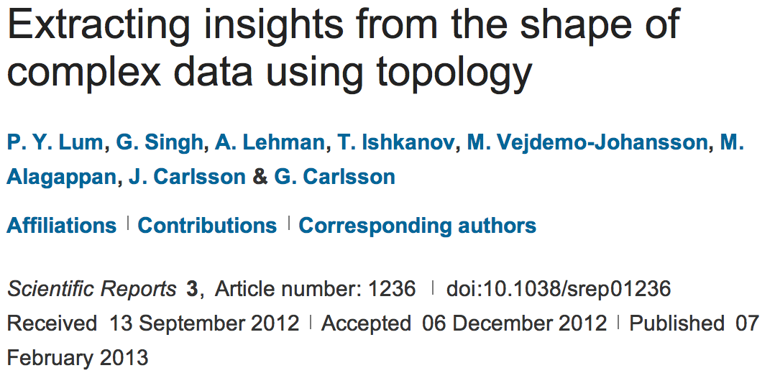
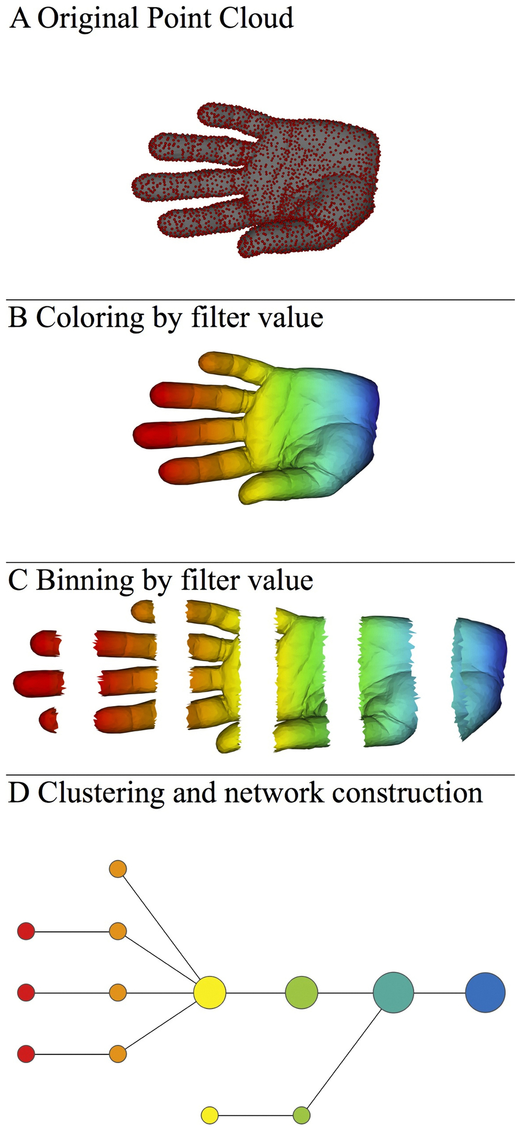
http://www.nature.com/srep/2013/130207/srep01236/full/srep01236.html

Slide 2

A) Data Set
Example: Point cloud data
representing a hand.
B) Function f : Data Set → R
Example: x-coordinate
f : (x, y, z) → x
Put data into overlapping bins.
Example: f⁻¹(a_{i}, b_{i})
Cluster each bin & create network.
Vertex = a cluster of a bin.
Edge = nonempty intersection
between clusters
http://www.nature.com/srep/2013/130207/srep01236/full/srep01236.html

Slide 3
Chose filter
Only need to cover the data points.
http://www.nature.com/srep/2013/130207/srep01236/full/srep01236.html

Slide 4
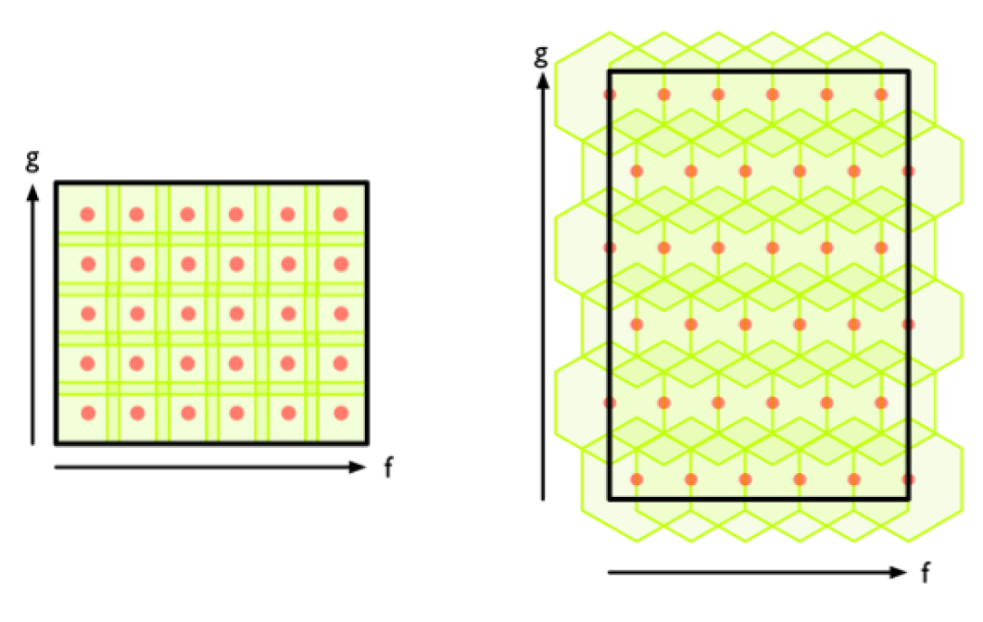
Chose filter
http://www.nature.com/srep/2013/130207/srep01236/full/srep01236.html

Slide 5
Chose filter
http://www.nature.com/srep/2013/130207/srep01236/full/srep01236.html

Slide 6
Application 3 (in paper): Basketball
Data: rates (per minute played) of rebounds, assists, turnovers, steals, blocked shots, personal fouls, and points scored for 452 players.
➔ Input: 452 points in R⁷
For each player, we have a vector
= (r, a, t, s, b, f, p) in R⁷
Distance: variance normalized Euclidean distance.
Clustering: Single linkage.
( min , min , min , min , min , min , min )
rebounds assists turnovers steals blocked shots personal fouls points scored
http://www.nature.com/srep/2013/130207/srep01236/full/srep01236.html

Slide 7
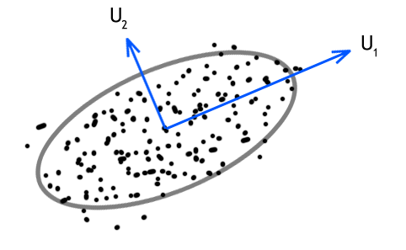
Filters: principle and secondary SVD values.
http://commons.wikimedia.org/wiki/File:SVD_Graphic_Example.png
Data
http://www.nature.com/srep/2013/130207/srep01236/full/srep01236.html

Slide 8
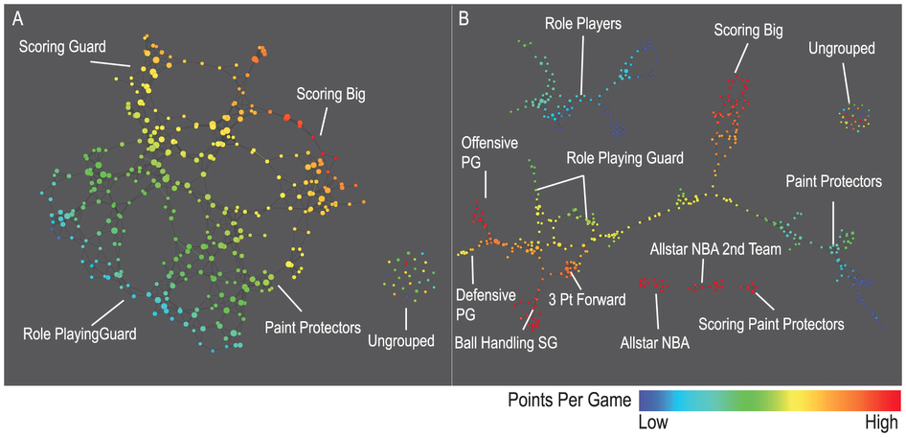
A) Low resolution map at 20 intervals for each filter B) High resolution map at 30 intervals for each filter. The overlap is such at that each interval overlaps with half of the adjacent intervals, the graphs are colored by points per game, and a variance normalized Euclidean distance metric is applied. Metric: Variance Normalized Euclidean; Lens: Principal SVD Value (Resolution 20, Gain 2.0x, Equalized) and Secondary SVD Value (Resolution 20, Gain 2.0x, Equalized). Color: red: high values, blue: low values.
http://www.nature.com/srep/2013/130207/srep01236/full/srep01236.html

Slide 9
LeBron James , Kobe Bryant, Brook Lopez
A) Low resolution map at 20 intervals for each filter B) High resolution map at 30 intervals for each filter. The overlap is such at that each interval overlaps with half of the adjacent intervals, the graphs are colored by points per game, and a variance normalized Euclidean distance metric is applied. Metric: Variance Normalized Euclidean; Lens: Principal SVD Value (Resolution 20, Gain 2.0x, Equalized) and Secondary SVD Value (Resolution 20, Gain 2.0x, Equalized). Color: red: high values, blue: low values.
http://www.nature.com/srep/2013/130207/srep01236/full/srep01236.html
Notes:
Compare how graphs drawn. Note disconnected means not close Don’t be mislead by graph drawing

Slide 10
Application 2: US House of Representatives Voting records
Data: (aye, abstain, nay, …. )
= ( +1 , 0 , -1 , … )
Distance: Pearson correlation
Filters: principal and secondary metric SVD
Clustering: Single linkage.
http://www.nature.com/srep/2013/130207/srep01236/full/srep01236.html

Slide 11
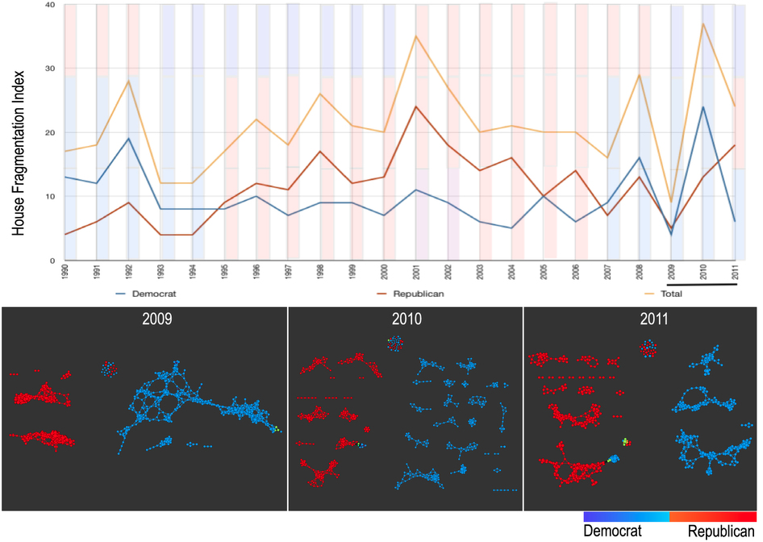
number of sub-networks formed each year per political party.
X-axis: 1990–2011. Y-axis: Fragmentation index. Color bars denote, from top to bottom, party of the President, party for the House, party for the Senate (red: republican; blue: democrat; purple: split). The bottom 3 panels are the actual topological networks for the members. Networks are constructed from voting behavior of the member of the house, with an “aye” vote coded as a 1, “abstain” as zero, and “nay” as a -1. Each node contains sets of members. Each panel labeled with the year contains networks constructed from all the members for all the votes of that year. Note high fragmentation in 2010 in both middle panel and in the Fragmentation Index plot (black bar). The distance metric and filters used in the analysis were Pearson correlation and principal and secondary metric SVD. Metric: Correlation; Lens: Principal SVD Value (Resolution 120, Gain 4.5x, Equalized) and Secondary SVD Value (Resolution 120, Gain 4.5x, Equalized). Color: Red: Republican; Blue: Democrats.
http://www.nature.com/srep/2013/130207/srep01236/full/srep01236.html

Slide 12
They determined what issues divided Republicans into the two main sub-groups in 2009:
The Credit Cardholders' Bill of Rights,
To reauthorize the Marine Turtle Conservation Act of 2004,
Generations Invigorating Volunteerism and Education (GIVE) Act,
To restore sums to the Highway Trust Fund and for other purposes,
Captive Primate Safety Act, Solar Technology Roadmap Act, Southern Sea Otter Recovery and Research Act.
http://www.nature.com/srep/2013/130207/srep01236/full/srep01236.html

Slide 13
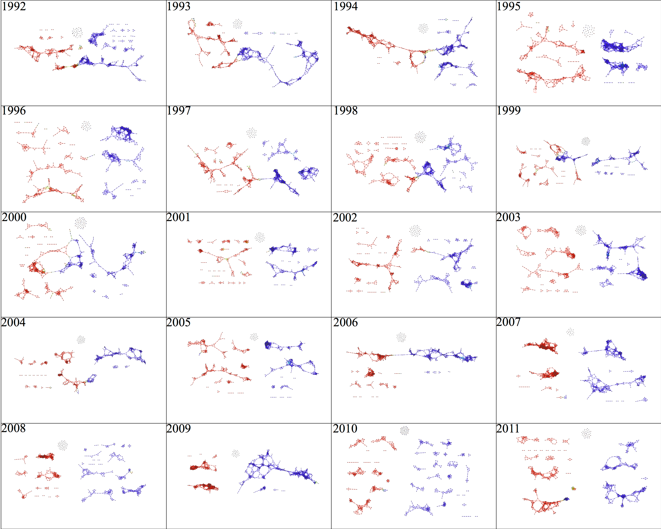

Slide 14
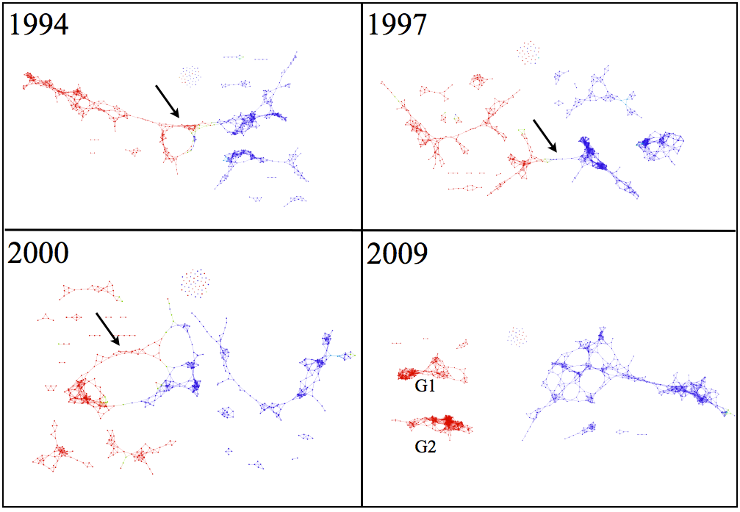

Slide 15
Three key ideas of topology that make extracting of patterns via shape possible.
1.) coordinate free.
No dependence on the coordinate system chosen.
Can compare data derived from different platforms
2.) invariant under “small” deformations.
less sensitive to noise
3.) compressed representations of shapes.
Input: dataset with thousands of points
Output: network with 13 vertices and 12 edges.
http://www.nature.com/srep/2013/130207/srep01236/full/srep01236.html

Slide 16
Application 1: breast cancer gene expression
Data: microarray gene expression data from 2 data sets, NKI and GSE2034
Distance: correlation distance
Filters: (1) L-infinity centrality:
f(x) = max{d(x, p) : p in data set}
captures the structure of the points far removed from the center or norm.
(2) NKI: survival vs. death
GSE2034: no relapse vs. relapse
Clustering: Single linkage.

Slide 17
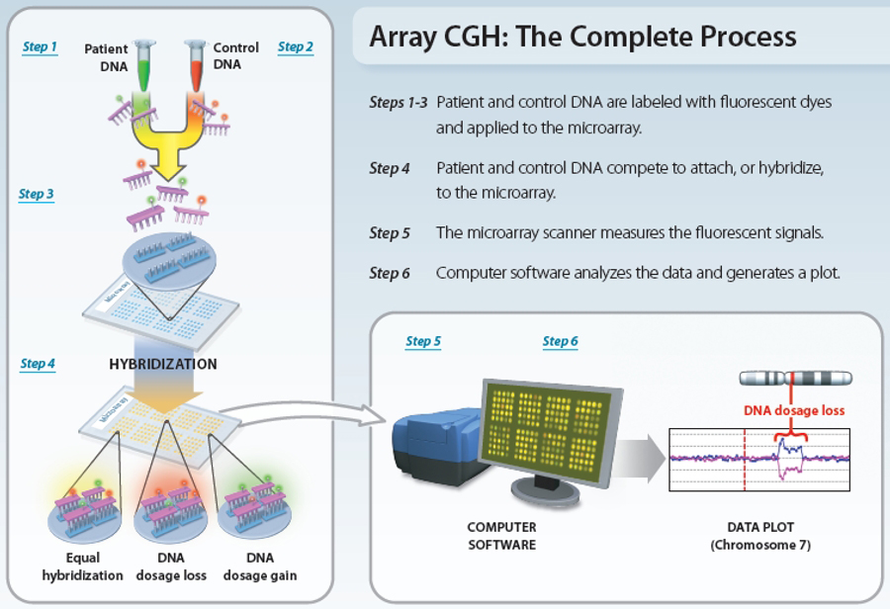
www.nature.com/scitable/topicpage/microarray-based-comparative-genomic-hybridization-acgh-45432

Slide 18
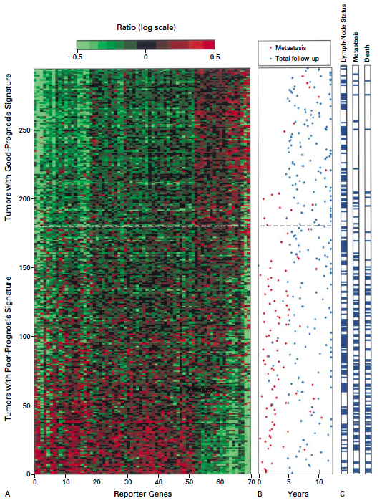
Gene expression profiling predicts clinical outcome of breast cancer
van 't Veer LJ, Dai H, van de Vijver MJ, He YD, Hart AA, Mao M, Peterse HL, van der Kooy K, Marton MJ, Witteveen AT, Schreiber GJ, Kerkhoven RM, Roberts C, Linsley PS, Bernards R, Friend SH
Nature. 2002 Jan 31;415(6871):530-6.

Slide 19
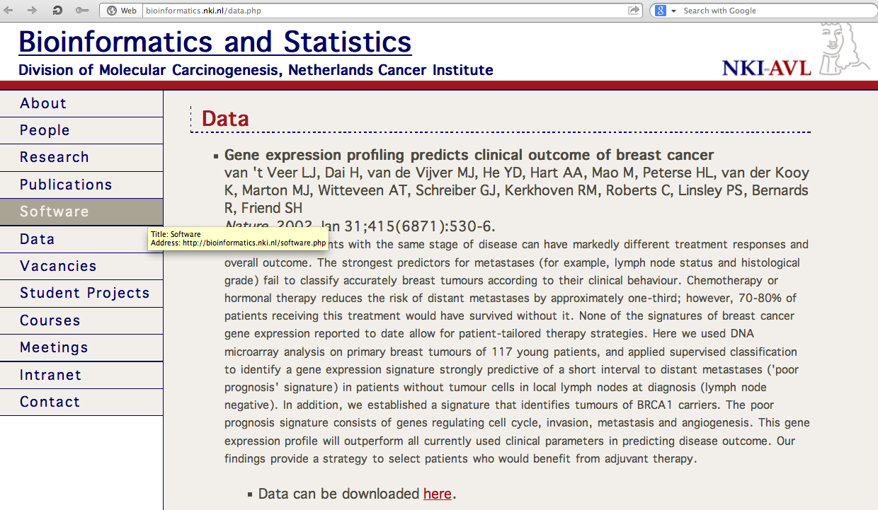
http://bioinformatics.nki.nl/data.php

Slide 20
2 breast cancer data sets:
1.) NKI (2002):
gene expression levels of 24,000 from 272 tumors. Includes node-negative and node-positive patients, who had or had not received adjuvant systemic therapy. Also includes survival information.
2.) GSE203414 (2005)
expression of 22,000 transcripts from total RNA of frozen tumour samples from 286 lymph-node-negative patients who had not received adjuvant systemic treatment. Also includes time to relapse information.

Slide 21
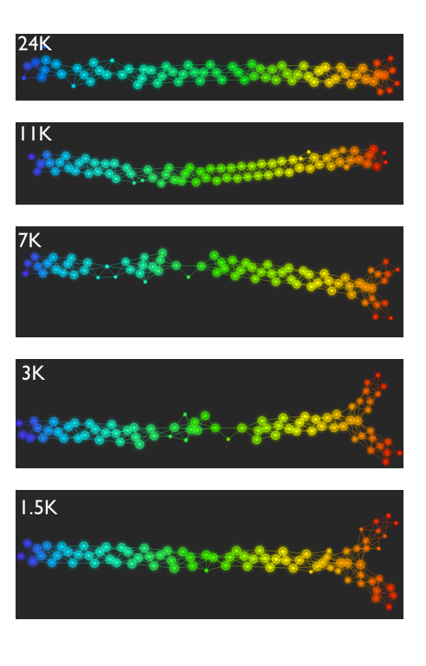
Fig. S1. Shape of the data becomes more distinct as the analysis columns are restricted to the top
varying genes.
24K: all the genes on the microarray were used in the analysis;
11K: 10,731 top most varying genes were used in the analysis;
7K: 6.688 top most varying genes were used in the analysis;
3K: 3212 top most varying genes were used in the analysis;
1.5K: 1553 top most varying genes were used in the analysis.
Graphs colored by the L-infinity centrality values. Red: high; Blue: low
http://www.nature.com/srep/2013/130207/srep01236/full/srep01236.html

Slide 22
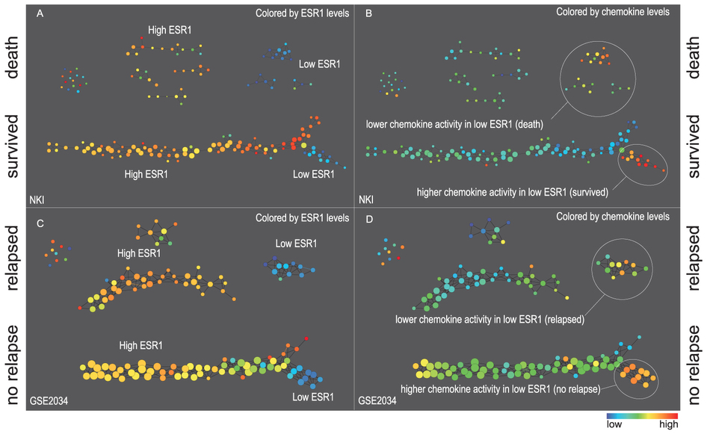
Two filter functions, L-Infinity centrality and survival or relapse were used to generate the networks. The top half of panels A and B are the networks of patients who didn't survive, the bottom half are the patients who survived. Panels C and D are similar to panels A and B except that one of the filters is relapse instead of survival. Panels A and C are colored by the average expression of the ESR1 gene. Panels B and D are colored by the average expression of the genes in the KEGG chemokine pathway. Metric: Correlation; Lens: L-Infinity Centrality (Resolution 70, Gain 3.0x, Equalized) and Event Death (Resolution 30, Gain 3.0x). Color bar: red: high values, blue: low values.
http://www.nature.com/srep/2013/130207/srep01236/full/srep01236.html

Slide 23
Comparison of our results with those of Van de Vijver and colleagues is difficult because of differences in patients, techniques, and materials used.
Their study included node-negative and node-positive patients, who had or had not received adjuvant systemic therapy, and only women younger than 53 years.
microarray platforms used in the studies differ—Affymetrix and Agilent.
Of the 70 genes in the study by van't Veer and co-workers, 48 are present on the Affymetrix U133a array, whereas only 38 of our 76 genes are present on the Agilent array. There is a three-gene overlap between the two signatures (cyclin E2, origin recognition complex, and TNF superfamily protein).
Despite the apparent difference, both signatures included genes that identified several common pathways that might be involved in tumour recurrence. This finding supports the idea that although there might be redundancy in gene members, effective signatures could be required to include representation of specific pathways.
From: Gene-expression profiles to predict distant metastasis of lymph-node-negative primary breast cancer, Yixin Wang et al, The Lancet, Volume 365, Issue 9460, 19–25 February 2005, Pages 671–679

Slide 24
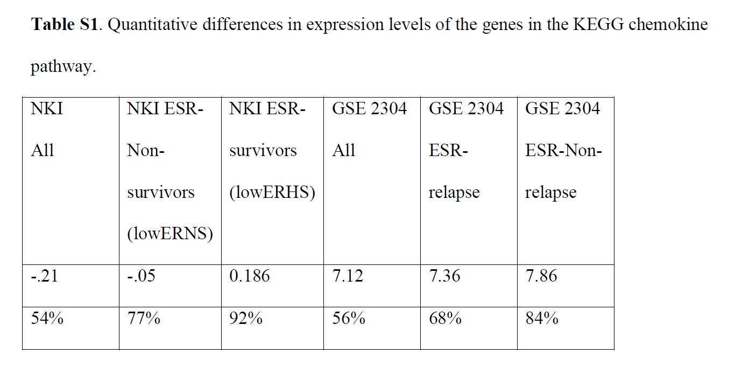
From: http://www.nature.com/srep/2013/130207/srep01236/full/srep01236.html
The numbers in the first row are the average levels of expressions of genes belonging to the chemokine pathway within the relevant groups. The second row gives these same levels reported as percentiles belonging to the collection of the chemokine expression levels across all the patients in the study to which the group belongs. Note that the lowERHS groups display very high chemokine expression levels, 92nd percentile in the case of NKI and 84th percentile in the case of GSE2304. The lowERNS groups are also consistently higher than the general population in the study, although to different degrees in the studies. The difference can perhaps be accounted for by the difference between the survival vs. non-relapse criteria in the two data sets.

Slide 25
www.nature.com/scitable/topicpage/microarray-based-comparative-genomic-hybridization-acgh-45432

Slide 26
Three key ideas of topology that make extracting of patterns via shape possible.
1.) coordinate free.
No dependence on the coordinate system chosen.
Can compare data derived from different platforms
2.) invariant under “small” deformations.
less sensitive to noise
3.) compressed representations of shapes.
Input: dataset with thousands of points
Output: network with 13 vertices and 12 edges.
http://www.nature.com/srep/2013/130207/srep01236/full/srep01236.html

Slide 27
Two filter functions, L-Infinity centrality and survival or relapse were used to generate the networks. The top half of panels A and B are the networks of patients who didn't survive, the bottom half are the patients who survived. Panels C and D are similar to panels A and B except that one of the filters is relapse instead of survival. Panels A and C are colored by the average expression of the ESR1 gene. Panels B and D are colored by the average expression of the genes in the KEGG chemokine pathway. Metric: Correlation; Lens: L-Infinity Centrality (Resolution 70, Gain 3.0x, Equalized) and Event Death (Resolution 30, Gain 3.0x). Color bar: red: high values, blue: low values.
http://www.nature.com/srep/2013/130207/srep01236/full/srep01236.html

Slide 28
Identifying subtypes of cancer in a consistent manner is a challenge in the field since sub-populations can be small and their relationships complex
High expression level of the estrogen receptor gene (ESR1) is positively correlated with improved prognosis, given that this set of patients is likely to respond to standard therapies.
But , there are still sub-groups of high ESR1 that do not respond well to therapy.
Low ESR1 levels are strongly correlated with poor prognosis
But there are patients with low ESR1 levels but high survival rates
Many molecular sub-groups have been identified,
But often difficult to identify the same sub-group in a broader setting, where data sets are generated on different platforms, on different sets of patients and at a different times, because of the noise and complexity in the data.
http://www.nature.com/srep/2013/130207/srep01236/full/srep01236.html

Slide 29
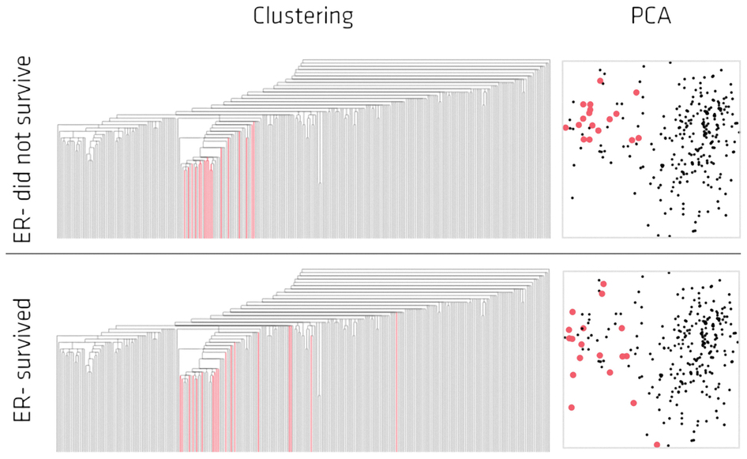
Highlighted in red are the lowERNS (top panel) and the lowERHS (bottom panel) patient sub-groups.
http://www.nature.com/srep/2013/130207/srep01236/full/srep01236.html

Slide 30
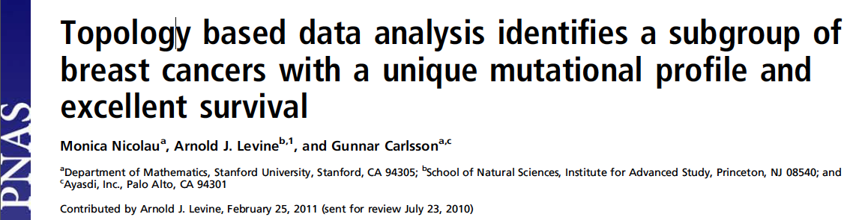
http://www.pnas.org/content/early/2011/04/07/1102826108

Slide 31
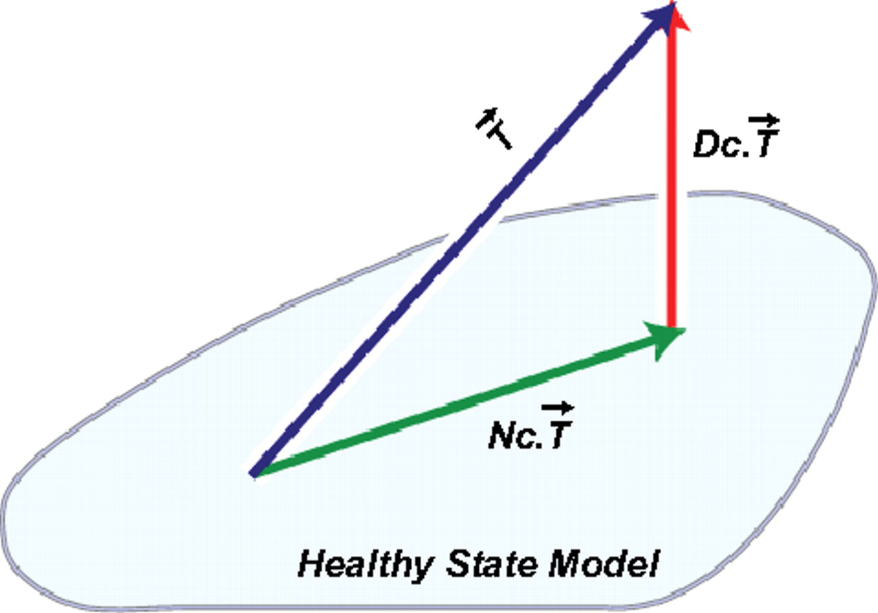
DSGA decomposition of the original tumor vector into the Normal component its linear models fit onto the Healthy State Model and the Disease component vector of residuals.
Nicolau M et al. PNAS 2011;108:7265-7270
©2011 by National Academy of Sciences
Notes:
DSGA decomposition of the original tumor vector into the Normal component its linear models fit onto the Healthy State Model and the Disease component vector of residuals.

Slide 32
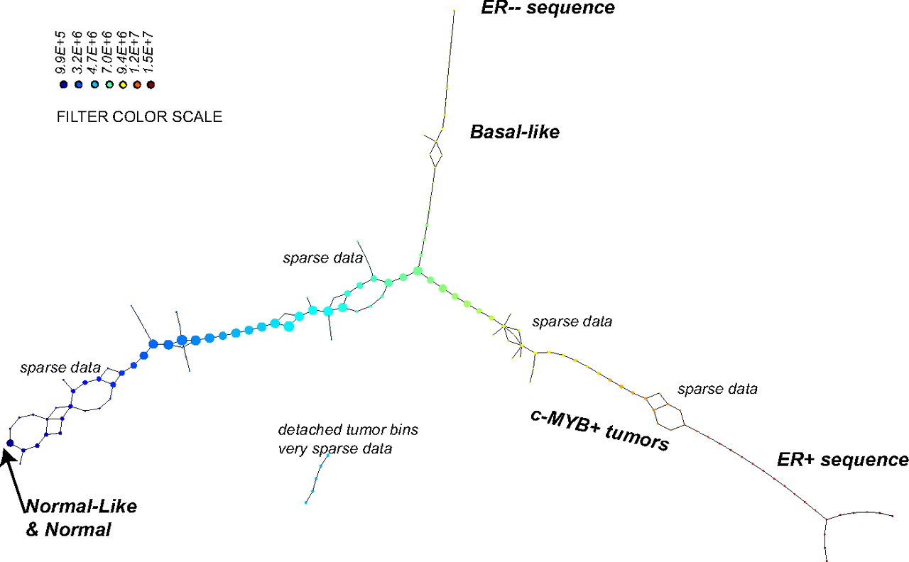
PAD analysis of the NKI data. The output has three progression arms, because tumors (data points) are ordered by the magnitude of deviation from normal (the HSM). Each bin is colored by the mean of the filter map on the points. Blue bins contain tumors whose total deviation from HSM is small (normal and Normal-like tumors). Red bins contain tumors whose deviation from HSM is large. The image of f was subdivided into 15 intervals with 80% overlap. All bins are seen (outliers included). Regions of sparse data show branching. Several bins are disconnected from the main graph. The ER− arm consists mostly of Basal tumors. The c-MYB+ group was chosen within the ER arm as the tightest subset, between the two sparse regions.
PAD analysis of the NKI data.
Nicolau M et al. PNAS 2011;108:7265-7270
©2011 by National Academy of Sciences
Notes:
PAD analysis of the NKI data. The output has three progression arms, because tumors (data points) are ordered by the magnitude of deviation from normal (the HSM). Each bin is colored by the mean of the filter map on the points. Blue bins contain tumors whose total deviation from HSM is small (normal and Normal-like tumors). Red bins contain tumors whose deviation from HSM is large. The image of f was subdivided into 15 intervals with 80% overlap. All bins are seen (outliers included). Regions of sparse data show branching. Several bins are disconnected from the main graph. The ER− arm consists mostly of Basal tumors. The c-MYB+ group was chosen within the ER arm as the tightest subset, between the two sparse regions.

Slide 33
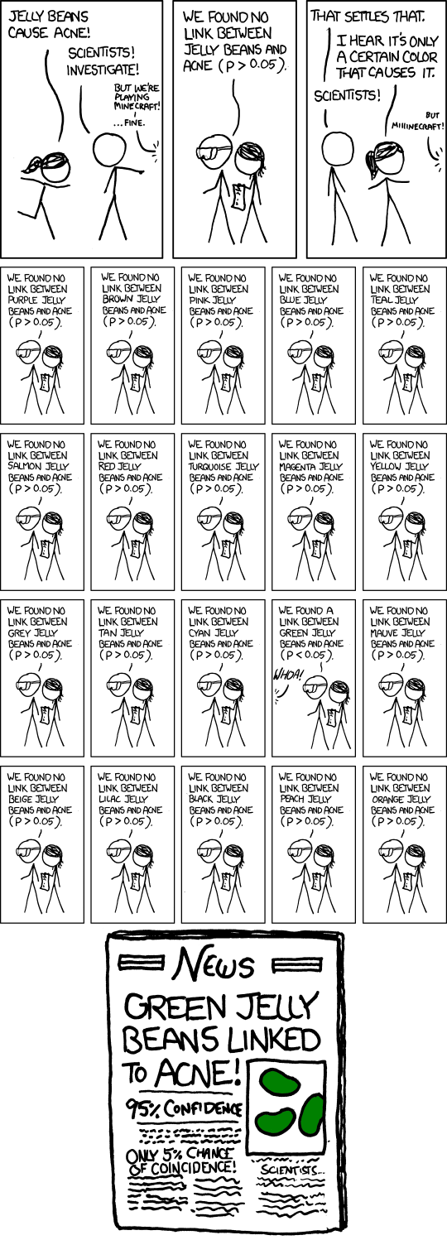
False Positives will occur

Slide 34
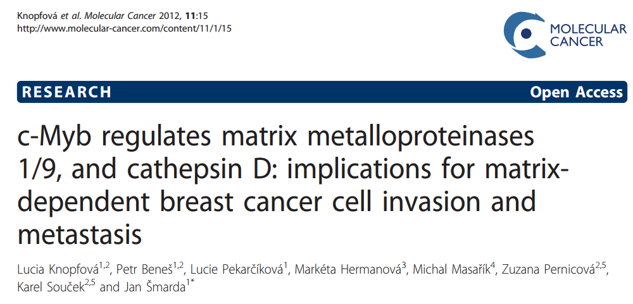
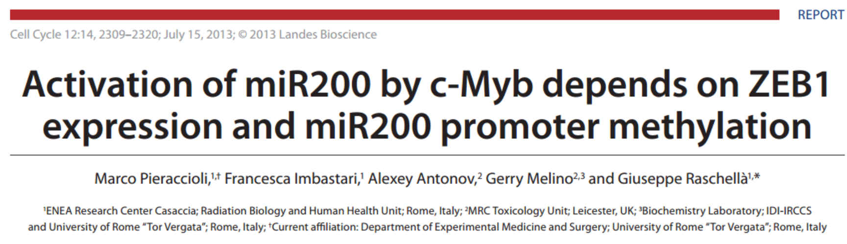

Slide 35
Note: Many, many choices were made
It helps to know what you are doing when you make choices, so collaborating with others is highly recommended.

Slide 36
A) Data Set
Example: Point cloud data
representing a hand.
B) Function f : Data Set → R
Example: x-coordinate
f : (x, y, z) → x
Put data into overlapping bins.
Example: f⁻¹(a_{i}, b_{i})
Cluster each bin & create network.
Vertex = a cluster of a bin.
Edge = nonempty intersection
between clusters
http://www.nature.com/srep/2013/130207/srep01236/full/srep01236.html

Slide 37
Note: Many, many choices were made
“It is useful to think of it as a camera, with lens adjustments and other settings. A different filter function may generate a network with a different shape, thus allowing one to explore the data from a different mathematical perspective.”
http://www.nature.com/srep/2013/130207/srep01236/full/srep01236.html

Slide 38
Note: we made many, many choices
“It is useful to think of it as a camera, with lens adjustments and other settings. A different filter function may generate a network with a different shape, thus allowing one to explore the data from a different mathematical perspective.”
False positives???
http://www.nature.com/srep/2013/130207/srep01236/full/srep01236.html

Slide 39
False Positives will occur
https://xkcd.com/882/

Slide 40
Note: Many, many choices were made
“It is useful to think of it as a camera, with lens adjustments and other settings. A different filter function may generate a network with a different shape, thus allowing one to explore the data from a different mathematical perspective.”
False positives vs. robustness
http://www.nature.com/srep/2013/130207/srep01236/full/srep01236.html

Slide 41
Topological Data Analysis (TDA): Three key ideas of topology that make extracting of patterns via shape possible.
1.) coordinate free.
No dependence on the coordinate system chosen.
Can compare data derived from different platforms
vital when one is studying data collected with different technologies, or from different labs when the methodologies cannot be standardized.
http://www.nature.com/srep/2013/130207/srep01236/full/srep01236.html

Slide 42
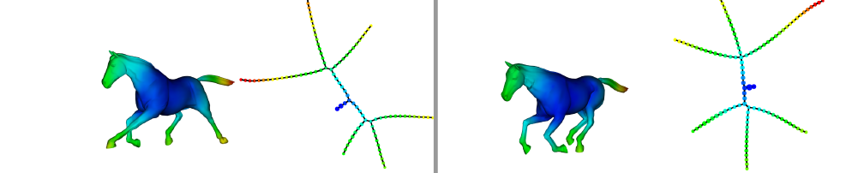
Topological Data Analysis (TDA): Three key ideas of topology that make extracting of patterns via shape possible.
2.) invariant under “small” deformations.
less sensitive to noise
Topological Methods for the Analysis of High Dimensional
Data Sets and 3D Object Recognition, Singh, Mémoli, Carlsson
Figure from http://comptop.stanford.edu/u/preprints/mapperPBG.pdf
http://www.nature.com/srep/2013/130207/srep01236/full/srep01236.html

Slide 43
Topological Data Analysis (TDA): Three key ideas of topology that make extracting of patterns via shape possible.
3.) compressed representations of shapes.
Input: dataset with thousands of points
Output: network with
13 vertices and 12 edges.
http://www.nature.com/srep/2013/130207/srep01236/full/srep01236.html

Slide 44
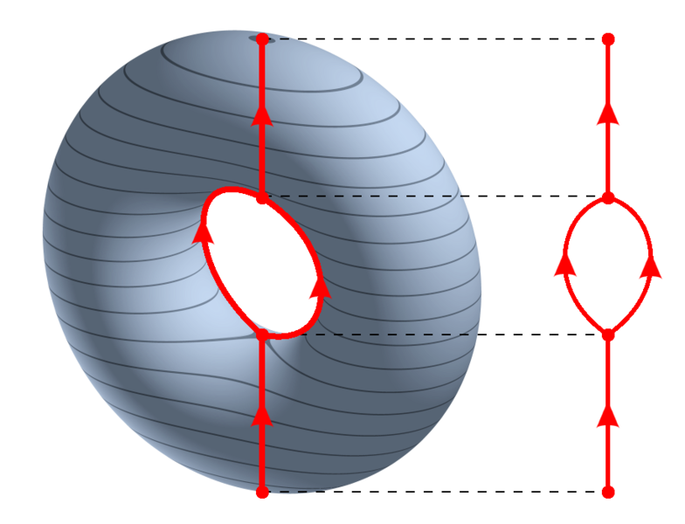
https://en.wikipedia.org/wiki/Reeb_graph

Slide 45
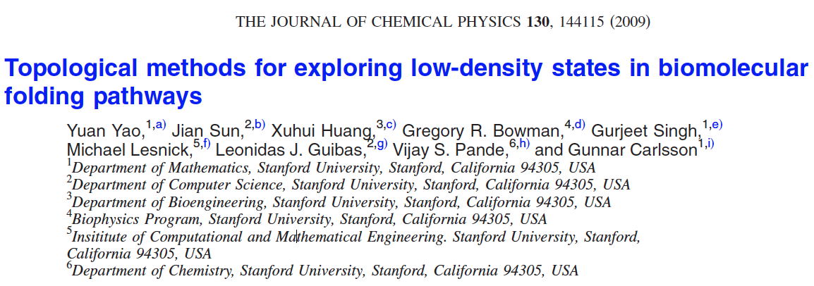
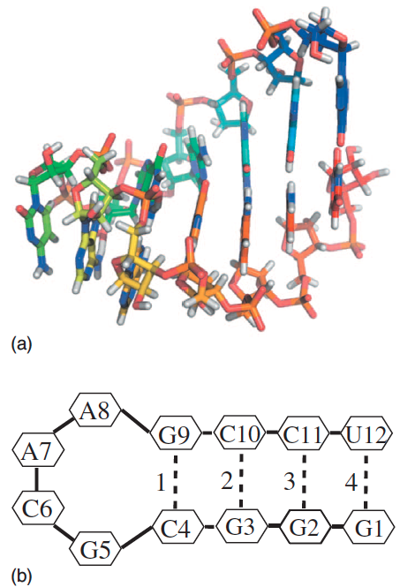
http://scitation.aip.org/content/aip/journal/jcp/130/14/10.1063/1.3103496

Slide 46
Data: Contact maps from 2,800 Serial Replica Exchange Molecular Dynamics (SREMD) simulations of the GCAA tetraloop on the Folding@home distributed computing platform.
760 trajectories with a complete unfolding event
550 trajectories with a complete refolding event.
Goal: To determine secondary structure pathways between folded and unfolded state

Slide 47
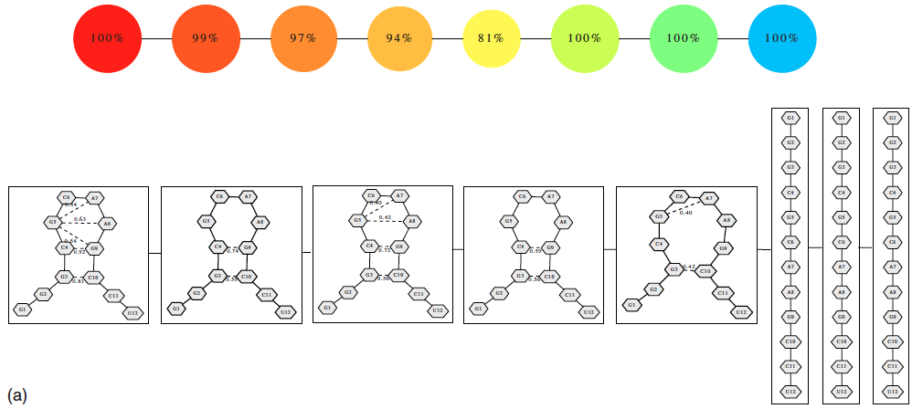
Problem: Many more folded and unfolded conformations than intermediate conformations
How to distinguish intermediate conformations from noise?
Solution
Choose f: space of conformations → R
f(conformation) = density

Slide 48
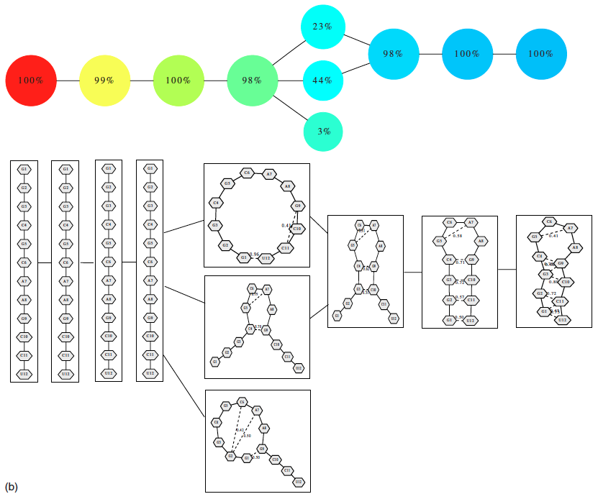
550 trajectories with a complete refolding event
2952 configurations

Slide 49

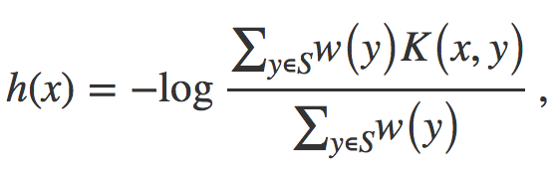


Distance = Hamming distance

Slide 50
550 trajectories with a complete refolding event
2952 configurations

Slide 51
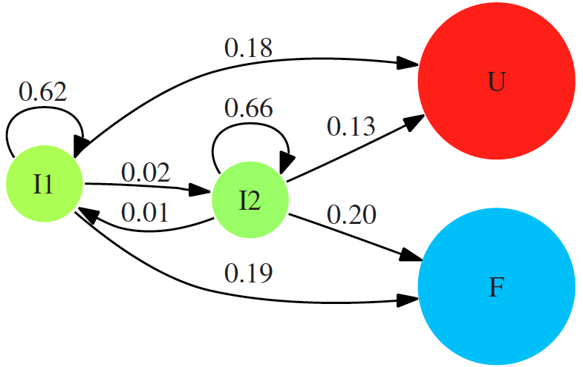

Slide 52
760 trajectories with a complete unfolding event
4330 configurations

