Slide 1
Goals for Thursday’s lab (meet in basement B5 MLH):
1.) Work with Python Mapper
Note: you must request a CLAS account unless you can run python on your own laptop: https://mail.divms.uiowa.edu/clas_linux/
2.) Work on creating your own code for mapper using functions found in
uploadDatatoRetc.R -- commands for reading data into R.
also includes commands taken from the Swirl course
Manipulating data with dplyr - Getting and Cleaning Data.
NOTE filter commands.
Focus on reading in data and creating overlapping bins. Remaining parts will be discussed later.
3.) Run script TDAmapper.r
4.) Have fun with R.

Slide 2
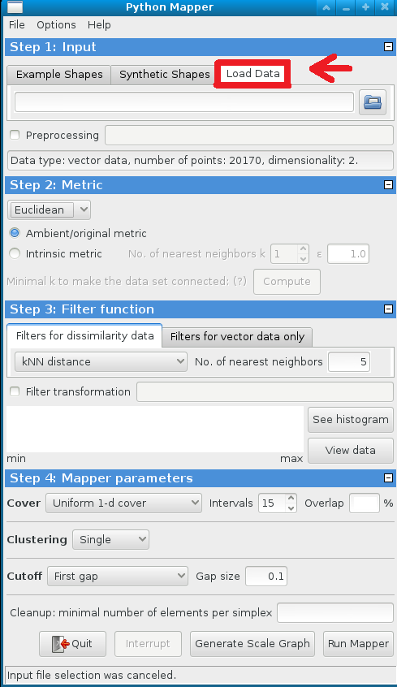
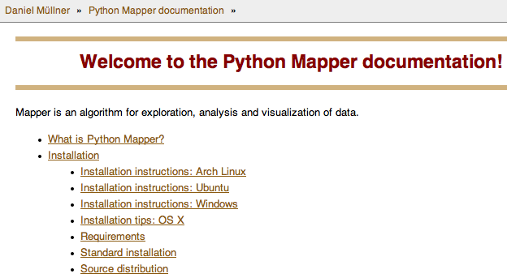
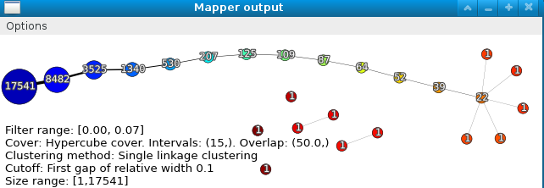
Python Mapper: http://danifold.net/mapper/
See also mappersummary2a.pdf - A quick introduction to Mapper for linux computers in B5 MLH

Slide 3
Goals for Thursday’s lab:
1.) Work with Python Mapper
Note: you must request a CLAS account unless you can run python on your own laptop.
2.) Work on creating your own code for mapper using functions found in
uploadDatatoRetc.R -- commands for reading data into R.
also includes commands taken from the Swirl course
Manipulating data with dplyr - Getting and Cleaning Data.
NOTE filter commands.
Focus on reading in data and creating overlapping bins. Remaining parts will be discussed later.
3.) Run script TDAmapper.r
4.) Have fun with R.

Slide 4
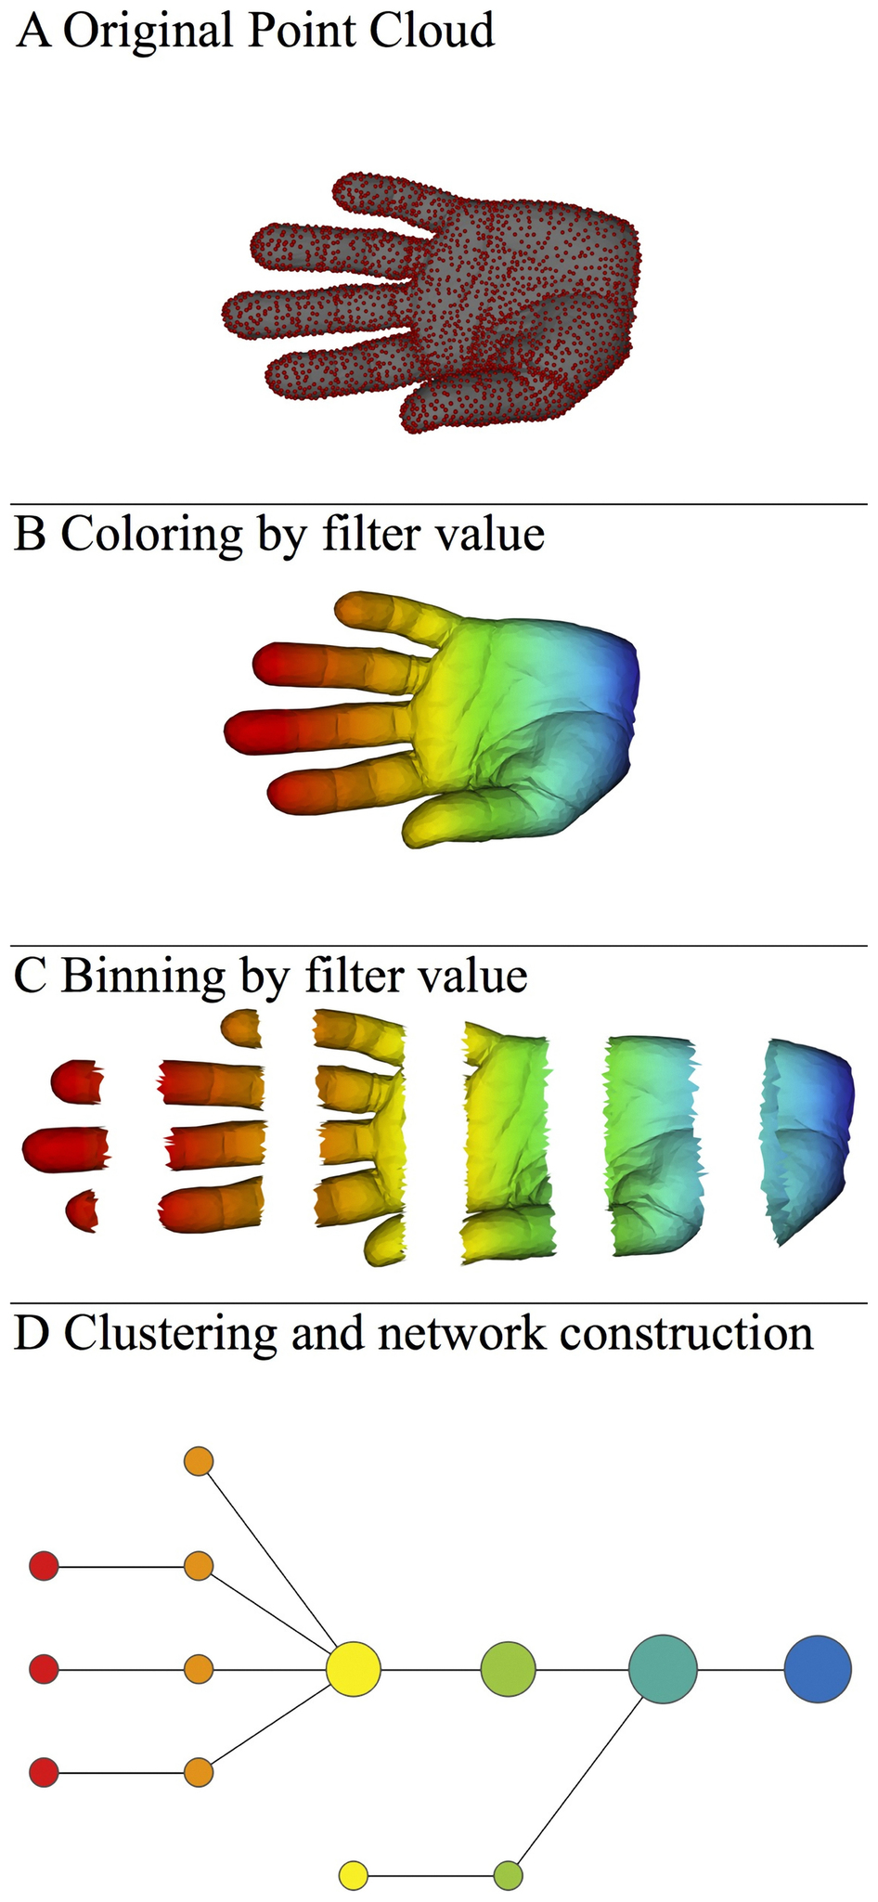
A) Data Set
Example: Point cloud data
representing a hand.
B) Function f : Data Set → R
Example: x-coordinate
f : (x, y, z) → x
Put data into overlapping bins.
Example: f⁻¹(a_{i}, b_{i})
Cluster each bin & create network.
Vertex = a cluster of a bin.
Edge = nonempty intersection
between clusters
http://www.nature.com/srep/2013/130207/srep01236/full/srep01236.html

Slide 5
Goals for Thursday’s lab:
1.) Work with Python Mapper
Note: you must request a CLAS account unless you can run python on your own laptop.
2.) Work on creating your own code for mapper using functions found in
uploadDatatoRetc.R -- commands for reading data into R.
also includes commands taken from the Swirl course
Manipulating data with dplyr - Getting and Cleaning Data.
NOTE filter commands.
Focus on reading in data and creating overlapping bins. Remaining parts will be discussed later.
3.) Run script TDAmapper.r
4.) Have fun with R.
Create Data Sets

Slide 6
What graph do you get when you apply mapper to the above blob if filter = projection to x-axis?

Slide 7
( ( ) ( ) ( ) ( ) ( ) )

Slide 8
( ( ) ( ) ( ) ( ) ( ) )

Slide 9
( ( ) ( ) ( ) ( ) ( ) )

Slide 10
( ( ) ( ) ( ) ( ) ( ) )

Slide 11
( ( ) ( ) ( ) ( ) ( ) )

Slide 12
( ( ) ( ) ( ) ( ) ( ) )

Slide 13
( ( ) ( ) ( ) ( ) ( ) )

Slide 14
( ( ) ( ) ( ) ( ) ( ) )

Slide 15
( ( ) ( ) ( ) ( ) ( ) )

Slide 17
Goals for Thursday’s lab:
1.) Work with Python Mapper
Note: you must request a CLAS account unless you can run python on your own laptop.
2.) Work on creating your own code for mapper using functions found in
uploadDatatoRetc.R -- commands for reading data into R.
also includes commands taken from the Swirl course
Manipulating data with dplyr - Getting and Cleaning Data.
NOTE filter commands.
Focus on reading in data and creating overlapping bins. Remaining parts will be discussed later.
3.) Run script TDAmapper.r
4.) Have fun with R. 5.) Sweave??
Create Data Sets

Slide 18
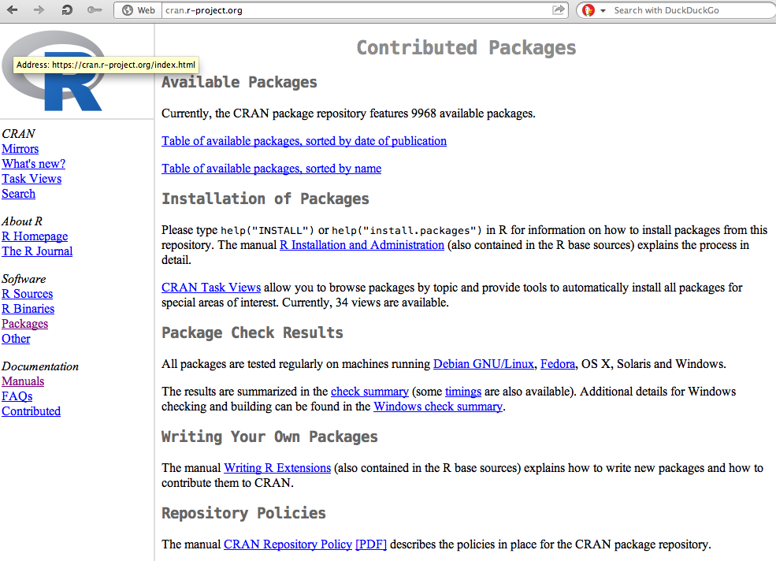
https://cran.r-project.org/
Packages

Slide 19
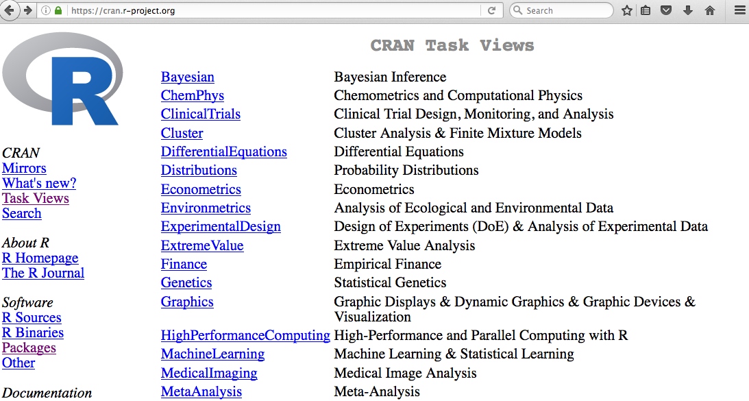

Slide 20
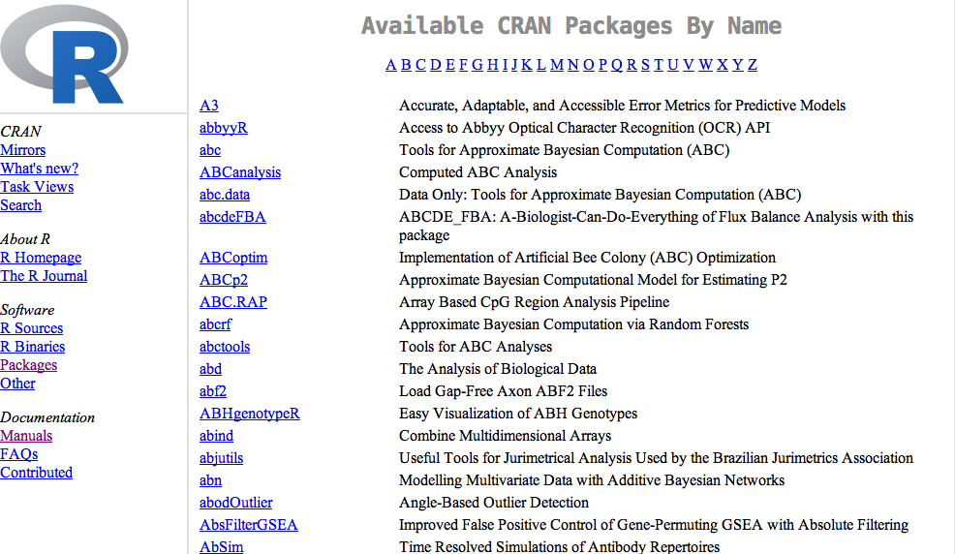

Slide 21

Additional packages can be found at other repositories such as http://bioconductor.org/

Slide 22
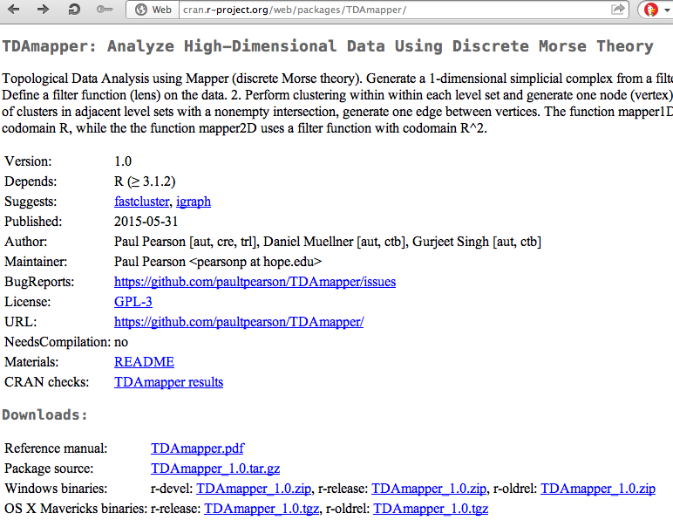
The TDAmapper package
Can download source code
useful info

Slide 23
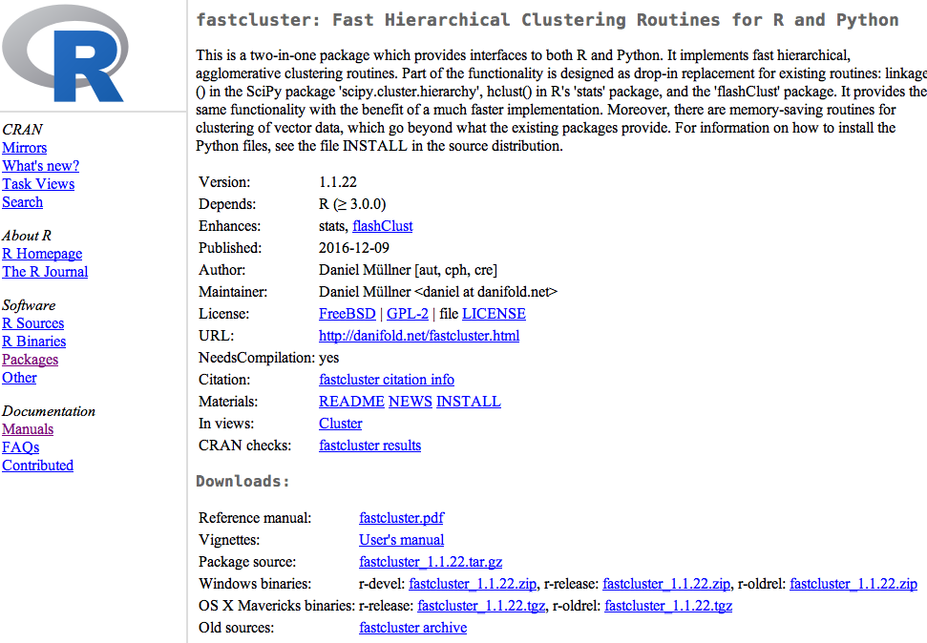
Vignettes are also useful

Slide 24
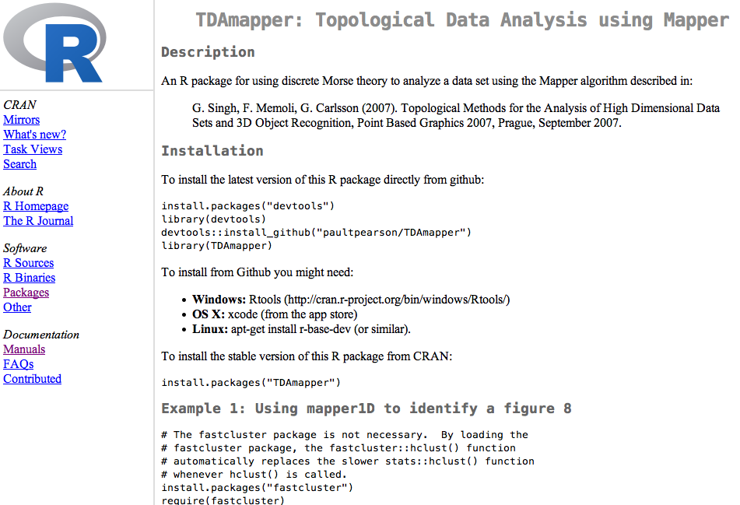
README
Do not install from GitHub unless you know what your are doing
Install in Rstudio
Examples are sometimes found in READMEs or Vignettes

Slide 25
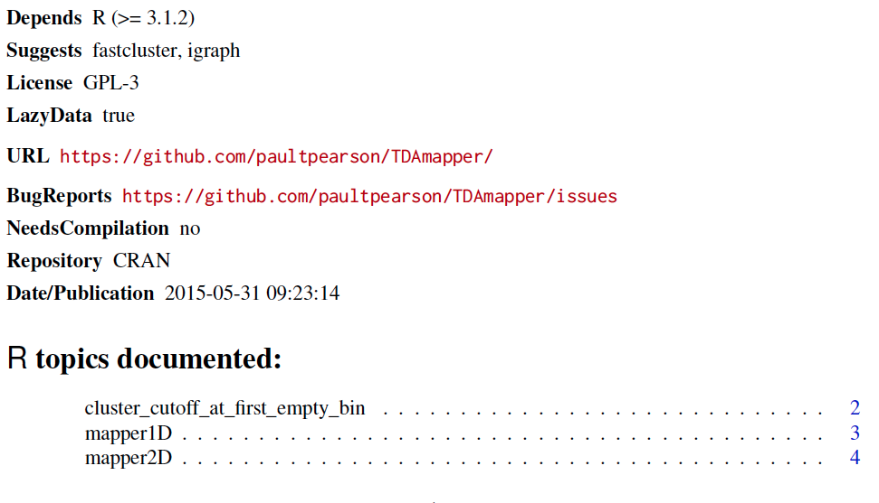
Reference manual:
The reference manual lists all commands contained in the package.

Slide 26
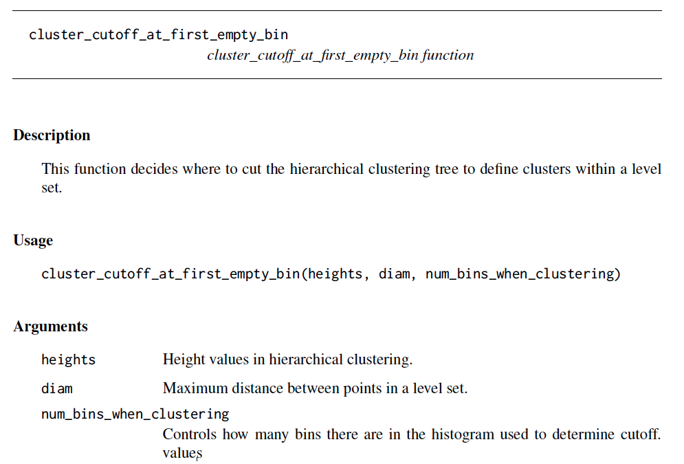
All reference manuals follow same format.
command name
Function inputs
Description of inputs

Slide 27
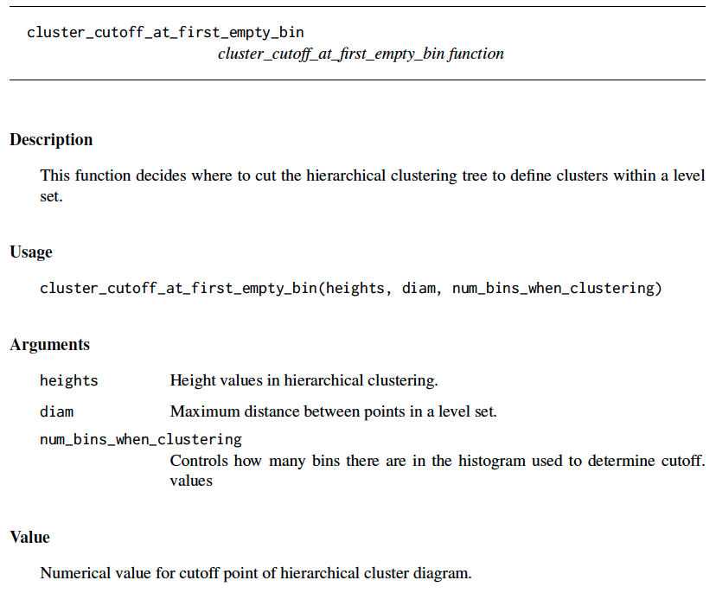
command name
All reference manuals follow same format.
Function inputs
Description of inputs
Description of output(s)

Slide 28
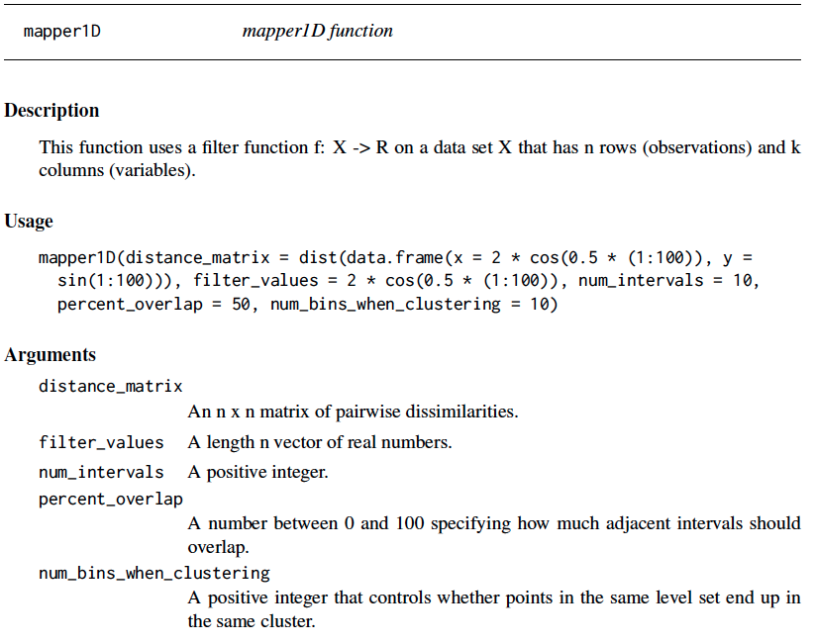

Slide 29
Can download source code
useful info

Slide 30
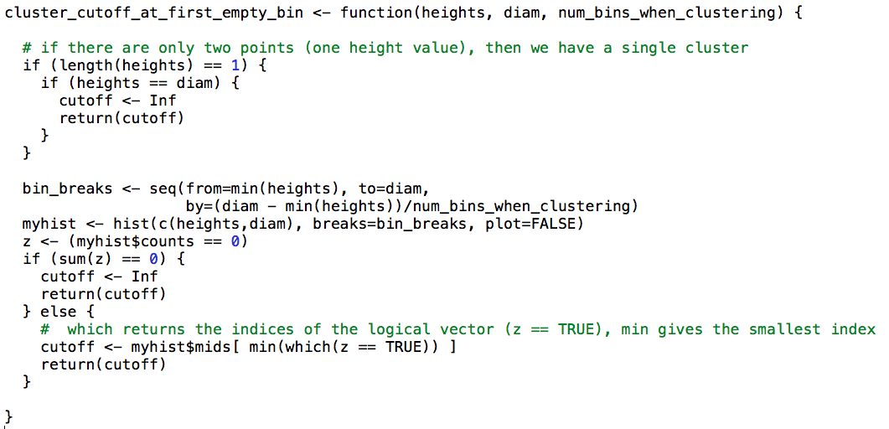

Slide 31
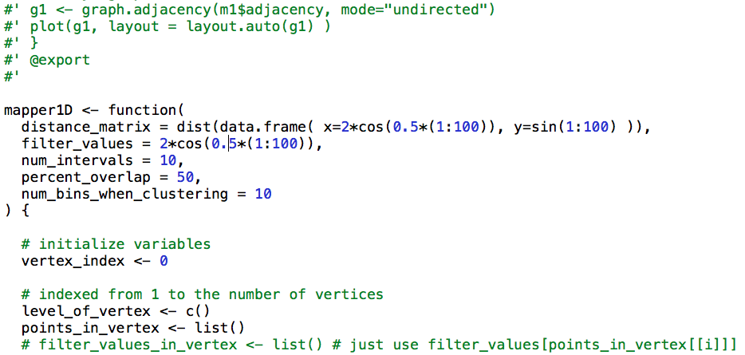
Note the version on GitHub contains commenting

Slide 32
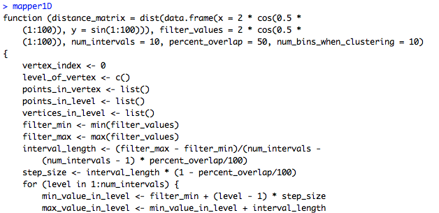
You can take a look at the code in Rstudio for any command just by typing the name of the command.
Note: mapper1d() calls this function
mapper1d allows you to view the code. Note no ()

Slide 33
A) Data Set
Example: Point cloud data
representing a hand.
B) Function f : Data Set → R
Example: x-coordinate
f : (x, y, z) → x
Put data into overlapping bins.
Example: f⁻¹(a_{i}, b_{i})
Cluster each bin & create network.
Vertex = a cluster of a bin.
Edge = nonempty intersection
between clusters
http://www.nature.com/srep/2013/130207/srep01236/full/srep01236.html

Slide 34
Topological Data Analysis (TDA): Three key ideas of topology that make extracting of patterns via shape possible.
1.) coordinate free.
No dependence on the coordinate system chosen.
Can compare data derived from different platforms
vital when one is studying data collected with different technologies, or from different labs when the methodologies cannot be standardized.
http://www.nature.com/srep/2013/130207/srep01236/full/srep01236.html

Slide 35
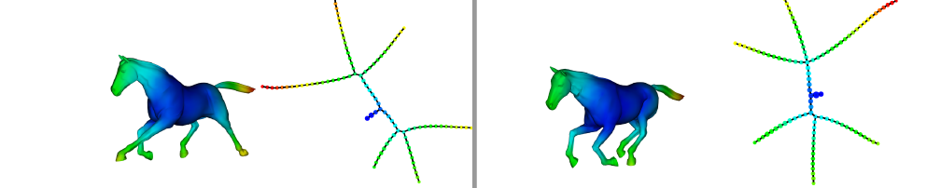
Topological Data Analysis (TDA): Three key ideas of topology that make extracting of patterns via shape possible.
2.) invariant under “small” deformations.
less sensitive to noise
Topological Methods for the Analysis of High Dimensional
Data Sets and 3D Object Recognition, Singh, Mémoli, Carlsson
Figure from http://comptop.stanford.edu/u/preprints/mapperPBG.pdf
http://www.nature.com/srep/2013/130207/srep01236/full/srep01236.html

Slide 36

Topological Data Analysis (TDA): Three key ideas of topology that make extracting of patterns via shape possible.
3.) compressed representations of shapes.
Input: dataset with thousands of points
Output: network with
13 vertices and 12 edges.
http://www.nature.com/srep/2013/130207/srep01236/full/srep01236.html

Slide 37
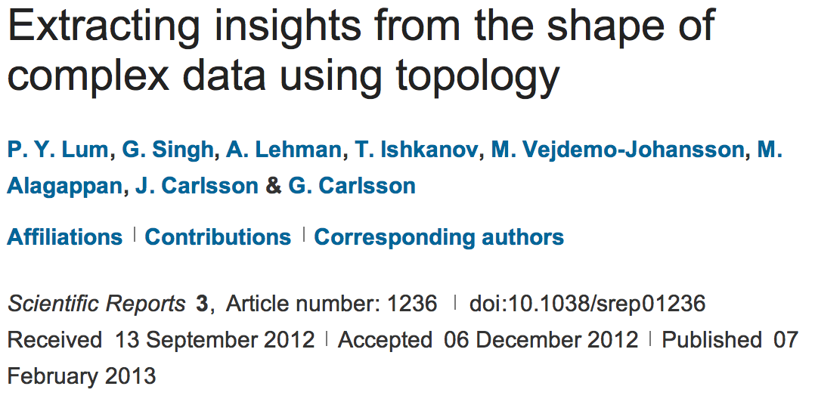
http://www.nature.com/srep/2013/130207/srep01236/full/srep01236.html

Slide 38
Chose filter
Only need to cover the data points.
http://www.nature.com/srep/2013/130207/srep01236/full/srep01236.html

Slide 39
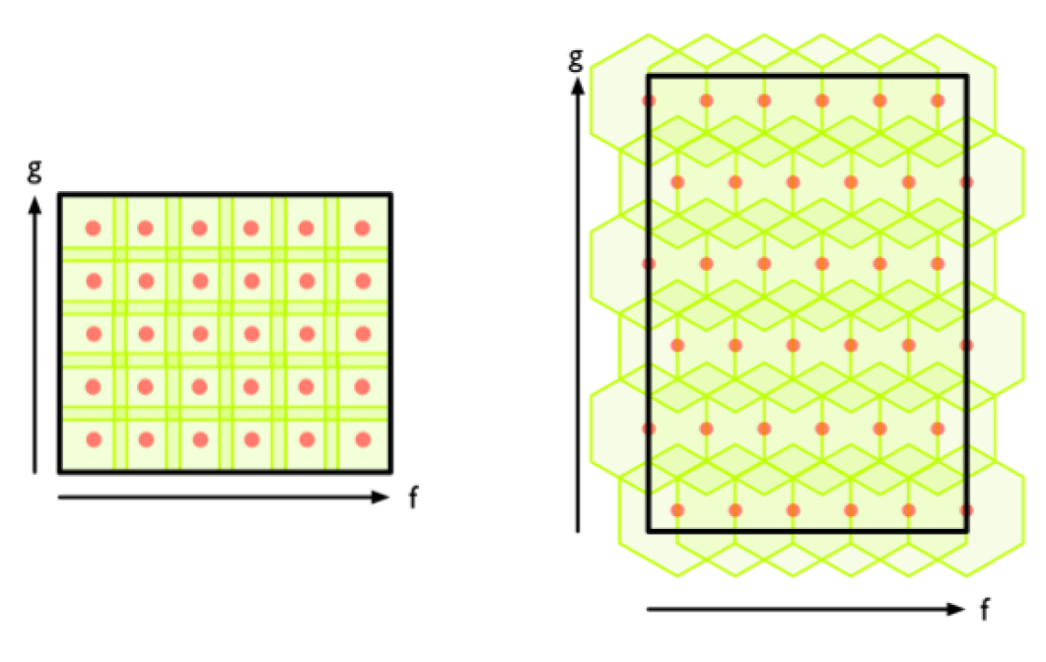
Chose filter
http://www.nature.com/srep/2013/130207/srep01236/full/srep01236.html

Slide 40
Chose filter
http://www.nature.com/srep/2013/130207/srep01236/full/srep01236.html

Slide 41
Application 3 (in paper): Basketball
Data: rates (per minute played) of rebounds, assists, turnovers, steals, blocked shots, personal fouls, and points scored for 452 players.
➔ Input: 452 points in R⁷
For each player, we have a vector
= (r, a, t, s, b, f, p) in R⁷
Distance: variance normalized Euclidean distance.
Clustering: Single linkage.
( min , min , min , min , min , min , min )
rebounds assists turnovers steals blocked shots personal fouls points scored
http://www.nature.com/srep/2013/130207/srep01236/full/srep01236.html

Slide 42
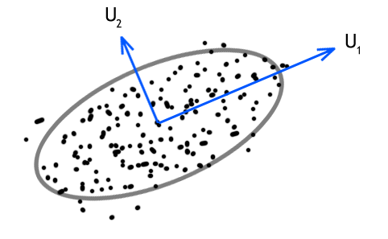
Filters: principle and secondary SVD values.
http://commons.wikimedia.org/wiki/File:SVD_Graphic_Example.png
Data
http://www.nature.com/srep/2013/130207/srep01236/full/srep01236.html

Slide 43
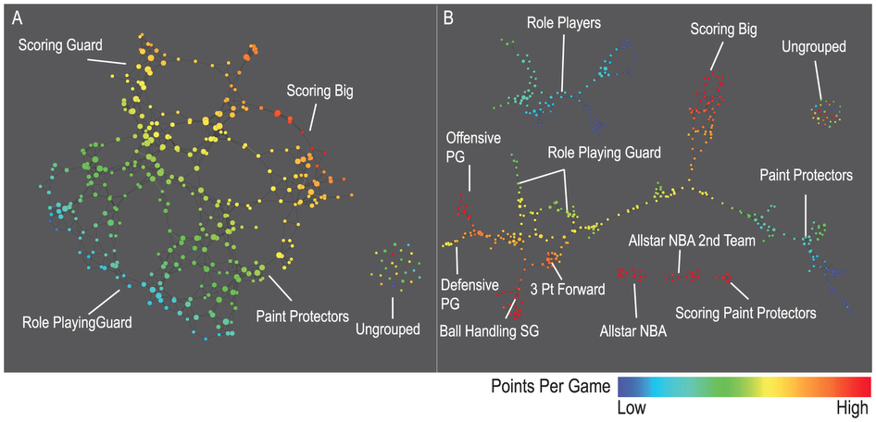
A) Low resolution map at 20 intervals for each filter B) High resolution map at 30 intervals for each filter. The overlap is such at that each interval overlaps with half of the adjacent intervals, the graphs are colored by points per game, and a variance normalized Euclidean distance metric is applied. Metric: Variance Normalized Euclidean; Lens: Principal SVD Value (Resolution 20, Gain 2.0x, Equalized) and Secondary SVD Value (Resolution 20, Gain 2.0x, Equalized). Color: red: high values, blue: low values.
http://www.nature.com/srep/2013/130207/srep01236/full/srep01236.html

Slide 44
LeBron James , Kobe Bryant, Brook Lopez
A) Low resolution map at 20 intervals for each filter B) High resolution map at 30 intervals for each filter. The overlap is such at that each interval overlaps with half of the adjacent intervals, the graphs are colored by points per game, and a variance normalized Euclidean distance metric is applied. Metric: Variance Normalized Euclidean; Lens: Principal SVD Value (Resolution 20, Gain 2.0x, Equalized) and Secondary SVD Value (Resolution 20, Gain 2.0x, Equalized). Color: red: high values, blue: low values.
http://www.nature.com/srep/2013/130207/srep01236/full/srep01236.html
Notes:
Compare how graphs drawn. Note disconnected means not close Don’t be mislead by graph drawing

Slide 45
Application 2: US House of Representatives Voting records
Data: (aye, abstain, nay, …. )
= ( +1 , 0 , -1 , … )
Distance: Pearson correlation
Filters: principal and secondary metric SVD
Clustering: Single linkage.
http://www.nature.com/srep/2013/130207/srep01236/full/srep01236.html

Slide 46
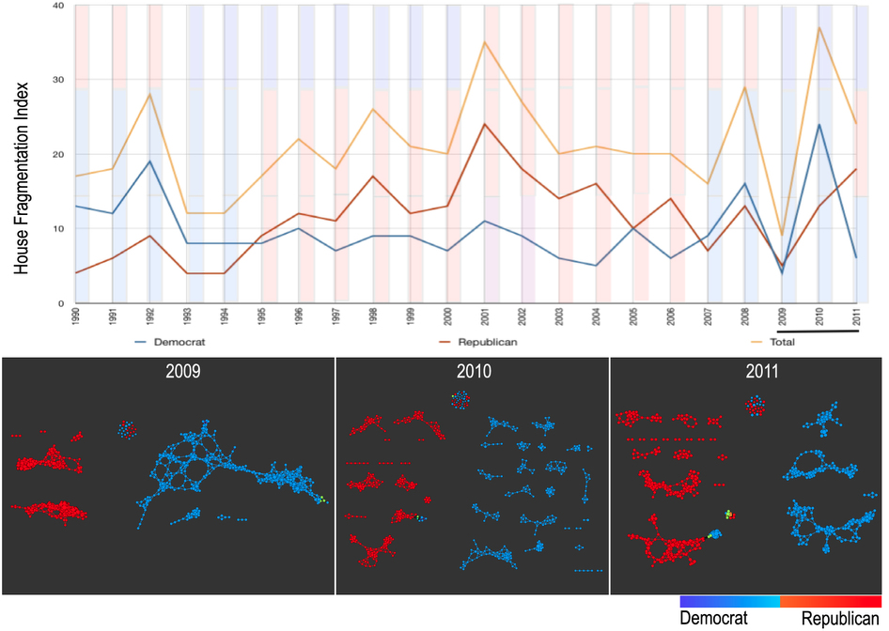
number of sub-networks formed each year per political party.
X-axis: 1990–2011. Y-axis: Fragmentation index. Color bars denote, from top to bottom, party of the President, party for the House, party for the Senate (red: republican; blue: democrat; purple: split). The bottom 3 panels are the actual topological networks for the members. Networks are constructed from voting behavior of the member of the house, with an “aye” vote coded as a 1, “abstain” as zero, and “nay” as a -1. Each node contains sets of members. Each panel labeled with the year contains networks constructed from all the members for all the votes of that year. Note high fragmentation in 2010 in both middle panel and in the Fragmentation Index plot (black bar). The distance metric and filters used in the analysis were Pearson correlation and principal and secondary metric SVD. Metric: Correlation; Lens: Principal SVD Value (Resolution 120, Gain 4.5x, Equalized) and Secondary SVD Value (Resolution 120, Gain 4.5x, Equalized). Color: Red: Republican; Blue: Democrats.
http://www.nature.com/srep/2013/130207/srep01236/full/srep01236.html

Slide 47
They determined what issues divided Republicans into the two main sub-groups in 2009:
The Credit Cardholders' Bill of Rights,
To reauthorize the Marine Turtle Conservation Act of 2004,
Generations Invigorating Volunteerism and Education (GIVE) Act,
To restore sums to the Highway Trust Fund and for other purposes,
Captive Primate Safety Act, Solar Technology Roadmap Act, Southern Sea Otter Recovery and Research Act.
http://www.nature.com/srep/2013/130207/srep01236/full/srep01236.html

Slide 48
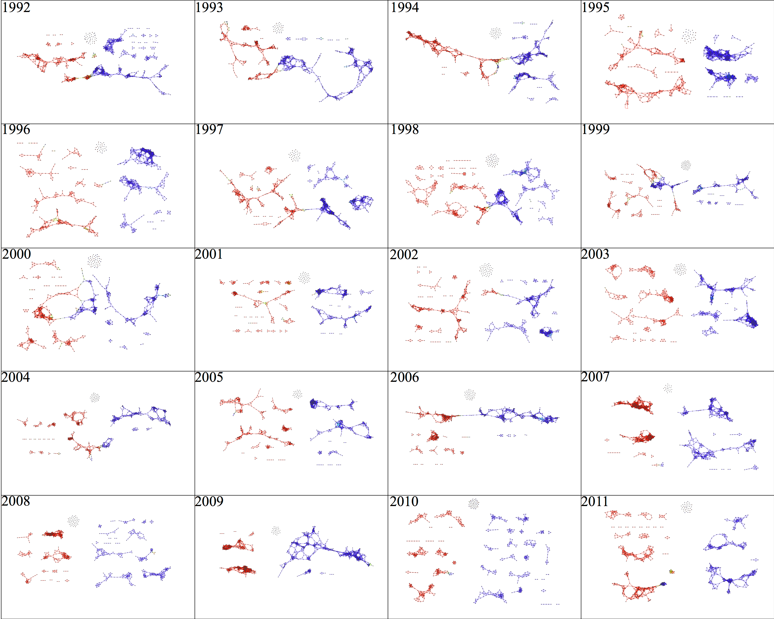

Slide 49
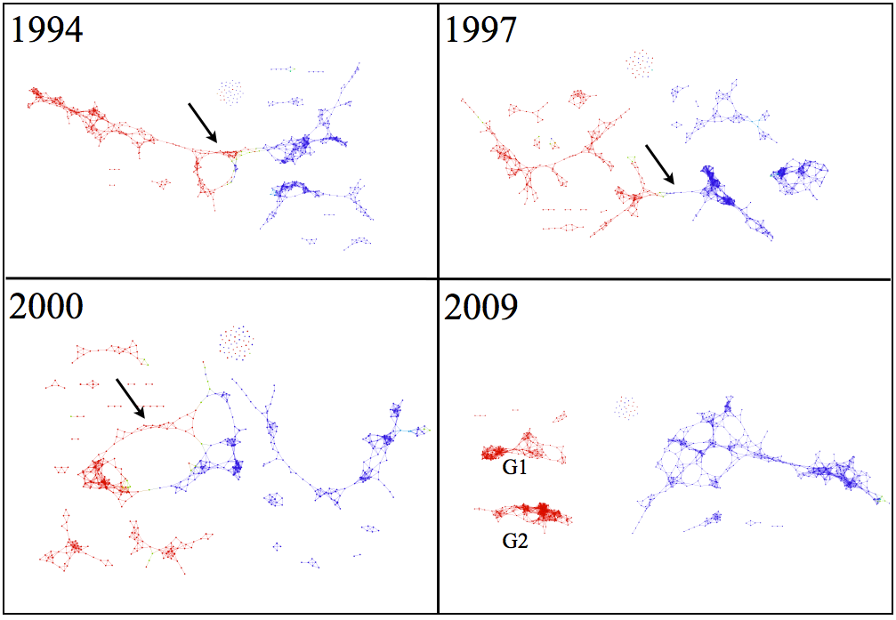

Slide 50
Application 1: breast cancer gene expression
Data: microarray gene expression data from 2 data sets, NKI and GSE2034
Distance: correlation distance
Filters: (1) L-infinity centrality:
f(x) = max{d(x, p) : p in data set}
captures the structure of the points far removed from the center or norm.
(2) NKI: survival vs. death
GSE2034: no relapse vs. relapse
Clustering: Single linkage.

Slide 51
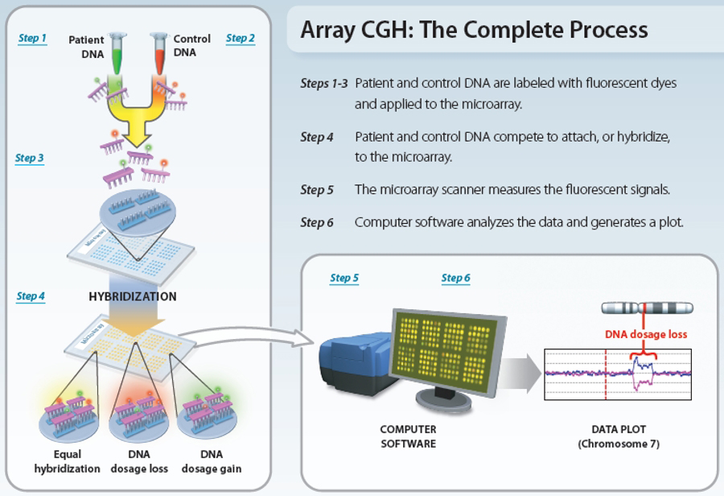
www.nature.com/scitable/topicpage/microarray-based-comparative-genomic-hybridization-acgh-45432

Slide 52
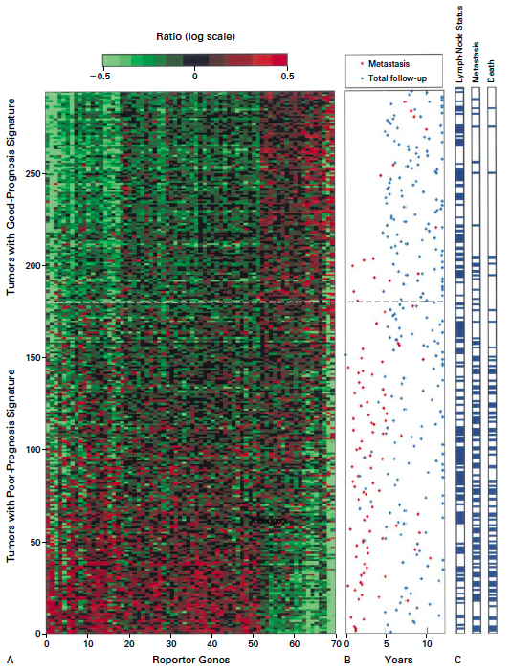
Gene expression profiling predicts clinical outcome of breast cancer
van 't Veer LJ, Dai H, van de Vijver MJ, He YD, Hart AA, Mao M, Peterse HL, van der Kooy K, Marton MJ, Witteveen AT, Schreiber GJ, Kerkhoven RM, Roberts C, Linsley PS, Bernards R, Friend SH
Nature. 2002 Jan 31;415(6871):530-6.

Slide 53
2 breast cancer data sets:
1.) NKI (2002):
gene expression levels of 24,000 from 272 tumors. Includes node-negative and node-positive patients, who had or had not received adjuvant systemic therapy. Also includes survival information.
2.) GSE203414 (2005)
expression of 22,000 transcripts from total RNA of frozen tumour samples from 286 lymph-node-negative patients who had not received adjuvant systemic treatment. Also includes time to relapse information.

Slide 54
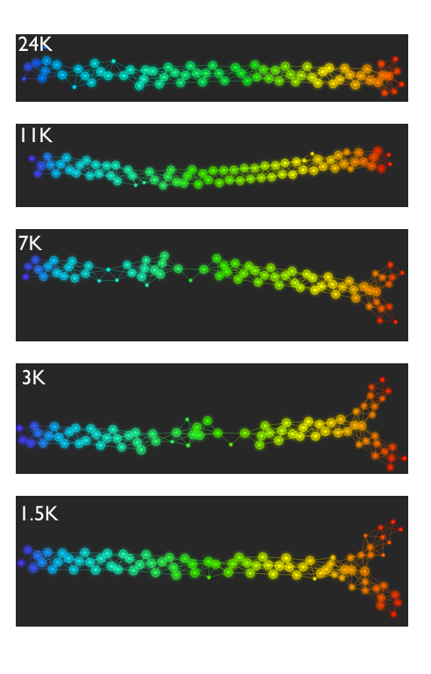
Fig. S1. Shape of the data becomes more distinct as the analysis columns are restricted to the top
varying genes.
24K: all the genes on the microarray were used in the analysis;
11K: 10,731 top most varying genes were used in the analysis;
7K: 6.688 top most varying genes were used in the analysis;
3K: 3212 top most varying genes were used in the analysis;
1.5K: 1553 top most varying genes were used in the analysis.
Graphs colored by the L-infinity centrality values. Red: high; Blue: low
http://www.nature.com/srep/2013/130207/srep01236/full/srep01236.html

Slide 55
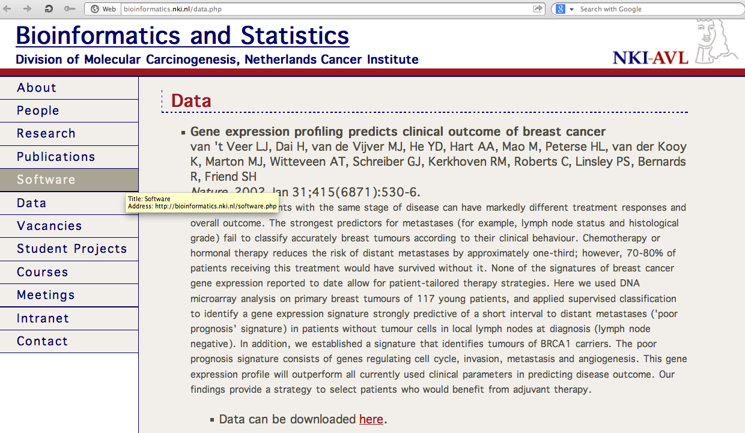
http://bioinformatics.nki.nl/data.php

Slide 56
Comparison of our results with those of Van de Vijver and colleagues is difficult because of differences in patients, techniques, and materials used.
Their study included node-negative and node-positive patients, who had or had not received adjuvant systemic therapy, and only women younger than 53 years.
microarray platforms used in the studies differ—Affymetrix and Agilent.
Of the 70 genes in the study by van't Veer and co-workers, 48 are present on the Affymetrix U133a array, whereas only 38 of our 76 genes are present on the Agilent array. There is a three-gene overlap between the two signatures (cyclin E2, origin recognition complex, and TNF superfamily protein).
Despite the apparent difference, both signatures included genes that identified several common pathways that might be involved in tumour recurrence. This finding supports the idea that although there might be redundancy in gene members, effective signatures could be required to include representation of specific pathways.
From: Gene-expression profiles to predict distant metastasis of lymph-node-negative primary breast cancer, Yixin Wang et al, The Lancet, Volume 365, Issue 9460, 19–25 February 2005, Pages 671–679

Slide 57
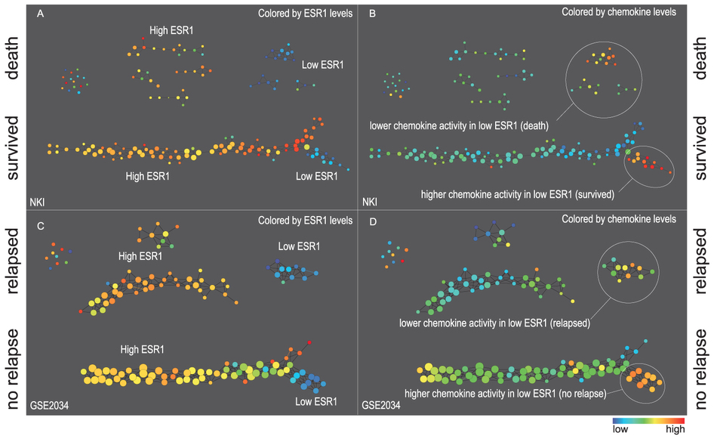
Two filter functions, L-Infinity centrality and survival or relapse were used to generate the networks. The top half of panels A and B are the networks of patients who didn't survive, the bottom half are the patients who survived. Panels C and D are similar to panels A and B except that one of the filters is relapse instead of survival. Panels A and C are colored by the average expression of the ESR1 gene. Panels B and D are colored by the average expression of the genes in the KEGG chemokine pathway. Metric: Correlation; Lens: L-Infinity Centrality (Resolution 70, Gain 3.0x, Equalized) and Event Death (Resolution 30, Gain 3.0x). Color bar: red: high values, blue: low values.
http://www.nature.com/srep/2013/130207/srep01236/full/srep01236.html

Slide 58
Identifying subtypes of cancer in a consistent manner is a challenge in the field since sub-populations can be small and their relationships complex
High expression level of the estrogen receptor gene (ESR1) is positively correlated with improved prognosis, given that this set of patients is likely to respond to standard therapies.
But , there are still sub-groups of high ESR1 that do not respond well to therapy.
Low ESR1 levels are strongly correlated with poor prognosis
But there are patients with low ESR1 levels but high survival rates
Many molecular sub-groups have been identified,
But often difficult to identify the same sub-group in a broader setting, where data sets are generated on different platforms, on different sets of patients and at a different times, because of the noise and complexity in the data.
http://www.nature.com/srep/2013/130207/srep01236/full/srep01236.html

Slide 59
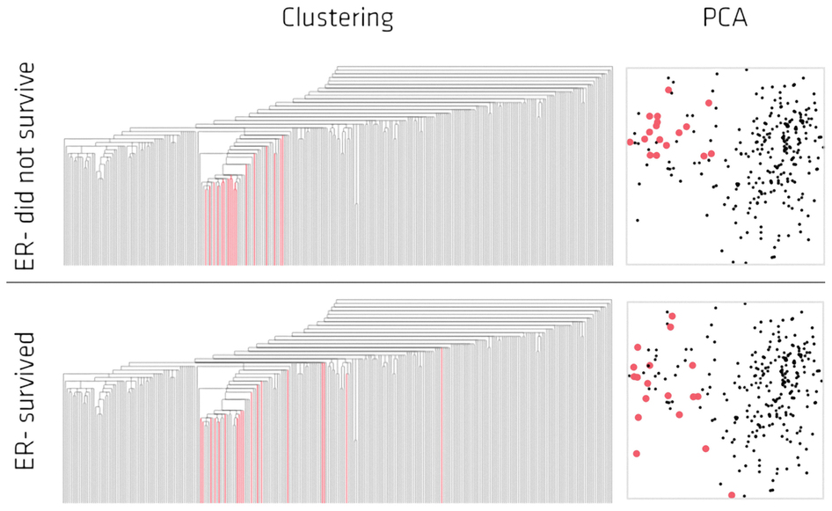
Highlighted in red are the lowERNS (top panel) and the lowERHS (bottom panel) patient sub-groups.
http://www.nature.com/srep/2013/130207/srep01236/full/srep01236.html

Slide 60
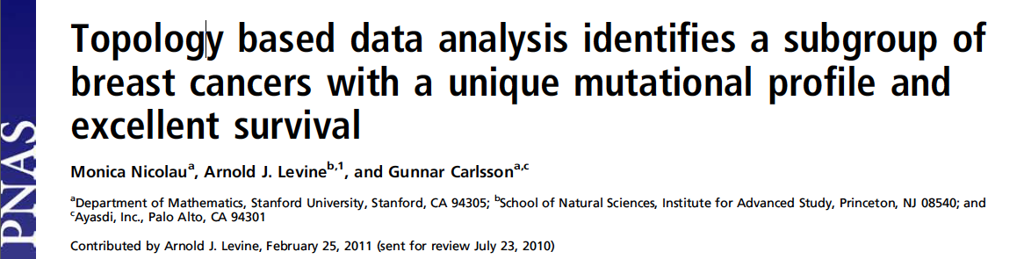
http://www.pnas.org/content/early/2011/04/07/1102826108

Slide 61
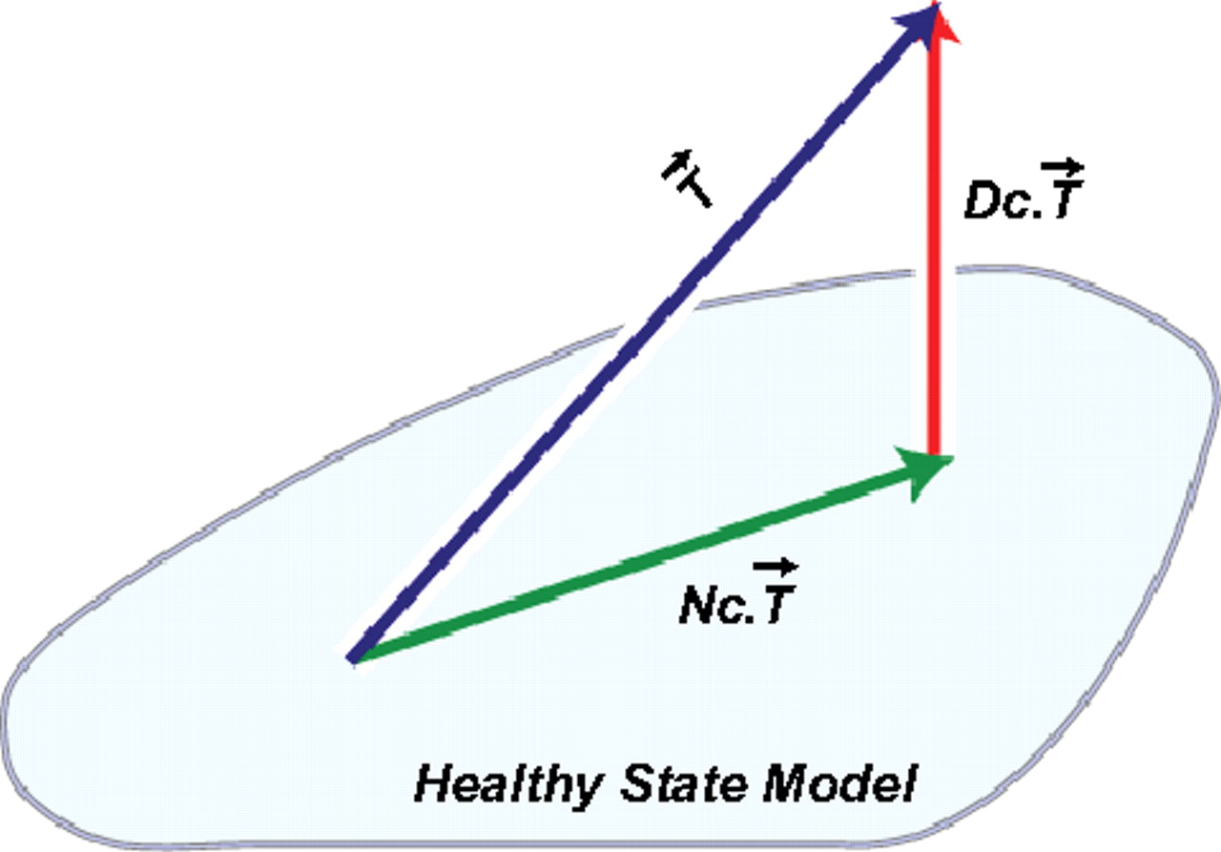
DSGA decomposition of the original tumor vector into the Normal component its linear models fit onto the Healthy State Model and the Disease component vector of residuals.
Nicolau M et al. PNAS 2011;108:7265-7270
©2011 by National Academy of Sciences
Notes:
DSGA decomposition of the original tumor vector into the Normal component its linear models fit onto the Healthy State Model and the Disease component vector of residuals.

Slide 62
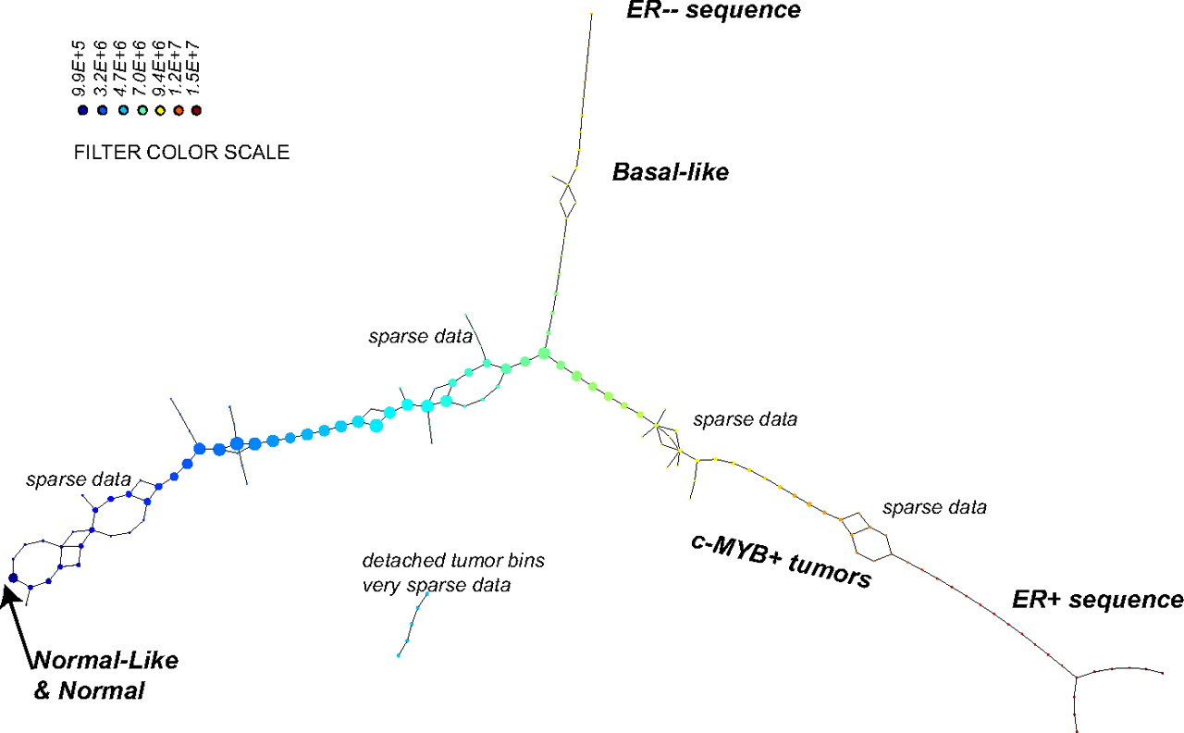
PAD analysis of the NKI data. The output has three progression arms, because tumors (data points) are ordered by the magnitude of deviation from normal (the HSM). Each bin is colored by the mean of the filter map on the points. Blue bins contain tumors whose total deviation from HSM is small (normal and Normal-like tumors). Red bins contain tumors whose deviation from HSM is large. The image of f was subdivided into 15 intervals with 80% overlap. All bins are seen (outliers included). Regions of sparse data show branching. Several bins are disconnected from the main graph. The ER− arm consists mostly of Basal tumors. The c-MYB+ group was chosen within the ER arm as the tightest subset, between the two sparse regions.
PAD analysis of the NKI data.
Nicolau M et al. PNAS 2011;108:7265-7270
©2011 by National Academy of Sciences
Notes:
PAD analysis of the NKI data. The output has three progression arms, because tumors (data points) are ordered by the magnitude of deviation from normal (the HSM). Each bin is colored by the mean of the filter map on the points. Blue bins contain tumors whose total deviation from HSM is small (normal and Normal-like tumors). Red bins contain tumors whose deviation from HSM is large. The image of f was subdivided into 15 intervals with 80% overlap. All bins are seen (outliers included). Regions of sparse data show branching. Several bins are disconnected from the main graph. The ER− arm consists mostly of Basal tumors. The c-MYB+ group was chosen within the ER arm as the tightest subset, between the two sparse regions.

Slide 63
PAD analysis of the NKI data. The output has three progression arms, because tumors (data points) are ordered by the magnitude of deviation from normal (the HSM). Each bin is colored by the mean of the filter map on the points. Blue bins contain tumors whose total deviation from HSM is small (normal and Normal-like tumors). Red bins contain tumors whose deviation from HSM is large. The image of f was subdivided into 15 intervals with 80% overlap. All bins are seen (outliers included). Regions of sparse data show branching. Several bins are disconnected from the main graph. The ER− arm consists mostly of Basal tumors. The c-MYB+ group was chosen within the ER arm as the tightest subset, between the two sparse regions.
PAD analysis of the NKI data.
Nicolau M et al. PNAS 2011;108:7265-7270
©2011 by National Academy of Sciences
Notes:
PAD analysis of the NKI data. The output has three progression arms, because tumors (data points) are ordered by the magnitude of deviation from normal (the HSM). Each bin is colored by the mean of the filter map on the points. Blue bins contain tumors whose total deviation from HSM is small (normal and Normal-like tumors). Red bins contain tumors whose deviation from HSM is large. The image of f was subdivided into 15 intervals with 80% overlap. All bins are seen (outliers included). Regions of sparse data show branching. Several bins are disconnected from the main graph. The ER− arm consists mostly of Basal tumors. The c-MYB+ group was chosen within the ER arm as the tightest subset, between the two sparse regions.

Slide 64
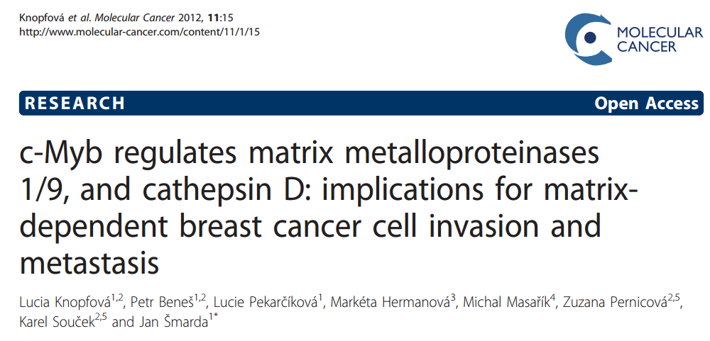
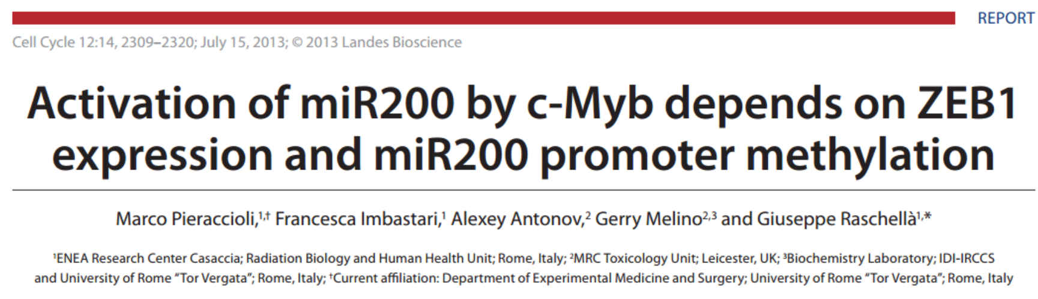

Slide 65
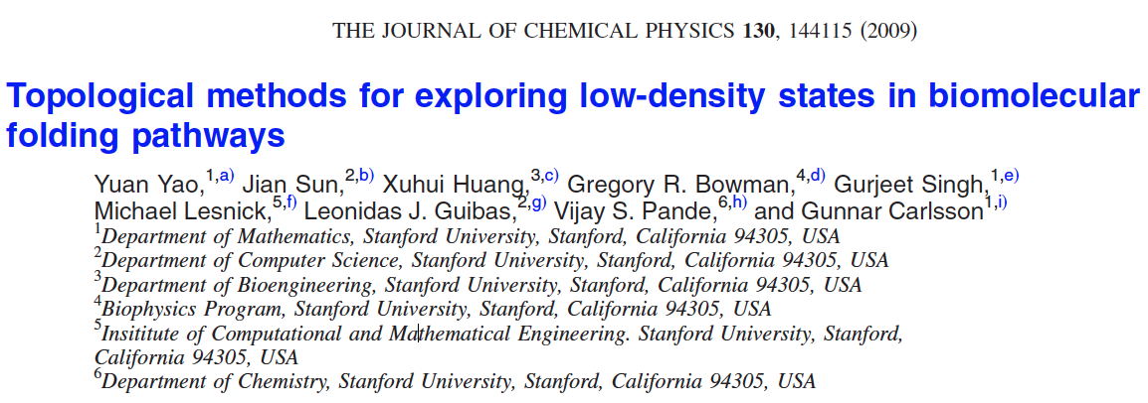
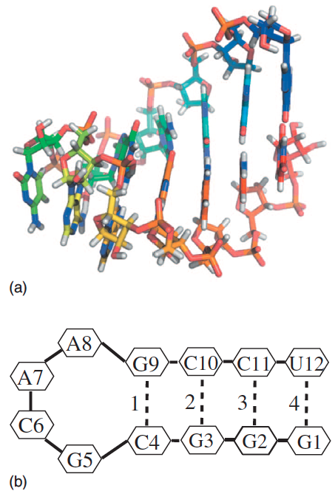
http://scitation.aip.org/content/aip/journal/jcp/130/14/10.1063/1.3103496

Slide 66
Data: Contact maps from 2,800 Serial Replica Exchange Molecular Dynamics (SREMD) simulations of the GCAA tetraloop on the Folding@home distributed computing platform.
760 trajectories with a complete unfolding event
550 trajectories with a complete refolding event.
Goal: To determine secondary structure pathways between folded and unfolded state

Slide 67
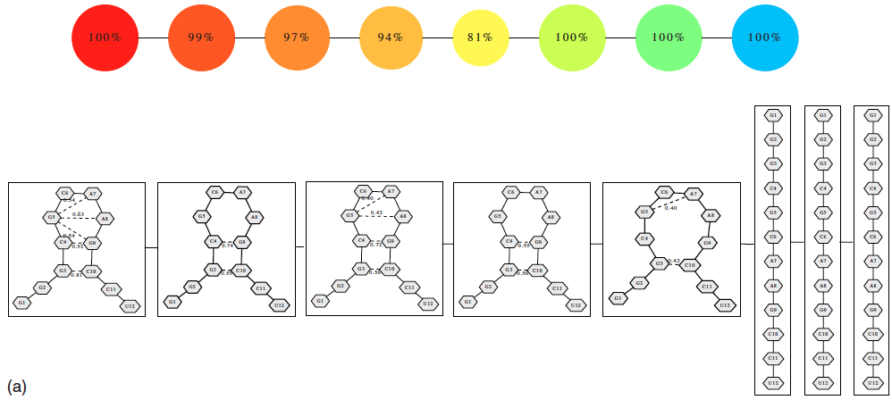
Problem: Many more folded and unfolded conformations than intermediate conformations
How to distinguish intermediate conformations from noise?
Solution
Choose f: space of conformations → R
f(conformation) = density

Slide 68
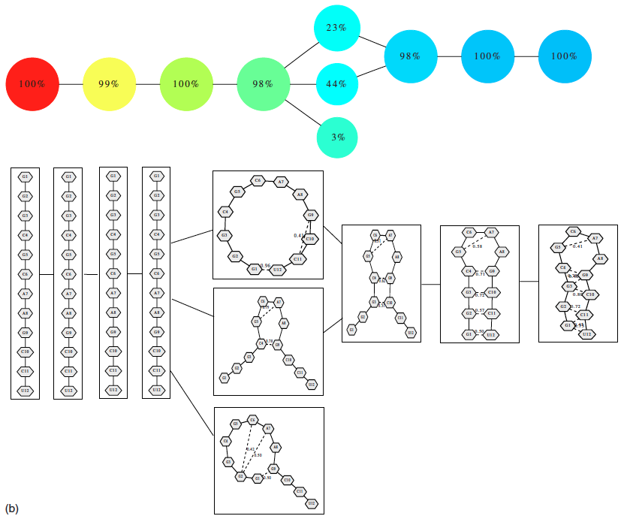
550 trajectories with a complete refolding event
2952 configurations

Slide 69

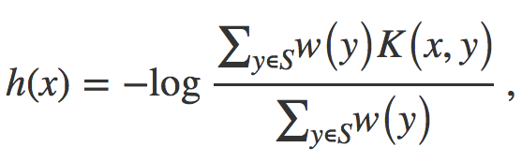


Distance = Hamming distance

Slide 70
550 trajectories with a complete refolding event
2952 configurations

Slide 71
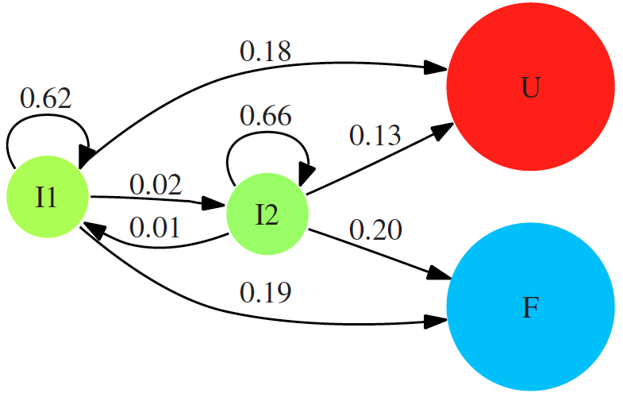

Slide 72
760 trajectories with a complete unfolding event
4330 configurations

