Slide 1
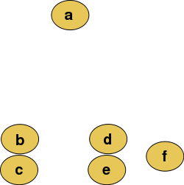
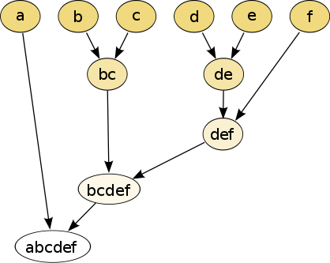
Hierarchical clustering
Isabel K. Darcy
Mathematics Department/Applied Math & Computational Sciences
University of Iowa
http://www.math.uiowa.edu/~idarcy/
This material is based upon work supported by the National Science Foundation under Grant No. DMS-1407216: EXTREEMS-QED: Large Data Analysis and Visualization at the University of Iowa
Any opinions, findings, and conclusions or recommendations expressed in this material are those of the author(s) and do not necessarily reflect the views of the National Science Foundation.
Notes:
data points.
In this very simplified case my data points lie in a two-dimensional plane. Normally data points are high dimensional.
For example, I may be comparing the expression or thousands of genes in tumor cells to healthy cells using microarray data. OR I might be comparing politicians voting records. Or I might be comparing the stats of basketball players. These three applications were all, by the way, published by Lum et al this past February in Nature’s Scientific Reports. I have included a link to their paper on my youtube site.
http://www.nature.com/srep/2013/130207/srep01236/full/srep01236.html

Slide 2
Hierarchical clustering
Data
Dendrogram
http://en.wikipedia.org/wiki/File:Clusters.svg
http://en.wikipedia.org/wiki/File:Hierarchical_clustering_simple_diagram.svg

Slide 3
Increasing threshold
Connect vertices whose distance is less than a given threshold
single linkage hierarchical clustering

Slide 4
Hierarchical clustering
Data
Dendrogram
http://en.wikipedia.org/wiki/File:Clusters.svg
http://en.wikipedia.org/wiki/File:Hierarchical_clustering_simple_diagram.svg

Slide 5
Increasing threshold
Connect vertices (or clusters) whose distance is less than a given threshold

Slide 6
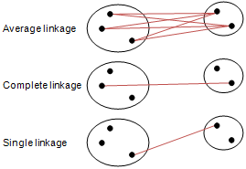
Different type of hierarchical clustering
What is the distance between 2 clusters?
http://en.wikipedia.org/wiki/File:Hierarchical_clustering_simple_diagram.svg
http://www.multid.se/genex/hs515.htm

Slide 7
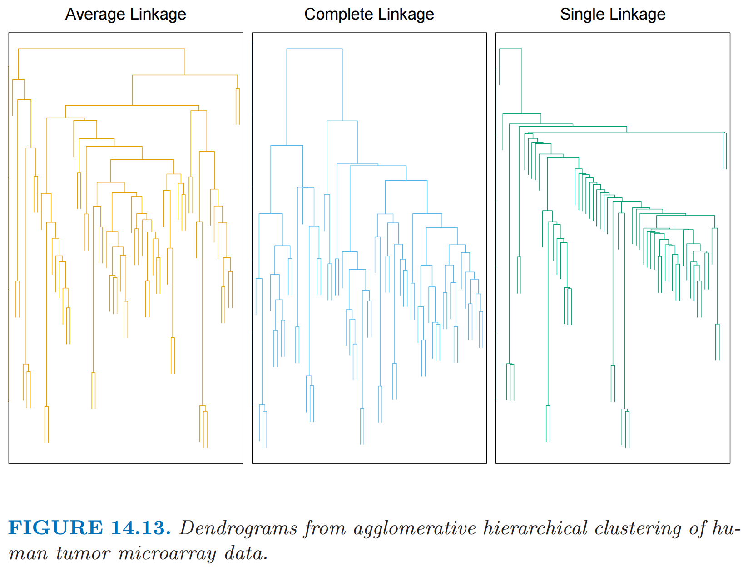
http://statweb.stanford.edu/~tibs/ElemStatLearn/
The Elements of Statistical Learning (2nd edition) Hastie, Tibshirani and Friedman

Slide 8
Goals for Thursday’s lab (meet in basement B5 MLH):
1.) Work with Python Mapper
Note: you must request a CLAS account unless you can run python on your own laptop: https://mail.divms.uiowa.edu/clas_linux/
2.) Work on creating your own code for mapper using functions found in
uploadDatatoRetc.R -- commands for reading data into R.
also includes commands taken from the Swirl course
Manipulating data with dplyr - Getting and Cleaning Data.
NOTE filter commands.
Focus on reading in data and creating overlapping bins. Remaining parts will be discussed later.
3.) Run script TDAmapper.r
4.) Have fun with R.

Slide 9
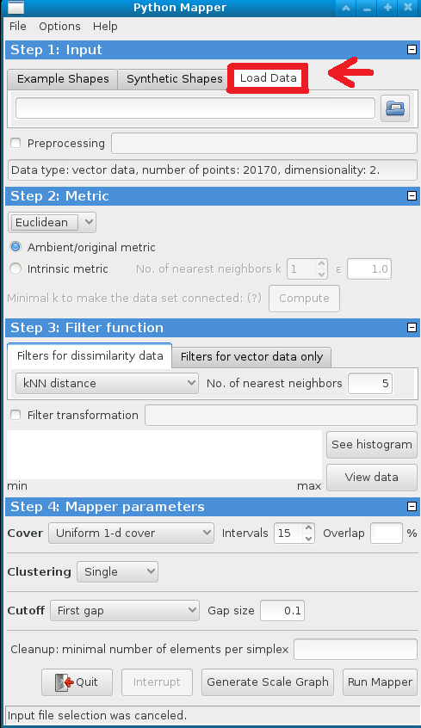
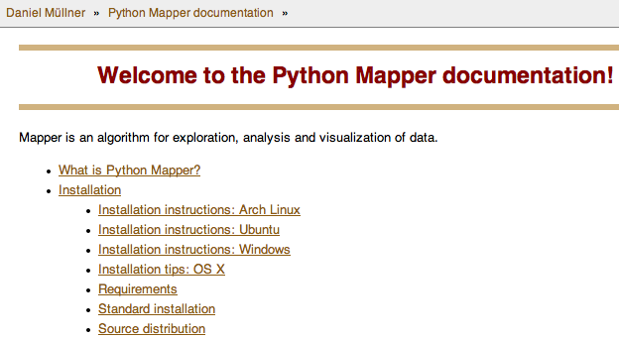
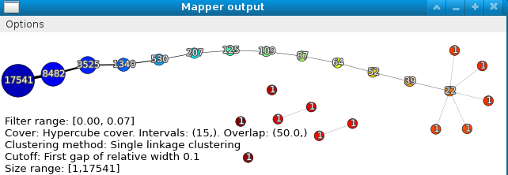
Python Mapper: http://danifold.net/mapper/
See also mappersummary2a.pdf - A quick introduction to Mapper for linux computers in B5 MLH

Slide 10
Goals for Thursday’s lab:
1.) Work with Python Mapper
Note: you must request a CLAS account unless you can run python on your own laptop.
2.) Work on creating your own code for mapper using functions found in
uploadDatatoRetc.R -- commands for reading data into R.
also includes commands taken from the Swirl course
Manipulating data with dplyr - Getting and Cleaning Data.
NOTE filter commands.
Focus on reading in data and creating overlapping bins. Remaining parts will be discussed later.
3.) Run script TDAmapper.r
4.) Have fun with R.

Slide 11
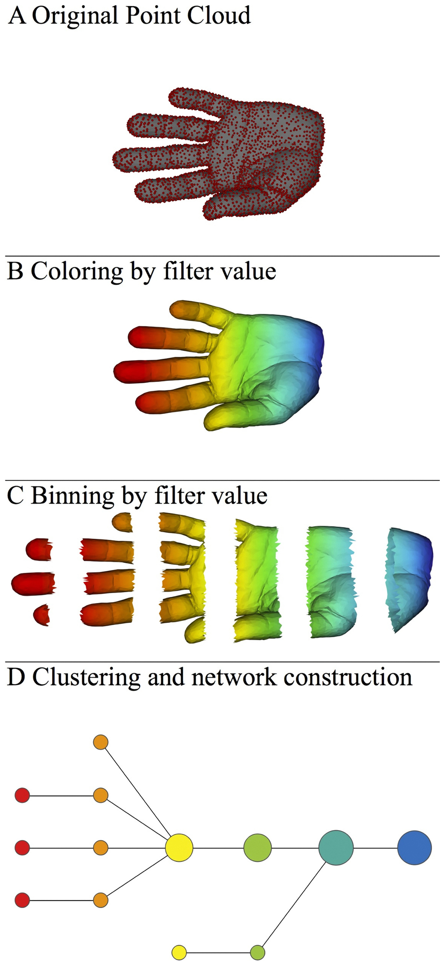
A) Data Set
Example: Point cloud data
representing a hand.
B) Function f : Data Set → R
Example: x-coordinate
f : (x, y, z) → x
Put data into overlapping bins.
Example: f⁻¹(a_{i}, b_{i})
Cluster each bin & create network.
Vertex = a cluster of a bin.
Edge = nonempty intersection
between clusters
http://www.nature.com/srep/2013/130207/srep01236/full/srep01236.html

Slide 12
Goals for Thursday’s lab:
1.) Work with Python Mapper
Note: you must request a CLAS account unless you can run python on your own laptop.
2.) Work on creating your own code for mapper using functions found in
uploadDatatoRetc.R -- commands for reading data into R.
also includes commands taken from the Swirl course
Manipulating data with dplyr - Getting and Cleaning Data.
NOTE filter commands.
Focus on reading in data and creating overlapping bins. Remaining parts will be discussed later.
3.) Run script TDAmapper.r
4.) Have fun with R.
Create Data Sets

Slide 13
What graph do you get when you apply mapper to the above blob if filter = projection to x-axis?

Slide 14
( ( ) ( ) ( ) ( ) ( ) )

Slide 15
( ( ) ( ) ( ) ( ) ( ) )

Slide 16
( ( ) ( ) ( ) ( ) ( ) )

Slide 17
( ( ) ( ) ( ) ( ) ( ) )

Slide 18
( ( ) ( ) ( ) ( ) ( ) )

Slide 19
( ( ) ( ) ( ) ( ) ( ) )

Slide 20
( ( ) ( ) ( ) ( ) ( ) )

Slide 21
( ( ) ( ) ( ) ( ) ( ) )

Slide 22
( ( ) ( ) ( ) ( ) ( ) )

Slide 24
Goals for Thursday’s lab:
1.) Work with Python Mapper
Note: you must request a CLAS account unless you can run python on your own laptop.
2.) Work on creating your own code for mapper using functions found in
uploadDatatoRetc.R -- commands for reading data into R.
also includes commands taken from the Swirl course
Manipulating data with dplyr - Getting and Cleaning Data.
NOTE filter commands.
Focus on reading in data and creating overlapping bins. Remaining parts will be discussed later.
3.) Run script TDAmapper.r
4.) Have fun with R. 5.) Sweave??
Create Data Sets

Slide 25
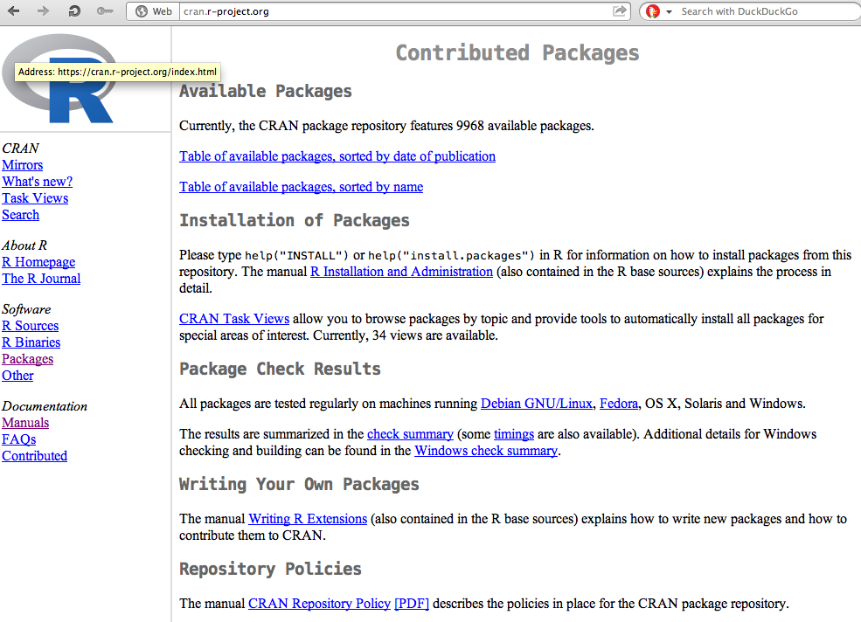
https://cran.r-project.org/
Packages

Slide 26
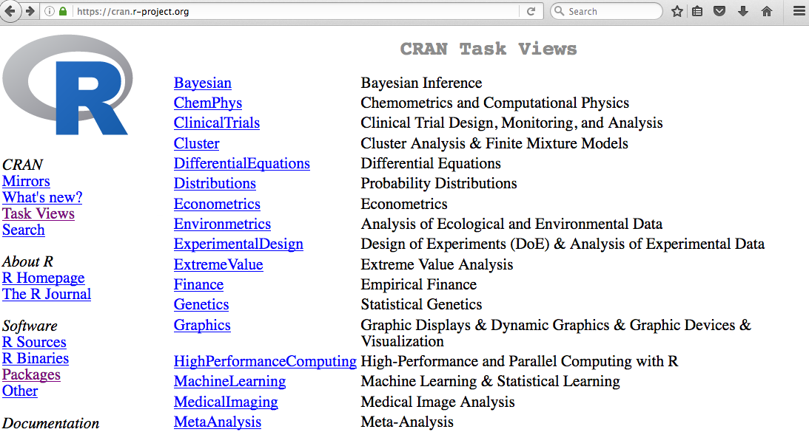

Slide 27
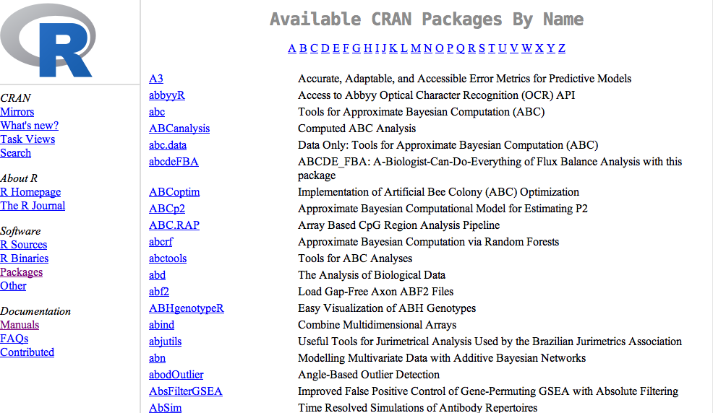

Slide 28
Additional packages can be found at other repositories such as http://bioconductor.org/

Slide 29
The TDAmapper package
Can download source code
useful info

Slide 30
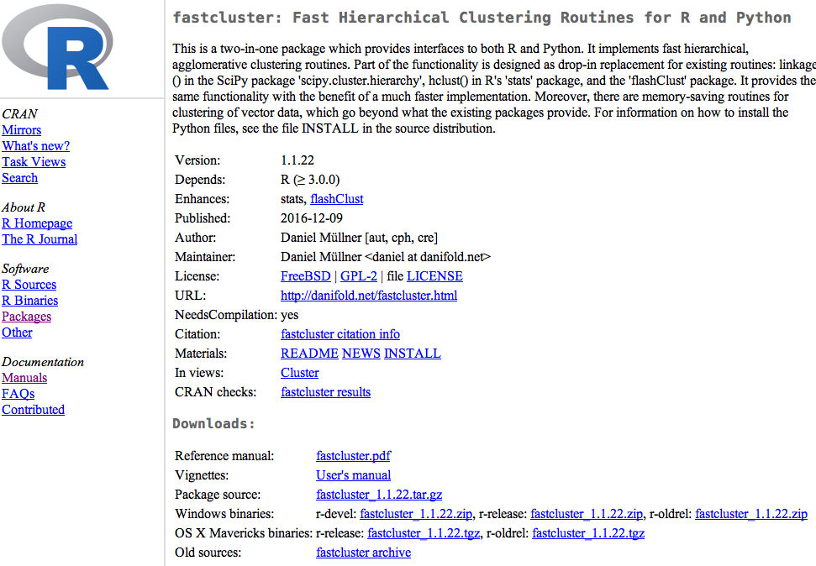
Vignettes are also useful

Slide 31
README
Do not install from GitHub unless you know what your are doing
Install in Rstudio
Examples are sometimes found in READMEs or Vignettes

Slide 32
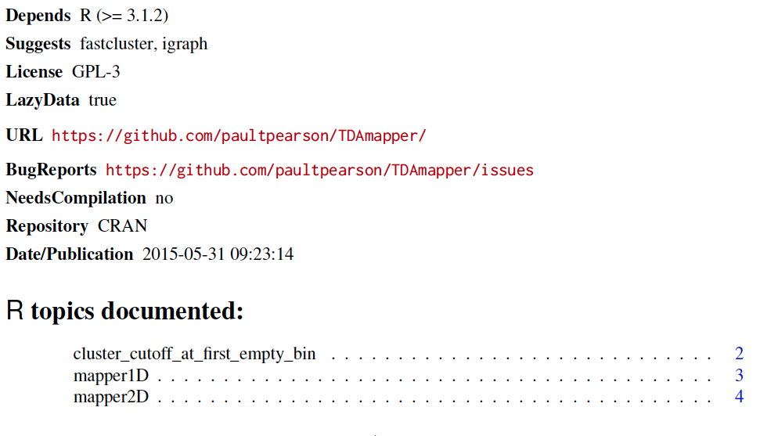
Reference manual:
The reference manual lists all commands contained in the package.

Slide 33
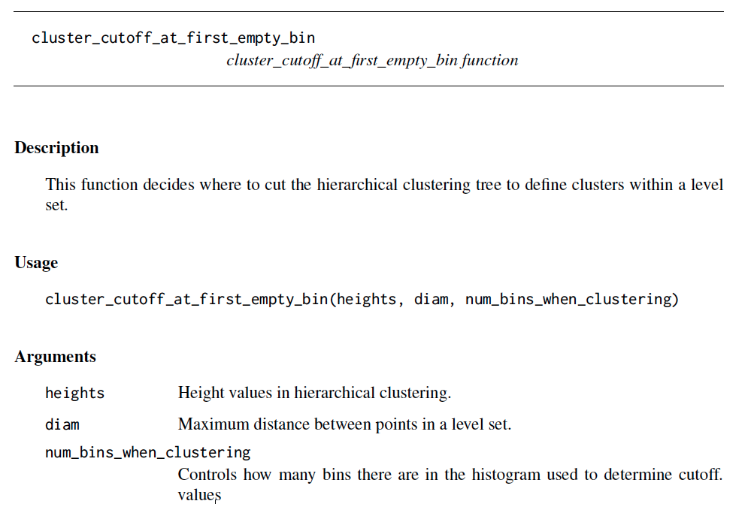
All reference manuals follow same format.
command name
Function inputs
Description of inputs

Slide 34
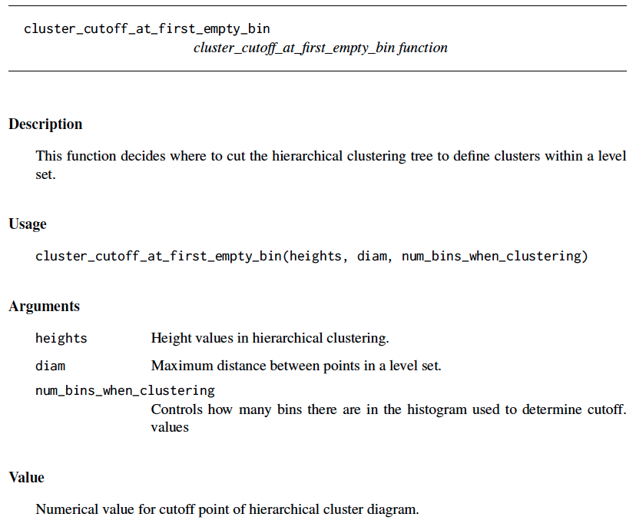
command name
All reference manuals follow same format.
Function inputs
Description of inputs
Description of output(s)

Slide 35
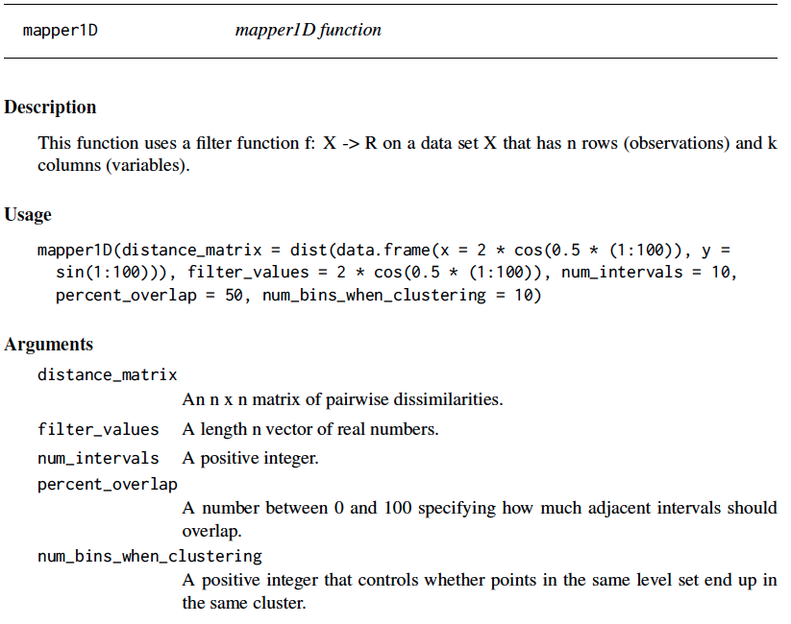

Slide 36
Can download source code
useful info

Slide 37
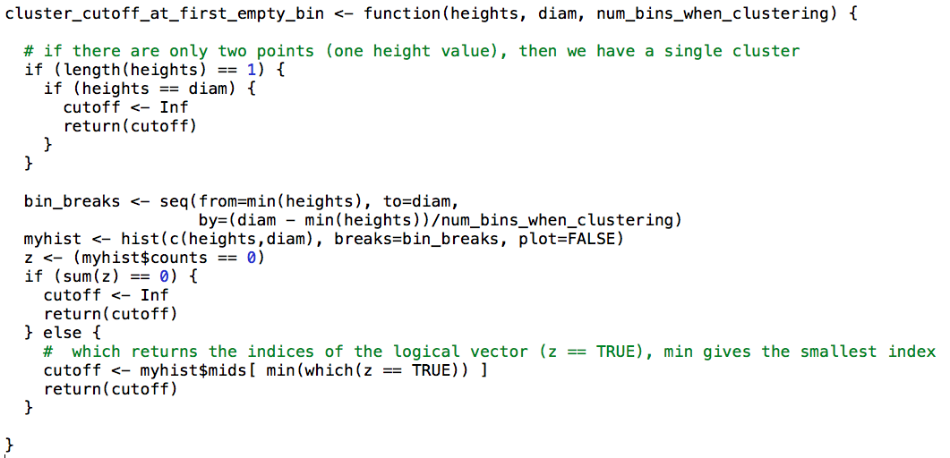

Slide 38
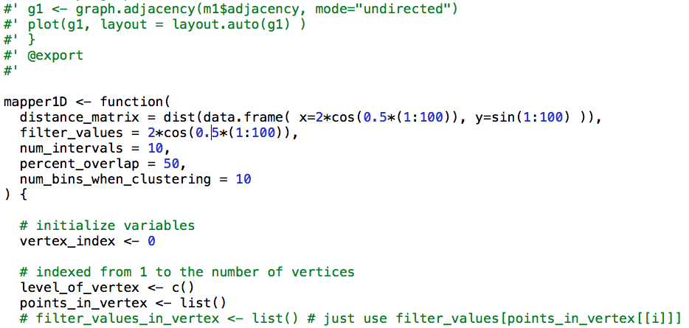
Note the version on GitHub contains commenting

Slide 39
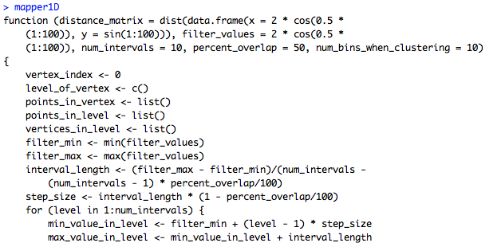
You can take a look at the code in Rstudio for any command just by typing the name of the command.
Note: mapper1d() calls this function
mapper1d allows you to view the code. Note no ()

Slide 40
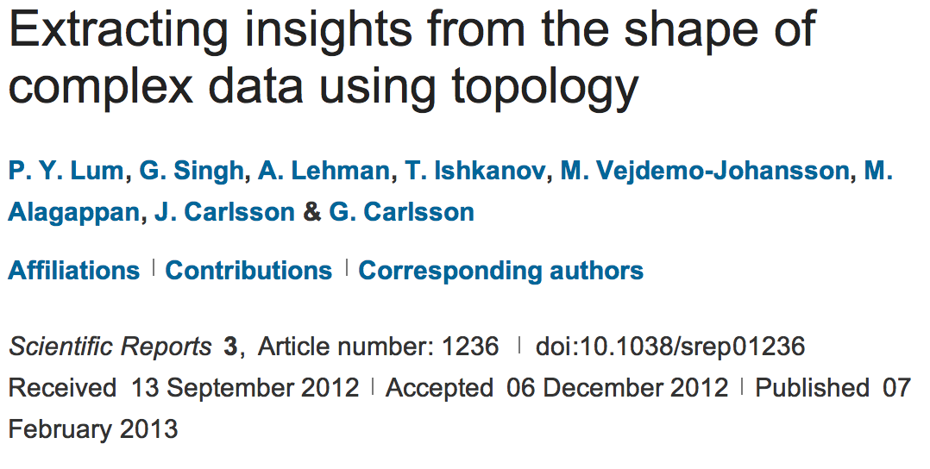
http://www.nature.com/srep/2013/130207/srep01236/full/srep01236.html

Slide 41
A) Data Set
Example: Point cloud data
representing a hand.
B) Function f : Data Set → R
Example: x-coordinate
f : (x, y, z) → x
Put data into overlapping bins.
Example: f⁻¹(a_{i}, b_{i})
Cluster each bin & create network.
Vertex = a cluster of a bin.
Edge = nonempty intersection
between clusters
http://www.nature.com/srep/2013/130207/srep01236/full/srep01236.html

Slide 42
Note: we made many, many choices
It helps to know what you are doing when you make choices, so collaborating with others is highly recommended.

Slide 43
We chose how to model the data set
A) Data Set
Example: Point cloud data
representing a hand.
http://www.nature.com/srep/2013/130207/srep01236/full/srep01236.html
Notes:
Be creative. Use ideas from pure and applied math (including stat) as well as area of application
Missing data, noise

Slide 44
Function f : Data Set → R
Ex 1: x-coordinate
f : (x, y, z) → x
Chose filter function
http://www.nature.com/srep/2013/130207/srep01236/full/srep01236.html

Slide 45
Function f : Data Set → R
Ex 1: x-coordinate
f : (x, y, z) → x
Ex 2: y-coordinate
g : (x, y, z) → y
Chose filter function
http://www.nature.com/srep/2013/130207/srep01236/full/srep01236.html

Slide 46
Function f : Data Set → R
Ex 1: x-coordinate
f : (x, y, z) → x
Chose filter function
Possible filter functions:
Principle component analysis
L-infinity centrality:
f(x) = max{d(x, p) : p in data set}
Norm: f(x) = ||x || = length of x
http://www.nature.com/srep/2013/130207/srep01236/full/srep01236.html
Notes:
Need distance
Depends on what prop you want to explore
Can also choose any co-domain

Slide 47
Chose bins
Put data into overlapping bins.
Example: f⁻¹(a_{i}, b_{i})
If equal length intervals:
Choose length.
Choose % overlap.
http://www.nature.com/srep/2013/130207/srep01236/full/srep01236.html
Notes:
Need covering Resolution multiscale

Slide 48
Create overlapping bins:
http://www.nature.com/srep/2013/130207/srep01236/full/srep01236.html

Slide 49
Chose how to cluster.
Normally need a definition of distance between data points
Cluster each bin & create network.
Vertex = a cluster of a bin.
Edge = nonempty intersection
between clusters
http://www.nature.com/srep/2013/130207/srep01236/full/srep01236.html

Slide 50
Note: Many, many choices were made
It helps to know what you are doing when you make choices, so collaborating with others is highly recommended.

Slide 51
Note: Many, many choices were made
“It is useful to think of it as a camera, with lens adjustments and other settings. A different filter function may generate a network with a different shape, thus allowing one to explore the data from a different mathematical perspective.”
http://www.nature.com/srep/2013/130207/srep01236/full/srep01236.html

Slide 52
Note: we made many, many choices
“It is useful to think of it as a camera, with lens adjustments and other settings. A different filter function may generate a network with a different shape, thus allowing one to explore the data from a different mathematical perspective.”
False positives???
http://www.nature.com/srep/2013/130207/srep01236/full/srep01236.html

Slide 53
False Positives will occur
https://xkcd.com/882/

Slide 54
Note: Many, many choices were made
“It is useful to think of it as a camera, with lens adjustments and other settings. A different filter function may generate a network with a different shape, thus allowing one to explore the data from a different mathematical perspective.”
False positives vs. robustness
http://www.nature.com/srep/2013/130207/srep01236/full/srep01236.html

Slide 55
Topological Data Analysis (TDA): Three key ideas of topology that make extracting of patterns via shape possible.
1.) coordinate free.
No dependence on the coordinate system chosen.
Can compare data derived from different platforms
vital when one is studying data collected with different technologies, or from different labs when the methodologies cannot be standardized.
http://www.nature.com/srep/2013/130207/srep01236/full/srep01236.html

Slide 56
Topological Data Analysis (TDA): Three key ideas of topology that make extracting of patterns via shape possible.
2.) invariant under “small” deformations.
less sensitive to noise
Topological Methods for the Analysis of High Dimensional
Data Sets and 3D Object Recognition, Singh, Mémoli, Carlsson
Figure from http://comptop.stanford.edu/u/preprints/mapperPBG.pdf
http://www.nature.com/srep/2013/130207/srep01236/full/srep01236.html

Slide 57
Topological Data Analysis (TDA): Three key ideas of topology that make extracting of patterns via shape possible.
3.) compressed representations of shapes.
Input: dataset with thousands of points
Output: network with
13 vertices and 12 edges.
http://www.nature.com/srep/2013/130207/srep01236/full/srep01236.html

Slide 58
http://www.nature.com/srep/2013/130207/srep01236/full/srep01236.html

Slide 59
Chose filter
Only need to cover the data points.
http://www.nature.com/srep/2013/130207/srep01236/full/srep01236.html

Slide 60
Chose filter
http://www.nature.com/srep/2013/130207/srep01236/full/srep01236.html

Slide 61
Chose filter
http://www.nature.com/srep/2013/130207/srep01236/full/srep01236.html

Slide 62
Application 3 (in paper): Basketball
Data: rates (per minute played) of rebounds, assists, turnovers, steals, blocked shots, personal fouls, and points scored for 452 players.
➔ Input: 452 points in R⁷
For each player, we have a vector
= (r, a, t, s, b, f, p) in R⁷
Distance: variance normalized Euclidean distance.
Clustering: Single linkage.
( min , min , min , min , min , min , min )
rebounds assists turnovers steals blocked shots personal fouls points scored
http://www.nature.com/srep/2013/130207/srep01236/full/srep01236.html

Slide 63
Filters: principle and secondary SVD values.
http://commons.wikimedia.org/wiki/File:SVD_Graphic_Example.png
Data
http://www.nature.com/srep/2013/130207/srep01236/full/srep01236.html

Slide 64
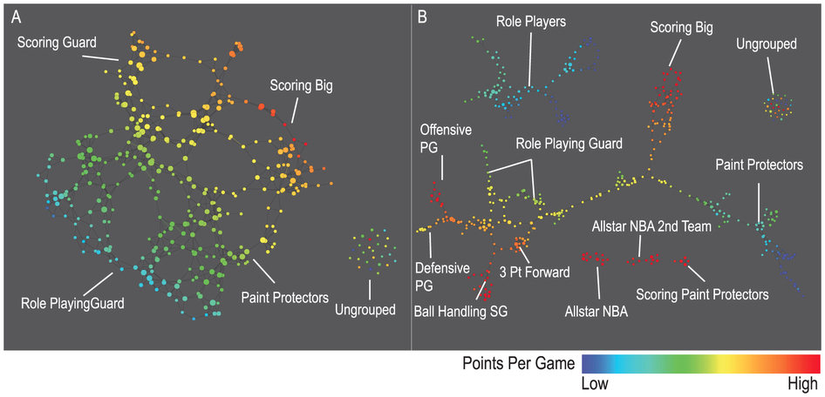
A) Low resolution map at 20 intervals for each filter B) High resolution map at 30 intervals for each filter. The overlap is such at that each interval overlaps with half of the adjacent intervals, the graphs are colored by points per game, and a variance normalized Euclidean distance metric is applied. Metric: Variance Normalized Euclidean; Lens: Principal SVD Value (Resolution 20, Gain 2.0x, Equalized) and Secondary SVD Value (Resolution 20, Gain 2.0x, Equalized). Color: red: high values, blue: low values.
http://www.nature.com/srep/2013/130207/srep01236/full/srep01236.html

Slide 65
LeBron James , Kobe Bryant, Brook Lopez
A) Low resolution map at 20 intervals for each filter B) High resolution map at 30 intervals for each filter. The overlap is such at that each interval overlaps with half of the adjacent intervals, the graphs are colored by points per game, and a variance normalized Euclidean distance metric is applied. Metric: Variance Normalized Euclidean; Lens: Principal SVD Value (Resolution 20, Gain 2.0x, Equalized) and Secondary SVD Value (Resolution 20, Gain 2.0x, Equalized). Color: red: high values, blue: low values.
http://www.nature.com/srep/2013/130207/srep01236/full/srep01236.html
Notes:
Compare how graphs drawn. Note disconnected means not close Don’t be mislead by graph drawing

Slide 66
Application 2: US House of Representatives Voting records
Data: (aye, abstain, nay, …. )
= ( +1 , 0 , -1 , … )
Distance: Pearson correlation
Filters: principal and secondary metric SVD
Clustering: Single linkage.
http://www.nature.com/srep/2013/130207/srep01236/full/srep01236.html

Slide 67
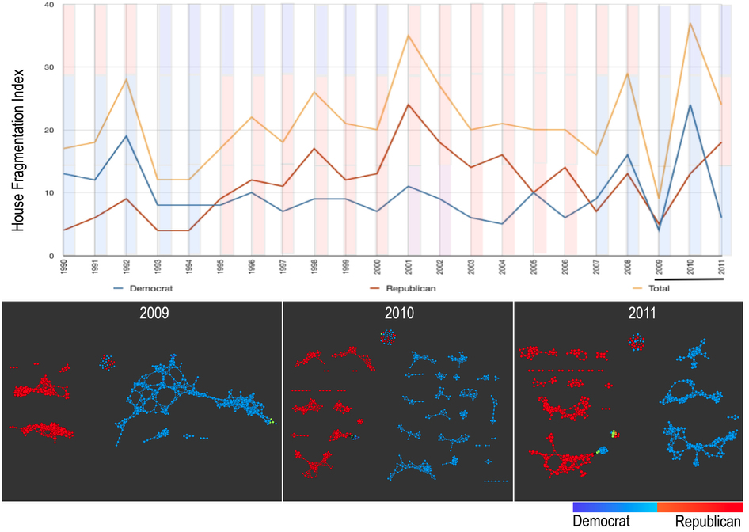
number of sub-networks formed each year per political party.
X-axis: 1990–2011. Y-axis: Fragmentation index. Color bars denote, from top to bottom, party of the President, party for the House, party for the Senate (red: republican; blue: democrat; purple: split). The bottom 3 panels are the actual topological networks for the members. Networks are constructed from voting behavior of the member of the house, with an “aye” vote coded as a 1, “abstain” as zero, and “nay” as a -1. Each node contains sets of members. Each panel labeled with the year contains networks constructed from all the members for all the votes of that year. Note high fragmentation in 2010 in both middle panel and in the Fragmentation Index plot (black bar). The distance metric and filters used in the analysis were Pearson correlation and principal and secondary metric SVD. Metric: Correlation; Lens: Principal SVD Value (Resolution 120, Gain 4.5x, Equalized) and Secondary SVD Value (Resolution 120, Gain 4.5x, Equalized). Color: Red: Republican; Blue: Democrats.
http://www.nature.com/srep/2013/130207/srep01236/full/srep01236.html

Slide 68
They determined what issues divided Republicans into the two main sub-groups in 2009:
The Credit Cardholders' Bill of Rights,
To reauthorize the Marine Turtle Conservation Act of 2004,
Generations Invigorating Volunteerism and Education (GIVE) Act,
To restore sums to the Highway Trust Fund and for other purposes,
Captive Primate Safety Act, Solar Technology Roadmap Act, Southern Sea Otter Recovery and Research Act.
http://www.nature.com/srep/2013/130207/srep01236/full/srep01236.html

Slide 69
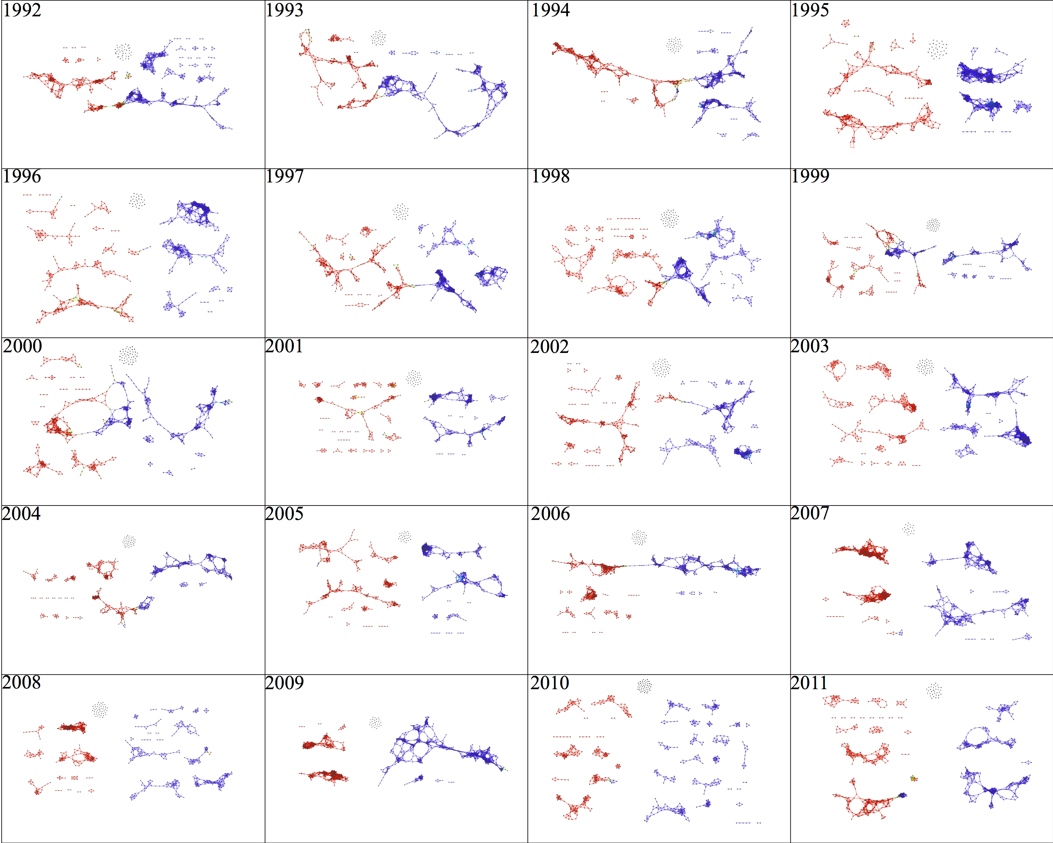

Slide 70
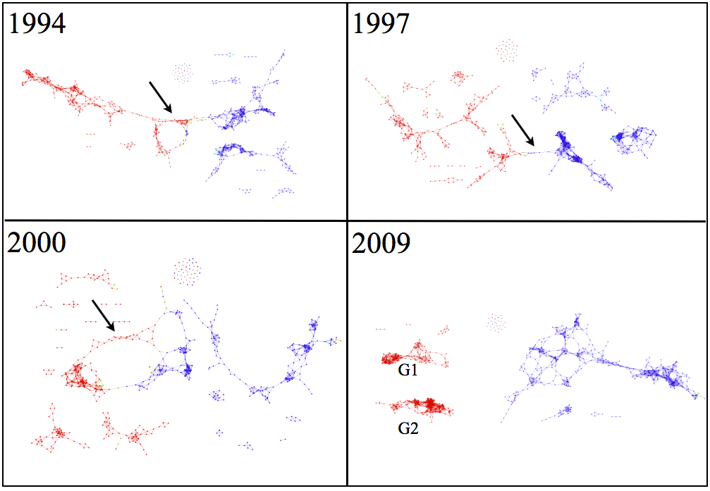

Slide 71
Application 1: breast cancer gene expression
Data: microarray gene expression data from 2 data sets, NKI and GSE2034
Distance: correlation distance
Filters: (1) L-infinity centrality:
f(x) = max{d(x, p) : p in data set}
captures the structure of the points far removed from the center or norm.
(2) NKI: survival vs. death
GSE2034: no relapse vs. relapse
Clustering: Single linkage.

Slide 72
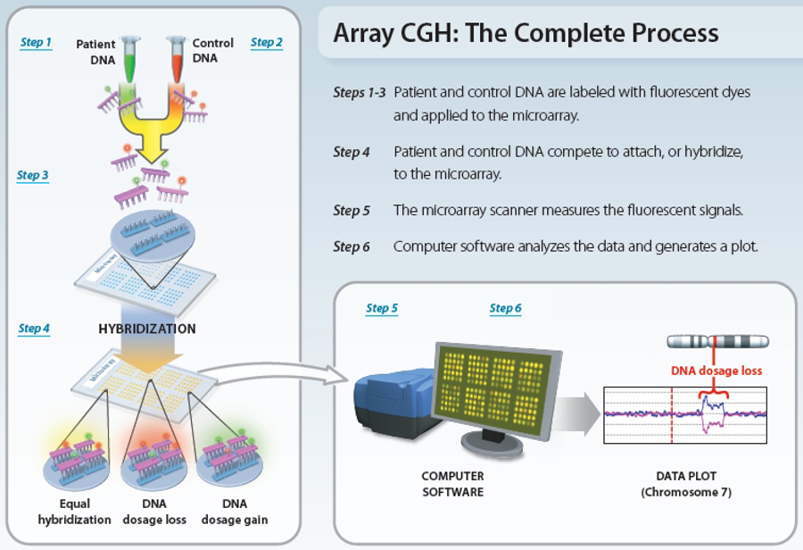
www.nature.com/scitable/topicpage/microarray-based-comparative-genomic-hybridization-acgh-45432

Slide 73
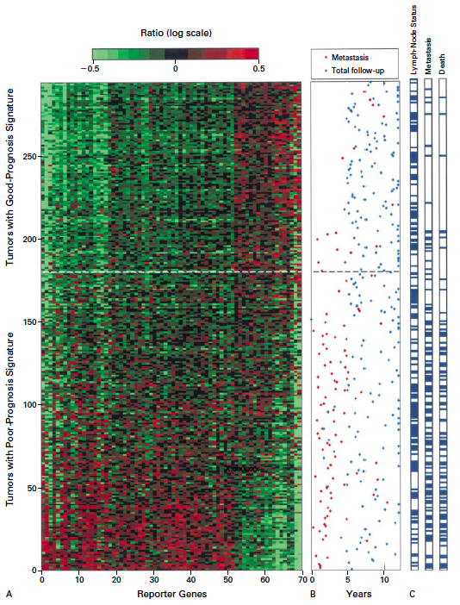
Gene expression profiling predicts clinical outcome of breast cancer
van 't Veer LJ, Dai H, van de Vijver MJ, He YD, Hart AA, Mao M, Peterse HL, van der Kooy K, Marton MJ, Witteveen AT, Schreiber GJ, Kerkhoven RM, Roberts C, Linsley PS, Bernards R, Friend SH
Nature. 2002 Jan 31;415(6871):530-6.

Slide 74
2 breast cancer data sets:
1.) NKI (2002):
gene expression levels of 24,000 from 272 tumors. Includes node-negative and node-positive patients, who had or had not received adjuvant systemic therapy. Also includes survival information.
2.) GSE203414 (2005)
expression of 22,000 transcripts from total RNA of frozen tumour samples from 286 lymph-node-negative patients who had not received adjuvant systemic treatment. Also includes time to relapse information.

Slide 75
Fig. S1. Shape of the data becomes more distinct as the analysis columns are restricted to the top
varying genes.
24K: all the genes on the microarray were used in the analysis;
11K: 10,731 top most varying genes were used in the analysis;
7K: 6.688 top most varying genes were used in the analysis;
3K: 3212 top most varying genes were used in the analysis;
1.5K: 1553 top most varying genes were used in the analysis.
Graphs colored by the L-infinity centrality values. Red: high; Blue: low
http://www.nature.com/srep/2013/130207/srep01236/full/srep01236.html

Slide 76
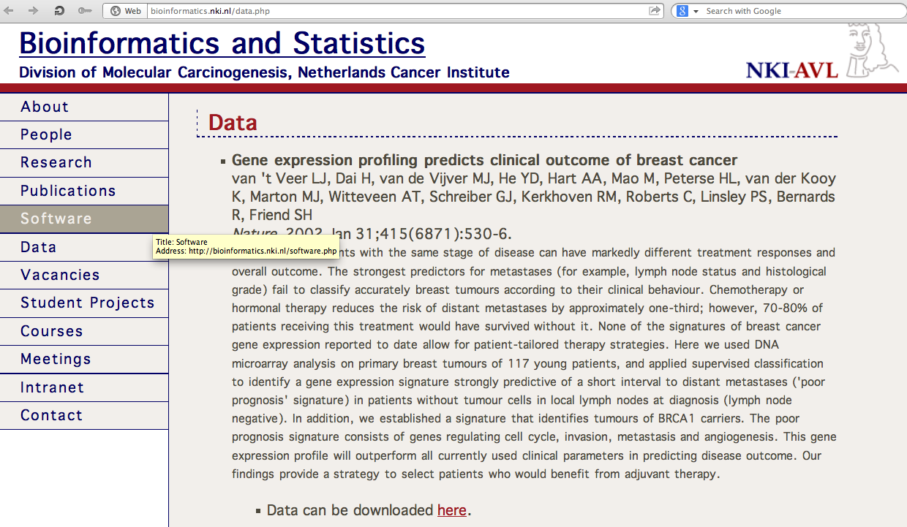
http://bioinformatics.nki.nl/data.php

Slide 77
Comparison of our results with those of Van de Vijver and colleagues is difficult because of differences in patients, techniques, and materials used.
Their study included node-negative and node-positive patients, who had or had not received adjuvant systemic therapy, and only women younger than 53 years.
microarray platforms used in the studies differ—Affymetrix and Agilent.
Of the 70 genes in the study by van't Veer and co-workers, 48 are present on the Affymetrix U133a array, whereas only 38 of our 76 genes are present on the Agilent array. There is a three-gene overlap between the two signatures (cyclin E2, origin recognition complex, and TNF superfamily protein).
Despite the apparent difference, both signatures included genes that identified several common pathways that might be involved in tumour recurrence. This finding supports the idea that although there might be redundancy in gene members, effective signatures could be required to include representation of specific pathways.
From: Gene-expression profiles to predict distant metastasis of lymph-node-negative primary breast cancer, Yixin Wang et al, The Lancet, Volume 365, Issue 9460, 19–25 February 2005, Pages 671–679

Slide 78
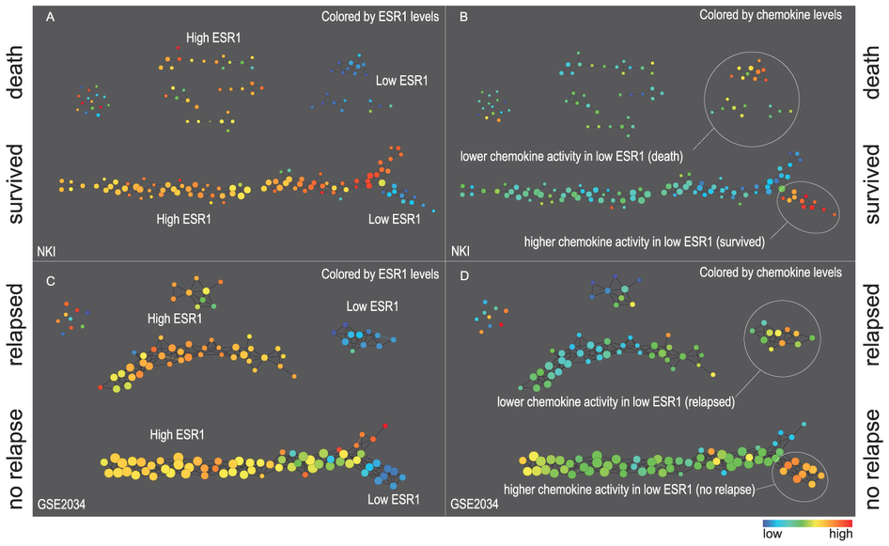
Two filter functions, L-Infinity centrality and survival or relapse were used to generate the networks. The top half of panels A and B are the networks of patients who didn't survive, the bottom half are the patients who survived. Panels C and D are similar to panels A and B except that one of the filters is relapse instead of survival. Panels A and C are colored by the average expression of the ESR1 gene. Panels B and D are colored by the average expression of the genes in the KEGG chemokine pathway. Metric: Correlation; Lens: L-Infinity Centrality (Resolution 70, Gain 3.0x, Equalized) and Event Death (Resolution 30, Gain 3.0x). Color bar: red: high values, blue: low values.
http://www.nature.com/srep/2013/130207/srep01236/full/srep01236.html

Slide 79
Identifying subtypes of cancer in a consistent manner is a challenge in the field since sub-populations can be small and their relationships complex
High expression level of the estrogen receptor gene (ESR1) is positively correlated with improved prognosis, given that this set of patients is likely to respond to standard therapies.
But , there are still sub-groups of high ESR1 that do not respond well to therapy.
Low ESR1 levels are strongly correlated with poor prognosis
But there are patients with low ESR1 levels but high survival rates
Many molecular sub-groups have been identified,
But often difficult to identify the same sub-group in a broader setting, where data sets are generated on different platforms, on different sets of patients and at a different times, because of the noise and complexity in the data.
http://www.nature.com/srep/2013/130207/srep01236/full/srep01236.html

Slide 80
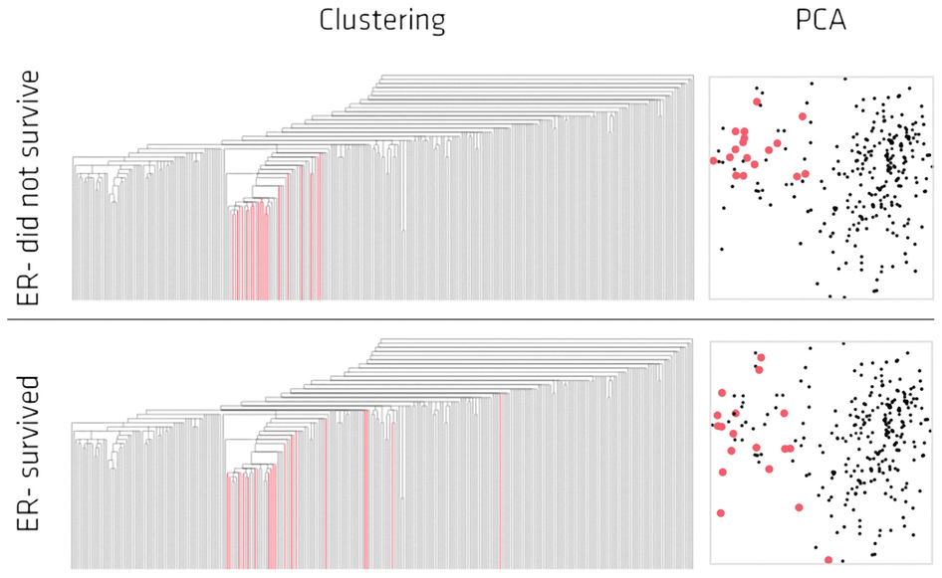
Highlighted in red are the lowERNS (top panel) and the lowERHS (bottom panel) patient sub-groups.
http://www.nature.com/srep/2013/130207/srep01236/full/srep01236.html

Slide 81
http://www.pnas.org/content/early/2011/04/07/1102826108

Slide 82
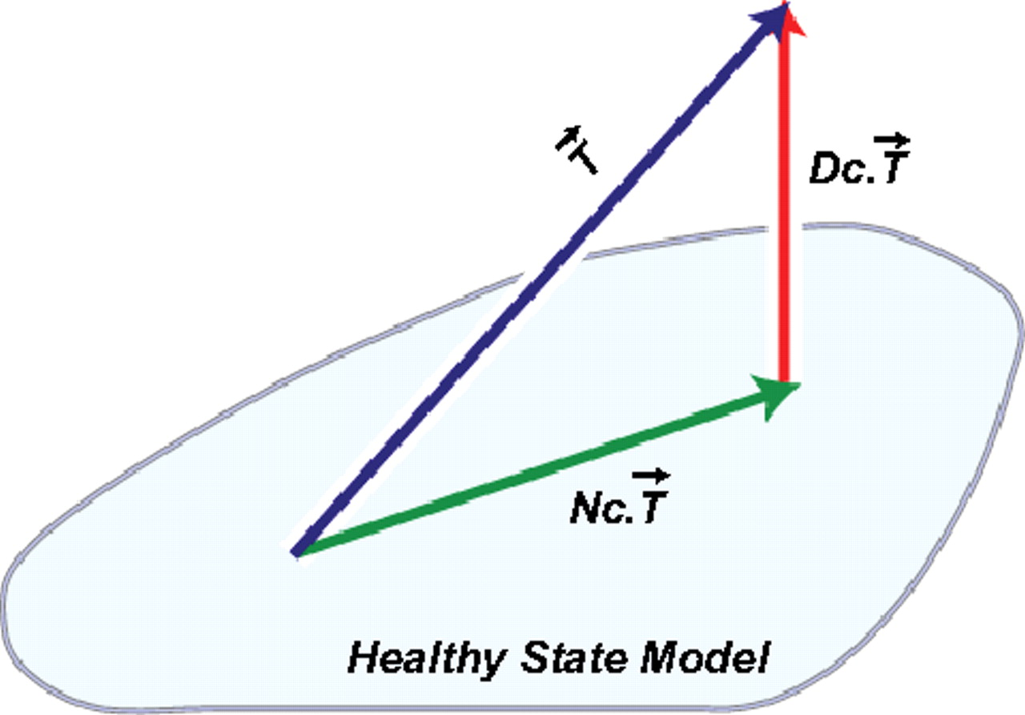
DSGA decomposition of the original tumor vector into the Normal component its linear models fit onto the Healthy State Model and the Disease component vector of residuals.
Nicolau M et al. PNAS 2011;108:7265-7270
©2011 by National Academy of Sciences
Notes:
DSGA decomposition of the original tumor vector into the Normal component its linear models fit onto the Healthy State Model and the Disease component vector of residuals.

Slide 83
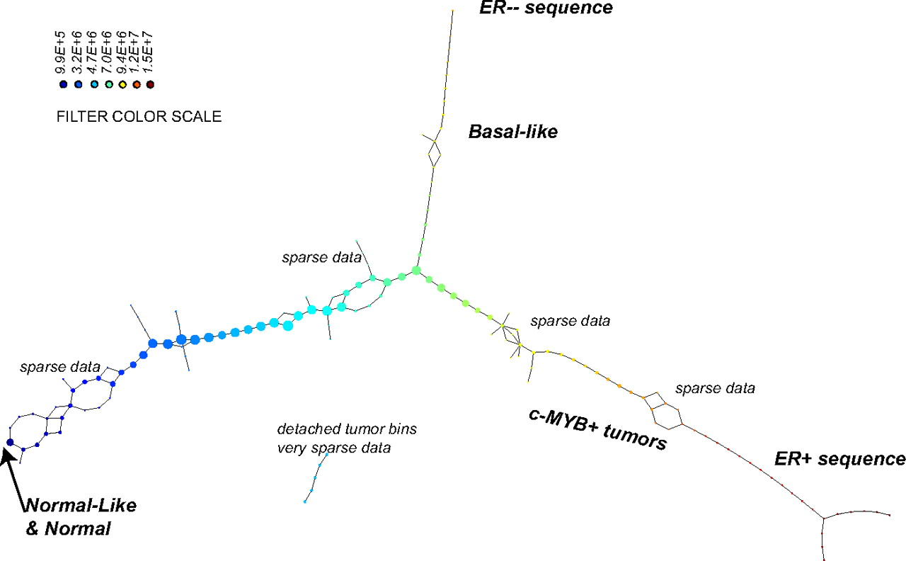
PAD analysis of the NKI data. The output has three progression arms, because tumors (data points) are ordered by the magnitude of deviation from normal (the HSM). Each bin is colored by the mean of the filter map on the points. Blue bins contain tumors whose total deviation from HSM is small (normal and Normal-like tumors). Red bins contain tumors whose deviation from HSM is large. The image of f was subdivided into 15 intervals with 80% overlap. All bins are seen (outliers included). Regions of sparse data show branching. Several bins are disconnected from the main graph. The ER− arm consists mostly of Basal tumors. The c-MYB+ group was chosen within the ER arm as the tightest subset, between the two sparse regions.
PAD analysis of the NKI data.
Nicolau M et al. PNAS 2011;108:7265-7270
©2011 by National Academy of Sciences
Notes:
PAD analysis of the NKI data. The output has three progression arms, because tumors (data points) are ordered by the magnitude of deviation from normal (the HSM). Each bin is colored by the mean of the filter map on the points. Blue bins contain tumors whose total deviation from HSM is small (normal and Normal-like tumors). Red bins contain tumors whose deviation from HSM is large. The image of f was subdivided into 15 intervals with 80% overlap. All bins are seen (outliers included). Regions of sparse data show branching. Several bins are disconnected from the main graph. The ER− arm consists mostly of Basal tumors. The c-MYB+ group was chosen within the ER arm as the tightest subset, between the two sparse regions.

Slide 84
PAD analysis of the NKI data. The output has three progression arms, because tumors (data points) are ordered by the magnitude of deviation from normal (the HSM). Each bin is colored by the mean of the filter map on the points. Blue bins contain tumors whose total deviation from HSM is small (normal and Normal-like tumors). Red bins contain tumors whose deviation from HSM is large. The image of f was subdivided into 15 intervals with 80% overlap. All bins are seen (outliers included). Regions of sparse data show branching. Several bins are disconnected from the main graph. The ER− arm consists mostly of Basal tumors. The c-MYB+ group was chosen within the ER arm as the tightest subset, between the two sparse regions.
PAD analysis of the NKI data.
Nicolau M et al. PNAS 2011;108:7265-7270
©2011 by National Academy of Sciences
Notes:
PAD analysis of the NKI data. The output has three progression arms, because tumors (data points) are ordered by the magnitude of deviation from normal (the HSM). Each bin is colored by the mean of the filter map on the points. Blue bins contain tumors whose total deviation from HSM is small (normal and Normal-like tumors). Red bins contain tumors whose deviation from HSM is large. The image of f was subdivided into 15 intervals with 80% overlap. All bins are seen (outliers included). Regions of sparse data show branching. Several bins are disconnected from the main graph. The ER− arm consists mostly of Basal tumors. The c-MYB+ group was chosen within the ER arm as the tightest subset, between the two sparse regions.

Slide 85
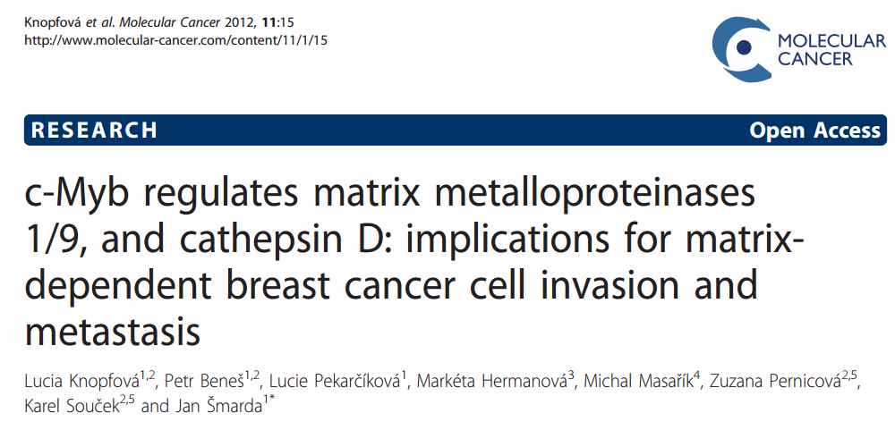

Slide 86
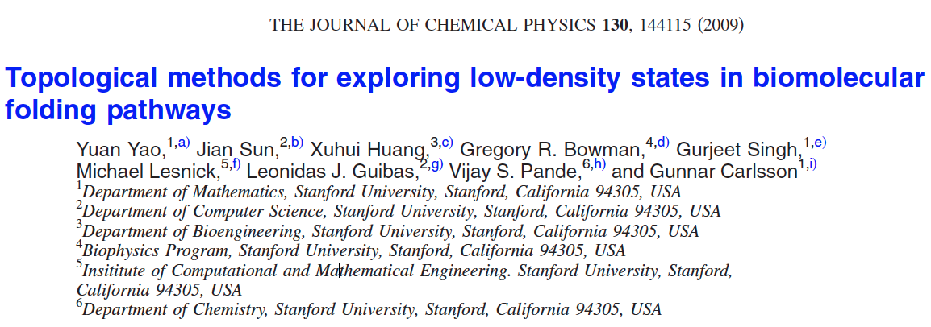
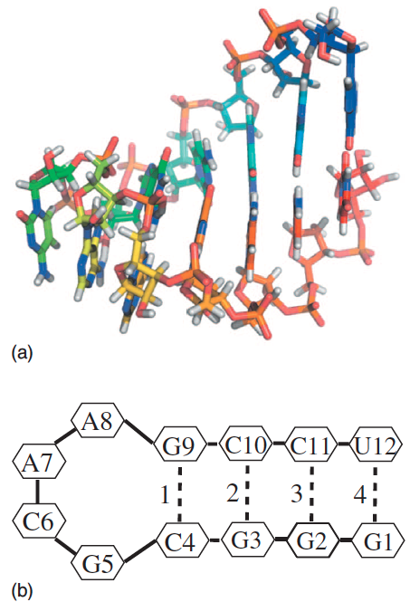
http://scitation.aip.org/content/aip/journal/jcp/130/14/10.1063/1.3103496

Slide 87
Data: Contact maps from 2,800 Serial Replica Exchange Molecular Dynamics (SREMD) simulations of the GCAA tetraloop on the Folding@home distributed computing platform.
760 trajectories with a complete unfolding event
550 trajectories with a complete refolding event.
Goal: To determine secondary structure pathways between folded and unfolded state

Slide 88
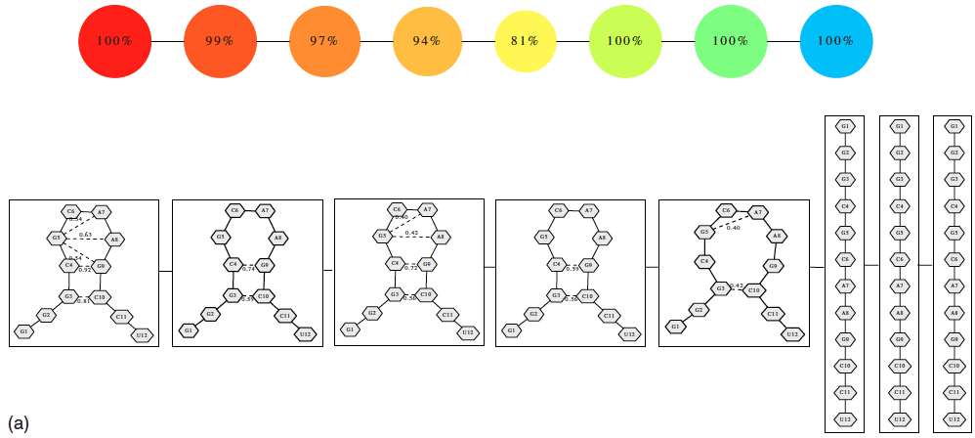
Problem: Many more folded and unfolded conformations than intermediate conformations
How to distinguish intermediate conformations from noise?
Solution
Choose f: space of conformations → R
f(conformation) = density

Slide 89
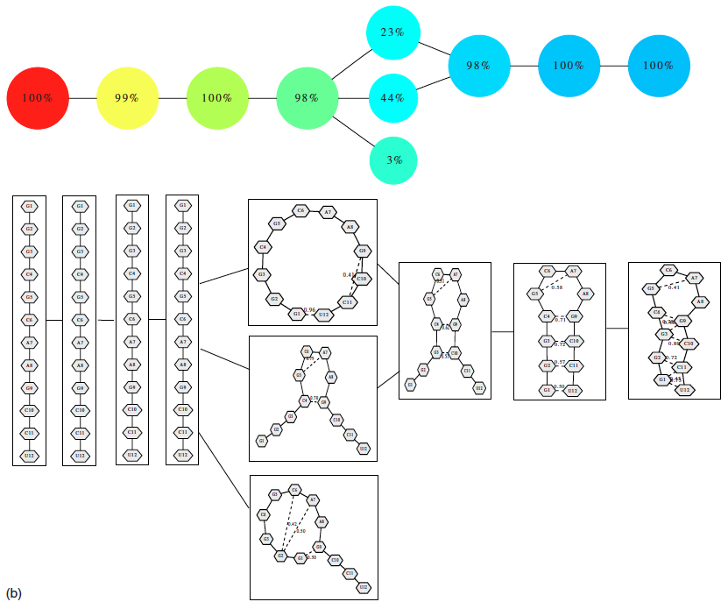
550 trajectories with a complete refolding event
2952 configurations

Slide 90
Distance = Hamming distance

Slide 91
550 trajectories with a complete refolding event
2952 configurations

Slide 92
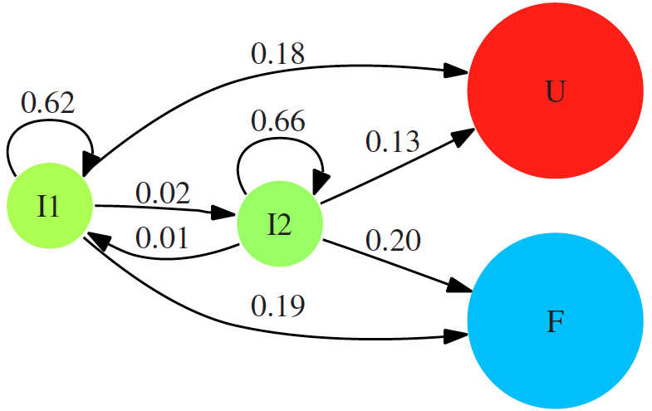

Slide 93
760 trajectories with a complete unfolding event
4330 configurations

