Slide 1
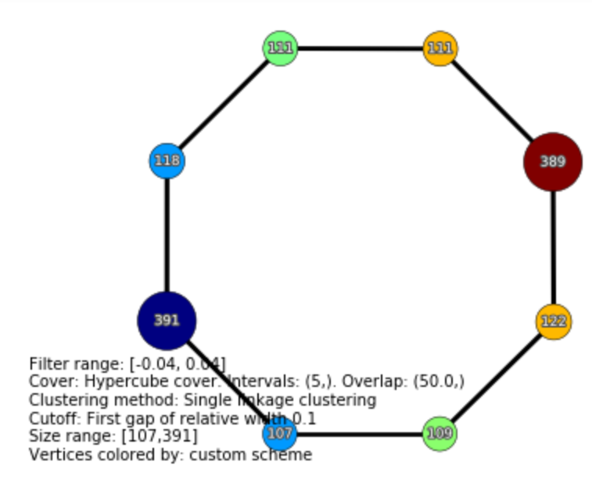
In Jupyter notebook
Choose how to color vertices in TDA mapper graph
Output the color code for each node in TDA mapper graph

Slide 2
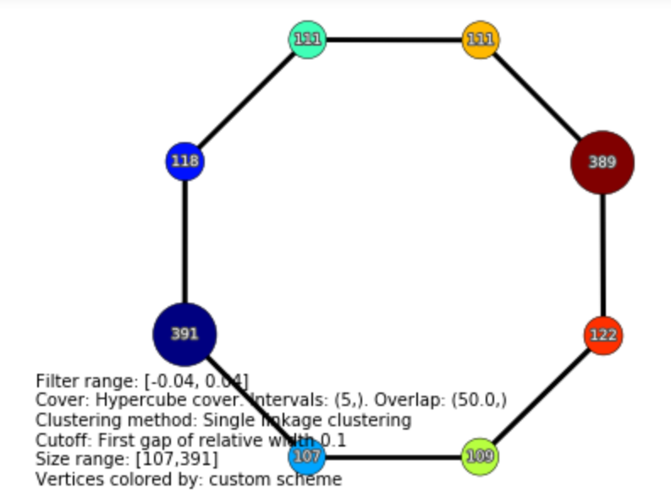
In Jupyter notebook
Choose how to color vertices in TDA mapper graph
Output the color code for each node in TDA mapper graph

Slide 3
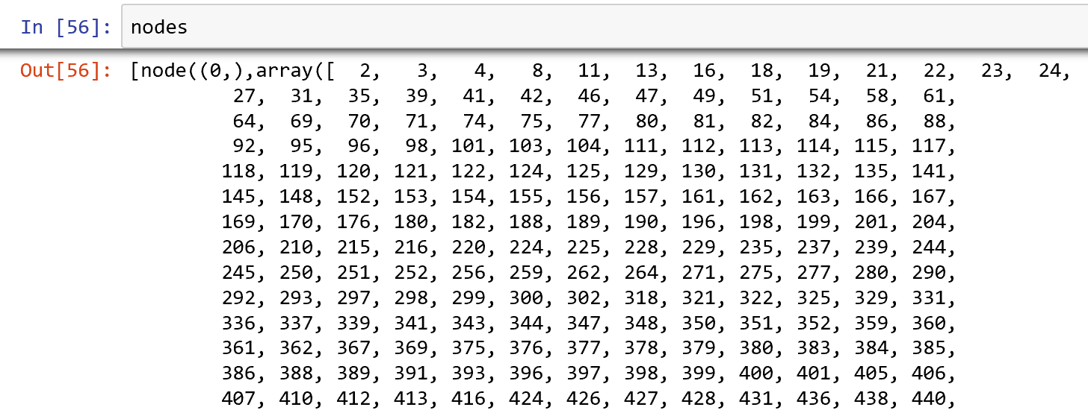

Slide 4
