Slide 1
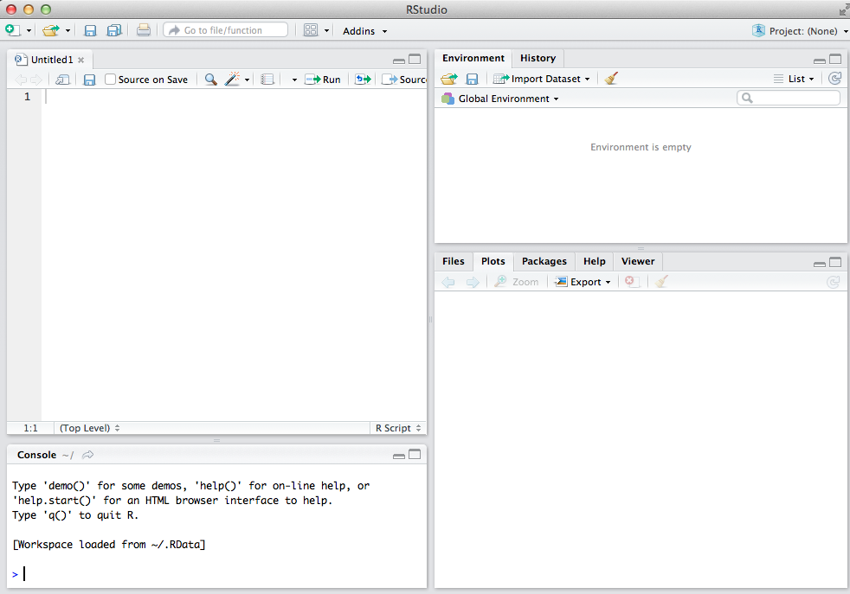
This is where R scripts will load. Feel free to modify R scripts (you may wish to save older versions).
List of all available data sets and variables.
This is where you will see images and help info, etc.
This is where you type commands (unless creating a script).

Slide 2
This is where you type commands (unless creating a script).

Slide 3
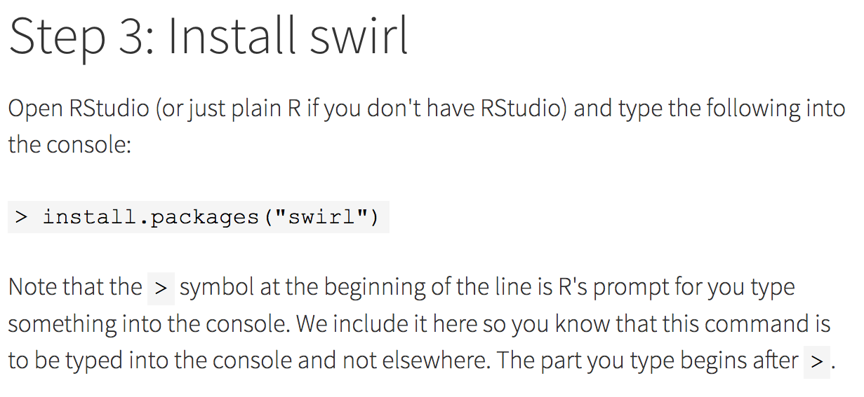
If you would like to learn R or statistics or data analysis via Swirl:
http://swirlstats.com/students.html

Slide 4
After you have installed a package using
> install.packages(“swirl”)
You can load the package using the library command:
> library(swirl)
Use the following to install Swirl courses:
> install_from_swirl("Course Name Here")
The following will start swirl:
> swirl()
For a list of courses:
http://swirlstats.com/scn/title.html
https://github.com/swirldev/swirl_courses#swirl-courses

Slide 5
Some notes:
1.) Normally you only need to install a package once.
e.g > install.packages(“TDAmapper”)
2.) If you want to use a package, you must load it
e.g > library(“TDAmapper”)
You only need to do this once per session.
3.) If you want to repeat a command, you can use the up-arrow on your keyboard to obtain previously typed commands in the console.
4.) When you start typing commands, R will show you some choices. You can click on the one you want.

Slide 6
This is where R scripts will load. Feel free to modify R scripts (you may wish to save older versions).
List of all available data sets and variables.
This is where you will see images and help info, etc.
This is where you type commands (unless creating a script).

Slide 7
If you click on a .r file, it will load in the upper left box of R-studio. You can also copy and past r scripts (.r files) into this box.
You can download some data files from
http://homepage.divms.uiowa.edu/~idarcy/COURSES/TDA/Data
Some sample R scripts available at http://homepage.divms.uiowa.edu/~idarcy/COURSES/TDA/Rfiles
Matrices_and_Data_Frames.R: commands from the Swirl course by this name.
uploadDatatoRetc.R: commands for reading data into R. Also includes commands from the Swirl course: Manipulating data with dplyr - Getting and Cleaning Data.
createArtificalDataSets.r: various ways to create artificial data.
TDAmapper.r: Modify this script by changing parameters and applying TDA mapper to a variety of data sets

Slide 8
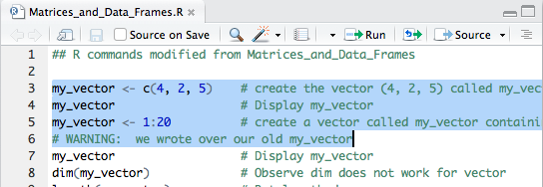
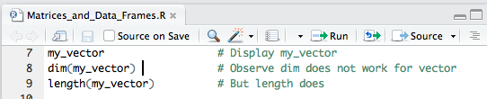
To run an R script:
1.) Select the section you want to run and click run
2.) Click on the line you want to run and click run. Continue clicking run to run the code line by line.
Run blue highlighted portion
Run line 8

Slide 9
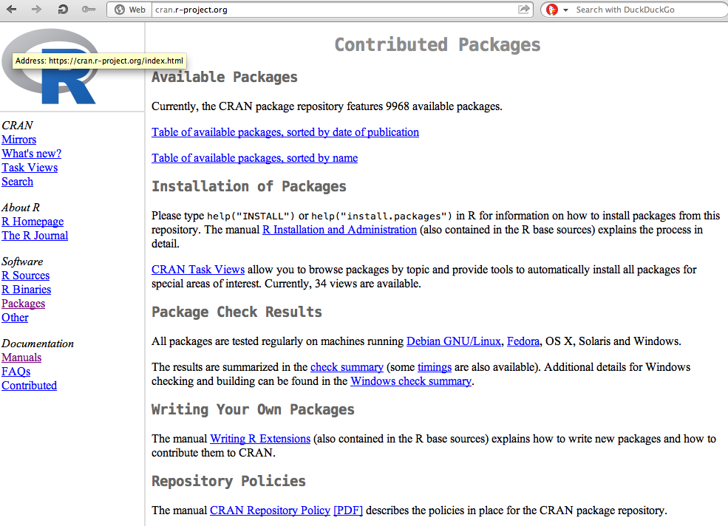
You can find R packates at
https://cran.r-project.org/
Packages

Slide 10
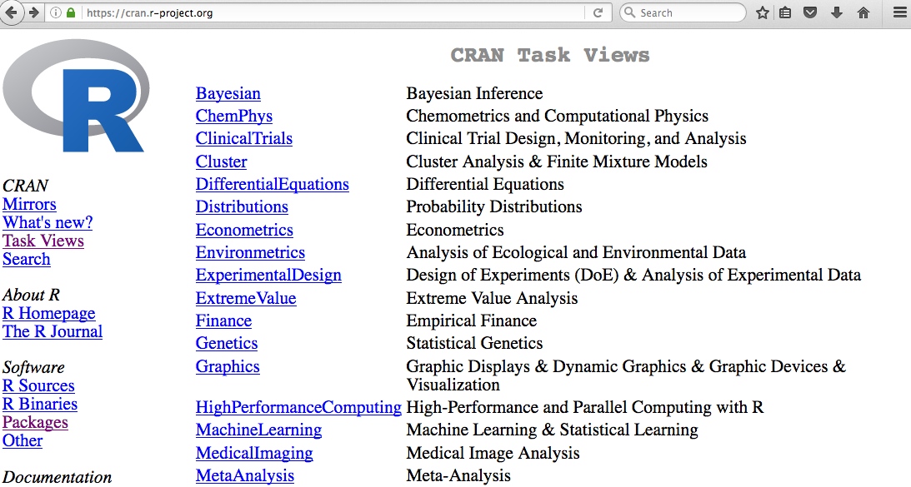

Slide 11
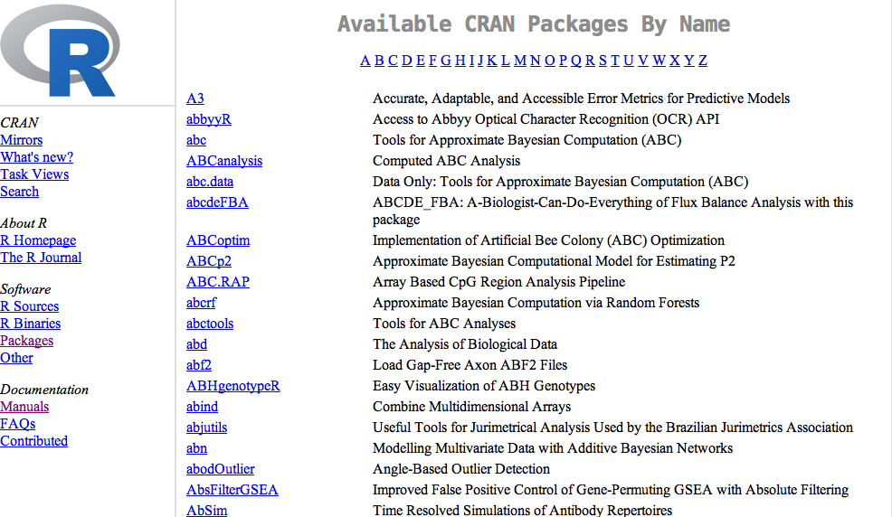
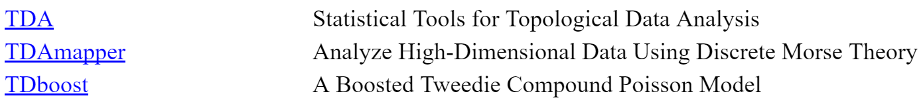

Slide 12
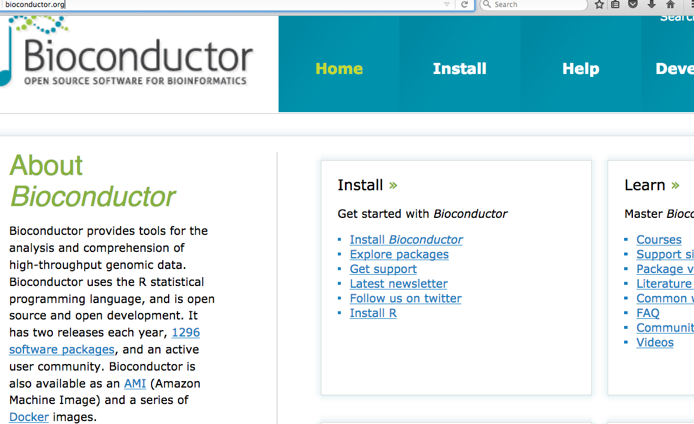
Additional packages can be found at other repositories such as http://bioconductor.org/

Slide 13
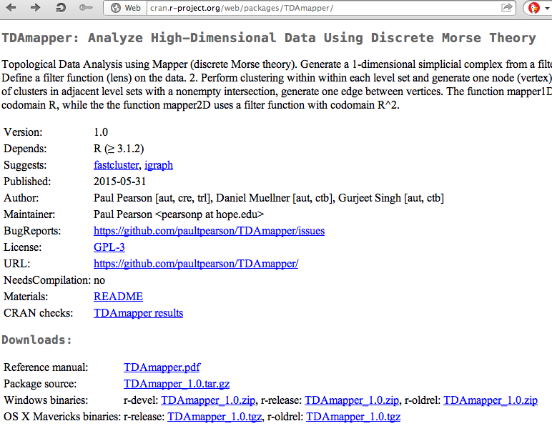
The TDAmapper package
Can download source code
useful info

Slide 14
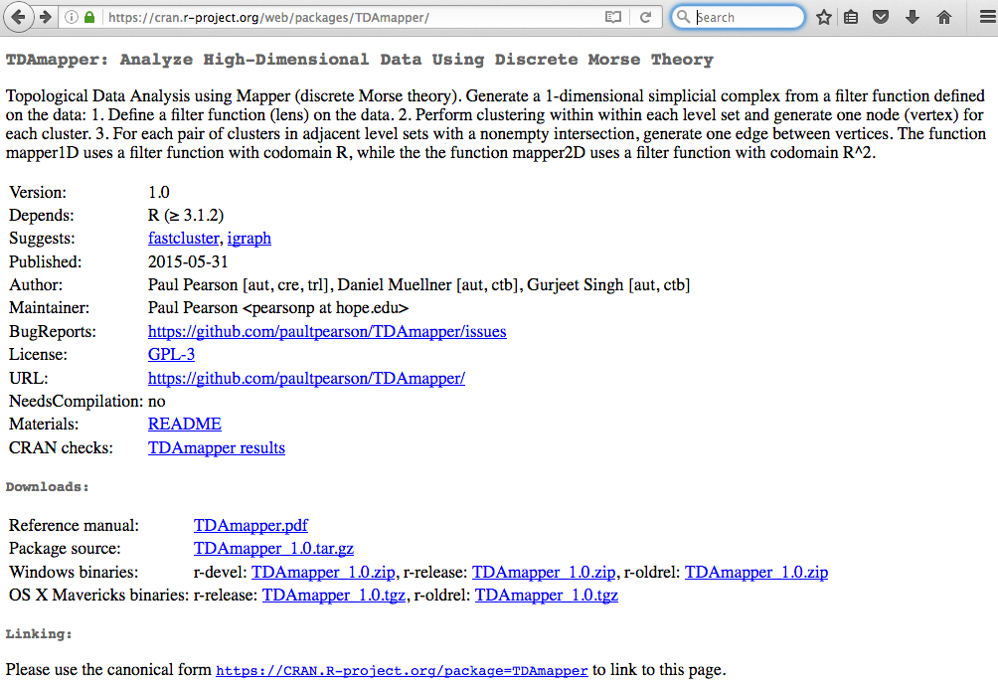
https://CRAN.R-project.org/package=TDAmapper
Click on README for info about package
Click on pdf for description of all TDAmapper commands

Slide 15
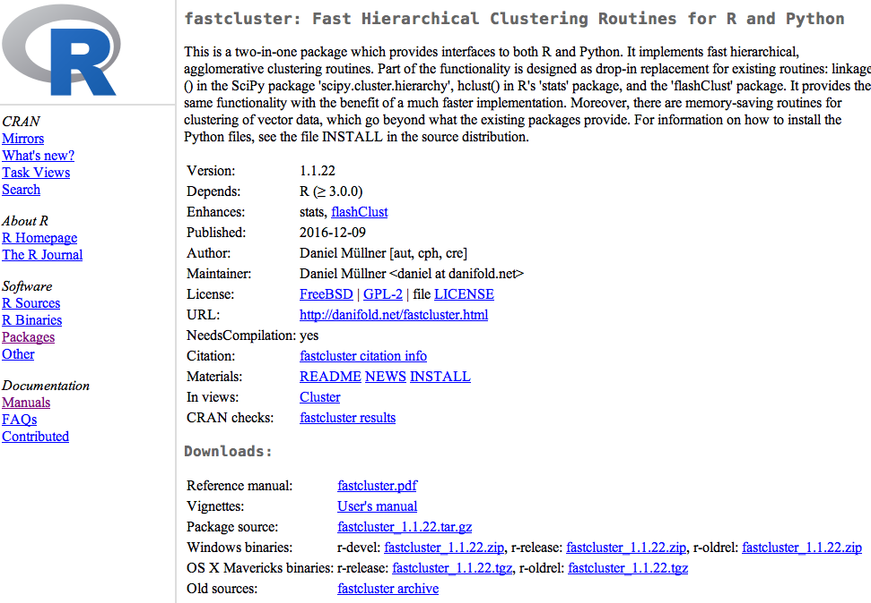
Vignettes are also useful

Slide 16
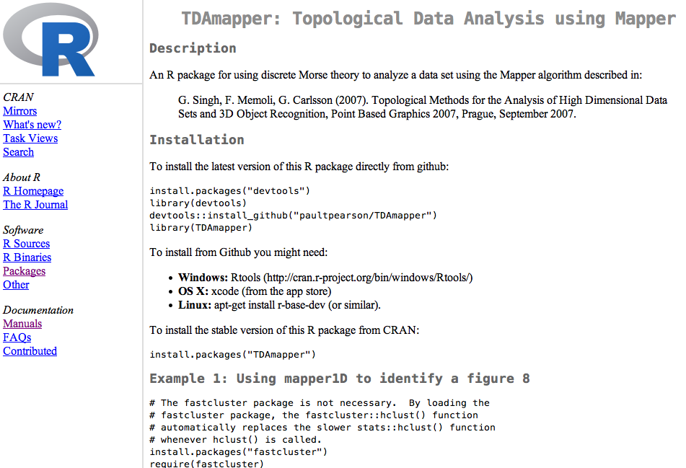
README
Do not install from GitHub unless you know what your are doing
Install in Rstudio
Examples are sometimes found in READMEs or Vignettes

Slide 17
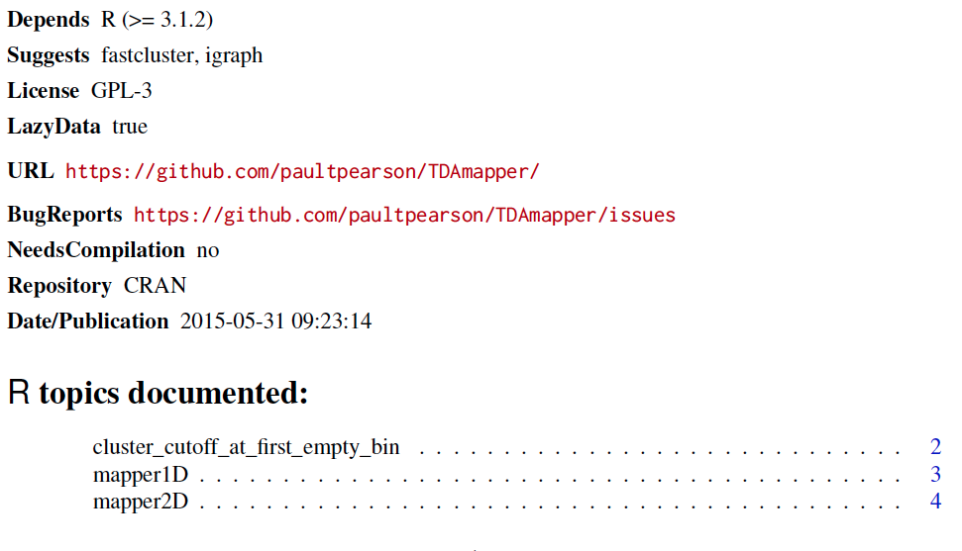
Reference manual:
The reference manual lists all commands contained in the package.

Slide 18
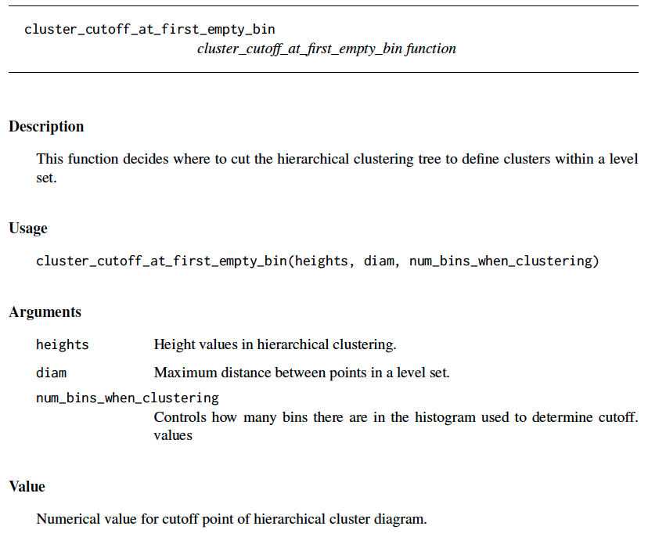
command name
All reference manuals follow same format.
Function inputs
Description of inputs
Description of output(s)

Slide 19
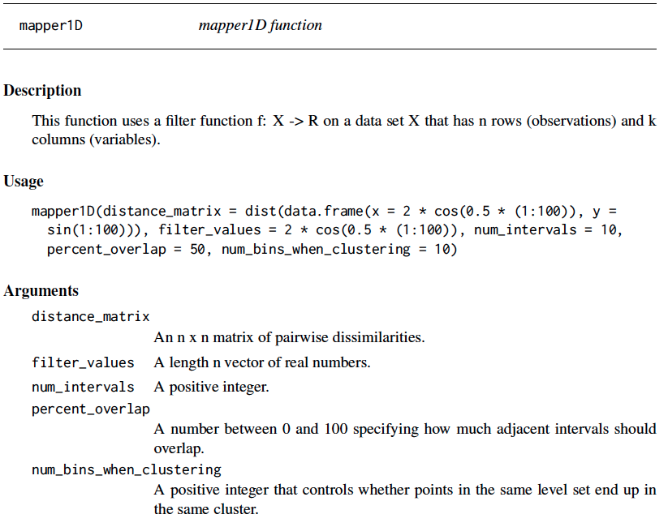

Slide 20
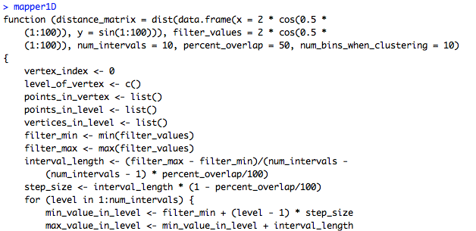
You can take a look at the code in Rstudio for any command just by typing the name of the command.
Note: mapper1d() calls this function
mapper1d allows you to view the code. Note no ()

Slide 21
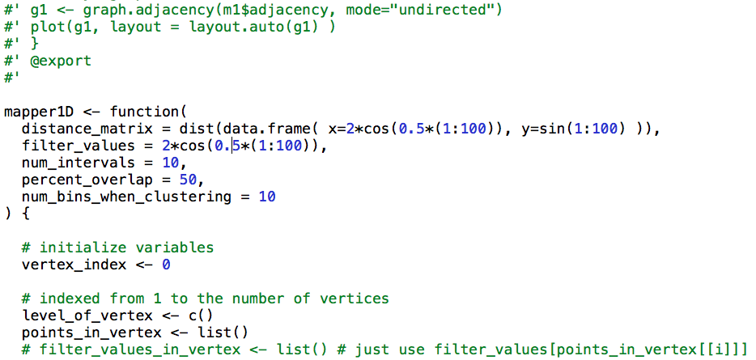
Note the version on GitHub contains commenting

Slide 22
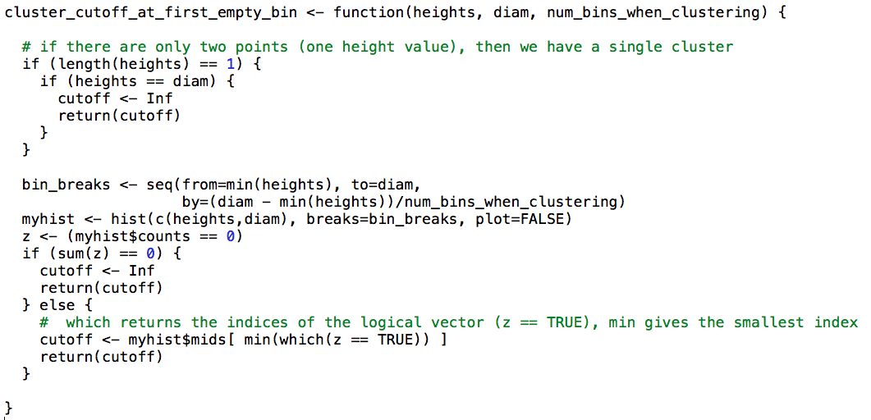

Slide 23
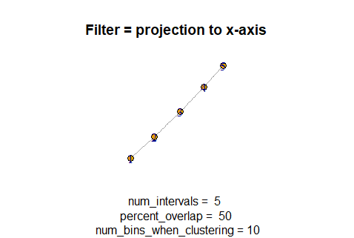
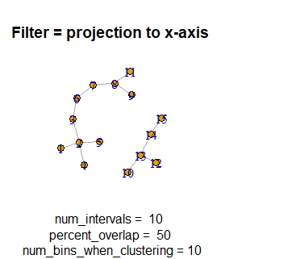
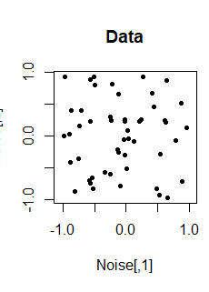
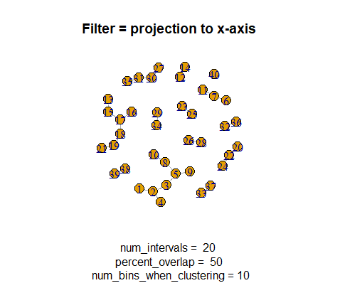
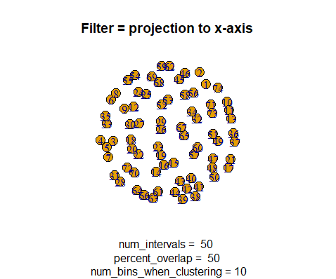
Possible Project:
Improve R package TDAmapper
Alternatively, use Python Mapper

Slide 24
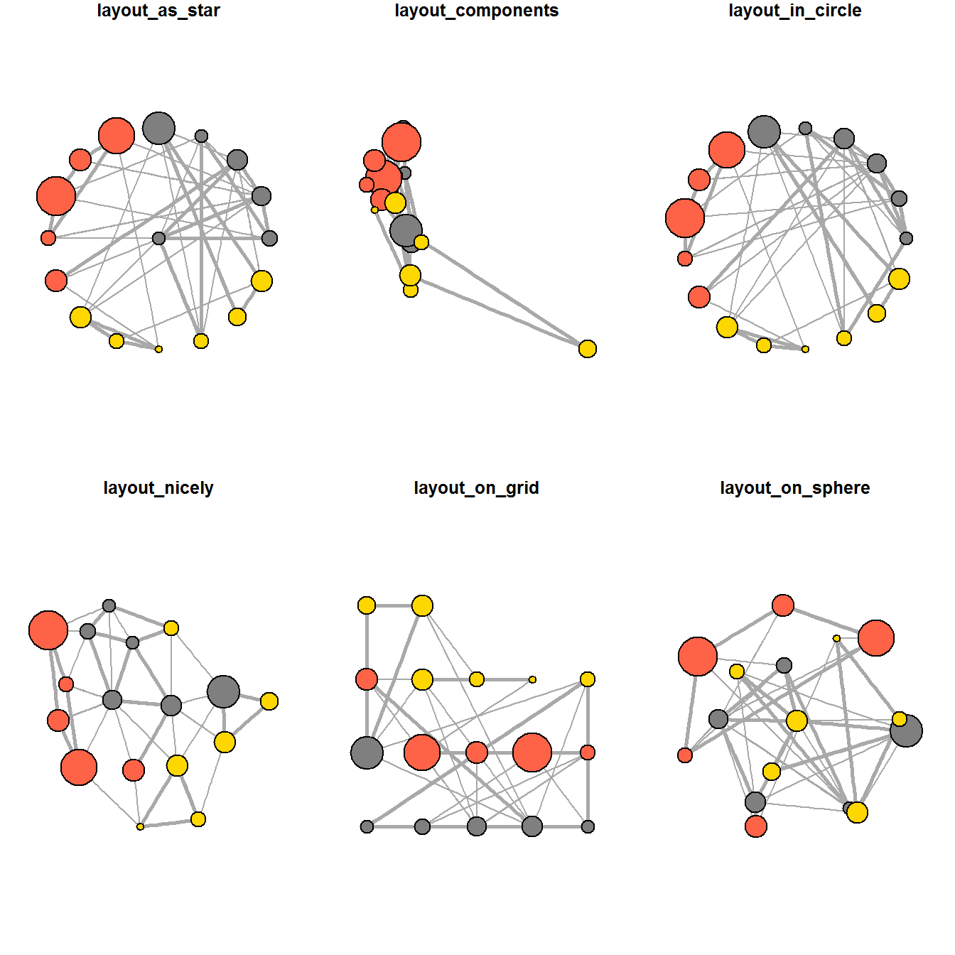
Network visualization with R
http://kateto.net/network-visualization

