Slide 1
Step 1: Download R and install R:
https://cran.rstudio.com/
Step 2: Download and install Rstudio after you install R:
http://www.rstudio.com/products/rstudio/download/
For some potentially useful tips, see:
http://socserv.mcmaster.ca/jfox/Courses/R/ICPSR/
R-install-instructions.html

Slide 2
From: http://socserv.mcmaster.ca/jfox/Courses/R/ICPSR/R-install-instructions.html
Installing R on Windows
Instead of installing R in the standard location, C:\Program Files\R\R-3.1.1, I suggest that you use C:\R\R-3.1.1. This will allow you to install packages without running R with administrator privileges and will avoid problems that sometimes occur when there are spaces in paths.

Slide 3
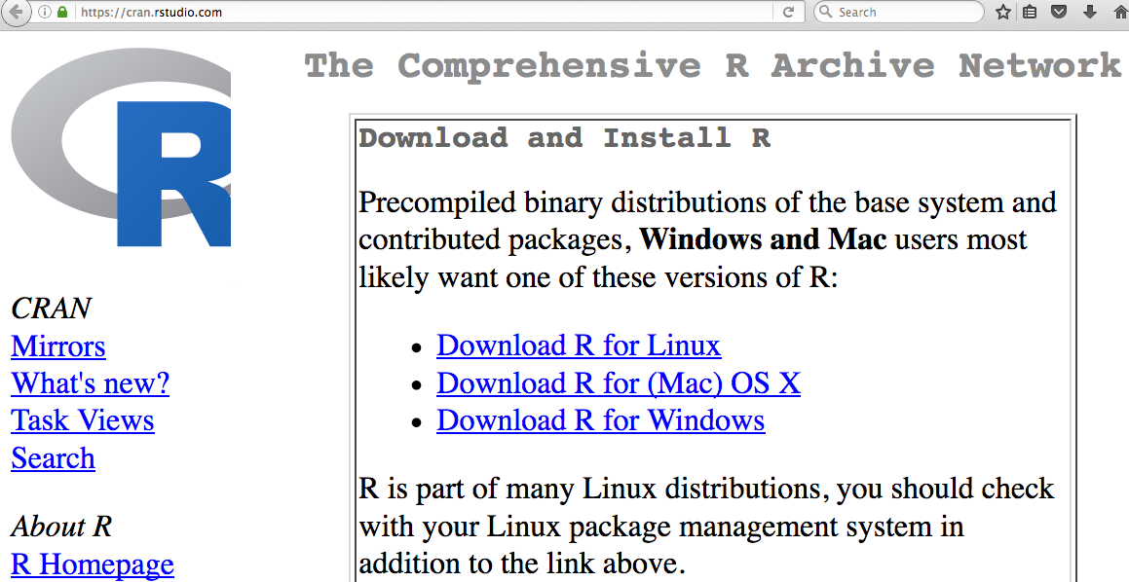
https://cran.rstudio.com/
Download and install R first

Slide 4
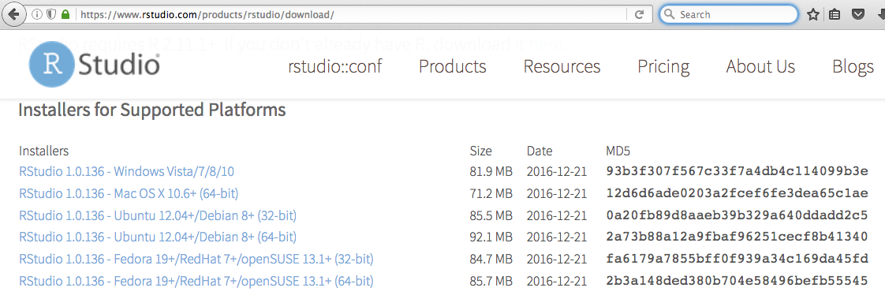
http://www.rstudio.com/products/rstudio/download/
To dowload Rstudio
Scroll down until you get to installers

Slide 5
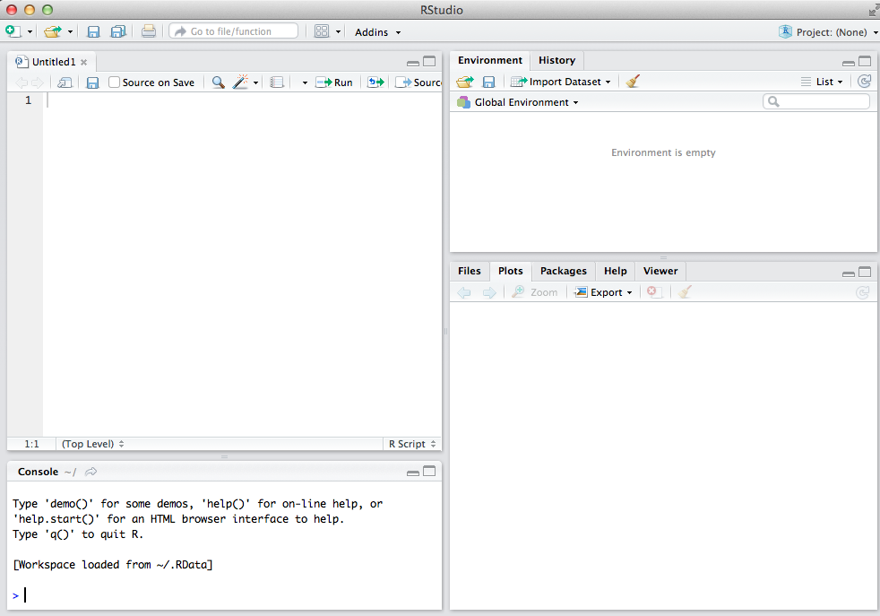
This is where you type commands

Slide 6
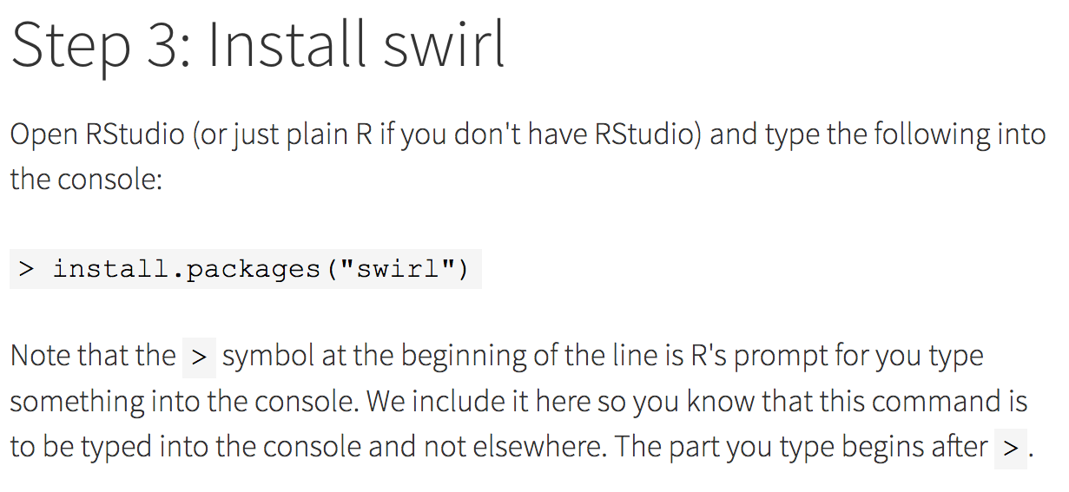
If you would like to learn R or statistics or data analysis via Swirl:
http://swirlstats.com/students.html

Slide 7
After you have installed a package using
> install.packages(“swirl”)
You can load the package using the library command:
> library(swirl)
Use the following to install Swirl courses:
> install_from_swirl("Course Name Here")
The following will start swirl:
> swirl()
For a list of courses:
http://swirlstats.com/scn/title.html
https://github.com/swirldev/swirl_courses#swirl-courses

Slide 8
Some notes:
1.) Normally you only need to install a package once.
e.g > install.packages(“TDAmapper”)
2.) If you want to use a package, you must load it
e.g > library(“TDAmapper”)
You only need to do this once per session.
3.) If you want to repeat a command, you can use the up-arrow on your keyboard to obtain previously typed commands in the console.
4.) When you start typing commands, R will show you some choices. You can click on the one you want.

Slide 9
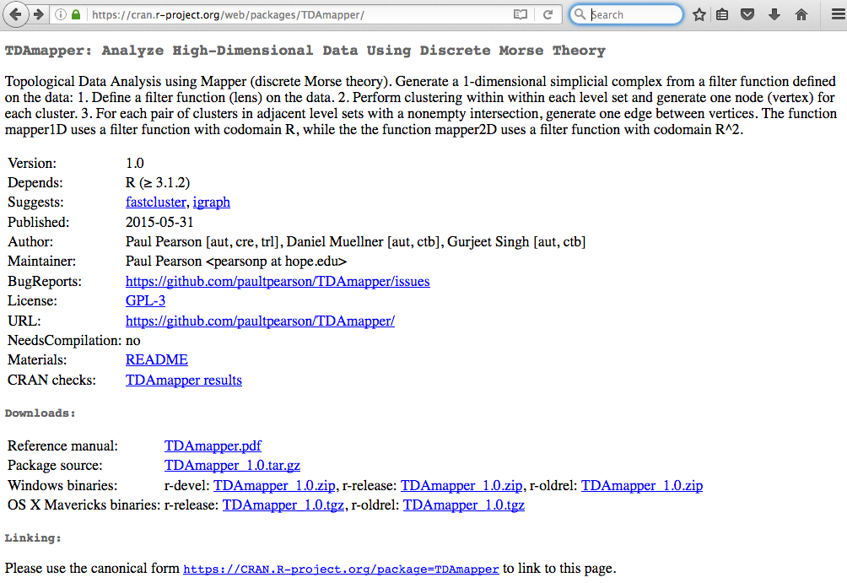
https://CRAN.R-project.org/package=TDAmapper
Click on README for info about package
Click on pdf for description of all TDAmapper commands

Slide 10
If you click on a .r file, it will load in the upper left box of R-studio.
You should download the following files from:
http://homepage.divms.uiowa.edu/~idarcy/COURSES/TDA/SPRING18/LAB1_Rintro
You can download some data files from
http://homepage.divms.uiowa.edu/~idarcy/COURSES/TDA/SPRING18/Data

Slide 11
This is where R scripts will load. Feel free to modify R scripts (you may wish to save older versions).
List of all available data sets and variables.
This is where you will see images and help info.
This is where you type commands

Slide 12
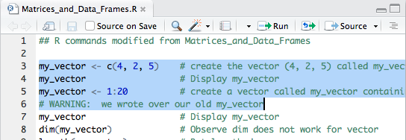
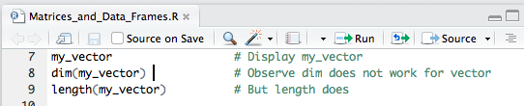
To run an R file:
1.) Select the section you want to run and click run
2.) Click on the line you want to run and click run. Continue clicking run to run the code line by line.
Run blue highlighted portion
Run line 8

