Slide 1
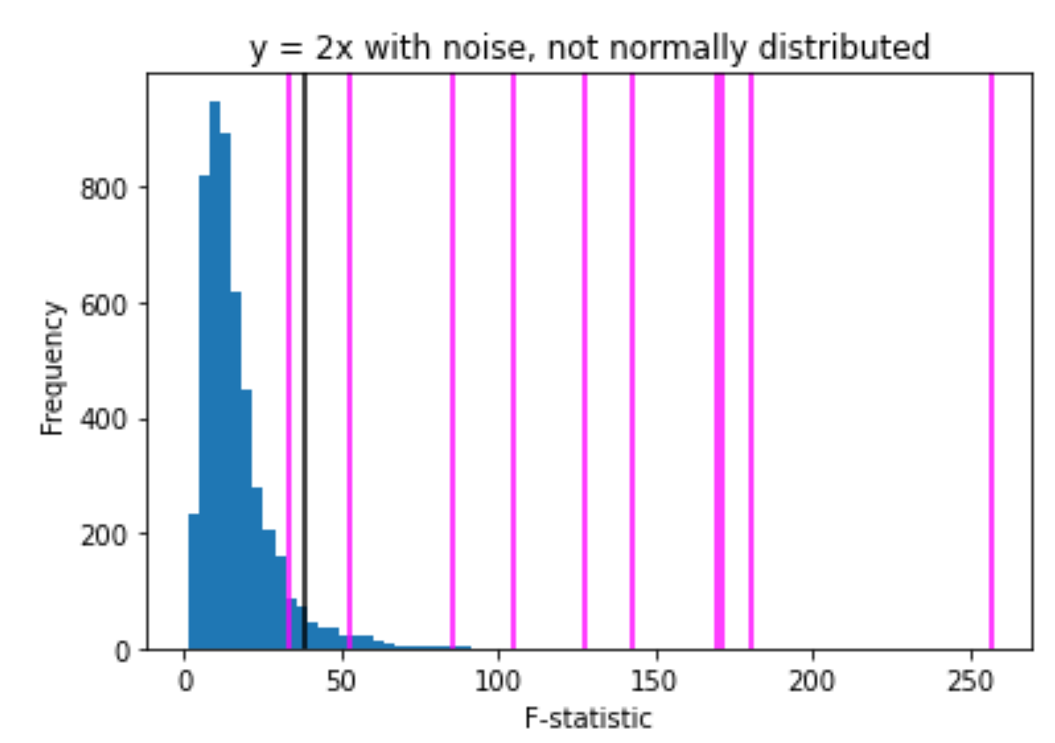
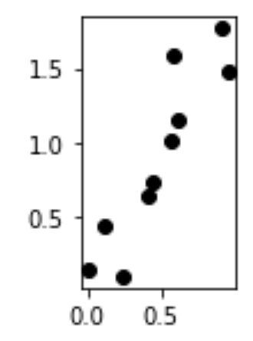
The P value is the probability of obtaining a test statistic at least as extreme as the one that was actually observed, assuming that the null hypothesis is true.
Null hypothesis: the probability that there is no relationship between x and y (i.e. the relationship is null)
False negatives:
There is a relationship between x and y
and
the F-statistic indicates that there is no relationship between x and y
True positive:
There is a relationship between x and y
and
the F-statistic indicates that there is a relationship between x and y

Slide 2
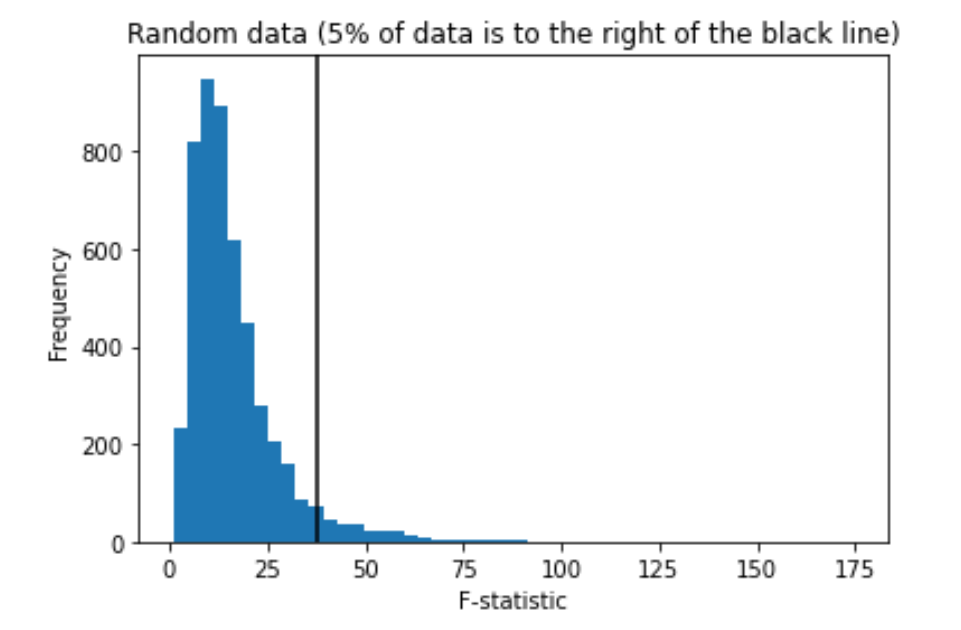
To calculate p-value from scratch (can alternatively use built-in functions)
Generate many random datasets. All datasets will satisfy some properties
For example, dimension, coordinate range, uniformly distributed, etc.
2. Calculate a statistic (such as the F-statistic) for each of the randomly generated datasets.
Generate a histogram.
Calculate the statistic for your real data and plot that value along the first coordinate.
The area to the right of this number is your p-value.
True negatives:
There is no relationship between x and y
and
the F-statistic indicates that there is no relationship between x and y
False positive:
There is no relationship between x and y
and
the F-statistic indicates that there is a relationship between x and y

Slide 3
When you review presentations,
You should give constructive criticism.
You should describe what is the one (or so things) you learned from the presentation.
Reviews will be graded based on completion, but excellent reviews may result in additional points added to other parts of final exam.
Presenters will be graded on how the 2nd question is answered. Did you teach one thing?
When presenting, you might want to start with.
“I plan to show/demonstrate/illustrate ….”
And end with
“I conclude …”

Slide 4
Written Project
Note your draft should include a description of one or more techniques that you learned in this class. You do not need to mention your data in this part of your written project. I just want you to summarize important concepts and go more in depth on one concept. Figures can be helpful.
Include output from your jupyter notebook(s). You don’t need to include them all. I would rather you go in depth on one or two. But including multiple results will make up for poor analysis (This is NOT true for the poster presentation)

Slide 5
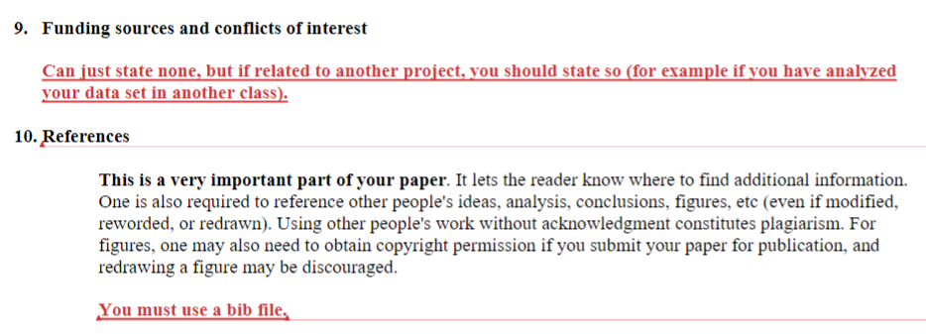
Written Project (30 points)
plus correcting your lab 2 - 5 notebooks if needed (10 points).

Slide 6
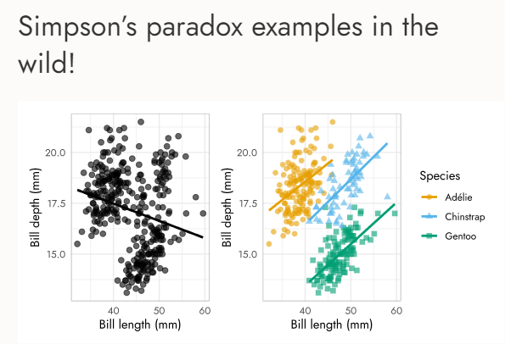
References:
https://matplotlib.org/stable/gallery/index.html, https://matplotlib.org/3.3.0/gallery/index.html
You may have used some labs from: https://www.science.smith.edu/~jcrouser/SDS293/
Also includes lecture notes and assignments.
http://www.deltanalytics.org/curriculum.html
Answers to problems in our textbook plus additional references: https://botlnec.github.io/islp/
O’Reilly Python for Data Analysis, 3E https://wesmckinney.com/book/
Advanced Data Analysis from an Elementary Point of View by Cosma Rohilla Shalizi
https://www.stat.cmu.edu/~cshalizi/ADAfaEPoV/ (R)
The Truth About Linear Regression https://www.stat.cmu.edu/~cshalizi/TALR/
See also http://bactra.org/teaching/
Open-source scientific/technical publishing system https://quarto.org/docs/gallery/
https://apreshill.github.io/palmerpenguins-useR-2022/#/allison-why-has-it-been-so-popular
https://jjallaire.github.io/visualization-curriculum/altair_scales_axes_legends.html
https://crsl4.github.io/julia-workshop/

Slide 7
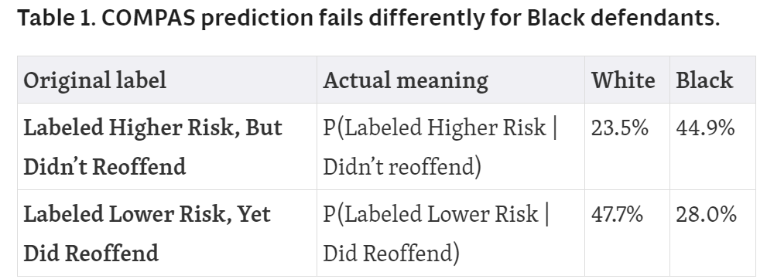
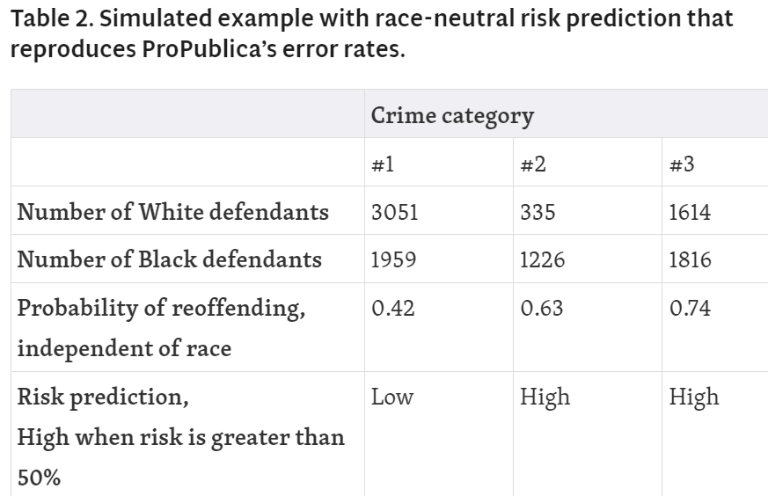
Transparency, Statistics, and Justice System Knowledge Is Essential for Science of Risk Assessment
by Greg Ridgeway Jan 31, 2020 Harvard Data Science Review (HDSR)
I forgot to mention yesterday:
My description of bias is, of course, biased.
https://apreshill.github.io/palmerpenguins-useR-2022/#/allison-why-has-it-been-so-popular
https://hdsr.mitpress.mit.edu/pub/vu6rc1yv/release/7

Slide 8
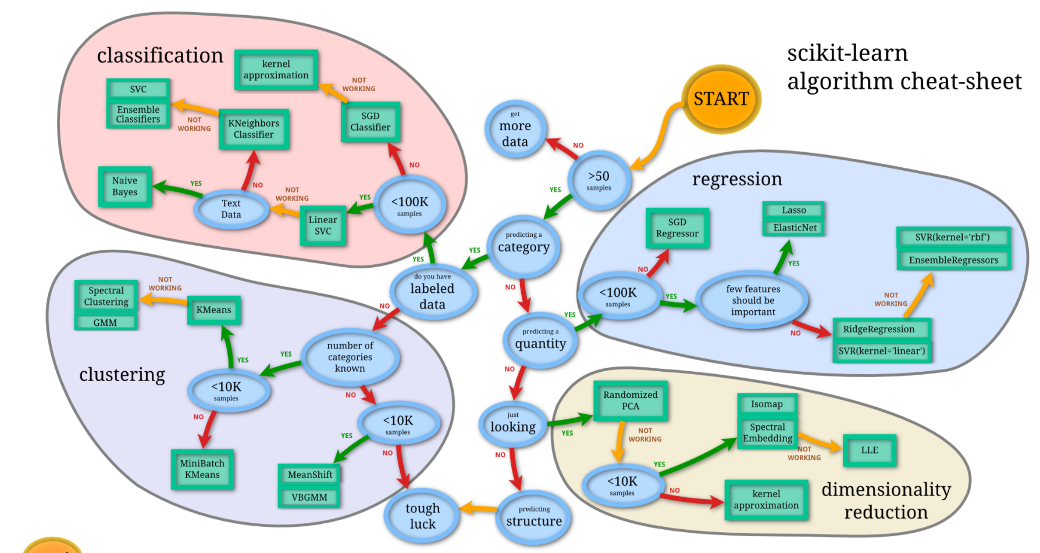
Python is great/horrible as many people have developed code that you can use/misuse.
https://nbviewer.jupyter.org/github/donnemartin/data-science-ipython-notebooks/blob/master/scikit-learn/scikit-learn-intro.ipynb

Slide 9
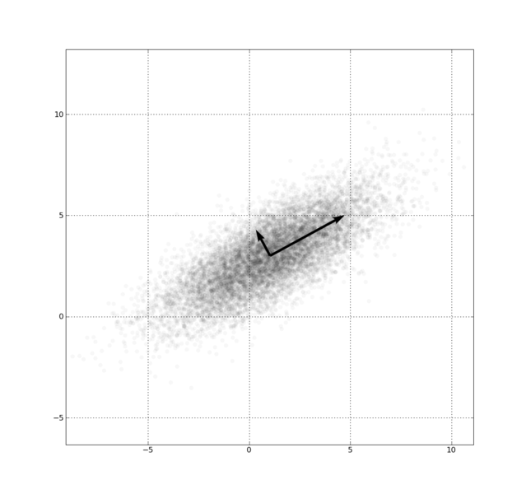
When to use Principal component analysis (PCA)
Mainly for visualization.
Can also be used for Dimension Reduction, but only if you are fine with changing your basis.
x_{i} → z_{i} = linear combination of x_{i}
http://en.wikipedia.org/wiki/File:GaussianScatterPCA.png

Slide 10
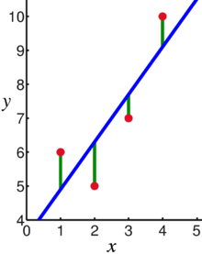
Linear regression = Least squares line (single variable x)
(or hyperplane for multiple variables)
Given x_{i} = input data and y_{i} = f(x_{i}) = label. ➔ Learn f
Supervised learning: use labeled data to create model:
f(x) = mx + b
Then use model to estimate new values:
Given new input $\tilde{x }$,
Estimate $\tilde{x }$’s label via
f($\tilde{x }$) = m $\tilde{x }$ + b
Supervised learning
Data: x_{i} = input data with no noise
y_{i} = labels
Find function
f: R → R
f(x) = mx + b
x = independent variable
y = dependent variable
(x, y) → (x, y’)
https://en.wikipedia.org/wiki/Linear_regression

Slide 11
6533
0
No data
The intercept is b₀ = 6533.
This is the slope of the line.
For each additional mile on the odometer,
the price decreases by an average of $0.0312
Do not interpret the intercept as the
“Price of cars that have not been driven”
https://web.stanford.edu/class/msande247s/kchap17.ppt

Slide 12
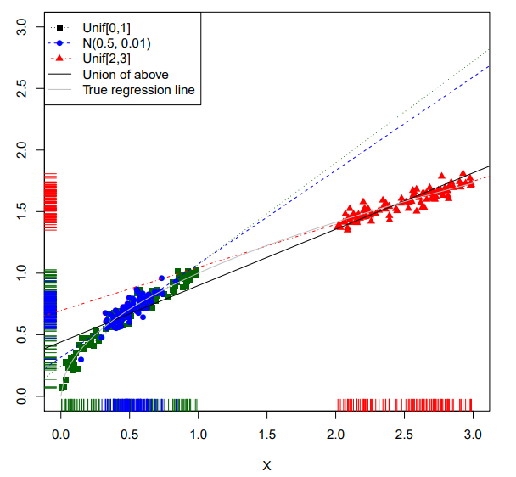
ADAfaEPoV.pdf (cmu.edu)
I said earlier that the best β in linear regression will depend on the distribution of the regressors, unless the conditional mean is exactly linear. Here is an illustration. For simplicity, let’s say that p = 1, so there’s only one regressor. I generated data from Y = √ X + , with ∼ N (0, 0.052 ) (i.e. the standard deviation of the noise was 0.05). Figure 2.1 shows the lines inferred from samples with three different distributions of X: X ∼ Unif(0, 1), X ∼ N (0.5, 0.01), and X ∼ Unif(2, 3). Some distributions of X lead to similar (and similarly wrong) regression lines; doing one estimate from all three data sets gives yet another answer
Figure 2.1 Behavior of the conditional distribution Y |X ∼ N ( √ X, 0.052 ) with different distributions of X. The dots (in different colors and shapes) show three different distributions of X (with sample values indicated by colored “rug” ticks on the axes), plus the corresponding regression lines. The solid line is the regression using all three sets of points, and the grey curve is the true regression function. (See Code Example 1 for the code use to make this figure.) Notice how different distributions of X give rise to different slopes, each of which may make sense as a local approximation to the truth.

Slide 13
Lurking Variable
https://emunix.emich.edu/~schu/MATH_170/Fall09_170/Evening%20session/Unit%203.ppt
Sometimes it is not clear which variable is the explanatory variable and which is the response variable
Sometimes the two variables are related without either one being an explanatory variable
Sometimes the two variables are both affected by a third variable, a lurking variable, that had not been included in the study
Correlation does NOT imply causation
Every time someone thoughtlessly uses regression for causal inference, an angel not only loses its wings, but is cast out of Heaven and falls in extremest agony into the everlasting fire.
ADAfaEPoV.pdf (cmu.edu)

Slide 14
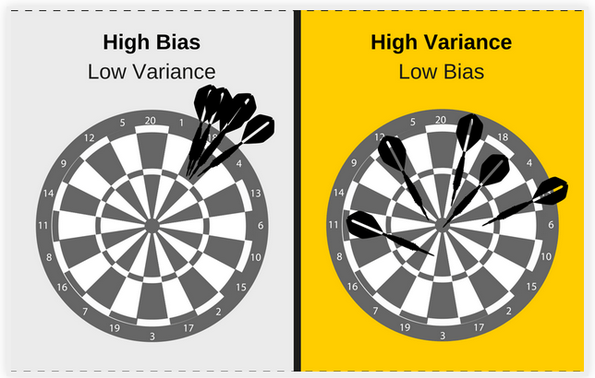
http://turing.iimas.unam.mx/~ivanvladimir/slides/rpyaa/02_regression.html#/44

Slide 15
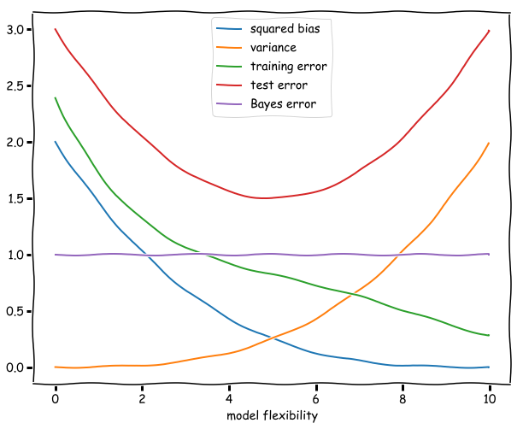
Squared bias. This is the error in our model introduced by the difference of our approximation and the true underlying function. A more flexible model will be increasingly similar, and the squared bias therefore diminishes as the flexibility increases. (It might even reach zero if for example the underlying function is a polynomial and by increasing the flexibility at a certain point we include the polynomials of this degree in our hypothesis space.)
Theoretical:
Squared bias compares the correct function to its approximation. For example, comparing the error between a function and Taylor series approximations.
https://botlnec.github.io/islp/sols/chapter2/exercise3/

Slide 16
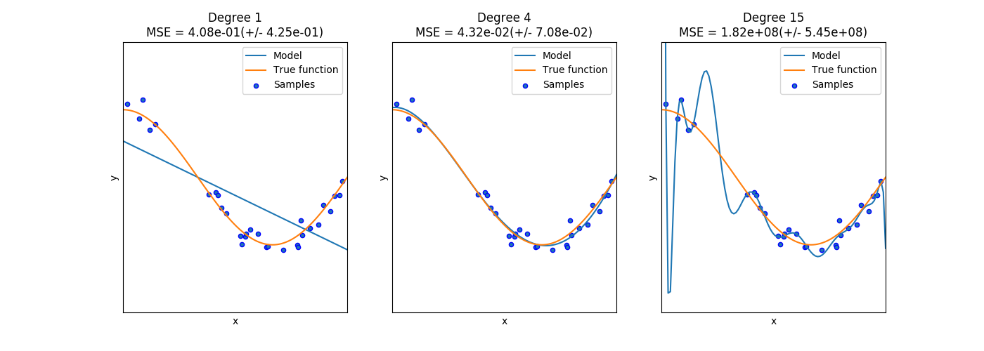
Ivan Meza http://turing.iimas.unam.mx/~ivanvladimir/slides/rpyaa/02_regression.html#/60
Theoretical:
Squared bias compares the correct function to its approximation. For example, comparing the error between a function and Taylor series approximations.
https://botlnec.github.io/islp/sols/chapter2/exercise3/

Slide 17
Variance. In the limit of a model with no flexibility the variance will be zero, since the model fit will be independent of the data. As the flexibility increases the variance will increase as well since the noise in a particular training set will correspondingly captured by the model. The curve described by the variance is a monotonically increasing function of the flexibility of the model.
The larger the number of parameters, the larger the effect of noise.
https://botlnec.github.io/islp/sols/chapter2/exercise3/

Slide 18
Ivan Meza http://turing.iimas.unam.mx/~ivanvladimir/slides/rpyaa/02_regression.html#/60
The larger the number of parameters, the larger the effect of noise.
Variance. In the limit of a model with no flexibility the variance will be zero, since the model fit will be independent of the data. As the flexibility increases the variance will increase as well since the noise in a particular training set will correspondingly be captured by the model. The curve described by the variance is a monotonically increasing function of the flexibility of the model.
https://botlnec.github.io/islp/sols/chapter2/exercise3/

Slide 19
Bias vs Variance trade-off
The larger the number of parameters, the larger the effect of noise.
Thus variance increases as the number of parameters increase.
Squared bias compares the correct
function to its approximation.
For example, comparing the error
between a function and its Taylor
series approximations.
Thus squared bias decreases as the
number of parameters increase.
Note the bias vs variance trade-off
https://botlnec.github.io/islp/sols/chapter2/exercise3/

Slide 20
Training error. The training error is given by the average (squared) difference between the predictions of the model and the observations. If a model if very unflexible this can be quite high, but as the flexibility increases this difference will decrease. If we consider polynomials for example increasing the flexibility of the model might mean increasing the degree of the polynomial to be fitted. The additional degrees of freedom will decrease the average difference and reduce the training error.
https://botlnec.github.io/islp/sols/chapter2/exercise3/

Slide 21
Test error. The expected test error is given by the formula: Variance + Bias + Bayes error, all of which are non-negative. The Bayes error is constant and a lower bound for the test error. The test error has a minimum at an intermediate level of flexibility: not too flexible, so that the variance does not dominate, and not too unflexible, so that the squared bias is not too high.
The plot of the test error thus resembles
sort of an upward (deformed) parabola:
high for unflexible models,
decreasing as flexibility increases
until it reaches a minimum.
Then the variance starts to dominate
and the test error starts increasing.
The distance between this minimum
and the Bayes irreducible error gives
us an idea of how well the best
function in the hypothesis space will fit.
https://botlnec.github.io/islp/sols/chapter2/exercise3/

Slide 22
Test error. The expected error when measuring the test data set
The test error has a minimum at an intermediate level of flexibility: not too flexible, so that the variance does not dominate, and not too unflexible, so that the squared bias is not too high.
https://botlnec.github.io/islp/sols/chapter2/exercise3/

Slide 23
Test error. The expected error when measuring the test data set
The test error has a minimum at an
intermediate level of flexibility: not too
flexible, so that the variance does not
dominate, and not too unflexible, so
that the squared bias is not too high.
The plot of the test error thus resembles
sort of an upward (deformed) parabola:
high for unflexible models, decreasing as
flexibility increases until it reaches a minimum.
Then the variance starts to dominate and
the test error starts increasing.
https://botlnec.github.io/islp/sols/chapter2/exercise3/

Slide 24
Ivan Meza http://turing.iimas.unam.mx/~ivanvladimir/slides/rpyaa/02_regression.html#/60
Underfitting versus overfitting
$$Ex: f\left(x\right)=a_{0}+a_{1}x+…+a_{n}x^{n}$$
https://botlnec.github.io/islp/sols/chapter2/exercise3/

Slide 25
Two interpretations of variance (equivalent for linear regression):
Variance: “provides a measure of randomness of a quantity.”
Variance effect: “gives the increase in error rate caused by randomness”
Two interpretations of bias (equivalent for linear regression):
Bias: “represents the systematic difference between a random variable and a particular value, e.g. the target”
Systematic effect: “the degree to which that systematic difference contributes to error.”

Slide 26
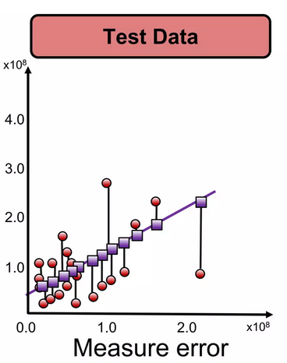
To avoid overfitting due to too many parameters:
https://www.slideshare.net/ankit_ppt/ml2-train-testsplitsvalidationlinearregression

Slide 27
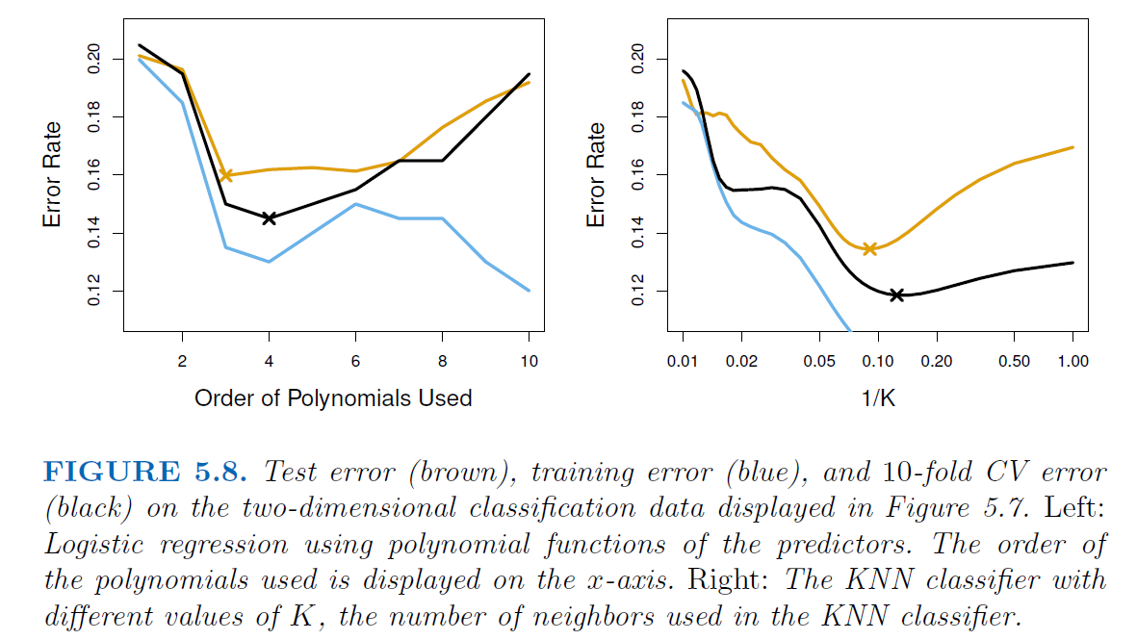
Kfold can also be used to compare different machine learning algorithms.
For example: logistic regression vs KNN classifier
Black curve = average of misclassifications over the 10 tests.
An Introduction to Statistical Learning https://www.statlearning.com/

Slide 28
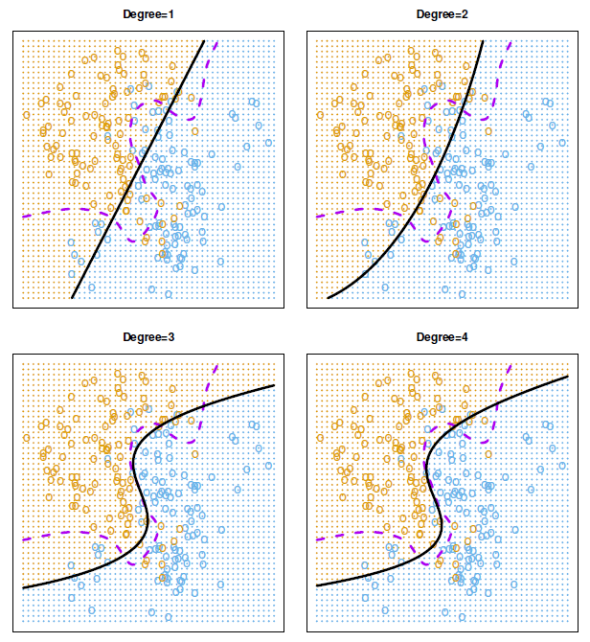
FIGURE 5.7. Logistic regression fits on the two-dimensional classification data
displayed in Figure 2.13. The Bayes decision boundary is represented using a purple dashed line. Estimated decision boundaries from linear, quadratic, cubic
and quartic (degrees 1–4) logistic regressions are displayed in black. The test error rates for the four logistic regression fits are respectively 0.201, 0.197, 0.160, and 0.162, while the Bayes error rate is 0.133.
An Introduction to Statistical Learning https://www.statlearning.com/

Slide 29
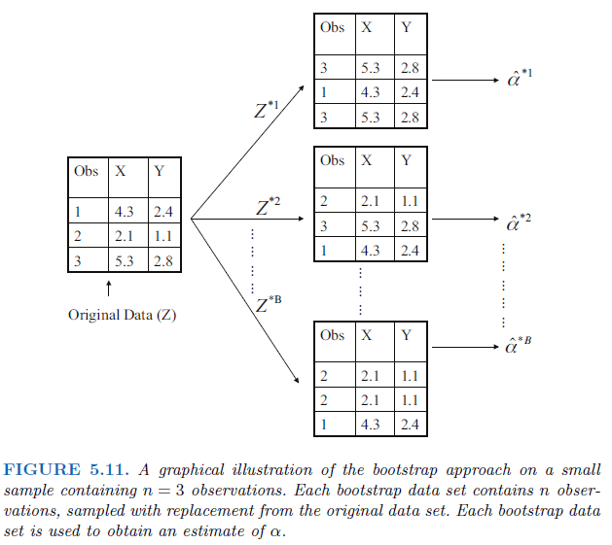
The bootstrap
The bootstrap is a widely applicable and extremely
powerful statistical tool that can be used to quantify
the uncertainty associated with a given estimator
or statistical learning method. As a simple example,
the bootstrap can be used to estimate the standard
errors of the coefficients from a linear regression fit.
In the specific case of linear regression, this is
not particularly useful, since we saw in Chapter 3
that standard statistical software such as
R outputs such standard errors automatically.
However, the power of the bootstrap lies
in the fact that it can be easily applied to
a wide range of statistical learning methods,
including some for which a measure of variability
is otherwise difficult to obtain and is not
automatically output by statistical software.
An Introduction to Statistical Learning https://www.statlearning.com/

