Slide 1

Poster Title
Authors
Affiliations
Introduction
Results
Conclusions
Include lots of figures and detailed figure captions.
Bullet points are much better than long paragraphs.
You do not need to use the headings in this sample.
Teach us one thing.
You can do that using your data (ie from written project) or if you have a good artificial data example, you can use that.
You can easily resize the columns if (for example) a wider middle column better accommodates your figures.
If you are working in a group:
Both names should be listed as authors. However,
You should each turn in a different poster as you will be giving different presentations
Posters can be related, but their should be an important difference. For example, you may each cover a different technique.
Bullet point is too small

Slide 2
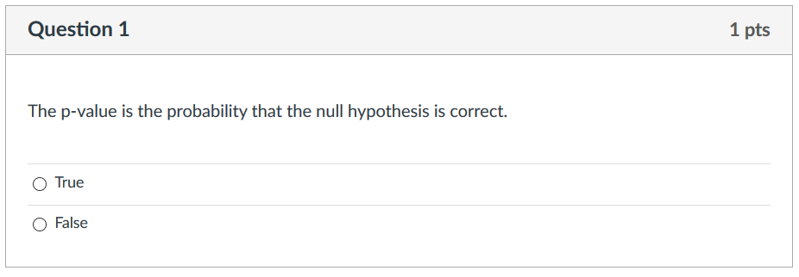
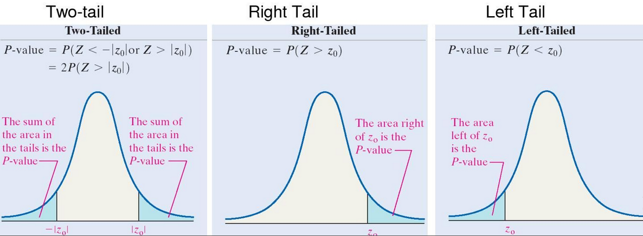
https://i.pinimg.com/originals/4d/96/f0/4d96f07215c63818917df1be3ec4b79c.jpg

Slide 3
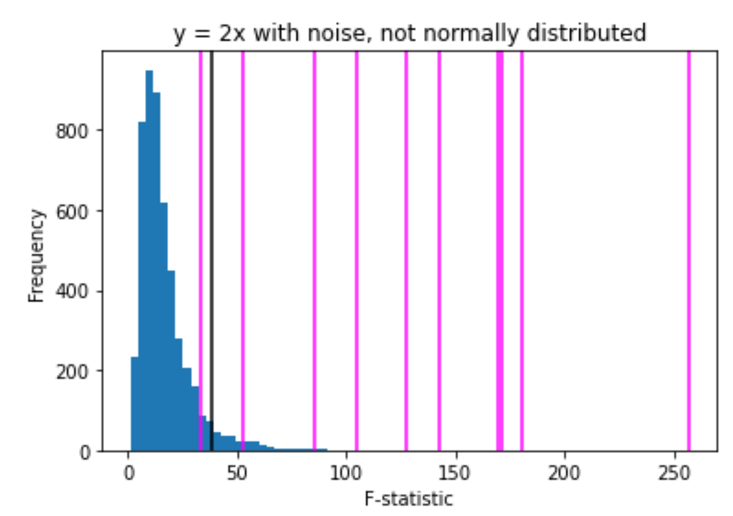
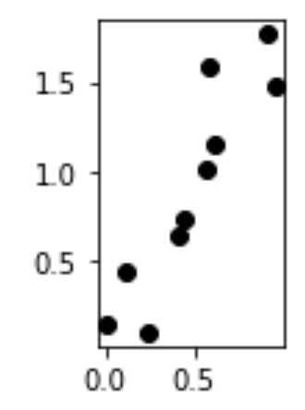
The P value is the probability of obtaining a test statistic at least as extreme as the one that was actually observed, assuming that the null hypothesis is true.
Null hypothesis: the probability that there is no relationship between x and y (i.e. the relationship is null)
False negatives:
There is a relationship between x and y
and
the F-statistic indicates that there is no relationship between x and y
True positive:
There is a relationship between x and y
and
the F-statistic indicates that there is a relationship between x and y

Slide 4
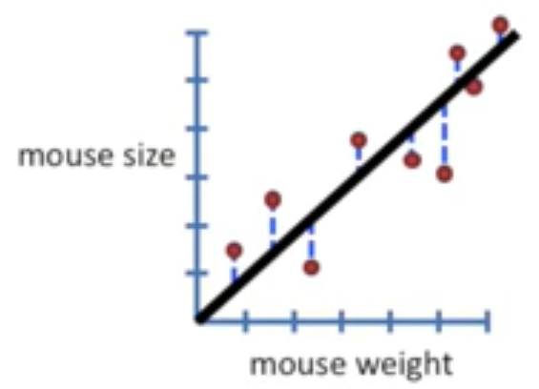
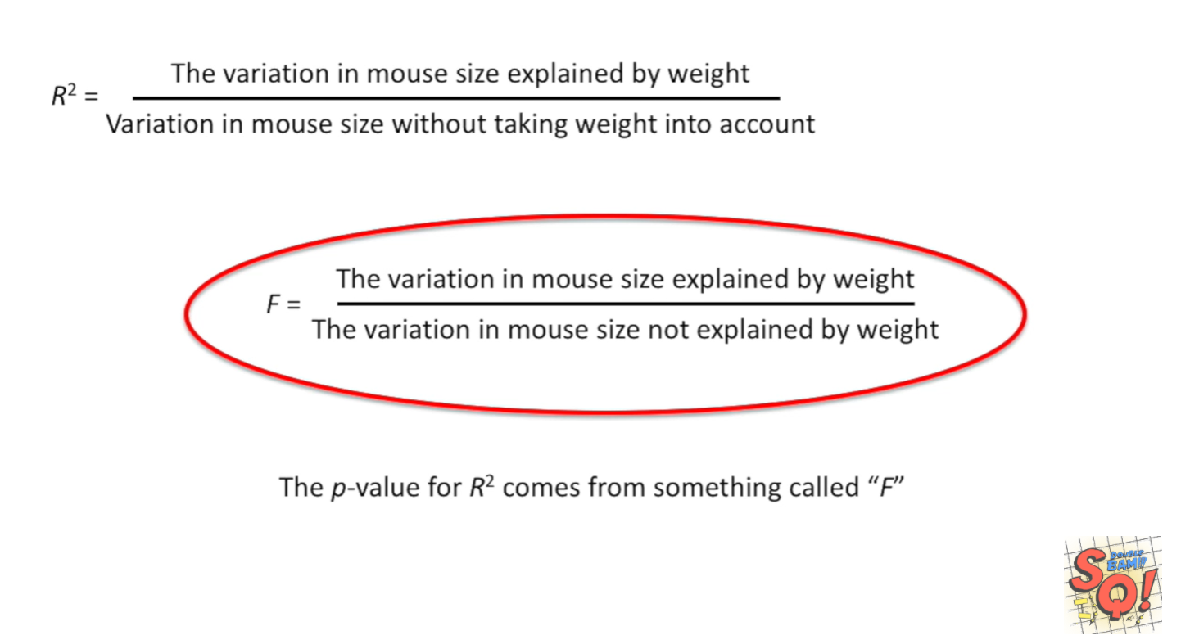
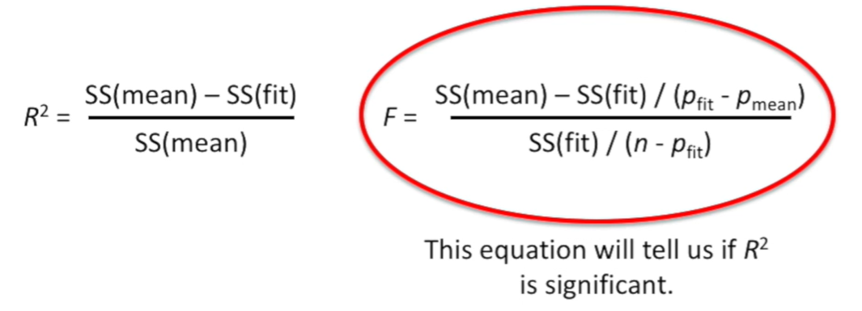
StatQuest: Linear Models Pt.1 - Linear Regression https://www.youtube.com/watch?v=nk2CQITm_eo

Slide 5
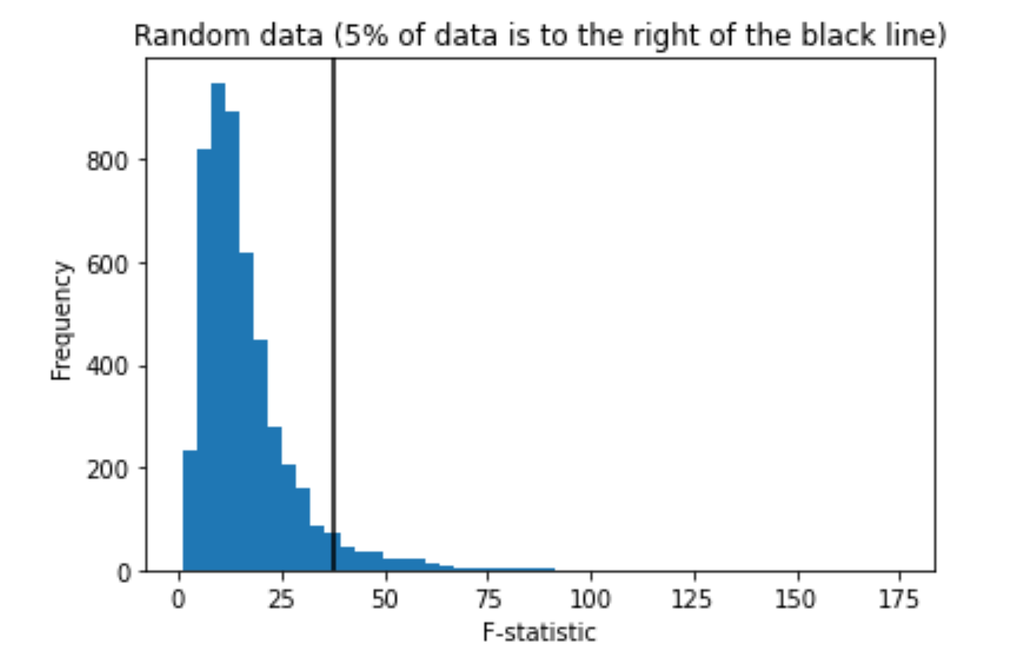
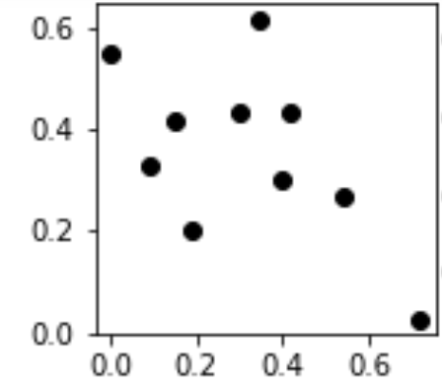
Negative: x does not predict y. There is no relationship between x and y.
The data used to generate the histogram below was randomly generated.
Thus there is no relationship between x and y. Thus the null hypothesis is true for these data sets
True negatives:
There is no relationship between x and y
and
the F-statistic indicates that there is no relationship between x and y
False positive:
There is no relationship between x and y
and
the F-statistic indicates that there is a relationship between x and y

Slide 6
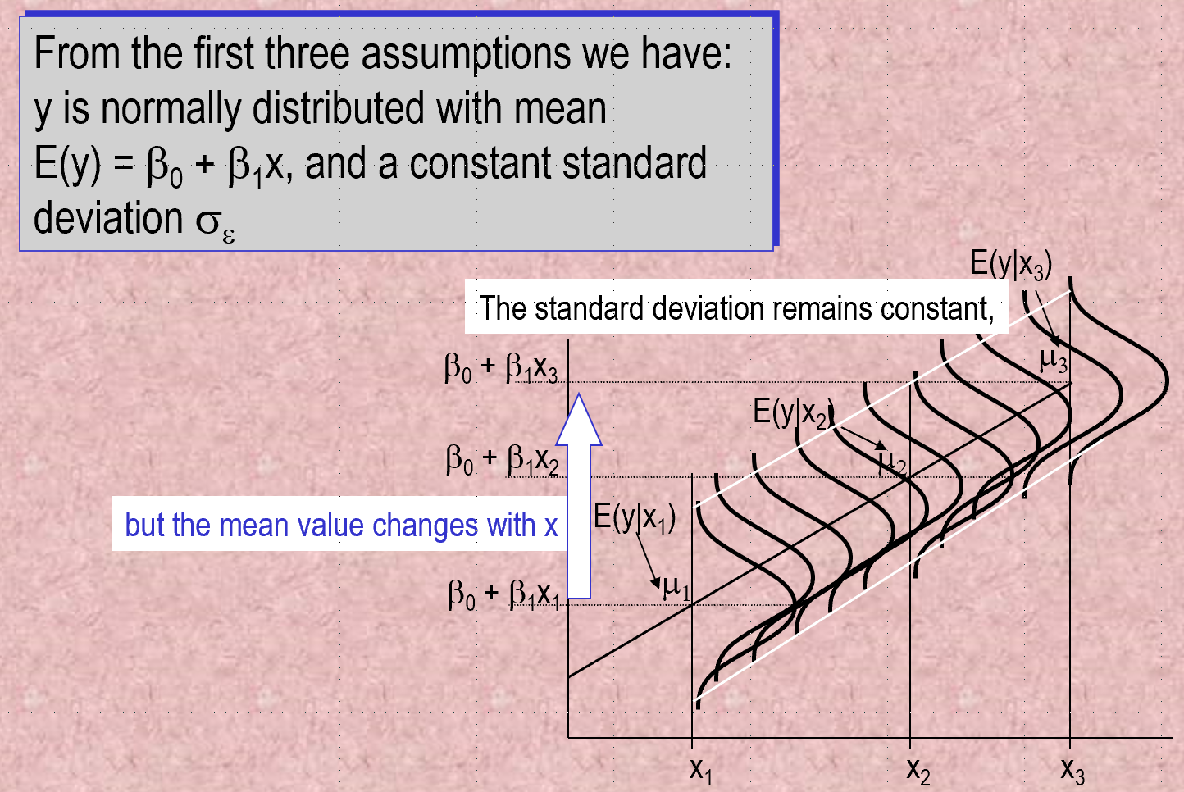
https://web.stanford.edu/class/msande247s/kchap17.ppt

Slide 7
Lurking Variable
Sometimes it is not clear which variable is the explanatory variable and which is the response variable
Sometimes the two variables are related without either one being an explanatory variable
Sometimes the two variables are both affected by a third variable, a lurking variable, that had not been included in the study
Correlation does NOT imply causation
https://emunix.emich.edu/~schu/MATH_170/Fall09_170/Evening%20session/Unit%203.ppt

Slide 8
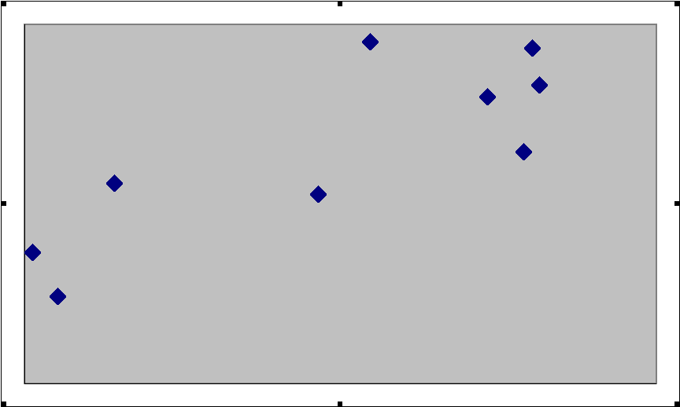
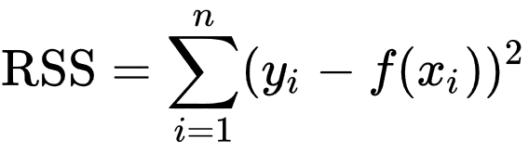
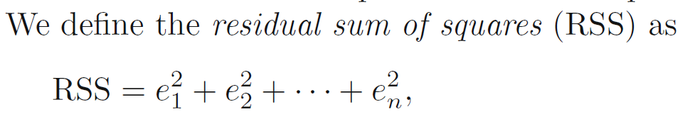
https://emunix.emich.edu/~schu/MATH_170/Fall09_170/Evening%20session/Unit%203.ppt
Here shows a residual on the scatter diagram
The residual
The regression line
The observed value y
The predicted value y
The x value of interest

Slide 9
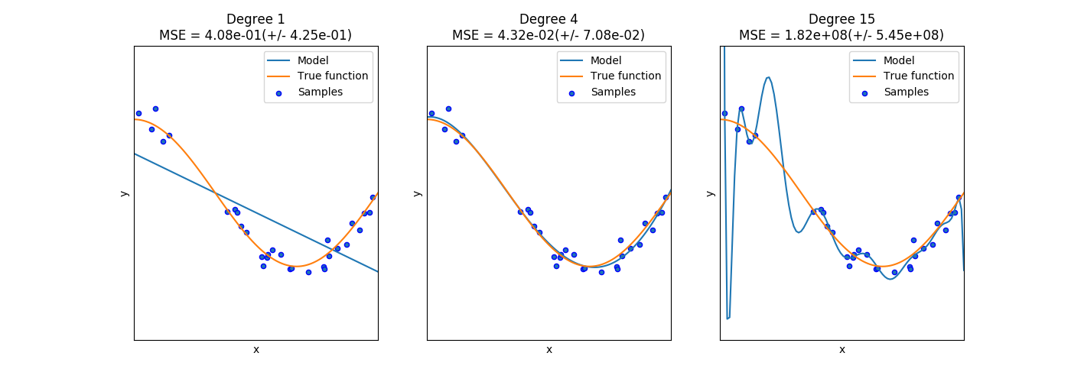
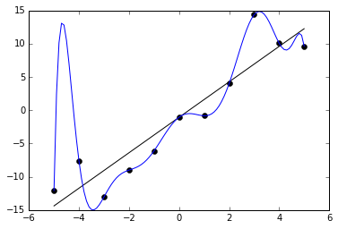
Ivan Meza http://turing.iimas.unam.mx/~ivanvladimir/slides/rpyaa/02_regression.html#/60
Underfitting versus overfitting
https://it.wikipedia.org/wiki/Overfitting

Slide 10
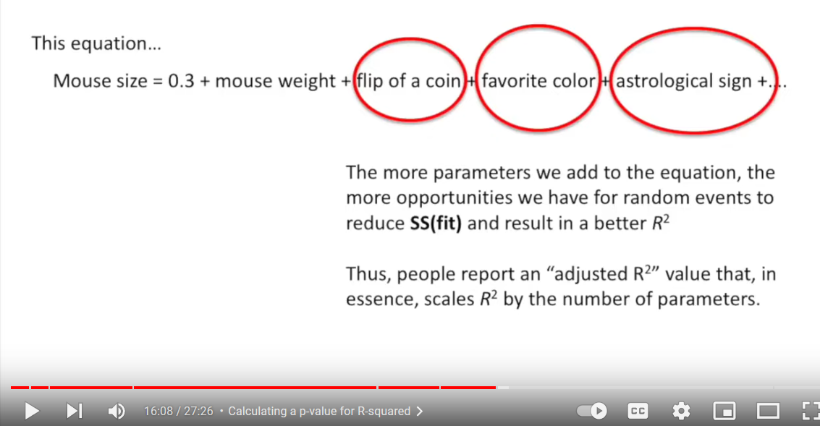
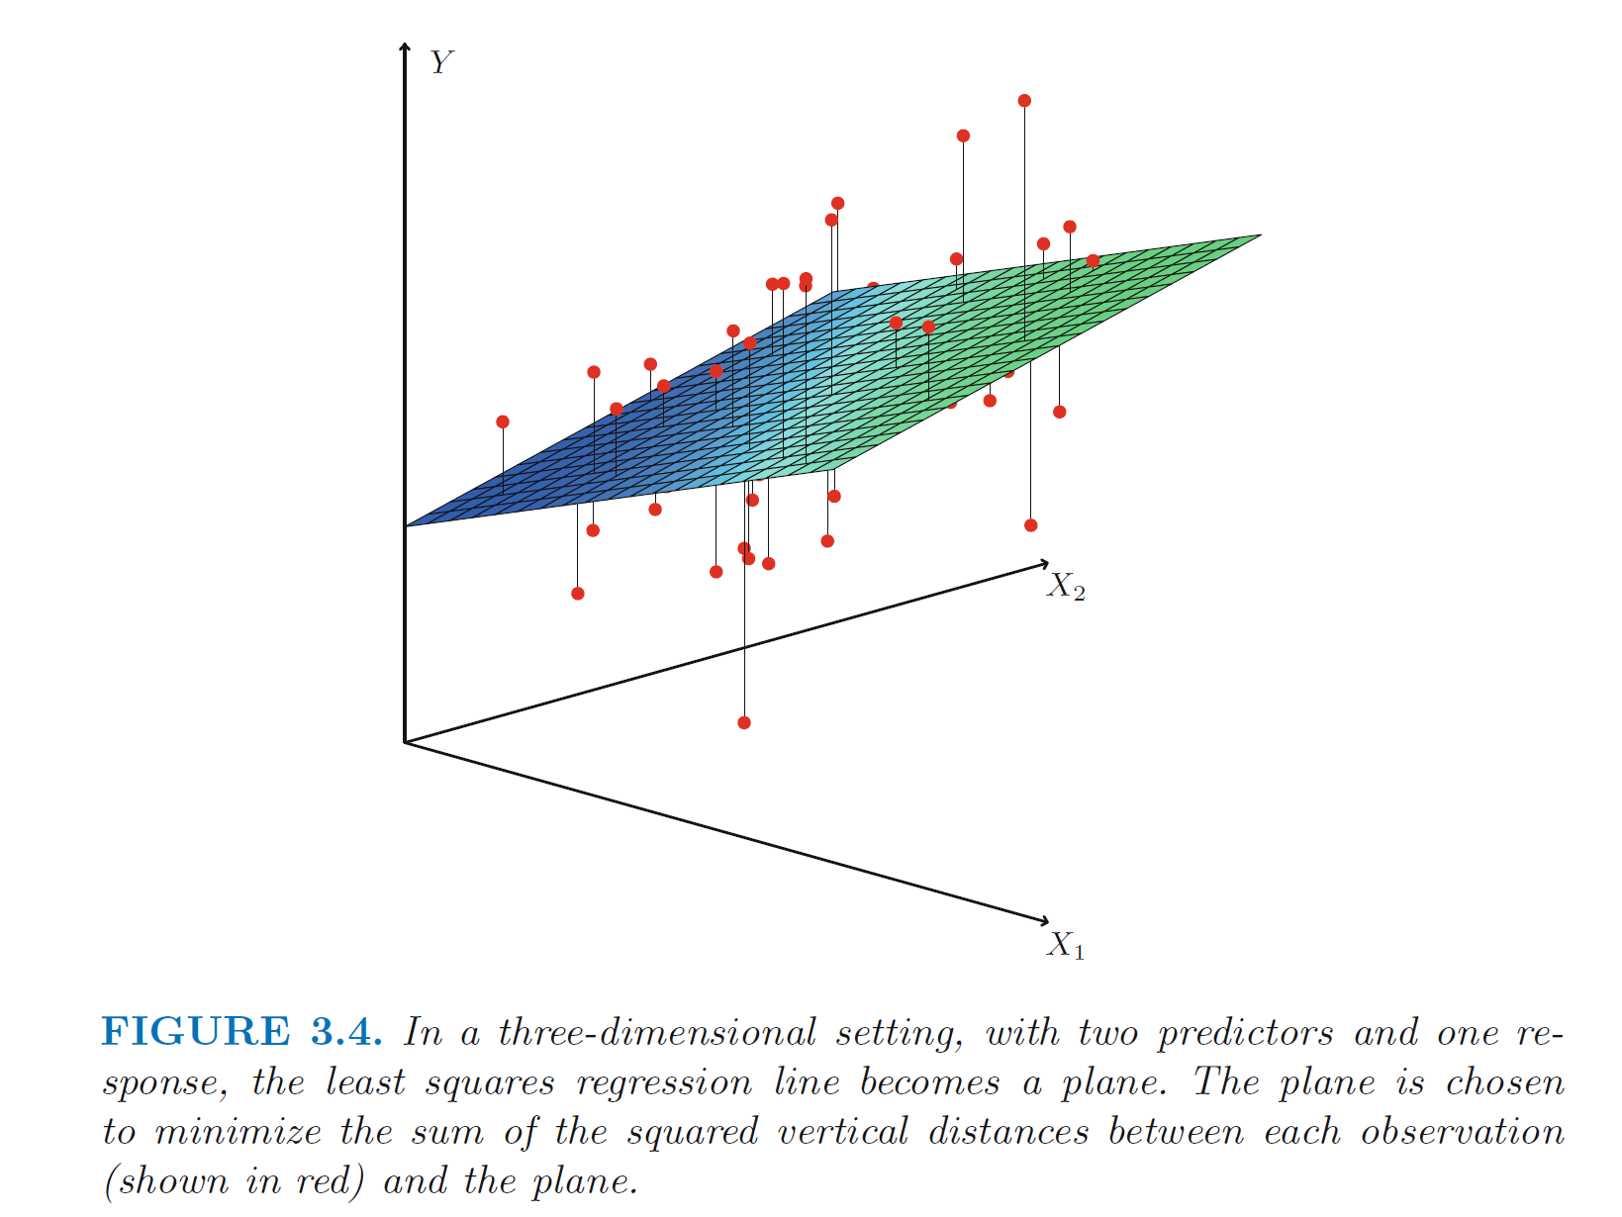
https://www.statlearning.com/
Overfitting
StatQuest: Linear Models Pt.1 - Linear Regression https://www.youtube.com/watch?v=nk2CQITm_eo

Slide 11
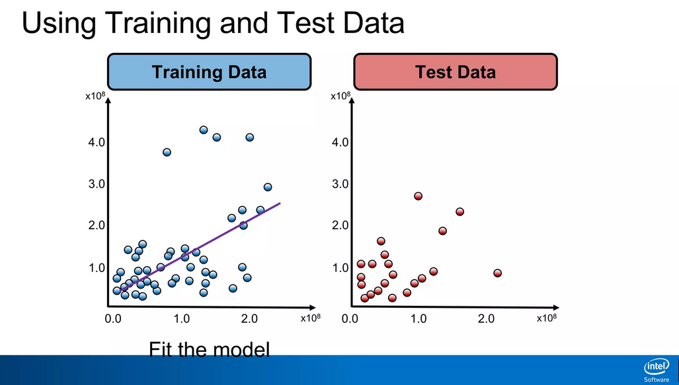
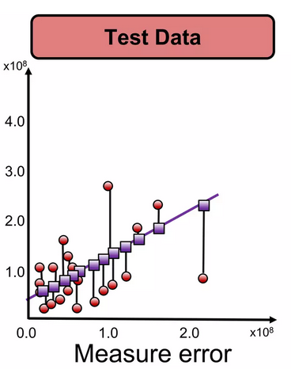
To avoid overfitting due to too many parameters:
https://www.slideshare.net/ankit_ppt/ml2-train-testsplitsvalidationlinearregression

Slide 12
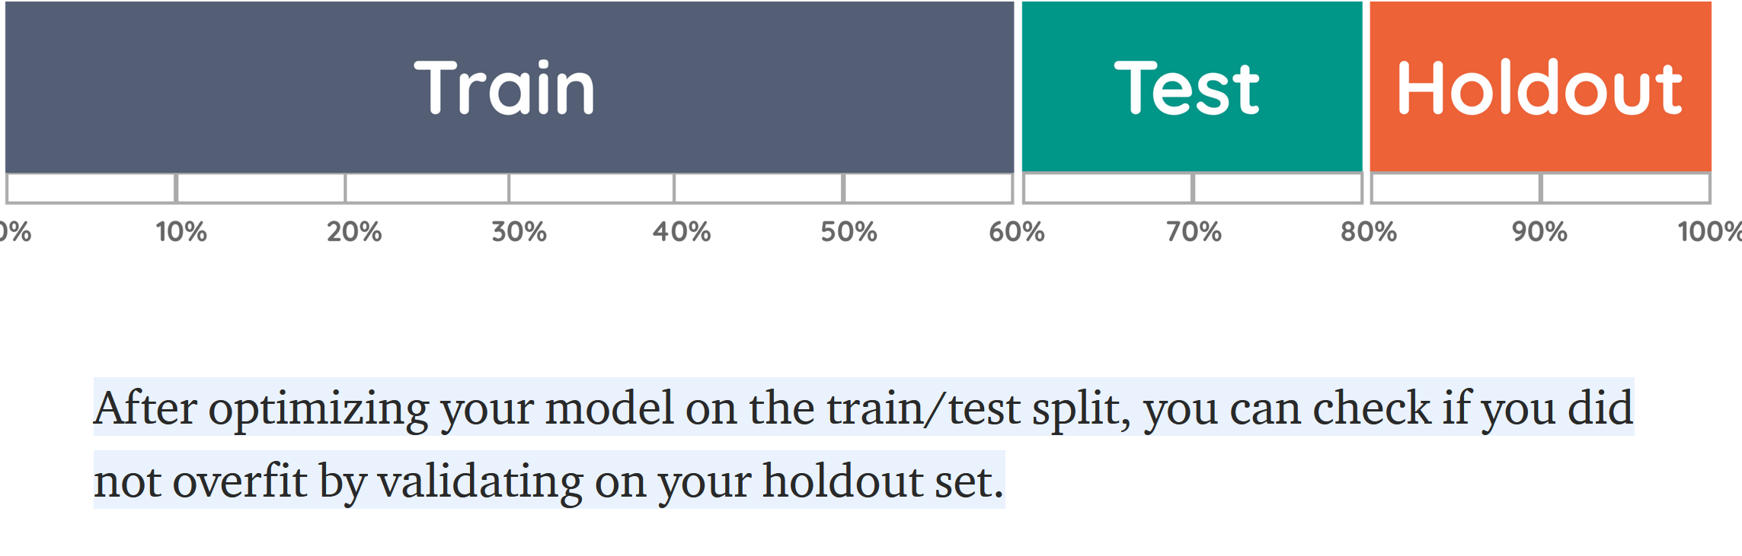
https://towardsdatascience.com/validating-your-machine-learning-model-25b4c8643fb7

Slide 13
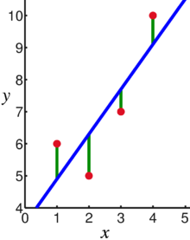
Supervised Learning: Use labeled data to predict unlabeled data.
2 types of supervised learning:
Regression: Predict continuous values.
Ex: Linear regression.
F(x_{new}) = b₀ + b₁x_{new}
2. Classification: Predict discrete values.
Ex: Logistic regression
https://en.wikipedia.org/wiki/Linear_regression

Slide 14
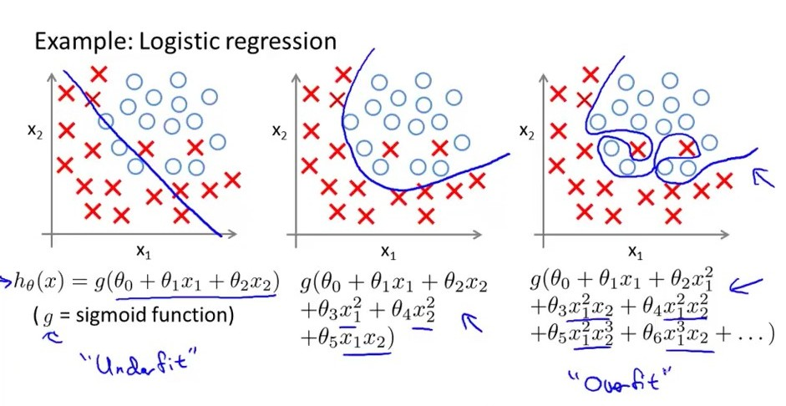
Two variables (x₁, x₂)and one label (x vs o)
Underfitting versus overfitting
https://stats.stackexchange.com/questions/71946/overfitting-a-logistic-regression-model

Slide 15
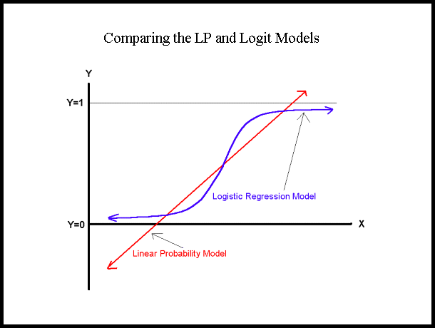
https://nlp.stanford.edu/~manning/courses/ling236/handouts/whitehead-logistic-regression.ppt

Slide 16
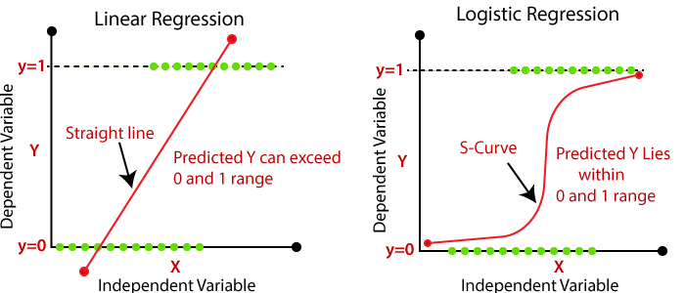
Devopedia. 2022. "Logistic Regression." Version 10, January 19. Accessed 2023-02-11. https://devopedia.org/logistic-regression

Slide 17
Devopedia. 2022. "Logistic Regression." Version 10, January 19. Accessed 2023-02-11. https://devopedia.org/logistic-regression

Slide 18
Devopedia. 2022. "Logistic Regression." Version 10, January 19. Accessed 2023-02-11. https://devopedia.org/logistic-regression

Slide 19
The Logistic Regression Model
The "logit" model solves these problems: ln[p/(1-p)] = α + βX + e
p is the probability that the event Y occurs, p(Y=1)
p/(1-p) is the "odds ratio"
ln[p/(1-p)] is the log odds ratio, or "logit"
https://nlp.stanford.edu/~manning/courses/ling236/handouts/whitehead-logistic-regression.ppt

Slide 20
Probability and Odds
On coin flip, p(H) = ½
On 2 dice roll, p(7) = 6/36 =1/6
https://jmg1.psychology.msstate.edu/8803/logisticReg09.ppt

Slide 21
Odds
On coin flip, Odds(H) = 1/1
Odds are 1 to 1 that your coin flip will be “heads”
On 2 dice roll, Odds(7) = 6/(30) = 1/5
Odds(7) = p(7)/[1 - p(7)] = 1/6 / 5/6 = 1/5
Odds are “1 to 5” that you will roll “seven”
https://jmg1.psychology.msstate.edu/8803/logisticReg09.ppt

Slide 22
Problems with Odds
Asymmetry
Possible range from 0 to “very large”
With 1 indicating no difference
Due to asymmetry
The same odds in opposite direction may appear different
Odds of 5.0 (5 to 1) of losing are the same as odds of .2 of winning (1 to 5)
https://jmg1.psychology.msstate.edu/8803/logisticReg09.ppt

Slide 23
More:
The logistic distribution constrains the estimated probabilities to lie between 0 and 1.
The estimated probability is: p = 1/[1 + exp(-α - β X)]
if you let α + β X =0, then p = .50
as α + β X gets really big, p approaches 1
as α + β X gets really small, p approaches 0
https://nlp.stanford.edu/~manning/courses/ling236/handouts/whitehead-logistic-regression.ppt

Slide 24
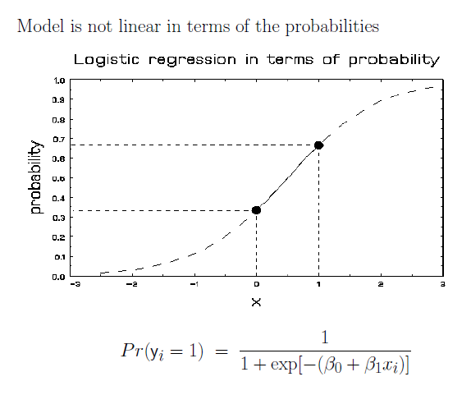
More Visualizations and Formulas
https://jmg1.psychology.msstate.edu/8803/logisticReg09.ppt

Slide 25
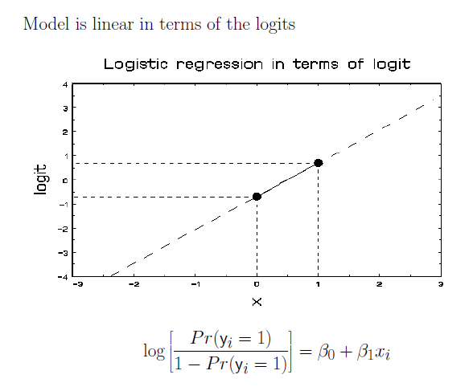
https://jmg1.psychology.msstate.edu/8803/logisticReg09.ppt

Slide 26
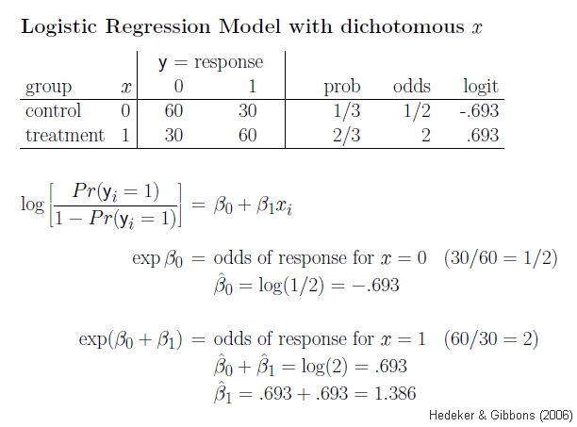
https://jmg1.psychology.msstate.edu/8803/logisticReg09.ppt

Slide 27
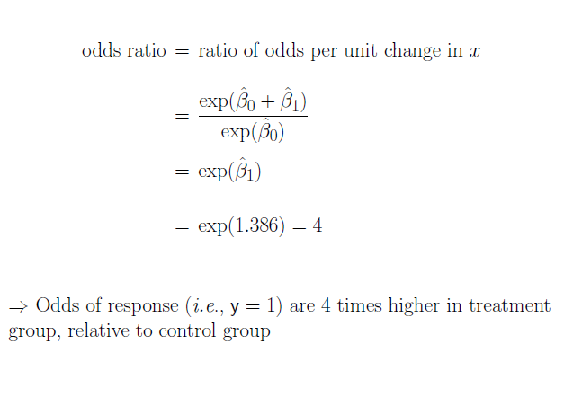
https://jmg1.psychology.msstate.edu/8803/logisticReg09.ppt

Slide 28
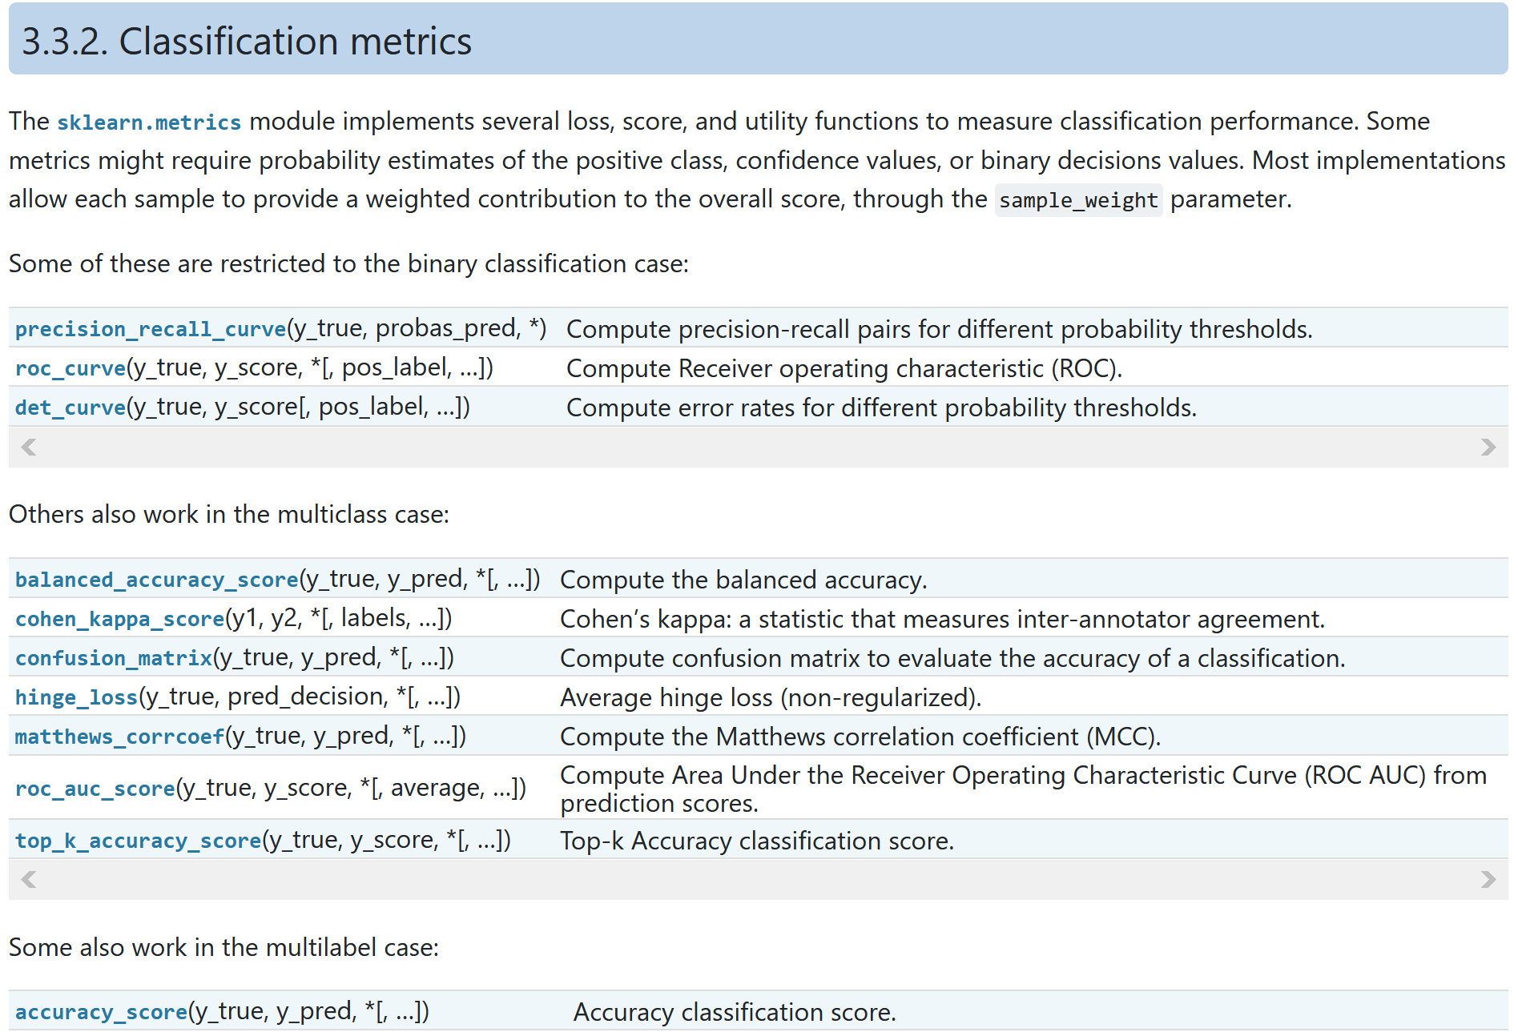
https://scikit-learn.org/stable/modules/model_evaluation.html#classification-metrics

Slide 29
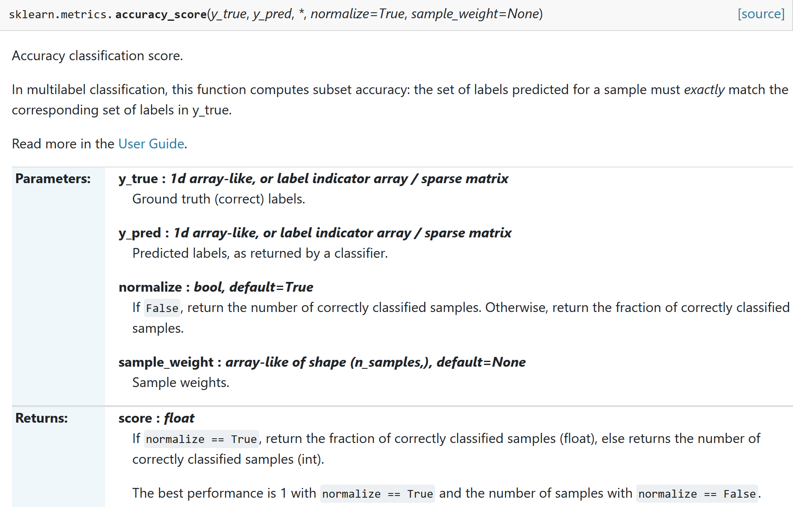

Slide 30
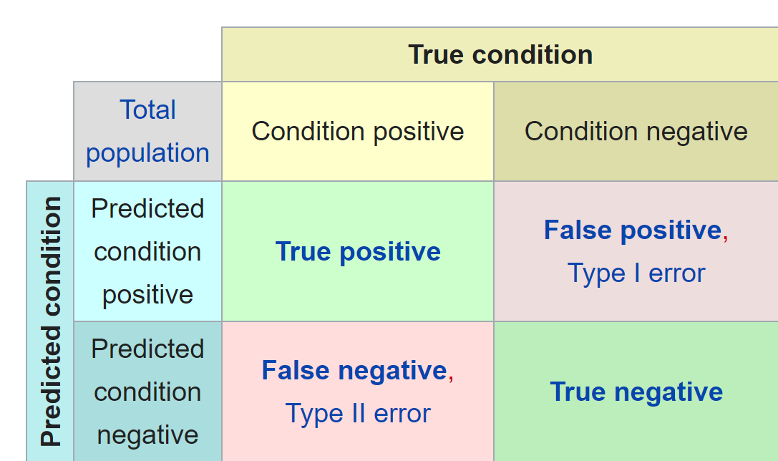
Confusion matrix
https://en.wikipedia.org/wiki/Confusion_matrix

Slide 31
Accuracy = $\frac{TP+TN}{sample population}$ = $\frac{\# of correct predictions}{total \# of predictions}$
Confusion matrix
https://en.wikipedia.org/wiki/Confusion_matrix

Slide 32
Precision = $\frac{TP}{TP+FP}$ = proportion of true positives among all positives
Confusion matrix
https://en.wikipedia.org/wiki/Confusion_matrix

Slide 33
Recall = $\frac{TP}{TP+FN}$ = proportion of actual positives correctly identified
Confusion matrix
https://en.wikipedia.org/wiki/Confusion_matrix

Slide 34
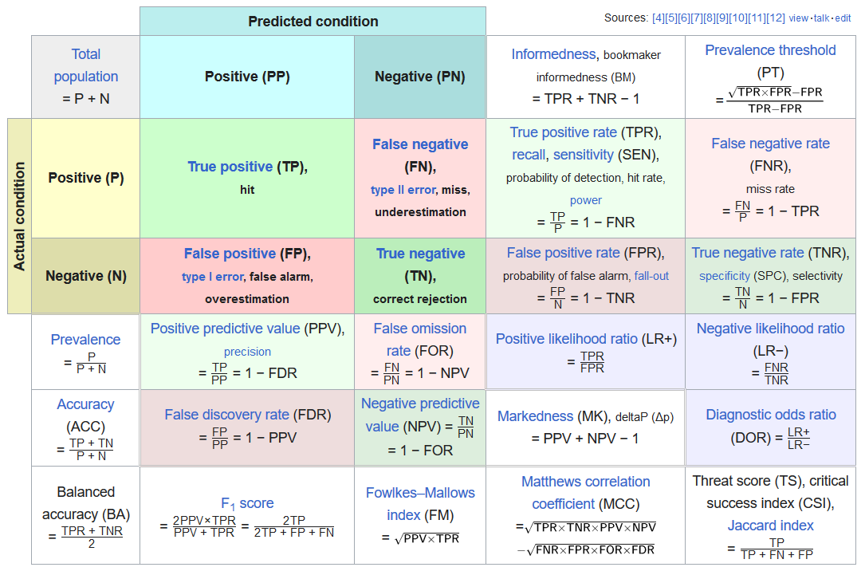
https://en.wikipedia.org/wiki/F-score#Formulation

Slide 35
https://www.kdnuggets.com/2022/10/classification-metrics-walkthrough-logistic-regression-accuracy-precision-recall-roc.html

Slide 36
https://www.kdnuggets.com/2022/10/classification-metrics-walkthrough-logistic-regression-accuracy-precision-recall-roc.html

Slide 37
https://www.kdnuggets.com/2022/10/classification-metrics-walkthrough-logistic-regression-accuracy-precision-recall-roc.html

