Slide 1
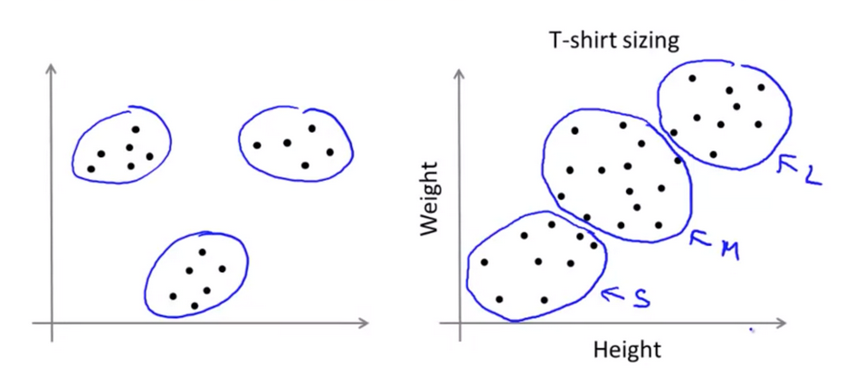
Clustering: Grouping “like” objects
https://hackerwins.github.io/2019-07-10/cs229a-week8
From Andrew Ng’s Machine Learning course

Slide 2
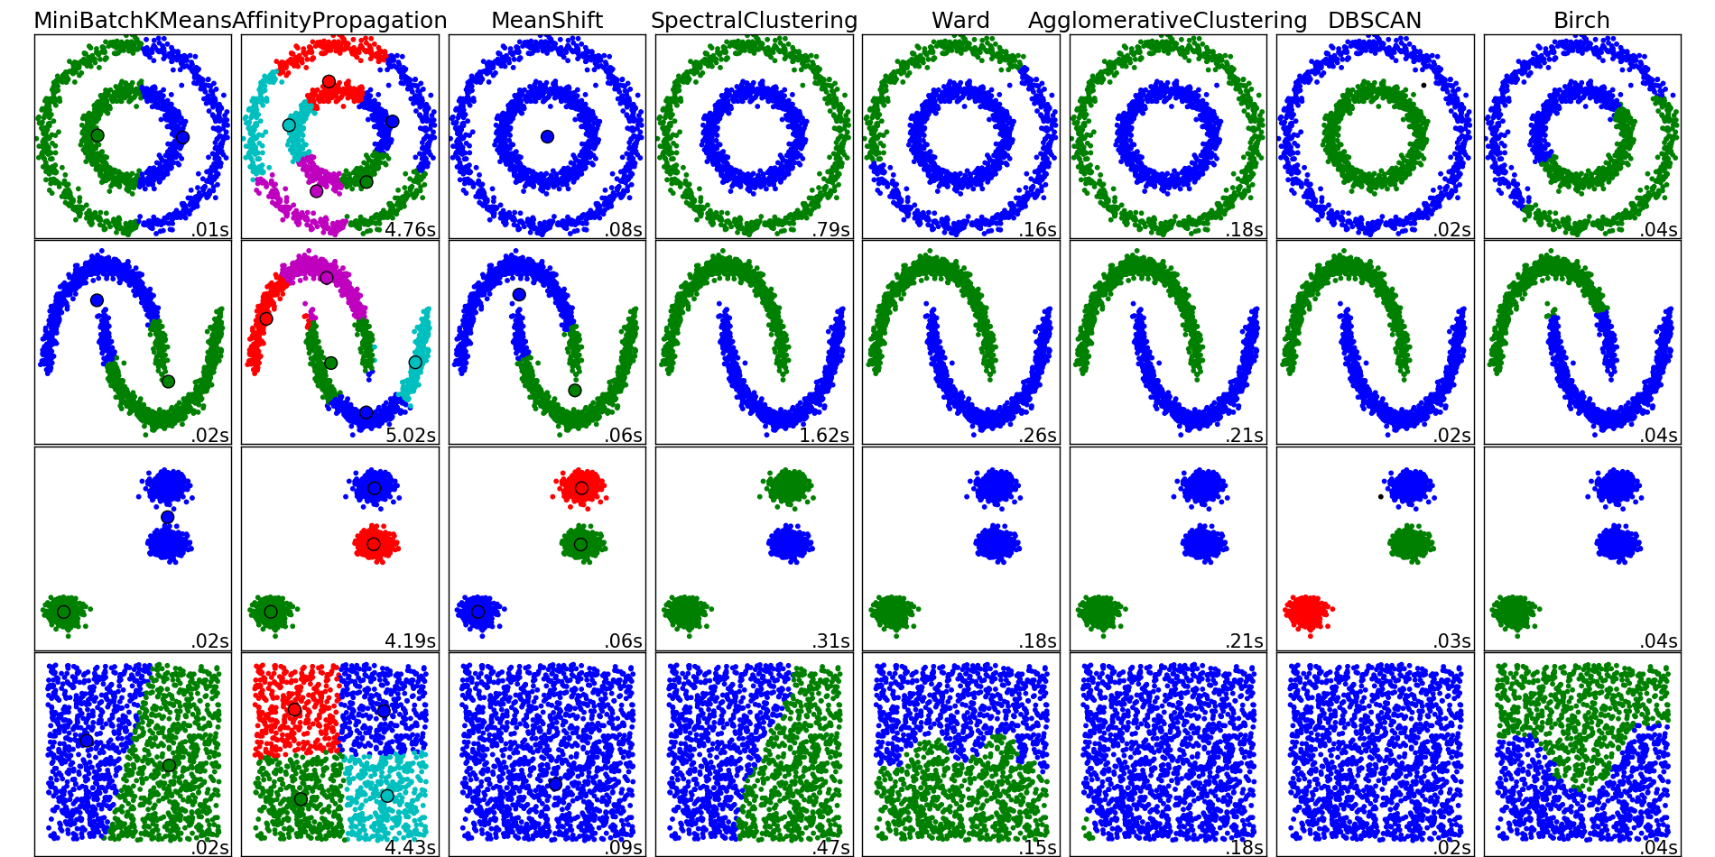
http://scikit-learn.org/stable/auto_examples/cluster/plot_cluster_comparison.html

Slide 3
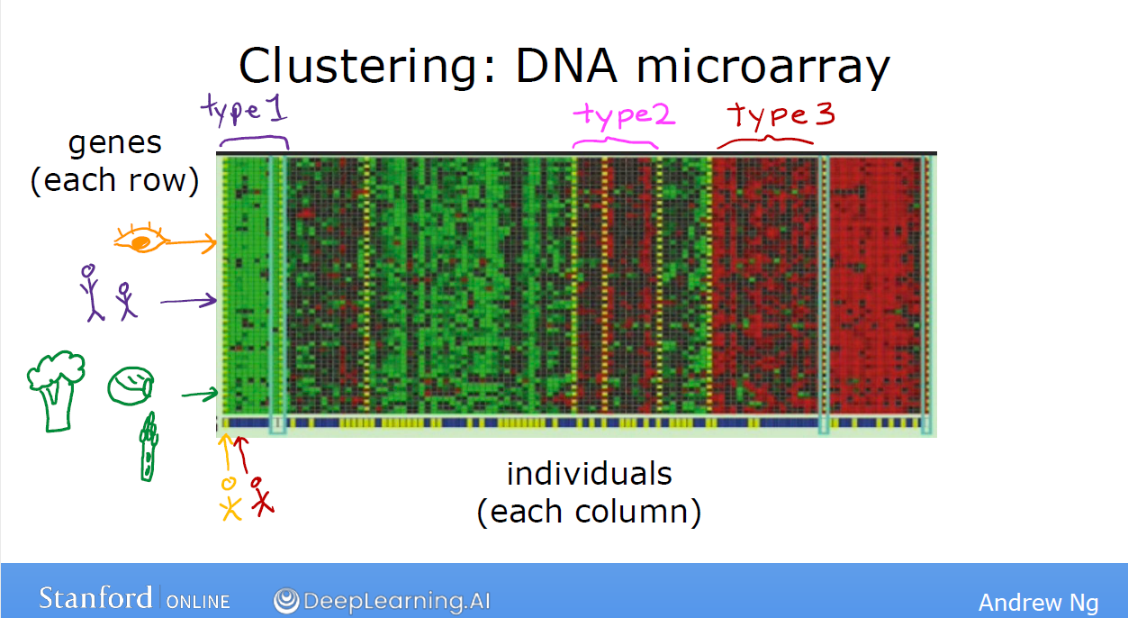
https://www.deeplearning.ai/

Slide 4
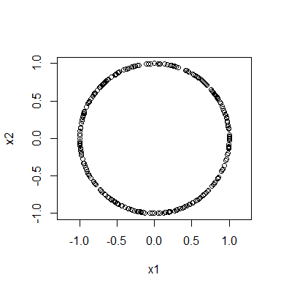
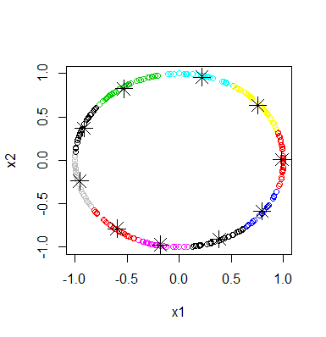
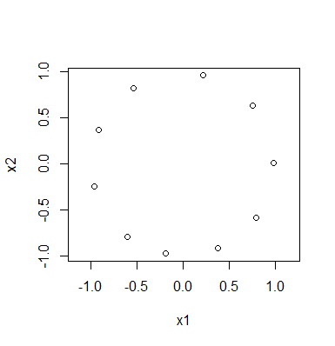
Reduce a data set:
Rstudio:
library("TDA")
circle = circleUnif(300, r = 1)
plot(circle, asp = 1)
cl <- kmeans(circle, 10)
plot(circle,col=cl$cluster)
points(cl$centers, pch=8, cex = 2)
plot(cl$centers, asp = 1)

Slide 5

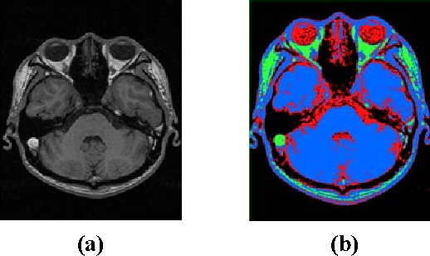
https://raw.githubusercontent.com/ozgyal/Image-Clustering/master/clusteredIm.png
2006 IEEE Southwest Symposium https://ieeexplore.ieee.org/document/1633722
Medical Image Segmentation Using K-Means Clustering and Improved Watershed Algorithm
H.P. Ng; S.H. Ong; K.W.C. Foong; P.S. Goh; W.L. Nowinski

Slide 6
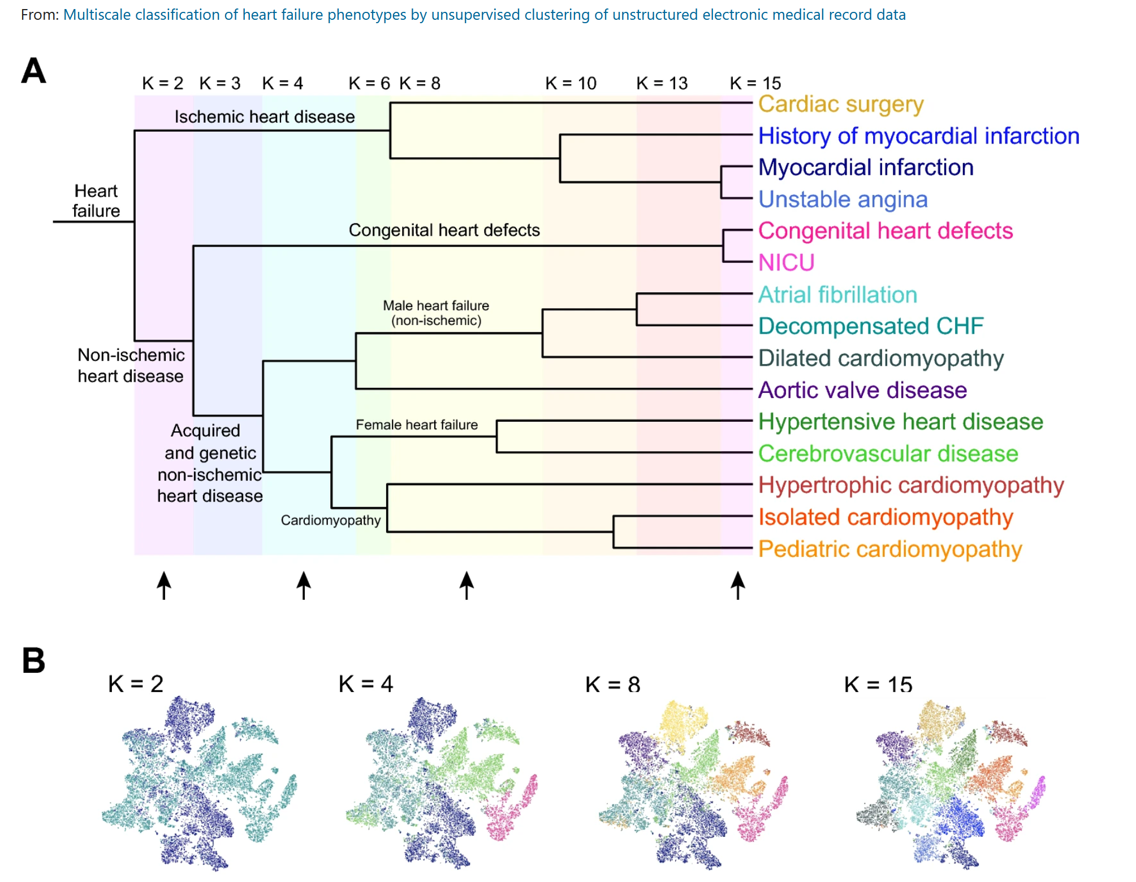
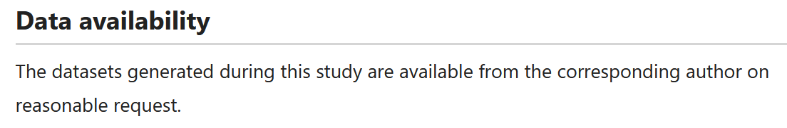
https://www.nature.com/articles/s41598-020-77286-6

Slide 7
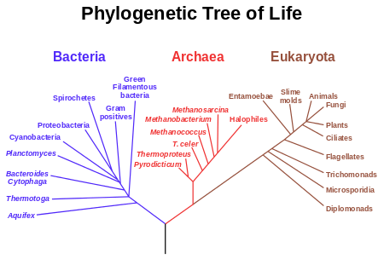

Slide 8
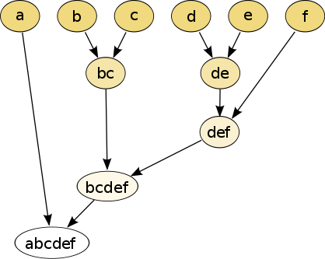
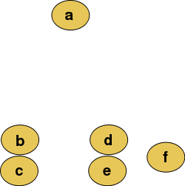
Hierarchical clustering
Data
Dendrogram
http://en.wikipedia.org/wiki/File:Clusters.svg
http://en.wikipedia.org/wiki/File:Hierarchical_clustering_simple_diagram.svg

Slide 9
Increasing threshold
Connect vertices whose distance is less than a given threshold
single linkage hierarchical clustering

Slide 10
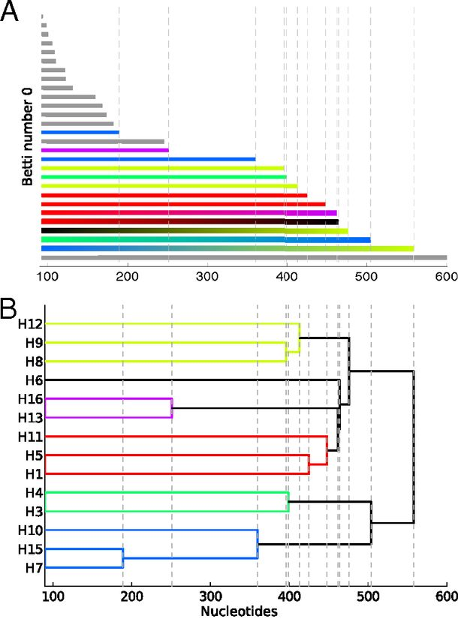
Reconstructing phylogeny from persistent homology of avian influenza HA. (A) Barcode plot in dimension 0 of all avian HA subtypes.
http://www.pnas.org/content/110/46/18566.full
When all vertices born at time 0, length of persistent homology bars for H₀
=
Merging heights of single-linkage clustering dendrogram
©2013 by National Academy of Sciences
Chan J M et al. PNAS 2013;110:18566-18571
Notes:
Reconstructing phylogeny from persistent homology of avian influenza HA. (A) Barcode plot in dimension 0 of all avian HA subtypes. Each bar represents a connected simplex of sequences given a Hamming distance of ε. When a bar ends at a given ε, it merges with another simplex. Gray bars indicate that two simplices of the same HA subtype merge together at a given ε. Solid color bars indicate that two simplices of different HA subtypes but same major clade merge together. Interpolated color bars indicate that two simplices of different major clades merge together. Colors correspond to known major clades of HA. For specific parameters, see SI Appendix, Supplementary Text. (B) Phylogeny of avian HA reconstructed from the barcode plot in A. Major clades are color-coded. (C) Neighbor-joining tree of avian HA (SI Appendix, Supplementary Text).

Slide 11
Increasing threshold
Connect vertices whose distance is less than a given threshold
single linkage hierarchical clustering

Slide 12
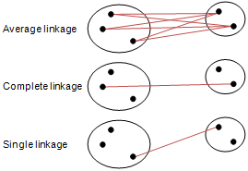
Different type of hierarchical clustering
What is the distance between 2 clusters?
http://en.wikipedia.org/wiki/File:Hierarchical_clustering_simple_diagram.svg
http://www.multid.se/genex/hs515.htm

Slide 13
Increasing threshold
Connect vertices (or clusters) whose distance is less than a given threshold

Slide 14
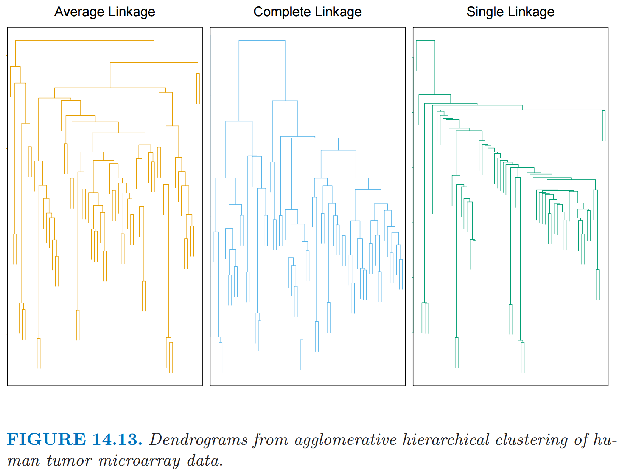
http://statweb.stanford.edu/~tibs/ElemStatLearn/
The Elements of Statistical Learning (2nd edition) Hastie, Tibshirani and Friedman

Slide 15
Different type of hierarchical clustering
What is the distance between 2 clusters?
http://en.wikipedia.org/wiki/File:Hierarchical_clustering_simple_diagram.svg
http://www.multid.se/genex/hs515.htm

Slide 16
Which pair is closer: a and b OR c and d?
a b
c
a b
c
d
d
http://statweb.stanford.edu/~tibs/ElemStatLearn/

Slide 17
Which pair is closer: a and b OR c and d?
a b
c
a b
c
d
d
http://statweb.stanford.edu/~tibs/ElemStatLearn/
The Elements of Statistical Learning (2nd edition) Hastie, Tibshirani and Friedman

Slide 18
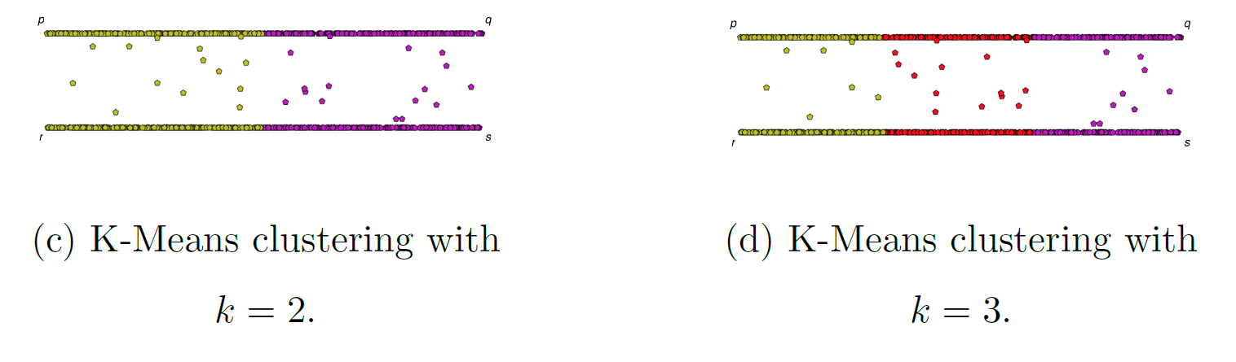
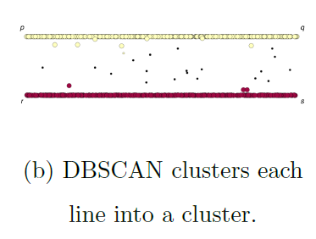
If you care about closeness:
Complete linkage
Average linkage
Ward’s linkage
K-means
If you care about connected components:
  Single linkage
  DBscan
Figures courtesy of Wako Bungula

Slide 19
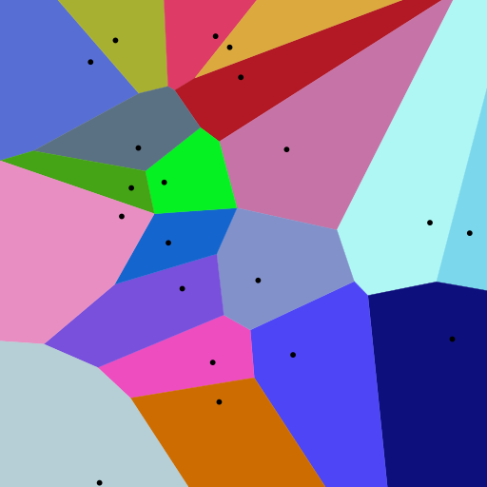
Background for
k-means clustering:
Creating Voronoi diagrams
https://commons.wikimedia.org/wiki/File:Euclidean_Voronoi_diagram.svg

Slide 20
Applications of Voronoi Diagrams https://www.ics.uci.edu/~eppstein/gina/scot.drysdale.html
Anthropology and Archeology -- Identify the parts of a region under the influence of different neolithic clans, chiefdoms, ceremonial centers, or hill forts.
Astronomy -- Identify clusters of stars and clusters of galaxies (Here we saw what may be the earliest picture of a Voronoi diagram, drawn by Descartes in 1644, where the regions described the regions of gravitational influence of the sun and other stars.)
Biology, Ecology, Forestry -- Model and analyze plant competition ("Area potentially available to a tree", "Plant polygons")
Cartography -- Piece together satellite photographs into large "mosaic" maps
Crystallography and Chemistry -- Study chemical properties of metallic sodium ("Wigner-Seitz regions"); Modelling alloy structures as sphere packings ("Domain of an atom")
Finite Element Analysis -- Generating finite element meshes which avoid small angles
Geography -- Analyzing patterns of urban settlements
Geology -- Estimation of ore reserves in a deposit using information obtained from bore holes; modelling crack patterns in basalt due to contraction on cooling
Geometric Modeling -- Finding "good" triangulations of 3D surfaces
Marketing -- Model market of US metropolitan areas; market area extending down to individual retail stores
Mathematics -- Study of positive definite quadratic forms ("Dirichlet tesselation", "Voronoi diagram")
Metallurgy -- Modelling "grain growth" in metal films
Meteorology -- Estimate regional rainfall averages, given data at discrete rain gauges ("Thiessen polygons")
Pattern Recognition -- Find simple descriptors for shapes that extract 1D characterizations from 2D shapes ("Medial axis" or "skeleton" of a contour)
Physiology -- Analysis of capillary distribution in cross-sections of muscle tissue to compute oxygen transport ("Capillary domains")
Robotics -- Path planning in the presence of obstacles
Statistics and Data Analysis -- Analyze statistical clustering ("Natural neighbors" interpolation)
Zoology -- Model and analyze the territories of animals
In addition to all these "real world" applications, Voronoi diagrams have several applications within the field of computer science, in particular, computational geometry.
Knuth's Post Office Problem -- Given a set of locations for post offices, how do you determine the closest post office to a given house? (Apparently, Knuth was ignoring the existence of ZIP codes.)
Closest Pair -- Given a set of points, which two are closest together?
All Nearest Neighbors -- Given a set of points, find each point's nearest neighbor
Euclidean Minimum Spanning Tree
Largest Empty Circle, also known as the Toxic Waste Dump Problem
Fixed Radius Near Neighbors -- Find all pairs of points closer than a given distance apart.
All k Nearest Neighbors -- Find each point's k closest neighbors
Enumerating interpoint distances in increasing order -- Find the closest pair, then the next closest pair, then the next closest pair, and so on.

Slide 21
Voronoi diagram:
Suppose your data points live in R^{n}.
A Voronoi diagram is a partition of space into Voronoi cells.
The Voronoi cell associated with v is
C_{v}= { x in R^{n} : d(x, v) ≤ d(x, w) for all w ≠ v }
= the set of all points in R^{n} closer v than to
any of the other points in your data set.
Notes:
data points.
In this very simplified case my data points lie in a two-dimensional plane. Normally data points are high dimensional.
For example, I may be comparing the expression or thousands of genes in tumor cells to healthy cells using microarray data. OR I might be comparing politicians voting records. Or I might be comparing the stats of basketball players. These three applications were all, by the way, published by Lum et al this past February in Nature’s Scientific Reports. I have included a link to their paper on my youtube site.
http://www.nature.com/srep/2013/130207/srep01236/full/srep01236.html

Slide 22
Voronoi diagram:
Suppose your data points live in R^{n}.
Choose data point v.
The Voronoi cell
associated with v is
H(v,w)
U
w ≠ v
Half-plane closer to v:
H(v,w) = { x in R^{n} : d(x, v) ≤ d(x, w) }
Notes:
data points.
In this very simplified case my data points lie in a two-dimensional plane. Normally data points are high dimensional.
For example, I may be comparing the expression or thousands of genes in tumor cells to healthy cells using microarray data. OR I might be comparing politicians voting records. Or I might be comparing the stats of basketball players. These three applications were all, by the way, published by Lum et al this past February in Nature’s Scientific Reports. I have included a link to their paper on my youtube site.
http://www.nature.com/srep/2013/130207/srep01236/full/srep01236.html

Slide 23
Voronoi diagram:
Suppose your data points live in R^{n}.
Choose data point v.
The Voronoi cell associated with v is
H(v,w)
U
w ≠ v
H(v,w) = { x in R^{n} : d(x, v) ≤ d(x, w) }
Notes:
data points.
In this very simplified case my data points lie in a two-dimensional plane. Normally data points are high dimensional.
For example, I may be comparing the expression or thousands of genes in tumor cells to healthy cells using microarray data. OR I might be comparing politicians voting records. Or I might be comparing the stats of basketball players. These three applications were all, by the way, published by Lum et al this past February in Nature’s Scientific Reports. I have included a link to their paper on my youtube site.
http://www.nature.com/srep/2013/130207/srep01236/full/srep01236.html

Slide 24
Voronoi diagram:
Suppose your data points live in R^{n}.
Choose data point v.
The Voronoi cell associated with v is
H(v,w)
U
w ≠ v
H(v,w) = { x in R^{n} : d(x, v) ≤ d(x, w) }
Notes:
data points.
In this very simplified case my data points lie in a two-dimensional plane. Normally data points are high dimensional.
For example, I may be comparing the expression or thousands of genes in tumor cells to healthy cells using microarray data. OR I might be comparing politicians voting records. Or I might be comparing the stats of basketball players. These three applications were all, by the way, published by Lum et al this past February in Nature’s Scientific Reports. I have included a link to their paper on my youtube site.
http://www.nature.com/srep/2013/130207/srep01236/full/srep01236.html

Slide 25
Voronoi diagram:
Suppose your data points live in R^{n}.
Choose data point v.
The Voronoi cell associated with v is
H(v,w)
U
w ≠ v
H(v,w) = { x in R^{n} : d(x, v) ≤ d(x, w) }
Notes:
data points.
In this very simplified case my data points lie in a two-dimensional plane. Normally data points are high dimensional.
For example, I may be comparing the expression or thousands of genes in tumor cells to healthy cells using microarray data. OR I might be comparing politicians voting records. Or I might be comparing the stats of basketball players. These three applications were all, by the way, published by Lum et al this past February in Nature’s Scientific Reports. I have included a link to their paper on my youtube site.
http://www.nature.com/srep/2013/130207/srep01236/full/srep01236.html

Slide 26
Voronoi diagram:
Suppose your data points live in R^{n}.
Choose data point v.
The Voronoi cell associated with v is
H(v,w)
U
w ≠ v
H(v,w) = { x in R^{n} : d(x, v) ≤ d(x, w) }
Notes:
data points.
In this very simplified case my data points lie in a two-dimensional plane. Normally data points are high dimensional.
For example, I may be comparing the expression or thousands of genes in tumor cells to healthy cells using microarray data. OR I might be comparing politicians voting records. Or I might be comparing the stats of basketball players. These three applications were all, by the way, published by Lum et al this past February in Nature’s Scientific Reports. I have included a link to their paper on my youtube site.
http://www.nature.com/srep/2013/130207/srep01236/full/srep01236.html

Slide 27
Voroncoi diagram:
Suppose your data points live in R^{n}.
Choose data point v.
The Voronoi cell associated with v is
H(v,w)
U
w ≠ v
H(v,w) = { x in R^{n} : d(x, v) ≤ d(x, w) }
Notes:
data points.
In this very simplified case my data points lie in a two-dimensional plane. Normally data points are high dimensional.
For example, I may be comparing the expression or thousands of genes in tumor cells to healthy cells using microarray data. OR I might be comparing politicians voting records. Or I might be comparing the stats of basketball players. These three applications were all, by the way, published by Lum et al this past February in Nature’s Scientific Reports. I have included a link to their paper on my youtube site.
http://www.nature.com/srep/2013/130207/srep01236/full/srep01236.html

Slide 28
Voroncoi diagram:
Suppose your data points live in R^{n}.
Choose data point v.
The Voronoi cell associated with v is
H(v,w)
U
w ≠ v
H(v,w) = { x in R^{n} : d(x, v) ≤ d(x, w) }
Notes:
data points.
In this very simplified case my data points lie in a two-dimensional plane. Normally data points are high dimensional.
For example, I may be comparing the expression or thousands of genes in tumor cells to healthy cells using microarray data. OR I might be comparing politicians voting records. Or I might be comparing the stats of basketball players. These three applications were all, by the way, published by Lum et al this past February in Nature’s Scientific Reports. I have included a link to their paper on my youtube site.
http://www.nature.com/srep/2013/130207/srep01236/full/srep01236.html

Slide 29
Voroncoi diagram:
Suppose your data points live in R^{n}.
Choose data point v.
The Voronoi cell associated with v is
H(v,w)
U
w ≠ v
Notes:
data points.
In this very simplified case my data points lie in a two-dimensional plane. Normally data points are high dimensional.
For example, I may be comparing the expression or thousands of genes in tumor cells to healthy cells using microarray data. OR I might be comparing politicians voting records. Or I might be comparing the stats of basketball players. These three applications were all, by the way, published by Lum et al this past February in Nature’s Scientific Reports. I have included a link to their paper on my youtube site.
http://www.nature.com/srep/2013/130207/srep01236/full/srep01236.html

Slide 30
Choose data point v.
The Voronoi cell associated with v is
H(v,w)
U
w ≠ v
Notes:
data points.
In this very simplified case my data points lie in a two-dimensional plane. Normally data points are high dimensional.
For example, I may be comparing the expression or thousands of genes in tumor cells to healthy cells using microarray data. OR I might be comparing politicians voting records. Or I might be comparing the stats of basketball players. These three applications were all, by the way, published by Lum et al this past February in Nature’s Scientific Reports. I have included a link to their paper on my youtube site.
http://www.nature.com/srep/2013/130207/srep01236/full/srep01236.html

Slide 31
Choose data point v.
The Voronoi cell associated with v is
H(v,w)
U
w ≠ v
Notes:
data points.
In this very simplified case my data points lie in a two-dimensional plane. Normally data points are high dimensional.
For example, I may be comparing the expression or thousands of genes in tumor cells to healthy cells using microarray data. OR I might be comparing politicians voting records. Or I might be comparing the stats of basketball players. These three applications were all, by the way, published by Lum et al this past February in Nature’s Scientific Reports. I have included a link to their paper on my youtube site.
http://www.nature.com/srep/2013/130207/srep01236/full/srep01236.html

Slide 32
Choose data point v.
The Voronoi cell associated with v is
H(v,w)
U
w ≠ v
Notes:
data points.
In this very simplified case my data points lie in a two-dimensional plane. Normally data points are high dimensional.
For example, I may be comparing the expression or thousands of genes in tumor cells to healthy cells using microarray data. OR I might be comparing politicians voting records. Or I might be comparing the stats of basketball players. These three applications were all, by the way, published by Lum et al this past February in Nature’s Scientific Reports. I have included a link to their paper on my youtube site.
http://www.nature.com/srep/2013/130207/srep01236/full/srep01236.html

Slide 33
Choose data point v.
The Voronoi cell associated with v is
H(v,w)
U
w ≠ v
Notes:
data points.
In this very simplified case my data points lie in a two-dimensional plane. Normally data points are high dimensional.
For example, I may be comparing the expression or thousands of genes in tumor cells to healthy cells using microarray data. OR I might be comparing politicians voting records. Or I might be comparing the stats of basketball players. These three applications were all, by the way, published by Lum et al this past February in Nature’s Scientific Reports. I have included a link to their paper on my youtube site.
http://www.nature.com/srep/2013/130207/srep01236/full/srep01236.html

Slide 34
Choose data point v.
The Voronoi cell associated with v is
H(v,w)
U
w ≠ v
Notes:
data points.
In this very simplified case my data points lie in a two-dimensional plane. Normally data points are high dimensional.
For example, I may be comparing the expression or thousands of genes in tumor cells to healthy cells using microarray data. OR I might be comparing politicians voting records. Or I might be comparing the stats of basketball players. These three applications were all, by the way, published by Lum et al this past February in Nature’s Scientific Reports. I have included a link to their paper on my youtube site.
http://www.nature.com/srep/2013/130207/srep01236/full/srep01236.html

Slide 35
Choose data point v.
The Voronoi cell associated with v is
H(v,w)
U
w ≠ v
Notes:
data points.
In this very simplified case my data points lie in a two-dimensional plane. Normally data points are high dimensional.
For example, I may be comparing the expression or thousands of genes in tumor cells to healthy cells using microarray data. OR I might be comparing politicians voting records. Or I might be comparing the stats of basketball players. These three applications were all, by the way, published by Lum et al this past February in Nature’s Scientific Reports. I have included a link to their paper on my youtube site.
http://www.nature.com/srep/2013/130207/srep01236/full/srep01236.html

Slide 36
Choose data point v.
The Voronoi cell associated with v is
H(v,w)
U
w ≠ v
Notes:
data points.
In this very simplified case my data points lie in a two-dimensional plane. Normally data points are high dimensional.
For example, I may be comparing the expression or thousands of genes in tumor cells to healthy cells using microarray data. OR I might be comparing politicians voting records. Or I might be comparing the stats of basketball players. These three applications were all, by the way, published by Lum et al this past February in Nature’s Scientific Reports. I have included a link to their paper on my youtube site.
http://www.nature.com/srep/2013/130207/srep01236/full/srep01236.html

Slide 37
Voronoi diagram:
Suppose your data points live in R^{n}.
Choose data point v.
The Voronoi cell associated with v is
H(v,w)
U
w ≠ v
The Voronoi cell associated with v is
C_{v}= { x in R^{n} : d(x, v) ≤ d(x, w) for all w ≠ v }
Notes:
data points.
In this very simplified case my data points lie in a two-dimensional plane. Normally data points are high dimensional.
For example, I may be comparing the expression or thousands of genes in tumor cells to healthy cells using microarray data. OR I might be comparing politicians voting records. Or I might be comparing the stats of basketball players. These three applications were all, by the way, published by Lum et al this past February in Nature’s Scientific Reports. I have included a link to their paper on my youtube site.
http://www.nature.com/srep/2013/130207/srep01236/full/srep01236.html

Slide 38
A Voronoi diagram is a partition of space into Voronoi cells.
Notes:
data points.
In this very simplified case my data points lie in a two-dimensional plane. Normally data points are high dimensional.
For example, I may be comparing the expression or thousands of genes in tumor cells to healthy cells using microarray data. OR I might be comparing politicians voting records. Or I might be comparing the stats of basketball players. These three applications were all, by the way, published by Lum et al this past February in Nature’s Scientific Reports. I have included a link to their paper on my youtube site.
http://www.nature.com/srep/2013/130207/srep01236/full/srep01236.html

Slide 39
A Voronoi diagram is a partition of space into Voronoi cells.
Notes:
data points.
In this very simplified case my data points lie in a two-dimensional plane. Normally data points are high dimensional.
For example, I may be comparing the expression or thousands of genes in tumor cells to healthy cells using microarray data. OR I might be comparing politicians voting records. Or I might be comparing the stats of basketball players. These three applications were all, by the way, published by Lum et al this past February in Nature’s Scientific Reports. I have included a link to their paper on my youtube site.
http://www.nature.com/srep/2013/130207/srep01236/full/srep01236.html

Slide 40
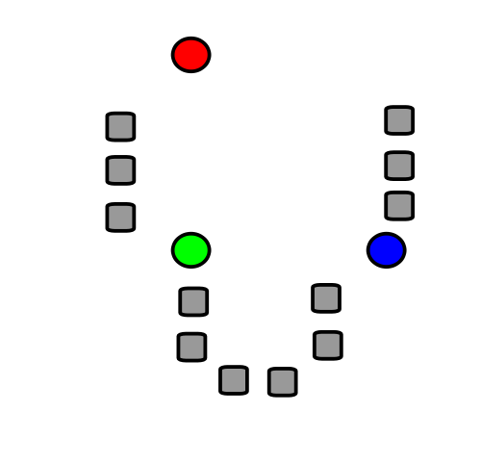
A very basic introduction to
k-means clustering
Notes:
data points.
In this very simplified case my data points lie in a two-dimensional plane. Normally data points are high dimensional.
For example, I may be comparing the expression or thousands of genes in tumor cells to healthy cells using microarray data. OR I might be comparing politicians voting records. Or I might be comparing the stats of basketball players. These three applications were all, by the way, published by Lum et al this past February in Nature’s Scientific Reports. I have included a link to their paper on my youtube site.
http://www.nature.com/srep/2013/130207/srep01236/full/srep01236.html

Slide 41
k-means clustering
k = desired number
of clusters
Data set = grey boxes
Let k = 3
Figure modified from https://en.wikipedia.org/wiki/File:K_Means_Example_Step_1.svg

Slide 42
k-means clustering
k = desired number
of clusters
Data set = grey boxes
Let k = 3
Step 1: Randomly choose
3 points
(points need not be in data set)
3 points = colored circle
Figure from https://en.wikipedia.org/wiki/File:K_Means_Example_Step_1.svg

Slide 43
Data set = grey boxes
Let k = 3
Randomly choose 3 points
(points need not be in data set)
3 points = colored circle
Partition data set into 3 voronoi cells corresponding to the 3 colored circles
Figure modified from https://en.wikipedia.org/wiki/File:K_Means_Example_Step_1.svg

Slide 44
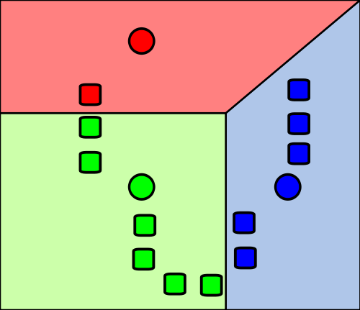
Data set = grey boxes
Let k = 3
Randomly choose 3 points
(points need not be in data set)
3 points = colored circle
Partition data set into 3 voronoi cells corresponding to the 3 colored circles
Figure modified from https://en.wikipedia.org/wiki/File:K_Means_Example_Step_1.svg

Slide 45
X
X
X
Data set = grey boxes
Let k = 3
Randomly choose 3 points
(points need not be in data set)
3 points = colored circle
Partition data set into 3 voronoi cells corresponding to the 3 colored circles
Figure modified from https://en.wikipedia.org/wiki/File:K_Means_Example_Step_1.svg

Slide 46
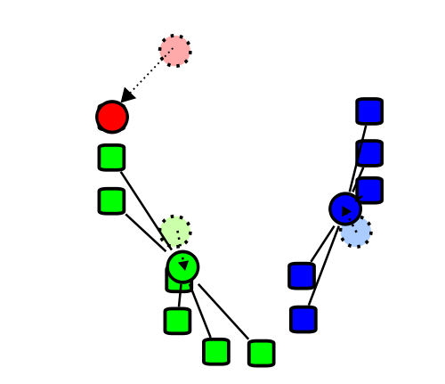
X
X
X
Repeat the process with
3 new points:
Find the centroids of the data cells in each of the voronoi cells
Figure modified from https://en.wikipedia.org/wiki/File:K_Means_Example_Step_1.svg

Slide 47
X
X
X
Repeat the process with
3 new points:
Find the centroids of the data cells in each of the voronoi cells
Figure modified from https://en.wikipedia.org/wiki/File:K_Means_Example_Step_1.svg

Slide 48
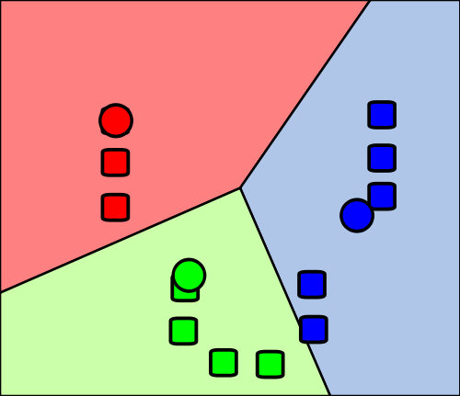
Re-partition data set into 3 voronoi cells corresponding to the 3 centroids
Figure modified from https://en.wikipedia.org/wiki/File:K_Means_Example_Step_1.svg

Slide 49
Re-partition data set into 3 voronoi cells corresponding to the 3 centroids
Repeat
Figure modified from https://en.wikipedia.org/wiki/File:K_Means_Example_Step_1.svg

Slide 50
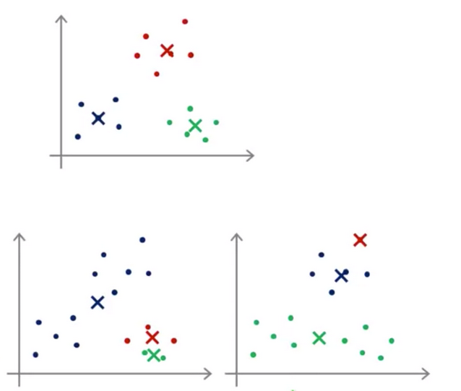
Depending on initial choice of points, can get stuck in a local minimum:
https://hackerwins.github.io/2019-07-10/cs229a-week8
From Andrew Ng’s Machine Learning course

Slide 51
Depending on initial choice of points, can get stuck in a local minimum:
In practice run k-means 50 – 1000 times, and then choose optimal clustering
https://www.deeplearning.ai/courses/machine-learning-specialization/

Slide 52
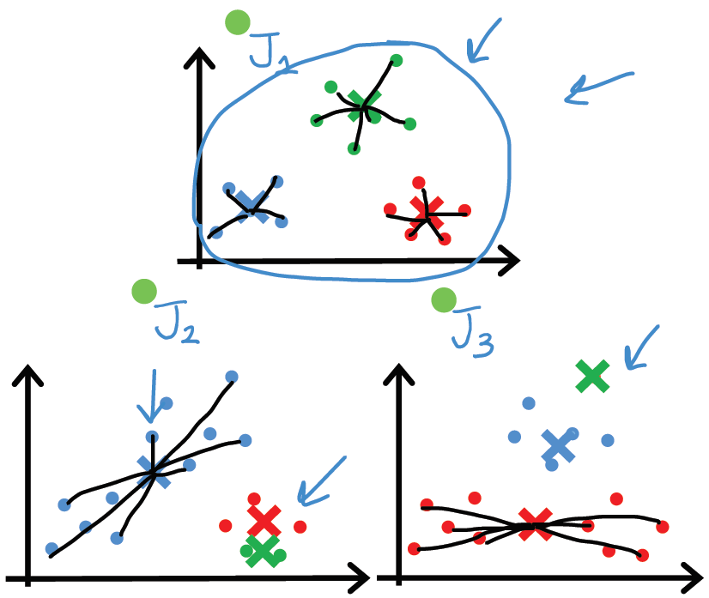
Depending on initial choice of points, can get stuck in a local minimum:
In practice run k-means 50 – 1000 times, and then choose optimal clustering
https://www.deeplearning.ai/courses/machine-learning-specialization/

Slide 53
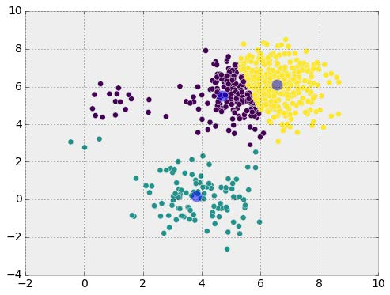

Many algorithms work best with normal distributions. But often data does NOT follow a normal distribution
https://commons.wikimedia.org/wiki/File:Standard_deviation_diagram.svg

Slide 54
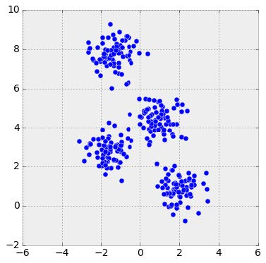
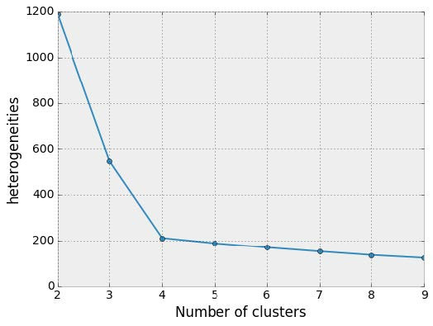
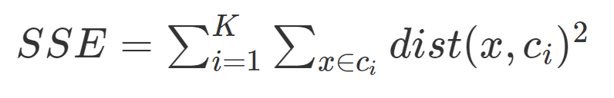
Choosing k:
Elbow method
http://sites.northwestern.edu/msia/2016/12/
08/k-means-shouldnt-be-our-only-choice/

Slide 55
x
x
x
x
How many clusters?
x
x
x
x
x
x
x
x
x
x
x
x
x
x
x
x
x
x
x
x
x
x
x
x
x
x
x
x
x
x
x
x
x
x
x
x
x
x
x
x
x
x
x
x
x
x
x
x
x
x
x
x
x
x
x
x
x
x
x
x

Slide 56
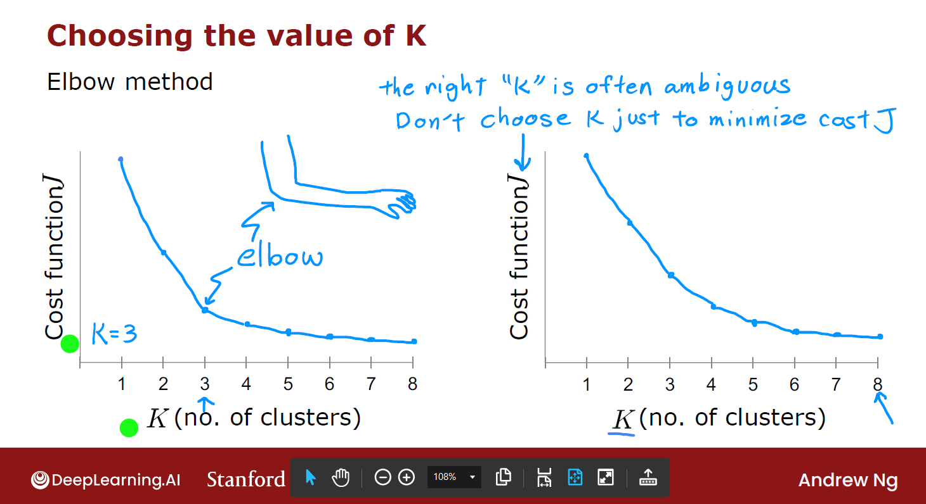
https://www.deeplearning.ai/courses/machine-learning-specialization/

Slide 57
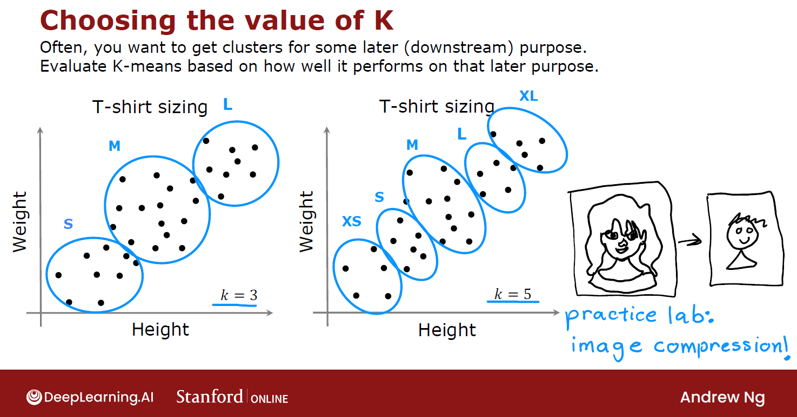
https://www.deeplearning.ai/courses/machine-learning-specialization/

