Slide 1
Using old inaccurate statistics: Ten out of every 1,000 women have breast cancer. Of these 10 women with breast cancer, 9 test positive. Of the 990 women without cancer, about 89 nevertheless test positive. A woman tests positive and wants to know whether she has breast cancer for sure, or at least what the chances are. What is the best answer?
Please answer attendance HW
Once individually FIRST
Talk to others
Change answer if needed when we discuss in class
You have unlimited attempts.

Slide 2
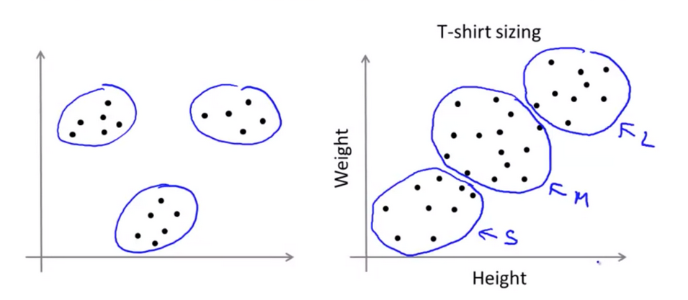
Clustering: Grouping “like” objects
https://hackerwins.github.io/2019-07-10/cs229a-week8
From Andrew Ng’s Machine Learning course

Slide 3
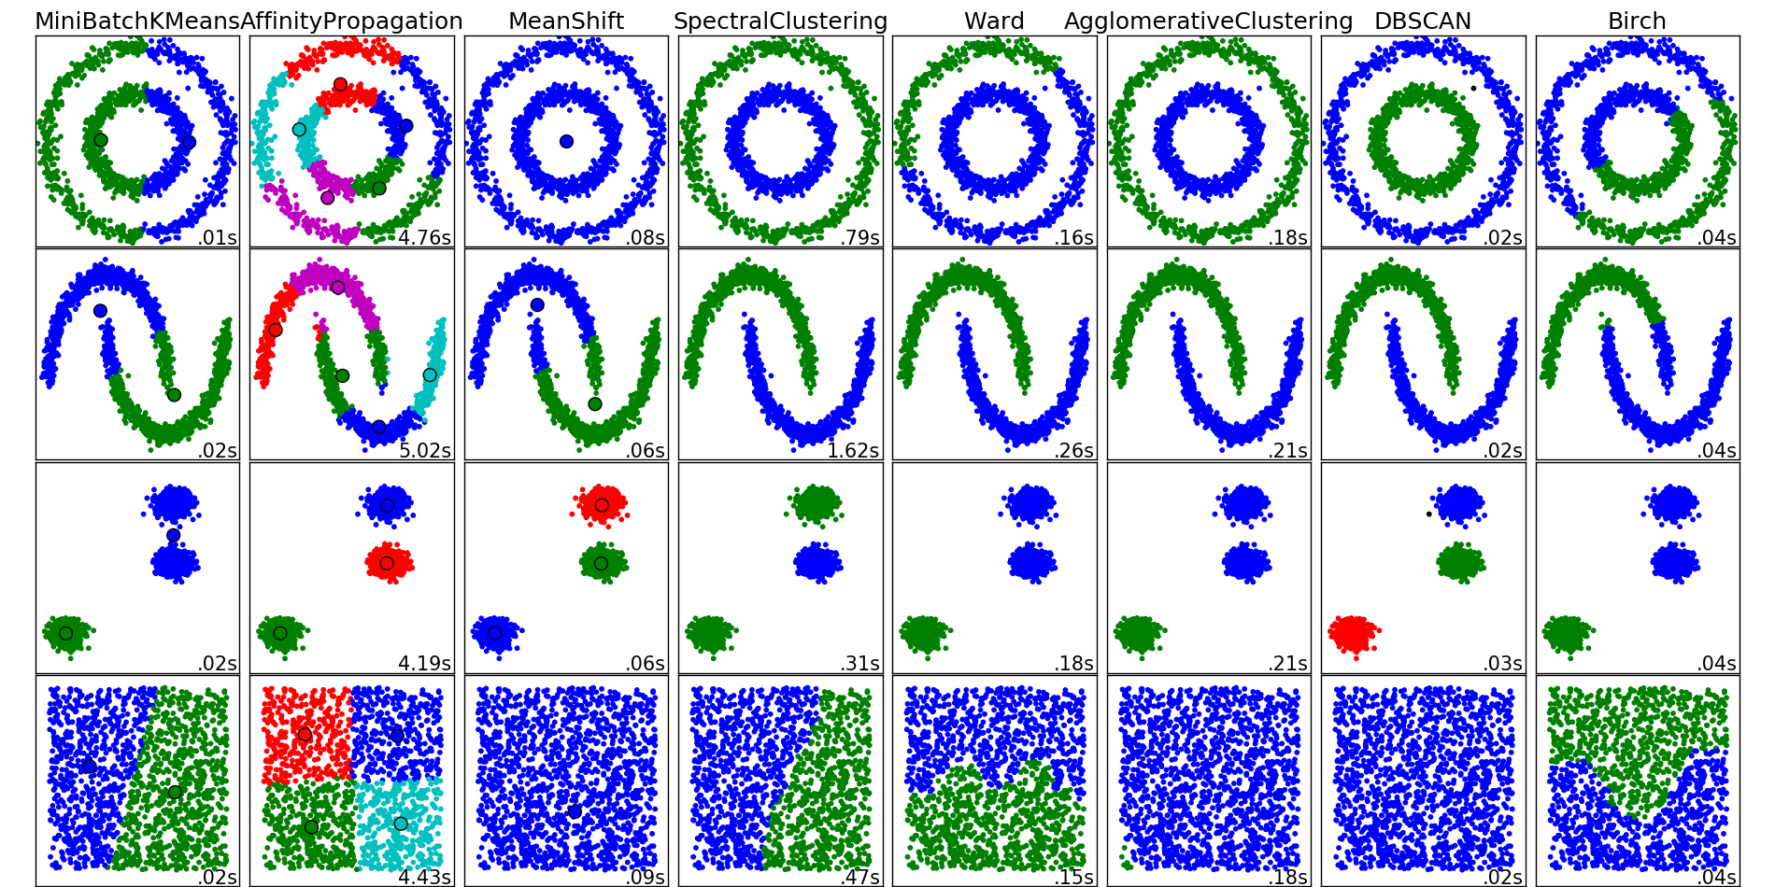
http://scikit-learn.org/stable/auto_examples/cluster/plot_cluster_comparison.html

Slide 4
https://www.deeplearning.ai/

Slide 5
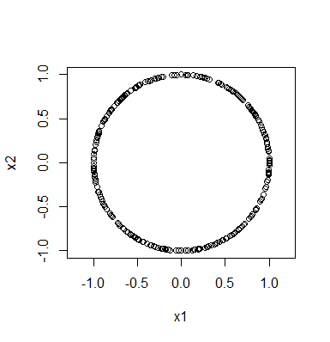
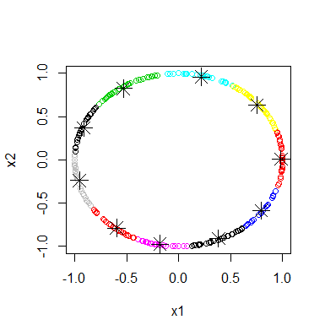
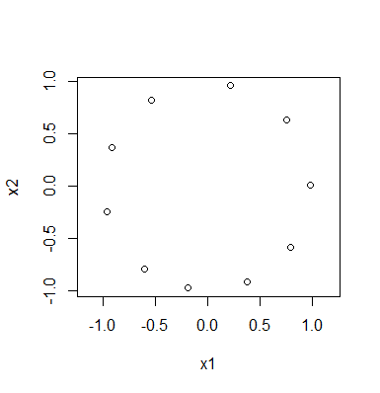
Reduce a data set:
Rstudio:
library("TDA")
circle = circleUnif(300, r = 1)
plot(circle, asp = 1)
cl <- kmeans(circle, 10)
plot(circle,col=cl$cluster)
points(cl$centers, pch=8, cex = 2)
plot(cl$centers, asp = 1)

Slide 6
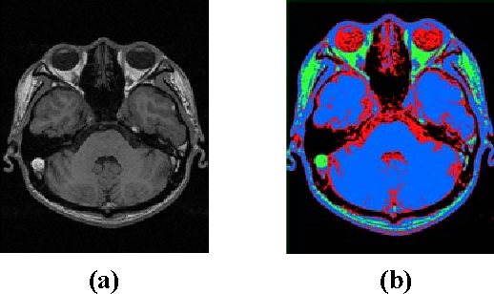
https://raw.githubusercontent.com/ozgyal/Image-Clustering/master/clusteredIm.png
2006 IEEE Southwest Symposium https://ieeexplore.ieee.org/document/1633722
Medical Image Segmentation Using K-Means Clustering and Improved Watershed Algorithm
H.P. Ng; S.H. Ong; K.W.C. Foong; P.S. Goh; W.L. Nowinski

Slide 7
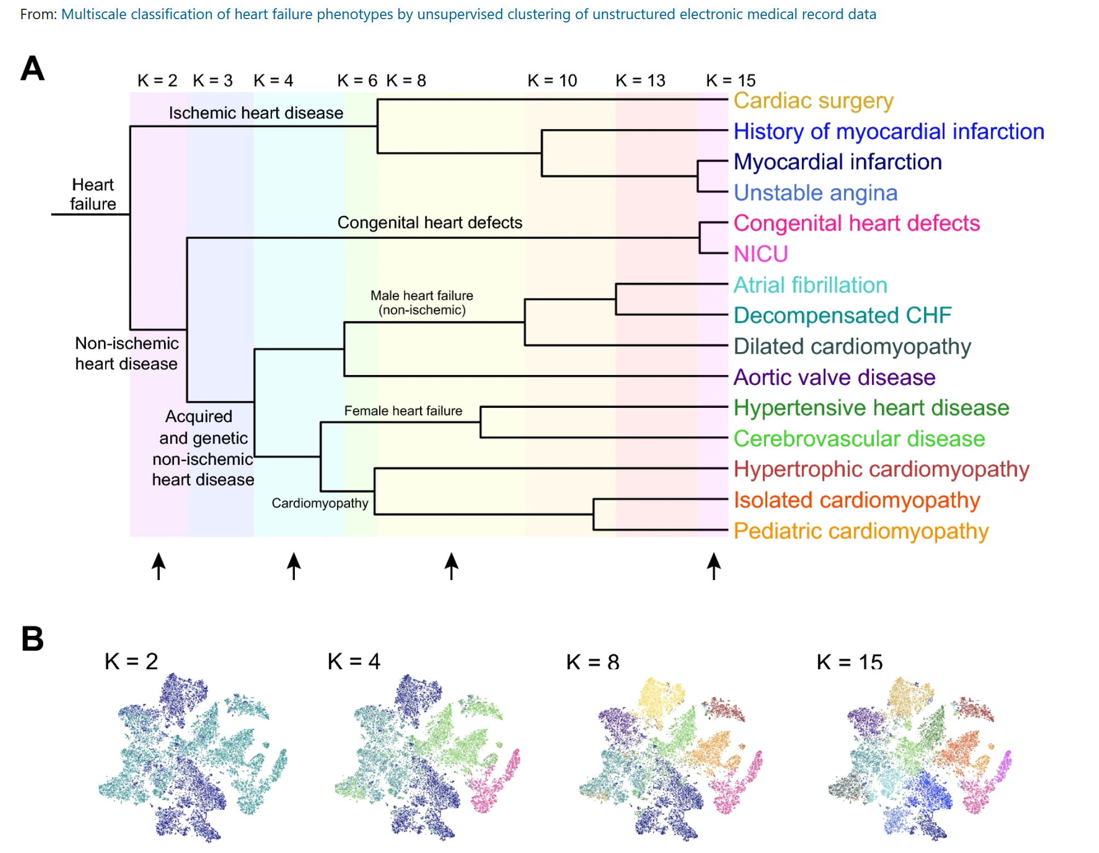
https://www.nature.com/articles/s41598-020-77286-6

Slide 8
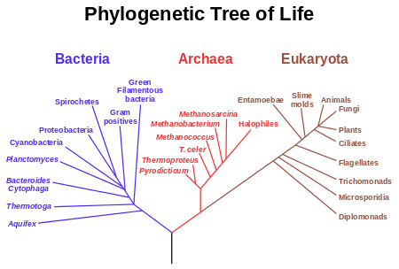

Slide 9
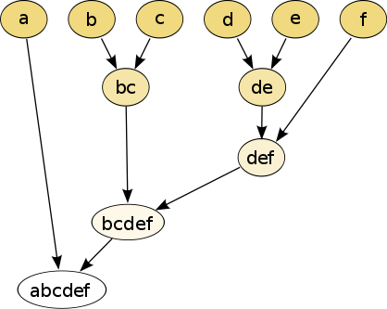
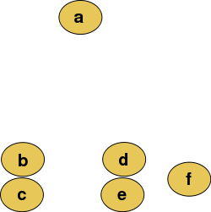
Hierarchical clustering
Data
Dendrogram
http://en.wikipedia.org/wiki/File:Clusters.svg
http://en.wikipedia.org/wiki/File:Hierarchical_clustering_simple_diagram.svg

Slide 10
Increasing threshold
Connect vertices whose distance is less than a given threshold
single linkage hierarchical clustering

Slide 11
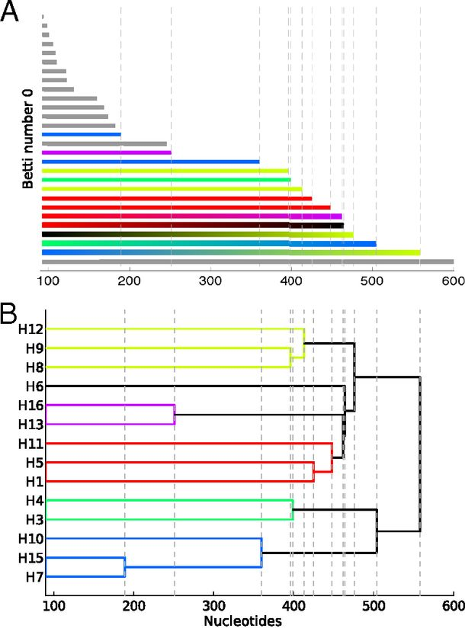
Reconstructing phylogeny from persistent homology of avian influenza HA. (A) Barcode plot in dimension 0 of all avian HA subtypes.
http://www.pnas.org/content/110/46/18566.full
When all vertices born at time 0, length of persistent homology bars for H₀
=
Merging heights of single-linkage clustering dendrogram
©2013 by National Academy of Sciences
Chan J M et al. PNAS 2013;110:18566-18571
Notes:
Reconstructing phylogeny from persistent homology of avian influenza HA. (A) Barcode plot in dimension 0 of all avian HA subtypes. Each bar represents a connected simplex of sequences given a Hamming distance of ε. When a bar ends at a given ε, it merges with another simplex. Gray bars indicate that two simplices of the same HA subtype merge together at a given ε. Solid color bars indicate that two simplices of different HA subtypes but same major clade merge together. Interpolated color bars indicate that two simplices of different major clades merge together. Colors correspond to known major clades of HA. For specific parameters, see SI Appendix, Supplementary Text. (B) Phylogeny of avian HA reconstructed from the barcode plot in A. Major clades are color-coded. (C) Neighbor-joining tree of avian HA (SI Appendix, Supplementary Text).

Slide 12
Increasing threshold
Connect vertices whose distance is less than a given threshold
single linkage hierarchical clustering

Slide 13
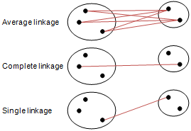
Different type of hierarchical clustering
What is the distance between 2 clusters?
http://en.wikipedia.org/wiki/File:Hierarchical_clustering_simple_diagram.svg
http://www.multid.se/genex/hs515.htm

Slide 14
Increasing threshold
Connect vertices (or clusters) whose distance is less than a given threshold

Slide 15
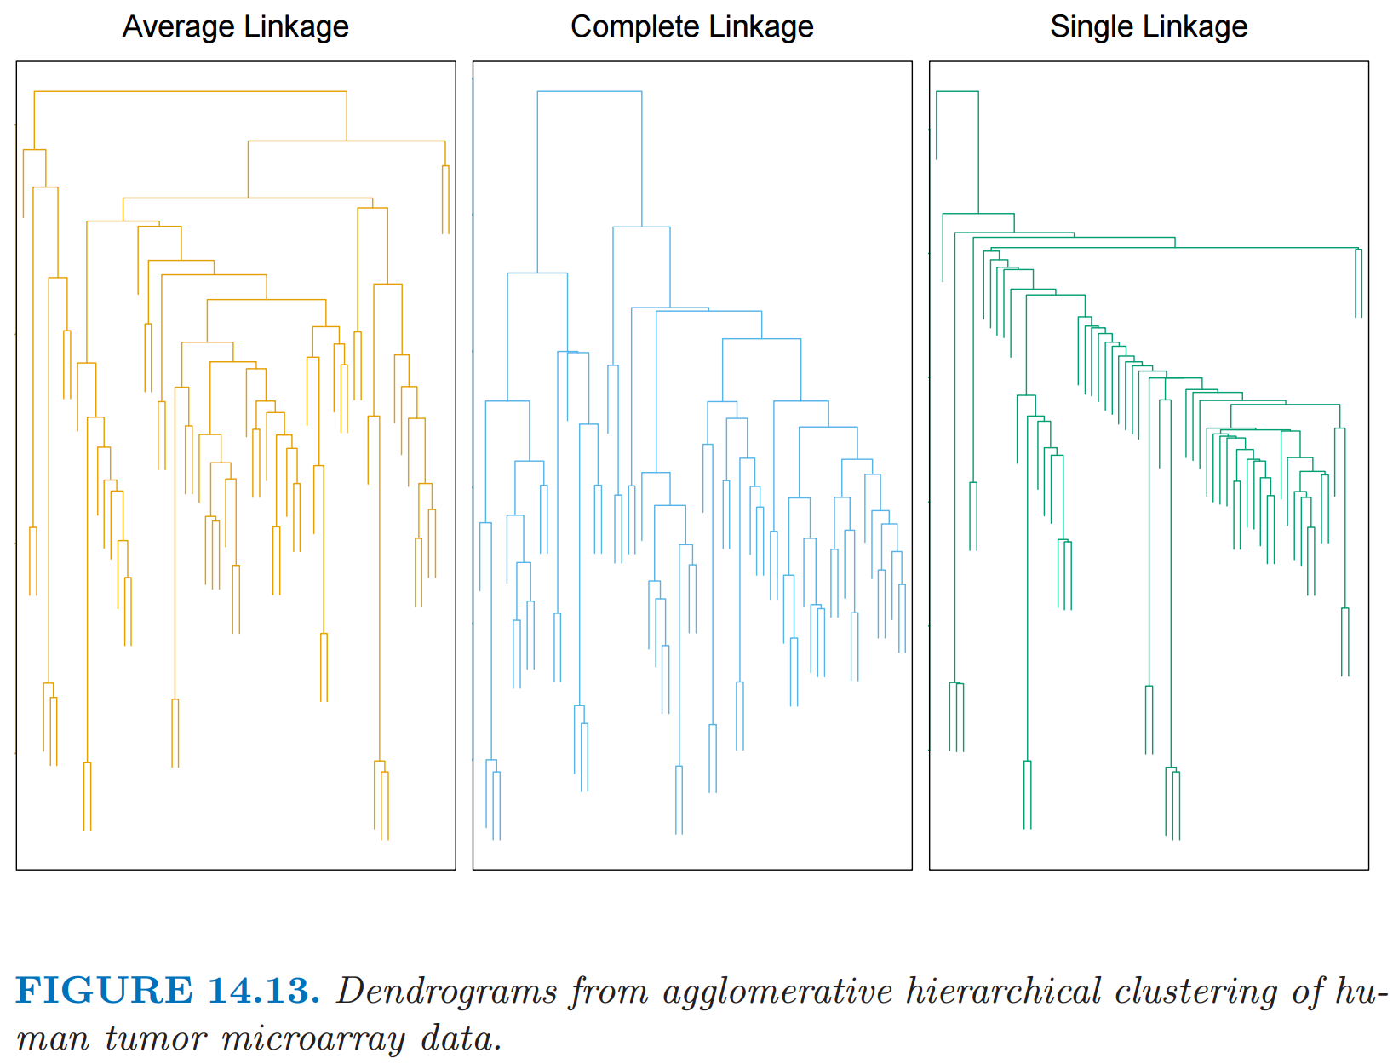
http://statweb.stanford.edu/~tibs/ElemStatLearn/
The Elements of Statistical Learning (2nd edition) Hastie, Tibshirani and Friedman

Slide 16
Different type of hierarchical clustering
What is the distance between 2 clusters?
http://en.wikipedia.org/wiki/File:Hierarchical_clustering_simple_diagram.svg
http://www.multid.se/genex/hs515.htm

Slide 17
Which pair is closer: a and b OR c and d?
a b
c
a b
c
d
d
http://statweb.stanford.edu/~tibs/ElemStatLearn/

Slide 18
Which pair is closer: a and b OR c and d?
a b
c
a b
c
d
d
http://statweb.stanford.edu/~tibs/ElemStatLearn/
The Elements of Statistical Learning (2nd edition) Hastie, Tibshirani and Friedman

Slide 19
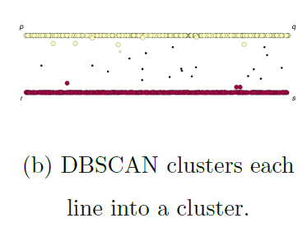
If you care about closeness:
Complete linkage
Average linkage
Ward’s linkage
K-means
If you care about connected components:
Single linkage
DBscan
Figures courtesy of Wako Bungula

Slide 20
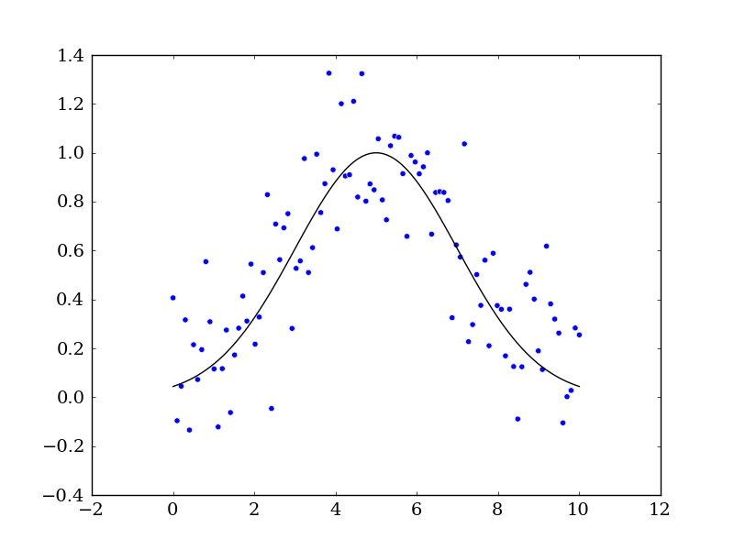
An issue affecting all types of data analysis:
NOISE
Measurement error noise:
In many cases x is known, but y-values can be affected by measurement errors.
In some cases, noise affects both x and y values.
Background noise: Points that appear but should not be part of the data set.

Slide 21
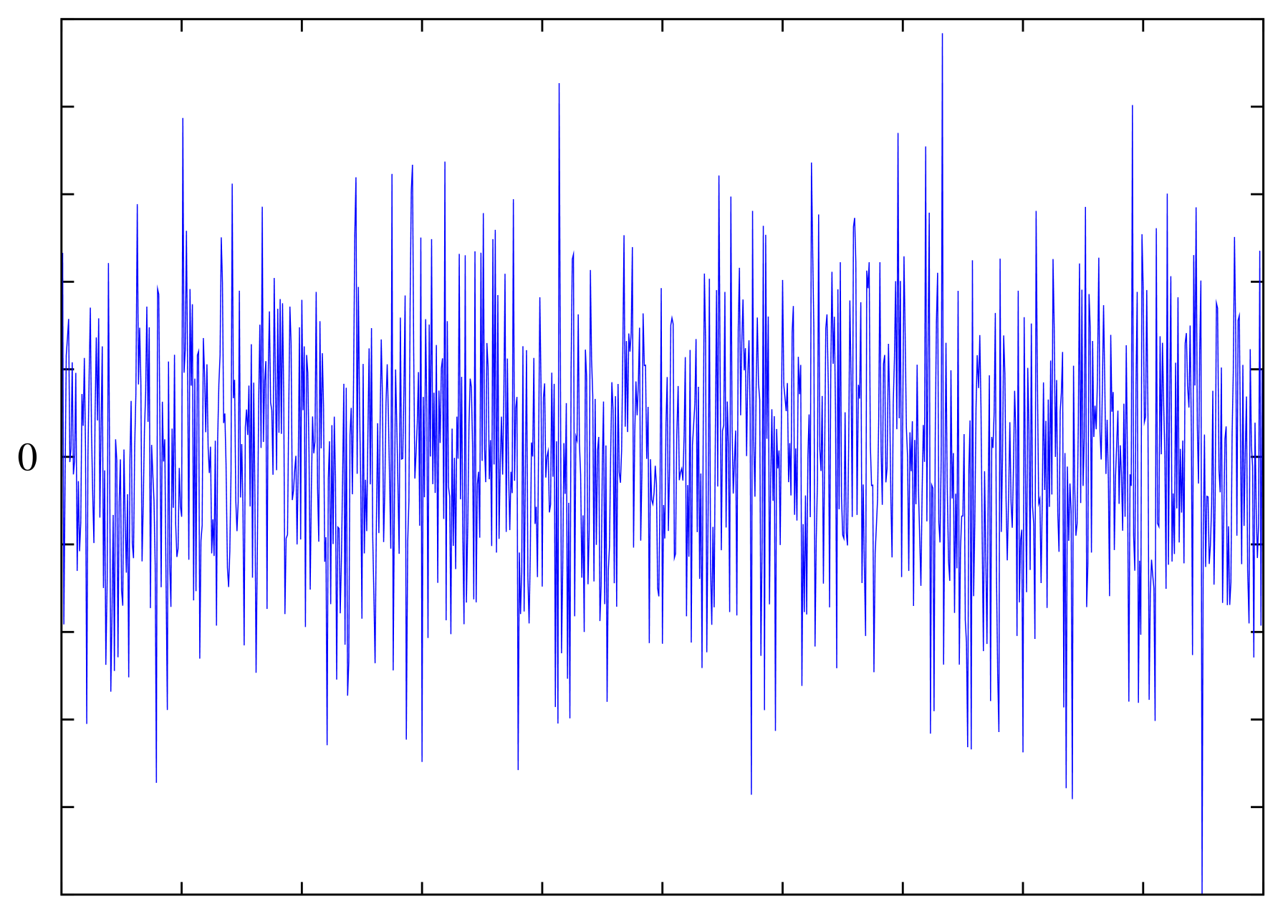
Background noise
Examples: images
and sound
Supercoiled DNA-directed knotting by T4 topoisomerase.
Wasserman SA, Cozzarelli NR. J Biol Chem. 1991
Can also have extra spikes or missing spikes in neuronal and heartbeat data.
https://upload.wikimedia.org/wikipedia/commons/d/d6/White-noise.png

Slide 22
Simple Gaussian We will generate fake data first and compare it to the real data:
import numpy as np
from scipy.optimize import curve_fit
import matplotlib.pyplot as mpl
# Let's create a function to model and create data
def func(x, a, x0, sigma):
return a*np.exp(-(x-x0)**2/(2*sigma**2))
# Generating clean data
x = np.linspace(0, 10, 100)
y = func(x, 1, 5, 2)
# Adding noise to the data
yn = y + 0.2 * np.random.normal(size=len(x))
# Plot out the current state of the data and model
fig = mpl.figure()
ax = fig.add_subplot(111)
ax.plot(x, y, c='k', label='Function')
ax.scatter(x, yn)
fig.savefig('model_and_noise.png')
From https://python4esac.github.io/fitting/examples1d.html
# Generates 100 points between 0 and 10 (no noise)
# y = $1ⅇ^{−{{\left(x−5\right)}^{2}}/{\left(2⋅2^{2}\right)}}$
# Add noise to y (not x)

Slide 23
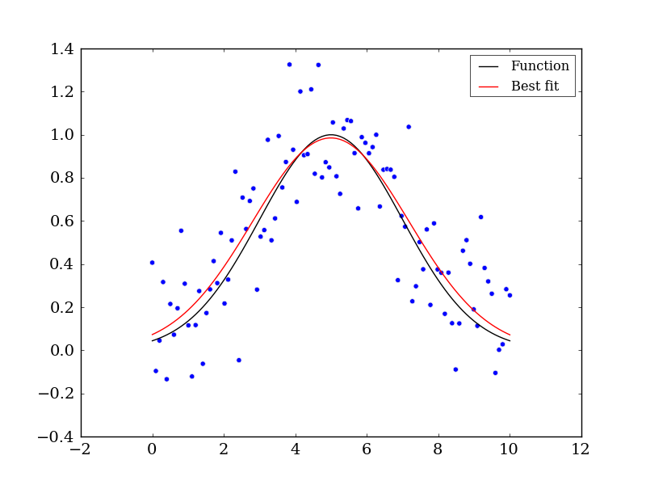
Simple Gaussian We will generate fake data first and compare it to the real data:
# Executing curve_fit on noisy data
popt, pcov = curve_fit(func, x, yn)
# popt returns the best fit values for parameters of the
# given model (func)
print popt
ym = func(x, popt[0], popt[1], popt[2])
ax.plot(x, ym, c='r', label='Best fit’)
ax.legend()
fig.savefig('model_fit.png')
Measurement noise distorts Gaussian.
Note red curve assumed Gaussian curve and noise normally distributed.

Slide 24
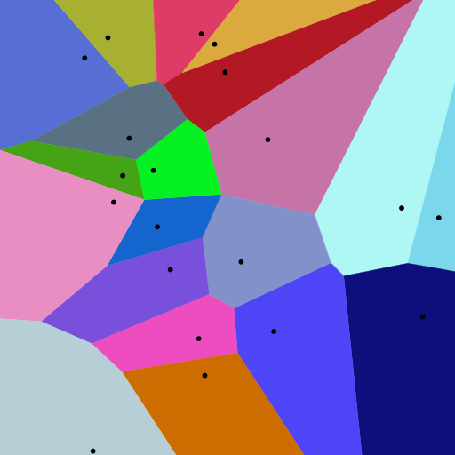
Background for
k-means clustering:
Creating Voronoi diagrams
https://commons.wikimedia.org/wiki/File:Euclidean_Voronoi_diagram.svg

Slide 25
Applications of Voronoi Diagrams https://www.ics.uci.edu/~eppstein/gina/scot.drysdale.html
Anthropology and Archeology -- Identify the parts of a region under the influence of different neolithic clans, chiefdoms, ceremonial centers, or hill forts.
Astronomy -- Identify clusters of stars and clusters of galaxies (Here we saw what may be the earliest picture of a Voronoi diagram, drawn by Descartes in 1644, where the regions described the regions of gravitational influence of the sun and other stars.)
Biology, Ecology, Forestry -- Model and analyze plant competition ("Area potentially available to a tree", "Plant polygons")
Cartography -- Piece together satellite photographs into large "mosaic" maps
Crystallography and Chemistry -- Study chemical properties of metallic sodium ("Wigner-Seitz regions"); Modelling alloy structures as sphere packings ("Domain of an atom")
Finite Element Analysis -- Generating finite element meshes which avoid small angles
Geography -- Analyzing patterns of urban settlements
Geology -- Estimation of ore reserves in a deposit using information obtained from bore holes; modelling crack patterns in basalt due to contraction on cooling
Geometric Modeling -- Finding "good" triangulations of 3D surfaces
Marketing -- Model market of US metropolitan areas; market area extending down to individual retail stores
Mathematics -- Study of positive definite quadratic forms ("Dirichlet tesselation", "Voronoi diagram")
Metallurgy -- Modelling "grain growth" in metal films
Meteorology -- Estimate regional rainfall averages, given data at discrete rain gauges ("Thiessen polygons")
Pattern Recognition -- Find simple descriptors for shapes that extract 1D characterizations from 2D shapes ("Medial axis" or "skeleton" of a contour)
Physiology -- Analysis of capillary distribution in cross-sections of muscle tissue to compute oxygen transport ("Capillary domains")
Robotics -- Path planning in the presence of obstacles
Statistics and Data Analysis -- Analyze statistical clustering ("Natural neighbors" interpolation)
Zoology -- Model and analyze the territories of animals
In addition to all these "real world" applications, Voronoi diagrams have several applications within the field of computer science, in particular, computational geometry.
Knuth's Post Office Problem -- Given a set of locations for post offices, how do you determine the closest post office to a given house? (Apparently, Knuth was ignoring the existence of ZIP codes.)
Closest Pair -- Given a set of points, which two are closest together?
All Nearest Neighbors -- Given a set of points, find each point's nearest neighbor
Euclidean Minimum Spanning Tree
Largest Empty Circle, also known as the Toxic Waste Dump Problem
Fixed Radius Near Neighbors -- Find all pairs of points closer than a given distance apart.
All k Nearest Neighbors -- Find each point's k closest neighbors
Enumerating interpoint distances in increasing order -- Find the closest pair, then the next closest pair, then the next closest pair, and so on.

Slide 26
Voronoi diagram:
Suppose your data points live in R^{n}.
A Voronoi diagram is a partition of space into Voronoi cells.
The Voronoi cell associated with v is
C_{v}= { x in R^{n} : d(x, v) ≤ d(x, w) for all w ≠ v }
= the set of all points in R^{n} closer v than to
any of the other points in your data set.
Notes:
data points.
In this very simplified case my data points lie in a two-dimensional plane. Normally data points are high dimensional.
For example, I may be comparing the expression or thousands of genes in tumor cells to healthy cells using microarray data. OR I might be comparing politicians voting records. Or I might be comparing the stats of basketball players. These three applications were all, by the way, published by Lum et al this past February in Nature’s Scientific Reports. I have included a link to their paper on my youtube site.
http://www.nature.com/srep/2013/130207/srep01236/full/srep01236.html

Slide 27
Voronoi diagram:
Suppose your data points live in R^{n}.
Choose data point v.
The Voronoi cell
associated with v is
H(v,w)
U
w ≠ v
Half-plane closer to v:
H(v,w) = { x in R^{n} : d(x, v) ≤ d(x, w) }
Notes:
data points.
In this very simplified case my data points lie in a two-dimensional plane. Normally data points are high dimensional.
For example, I may be comparing the expression or thousands of genes in tumor cells to healthy cells using microarray data. OR I might be comparing politicians voting records. Or I might be comparing the stats of basketball players. These three applications were all, by the way, published by Lum et al this past February in Nature’s Scientific Reports. I have included a link to their paper on my youtube site.
http://www.nature.com/srep/2013/130207/srep01236/full/srep01236.html

Slide 28
Voronoi diagram:
Suppose your data points live in R^{n}.
Choose data point v.
The Voronoi cell associated with v is
H(v,w)
U
w ≠ v
H(v,w) = { x in R^{n} : d(x, v) ≤ d(x, w) }
Notes:
data points.
In this very simplified case my data points lie in a two-dimensional plane. Normally data points are high dimensional.
For example, I may be comparing the expression or thousands of genes in tumor cells to healthy cells using microarray data. OR I might be comparing politicians voting records. Or I might be comparing the stats of basketball players. These three applications were all, by the way, published by Lum et al this past February in Nature’s Scientific Reports. I have included a link to their paper on my youtube site.
http://www.nature.com/srep/2013/130207/srep01236/full/srep01236.html

Slide 29
Voronoi diagram:
Suppose your data points live in R^{n}.
Choose data point v.
The Voronoi cell associated with v is
H(v,w)
U
w ≠ v
H(v,w) = { x in R^{n} : d(x, v) ≤ d(x, w) }
Notes:
data points.
In this very simplified case my data points lie in a two-dimensional plane. Normally data points are high dimensional.
For example, I may be comparing the expression or thousands of genes in tumor cells to healthy cells using microarray data. OR I might be comparing politicians voting records. Or I might be comparing the stats of basketball players. These three applications were all, by the way, published by Lum et al this past February in Nature’s Scientific Reports. I have included a link to their paper on my youtube site.
http://www.nature.com/srep/2013/130207/srep01236/full/srep01236.html

Slide 30
Voronoi diagram:
Suppose your data points live in R^{n}.
Choose data point v.
The Voronoi cell associated with v is
H(v,w)
U
w ≠ v
H(v,w) = { x in R^{n} : d(x, v) ≤ d(x, w) }
Notes:
data points.
In this very simplified case my data points lie in a two-dimensional plane. Normally data points are high dimensional.
For example, I may be comparing the expression or thousands of genes in tumor cells to healthy cells using microarray data. OR I might be comparing politicians voting records. Or I might be comparing the stats of basketball players. These three applications were all, by the way, published by Lum et al this past February in Nature’s Scientific Reports. I have included a link to their paper on my youtube site.
http://www.nature.com/srep/2013/130207/srep01236/full/srep01236.html

Slide 31
Voronoi diagram:
Suppose your data points live in R^{n}.
Choose data point v.
The Voronoi cell associated with v is
H(v,w)
U
w ≠ v
H(v,w) = { x in R^{n} : d(x, v) ≤ d(x, w) }
Notes:
data points.
In this very simplified case my data points lie in a two-dimensional plane. Normally data points are high dimensional.
For example, I may be comparing the expression or thousands of genes in tumor cells to healthy cells using microarray data. OR I might be comparing politicians voting records. Or I might be comparing the stats of basketball players. These three applications were all, by the way, published by Lum et al this past February in Nature’s Scientific Reports. I have included a link to their paper on my youtube site.
http://www.nature.com/srep/2013/130207/srep01236/full/srep01236.html

Slide 32
Voroncoi diagram:
Suppose your data points live in R^{n}.
Choose data point v.
The Voronoi cell associated with v is
H(v,w)
U
w ≠ v
H(v,w) = { x in R^{n} : d(x, v) ≤ d(x, w) }
Notes:
data points.
In this very simplified case my data points lie in a two-dimensional plane. Normally data points are high dimensional.
For example, I may be comparing the expression or thousands of genes in tumor cells to healthy cells using microarray data. OR I might be comparing politicians voting records. Or I might be comparing the stats of basketball players. These three applications were all, by the way, published by Lum et al this past February in Nature’s Scientific Reports. I have included a link to their paper on my youtube site.
http://www.nature.com/srep/2013/130207/srep01236/full/srep01236.html

Slide 33
Voroncoi diagram:
Suppose your data points live in R^{n}.
Choose data point v.
The Voronoi cell associated with v is
H(v,w)
U
w ≠ v
H(v,w) = { x in R^{n} : d(x, v) ≤ d(x, w) }
Notes:
data points.
In this very simplified case my data points lie in a two-dimensional plane. Normally data points are high dimensional.
For example, I may be comparing the expression or thousands of genes in tumor cells to healthy cells using microarray data. OR I might be comparing politicians voting records. Or I might be comparing the stats of basketball players. These three applications were all, by the way, published by Lum et al this past February in Nature’s Scientific Reports. I have included a link to their paper on my youtube site.
http://www.nature.com/srep/2013/130207/srep01236/full/srep01236.html

Slide 34
Voroncoi diagram:
Suppose your data points live in R^{n}.
Choose data point v.
The Voronoi cell associated with v is
H(v,w)
U
w ≠ v
Notes:
data points.
In this very simplified case my data points lie in a two-dimensional plane. Normally data points are high dimensional.
For example, I may be comparing the expression or thousands of genes in tumor cells to healthy cells using microarray data. OR I might be comparing politicians voting records. Or I might be comparing the stats of basketball players. These three applications were all, by the way, published by Lum et al this past February in Nature’s Scientific Reports. I have included a link to their paper on my youtube site.
http://www.nature.com/srep/2013/130207/srep01236/full/srep01236.html

Slide 35
Choose data point v.
The Voronoi cell associated with v is
H(v,w)
U
w ≠ v
Notes:
data points.
In this very simplified case my data points lie in a two-dimensional plane. Normally data points are high dimensional.
For example, I may be comparing the expression or thousands of genes in tumor cells to healthy cells using microarray data. OR I might be comparing politicians voting records. Or I might be comparing the stats of basketball players. These three applications were all, by the way, published by Lum et al this past February in Nature’s Scientific Reports. I have included a link to their paper on my youtube site.
http://www.nature.com/srep/2013/130207/srep01236/full/srep01236.html

Slide 36
Choose data point v.
The Voronoi cell associated with v is
H(v,w)
U
w ≠ v
Notes:
data points.
In this very simplified case my data points lie in a two-dimensional plane. Normally data points are high dimensional.
For example, I may be comparing the expression or thousands of genes in tumor cells to healthy cells using microarray data. OR I might be comparing politicians voting records. Or I might be comparing the stats of basketball players. These three applications were all, by the way, published by Lum et al this past February in Nature’s Scientific Reports. I have included a link to their paper on my youtube site.
http://www.nature.com/srep/2013/130207/srep01236/full/srep01236.html

Slide 37
Choose data point v.
The Voronoi cell associated with v is
H(v,w)
U
w ≠ v
Notes:
data points.
In this very simplified case my data points lie in a two-dimensional plane. Normally data points are high dimensional.
For example, I may be comparing the expression or thousands of genes in tumor cells to healthy cells using microarray data. OR I might be comparing politicians voting records. Or I might be comparing the stats of basketball players. These three applications were all, by the way, published by Lum et al this past February in Nature’s Scientific Reports. I have included a link to their paper on my youtube site.
http://www.nature.com/srep/2013/130207/srep01236/full/srep01236.html

Slide 38
Choose data point v.
The Voronoi cell associated with v is
H(v,w)
U
w ≠ v
Notes:
data points.
In this very simplified case my data points lie in a two-dimensional plane. Normally data points are high dimensional.
For example, I may be comparing the expression or thousands of genes in tumor cells to healthy cells using microarray data. OR I might be comparing politicians voting records. Or I might be comparing the stats of basketball players. These three applications were all, by the way, published by Lum et al this past February in Nature’s Scientific Reports. I have included a link to their paper on my youtube site.
http://www.nature.com/srep/2013/130207/srep01236/full/srep01236.html

Slide 39
Choose data point v.
The Voronoi cell associated with v is
H(v,w)
U
w ≠ v
Notes:
data points.
In this very simplified case my data points lie in a two-dimensional plane. Normally data points are high dimensional.
For example, I may be comparing the expression or thousands of genes in tumor cells to healthy cells using microarray data. OR I might be comparing politicians voting records. Or I might be comparing the stats of basketball players. These three applications were all, by the way, published by Lum et al this past February in Nature’s Scientific Reports. I have included a link to their paper on my youtube site.
http://www.nature.com/srep/2013/130207/srep01236/full/srep01236.html

Slide 40
Choose data point v.
The Voronoi cell associated with v is
H(v,w)
U
w ≠ v
Notes:
data points.
In this very simplified case my data points lie in a two-dimensional plane. Normally data points are high dimensional.
For example, I may be comparing the expression or thousands of genes in tumor cells to healthy cells using microarray data. OR I might be comparing politicians voting records. Or I might be comparing the stats of basketball players. These three applications were all, by the way, published by Lum et al this past February in Nature’s Scientific Reports. I have included a link to their paper on my youtube site.
http://www.nature.com/srep/2013/130207/srep01236/full/srep01236.html

Slide 41
Choose data point v.
The Voronoi cell associated with v is
H(v,w)
U
w ≠ v
Notes:
data points.
In this very simplified case my data points lie in a two-dimensional plane. Normally data points are high dimensional.
For example, I may be comparing the expression or thousands of genes in tumor cells to healthy cells using microarray data. OR I might be comparing politicians voting records. Or I might be comparing the stats of basketball players. These three applications were all, by the way, published by Lum et al this past February in Nature’s Scientific Reports. I have included a link to their paper on my youtube site.
http://www.nature.com/srep/2013/130207/srep01236/full/srep01236.html

Slide 42
Voronoi diagram:
Suppose your data points live in R^{n}.
Choose data point v.
The Voronoi cell associated with v is
H(v,w)
U
w ≠ v
The Voronoi cell associated with v is
C_{v}= { x in R^{n} : d(x, v) ≤ d(x, w) for all w ≠ v }
Notes:
data points.
In this very simplified case my data points lie in a two-dimensional plane. Normally data points are high dimensional.
For example, I may be comparing the expression or thousands of genes in tumor cells to healthy cells using microarray data. OR I might be comparing politicians voting records. Or I might be comparing the stats of basketball players. These three applications were all, by the way, published by Lum et al this past February in Nature’s Scientific Reports. I have included a link to their paper on my youtube site.
http://www.nature.com/srep/2013/130207/srep01236/full/srep01236.html

Slide 43
A Voronoi diagram is a partition of space into Voronoi cells.
Notes:
data points.
In this very simplified case my data points lie in a two-dimensional plane. Normally data points are high dimensional.
For example, I may be comparing the expression or thousands of genes in tumor cells to healthy cells using microarray data. OR I might be comparing politicians voting records. Or I might be comparing the stats of basketball players. These three applications were all, by the way, published by Lum et al this past February in Nature’s Scientific Reports. I have included a link to their paper on my youtube site.
http://www.nature.com/srep/2013/130207/srep01236/full/srep01236.html

Slide 44
A Voronoi diagram is a partition of space into Voronoi cells.
Notes:
data points.
In this very simplified case my data points lie in a two-dimensional plane. Normally data points are high dimensional.
For example, I may be comparing the expression or thousands of genes in tumor cells to healthy cells using microarray data. OR I might be comparing politicians voting records. Or I might be comparing the stats of basketball players. These three applications were all, by the way, published by Lum et al this past February in Nature’s Scientific Reports. I have included a link to their paper on my youtube site.
http://www.nature.com/srep/2013/130207/srep01236/full/srep01236.html

Slide 45
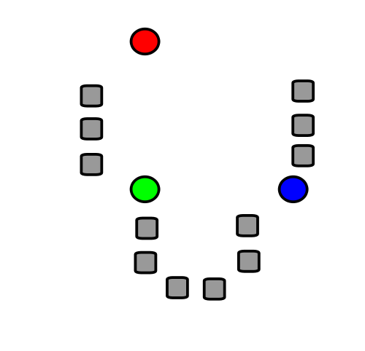
A very basic introduction to
k-means clustering
Notes:
data points.
In this very simplified case my data points lie in a two-dimensional plane. Normally data points are high dimensional.
For example, I may be comparing the expression or thousands of genes in tumor cells to healthy cells using microarray data. OR I might be comparing politicians voting records. Or I might be comparing the stats of basketball players. These three applications were all, by the way, published by Lum et al this past February in Nature’s Scientific Reports. I have included a link to their paper on my youtube site.
http://www.nature.com/srep/2013/130207/srep01236/full/srep01236.html

Slide 46
k-means clustering
k = desired number
of clusters
Data set = grey boxes
Let k = 3
Figure modified from https://en.wikipedia.org/wiki/File:K_Means_Example_Step_1.svg

Slide 47
k-means clustering
k = desired number
of clusters
Data set = grey boxes
Let k = 3
Step 1: Randomly choose
3 points
(points need not be in data set)
3 points = colored circle
Figure from https://en.wikipedia.org/wiki/File:K_Means_Example_Step_1.svg

Slide 48
Data set = grey boxes
Let k = 3
Randomly choose 3 points
(points need not be in data set)
3 points = colored circle
Partition data set into 3 voronoi cells corresponding to the 3 colored circles
Figure modified from https://en.wikipedia.org/wiki/File:K_Means_Example_Step_1.svg

Slide 49
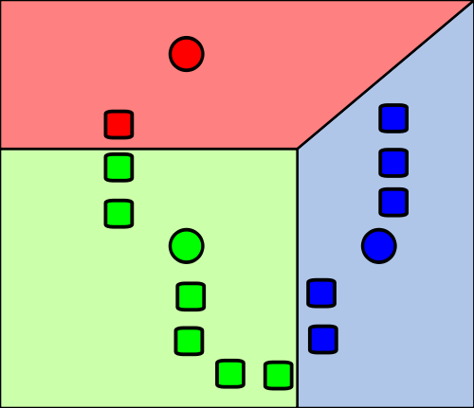
Data set = grey boxes
Let k = 3
Randomly choose 3 points
(points need not be in data set)
3 points = colored circle
Partition data set into 3 voronoi cells corresponding to the 3 colored circles
Figure modified from https://en.wikipedia.org/wiki/File:K_Means_Example_Step_1.svg

Slide 50
X
X
X
Data set = grey boxes
Let k = 3
Randomly choose 3 points
(points need not be in data set)
3 points = colored circle
Partition data set into 3 voronoi cells corresponding to the 3 colored circles
Figure modified from https://en.wikipedia.org/wiki/File:K_Means_Example_Step_1.svg

Slide 51
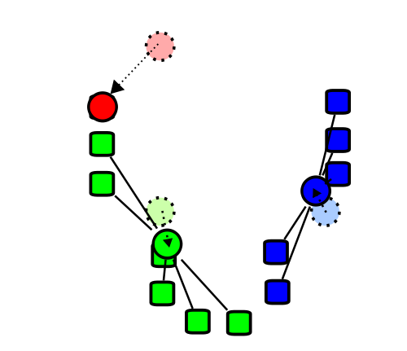
X
X
X
Repeat the process with
3 new points:
Find the centroids of the data cells in each of the voronoi cells
Figure modified from https://en.wikipedia.org/wiki/File:K_Means_Example_Step_1.svg

Slide 52
X
X
X
Repeat the process with
3 new points:
Find the centroids of the data cells in each of the voronoi cells
Figure modified from https://en.wikipedia.org/wiki/File:K_Means_Example_Step_1.svg

Slide 53
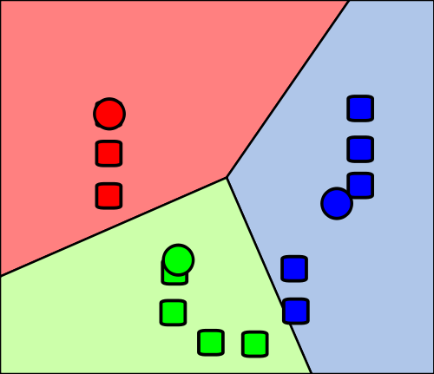
Re-partition data set into 3 voronoi cells corresponding to the 3 centroids
Figure modified from https://en.wikipedia.org/wiki/File:K_Means_Example_Step_1.svg

Slide 54
Re-partition data set into 3 voronoi cells corresponding to the 3 centroids
Repeat
Figure modified from https://en.wikipedia.org/wiki/File:K_Means_Example_Step_1.svg

Slide 55
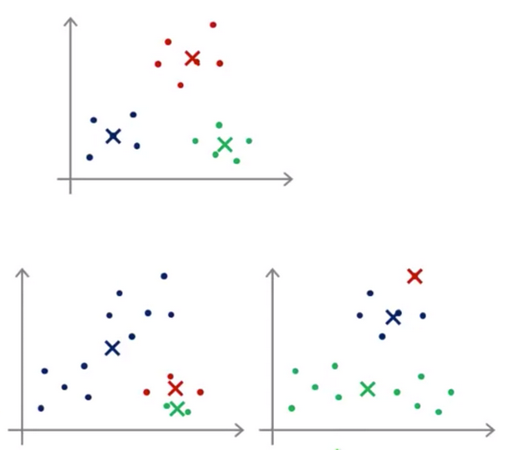
Depending on initial choice of points, can get stuck in a local minimum:
https://hackerwins.github.io/2019-07-10/cs229a-week8
From Andrew Ng’s Machine Learning course

Slide 56
Depending on initial choice of points, can get stuck in a local minimum:
In practice run k-means 50 – 1000 times, and then choose optimal clustering
https://www.deeplearning.ai/courses/machine-learning-specialization/

Slide 57
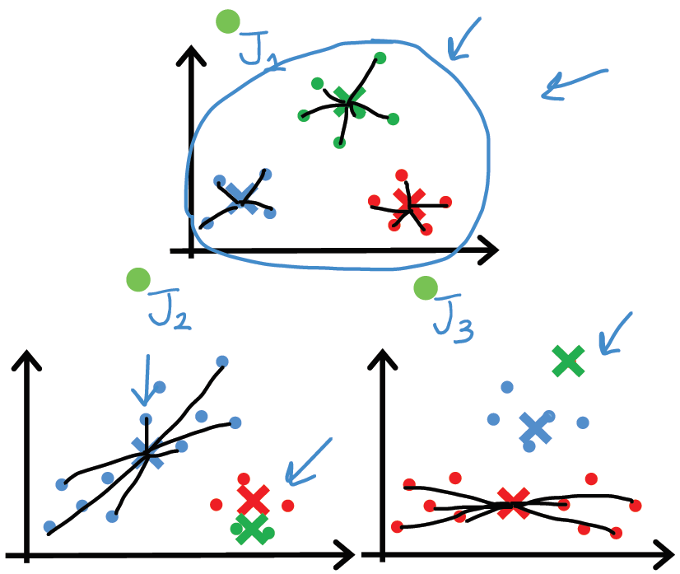
Depending on initial choice of points, can get stuck in a local minimum:
In practice run k-means 50 – 1000 times, and then choose optimal clustering
https://www.deeplearning.ai/courses/machine-learning-specialization/

Slide 58
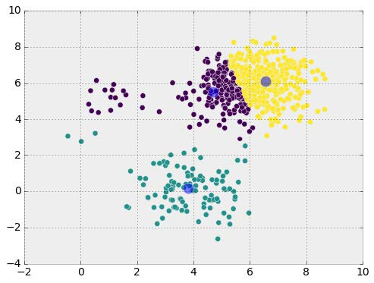
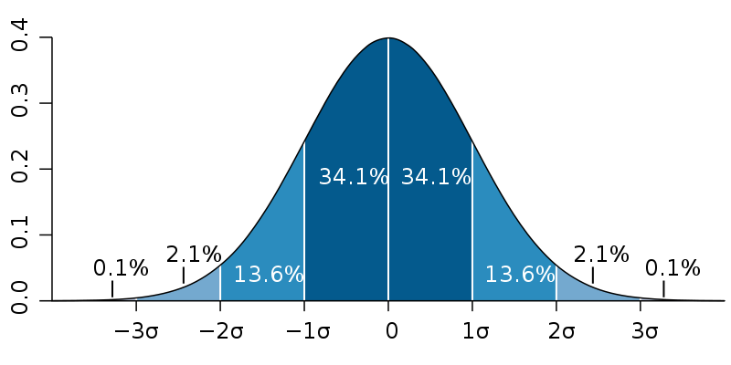
Many algorithms work best with normal distributions. But often data does NOT follow a normal distribution
https://commons.wikimedia.org/wiki/File:Standard_deviation_diagram.svg

Slide 59
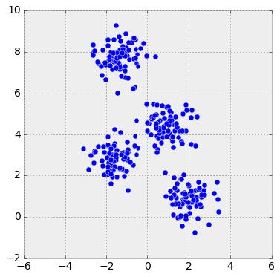
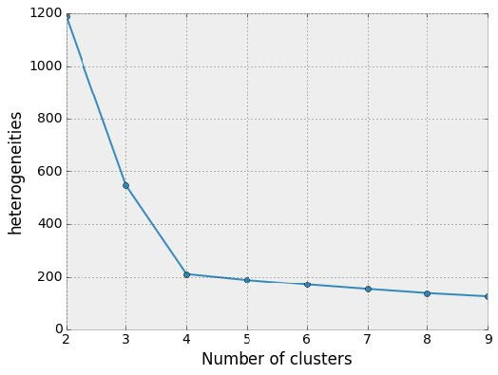
Choosing k:
Elbow method
http://sites.northwestern.edu/msia/2016/12/
08/k-means-shouldnt-be-our-only-choice/

Slide 60
x
x
x
x
How many clusters?
x
x
x
x
x
x
x
x
x
x
x
x
x
x
x
x
x
x
x
x
x
x
x
x
x
x
x
x
x
x
x
x
x
x
x
x
x
x
x
x
x
x
x
x
x
x
x
x
x
x
x
x
x
x
x
x
x
x
x
x

Slide 61
https://www.deeplearning.ai/courses/machine-learning-specialization/

Slide 62
https://www.deeplearning.ai/courses/machine-learning-specialization/

Slide 63
If you care about closeness:
Complete linkage
Average linkage
Ward’s linkage
K-means
If you care about connected components:
Single linkage
DBscan
Figures courtesy of Wako Bungula

Slide 64
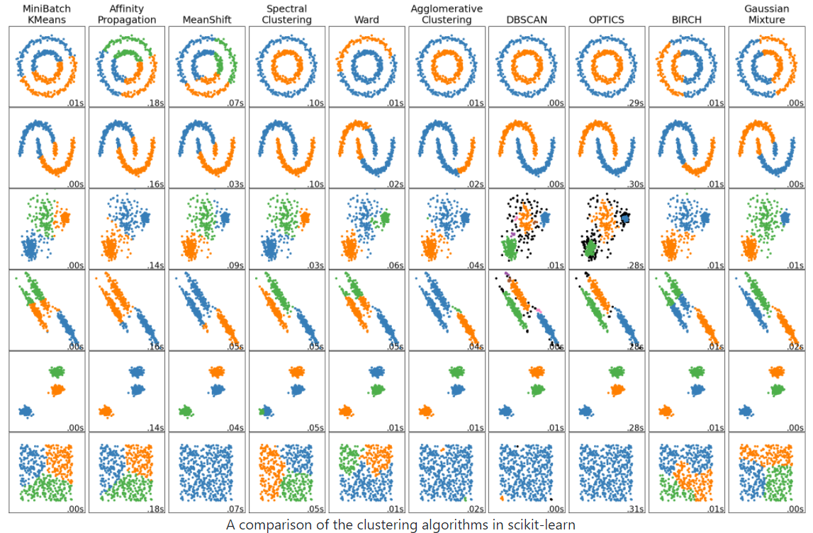
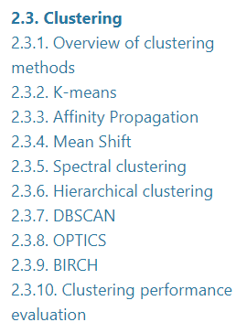
http://scikit-learn.org/stable/auto_examples/cluster/plot_cluster_comparison.html
Maybe start with: Ward’s linkage hierarchical clustering, k-means, etc.
2.3. Clustering — scikit-learn 1.2.2 documentation

Slide 65
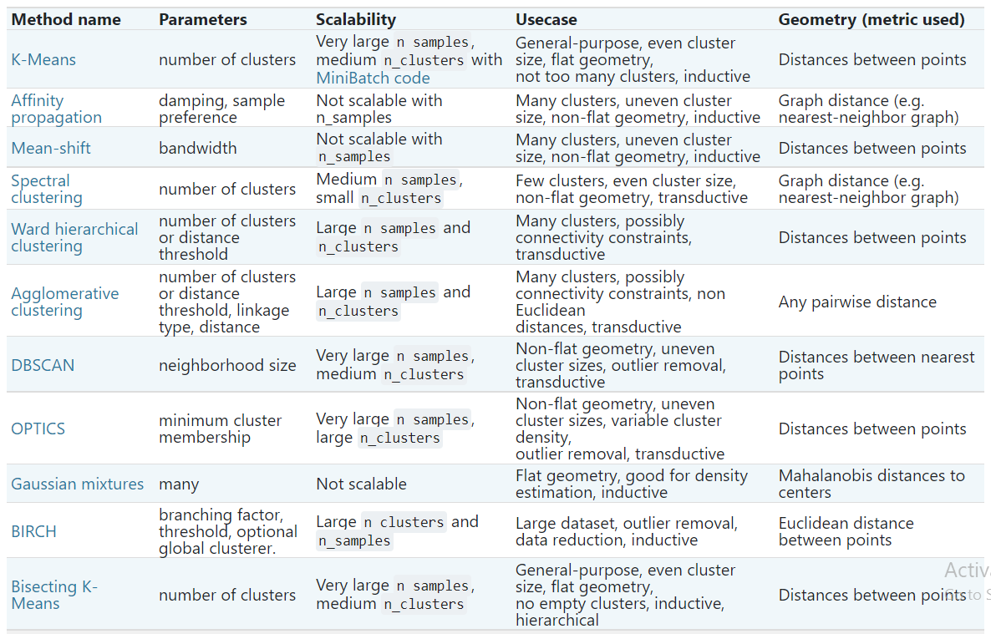
Maybe start with: Ward’s linkage hierarchical clustering, k-means, etc.
2.3. Clustering — scikit-learn 1.2.2 documentation

Slide 66
Different type of hierarchical clustering
What is the distance between 2 clusters?
http://en.wikipedia.org/wiki/File:Hierarchical_clustering_simple_diagram.svg
http://www.multid.se/genex/hs515.htm

Slide 67
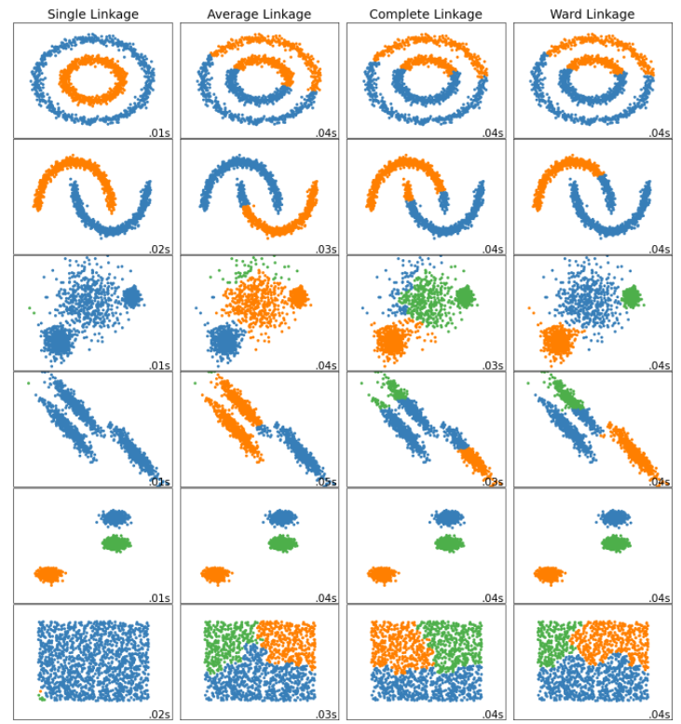
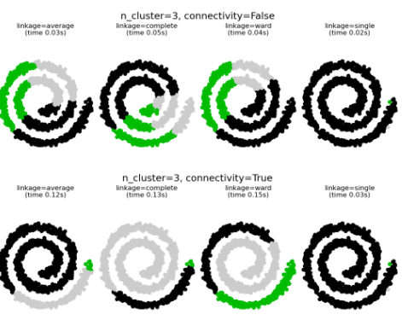
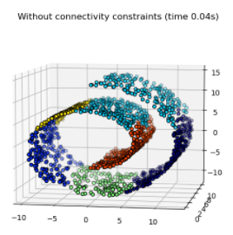
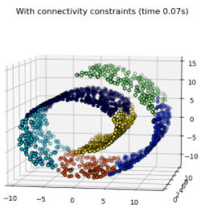
Ward minimizes the sum of squared differences within all clusters. It is a variance-minimizing approach and in this sense is similar to the k-means objective function but tackled with an agglomerative hierarchical approach.
Warning: Connectivity constraints with single, average and complete linkage can enhance the ‘rich getting richer’…

Slide 69
If you care about closeness:
Complete linkage
Average linkage
Ward’s linkage
K-means
If you care about connected components:
Single linkage
DBscan
Figures courtesy of Wako Bungula

Slide 70
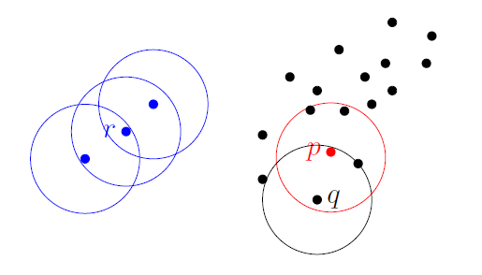
Dbscan (Density-based spatial clustering of applications with noise )
Figures courtesy of Wako Bungula

Slide 71
Figures courtesy of Wako Bungula

Slide 72
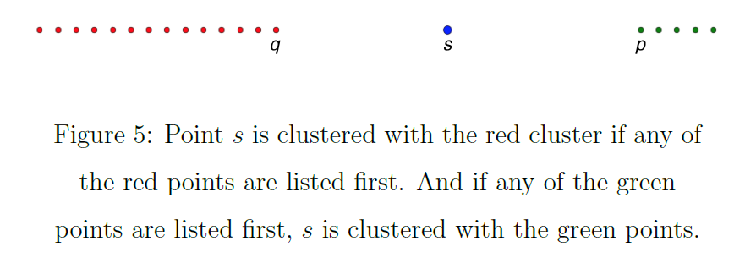
Figures courtesy of Wako Bungula

Slide 73
Figures courtesy of Wako Bungula

Slide 74
http://scikit-learn.org/stable/auto_examples/cluster/plot_cluster_comparison.html

