Slide 1
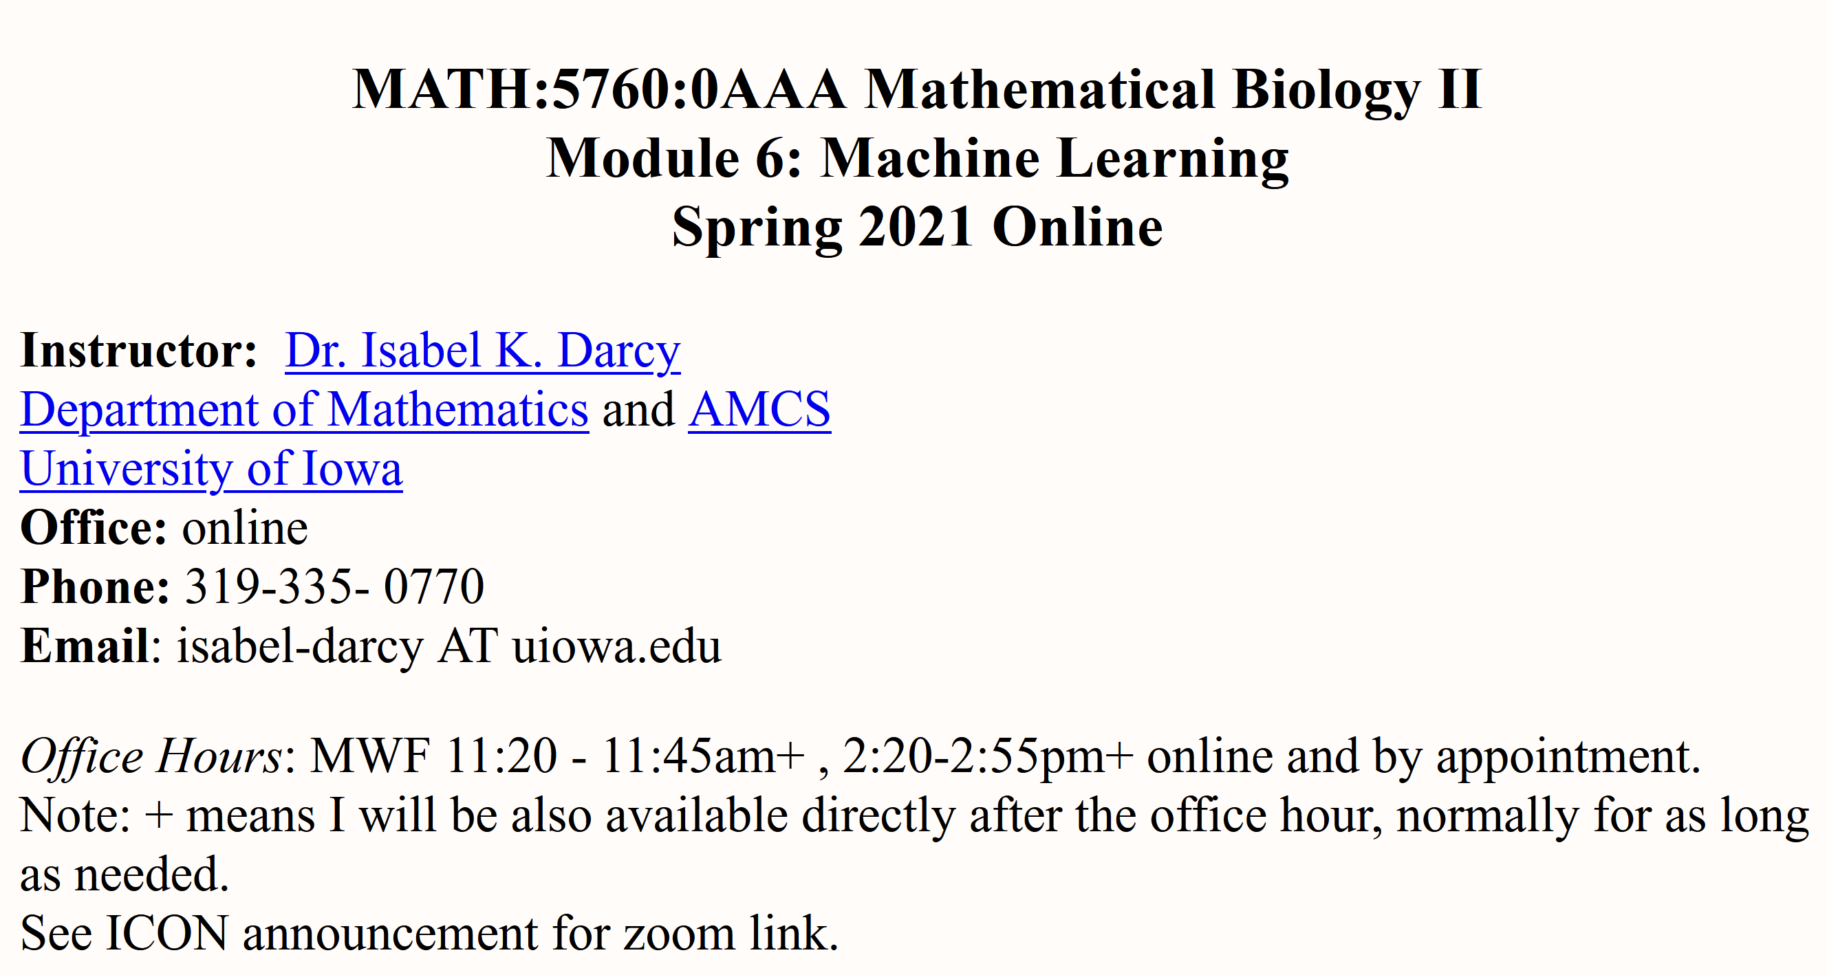
http://homepage.divms.uiowa.edu/~idarcy/COURSES/MB/SPRING21/5760.html

Slide 2
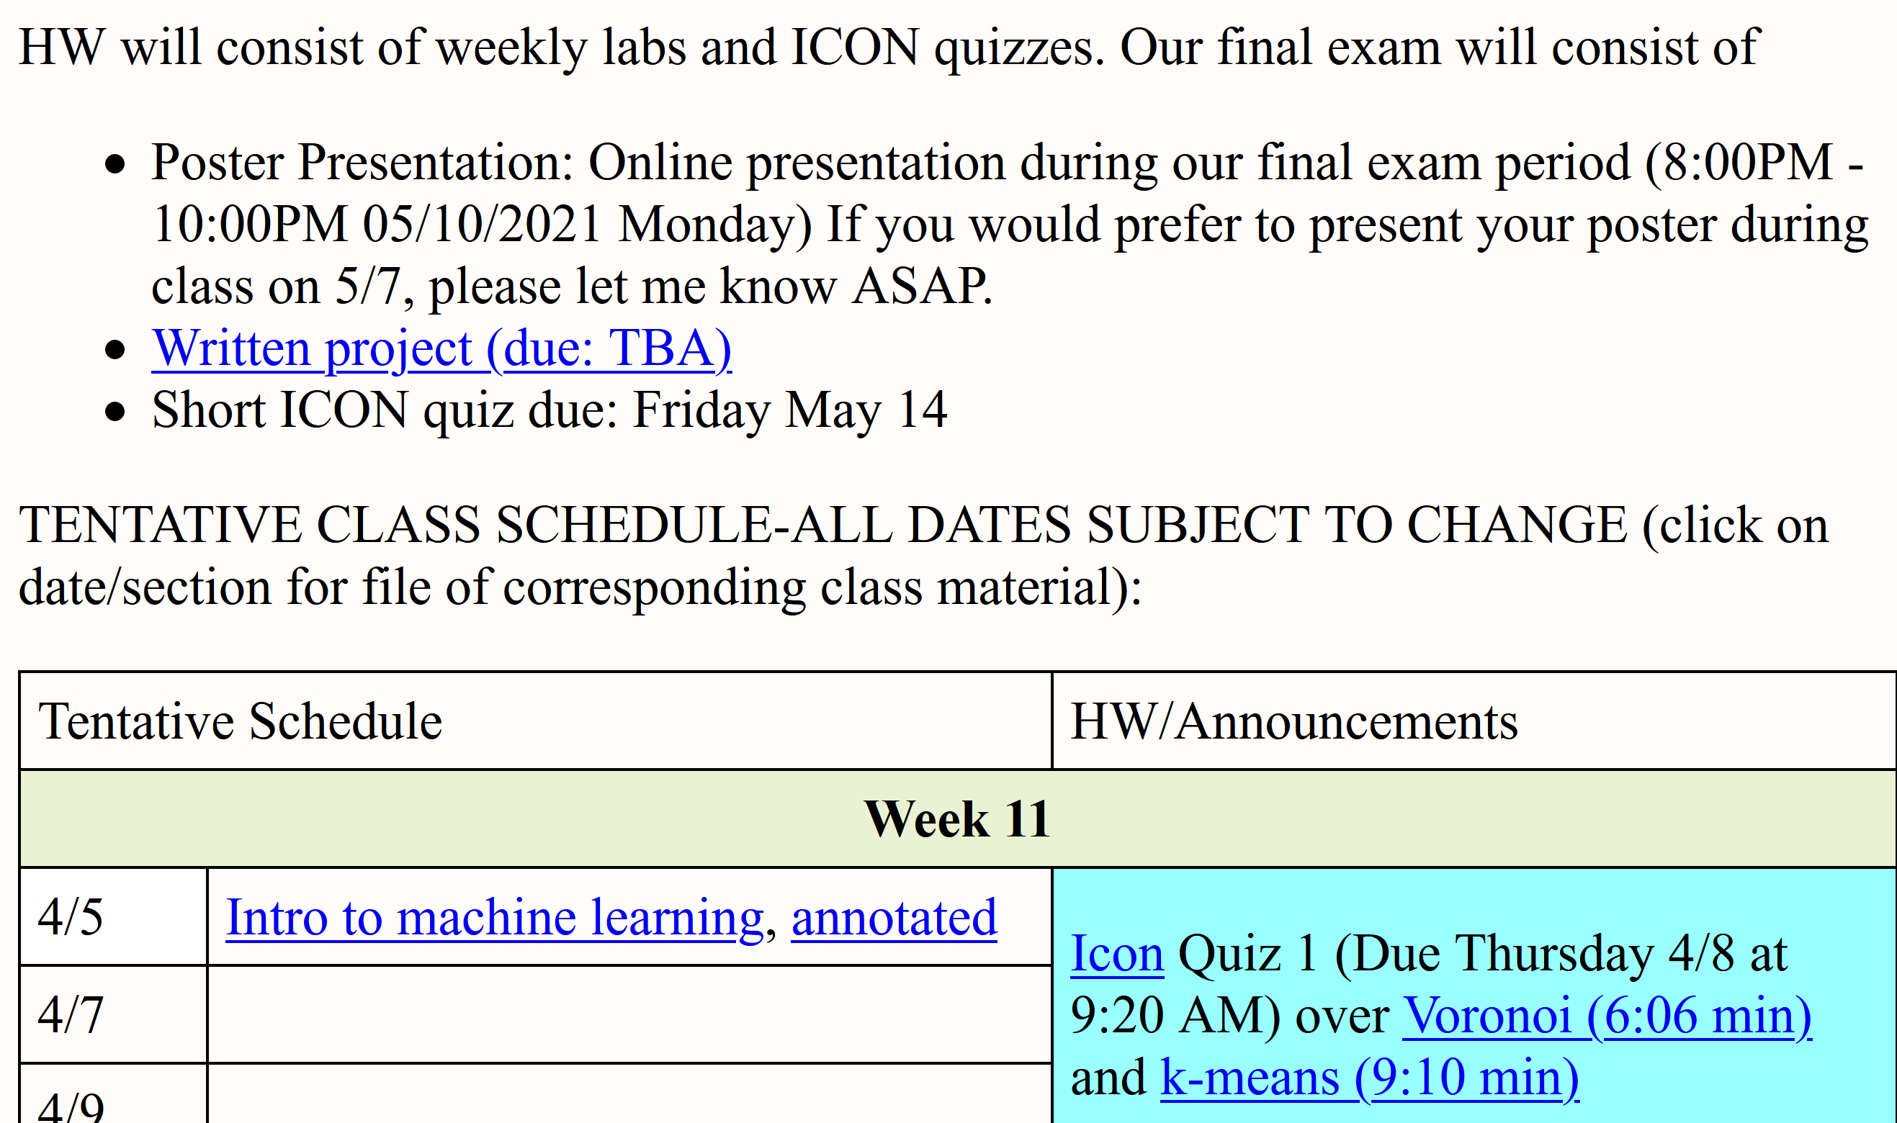

Slide 3
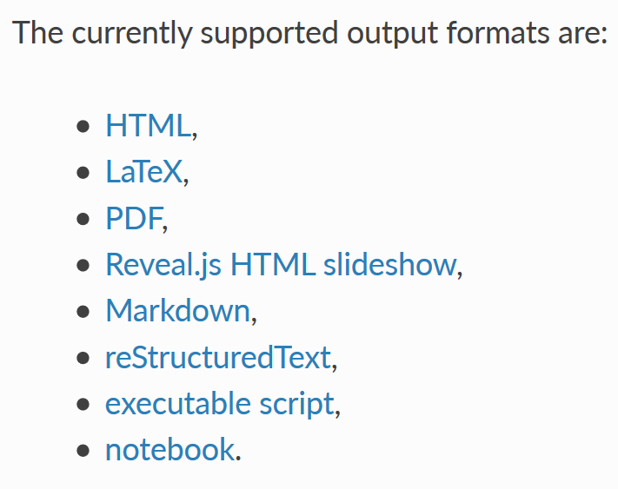
A jupyter notebook can be converted into a variety of formats per
https://nbconvert.readthedocs.io/en/latest/usage.html

Slide 4
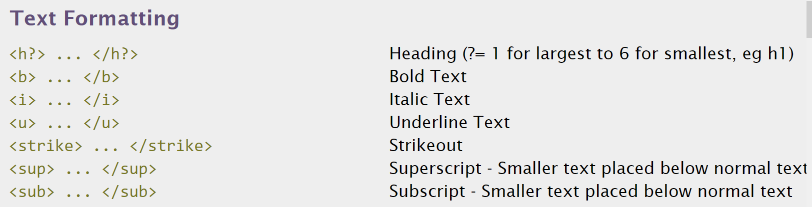
http://www.simplehtmlguide.com/cheatsheet.php

Slide 5
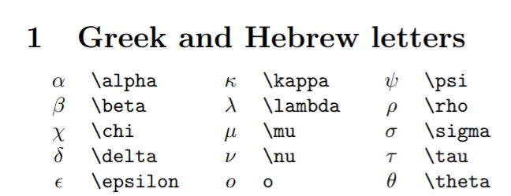
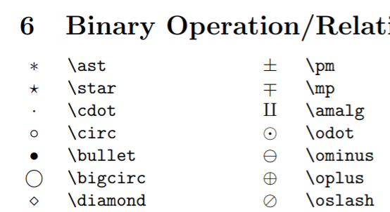
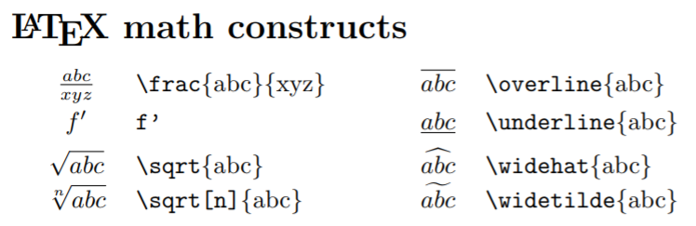
http://reu.dimacs.rutgers.edu/Symbols.pdf
Put latex command between $ signs,e.g.: $\alpha$

Slide 6
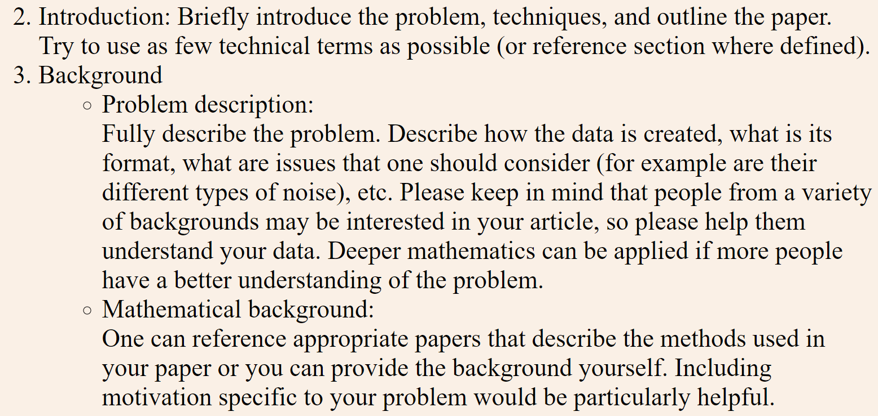
http://homepage.divms.uiowa.edu/~idarcy/COURSES/MB/SPRING21/project.html

Slide 7
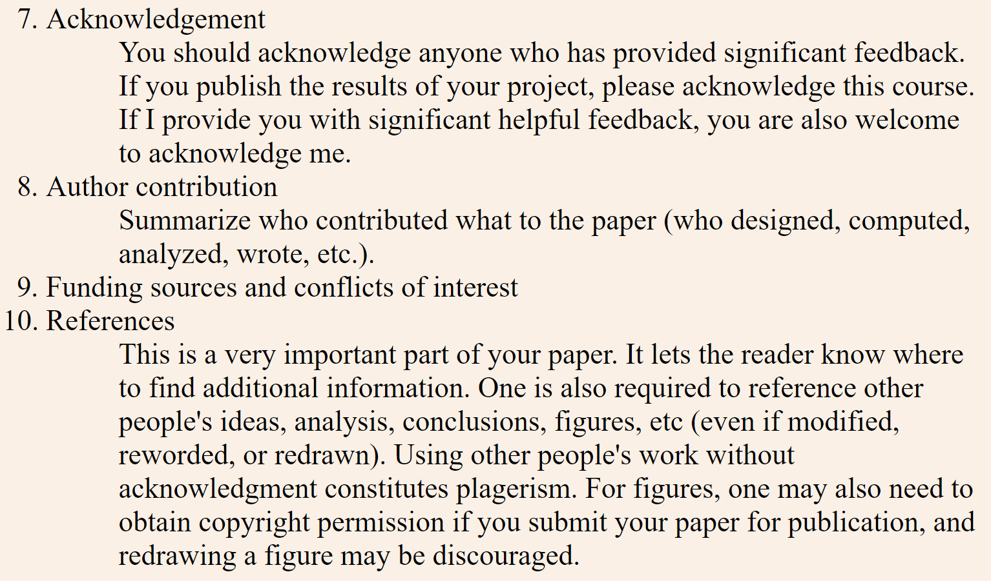
http://homepage.divms.uiowa.edu/~idarcy/COURSES/MB/SPRING21/project.html

Slide 8
Some journals require an author’s contributions section. For example:
Authors' contributions
CM and JN contributed to the mathematical analysis for applying the coloring invariant. JN also drafted significant portions of the sections The coloring invariants, Tangle generation, Checking the coloring invariants . AP, JS, and TT developed the software implementing the coloring invariant calculations. RM contributed to the Non-drawable section and is responsible for the subroutine which determines if a matrix corresponds to a drawable tangle. He was assisted by ND and JS. JC, ND, SM, and JS developed equivalence moves which were implemented by ND, RM, and JS. ID conceived of and oversaw this project, drafted much of the manuscript, and contributed to the mathematical and software development. All authors read and approved the final manuscript.
https://link.springer.com/article/10.1186/1471-2105-7-435
each student will be graded individually

Slide 9
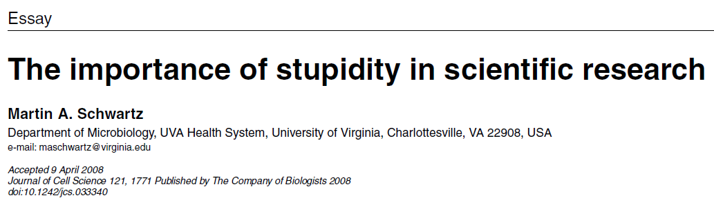
http://jcs.biologists.org/content/121/11/1771
I'd like to suggest that our Ph.D. programs often do students a disservice in two ways. First, I don't think students are made to understand how hard it is to do research. And how very, very hard it is to do important research. It's a lot harder than taking even very demanding courses. What makes it difficult is that research is immersion in the unknown. We just don't know what we're doing. We can't be sure whether we're asking the right question or doing the right experiment until we get the answer or the result.

Slide 10
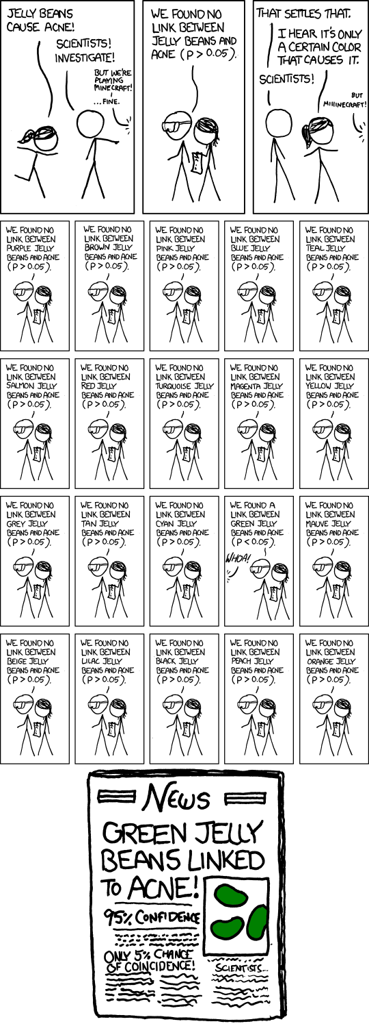
False Positives will occur
https://xkcd.com/882/

Slide 11
Consider publishing your work in either a research journal or a journal aimed at students.
There is an incentive ($250 for paper submitted; $250 for paper published) but the paper must be in an Q1 or Q2 journal. Undergrad journals don't qualify.
For journal rankings see: https://www.scimagojr.com/
Avoid publishing in fake journals.

Slide 12

https://writingcenter.uiowa.edu/#services

Slide 13

https://speakingcenter.uiowa.edu/about-us

Slide 14
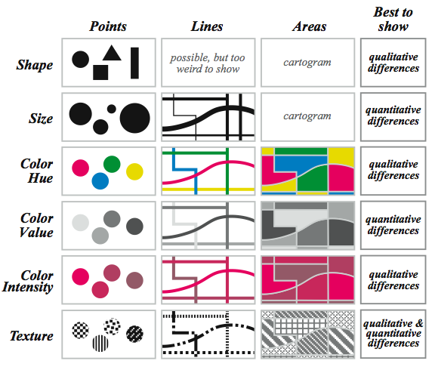
Visual variables for quantitative phenomena
Krygier and Wood, 2002
Slide modified from: https://drive.google.com/drive/folders/0B8M300Hbnx9leDBERlhkS1JPZkE

Slide 15
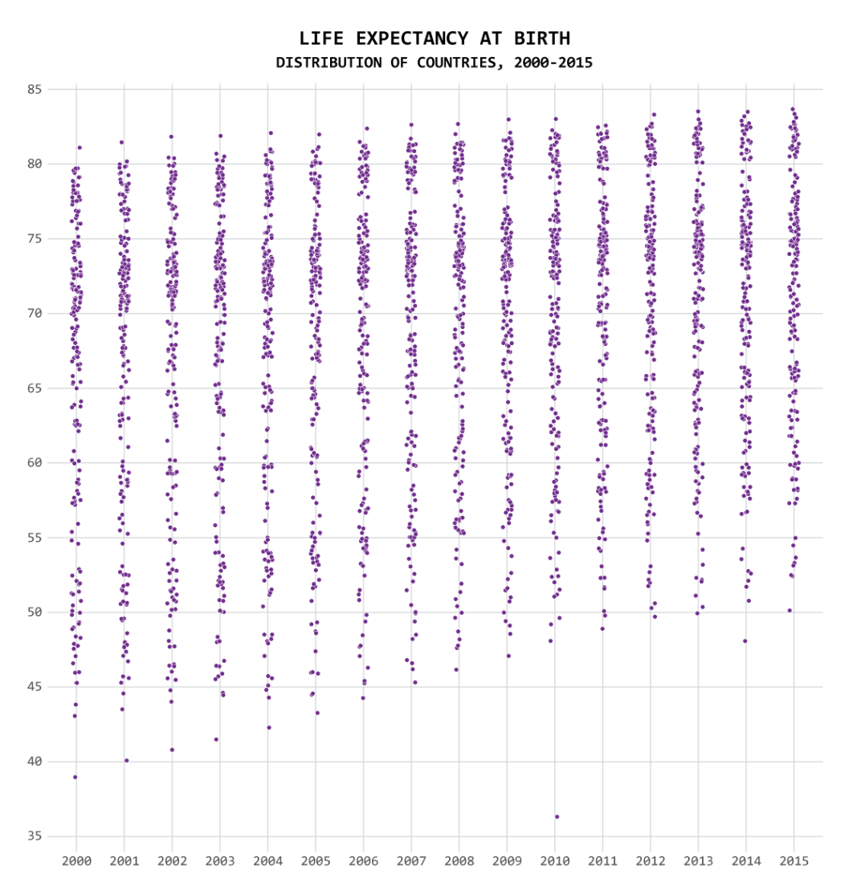
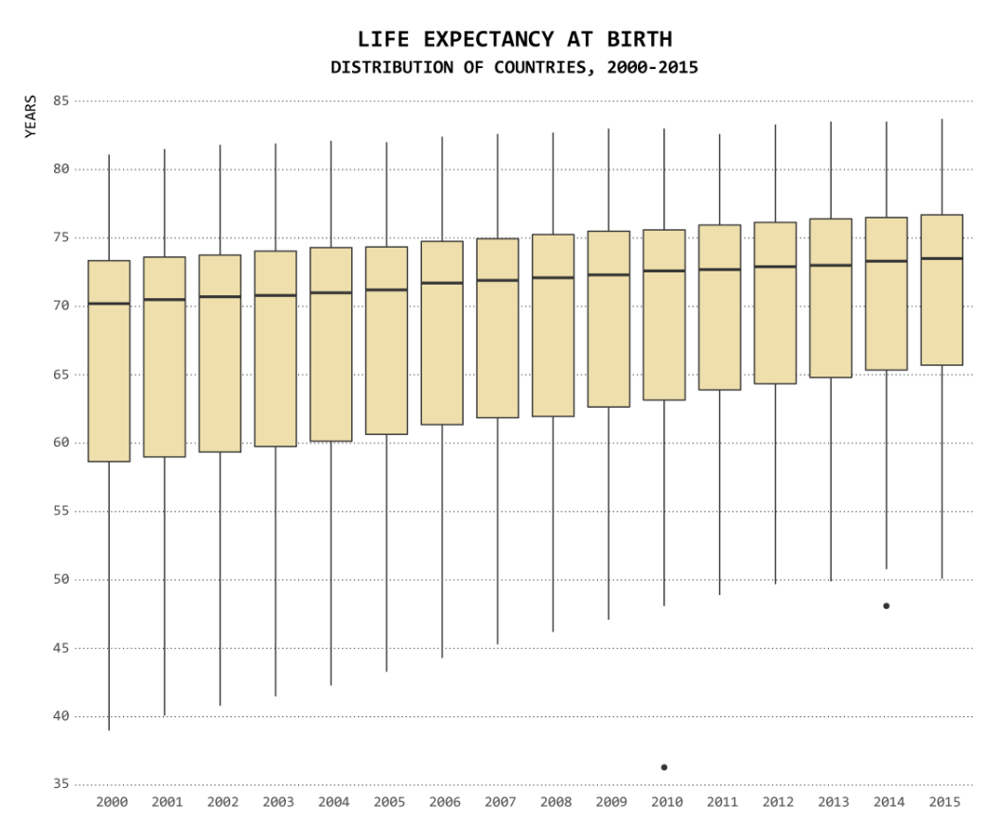
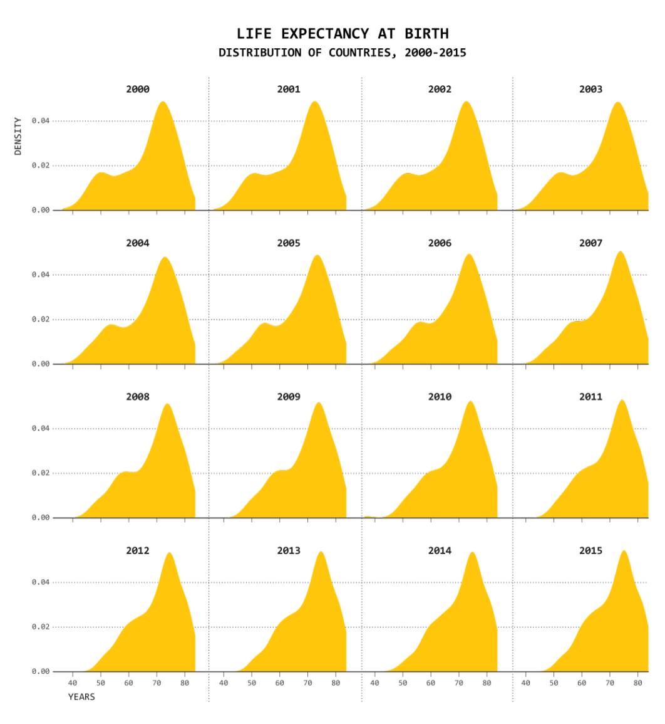
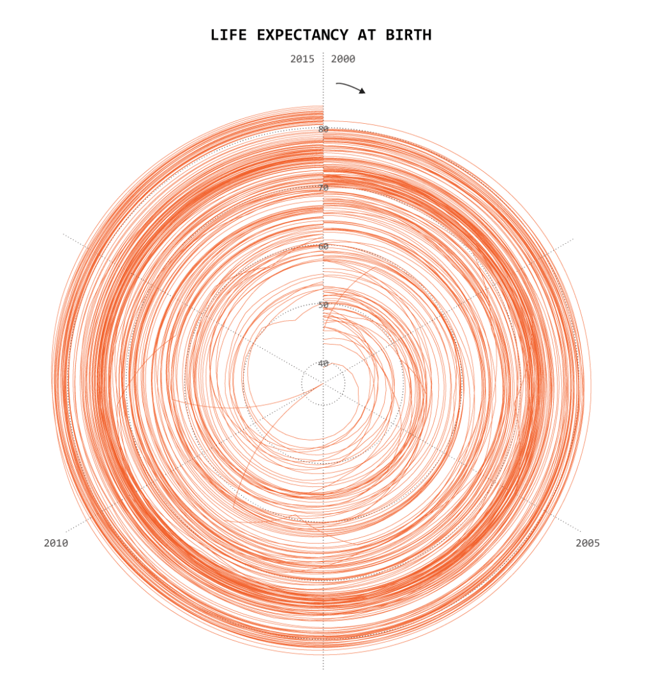
One Dataset, Visualized 25 Ways
https://flowingdata.com/2017/01/24/one-dataset-visualized-25-ways/

Slide 16
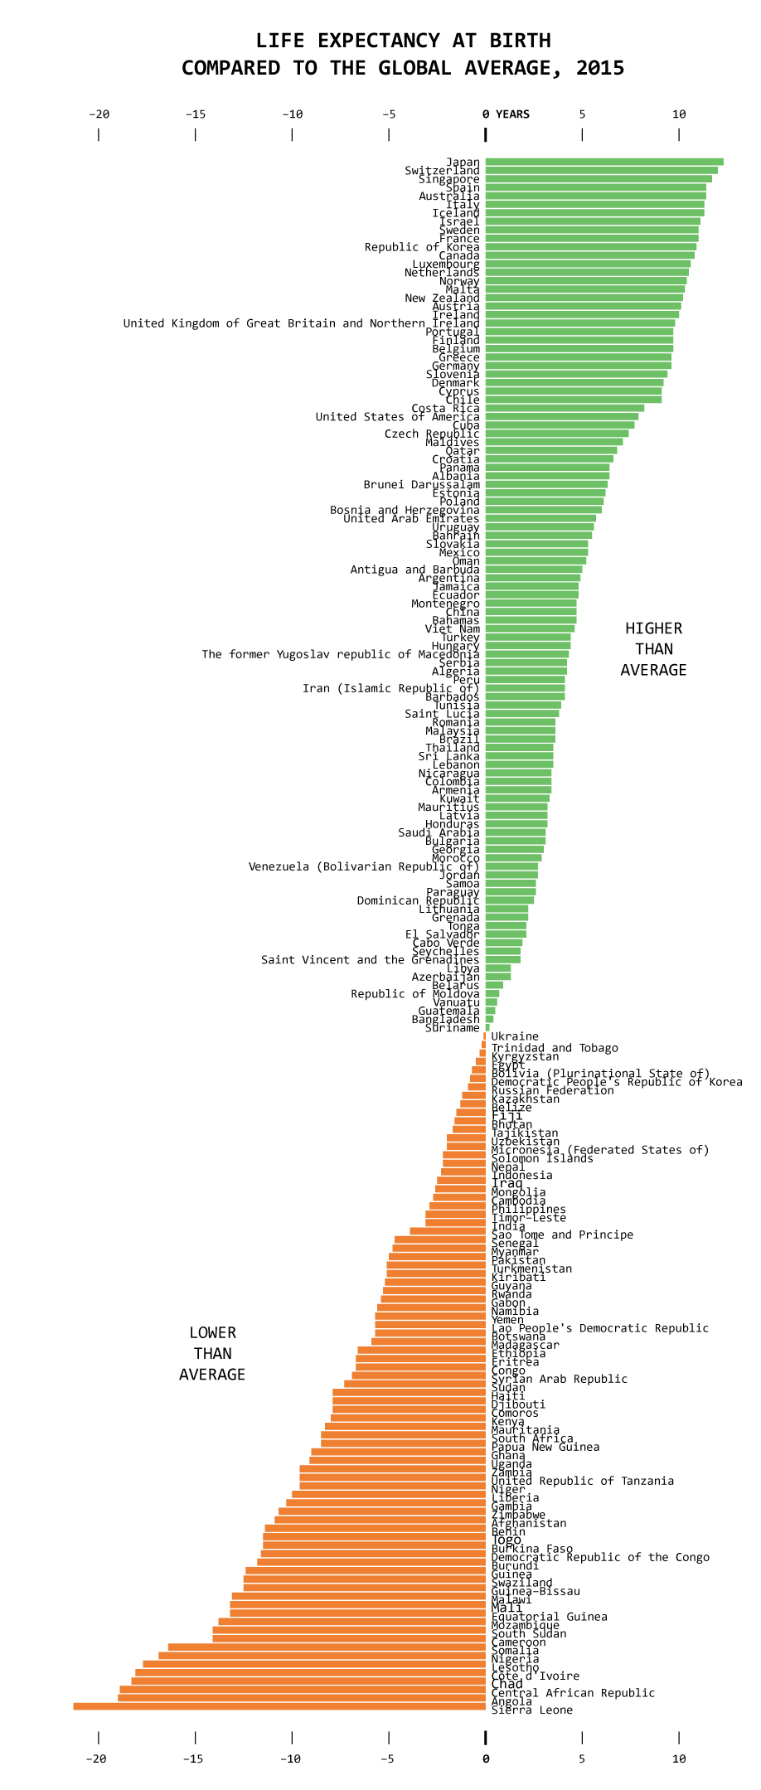
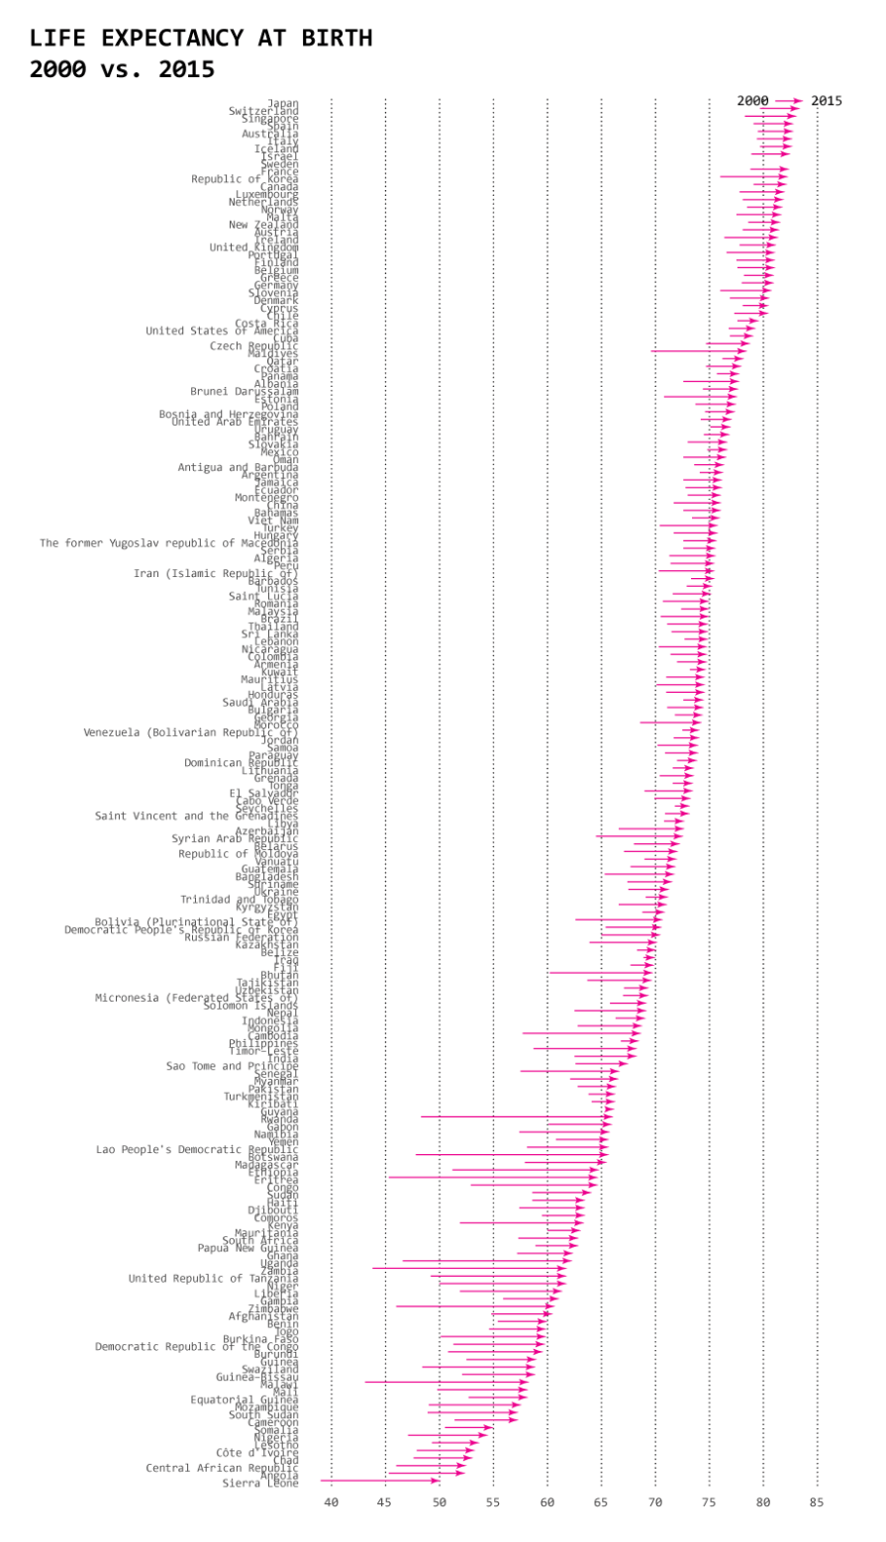
One Dataset, Visualized 25 Ways
https://flowingdata.com/2017/01/24/one-dataset-visualized-25-ways/

Slide 17
One Dataset, Visualized 25 Ways
One Dataset, Visualized 25 Ways
https://flowingdata.com/2017/01/24/one-dataset-visualized-25-ways/

Slide 18
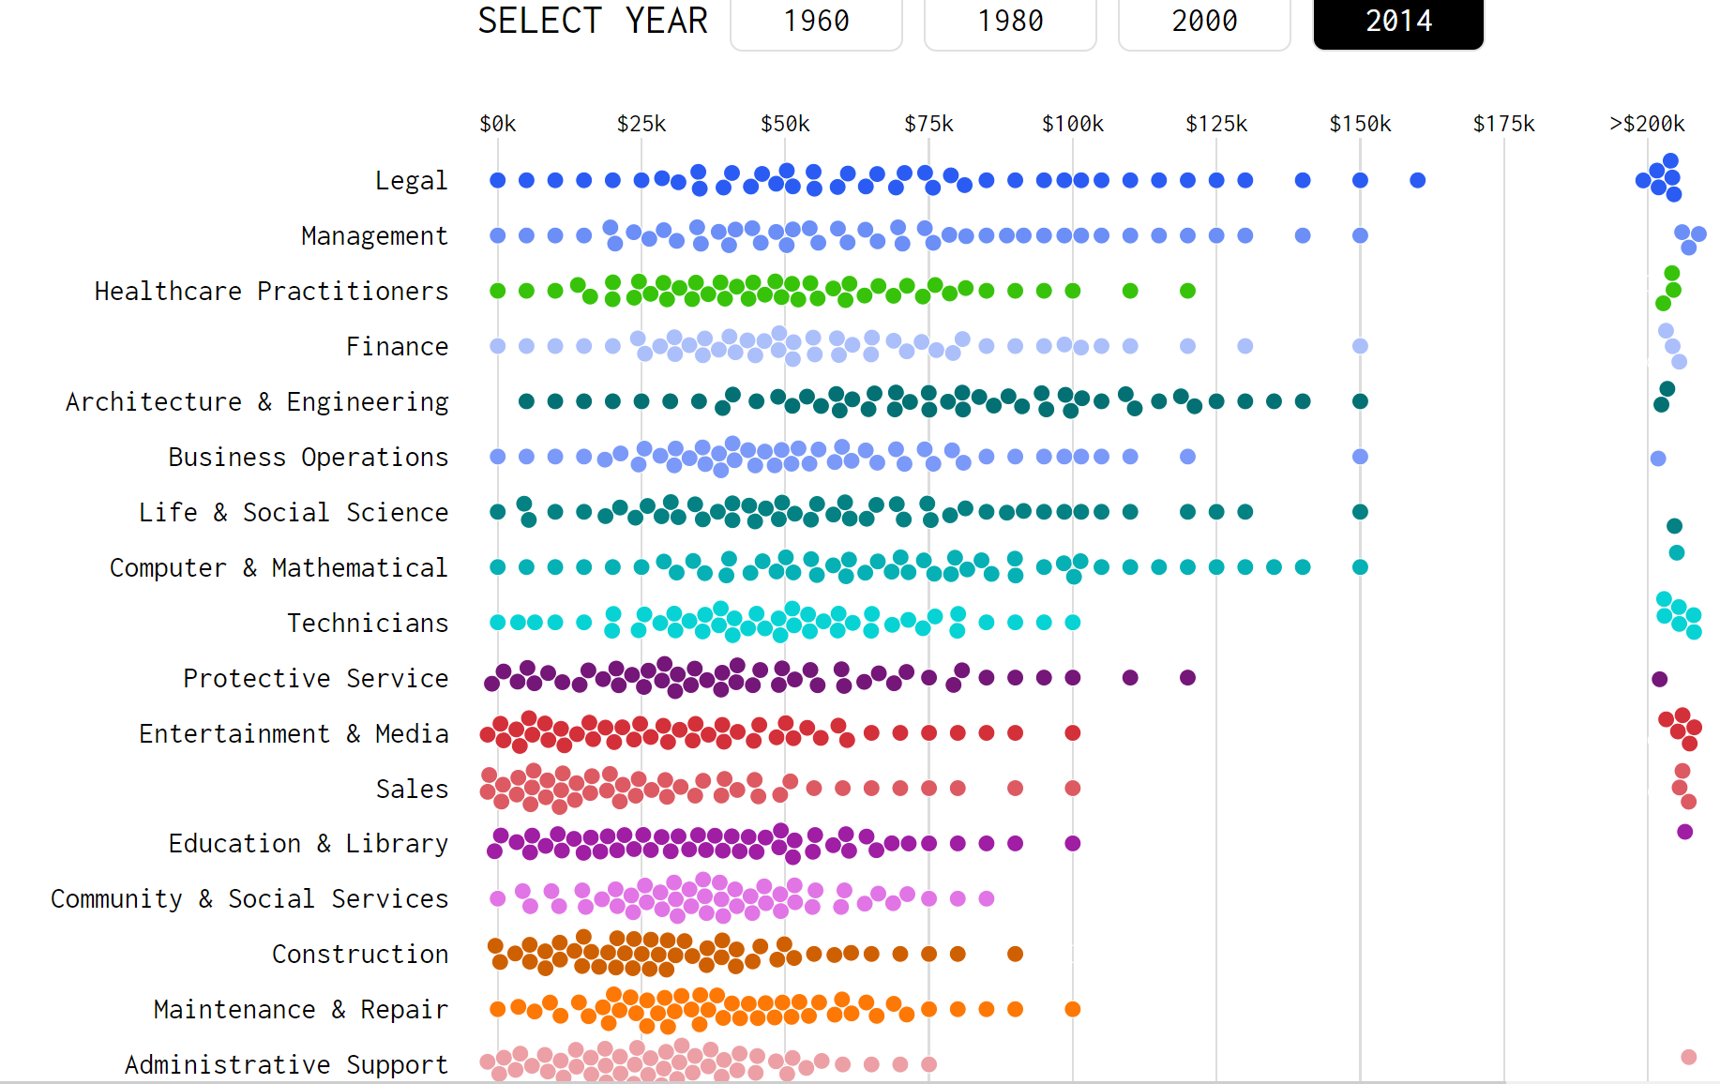
https://flowingdata.com/2016/06/28/distributions-of-annual-income/

Slide 19
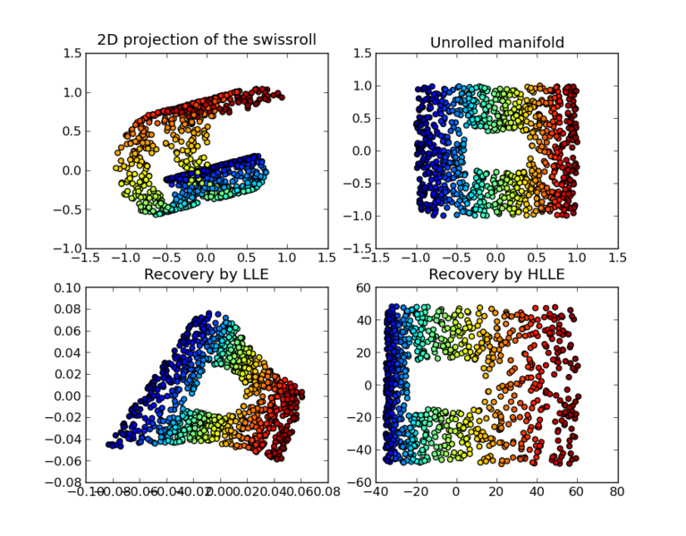
https://en.wikipedia.org/wiki/Nonlinear_dimensionality_reduction

Slide 20
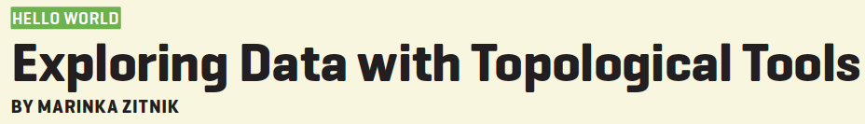
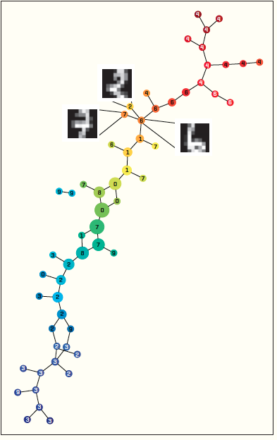
https://dl-acm-org/citation.cfm?id=2634549.2627814&coll=portal&dl=ACM
XRDS • SUMMER 2014 • VOL .20 • NO.4

Slide 21
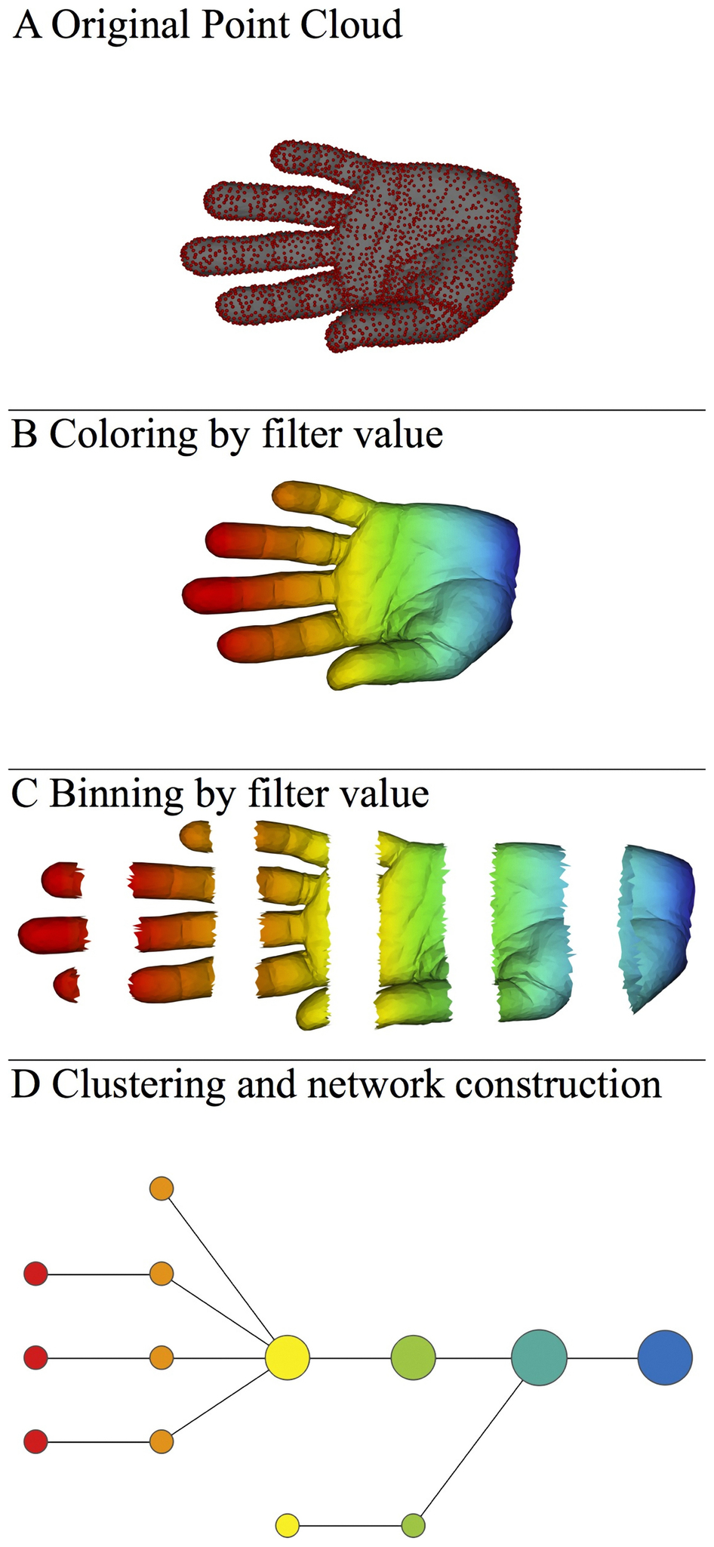
A) Data Set
Example: Point cloud data
representing a hand.
B) Function f : Data Set → R
Example: x-coordinate
f : (x, y, z) → x
Put data into overlapping bins.
Example: f⁻¹(a_{i}, b_{i})
Cluster each bin & create network.
Vertex = a cluster of a bin.
Edge = nonempty intersection
between clusters
http://www.nature.com/srep/2013/130207/srep01236/full/srep01236.html

Slide 22
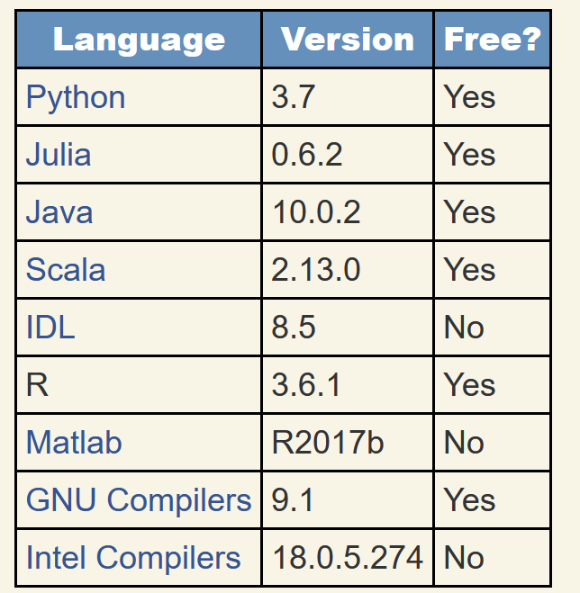
https://modelingguru.nasa.gov/docs/DOC-2783

Slide 23
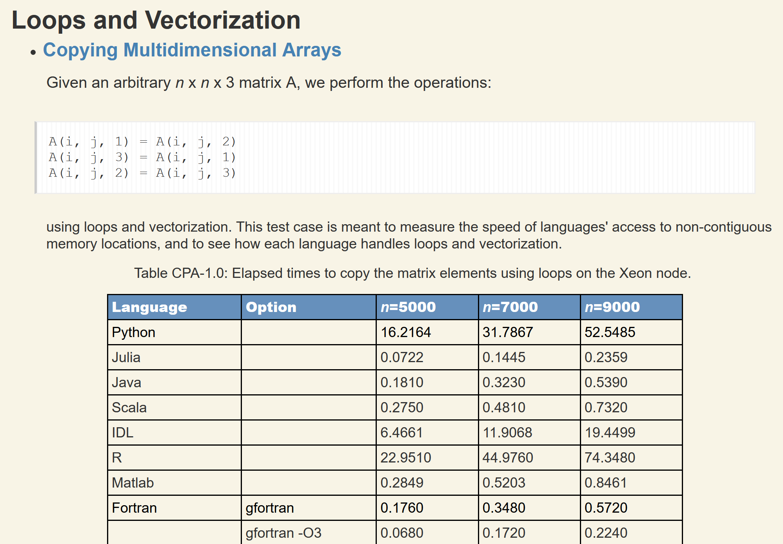
https://modelingguru.nasa.gov/docs/DOC-2783
Created on: Jul 2, 2019 2:51 PM by Alexander Medema - Last Modified: Nov 4, 2019 10:15 PM by Jules Kouatchou

Slide 24
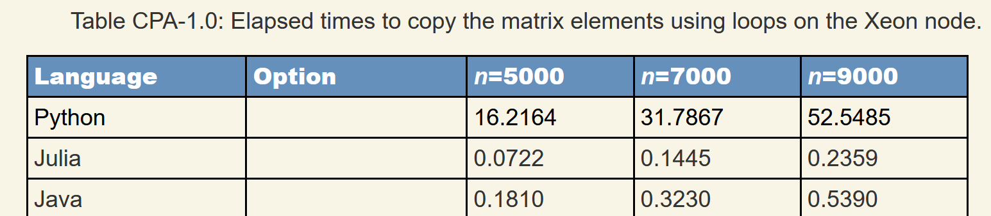
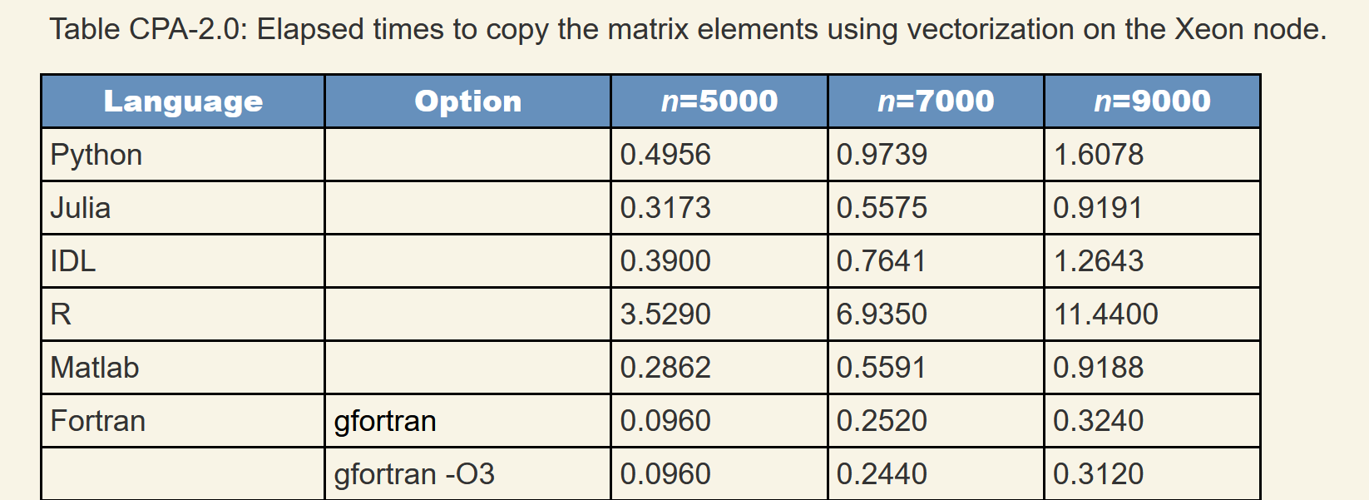
https://modelingguru.nasa.gov/docs/DOC-2783

Slide 25
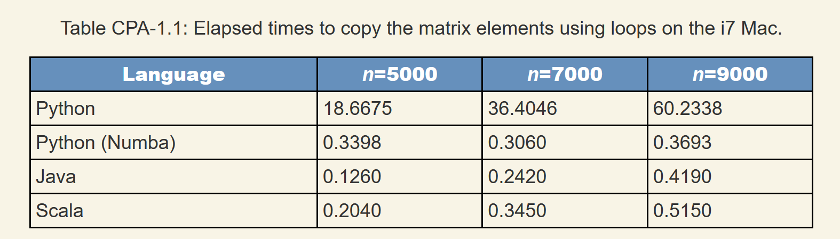
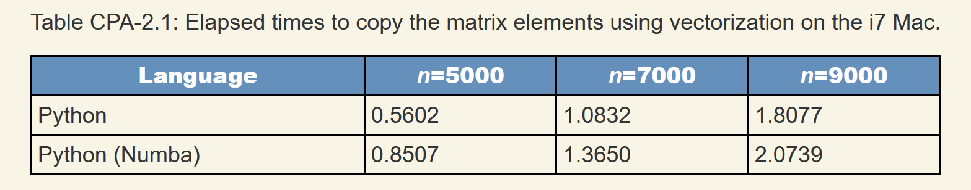
https://modelingguru.nasa.gov/docs/DOC-2783

Slide 26
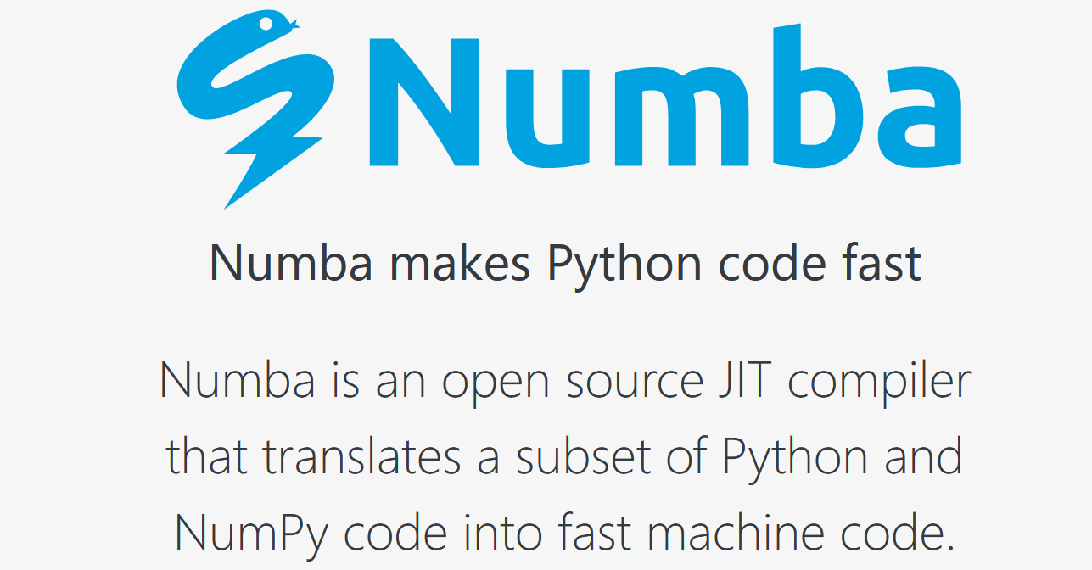
https://numba.pydata.org/

Slide 27
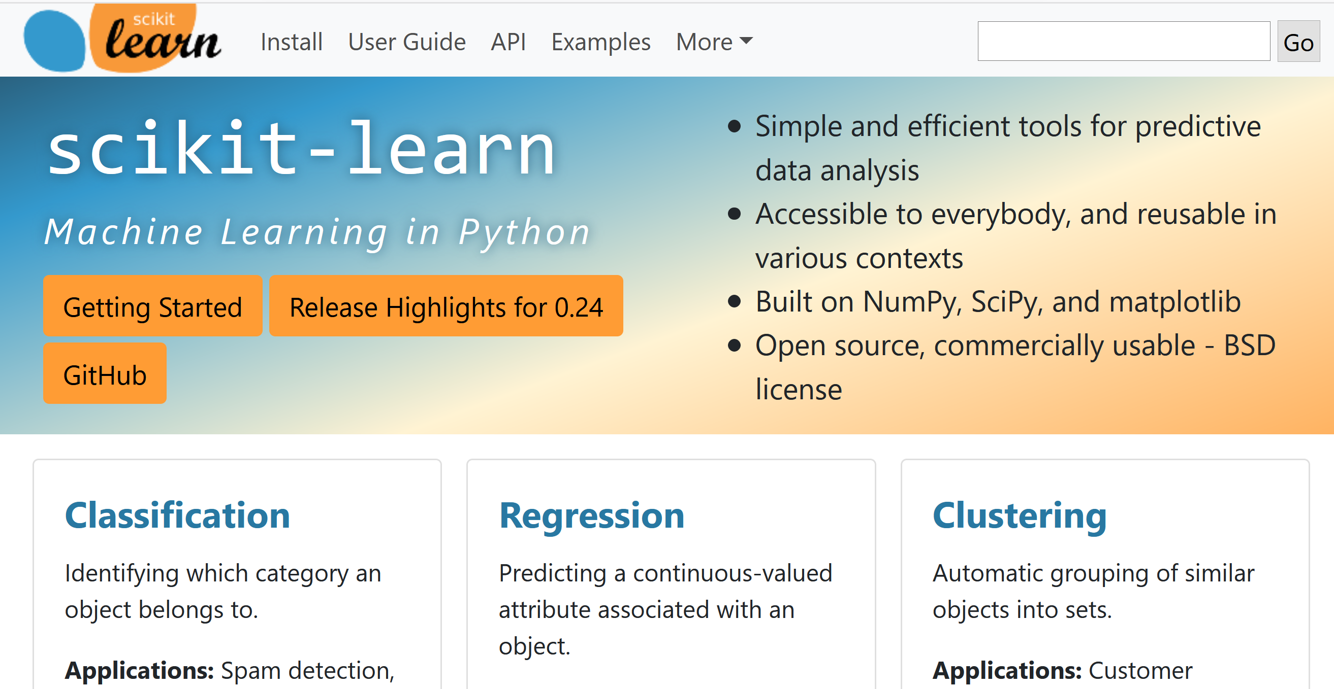
https://scikit-learn.org

Slide 28
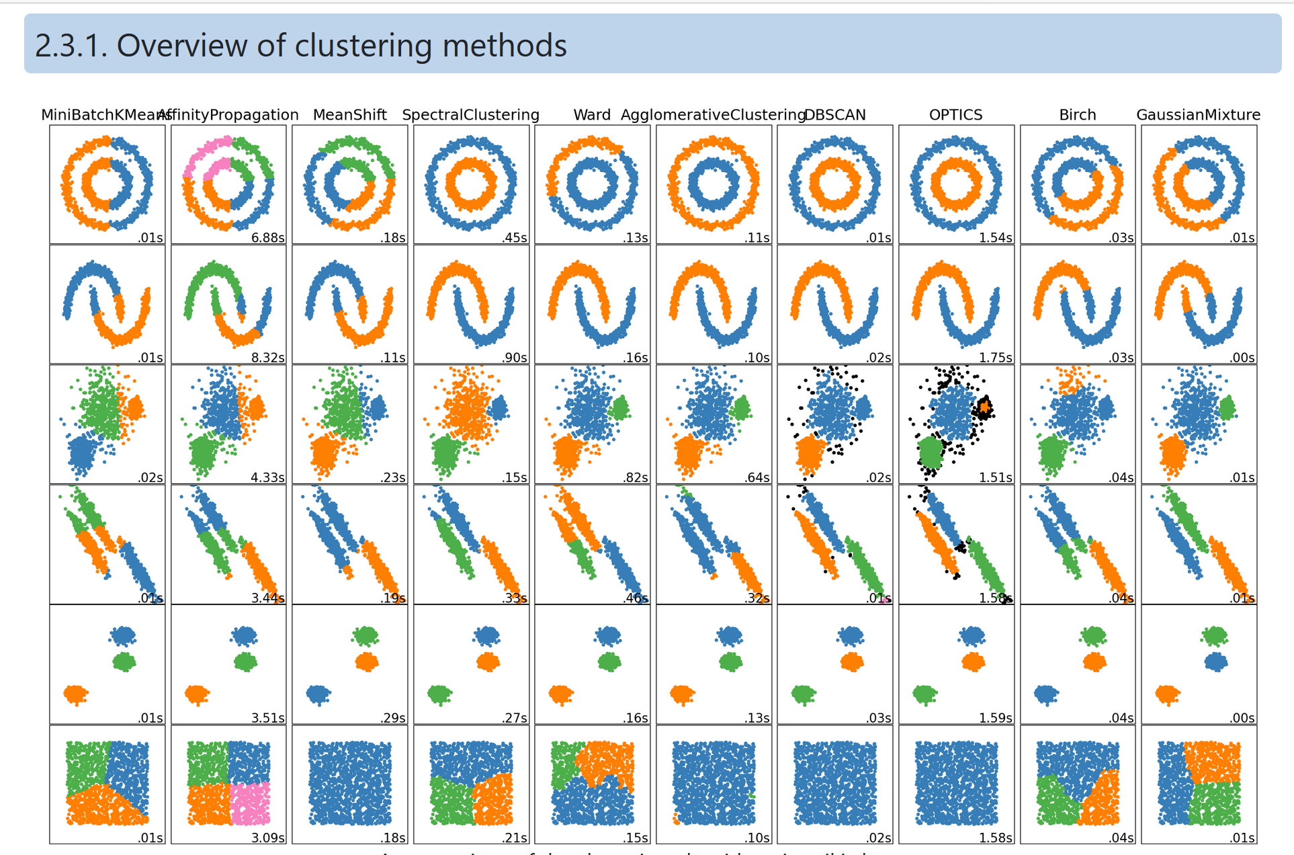
https://scikit-learn.org/stable/modules/clustering.html

Slide 29
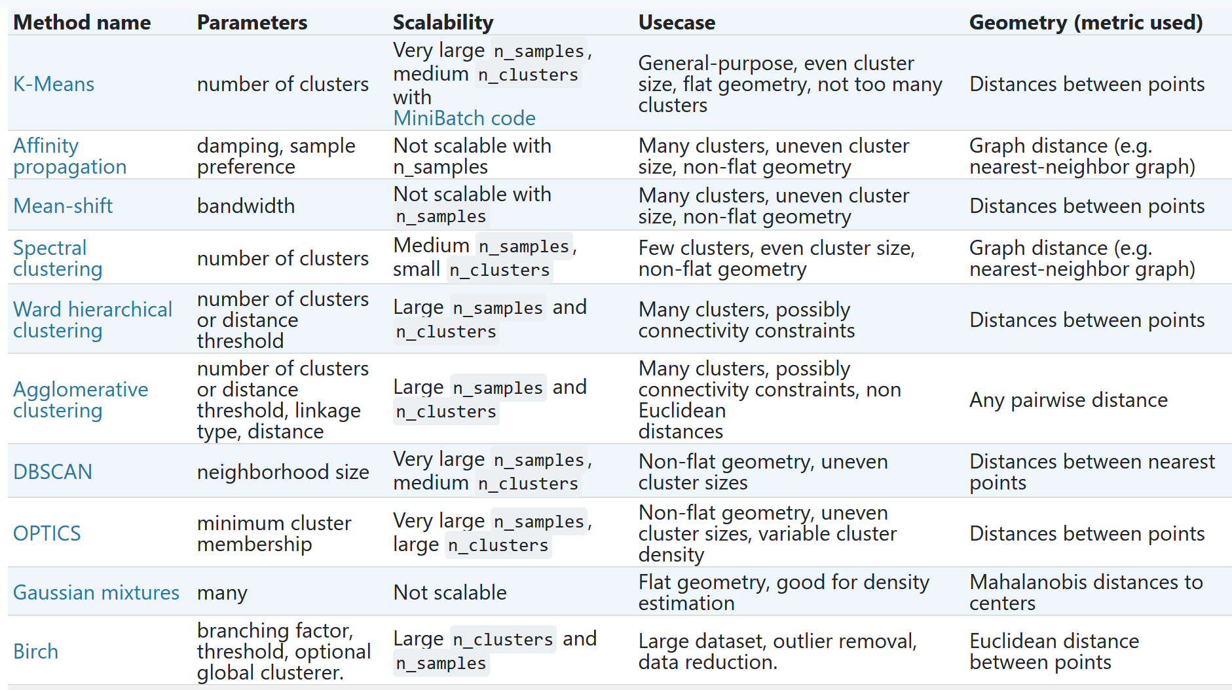
https://scikit-learn.org/stable/modules/clustering.html#clustering

Slide 30
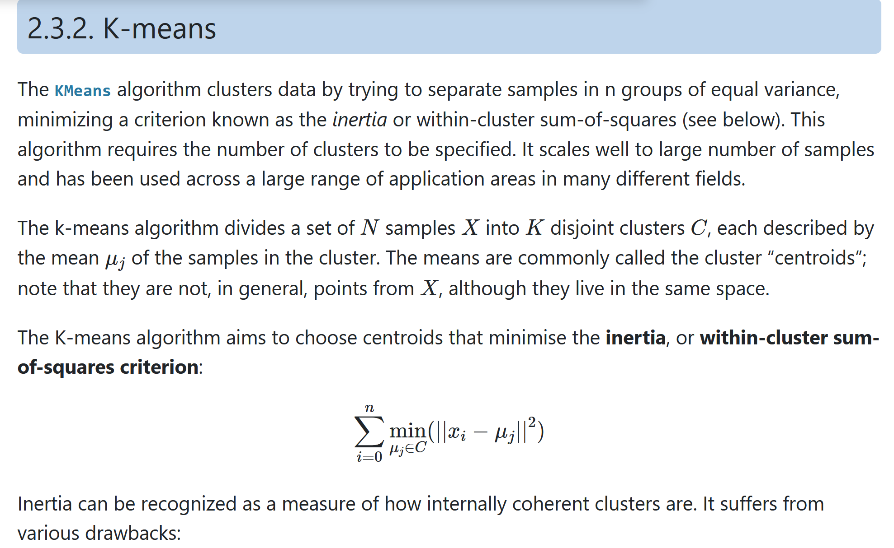
https://scikit-learn.org/stable/modules/clustering.html#k-means

Slide 31
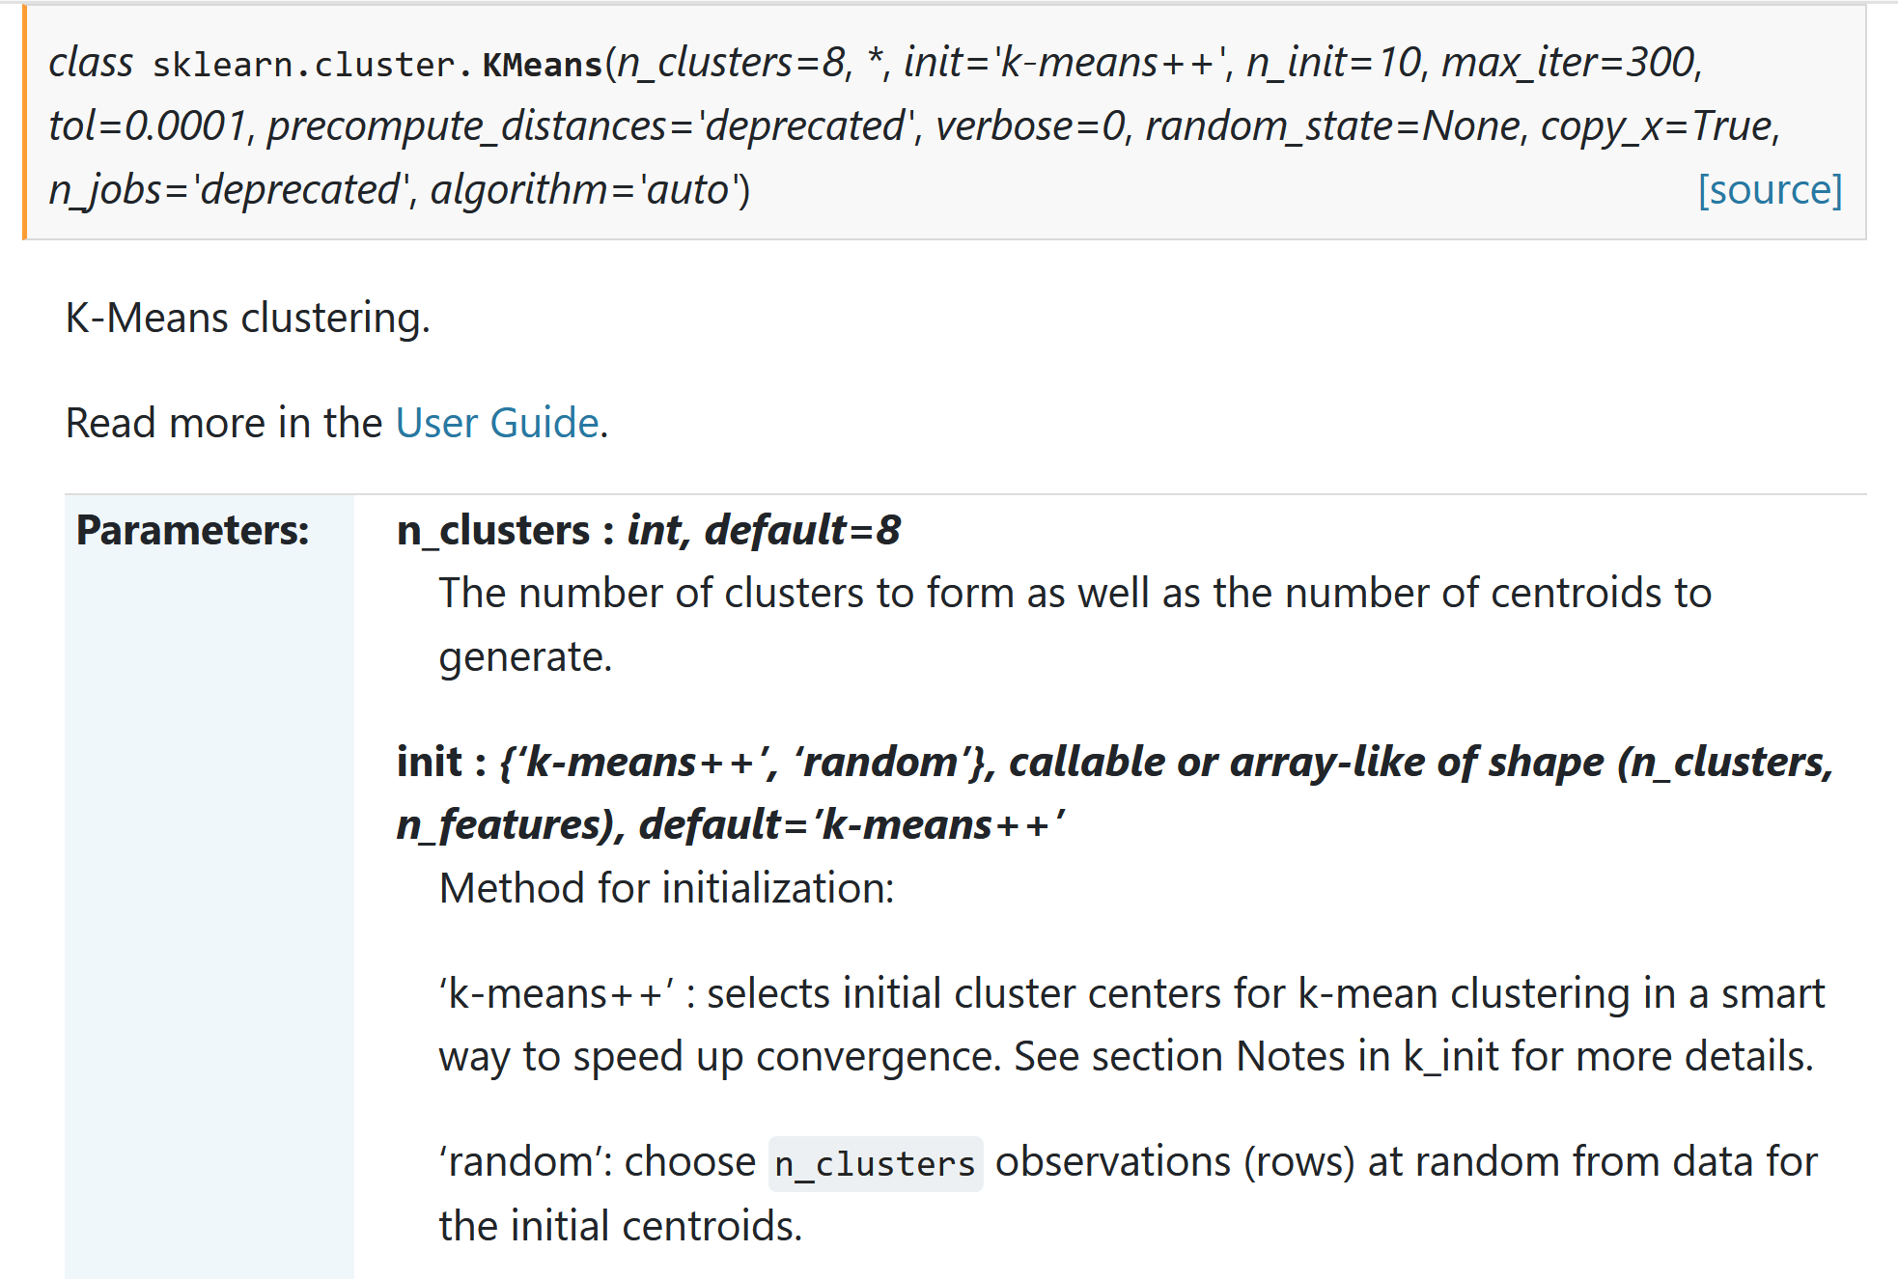

Slide 32

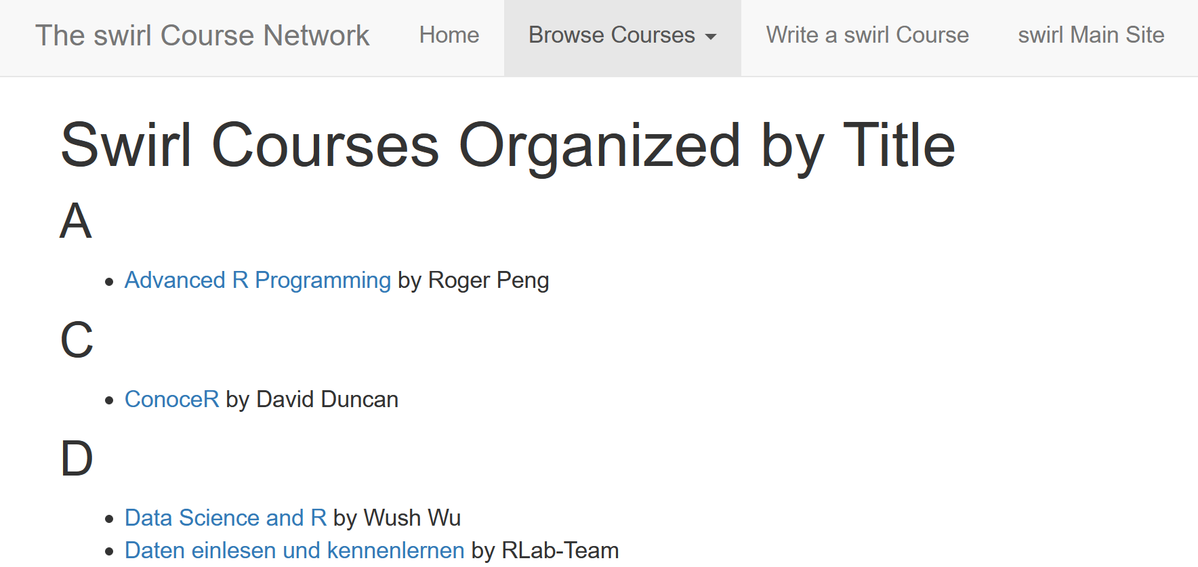
https://www.r-project.org/
https://swirlstats.com/scn/title.html

Slide 33

Additional packages can be found at other repositories such as http://bioconductor.org/

Slide 34
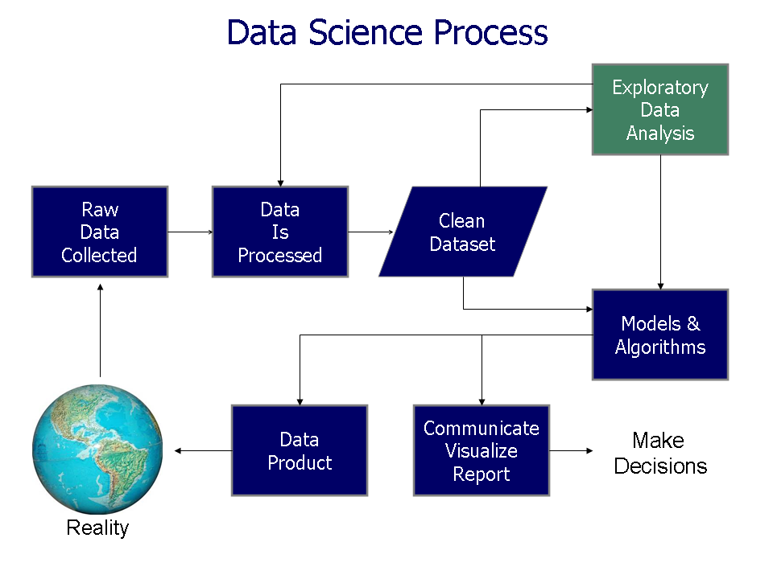
https://commons.wikimedia.org/wiki/File%3AData_visualization_process_v1.png

Slide 35

Machine Learning overview
Chapter 19
14.1
https://www.csee.umbc.edu/courses/graduate/671/fall20/notes/14_machine_learning/14_1_intro.pptx

Slide 36
So What Is Machine Learning?
Automating automation
Getting computers to program themselves
Writing software is the bottleneck
Let the data do the work instead!
https://courses.cs.washington.edu/courses/cse446/09wi/slides/intro.ppt

Slide 37
Traditional Programming
Machine Learning
Data
Computer
Output
Program
Data
Computer
Program
Output
https://courses.cs.washington.edu/courses/cse446/09wi/slides/intro.ppt

Slide 38
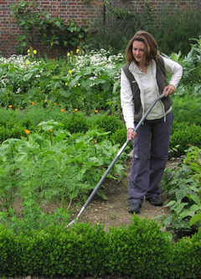
Magic?
No, more like gardening
Seeds = Algorithms
Nutrients = Data
Gardener = You
Plants = Programs
https://courses.cs.washington.edu/courses/cse446/09wi/slides/intro.ppt

Slide 39
What is Machine Learning?
Machine Learning By: Jennie E. Brand, Bernard Koch & Jiahui Xu
https://methods-sagepub-com.proxy.lib.uiowa.edu/foundations/machine-learning
“Machine learning is a computational and statistical approach to extracting patterns and trends from data (Maini & Sabri, 2017). A machine learning algorithm is also defined as a computer program that learns from experience with data with respect to some class of tasks and improves its performance with greater experience (Mitchell, 1997).”
Hands-on Scikit-Learn for Machine Learning Applications by David Paper
https://link-springer-com.proxy.lib.uiowa.edu/book/10.1007%2F978-1-4842-5373-1
Machine learning is getting computers to program themselves. We use algorithms to
make this happen. An algorithm is a set of rules used to calculate or problem solve
with a computer.
Machine learning advocates create, study, and apply algorithms to improve
performance on data-driven tasks. They use tools and technology to answer questions
about data by training a machine how to learn.

Slide 40
Types of Learning
Supervised (inductive) learning
  Training data includes desired outputs
Unsupervised learning
  Training data does not include desired outputs
Semi-supervised learning
  Training data includes a few desired outputs
Reinforcement learning
  Rewards from sequence of actions
https://courses.cs.washington.edu/courses/cse446/09wi/slides/intro.ppt

Slide 41
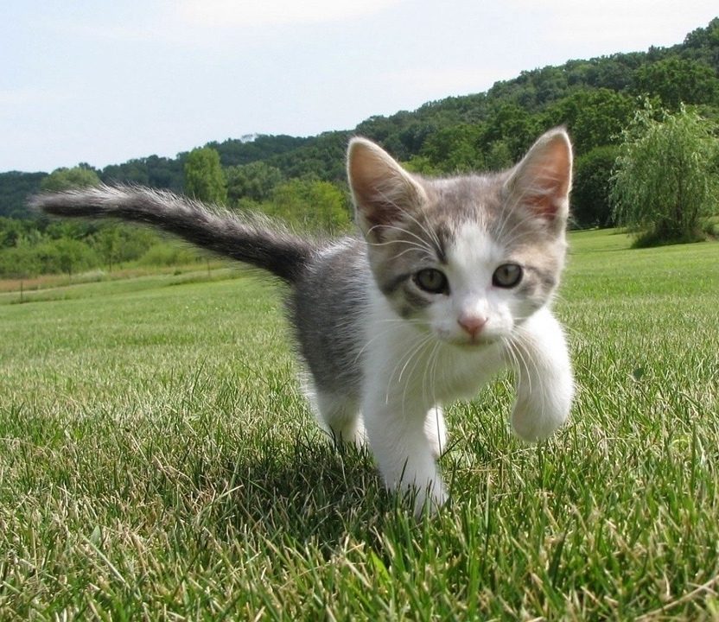
Supervised vs Reinforcement vs Unsupervised Learning
Supervised Learning
Data: (x, y)
x is data, y is label
Goal: Learn a function to map x → y
Examples: Classification, regression, object detection, semantic segmentation, image captioning, etc.
Cat
Classification
This image is CC0 public domain
https://www.cc.gatech.edu/classes/AY2020/cs7643_fall/slides/L23_generative2.pptx
Slide Credit: Fei-Fei Li, Justin Johnson, Serena Yeung, CS 231n
Notes:
So far talked about SL
Type of problem where have Data X, Labels Y, goals is to learn a function mapping from x to y

Slide 42
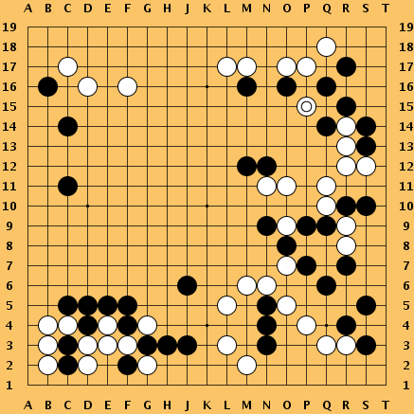
Supervised vs Reinforcement vs Unsupervised Learning
Reinforcement Learning
Given: (e, r)
Environment e, Reward function r (evaluative feedback)
Goal: Maximize expected reward
Examples: Robotic control, video games, board games, etc.
https://www.cc.gatech.edu/classes/AY2020/cs7643_fall/slides/L23_generative2.pptx
Slide Credit: Fei-Fei Li, Justin Johnson, Serena Yeung, CS 231n
Notes:
So far talked about SL
Type of problem where have Data X, Labels Y, goals is to learn a function mapping from x to y

Slide 43
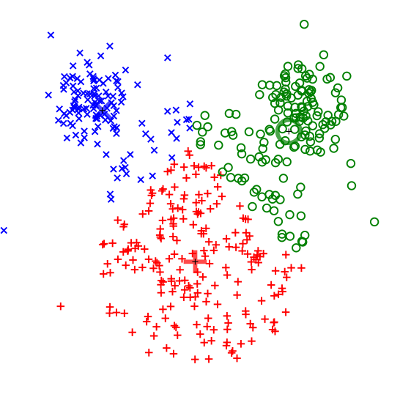
Supervised vs Reinforcement vs Unsupervised Learning
Unsupervised Learning
Data: x
Just data, no labels!
Goal: Learn some underlying hidden structure of the data
Examples: Clustering, dimensionality reduction, feature learning, density estimation, etc.
K-means clustering
This image is CC0 public domain
https://www.cc.gatech.edu/classes/AY2020/cs7643_fall/slides/L23_generative2.pptx
Slide Credit: Fei-Fei Li, Justin Johnson, Serena Yeung, CS 231n
Notes:
Clustering - find groups within the data that are similar through some metric

Slide 44
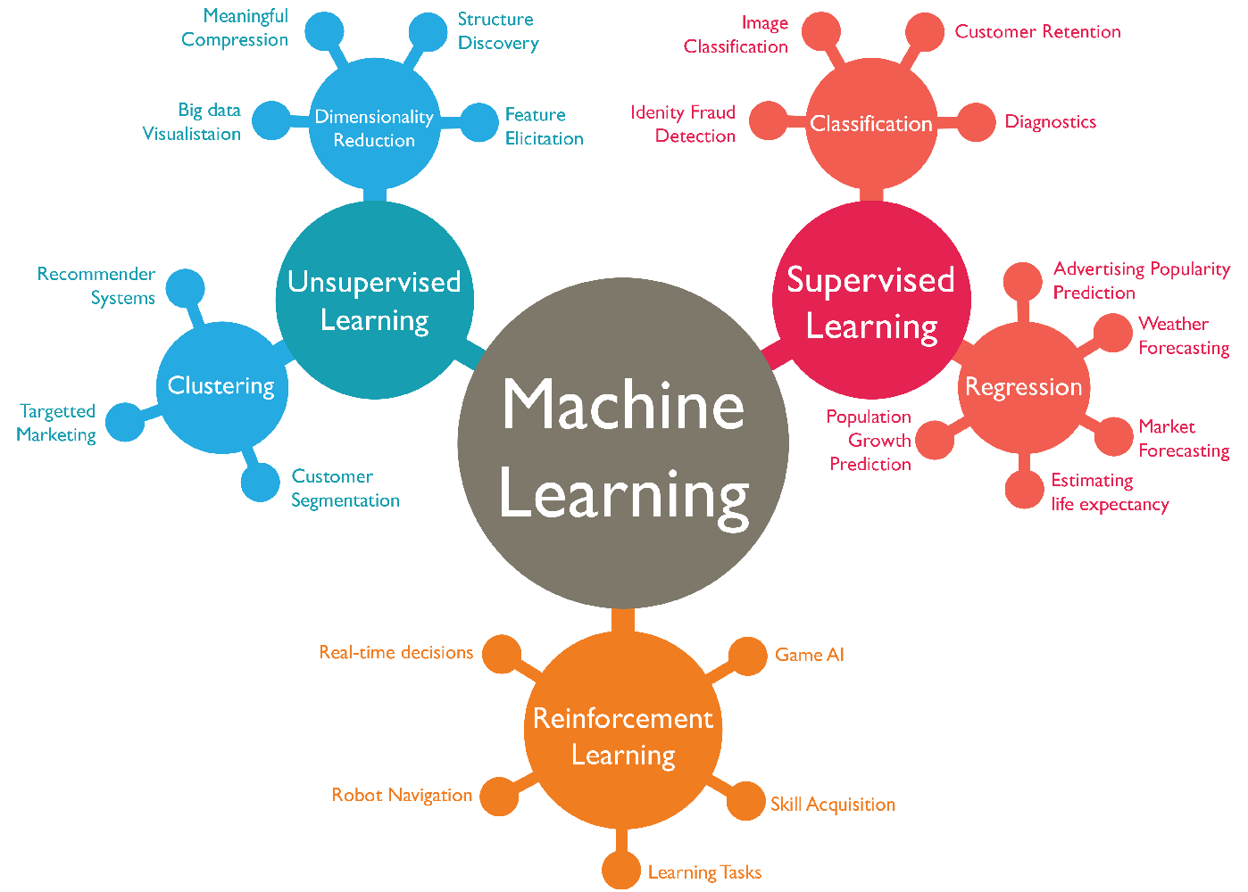
https://www.favouriteblog.com/wp-content/uploads/2017/07/Types-of-Learning.png

Slide 45
Supervised vs Reinforcement vs Unsupervised Learning
Supervised Learning
Data: (x, y)
x is data, y is label
Goal: Learn a function to map x → y
Examples: Classification, regression, object detection, semantic segmentation, image captioning, etc.
Unsupervised Learning
Data: x
Just data, no labels!
Goal: Learn some underlying hidden structure of the data
Examples: Clustering, dimensionality reduction, feature learning, density estimation, etc.
https://www.cc.gatech.edu/classes/AY2020/cs7643_fall/slides/L23_generative2.pptx
Slide Credit: Fei-Fei Li, Justin Johnson, Serena Yeung, CS 231n
Notes:
To summarize differences, sup uses labeled data to learn a function mapping from x to y
Unsup uses no labels, tries to learn some underlying hidden structure of the data, whether grouping, axes of variation, underlying density

Slide 46
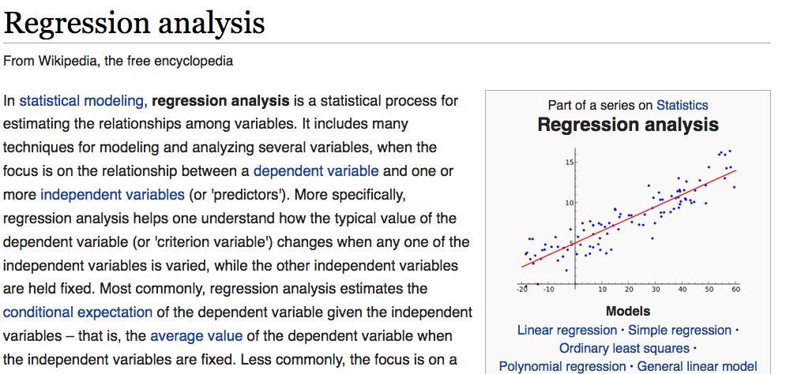
https://en.wikipedia.org/wiki/Regression_analysis

