Slide 1
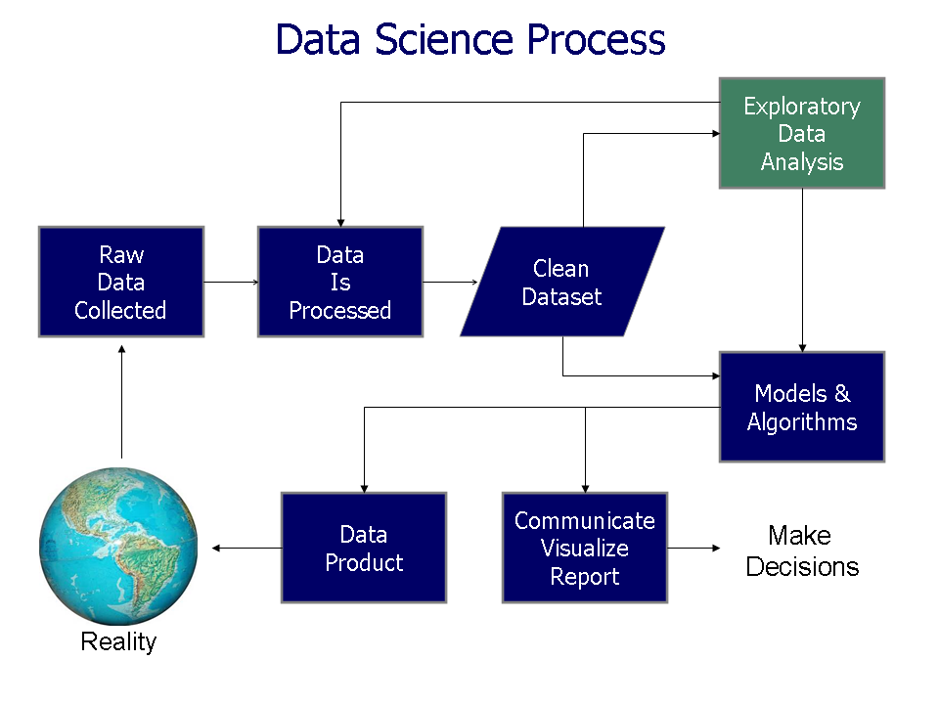
https://commons.wikimedia.org/wiki/File%3AData_visualization_process_v1.png

Slide 2
Resources for finding articles including articles about data sets:
https://mathscinet-ams-org.proxy.lib.uiowa.edu/mathscinet
https://www.ncbi.nlm.nih.gov/
https://arxiv.org/list/math/recent
https://scholar.google.com/
Can also search for excel filetype:
Duckduckgo: topic site:edu filetype:xls
Another great resource: https://www.kaggle.com/

Slide 3
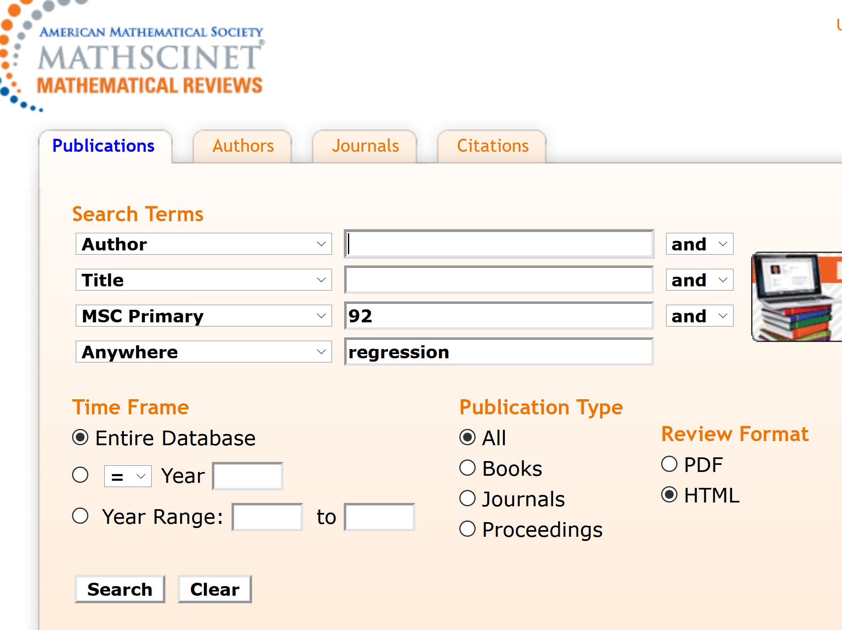
https://mathscinet-ams-org.proxy.lib.uiowa.edu/mathscinet

Slide 4
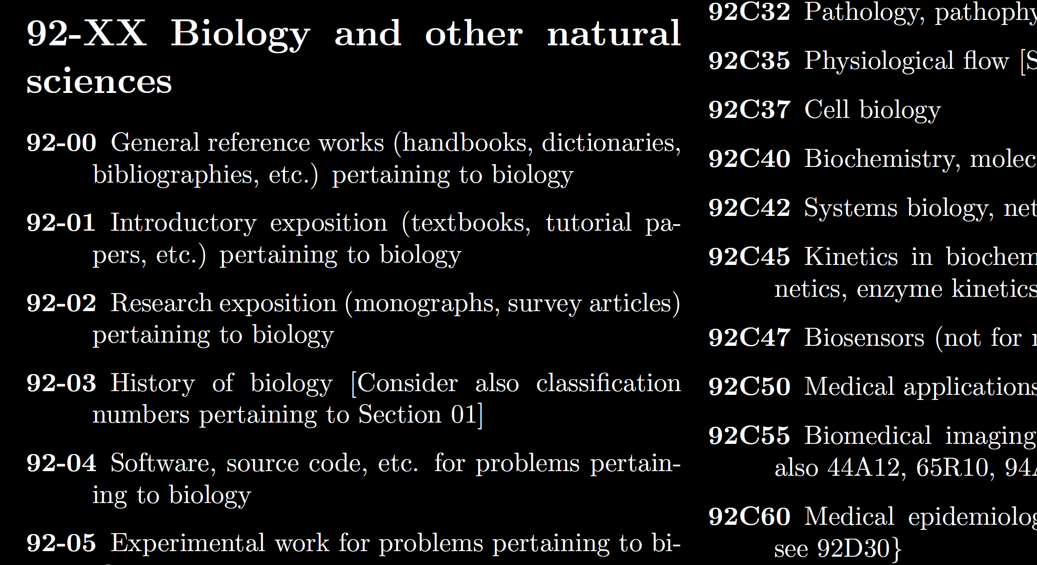
https://mathscinet-ams-org.proxy.lib.uiowa.edu/msnhtml/msc2020.pdf

Slide 5
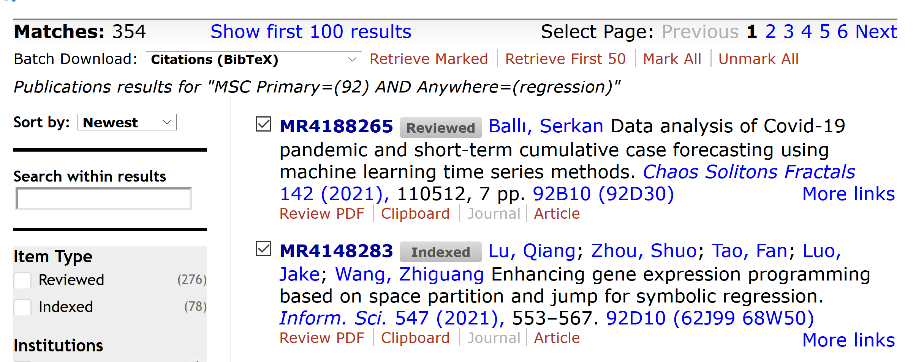
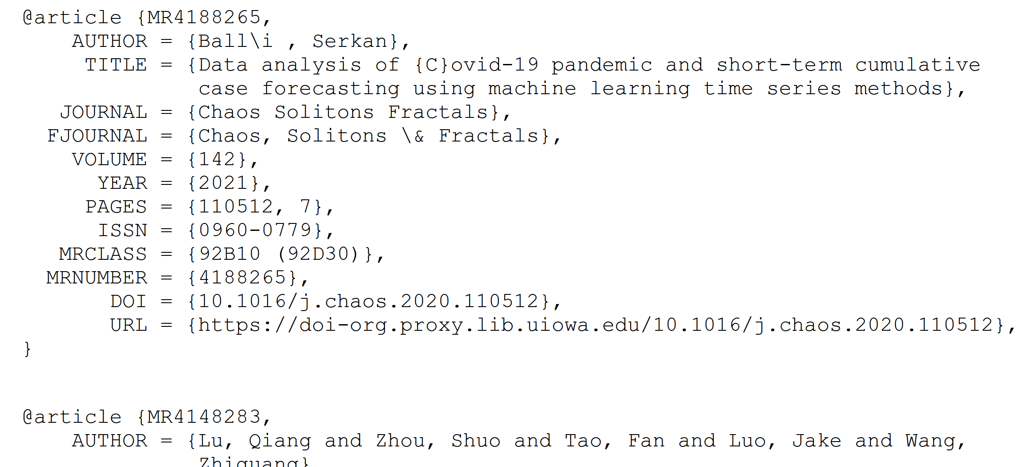

Slide 6

https://archive.ics.uci.edu/

Slide 7
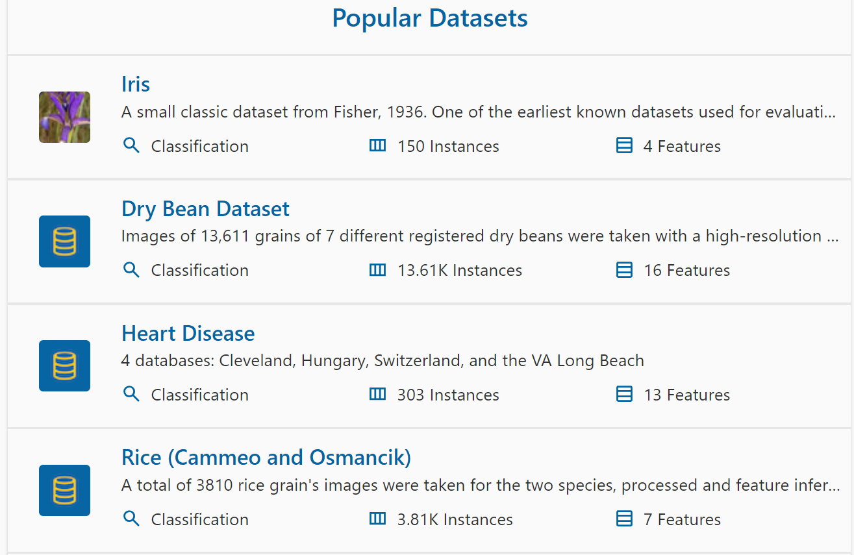
https://archive.ics.uci.edu/

Slide 8
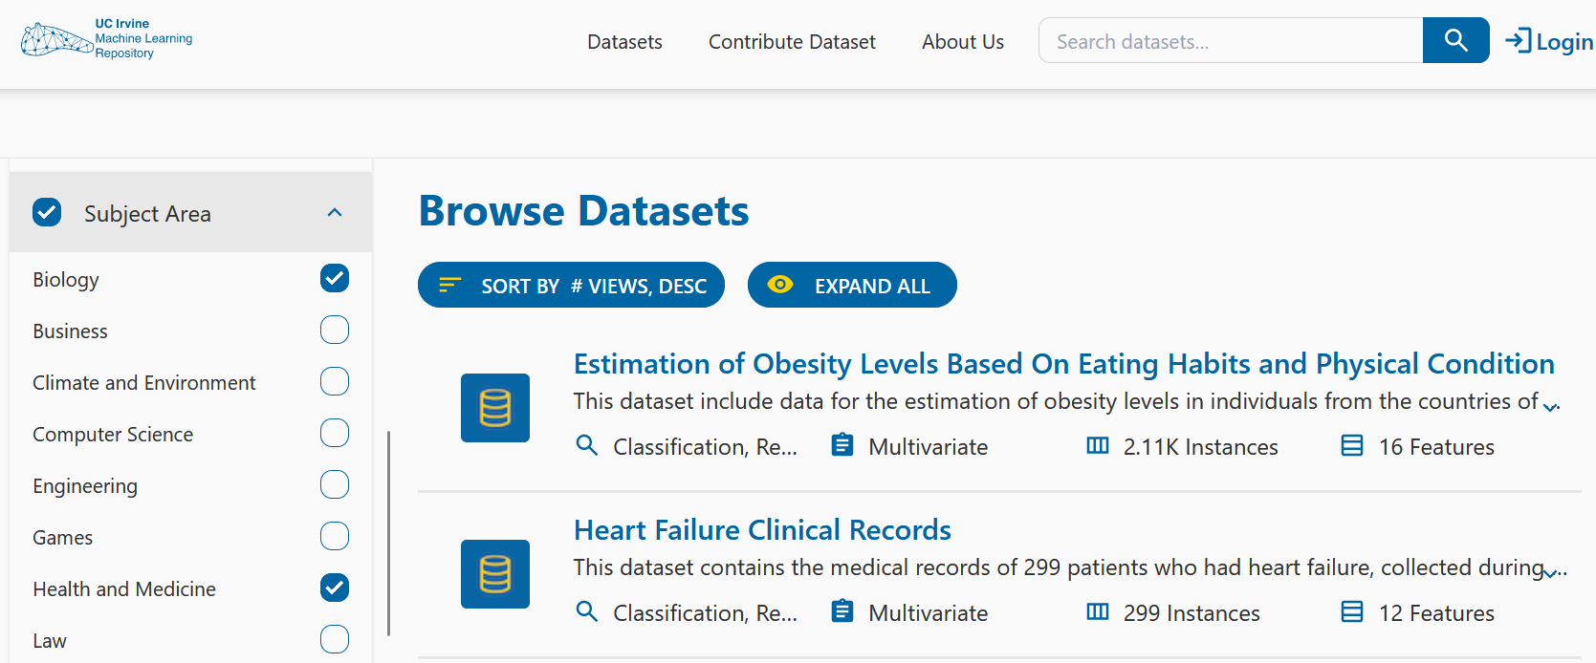
https://archive.ics.uci.edu/datasets?Task=Clustering&skip=0&take=25&sort=desc&orderBy=NumHits&search=&Area=Biology&Area=Health+and+Medicine

Slide 9
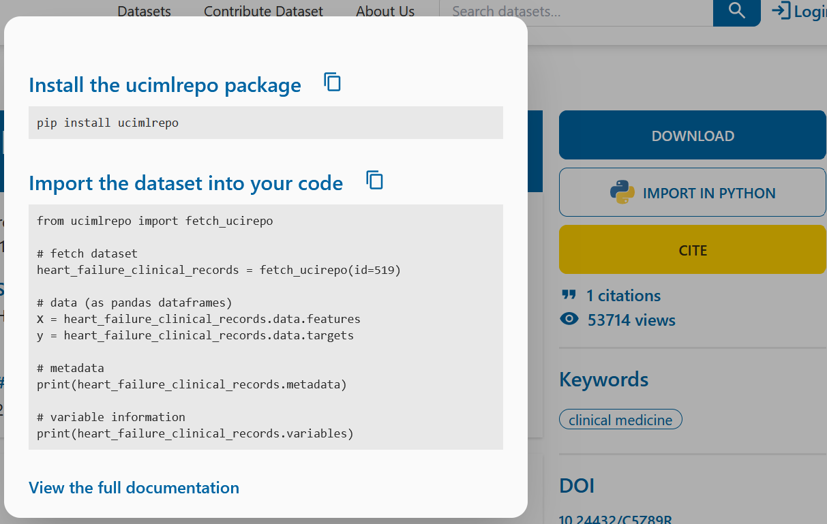
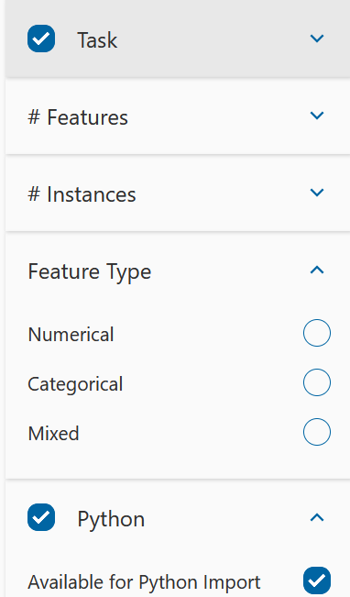
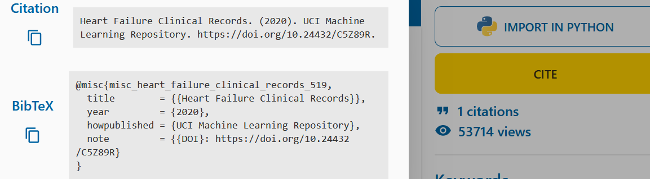

Slide 10
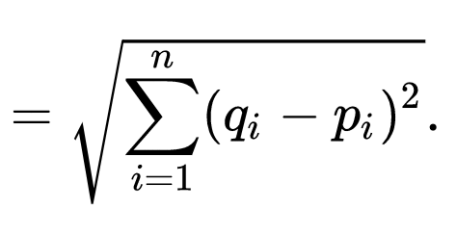

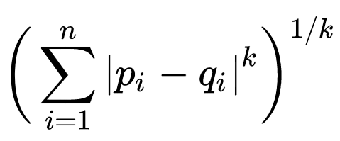

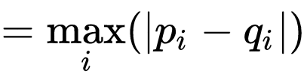
q
d(p, q) = ??
Euclidean
Minkowski distance
Chebyshev distance
5
4
p
3

Slide 11
q
d(p, q) = ??
Euclidean
5
Minkowski distance (k = 1)
7
Chebyshev distance
4
5
4
p
3

Slide 12
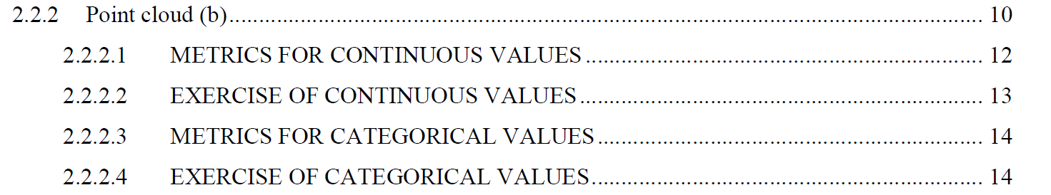
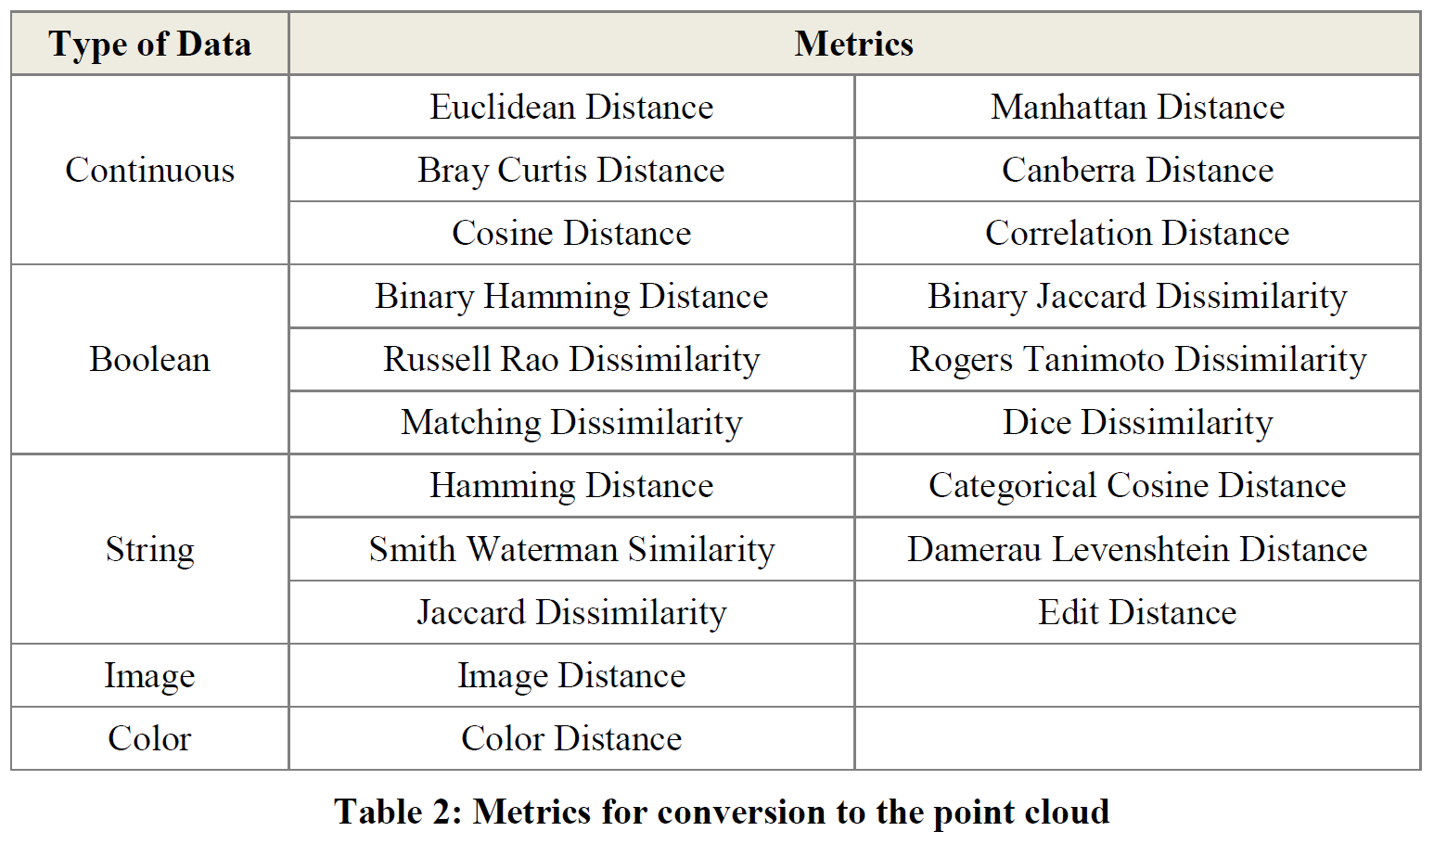
Section 2.2.2: Distances
http://www.bigdata.uni-frankfurt.de/wp-content/uploads/2015/10/
Evaluating-Ayasdi’s-Topological-Data-Analysis-For-Big-Data_HKim2015.pdf

Slide 13
Application 3 (in paper): Basketball
Data: rates (per minute played) of rebounds, assists, turnovers, steals, blocked shots, personal fouls, and points scored for 452 players.
➔ Input: 452 points in R⁷
For each player, we have a vector
= (r, a, t, s, b, f, p) in R⁷
Distance: variance normalized Euclidean distance.
Clustering: Single linkage.
( min , min , min , min , min , min , min )
rebounds assists turnovers steals blocked shots personal fouls points scored
http://www.nature.com/srep/2013/130207/srep01236/full/srep01236.html

Slide 14
Distance: variance normalized Euclidean distance.
( min , min , min , min , min , min , min )
rebounds assists turnovers steals blocked shots personal fouls points scored

Slide 15
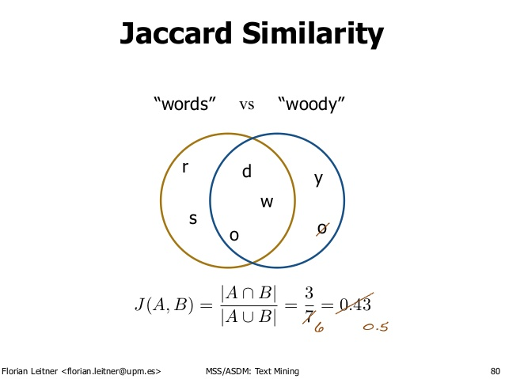
http://d-roger.com/2016/09/07/finding-similar-items-查找相似项/
Jacard Distance = 1 – J(A, B)

Slide 16
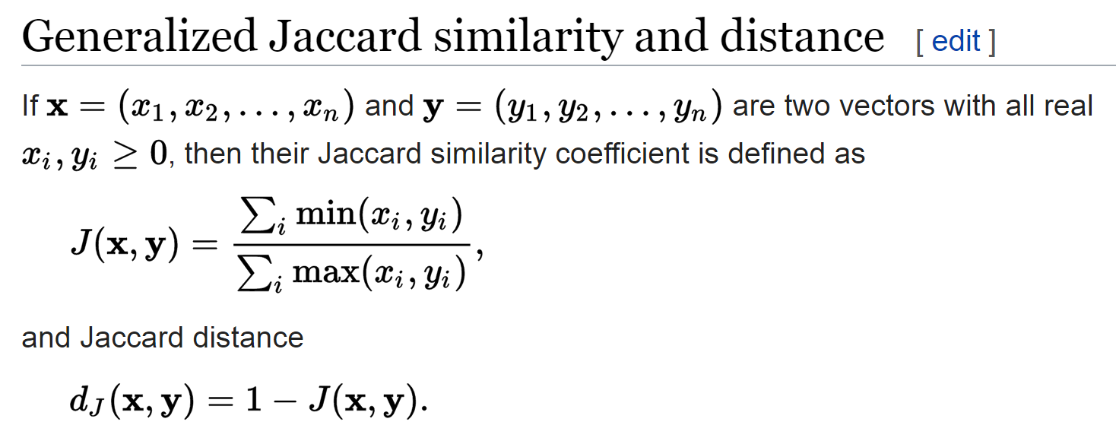
https://en.wikipedia.org/wiki/Jaccard_index

Slide 17
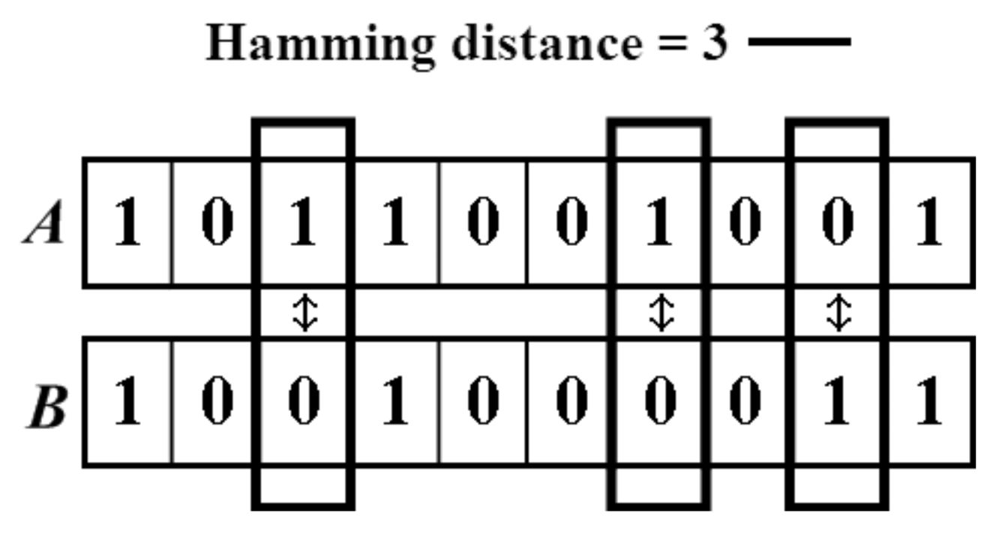

https://people.rit.edu/rmb5229/320/project3/hamming.html
http://rosalind.info/glossary/hamming-distance/
Hamming Distance = 7

Slide 18
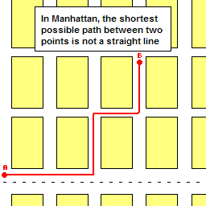
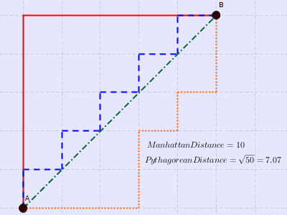

http://www.joachimdespland.com/mammoth.html
http://bloggity.nurdz.com/gamedev-math/manhattan/
http://www.improvedoutcomes.com/docs/WebSiteDocs/Clustering/Clustering_Parameters/Manhattan_Distance_Metric.htm

Slide 19
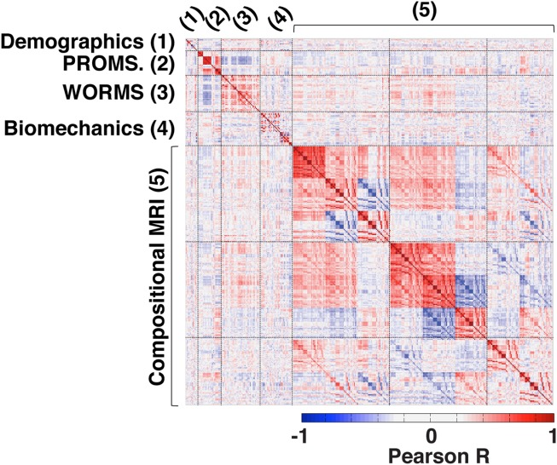
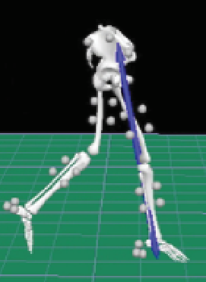
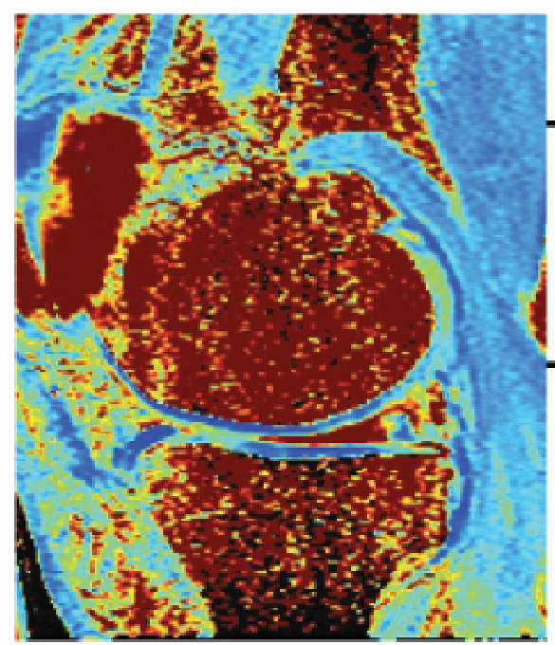
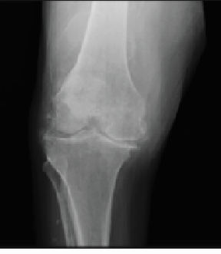

https://onlinelibrary.wiley.com/doi/full/10.1002/jmri.25750

Slide 20
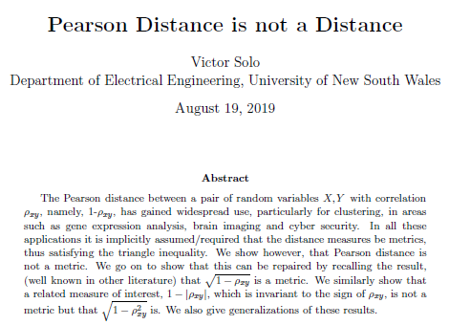
https://arxiv.org/abs/1908.06029

Slide 21
Section 2.2.2: Distances
http://www.bigdata.uni-frankfurt.de/wp-content/uploads/2015/10/
Evaluating-Ayasdi’s-Topological-Data-Analysis-For-Big-Data_HKim2015.pdf

Slide 22
In R^{n}
If n small, (variance normalized) Euclidean distance often makes sense
If n is large, consider Chebyshev distance
or performing PCA first to project data into R^{d}, for small d
and then using Euclidean distance
Chebyshev distance:

Slide 23
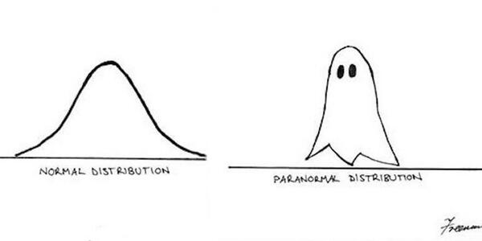
Normality
How to assess/detect it
What to do if you have non-normal data
https://fs.wp.odu.edu/abraitma/workshops/

Slide 24
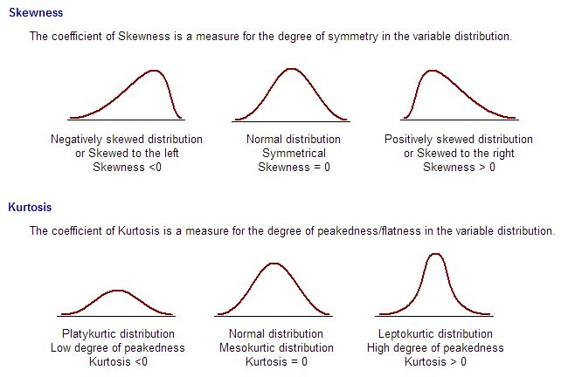
Assessing Normality
Skewness and Kurtosis
Negatively Skewed
Normal
Positively Skewed
Platykurtic
Normal
Leptokurtic
https://fs.wp.odu.edu/abraitma/workshops/

Slide 25
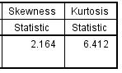
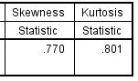

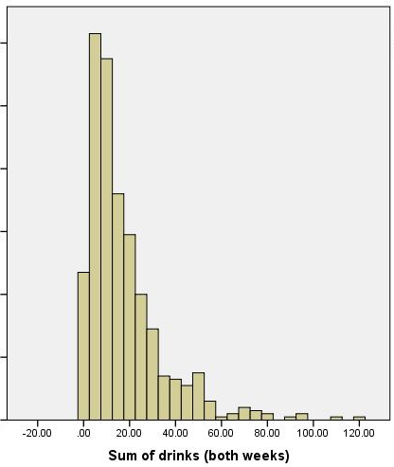
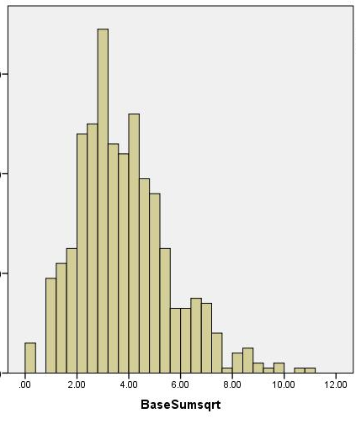
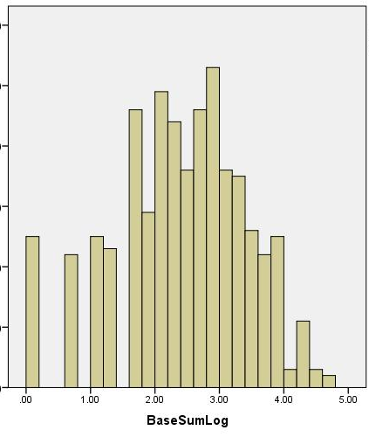
Non-Normality: Transformation
Sum of drinks past 2 weeks: positively skewed
Original square root log
https://fs.wp.odu.edu/abraitma/workshops/

Slide 26
What to do about Missing Data
Delete incomplete cases?
Complete Case Analysis (aka Listwise Deletion)
  Delete everyone from your sample who has missing data
  Final sample includes only individuals with all data
Available Case Analysis (aka Pairwise Deletion)
  Exclude people from relevant analyses who have missing data
  E.g., If missing on depressive symptoms, then missing from regression that examines influence of meditation on depressive symptoms
    Present for regression that examines influence of meditation on anxiety
https://fs.wp.odu.edu/abraitma/workshops/

Slide 27

Outliers
How to identify them
What to do about them
Start with univariate (one variable at a time)
Touch on multivariate
https://fs.wp.odu.edu/abraitma/workshops/

Slide 28
Outliers
Why do we care?
  Have a stronger influence on the data
  Can influence results of study
r = -.426
r = -.567
Same data, changed one value from 37 to 150
https://fs.wp.odu.edu/abraitma/workshops/

Slide 29
Datalogs
Date can be helpful, but not required
  Who did it an be very helpful if there are multiple hands in the project
ACTIVITIES are required, with specific details
  What you did
  Why you did it
Missing data
  What percentage for data? Each variable?
  How did you address it?
Outliers
  How many for each variable?
  Old and new values?
Recoding
  What dummy codes did you create? Why?
  What composites scores did you create? Means or sums or something else?
    Did you remember to reverse score??
Did you check linearity? Normality?
  Confirmed for which variables?
  What adjustments were made for which variables (if any)?
https://fs.wp.odu.edu/abraitma/workshops/

Slide 30
Possible Partial data pipeline
0.) Download data (eg from http://archive.ics.uci.edu/ml/index.php or elsewhere
Data is often an excel file where rows = data points
columns = variables
1.) Remove missing data (remove data points = rows with missing values)
2.) Calculate statistics (mean, median, sd, etc) and also visualize the data including with PCA
3.) Remove outliers ?? (remove data points = rows with unusual values)
4.) Remove variables that have little effect (remove columns with low variance)
Warning: Sometimes variables with low variance contain useful information
Ex: multiple small changes in speed could indicate weaving in and out of
traffic = bad driving = increased insurance cost.
5.) “Normalize” the data ??
6.) Calculate statistics (mean, median, sd, etc) and also visualize the data including with PCA

Slide 31
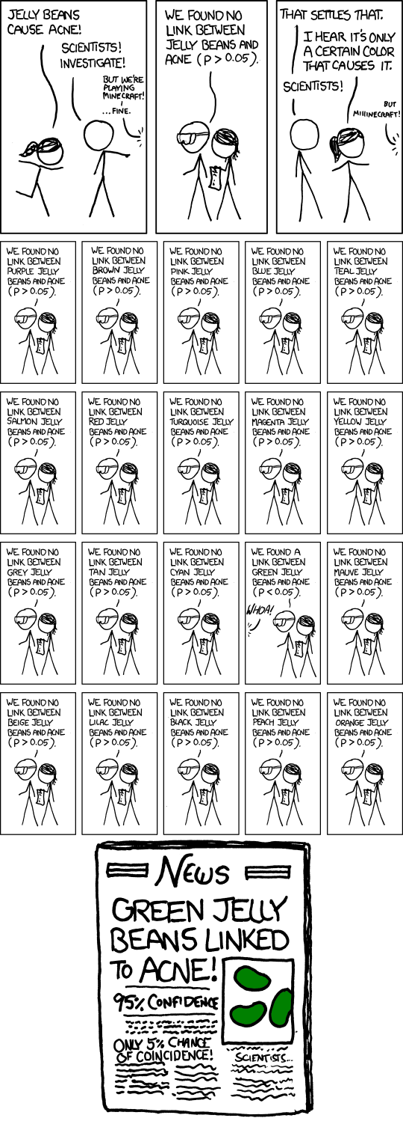
False Positives will occur
https://xkcd.com/882/

Slide 32
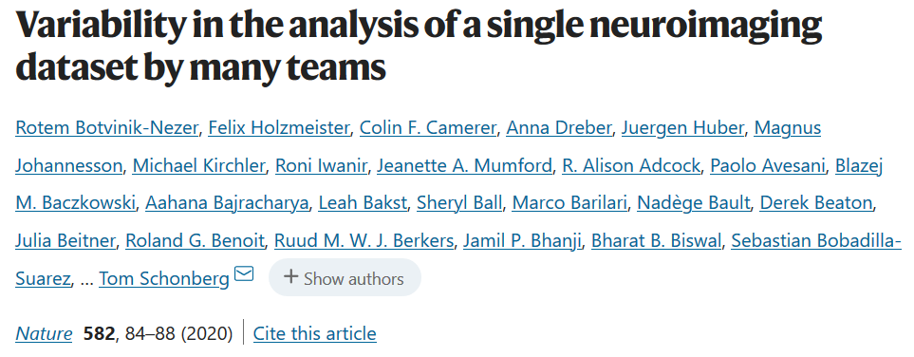
Even if you do everything right, False Positives will occur
Moreover the sample size of most biological data sets is small.
https://www.nature.com/articles/s41586-020-2314-9
“Here we assess the effect of this flexibility on the results of functional magnetic resonance imaging by asking 70 independent teams to analyse the same dataset, testing the same 9 ex-ante hypotheses”
“Our findings show that analytical flexibility can have substantial effects on scientific conclusions,”

Slide 33


https://blogs.scientificamerican.com/talking-back/new-study-neuroscience-research-gets-an-f-for-reliability/
“The study—led by researchers at the University of Bristol—looked at 48 neuroscience meta-analyses (studies of studies) from 2011 and found that their statistical power reaches only 21 percent, meaning that there is only about a one in five chance that any effect being investigated by the researchers—whether a compound acts as an anti-depressant in rat brains, for instance—will be discovered. Anything that does turn up, moreover, is more likely to be false. The low power stems from the small size of the studies and minuscule effects.”
“other areas of biology, which also suffer from the same phenomenon—he cited studies on cancer and cardiology that are powered at 34 percent. “

Slide 34
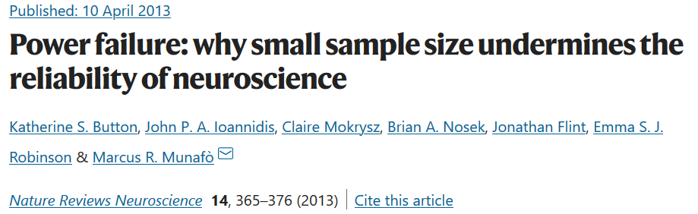
“low power also reduces the likelihood that a statistically significant result reflects a true effect”
It has been claimed and demonstrated that many (and possibly most) of the conclusions drawn from biomedical research are probably false¹. A central cause for this important problem is that researchers must publish in order to succeed, and publishing is a highly competitive enterprise, with certain kinds of findings more likely to be published than others. Research that produces novel results, statistically significant results (that is, typically p < 0.05) and seemingly 'clean' results is more likely to be published^{2,3}. As a consequence, researchers have strong incentives to engage in research practices that make their findings publishable quickly, even if those practices reduce the likelihood that the findings reflect a true (that is, non-null) effect⁴. Such practices include using flexible study designs and flexible statistical analyses and running small studies with low statistical power^{1,5}. A simulation of genetic association studies showed that a typical dataset would generate at least one false positive result almost 97% of the time⁶, and two efforts to replicate promising findings in biomedicine reveal replication rates of 25% or less^{7,8}. Given that these publishing biases are pervasive across scientific practice, it is possible that false positives heavily contaminate the neuroscience literature as well, and this problem may affect at least as much, if not even more so, the most prominent journals^{9,10}.

Slide 35

https://www.sciencedirect.com/science/article/pii/S089662731200428X

Slide 36
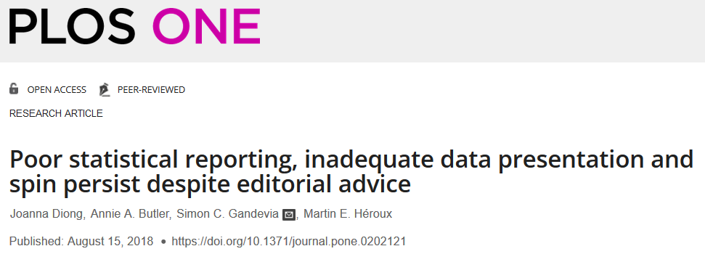
https://journals.plos.org/plosone/article?id=10.1371/journal.pone.0202121

Slide 37
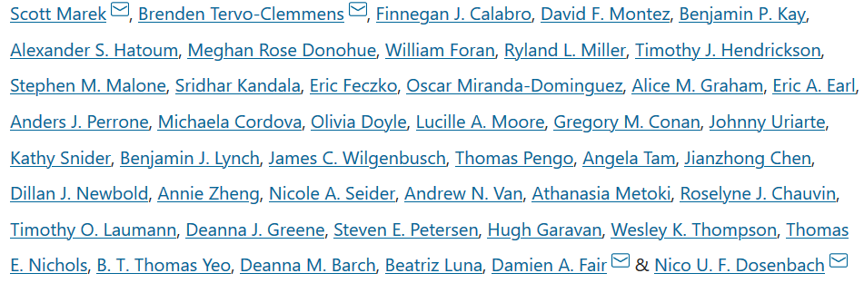
https://www.nature.com/articles/s41586-022-04492-9
Reproducible brain-wide association studies require thousands of individuals
Nature volume 603,
pages 654–660 (2022)
Magnetic resonance imaging (MRI) has transformed our understanding of the human brain through well-replicated mapping of abilities to specific structures (for example, lesion studies) and functions^{1,2,3} (for example, task functional MRI (fMRI)). Mental health research and care have yet to realize similar advances from MRI. A primary challenge has been replicating associations between inter-individual differences in brain structure or function and complex cognitive or mental health phenotypes (brain-wide association studies (BWAS)). Such BWAS have typically relied on sample sizes appropriate for classical brain mapping⁴ (the median neuroimaging study sample size is about 25), but potentially too small for capturing reproducible brain–behavioural phenotype associations^{5,6}. Here we used three of the largest neuroimaging datasets currently available—with a total sample size of around 50,000 individuals—to quantify BWAS effect sizes and reproducibility as a function of sample size. BWAS associations were smaller than previously thought, resulting in statistically underpowered studies, inflated effect sizes and replication failures at typical sample sizes. As sample sizes grew into the thousands, replication rates began to improve and effect size inflation decreased. More robust BWAS effects were detected for functional MRI (versus structural), cognitive tests (versus mental health questionnaires) and multivariate methods (versus univariate). Smaller than expected brain–phenotype associations and variability across population subsamples can explain widespread BWAS replication failures. In contrast to non-BWAS approaches with larger effects (for example, lesions, interventions and within-person), BWAS reproducibility requires samples with thousands of individuals.

Slide 38
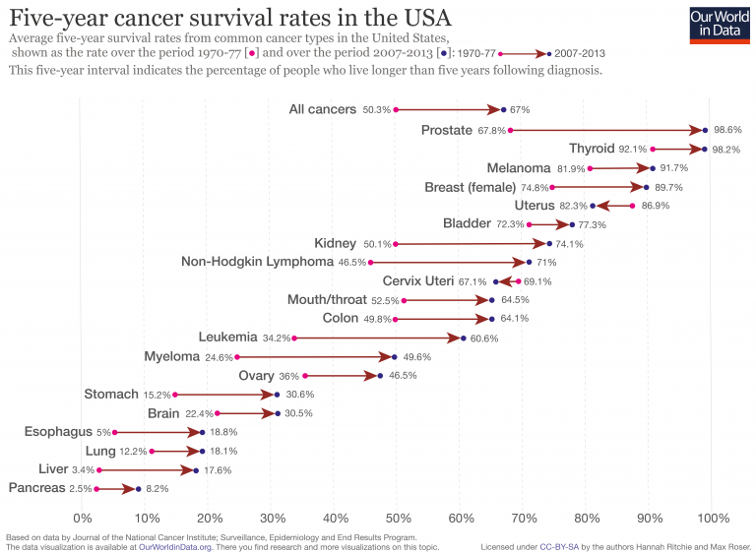
https://ourworldindata.org/cancer-death-rates-are-falling-five-year-survival-rates-are-rising
Despite the fact that we might not know what we are doing, we are making progress where some progress is due to research and others to changes in behavior.

Slide 39
Dimensionality Reduction: Given dataset D R^{N}
Want: embedding f: D → R^{n} where n << N
    which “preserves” the structure of the data.
Many reduction methods:
f₁: D → R, f₂: D → R, … f_{n}: D → R
(f₁, f₂, … f_{n}): D → R^{n}
Many are linear, M: R^{N} → R^{n}, Mx = y
But there are also non-linear dimensionality reduction algorithms.
U

Slide 40
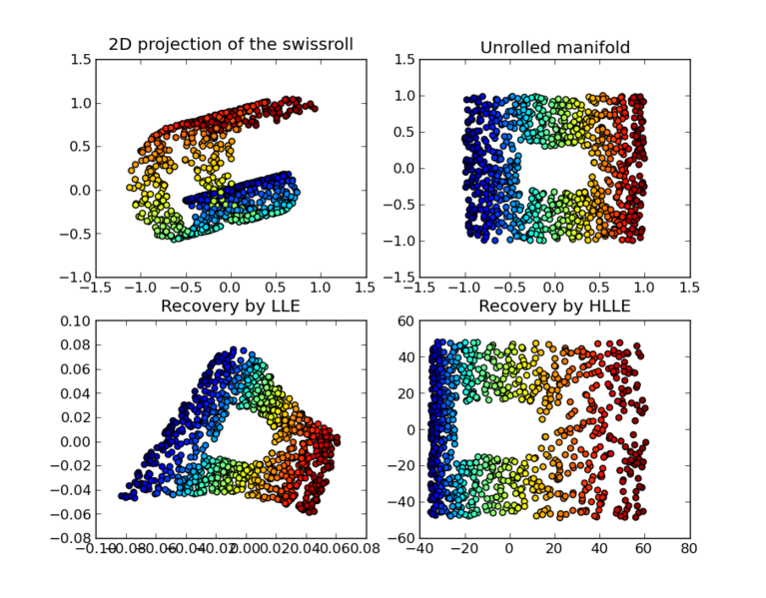
https://en.wikipedia.org/wiki/Nonlinear_dimensionality_reduction

Slide 41
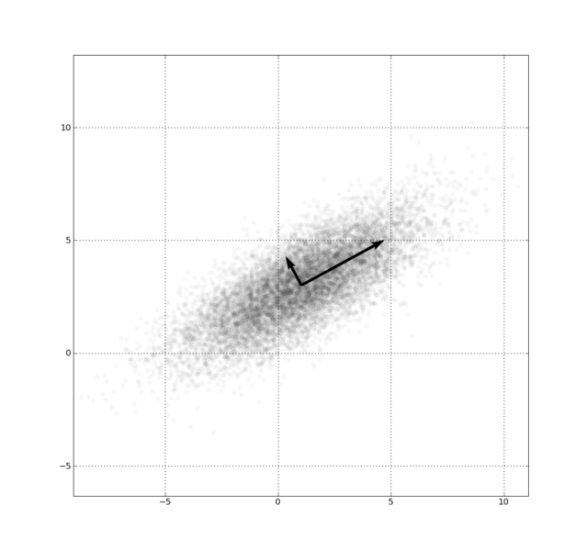
Example: Principle component analysis (PCA)
http://en.wikipedia.org/wiki/File:GaussianScatterPCA.png

Slide 42
Why use PCA in data analysis?
Reduce dimension.
Visualization.
Fewer variables = less memory (data compression).
Fewer variables = faster computing time (usually).

Slide 43
Why use PCA in data analysis?
Consider the points (0, 0, …, 0), (1, 0, …, 0), (10, 0, …, 0)
Add noise to first point (0, 0, …, 0) → (0, 1, …, 1)
In R¹⁰⁰, d((0, 1, …, 1), (1, 0, …, 0)) = 10 > 9.
Add small noise to first point (0, 0, …, 0) → (0, 0.1, …, 0.1)
In R^{39,900}, d((0, 0.1, …, 0.1), (1, 0, …, 0)) = 20 > 9.
0 1 10

Slide 44
In R^{n}
If n small, Euclidean distance often makes sense
If n is large, consider Chebyshev distance or
performing PCA first to project data into R^{d}, for small d
and then using Euclidean distance
Chebyshev distance:

Slide 45
Example: Principle component analysis (PCA)
http://en.wikipedia.org/wiki/File:GaussianScatterPCA.png

Slide 46
Principal components
1. principal component (PC1)
  The eigenvalue with the largest absolute value will indicate that the data have the largest variance along its eigenvector, the direction along which there is greatest variation
2. principal component (PC2)
  the direction with maximum variation left in data, orthogonal to the 1. PC
In general, only few directions manage to capture most of the variability in the data.
www.cse.buffalo.edu/faculty/azhang/data-mining/pca.ppt

Slide 47
Example: Principle component analysis (PCA)
x_{i} → z_{i} = linear combination of x_{i}
http://en.wikipedia.org/wiki/File:GaussianScatterPCA.png

Slide 48
If you do NOT want to change your basis, you can calculate standard deviation for each variable and only keep the variables with high standard deviation.
You can then visualize your dataset using PCA.

Slide 49
PCA on all Genes
Leukemia data, precursor B and T
Plot of 34 patients, dimension of 8973 genes reduced to 2
www.cse.buffalo.edu/faculty/azhang/data-mining/pca.ppt

Slide 50
PCA on 100 top significant genes
Leukemia data, precursor B and T
Plot of 34 patients, dimension of 100 genes reduced to 2
www.cse.buffalo.edu/faculty/azhang/data-mining/pca.ppt

