Slide 1
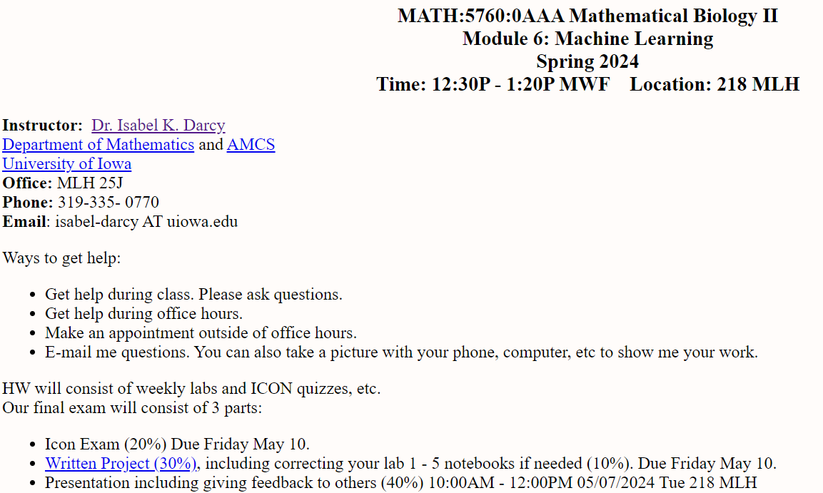
http://homepage.math.uiowa.edu/~idarcy/COURSES/MB/SPRING24/5760.html
https://notebooks.hpc.uiowa.edu/

Slide 2
Machine Learning overview Chapter 19
14.1
https://www.csee.umbc.edu/courses/graduate/671/fall20/notes/14_machine_learning/14_1_intro.pptx

Slide 3
So What Is Machine Learning?
Automating automation
Getting computers to program themselves
Writing software is the bottleneck
Let the data do the work instead!
https://courses.cs.washington.edu/courses/cse446/09wi/slides/intro.ppt

Slide 4
Traditional Programming
Machine Learning
Data
Computer
Output
Program
Data
Computer
Program
Output
https://courses.cs.washington.edu/courses/cse446/09wi/slides/intro.ppt

Slide 5
Traditional Programming
Machine Learning
Data
Computer
Output
Program
Data
Computer
Program
Output
Or function f(x): Data → ?
https://courses.cs.washington.edu/courses/cse446/09wi/slides/intro.ppt

Slide 6
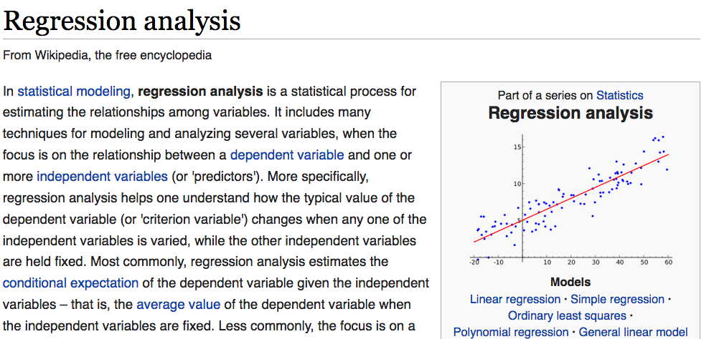
https://en.wikipedia.org/wiki/Regression_analysis

Slide 7
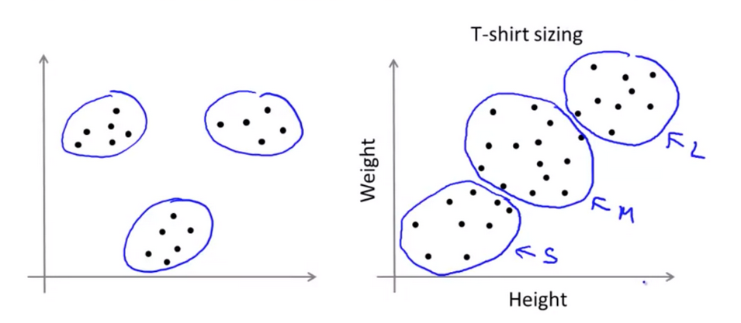
Clustering: Grouping “like” objects
https://hackerwins.github.io/2019-07-10/cs229a-week8
From Andrew Ng’s Machine Learning course

Slide 8
Magic?
No, more like gardening
Seeds = Algorithms
Nutrients = Data
Gardener = You
Plants = Programs
https://courses.cs.washington.edu/courses/cse446/09wi/slides/intro.ppt

Slide 9
What is Machine Learning?
Machine Learning By: Jennie E. Brand, Bernard Koch & Jiahui Xu
https://methods-sagepub-com.proxy.lib.uiowa.edu/foundations/machine-learning
“Machine learning is a computational and statistical approach to extracting patterns and trends from data (Maini & Sabri, 2017). A machine learning algorithm is also defined as a computer program that learns from experience with data with respect to some class of tasks and improves its performance with greater experience (Mitchell, 1997).”
Hands-on Scikit-Learn for Machine Learning Applications by David Paper
https://link-springer-com.proxy.lib.uiowa.edu/book/10.1007%2F978-1-4842-5373-1
Machine learning is getting computers to program themselves. We use algorithms to
make this happen. An algorithm is a set of rules used to calculate or problem solve
with a computer.
Machine learning advocates create, study, and apply algorithms to improve
performance on data-driven tasks. They use tools and technology to answer questions
about data by training a machine how to learn.

Slide 10
Types of Learning
Supervised (inductive) learning
Training data includes desired outputs
Unsupervised learning
Training data does not include desired outputs
Semi-supervised learning
Training data includes a few desired outputs
Reinforcement learning
Rewards from sequence of actions
https://courses.cs.washington.edu/courses/cse446/09wi/slides/intro.ppt

Slide 11
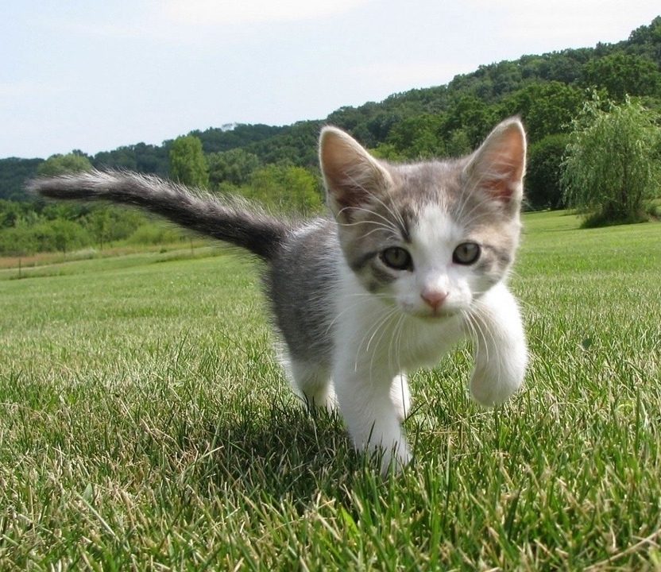
Supervised vs Reinforcement vs Unsupervised Learning
Supervised Learning
Data: (x, y)
x is data, y is label
Goal: Learn a function to map x → y
Examples: Classification, regression, object detection, semantic segmentation, image captioning, etc.
Cat
Classification
This image is CC0 public domain
https://www.cc.gatech.edu/classes/AY2020/cs7643_fall/slides/L23_generative2.pptx
Slide Credit: Fei-Fei Li, Justin Johnson, Serena Yeung, CS 231n
Notes:
So far talked about SL
Type of problem where have Data X, Labels Y, goals is to learn a function mapping from x to y

Slide 12
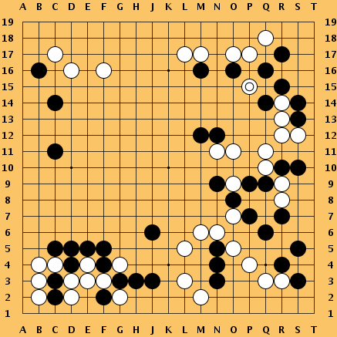
Supervised vs Reinforcement vs Unsupervised Learning
Reinforcement Learning
Given: (e, r)
Environment e, Reward function r (evaluative feedback)
Goal: Maximize expected reward
Examples: Robotic control, video games, board games, etc.
https://www.cc.gatech.edu/classes/AY2020/cs7643_fall/slides/L23_generative2.pptx
Slide Credit: Fei-Fei Li, Justin Johnson, Serena Yeung, CS 231n
Notes:
So far talked about SL
Type of problem where have Data X, Labels Y, goals is to learn a function mapping from x to y

Slide 13
Supervised vs Reinforcement vs Unsupervised Learning
Unsupervised Learning
Data: x
Just data, no labels!
Goal: Learn some underlying hidden structure of the data
Examples: Clustering, dimensionality reduction, feature learning, density estimation, etc.
K-means clustering
This image is CC0 public domain
https://www.cc.gatech.edu/classes/AY2020/cs7643_fall/slides/L23_generative2.pptx
Slide Credit: Fei-Fei Li, Justin Johnson, Serena Yeung, CS 231n
Notes:
Clustering - find groups within the data that are similar through some metric

Slide 14
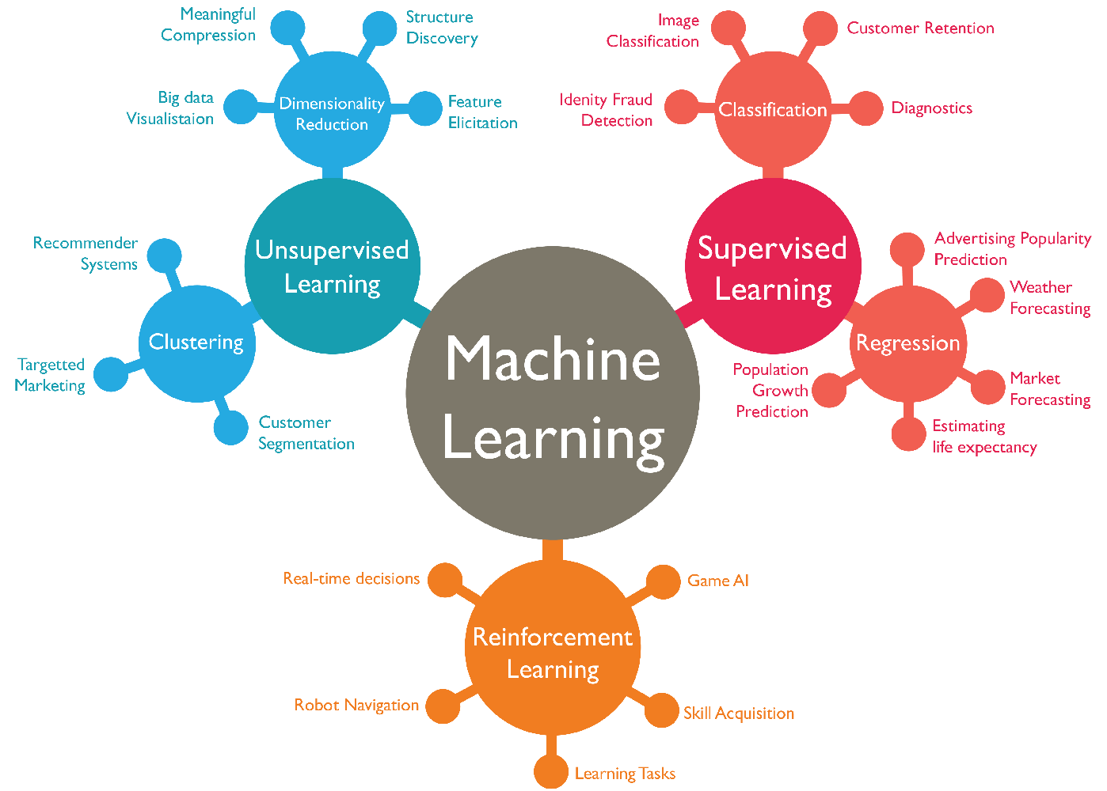
https://www.favouriteblog.com/wp-content/uploads/2017/07/Types-of-Learning.png

Slide 15
Supervised vs Reinforcement vs Unsupervised Learning
Supervised Learning
Data: (x, y)
x is data, y is label
Goal: Learn a function to map x → y
Examples: Classification, regression, object detection, semantic segmentation, image captioning, etc.
Unsupervised Learning
Data: x
Just data, no labels!
Goal: Learn some underlying hidden structure of the data
Examples: Clustering, dimensionality reduction, feature learning, density estimation, etc.
https://www.cc.gatech.edu/classes/AY2020/cs7643_fall/slides/L23_generative2.pptx
Slide Credit: Fei-Fei Li, Justin Johnson, Serena Yeung, CS 231n
Notes:
To summarize differences, sup uses labeled data to learn a function mapping from x to y
Unsup uses no labels, tries to learn some underlying hidden structure of the data, whether grouping, axes of variation, underlying density

Slide 16
https://en.wikipedia.org/wiki/Regression_analysis

Slide 17
http://jcs.biologists.org/content/121/11/1771
I'd like to suggest that our Ph.D. programs often do students a disservice in two ways. First, I don't think students are made to understand how hard it is to do research. And how very, very hard it is to do important research. It's a lot harder than taking even very demanding courses. What makes it difficult is that research is immersion in the unknown. We just don't know what we're doing. We can't be sure whether we're asking the right question or doing the right experiment until we get the answer or the result.

Slide 18
False Positives will occur
https://xkcd.com/882/

Slide 19
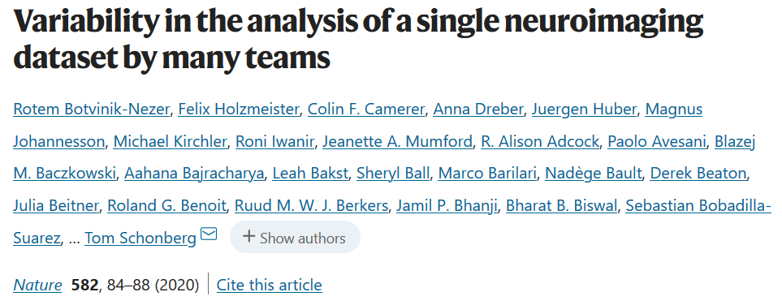
Even if you do everything right, False Positives will occur
Moreover the sample size of most biological data sets is small.
https://www.nature.com/articles/s41586-020-2314-9
“Here we assess the effect of this flexibility on the results of functional magnetic resonance imaging by asking 70 independent teams to analyse the same dataset, testing the same 9 ex-ante hypotheses”
“Our findings show that analytical flexibility can have substantial effects on scientific conclusions,”

Slide 20
http://homepage.math.uiowa.edu/~idarcy/COURSES/MB/SPRING24/5760.html

Slide 21
Some journals require an author’s contributions section. For example:
Authors' contributions
CM and JN contributed to the mathematical analysis for applying the coloring invariant. JN also drafted significant portions of the sections The coloring invariants, Tangle generation, Checking the coloring invariants . AP, JS, and TT developed the software implementing the coloring invariant calculations. RM contributed to the Non-drawable section and is responsible for the subroutine which determines if a matrix corresponds to a drawable tangle. He was assisted by ND and JS. JC, ND, SM, and JS developed equivalence moves which were implemented by ND, RM, and JS. ID conceived of and oversaw this project, drafted much of the manuscript, and contributed to the mathematical and software development. All authors read and approved the final manuscript.
https://link.springer.com/article/10.1186/1471-2105-7-435
each student will be graded individually

Slide 22
Consider publishing your work in either a research journal or a journal aimed at students.
There is an incentive ($250 for paper submitted; $250 for paper published) but the paper must be in an Q1 or Q2 journal. Undergrad journals don't qualify.
For journal rankings see: https://www.scimagojr.com/
Avoid publishing in fake journals.

Slide 23
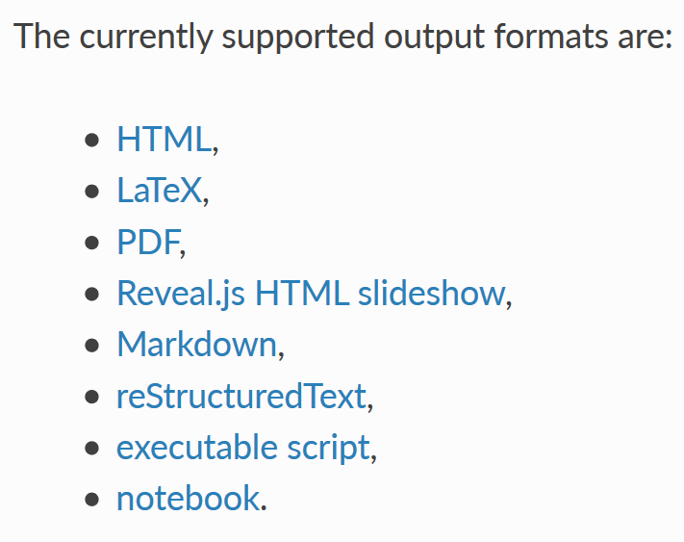
A jupyter notebook can be converted into a variety of formats per
https://nbconvert.readthedocs.io/en/latest/usage.html
You can use both Jupyter notebook and latex plus cut and paste.
Consider using different names for notebook latex output and your project writeup so you don’t accidently write over your project writeup.

Slide 24
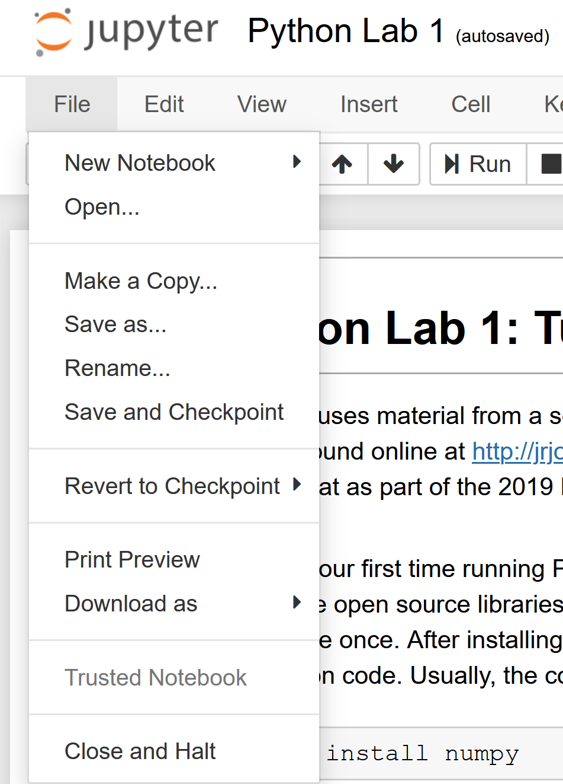
For your final exam written project, you will turn in your weekly labs into a draft of a paper.
Do not spend too much time on formatting.
You must use a bib file.

Slide 25
http://www.simplehtmlguide.com/cheatsheet.php

Slide 26
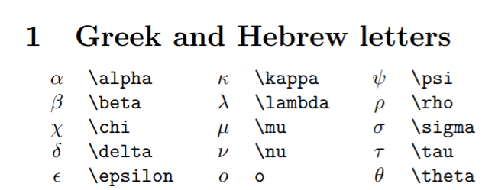
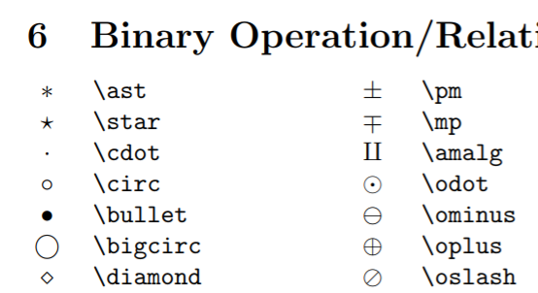
http://reu.dimacs.rutgers.edu/Symbols.pdf
Put latex command between $ signs,e.g.: $\alpha$

Slide 27
https://writingcenter.uiowa.edu/#services
Consider e-mailing your writing on a weekly basis

Slide 28
https://speakingcenter.uiowa.edu/about-us

Slide 29
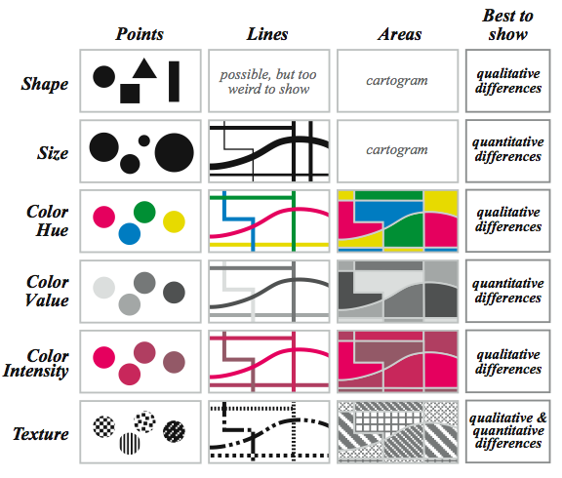
Visual variables for quantitative phenomena
Krygier and Wood, 2002
For poster use thick lines and think about accessibility.
Slide modified from: https://drive.google.com/drive/folders/0B8M300Hbnx9leDBERlhkS1JPZkE

Slide 30
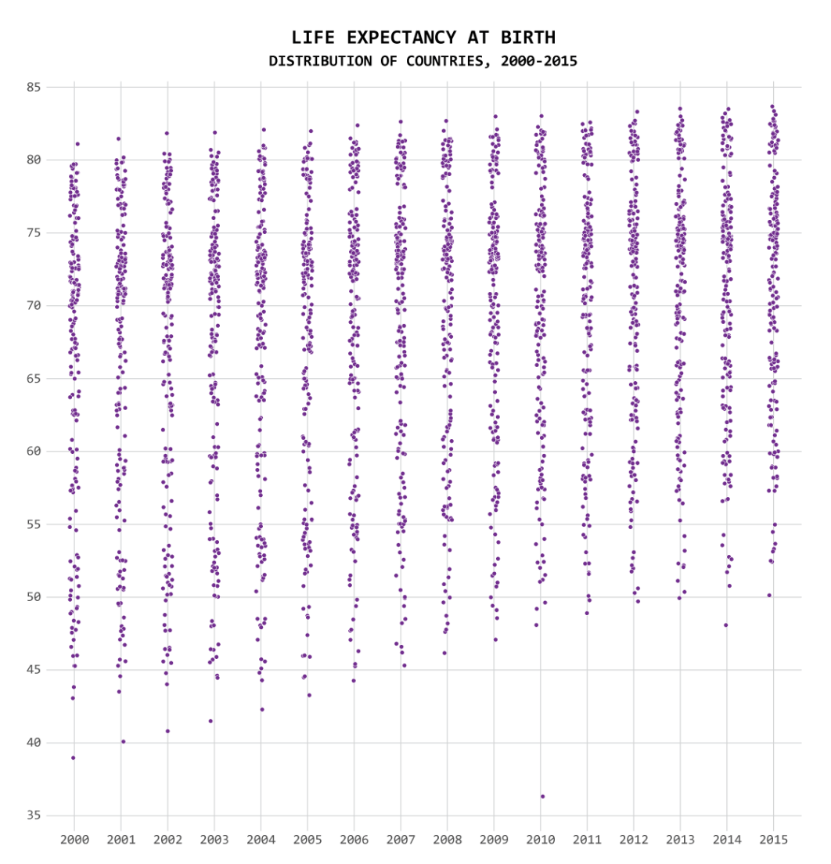
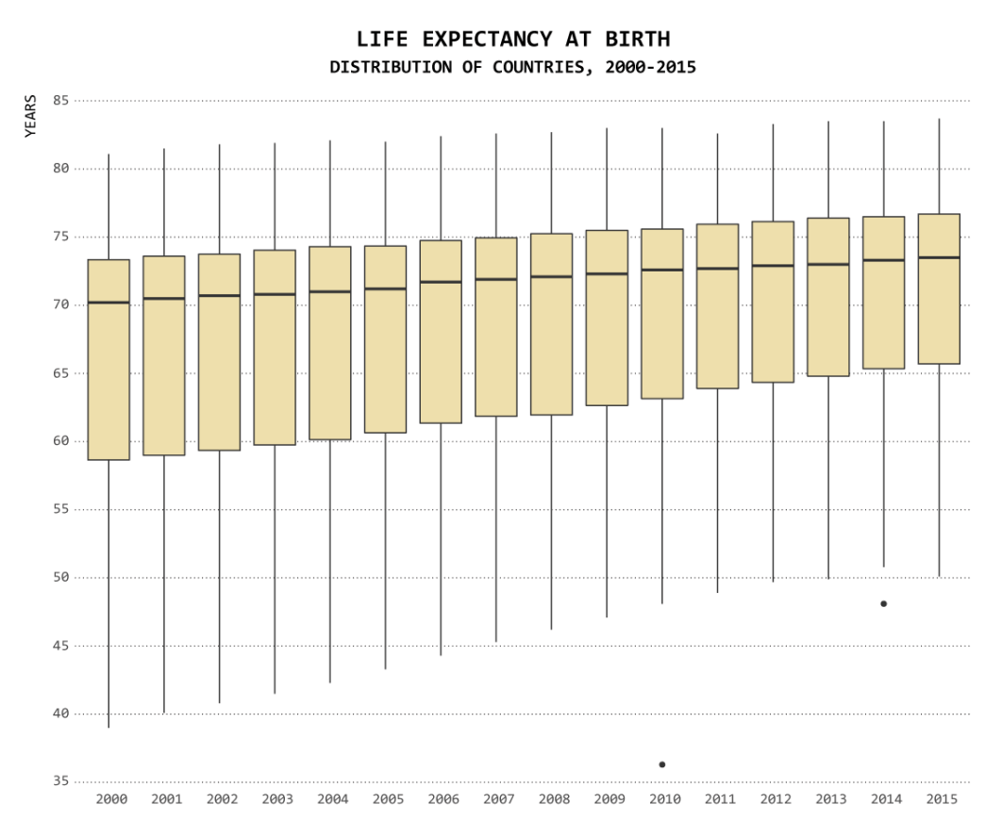
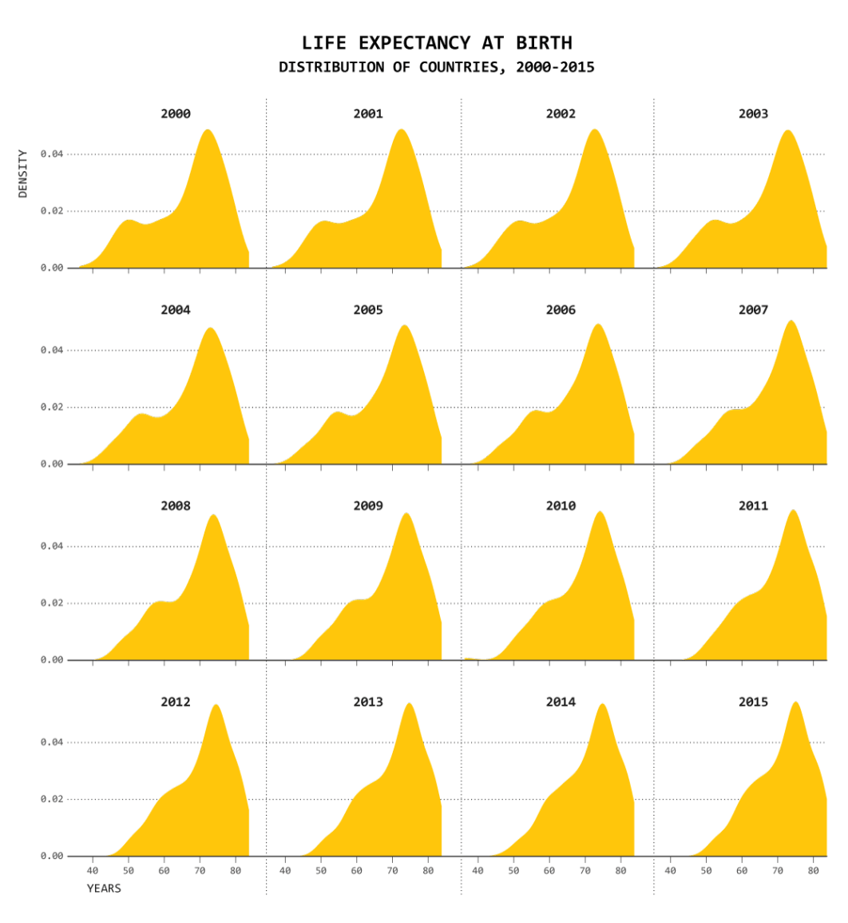
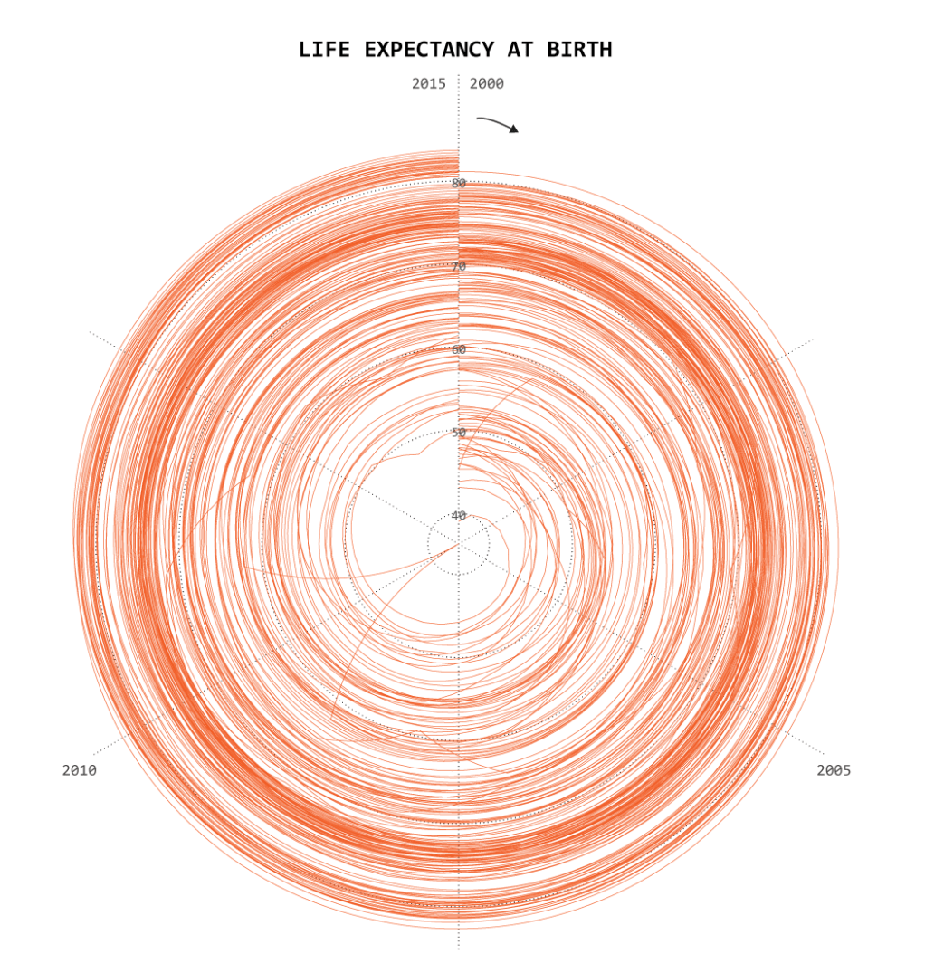
One Dataset, Visualized 25 Ways
https://flowingdata.com/2017/01/24/one-dataset-visualized-25-ways/

Slide 31
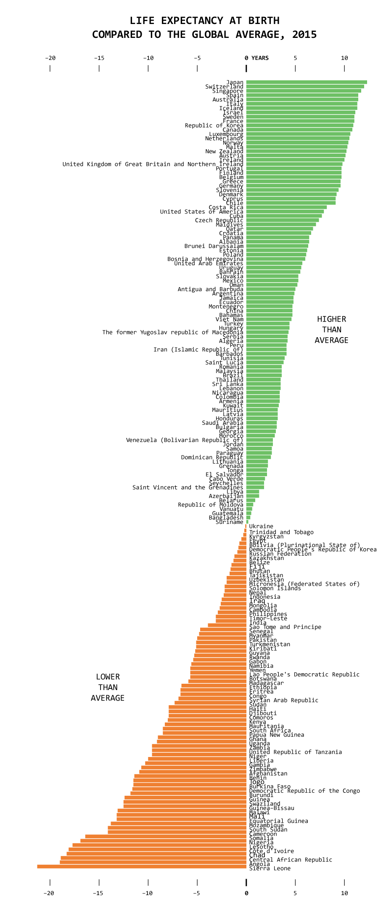
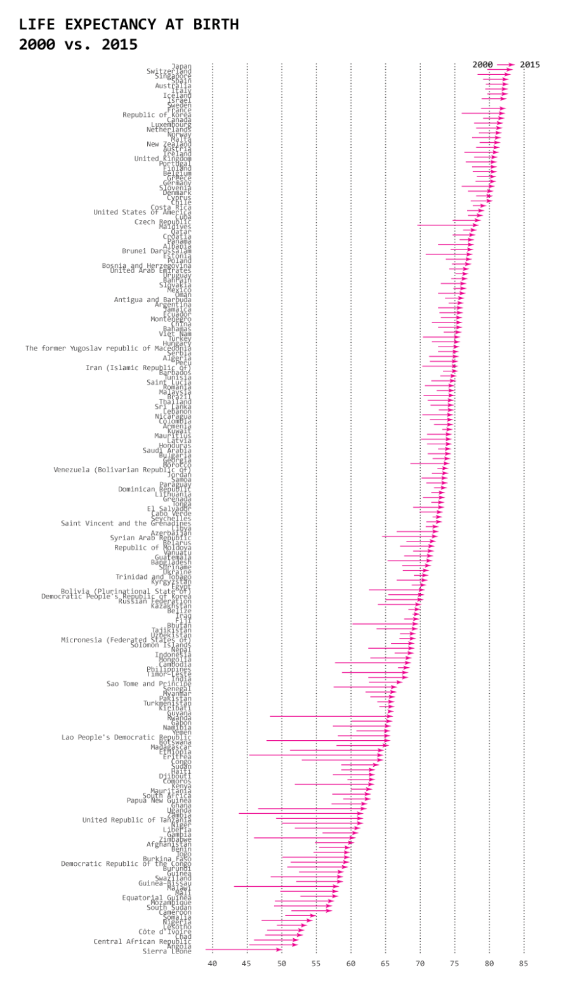
One Dataset, Visualized 25 Ways
https://flowingdata.com/2017/01/24/one-dataset-visualized-25-ways/

Slide 32
One Dataset, Visualized 25 Ways
One Dataset, Visualized 25 Ways
https://flowingdata.com/2017/01/24/one-dataset-visualized-25-ways/

Slide 33
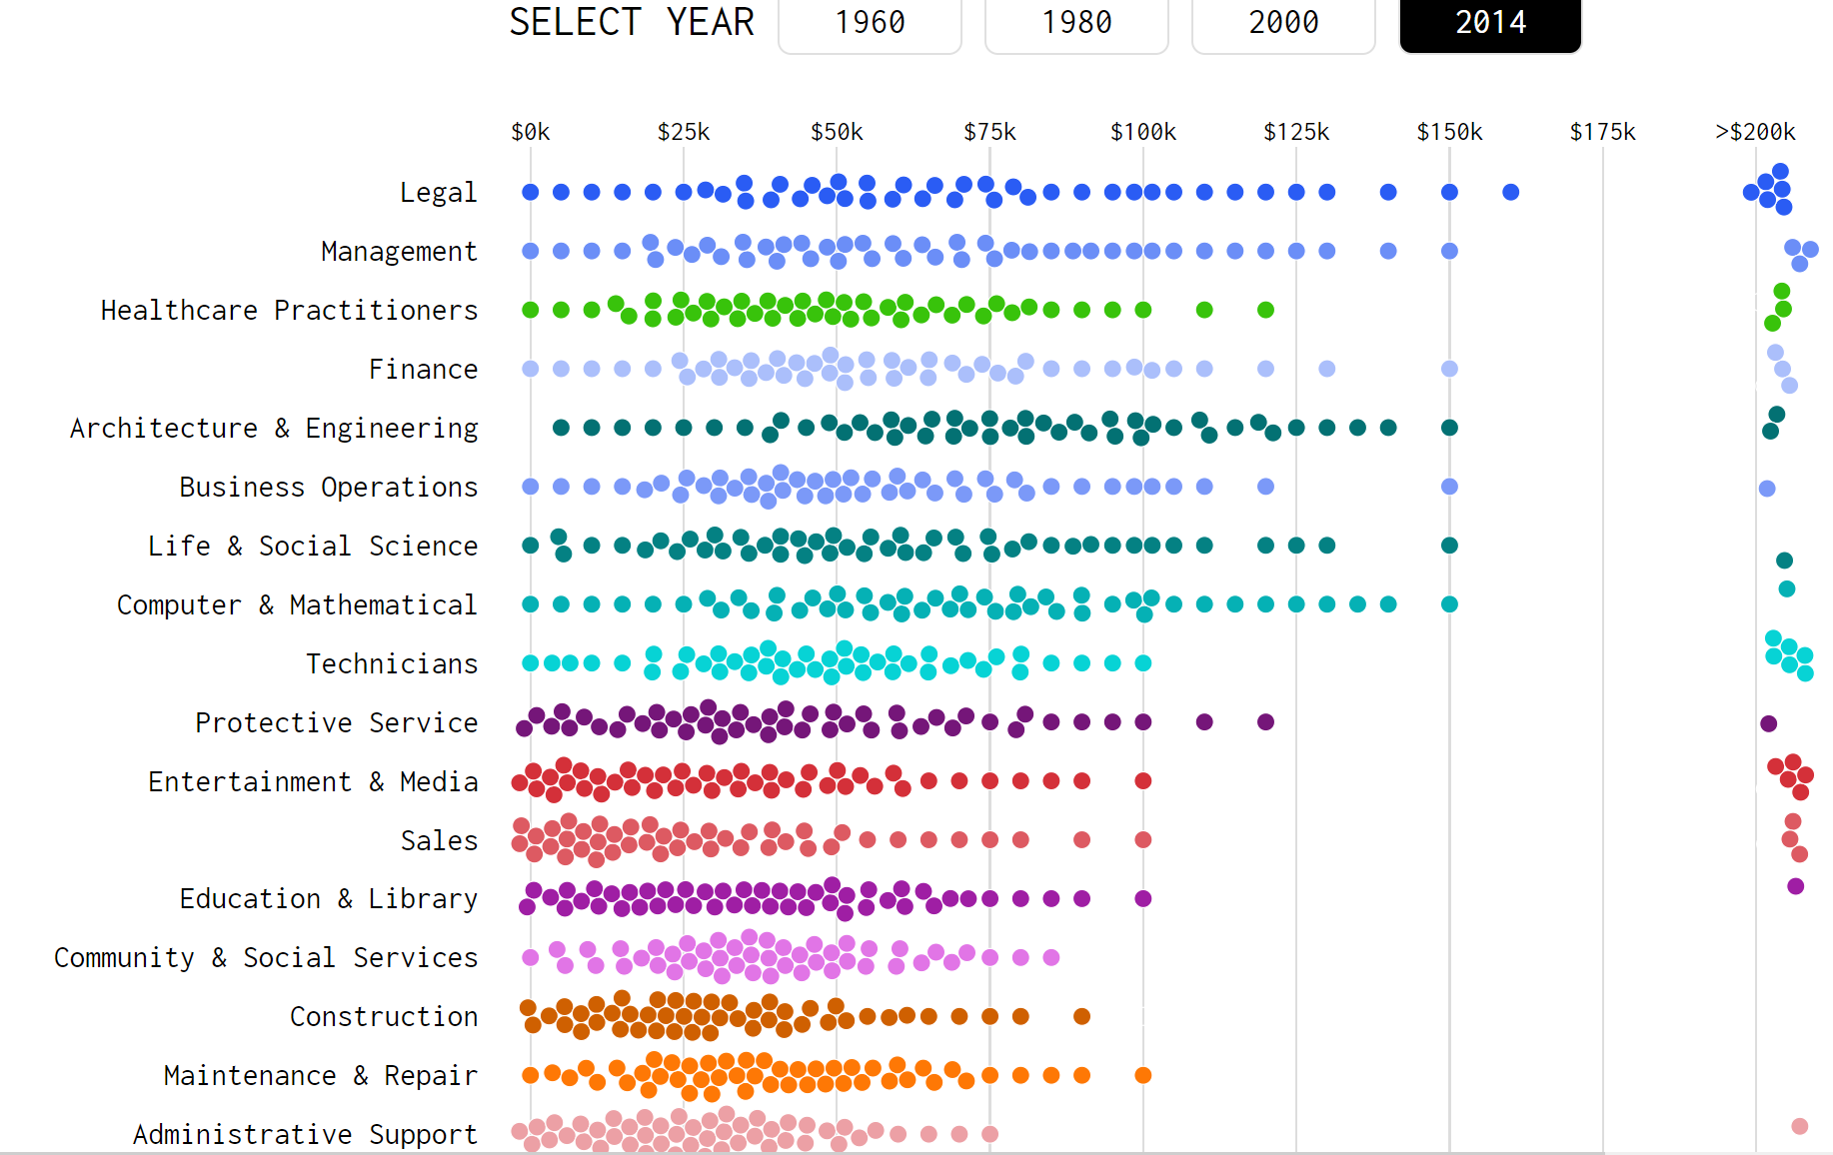
https://flowingdata.com/2016/06/28/distributions-of-annual-income/

Slide 34
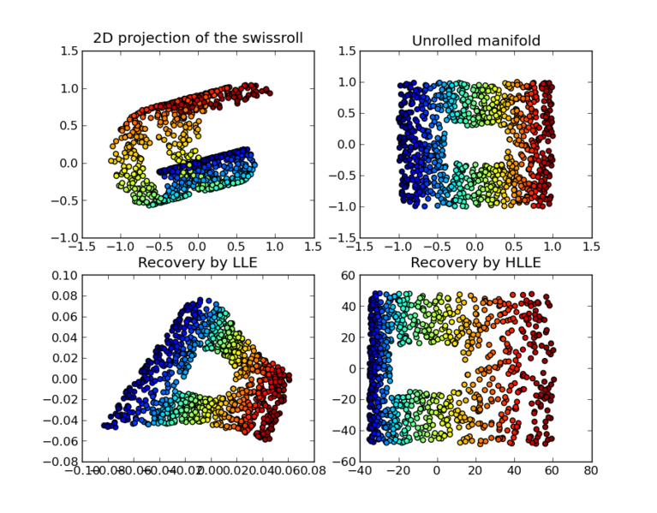
https://en.wikipedia.org/wiki/Nonlinear_dimensionality_reduction

Slide 35
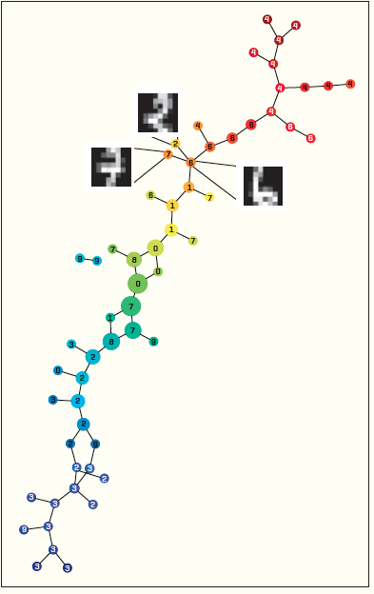
https://dl-acm-org/citation.cfm?id=2634549.2627814&coll=portal&dl=ACM
XRDS • SUMMER 2014 • VOL .20 • NO.4

Slide 36
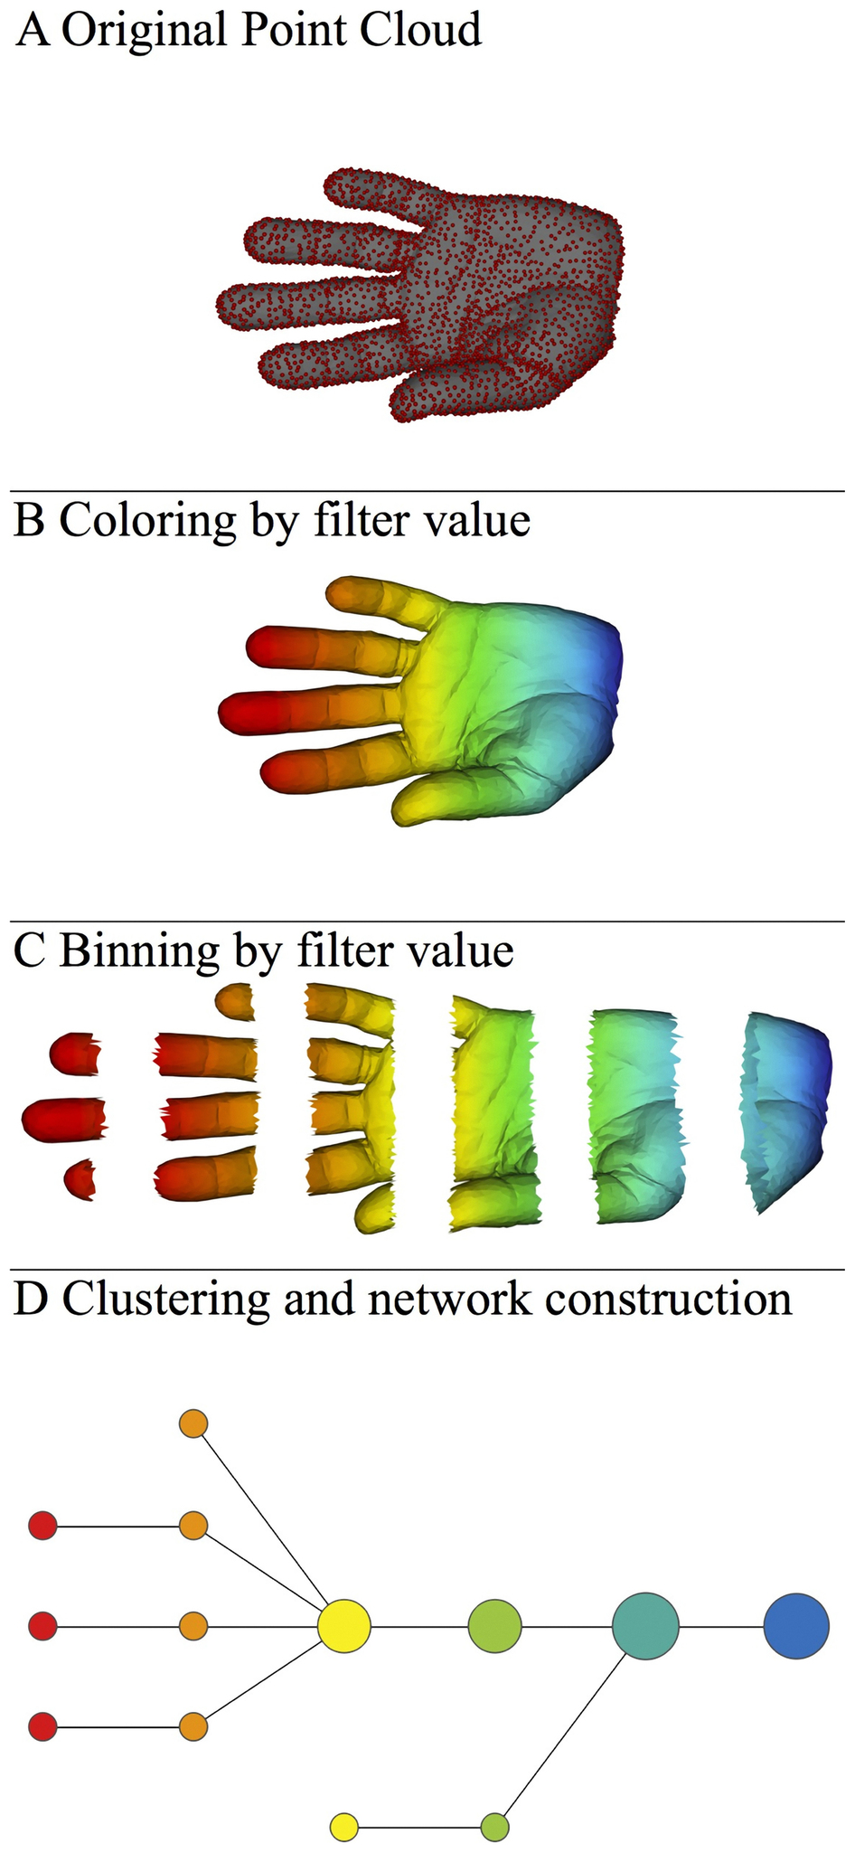
A) Data Set
Example: Point cloud data
representing a hand.
B) Function f : Data Set → R
Example: x-coordinate
f : (x, y, z) → x
Put data into overlapping bins.
Example: f⁻¹(a_{i}, b_{i})
Cluster each bin & create network.
Vertex = a cluster of a bin.
Edge = nonempty intersection
between clusters
http://www.nature.com/srep/2013/130207/srep01236/full/srep01236.html

Slide 37
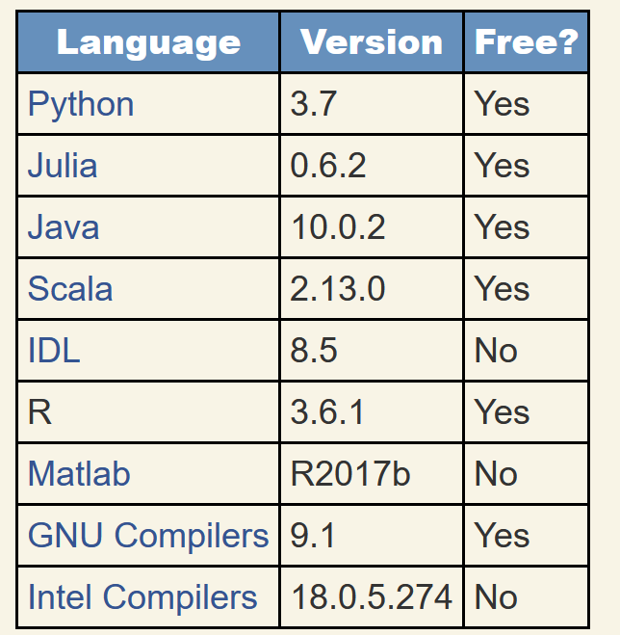
https://modelingguru.nasa.gov/docs/DOC-2783
Which programming language should you use?

Slide 38
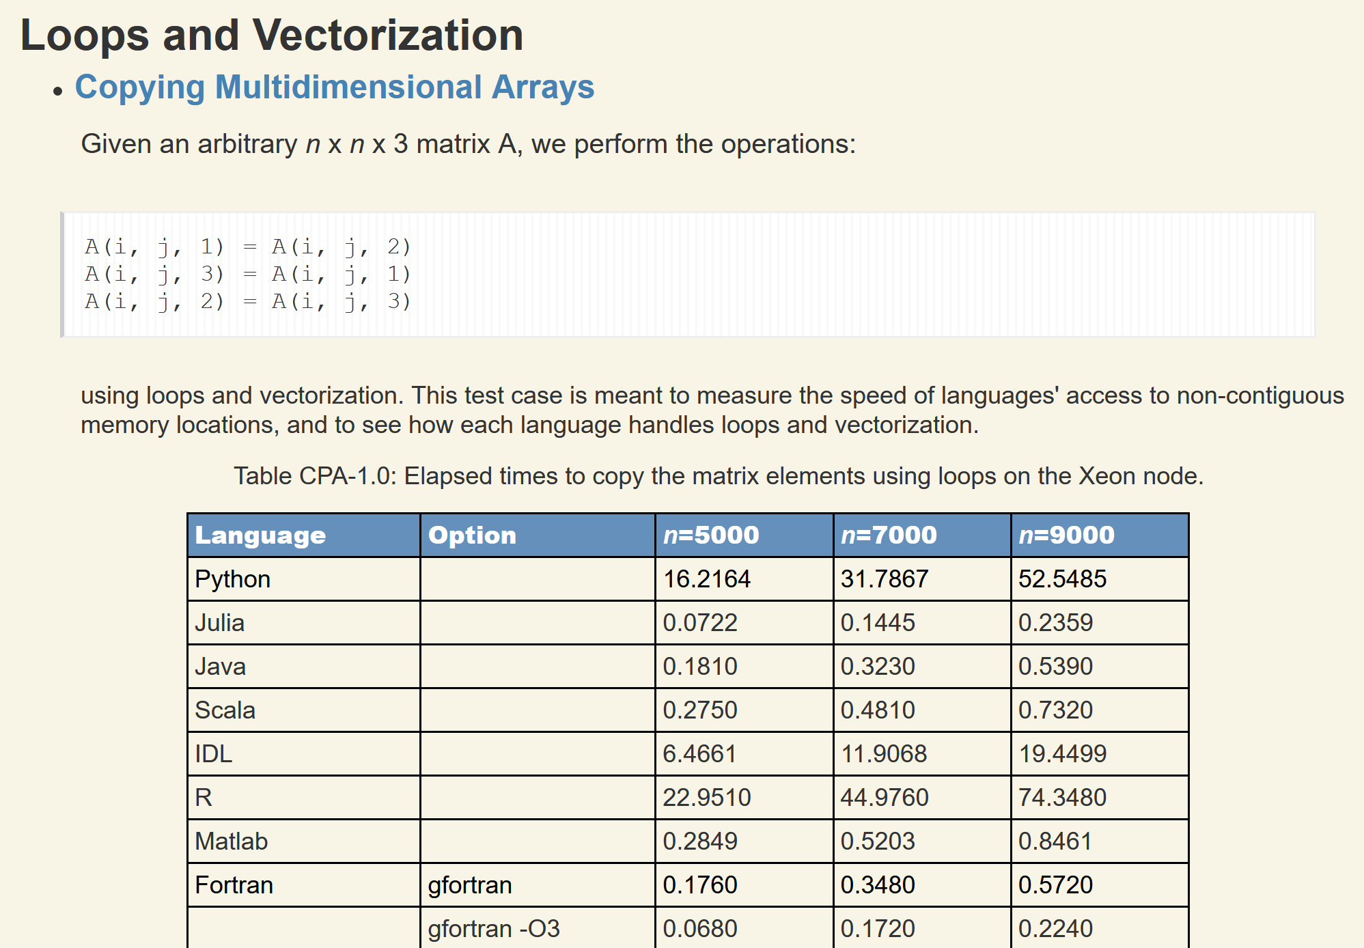
https://modelingguru.nasa.gov/docs/DOC-2783
Created on: Jul 2, 2019 2:51 PM by Alexander Medema - Last Modified: Nov 4, 2019 10:15 PM by Jules Kouatchou

Slide 39
https://inmas.us/

Slide 40
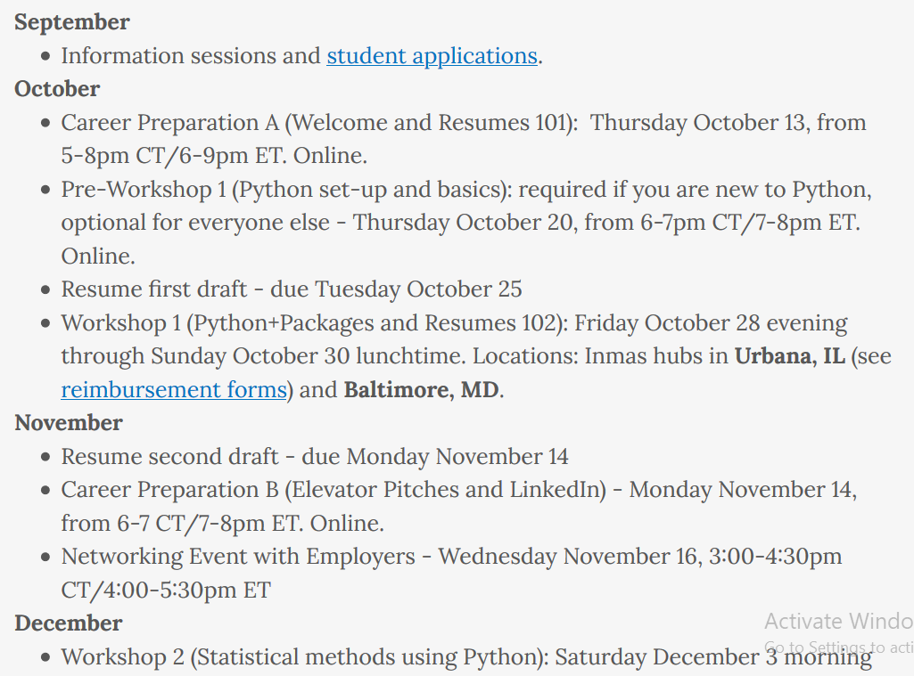
https://inmas.us/

Slide 41
A few notes from an unrelated colloquium regarding moving into industry:
https://www.datacamp.com/ Build data skills online (elementary broad overview)
Insight vs DataIncubator
Some recommended courses
Statistical Inference 1 and 2
Applied statistics 1 and 2*
*Computing and Statistics
CS:5110 Introduction to Informatics (python)
Github is your portfolio comment your code!!!!!!
Kaggle competition/Kaggle notebooks
Program using google
Social media is often not accurate including linkedin
You are all very smart people
*Rhonda 2: Applied statistics 2

Slide 42
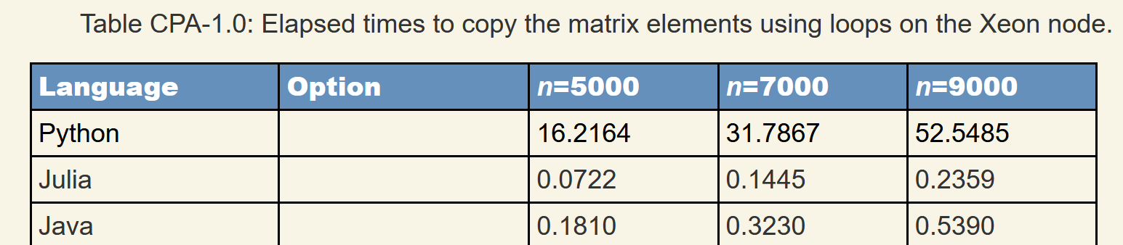
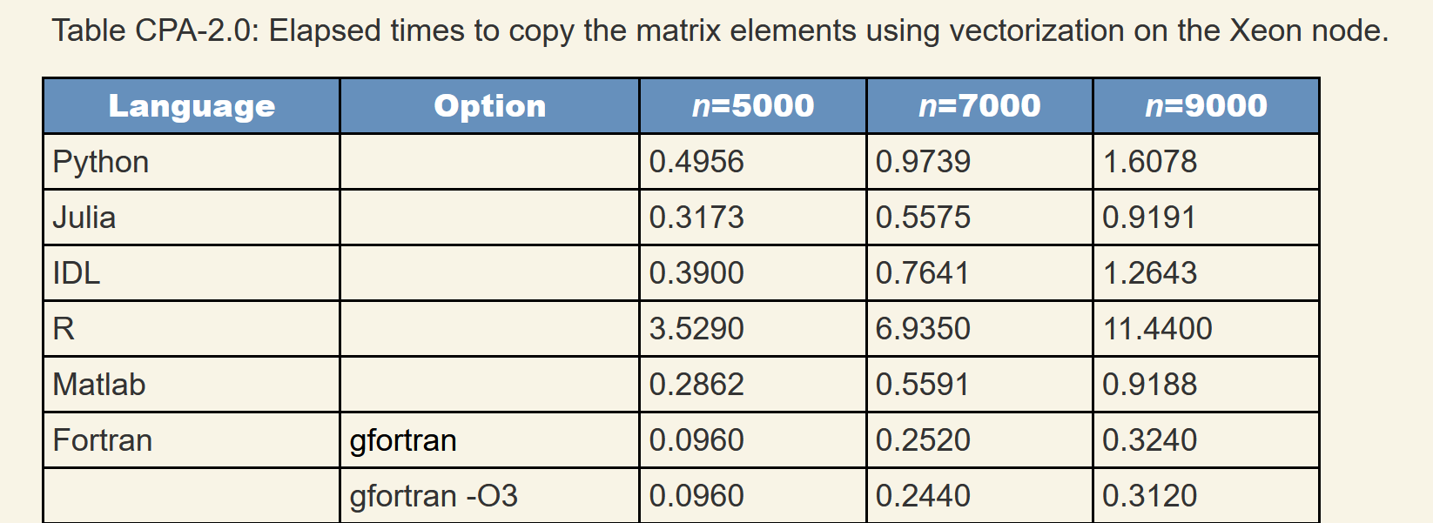
https://modelingguru.nasa.gov/docs/DOC-2783

Slide 43
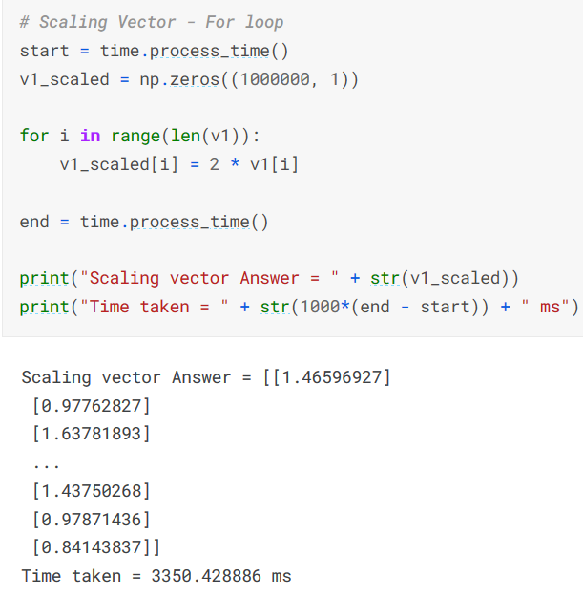
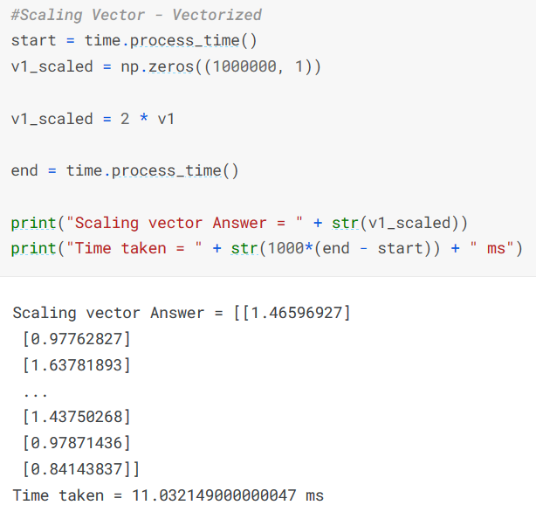
https://www.kaggle.com/code/yushg123/for-loops-vs-vectorized-who-wins-and-by-how-much

Slide 44
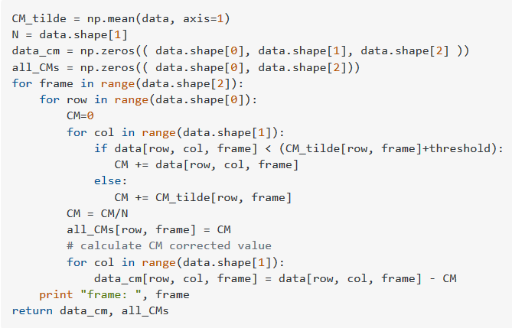
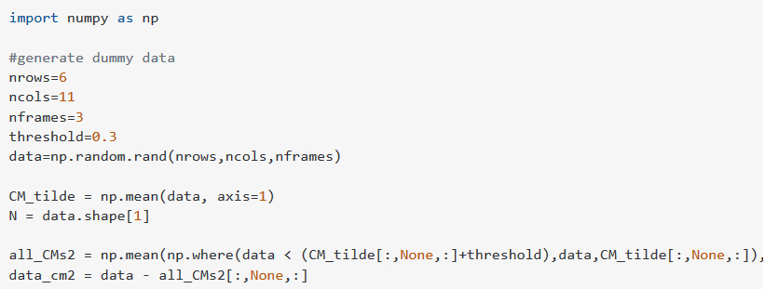
https://stackoverflow.com/questions/33792040/numpy-vectorization-instead-of-for-loops
versus

Slide 45
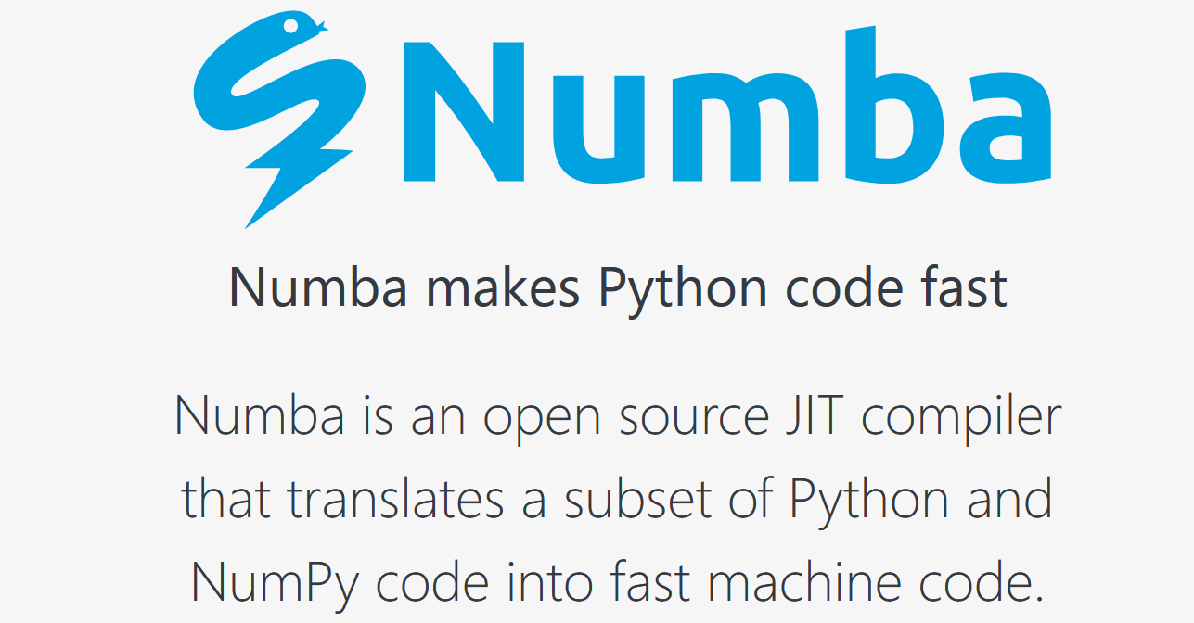
https://numba.pydata.org/

Slide 46
https://modelingguru.nasa.gov/docs/DOC-2783

Slide 47
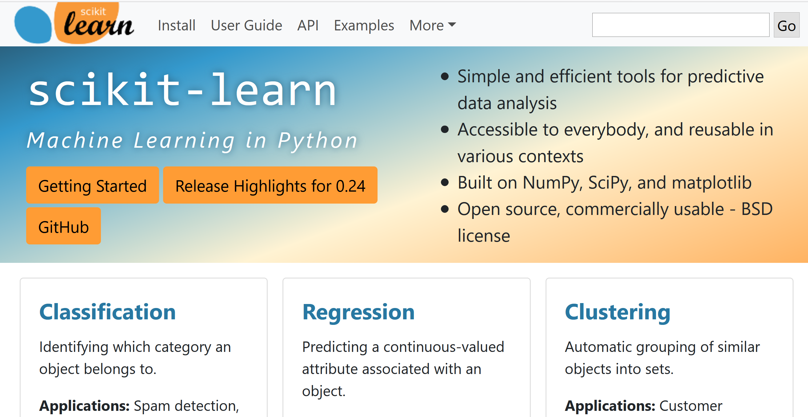
https://scikit-learn.org
Both python and R have large well-developed libraries.

Slide 48
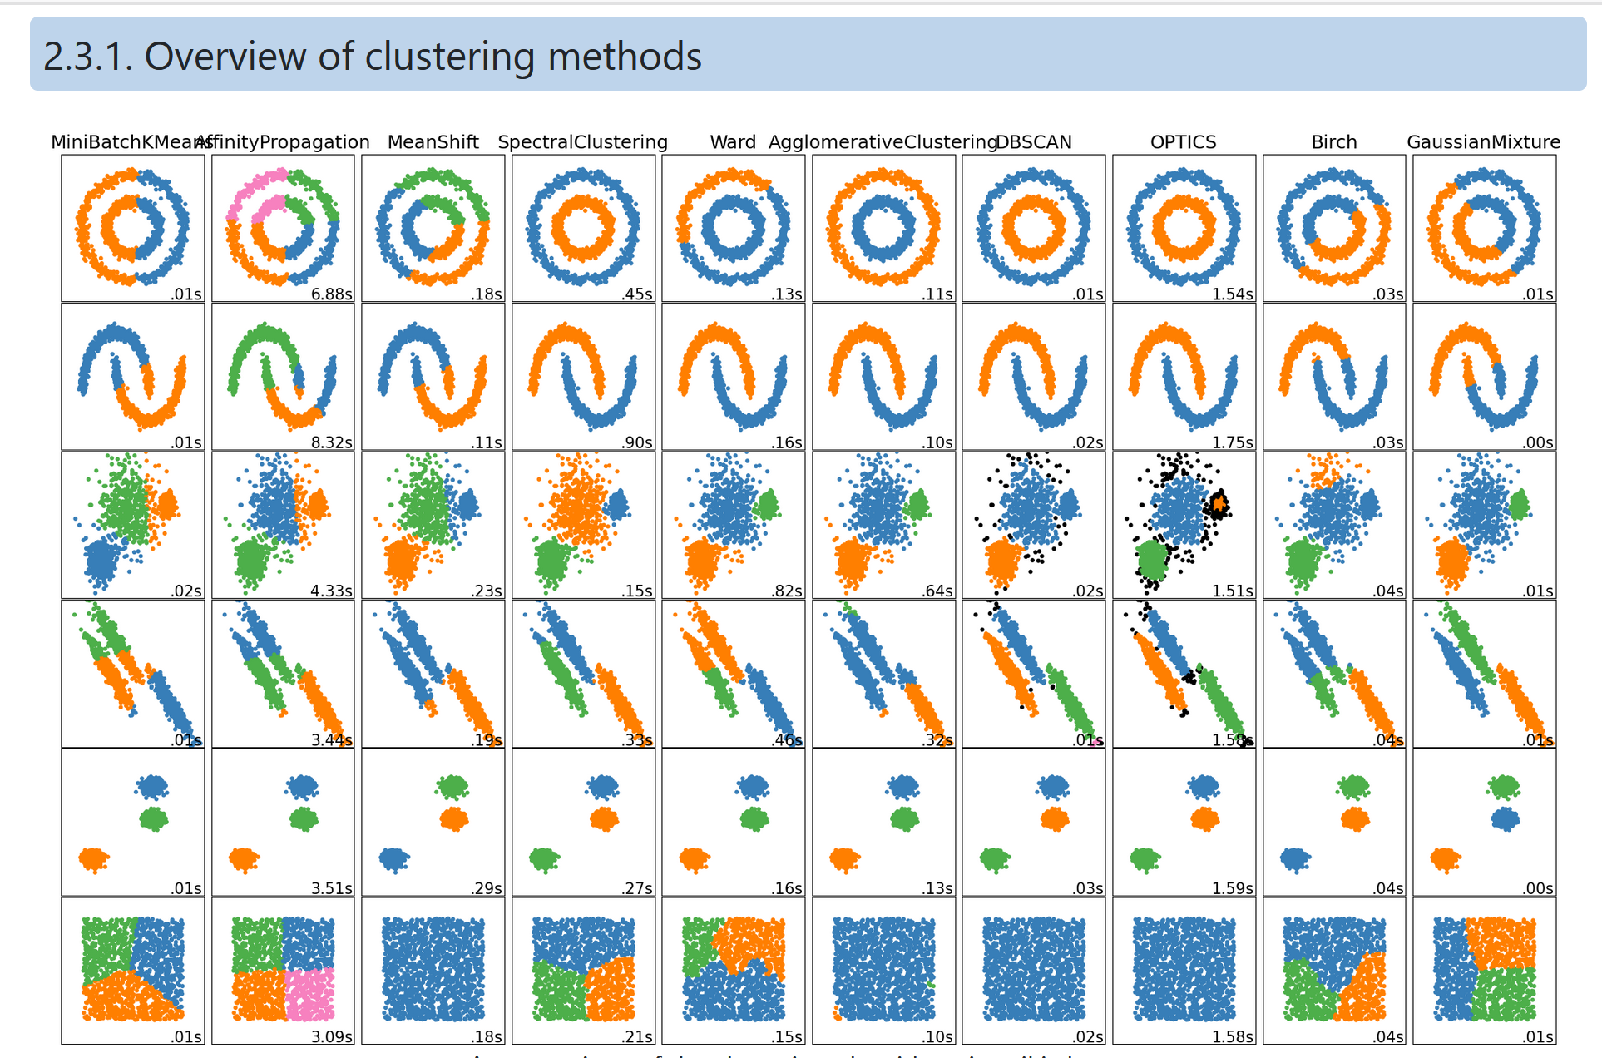
https://scikit-learn.org/stable/modules/clustering.html

Slide 49
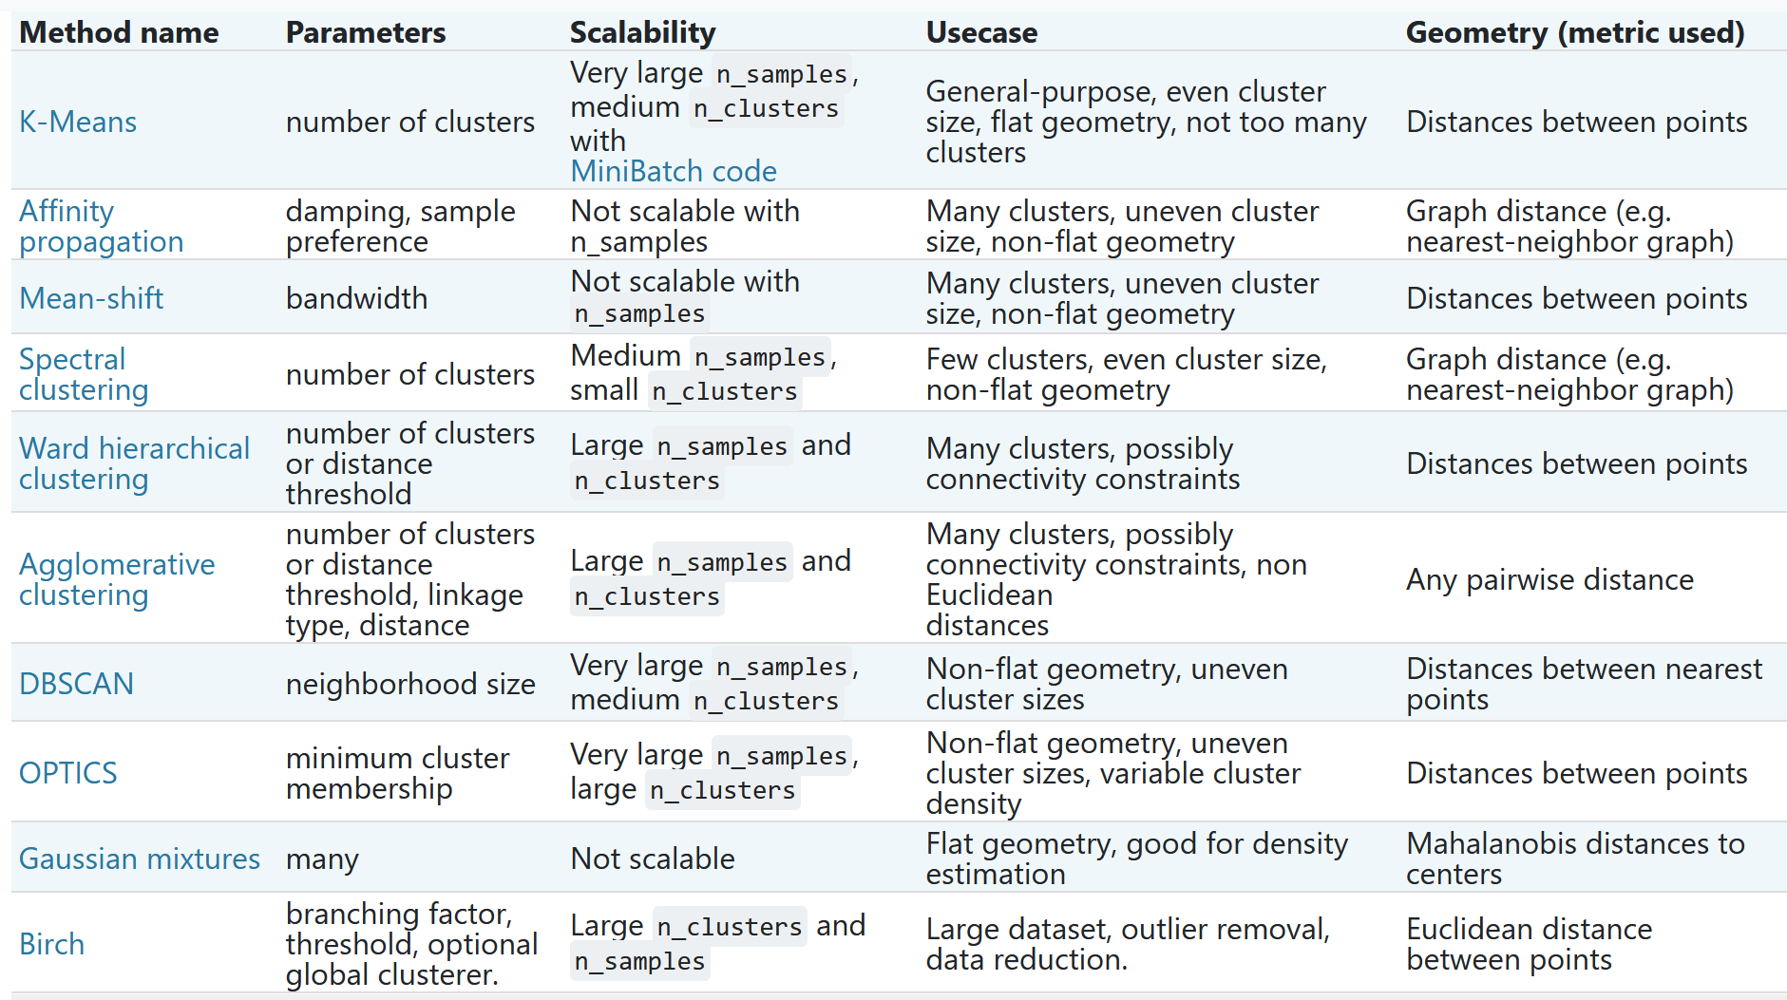
https://scikit-learn.org/stable/modules/clustering.html#clustering

Slide 50
https://scikit-learn.org/stable/modules/clustering.html#k-means

Slide 52
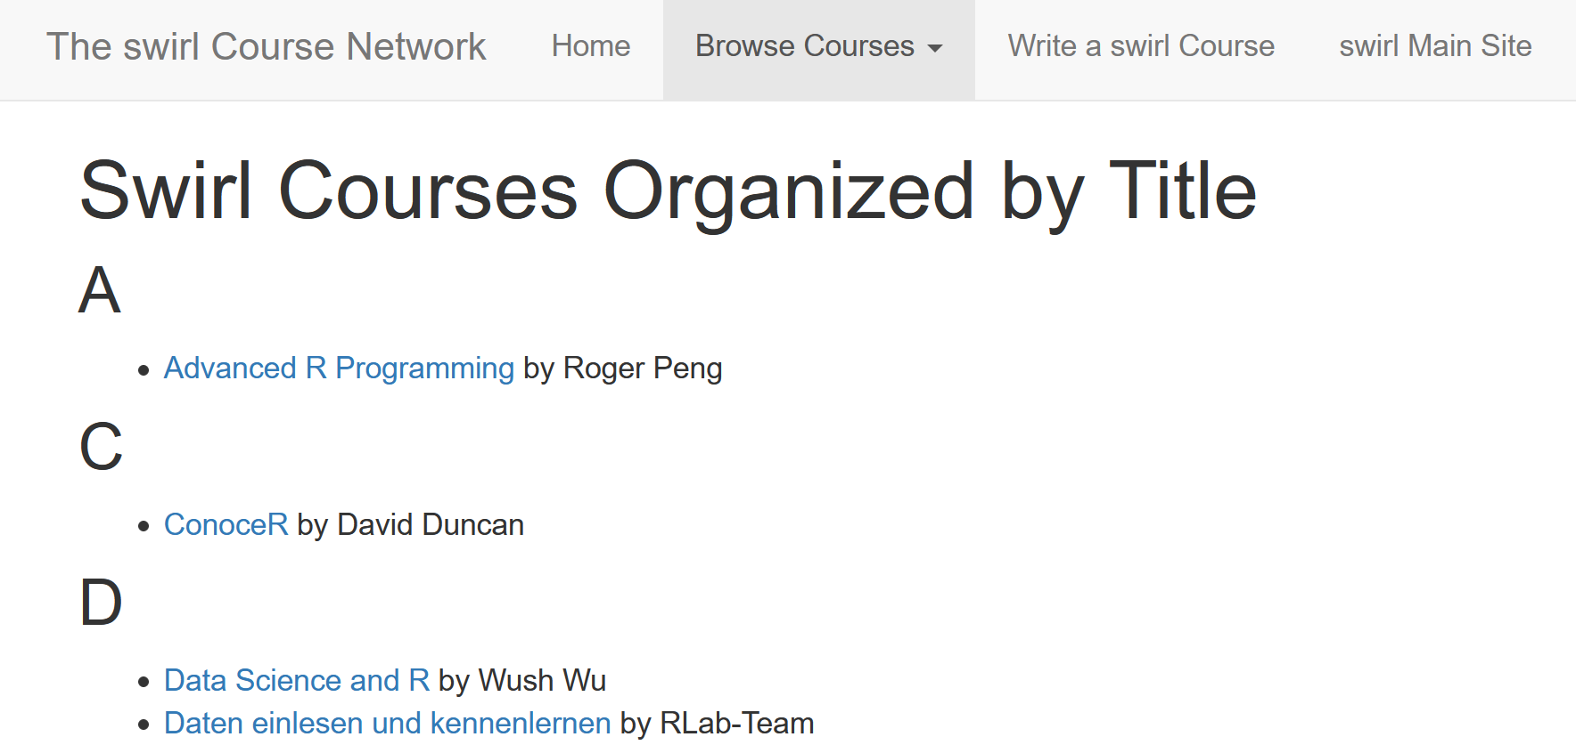
https://swirlstats.com/scn/title.html
https://www.r-project.org/

Slide 53
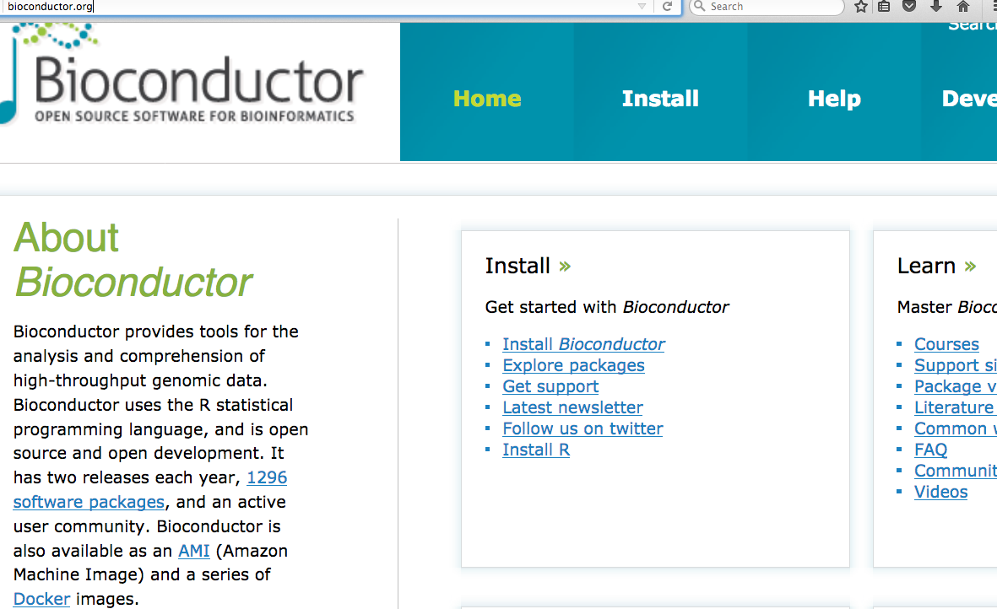
Additional R packages can be found at other repositories such as http://bioconductor.org/

Slide 54
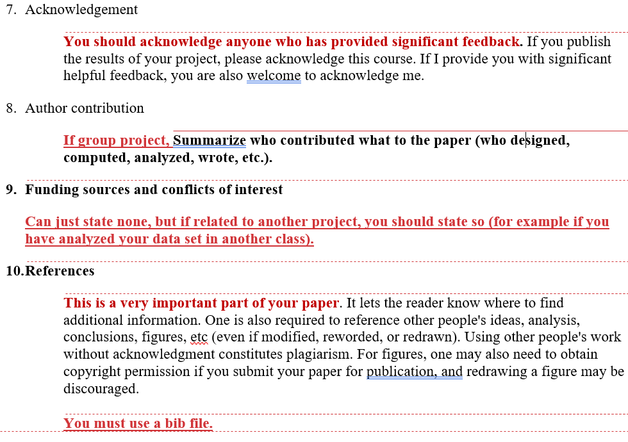

Slide 55
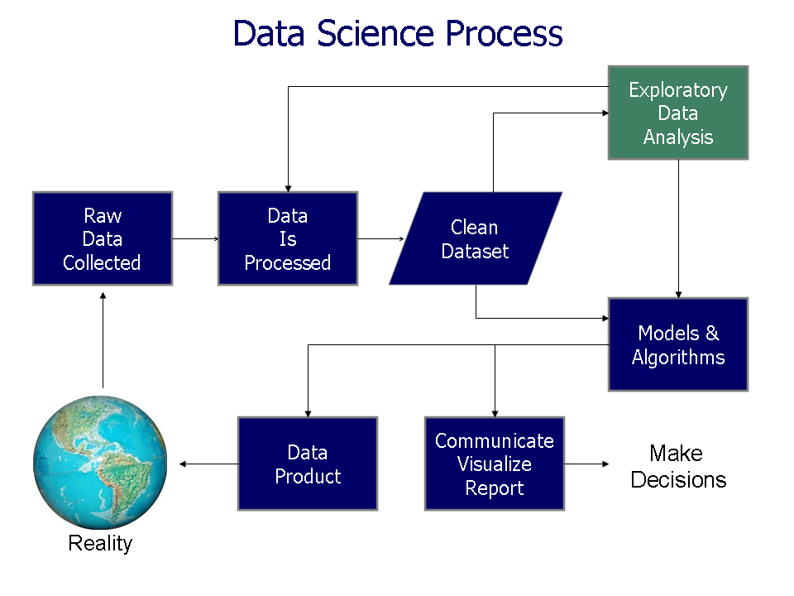
https://commons.wikimedia.org/wiki/File%3AData_visualization_process_v1.png

