Slide 1
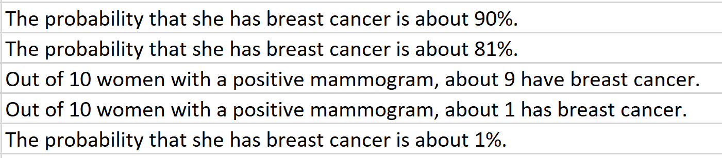
Using old inaccurate statistics: Ten out of every 1,000 women have breast cancer. Of these 10 women with breast cancer, 9 test positive. Of the 990 women without cancer, about 89 nevertheless test positive. A woman tests positive and wants to know whether she has breast cancer for sure, or at least what the chances are. What is the best answer?
Please answer attendance HW
Once individually FIRST
Talk to others
Change answer if needed when we discuss in class
You have unlimited attempts.

Slide 2
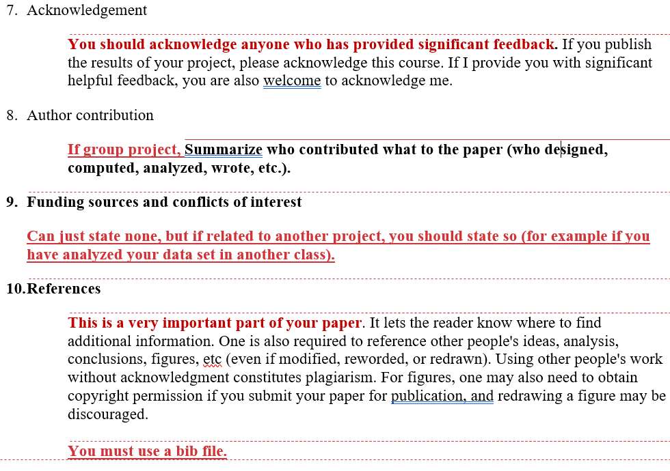

Slide 3
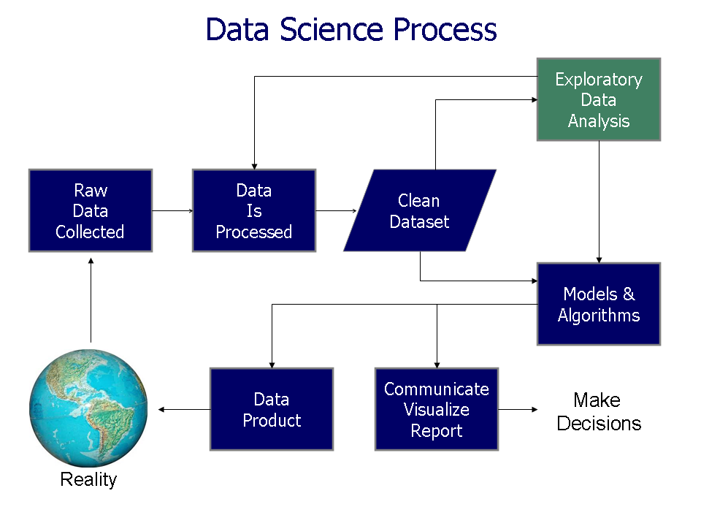
https://commons.wikimedia.org/wiki/File%3AData_visualization_process_v1.png

Slide 4
Possible Partial data pipeline
0.) Download data (eg from http://archive.ics.uci.edu/ml/index.php or elsewhere
Data is often an excel file where rows = data points
columns = variables
1.) Remove missing data (remove data points = rows with missing values)
2.) Calculate statistics (mean, median, sd, etc) and also visualize the data including with PCA
3.) Remove outliers ?? (remove data points = rows with unusual values)
4.) Remove variables that have little effect (remove columns with low variance)
Warning: Sometimes variables with low variance contain useful information
Ex: multiple small changes in speed could indicate weaving in and out of
traffic = bad driving = increased insurance cost.
5.) “Normalize” the data ??
6.) Calculate statistics (mean, median, sd, etc) and also visualize the data including with PCA

Slide 5
Dimensionality Reduction: Given dataset D R^{N}
Want: embedding f: D → R^{n} where n << N
    which “preserves” the structure of the data.
Many reduction methods:
f₁: D → R, f₂: D → R, … f_{n}: D → R
(f₁, f₂, … f_{n}): D → R^{n}
Many are linear, M: R^{N} → R^{n}, Mx = y
But there are also non-linear dimensionality reduction algorithms.
U

Slide 6
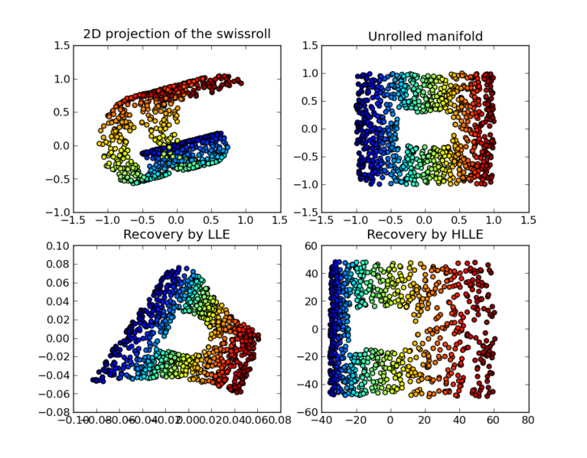
https://en.wikipedia.org/wiki/Nonlinear_dimensionality_reduction

Slide 7
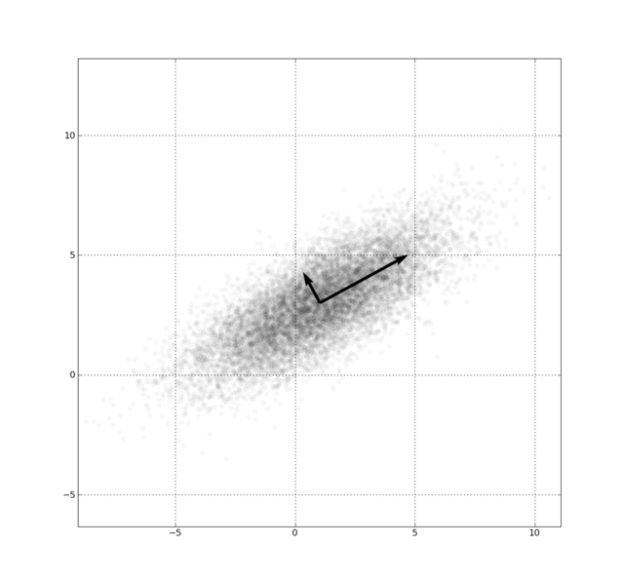
Example: Principle component analysis (PCA)
http://en.wikipedia.org/wiki/File:GaussianScatterPCA.png

Slide 8
Why use PCA in data analysis?
Reduce dimension.
Visualization.
Fewer variables = less memory (data compression).
Fewer variables = faster computing time (usually).

Slide 9
Why use PCA in data analysis?
Consider the points (0, 0, …, 0), (1, 0, …, 0), (10, 0, …, 0)
Add noise to first point (0, 0, …, 0) → (0, 1, …, 1)
In R¹⁰⁰, d((0, 1, …, 1), (1, 0, …, 0)) = 10 > 9.
Add small noise to first point (0, 0, …, 0) → (0, 0.1, …, 0.1)
In R^{39,900}, d((0, 0.1, …, 0.1), (1, 0, …, 0)) = 20 > 9.
0 1 10

Slide 10
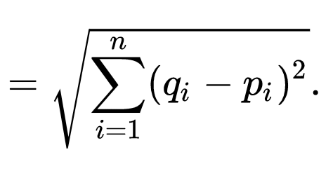

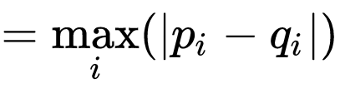
In R^{n}
If n small, Euclidean distance often makes sense
If n is large, consider Chebyshev distance or
performing PCA first to project data into R^{d}, for small d
and then using Euclidean distance
Chebyshev distance:

Slide 11
Example: Principle component analysis (PCA)
x_{i} → z_{i} = linear combination of x_{i}
http://en.wikipedia.org/wiki/File:GaussianScatterPCA.png

Slide 12
PCA on all Genes
Leukemia data, precursor B and T
Plot of 34 patients, dimension of 8973 genes reduced to 2
www.cse.buffalo.edu/faculty/azhang/data-mining/pca.ppt

Slide 13
PCA on 100 top significant genes
Leukemia data, precursor B and T
Plot of 34 patients, dimension of 100 genes reduced to 2
www.cse.buffalo.edu/faculty/azhang/data-mining/pca.ppt

Slide 14
Principal Component Analysis: one attribute first
Temperature
42
40
24
30
15
18
15
30
15
30
35
30
40
30
Question: how much spread is in the data along the axis? (distance to the mean)
Variance=Standard deviation^2
www.cse.buffalo.edu/faculty/azhang/data-mining/pca.ppt

Slide 15
Now consider two dimensions
X=Temperature | Y=Humidity
40 | 90
40 | 90
40 | 90
30 | 90
15 | 70
15 | 70
15 | 70
30 | 90
15 | 70
30 | 70
30 | 70
30 | 90
40 | 70
30 | 90
Covariance: measures the
correlation between X and Y
cov(X,Y)=0: independent
Cov(X,Y)>0: move same dir
Cov(X,Y)<0: move oppo dir
www.cse.buffalo.edu/faculty/azhang/data-mining/pca.ppt

Slide 16
More than two attributes: covariance matrix
Contains covariance values between all possible dimensions (=attributes):
Example for three attributes (x,y,z):
www.cse.buffalo.edu/faculty/azhang/data-mining/pca.ppt

Slide 17
Steps of PCA
Let be the mean vector (taking the mean of all rows)
Adjust the original data by the mean
  X’ = X –
Compute the covariance matrix C of adjusted X
Find the eigenvectors and eigenvalues of C.
For matrix C, vectors e (=column vector) having same direction as Ce :
  eigenvectors of C is e such that Ce=λe,
  λ is called an eigenvalue of C.
Ce=λe ⇔ (C-λI)e=0
  Most data mining packages do this for you.
www.cse.buffalo.edu/faculty/azhang/data-mining/pca.ppt

Slide 18
Principal components
1. principal component (PC1)
  The eigenvalue with the largest absolute value will indicate that the data have the largest variance along its eigenvector, the direction along which there is greatest variation
2. principal component (PC2)
  the direction with maximum variation left in data, orthogonal to the 1. PC
In general, only few directions manage to capture most of the variability in the data.
www.cse.buffalo.edu/faculty/azhang/data-mining/pca.ppt

Slide 19
Example: Principle component analysis (PCA)
http://en.wikipedia.org/wiki/File:GaussianScatterPCA.png

Slide 20
Eigenvalues
Calculate eigenvalues λ and eigenvectors x for covariance matrix:
  Eigenvalues λ_{j} are used for calculation of [% of total variance] (V_{j}) for each component j:
www.cse.buffalo.edu/faculty/azhang/data-mining/pca.ppt

Slide 21
Principal components - Variance
www.cse.buffalo.edu/faculty/azhang/data-mining/pca.ppt

Slide 22
Example: Principle component analysis (PCA)
x_{i} → z_{i} = linear combination of x_{i}
http://en.wikipedia.org/wiki/File:GaussianScatterPCA.png

Slide 23

Machine Learning overview
Chapter 19
14.1
https://www.csee.umbc.edu/courses/graduate/671/fall20/notes/14_machine_learning/14_1_intro.pptx

Slide 24
So What Is Machine Learning?
Automating automation
Getting computers to program themselves
Writing software is the bottleneck
Let the data do the work instead!
https://courses.cs.washington.edu/courses/cse446/09wi/slides/intro.ppt

Slide 25
Traditional Programming
Machine Learning
Data
Computer
Output
Program
Data
Computer
Program
Output
https://courses.cs.washington.edu/courses/cse446/09wi/slides/intro.ppt

Slide 26

Magic?
No, more like gardening
Seeds = Algorithms
Nutrients = Data
Gardener = You
Plants = Programs
https://courses.cs.washington.edu/courses/cse446/09wi/slides/intro.ppt

Slide 27
What is Machine Learning?
Machine Learning By: Jennie E. Brand, Bernard Koch & Jiahui Xu
https://methods-sagepub-com.proxy.lib.uiowa.edu/foundations/machine-learning
“Machine learning is a computational and statistical approach to extracting patterns and trends from data (Maini & Sabri, 2017). A machine learning algorithm is also defined as a computer program that learns from experience with data with respect to some class of tasks and improves its performance with greater experience (Mitchell, 1997).”
Hands-on Scikit-Learn for Machine Learning Applications by David Paper
https://link-springer-com.proxy.lib.uiowa.edu/book/10.1007%2F978-1-4842-5373-1
Machine learning is getting computers to program themselves. We use algorithms to
make this happen. An algorithm is a set of rules used to calculate or problem solve
with a computer.
Machine learning advocates create, study, and apply algorithms to improve
performance on data-driven tasks. They use tools and technology to answer questions
about data by training a machine how to learn.

Slide 28
Types of Learning
Supervised (inductive) learning
  Training data includes desired outputs
Unsupervised learning
  Training data does not include desired outputs
Semi-supervised learning
  Training data includes a few desired outputs
Reinforcement learning
  Rewards from sequence of actions
https://courses.cs.washington.edu/courses/cse446/09wi/slides/intro.ppt

Slide 29

Supervised vs Reinforcement vs Unsupervised Learning
Supervised Learning
Data: (x, y)
x is data, y is label
Goal: Learn a function to map x → y
Examples: Classification, regression, object detection, semantic segmentation, image captioning, etc.
Cat
Classification
This image is CC0 public domain
https://www.cc.gatech.edu/classes/AY2020/cs7643_fall/slides/L23_generative2.pptx
Slide Credit: Fei-Fei Li, Justin Johnson, Serena Yeung, CS 231n
Notes:
So far talked about SL
Type of problem where have Data X, Labels Y, goals is to learn a function mapping from x to y

Slide 30
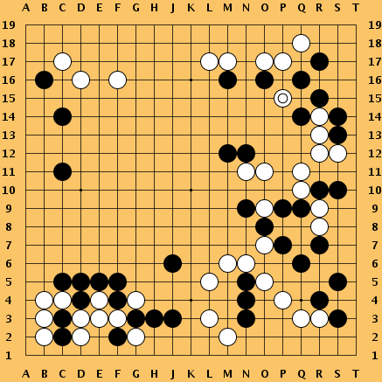
Supervised vs Reinforcement vs Unsupervised Learning
Reinforcement Learning
Given: (e, r)
Environment e, Reward function r (evaluative feedback)
Goal: Maximize expected reward
Examples: Robotic control, video games, board games, etc.
https://www.cc.gatech.edu/classes/AY2020/cs7643_fall/slides/L23_generative2.pptx
Slide Credit: Fei-Fei Li, Justin Johnson, Serena Yeung, CS 231n
Notes:
So far talked about SL
Type of problem where have Data X, Labels Y, goals is to learn a function mapping from x to y

Slide 31
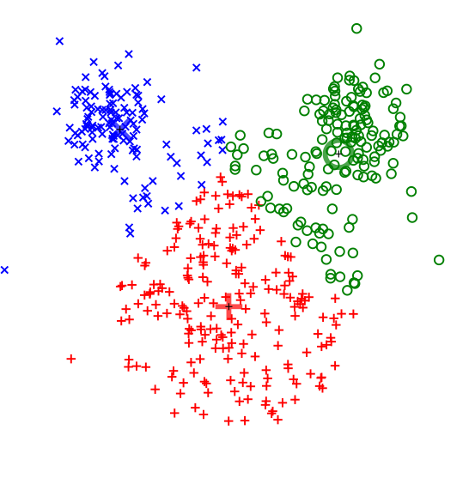
Supervised vs Reinforcement vs Unsupervised Learning
Unsupervised Learning
Data: x
Just data, no labels!
Goal: Learn some underlying hidden structure of the data
Examples: Clustering, dimensionality reduction, feature learning, density estimation, etc.
K-means clustering
This image is CC0 public domain
https://www.cc.gatech.edu/classes/AY2020/cs7643_fall/slides/L23_generative2.pptx
Slide Credit: Fei-Fei Li, Justin Johnson, Serena Yeung, CS 231n
Notes:
Clustering - find groups within the data that are similar through some metric

Slide 32
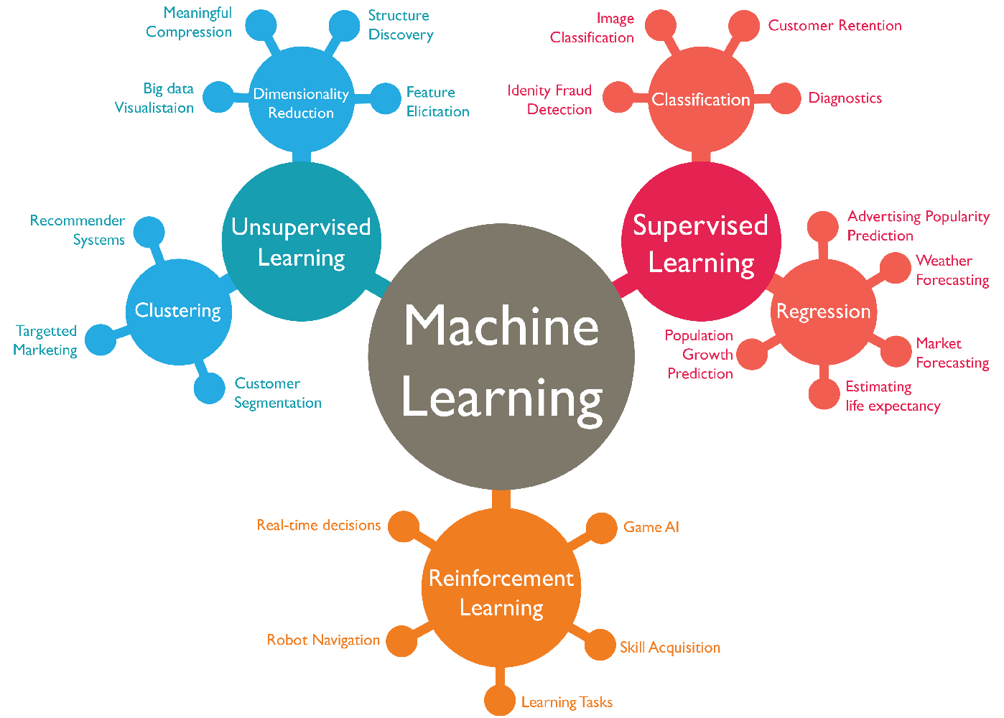
https://www.favouriteblog.com/wp-content/uploads/2017/07/Types-of-Learning.png

Slide 33
Supervised vs Reinforcement vs Unsupervised Learning
Supervised Learning
Data: (x, y)
x is data, y is label
Goal: Learn a function to map x → y
Examples: Classification, regression, object detection, semantic segmentation, image captioning, etc.
Unsupervised Learning
Data: x
Just data, no labels!
Goal: Learn some underlying hidden structure of the data
Examples: Clustering, dimensionality reduction, feature learning, density estimation, etc.
https://www.cc.gatech.edu/classes/AY2020/cs7643_fall/slides/L23_generative2.pptx
Slide Credit: Fei-Fei Li, Justin Johnson, Serena Yeung, CS 231n
Notes:
To summarize differences, sup uses labeled data to learn a function mapping from x to y
Unsup uses no labels, tries to learn some underlying hidden structure of the data, whether grouping, axes of variation, underlying density

Slide 34
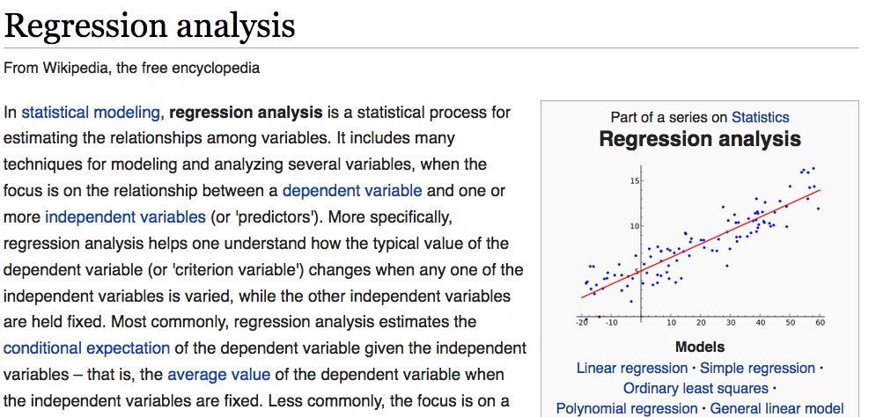
https://en.wikipedia.org/wiki/Regression_analysis

Slide 35
Supervised vs Reinforcement vs Unsupervised Learning
Supervised Learning
Data: (x, y)
x is data, y is label
Goal: Learn a function to map x → y
Examples: Classification, regression, object detection, semantic segmentation, image captioning, etc.
Unsupervised Learning
Data: x
Just data, no labels!
Goal: Learn some underlying hidden structure of the data
Examples: Clustering, dimensionality reduction, feature learning, density estimation, etc.
https://www.cc.gatech.edu/classes/AY2020/cs7643_fall/slides/L23_generative2.pptx
Slide Credit: Fei-Fei Li, Justin Johnson, Serena Yeung, CS 231n
Notes:
To summarize differences, sup uses labeled data to learn a function mapping from x to y
Unsup uses no labels, tries to learn some underlying hidden structure of the data, whether grouping, axes of variation, underlying density

