Slide 1
The Logistic Regression Model
The "logit" model solves these problems: ln[p/(1-p)] = α + βX + e
p is the probability that the event Y occurs, p(Y=1)
p/(1-p) is the "odds ratio"
ln[p/(1-p)] is the log odds ratio, or "logit"
https://nlp.stanford.edu/~manning/courses/ling236/handouts/whitehead-logistic-regression.ppt

Slide 2
More:
The logistic distribution constrains the estimated probabilities to lie between 0 and 1.
The estimated probability is: p = 1/[1 + exp(-α - β X)]
if you let α + β X =0, then p = .50
as α + β X gets really big, p approaches 1
as α + β X gets really small, p approaches 0
https://nlp.stanford.edu/~manning/courses/ling236/handouts/whitehead-logistic-regression.ppt

Slide 3
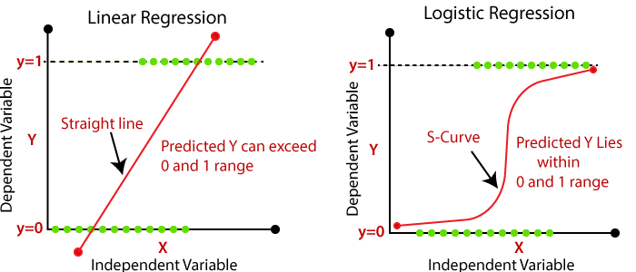
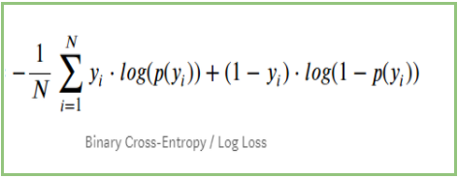
Devopedia. 2022. "Logistic Regression." Version 10, January 19. Accessed 2023-02-11. https://devopedia.org/logistic-regression
Linear model General linear model
Cost function for linear regression Cost function for logistic regression (maximum likelihood)
Minimize cost function to find best function f
(eg: if f(x) = mx + b, find m and b that minimizes Minimize cost function to find best probability function. This
cost function RSS. corresponds to finding best m and b that minimizes cost for
p(x) = 1/[1 + exp(-b - mx)]
Validating model: R², F-statistic, p-value, etc

Slide 4
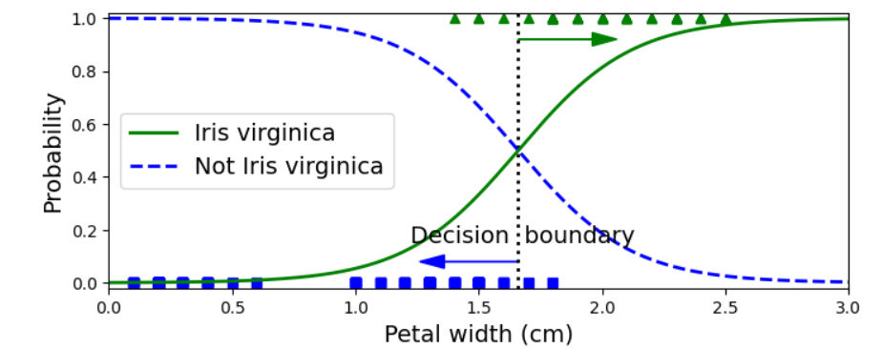
Decision Boundary: p = 0.5

Slide 5
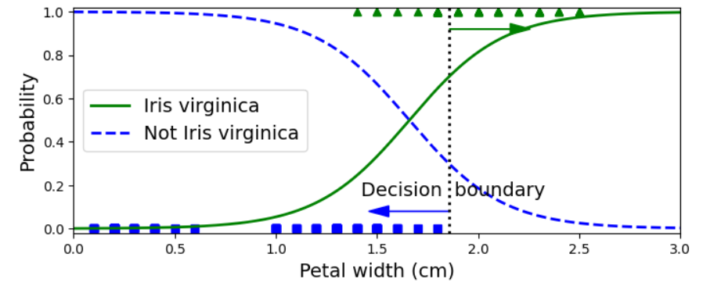
Decision Boundary: p = 0.7
Once you have chosen the decision boundary, you can compute the confusion matrix, which can be used to calculate a variety of classification metrics to determine classification performance.

Slide 6
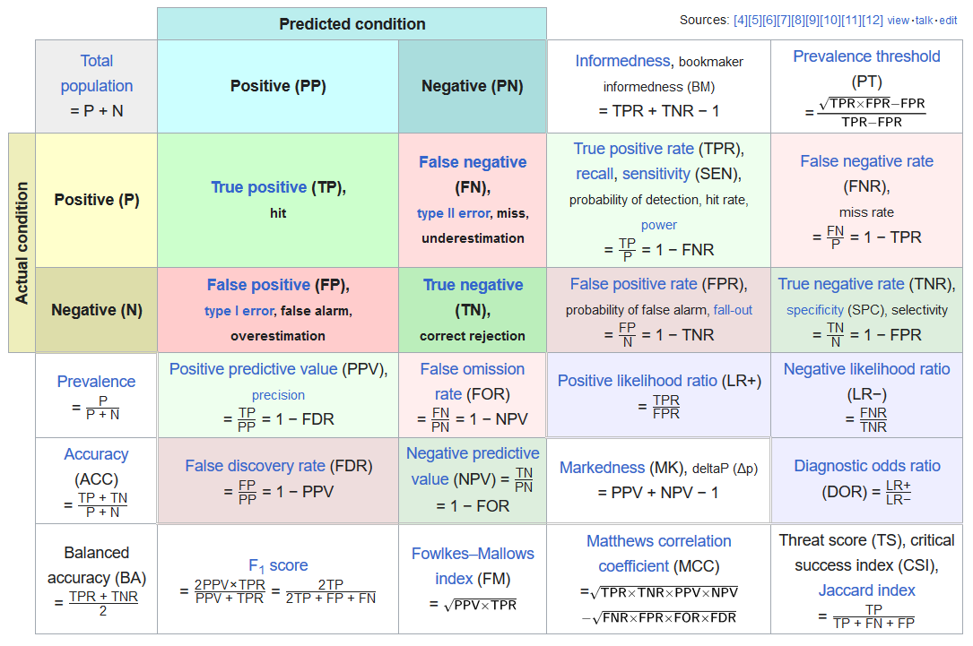
Confusion matrix
https://en.wikipedia.org/wiki/F-score#Formulation

Slide 7
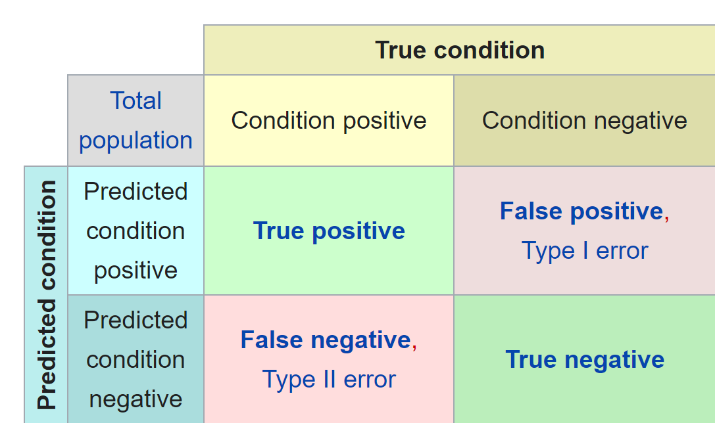
Accuracy = $\frac{TP+TN}{sample pop}$
= $\frac{\# of correct predictions}{total \# of predictions}$
= 10 + 9
12 + 12

Slide 8
Increasing decision boundary increases precision
Precision = $\frac{TP}{TP+FP}$
= proportion of true positives
among all positives
=
$$\frac{9}{9+2}$$

Slide 9
Increasing decision boundary decreases recall.
Recall = $\frac{TP}{TP+FN}$
= proportion of actual
positives correctly identified
= $\frac{9}{12}$

Slide 10
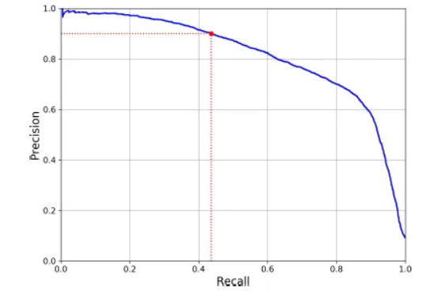
https://medium.com/@syuumak/precision-recall-tradeoff-1f5b10cc729d
Precision = $\frac{TP}{TP+FP}$
= proportion of true positives
among all positives
Recall = $\frac{TP}{TP+FN}$
= proportion of actual positives
correctly identified

Slide 11
https://en.wikipedia.org/wiki/F-score#Formulation

Slide 12
Recall = $\frac{TP}{TP+FN}$ = proportion of actual positives correctly identified
Confusion matrix
https://en.wikipedia.org/wiki/Confusion_matrix

Slide 13
Recall = $\frac{TP}{TP+FN}$ = proportion of actual positives correctly identified
Confusion matrix
https://en.wikipedia.org/wiki/Confusion_matrix

Slide 14
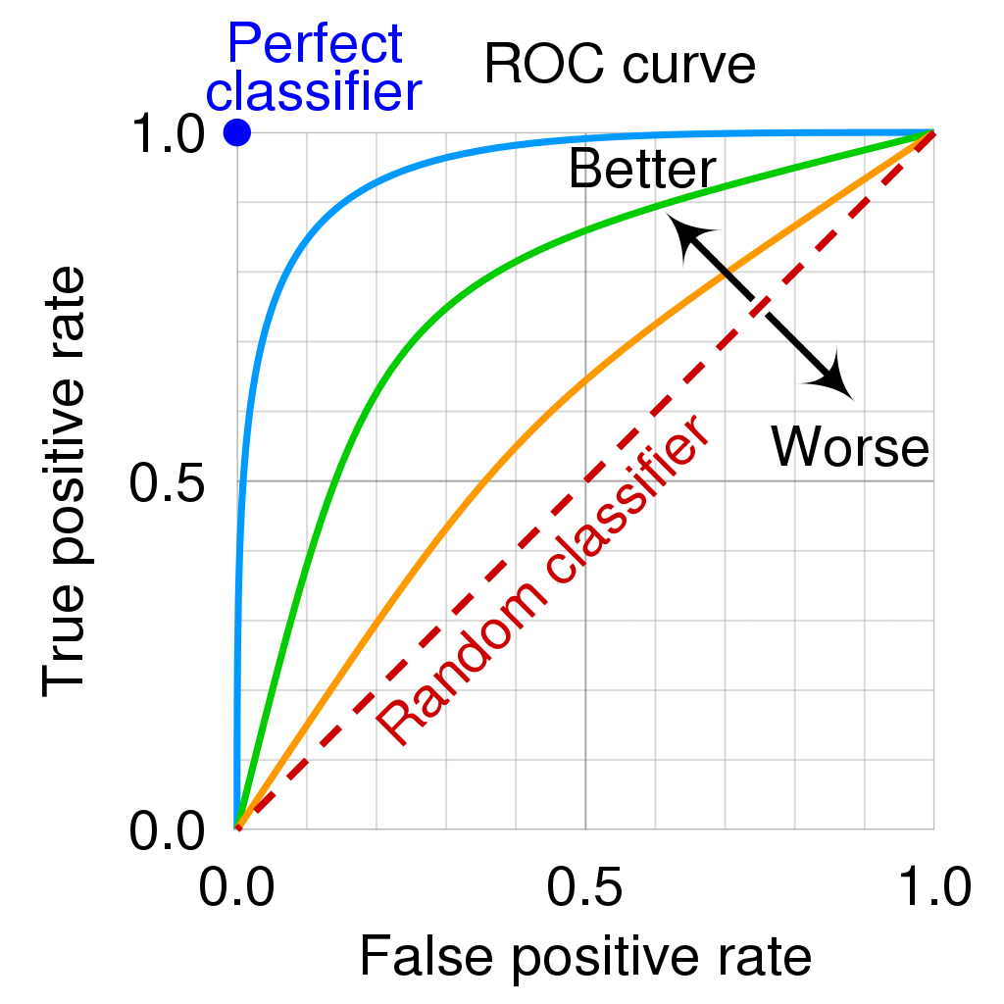
ROC curve (receiver operating characteristic curve):
plot (TPR, FPR) for every possible decision threshold
Lowering the classification threshold classifies more items as positive, thus increasing both False Positives and True Positives
https://en.wikipedia.org/wiki/Receiver_operating_characteristic

Slide 15
ROC curve (receiver operating characteristic curve):
plot (TPR, FPR) for every possible decision threshold
Lowering the classification threshold classifies more items as positive, thus increasing both False Positives and True Positives
Area of random classifier = 0.5
https://en.wikipedia.org/wiki/Receiver_operating_characteristic

Slide 16
Area of perfect classifier = 1.0
ROC curve (receiver operating characteristic curve):
plot (TPR, FPR) for every possible decision threshold
Lowering the classification threshold classifies more items as positive, thus increasing both False Positives and True Positives
Area of random classifier = 0.5
https://en.wikipedia.org/wiki/Receiver_operating_characteristic

Slide 17
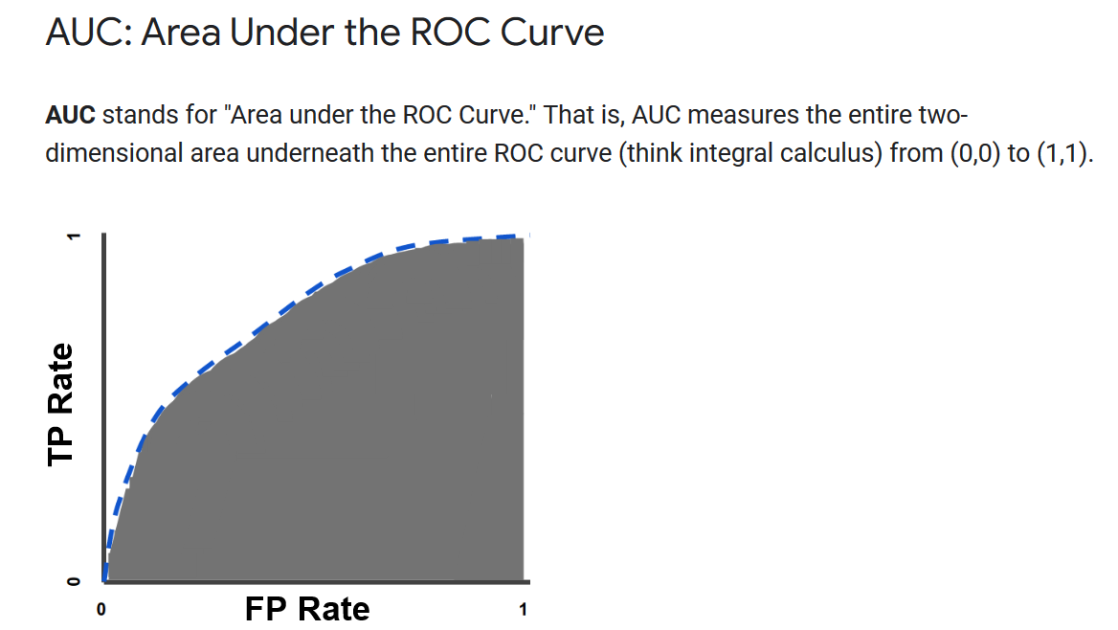
AUC is as the probability that the model ranks a random positive example more highly than a random negative example.
AUC represents the probability that a random positive (green) example is positioned to the right of a random negative (red) example.
https://developers.google.com/machine-learning/crash-course/classification/roc-and-auc

Slide 18
https://www2.stat.duke.edu/courses/Spring13/sta102.001/Lec/Lec20.pdf

Slide 19
https://www2.stat.duke.edu/courses/Spring13/sta102.001/Lec/Lec20.pdf

Slide 20
https://www2.stat.duke.edu/courses/Spring13/sta102.001/Lec/Lec20.pdf

Slide 21
https://www2.stat.duke.edu/courses/Spring13/sta102.001/Lec/Lec20.pdf

Slide 22
Some circles correspond to more than one data point.
https://www2.stat.duke.edu/courses/Spring13/sta102.001/Lec/Lec20.pdf

Slide 23
Not valid since Age = 0 is outside of included data range.
https://www2.stat.duke.edu/courses/Spring13/sta102.001/Lec/Lec20.pdf

Slide 24
https://www2.stat.duke.edu/courses/Spring13/sta102.001/Lec/Lec20.pdf

Slide 25
Some circles correspond to more than one data point.
https://www2.stat.duke.edu/courses/Spring13/sta102.001/Lec/Lec20.pdf

Slide 26
https://www2.stat.duke.edu/courses/Spring13/sta102.001/Lec/Lec20.pdf

Slide 27
since p = 1.17(1-p) → (1 + 1.17)p = 1.17
Thus for a 26 year old,
= 1.17(0.94) = 1.10 for odds
Probability = 1.1/2.1 = 0.524 = 0.972(0.539)
https://www2.stat.duke.edu/courses/Spring13/sta102.001/Lec/Lec20.pdf

Slide 28
Devopedia. 2022. "Logistic Regression." Version 10, January 19. Accessed 2023-02-11. https://devopedia.org/logistic-regression
Cost functions: Solution corresponds to minimum of cost function

Slide 29
http://courses.atlas.illinois.edu/spring2016/STAT/STAT200/RProgramming/Maximum_Likelihood.html

Slide 30
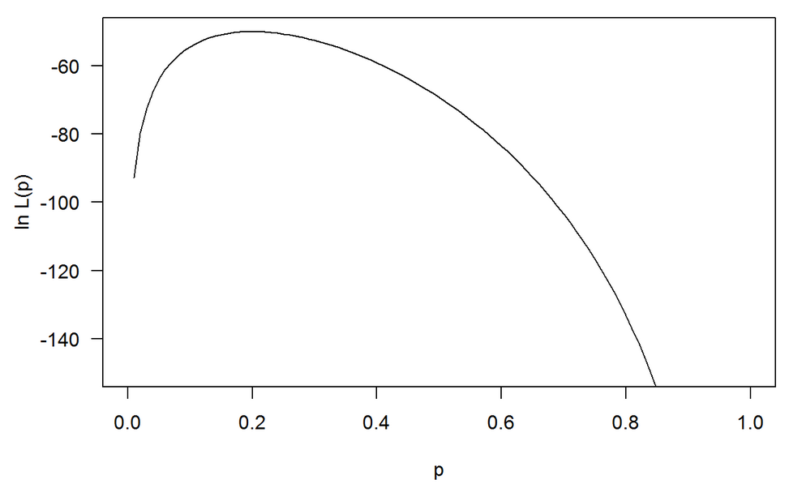
Maximum occurs at 0.2
http://courses.atlas.illinois.edu/spring2016/STAT/STAT200/RProgramming/Maximum_Likelihood.html

Slide 31
Devopedia. 2022. "Logistic Regression." Version 10, January 19. Accessed 2023-02-11. https://devopedia.org/logistic-regression
Linear model General linear model
Cost function for linear regression Cost function for logistic regression
Minimize cost function to find best function f
(eg: if f(x) = mx + b, find m and b that minimizes Minimize cost function to find best probability function. This
cost function RSS. corresponds to finding best m and b that minimizes cost for
p(x) = 1/[1 + exp(-b - mx)]

Slide 32
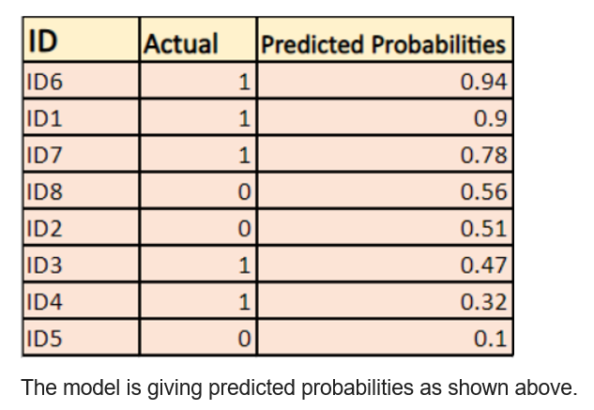
https://devopedia.org/logistic-regression
Log Loss - Logistic Regression's Cost Function for Beginners (analyticsvidhya.com)

Slide 33
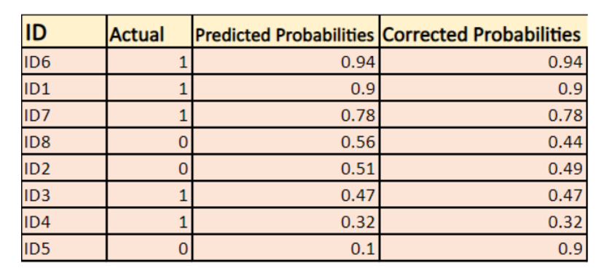
Corrected probabilities $=\left\{\begin{matrix}p\left(y_{i}\right) if p\left(y_{i}\right)=1 \\ 1−ρ\left(y_{i}\right) if {p(y}_{\dot{i}})=0\end{matrix}\right.$
Log Loss - Logistic Regression's Cost Function for Beginners (analyticsvidhya.com)

Slide 34
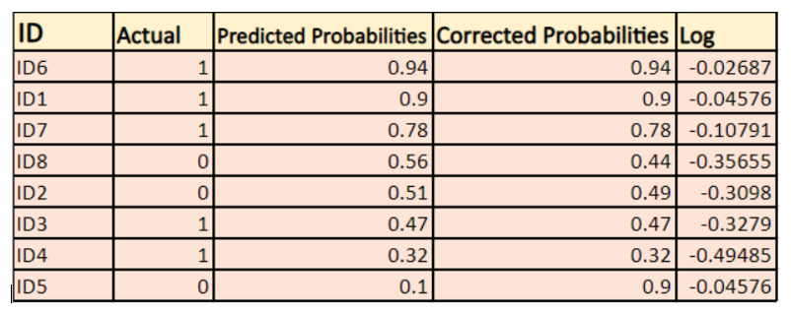
Log Loss - Logistic Regression's Cost Function for Beginners (analyticsvidhya.com)

Slide 35
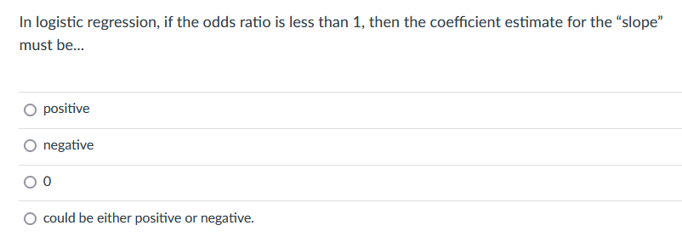
“slope” = m
p(x) = 1/[1 + exp(-b - mx)] → ln[p/(1-p)] = b + mx

Slide 36
since p = 1.17(1-p) → (1 + 1.17)p = 1.17
Odds ratio:
Thus for a 26 year old,
= 1.17(0.94) = 1.10 for odds
Probability = 1.1/2.1 = 0.524
https://www2.stat.duke.edu/courses/Spring13/sta102.001/Lec/Lec20.pdf

Slide 37
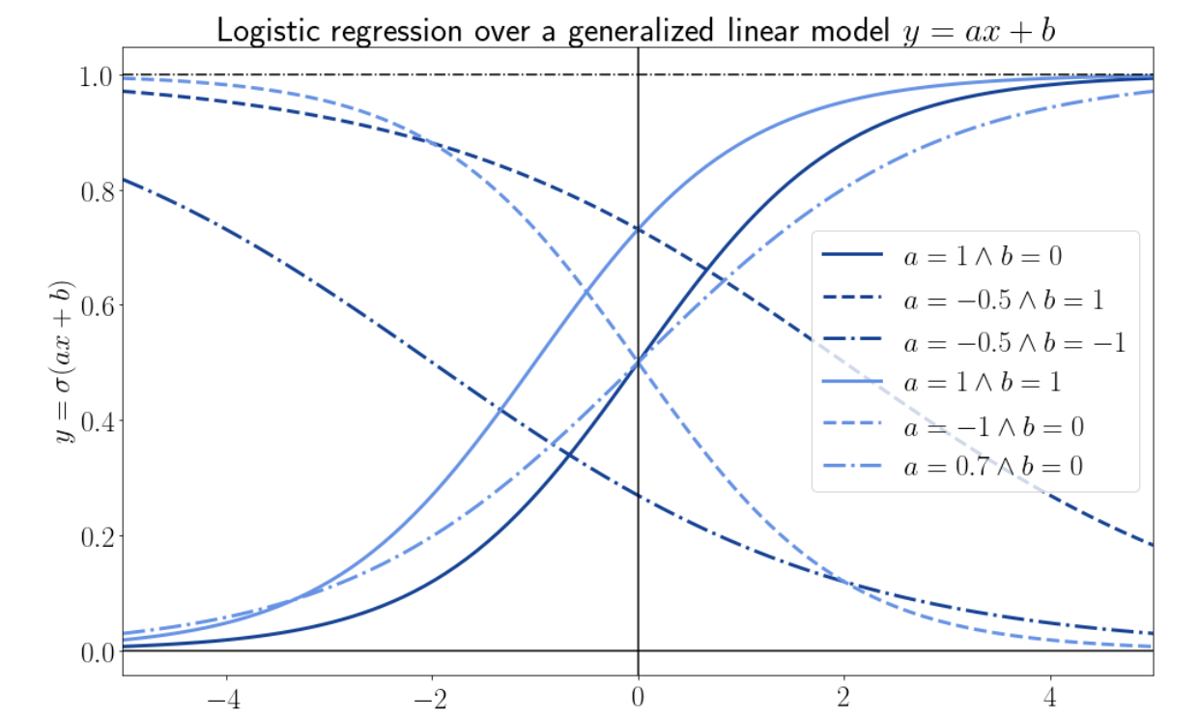
Why Does the Cost Function of Logistic Regression Have a Logarithmic Expression? | Baeldung on Computer Science

Slide 38
Correlation is NOT causation.
There may be a confounding variable affecting the results.
https://en.wikipedia.org/wiki/Confounding:
In statistics, a confounder (also confounding variable, confounding factor, extraneous determinant or lurking variable) is a variable that influences both the dependent variable and independent variable, causing a spurious association.

Slide 39
An Introduction to Statistical Learning
https://www.statlearning.com/

Slide 40
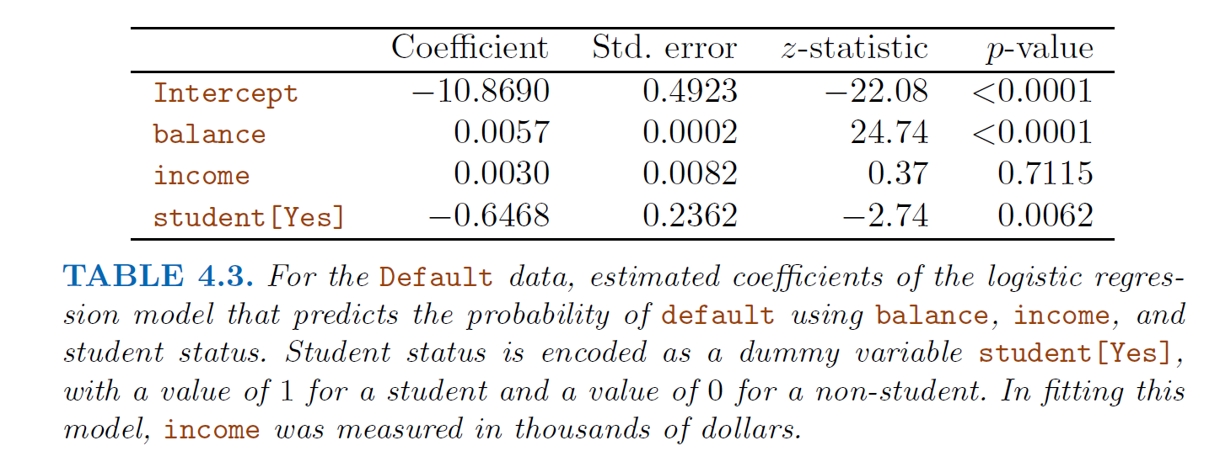
An Introduction to Statistical Learning
https://www.statlearning.com/

Slide 41
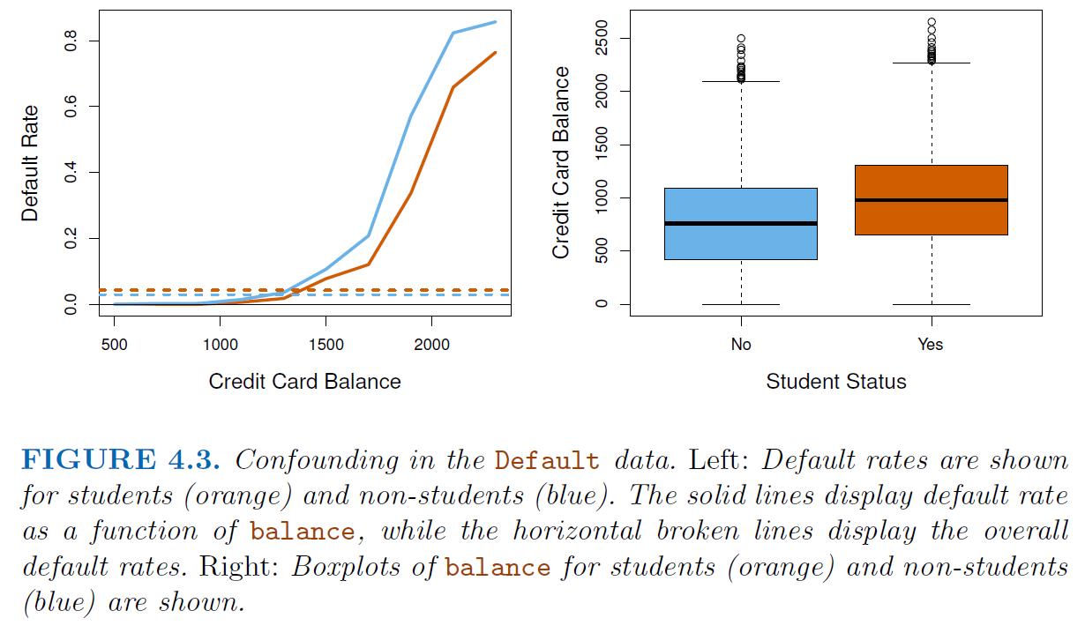
An Introduction to Statistical Learning https://www.statlearning.com/

Slide 42
Devopedia. 2022. "Logistic Regression." Version 10, January 19. Accessed 2023-02-11. https://devopedia.org/logistic-regression
Linear model General linear model
Cost function for linear regression Cost function for logistic regression
Minimize cost function to find best function f
(eg: if f(x) = mx + b, find m and b that minimizes Minimize cost function to find best probability function. This
cost function RSS. corresponds to finding best m and b that minimizes cost for
p(x) = 1/[1 + exp(-f(x)]

Slide 43
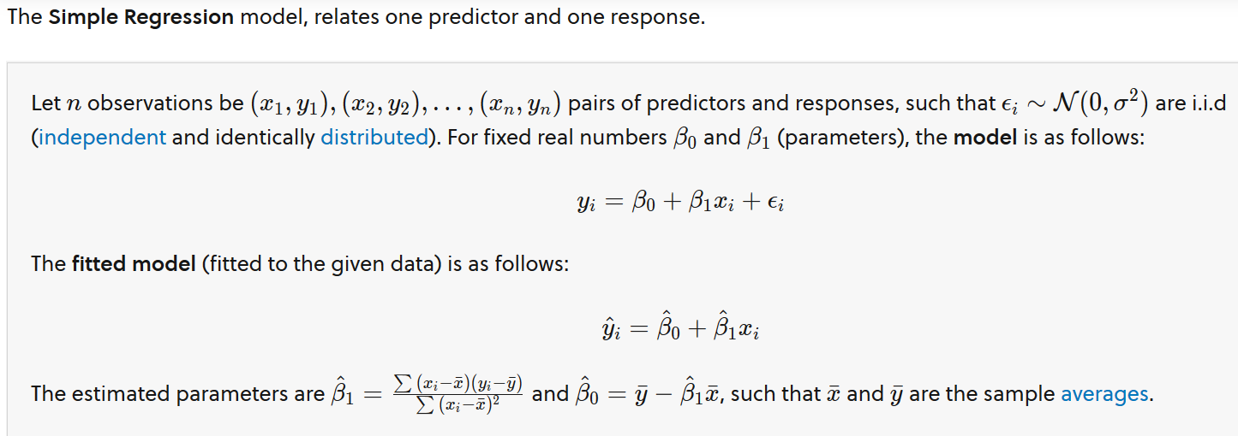
Multivariate Regression. Brilliant.org. Retrieved 19:29, April 16, 2023, from https://brilliant.org/wiki/multivariate-regression/

Slide 44
Multiple Variable Regression
Multivariate Regression. Brilliant.org. Retrieved 19:29, April 16, 2023, from https://brilliant.org/wiki/multivariate-regression/

Slide 45
Multivariate Regression. Brilliant.org. Retrieved 19:29, April 16, 2023, from https://brilliant.org/wiki/multivariate-regression/

Slide 46
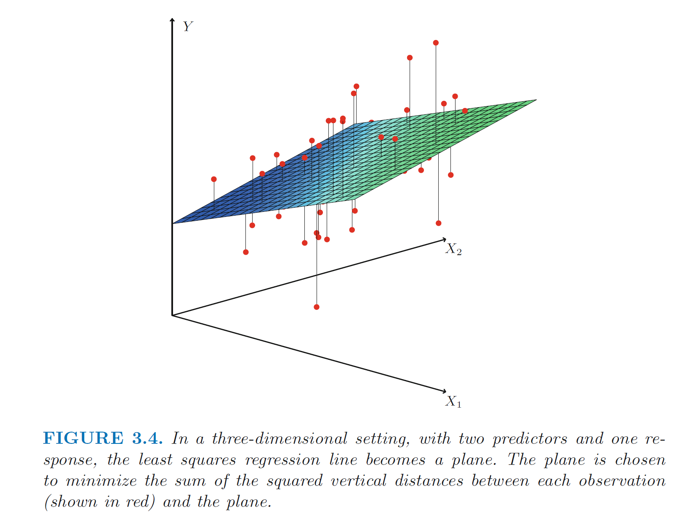
Multivariable
linear regression
(not logistic)
https://www.statlearning.com/

Slide 47
$$f\left(x\right)=a_{0}+a_{1}x_{1}+ax_{2}+⋯+a_{n}x_{n}$$
Overfitting: Too many variables
StatQuest: Linear Models Pt.1 - Linear Regression https://www.youtube.com/watch?v=nk2CQITm_eo

Slide 48
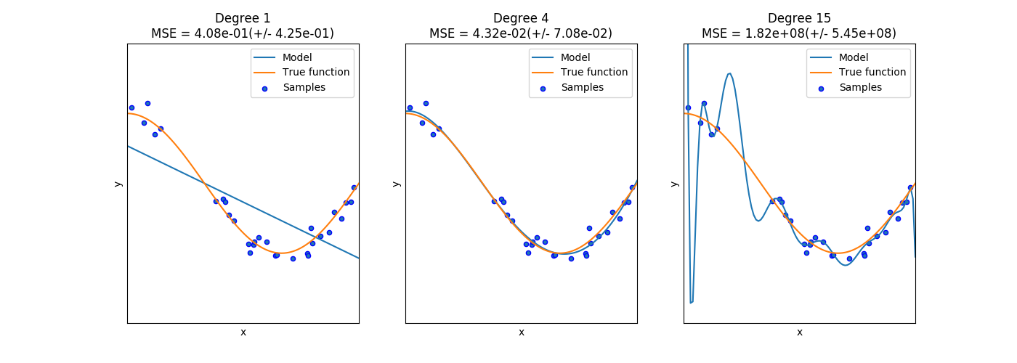
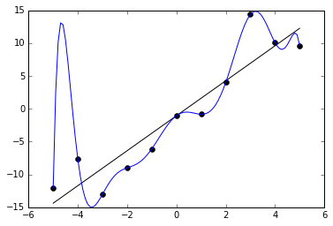
Ivan Meza http://turing.iimas.unam.mx/~ivanvladimir/slides/rpyaa/02_regression.html#/60
Overfitting: Too many parameters
Underfitting versus overfitting
$$Ex: f\left(x\right)=a_{0}+a_{1}x+…+a_{n}x^{n}$$
https://it.wikipedia.org/wiki/Overfitting

Slide 49
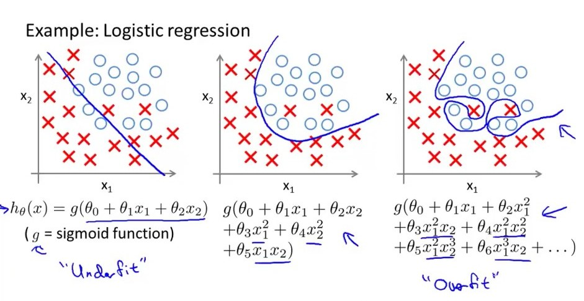
Overfitting: Too many parameters
Underfitting versus overfitting
https://stats.stackexchange.com/questions/71946/overfitting-a-logistic-regression-model

Slide 50
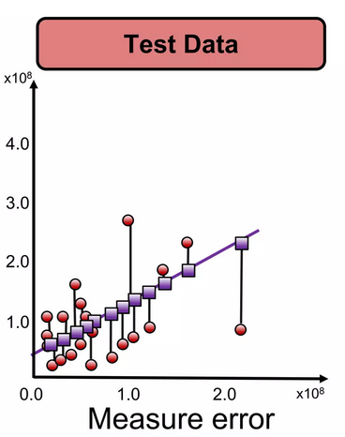
To avoid overfitting due to too many parameters:
https://www.slideshare.net/ankit_ppt/ml2-train-testsplitsvalidationlinearregression

Slide 51
How do you split the data?

Slide 52
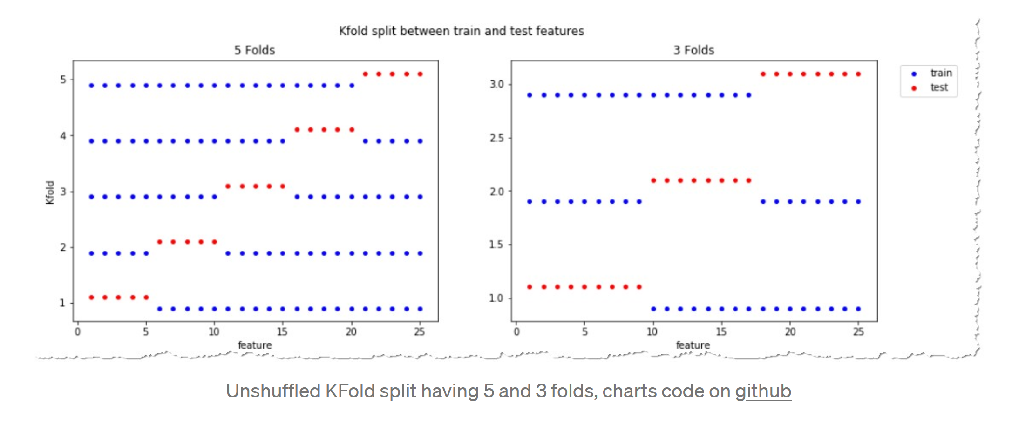
https://towardsdatascience.com/complete-guide-to-pythons-cross-validation-with-examples-a9676b5cac12

Slide 53
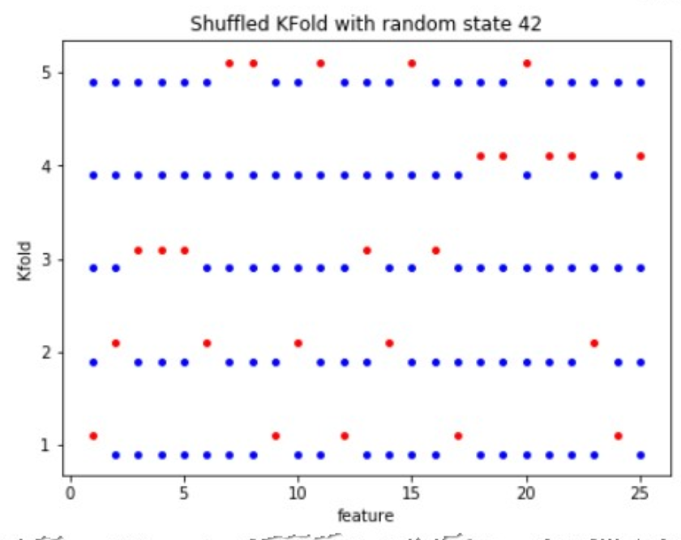
https://towardsdatascience.com/complete-guide-to-pythons-cross-validation-with-examples-a9676b5cac12

Slide 54
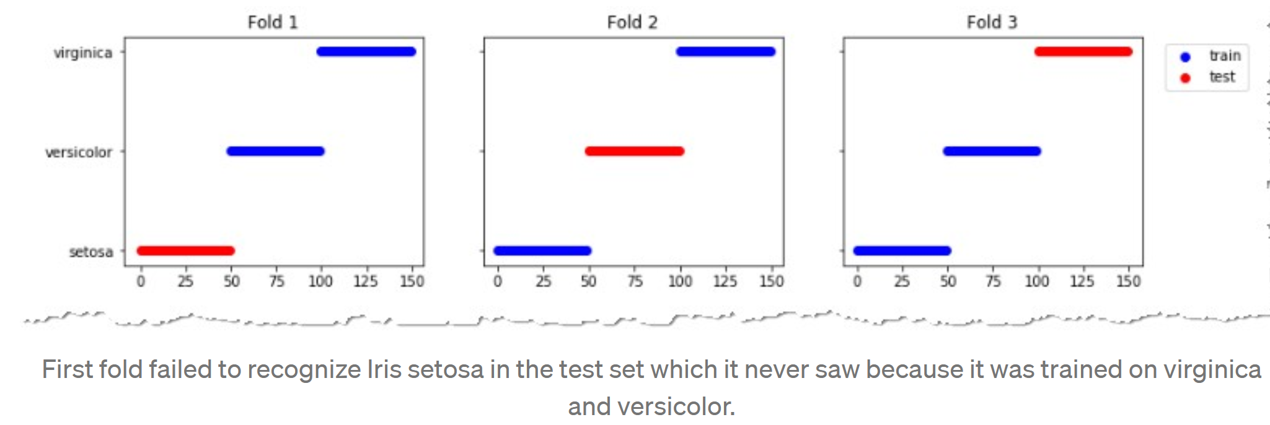
https://towardsdatascience.com/complete-guide-to-pythons-cross-validation-with-examples-a9676b5cac12

Slide 55
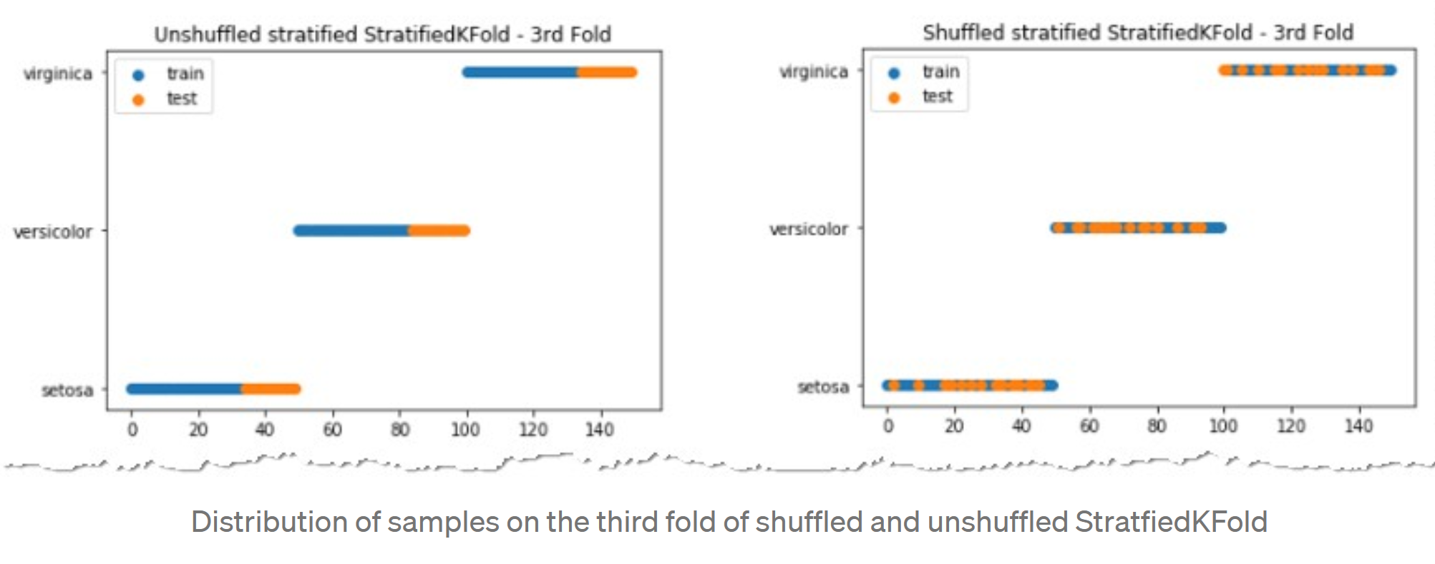
https://towardsdatascience.com/complete-guide-to-pythons-cross-validation-with-examples-a9676b5cac12

Slide 56
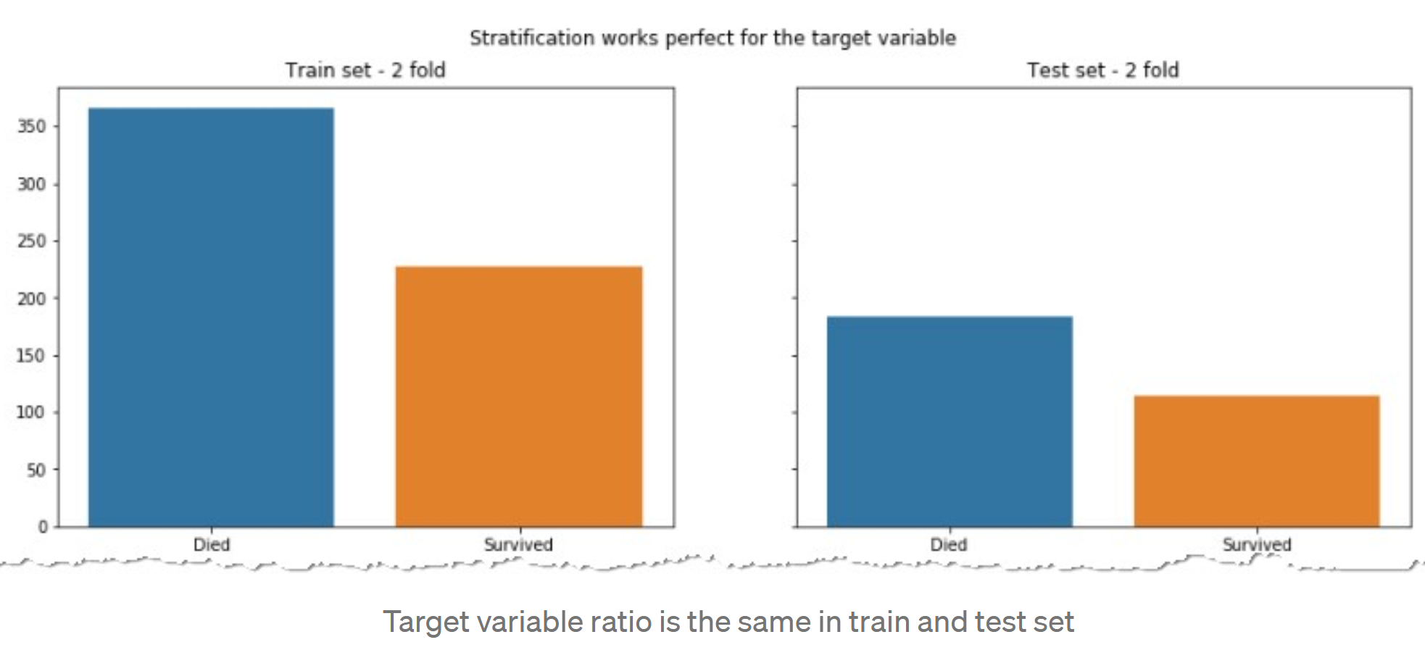
https://towardsdatascience.com/complete-guide-to-pythons-cross-validation-with-examples-a9676b5cac12

Slide 57
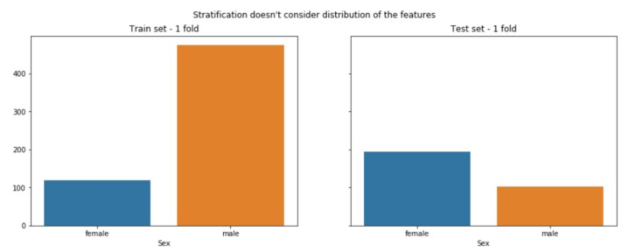
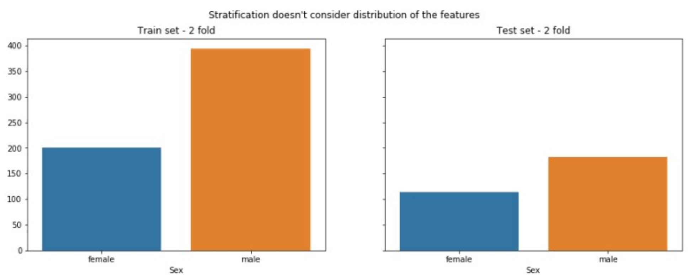
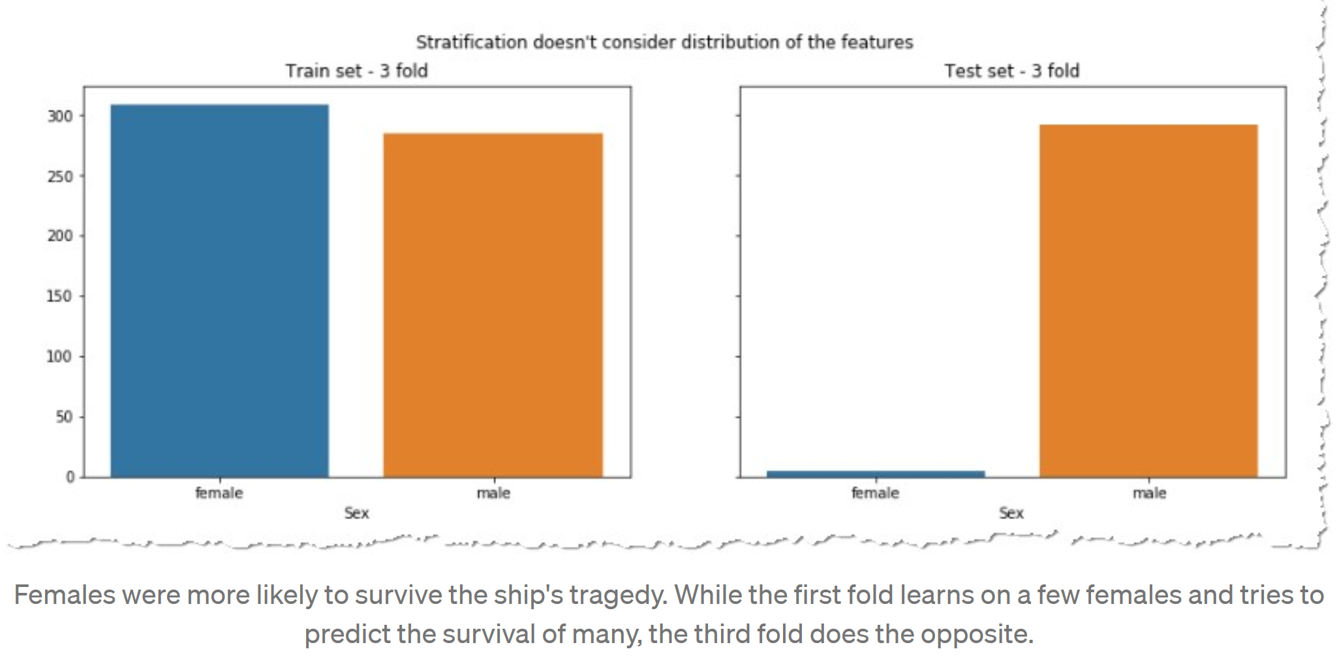
https://towardsdatascience.com/complete-guide-to-pythons-cross-validation-with-examples-a9676b5cac12

Slide 58
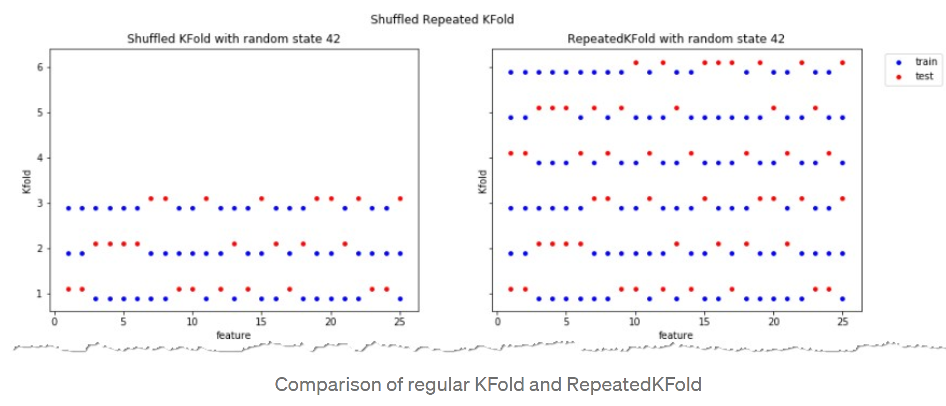
https://towardsdatascience.com/complete-guide-to-pythons-cross-validation-with-examples-a9676b5cac12

Slide 59
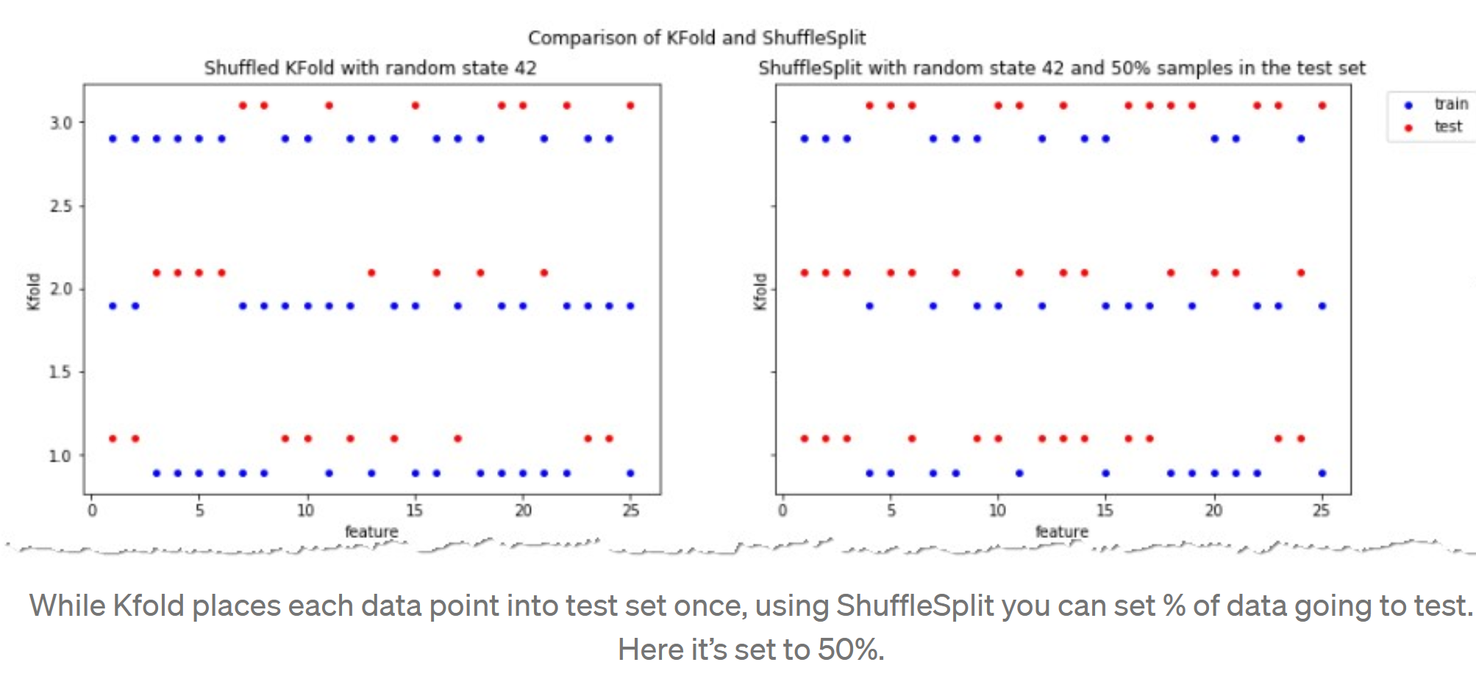
https://towardsdatascience.com/complete-guide-to-pythons-cross-validation-with-examples-a9676b5cac12

Slide 60
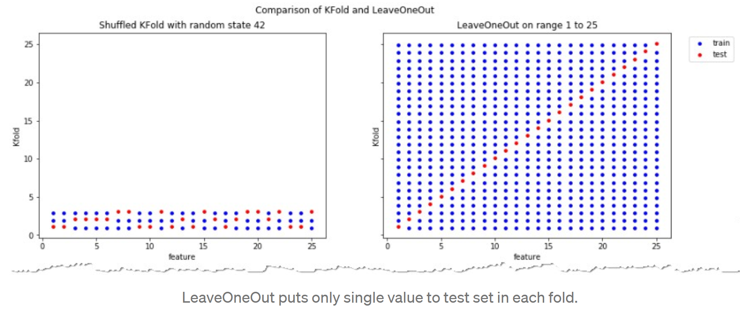
https://towardsdatascience.com/complete-guide-to-pythons-cross-validation-with-examples-a9676b5cac12

Slide 61
https://towardsdatascience.com/validating-your-machine-learning-model-25b4c8643fb7

