Slide 1
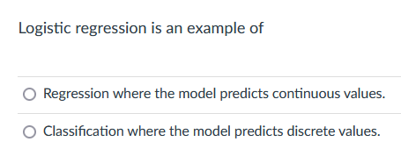
Please include 5760 in your e-mails to me.
Thursday’s zoom office hours moved to Friday due to
Panorama of Geometry and Topology #6
Spring 2023 (Francis Bonahon)
Thursday April 20th 5:30-6:30pm at 110 MLH
Francis Bonahon (USC)
Panorama seminar: Freeways and circle packings

Slide 2
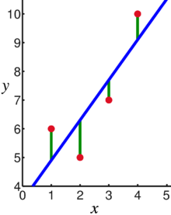
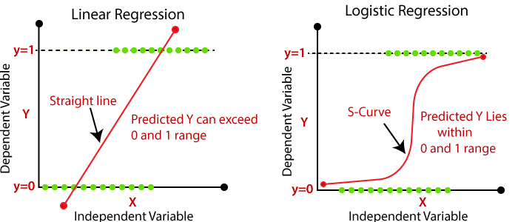
Supervised Learning: Use labeled data to predict unlabeled data.
2 types of supervised learning:
Regression: Predict continuous values.
    Ex: Linear regression.
F(x_{new}) = b₀ + b₁x_{new}
2. Classification: Predict discrete values.
    Ex: Logistic regression
https://en.wikipedia.org/wiki/Linear_regression

Slide 3
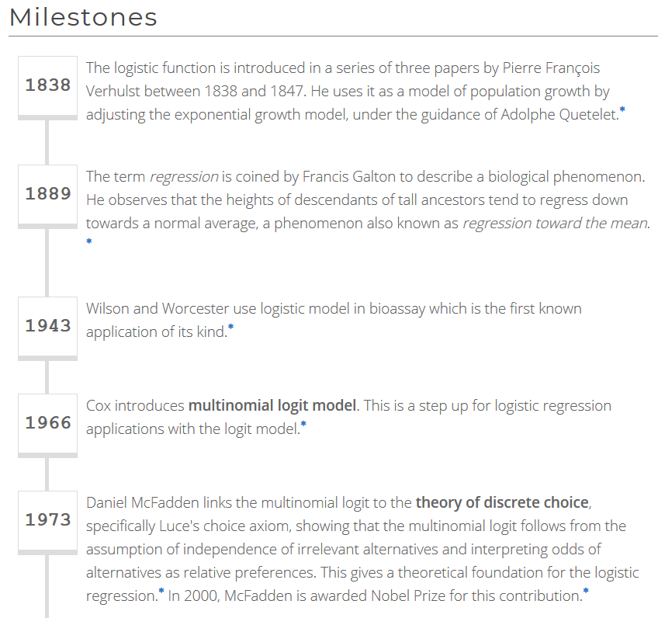
https://devopedia.org/logistic-regression

Slide 4
Probability and Odds
On coin flip, p(H) = ½
On 2 dice roll, p(7) = 6/36 =1/6
https://jmg1.psychology.msstate.edu/8803/logisticReg09.ppt

Slide 5
Odds
On coin flip, Odds(H) = 1/1
Odds are 1 to 1 that your coin flip will be “heads”
On 2 dice roll, Odds(7) = 6/(30) = 1/5
Odds(7) = p(7)/[1 - p(7)] = 1/6 / 5/6 = 1/5
Odds are “1 to 5” that you will roll “seven”
https://jmg1.psychology.msstate.edu/8803/logisticReg09.ppt

Slide 6
Problems with Odds
Asymmetry
  Possible range from 0 to “very large”
    With 1 indicating no difference
Due to asymmetry
  The same odds in opposite direction may appear different
  Odds of 5.0 (5 to 1) of losing are the same as odds of .2 of winning (1 to 5)
https://jmg1.psychology.msstate.edu/8803/logisticReg09.ppt

Slide 7
The Logistic Regression Model
The "logit" model solves these problems:
ln[p/(1-p)] = α + βX + e
p is the probability that the event Y occurs, p(Y=1)
p/(1-p) is the "odds ratio"
ln[p/(1-p)] is the log odds ratio, or "logit"
https://nlp.stanford.edu/~manning/courses/ling236/handouts/whitehead-logistic-regression.ppt

Slide 8
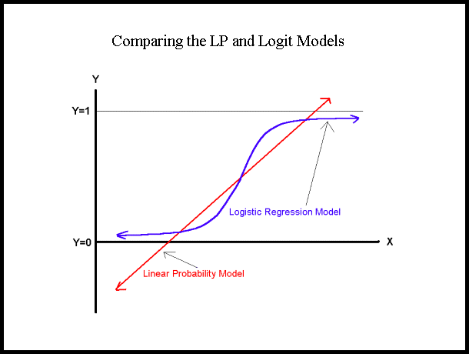
More:
The logistic distribution constrains the estimated probabilities to lie between 0 and 1.
The estimated probability is:
p = 1/[1 + exp(-α - β X)]
if you let α + β X =0, then p = .50
as α + β X gets really big, p approaches 1
as α + β X gets really small, p approaches 0
https://nlp.stanford.edu/~manning/courses/ling236/handouts/whitehead-logistic-regression.ppt

Slide 9
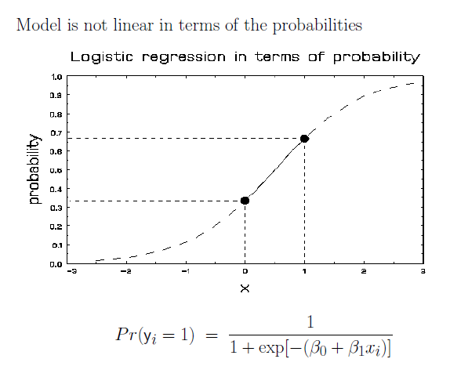
More Visualizations and Formulas
https://jmg1.psychology.msstate.edu/8803/logisticReg09.ppt

Slide 10
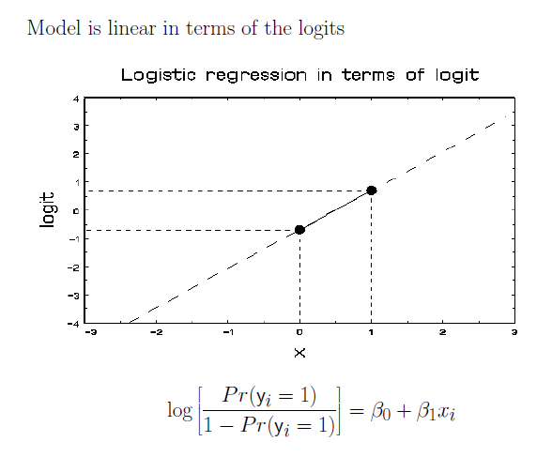
https://jmg1.psychology.msstate.edu/8803/logisticReg09.ppt

Slide 11
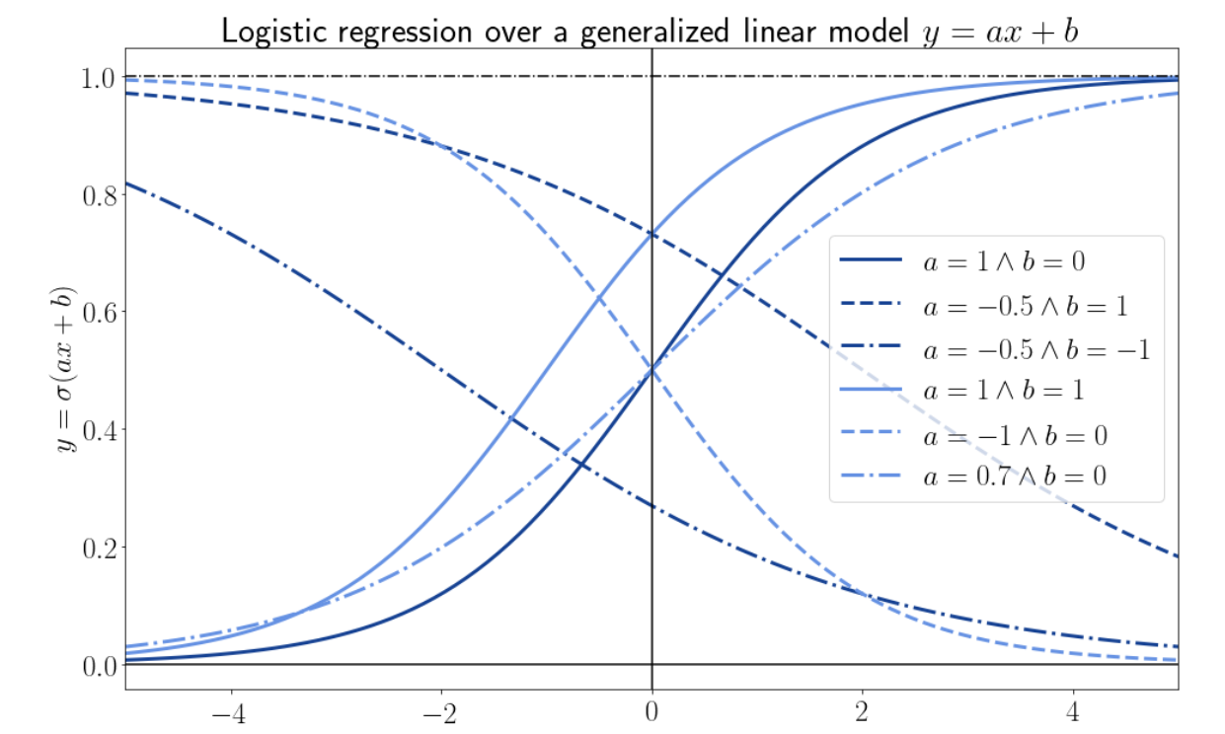
Why Does the Cost Function of Logistic Regression Have a Logarithmic Expression? | Baeldung on Computer Science

Slide 12
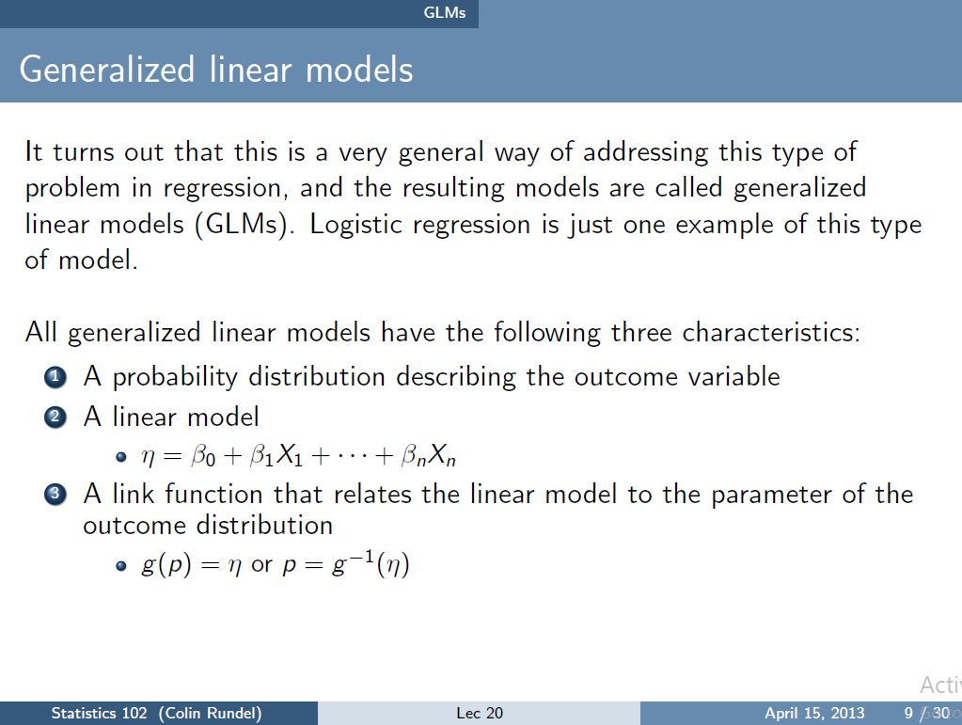
https://www2.stat.duke.edu/courses/Spring13/sta102.001/Lec/Lec20.pdf

Slide 13
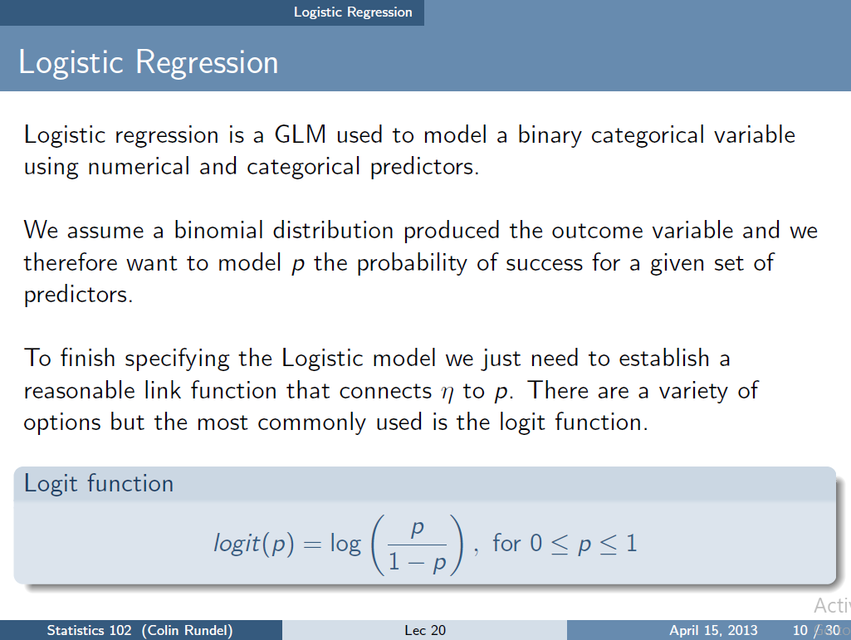
https://www2.stat.duke.edu/courses/Spring13/sta102.001/Lec/Lec20.pdf

Slide 14
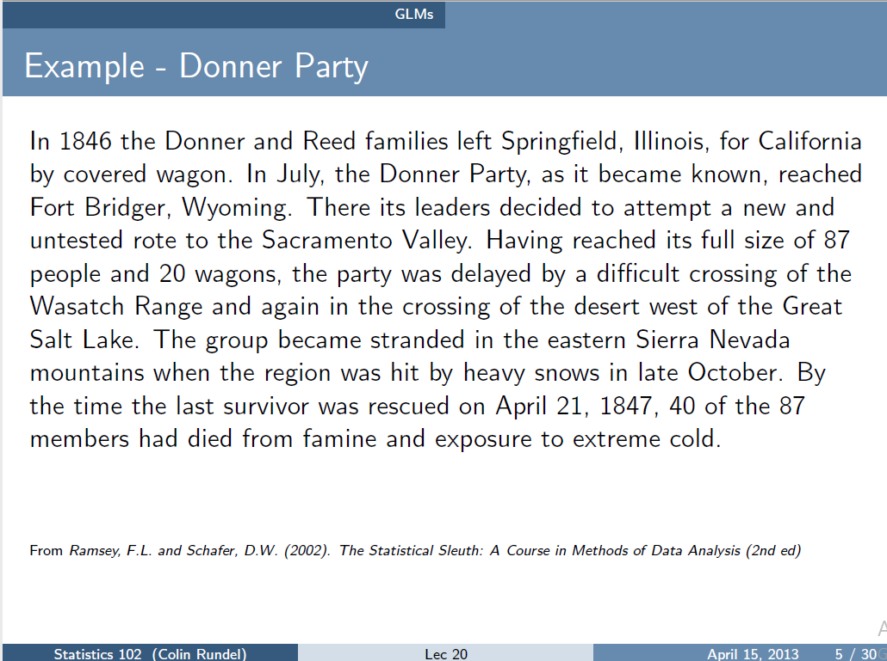
https://www2.stat.duke.edu/courses/Spring13/sta102.001/Lec/Lec20.pdf

Slide 15
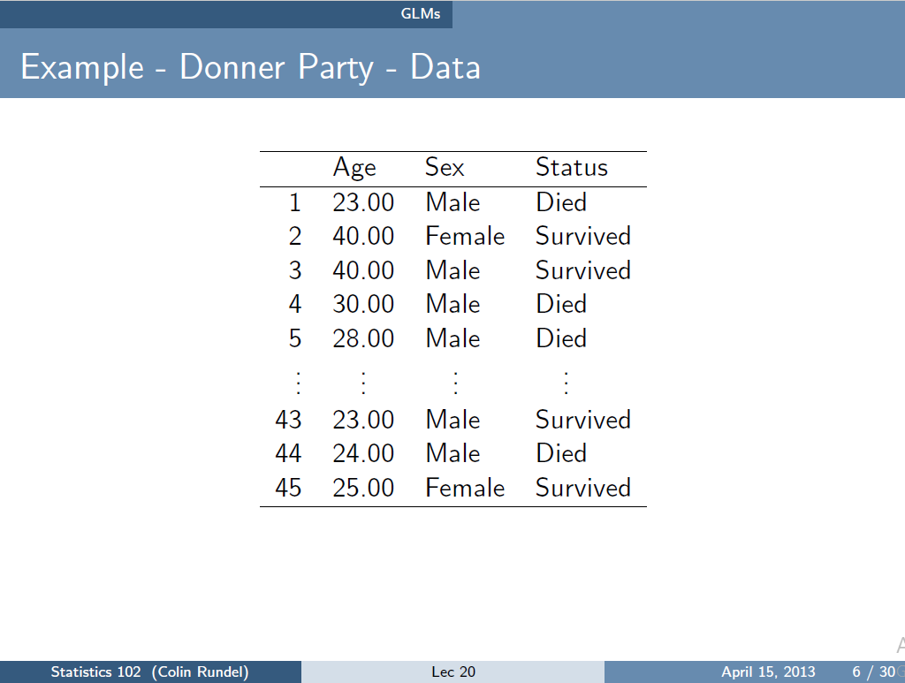
https://www2.stat.duke.edu/courses/Spring13/sta102.001/Lec/Lec20.pdf

Slide 16
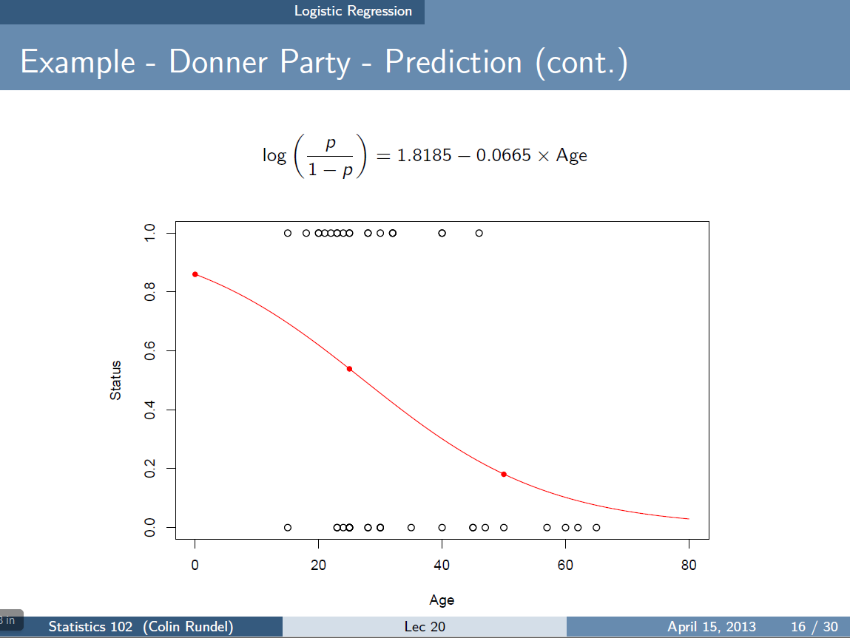
Some circles correspond to more than one data point.
https://www2.stat.duke.edu/courses/Spring13/sta102.001/Lec/Lec20.pdf

Slide 17
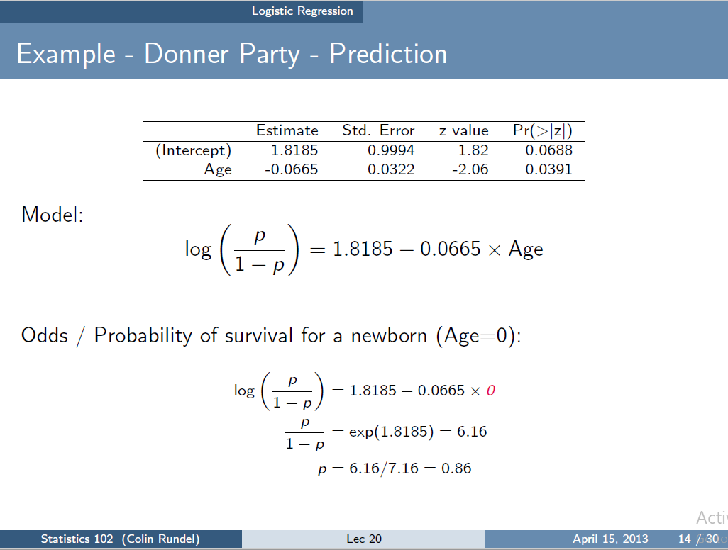
Not valid since Age = 0 is outside of included data range.
https://www2.stat.duke.edu/courses/Spring13/sta102.001/Lec/Lec20.pdf

Slide 18
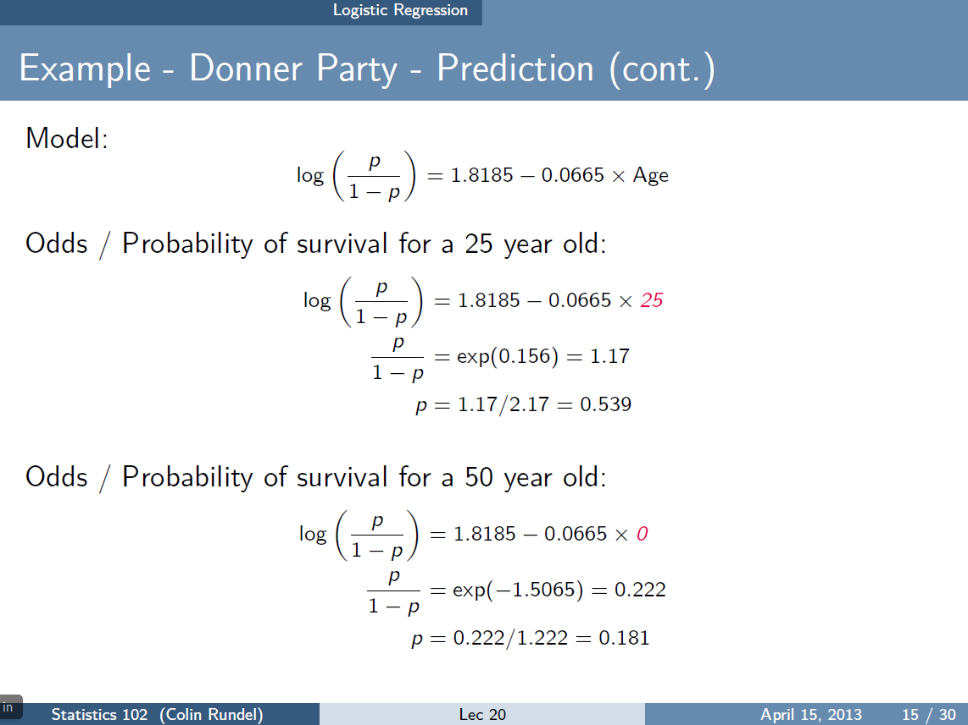
https://www2.stat.duke.edu/courses/Spring13/sta102.001/Lec/Lec20.pdf

Slide 19
Some circles correspond to more than one data point.
https://www2.stat.duke.edu/courses/Spring13/sta102.001/Lec/Lec20.pdf

Slide 20
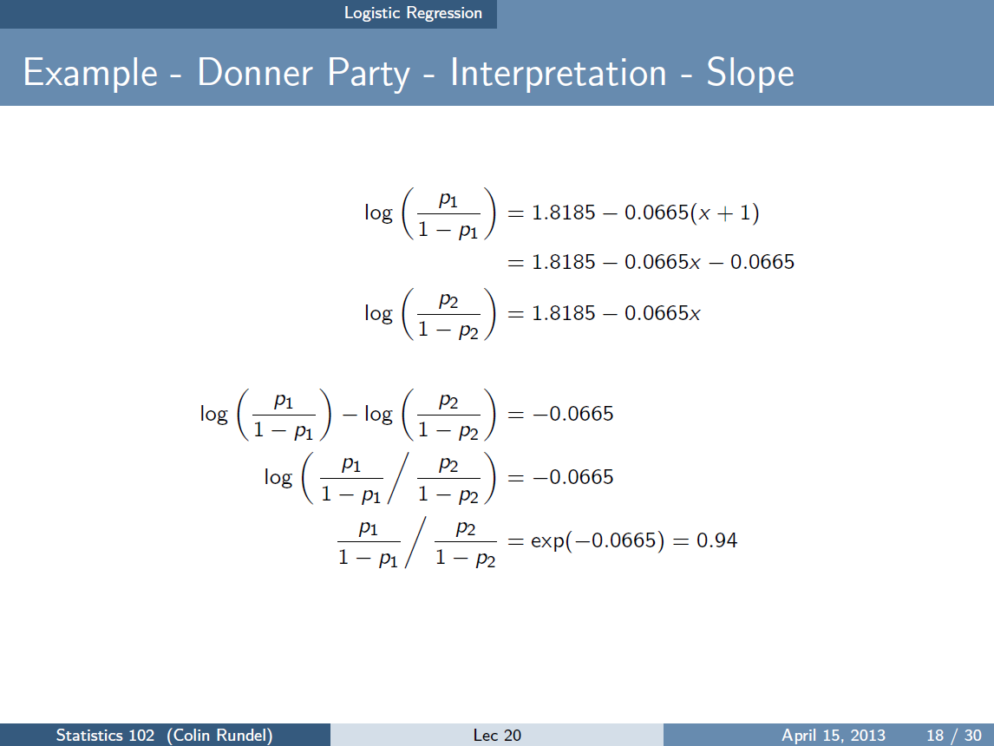
https://www2.stat.duke.edu/courses/Spring13/sta102.001/Lec/Lec20.pdf

Slide 21
since p = 1.17(1-p) → (1 + 1.17)p = 1.17
Thus for a 26 year old,
= 1.17(0.94) = 1.10 for odds
Probability = 1.1/2.1 = 0.524
https://www2.stat.duke.edu/courses/Spring13/sta102.001/Lec/Lec20.pdf

Slide 22
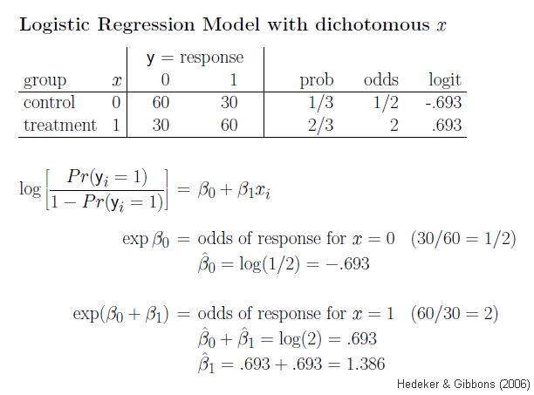
https://jmg1.psychology.msstate.edu/8803/logisticReg09.ppt

Slide 23
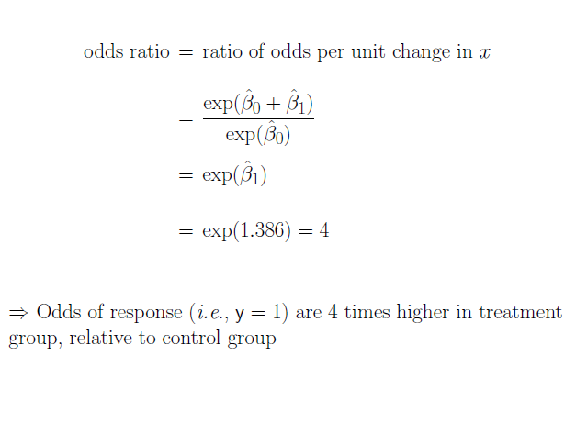
https://jmg1.psychology.msstate.edu/8803/logisticReg09.ppt

Slide 24
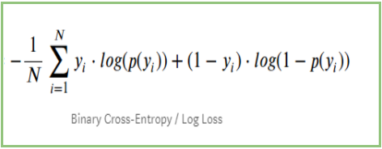
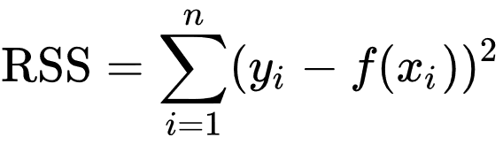
Devopedia. 2022. "Logistic Regression." Version 10, January 19. Accessed 2023-02-11. https://devopedia.org/logistic-regression
Cost functions: Solution corresponds to minimum of cost function

Slide 25
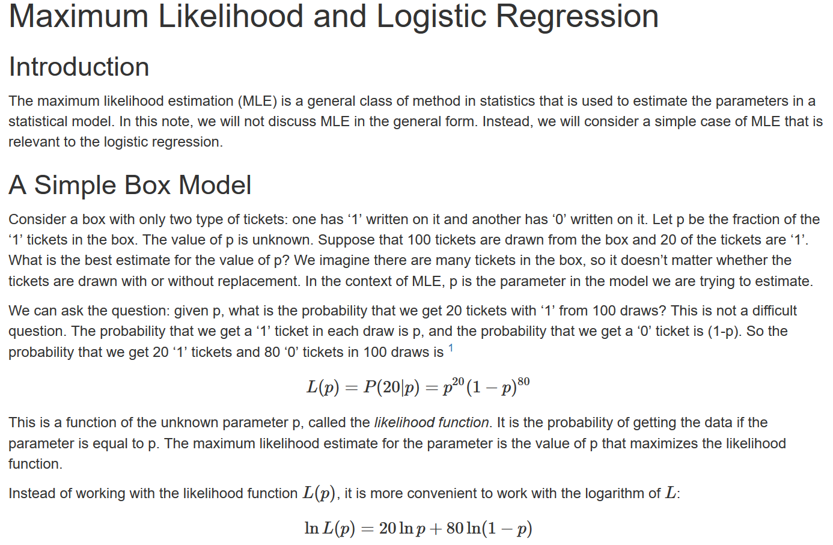
http://courses.atlas.illinois.edu/spring2016/STAT/STAT200/RProgramming/Maximum_Likelihood.html

Slide 26


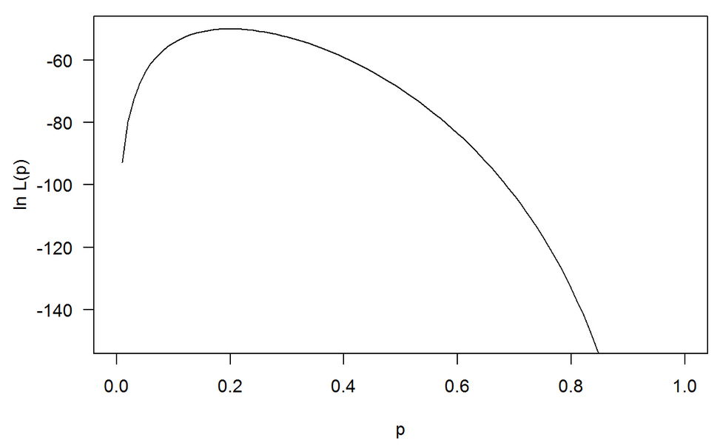
Maximum occurs at 0.2
http://courses.atlas.illinois.edu/spring2016/STAT/STAT200/RProgramming/Maximum_Likelihood.html

Slide 27
Devopedia. 2022. "Logistic Regression." Version 10, January 19. Accessed 2023-02-11. https://devopedia.org/logistic-regression
Linear model General linear model
Cost function for linear regression Cost function for logistic regression
Minimize cost function to find best function f
(eg: if f(x) = mx + b, find m and b that minimizes Minimize cost function to find best probability function. This
cost function RSS. corresponds to finding best m and b that minimizes cost for
p(x) = 1/[1 + exp(-b - mx)]

Slide 28
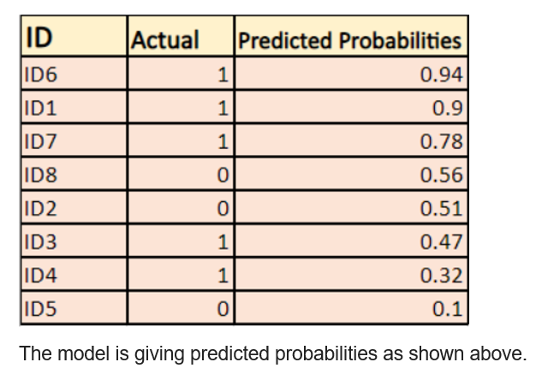
https://devopedia.org/logistic-regression
Log Loss - Logistic Regression's Cost Function for Beginners (analyticsvidhya.com)

Slide 29
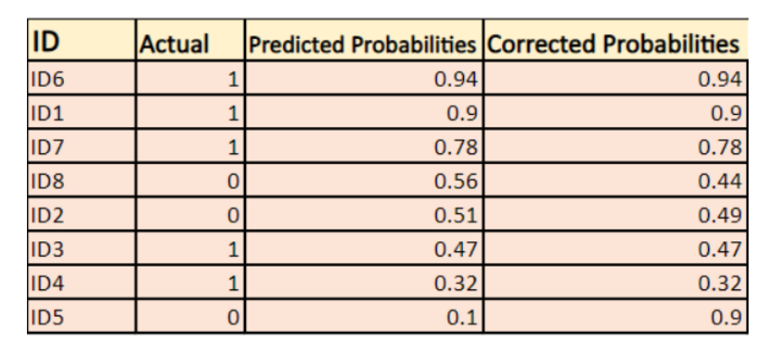
Log Loss - Logistic Regression's Cost Function for Beginners (analyticsvidhya.com)

Slide 30
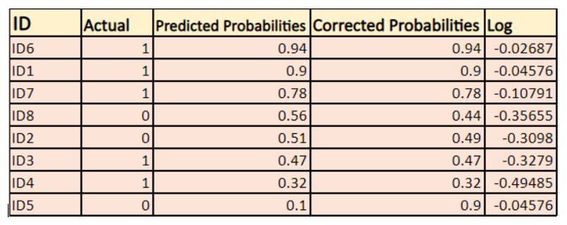

Log Loss - Logistic Regression's Cost Function for Beginners (analyticsvidhya.com)

Slide 31
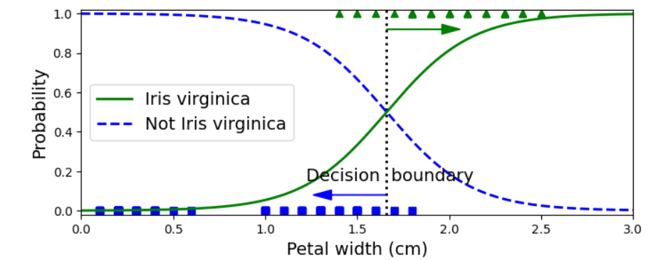
Decision Boundary: p = 0.5

Slide 32
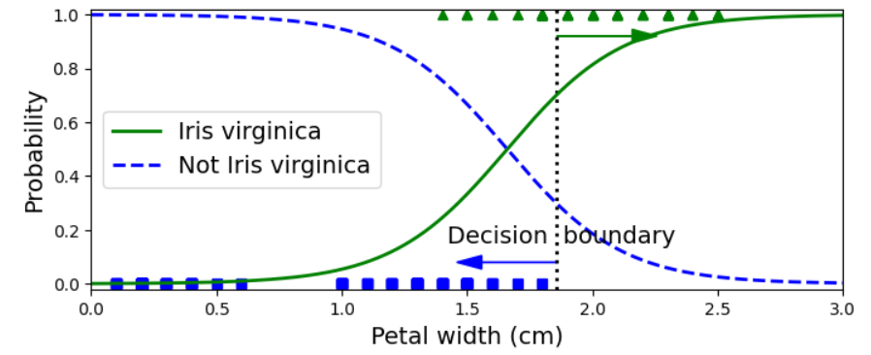
Decision Boundary: p = 0.7

Slide 33
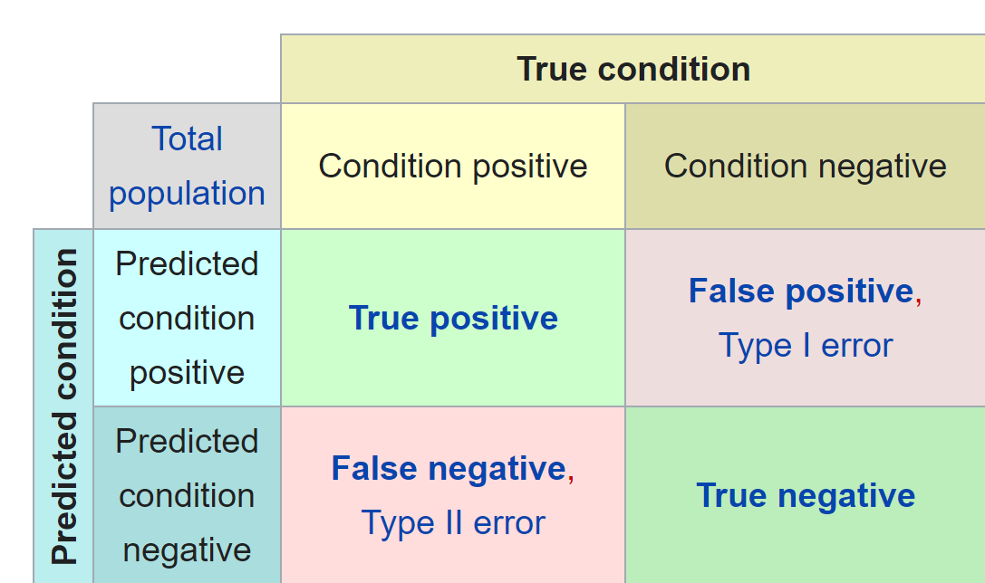
Confusion matrix
https://en.wikipedia.org/wiki/Confusion_matrix

Slide 34
Accuracy = $\frac{TP+TN}{sample population}$ = $\frac{\# of correct predictions}{total \# of predictions}$
Confusion matrix
https://en.wikipedia.org/wiki/Confusion_matrix

Slide 35

Accuracy = $\frac{TP+TN}{sample pop}$
= $\frac{\# of correct predictions}{total \# of predictions}$
=
12 + 12

Slide 36
Precision = $\frac{TP}{TP+FP}$ = proportion of true positives among all positives
Confusion matrix
https://en.wikipedia.org/wiki/Confusion_matrix

Slide 37

Increasing decision boundary increases precision
Precision = $\frac{TP}{TP+FP}$
= proportion of true positives
among all positives
=

Slide 38
Recall = $\frac{TP}{TP+FN}$ = proportion of actual positives correctly identified
Confusion matrix
https://en.wikipedia.org/wiki/Confusion_matrix

Slide 39

Increasing decision boundary decreases recall.
Recall = $\frac{TP}{TP+FN}$
= proportion of actual
positives correctly identified
=
12

Slide 40
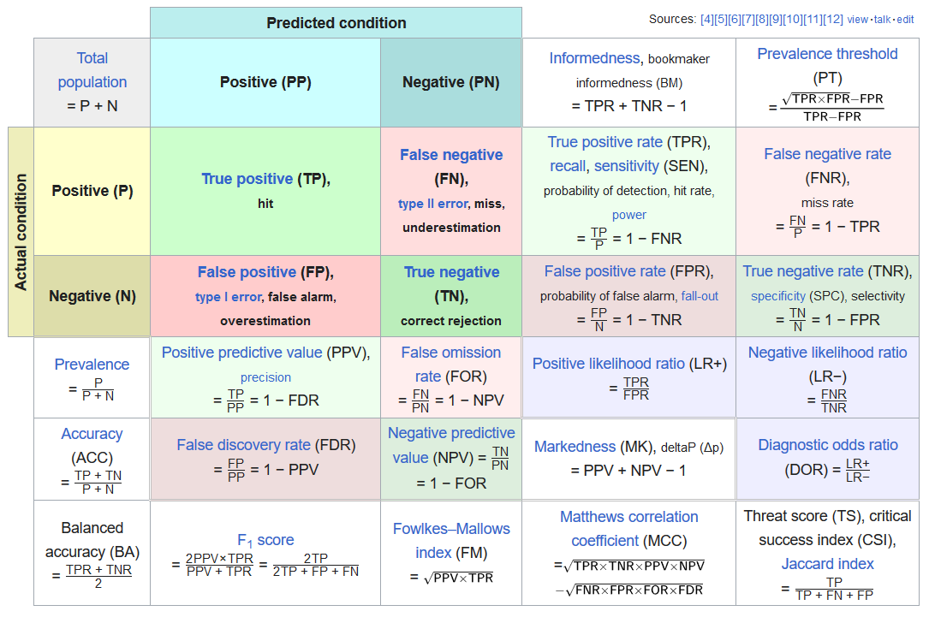
https://en.wikipedia.org/wiki/F-score#Formulation

