Slide 1
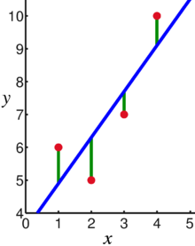
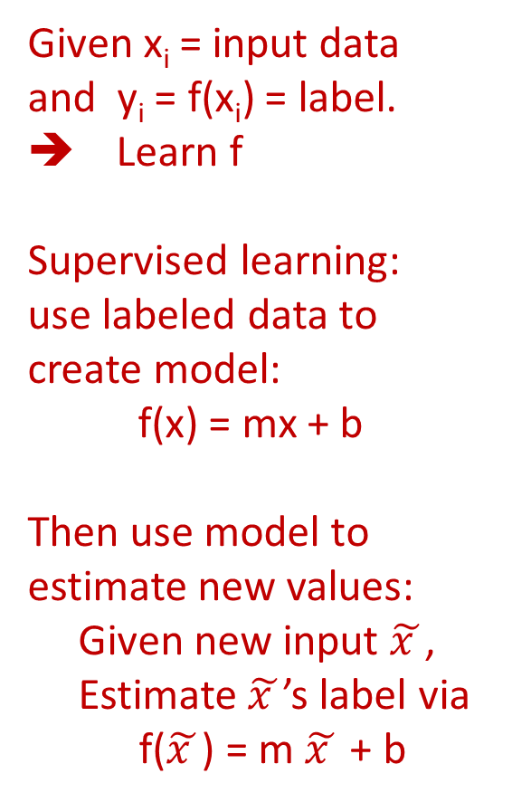
Linear regression = Least squares line (single variable x)
(or hyperplane for multiple variables)
Given x_{i} = input data and y_{i} = f(x_{i}) = label. ➔ Learn f
Supervised learning: use labeled data to create model:
f(x) = mx + b
Then use model to estimate new values:
Given new input $\tilde{x }$,
Estimate $\tilde{x }$’s label via
f($\tilde{x }$) = m $\tilde{x }$ + b
Supervised learning
Data: x_{i} = input data with no noise
y_{i} = labels
Find function
f: R → R
f(x) = mx + b
x = independent variable
y = dependent variable
(x, y) → (x, y’)
https://en.wikipedia.org/wiki/Linear_regression

Slide 2
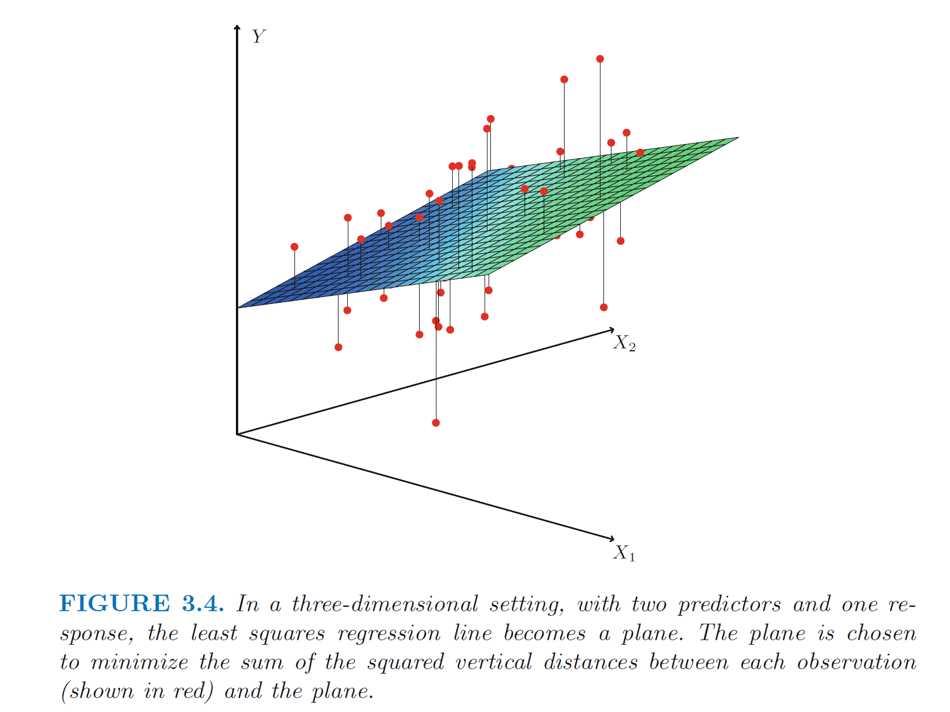
https://en.wikipedia.org/wiki/Linear_regression
https://www.statlearning.com/

Slide 3
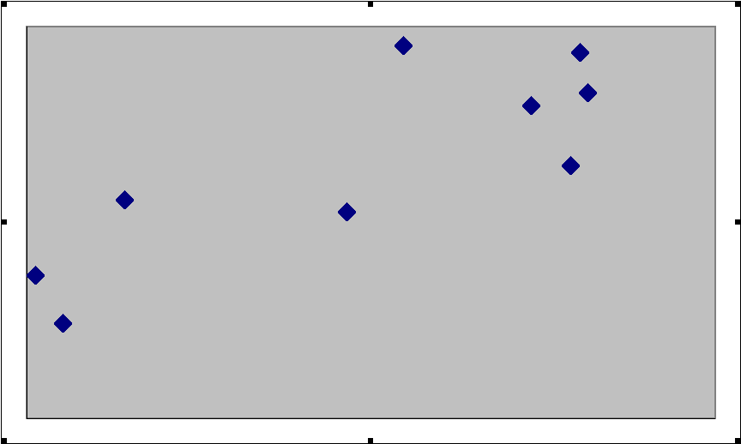
What is a Residual?
Here shows a residual on the scatter diagram
The residual
The regression line
The observed value y
The predicted value y
The x value of interest
https://emunix.emich.edu/~schu/MATH_170/Fall09_170/Evening%20session/Unit%203.ppt

Slide 4
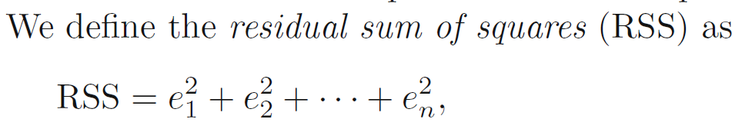
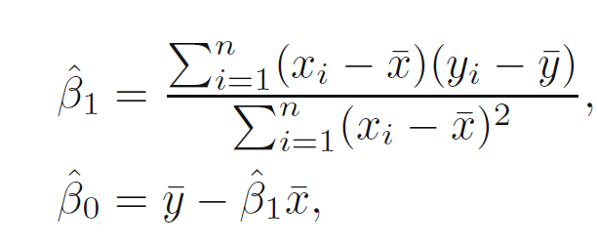
https://en.wikipedia.org/wiki/Linear_regression
https://www.statlearning.com/

Slide 5
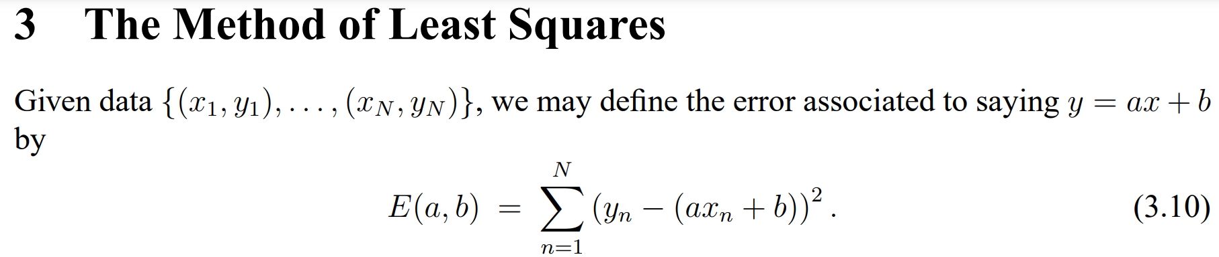
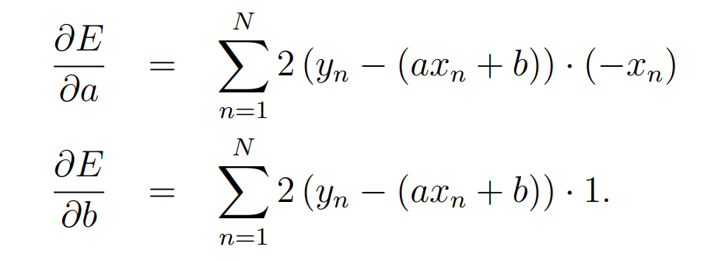
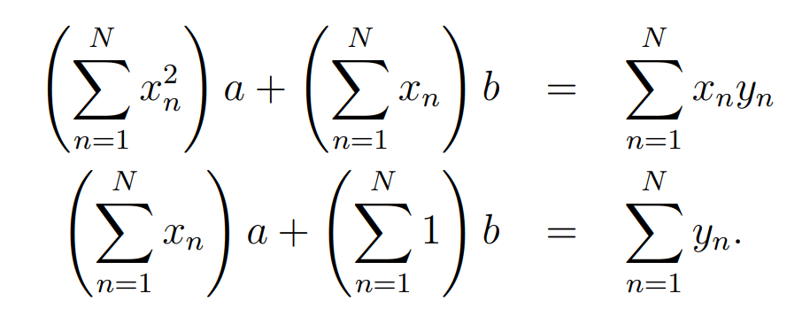
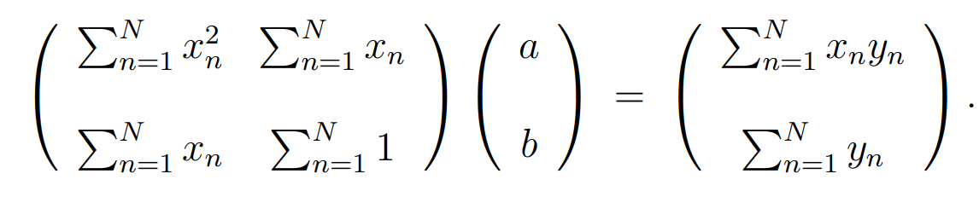
➔
https://web.williams.edu/Mathematics/sjmiller/public_html/BrownClasses/54/handouts/MethodLeastSquares.pdf

Slide 6
Find the Equation of a Linear Regression Line
The equation is determined by:
  b₀: y-intercept
  b₁: slope
Values that satisfy the least squares criterion:
https://en.wikipedia.org/wiki/Linear_regression

Slide 7
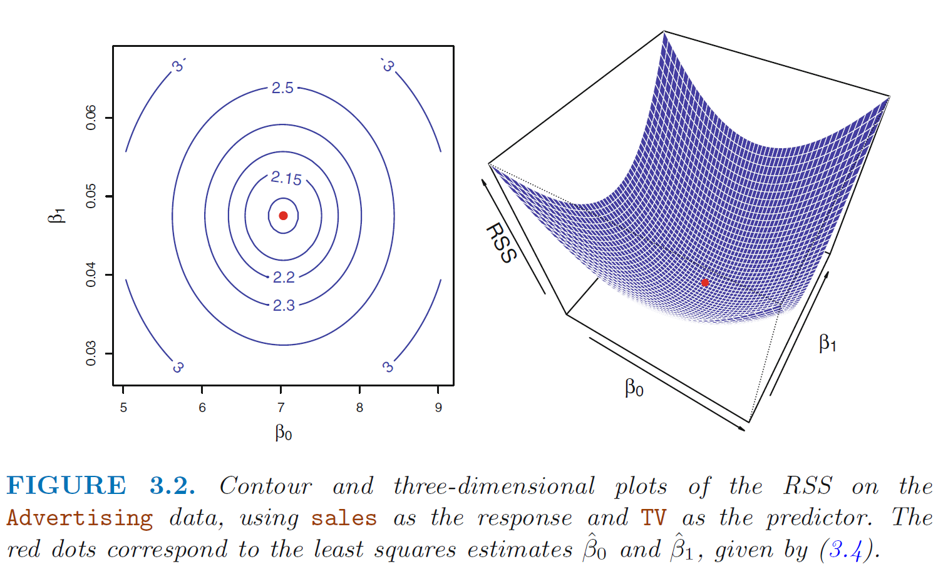
Optimization via Gradient Descent
https://www.statlearning.com/

Slide 8
Please Note
Perfect positive correlation: all the points lie along a line with positive slope
Perfect negative correlation: all the points lie along a line with negative slope
If the points lie along a horizontal or vertical line: no correlation
If the points exhibit some other nonlinear pattern: nonlinear relationship
Need some way to measure the strength of correlation

Slide 9
Coefficient of determination
https://web.stanford.edu/class/msande247s/kchap17.ppt
RSS = SSE is very affected by outliers, thus use
  When we want to measure the strength of the linear relationship, we use the coefficient of determination.

Slide 10
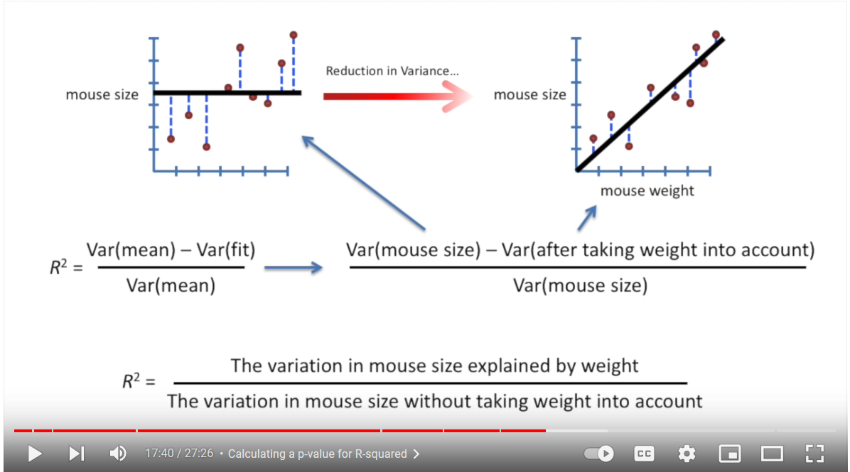
StatQuest: Linear Models Pt.1 - Linear Regression https://www.youtube.com/watch?v=nk2CQITm_eo

Slide 11
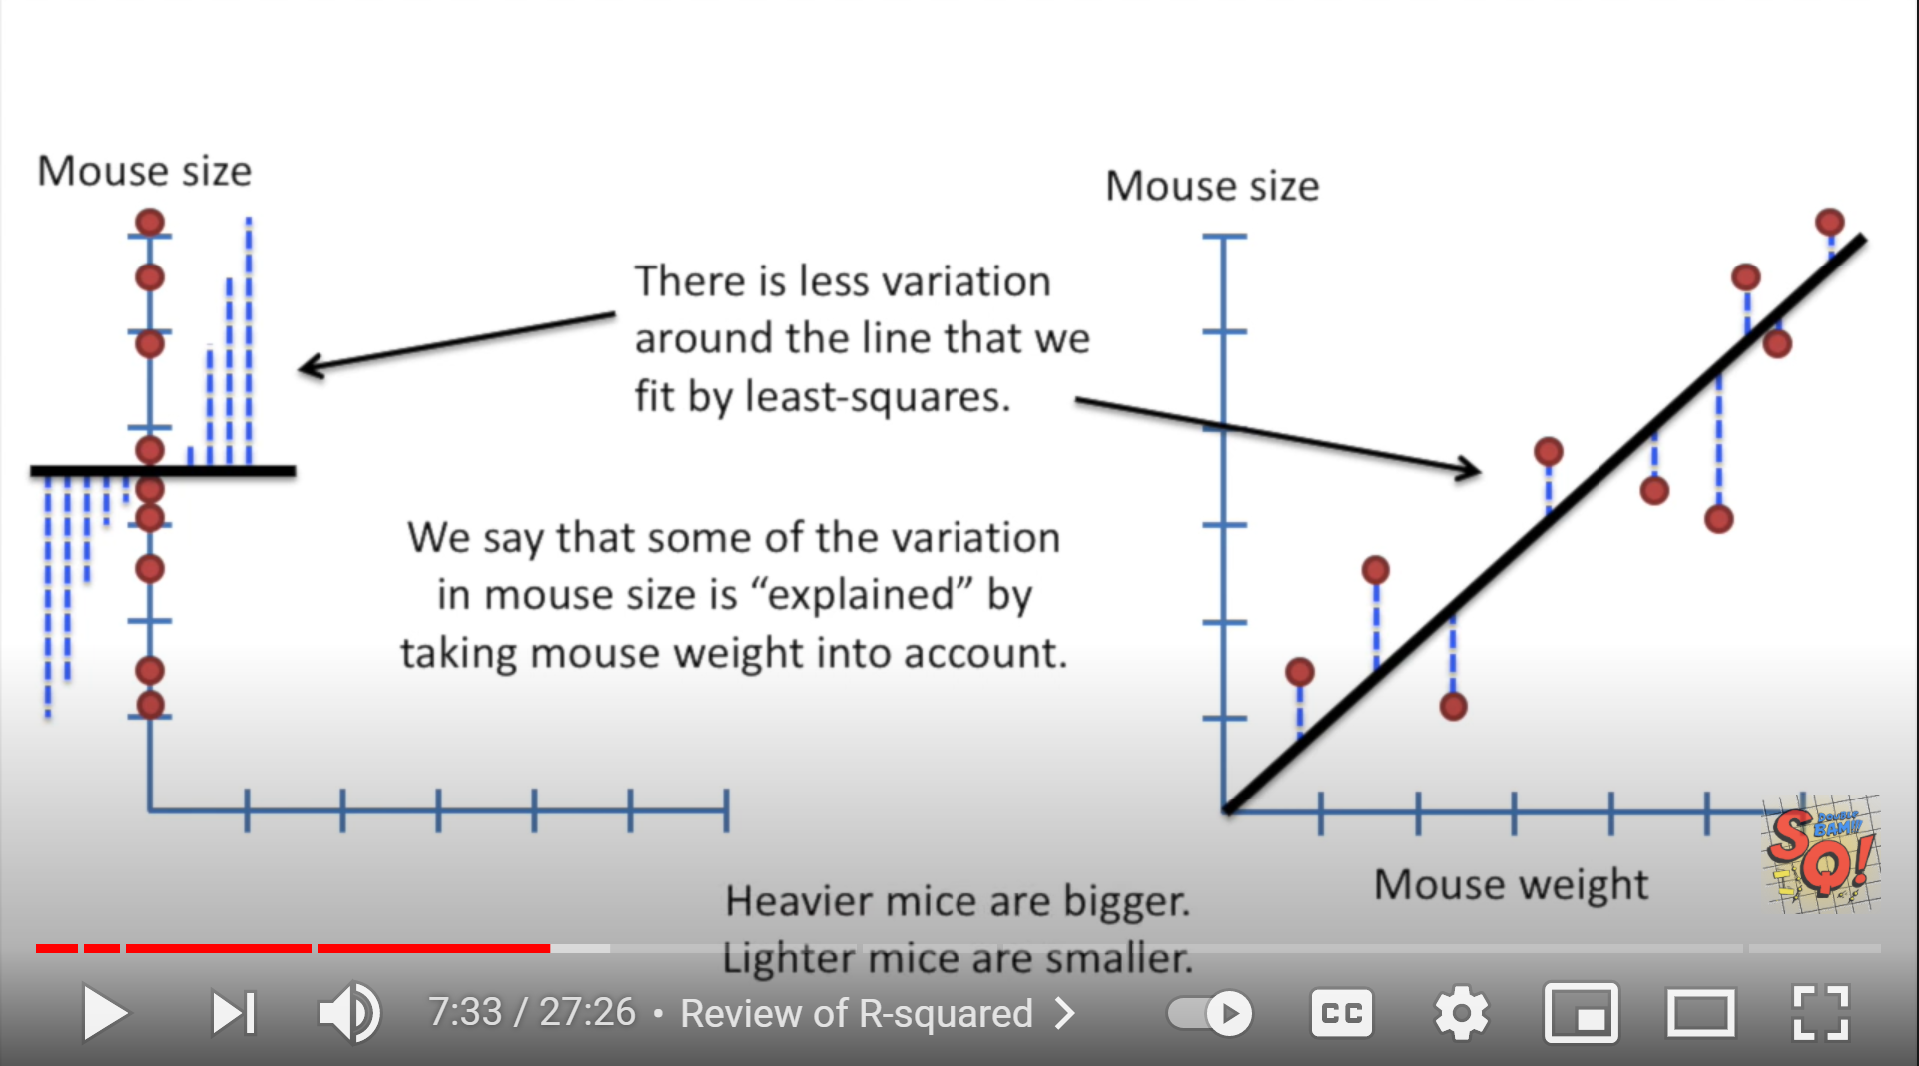
StatQuest: Linear Models Pt.1 - Linear Regression https://www.youtube.com/watch?v=nk2CQITm_eo

Slide 12
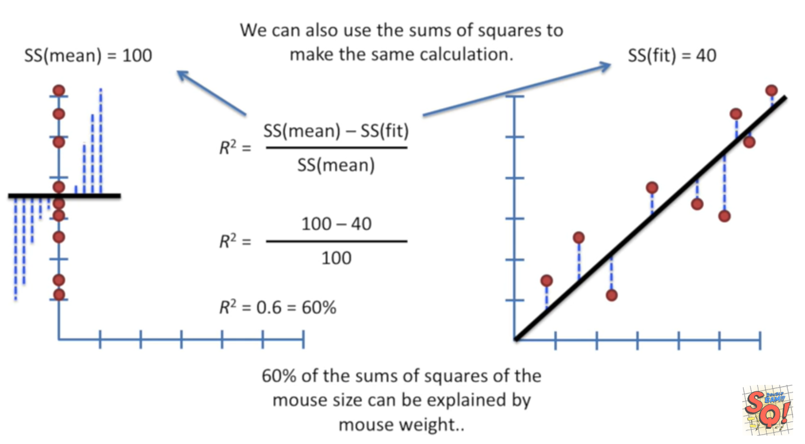
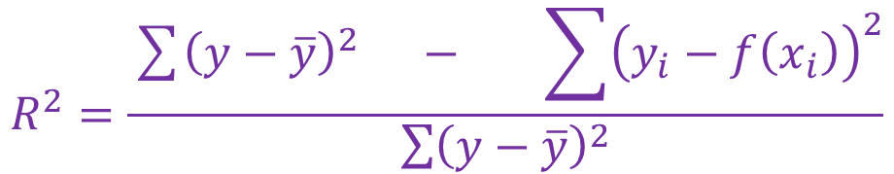
$$R^{2}=\frac{\sum{{\left(y−\overline{y}\right)}^{2}} − \sum{{\left(y_{i}−f\left(x_{i}\right)\right)}^{2}}}{\sum{{\left(y−\overline{y}\right)}^{2}}}$$
StatQuest: Linear Models Pt.1 - Linear Regression https://www.youtube.com/watch?v=nk2CQITm_eo

Slide 13
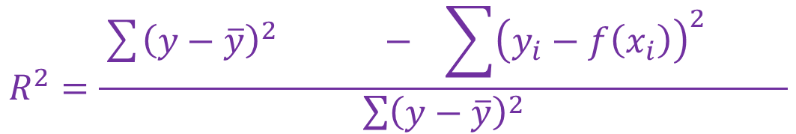
$$R^{2}=\frac{\sum{{\left(y−\overline{y}\right)}^{2}} − \sum{{\left(y_{i}−f\left(x_{i}\right)\right)}^{2} }}{\sum{{\left(y−\overline{y}\right)}^{2}}}$$

Slide 14
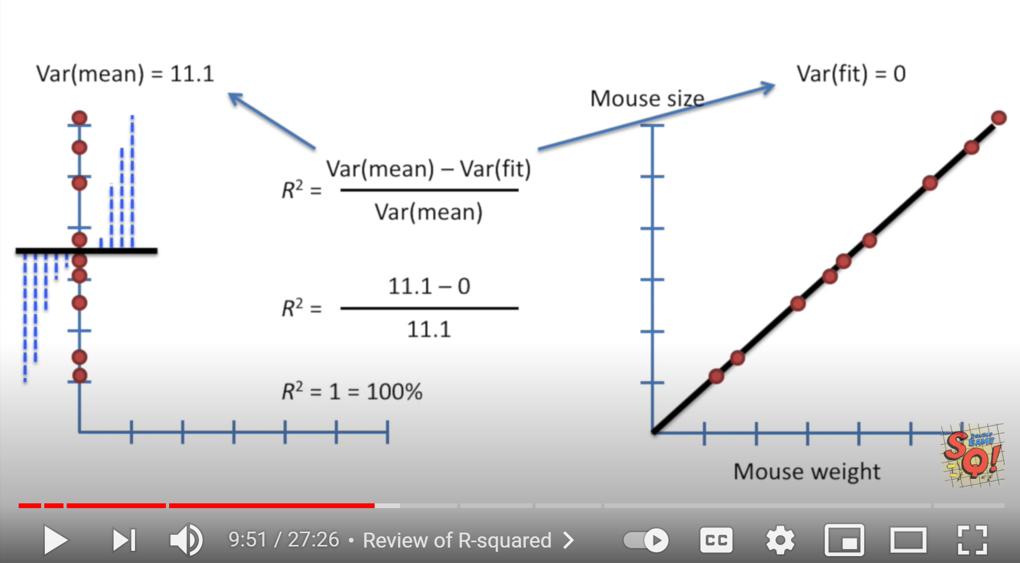
StatQuest: Linear Models Pt.1 - Linear Regression https://www.youtube.com/watch?v=nk2CQITm_eo

Slide 15
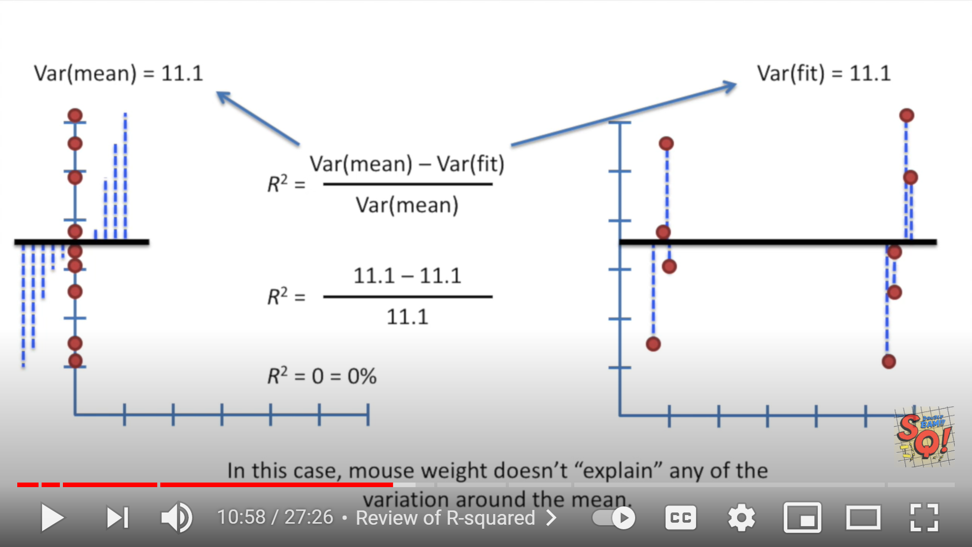
StatQuest: Linear Models Pt.1 - Linear Regression https://www.youtube.com/watch?v=nk2CQITm_eo

Slide 16
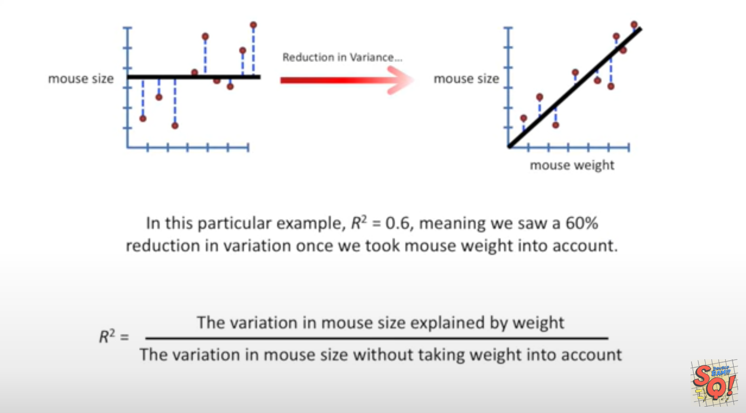
StatQuest: Linear Models Pt.1 - Linear Regression https://www.youtube.com/watch?v=nk2CQITm_eo

Slide 17
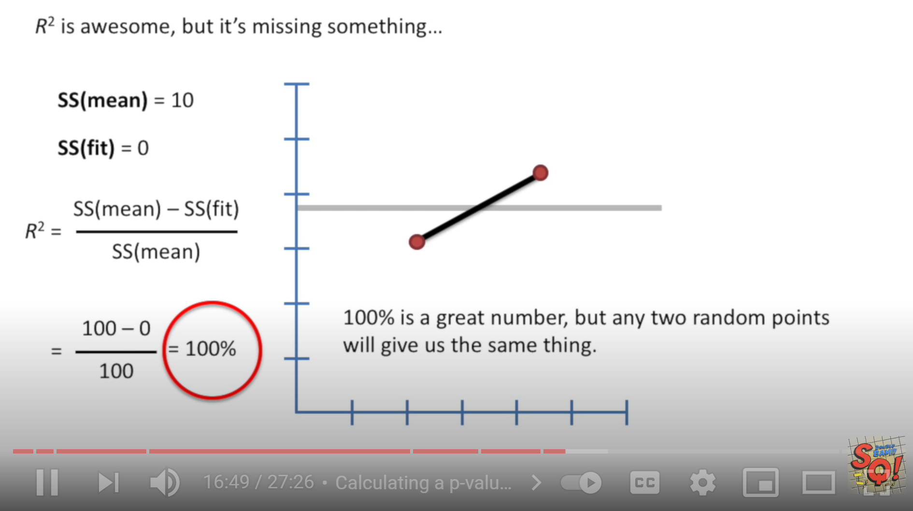
Suppose you only have 2 data points:
StatQuest: Linear Models Pt.1 - Linear Regression https://www.youtube.com/watch?v=nk2CQITm_eo

Slide 18
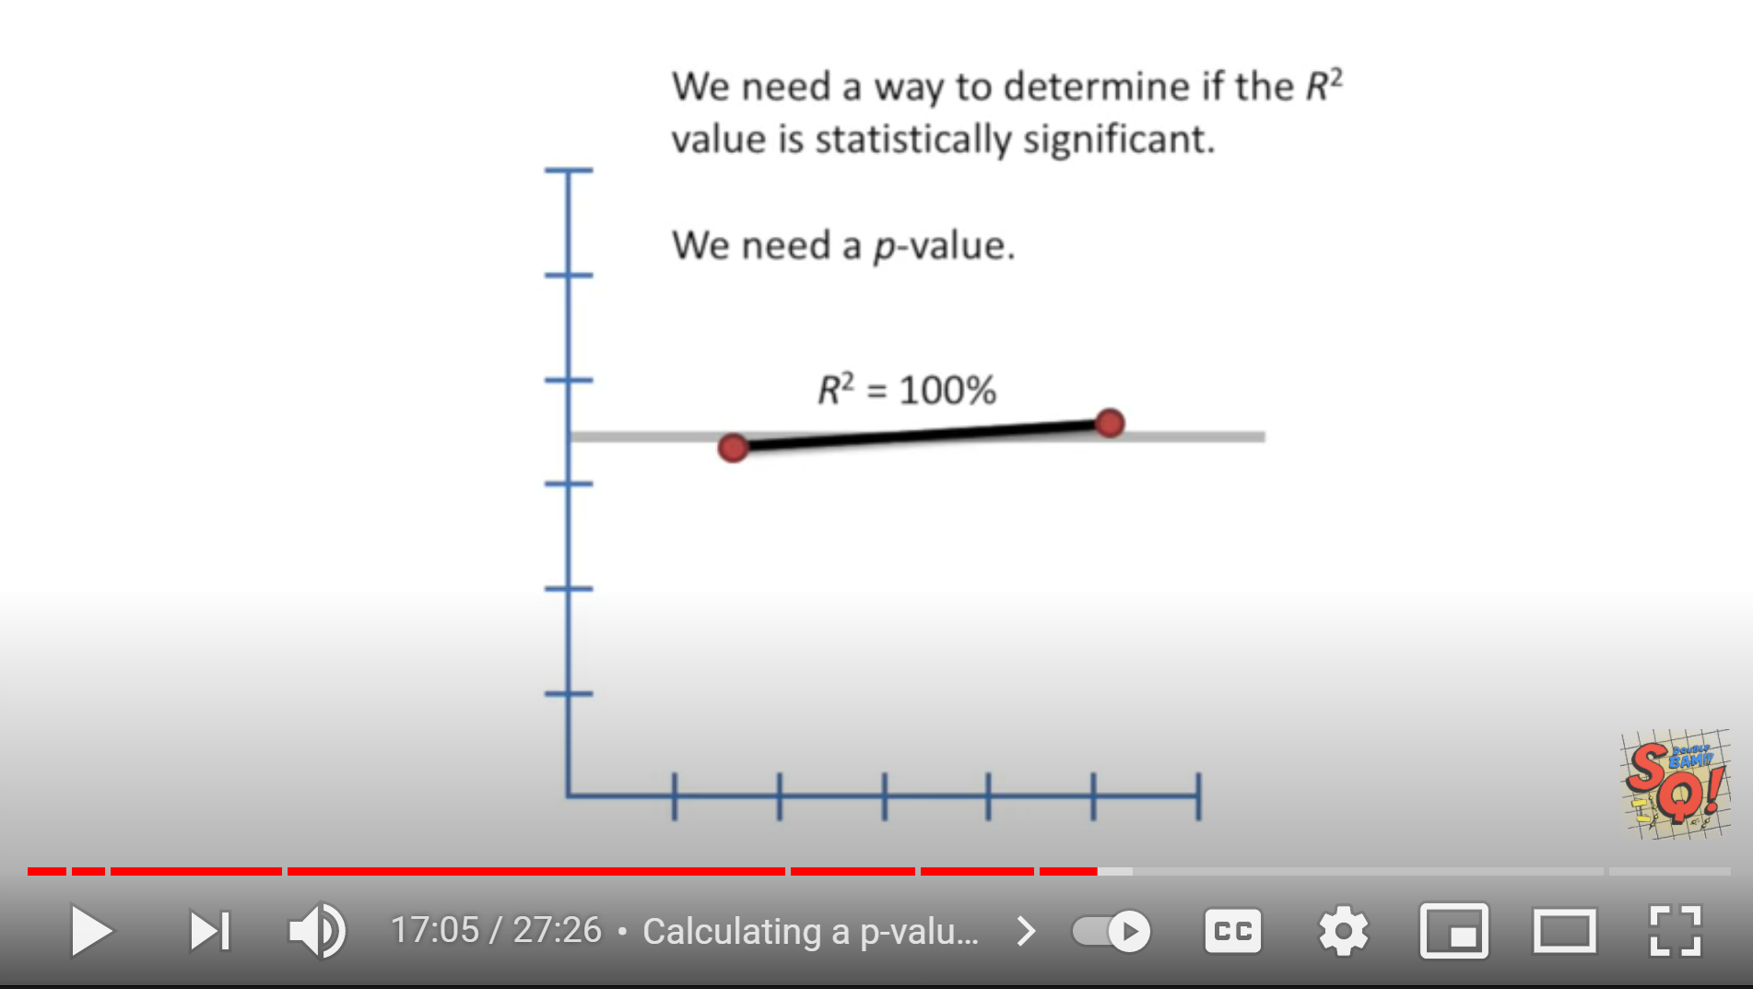
StatQuest: Linear Models Pt.1 - Linear Regression https://www.youtube.com/watch?v=nk2CQITm_eo

Slide 19
StatQuest: Linear Models Pt.1 - Linear Regression https://www.youtube.com/watch?v=nk2CQITm_eo

Slide 20
StatQuest: Linear Models Pt.1 - Linear Regression https://www.youtube.com/watch?v=nk2CQITm_eo

Slide 21
StatQuest: Linear Models Pt.1 - Linear Regression https://www.youtube.com/watch?v=nk2CQITm_eo

Slide 22
Suppose your data set contains exactly 2 points:
StatQuest: Linear Models Pt.1 - Linear Regression https://www.youtube.com/watch?v=nk2CQITm_eo

Slide 23
StatQuest: Linear Models Pt.1 - Linear Regression https://www.youtube.com/watch?v=nk2CQITm_eo

Slide 24
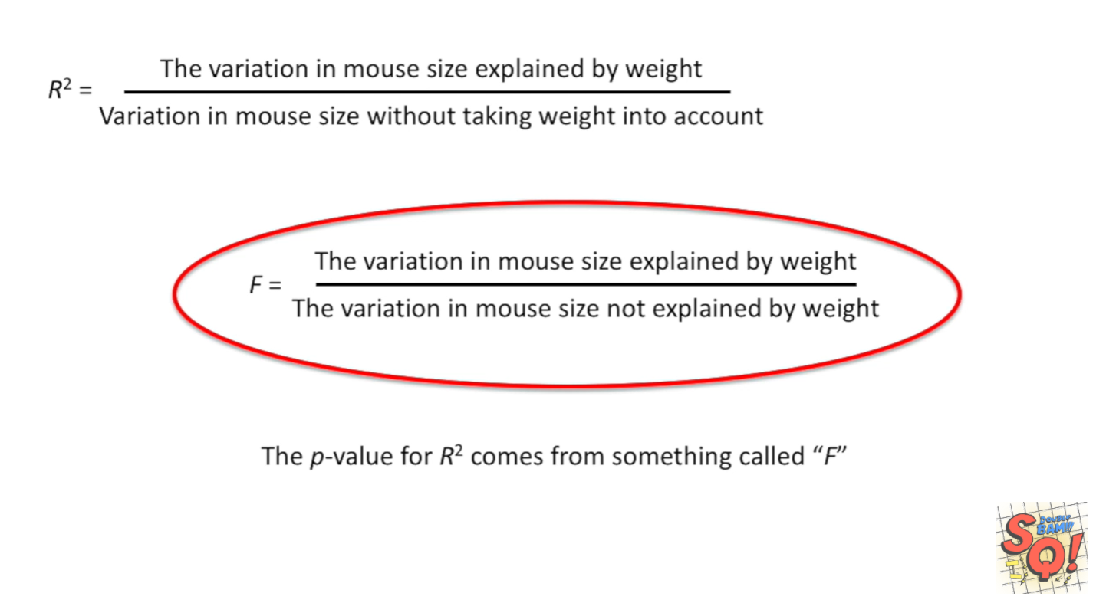
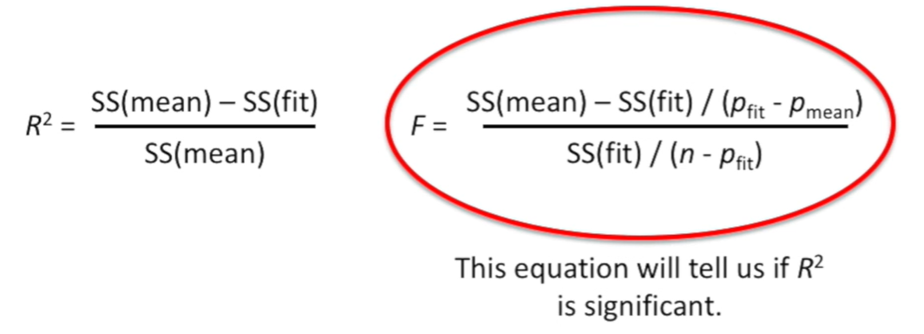

Slide 25
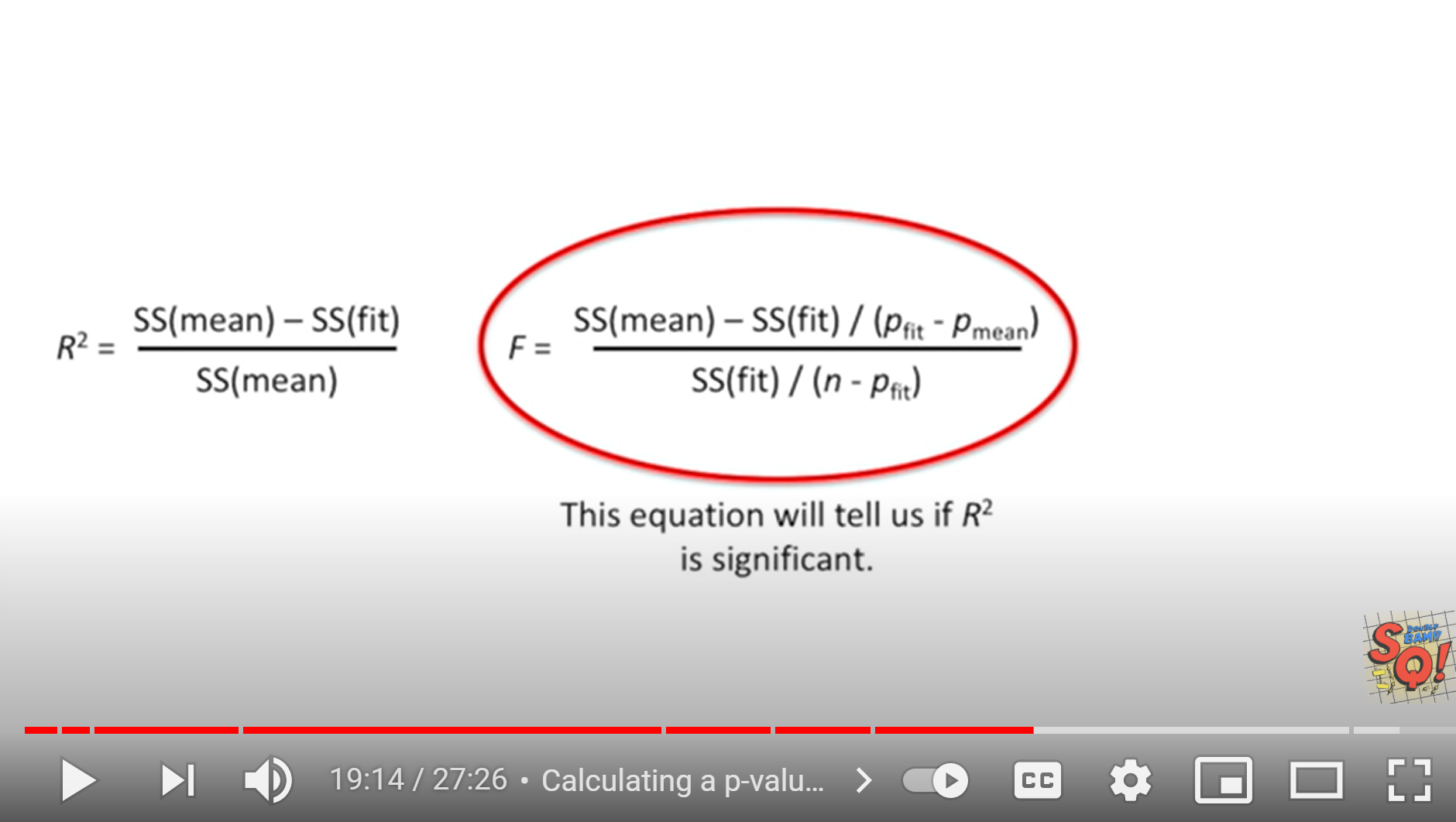
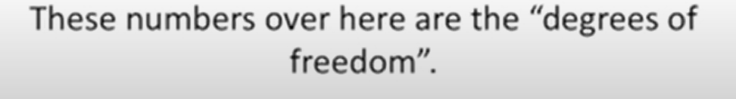
StatQuest: Linear Models Pt.1 - Linear Regression https://www.youtube.com/watch?v=nk2CQITm_eo

Slide 26
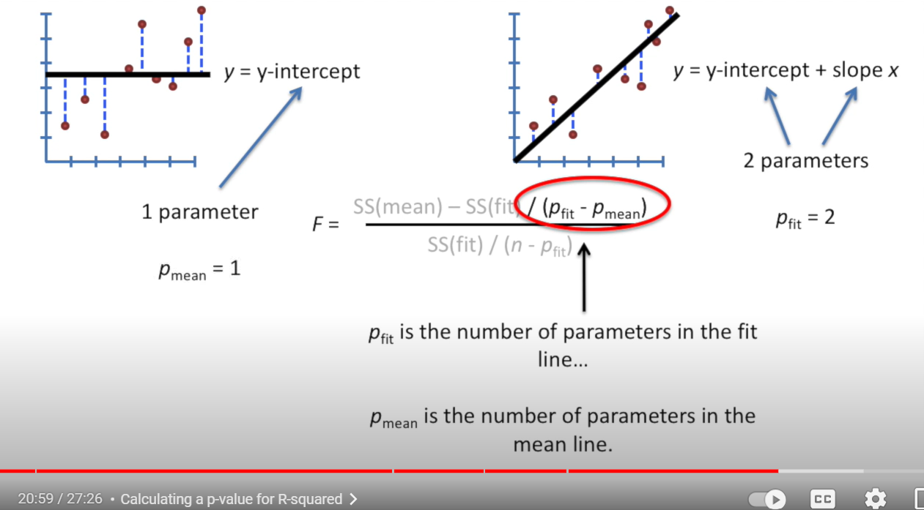

Slide 27
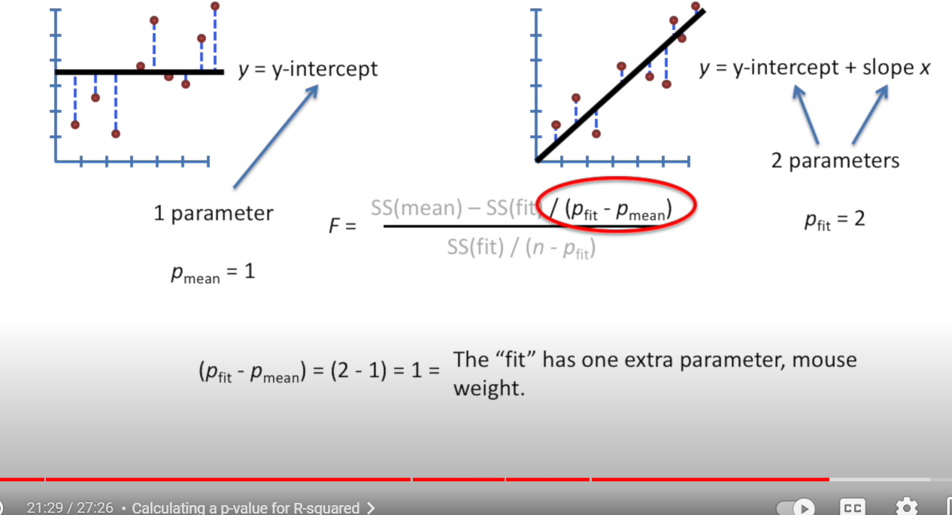

Slide 28
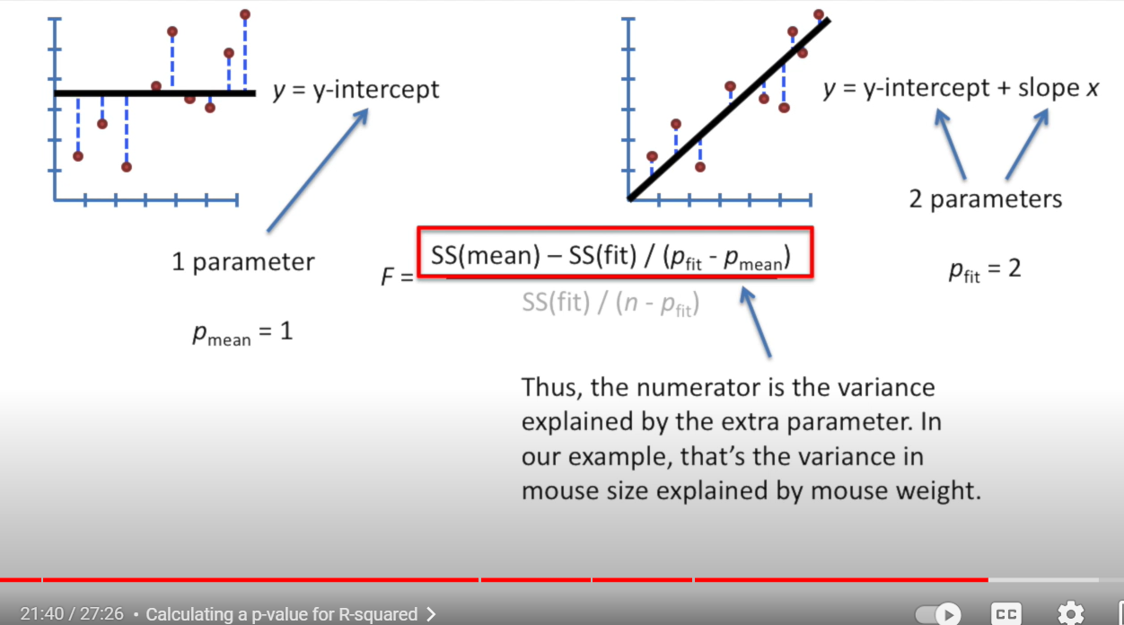

Slide 29
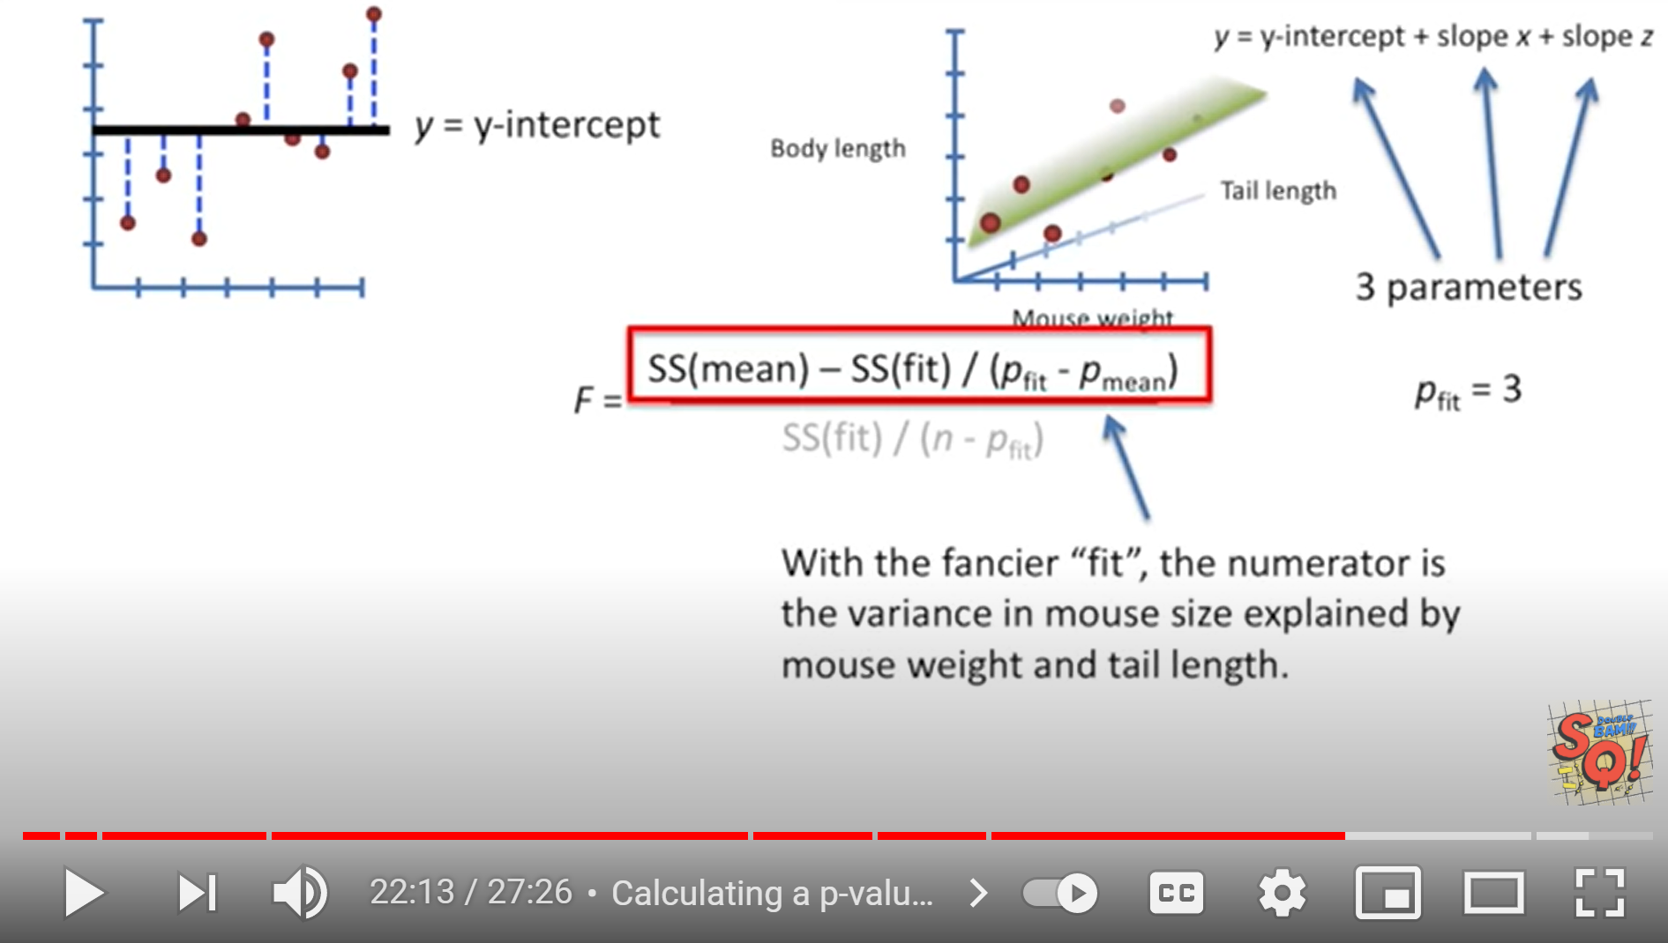
StatQuest: Linear Models Pt.1 - Linear Regression https://www.youtube.com/watch?v=nk2CQITm_eo

Slide 30
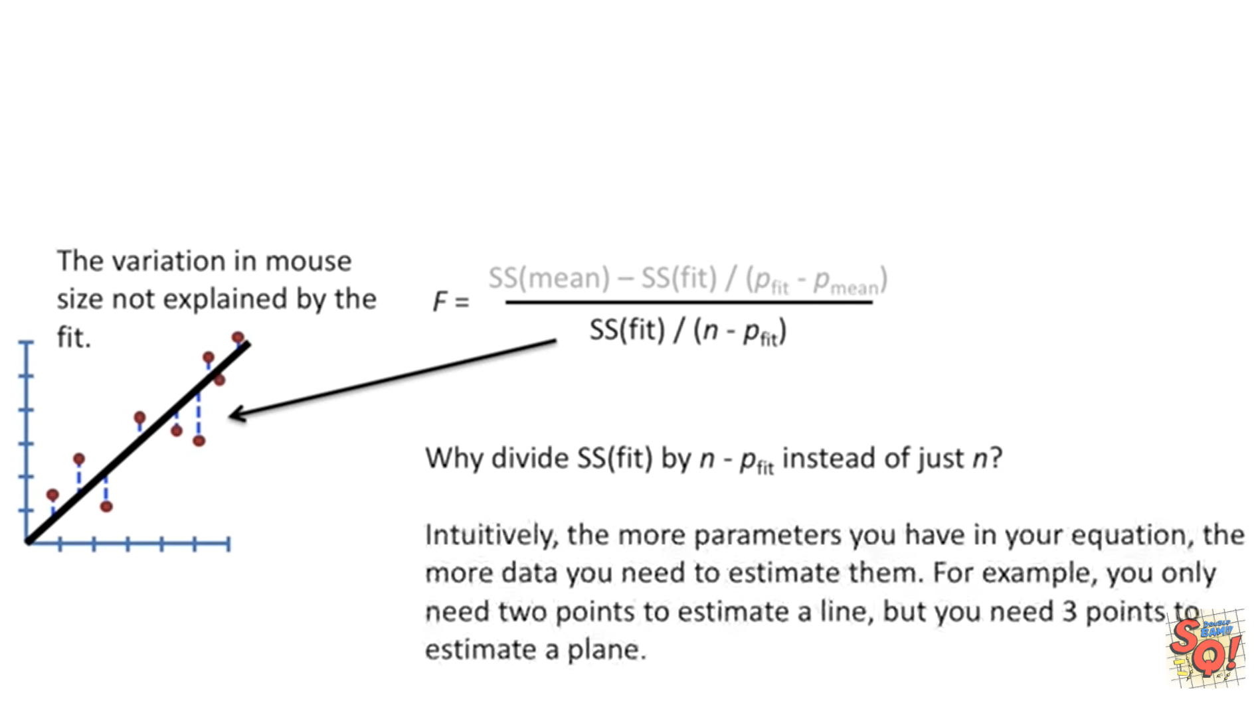
StatQuest: Linear Models Pt.1 - Linear Regression https://www.youtube.com/watch?v=nk2CQITm_eo

Slide 31
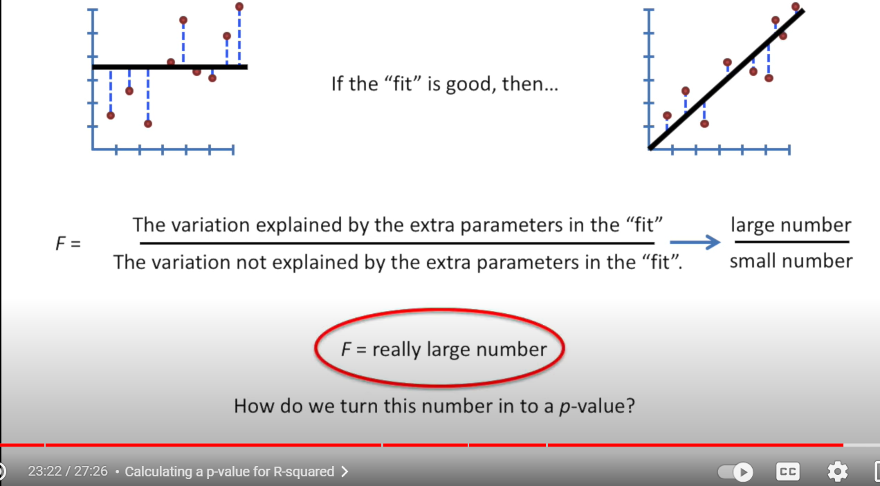

Slide 32
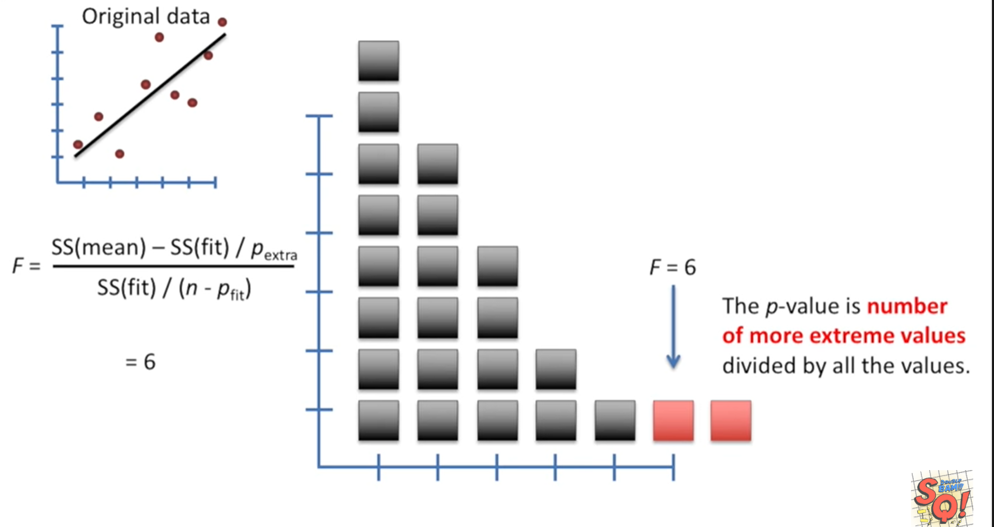
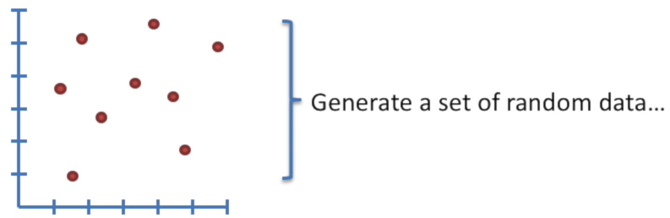
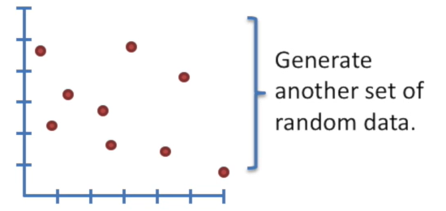
StatQuest: Linear Models Pt.1 - Linear Regression https://www.youtube.com/watch?v=nk2CQITm_eo

Slide 33
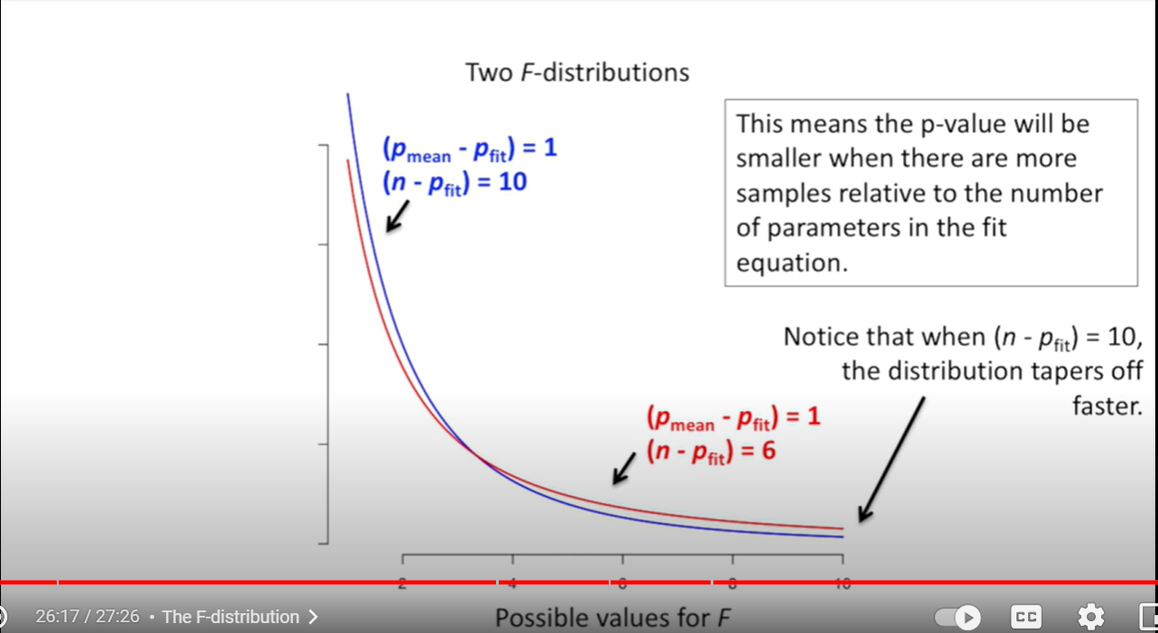

Slide 34
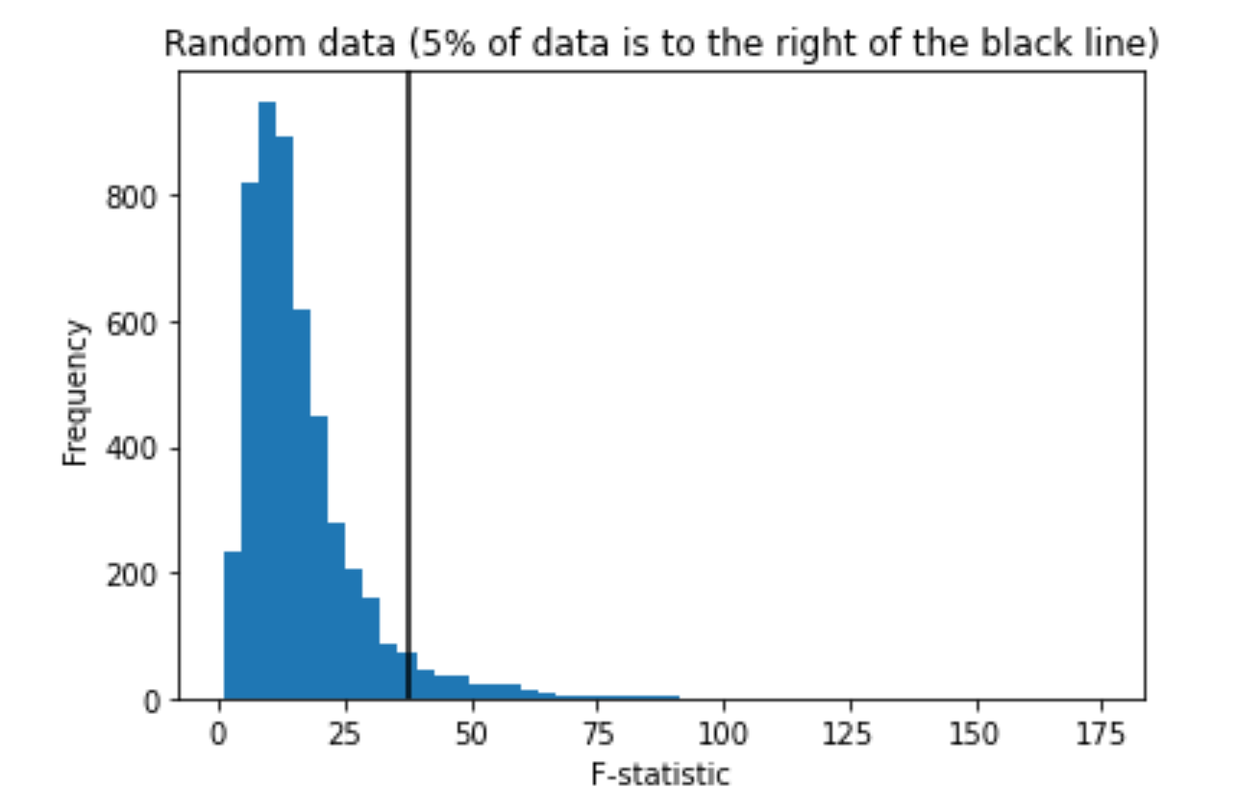
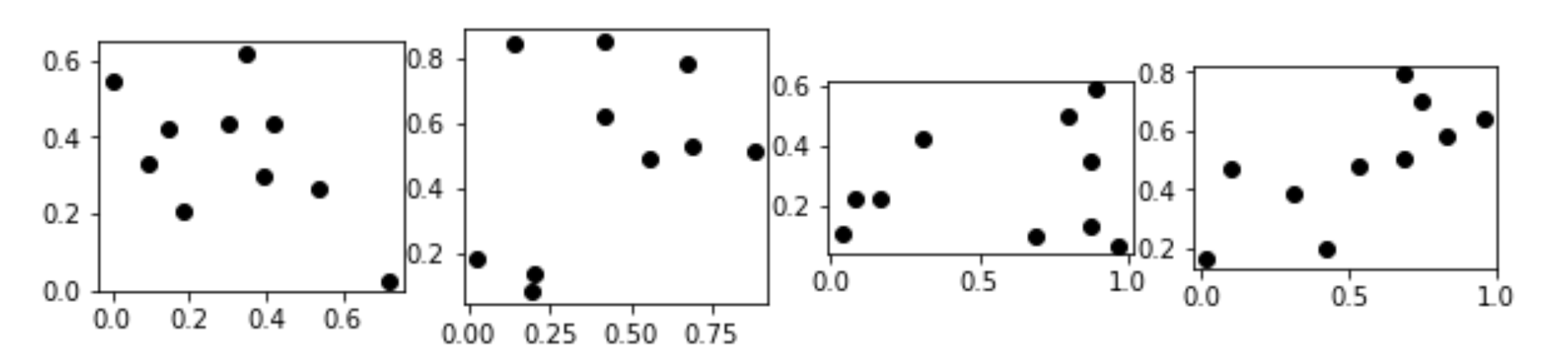
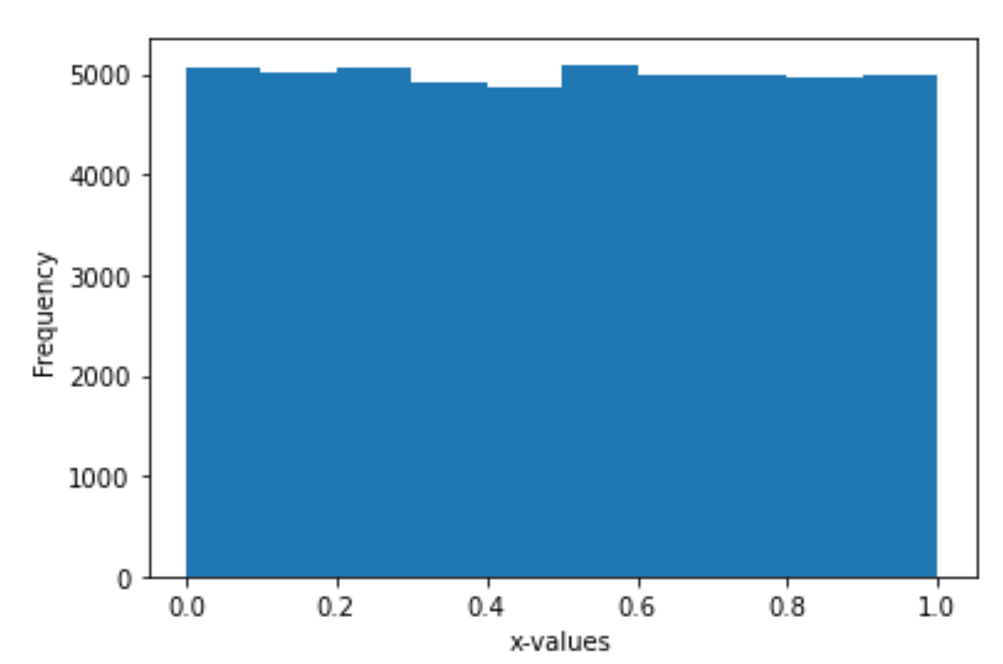
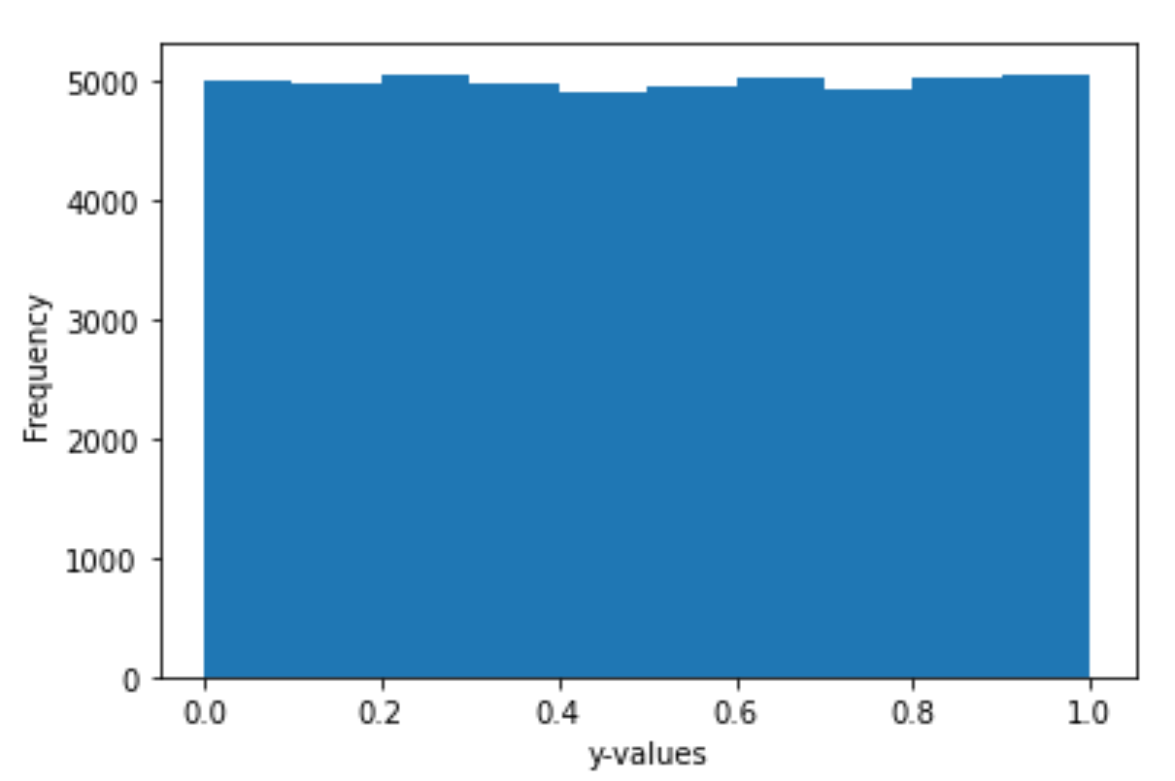
The P value is the probability of obtaining a test statistic at least as extreme as the one that was actually observed, assuming that the null hypothesis is true.
Null hypothesis: the probability that there is no relationship between x and y (i.e. the relationship is null)
The “magic p-value” is sometimes thought to be 0.05 = 5%
x and y generated independently.
Statistical Literacy of Obstetrics-Gynecology Residents
https://meridian.allenpress.com/jgme/article/5/2/272/200601/Statistical-Literacy-of-Obstetrics-Gynecology (2013)
Helping Doctors and Patients Make Sense of Health Statistics
https://journals.sagepub.com/doi/10.1111/j.1539-6053.2008.00033.x?url_ver=Z39.88-2003&rfr_id=ori%3Arid%3Acrossref.org&rfr_dat=cr_pub++0pubmed& (2007)

Slide 35
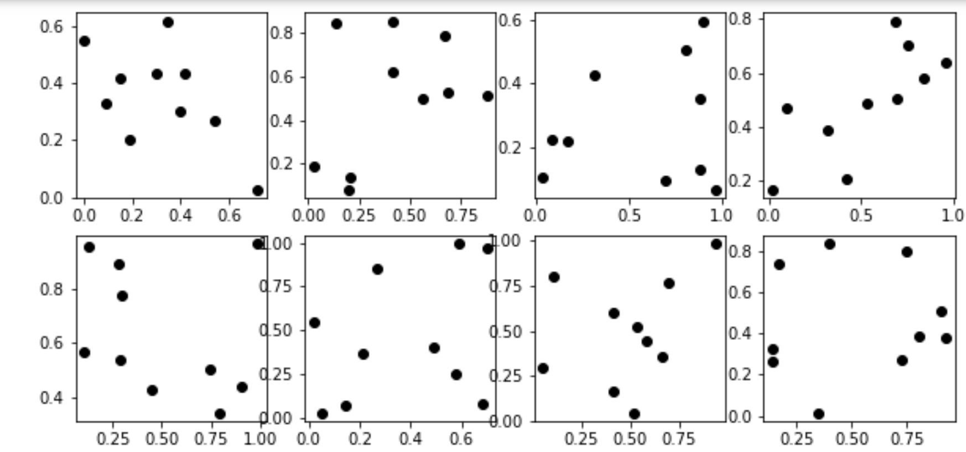
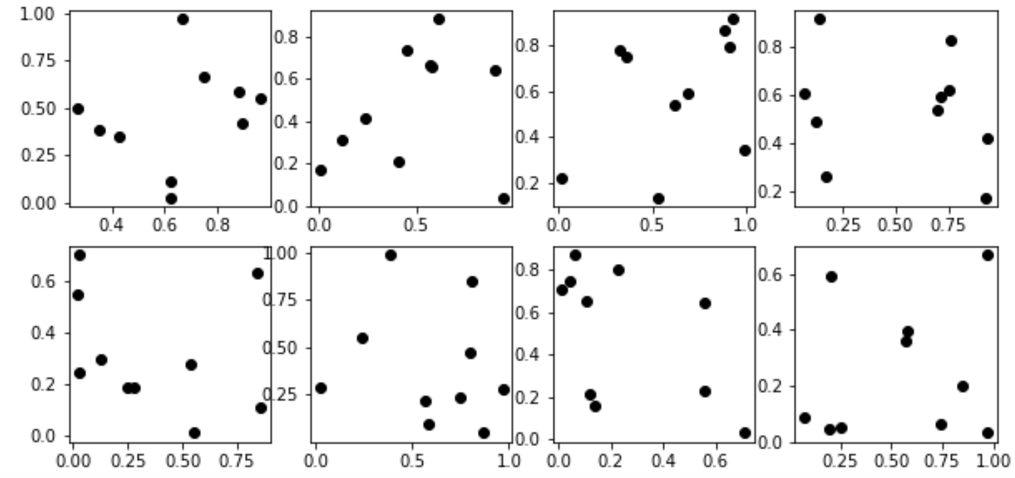
np.random.seed(1)
x = np.random.random((K,N))
np.random.seed(2)
y = np.random.random((K, N))

Slide 36
Negative: x does not predict y. There is no relationship between x and y.
The data used to generate the histogram below was randomly generated.
Thus there is no relationship between x and y. Thus the null hypothesis is true for these data sets
True negatives:
There is no relationship between x and y
and
the F-statistic indicates that there is no relationship between x and y
False positive:
There is no relationship between x and y
and
the F-statistic indicates that there is a relationship between x and y

Slide 37
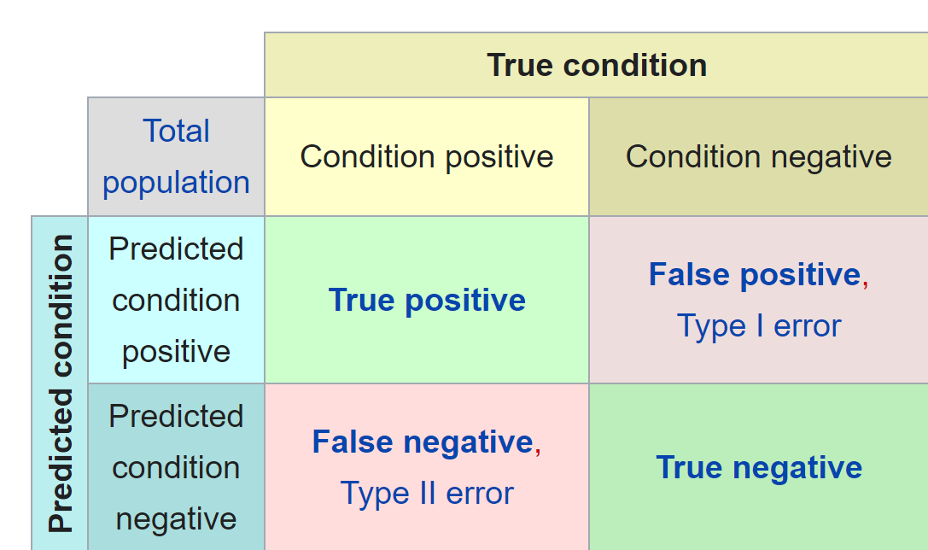
Confusion matrix
https://en.wikipedia.org/wiki/Confusion_matrix

Slide 38
Negative: x does not predict y. There is no relationship between x and y.
The data used to generate the histogram below was randomly generated.
Thus there is no relationship between x and y. Thus the null hypothesis is true for these data sets
True negatives:
There is no relationship between x and y
and
the F-statistic indicates that there is no relationship between x and y
False positive:
There is no relationship between x and y
and
the F-statistic indicates that there is a relationship between x and y

Slide 39
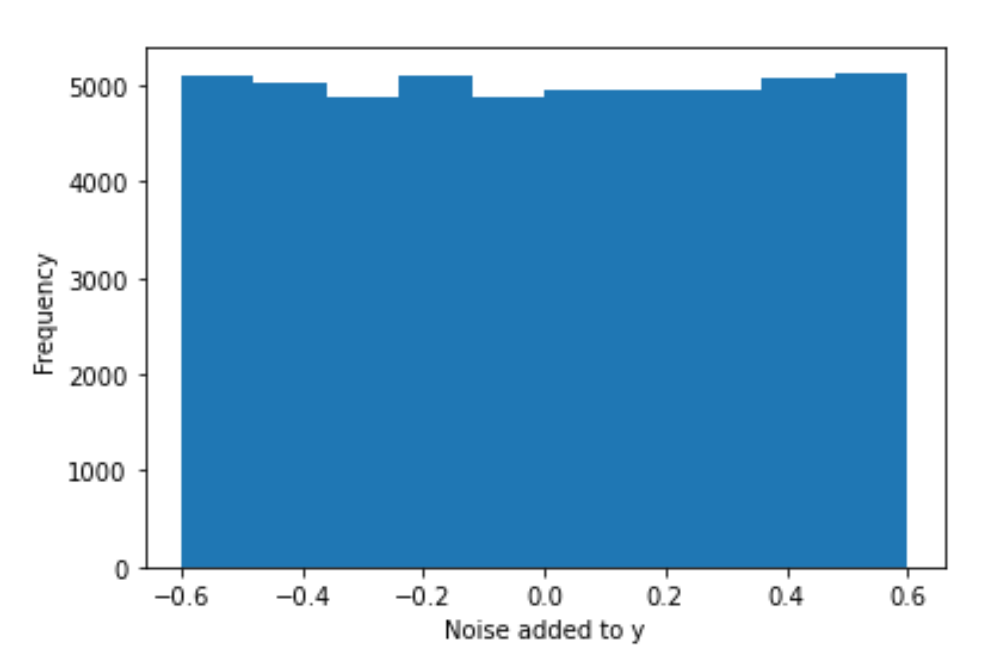
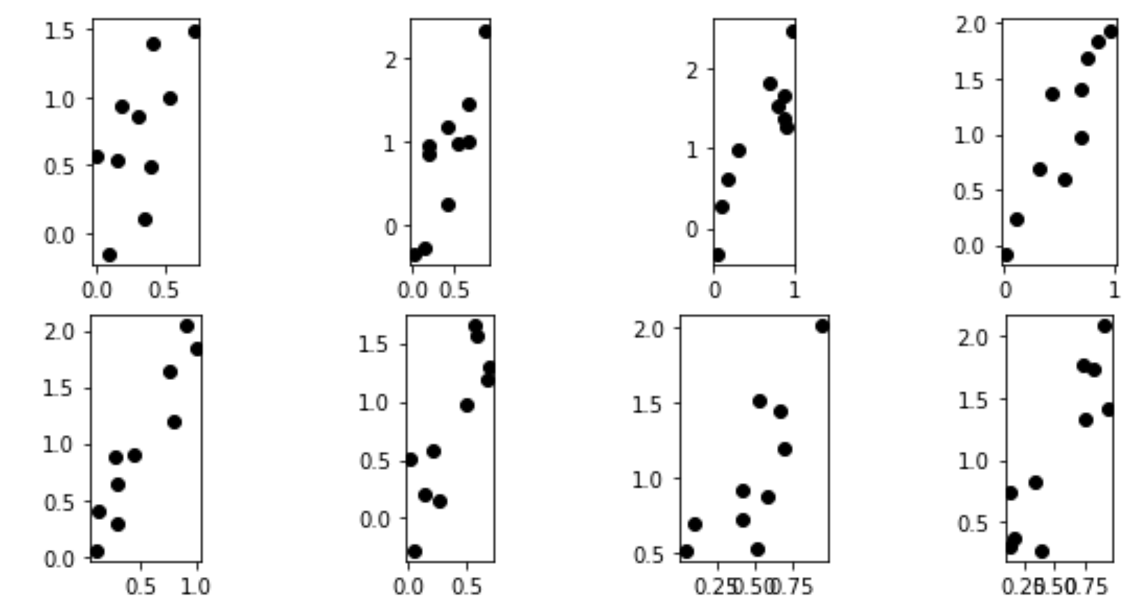
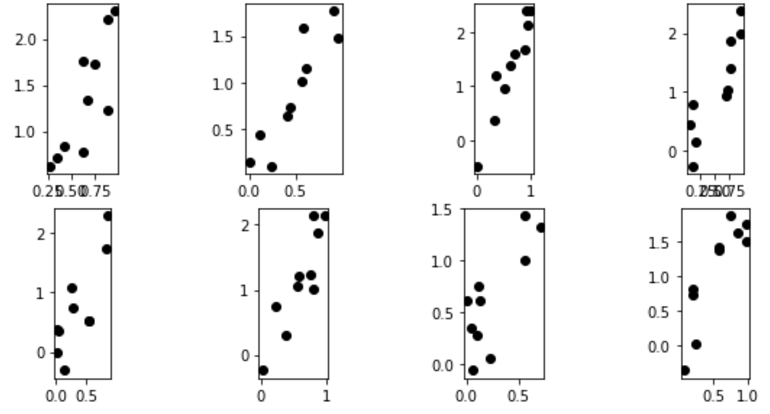
np.random.seed(4)
Noise = np.random.random((K, N)) - 0.5
y_NOISY = 2*x + 1.2*Noise

Slide 40
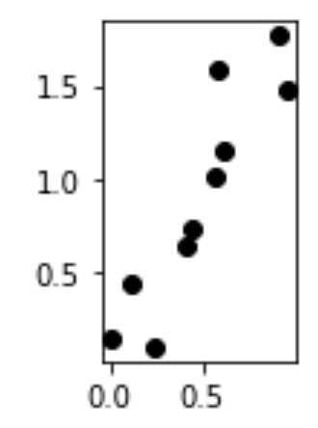
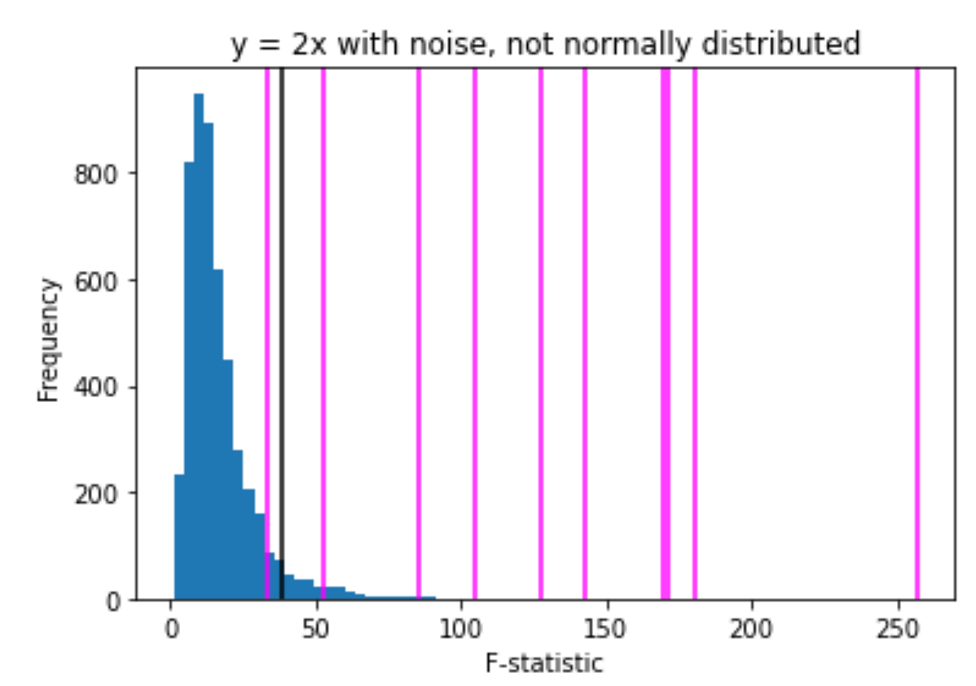
Positive: x predicts y. There is a relationship between x and y.
The data used to generate the pink lines below was NOT randomly generated.
Noise = np.random.random((K, N)) - 0.5
y_NOISY = 2*x + 1.2*Noise
False negatives:
There is a relationship between x and y
and
the F-statistic indicates that there is no relationship between x and y
True positive:
There is a relationship between x and y
and
the F-statistic indicates that there is a relationship between x and y

Slide 41
The P value is the probability of obtaining a test statistic at least as extreme as the one that was actually observed, assuming that the null hypothesis is true.
Null hypothesis: the probability that there is no relationship between x and y (i.e. the relationship is null)
False negatives:
There is a relationship between x and y
and
the F-statistic indicates that there is no relationship between x and y
True positive:
There is a relationship between x and y
and
the F-statistic indicates that there is a relationship between x and y

Slide 42
Noise = np.random.random((K, N)) - 0.5
y_NOISY = 2*x + 1.2*Noise

Slide 43
17.4 Error Variable: Required Conditions
The error ε is a critical part of the regression model.
Four requirements involving the distribution of ε must be satisfied.
  The probability distribution of ε is normal.
  The mean of ε is zero: E(ε) = 0.
  The standard deviation of ε is σ_{ε} for all values of x.
  The set of errors associated with different values of y are all independent.
https://web.stanford.edu/class/msande247s/kchap17.ppt

Slide 44
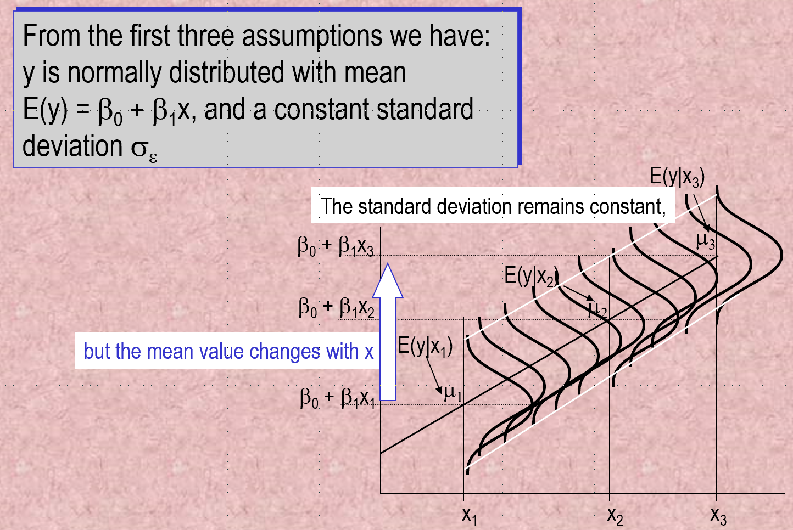
https://web.stanford.edu/class/msande247s/kchap17.ppt

Slide 45
6533
0
No data
The intercept is b₀ = 6533.
This is the slope of the line.
For each additional mile on the odometer,
the price decreases by an average of $0.0312
Do not interpret the intercept as the
“Price of cars that have not been driven”
https://web.stanford.edu/class/msande247s/kchap17.ppt

Slide 46
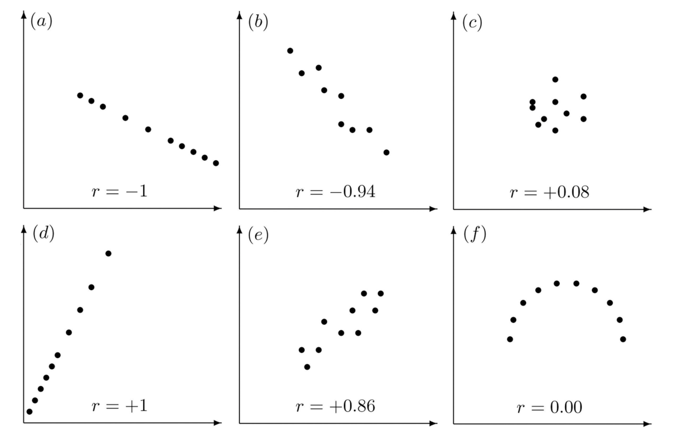
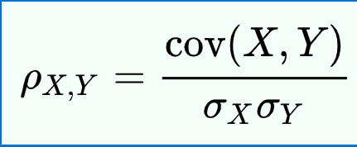

Properties of Linear Correlation Coefficients
https://emunix.emich.edu/~schu/MATH_170/Fall09_170/Evening%20session/Unit%203.ppt
Some properties of the linear correlation coefficient
  r is a unitless measure (so that r would be the same for a data set whether x and y are measured in feet, inches, meters etc.)
  r is always between –1 and +1.
        r = -1 : perfect negative correlation
        r = +1: perfect positive correlation
  Positive values of r correspond to positive relations
  Negative values of r correspond to negative relations
https://en.wikipedia.org/wiki/Pearson_correlation_coefficient
https://stats.libretexts.org/Bookshelves/Introductory_Statistics/Book%3A_Introductory_Statistics_(Shafer_and_Zhang)/10%3A_Correlation_and_Regression/10.02%3A_The_Linear_Correlation_Coefficient

Slide 47
Lurking Variable
Sometimes it is not clear which variable is the explanatory variable and which is the response variable
Sometimes the two variables are related without either one being an explanatory variable
Sometimes the two variables are both affected by a third variable, a lurking variable, that had not been included in the study
https://emunix.emich.edu/~schu/MATH_170/Fall09_170/Evening%20session/Unit%203.ppt

Slide 48
Example 1
An example of a lurking variable
A researcher studies a group of elementary school children
  Y = the student’s height
  X = the student’s shoe size
It is not reasonable to claim that shoe size causes height to change
The lurking variable of age affects both of these two variables
https://emunix.emich.edu/~schu/MATH_170/Fall09_170/Evening%20session/Unit%203.ppt

Slide 49
More Examples
Some other examples
Rainfall amounts and plant growth
  Explanatory variable – rainfall
  Response variable – plant growth
  Possible lurking variable – amount of sunlight
Exercise and cholesterol levels
  Explanatory variable – amount of exercise
  Response variable – cholesterol level
  Possible lurking variable – diet
https://emunix.emich.edu/~schu/MATH_170/Fall09_170/Evening%20session/Unit%203.ppt

