Slide 1
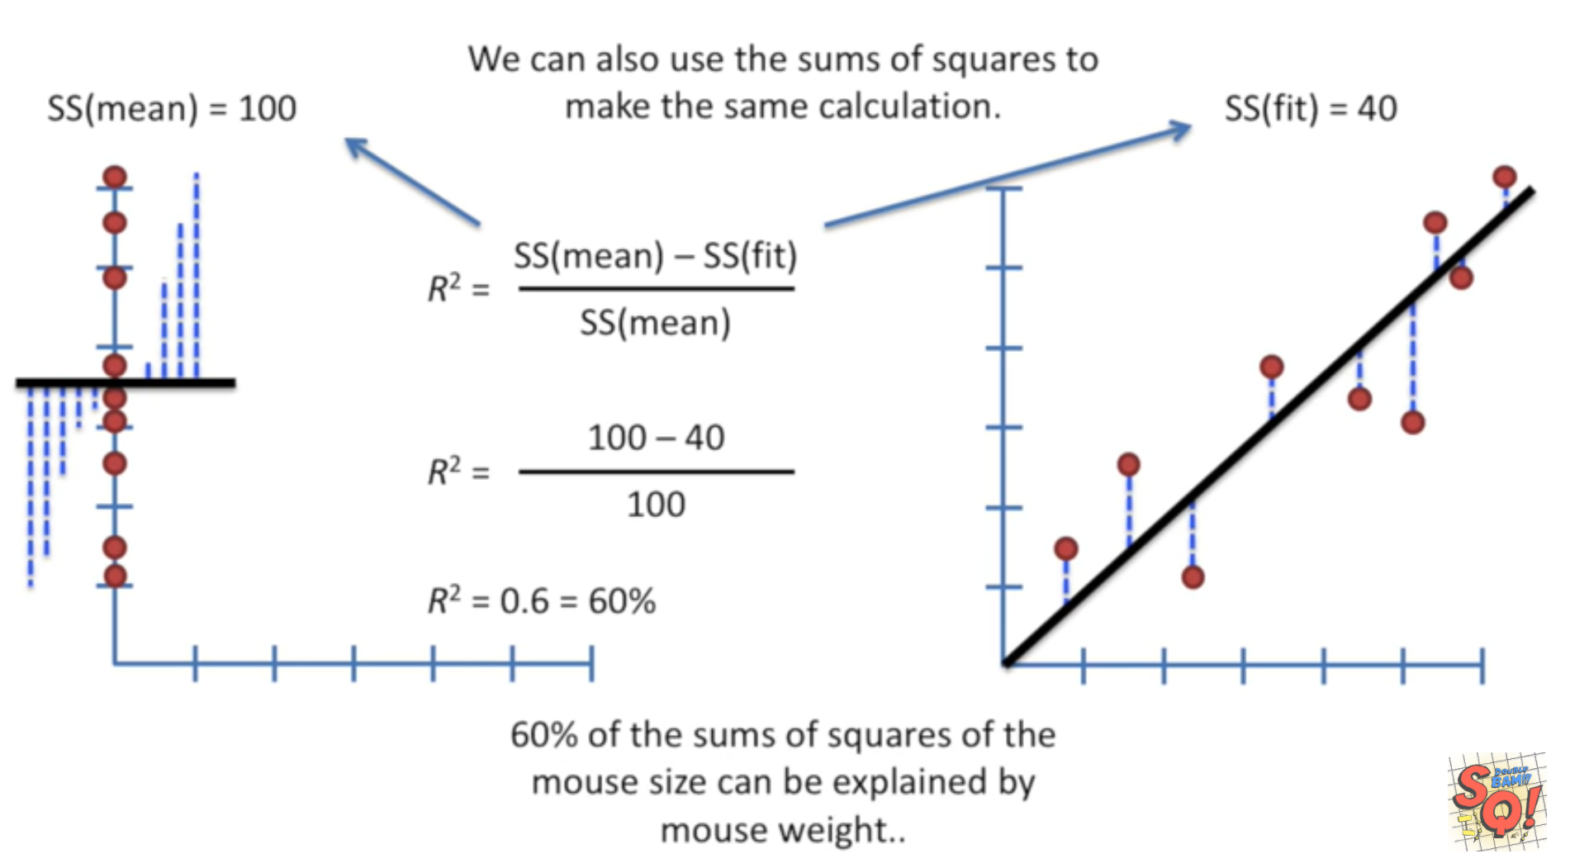
StatQuest: Linear Models Pt.1 - Linear Regression https://www.youtube.com/watch?v=nk2CQITm_eo

Slide 2
StatQuest: Linear Models Pt.1 - Linear Regression https://www.youtube.com/watch?v=nk2CQITm_eo

Slide 3
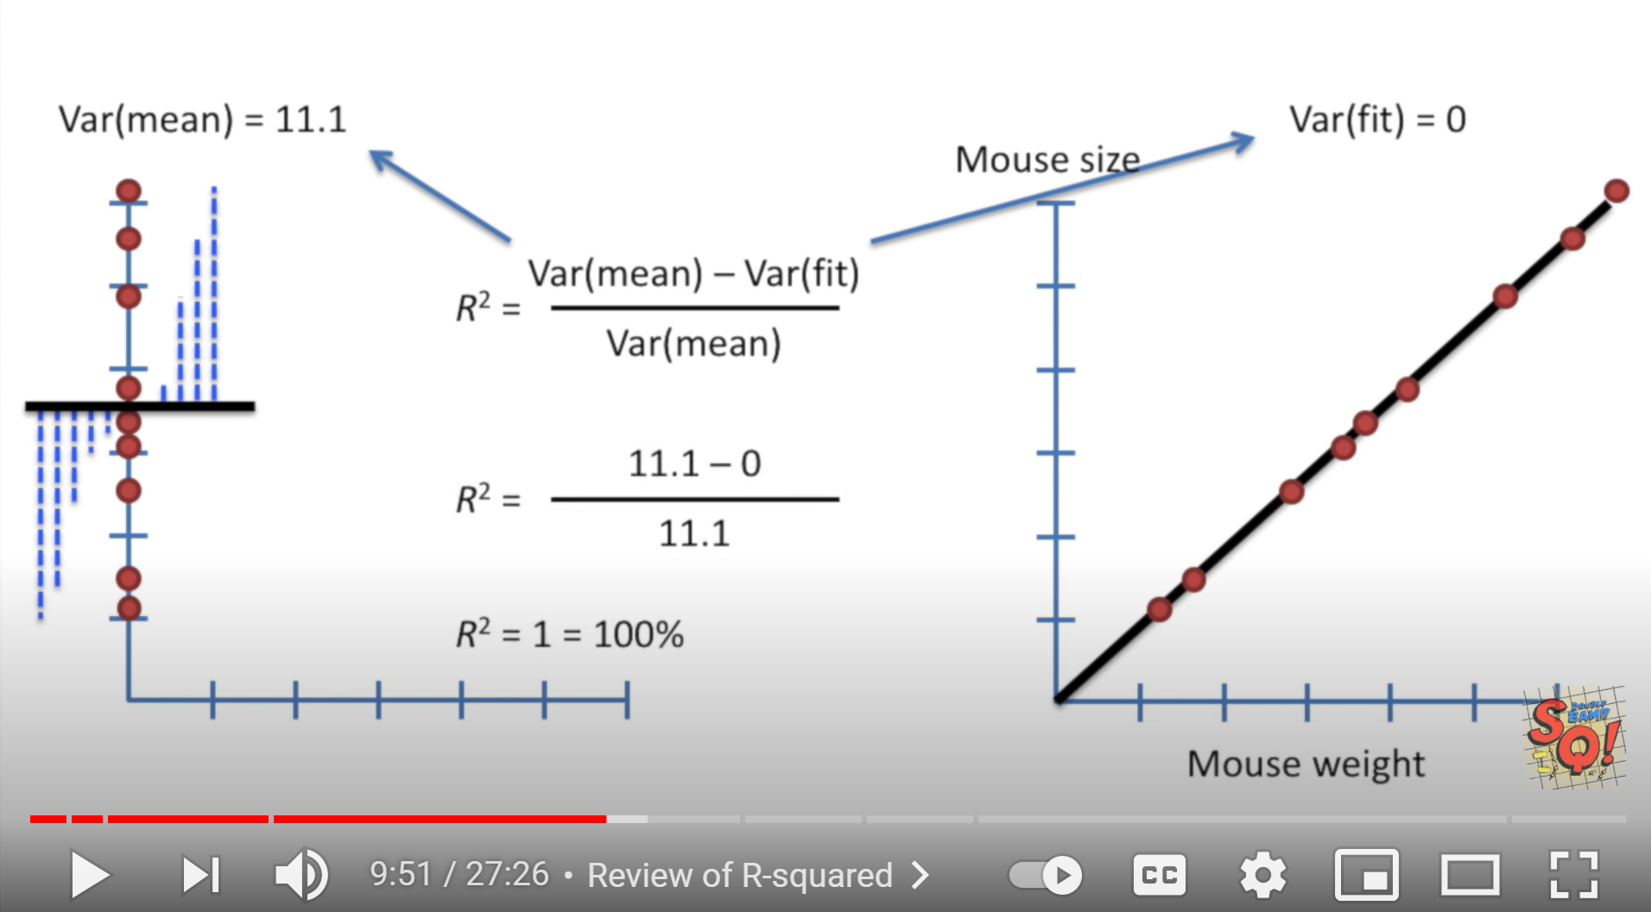
StatQuest: Linear Models Pt.1 - Linear Regression https://www.youtube.com/watch?v=nk2CQITm_eo

Slide 4
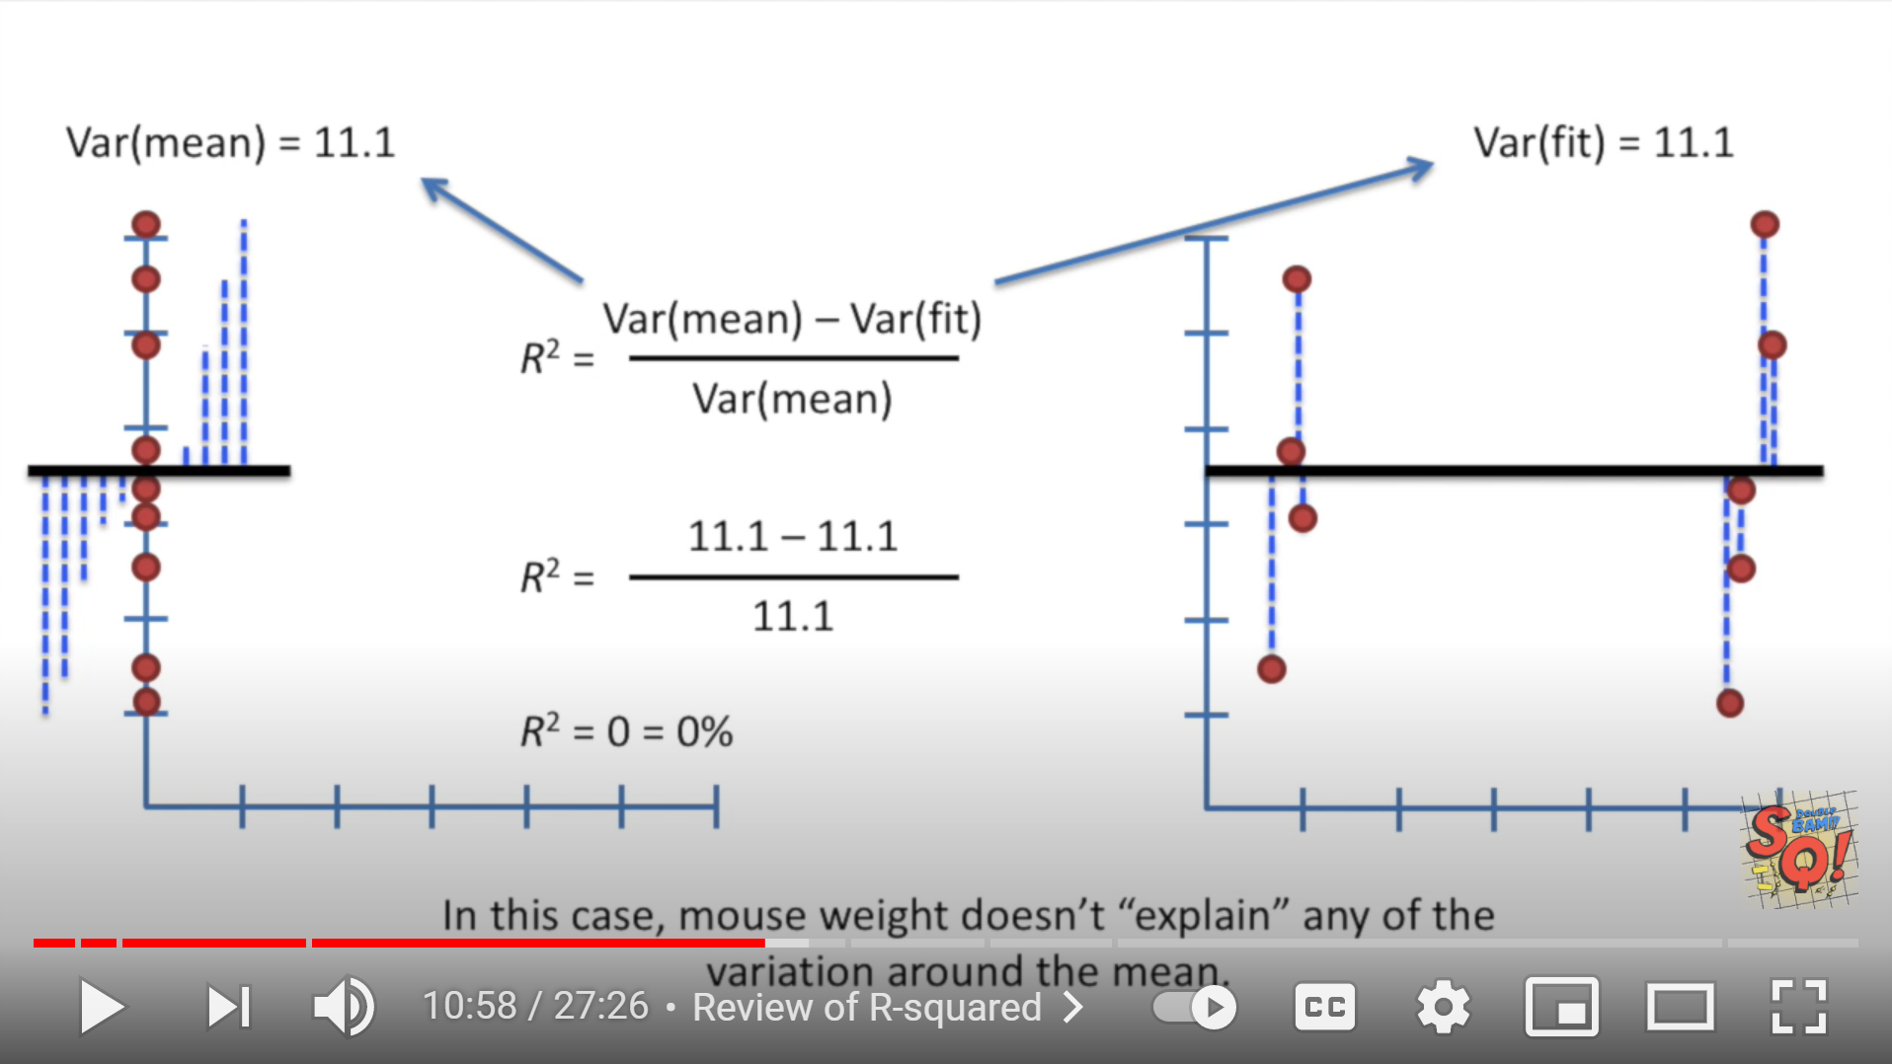
StatQuest: Linear Models Pt.1 - Linear Regression https://www.youtube.com/watch?v=nk2CQITm_eo

Slide 5
StatQuest: Linear Models Pt.1 - Linear Regression https://www.youtube.com/watch?v=nk2CQITm_eo

Slide 6
StatQuest: Linear Models Pt.1 - Linear Regression https://www.youtube.com/watch?v=nk2CQITm_eo

Slide 7
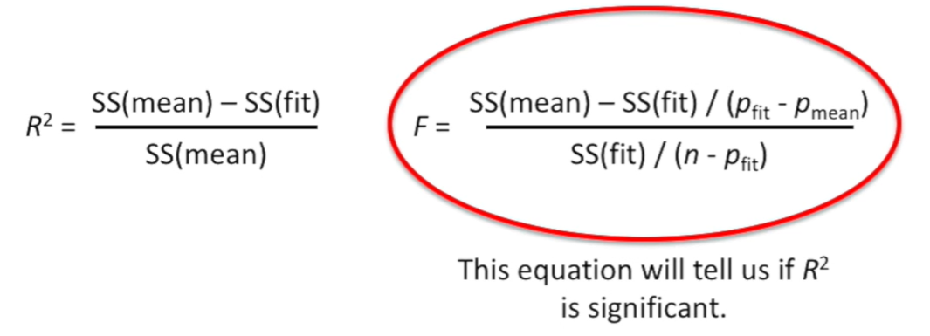

Slide 8
StatQuest: Linear Models Pt.1 - Linear Regression https://www.youtube.com/watch?v=nk2CQITm_eo

Slide 9
StatQuest: Linear Models Pt.1 - Linear Regression https://www.youtube.com/watch?v=nk2CQITm_eo

Slide 10
StatQuest: Linear Models Pt.1 - Linear Regression https://www.youtube.com/watch?v=nk2CQITm_eo

Slide 11
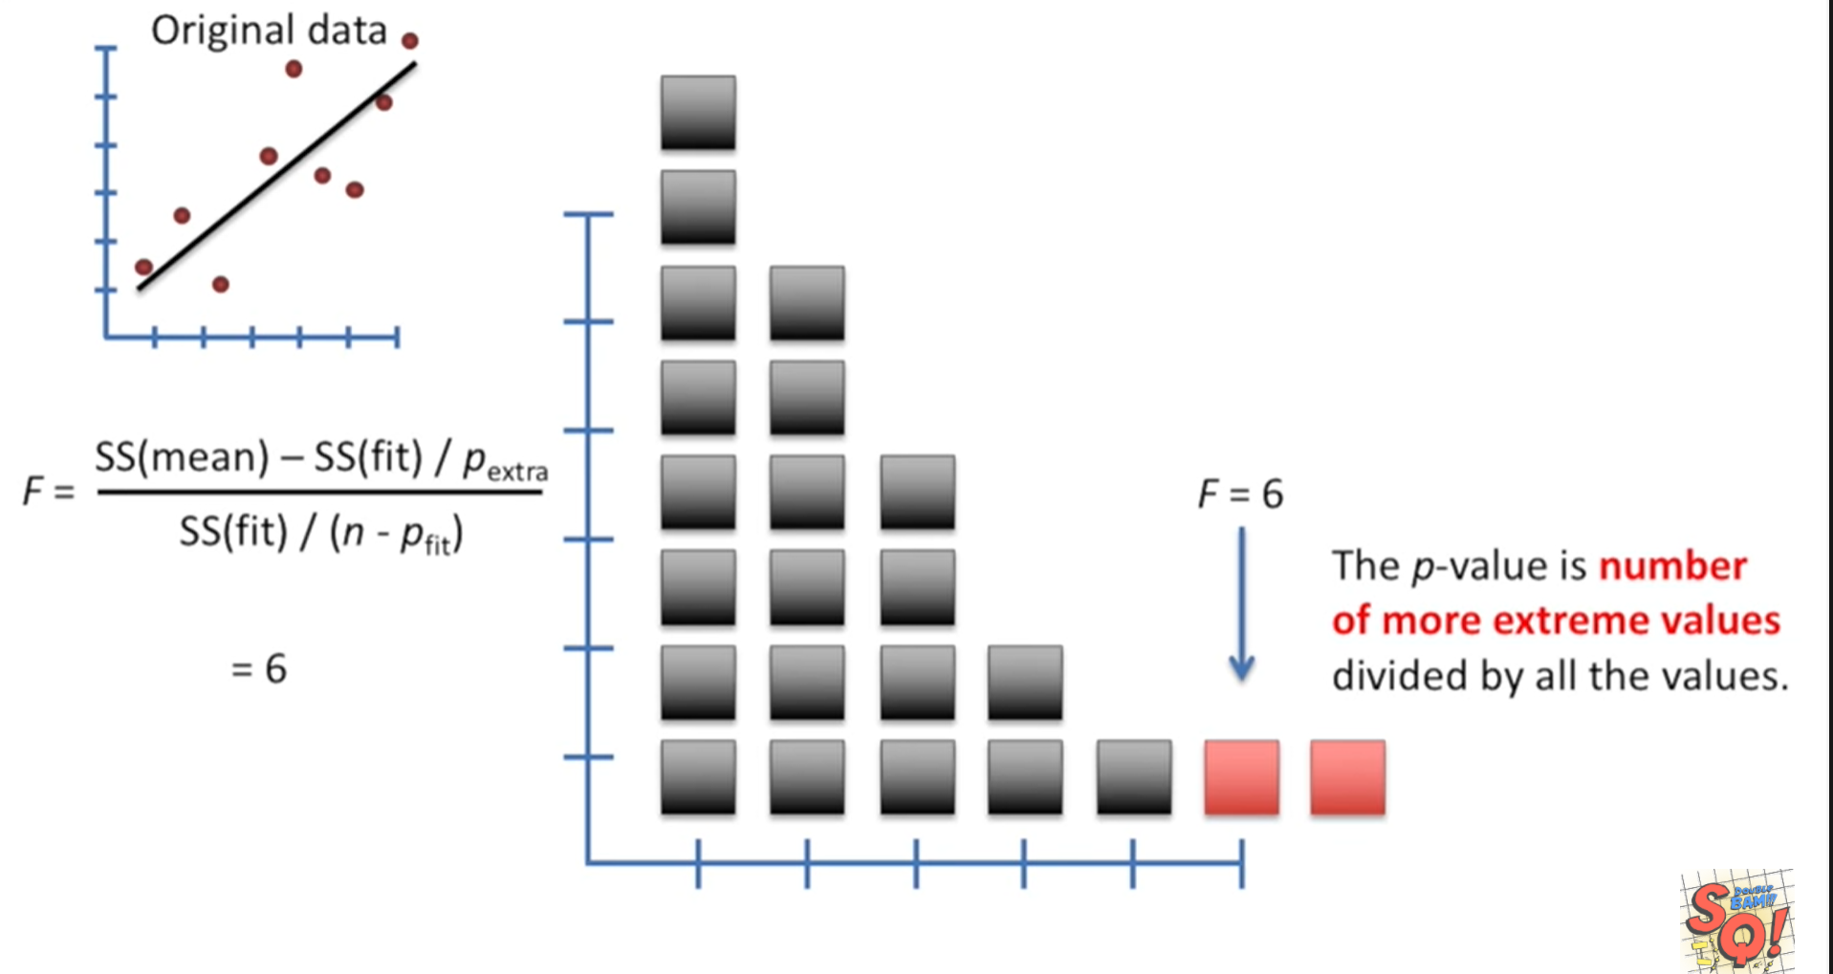
StatQuest: Linear Models Pt.1 - Linear Regression https://www.youtube.com/watch?v=nk2CQITm_eo

Slide 12
HW 2: Partial draft of paper (due Saturday 5/1)
Data description:
Describe data including number of data points and dimension. Consider using statistics, graphical representations (eg PCA), clustering to also describe data.
Appendix (or part of main paper, depending on results):
Analyze your data using some of the techniques covered in class/labs. Include a 1+ paragraph description of the results.
Not all techniques are good for all data. Explaining why a technique is not good for your data should be included in your paper.
HW 3 (due Wednesday May 5): Create an artificial data set to illustrate something covered in class that I can use in a review.
http://clt.astate.edu/crbrown/statchapter12a.ppt

Slide 13
17.4 Error Variable: Required Conditions
The error ε is a critical part of the regression model.
Four requirements involving the distribution of ε must be satisfied.
The probability distribution of ε is normal.
The mean of ε is zero: E(ε) = 0.
The standard deviation of ε is σ_{ε} for all values of x.
The set of errors associated with different values of y are all independent.
https://web.stanford.edu/class/msande247s/kchap17.ppt

Slide 14
From the first three assumptions we have:
y is normally distributed with mean
E(y) = β₀ + β₁x, and a constant standard deviation σ_{ε}
E(y|x₃)
The standard deviation remains constant,
β₀ + β₁x₃
μ₃
E(y|x₂)
β₀ + β₁x₂
μ₂
but the mean value changes with x
E(y|x₁)
β₀ + β₁x₁
μ₁
x₁
x₂
x₃
https://web.stanford.edu/class/msande247s/kchap17.ppt

