Slide 1
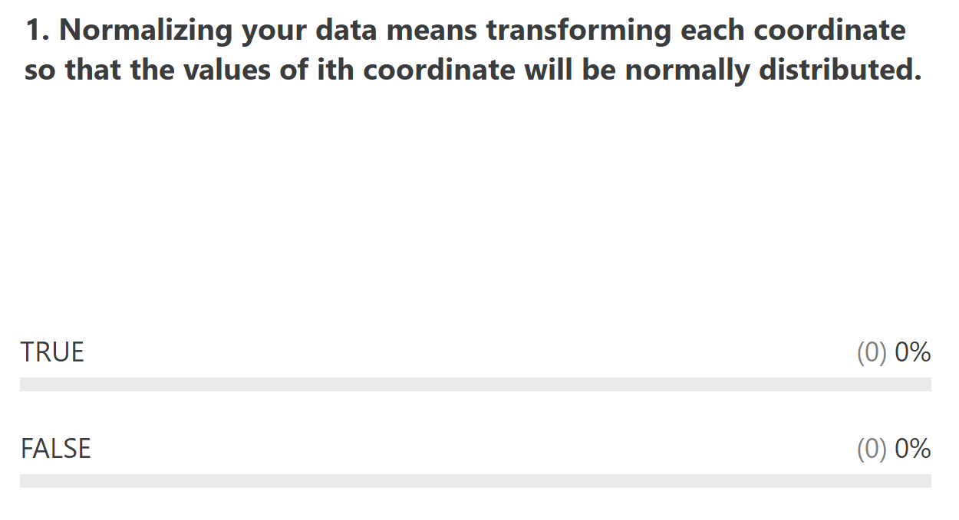
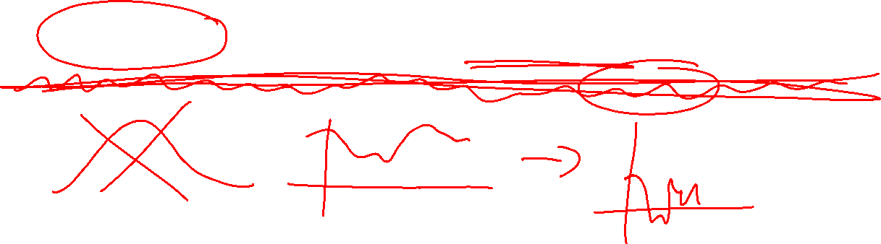

Slide 2

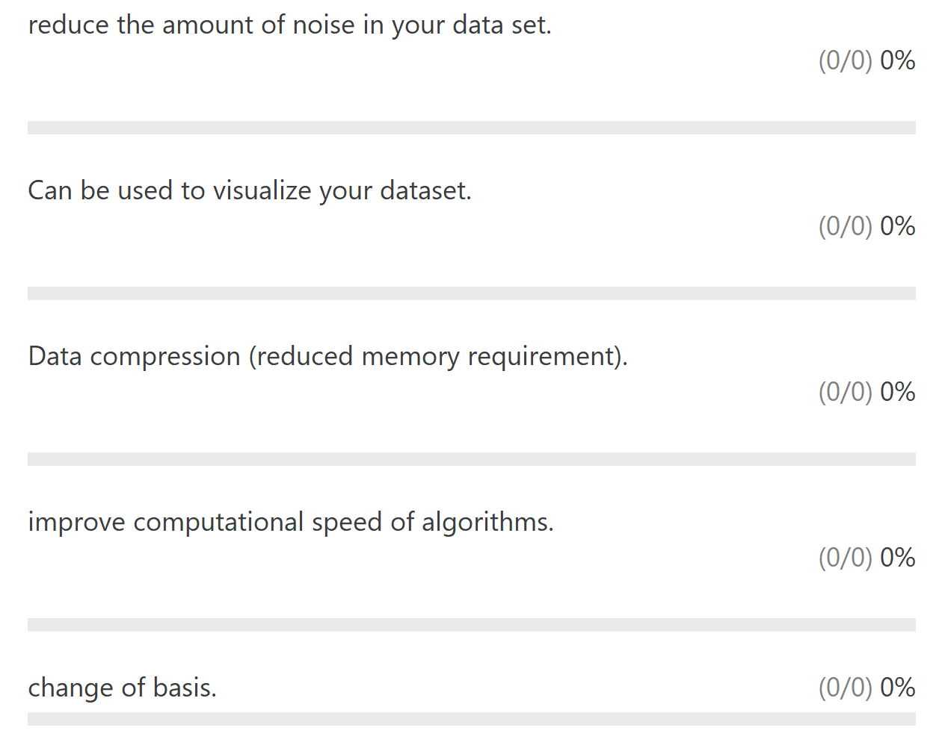
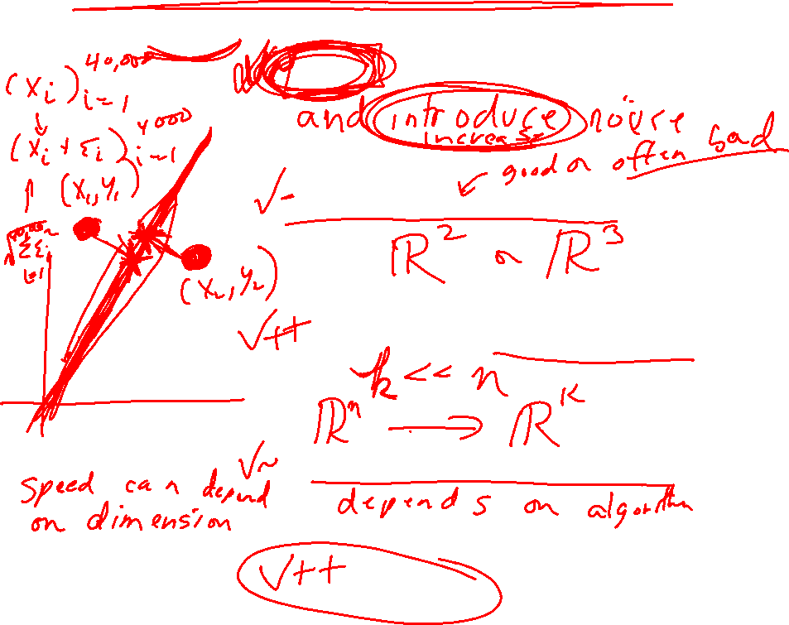

Slide 3
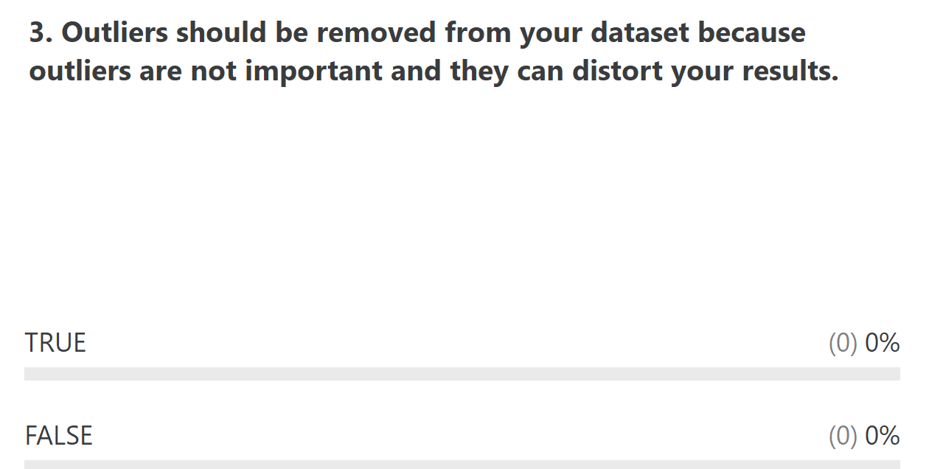
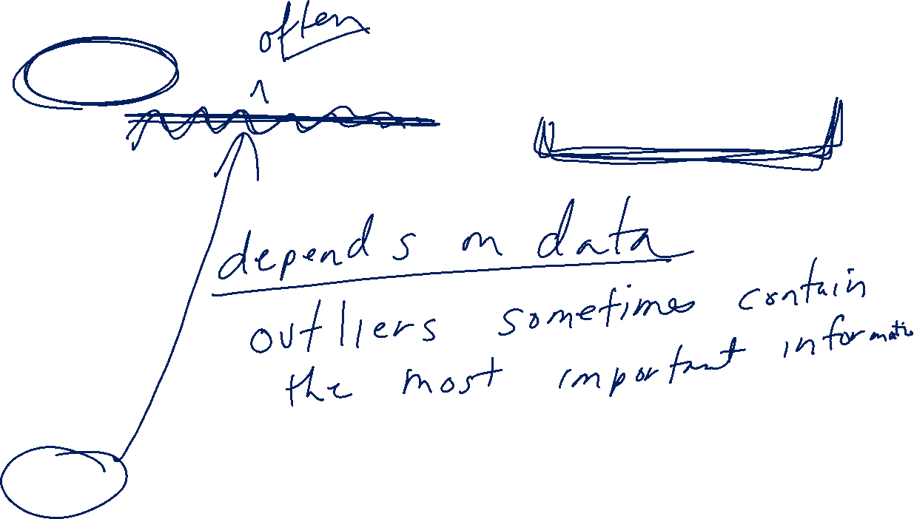

Slide 4
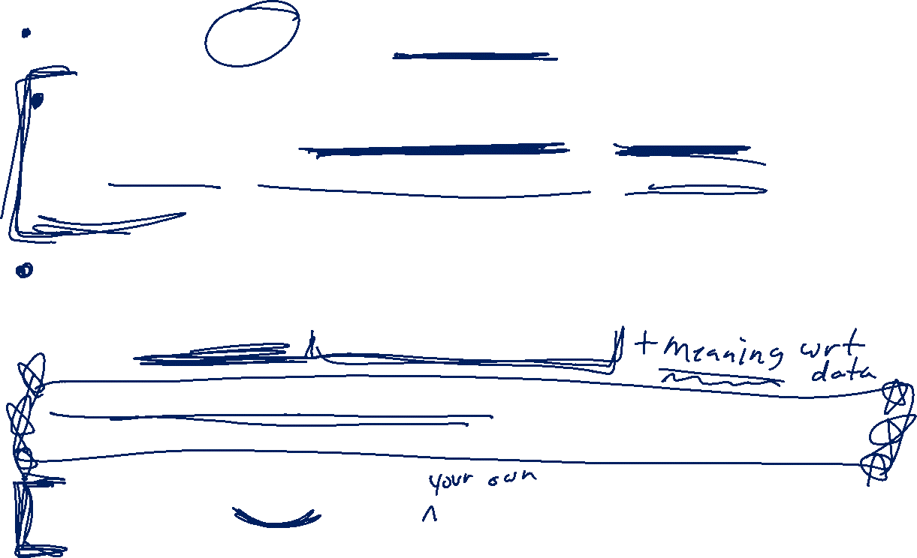
HW 2: Partial draft of paper (due Friday 4/30)
Data description:
Describe data including number of data points and dimension. Consider using statistics, graphical representations (eg PCA), clustering to also describe data.
Appendix (or part of main paper, depending on results):
Analyze your data using some of the techniques covered in class/labs. Include a 1+ paragraph description of the results.
Not all techniques are good for all data. Explaining why a technique is not good for your data should be included in your paper.
HW 3 (due Friday May 7): Create an artificial data set to illustrate something covered in class that I can use in a review.
http://clt.astate.edu/crbrown/statchapter12a.ppt

Slide 5

PCA on all Genes
Leukemia data, precursor B and T
Plot of 34 patients, dimension of 8973 genes reduced to 2
www.cse.buffalo.edu/faculty/azhang/data-mining/pca.ppt

Slide 6

PCA on 100 top significant genes
Leukemia data, precursor B and T
Plot of 34 patients, dimension of 100 genes reduced to 2
www.cse.buffalo.edu/faculty/azhang/data-mining/pca.ppt

Slide 7
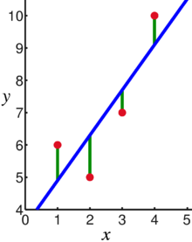
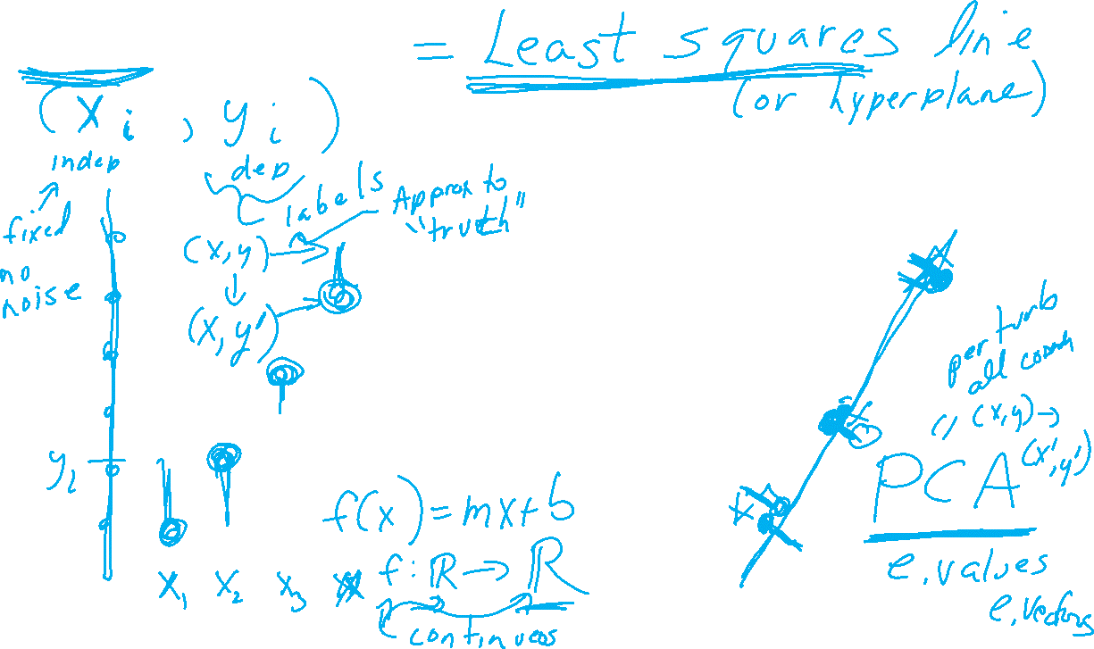
Linear regression
https://en.wikipedia.org/wiki/Linear_regression

Slide 8
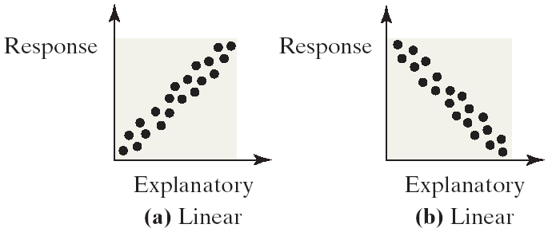
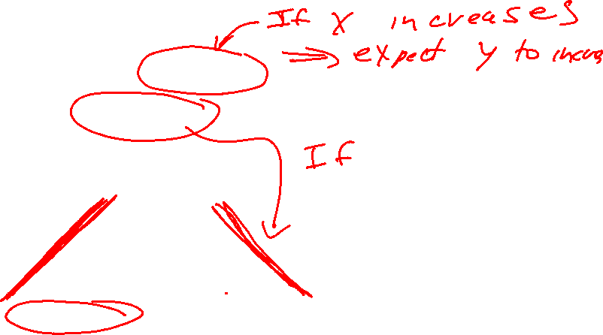
Linear Correlations
Linear relations or linear correlations have points that cluster around a line
Linear relations can be either positive (the points slants upwards to the right) or negative (the points slant downwards to the right)
https://emunix.emich.edu/~schu/MATH_170/Fall09_170/Evening%20session/Unit%203.ppt

Slide 9
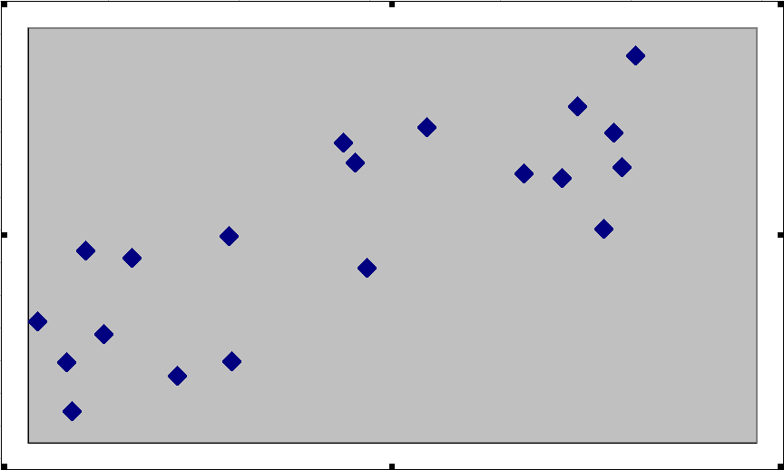
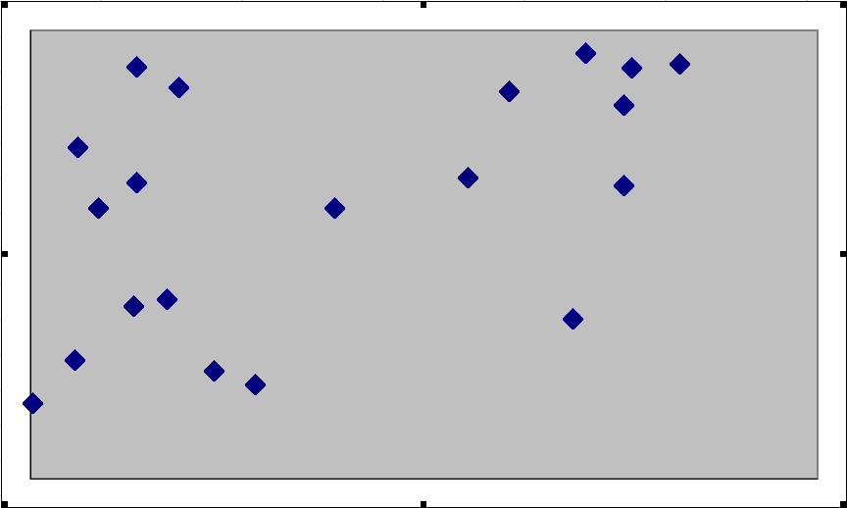
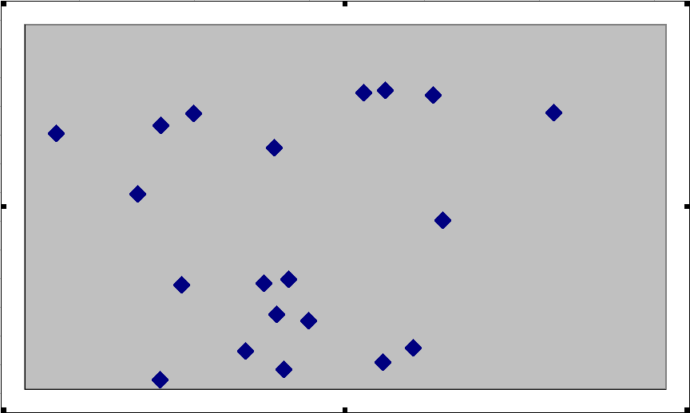
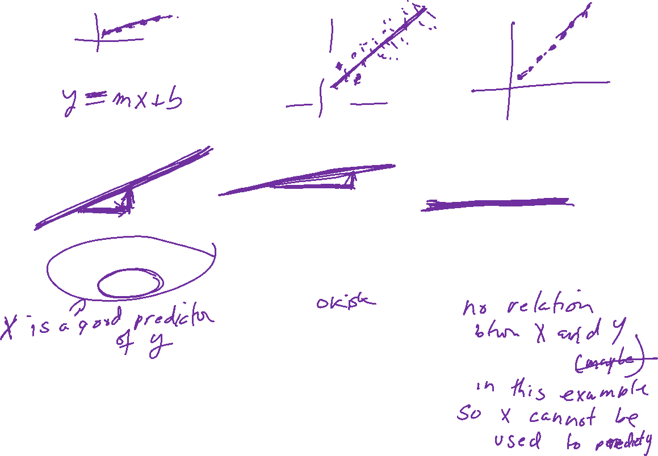
Positive Correlation Coefficients
Examples of positive correlation
In general, if the correlation is visible to the eye, then it is likely to be strong
Strong Positive
r = .8
Moderate Positive
r = .5
Very Weak
r = .1
https://emunix.emich.edu/~schu/MATH_170/Fall09_170/Evening%20session/Unit%203.ppt

Slide 10
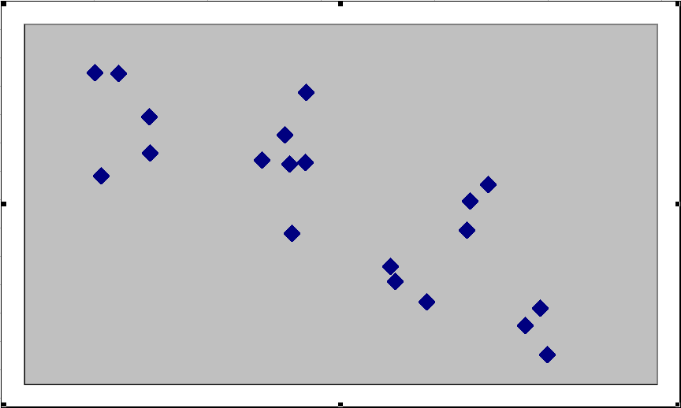
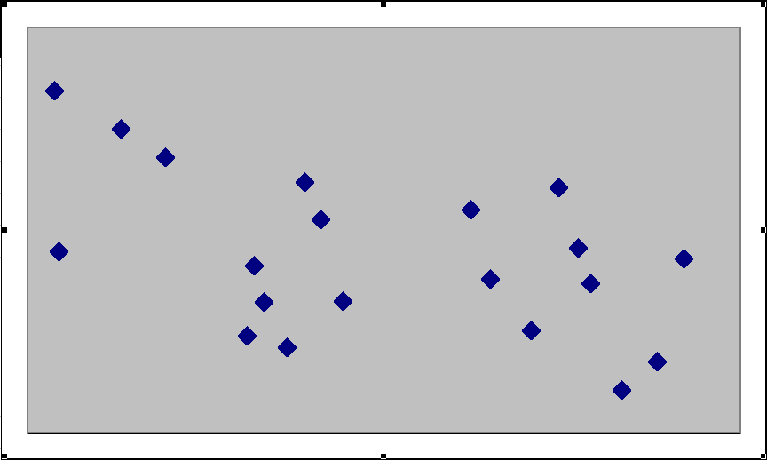
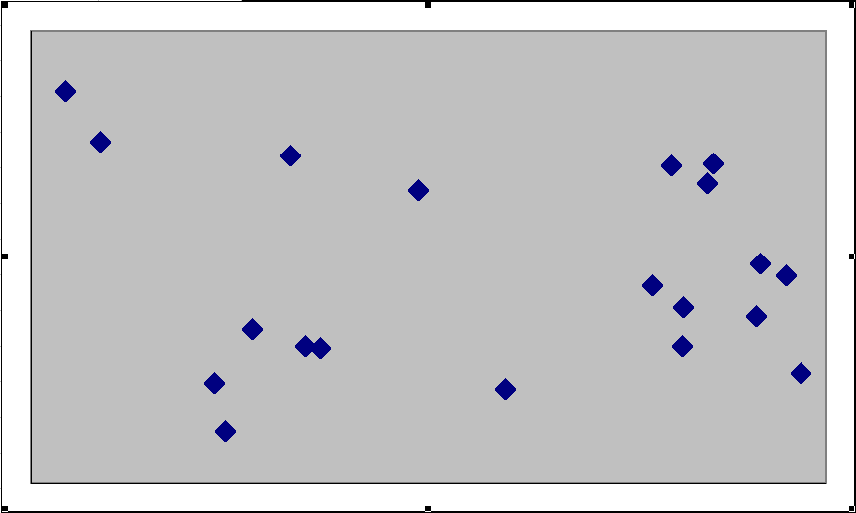
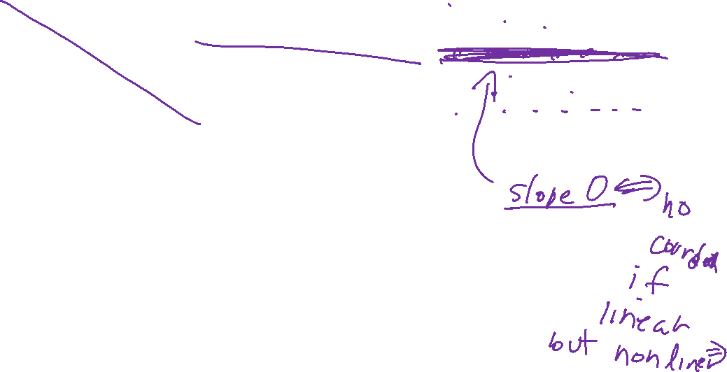
Negative Correlation Coefficients
Examples of negative correlation
In general, if the correlation is visible to the eye, then it is likely to be strong
Strong Negative
r = –.8
Moderate Negative
r = –.5
Very Weak
r = –.1
https://emunix.emich.edu/~schu/MATH_170/Fall09_170/Evening%20session/Unit%203.ppt

Slide 11
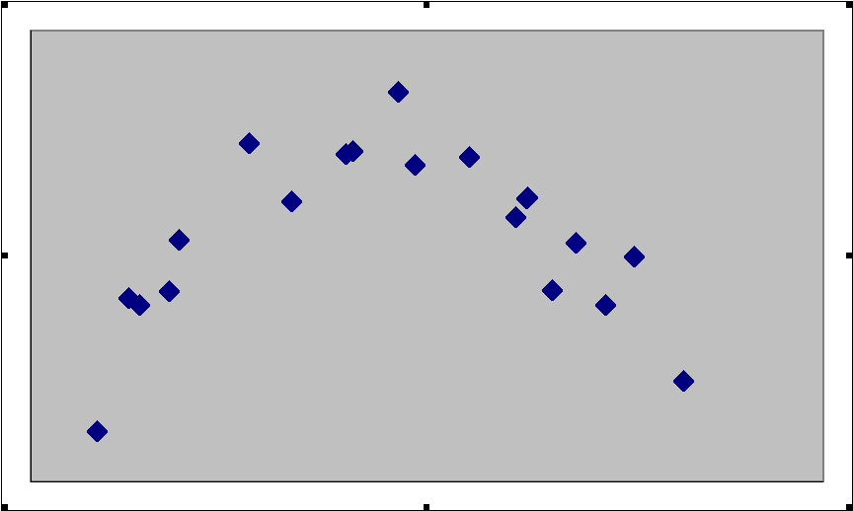
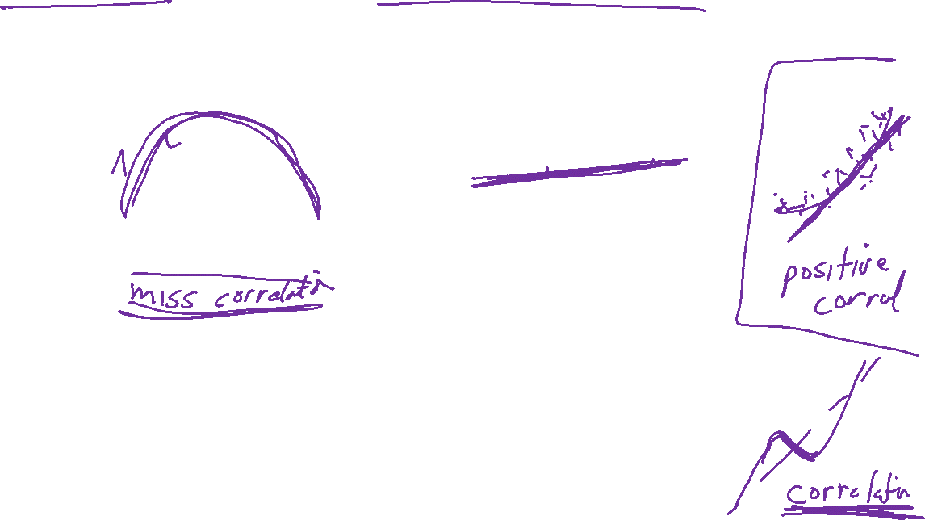
Nonlinear versus No Correlation
Nonlinear correlation and no correlation
Both sets of variables have r = 0.1, but the difference is that the nonlinear relation shows a clear pattern
Nonlinear Relation
No Relation
https://emunix.emich.edu/~schu/MATH_170/Fall09_170/Evening%20session/Unit%203.ppt

Slide 12
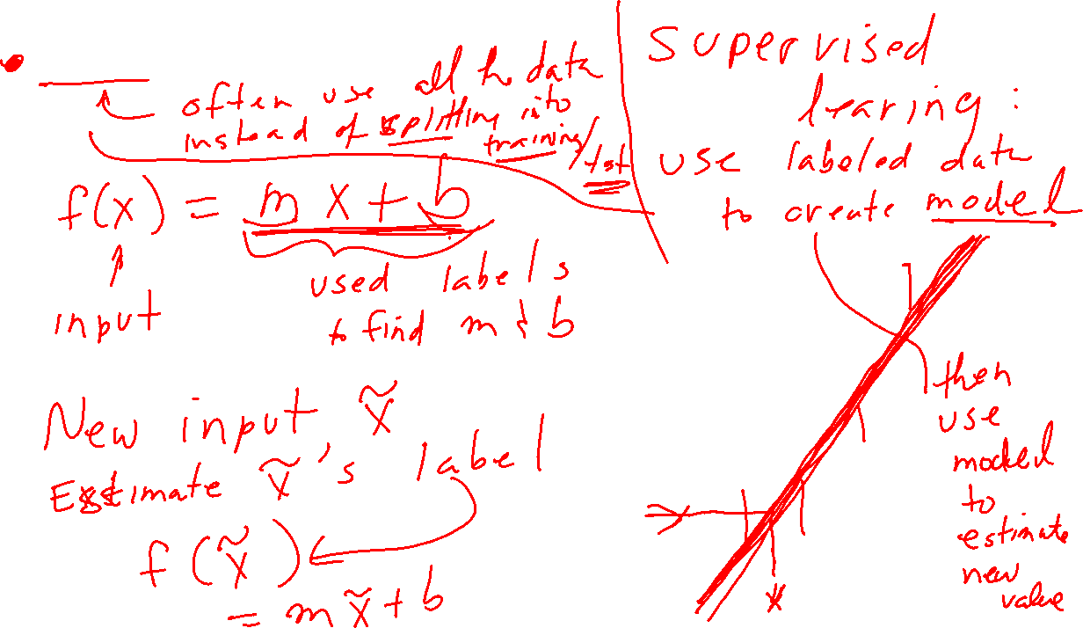
Linear regression
https://en.wikipedia.org/wiki/Linear_regression

