Slide 1
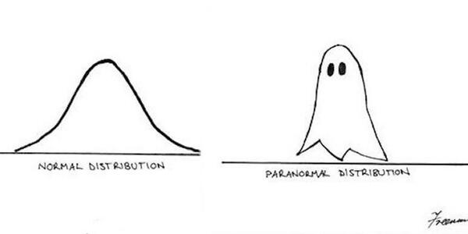
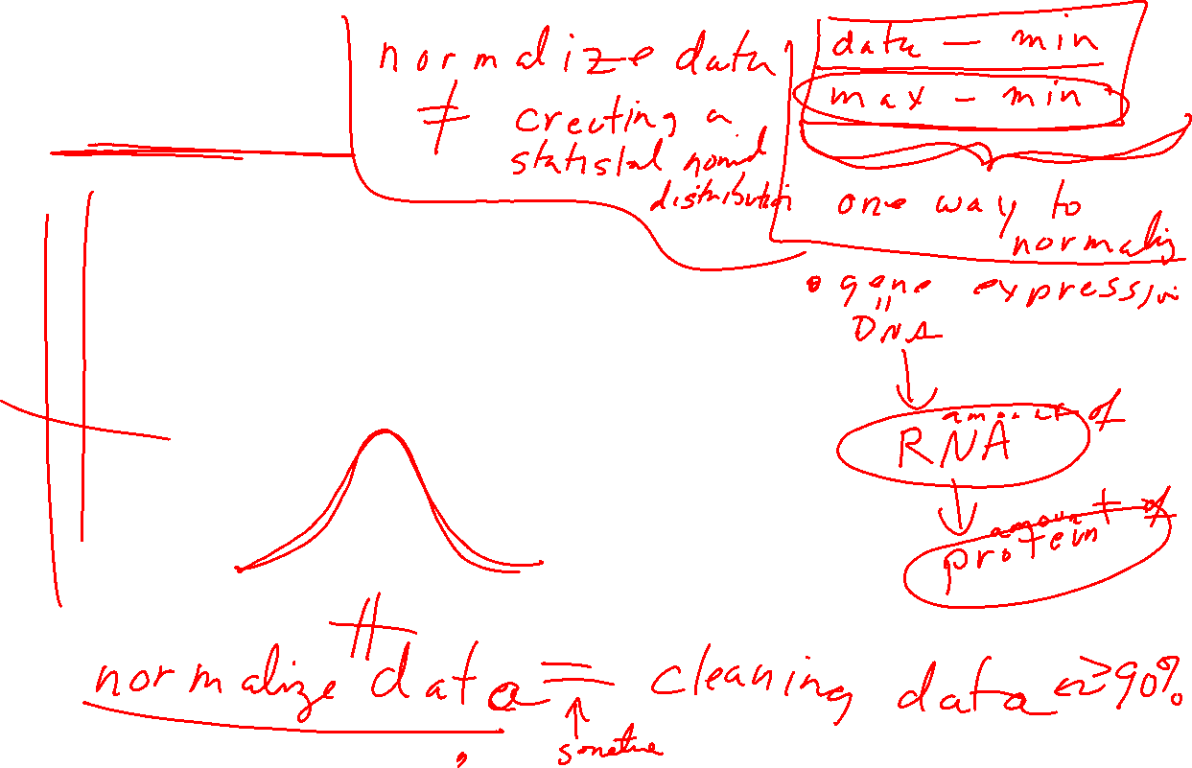
Normality
How to assess/detect it
What to do if you have non-normal data
https://fs.wp.odu.edu/abraitma/workshops/

Slide 2
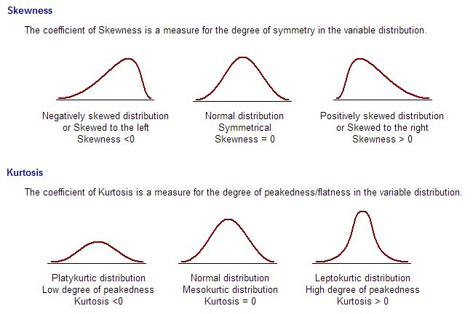
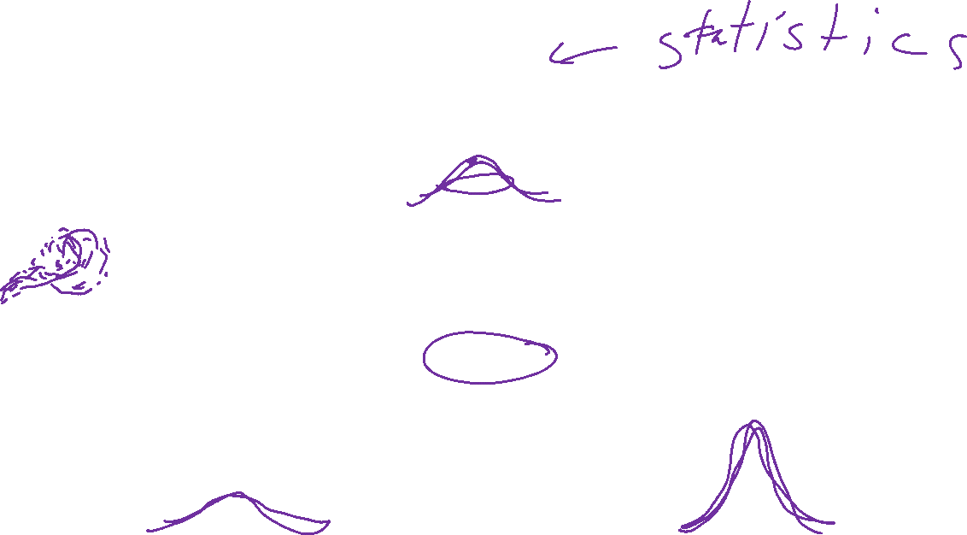
Assessing Normality
Skewness and Kurtosis
Negatively Skewed
Normal
Positively Skewed
Platykurtic
Normal
Leptokurtic
https://fs.wp.odu.edu/abraitma/workshops/

Slide 3
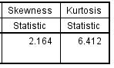
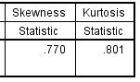

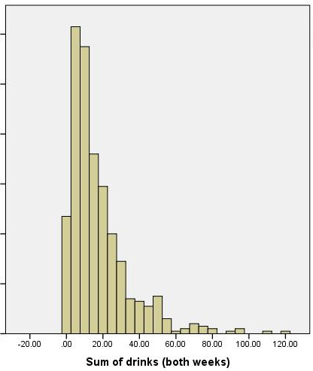
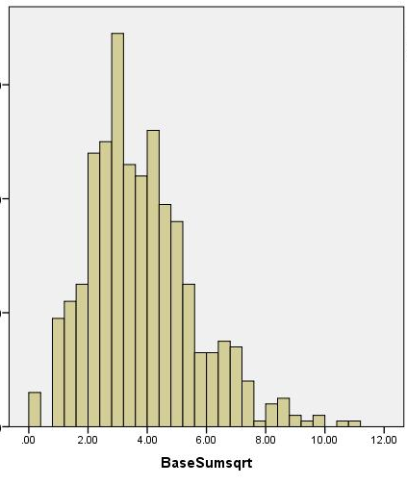
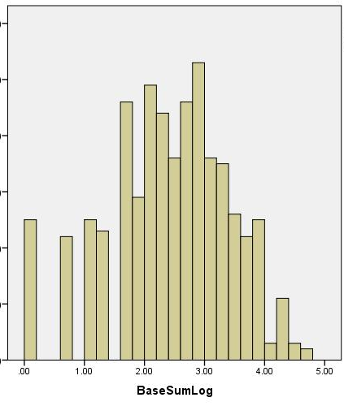
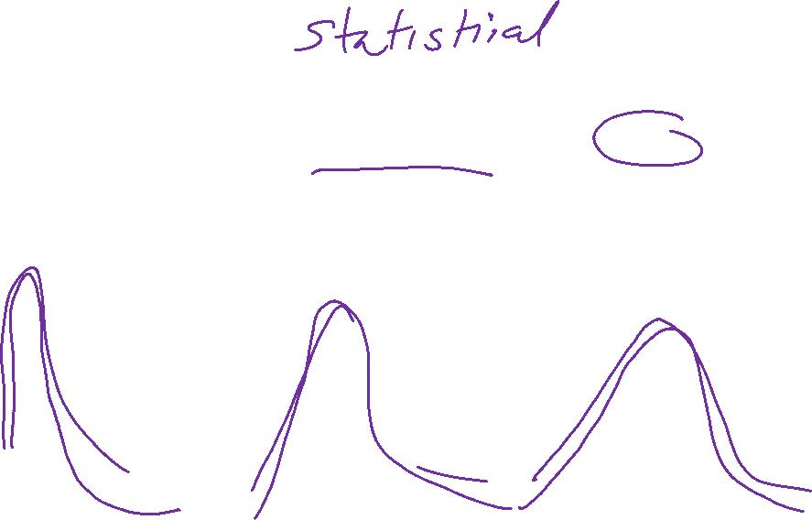
Non-Normality: Transformation
Sum of drinks past 2 weeks: positively skewed
Original square root log
https://fs.wp.odu.edu/abraitma/workshops/

Slide 4
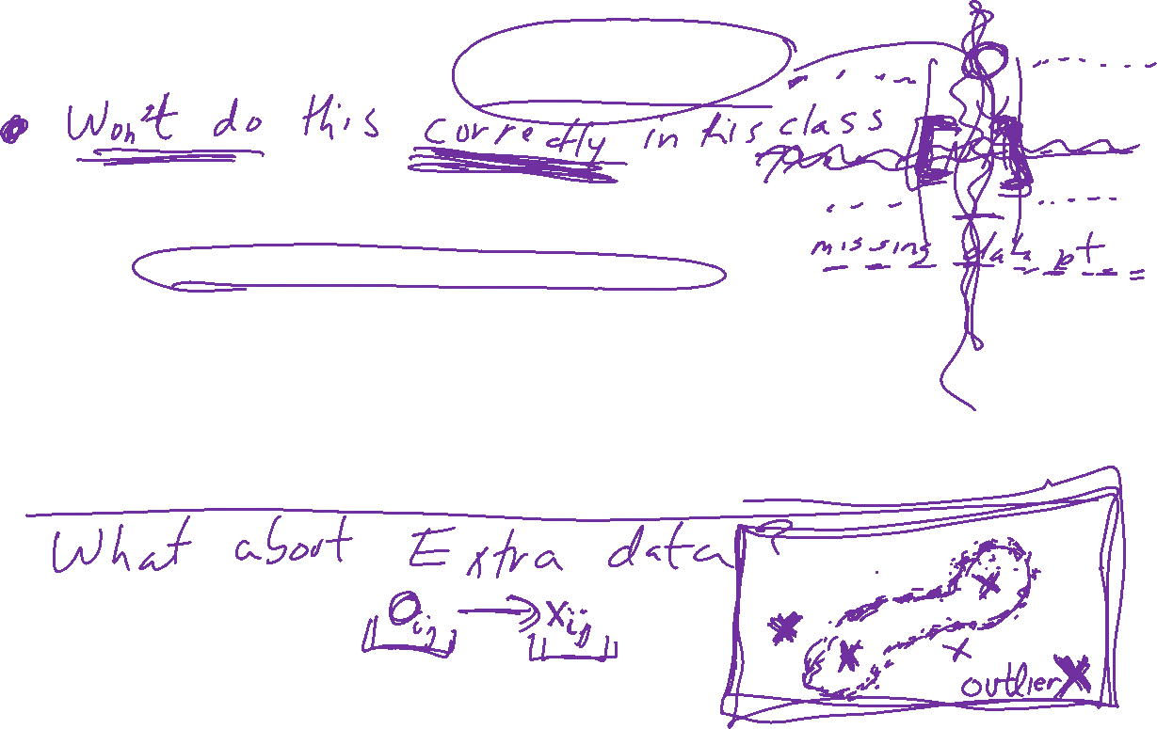
What to do about Missing Data
Delete incomplete cases?
Complete Case Analysis (aka Listwise Deletion)
  Delete everyone from your sample who has missing data
  Final sample includes only individuals with all data
Available Case Analysis (aka Pairwise Deletion)
  Exclude people from relevant analyses who have missing data
  E.g., If missing on depressive symptoms, then missing from regression that examines influence of meditation on depressive symptoms
    Present for regression that examines influence of meditation on anxiety
https://fs.wp.odu.edu/abraitma/workshops/

Slide 5


Outliers
How to identify them
What to do about them
Start with univariate (one variable at a time)
Touch on multivariate
https://fs.wp.odu.edu/abraitma/workshops/

Slide 6

Outliers
Why do we care?
  Have a stronger influence on the data
  Can influence results of study
r = -.426
r = -.567
Same data, changed one value from 37 to 150
https://fs.wp.odu.edu/abraitma/workshops/

Slide 7
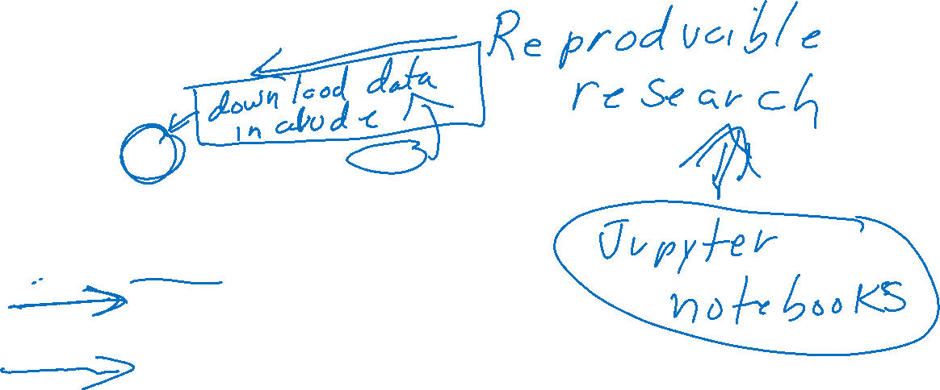
Datalogs
Date can be helpful, but not required
  Who did it an be very helpful if there are multiple hands in the project
ACTIVITIES are required, with specific details
  What you did
  Why you did it
Missing data
  What percentage for data? Each variable?
  How did you address it?
Outliers
  How many for each variable?
  Old and new values?
Recoding
  What dummy codes did you create? Why?
  What composites scores did you create? Means or sums or something else?
    Did you remember to reverse score??
Did you check linearity? Normality?
  Confirmed for which variables?
  What adjustments were made for which variables (if any)?
https://fs.wp.odu.edu/abraitma/workshops/

Slide 8

Dimensionality Reduction: Given dataset D R^{N}
Want: embedding f: D → R^{n} where n << N
    which “preserves” the structure of the data.
Many reduction methods:
f₁: D → R, f₂: D → R, … f_{n}: D → R
(f₁, f₂, … f_{n}): D → R^{n}
Many are linear, M: R^{N} → R^{n}, Mx = y
But there are also non-linear dimensionality reduction algorithms.
U

Slide 9
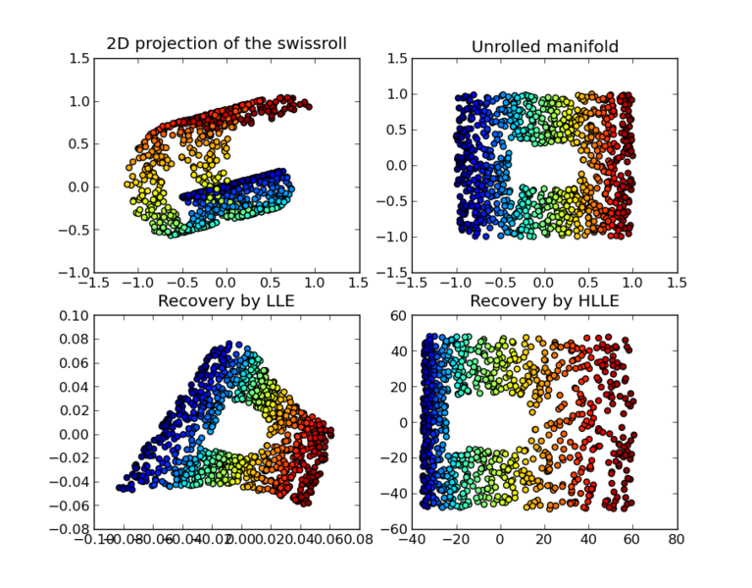

https://en.wikipedia.org/wiki/Nonlinear_dimensionality_reduction

Slide 10
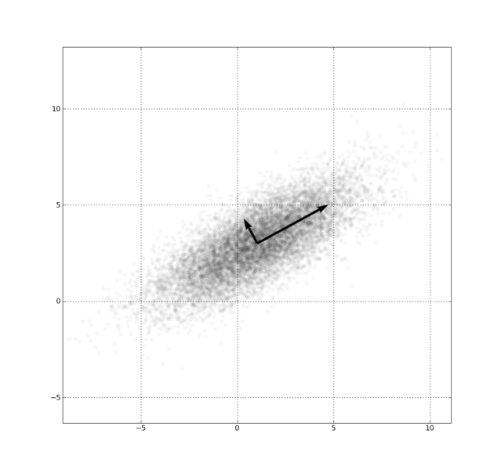
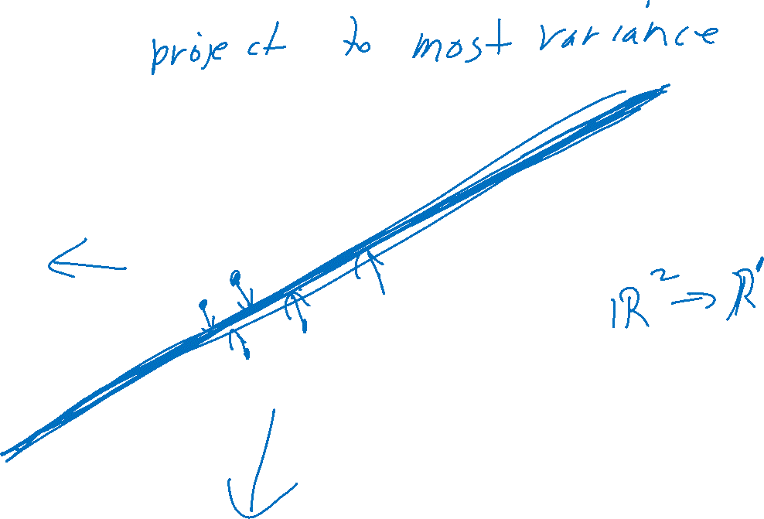
Example: Principle component analysis (PCA)
http://en.wikipedia.org/wiki/File:GaussianScatterPCA.png

Slide 11
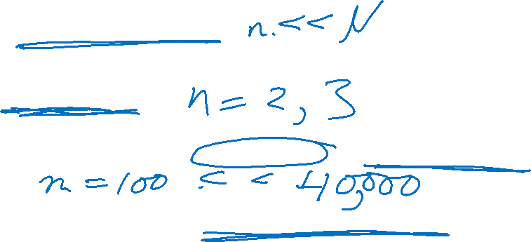
Why use PCA in data analysis?
Reduce dimension.
Visualization.
Fewer variables = less memory (data compression).
Fewer variables = faster computing time (usually).

Slide 12
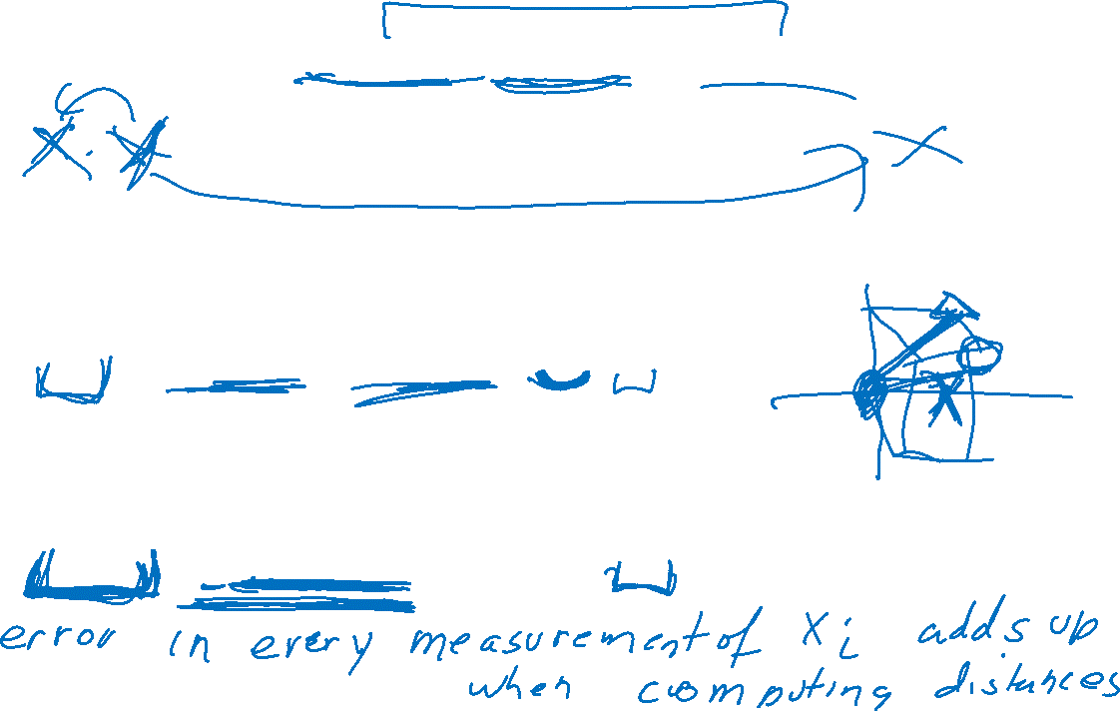
Why use PCA in data analysis?
Consider the points (0, 0, …, 0), (1, 0, …, 0), (10, 0, …, 0)
Add noise to first point (0, 0, …, 0) → (0, 1, …, 1)
In R¹⁰⁰, d((0, 1, …, 1), (1, 0, …, 0)) = 10 > 9.
Add small noise to first point (0, 0, …, 0) → (0, 0.1, …, 0.1)
In R^{39,900}, d((0, 0.1, …, 0.1), (1, 0, …, 0)) = 20 > 9.
0 1 10

Slide 13
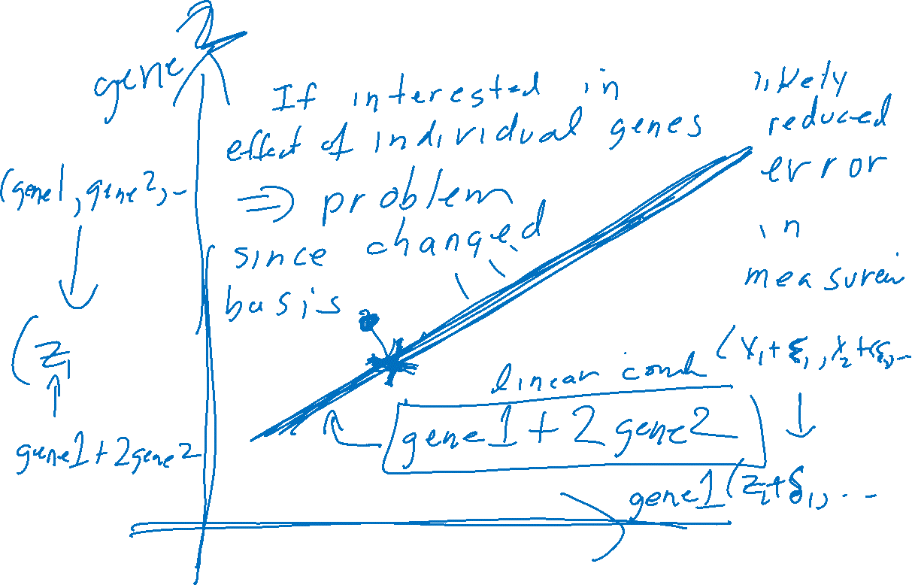
Example: Principle component analysis (PCA)
http://en.wikipedia.org/wiki/File:GaussianScatterPCA.png

Slide 14
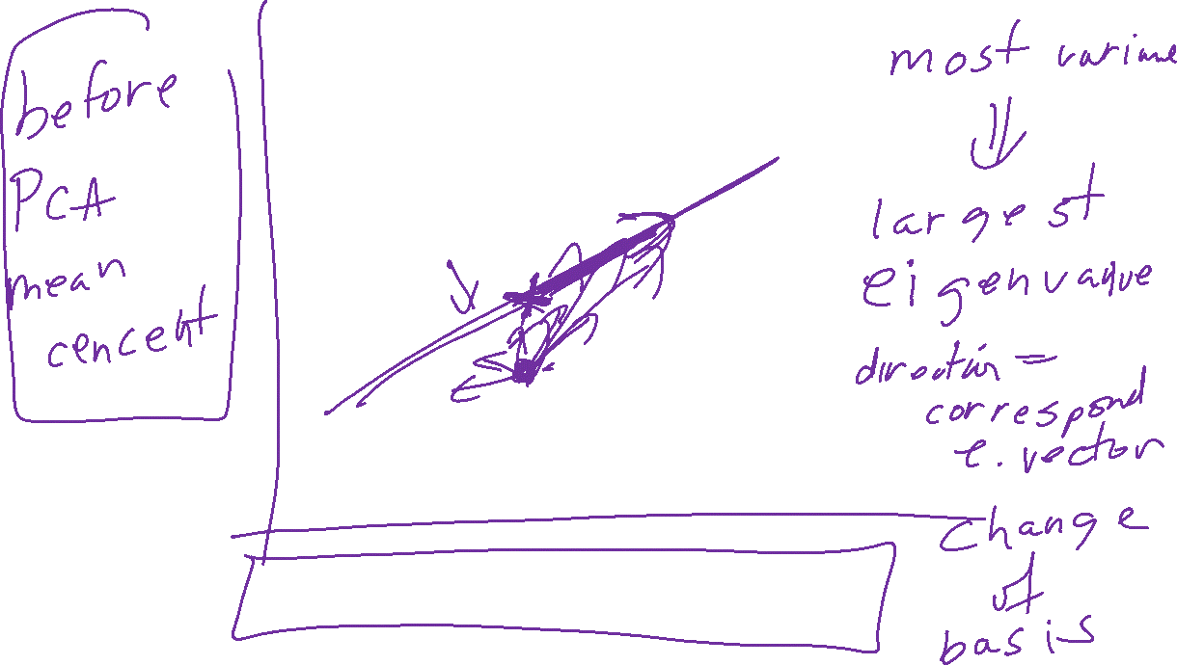
Example: Principle component analysis (PCA)
x_{i} → z_{i} = linear combination of x_{i}
http://en.wikipedia.org/wiki/File:GaussianScatterPCA.png

Slide 15
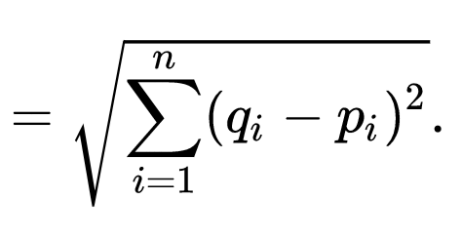

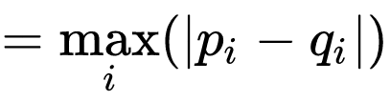

In R^{n}
If n small, Euclidean distance often makes sense
If n is large, consider Chebyshev distance or
performing PCA first to project data into R^{d}, for small d
and then using Euclidean distance
Chebyshev distance:

Slide 16
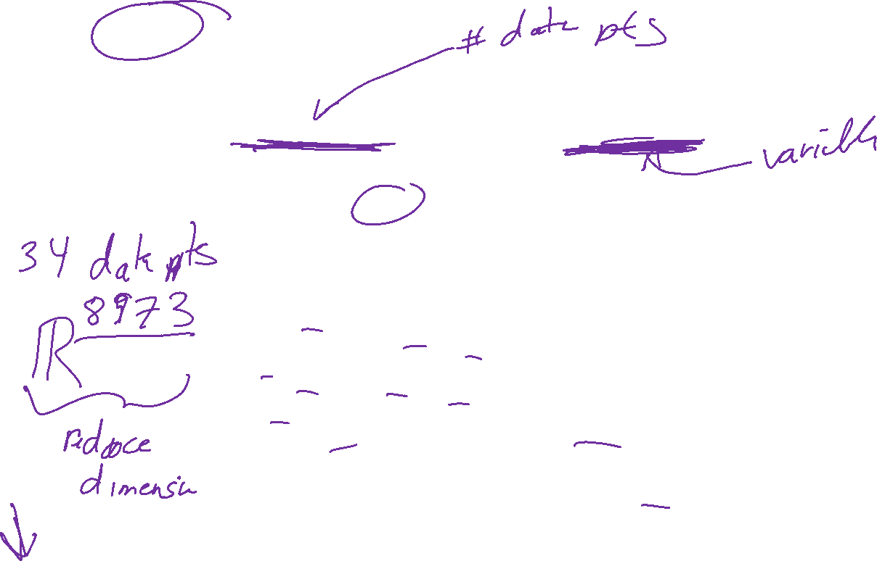
PCA on all Genes
Leukemia data, precursor B and T
Plot of 34 patients, dimension of 8973 genes reduced to 2
www.cse.buffalo.edu/faculty/azhang/data-mining/pca.ppt

Slide 17
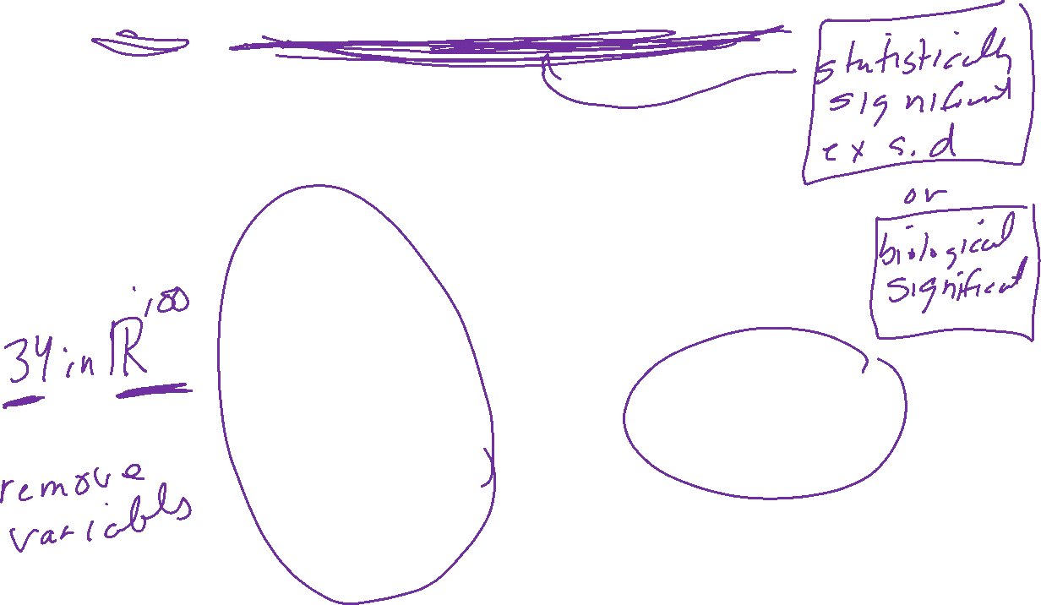
PCA on 100 top significant genes
Leukemia data, precursor B and T
Plot of 34 patients, dimension of 100 genes reduced to 2
www.cse.buffalo.edu/faculty/azhang/data-mining/pca.ppt

Slide 18

Principal Component Analysis: one attribute first
Temperature
42
40
24
30
15
18
15
30
15
30
35
30
40
30
Question: how much spread is in the data along the axis? (distance to the mean)
Variance=Standard deviation^2
www.cse.buffalo.edu/faculty/azhang/data-mining/pca.ppt

Slide 19

Now consider two dimensions
X=Temperature | Y=Humidity
40 | 90
40 | 90
40 | 90
30 | 90
15 | 70
15 | 70
15 | 70
30 | 90
15 | 70
30 | 70
30 | 70
30 | 90
40 | 70
30 | 90
Covariance: measures the
correlation between X and Y
cov(X,Y)=0: independent
Cov(X,Y)>0: move same dir
Cov(X,Y)<0: move oppo dir
www.cse.buffalo.edu/faculty/azhang/data-mining/pca.ppt

Slide 20
More than two attributes: covariance matrix
Contains covariance values between all possible dimensions (=attributes):
Example for three attributes (x,y,z):
www.cse.buffalo.edu/faculty/azhang/data-mining/pca.ppt

Slide 21
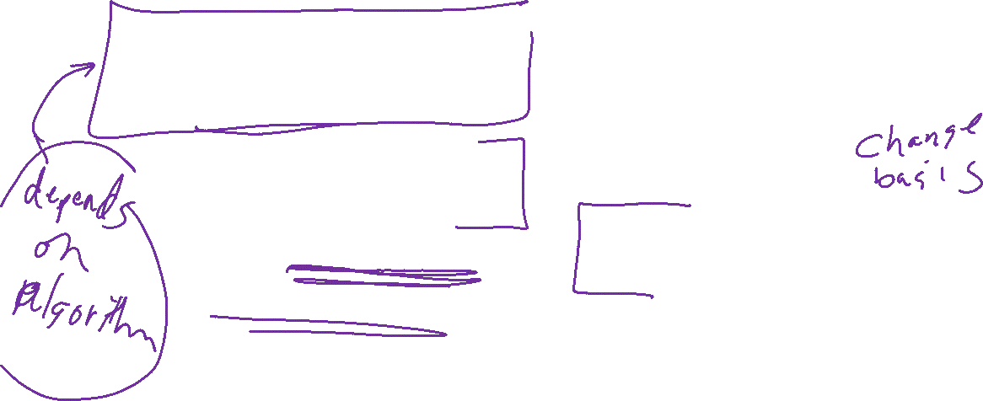
Steps of PCA
Let be the mean vector (taking the mean of all rows)
Adjust the original data by the mean
  X’ = X –
Compute the covariance matrix C of adjusted X
Find the eigenvectors and eigenvalues of C.
For matrix C, vectors e (=column vector) having same direction as Ce :
  eigenvectors of C is e such that Ce=λe,
  λ is called an eigenvalue of C.
Ce=λe ⇔ (C-λI)e=0
  Most data mining packages do this for you.
www.cse.buffalo.edu/faculty/azhang/data-mining/pca.ppt

Slide 22

Principal components
1. principal component (PC1)
  The eigenvalue with the largest absolute value will indicate that the data have the largest variance along its eigenvector, the direction along which there is greatest variation
2. principal component (PC2)
  the direction with maximum variation left in data, orthogonal to the 1. PC
In general, only few directions manage to capture most of the variability in the data.
www.cse.buffalo.edu/faculty/azhang/data-mining/pca.ppt

Slide 23

Eigenvalues
Calculate eigenvalues λ and eigenvectors x for covariance matrix:
  Eigenvalues λ_{j} are used for calculation of [% of total variance] (V_{j}) for each component j:
www.cse.buffalo.edu/faculty/azhang/data-mining/pca.ppt

Slide 24
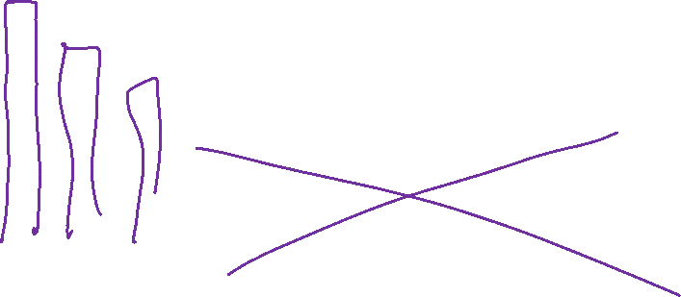
Principal components - Variance
www.cse.buffalo.edu/faculty/azhang/data-mining/pca.ppt

